Slide 1
Proof Mate: An Interactive Proof Helper for PVS
(tool paper)
Paolo Masci
National Institute of Aerospace
paolo.masci@nianet.org
Aaron Dutle
NASA Langley Research Center
aaron.m.dutle@nasa.gov
NASA Formal Methods 2022
May 27, 2022

Slide 2
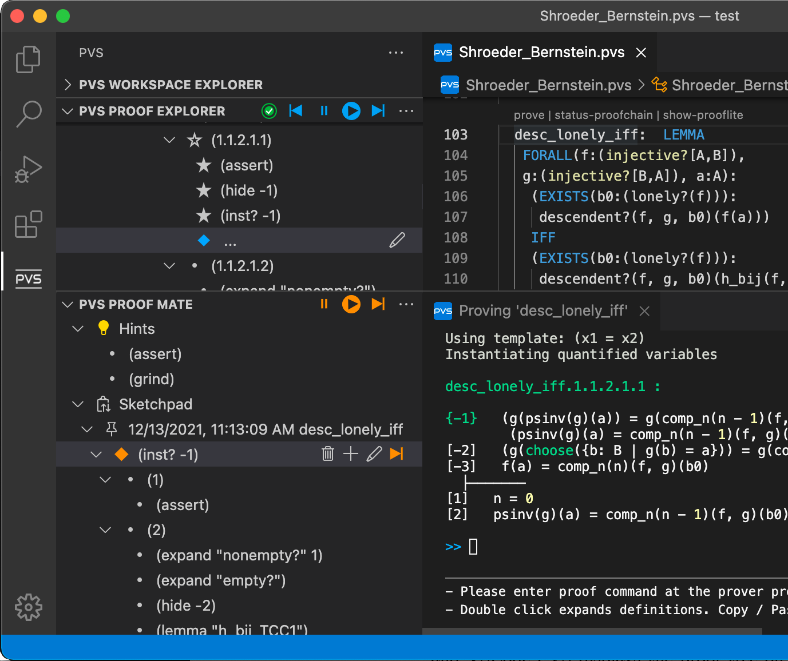
Contribution
Proof Mate tool, a new extension designed to further improve the front-end of the PVS verification system
- Suggest proof commands
- Sketch proof attempts
- Repair broken proofs
Tool integrated in VSCode-PVS¹, available for download from the Visual Studio Code marketplace (NASA Open Source License)
[1] Masci, P., Muñoz, C.A.: An Integrated Development Environment for the Prototype Verification System, F-IDE Workshop, EPTCS, vol. 310, 2019
Download link: https://github.com/nasa/vscode-pvs

Slide 3
Background on the PVS Verification System
PVS is an interactive theorem prover extensively used by NASA Langley Research Center's formal methods team for the verification of avionics algorithms and protocols
Recent analysis examples
- Compact Position Reporting¹, a core component of the ADS-B protocol
- DAIDALUS², a collection of algorithms for aircraft route conflict detection and maneuver guidance
[1] Dutle, A., Moscato, M., Titolo, L., Muñoz, et al: Formal analysis of the Compact Position Reporting algorithm. Formal Aspects of Computing, 2020
[2] Muñoz, C., Narkawicz, A.: Formal Analysis of Extended Well-Clear Boundaries for Unmanned Aircraft. In 8th NASA Formal Methods Symposium, 2016

Slide 4
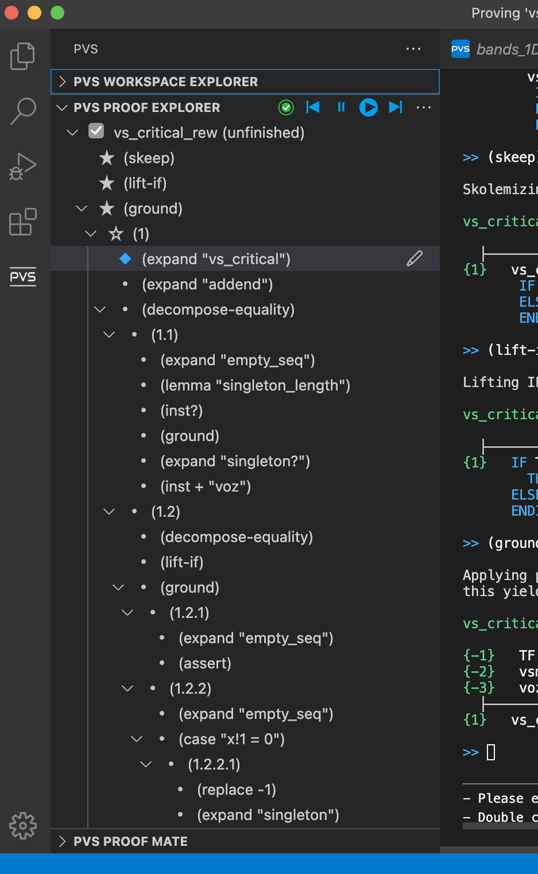
Proving in PVS
- PVS builds on the sequent calculus
- Proofs are constructed interactively by entering proof commands at a prover console
- Proof commands are organized into a proof tree
- In the standard VSCode-PVS front-end, the proof tree is displayed in Proof Explorer as a collapsible tree
- Edit operations in Proof Explorer are allowed but intentionally limited because the proof tree shown in the view is intended to reflect the proof structure computed by PVS when a proof command is executed

Slide 5
Proof Mate
New interactive view designed to support proof development, editing and repair
- Not tied directly to the proof structure generated by PVS
- Unrestricted editing functions, e.g., for experimenting and writing proof ideas in the mind of a proof engineer developing the proof

Slide 6
Suggesting Proof Commands
Proof Mate provides hints suggesting
proof commands that can be used to
make progress with the proof
- Suggestions are based on heuristics capturing expert knowledge on common PVS proof patterns
- Example heuristic: "if the proof state contains a universal quantifier, then recommend skolemization commands"
- 10 heuristics are currently implemented

Slide 7
Sketching Proof Attempts
Proof Mate provides a sketchpad that can be used to create proof clips reflecting ideas in the mind of the proof engineer
- Add/delete/edit proof commands and proof branches
- Copy/paste proof fragments across different proof sessions
- Execute proof fragments
- Point-and-click interactions

Slide 8
Repairing Broken Proofs
A PVS proof may break when a definition used in a theorem is changed, e.g., to refactor terms or to reflect new hypotheses in a theorem
- When a proof breaks, PVS automatically prunes sections of the proof tree that are not valid anymore, to ensure the proof structure is well-formed
- From a user's perspective, part of the proof is discarded and lost
Proof Mate seamlessly detects broken proofs and saves proof sections that would otherwise be lost
- The saved fragments can be inspected to understand what caused the break and identify the necessary repair actions

Slide 9
Final Remarks
Proof Mate introduces new capabilities to both novice and expert PVS users
- The proof command suggester is especially useful to novice users, provides guidance based on heuristics capturing expert knowledge on common proof patterns in PVS
- Sketchpad functions can be used to create proof ideas, as well as to repair broken proofs
On-going and future work
- Use of machine learning techniques to identify and suggest lemmas
- Create local proof strategies from a set of proof commands

