Slide 1
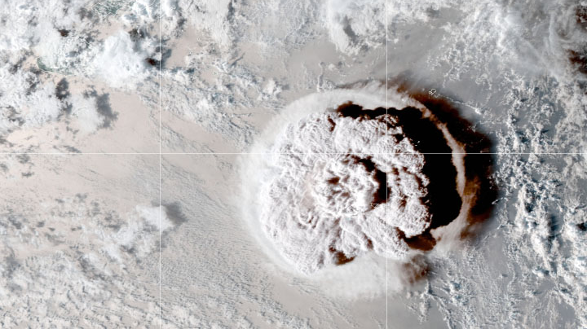
Volcano Response initiative
J.-P. Vernier, NIA/NASA Langley Research Center, Hampton, VA
C. Timmreck, Max-Planck-Institut für Meteorologie, Hamburg, Germany
SSiRC Workshop, Leeds, May 2022

Slide 2
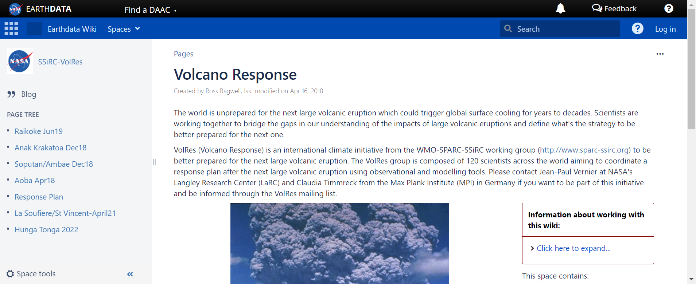
What is VolRes ?

Slide 3
Recent VolRes response activities
June 2019
after the Raikoke eruption
Significant community discussion during the first 3 weeks after the eruption
Eruption information document was prepared and share to the community within a week
Discussion shared with the community led a special issue in ACP/AMT/GMT
Apr. 2020
after La Soufiere eruption
Small eruption (SO2<0.4 Tg) no significant discussion
Jan.–Feb. 2021
after Honga Tonga-Hunga Ha’apai
Significant discussion on the mailing list
Mailing list grow to 245 members quickly
Summary document was prepared to share the main findings (included on the SSiRC webpage)

Slide 4
VolRes’ next setp
Do we need to better structure volcano responses or should we provide discussion forum for idea exchanges ?
Should we re-engage with the community about preparing a response plan ?
Send a survey within the next weeks to get feedbacks to move forward

