Slide 1
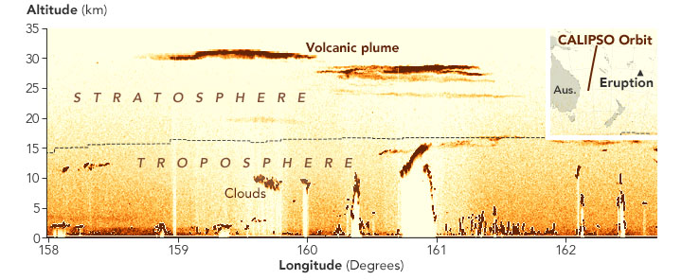
Brazil Volcano (BraVo) campaign
Balloon deployment
J.-P. Vernier, NIA/NASA Langley, USA
J. Mau, NASA Langley, USA
A. Pandit, NIA/NASA Langley, USA
D. Quintao, UNESP, Bauru, Brazil
B. Biazon, UNESP, Bauru, Brazil
E. Landfullo, IPEN/CNEN-SP, Sao Paulo, Brazil
F. Lopes , IPEN/CNEN-SP, Sao Paulo, Brazil
H. Vernier, LPC2E-CNRS
Stratospheric plume Credit: earthobservatory.nasa.gov, CALIPSO team

Slide 2
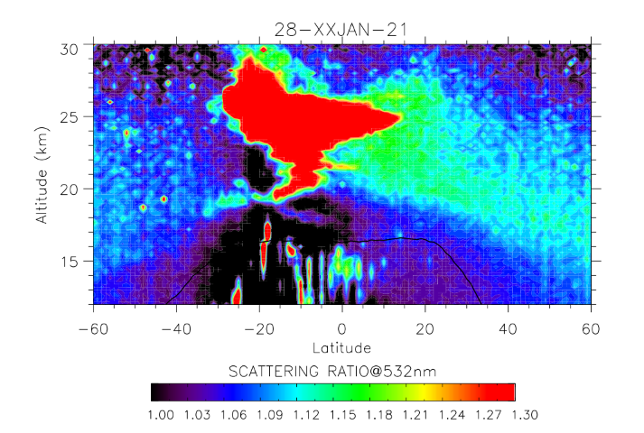
Early transport of the HT-HH plume observed by CALIOP
28 January 2022 -06 February 2022

Slide 3
Science questions triggered by this eruption
1. What is the chemical composition of the Hunga-Tonga plume and how it will evolve within the next 6 months ?
2. What are the microphysical properties and how it will affect its dispersion ?
3. Will the Hunga-Tonga plume have radiative and climate impacts ?

Slide 4
Instruments from NIA/NASA LaRC to study the plume
Aerosol Sampler -> aerosol chemical composition for lab analysis (Ion Chromatography, Aerosol Mass spectrometry (2.2 kg)
Lightweight OPC (POPC) -> aerosol size distribution 6 channels (1.6 kg)
Very lightweight OPC (NPOPC) -> aerosol size distribution 30 channels (0.8 kg)
COBALD backscatter sonde -> aerosol backscatter, satellite validation, ground-based lidar comparison (0.5 kg)

Slide 5
4 flight sequences to sample HT-HH plume
Flight D-1 (previous Nighttime), 7pm
Flight Day
10 am
Flight #CN: COBALD-NPOPC
Flight #NS: NPOPC-Sampler
Balloon (1500g)
Balloon (2000g)
Parachute (3-4 ft)
Parachute
(4-5 ft)
SPOT
SPOT
COBALD/NPOPC/Imet
~1.5 kg
Sampler/NPOPC/POPC/Imetx2
0.5 kg + 2.2 kg= 2.7 kg
ECC
: 0.5 kg
CFH
: 0.7 kg
Lightweight: 1 .5 kg
Medium weight: 3.9 kg

Slide 6
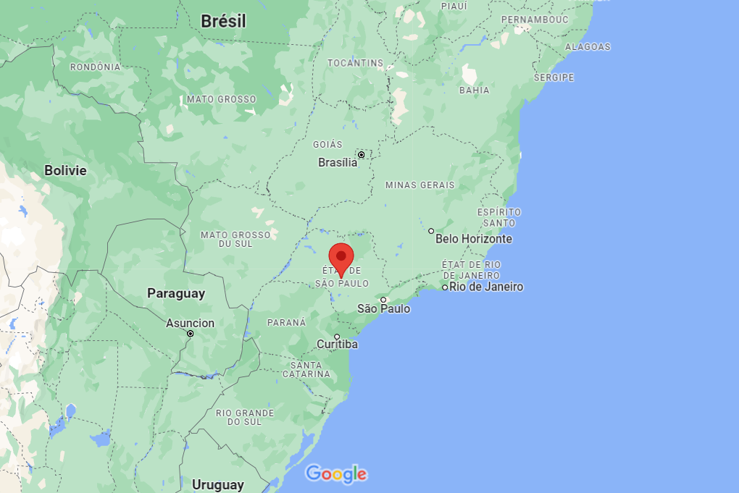
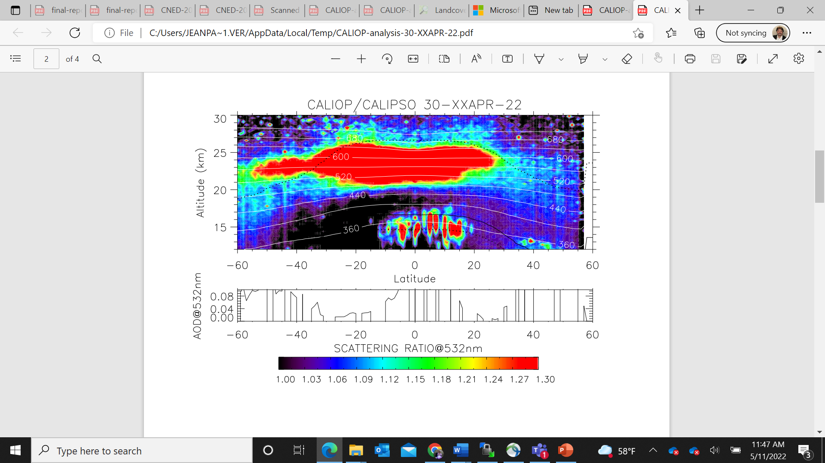
CALIPSO recent observations of the plume
CALIOP/CALIPSO 30 April-8 May 2022
Bauru
-19.54,-60.57

Slide 7
Conclusions:
HT-HH January eruption was the most explosive event recorded in the satellite era (plume up to 55 km)
VolRes triggered some discussions among the community to plan for a deployment
Goal: derive size distribution of the HT-HH volcanic aerosols, chemical composition, is there a significant fraction of “unusual” materials which may have been injected ? Sea salt ?

