Slide 1
EDLA Considerations for Initial Human Missions to Mars
Douglas Trent, Ph.D.
Entry, Descent, Landing, and Ascent Lead, ESDMD Mars Architecture Team
Humans to Mars Summit, Washington, D.C.
May 19, 2022

Slide 2
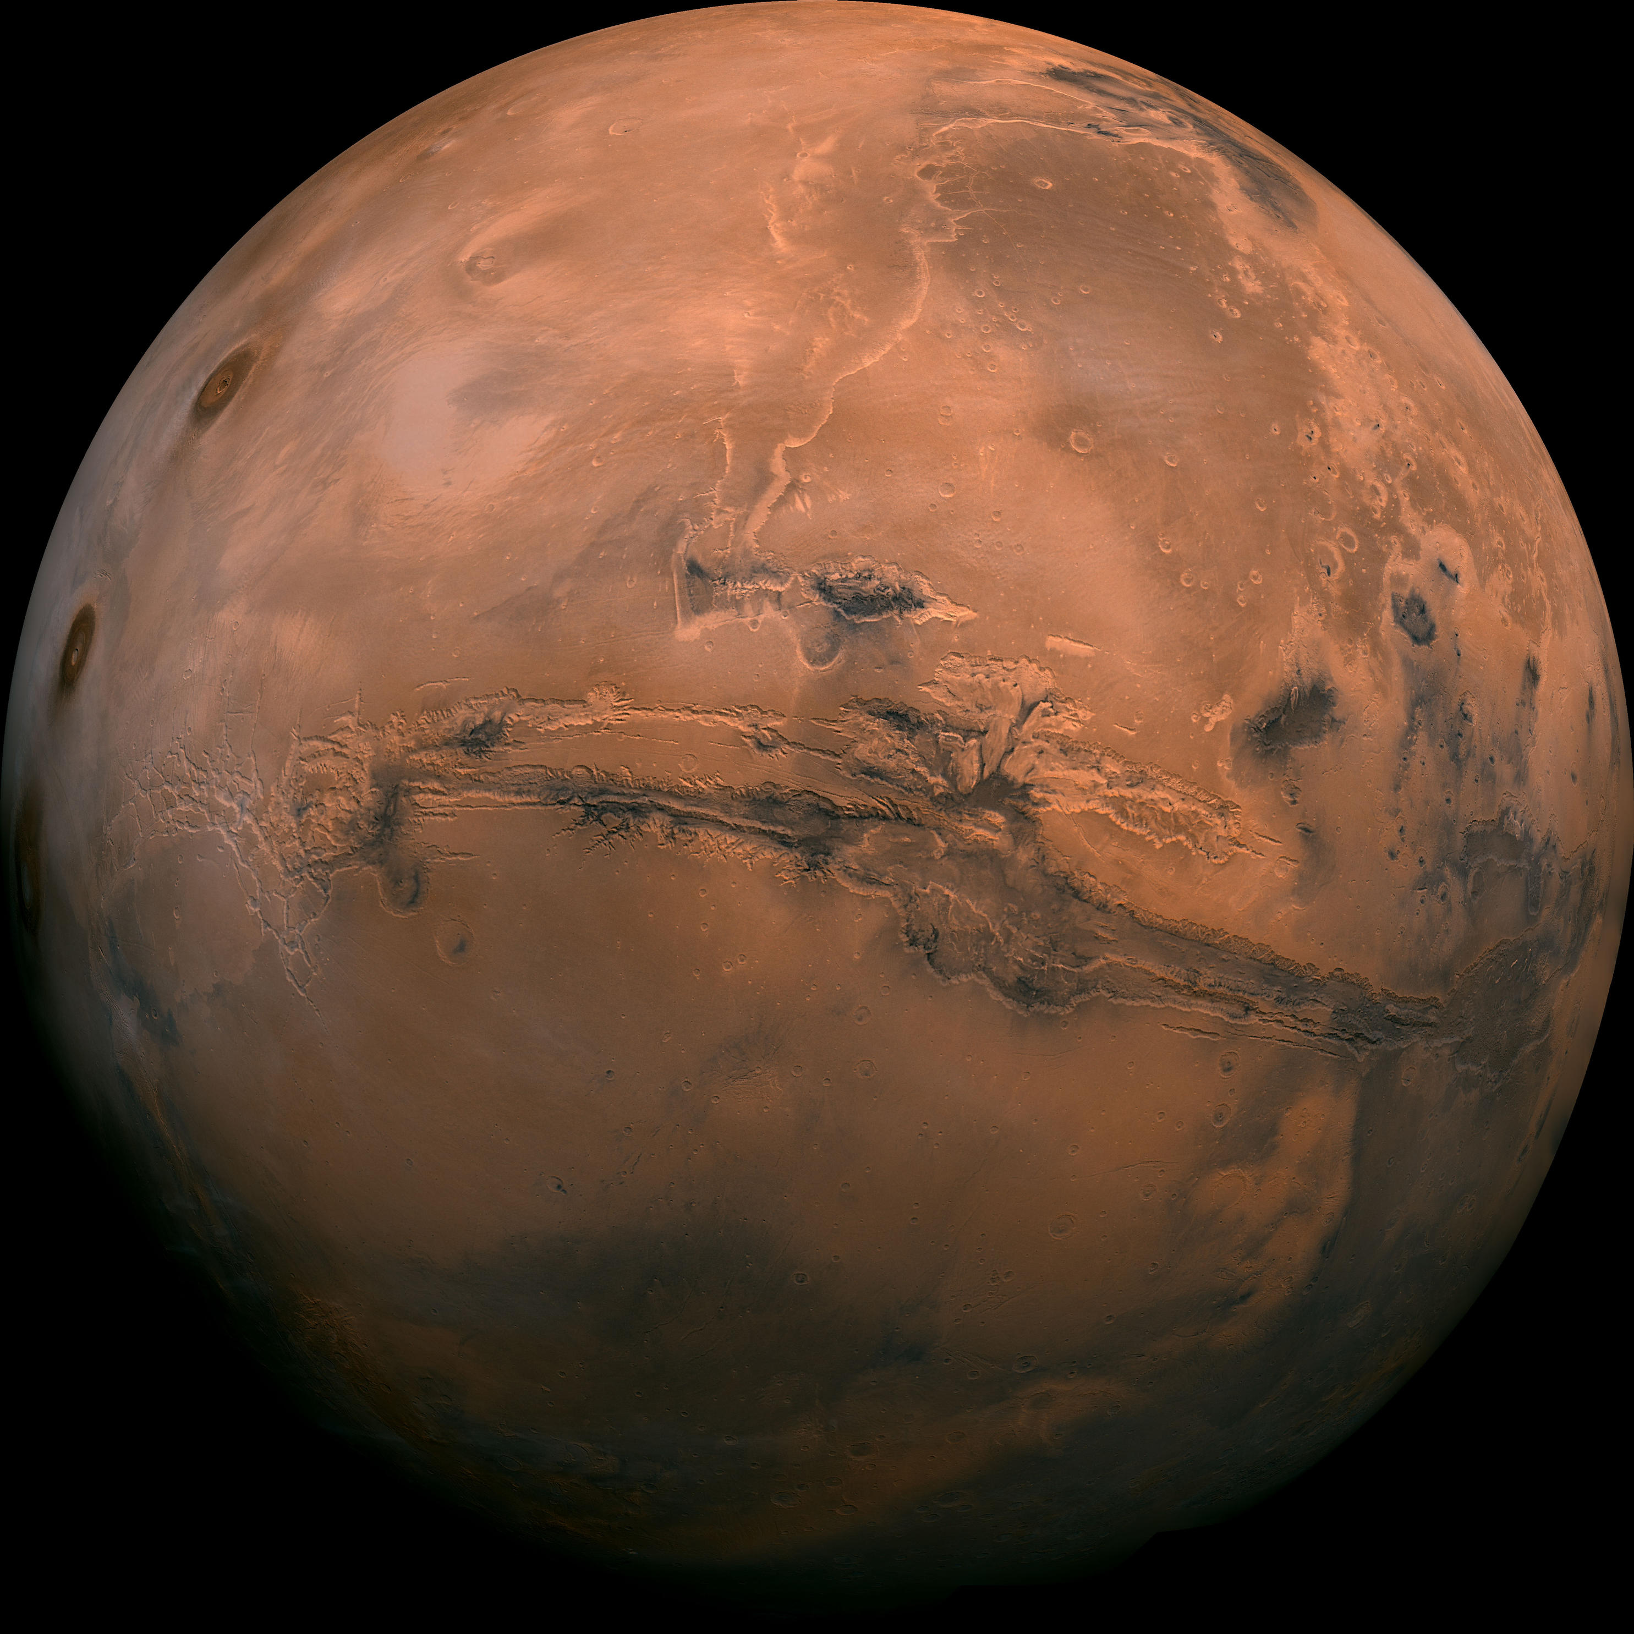
Mars poses many unique problems for Human Spaceflight
Distance
Time Away from Earth
Entry, Descent, Landing … and Ascent
2022 Humans to Mars Summit

Slide 3
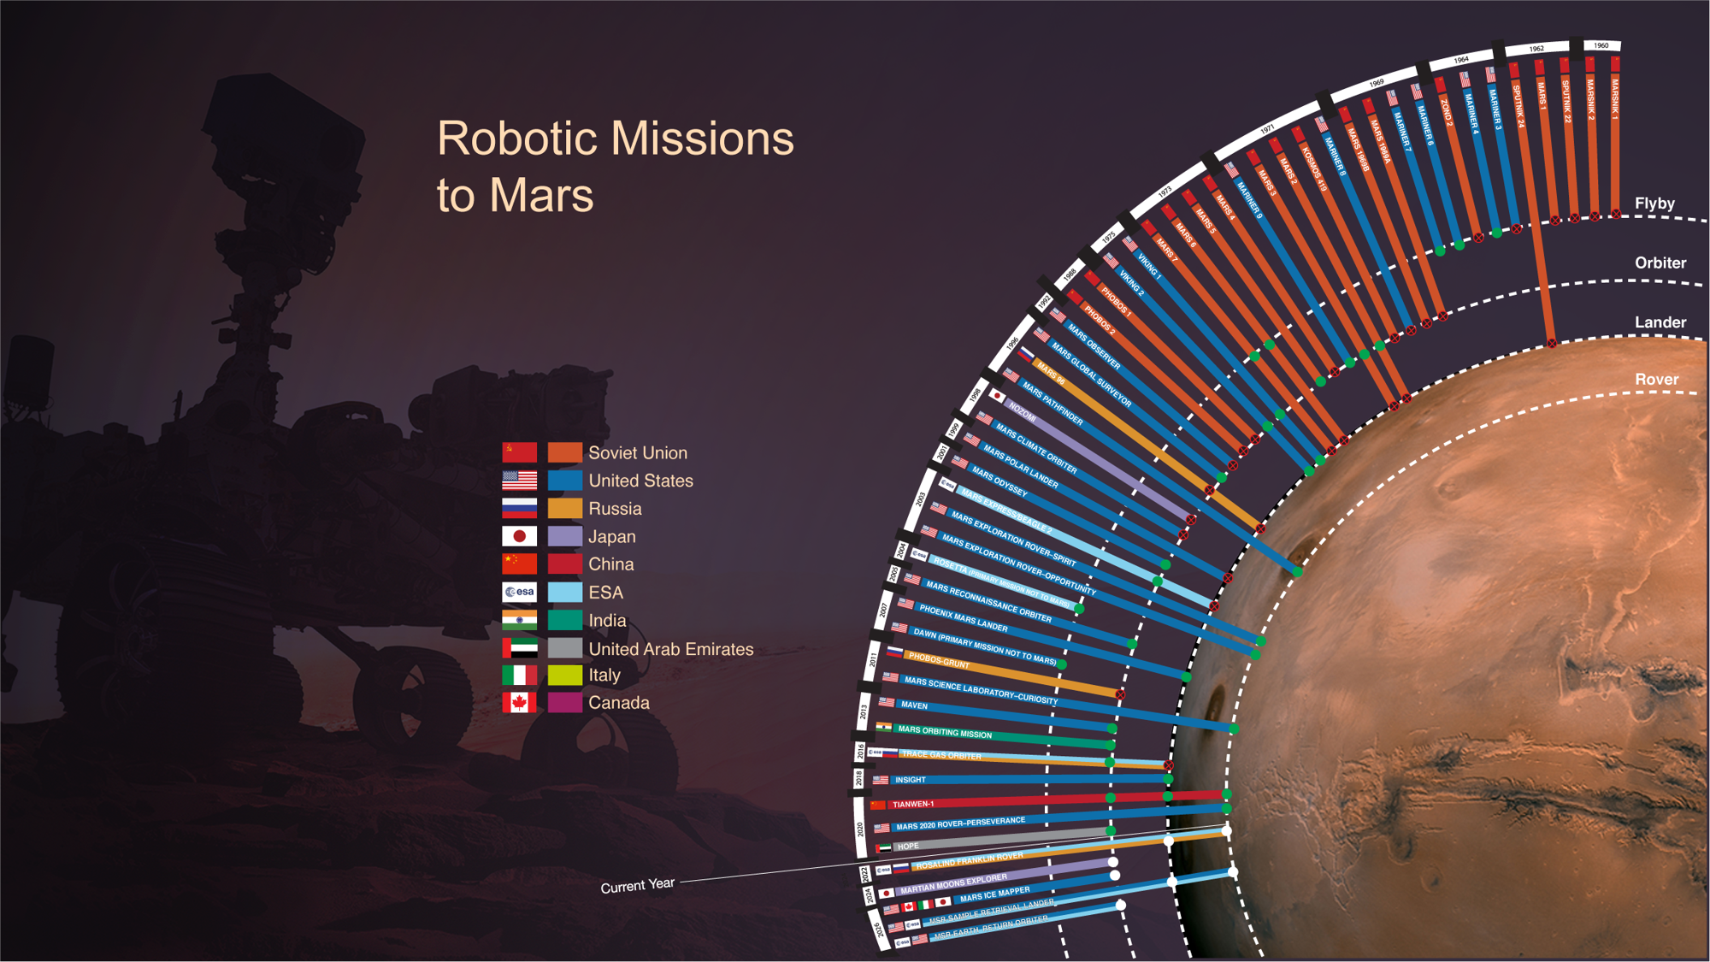
Mars EDL, 1960 - 2000
Success
3
Failure
7
Mars EDL, 2000 - Present
Success
7
Failure
2

Slide 4
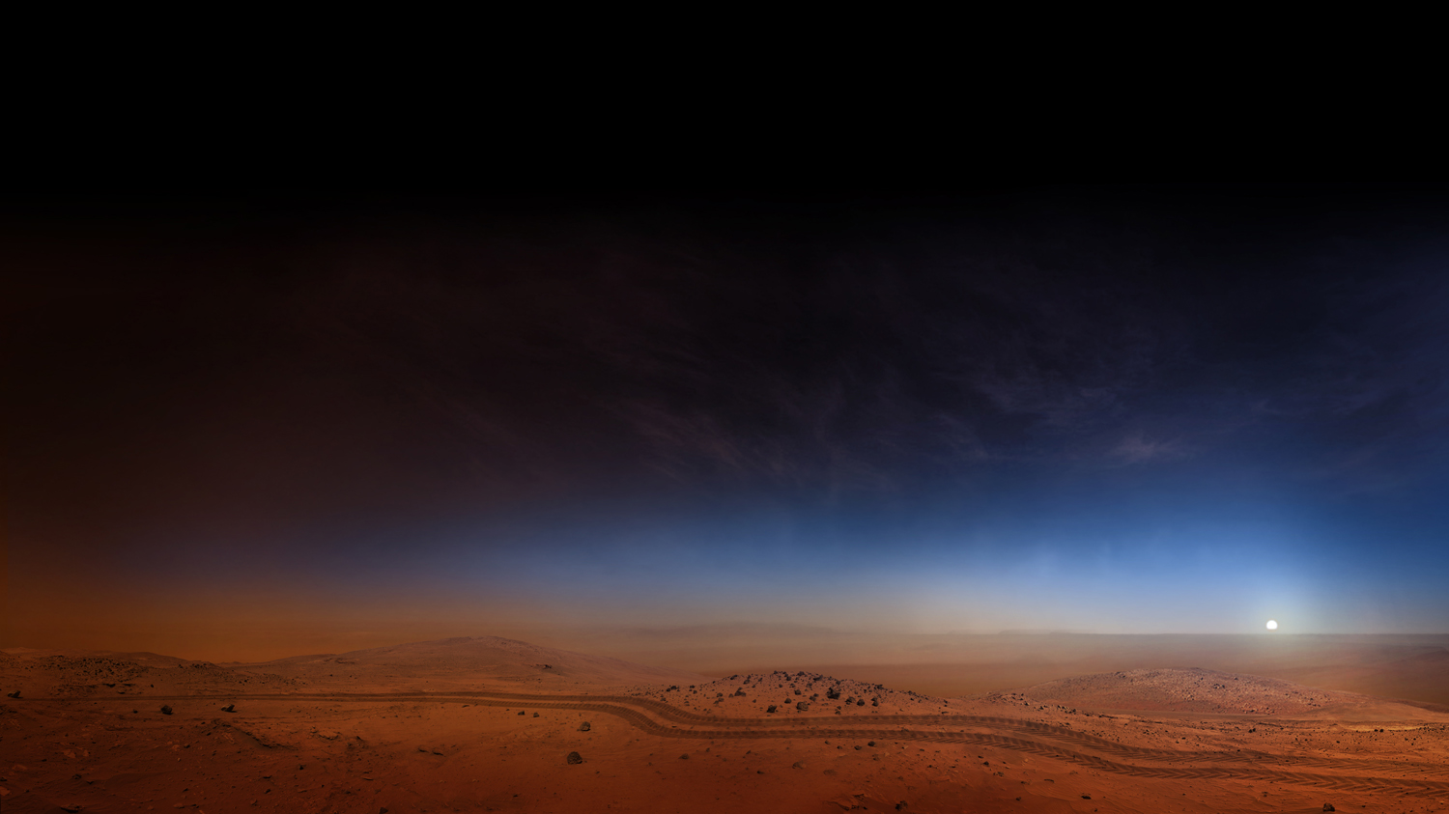





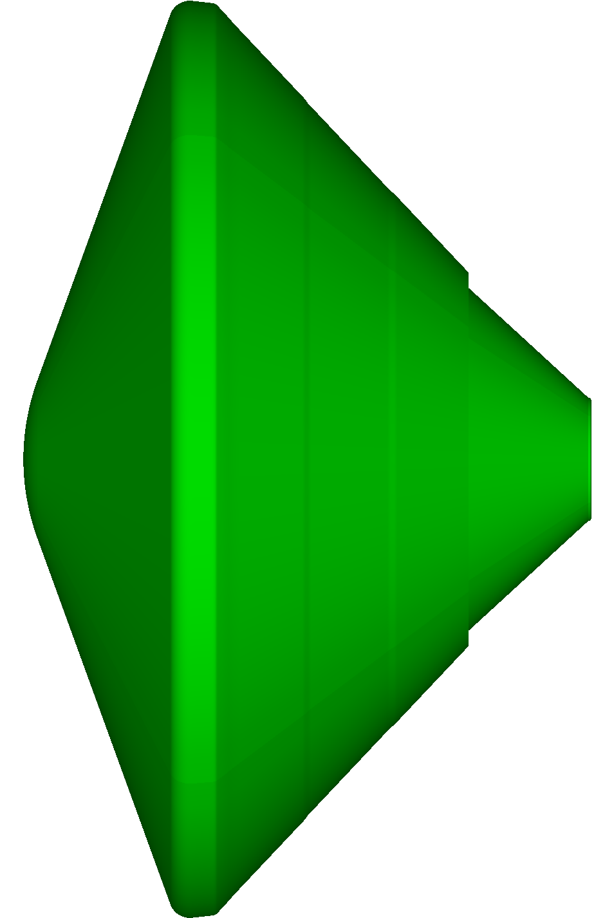
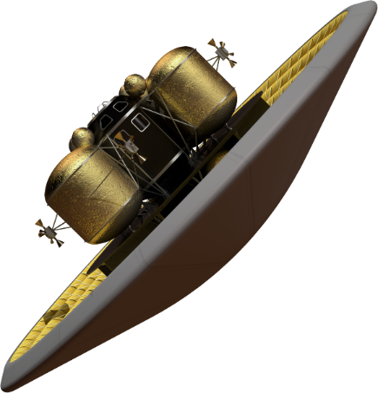
Mars EDL Progression
 | Viking 1&2 | Pathfinder | Spirit & Opportunity | Phoenix | Curiosity | InSight | Perseverance
Diameter (m) | 3.505 Rigid | 2.65 Rigid | 2.65 Rigid | 2.65 Rigid | 4.5 Rigid | 2.65 Rigid | 4.5 Rigid
Entry Mass (kg) | 930 | 585 | 840 | 602 | 3,151 | 606 | 3,369
Landed Mass (kg) | 603 | 360 | 539 | 364 | 899 | 375 | 1,026
Landing Altitude (km) | -3.5 | -1.5 | -1.5 | -3.5 | -4.4 | -2.6 | -2.5
Peak Heat Rates (w/cm²) | 24 | 106 | 45 | 56 | 78 | 51.8 | 68
Landing Ellipse (km) | 280 x 130 | 200 x 70 | 150 x 20 | 130 x 27 | 25 x 20 | 130 x 27 | 7.7 x 6.6
Ballistic Guidance | Unguided | Unguided | Unguided | Unguided | Bank Angle Control | Unguided | Bank Angle Control
Technologies | Parachute + Retro-propulsion | Parachute + Airbags | Parachute + Airbags | Parachute + Retro-propulsion | Parachute + SkyCrane | Parachute + Retro-propulsion | Parachute + SkyCrane + TRN
 | Human Class Lander (Government Reference)
 | 16-19 Inflatable
 | 47,000-65,000
 | 36,000-40,000
 | +2
 | 120 - 350
 | 0.1 x 0.1
 | Direct Force Control
 | HIAD + Supersonic Retro-propulsion + TRN
Steady Progression of “in family” EDL
New Paradigm Needed for Human Class Landers
2022 Humans to Mars Summit

Slide 5
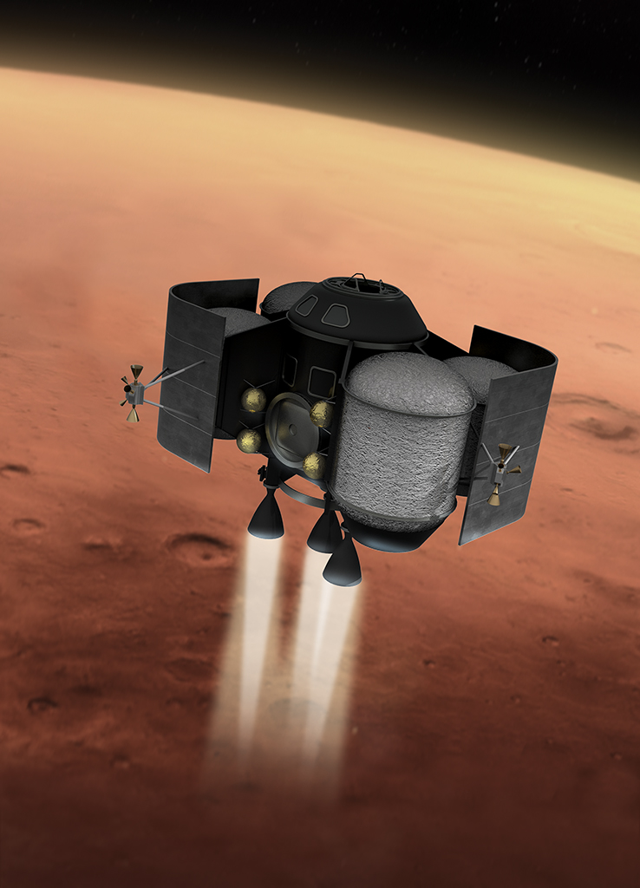
Humans have ascended from only two celestial bodies to date
Earth
  Significant in-person ground support
  Generous delay/abort capability
Moon
  Vehicle is delivered with crew prepared for ascent
  Real-time ground support via coms
Mars
  Little to no margin for delays
  Little to no real-time ground support
  Vehicle likely arrives unprepared for launch
100’s human launches
6 human launches
0 human launches
2022 Humans to Mars Summit

Slide 6
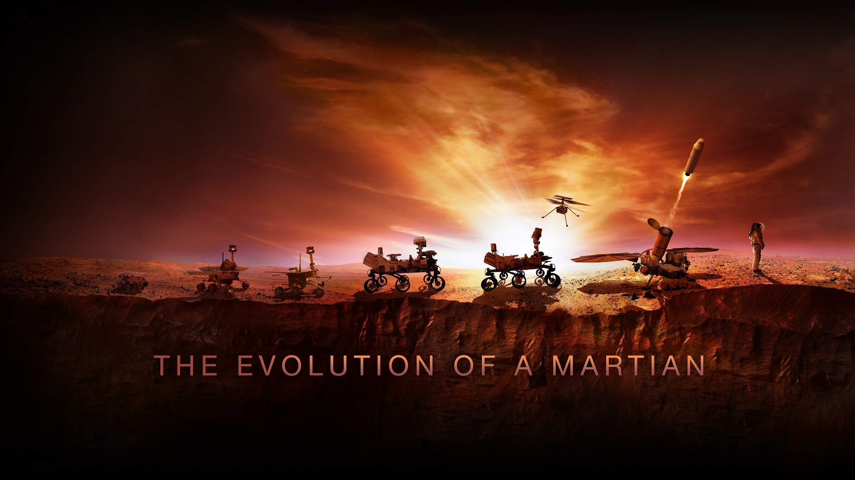

National Aeronautics and
Space Administration
douglas.trent@nasa.gov

