Slide 1
History of Engineering
Michael D. Watson, Ph.D.
NASA Marshall Space Flight Center

Slide 2
History of Engineering Disciplines
Engineering History
Engineering Culture History
  Civil Engineering
  Materials Engineering
  Mechanical Engineering
  Aerospace Engineering
  Electrical Engineering
  Computer Engineering
  Software Engineering
  Systems Engineering
Engineering Professional Societies and Reference Sites

Slide 3
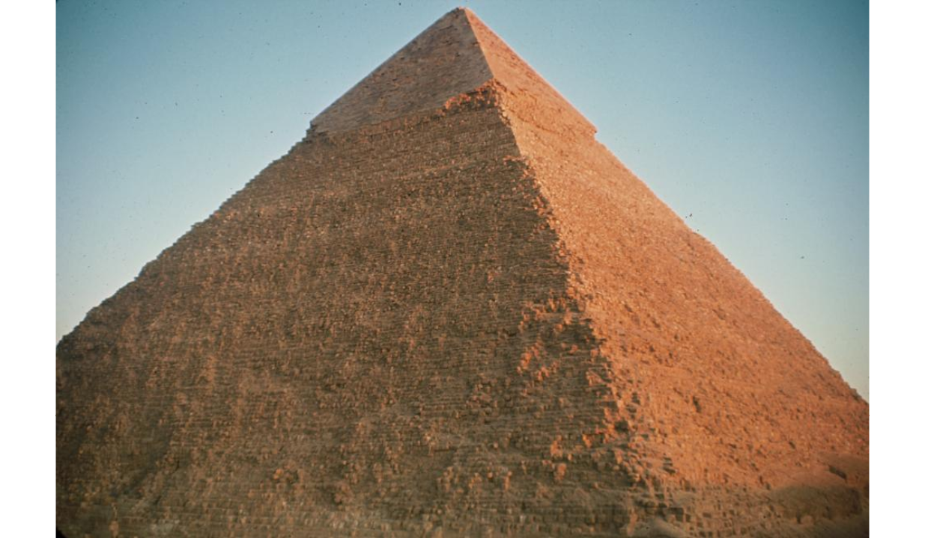
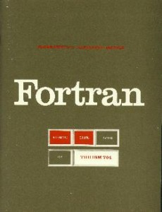
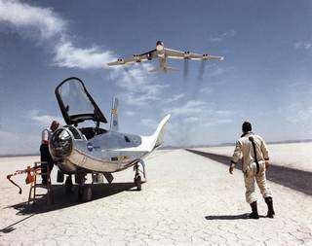
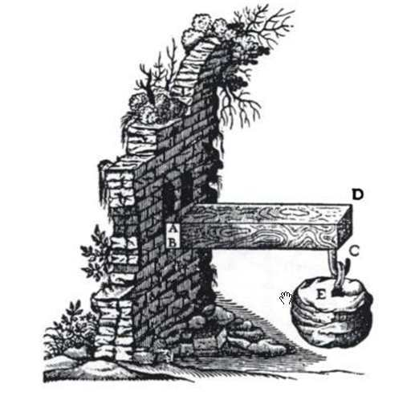
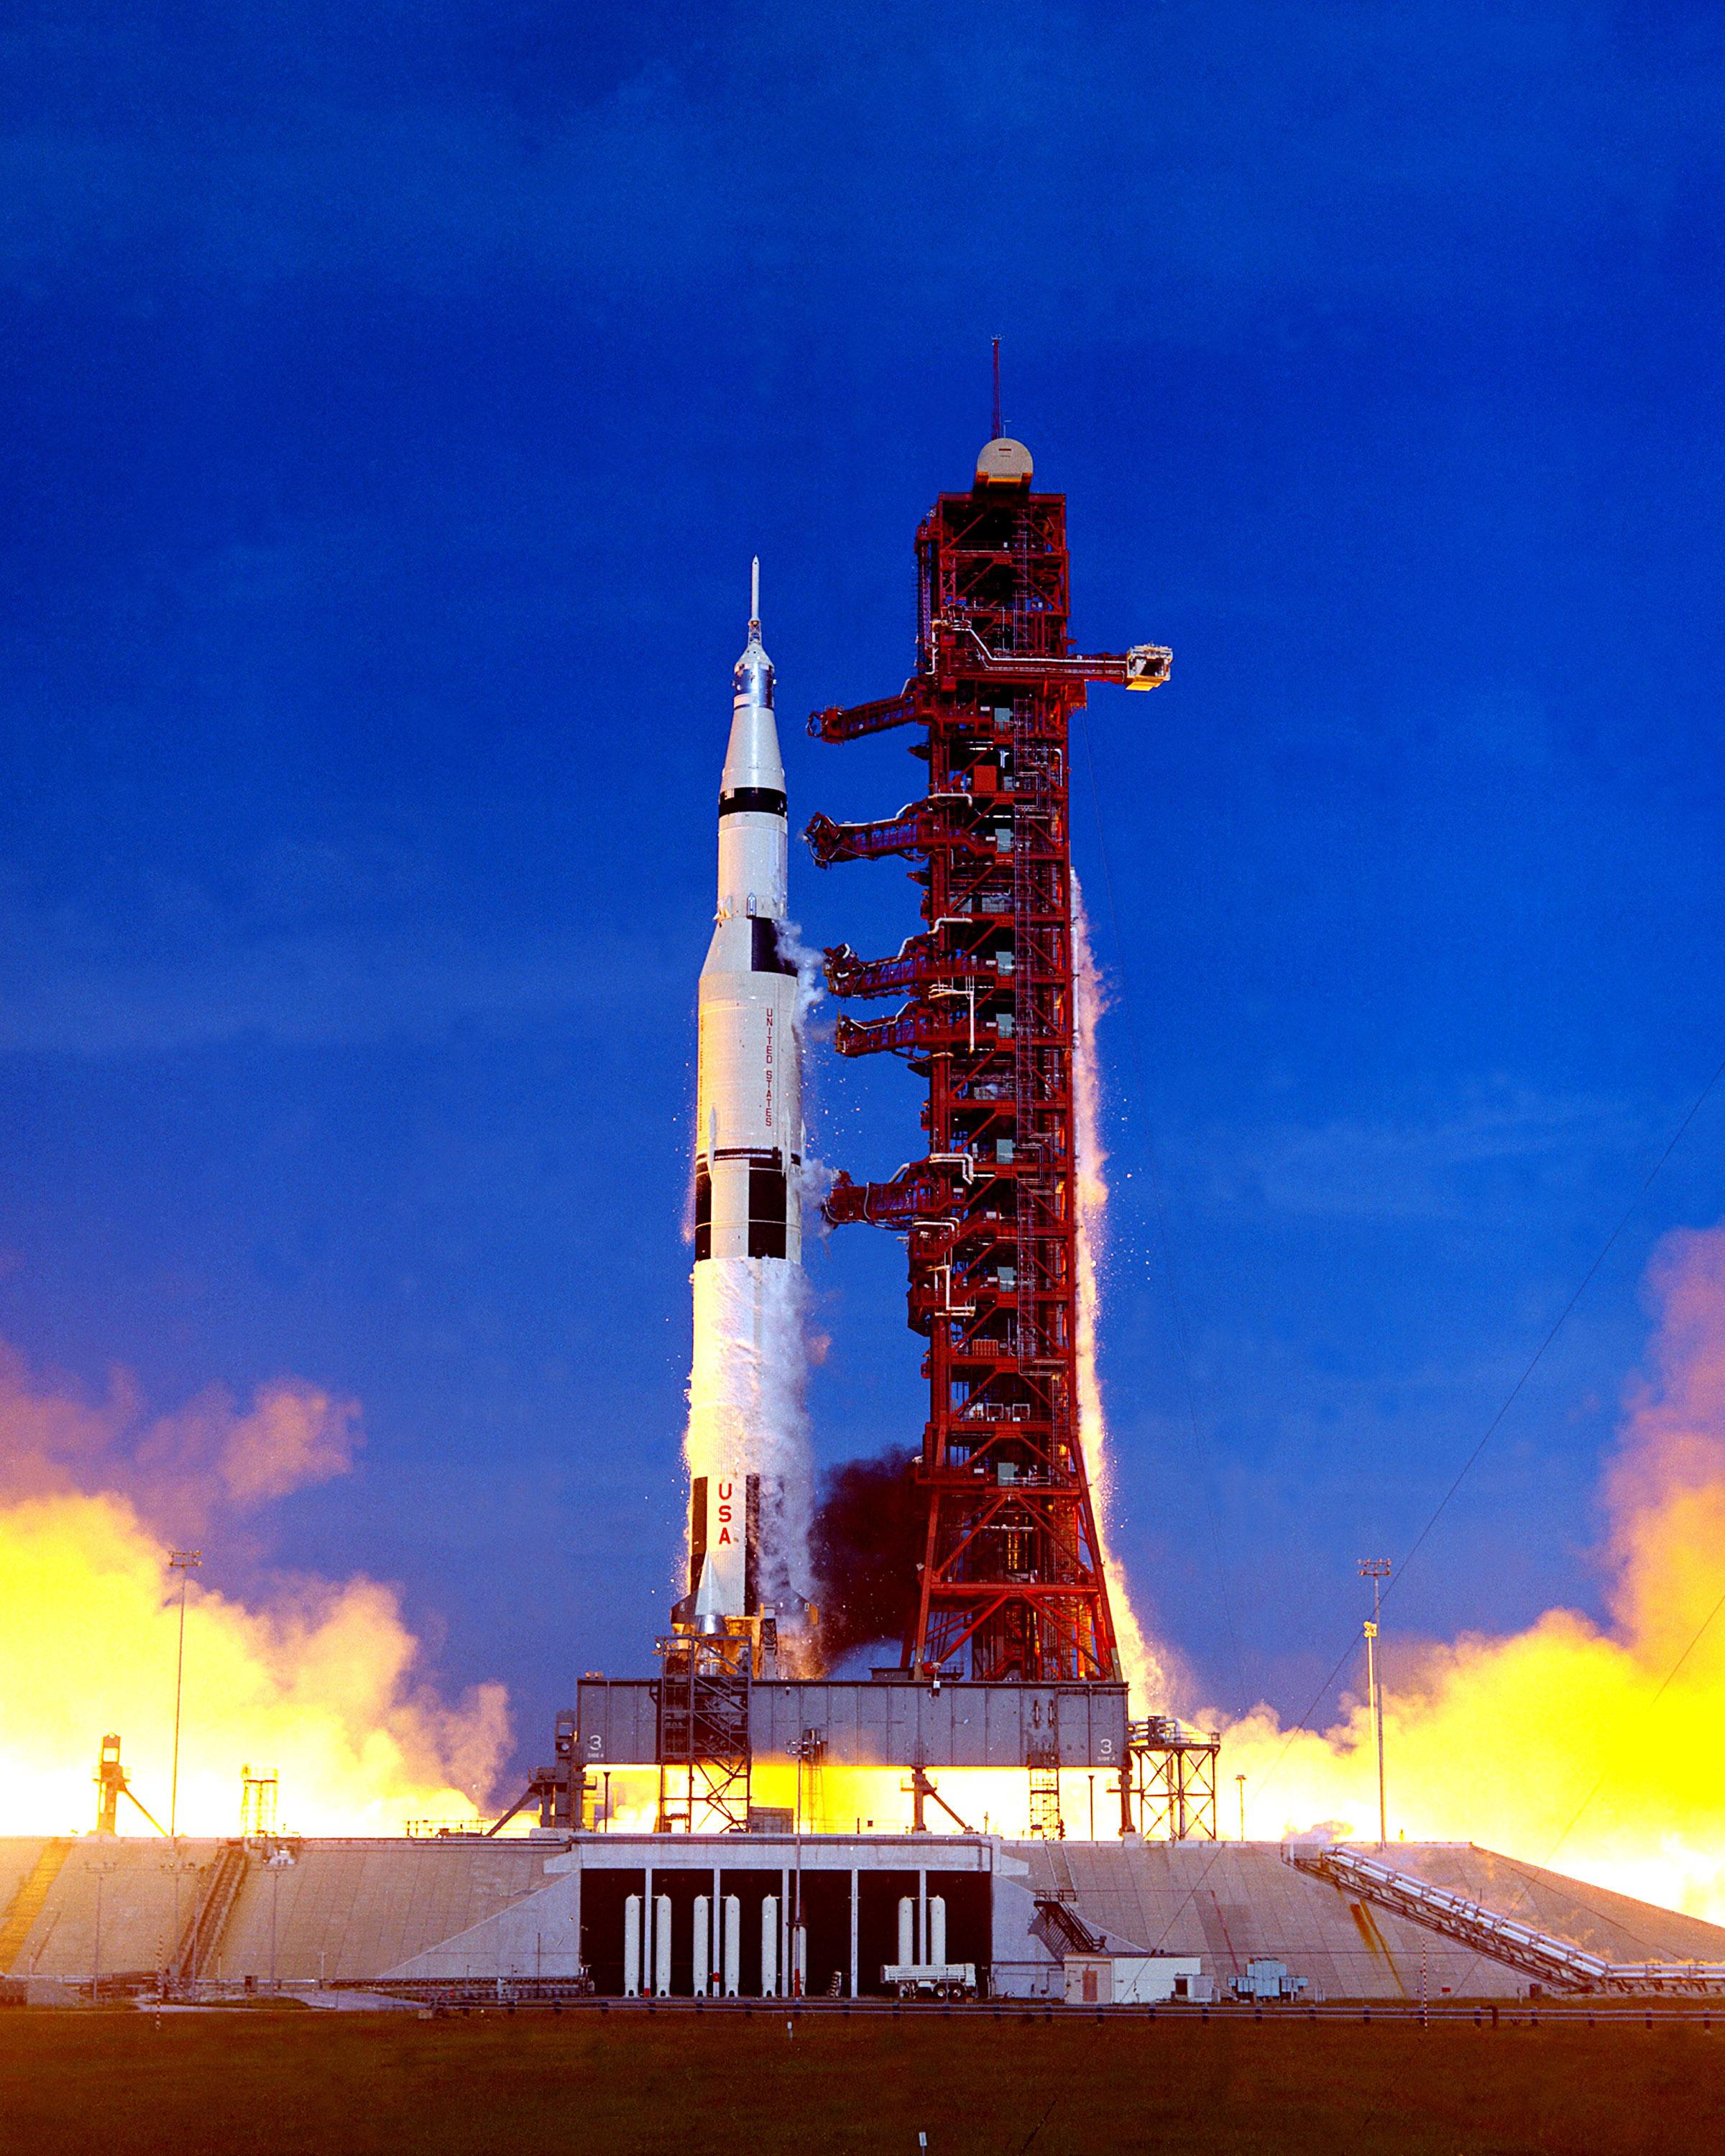
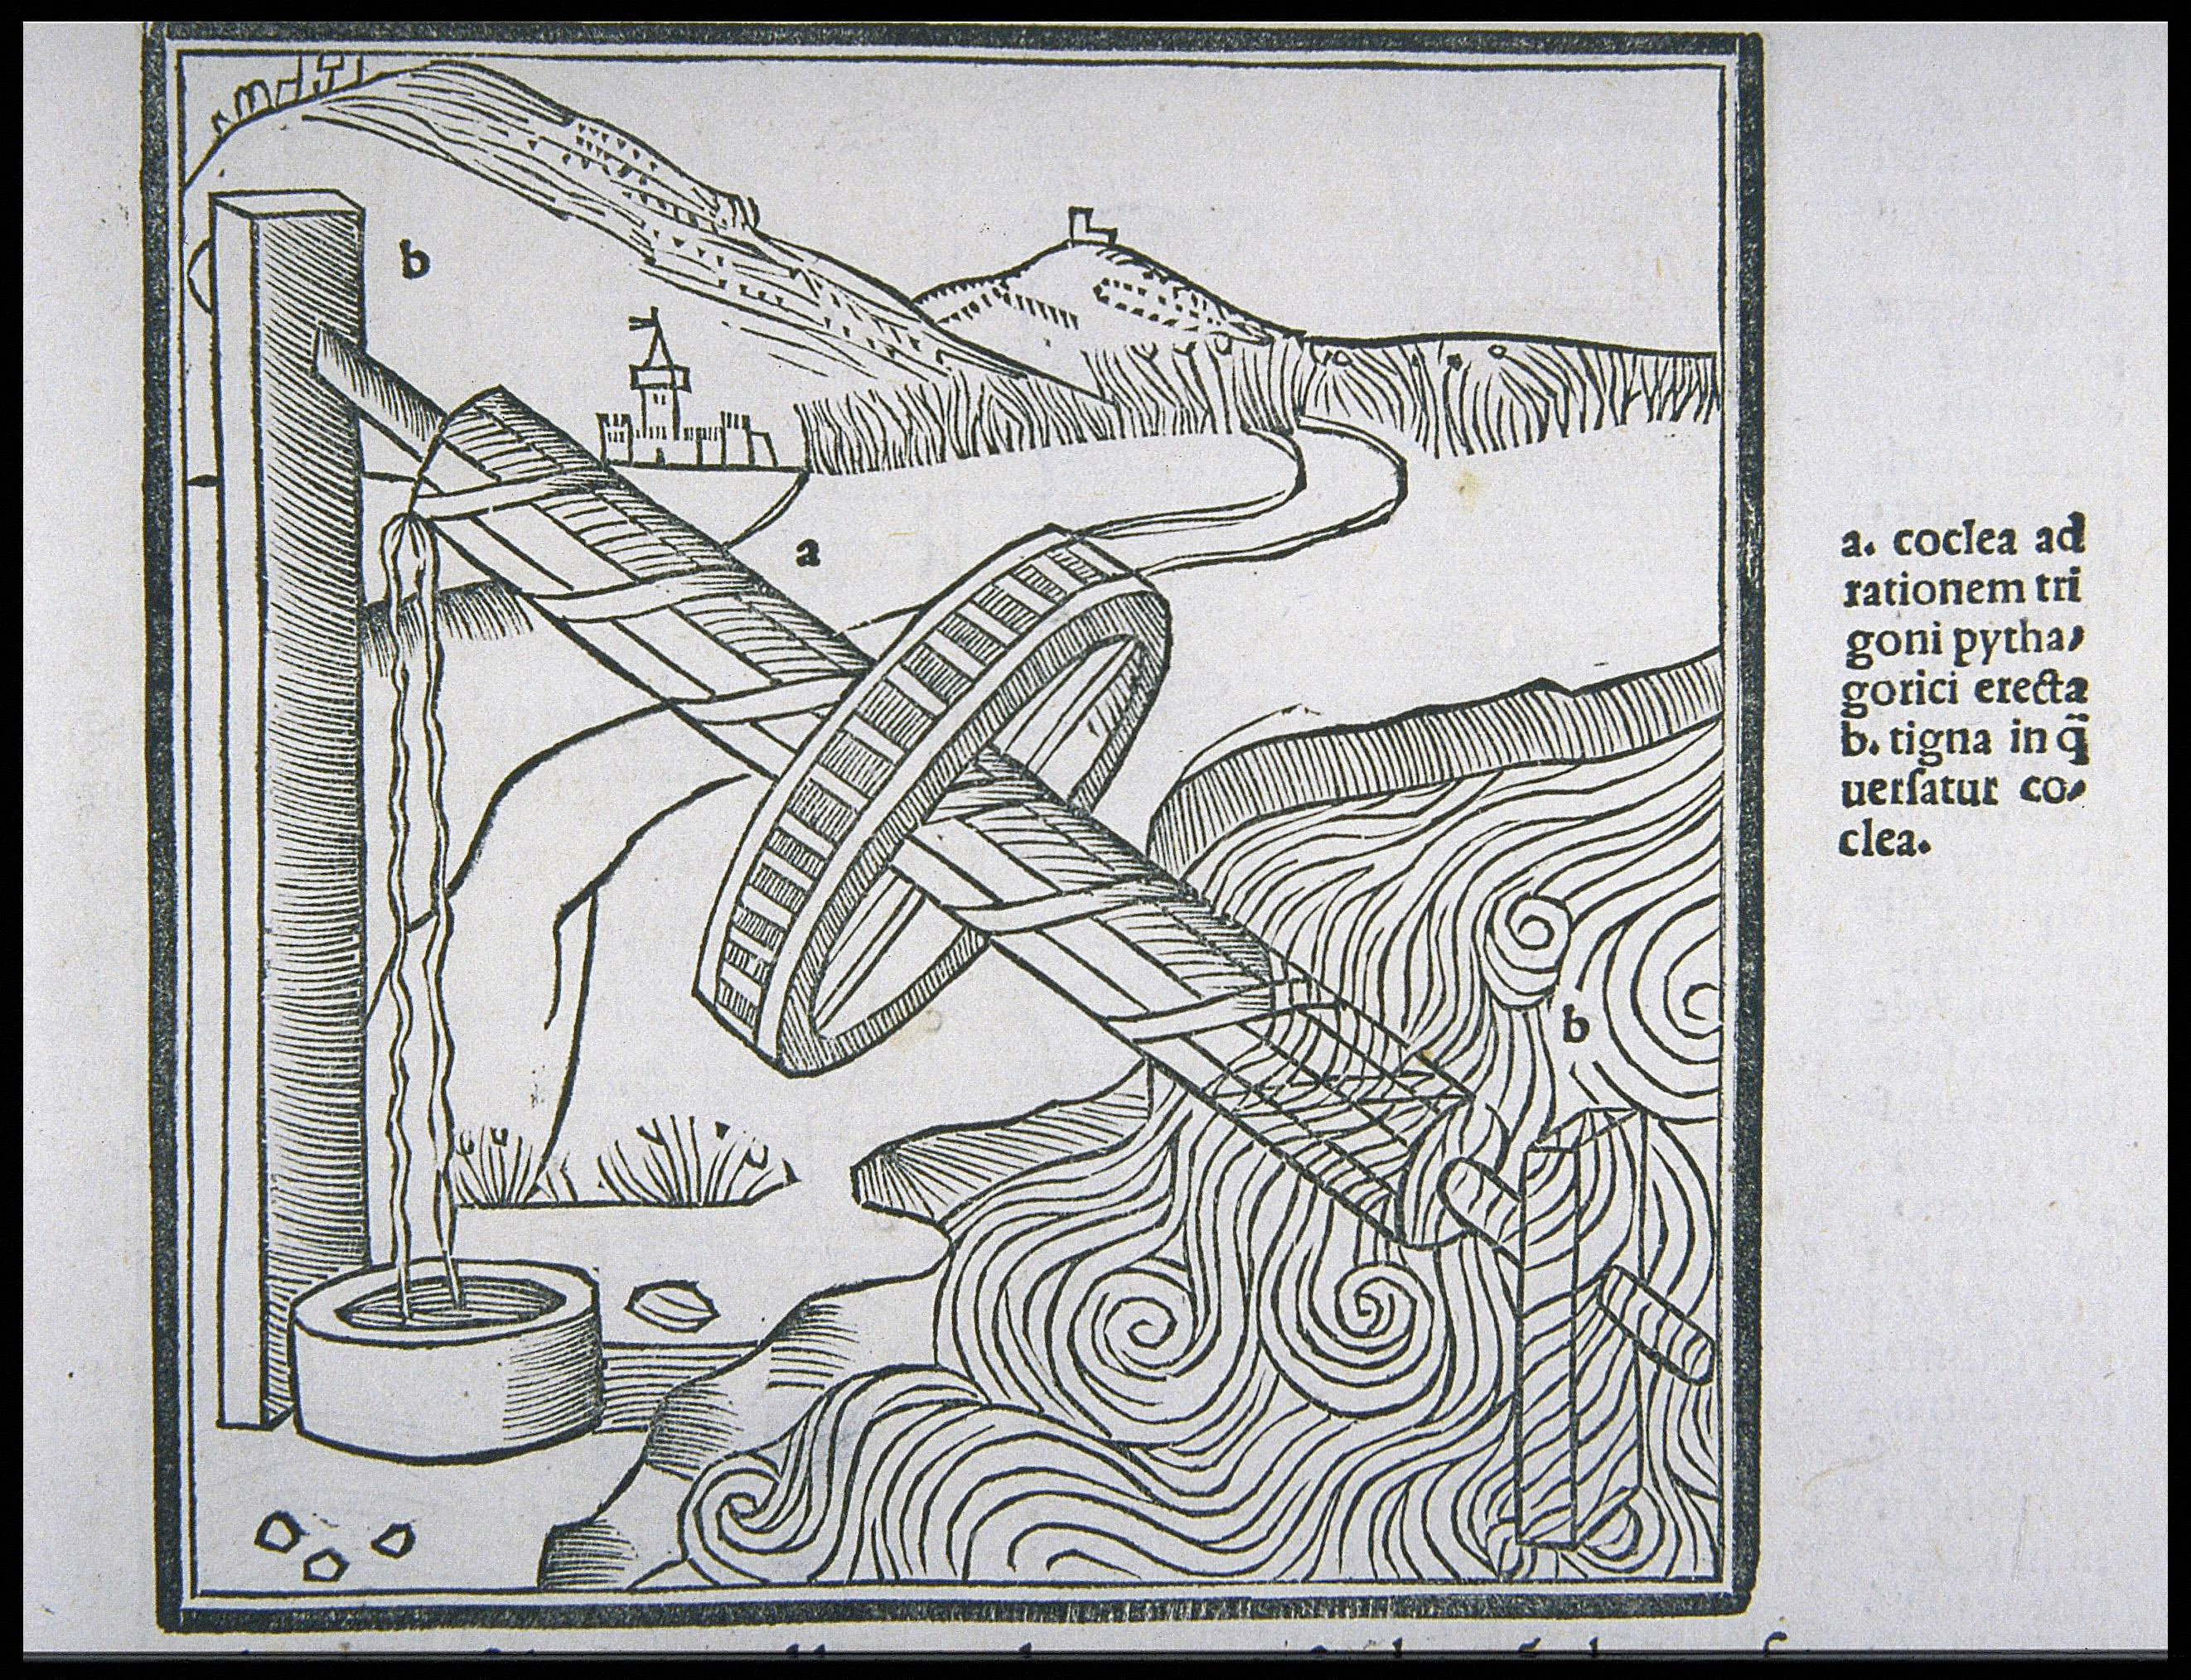
Engineering History Summary
Engineering Disciplines start first in practice
  Some disciplines were in practice 1000’s of years in some aspect before formalizing as a discipline
    Civil Engineering (Buildings, Bridges, Aqueducts)
    Materials
    Mechanical Engineering
    Optical Engineering
  Newer disciplines are still based on practice
    Systems Engineering
Disciplines begin to form once the basic physics are defined
  Electrical Engineering
  Computer Engineering
  Aerodynamics
  Software Engineering
Formalization as Engineering Disciplines have all occurred since the 1800’s
Eliot Elisofon Photographic Archives, The pyramid of Kfafre, Pyramids of Giza, Egypt, slide, Accessed at
https://www.si.edu/spotlight/ancient-egypt/pyramid
First IBM Fortran Manual, https://www.fortran.com/
HL-10
Galileo’s Cantilever Beam Proof Construction, Accessed at: https://newtonexcelbach.com/2008/02/27/the-history-of-the-theory-of-beam-bending-part-1/
Apollo 15
Vitruvius Water Screw, Cornell University, accessed at: https://digital.library.cornell.edu/catalog/ss:11177730

Slide 4
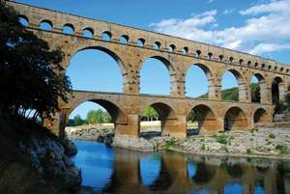
History of Civil Engineering
Civil Engineering
  Structures, roads, bridges, buildings, aqueducts have been built for many millennia
    Egyptian Pyramids are some of the oldest building structures we know, circa 2700 B.C.
  Marcus Vitruvius Pollio documented the basic civil engineering understanding in his “Ten Books on Architecture”, circa 30-20 B.C.
    He dealt with
      Book 1: First Principles and the Layout of Cities
      Book 2: Building Materials
      Books 3 – 6: Temples, Public Buildings, Private Buildings
      Book 7: Finishing
      Book 8: Water
      Book 9: Sundials and Clocks
      Book 10: Machines
  Galileo provided the next big step by defining the definition of the strength of materials for a cantilevered beam in 1638*
    W = Sbh²/2L
Eliot Elisofon Photographic Archives, The pyramid of Kfafre, Pyramids of Giza, Egypt, slide, Accessed at
https://www.si.edu/spotlight/ancient-egypt/pyramid
Britannica. 2019. “Aqueduct.” accessed at
https://www.britannica.com/technology/aqueduct-engineering.
*Henry Petroski, :Design Paradigms: Case Histories of
Error and Judgement in Engineering”, Cambridge, 2010

Slide 5
History of Civil Engineering
Civil Engineering
  Galileo’s initial equation was later revised to the correct form in 1713 by A. Parent*
    W = Sbh²/6L
    It took most of the 1700’s for the correct form to come into practice
  Once the strength of materials formula was established Civil Engineering became a formal engineering discipline in the early 1700’s and 1800’s**
    Named Civil Engineering to distinguish it from Military Engineering
    French National School of Bridges and Highways in 1747
    Rensselear Polytechnic Institute degree in 1835
    King’s College courses in 1838
Galileo’s Cantilever Beam Proof Construction,
Accessed at: https://newtonexcelbach.com/2008/02/27/the-history-of-the-theory-of-beam-bending-part-1/
*Henry Petroski, :Design Paradigms: Case Histories of Error and Judgement in Engineering”, Cambridge, 2010
**Britannica. 2019. “Civil Engineering.” accessed at https://www.britannica.com/technology/civil-engineering

Slide 6
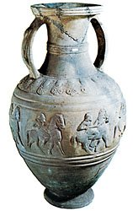
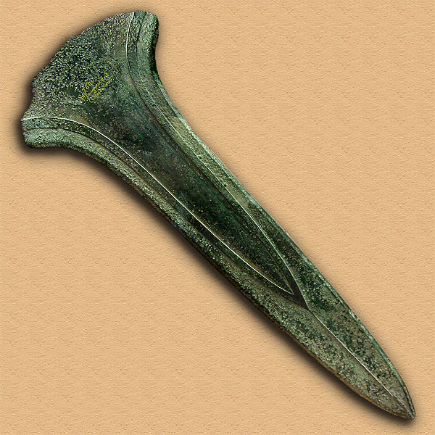
History of Materials Engineering
Materials Engineering*
  Materials have been mined and refined from a very early time*
    Clay pottery before 10,000 B.C.
    First copper pins and lead pins are dated to 9000 – 7000 B.C. in Western Iran
    Glass dated to 4000 B.C. in Egypt
    Crucible furnaces for copper date to 3300-3000 B.C.in Israel
    Bronze (copper and tin) first appeared around 3000 B.C. in Iran and 2000 B.C. in Asia
    Greek specifications for the quality of bronze date from 360 B.C.
    Silver was being worked back to 3150-2790 B.C. in the Aegean islands and regions
    Brass (copper and zinc) dates to 2000 B.C. in Cyprus and China
      Roman Zinc process documented by Pliny the Elder, “Natural History”, 77 A.D.**
    Glazed pottery dated to 700 B.C. in Assyria
    Porcelain dated to 700-800 A.D. in China
    Iron dates back to 2000-1500 B.C.
      Steel first case hardened in the same timeframe
      Blast furnace developed in late 400’s A.D. (Belgium) and came into prominence in 1500 A.D. (Britain)
        High temperature blast air in 1828 by J. B. Neilson
      Coke fired furnaces first used in 1709 by Abraham Darby
      Crucible steel in the 1740 by Benjamin Huntsman
      Bessemer Steel in 1856 by Henry Bessemer
      Alloy Steel in 1868 by R. F. Mushet
      Stainless Steel in 1913 by Harry Brearley
Etruscan amphora of bucchero ware decorated with a frieze of horsemen in relief, 6th century bc. In the British Museum. Accessed at: https://www.britannica.com/art/pottery
Bronze Age Sword
Wikipedia accessed at https://en.wikipedia.org/wiki/Materials_science
*“An Encyclopedia of the History of Technology”, Ed. by Ian McNeil, Routledge, NY, 1990
**Britannica. 2019. “Pliny the Elder.” accessed at https://www.britannica.com/biography/Pliny-the-Elder

Slide 7
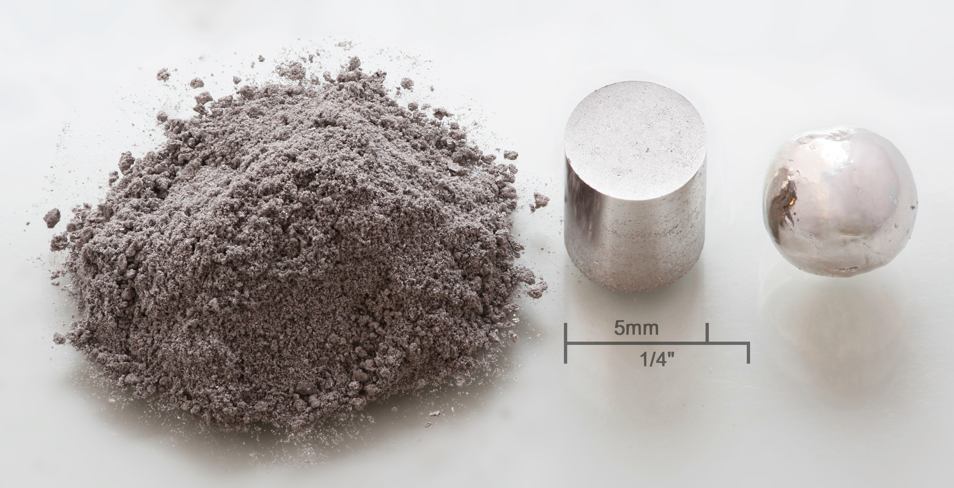

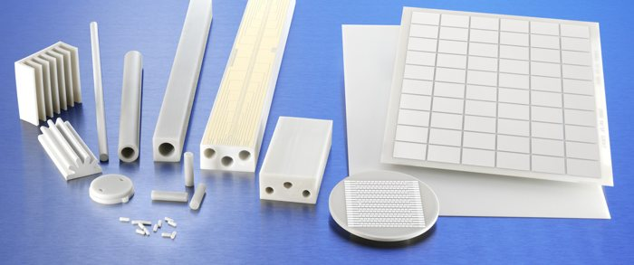
History of Materials Engineering
Materials Engineering*
  Materials have been mined and refined from a very early time*
    Power metallurgy dates to smiths in the 400’s A.D. by Wayland the Smith (the story of Wayland is somewhat more a legend than confirmed history)
    Nickel (paktong) came to Europe from China in the 1500’s
    Aluminum was first produced by Hans Christian Oersted (Danish) in 1825
    Magnesium isolated in 1808 by Humphry Davy and first commercial quanty process in 1857 (Deville and Caron)
    Beryllium was also first identified by Wohler in 1828 and pure beryllium produced in the 1921 following processes by Goldschmidt, Stock, Praetorius, and Priess
    Titanium first produced in 1896 by Henry Mossian
    Age hardening of metals (Al by Alfred Wilm in 1906), high temperature alloys (NiCr by Marsh in 1906), and sintering (carbides produced by Voigtlander and Lohmann in 1914) in the early 1900’s
    Rare Earth metal alloys (Heraeus in 1934) began use in the 1930’s
    Niobium commercially available in 1960
First Materials Science and Engineering Program started at Northwestern University in 1955**
  Previously universities had separate departments for metallurgy and ceramics
Rhodium metal: powder, pressed pellet (3×10⁵ psi) remelted.
By Alchemist-hp (talk) www.pse-mendelejew.dederivative work: Purpy Pupple (talk) - Own work, CC BY-SA 3.0 de, https://commons.wikimedia.org/w/index.php?curid=7636785
American Elements accessed at:
https://www.americanelements.com/magnesium-blocks-7439-95-4
CeramTec AlN products accessed at: https://www.ceramtec.com/substrates/
*“An Encyclopedia of the History of Technology”, Ed. by Ian McNeil, Routledge, NY, 1990
**Northwestern University accessed at https://www.northwestern.edu/newscenter/stories/2005/10/materials.html

Slide 8
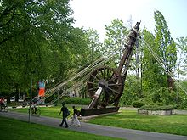
History of Mechanical Engineering
Mechanical Engineering*
  Power
    Waterpower first harnessed circa 400 B. C. by Greeks and then the Romans to grind grain
    Vitruvious 9th book on “Sundials and Clocks” and his 10th book on “Machines” documented several mechanical devices
      Water clocks reference the principles of pneumatics and hydraulic machines (both discovered by Ctesibius of Alexandria)
      Principles of Machines (‘run by many workers’) and Instruments (run by a ‘skilled workman’) are defined
        Mounting (fixed)
        Pressure (pneumatics)
        Tractor (motionary)
      Cranes and Hoists
      Types of Motion (circular and linear)
      Raising Water
      Water wheels
      Water Screws
      Water Pump
      Water Organ
      Hodometer
      (Arrow) Catapults
      Ballistae (Stone Catapults)
      Seige Engines
      Defenses
Roman Treadwheel Crane on Wikipedia accessed on: https://en.wikipedia.org/wiki/Treadwheel_crane
*“An Encyclopedia of the History of Technology”, Ed. by Ian McNeil, Routledge, NY, 1990
Vitruvius Water Screw, Cornell University, accessed at: https://digital.library.cornell.edu/catalog/ss:11177730

Slide 9
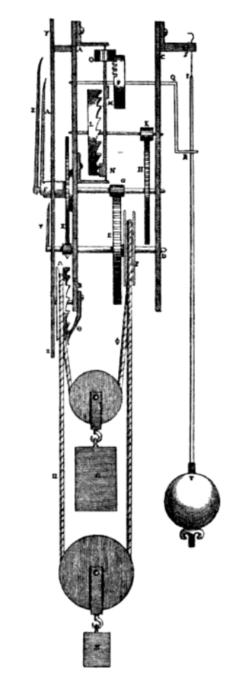
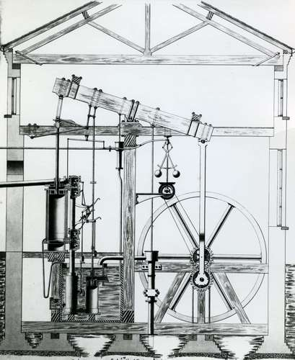
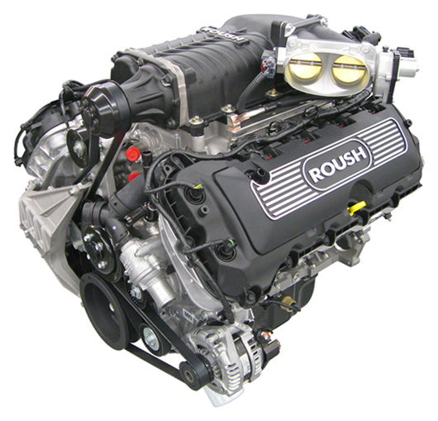
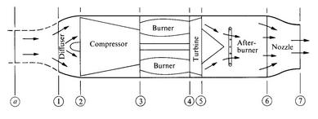
History of Mechanical Engineering
Mechanical Engineering*
  Mechanical Statics evolved from the Civil Engineering content
  Mechanical Dynamics
    Galileo’s observations of motion in free fall, inclined plane, pendulum in early 1600’s
    Pendulum clock in 1657 by Christian Huygens
    Hooke’s Law by Robert Hooke in 1678
    Newton’s Laws defined by Sir Isaac Newton in Principia Mathematica, 1687
      3 Laws of Mechanics
      Law of Gravity
  Thermodynamics
    Steam engine by Thomas Newcomen in 1712
    Improved steam engine by James Watt in 1768
    Carnot Cycle defined by Sadi Carnot in 1824
    First called “Thermodynamics” in 1849 by Lord Kelvin (William Thomson)
    1st and 2nd Laws of Thermodynamics by William Rankine, Rudolph Clausius, and Lord Kelvin in 1850’s
    First textbook in 1859 by William Rankine at University of Glasgow
    Stirling cycle by Robert Stirling in 1816
    Ericsson cycle by John Ericsson in 1826
    Four stroke engine cycle by Beau de Rochas (1862) and Nikolaus Otto (1876)
    Gas Turbine engine in 1870 by George Brayton
    Compression Ignition engine by Rudolph Diesel (1890s)
    Rayleigh Flow by Lord Rayleigh (John Williams Strutt) circa 1900
    Control Volume methods applied systematically by Ludwig Prandtl in 1913
      Allows dealing with system effects
Huygens Pendulum Clock, accessed at: https://www.aps.org/publications/apsnews/201706/history.cfm
Watt Steam Engine, accessed at: https://www.britannica.com/biography/James-Watt/Later-years
Roush Ford Coyote V8, accessed at: https://www.roushperformance.com/engines
Brayton Cycle Engine, accessed at:https://web.mit.edu/16.unified/www/SPRING/propulsion/notes/node27.html
*“An Encyclopedia of the History of Technology”, Ed. by Ian McNeil, Routledge, NY, 1990

Slide 10
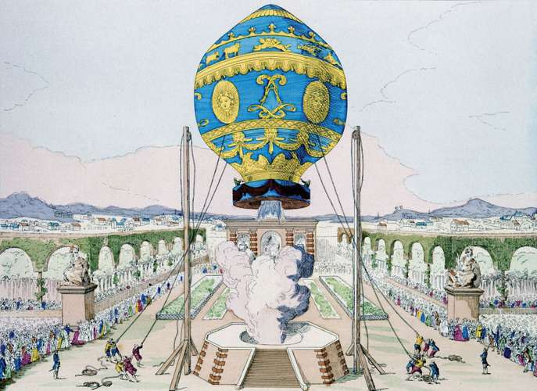
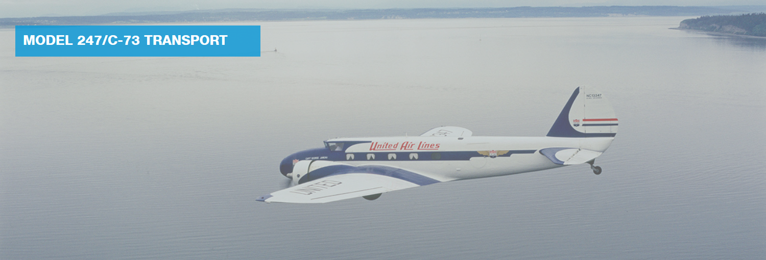
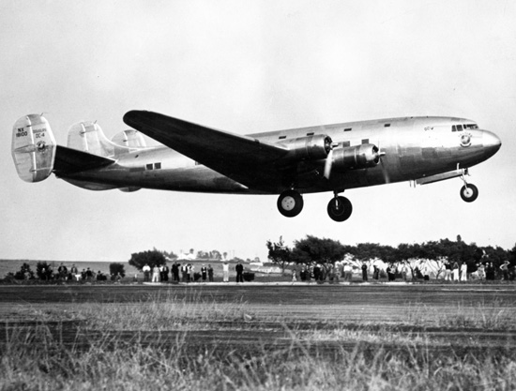
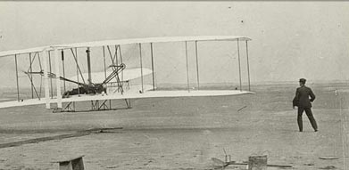
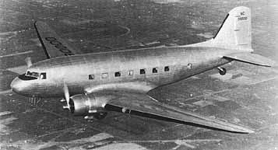
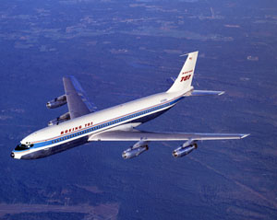
History of Aerospace Engineering
Aerospace Engineering
  Aeronautics*
    Hydrogen gas first produced by Henry Cavendish (reported in 1766)**
    First human balloon flight by Montgolfier Brothers, 1783
    Principles of dynamic flight by Sir George Cayley in 1809-1810
    First gliders by Otto Lilienthal in 1890s
    First powered flight by Orville and Wilbur Wright, 1903
    Jet turbine first patented in 1930 by George Whittle***
      Similar development by Hans von Ohain in mid 1930’s
    Boeing 247, first solely commercial passenger plane in 1933
    Douglas DC-3 in 1935, Highly successful elegant system
    Reporting of swept back wing testing for supersonic flight by Adolph Busemann in 1935
      Thinner wings, lower chord/span ratio,
    First flying quality specifications for DC-4 in 1937 by Edward Warren****
    First jet turbine aircraft (HE-168) in 1939***
    Laminar airflow defined in 1940’s****
      Previously, wing design was done through testing and test result catalogs (NACA) of wing shapes
    Boeing 707 first flew in 1954***
Montgolfier Balloon Flight, accessed at: https://www.britannica.com/biography/Montgolfier-brothers
Wright Brothers First Flight. accessed at: https://airandspace.si.edu/exhibitions/wright-brothers/online/fly/1903/
Boeing 247, accessed at:
https://www.boeing.com/history/products/model-247-c-73.page
DC-4E
DC-3
Boeing 707, accessed at:
https://www.boeing.com/history/products/707.page
*“An Encyclopedia of the History of Technology”, Ed. by Ian McNeil, Routledge, NY, 1990
**https://www.britannica.com/biography/Henry-Cavendish
***Jean Ford Brennan, “The Elegant Solution”, van Nostrand, 1967
****Watler G. Vincenti, “What Engineers Know and How They Know It”, Johns Hopkins University Press, 1990, pg. 84

Slide 11
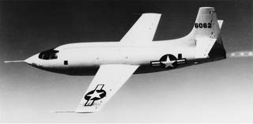
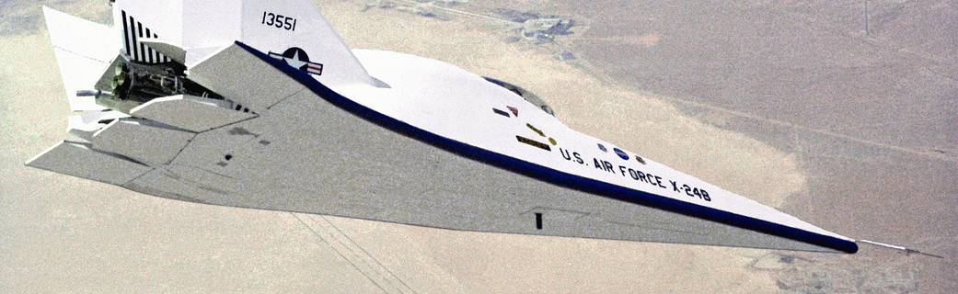
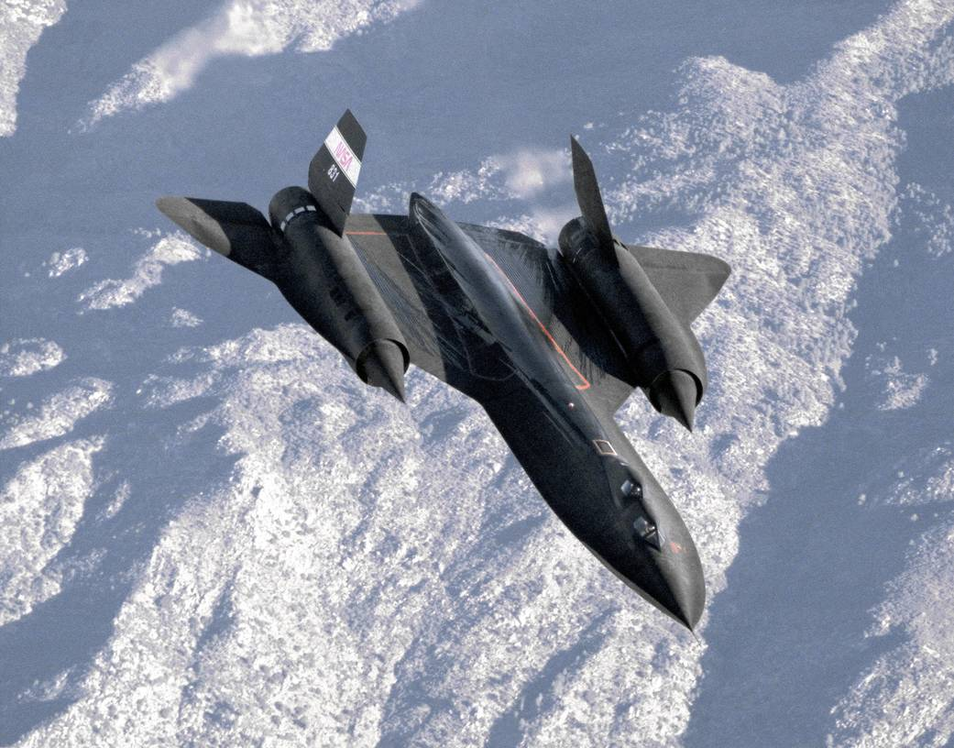
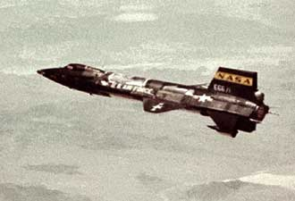
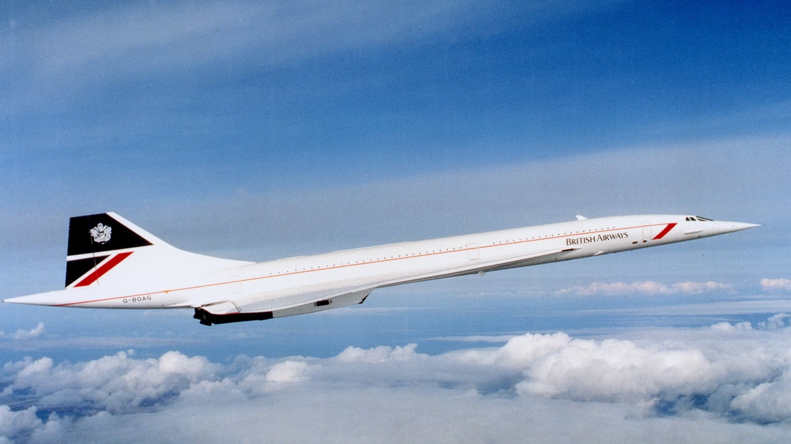
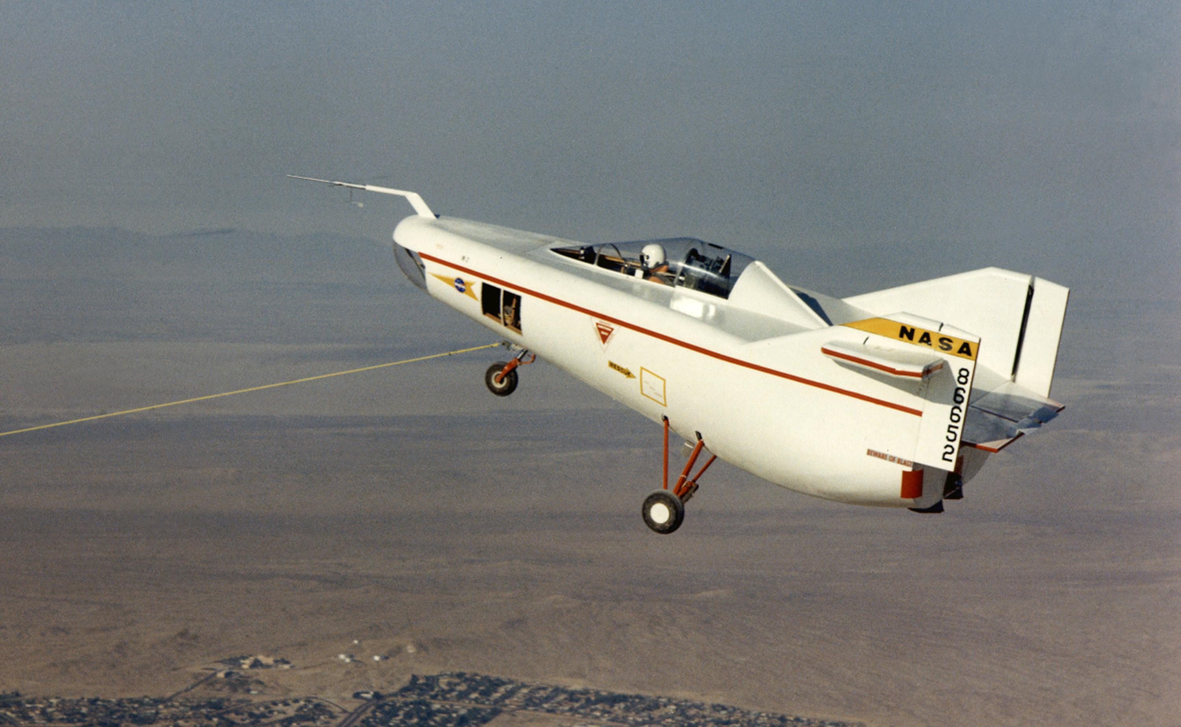
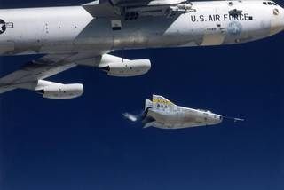
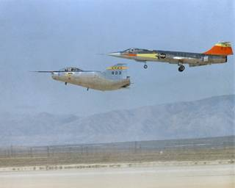
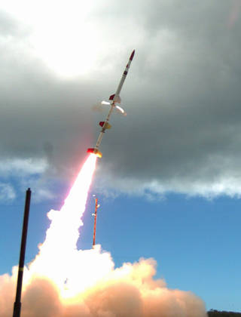
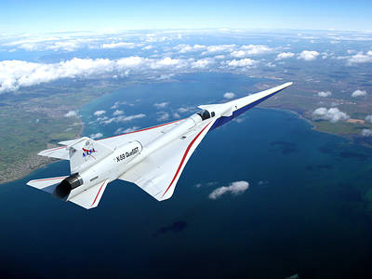
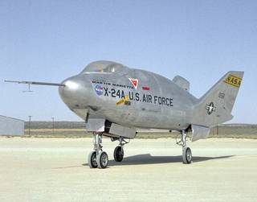
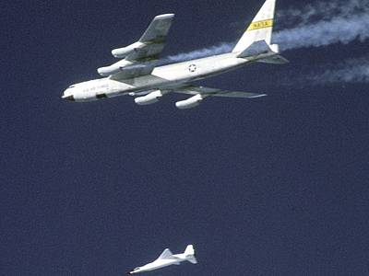
History of Aerospace Engineering
Aerospace Engineering
  Aeronautics*
    Supersonic Flight
      XS-1 built by Bell Aircraft broke sound barrier 14 October 1947 flown by Cpt. Chuck Yeager
    Rocket Plane
      X-15 tested from 1959-1968
        Demonstrated Reaction Control System and paving way for Space Shuttle design
        Mach 6.7
        266,000+ ft altitude
    Lifting Bodies developed in the 1960’s
      M2-F1 was first lifting body built in 1963
      M2-F2 built by Northrup Grumman tested from 1966-1967
        Landing accident in 1967 used in “Six Million Dollar Man opening”
      M2-F3 was the rebuild of the M2-F2 with a third stabilizer fin tested from 1970-1972
      HL-10 build by Northrup Grumman and tested in 1970
        Contributed to Space Shuttle design
        Aceeived Mach 1.86 and 90,000+ ft altitude on separate test flights
      X-24A built by Martin Aerospace and tested from 1969-1970
        Contributed to Space Shuttle design
        Basis for X-38 design
      X-24B modified X-24A by Martin Aerospace and tested from 1973-1975
        Contributed to Space Shuttle design
    Supersonic Flight
      SR-71 by Lockheed Martin Skunk works 1964-1999
      Concorde flew 1973 – 2003
      NASA X-59 undergoing flight test at AFRC
    Hypersonic Flight
      NASA X-43 in 2003-4
      NASA, AFRL, Australia
      HIFIRE in 2012 - 2017
XS-1
X-24B
SR-71
X-15
https://www.britannica.com/technology/Concorde
M2-F1
Concorde
M2-F3
M2-F2
X-59
X-24A
X-43
*https://www.nasa.gov/centers/dryden/history/HistoricAircraft
HL-10

Slide 12
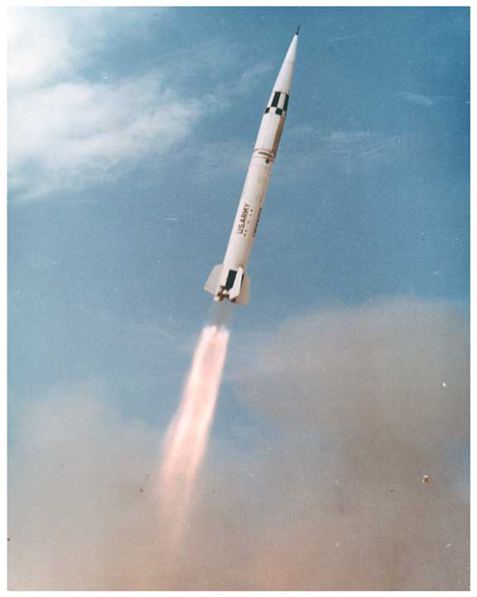
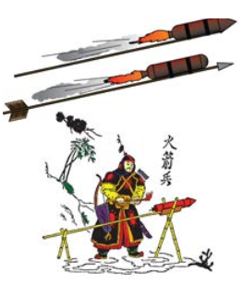
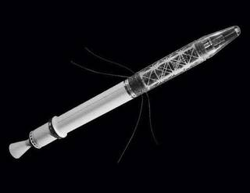
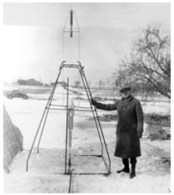
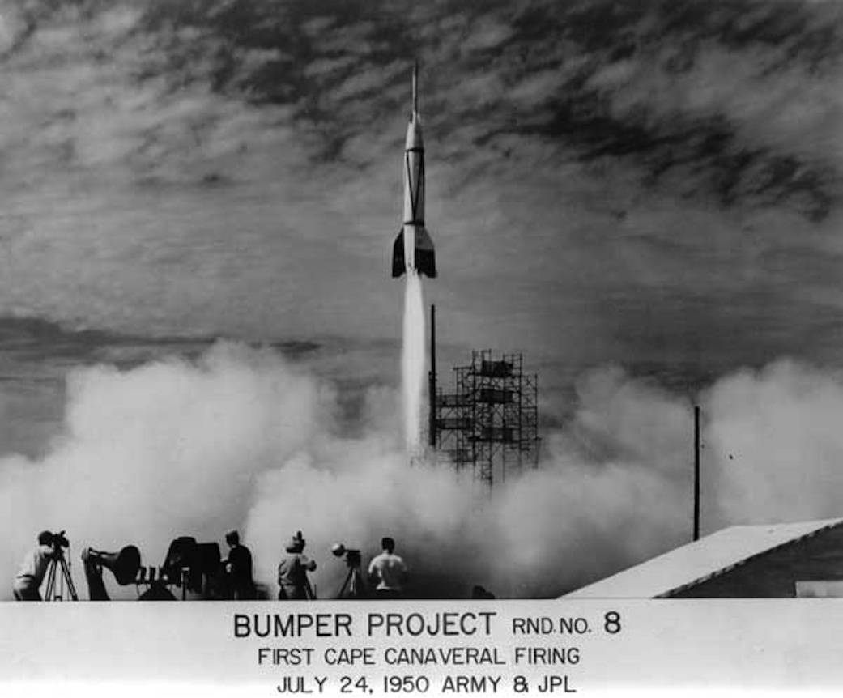
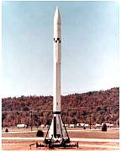
History of Aerospace Engineering
Aerospace Engineering
  Rocketry*
    Chinese used black powder rockets in 1232 AD.
    First known in Europe circa 1300 AD.
    Rocket Equation by Konstantin Tsiolkovsky in 1903**
    First liquid fuel rocket in 1926 by Robert Goddard
    Private Missile, SRM, developed by JPL for the Army and used late in WWII***
      First castable solid propellant
    V-2 rocket first launched in 1942, LOX/RP
    JPL developed Corporal in late 1940’s (liquid)***
      Without Altitude Control (WAC) Corporal first object into space in 1950 on top of V-2
    JPL developed Sergeant in 1950s as a solid****
      Thiokol polysulfide, LP-2, based
      Basis for Polaris and Minuteman Missiles
    Thiokol developed PBAN in 1954****
    Sputnik launched 4 October 1957
    Explorer 1 launched on a Jupiter-C 31 January 1958
    Silverstein Committee met in December 1959 led by Abe Silverstein, NASA Director of Space Flight Development**
    First human in space
      Yuri Gagarin, 12 April 1961
      Alan B. Shepard, 4 May 1961
    HTPB developed by Karl Klagger at Aerojet starting in 1961 and proposed to NASA for Aerobee configurations in 1969****
Sergeant
Explorer 1
Robert Goddard
V-2 with WAC Corporal
Corporal
*“An Encyclopedia of the History of Technology”, Ed. by Ian McNeil, Routledge, NY, 1990
**Bilstein, R. E., “Stages to Saturn”, NASASP-4206, 1980, ***Johnson, S. B., “Secrets of Apollo”, Johns Hopkins University Press, 2002
****Hunley, J. D., “THE HISTORY OF SOLID-PROPELLANT ROCKETRY:WHAT WE DO AND DO NOT KNOW”, AIAA, 1999

Slide 13
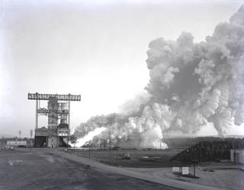
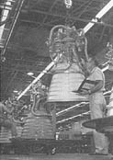
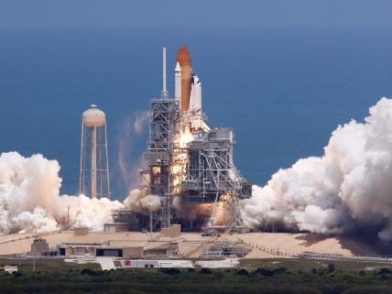
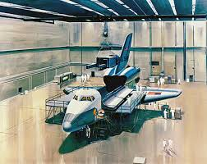
History of Aerospace Engineering
Aerospace Engineering
  Rocketry**
    LOX-RP Engines
      F-1 proposed by Rocketdyne in 1955/1956 and contracted in 1958
      H-1 contracted with Rocketdyne in 1958
    LOX/LH2 Engines
      Ohio State fired first sizable liquid hydrogen engine in 1945 under Herrick Johnston
      Aerojet spun out of JPL and developed liquid hydrogen production, test stands, engine injectors, thrust chambers, and pump for the JPL High Altitude Test Vehicle (HATV) for the U.S. Navy from 1945 to 1949 under Theodore von Karman
      Lewis Research Center (LeRC, now GRC) developed Liquid Hydrogen propulsion from 1953-1957
      RL-10 contracted with Pratt & Whitney in 1960 (LR-119 became RL-10-A-1) based on LeRC development
      Rocketdyne contracted for the J-2, higher thrust, in 1960
    Space Shuttle conceived in 1969*
      STS-1, 12 April 1981
      Lifting Body
      Re-useable Vehicle (Orbiter, Boosters)
F-1 Test at MSFC
Apollo 15
RL-10
STS-132
**Bilstein, R. E., “Stages to Saturn”, NASASP-4206, 1980

Slide 14
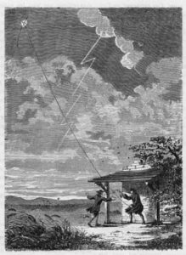
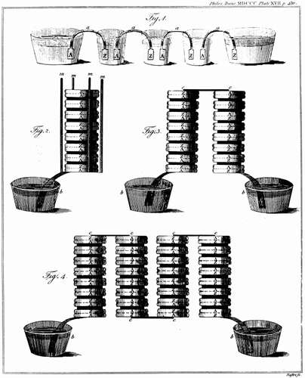
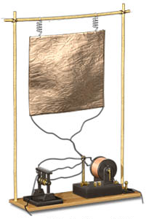
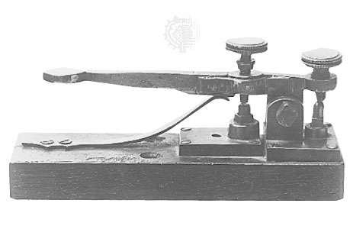
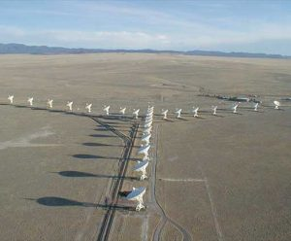
History of Electrical Engineering
Electrical Engineering*
  Static electricity known in the 500s BC
    Thales of Miletus recorded static electrical attraction when amber rubbed
  Magnetism known from Roman times
    Pliny the Elder (77 AD) wrote about lodestone (magnetic iron oxide)
    Magnetic compasses developed in Mid-evil times
      Peter Peregrinus documented compass making in 1269 AD including difference in indicated North and true North
  Charles Gilbert published first book on magnetism and electricity in 1600
  Benjamin Franklin captured electrical charge during a storm in 1752
  Electric current first recognized by Alessandro Volta in 1800 from work by Luigi Galvani
  William Cruickshank developed first battery shortly after 1800
  Michael Faraday
    Demonstrated electric motor in 1821
    Established relationship between electricity and magnetism in 1831
    Laws of electrochemistry in 1834
  Electric telegraph by Samuel Morse in 1832**
  Cooke and Wheatstone applied a magneto to telegraph in 1838
  Electromagnetic Laws published by James Clerk Maxwell in 1861 and 1862
  Electromagnetic waves demonstrated by Heinrich Hertz in 1887
  Wave propagation through tubes by J. J. Thompson in 1893
  X-rays detected by Wilhelm Rontgen in 1895
  Wireless transmission developed by Guglielmo Marconi in 1896
  Radio wave detection (Radar) hypothesized by Oliver Heaviside and Arthur Kennelly in 1901
  Radio waves from stars (radio astronomy) detected by Karl G. Jansky in 1933
Ben Franklin Kite Experiment, accessed at: http://www.benjamin-franklin-history.org/kite-experiment/
Volta Wet Cell, accessed at: https://www.britannica.com/technology/battery-electronics/Alkaline-storage-batteries
https://www.britannica.com/technology/telegraph
https://public.nrao.edu/telescopes/radio-telescopes/
https://nationalmaglab.org/education/magnet-academy/history-of-electricity-magnetism/museum/marconi-radio/
*“An Encyclopedia of the History of Technology”, Ed. by Ian McNeil, Routledge, NY, 1990
**Jean Ford Brennan, “The Elegant Solution”, van Nostrand, 1967

Slide 15
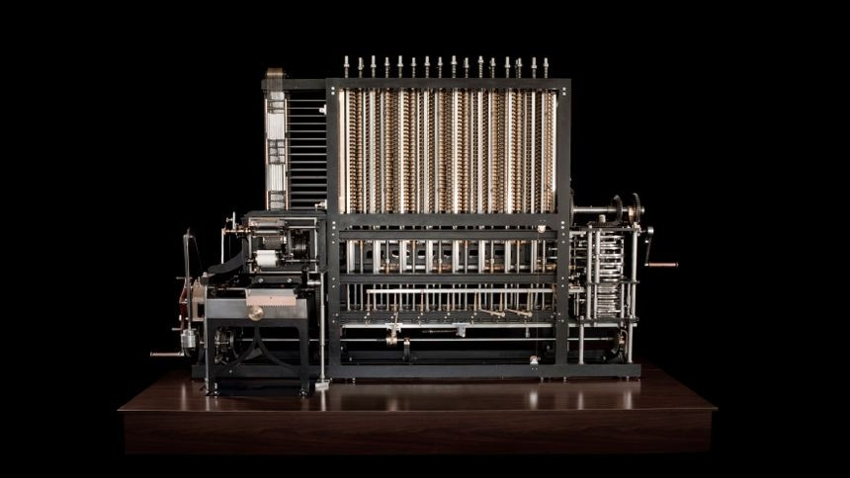




History of Computer Engineering
Computer Engineering*
  Binary numbers may have been used by Chinese in 2000 BC.
    Leibnitz rediscovered in 1600’s AD.
  Abacus invented by Greeks and Chinese about the same time around 500 BC.
  Logarithms discovered by John Napier in 1600’s
  Slide rule invented by William Oughtred in 1600’s
  Mechanical adding machine built by Blaise Pascal in 1600’s
  Analytical Engine proposed by Charles Babbage in 1812
  Boolean Algebra developed by George Boole in 1850’s
  Alan Touring paper, “Can a Machine Think” in 1936
  Howard Aiken IBM began work on Automatic Sequence Controlled Calculator (ASCC) for IBM in 1939
  Electromechanical relays used for Complex Calculator by George Stibitz in 1940**
  Transistor invented by John Bardeen, Walter Brattain, and William Shockley in 1945**
  Electronic Numerical Integrator and Calculator (ENIAC) first electronic computer using vacuum tubes in 1946
  Information Theory by Claude Shannon in 1948
  Universal Automatic Computer (UnivAC) developed by J. Presper Eckert and John Mauchley for Remington Rand in 1951
  Stored instructions, iterative execution, branching (von Neuman architecture) developed by John von Neuman in the Princeton University Institue for Advanced Study (I.A.S.) machine in 1952
  Magnetic memory developed by Jay Forrester at MIT in late 1940’s
  Punch cards and tape storage in the IBM 702 in 1954
  Formula Translator (ForTran) developed by IBM to aid customer programming in 1954
  IBM 709 released in 1957 and used for Mercury capsule tracking
  IBM 7090 released in 1959 and used for Saturn V design
  First Transistor based IBM 360 released in 1964
1st Babbage Analytical Engine built in 2002 https://www.computerhistory.org/babbage//
UnivAC https://www.census.gov/history/www/innovations/technology/univac_i.html
https://www.ibm.com/ibm/history/exhibits/mainframe/mainframe_PP7090.html
https://www.ibm.com/ibm/history/exhibits/mainframe/mainframe_PP709.html
First IBM Fortran Manual, https://www.fortran.com/
*Jean Ford Brennan, “The Elegant Solution”, van Nostrand, 1967
**“An Encyclopedia of the History of Technology”, Ed. by Ian McNeil, Routledge, NY, 1990
IBM 360 Model 30 in 1970 https://www.ibm.com/ibm/history/exhibits/mainframe/mainframe_2423PH2030.html

Slide 16




History of Optical Engineering
Optical Engineering*
  Mirrors date back to antiquity
    Mirrors (polished metal) found in Egypt from 1900 BC or earlier.
    Mirrors referenced in Exodus 38:8 (1200 BC.)
  Refractive lens (“burning glass”) referenced in play by Aristophanes in 424 BC.
  Law of Reflection by Euclid in 300 BC.
  Archimedes may have used mirrors to defend Syracuse, Greece in 212 BC.**
  Seneca referenced glass globe filled with water as a magnifying class circa 45 AD.
  Pliny the Elder recorded refractive lenses (“burning glass”) in 77 AD.
  Eye glasses first suggested by Roger Bacon, circa 1250 AD.
  Refracting telescope patent by Hans Lippershey in 1608
    Galileo Galilei built telescope in 1609
  Microscope first built by Zacharias Janssen in about 1610
  Johannes Kepler published internal refraction, refraction small angle approximation and thin lens approximation (paraxial optics), positive (Keplerian) and negative (Galilean) telescope eyepieces
  Law of Refraction (Snell’s Law) by Willebrord Snell in 1621
  Law of Refractions in terms of sine angles by Rene Descartes in 1637
  Fermat’s Principle (least time propagation) by Pierre de Fermat in 1657 (Optical Path Length)
  Sir Isaac Newton first described the different wavelengths of light
  Diffraction noted by Francesco Maria Grimaldi and documented by Robert Hooke in 1665
    Spherical nature of light
    Thin film interference
  Chirstian Huygens first observed the light slowed by refractive index and polarization of light in 1680’s
  The 1700’s were development of these results
    Leonhard Euler proposed achromatic lenses
    John Dolland built first achromatic lens in 1758 using crown and flight glass lenses
    Bifocals invented by Benjamin Franklin in 1784***
https://www.ancient.eu/image/6036/ancient-egyptian-mirror/
https://web.mit.edu/2.009/www/experiments/deathray/10_ArchimedesResult.html
1790 Bifocals, accessed at: https://invention.si.edu/benjamin-franklin-s-inventions
Prism Refraction https://www.britannica.com/technology/prism-optics
*Hecht, “Optics”, 2nd ed., Addison Wesley, Mass., 1987
**https://web.mit.edu/2.009/www/experiments/deathray/10_ArchimedesResult.html
***https://www.britannica.com/science/eyeglasses

Slide 17




History of Optical Engineering
Optical Engineering*
  Thomas Young explained wave theory in 1802 and 1803.
  Diffraction Theory by Fresnel in 1815
  Spectral Nature of light by William Hyde Wollaston in 1802
  Joseph Fraunhofer extended spectral understanding in early 1800’s (prior to 1826)
  Speed of light first measured by Armand Hippolyte Louis Fizeau in 1849
  Michael Faraday established relationship between electromagnetism and light
  Maxwell’s Laws by John Clerk Maxwell in 1861/1862 confirmed speed of light measurements
  George Biddel Airy examined stellar aberrations with water filled telescope in 1871
  Robert Kirchhoff and Robert Wilhelm Bunsen established atomic spectrial signatures in 1860-1890
  Albert Abraham Michelson and Edward Williams Morely used interferometer to disprove existence of aether in 1881
  Quantum nature of matter shown by Karl Ernst Ludwig Planck in 1900
    Plank’s Constant
  Theory of Special Relativity by Albert Einstein in 1905 explained the Fresnel theories, Airy pattern, and Michelson – Morely measurements
    Photon defined
  Fourier analysis developed in 1950’s based on spatial frequency
  Laser invented in 1958 by Townes and Schawlow
https://www.thorlabs.com/newgrouppage9.cfm?objectgroup_id=9026
https://en.wikipedia.org/wiki/Diffraction
http://www.columbia.edu/~nas2173/Lab6_InterferometerNS2.pdf
https://www.cambridgeincolour.com/tutorials/diffraction-photography.htm
*Hecht, “Optics”, 2nd ed., Addison Wesley, Mass., 1987

Slide 18


History of Software Engineering
Software Engineering*
  First computers programmed by machine language in late 1940s and early 1950s
  Formula Translator (ForTran) developed by IBM to aid customer programming in 1954**
  Common Business-Oriented Language (COBOL) for Department of Defense in 1959
  BASIC developed by John Kemeny and Thomas Kurtz in 1964 for student use at Dartmouth College
  Simula by Kristen Nygaard in 1965 (Simulation Language)*****
  Pascal developed by Niklaus Wirth in 1969
  UNIX developed by AT&T in 1969
  Berkley UNIX
  Waterfall lifecycle model in 1970 by W. W. Royce
  C language***
    developed Dennis Ritchie in 1972
    Kernighan and Ritchie upgraded C in 1978
    ANSI Standard C in 1989
  C++ (C with Classes)****
    Object Oriented extension of C using Simula concepts started by Bjarne Straustrup in 1979
    Standardized in 2011
  Microsoft founded by Bill Gates and Paul Allen in 1975
  Apple Computer started by Steve Jobs and Steve Wozniak in 1976
  Software Economics by Barry Boehm in 1981
  Java developed by James Gosling, Michael Sheridan, and Patrick Naughton in 1991
Simula Research Laboratory in Fornebu, Norway, accessed at: https://www.simula.no/research
First IBM Fortran Manual, https://www.fortran.com/
Requirements
Design
Implementation
Verification
Maintenance
Object Oriented Model^
Waterfall Life Cycle Model
*“An Encyclopedia of the History of Technology”, Ed. by Ian McNeil, Routledge, NY, 1990
**Jean Ford Brennan, “The Elegant Solution”, van Nostrand, 1967
***https://www.javatpoint.com/history-of-c-language
****http://www.cplusplus.com/info/history/
*****https://www.sciencedirect.com/science/article/pii/S0890540113000795
^https://www.geeksforgeeks.org/basic-object-oriented-data-model/

Slide 19




History of Industrial Engineering
Systems Engineering
  Industrial Engineering*
    Frederick W. Taylor increased machine tool cutting speeds and balanced feed rates and assembly rates to increase overall production rates and tool life in 1900
      Time studies of assembly operations and incentives to manage production floor (Taylor System of Scientific Management)
    Ransome Olds introduced automotive assembly line using subcontracted parts in 1899
    Henry Ford perfected the production line, vastly reducing automotive production time and cost from 1913 to 1916
    Improving the assembly time and reducing cost led to revolution in machine tools to keep up or improve maching time and tool life
    Metrology also improved by production line pace
      Micrometer caliper in 1877 by Brown & Sharpe improved to .0001 in accuracy by diamond cutting in 1930 by Coventry Gauge and Tool Co.
    Automated manufacturing tools first provided by George Deval and Joseph Engleberger in 1956 (Unimate)
    Visual sensing demonstrated in 1970
    Fiat used robotic transports in production in 1979
https://media.ford.com/content/fordmedia/fna/us/en/features/game-changer--100th-anniversary-of-the-moving-assembly-line.html
https://www.automotivemanufacturingsolutions.com/the-rise-of-robotics/34027.article
*“An Encyclopedia of the History of Technology”, Ed. by Ian McNeil, Routledge, NY, 1990

Slide 20





History of Systems Engineering
Systems Engineering
  Systems Engineering*
    Systems Engineering developed in response to system reliability, cost, and scheduling issues in 1950s aerospace projects
      Large overruns in cost and schedule for ICBMs drove the need for better integration and system management
      Issues where not single problems but traced to integration of various engineering and project discipline contributions
        Army Air Research and Development Command (Rhidnour Report) in 1949
    Weapons Systems Engineering developed at Bell Labs during WWII fostered by Ivan Getting at MIT leading to courses in 1945
    Simon Ramo developed systems methods at Hughes Aircraft in development of Falcon guided missile and advocated for discipline of systems engineering
      These methods passed to Gen. Bernard Schriever director of the Air Force Western Development Division (WDD) responsible for ICBM development programs, development of Atlas and Titan rockets
    Ramo and Wooldridge left Hughes Aircraft to form new systems engineering company at encouragement of DoD in 1953
    First statement of systems engineering functions in 1956 by WDD
    JPL Corporal had a reliability of 40% in 1956, Atlas was 50%, Titan 66%
    Thompson, Ramo, Wooldridge, TRW formed in 1958
Titan I
https://www.nps.gov/articles/titan-icbm.htm
Atlas SM-65
https://www.nps.gov/articles/mimiarmsrace-04.htm
General Bernard Schriever
https://www.nps.gov/articles/mimiarmsrace-03.htm?utm_source=article&utm_medium=website&utm_campaign=experience_more&utm_content=small
Western Development Division
Corporal Missile
https://www.designation-systems.net/dusrm/m-5.html
*Johnson, S. B., “Secrets of Apollo”, Johns Hopkins University Press, 2002,
**An Identification of Pragmatic Principles – Final Report, ed. J. C. Defoe, 1993. ***INCOSE Systems Engineering Handbook, 4.0, 2015

Slide 21



History of Systems Engineering
Systems Engineering
  Systems Engineering*
    Aerospace Corporation formed by the Air Force in 1960 as a nonprofit organization due to conflict of interest charges again TRW and Air Force relationship
    Boeing brought aircraft design controls into the Minuteman development program leading the Air Force to define Configuration Management in 1959, advocated by Col. Sam Phillips
    Schriever Plan led to formation of Air Force Systems Command in 1961
    Configuration Management formalized by Air Force in 1962
    Matrix Organization first used by General Dynamics in 1963
    Systems reliability improved from 50% in 1958 to 80-95% in 1963 through application of systems engineering methods
    Space Systems Engineering taught at Stanford University by JPL engineers in 1963
    National Council on Systems Engineering (NCOSE) founded in 1990 (INCOSE in 1995)
    First systems engineering processes as a set of Pragmatic Principles ed. by J. Defoe in 1993.**
    INCOSE Systems Engineering Handbook 1.0 in 1998 ***
    INCOSE Systems Engineering Principles Publication in 2022
Aerospace
Corporation
Minuteman I
https://www.nps.gov/articles/minuteman_and_minute-man.htm
CEO
CTO, CIO, CFO
Engineering
Project 1
Project 2
Systems Engineering
Propulsion Engineering
Mechanical Engineering
Electrical Engineering
Computer
Software Engineering
Housing
Mechanisms
Electrical
Motor
Controller
Frame
System
System
Apollo 15
Organizational Matrix
*Johnson, S. B., “Secrets of Apollo”, Johns Hopkins University Press, 2002,
**An Identification of Pragmatic Principles – Final Report, ed. J. C. Defoe, 1993. ***INCOSE Systems Engineering Handbook, 4.0, 2015

Slide 22
Engineering Professional Societies
Engineering Professional Societies offer many educational resources through their websites
  American Institute of Aeronautics and Astronautics (AIAA)
  American Institute of Chemical Engineers (AIChE)
  American Society of Civil Engineers (ASCE)
  American Society of Engineering Management (ASEM)
  American Society for Metals (ASM)
  American Society of Mechanical Engineers (ASME)
  American Society of Naval Engineers (ASNE)
  Electrical Power Research Institute (EPRI)
  International Council on Systems Engineering (INCOSE)
  International Electrical and Electronic Engineers (IEEE)
  Optica (formerly the Optical Society of America (OSA))
  Society of Automotive Engineers (SAE)
  Society for Photo Instrumentation Engineers (SPIE)
  Systems Engineering Book of Knowledge (SEBoK)
NASA Systems Engineering Research: https://www.nasa.gov/consortium

