Slide 1
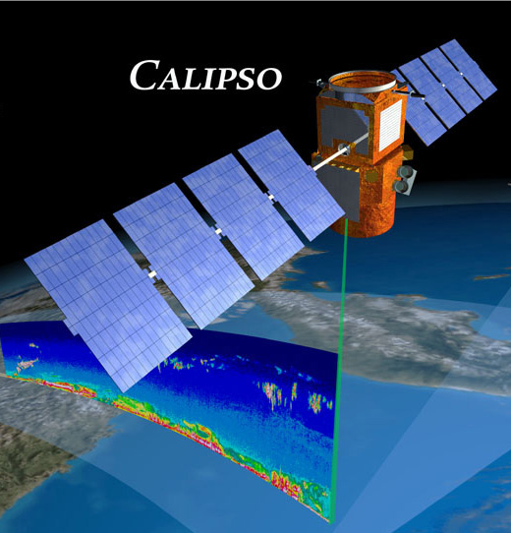
NASA Satellites and Data Fusion: A Case Study with Coral Reefs
Based on results of the Geophysical observations toolkit for evaluating coral health (GOTECH) Project
NASA Langley Research Center OCIO Data Science Team
The use of trademarks or names of manufacturers in this report is for accurate reporting and does not constitute an official endorsement, either expressed or implied, of such products or manufacturers by the National Aeronautics and Space Administration.
Notes:
The purpose of this presentation is to give you a sense of a NASA application in which we use existing space assets to assist with Earth-based CONOPS using artificial intelligence.

Slide 2
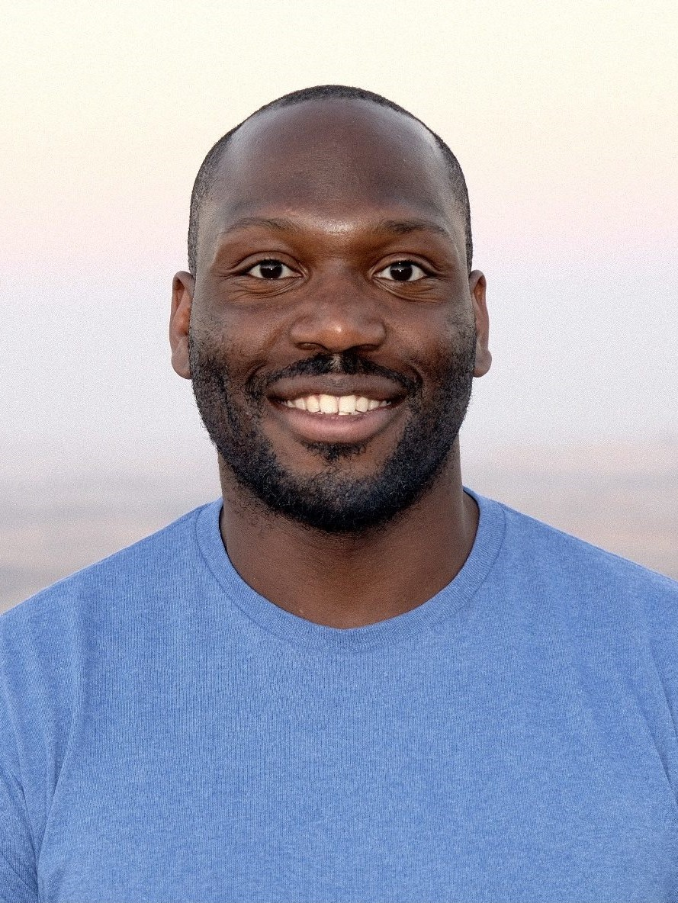
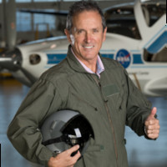
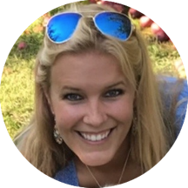
Points of Contact
Dr. Newton Campbell NASA AI SME newton.h.campbell@nasa.gov | Mr. Douglas Trent NASA Program Manager | Dr. Katey Lesneski Coral Vita Director of Restoration Science
Notes:
NASA Langley - NASA's Langley Research Center (LaRC) has a long history of conducting Earth Science research, using a variety of satellites to image the land, oceans, and atmosphere. Data from satellite imagery, combined with data from open-source reef databases, has the potential to inform coral reef vitality in known and unexplored areas.
OCIO Data Science Team – Within Langley's Office of the Chief Information Officer (OCIO) is a Data Science team that provides Data Science consulting expertise to Principal Investigators (PI) and subject matter experts (SME) on their research projects. The Data Science team's support of PI and SME customers, primarily at Langley initially, has recently expanded to include other centers as the agency transforms to a One NASA enterprise. In the case of the GOTECH project, the SME customer is an industry partner named Coral Vita.
Coral Vita - Coral Vita was founded by ecological entrepreneurs to restore coral reefs by growing replacement coral in land-based farms. The Bahamas-based company uses advanced techniques to grow coral up to 50x faster, while boosting resiliency to warming and acidifying oceans. The hardier land-grown coral is outplanted to degraded reefs to bring them back to life. Coral Vita is one of five global winners of the first-ever Earthshot grand prize of £1 million, awarded in 2021 by Prince William, Duke of Cambridge.
Georgia Tech - The Georgia Institute of Technology is ranked in the Top Ten nationwide by US News & World Report for its Industrial Systems & Engineering (ISyE) graduate program (#1), its Statistics & Operational Research (#8), its Business, Quantitative Analysis (#6) and its college of Computer Science (#9). Georgia Tech's Masters of Science in Analytics program blends the strengths of the three colleges -- ISyE, Business and Computing – to produce graduates with the interdisciplinary skills needed to obtain deep insights into analytics problems.
The MS Analytics program includes a one-semester applied analytics Practicum as a graduation requirement. During the Practicum, small teams of students work on impactful graduate-level data science projects submitted by industry.¹² The Langley OCIO Data Science team has previously collaborated with Georgia Tech on its MS Analytics practicum and selected this program to execute the GOTECH project.
National Institute of Aerospace - The National Institute of Aerospace (NIA) was created by NASA's Langley Research Center in 2002 as a nonprofit research, graduate education, and outreach institute located in Hampton, VA. NIA collaborates with NASA, other government agencies and laboratories, universities, and industry to conduct leading-edge research and technology development in space exploration, aeronautics, and science.

Slide 3
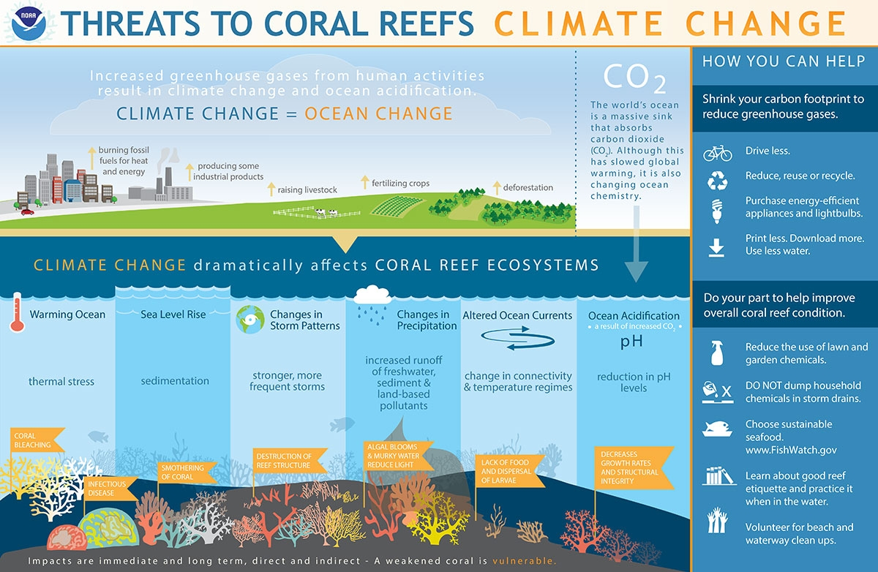
Goals and Motivations
The ocean is Earth’s dominant climate regulator
Global warming has raised the average global temperature by about 1.2°F (0.68°C) over the past century
Over the next 20 years, scientists estimate about 70 to 90% of all coral reefs will disappear primarily as a result of warming ocean waters and increased acidity
Why NASA? 51 U.S.C. § 20112
Credit: https://www.noaa.gov/media/image_download/2e0c08d2-3631-4be8-848e-c0c60aab0a95
Notes:
According to the NASA Global Land-Ocean Temperature Index, global warming has raised the Earth’s temperature by about 1.18°C since 1880. More than 90% of this warming occurred in the ocean. The ocean is the Earth’s primary climate regulator, as ocean waters absorb most of the sun’s radiation. Within the ocean, much of the warming occurs at a depth of about 2,300 feet (700 meters), where much of the marine life relevant to human populations exist. In addition, due to the atmospheric carbon dioxide that the ocean absorbs, we have observed a faster synthesis of carbonic acid in the past 100-200 years than has occurred on Earth in the last 65 million years. Specifically, acidic ocean water is causing coral to grow more slowly and is weakening coral reefs around the planet. These reefs create a home for many living things and their health is essential to many ecosystems. Today, a number of organizations are interested in reconstituting coral reefs. Unfortunately, we do not have a consistent, real-time picture of which reefs need reconstitution, to allow for prioritization. The problem that we are trying to solve is that none of the existing Coral Reef databases alone capture enough data to make such a decision.
And if you’re wondering why NASA? Well, this is a part of our statutory responsibility. Its why we launch so many Earth-observing satellites. According to 51 U.S.C. 20112, one of our responsibilities as an agency is to "provide for the widest practicable and appropriate dissemination of information concerning its activities and the results thereof." In short, we have always sought to inform the public. Our work in air and space are there to inform the public. Earth is a part of space. And in this project, we continue that legacy.

Slide 4
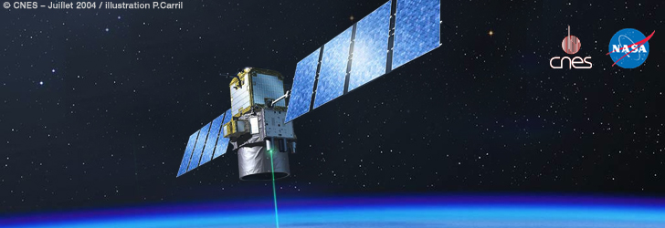
CALIPSO
Launched in 2006 – NASA/CNES
Mission Objective: Understand how aerosols and clouds interact with each other
Part of the a-train of satellites (and the c-train)
Has been used to track migration of Ocean animals (Behrenfeld et. Al., 2019)
*Credit: https://www-calipso.larc.nasa.gov/banner/calipso.jpg
*From https://youtu.be/zO3OW60VF8M
*From https://youtu.be/_anHG8awnUg
Notes:
NASA and its international partners operate several Earth-observing satellites that closely follow one another along the same (or very similar) orbital “track.” A particular example of a coordinated group of satellites are in a sun-synchronous polar orbit, crossing the equator in an ascending (northbound) direction at about 1:30 PM local solar time, within seconds to minutes of each other—hence the name Afternoon Constellation. This allows near-simultaneous observations from a wide variety of instruments that are synergistically used to aid the scientific community in advancing our knowledge of Earth-system science and applying this knowledge for the benefit of society.
The original Afternoon Constellation comprised a single set of coordinated satellites, that began in earnest in 2006 when CloudSat and CALIPSO joined in orbit with the Aqua (launched in 2002), Aura (2004), and PARASOL (2004) satellites. The constellation was nicknamed the “A-Train” because satellite names starting with an “A” led and trailed the constellation at the time. The train was later expanded with the inclusion of GCOM-W1 (2012) and OCO-2 (2014). On November 16, 2011, PARASOL was lowered to 9.5 km under the A-Train and on December 18, 2013 PARASOL ceased operation, fully exiting the A-Train. In February 2018, CloudSat lowered its orbit out of the A-Train after technical issues that potentially affected the satellite’s maneuvering capability. In September 2018, CALIPSO executed a series of maneuvers to join CloudSat’s orbit. So the international Afternoon Constellation now includes the A-Train satellites (OCO-2, GCOM-W1, Aqua, and Aura) as well as the C-Train satellites (“C” for CALIPSO and CloudSat). The C-Train flies 16.5 km (~10 mi) below the A-Train and therefore follows a slightly different ground track, though it intersects the A-Train ground track about every 20 days allowing for regular simultaneity between A-Train and C-Train instrument observations. The instruments on these satellites are used synergistically to improve our knowledge of clouds, aerosols, atmospheric chemistry, and other elements critical for understanding Earth’s environment and changing climate.
Now, CALIPSO is a joint U.S. (NASA) / French (Centre National d'Etudes Spatiales/CNES) mission. Observations from spaceborne lidar, combined with passive imagery from the satellite have led to improved understanding of the role aerosols and clouds play in regulating the Earth's climate, in particular, how aerosols and clouds interact with one another. And in recent years, its led to other use cases, such as observing the migration of animals under the ocean or analyzing Australian bush fires.

Slide 5
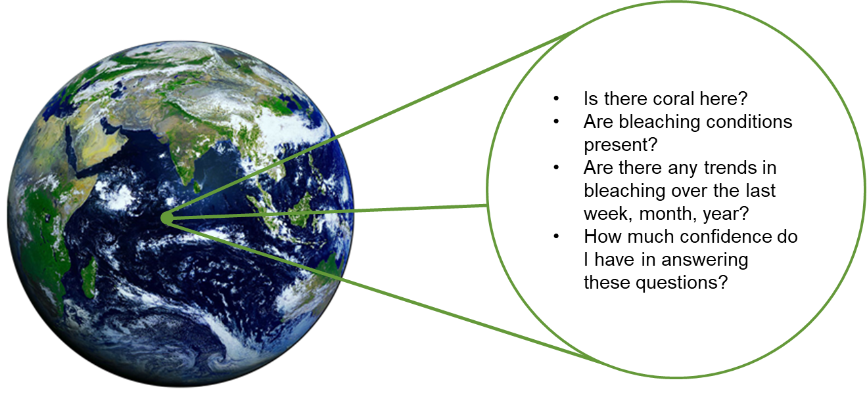
Introduction: Basic Goals (from Student Team)
Notes:
The health of coral reefs is essential to many ecosystems. Unfortunately, reporting about bleaching and other vitality indicators typically rely on human sightings and manual data entry. This information is limited at best and inaccurate or erroneous at worst. Satellites such as GOES-R and NOAA-20 have demonstrated utility in inferring bleaching activity. While this data has proved useful, NASA seeks to further leverage its mission capability by bringing space-based LIDAR to bear on the problem. ICESat-2 is one mission that has begun to explore this capability.
So on July 24, 2020, the OCIO Data Science Team (DST) hosted a Jam Session, one of their custom hackathons, to assess the suitabililty of the above-named databases for machine learning studies. During a typical Jam Session, the DST solicits data scientists and analysts from across the NASA community to address a specific problem using advanced technologies and libraries. At this Jam Session, the team focused on analyzing coral reef databases using advanced computing resources provided by the NASA Marshall and Agency Computing Services (MACS) Google Cloud Platform (GCP) environment. A key question was whether or not the open data provided about coral reefs was sufficient to compare against other measurements for machine learning. Participants mined and summarized results from the following datasets, performing knowledge discovery and identifying inconsistencies within the dataset.
The session revealed significant problems with any attempts to gather reliable information from a single coral reef database. These datasets were produced mainly through human observation over widely varying time scales. For example, coral bleaching, a phenomenon caused by the breakdown of the symbiosis between corals and their symbiotic microalgae, is often identified and reported by scuba divers that observe a loss of pigments and symbionts. Many other reports come from one-time observations during a scuba expedition or deliberate observation mission. During the Jam Session, participants noted data indicating that a patch of coral was bleaching at a specific time in one location would often be marked as normal or of low-severity by another database at the same corresponding time. In addition, each database tracks both temporal and spatial scales differently. This makes it difficult for any one of these data sources to serve as ground truth for any form of machine learning-based inference.
In GOTECH, we investigated CALIPSO as an alternative, uncharacteristic satellite for this exploration. The project is motivated by the notion that NASA can leverage unintended space instruments to address climate-related missions.

Slide 6
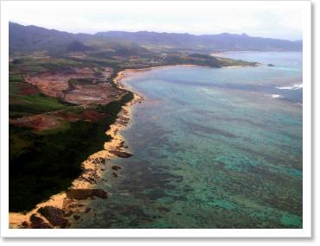
CONCEPT OF OPERATIONS
Open-Source Reef Data
Coral Reef Information System
Ocean Color
Web
ReefBASE
Ground Truth
Training
Supervised Learning
Data Fusion
- Are the coral healthy here?
- Can we reconstitute coral here?
Geovisualization
Models
Inference
Unfamiliar Region
Notes:
On the GOTECH project, the student team will develop machine learning models that predict the vitality of coral reefs in geographic regions based on backscatter data from the CALIPSO satellite. To train these models, students will fuse data to from a common operating picture of how coral reefs have grown and decayed round the world.
Explicitly, the challenge here is to fuse open data sources regarding coral reefs to serve as ground truth for a machine learning model that predicts, based solely on CALIPSO imagery at a certain location, properties of the vitality of coral reefs at that location. The student team will incorporate at least four data sources and demonstrate prediction from (solely) CALIPSO imagery on at least two machine learning models. The data fusion process must be repeatable and extendible, so that other data sources can be incorporated. NASA will provide coral reef subject-matter experts, such as those at Coral Vita, to help students understand the data that they are fusing and verify their assumptions. This study will occur over the 14-week summer semester at Georgia Tech, resulting in a Final Report of the models' performance.

Slide 7
Technical approach
Cross-Validate Open-Source Reef Databases
Time-Align and Geo-Align with Corresponding CALIPSO Data
Correlate imagery backscatter with state of Coral in observed global regions
Interpret trends in known global region based on backscatter alone

Slide 8
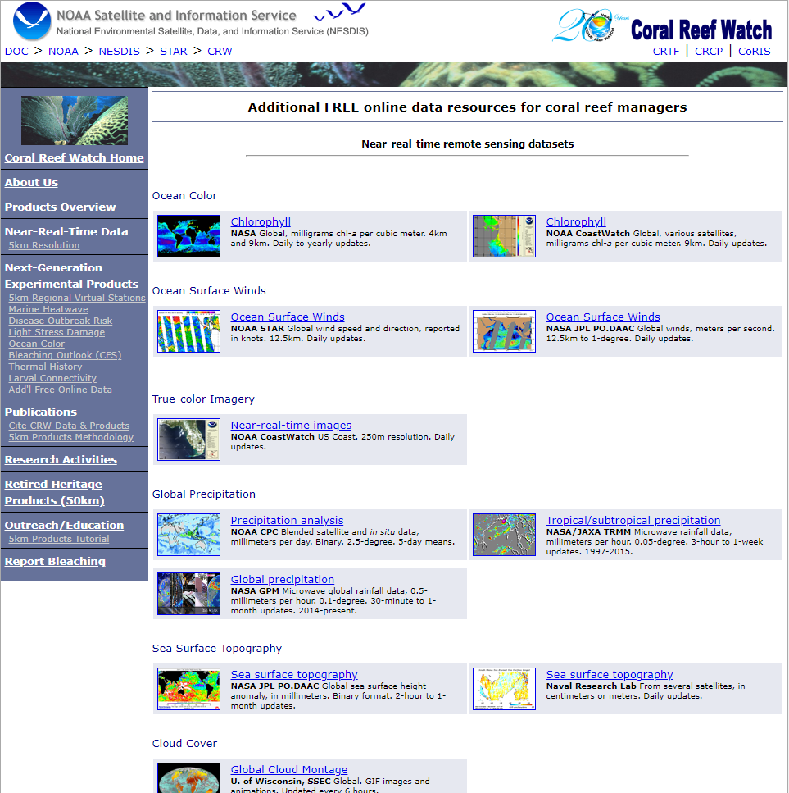
Cross-Validate Open Source Reef Databases
Question: What data can be pulled from these systems?
Challenge: develop a timeline of growth and decay across the globe
Examples
Coral Reef information systems
ReefBase
Coral Restoration Database
NOAA's CoRIS
Giovanni
NOAA CoastWatch
Notes:
Technical Area 1: Cross-Validate the Open-Source Reef Databases
Questions: What data can be pulled from these systems to serve as ground truth from?
Challenge: Students shall identify at least four coral databases to combine into a single dataset for this technical area. Students will provide scripts to download and synthesize data from each source into a fused dataset. Below is an initial listing of sites. Students are welcome to identify additional databases to serve as ground truth.
ReefBase
Coral Restoration Database
NOAA's CoRIS
Giovanni
NOAA CoastWatch
Deliverable: Students will provide one unified data source with fused data from each of the data sources and the scripts that were used for downloading and data fusion.

Slide 9
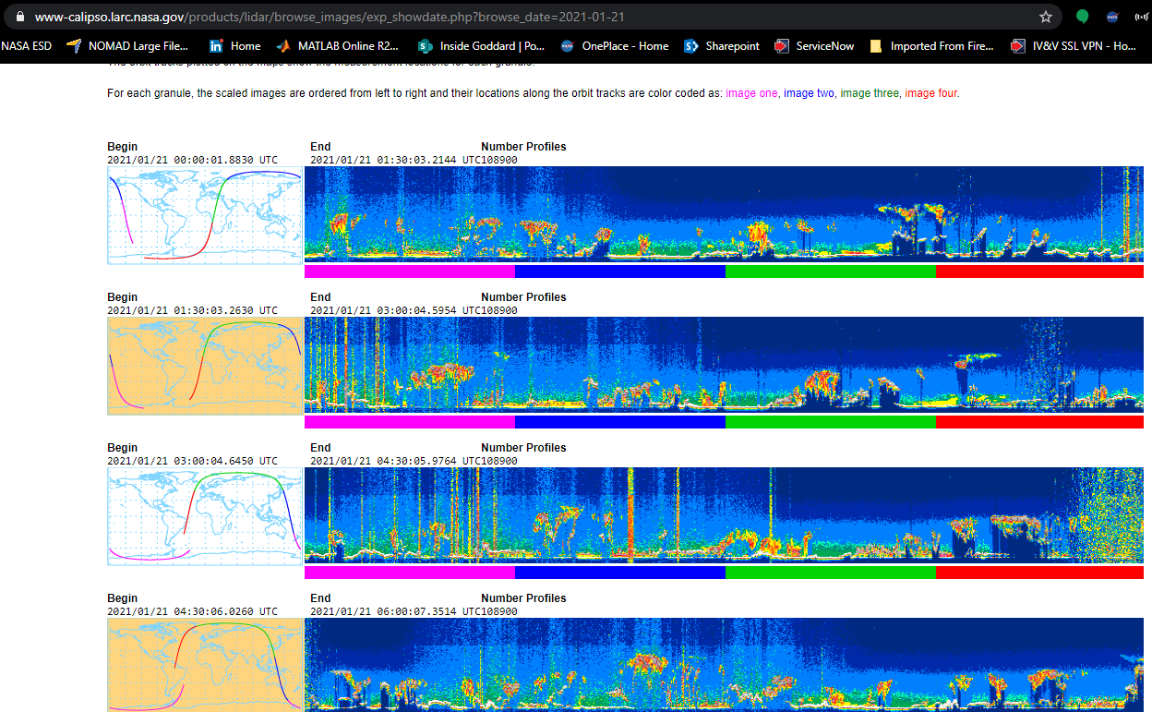
Download Corresponding CALIPSO imagery
Questions: What CALIPSO data do we need for training? What CALIPSO data do we need for inference?
Challenge: develop api clients to acquire necessary data for neural network training and inference
Key ResourceS:
Data Management System Description
Calipso Data Products
Atmospheric Science Data Center
Notes:
Technical Area 2: Time-Align and Geo-Align with Corresponding CALIPSO Data
Questions: What CALIPSO data do we need for training? What CALIPSO data do we need for inference?
Challenge: Develop API clients for the CALIPSO database to acquire necessary data for neural network training and inference.
Deliverables: Students will provide scripts for downloading the necessary data for training and inference and all the specific training/inference data used to produce the final report.
The CALIPSO payload consists of three co-aligned, near-nadir viewing instruments: a 2-wavelength polarization-sensitive lidar, an imaging infrared radiometer (IIR), and a high-resolution wide field camera (WFC). CALIOP is the name of the CALIPSO lidar and is an acronym for Cloud-Aerosol Lidar with Orthogonal Polarization. The lidar profiles provide information on the vertical distribution of aerosols and clouds, cloud particle phase, and classification of aerosol size. The CALIOP laser transmitter subsystem transmits laser light simultaneously at 532 nm and 1064 nm at a pulse repetition rate of 20.16 Hz. The CALIOP receiver subsystem measures backscatter intensity at 1064 nm and at two orthogonally polarized components of the 532 nm backscattered signal. The IIR provides medium spatial resolution nadir viewing images at 8.65, 10.6, and 12.05 m, providing information on cirrus cloud particle size and infrared emissivity. The WFC digital camera collects daytime high spatial resolution imagery in the 620 - 670 nm wavelength range and is used to ascertain cloud homogeneity, aid in cloud clearing, and provide meteorological context. CALIPSO provides complementary, near-simultaneous, observations with the other active and passive instruments in the constellation to better understand the effects of clouds and aerosols on climate, weather, and air quality. The Data Management System (DMS) uses the CALIPSO Automated Processing System (CAPS) to convert the CALIPSO instrument data into scientific data products.

Slide 10
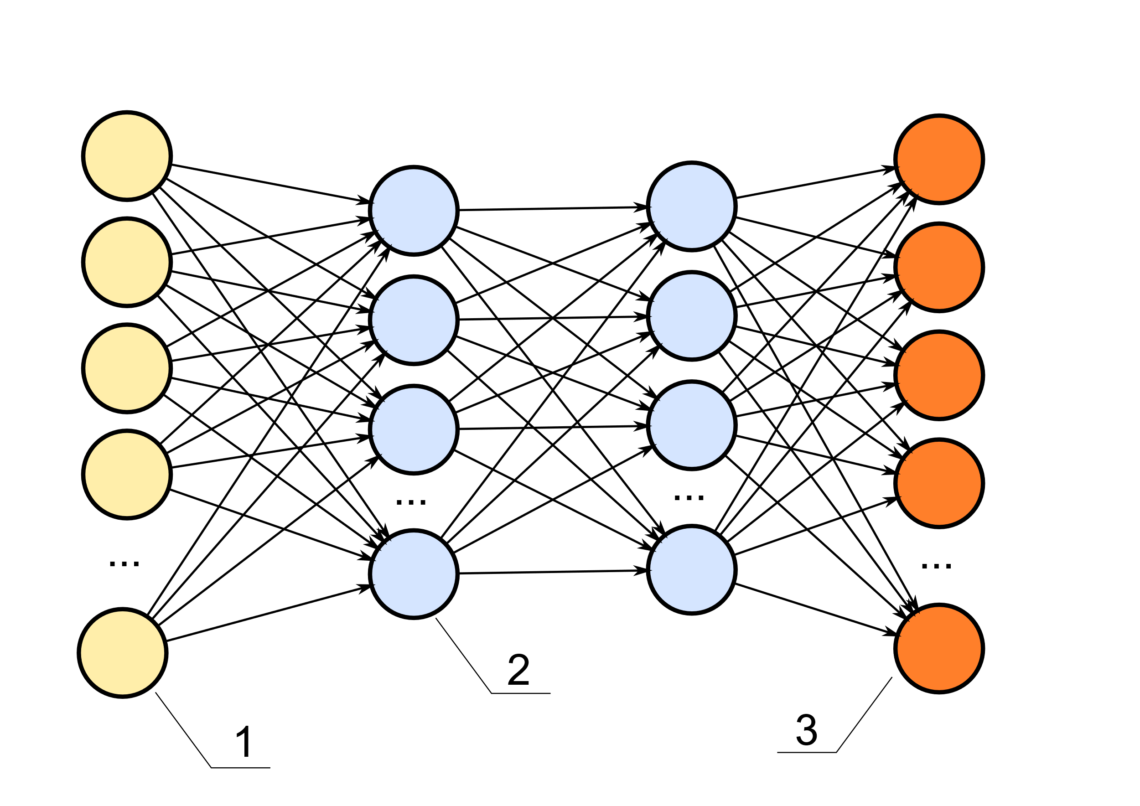
Correlate imagery backscatter with state of Coral in all global regions
Question: what neural network architectures are appropriate for this kind of inference? Can we infer growth and decay?
Challenge: demonstrate, using neural network models, that we can infer
Existence
Vitality Properties
growth or decay
Use automatic hyperparameter tuning (or similar methods) to identify the best parameters.
Notes:
Technical Area 3: Correlate Imagery Backscatter with Coral Vitality
Question: What neural network architectures are appropriate for this kind of inference? Can we infer the growth and decay of coral?
Challenge: Choose two neural network models for this challenge. Implement methods for neural network training using the unified dataset. Use neural network inference (based on CALIPSO imagery) to demonstrate that we can predict the existence of coral in an observed region. Use inference to confirm that we can predict properties of vitality in an observed region.
Deliverables: Students will provide scripts for inference and training, a description of the data that was used for each, a description of how each model was trained, and a saved version of reported models. These descriptions can be provided in the Final Report.

Slide 11
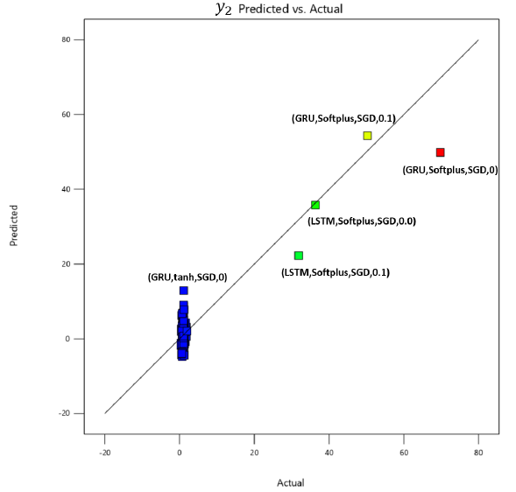
Interpret trends in known global region based on backscatter alone
Questions: can we infer where growth and decay are happening from calipso backscatter data?
Challenge: design and develop experiments to demonstrate predictive accuracy of the developed models. Characterize how changes to model architectures impact inference.
Notes:
Technical Area 4: Interpret Trends in a Known Global Region based on Backscatter Alone
Question: Can we infer where growth and decay are happening from CALIPSO backscatter data? How does inference work across two different models?
Challenge: Design and develop experiments to demonstrate the predictive accuracy of the developed models. Compare and contrast their performance. Characterize how changes to each model architecture impact performance.
Deliverables: Students will provide scripts for analysis (preferably in Jupyter notebooks), a description of the data used for analysis, a description of the response surface for each model, and future recommendations. These descriptions can be provided in the Final Report.

Slide 12
Outcomes
Data Fusion Algorithms and Downloadable Scripts/Notebooks/DATA
demonstrable set of machine learning models that can predict coral vitality based on satellite imagery
Experience of using real-world data and subject-matter expertise to inform machine learning models
enumeration of most significant variables that correlate backscatter with reef vitality
A common picture across reef databases about the current state of coral reefs

Slide 13
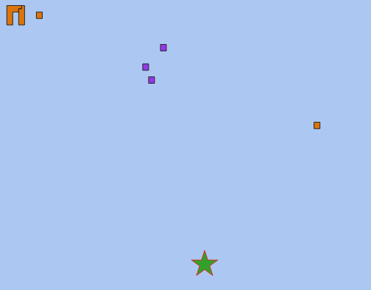
Team 1 APPROACH
Seagrass
Coral/Algae
Seagrass
CALIOP Lidar Reading
Australian Institute of Marine Science
Closest Point
Allen Coral Atlas
Distance within 0.5 degrees
Date within 14 days
Distance within 0.5 degrees
Distance within 0.5 degrees
And nearest NEO after CALIPSO

Slide 14
Team 1 TECHNOLOGIES
Australian Institute of Marine Science
Allen Coral Atlas
Baseline Dataset
(Dense, Coral/Algae)
Florida Dataset
(Dense, Coral/Algae)
Primary Research
GBR Dataset
(Sparse, Coral Only)
2-Way Temporal and Spatial
PostGIS
Match Long-Lat coordinates
0.5° (~3.5 miles) distance threshold
~3.6 million matched records
Model Competition
[Random Forest, XGBoost Classifier, SVC, Neural Network]

Slide 15
TEAM 2
Challenges:
Performing spatial joins in using postGIS on larger datasets was time consuming →
needed to perform joins on local machine or Colab+
Inserting data into PostgreSQL database was extremely time consuming → Google Colab TPU accelerator sped up the process by ~10x!
Allen Coral
WCMC
ReefBase
Florida Bleachwatch
1. Direct Download
3. Insert data into DB
PostgreSQL
Google Colab / Local Machine
4. Query DB
NOAA Bleaching Alert
Giovanni
Calipso
1. API
Fused Dataset
5. Data Fusion
2. Data Preprocessing

Slide 16
TEAM 2 Technologies
Data Storage: PostgreSQL on Google Cloud Platform
ETL, Data Fusion, and Exploratory Data Analysis on local machine and Google Colab
GeoPandas
Pandas
Numpy
Seaborn
Matplotlib
Modeling on local machine and Google Colab leveraging GPU for Deep Learning Models
PyTorch
Keras
SciKit Learn

Slide 17
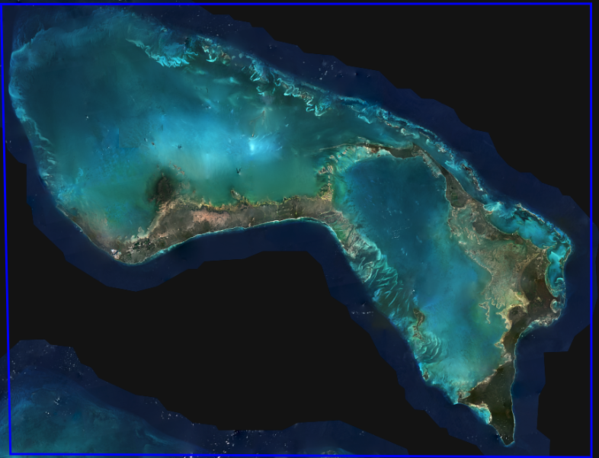
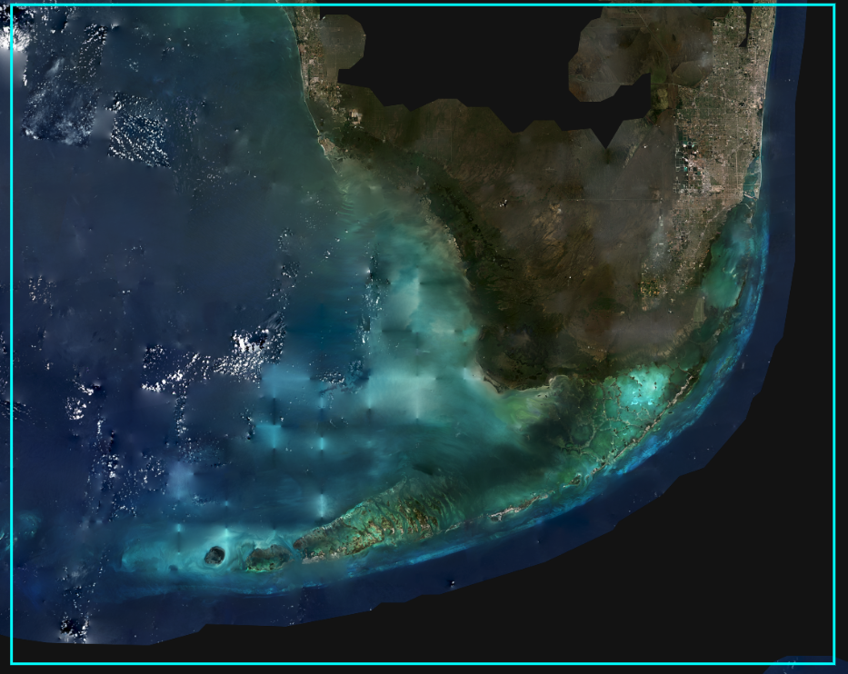
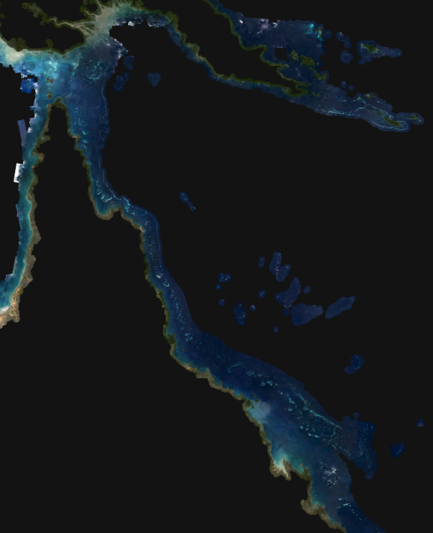
TEAM 1 – Region Of Focus
Grand Bahama
Florida
Great Barrier Reef
Advantages
Advantages
Advantages
+ HQ of Coral Vita
+ GOTECH access to local subject matter experts
- Small geographical footprint made aligning coral data with CALIPSO records difficult.
+ Large footprint (frequent CALIPSO flyovers)
+ Frequently monitored reef activity
- Lack of reliable ground-truth survey data.
+ Large footprint
+ Frequently monitored reef activity
+ Most reliable, consistent, survey data of the three.
- Sparse data set not ideal for predictive modeling
Disadvantages
Disadvantages
Disadvantages
The Satellite Coral Reef Mosaic is © 2020 Planet Labs and licensed CC BY-SA-NC 4.0 (https://creativecommons.org/licenses/by-nc-sa/4.0/)

Slide 18
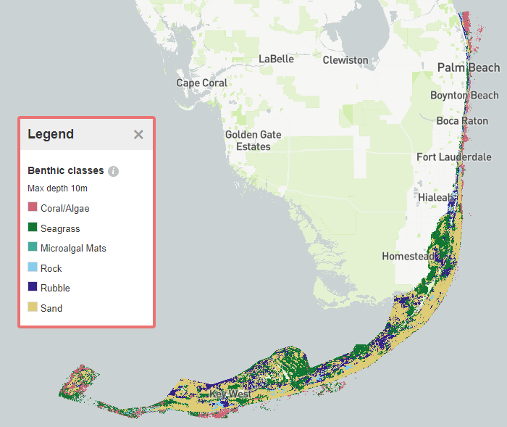
TEAM 2 – Region of Focus
Florida use-case:
One of few locations with detailed bleaching survey reports containing GIS information and dates ranging from 2014-2020.
Total of 2210 reports submitted with 1318 bleaching events and 892 non-bleaching events.
Unique locations: 1690
Over 2M unique locations from Allen Coral Atlas database.

Slide 19
Datasets
Team 1
Team 2
Dataset | Utility in Study
CALIPSO | Spatial/Temporal LIDAR observations used for training data and sole dataset for inference
UNEP World Conservation Monitoring Center (WCMC) | Worldwide coral observations specified using geojson polygons
Allen Coral Atlas | Coral/Algae recorded polygons aggregated to centroids by the student team. Potentially coincides with ~2.4 million CALIPSO records
ReefBase | Coral location and bleaching data from over 120 countries and territories
Dataset | Utility in Study
CALIPSO | Spatial/Temporal LIDAR observations used for training data and sole dataset for inference
NASA Earth Observations Chlorophyll Concentration Map | 8-day aggregations of chlorophyll concentration in the ocean, with a granularity of ~.69 square miles.
Allen Coral Atlas | Coral/Algae recorded polygons aggregated to centroids by the student team. Potentially coincides with ~2.4 million CALIPSO records
Australian Institute of Marine Science | High-accuracy coral observations concentrated on the Great Barrier Reef using Manta Tow observations
Observation
Observation & Vitality
Dataset | Utility in Study
CALIPSO | Spatial/Temporal LIDAR observations used for training data and sole dataset for inference
Florida Bleach Watch Report | Comprehensive surveys on coral health provided by volunteer field observations
NOAA Coastwatch Coral Reef Watch Bleaching Report | Satellite coral bleaching heat stress monitoring with 5 km coverage areas
NASA Giovanni | Contains properties for inference such as chlorophyll, organic/inorganic particulates, and PAR over 5 km coverage areas
Vitality

Slide 20
DATASET ISSUES
Dataset | Issues that Compromise this Study
Allen Coral Atlas | The presence of coral and the presence of algae are highly correlated
Australian Institute of Marine Science | Very small number of highly accurate observations
CALIPSO | Requires Large Data Pulls for this CONOPS Temporal gaps due to flyovers from the satellite make it difficult to align with other datasets Spatial gaps due to satellite trajectory miss significant number of potential data alignments
Florida Bleach Watch | Smaller number of observations based on data collection methods Sometimes unreliable observations based on data collection methods
Dataset | Issues that Compromise this Study
NASA Earth Observations Chlorophyll Concentration Map | Significant temporal and spatial misalignment with CALIPSO data
NASA Giovanni | 4km resolution Data acquisition scales exponentially
NOAA CoastWatch (DHW) | Bleaching reports are from modeling, not real-world observations Reported bleaching erroneous
ReefBase | Significant gaps in temporal, spatial, and characteristic data features
UNEP World Conservation Monitoring Centre (WCMC) | 85% of database observations are older (1999-2002) ~43% of the database is unvalidated

Slide 21
Team 1 Prediction

Slide 22
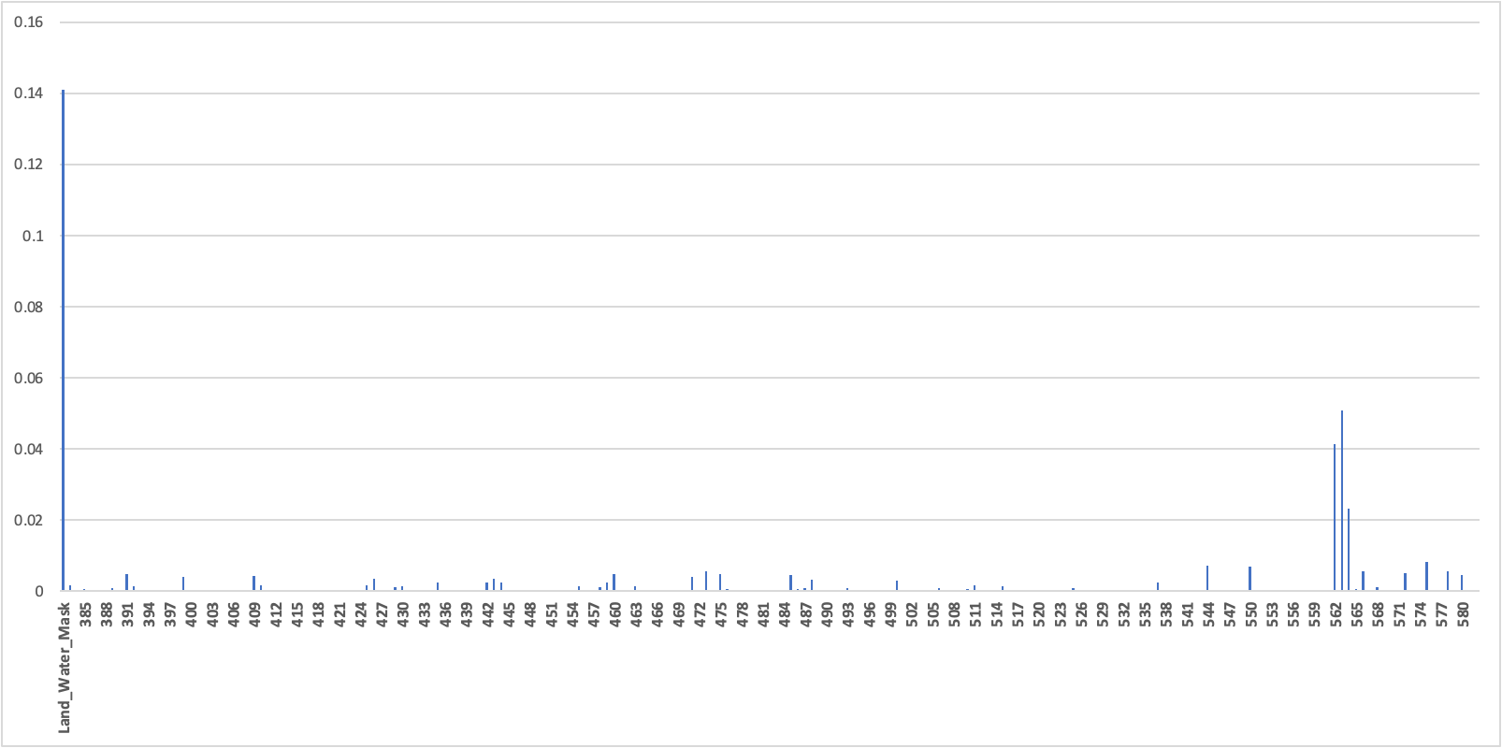
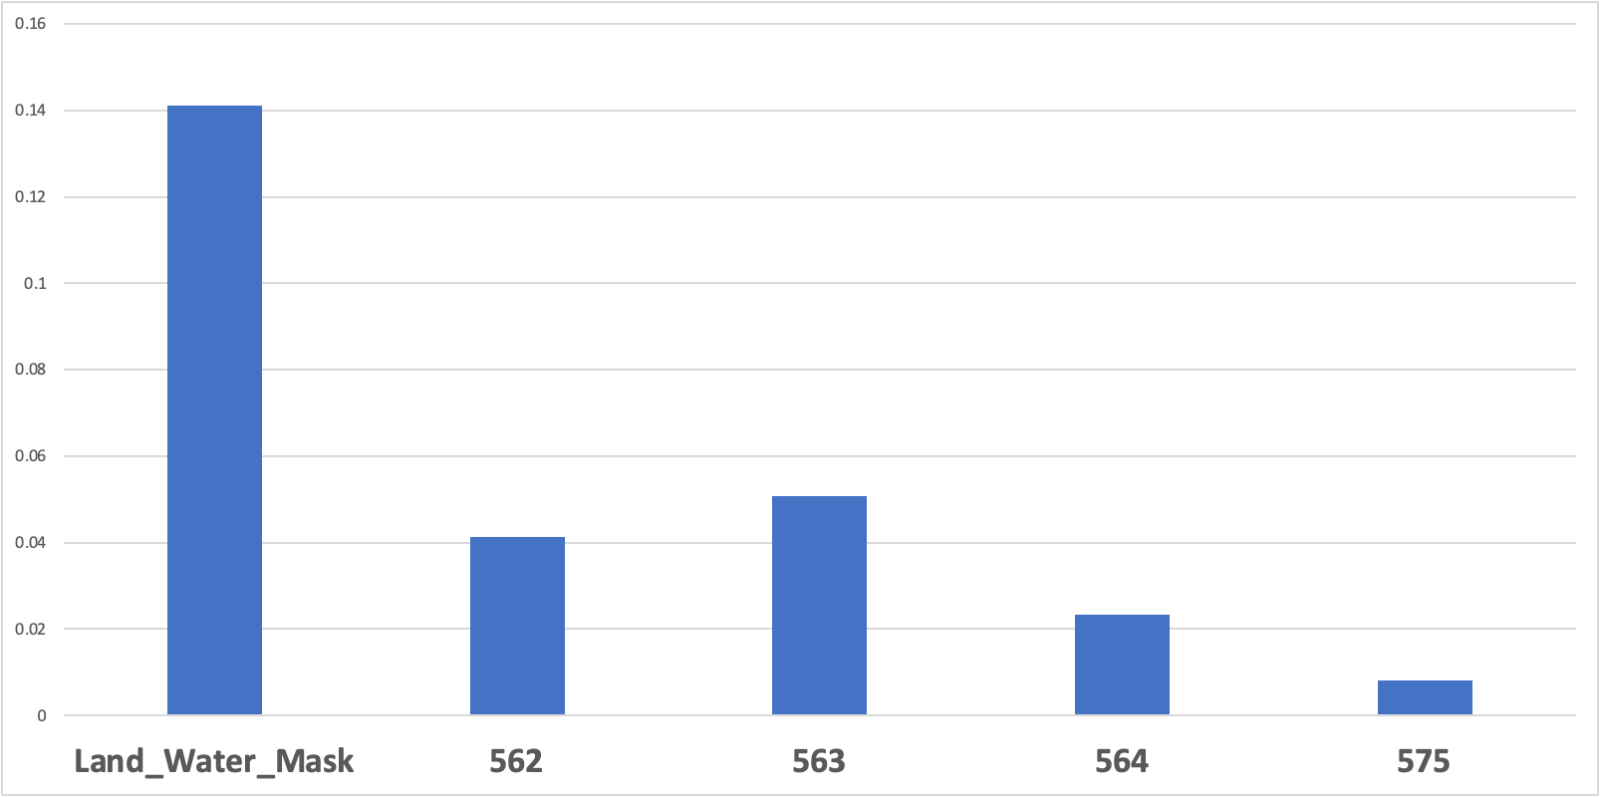
Feature Importance*
* Random Forest with default parameters
CALIPSO data was obtained from the NASA Langley Research Center Atmospheric Science Data Center from https://subset.larc.nasa.gov/calipso/.
*From Team 1 Final Presentation

Slide 23
Team 1: Presence of Coral/Algae (Florida Baseline / NEO Only)
Random Forest
XGBoost Classifier
False
True
False
True
9,038 | 957
1,337 | 13,335
5,790 | 4,205
2,034 | 12,638
False
False
True
True
Accuracy: 90.7%
Accuracy: 74.7%
SVC
ANN
False
True
False
True
5,004 | 4,991
2,012 | 12,660
5,899 | 4,096
2,735 | 11,937
False
False
True
True
Accuracy: 71.61%
Accuracy: 72.31%
*From Team 1 Final Presentation

Slide 24
Team 1: Presence of Coral/Algae (Florida)
Random Forest
XGBoost Classifier
False
True
False
True
7,013 | 2,982
2,149 | 12,523
6,832 | 3,163
2,044 | 12,628
False
False
True
True
Accuracy: 79.2%
Accuracy: 78.9%
SVC
ANN
False
True
False
True
4,547 | 5,448
759 | 13,913
7,461 | 2,534
2,383 | 12,289
False
False
True
True
Accuracy: 74.84%
Accuracy: 80.1%
*From Team 1 Final Presentation

Slide 25
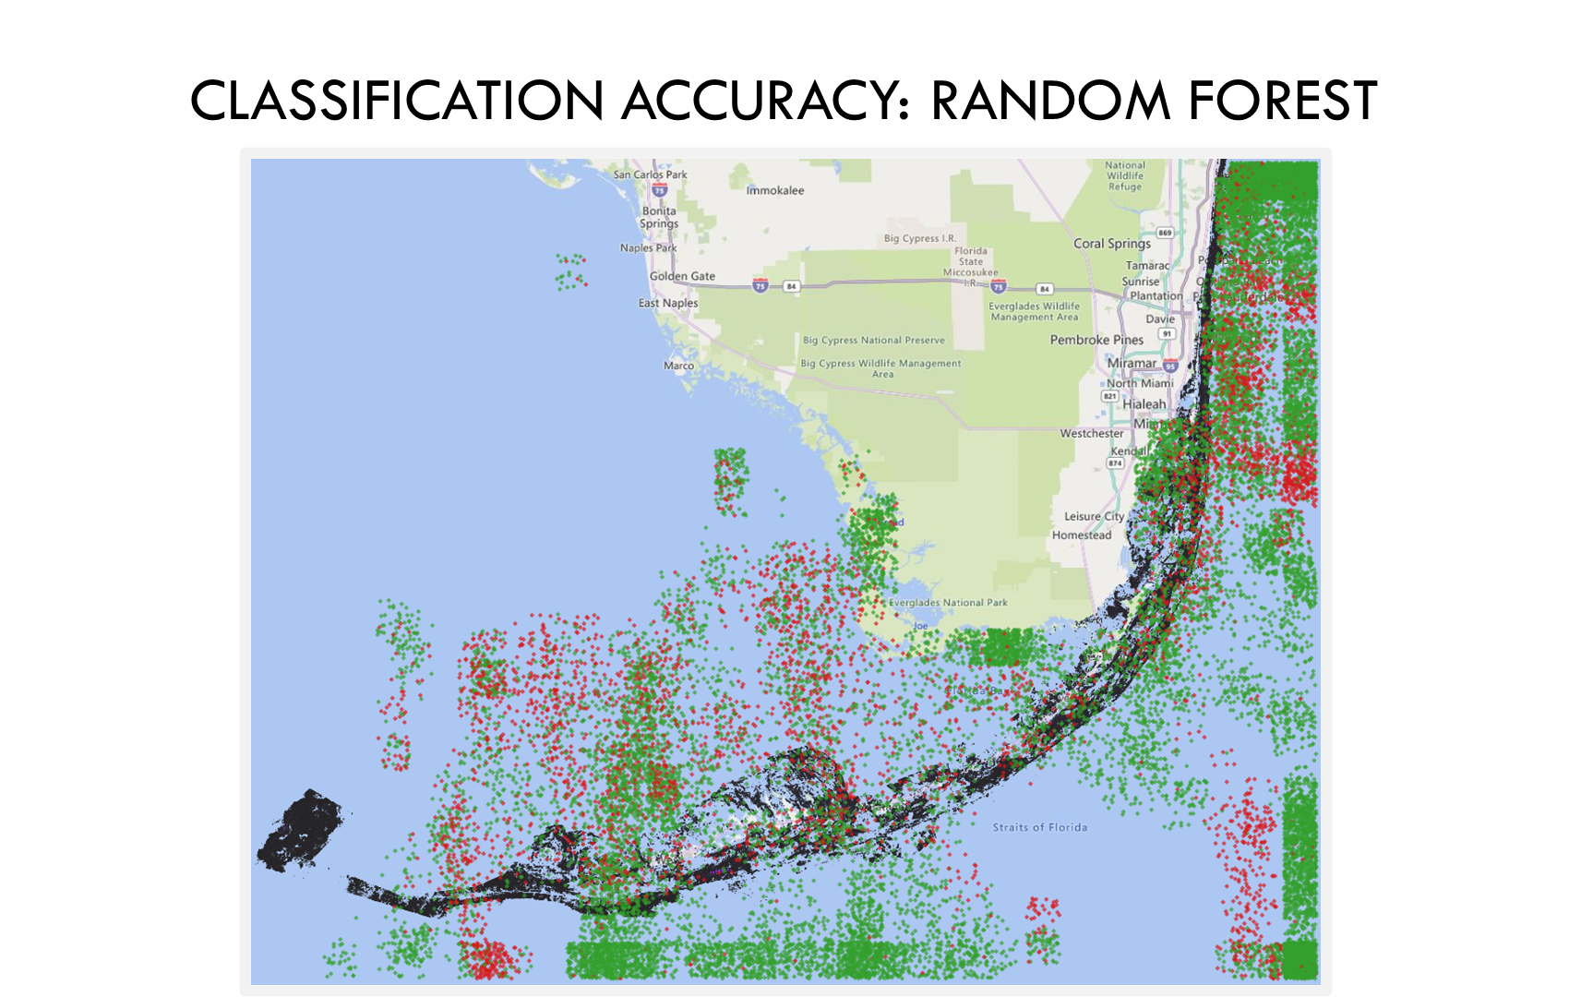
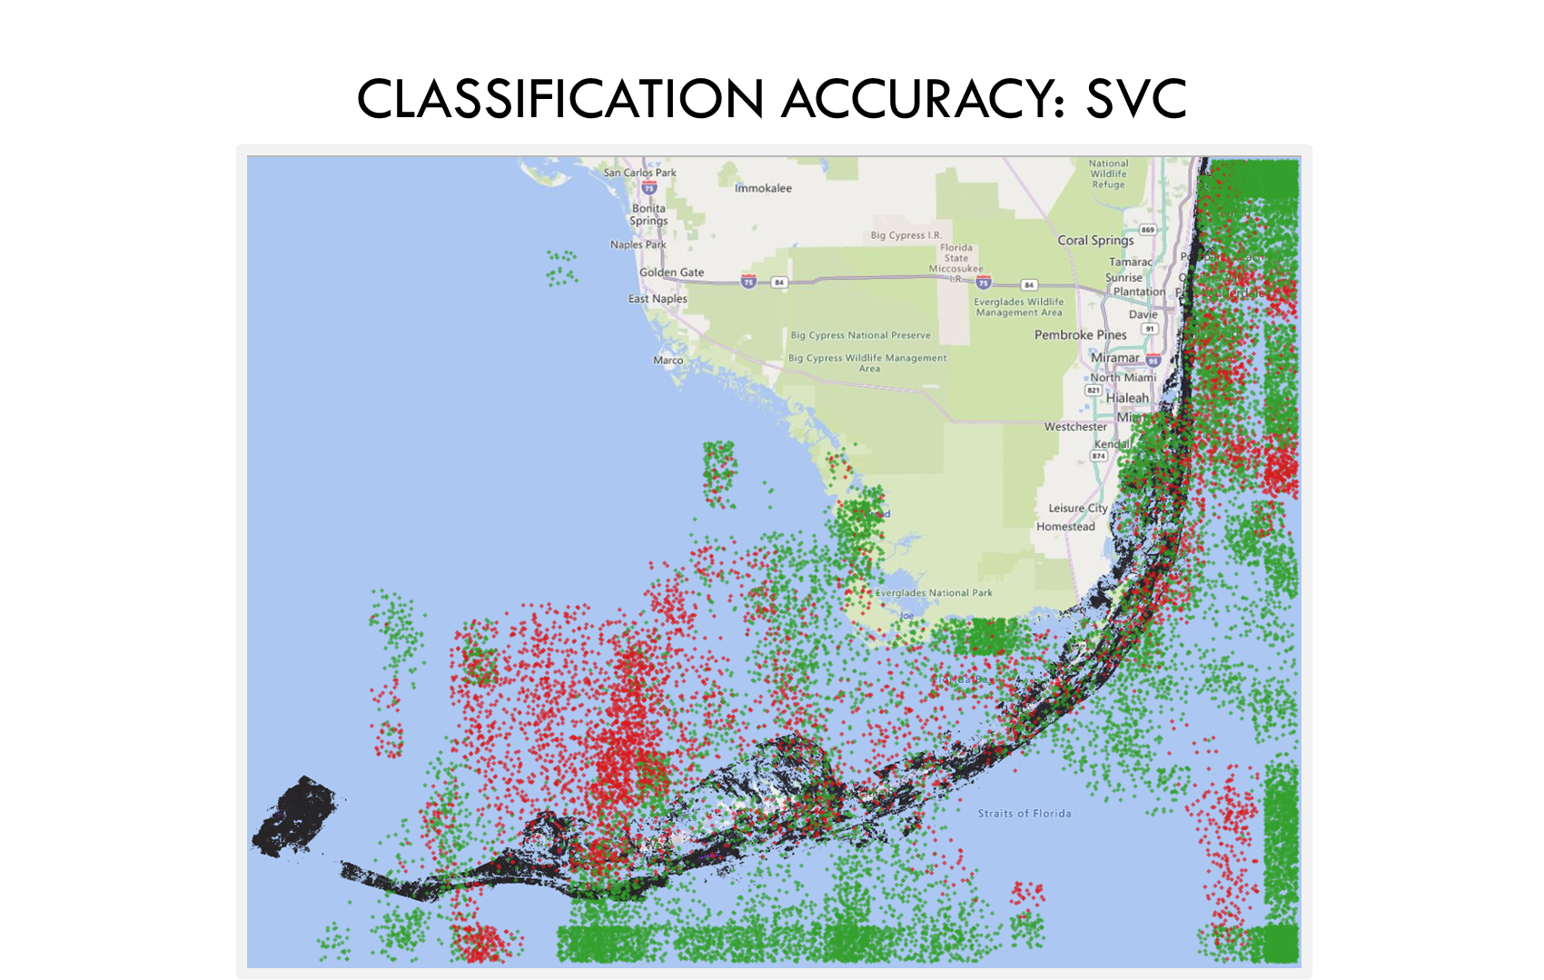
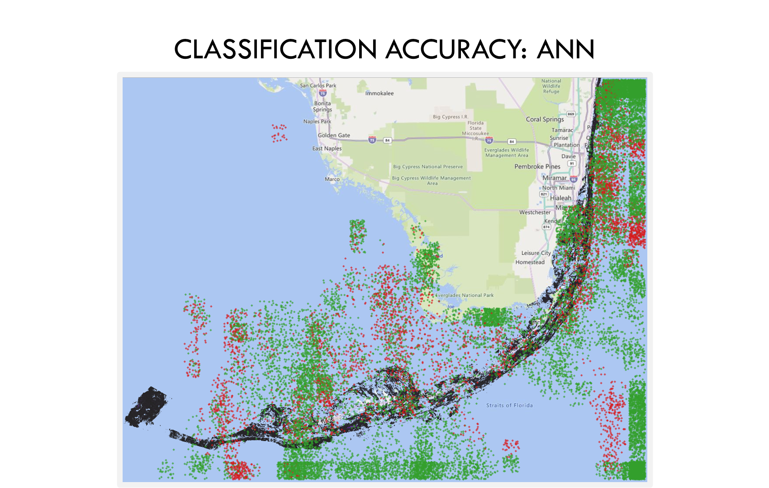
*From Team 1 Final Presentation

Slide 26
Presence of Coral (Great Barrier Reef)
Random Forest
XGBoost Classifier
False
True
False
True
3,263 | 2,570
507 | 5,320
3,615 | 2,218
816 | 5,011
False
False
True
True
Accuracy: 73.6%
Accuracy: 74.0%
SVC
ANN
False
True
False
True
3,224 | 2,609
688 | 5,139
3,789 | 2,044
1,588 | 4,239
False
False
True
True
Accuracy: 71.7%
Accuracy: 68.9%
*From Team 1 Final Presentation

Slide 27
Team 2 Prediction

Slide 28
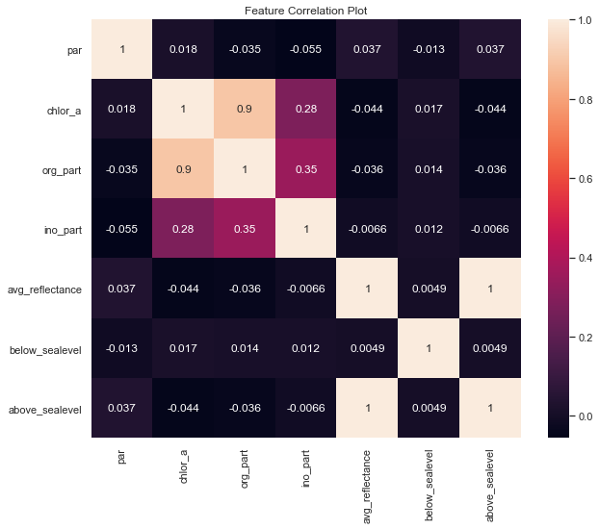
Correlation Plot
Strong correlation observed between Chlorophyll and Organic Particulates.
The average reflectance data from 300 Calipso features along with features below and above Sea Level show no correlation to other coral reef parameters.
No other significant correlations to note.
*From Team 2 Final Presentation
Notes:
kareem add comments

Slide 29
Technical Area 4: Model and Data Tuning
We wanted to to see if we could improve on our top performing accuracy of 75.38%
The team identified 2 major areas where we thought we could enhance performance
Only implement features which show a statistical difference between classes for CALIPSO reflectance data
Augment the training data with the 4 Giovanni parameters: Photosynthetically Available Radiation (PAR), Chlorohphyll A, Organic Particulate, and Inorganic Particulate
Parameters | Distance from Labels | Hypothesis
Calipso | 10 m 50 m 1 km | Models will perform better for larger distances from Labels. Models using Calipso + Giovanni parameters will perform best.
Calipso using Feature Selection
Calipso + Giovanni
*From Team 2 Final Presentation
Notes:
Quinn -

Slide 30
Interpret Trends in a Known Global Region based on Backscatter Alone
Models at a distance filter of 10m:
Model | Full Model Accuracy | 23 Features Accuracy | Full + Giovanni | 23 Features + GIovanni | Notes
Feed Forward Neural Network | 68.63 | 65.51 | 76.16 | N/A | Across all models and methods, the best accuracy achieved is 77.67% Limitations on the CALIPSO reflectance data severely hurt model performance
1D CNN | 75.31 | 66.78 | N/A | N/A
Logistic Regression | 53.65 | 49.72 | 66.27 | 56.27
Random Forest | 60.75 | 58.55 | 69.17 | 66.68
*From Team 2 Final Presentation
Notes:
result is yellow as it might be our best model with being our “best:

Slide 31
Interpret Trends in a Known Global Region based on Backscatter Alone
Models at a distance filter of 50m:
Model | Full Model Accuracy | 23 Features Accuracy | Full + Giovanni | 23 Features + GIovanni | Notes
Feed Forward Neural Network | 72.85 | 66.40 | 74.82 | N/A | Across all models and methods, the best accuracy achieved is 77.67% Limitations on the CALIPSO reflectance data severely hurt model performance
1D CNN | 75.38 | 69.49 | N/A | N/A
Logistic Regression | 51.11 | 51.11 | 64.61 | 53.60
Random Forest | 59.88 | 58.07 | 69.41 | 68.94
*From Team 2 Final Presentation
Notes:
results for each model - Quinn

Slide 32
Interpret Trends in a Known Global Region based on Backscatter Alone
Models at a distance filter of 1000m:
Model | Full Model Accuracy | 23 Features Accuracy | Full + Giovanni | 23 Features + GIovanni | Notes
Feed Forward Neural Network | 73.14 | 68.65 | 77.67 | N/A | Across all models and methods, the best accuracy achieved is 77.67% Limitations on the CALIPSO reflectance data severely hurt model performance
1D CNN | 75.84 | 71.98 | N/A | N/A
Logistic Regression | 48.68 | 48.68 | 63.96 | 63.96
Random Forest | 61.74 | 51.97 | 68.88 | 65.22
*From Team 2 Final Presentation
Notes:
results for each model - Quinn

Slide 33
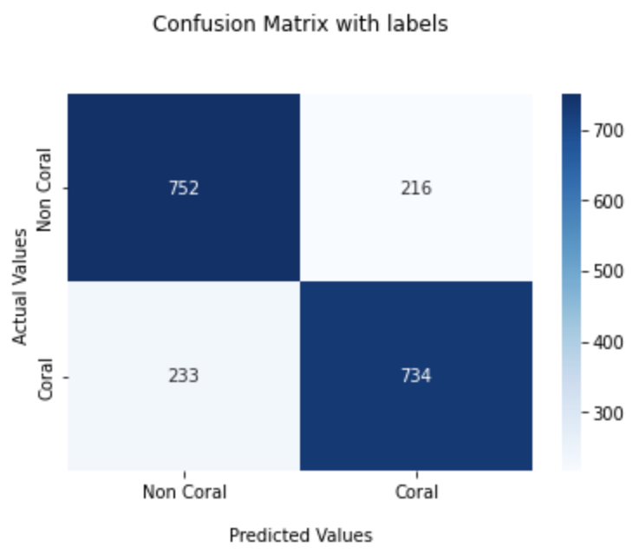
Best Models
Best Accuracy Overall:
77.67% - Feed Forward Neural Network with Full CALIPSO + Giovanni features with 1000m filter
Best Accuracy that meets the NASA Requirements (CALIPSO only):
75.84% - 1D CNN with Full CALIPSO and 1000m filter
Team’s Pick:
75.31% - 1D CNN with Full CALIPSO and 10m filter
This model achieves the goals of the NASA prompt while providing a tool that can inform the Coral Vita team of a coral location to within 10m of a given lat/lon point which seems to far outweigh the marginal gain in accuracy presented by the other 2 models
Team’s Pick Confusion Matrix
*From Team 2 Final Presentation
Notes:
andy confusion matrix

Slide 34
Conclusions
Established a NASA template/Process for this kind of project
Each data source provides unique challenges
The process is technically viable
Even though the students provided academic levels of accuracy
More complex models and Additional Satellites can provide actionable results
Team 1 Final Report and Presentation
https://sites.gatech.edu/gotech/teams/team-1/
Team 2 Final Report and Presentation
https://sites.gatech.edu/gotech/teams/team-2/
NASA Final Report Under Review
Repeating the project with additional satellites in the fall
Notes:
Each data source provided unique challenges that students worked to overcome. In addition, storage and computation of the data also provided challenges. The nature of this data requires the capture, storage, and joining of millions of data points at a time. As a result, students had to curate their algorithms to adapt to aid high-performance computing environments in capturing, fusing, and processing the data.
In the end, the models trained by both teams were compelling. However, they only provided academically acceptable confidence levels for predicting the presence of coral and vitality. The lack of separability between coral and algae and temporal and spatial sparsity among the datasets are key barriers that could be overcome by introducing additional datasets. Fundamentally, the students' models were trivial, indicating that a combination of other feature selection, tuning, and fusion of additional data sources (including additional satellites) would provide actionable results for coral reef restoration groups.

Slide 35
Special Thanks To
Organization Leads and SMEs
Student Research Teams
NASA | Patrick Geitner | Langley Data Science Intern
 | Ed McLarney | NASA AI/ML Lead, Langley DS Lead
 | Shan Zeng | Langley Earth Sciences Research
Coral Vita | Joe Oliver | Director of Restoration Operations
 | Sam Teicher | Chief Reef Officer
Georgia Institute of Technology | Ann Blasick | Corporate Relations Manager
 | Mariana Campili-Warren | MS Analytics Instructional Lead
 | Renata Haque | Practicum Teaching Assistant
 | Joel Sokol | Director, MS Analytics Program
National Institute of Aerospace | Carly Bosco | Director, Research Programs
 | Shi Broadwell | Deputy Program Mgr for Langley
 | Douglas Stanley | President & Executive Director
GT Student Team 1 | Tina Guo
 | Josh Mattingly
 | Dan Schauder
GT Student Team 2 | Kareem Naguib
 | Quinn Stank
 | Andrew Wang

