Slide 1


AeroSat – International Satellite Aerosol Science Network
Bringing the international aerosol remote-sensing community together to brainstorm the way forward
Chairs: R. Kahn, T. Popp Vice-Chairs: A. Sayer, L. Sogacheva
• Founded in 2013 as an international forum for satellite remote-sensing experts
• Aims to provide an open forum with emphasis on discussion
• Meets annually, jointly with the AeroCom modeling community to exchange ideas
• Highlights leading issues in satellite aerosol retrievals, products, and applications, especially to modeling
• Identifies possible approaches to addressing the leading issues
• Encourages participation in AeroSat “experiments” aimed at exploring possibilities and addressing issues

Slide 2
AeroSat Group Dynamics
• Unlike most major meetings, AeroSat is organized as a meeting of experts on the topics covered, focused on DISCUSSION
(i.e., little-to-no time is spent on introductory material in the sessions)
• Oral Presentations are held to a minimum (1 or 2/session @ 5-10 min each);
leaving maximum time for group participation
• Speakers are usually asked to briefly summarize the state of the entire field, not just cover their own work
• In most cases, the work of individual groups is presented in posters
• Each session has a moderator who presents 1-2 slides of key questions, developed in collaboration
with the speakers in the session
• The moderator also focuses the discussion on the key questions; calls in sequence on several people who raise hands to speak, so the discussion keeps moving and everyone who wants gets the opportunity to participate
• Each session has a rapporteur to keep notes on emerging ideas; the chairs subsequently edit and archive the notes*
• When possible, the seating arrangement is in concentric circles; 75 or more have participated this way*
* In the virtual space, we instead supported an on-line bulletin board (board.net) hosting extensive, interactive discussions

Slide 3
AeroSat Study Topics
• Comparing Satellite Aerosol Retrieval Algorithms
• Comparing Satellite AOD Products and Trends
• Aerosol Typing*; Particle Property Assumptions, Retrieval Constraints, and Comparison w/Models
• Characterizing Dust Aerosols
• Pixel-level Uncertainties
• Long-term Aerosol Data Records
• Constraining Wildfire Smoke Injection Height and Source Strength (joint with AeroCom)
Additional AeroSat Discussion Topics
• Aerosol Vertical Distribution
• Aerosol-Cloud Interactions; CCN Retrieval
• Suborbital and Laboratory Aerosol Measurements
• Air Quality
• Climate Variables
*Related Activities: Commission on constraining Aerosol Properties (Y. Balkanski); Models, In situ, and Remote Sensing of Aerosols (MIRA) (G. Schuster)

Slide 4
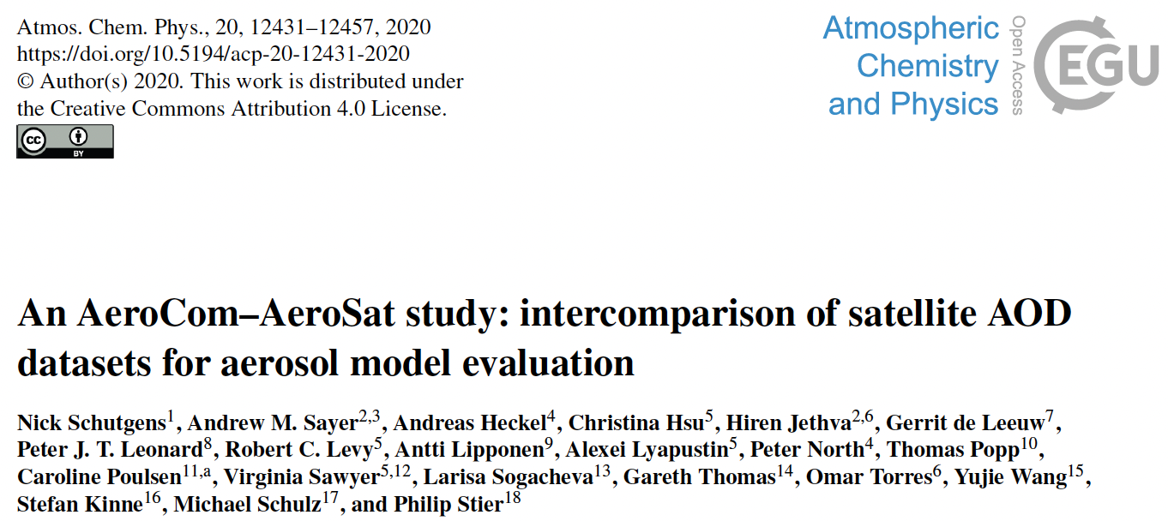
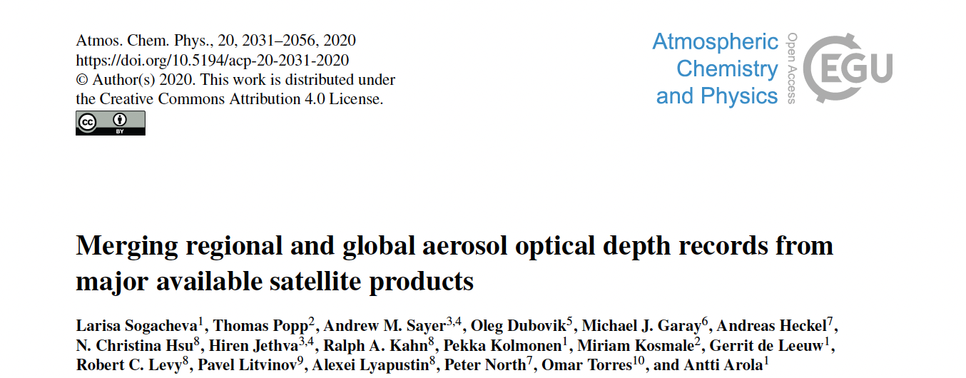
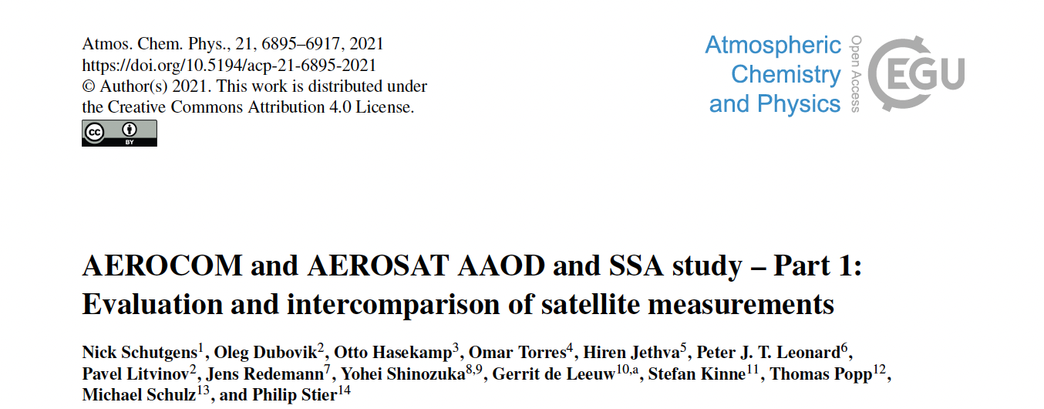
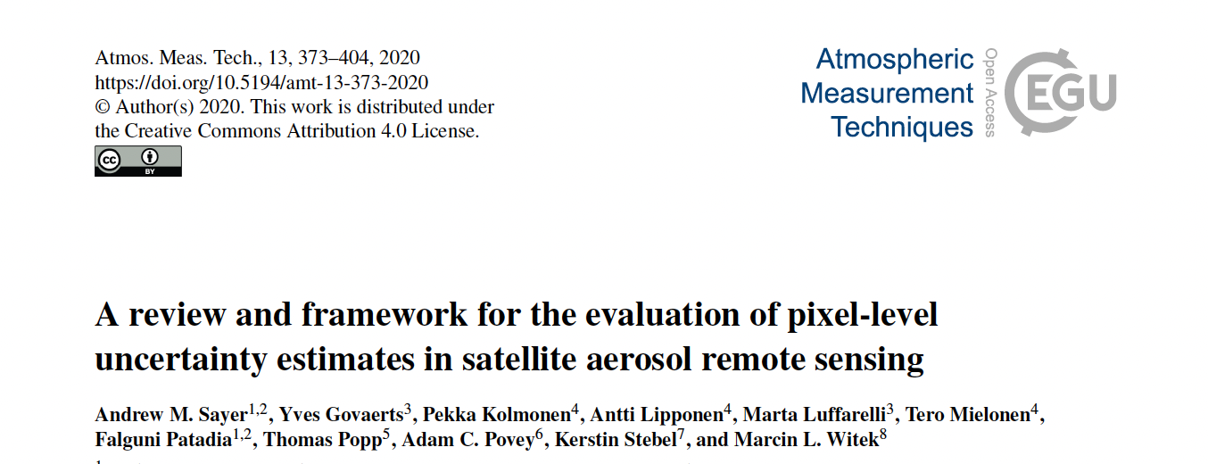
Some AeroSat Study Publications

Slide 5
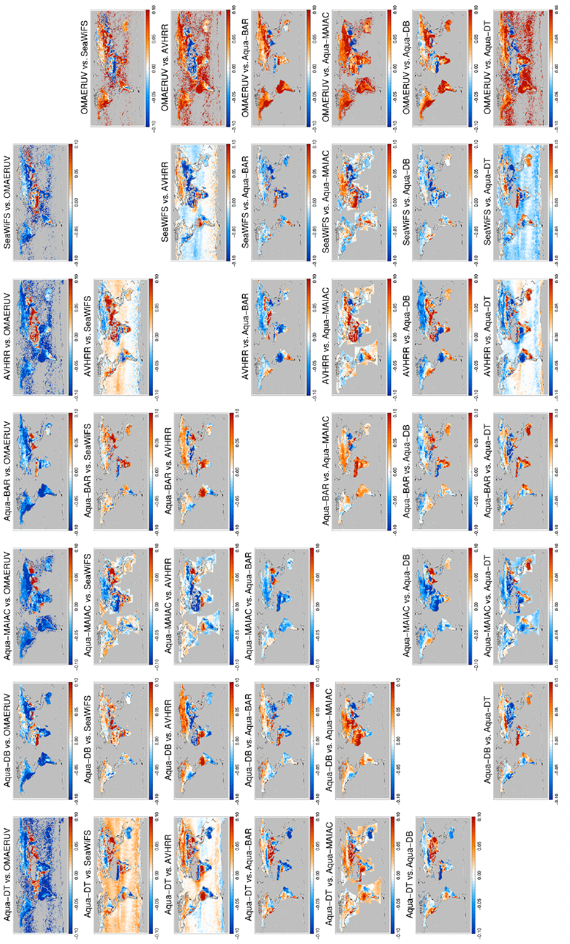
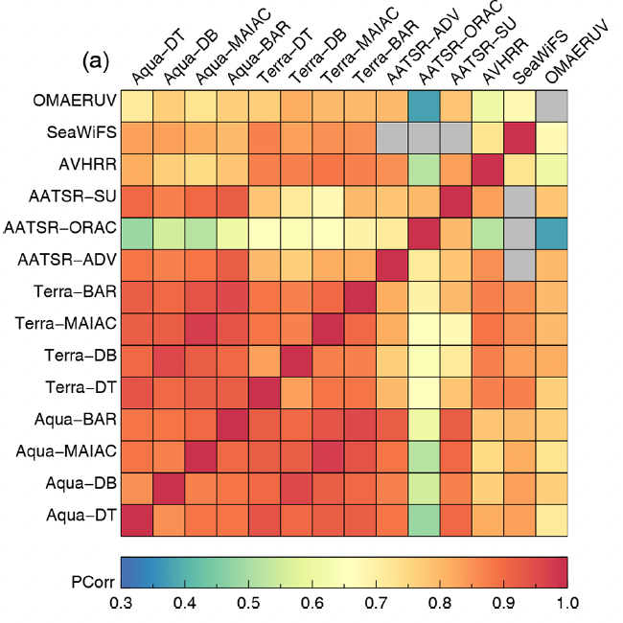
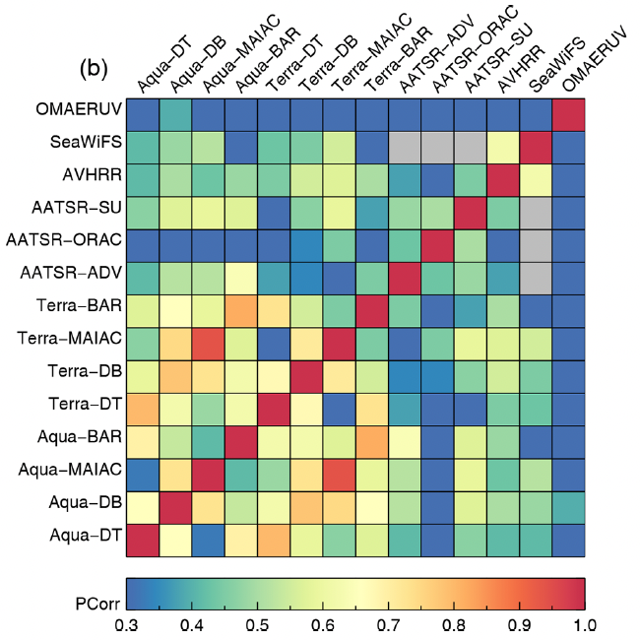
Intercomparison of Satellite AOD Datasets
Schutgens et al. 2020
• 5 sensors, 9 algorithms
• Daily products, 1˚x1˚, 2006; 2008; 2010
• AERONET/MAN as validation standard
• Typically, 15-25% biases; random error larger
• Differences due largely to Cloud Masking
• Diversity varies geographically; indicates ~uncertainty
Pairwise AOD Correlations
Pairwise Spatial Coverage Correlations
Pairwise afternoon- product comparisons, ±1 hr

Slide 6
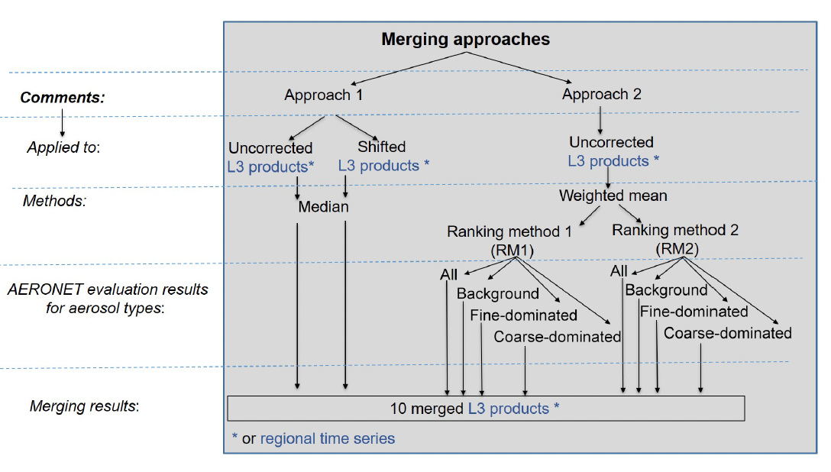
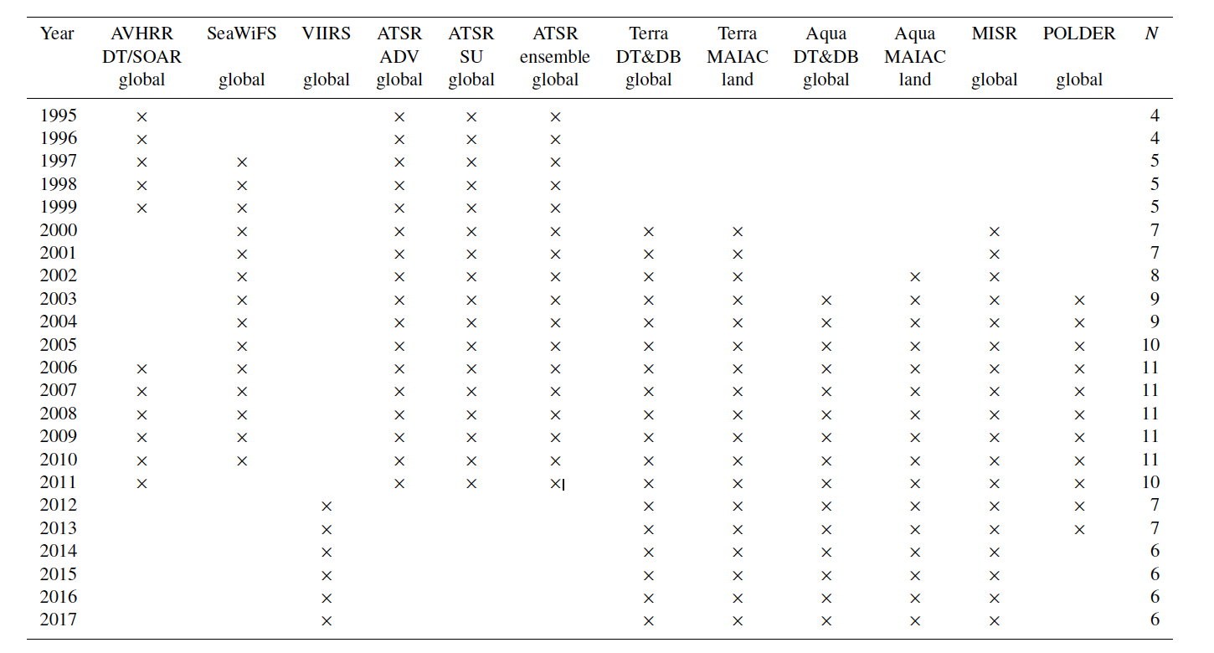
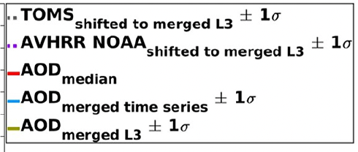
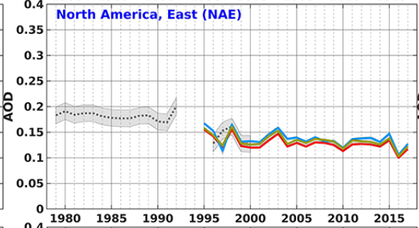
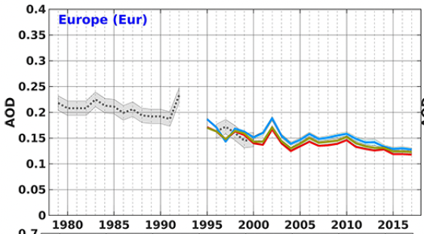
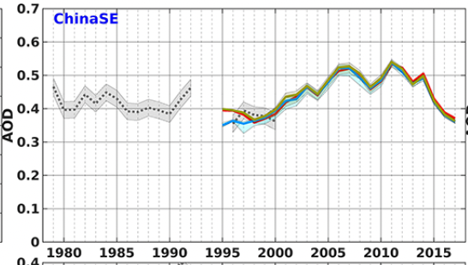
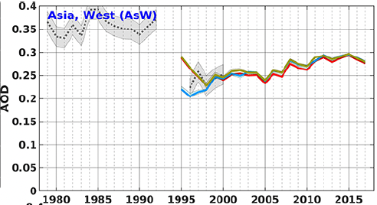
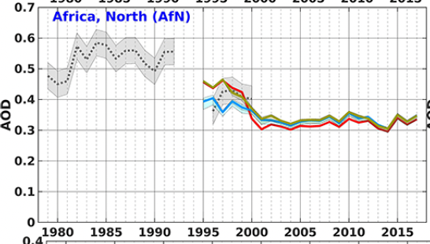
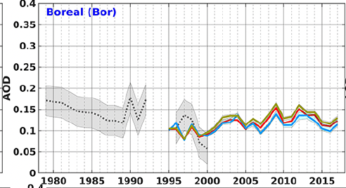
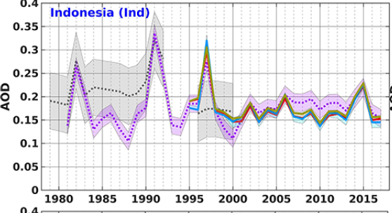
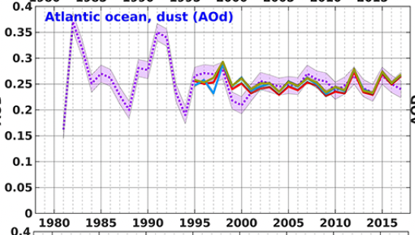
Merging Regional & Global AOD Records, 1995-2017
Sogacheva et al. 2020
• 16 monthly products, 1˚x1˚
• AERONET as validation standard
• Several weighting methods tested
• However, similar results
• Robust trends

Slide 7
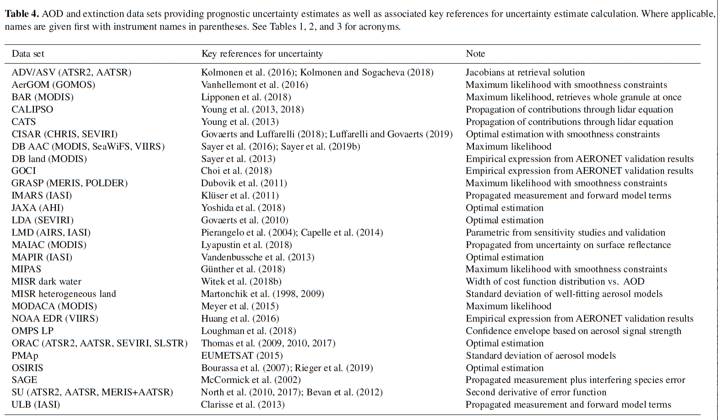
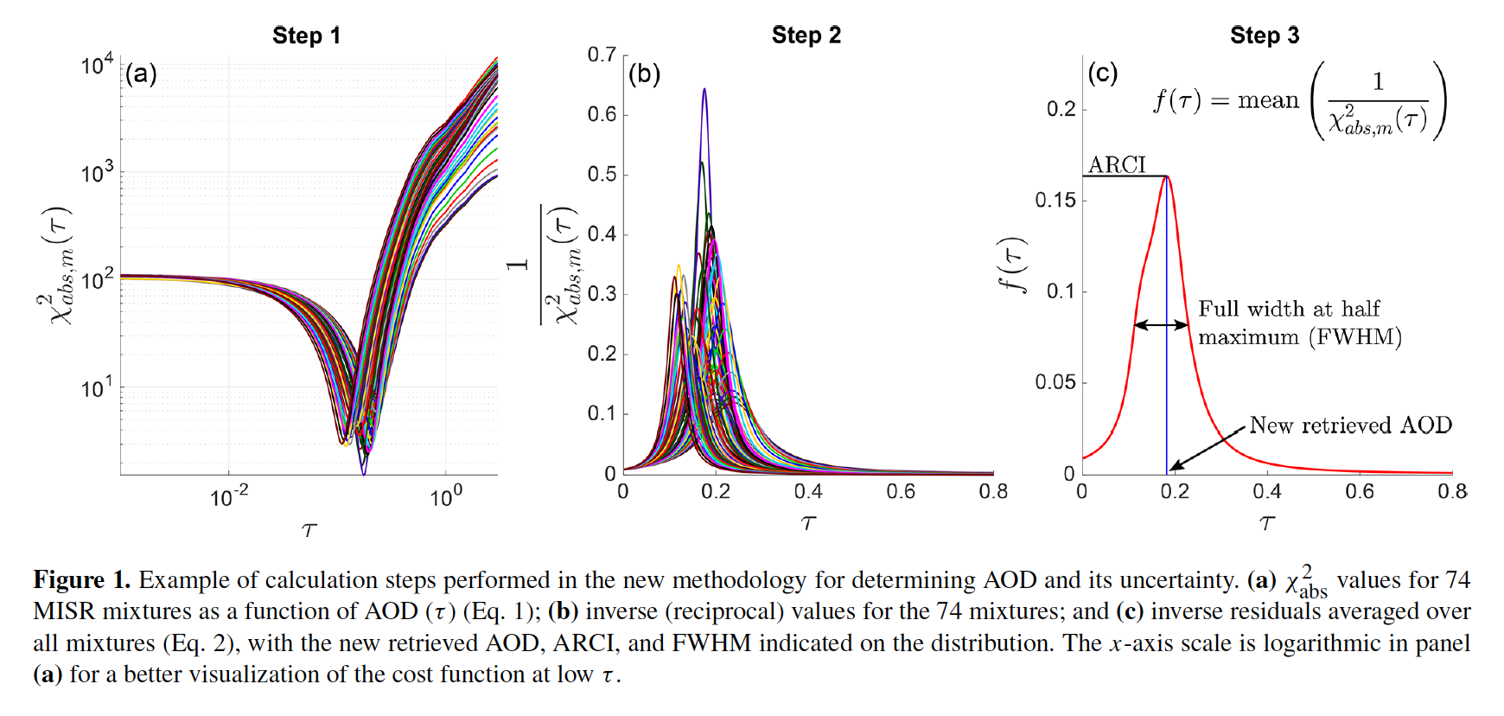
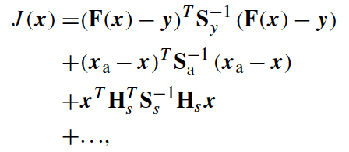
Pixel-Level AOD Uncertainty
Sayer et al., AMT 2020
Optimal Estimation
-- Covariance matrix elements
Cost Function width (MISR)
-- Aerosol optical model included

Slide 8
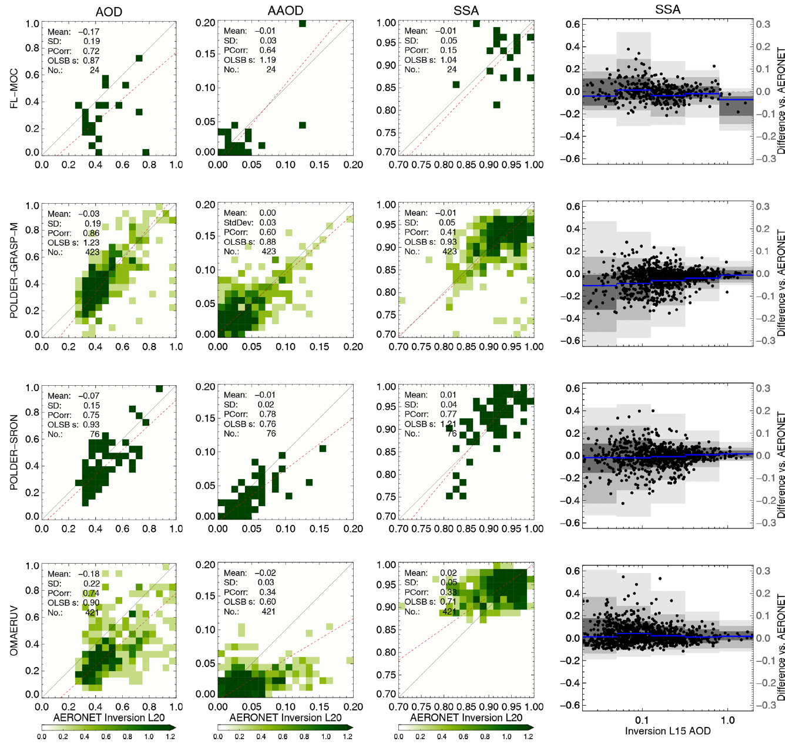
Intercomparison of Satellite AAOD and SSA Datasets
Schutgens et al. 2021
AOD
AAOD
SSA
SSA vs. AOD
• 4 products: 2 POLDER, 1 OMI; 1 MODIS/OMI/CALIOP
• Daily products, 1˚x1˚, 30 min, 2006; 2008; 2010
• AERONET as validation standard
• AOD thresholds, temporal averaging, for robust results
• AAOD more robust; AOD>~1 required for good SSA

Slide 9
AeroSat Web Site
https://aero-sat.org
• Mission Statement
• Past Meeting Agendas w/slides & edited notes from discussion sessions
• Upcoming meeting information
• Publications
• Related web links

