Slide 1





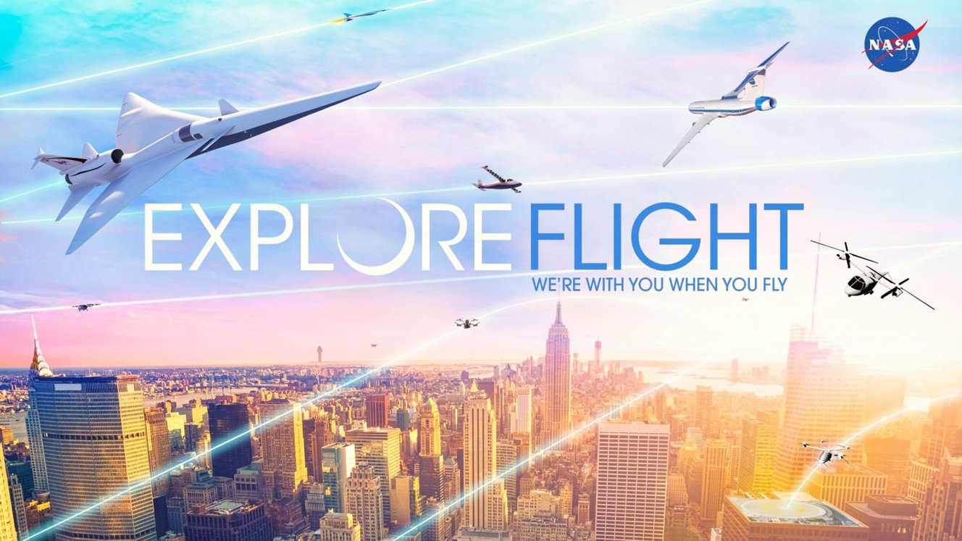
Digital Flight
A New Cooperative Operating Mode to Complement VFR and IFR
AEEC / IATA EFB Users Forum
June 1-3, 2022, Annapolis MD
David Wing
Convergent Aeronautics Solutions (CAS)
National Aeronautics & Space Administration

Slide 2
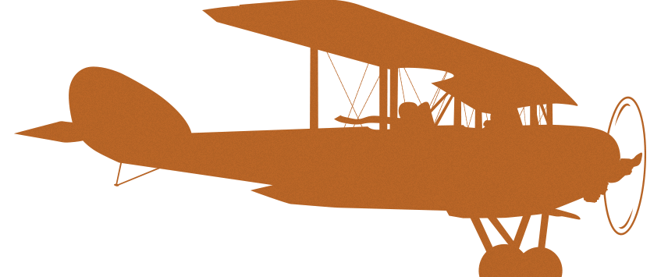


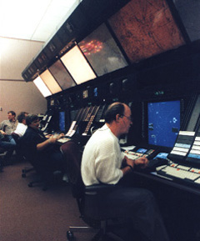
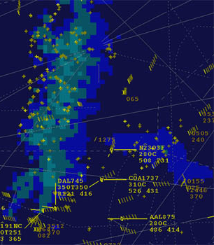
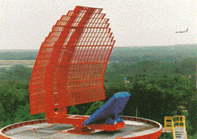



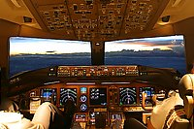
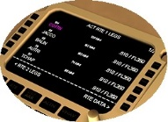
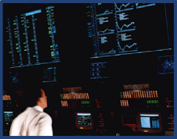
20th Century Evolution of Operations
Visual Separation
See-and-Avoid
A ∙ –
N – ∙
“Airways” Formed
Origins of
Instrument Flight
Rules (IFR)
Flexibility
Access
N – ∙
A ∙ –
Origins of
Visual Flight
Rules (VFR)
Flexibility
Access
Increased Collision Risk
Radio Navigation
Airway Traffic Control
(ATC)
Radar Separation
Radar Surveillance
Procedural Separation
Relayed Communications
10 minutes or
different altitudes
Flight Visibility
Limits Access
ARINC
ATC
Capacity
Flexibility
Access
Direct Pilot-Controller Communications
Mobility is Limited Under Current
Flight Rules
Global Precision
Navigation
Initial Trajectory-Based Operations
Limits Flexibility
ATC Capacity
Capacity
Flexibility
Access
Advanced Avionics and Air Traffic Management Automation

Slide 3
What Problems are Being Addressed?
Current flight rules and procedures are:
Not adaptable to meet evolving and diversifying needs for airspace access and operational flexibility
Not scalable to meet ops tempo and density of new entrants (e.g., UAS, AAM)
  ATM workload constraints
  Physical separation constraints
Not accommodating of future flight concepts
(e.g., self-piloted, highly autonomous aircraft)
Not ensuring operational predictability required for electric-powered aircraft
Not conducive to capacity growth for runway-independent and non-towered airport operations
“New and adapted flight rules and procedures will be required to efficiently manage these increasingly dynamic operations of differing priority and types.”
A New Digital Era of Aviation: The Path Forward for Airspace & Traffic Management
-- Airbus and Boeing, 2020
AAM Advanced Air Mobility
ATM Air Traffic Management
UAS Unmanned Aircraft System

Slide 4



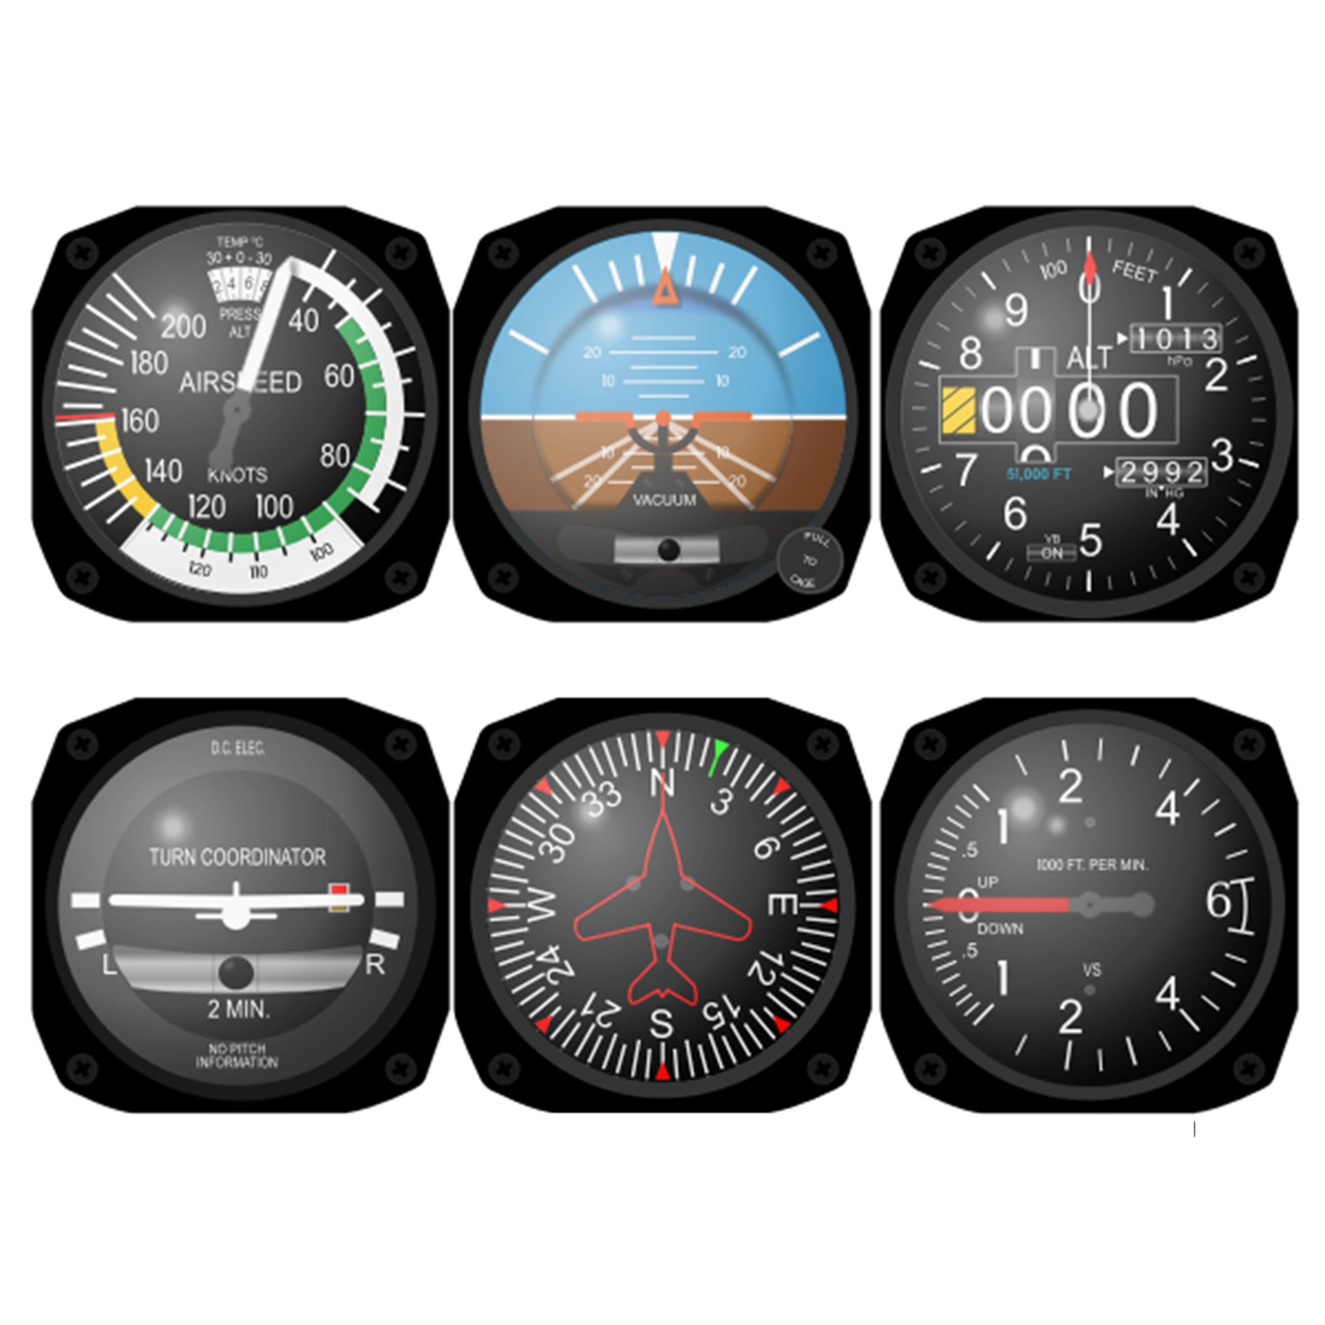

Operating Mode Enabled by Connected Digital Technology
Visual Flight
Pilot sees and avoids
Distributed decision-making
No centralized coordination or intent sharing
Self-managed by cooperative procedures and rules
Limited to no dependence on technology
Pilot
Flexible
Scalable
Operator is the separator
(relying upon automation and services)
Proposed: Digital Flight
Distributed decision-making
No centralized coordination, but with intent sharing
Self-managed by encoded cooperative practices
Highly automated separation
Collaborative with ATC traffic flow management
Decision-Maker
Operator
Automation
Operating
Environment
Predictable
Accessible
ATC is the separator*
(relying upon controller-pilot comms)
Instrument Flight
Federated/centralized decision-making
Intent sharing via flight plan and clearances
Centrally managed conflict management
ATC
Pilot
* As defined in ICAO 9854 Global ATM Operational Concept, Section 2.7.18

Slide 5
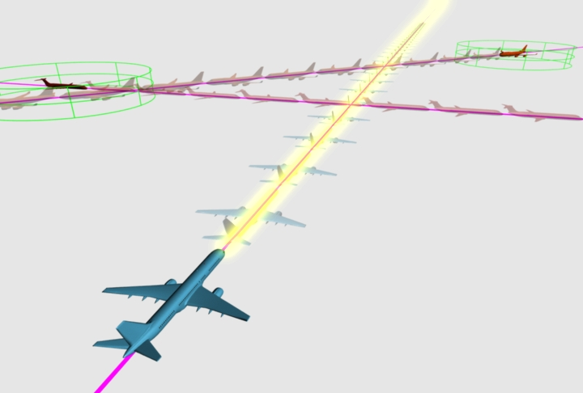
Digital Flight (DF)
A proposed cooperative operating mode
  in which operators ensure flight-path safety
  through highly-automated self-separation
  enabled by connected digital technologies
  and formal cooperative practices
  in lieu of
  VFR’s visual procedures and
  IFR’s ATC separation services
Image: J. Ponthieux, NASA LaRC
ATC Air Traffic Control

Slide 6
Formalizing Digital Flight (DF)
DF Operator
Responsibilities
Intent Management
Maintain and share a current
digital prediction of the intended flight path
and intended conformance
Airspace Integration
Contribute to airspace integration via dependable states (e.g., intent sharing, RTA) while navigating safety
Automated Separation
Employ certified digital automation connected to appropriate authorized data sources to ensure separation from all traffic
Cooperative Practices
Operate cooperatively by respecting VFR and IFR traffic, shoulder burdens equitably, and coordinate maneuvers as needed
DF Operator
Benefits
Access
Operate in all airspace classes and visibility without specific ATC clearance
Flexibility
  Dynamically manage flightpath changes through automation rather than by sight or ATC clearance
Self-Predictability
Operate with greater confidence and control of operational outcomes
Aviation
Benefits
Equity
Widely available mode
Diversity
Powerful tool for innovation
Scalability
Grows organically
RTA Required Time of Arrival

Slide 7









Digital Flight at its Core
Essential Elements
Architectural Flexibility
Cooperative Practices for Conflict Management
Spectrum
Digital Flight
    Self-Provision
    Services Provision
Digital Information Connectivity
& Services
Shared Traffic
Awareness
Flightpath Automation
Responsible for Separation
    Location of automation
    and decision-making

Slide 8
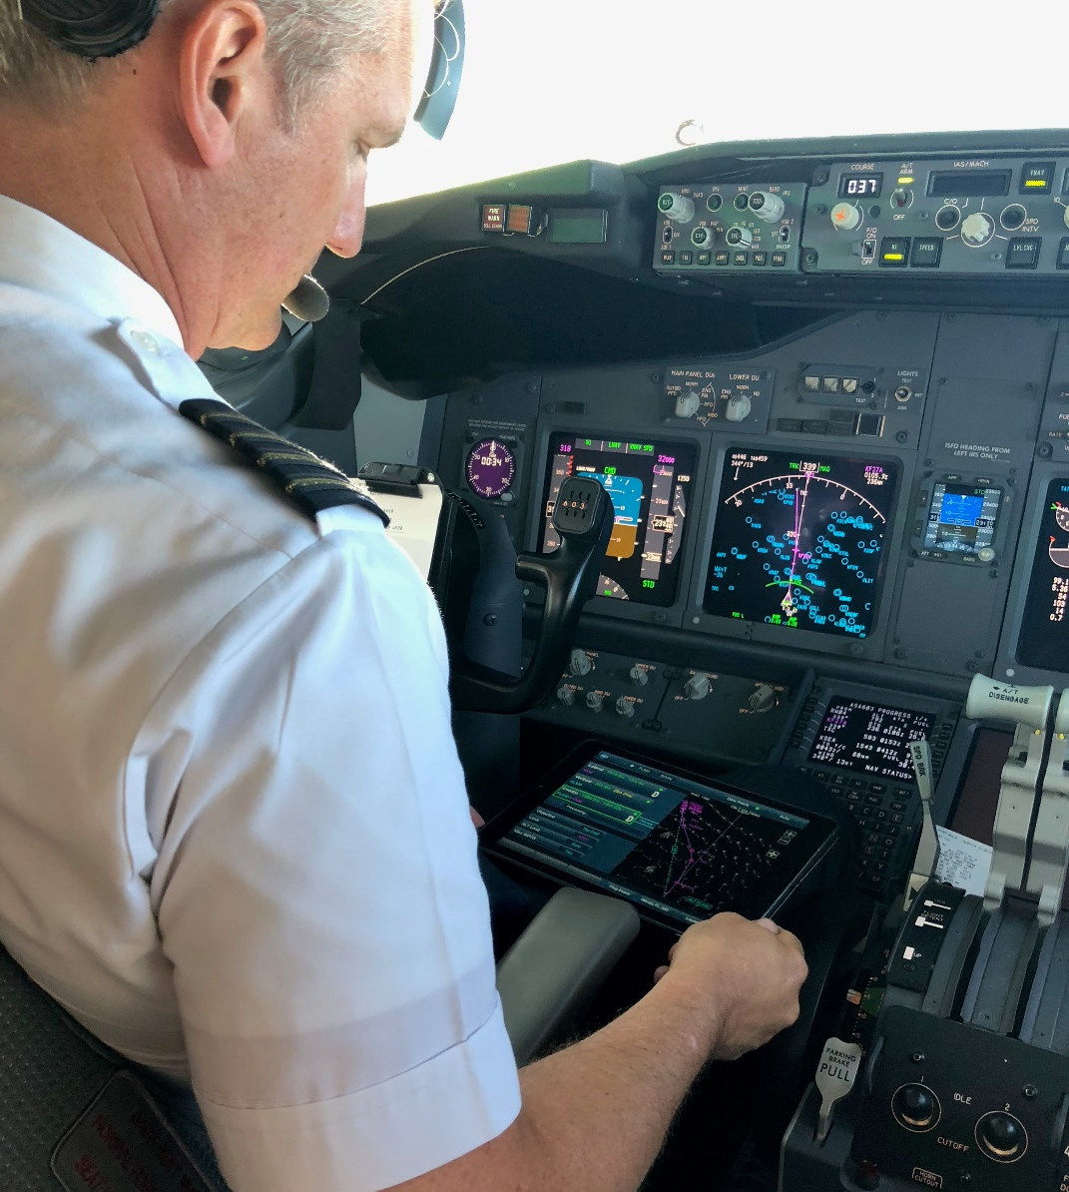


EFB Tech is Building Toward Digital Flight
Traffic Aware Strategic Aircrew Requests
Digital Flight Essential Elements in TASAR
Cooperative Practices for Conflict Management
Digital Flight
NASA technology for flight optimization
Validated w/ Alaska Airlines in 2018-2019 operations
Now commercially available
Digital Information Connectivity
& Services
Shared Traffic
Awareness
Flightpath Automation
Responsible for Separation
Notes:
EFB – Electronic Flight Bag
TASAR – Traffic Aware Strategic Aircrew Requests

Slide 9
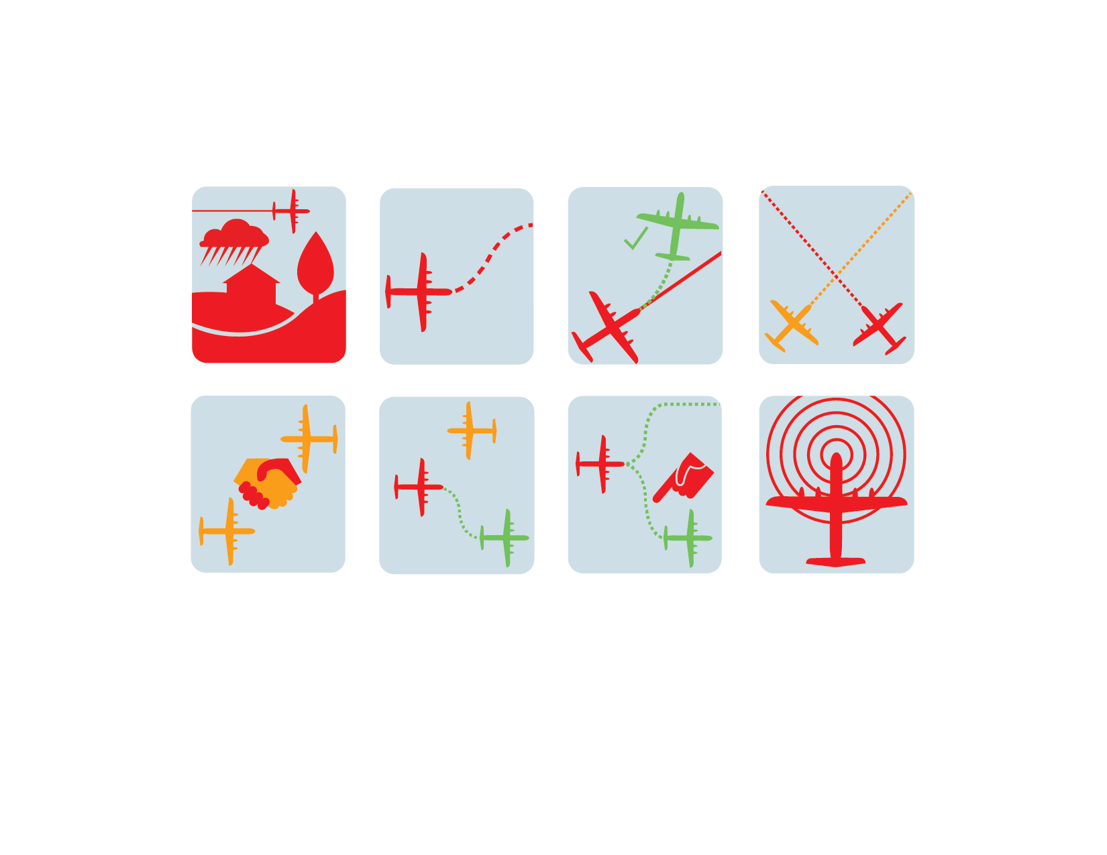
Highly-Automated Separation Provision
Build and maintain a 4D digital model of the operating environment
Includes at least local winds, weather, special activity airspace, traffic, obstructions, airspace constraints, landing facilities status
Coordinate to determine resolution burden, timing, and (when appropriate) direction
Applies rules to equitably distribute the separation task, increase stability, and ensure safety
Build and maintain a prediction of “ownship” intended flight path
Accounts for prediction uncertainties and conformance errors
Enables intent sharing with the operational community
Compute conflict resolution options strategically first, tactically if needed
Promotes predictability while preserving safety
Pre-check operator-desired changes to
intended flight path for conflicts
Precludes any maneuvers that create new conflicts
Select from computed resolutions and execute
Enables operator the opportunity to be engaged and incorporate dynamic preferences
Detect conflicts on current flight path
Uses appropriate look-ahead horizons and pairwise separation criteria
Share intent changes as they happen
Promotes common situation awareness and increases stability

Slide 10





Problem: Emerging Patchwork of Operating Modes and Underlying Rules
Sky for All
Vision
UML 4+
IFR
Airline / Bus. Aviation
“Reduced operating costs”
Achieve Scalable Secure Digital Aviation System
Assure Safety as Operations Diversify & Grow
Design for Sustainability & Resiliency
Enable Equitable Access for Diverse Ops
Enhance Quality of Life
Promote and Empower Operator Mobility
Transform Existing Aviation Ecosystem
uETM
Urban Air Mobility
“Dense / complex urban operations”
High Altitude Ops
“Cooperative separation”
Emergency Air Svcs
“All Weather Safe Response”
Larger UAS
“Seamless integration in the NAS”
VFR / IFR
Regional Air Mobility
“Community-friendly regional travel”
UTM
General Aviation
“Simplified Vehicle Operations”
Small UAS
“Beyond visual line of sight”
Transformation Accumulation
Evolving, proven capability maturity/TRL to serve needs & risk targets
Notes:
UAS – Uncrewed Aircraft System
UTM – UAS Traffic Management
VFR – Visual Flight Rules
IFR – Instrument Flight Rules
uETM – Upper Class E Traffic Management
UML – Urban Air Mobility Maturity level
NAS – National Airspace System

Slide 11

Problem: Emerging Patchwork of Operating Modes and Underlying Rules
Sky for All
Vision
Approach: Common New Operating Mode
UML 4+
IFR
Harmonization through Digital Flight
Common operating mode
Serving unique market needs
Airline / Bus. Aviation
“Reduced operating costs”
Achieve Scalable Secure Digital Aviation System
Assure Safety as Operations Diversify & Grow
Design for Sustainability & Resiliency
Enable Equitable Access for Diverse Ops
Enhance Quality of Life
Promote and Empower Operator Mobility
Transform Existing Aviation Ecosystem
uETM
Urban Air Mobility
“Dense / complex urban operations”
  DF increases flexibility to optimize under dynamic conditions
High Altitude Ops
“Cooperative separation”
  DF enables expansion beyond capacity-limited corridors
Emergency Air Svcs
“All Weather Safe Response”
  DF optimizes flexible operations in Upper
  Class E airspace
  DF increases safety and access
  in all visibility conditions
Larger UAS
“Seamless integration in the NAS”
VFR / IFR
Regional Air Mobility
“Community-friendly regional travel”
  DF reduces lost-link contingency impacts and maximize NAS access
UTM
General Aviation
“Simplified Vehicle Operations”
  DF increases scale of access to non-towered airports
Small UAS
“Beyond visual line of sight”
  DF reduces training costs while increasing safety and access
  DF enables access above 400’ and BVLoS
Digital Flight Rules
Transformation Accumulation
Evolving, proven capability maturity/TRL to serve needs & risk targets
Notes:
UAS – Uncrewed Aircraft System
UTM – UAS Traffic Management
VFR – Visual Flight Rules
IFR – Instrument Flight Rules
uETM – Upper Class E Traffic Management
UML – Urban Air Mobility Maturity level
NAS – National Airspace System

Slide 12






Community Engagement: Outputs from Workshops
Various Barriers Identified
Paths Forward / “Chisels”
Safety & Certification
Regulations
Technology
Concept Communication
    Develop Concept of Use to describe
    capabilities and use-cases for DF and
    reduce identified uncertainties
Stakeholder Engagement
    Engage with key stakeholders to communicate concept and potential DF policy, especially FAA
Modelling and Simulation
    Conduct detailed M&S to quantify improvements in safety, security, and efficiency resulting from DF
Technology Demonstration
    Define and conduct real-world demonstrations of DF capabilities including vehicle-to-vehicle datalinks
Responsibilities
Combined Operations
Implementation Path
Impact on Non-DF Users
Business Case Uncertainty
Safety and Certification
  Difficulty of certifying safety-critical automation systems
Regulations
  Lead time and complexity to implement rulemaking
Technology
  Feasibility of enabling technologies and data links
Responsibilities
  Uncertainty about operator and controller responsibilities
Combined Operations
  Challenge of integrating with IFR and VFR
Implementation Path
  Viable early operational capabilities
Impact on Non-DF Users
  Both operations and cost
Business Case Uncertainty
  Minimum viable products and return on investment

Slide 13
Digital Flight: A Moonshot for Aviation
DF S-Curve →
“We set sail on this new sea…
for the progress of all people.”
John F. Kennedy
Sept. 12, 1962
DF applications
expand and accelerate
Initial rulemaking
is complete
Rulemaking
process begins
Core rule content
accepted in principle by industry
First DF certification and operational approval
Digital
services
diversify
Standards are complete
Industry engagement accelerates
Vetting with
existing and emerging operators
Limits of
waivered
operations
is reached
Increasing
diversity, complexity,
and innovation
R&D provides data for standards
Digital services
proliferate
Collaborative refinement
Standards
development
underway
Digital services
emerge
First authorized
Digital Flight
Diversity of
DF-aligned operations
increases
DF-aligned operations expand under IFR waivers
Candidate rule
contours outlined
Prototypes developed
DF-aligned
operations underway
Rulemaking
Standards
Momentum
Digital Flight

Slide 14
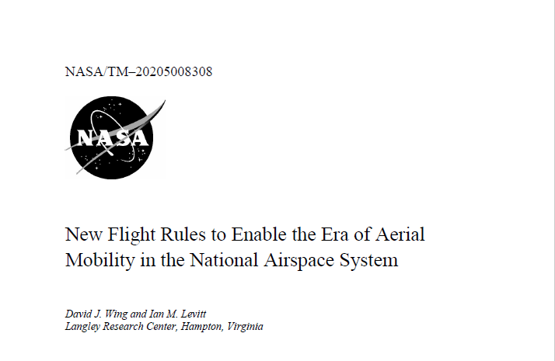
Thank You!
Digital Flight
New operating mode
Safely scalable through
highly automated self-separation
Enables greater aviation diversity by
increasing operator access and flexibility
Transforming aviation’s contribution to society
NASA publication to spark
a conversation about
Digital Flight
https://ntrs.nasa.gov/
Search “DFR”
Click to access this paper
We Invite Your Thoughts
What are the barriers?
How do we overcome them?
How do we make Digital Flight real?
david.wing@nasa.gov

