Slide 1
SSA Operators' Workshop
NASA CARA Best Practices:
Potentially Active
Secondary Payloads
R.A. Baker
M.R. Johnson
2 June 2022

Slide 2
Outline
CARA Process Overview
  Nominal event evolution
Event with Potential Active Secondary
  CARA Best Practices
  Event Example
Summary

Slide 3
CARA process overview

Slide 4
CARA Process Overview
Note: For this presentation CARA assets will be referred to as the primary
Resident Space Objects (RSOs) are divided into multiple orbit regimes based on Apogee and Perigee
  Low Earth Orbit (LEO) regime contains majority of RSOs and CARA-protected assets
  Events within the LEO regime considered for this presentation
CARA assets screened daily to predict close approach events with RSOs
  LEO screening identifies events up to 7 days into the future, but planning most often begins in earnest 2-3 days prior to an event Time of Closest Approach (TCA)
  Maneuverable assets provide owner/operator (o/o) ephemeris that is screened against the ASW solution and secondary o/o ephemeris files (if available)
Event planning takes place between CARA and Mission Operations Team
  Identify, plan, and screen potential mitigation maneuvers
  Determine maneuver Go/No Go based on event Pc at decision time

Slide 5
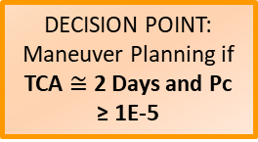
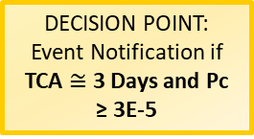
Nominal Event Timeline
3-7 days prior to TCA
  Review event details; identify advanced analysis needed for any events
  Orbit Determination (OD)s of objects are flagged, manually reviewed and evaluated by the CARA OSAs
  Secondary Owner/Operator (O/O) contacted to coordinate mitigation plans (if applicable)
  Review space weather predictions
1-3 days prior to TCA
  CARA contacts mission team and event planning begins should Pc remain high
  Mitigation maneuvers are screened for post-maneuver events
.5 day to TCA
  Final go/no go to perform mitigation maneuver based on latest available event Pc
0. Conjunction Identification, Internal Analysis, and Monitoring
7 Days > TCA ≥ 3 Days
All Identified Events
Stop Planning – Monitor Only
DECISION POINT:
Event Notification if
TCA $≅$ 3 Days and Pc ≥ 3E-5
Initial Notification and Request for Planning Timeline
no
yes
Stop Planning – Monitor Only
DECISION POINT:
Maneuver Planning if
TCA $≅$ 2 Days and Pc ≥ 1E-5
2. Maneuver
Planning
no
yes
Waive Maneuver – Monitor Only
DECISION POINT:
Maneuver Go / No-Go if TCA ≤ .5 Day and Pc ≥ 1E-4
3. Maneuver Execution
no
yes
TCA
Notes:
Event with potentially active secondary (timeline shifts for coordination with secondary- investigate maneuverability status, reach out to secondary o/o)
Secondary OD: LUPI/DC span long, no recent tracking (more than 7-10 days)
Additional analysis required, reach out to OSAs and Analysis team to evaluate the actionability of the OD (go into more detail during the case studies presented)
Low Rel Vel: additional analysis required monte carlo

Slide 6
Event with potentially active secondary
7 days prior to TCA
Event identified with potentially active secondary
  Event of concern if Pc>1e-7 OR miss distance < 500 meters (regardless of Pc)
  CARA Operations Team begins investigation of maneuver capabilities
    Investigation includes:
      Check maneuver status flag on Space-track.org
        Note any contact information for future use
      Analysis of TLEs
        Check apogee and perigee for any obvious state changes
      Open-source data
        Research spacecraft configuration for propulsion capabilities
5 days prior to TCA
If event of concern still meets the criteria outlined above
  Will reach out to secondary owner/operator to inquire about the spacecraft’s maneuver capabilities
  This process can be more complicated if secondary owner/operator is a foreign service operator
0. Conjunction Identification, Internal Analysis, and Monitoring
Notes:
OR miss distance < 500 meters (regardless of Pc)
Even though CARA’s mission utilize Pc to determine the level of risk for a potential conjunction event, it is not always clear what the Secondary O/O involved in the conjunction may use as their mitigation threshold- so we reach out for either case

Slide 7
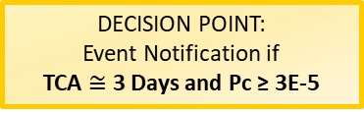
Event with potentially active secondary
3 days prior to TCA
If event is introduced by CARA asset’s nominal maneuver
  Will work with mission to re-plan or waive off the maneuver
If event is moderate risk (Pc>1e-7)
  CARA will send notice to Secondary O/O asking that they not maneuver their spacecraft between now and TCA
If event reaches the planning threshold (Pc>3e-5)
  CARA will work with mission and Secondary O/O to develop a plan on which spacecraft will be taking the mitigative action should the risk increase (Pc>1e-4)
Maneuver commit point
If risk is high (Pc>1e-4)
  CARA will provide the Secondary O/O with maneuver information for the CARA planned maneuver
  Or will request maneuver information from Secondary O/O
DECISION POINT:
Event Notification if
TCA $≅$ 3 Days and Pc ≥ 3E-5
DECISION POINT:
Maneuver Go / No-Go if TCA ≤ .5 Day and Pc ≥ 1E-4

Slide 8
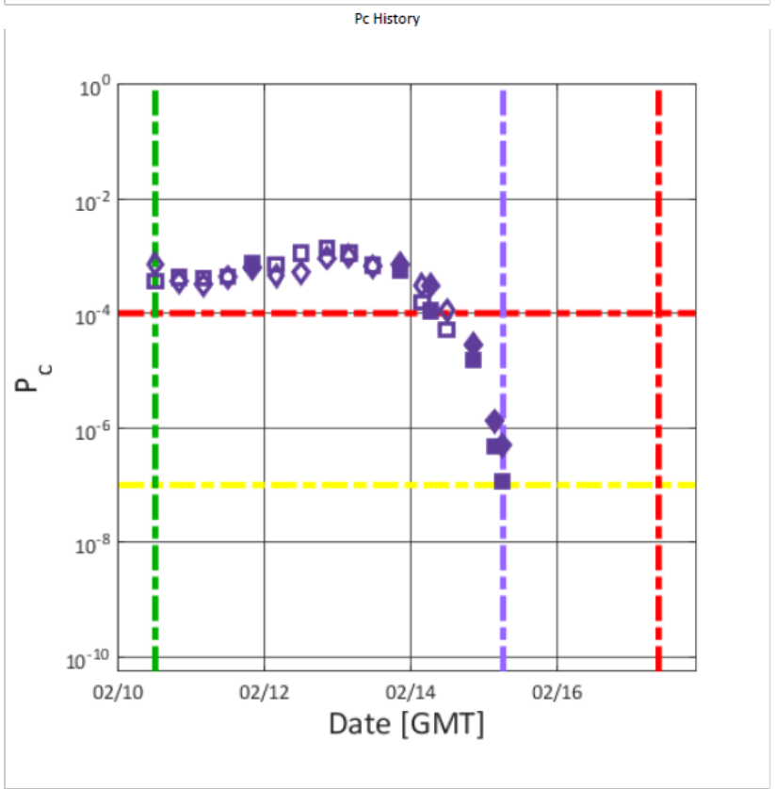
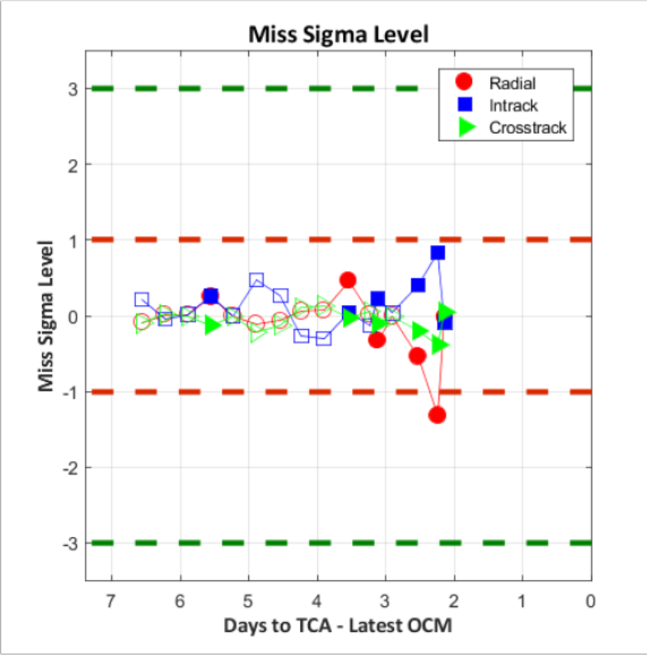
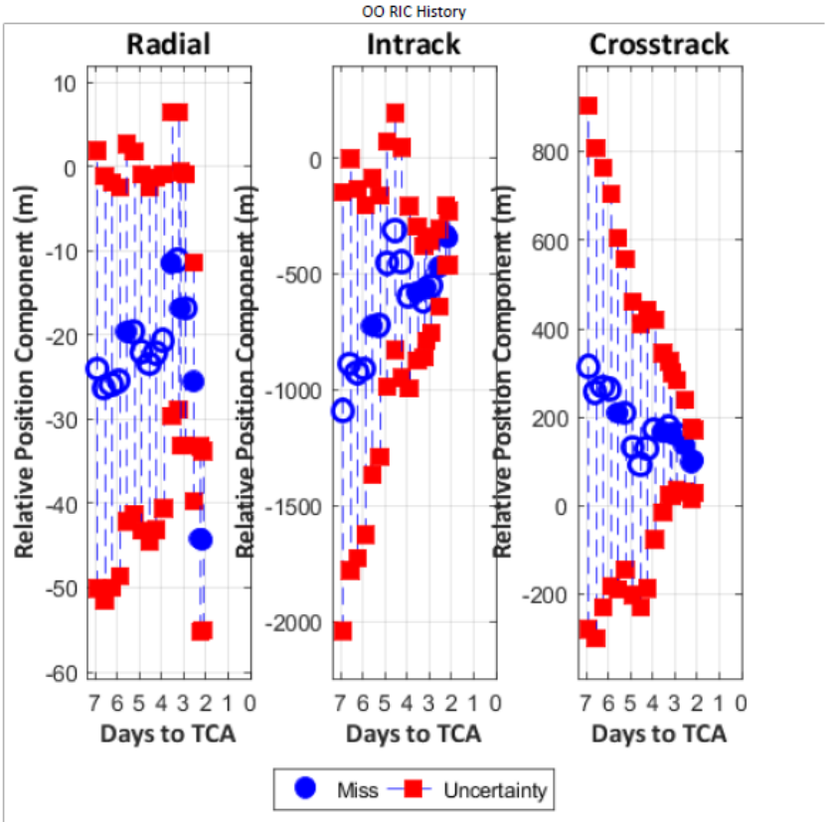
Nominal Event Progression
In plots
Miss Components with Error Bars
  Radial, In-track, Cross-track miss components +/- 1-sigma uncertainty
Miss Sigma Plot
  Identifies how an event’s miss components have changed compared to previous screening data
Probability of Collision (Pc) vs Time
  Pc identified at high levels and/or increases to peak before decreasing to low levels prior to TCA
Notes:
Pc vs Time
Mitigation action needed if Pc does not decrease at Go/No Go prior to TCA
Miss Components with Error Bars
Covariance contracts as TCA approaches given updated tracking, improved atmospheric predictions, and other event factors
Miss Sigma Plot
Small changes can indicate high confidence in solution or stale data

Slide 9
Event Timeline Notes
All high Pc (> 1E-4) events require mitigation, if mission capabilities exist to do so, to include
  Propulsive maneuvers
  Differential drag changes
  Slew to minimum projected area

Slide 10
active secondary

Slide 11
Background on Active Payloads
Active maneuverable payloads can add CA complications
  What is considered maneuverable?
    Any ability for a spacecraft to change its orbit trajectory in a non-Keplerian way.
      This includes chemical propulsion, low or electrical thrust, and differential drag
  Non-maneuverable payloads can be treated the same as debris from a CA perspective
    Additional analysis may need to be performed to consider the larger size of non-maneuverable payload
Maneuverability Complications
  USSPACECOM OD is based off of passive tracking
    Thus, all O/Os are reliant on O/O ephemeris data to communicate maneuver information
  Need to confirm if another payload is actively maneuvering or planning to maneuver if a conjunction event is identified between two payloads
    If two active/maneuverable payloads are conjuncting, who moves?
    How can two O/Os successfully communicate their intentions to maneuver or not?
Notes:
USSPACECOM OD does not incorporate any maneuvers into orbit predictions

Slide 12
Background on Active Payloads
Best Practices: O/O ephemeris solutions
  Currently need to be provided to USSPACECOM for screening via Space-Track.org for other spacecraft O/Os to have cognizance of future predictions
  Need accurate O/O ephemeris with maneuver predictions to have confidence that event predictions reflect actual situation on orbit
    State predictions, covariance realism, and maneuver modeling are all important
Best Practices: Using Space-Track.org and Contacting an O/O
  Space-Track.org provides maneuverability and contact information for a large group of commercial and agency operators
  This information needs to be set by each O/O and should be routinely reviewed for accuracy
  CARA uses the contact information provided to communicate:
    High interest events
    Confirm maneuver capabilities
    Coordinate mitigation actions

Slide 13
CARA Active Payload Process
5-7 days to TCA consider the following criteria:
  Yellow Pc (>1e-7)
  Miss < 500 m (LEO) and <5 km (NONLEO) regardless of Pc
  Miss criteria included due to varying CONOPS other O/Os may have
For any “potentially active payloads” meeting this criteria, begin with space-track.org flagging
  Active/Dead
  Maneuverability: Yes/No/UNKNOWN
If the spacecraft is found to be maneuverable or the maneuverability status is unknown, CARA will reach out to the Secondary O/O to inquire about the maneuverability and coordinate mitigation efforts
  Unknown?: Can also analyze possible maneuverability by plotting TLEs

Slide 14
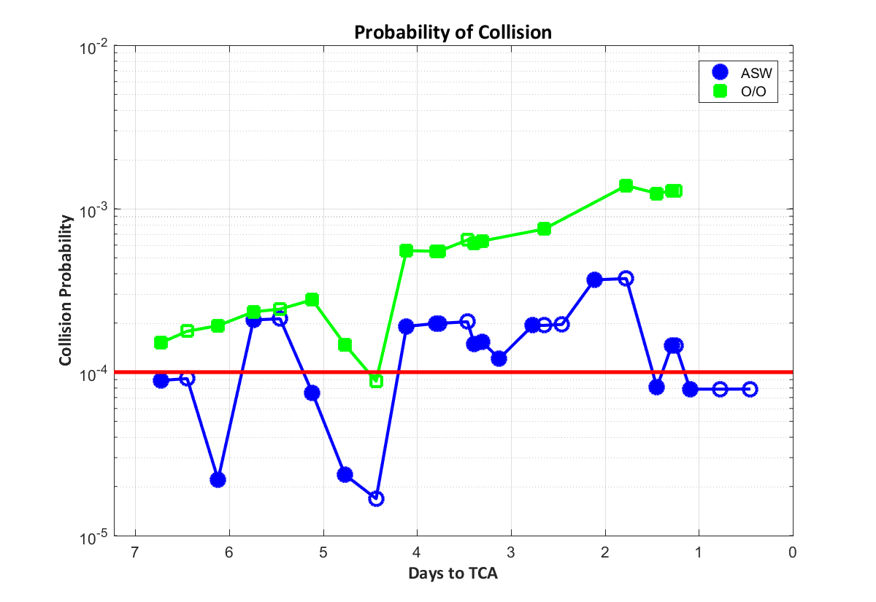
Active Payload Event Example
CARA Mission versus a maneuverable secondary object
Event Background
  At <7 days to TCA Event first identified
    High risk using mission O/O solution (~2e-4)
  At ~ 5 days to TCA CARA mission and the Secondary O/O were contacted
    Secondary O/O confirmed that the spacecraft had no maneuvers planned prior to TCA and would monitor event
  At ~1 day to TCA CARA mission performed RMM
    Pc remained high throughout event evolution
    All efforts were coordinated with the Secondary O/O through the event to ensure only one mission maneuvered

Slide 15
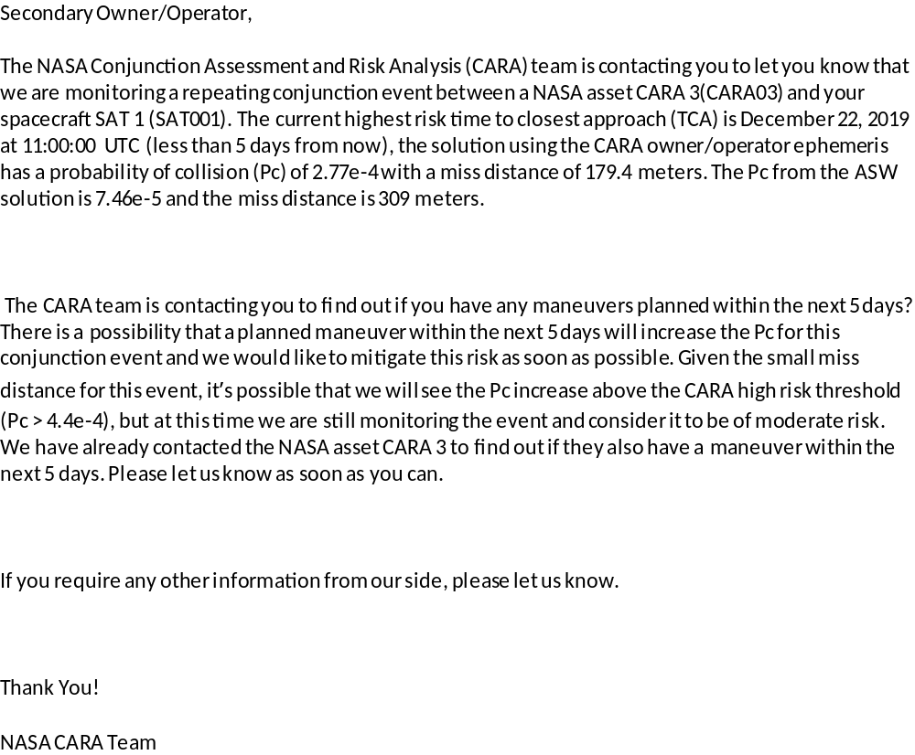
Email Template
Email Example sent from the CARA team to a potentially active Secondary O/O
  Conveys operational/maneuverable status of CARA asset
  Describes intentions of CARA asset to perform a mitigation maneuver should Pc remain high close to TCA
  Asks Secondary O/O to communicate any maneuver plans and if possible, not maneuver prior to TCA to minimize potential of spacecraft maneuvering into each other

Slide 16
Active Payload Summary
The collaborative effort between the CARA team, CARA mission, and Secondary O/O was important for a safe outcome
  Cooperation from the Secondary O/O was essential
    Sharing maneuver plans
    Agreeing not to maneuver
Areas of improvement for all O/Os
  Maneuverable Status flagged appropriately on Space-Track.org
  Current contact information updated in Space-Track.org
  Ephemerides delivered at a regular cadence to the 18th for screening
    Nominally planned maneuvers modeled in the ephems
    Ideally with covariance
  Some contact information on Space-Track.org listed as private reducing ability to coordinate between O/Os

Slide 17
Helpful Links
NASA CARA CA Best Practices Handbook
  https://nodis3.gsfc.nasa.gov/OCE_docs/OCE_50.pdf
Space-track.org
  https://www.space-track.org/auth/login
NEW! NASA’s official CARA site
  https://www.nasa.gov/conjunction-risk-analysis-and-mitigation

Slide 18
Summary and Conclusions
Many if not most events will present themselves early in the screening cycle allowing maximum time to evaluate and respond
Developing procedures for addressing various event scenarios improves response outcomes

Slide 19
Back up slides

Slide 20
CARA OSAs
CARA OSAs at the 18th SPCS (VAFB) are dedicated analysts for the NASA CARA Team
  Perform three LEO (~00:00, 08:00, 16:00 UTC) and two NONLEO (~00:00 and 16:00 UTC) screenings daily
  Manually evaluate ODs that are flagged
  Evaluate tasking levels
  Evaluate RSOs’ maneuver capabilities
  Perform off-nominal screenings as requested
  Run Automatic Observation Notification (AON) process for a specific list of HIEs
    Process runs every 15 minutes and notifies the OSA that an observation was received for a secondary object
    Both the primary’s and secondary’s OD are manually evaluated and a one vs one screening is performed
    Results are provided to the CARA Analysts and the mission
Notes:
Flags include unreasonable expected force parameter values, long LUPI spans,

