Slide 1

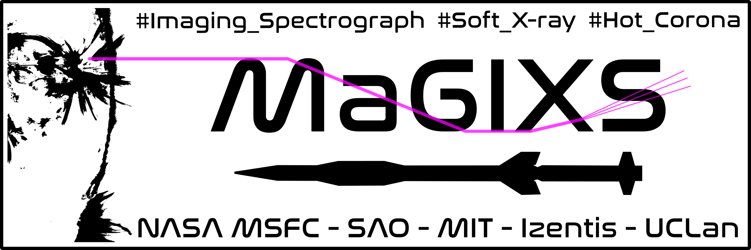
Preliminary Results from the
Marshall Grazing Incidence X-ray Spectrometer (MaGIXS)
Amy Winebarger (NASA MSFC) - PI
Sabrina Savage (NASA MSFC) - PS
Ken Kobayashi (NASA MSFC) – IS
Panchapakesan S. Athiray (NPP/USRA)
Dyana Beabout (NASA MSFC)
Stephen Bradshaw (Rice Univ)
Patrick Champey (NASA MSFC)
Peter Cheimets (SAO)
Jonathan Cirtain (BWXT)
Ed DeLuca (SAO)
Giulio Del Zanna (Univ of Cambridge)
Jaroslav Dudik (Astronomical Institute of the CAS)
Leon Golub (SAO)
Helen Mason (Univ of Cambridge)
David McKenzie (NASA MSFC)
Brian Ramsey (NASA MSFC)
Katharine Reeves (SAO)
Paola Testa (SAO)
Genevieve Vigil (NASA/MSFC)
Robert W. Walsh (UCLAN)
Harry Warren (NRL)
Amy.Winebarger@nasa.gov
Program Scientist for NASA H-FORT (CubeSat), Deputy Program Scientist for NASA Sounding Rockets

Slide 2
MaGIXS Science Goal
Goal: Determine heating frequency of active region core loops.
Method:
Obtain soft x-ray spectra (6-25 Angstrom)
Make four unique measurements to determine the frequency of heating
Measurement | High Frequency | Low Frequency
Ratio of Fe XVIII to Fe XVII | Small | Large
Abundance | Enhanced low-FIP lines (i.e., coronal) | Non-enhanced low-FIP lines (i.e., photospheric)
Distribution of plasma | Maxwellian | Non-Maxwellian (e.g., kappa)
Time evolution of Fe XVII | Steady Fe XVII emission | Variable Fe XVII emission

Slide 3
Instrument Design
Slot
Telescope: Wolter Type-I
Effective Focal Length ~ 1 m
Resulting instrument parameters:
Wavelength Range: 6.0 - 24.0 Å (0.5 - 2.0 keV)
Plate Scale: 11 mÅ / pixel
2.8 arcsec / pixel (cross-dispersion)
~7 arcsec / pixel (dispersion)
Resolution: ~40”/150 mÅ
Spectrograph: Two matched parabolic mirrors
Blazed Planar Varied Line Space
Detector: Low Noise CCD Camera
Operated in Frame Transfer Mod
Champey et al., in publication (MaGIXS Instrument Paper); Kobayashi et al. 2018; Champey et al. 2019; Athiray et al. (2020, 2021)

Slide 4
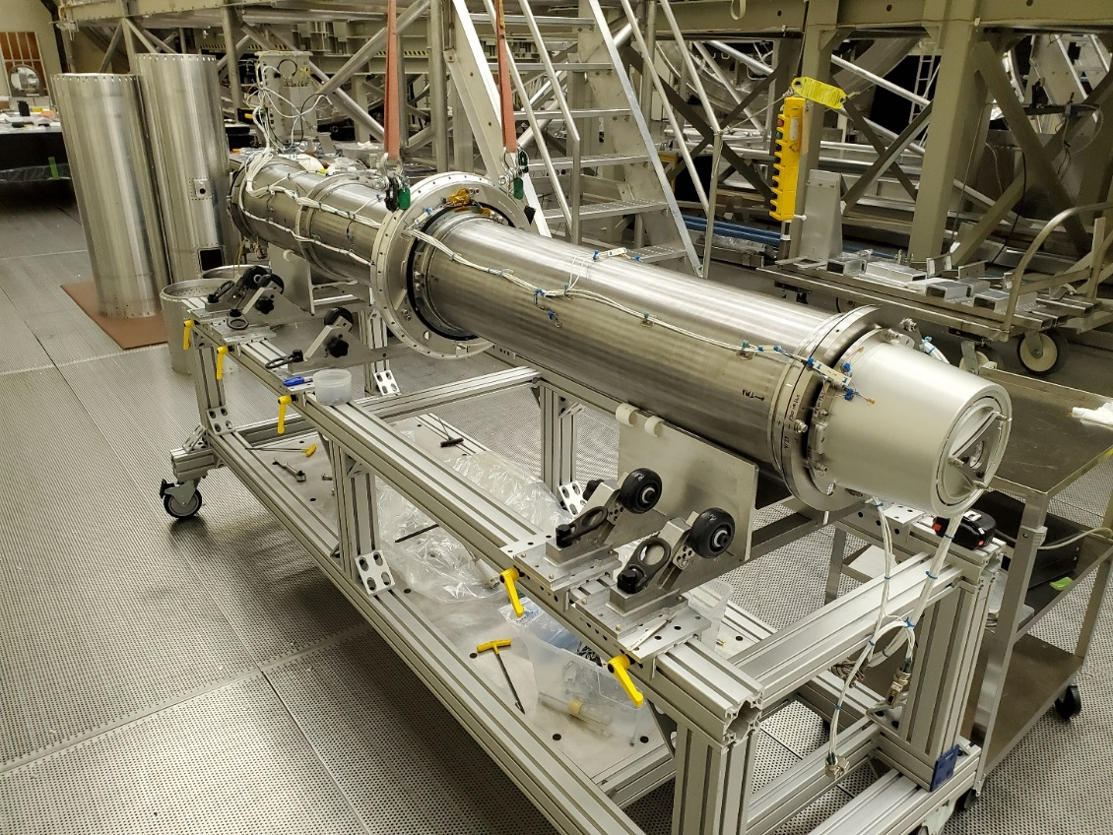
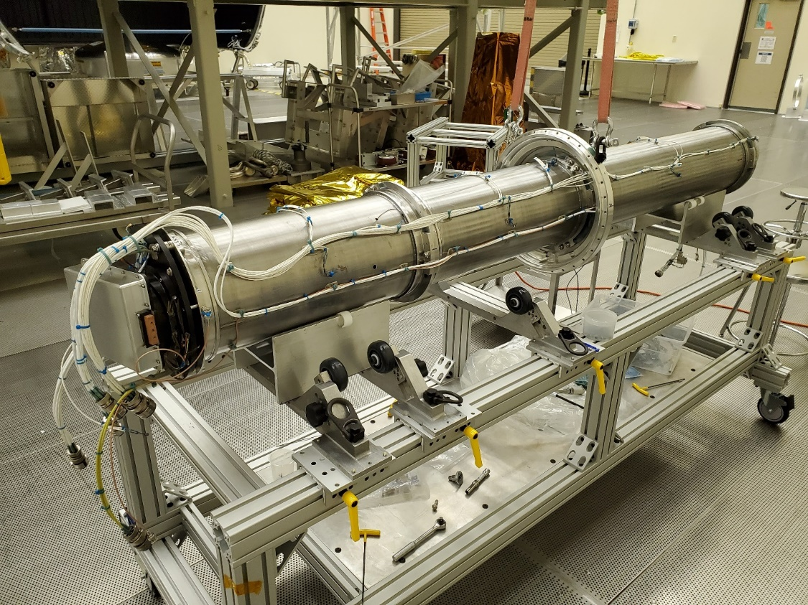
Instrument Design
Optical bench: the structure internal to the rocket skins supports the optical system…
Telescope Mirror Assembly (TMA)
Science Camera
SOA interface (embedded inside bench)
Slit interface Plate: Telescope focal plane, Slit-Jaw system, and interface to rocket skin
~1.5 m between TMA and SOA
Champey et al., in publication (MaGIXS Instrument Paper); Kobayashi et al. 2018; Champey et al. 2019; Athiray et al. (2020, 2021)

Slide 5
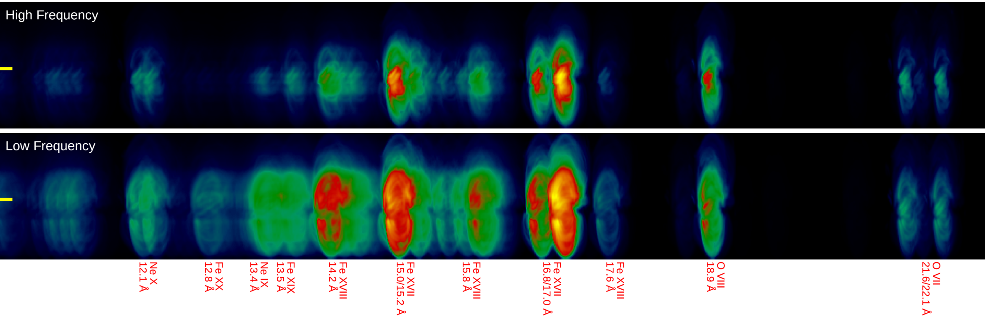
MaGIXS data are “Overlappograms”
Spectrally pure images of the Sun overlap and are squashed in spectral direction

Slide 6
MaGIXS data are “Overlappograms”
Some spectral lines look similar, others look different based on the two heating models.

Slide 7
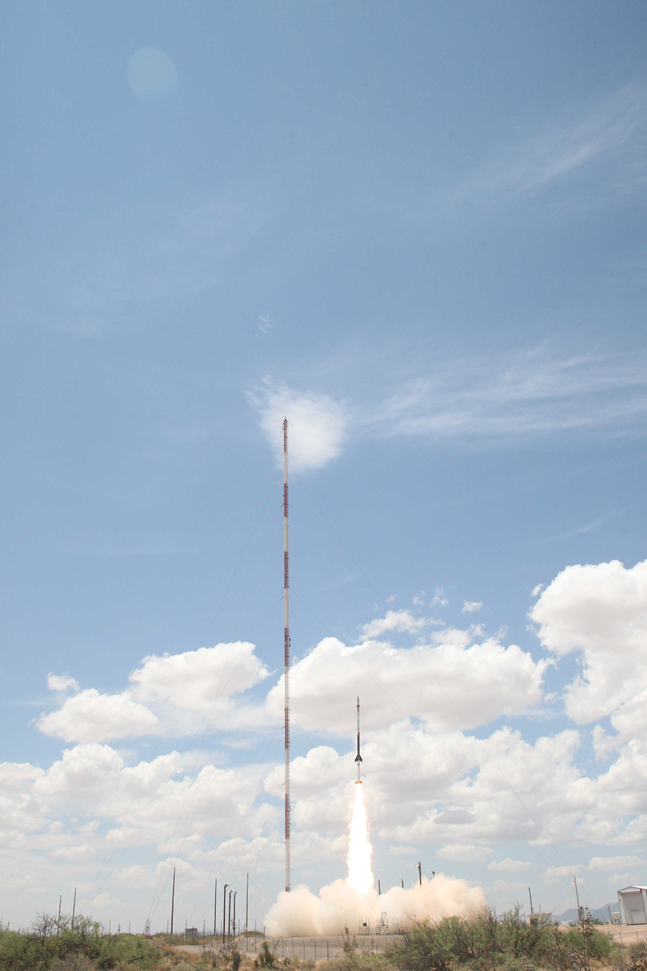
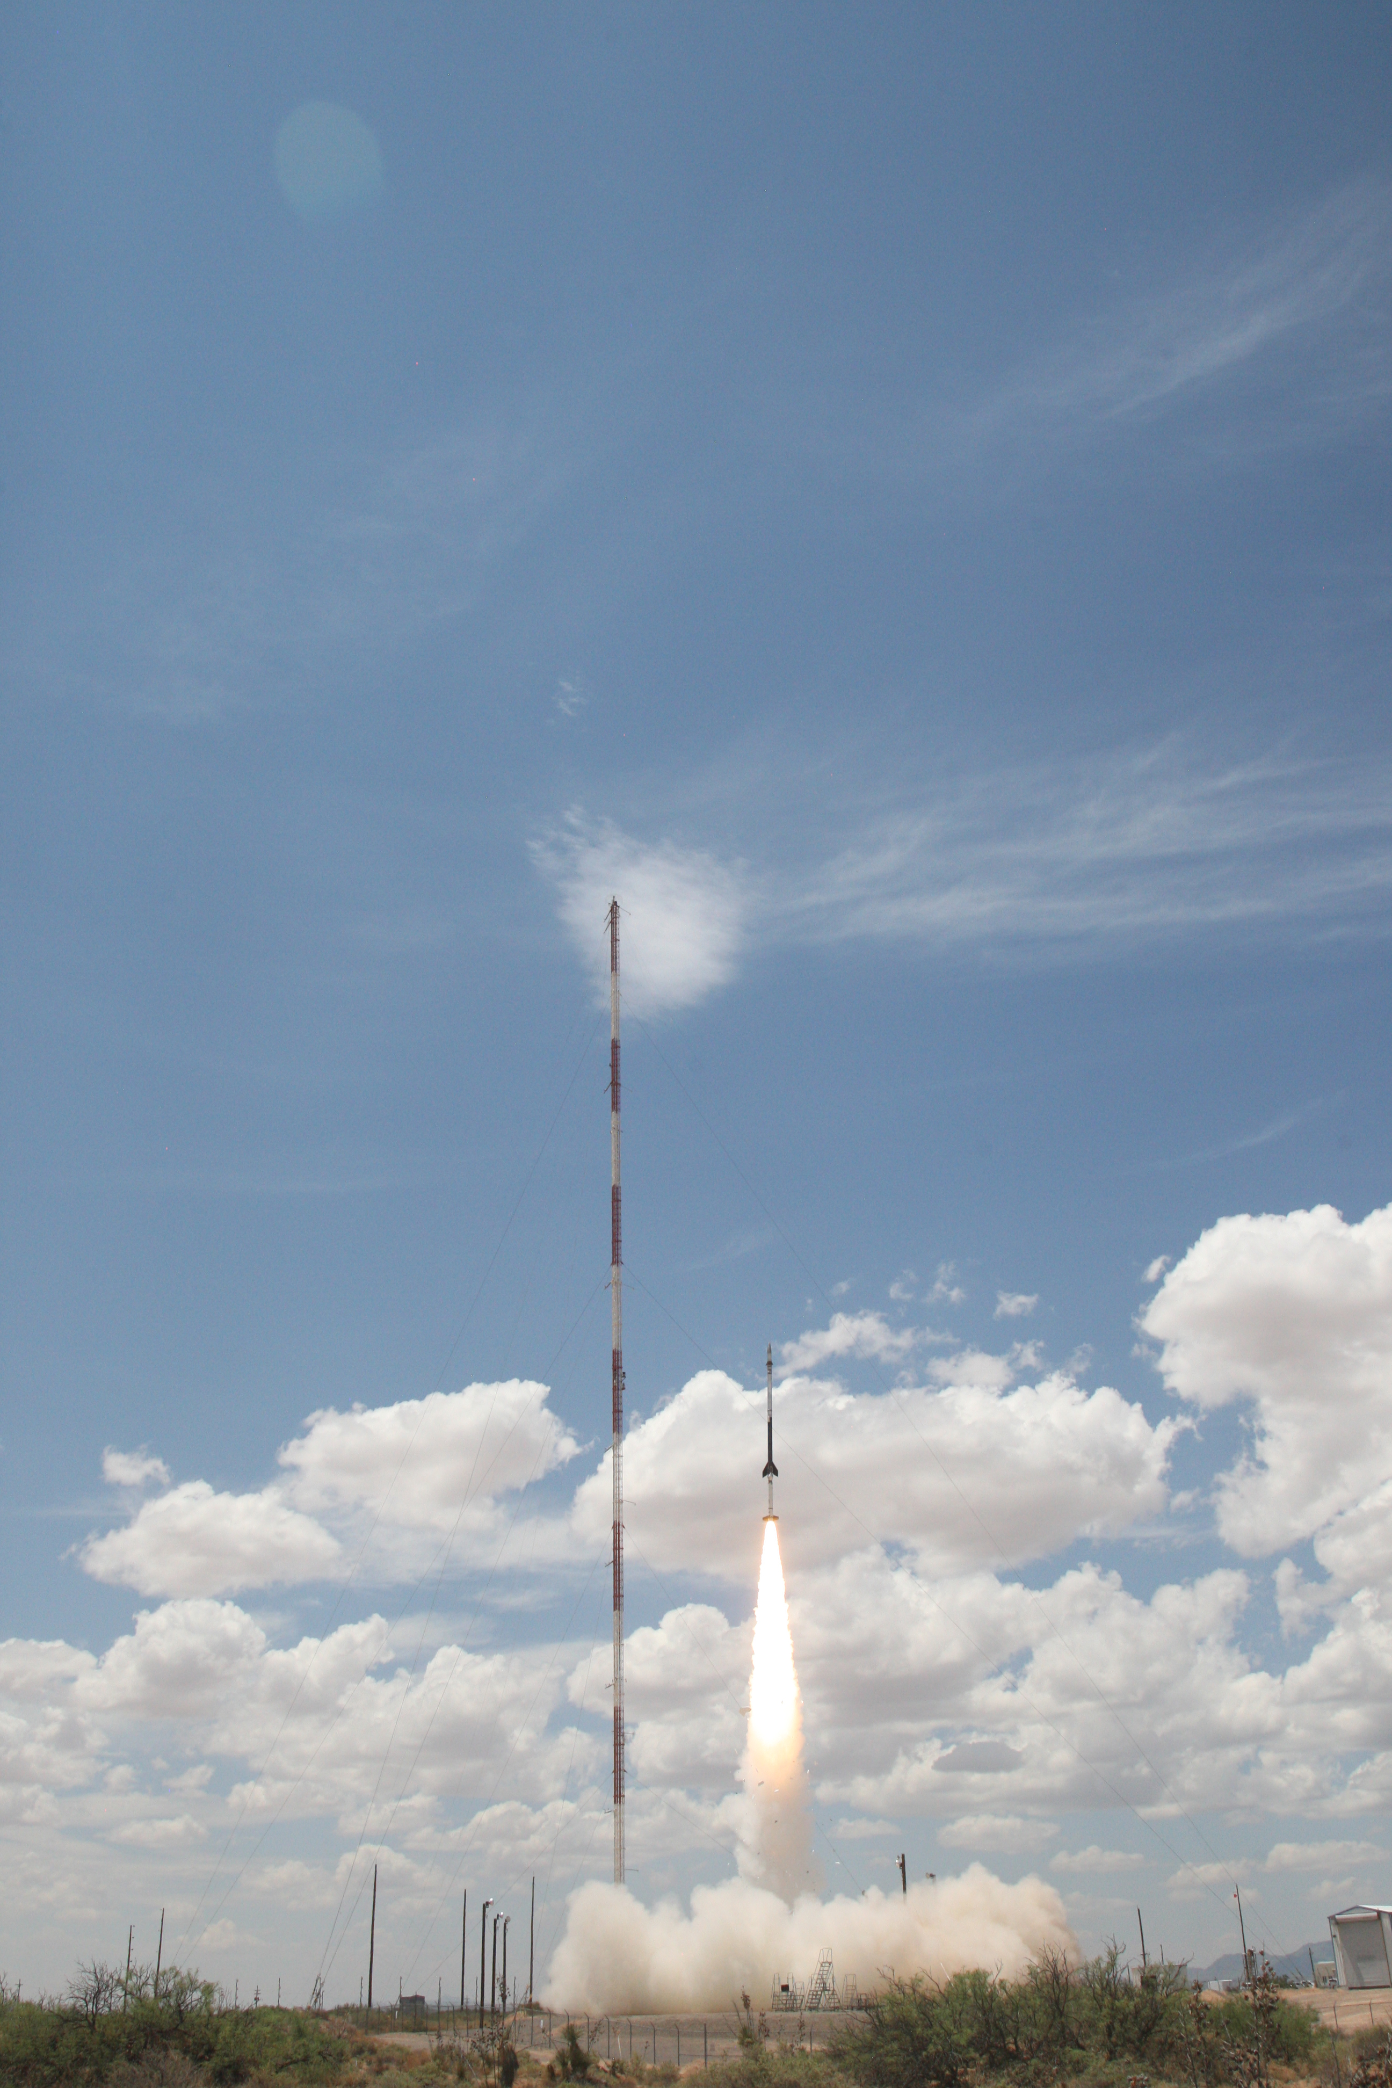
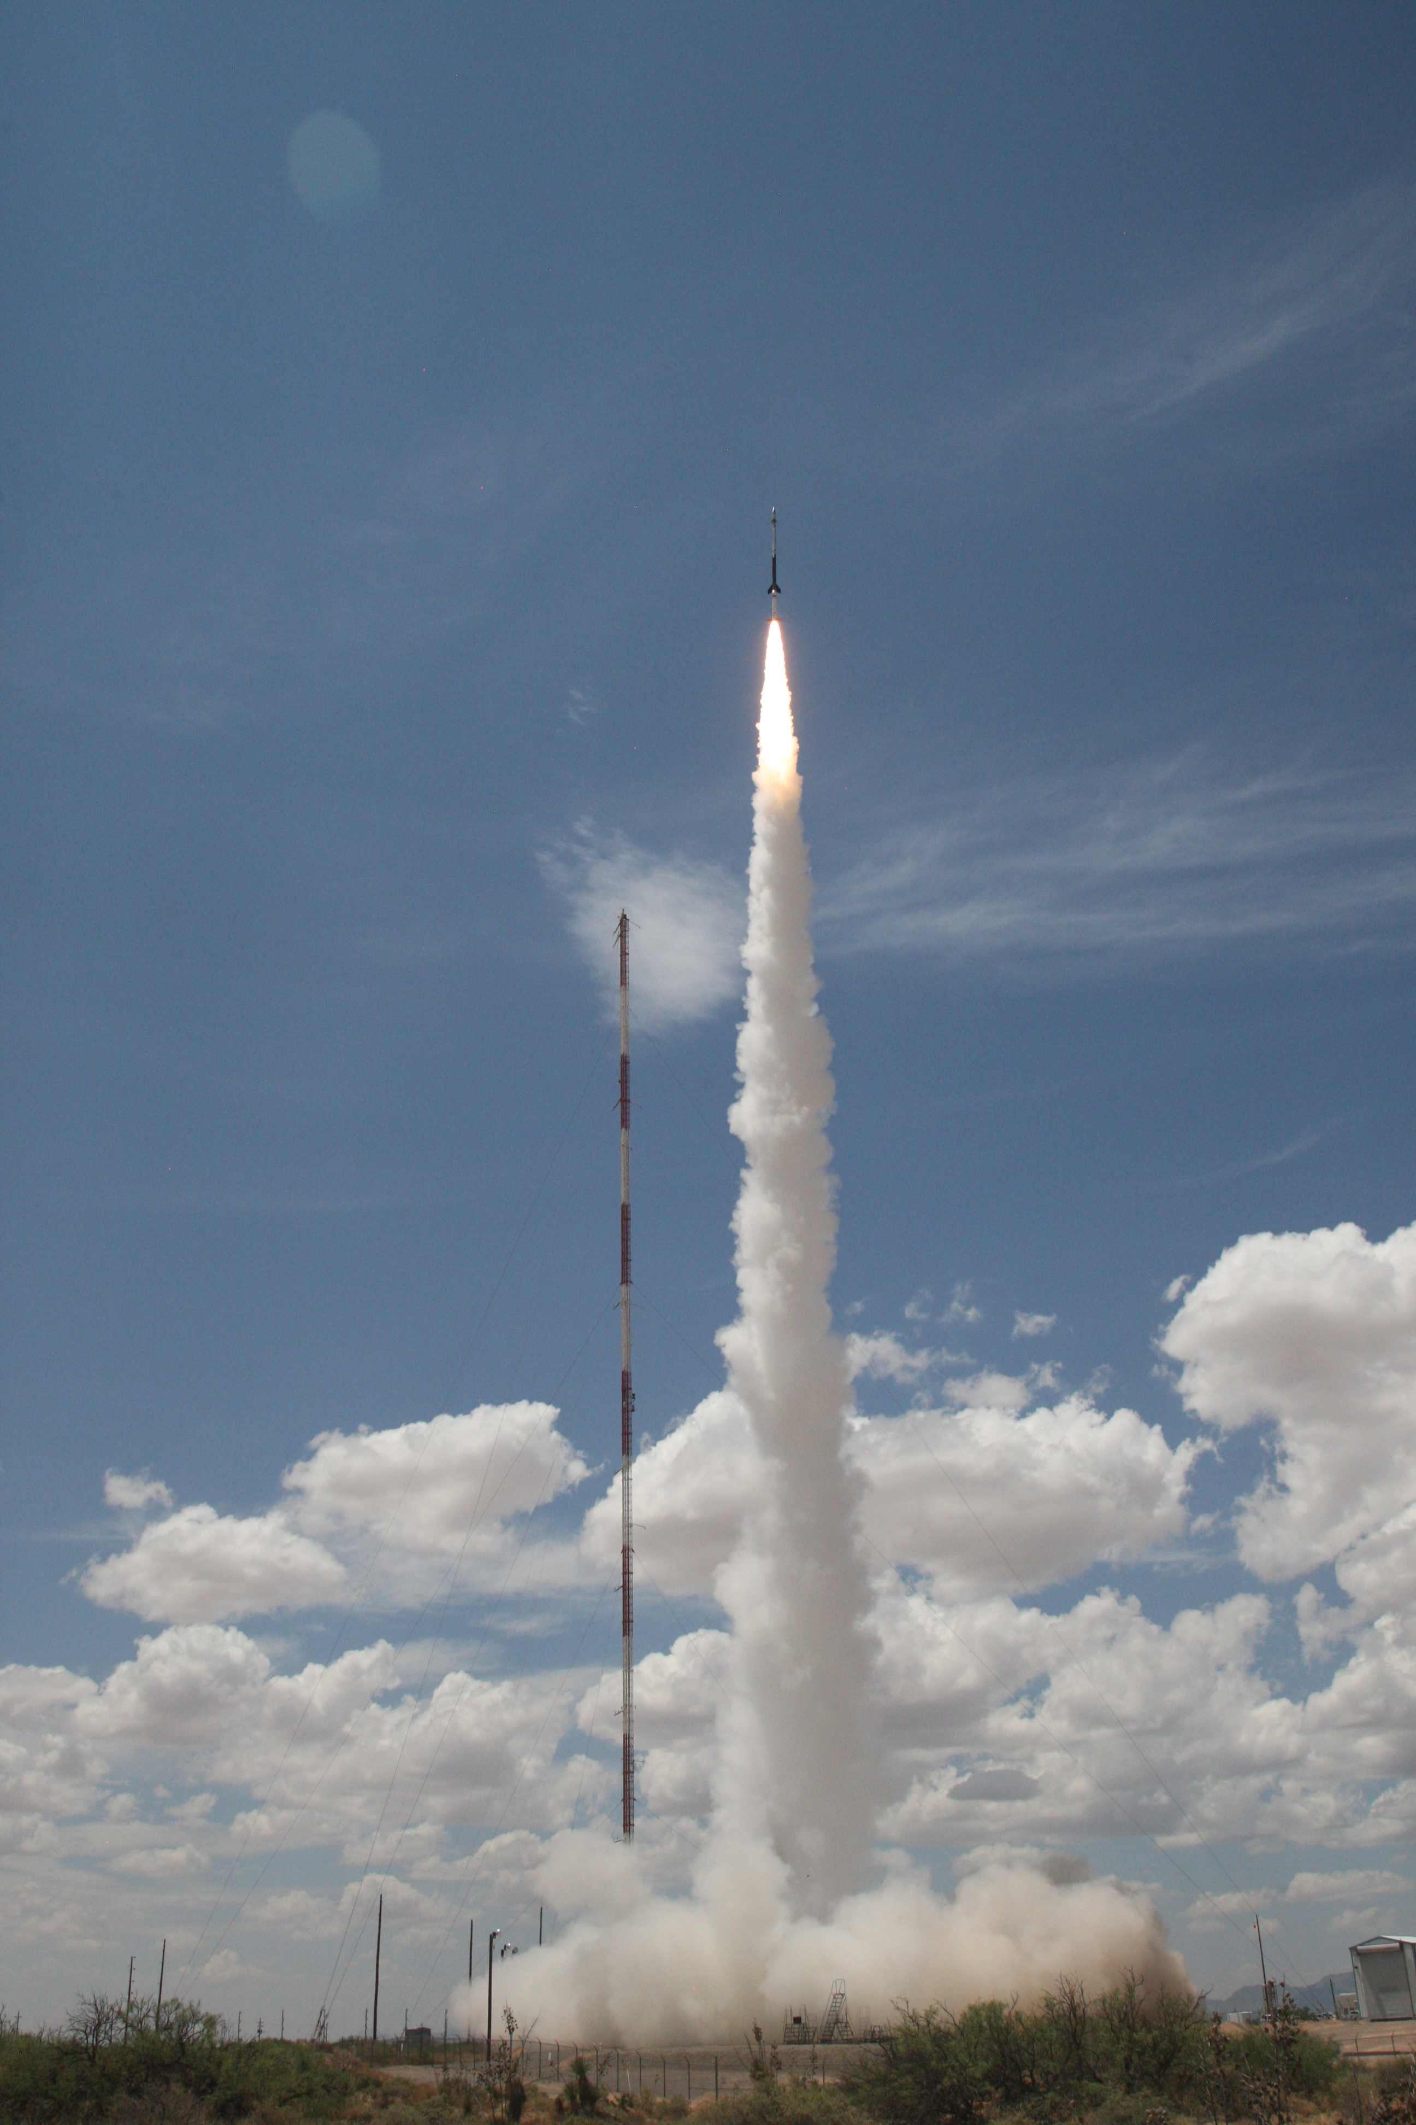
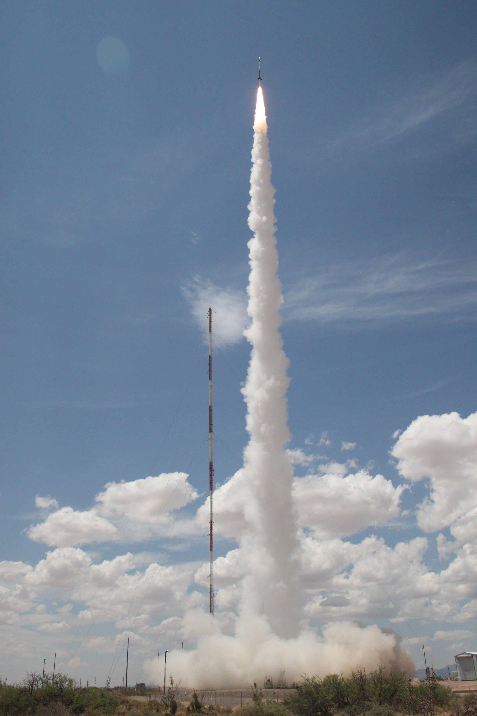
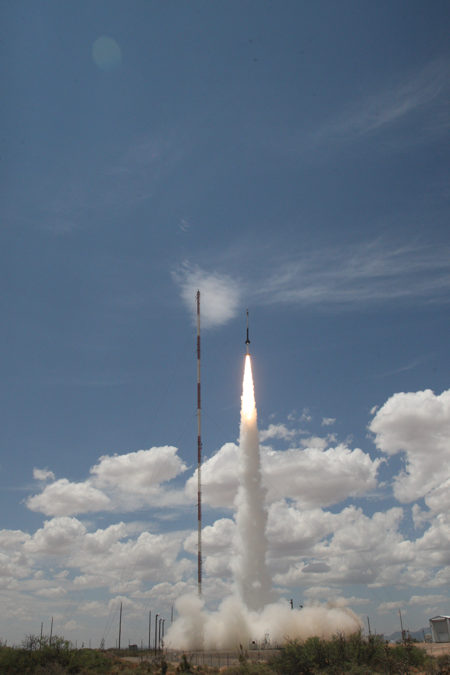
MaGIXS Launch – July 30, 2021
~18:20 UT
~296 s science data

Slide 8
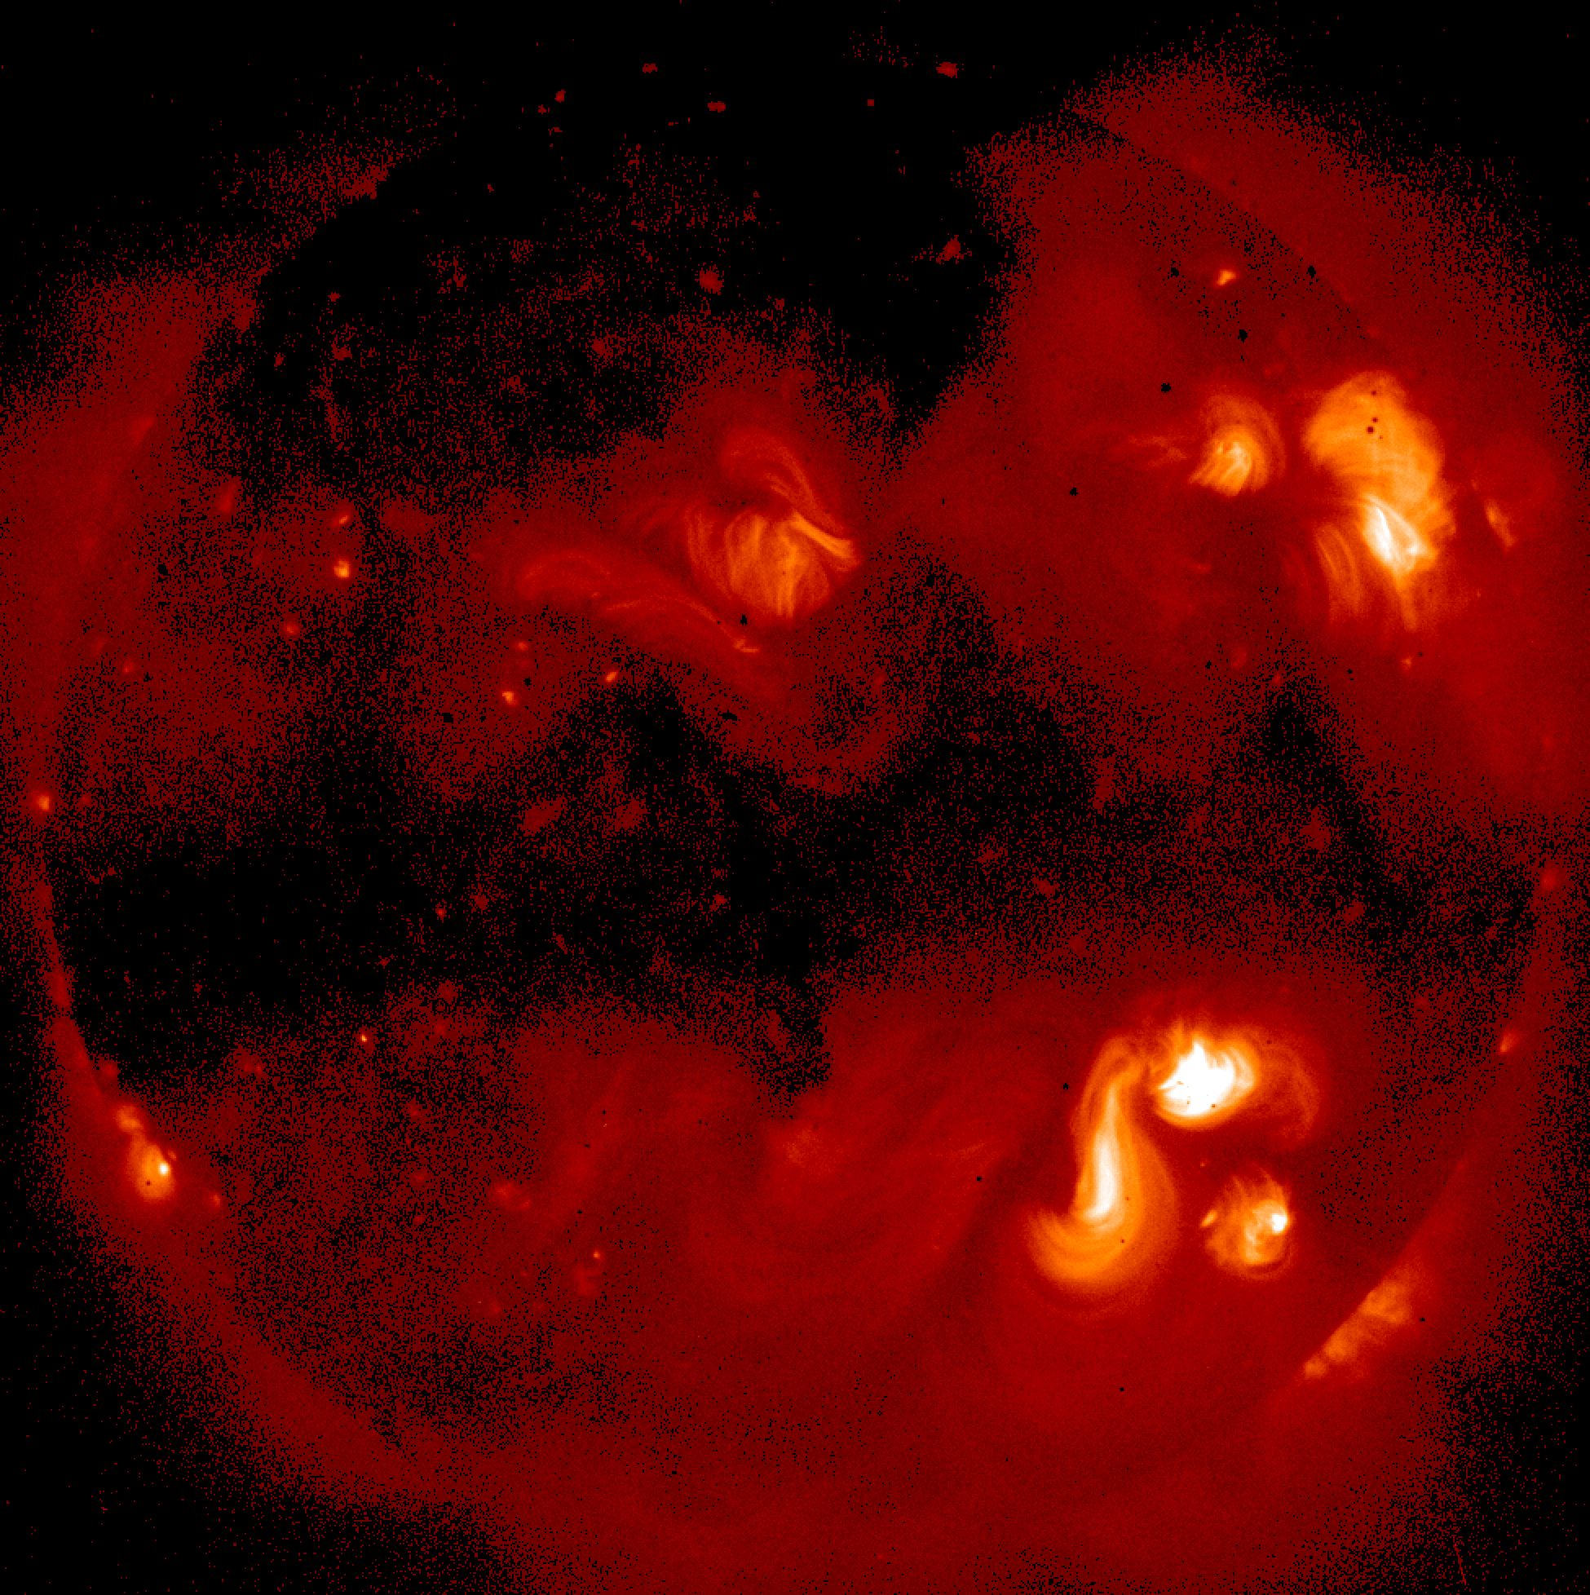
MaGIXS Targets
Planned Roll ~ 22 degrees
Secondary Target
Primary Target
--

Slide 9
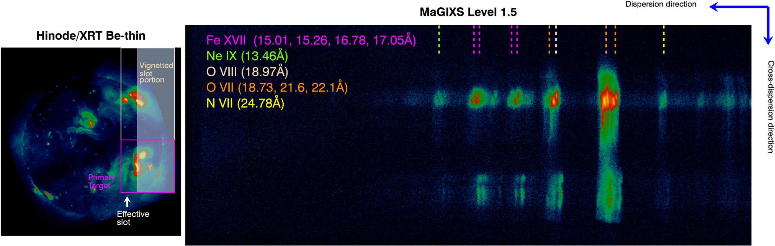
MaGIXS Pointing
Planned Observation
Actual Observation
Actual observations show:
Internal vignetting in the system
Slot was offset
Primary targets were missed

Slide 10
MaGIXS Observations
MaGIXS Soft X-ray Spectra!!
Energy
Overlapping Spectral Dispersion
𝜆
Spatial Direction

Slide 11
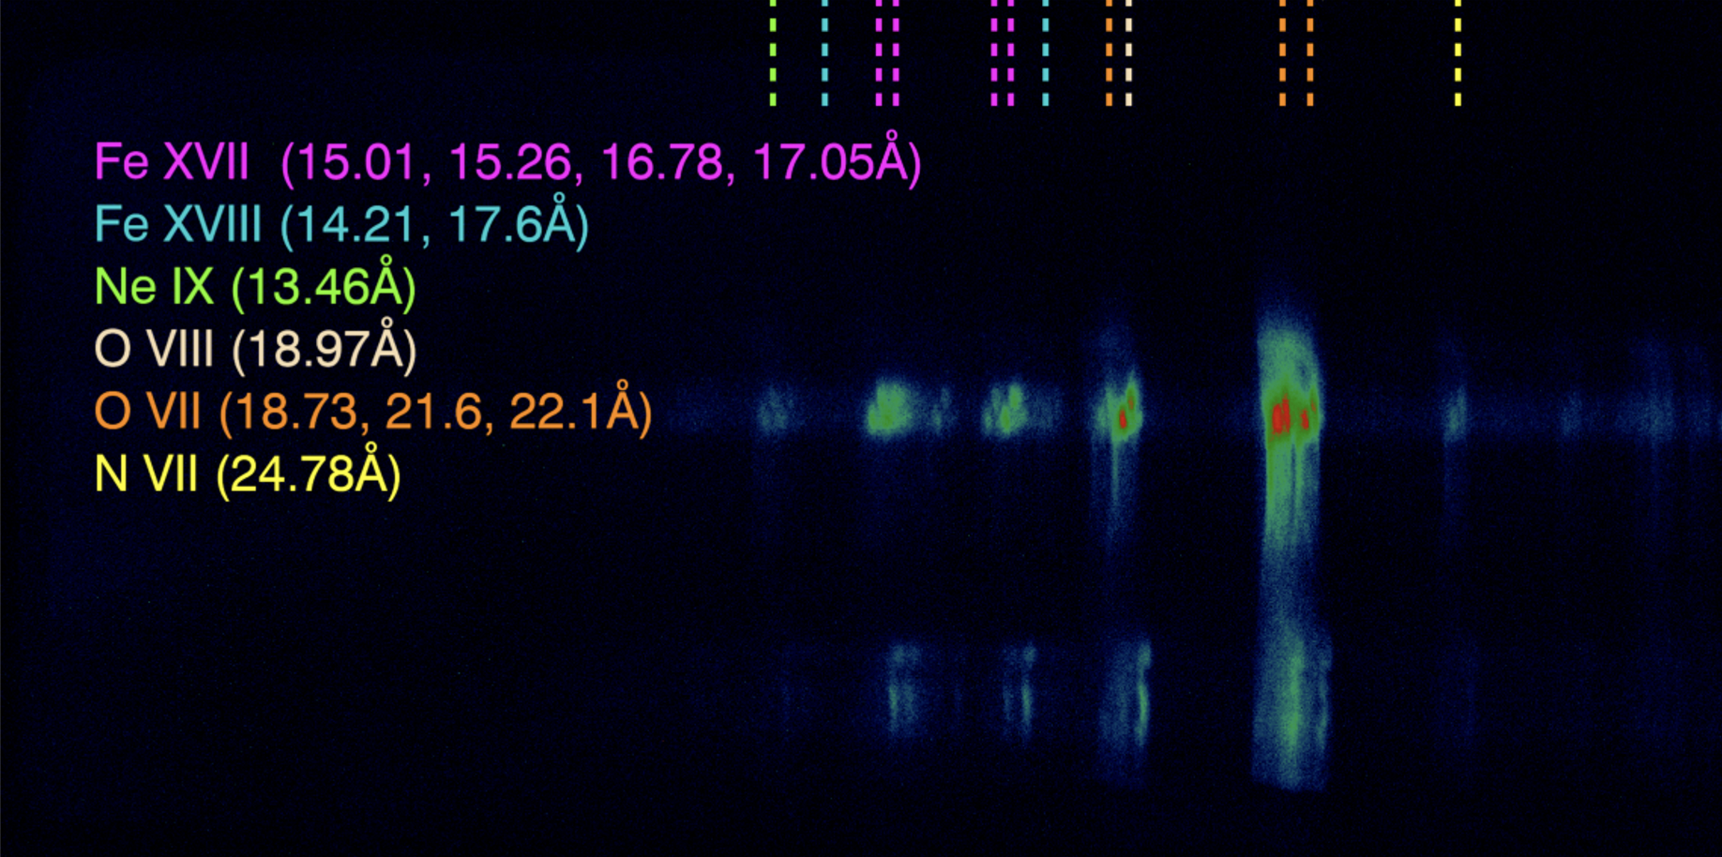
MaGIXS Direct Analysis

Slide 12
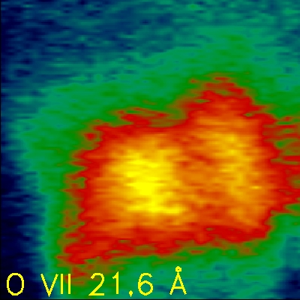
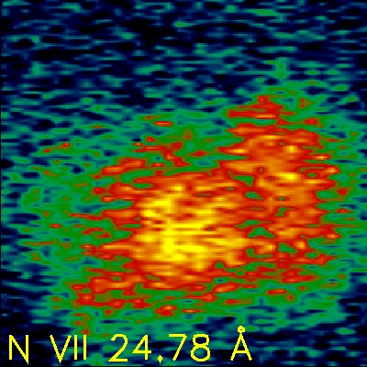
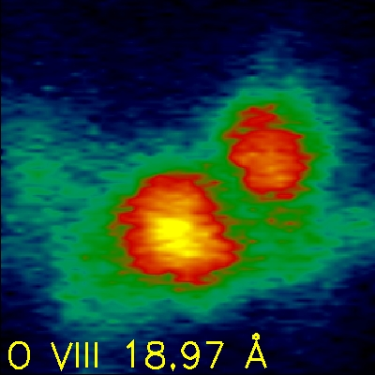
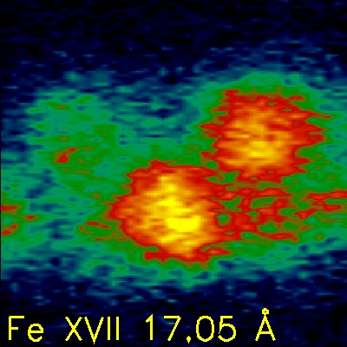
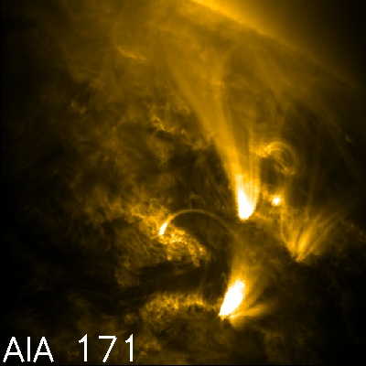
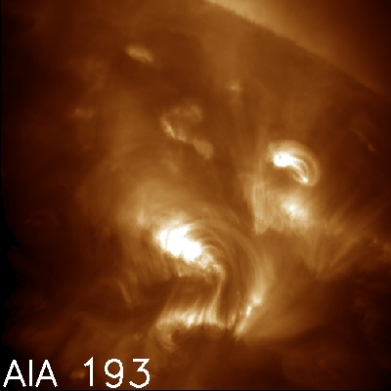
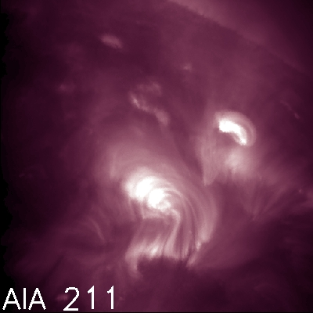
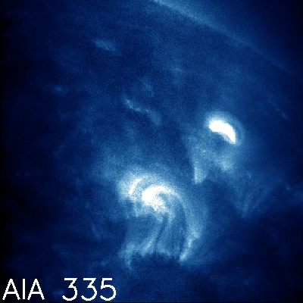
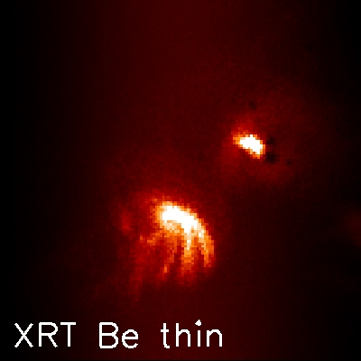
MaGIXS Direct Analysis
Log T ~6.3
Log T ~6.3
MaGIXS intensities taken straight from Science Data
Log T ~6.5
Log T ~6.7
Log T ~5.95
Log T ~6.2
Log T ~6.25
Log T ~6.4
Log T >6.4
Spot 2
Spot 1

Slide 13

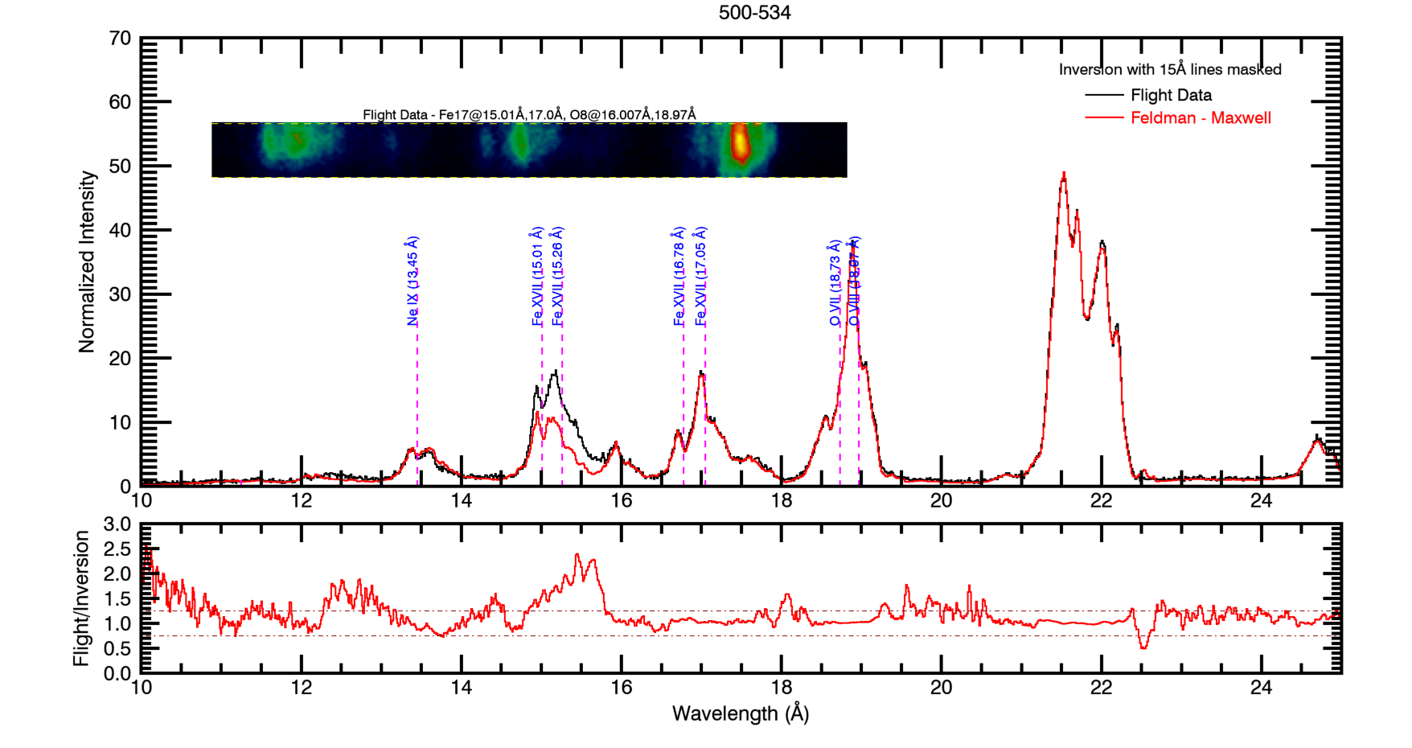

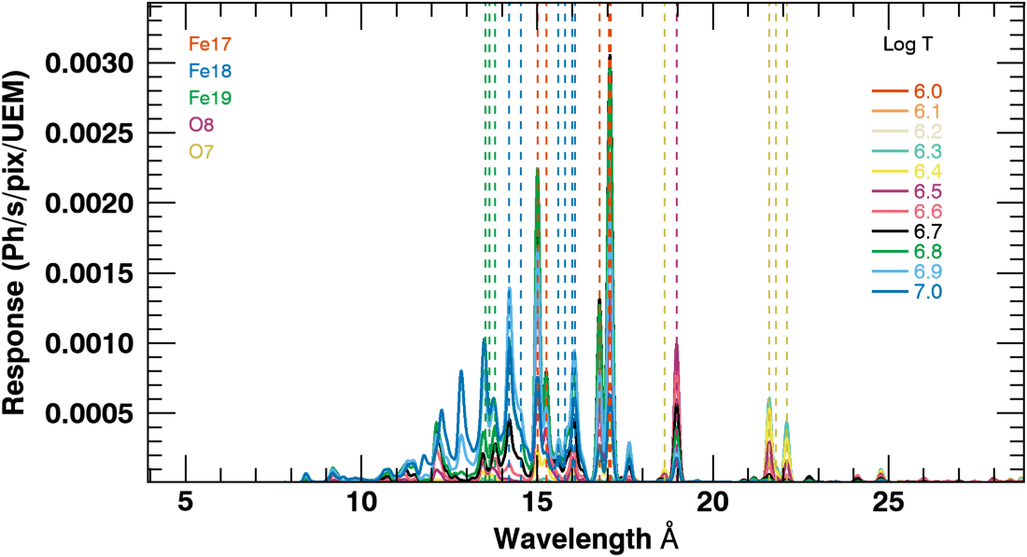
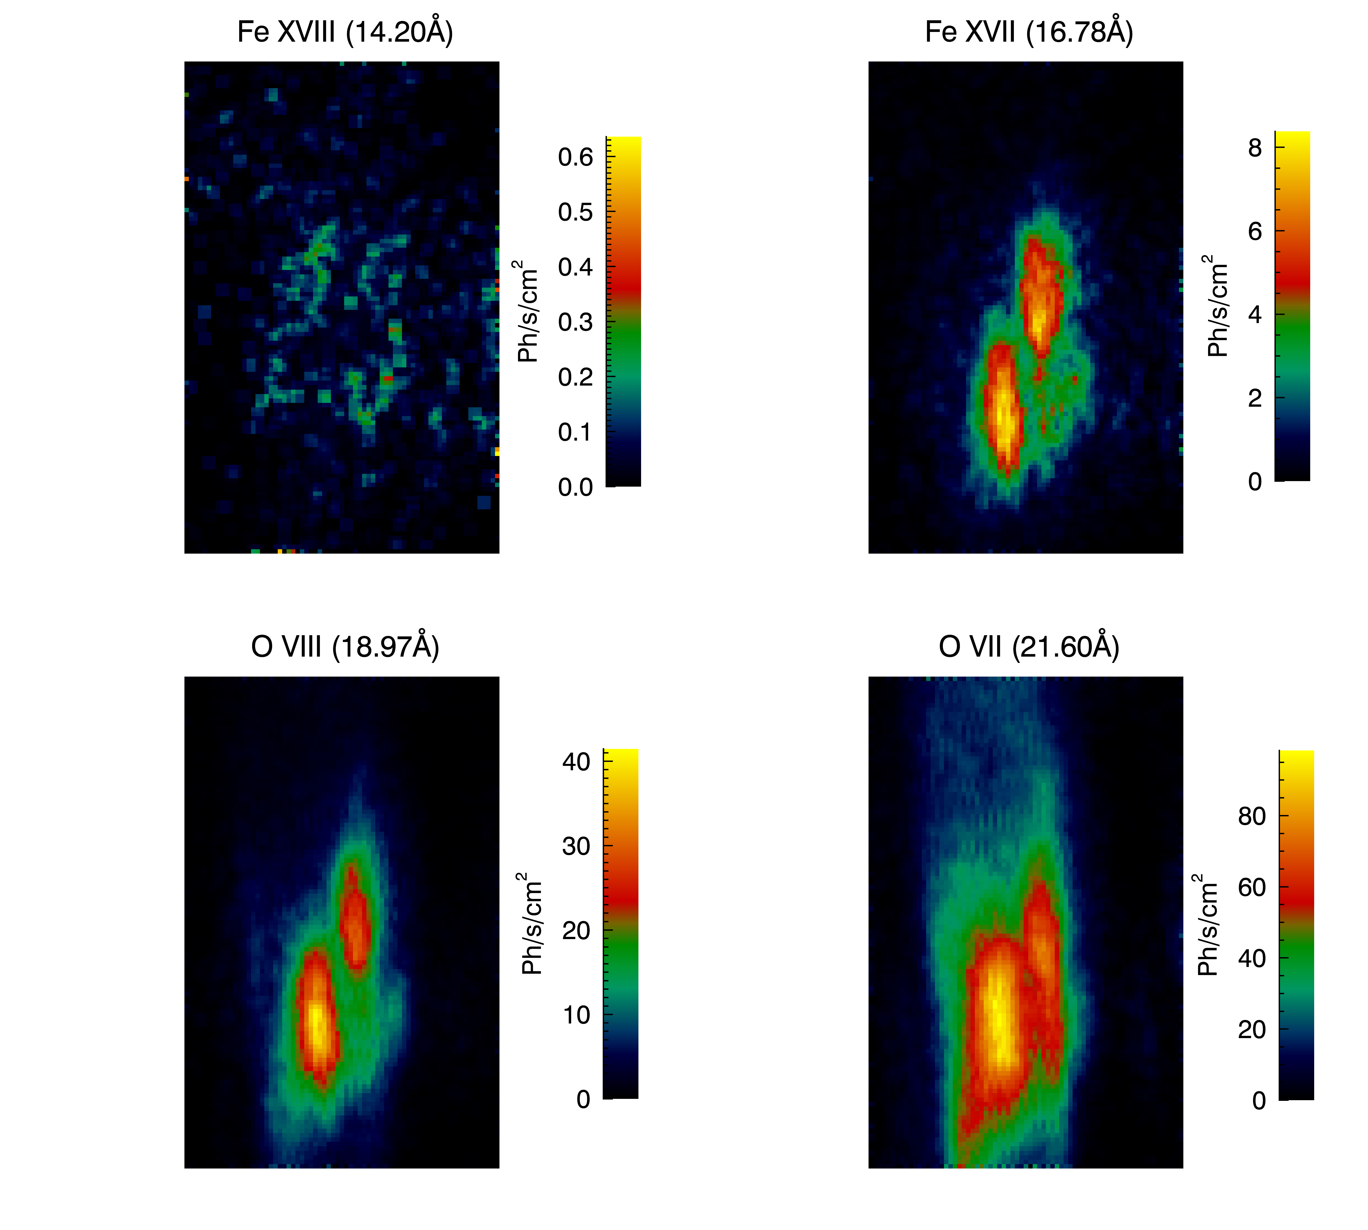
MaGIXS Inversion
Outputs
Inputs
Inversion Algorithm
(e.g., LASSOLARS, ELASTIC NET available from scikit in python)
Fitted spectra
MaGIXS Data
Atomic Data + Instrument Response
Savage et al,. in prep (MaGIXS Mission Paper)
Spectrally Pure Maps

Slide 14
MaGIXS Analysis
Use these products to make these measurements
Fitted spectra
Measurement | High Frequency | Low Frequency
Ratio of Fe XVIII to Fe XVII | Small | Large
Abundance | Enhanced low-FIP lines (i.e., coronal) | Non-enhanced low-FIP lines (i.e., photospheric)
Distribution of plasma | Maxwellian | Non-Maxwellian (e.g., kappa)
Time evolution of Fe XVII | Steady Fe XVII emission | Variable Fe XVII emission
Determine heating frequency in Spot 1
Spectrally Pure Maps
Savage et al,. in prep (MaGIXS Mission Paper)

Slide 15
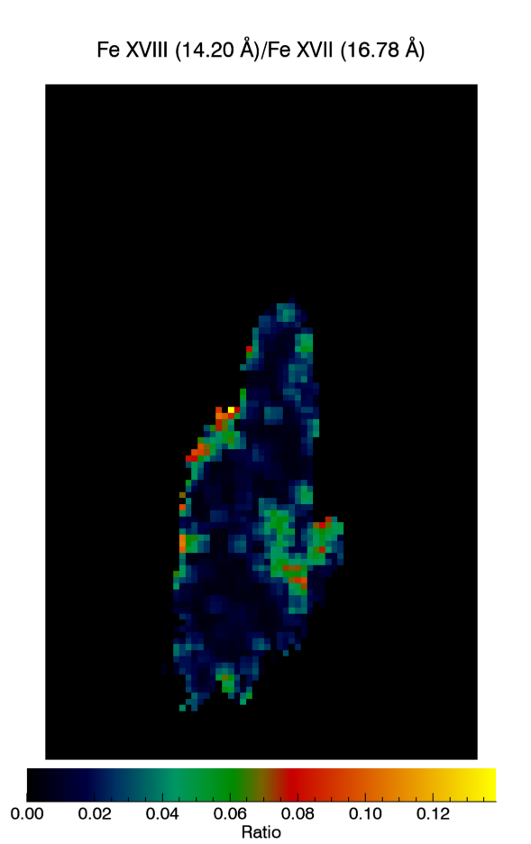
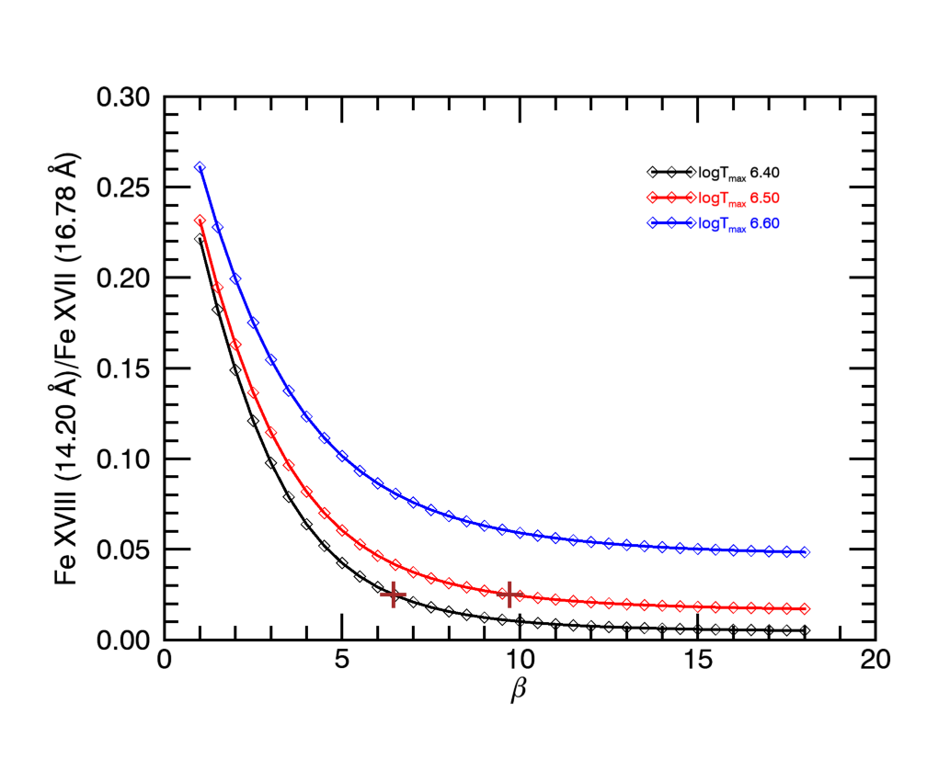
Ratio of Fe XVIII to Fe XVII
Savage et al,. in prep (MaGIXS Mission Paper)

Slide 16
Ratio of Fe XVIII to Fe XVII
Measurement | High Frequency | Low Frequency
Ratio of Fe XVIII to Fe XVII | Small | Large
Abundance | Enhanced low-FIP lines (i.e., coronal) | Non-enhanced low-FIP lines (i.e., photospheric)
Distribution of plasma | Maxwellian | Non-Maxwellian (e.g., kappa)
Time evolution of Fe XVII | Steady Fe XVII emission | Variable Fe XVII emission
Low Frequency
High Frequency
Savage et al,. in prep (MaGIXS Mission Paper)

Slide 17
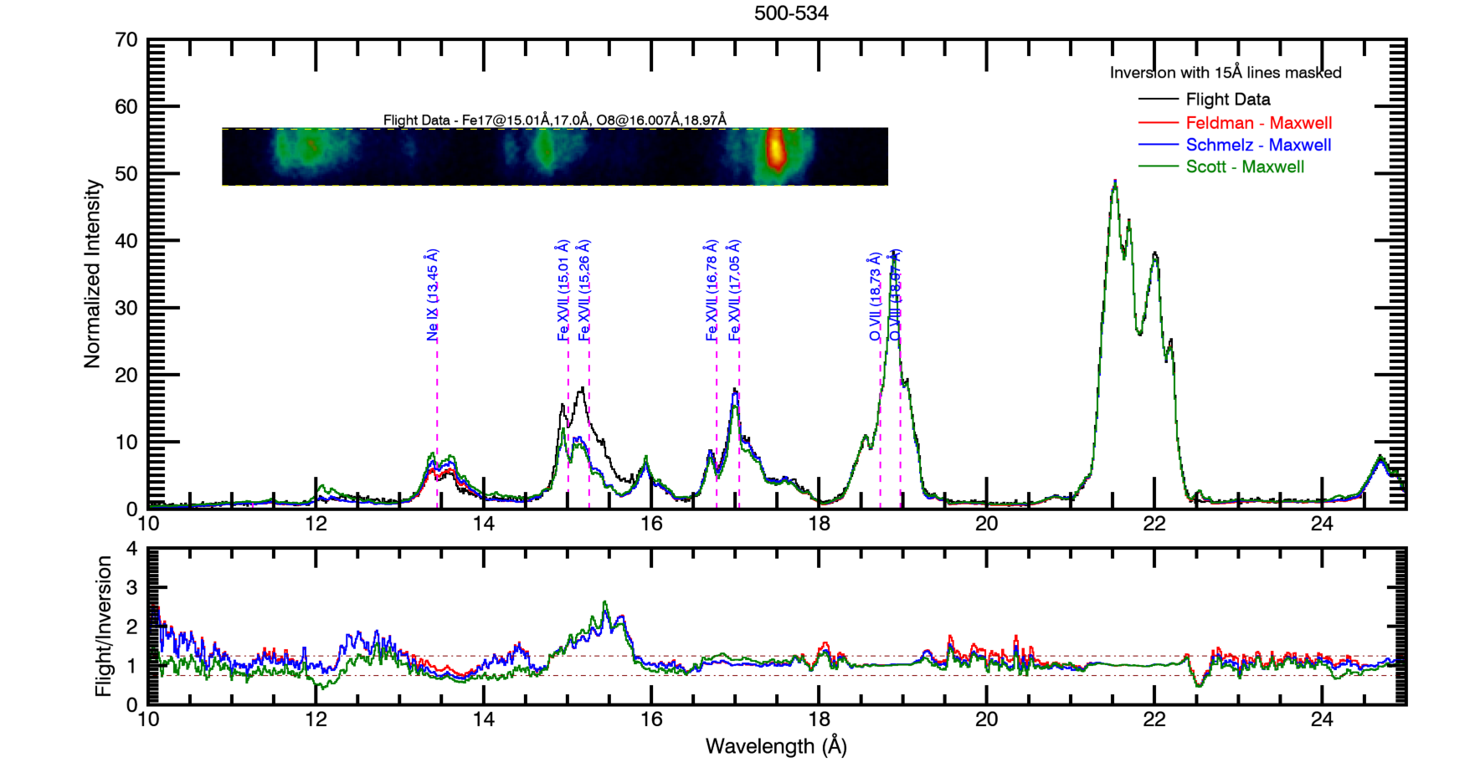
Abundance
Savage et al,. in prep (MaGIXS Mission Paper)

Slide 18
Abundance
For this region, the differences between the abundances are not significantly different.
Measurement | High Frequency | Low Frequency
Ratio of Fe XVIII to Fe XVII | Small | Large
Abundance | Enhanced low-FIP lines (i.e., coronal) | Non-enhanced low-FIP lines (i.e., photospheric)
Distribution of plasma | Maxwellian | Non-Maxwellian (e.g., kappa)
Time evolution of Fe XVII | Steady Fe XVII emission | Variable Fe XVII emission
Savage et al,. in prep (MaGIXS Mission Paper)

Slide 19
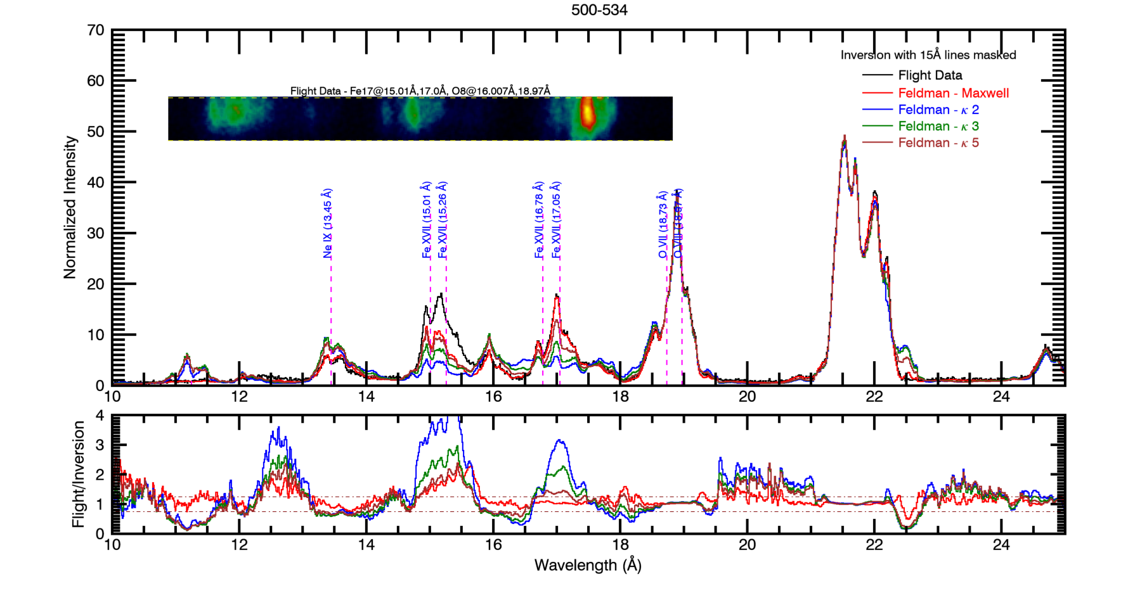
Distribution of Plasma
Savage et al,. in prep (MaGIXS Mission Paper)

Slide 20
Distribution of Plasma
For this region, the Maxwellian distribution best matches the data.
Measurement | High Frequency | Low Frequency
Ratio of Fe XVIII to Fe XVII | Small | Large
Abundance | Enhanced low-FIP lines (i.e., coronal) | Non-enhanced low-FIP lines (i.e., photospheric)
Distribution of plasma | Maxwellian | Non-Maxwellian (e.g., kappa)
Time evolution of Fe XVII | Steady Fe XVII emission | Variable Fe XVII emission
Savage et al,. in prep (MaGIXS Mission Paper)

Slide 21
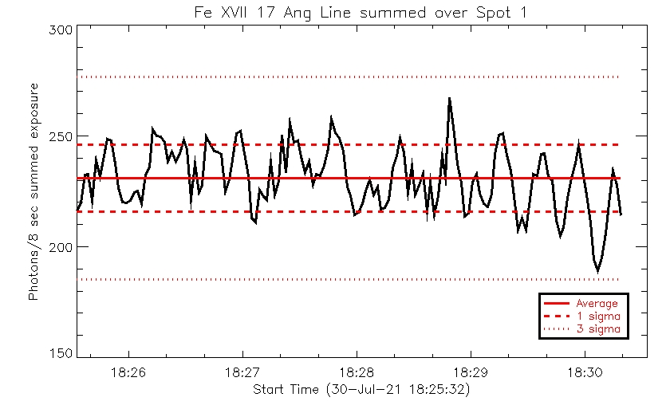
Time Evolution of Fe XVII
Deviations from average consistent with photon noise.
Savage et al,. in prep (MaGIXS Mission Paper)

Slide 22
Time Evolution of Fe XVII
For this region, there is no statistically significant variations in intensity.
Measurement | High Frequency | Low Frequency
Ratio of Fe XVIII to Fe XVII | Small | Large
Abundance | Enhanced low-FIP lines (i.e., coronal) | Non-enhanced low-FIP lines (i.e., photospheric)
Distribution of plasma | Maxwellian | Non-Maxwellian (e.g., kappa)
Time evolution of Fe XVII | Steady Fe XVII emission | Variable Fe XVII emission
Savage et al,. in prep (MaGIXS Mission Paper)

Slide 23
MaGIXS Results and Future Work
MaGIXS-1 met comprehensive success critera
Analysis of Spot 1 shows region is most consistent with high-frequency heating.
Measurement | High Frequency | Low Frequency
Ratio of Fe XVIII to Fe XVII | Small | Large
Abundance | Enhanced low-FIP lines (i.e., coronal) | Non-enhanced low-FIP lines (i.e., photospheric)
Distribution of plasma | Maxwellian | Non-Maxwellian (e.g., kappa)
Time evolution of Fe XVII | Steady Fe XVII emission | Variable Fe XVII emission
Savage et al,. in prep (MaGIXS Mission Paper)

Slide 24
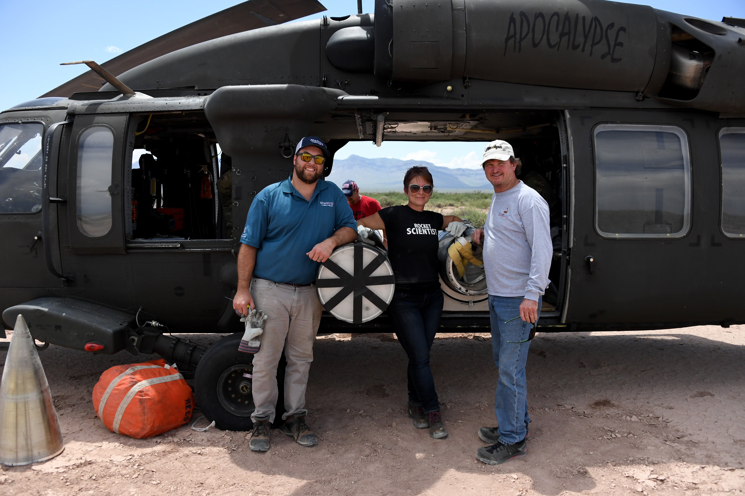
MaGIXS Results and Future Work
MaGIXS-1 met comprehensive success critera
Analysis of Spot 1 shows region is consistent with high-frequency heating.
However,
MaGIXS-1 observations were limited by vignetting function and missed the majority of the primary target.
Observations included two bright points and one loop structure, not the active region core as proposed.
Low flux limited the conclusions.
MaGIXS-1 was recovered.
MaGIXS-2 will launch in 2023.
MaGIXS-1 Recovery Team
Savage et al,. in prep (MaGIXS Mission Paper)

Slide 25
MaGIXS-2 instrument changes
MaGIXS–2 will have
Easier alignment process
Better spatial resolution (x4)
Better spectral resolution (x4)
Larger FOV (4’ –> 12’)
Higher throughput

Slide 26
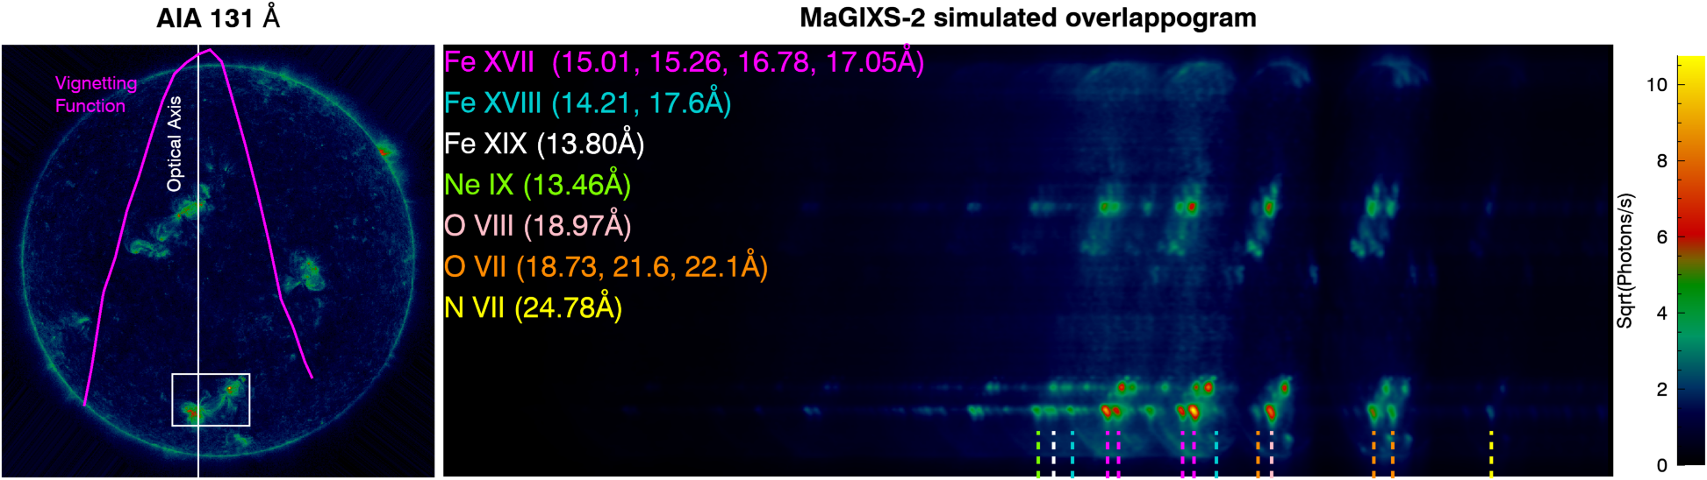
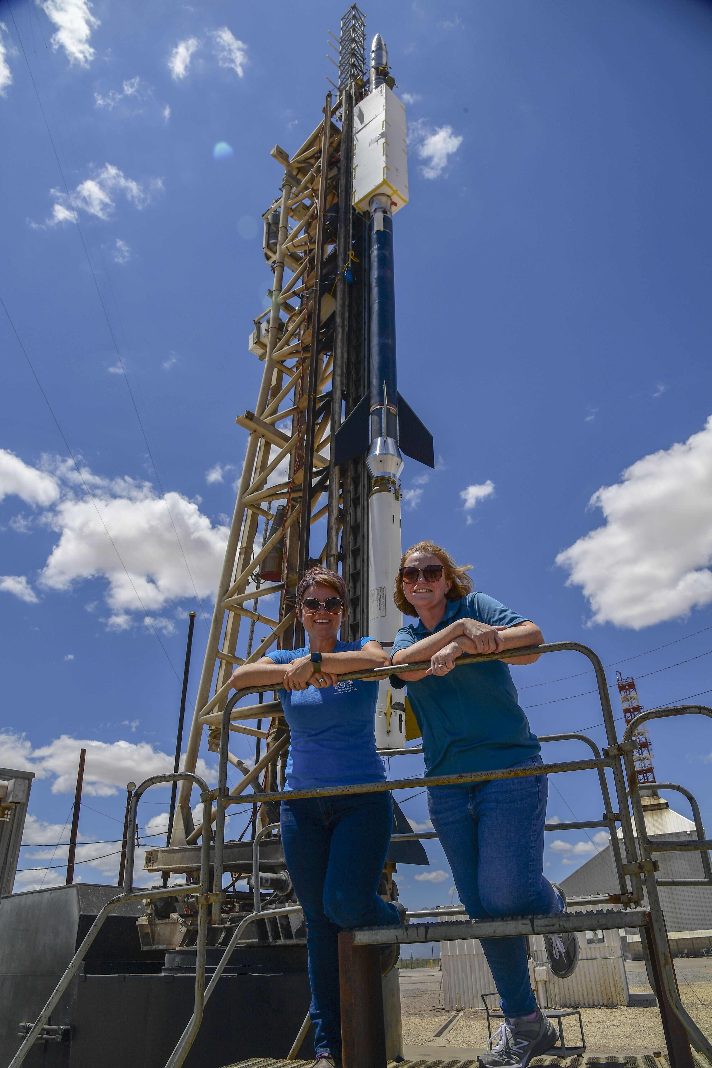
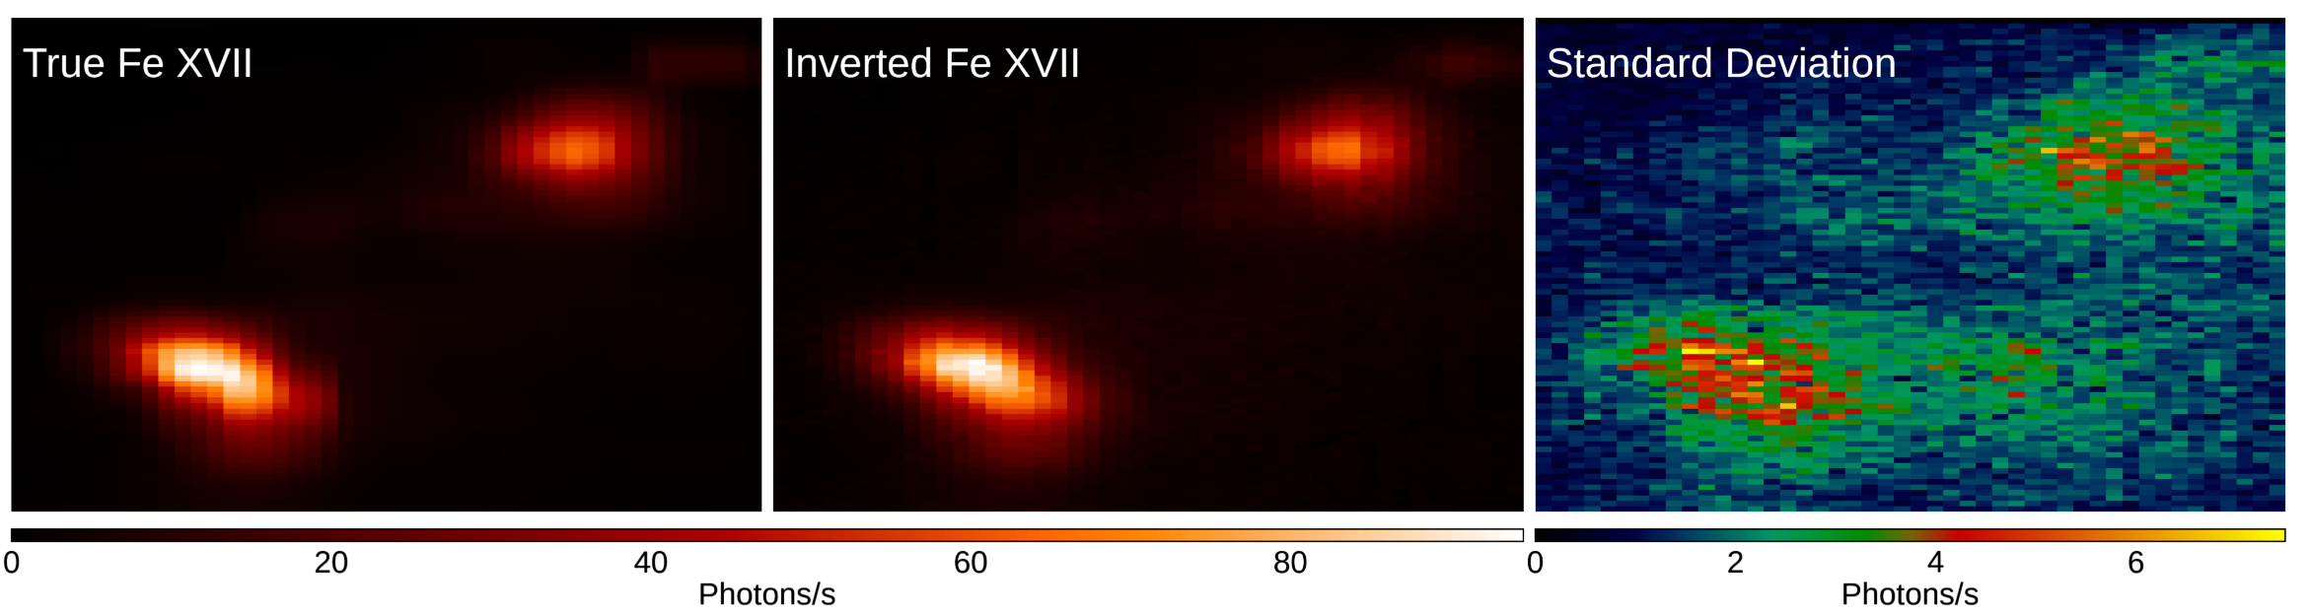
MaGIXS-2 Predictions
Happy scientists

Slide 27
Back up

Slide 28
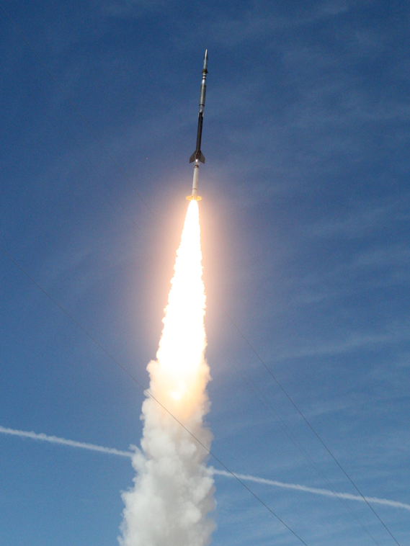
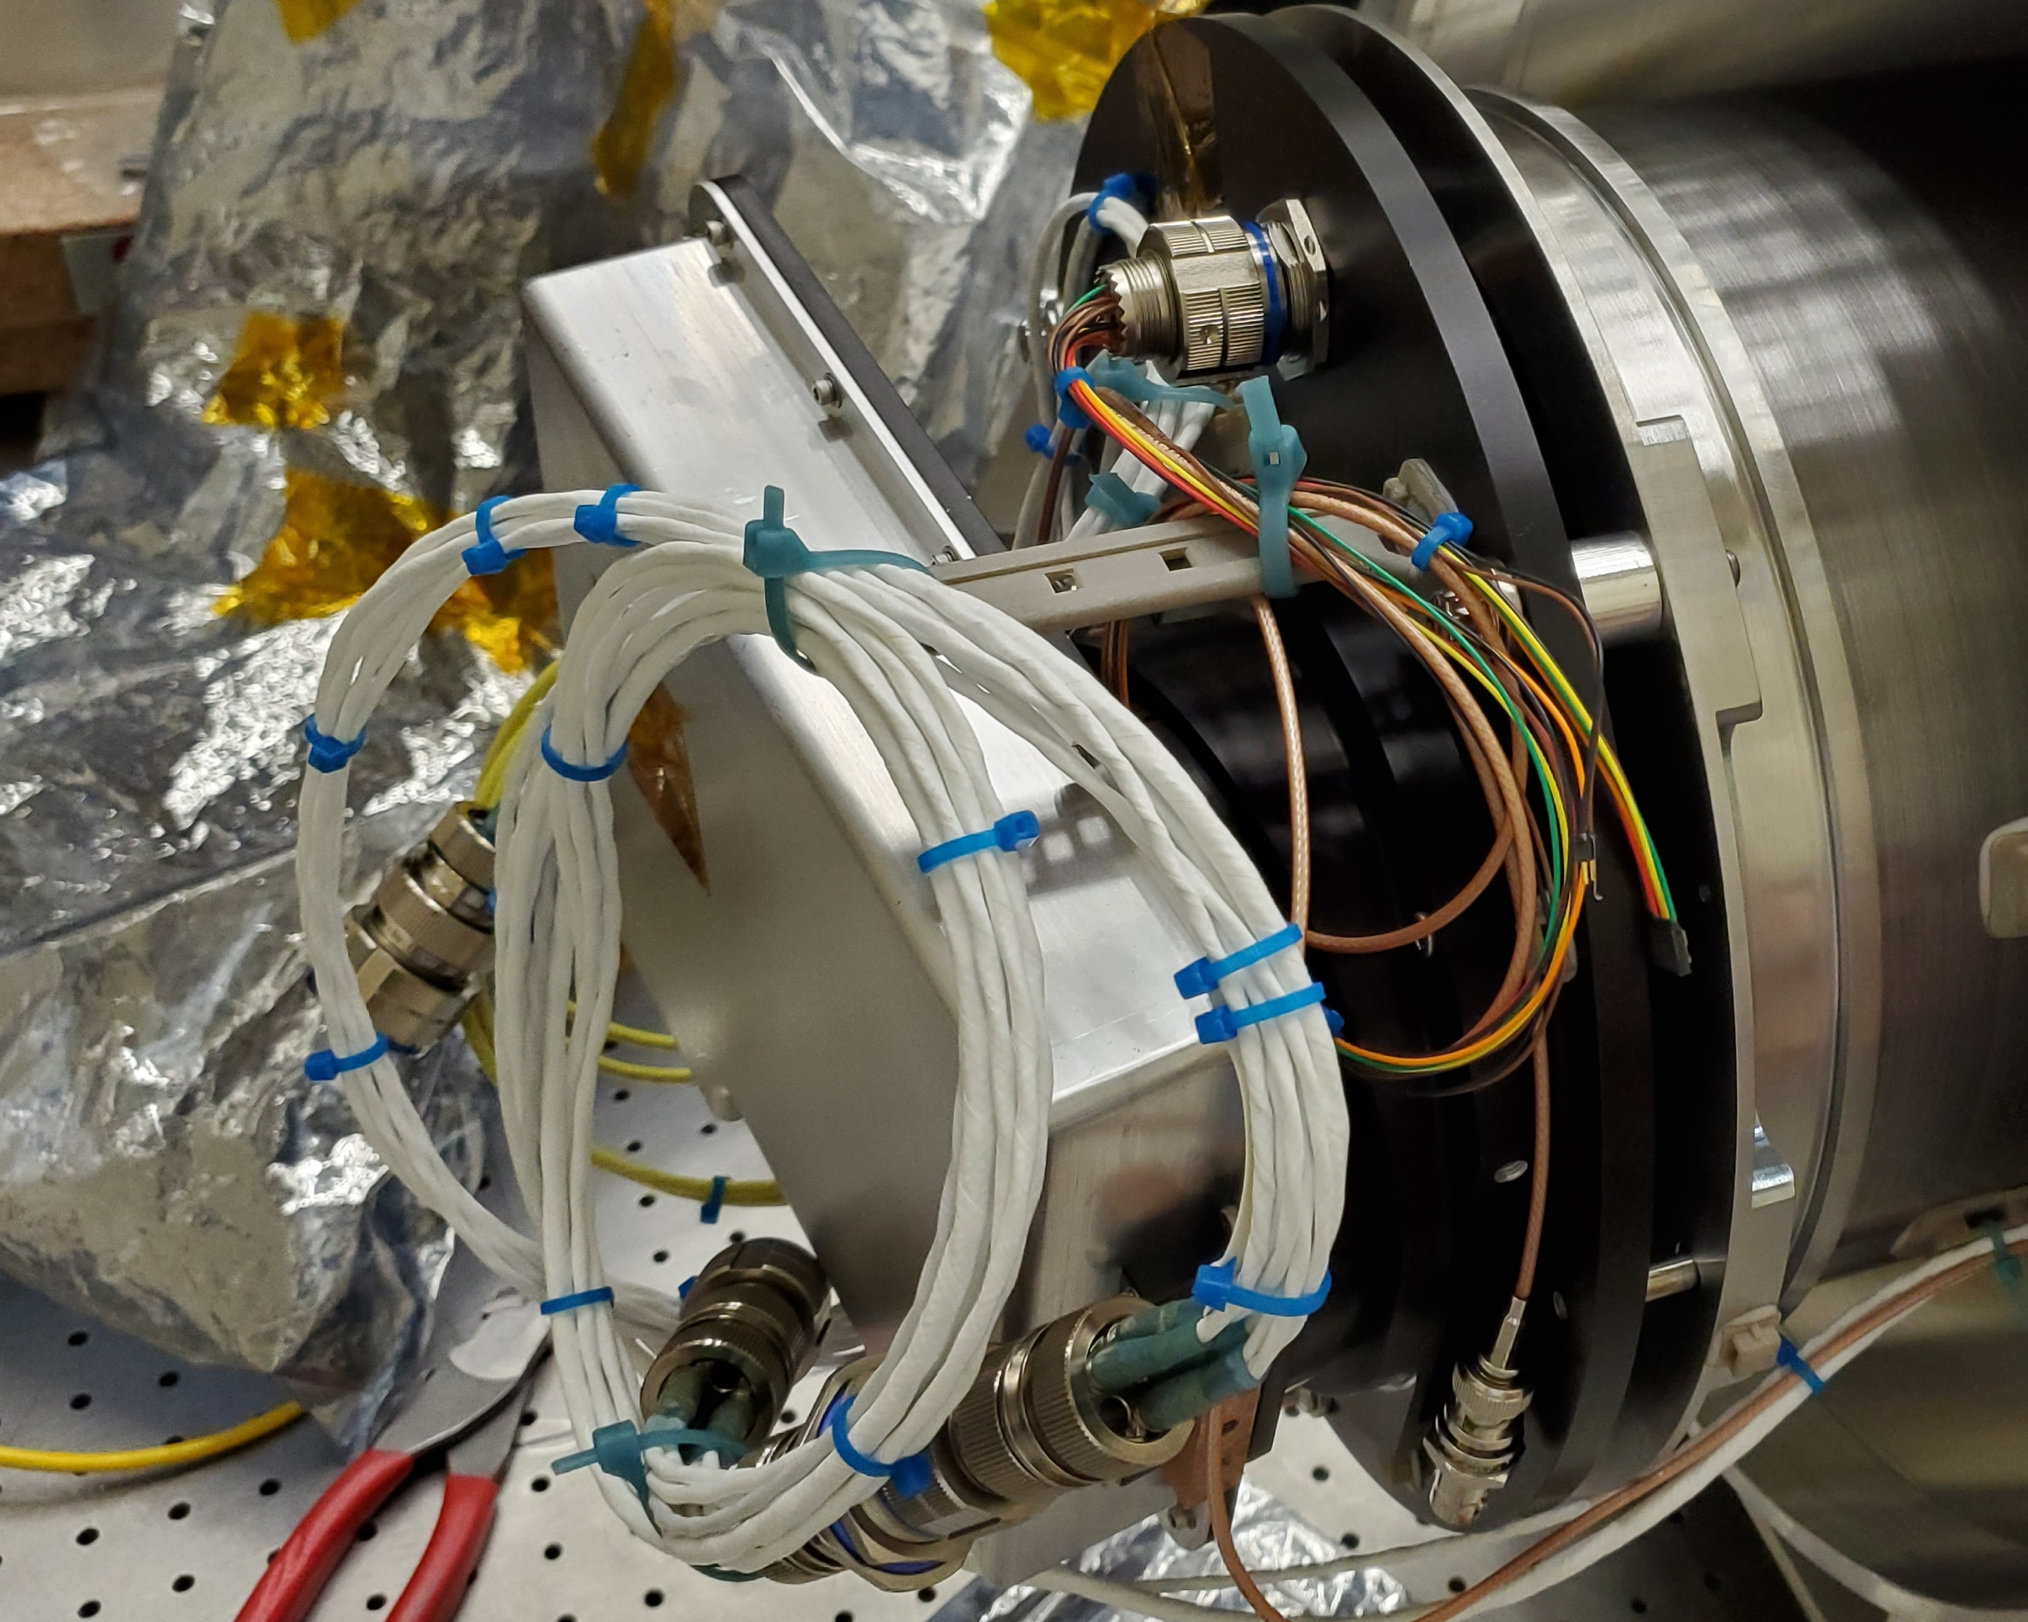
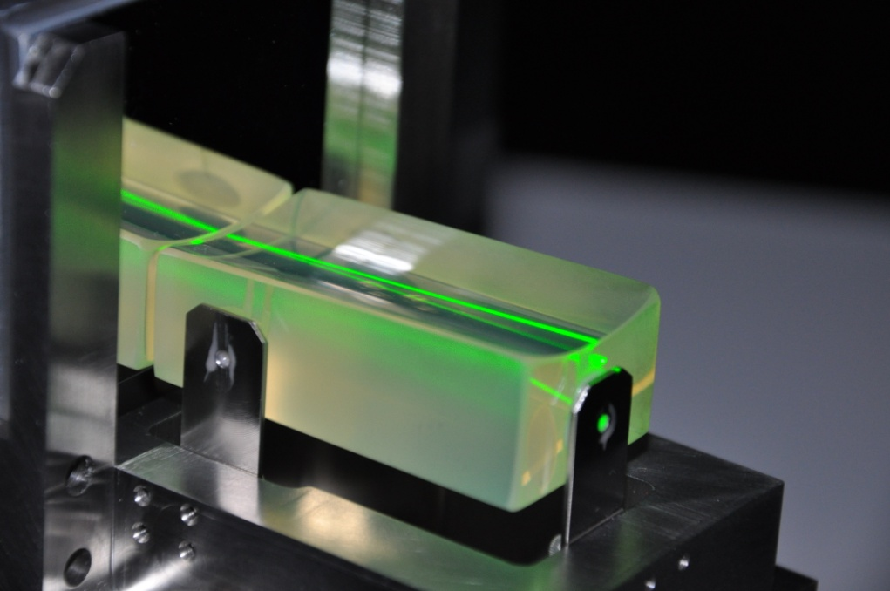
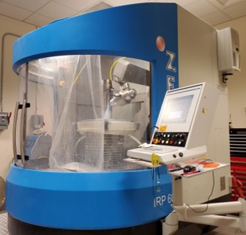
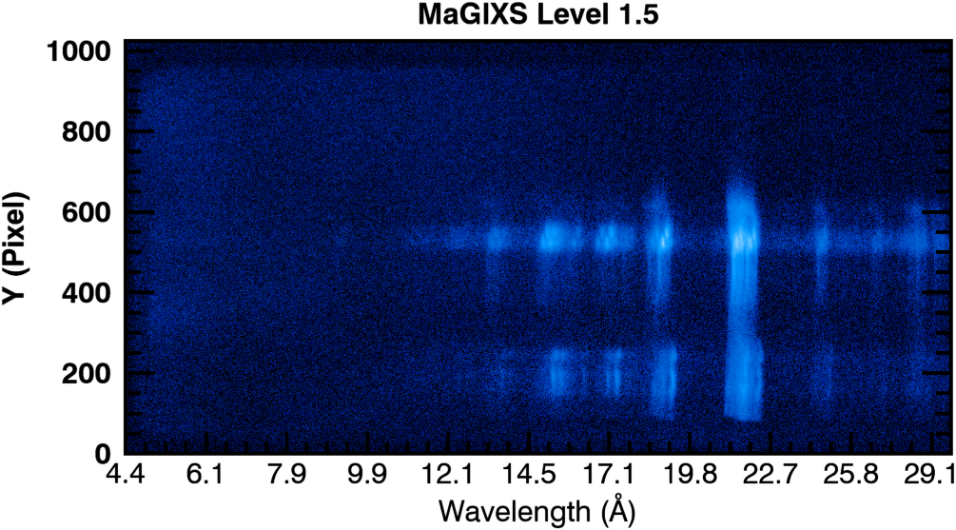
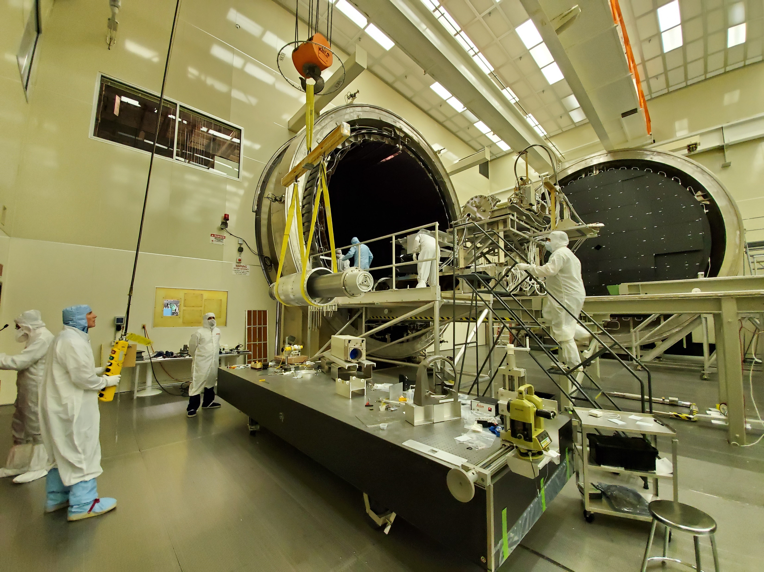
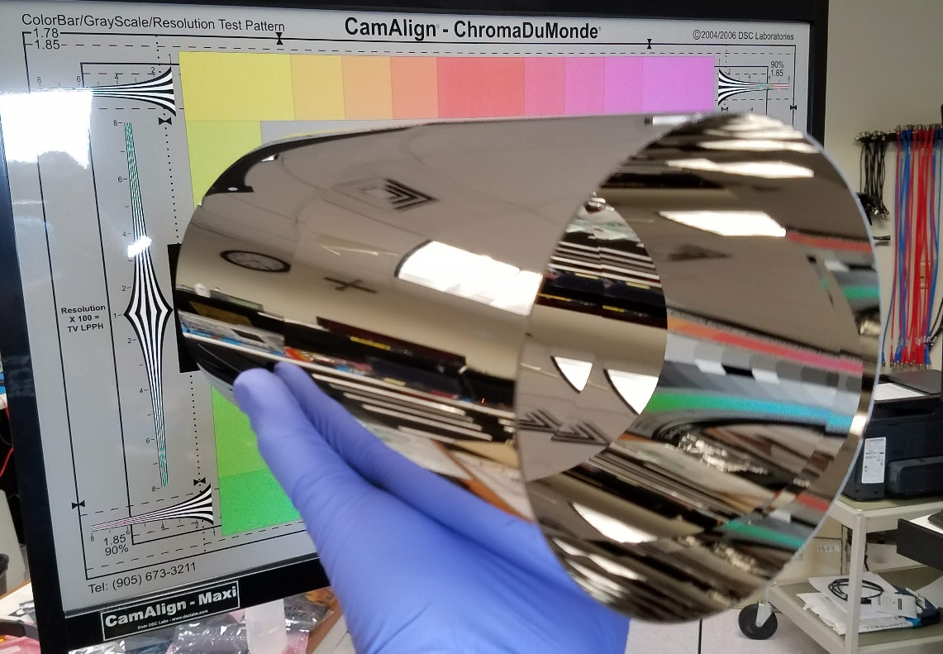
Technologies Developed During MaGIXS
Previous developments
MaGIXS ITD (2012)
MaGIXS LCAS (2014)
SMEX/MoO (2016)
COSIE Cat 3 and MUSE Phase A
MaGIXS Launch
(July 30, 2021)
Low noise CCD camera (CLASP LCAS, Hi-C 2 LCAS)
Novel Slitjaw Design
X-ray grating Fabrication
X-ray alignment Strategy
X-ray Grating Modeling
High Resolution X-ray Optics
Calibration Methods
Spatial Spectral inversion algorithms
X-ray Spatial-Spectral Observations unlocked for future satellite missions.

Slide 29
Back up slide addressing 15 Ang enhancement

Slide 30
Statement of the problem
Inversion of MaGIXS data shows the relative intensity of Fe XVII lines at 15Å and 17Å do not agree with the observed flight data. We see more intensity at 15Å at flight than inversion. In other words, we cannot find a solution that matches the observed relative intensities of Fe XVII lines at 15Å and 17Å.
To understand and quantify this, we tried MaGIXS inversion by masking 15Å lines, forward calculate MaGIXS data and compared with flight data
  Inverted line intensities at ~ 17Å (16.78, 17.05) agrees well with flight observation
  Inverted line intensities at ~ 15Å can be up to 2-3 times less bright than observation

Slide 31
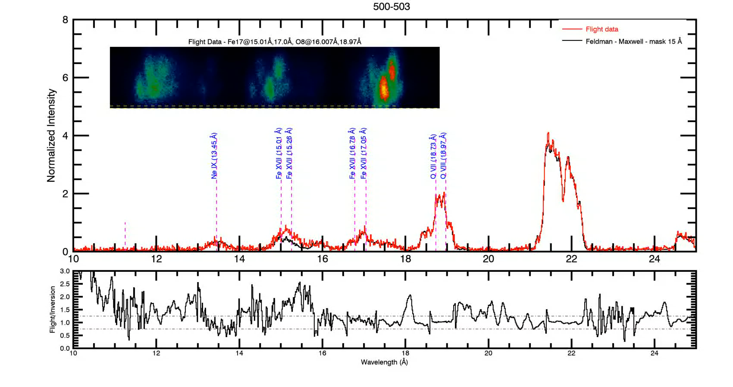
Statement of the problem : Contd
Mask 15A lines and perform inversion
Convolve the solution with unmasked response and compare with flight data to quantify the offset.
MASKED
Question : Why do we see enhanced intensity around 15A lines?

Slide 32

Possible explanations
Departure from thermal equilibrium : Non-Maxwellian electron distribution
Instrument artifact – Effective area at 15Å wrong
  Ni, Ir edge around 14.5 Å
Relative line intensities at ~ 15Å, 17Å in CHIANTI database is wrong
  Fe XVII
    Literature indicate discrepancies in Fe XVII line ratios in this range - (Bhatia et al, 2001, Saba et al 1999); Updated database should have all resolved – (Del Zanna 2011)
    Only one paper reported enhanced 15.01/16.78 – Rose et al, 2007, A&A, 887
  Fe XVI
    Intensity of Fe XVI lines near 15Å may not well modeled in Chianti
Abundance issue - FIP bias > 4
~15% enhancement per bounce required
4-5 times enhancement in Fe 16 required

Slide 33
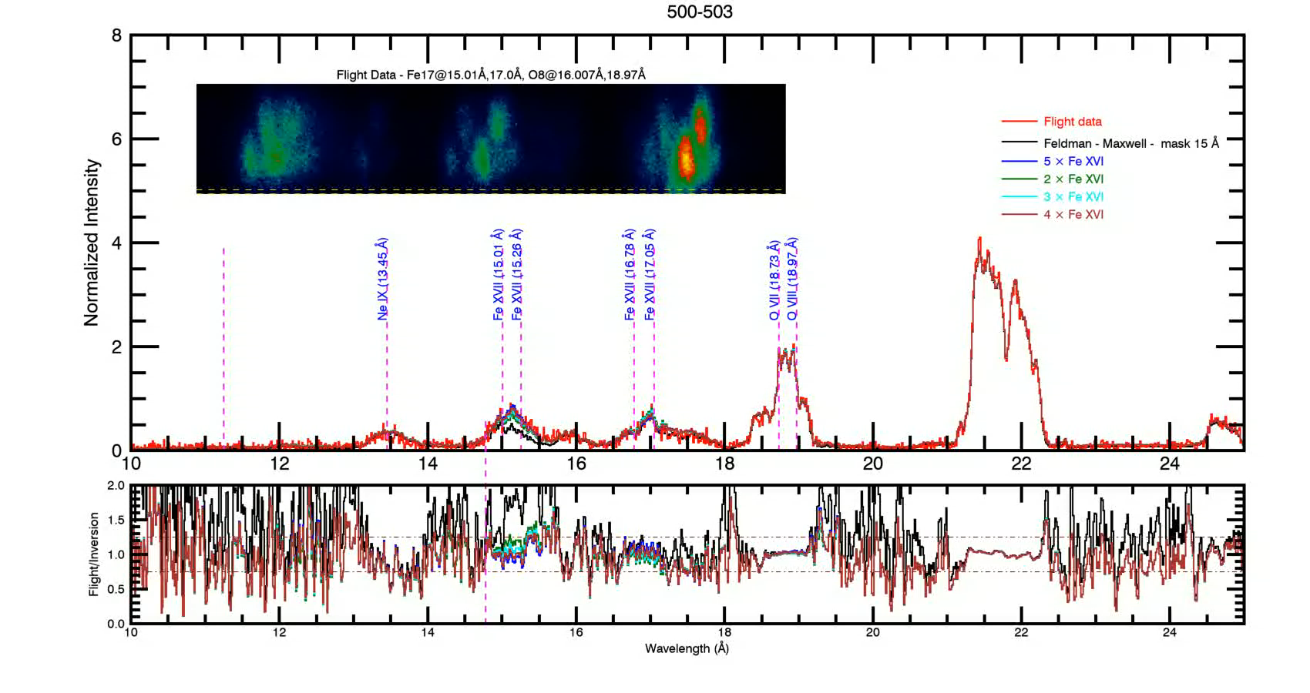
Scaling Fe16 lines in CHIANTI
4 - 5 times enhancement in Fe XVI lines required

