Slide 1
Developing Machine Learning Tool for
MISSE Specimens Image Analysis
Intern: Carlos A. Perez (University of Puerto Rico)
Mentors: Sheila A. Thibeault, Jin Ho Kang, and Keith L. Gordon
May 27, 2022
All Images Credit: NASA
2022 Spring Intern Symposium

Slide 2
Introduction
The Materials International Space Station Experiment (MISSE) missions are collections of experiments focused on the investigation of the effects that occur because of the exposure of the materials to the space environment. The specimens are mounted on the exterior of the International Space Station and are exposed to extreme conditions. There have been 15 MISSE missions since the first mission in 2001. This project will evaluate the MISSE-9 – MISSE-15 specimens and investigate possible options for a computer aided analysis.

Slide 3
Objectives
Collect high-resolution photographic images and data from MISSE-9 - MISSE-15
Analyze the MISSE images to determine possible changes
Determine options to quantify the changes in the MISSE images
Identify methods to automate the computer aided analysis
Apply the methods identified and develop a process to automate the computer aided analysis

Slide 4
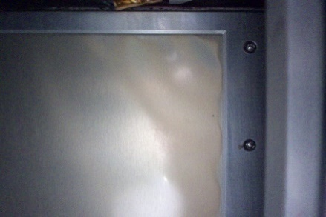
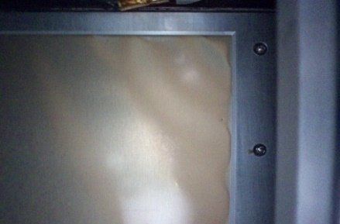
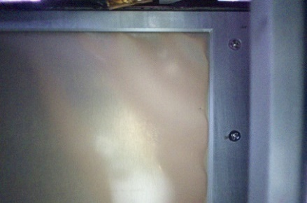
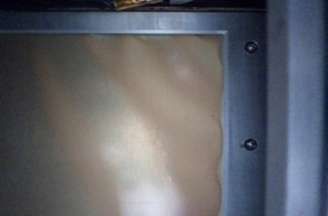


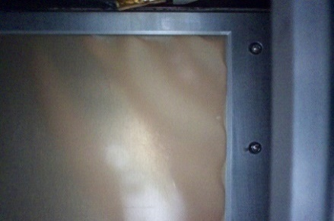
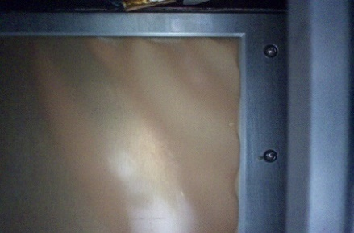
Example of Change in a Material
Space exposure images of MISSE-11, MIR1 (polyvinyl fluoride) specimen
June 2019
July 2019
August 2019
September 2019
October 2019
December 2019
January 2020
February 2020

Slide 5
Computer Program Design
The programming language selected for this project is Python
To manipulate the image data, the PIL (Python Imaging Library) and Matplotlib libraries were installed
The objective of the program is to provide a quantitative result for the qualitative observations
To achieve the desired objective, the program needs to complete the following steps:
  Open and read an image
  Distribute points across the image
  Detect the color in the points selected
  Compare the values within all the images
  Display the results

Slide 6
Color Detection
The quantification of the colors was obtained by using the RGB (Red, Green, Blue) Code:
  It contains 16.8 million combinations of colors
  It is divided by 3 elements
  It has tools that allow an easy application to Python programming
To manage other values that can affect the results of the images, the HSV (Hue, Saturation, Value) Code was also applied
RGB | HSV
Red: 34 | Hue: 110
Green: 188 | Saturation: 177
Blue: 126 | Value: 111
Example of the RGB Code and HSV Code results given a specific color

Slide 7
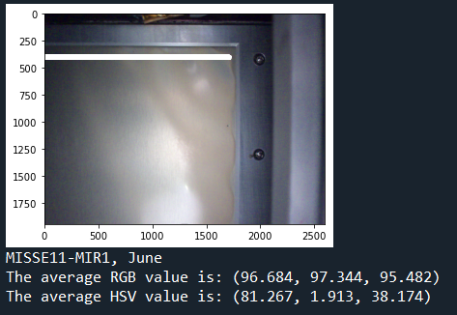
Color Output
1700 points were drawn in each image using Matplotlib
An algorithm was applied to detect the RGB and HSV values of each point in the images
The average for each of the parameters was calculated to obtain a final color
Color output example for the June 2019 image

Slide 8
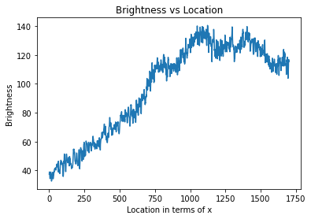
Brightness
The Value from the HSV Code is the brightness
The brightness was different in each image
To analyze the brightness in a specimen, a graph was made showing the variation as a function of location
Similarly, other graphs were created to compare the red, green, and blue components in the images
Graph of brightness versus location for the June 2019 image

Slide 9
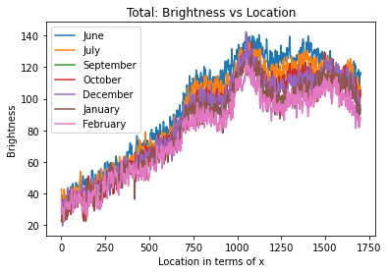
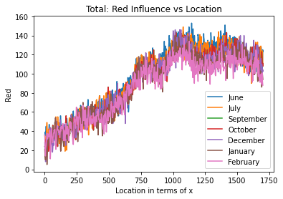
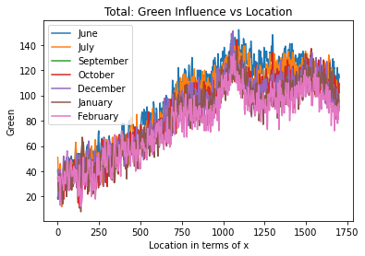
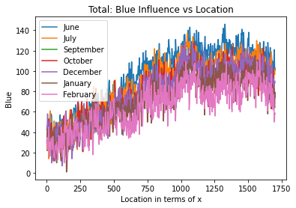
Results
To analyze the changes, the graphs of the brightness and the red, green, and blue components were plotted for each monthly image
Graphs of the brightness and the red, green, and blue components

Slide 10


Results
MISSE-11, MIR1 (polyvinyl fluoride)
The results revealed that there was a monthly decrease in the brightness and in the RGB values
The brightness is reflected to a lesser extent each month, which affirms that the color is getting darker
By comparing the first and last images, an evident change was observed on the average of the RGB values
June 2019
February 2020
June 2019
RGB values:
(96.68, 97.34, 95.48)
February 2020
RGB values:
(85.44, 77.20, 64.82)
Color comparison between the first and last images for polyvinyl fluoride

Slide 11
Challenges
Difficulties encountered:
  Currently, the program must be manually updated, therefore the process will be inefficient for the large number of MISSE specimens
  The MISSE missions have specimens with different shapes
  Background lighting in the images is not equally distributed
  Specimens are not always in the center of the images
  Aluminum frames surrounding the specimens do not appear constant

Slide 12
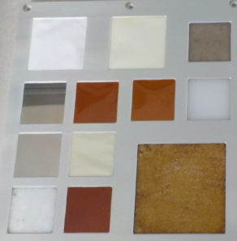
Instance Segmentation
The first step for automating the computer tool was to isolate the specimen in each image
Instance segmentation identifies a specific object based on a pre-trained model
This technique allows the manipulation of a desired object in an image
A mask is created around the object to outline the specimen
Example of instance segmentation on MISSE-9 ground photos

Slide 13
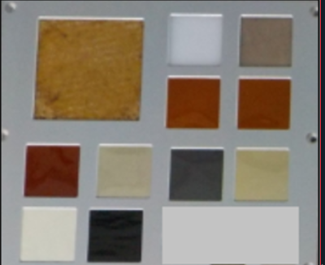
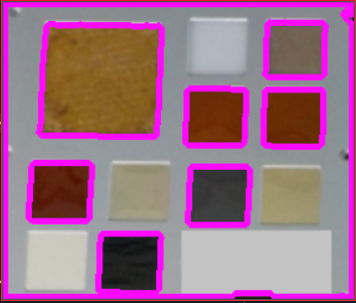
Edge Detection
Edge detection techniques apply filters to differentiate the contour or edge lines from the background
The filters that were applied are: grayscale, sobel edge detection, and canny edge detection
Edges of the specimen are highlighted in contrast to the aluminum frame
A current issue is that specimens with lighter colors are not being identified
Example of edge detection on MISSE-9 ground photos

Slide 14
Next Steps
Continue project during the Summer of 2022
Continue to work with subject matter experts in computer science
Optimize the application of the discussed methods
Integrate the various techniques with the specimen analysis

Slide 15
Acknowledgments
I would like to express my sincere gratitude to:
Mentors
  Sheila Thibeault
  Jin Ho Kang
  Keith Gordon
  Charles Liles
  Hari Ilangovan
  Guohui Song (Old Dominion University)
Computer subject matter experts
  Edward McLarney
  Jeffrey Brandt
  Douglas Trent
  Herbert Schilling
  All the computer scientists who are assisting us
Alpha Space /Aegis Aerospace Inc.
  Allen Hebert
  Allison Goode
  Jeffrey Buell
NIFS coordinators
  Jessica Gangitano
  Valerie Ellis
  Jalisa Thomas
  Patricia Sanchez
  Christine Dillard
  Kassandra Lerman
  Bartholomew Upah

