Slide 1


OSAM-2: Plans and Progress for the First Demonstration of Structural Manufacturing in Space
National Aeronautics and Space Administration
Lawrence D. Huebner, NASA
Paul Shestople, Simon Patané, Daniel Hillsberry, Redwire Space
National Space & Missile Materials Symposium
27-30 June 2022
Madison, WI
Distribution A. Approved for public release: distribution unlimited.

Slide 2
Background
OSAM-2 began as a NASA Space Technology Mission Directorate Tipping Point project in 2016 in which an investment made in ground development and demonstration and/or flight demonstration will result in:
  Significant advancement of technology’s maturation
  High likelihood for utilization of technology in commercially fielded space application
  Significant improvement in ability to successfully bring space technology to market
Topic area was “Robotic In-Space Manufacturing and Assembly of Spacecraft and Space Structures”
  Made In Space, Inc. (now Redwire) proposed Archinaut One, an in-space robotic precision manufacturing and assembly system for larger-than-deployable structures
  Manufacturing / assembly in the operational environment allows manufactured parts to be designed for that environment (and not for launch loads and need to deploy)
In 2020 NASA budget language, NASA began using On-orbit Servicing, Assembly, and Manufacturing Mission 2 (OSAM-2) for Archinaut One
  Restore-L + SPIDER (SPace Infrastructure DExterous Robot) became OSAM-1
Distribution A. Approved for public release: distribution unlimited.

Slide 3
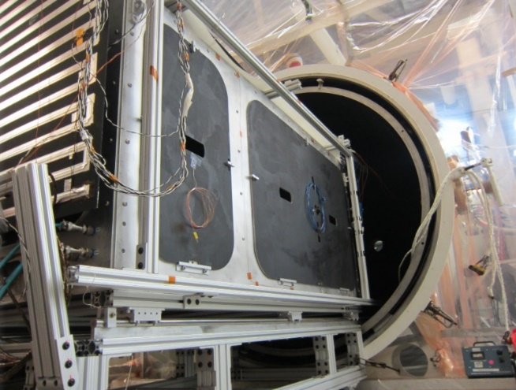
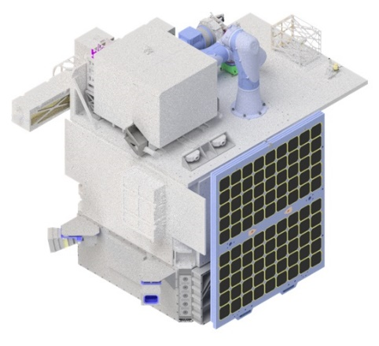
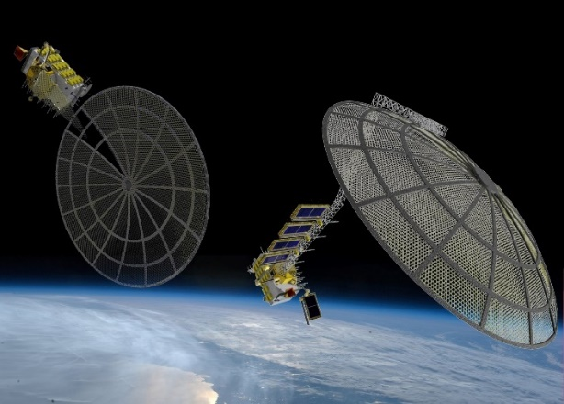
OSAM-2 Technology Development Plan
Phase I: Development
Extended Structure Additive Manufacturing Machine (ESAMM) successfully tested in 2017
Ground Based Manufacturing & Assembly System Hardware (GBMASH) successfully tested in 2018
Phase II: Demonstration
OSAM-2 (Archinaut One): In-space demo of extended structure additive manufacturing, robotic manipulation, and part verification/validation
Focus on demonstrating capabilities relevant to commercial and government (NASA/DoD) missions
5-Year, $74M flight demonstration mission funded by STMD
Phase III: Commercialization
Deployment of commercial products in space
Extended structure additive manufacturing, robotic assembly, and verification/validation capabilities applied to commercial and government missions
Deployment funded by customers
First generation space infrastructure
Distribution A. Approved for public release: distribution unlimited.

Slide 4
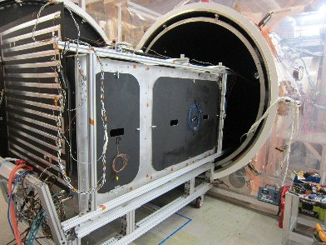
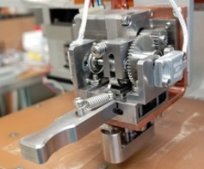
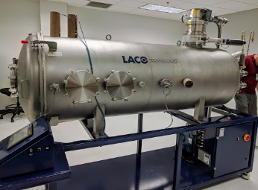
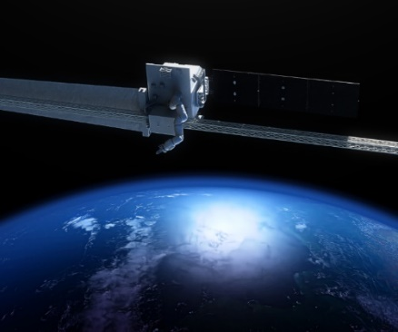
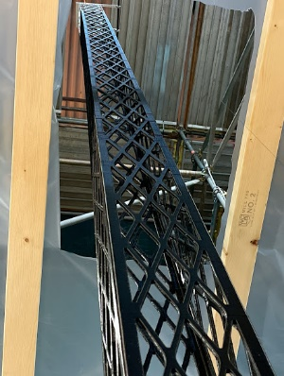
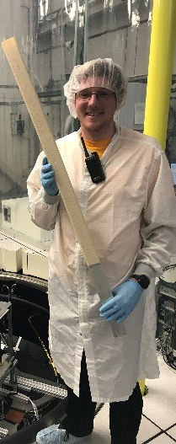
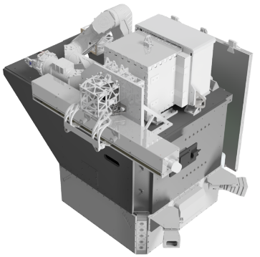
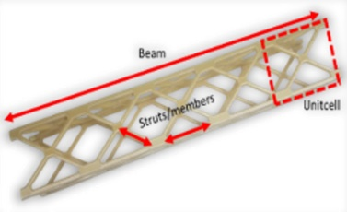
OSAM-2 Development Timeline
GBMASH: Additive Manufacturing and Robotics in TVAC
Extruder Upgrades and Testing
TVAC Printing with flight-like Hardware
Archinaut
Phase I ATP
Flight Payload
Integration at Redwire
2017
2018
2019
2020
2021
2022
2023
PDR 3/2020
CDR
12/2021
Launch
Archinaut
Phase II ATP
Payload End-to-End Test Begins
World’s Longest AM Beam
(37.5 m)
850 mm beam printed in TVAC
Flight Beam Design and Analysis
Vertical Beam Test:
Flight-like hardware printing against flight loads
OSAM-2 AI&T Begins
Distribution A. Approved for public release: distribution unlimited.

Slide 5
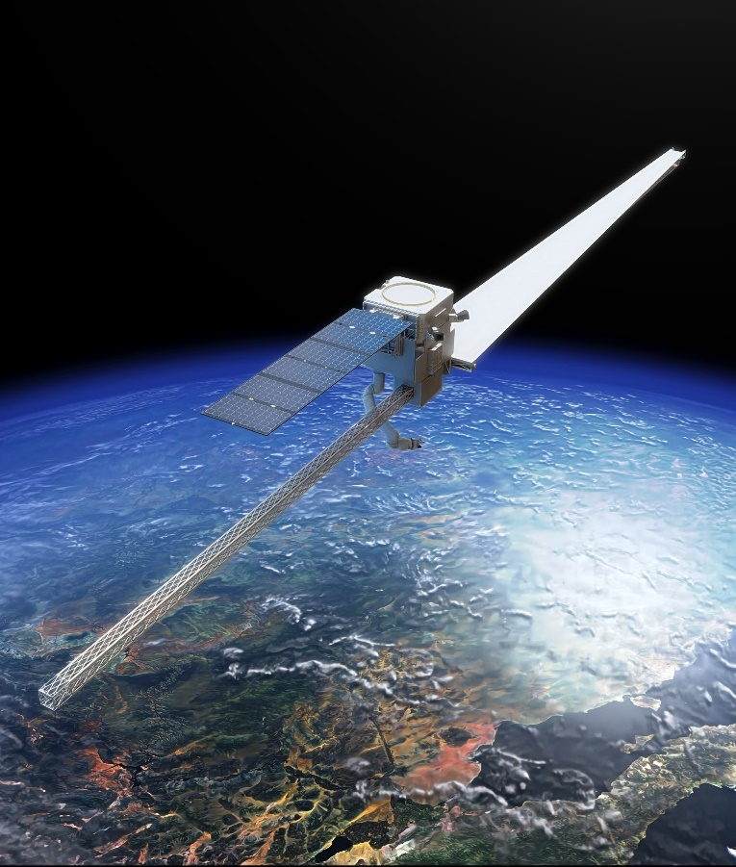
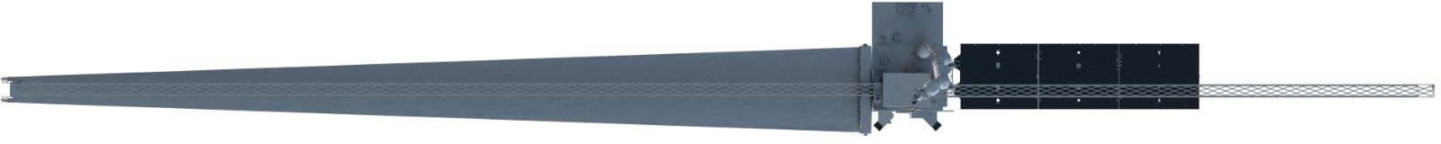
Mission Overview
NASA STMD Tipping Point project to demonstrate on-orbit additive manufacturing and robotic manipulation on an ESPA-class spacecraft
  Inclination: 97.4° ± 0.1°
  Orbit: 500 + 25 km (Sun Synchronous, dawn-dusk preferred)
Led by Redwire (formerly Made In Space); managed by NASA’s Technology Demonstration Missions Program Office
Major Subsystems
  Extended Structure Additive Manufacturing Machine (ESAMM)
  Motiv Space Systems xLink 1.5 Robotic Arm
  Northrop Grumman Payload Support Structure Assembly (PSSA)
  Blue Canyon Technologies X-Sat Saturn Bus
1st Beam with surrogate solar array (10 m)
2nd Beam (6 m)
Distribution A. Approved for public release: distribution unlimited.

Slide 6

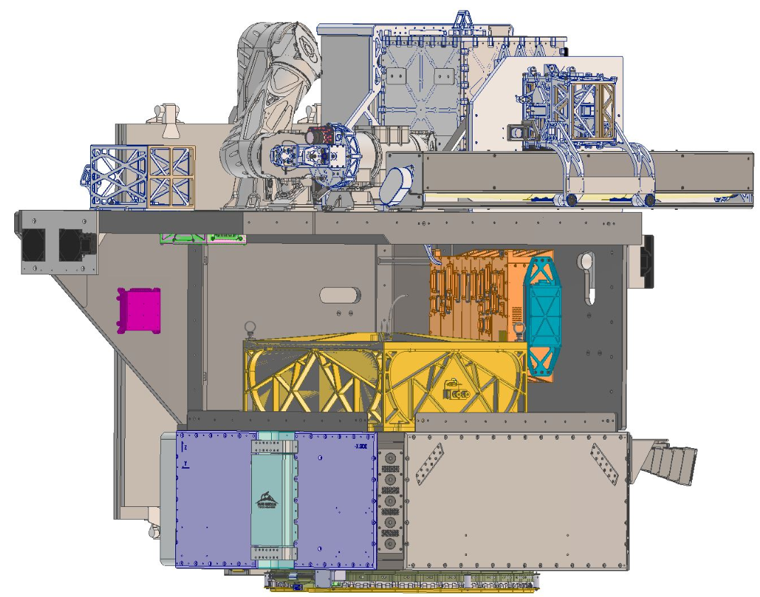





Spacecraft and Subsystems
Motiv Space Systems
Robotic Arm
Extended Structure Additive Manufacturing Machine (ESAMM)
Robotic Arm End Effector
Beam Lockout Assembly
Surrogate Solar
Array Assembly
Northrop Grumman
Payload Support
Structure Assembly
Payload Avionics
Blue Canyon Technologies Hyperion Solar Array
Blue Canyon Technologies
X-Sat Saturn Bus
Feedstock Canister
Distribution A. Approved for public release: distribution unlimited.

Slide 7
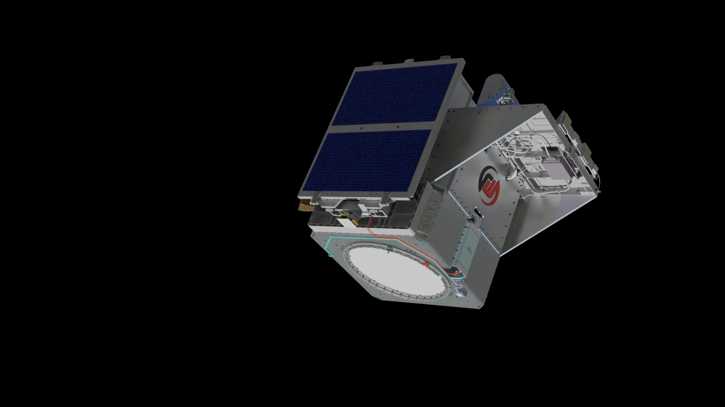
Concept of Operations Animation
Distribution A. Approved for public release: distribution unlimited.

Slide 8
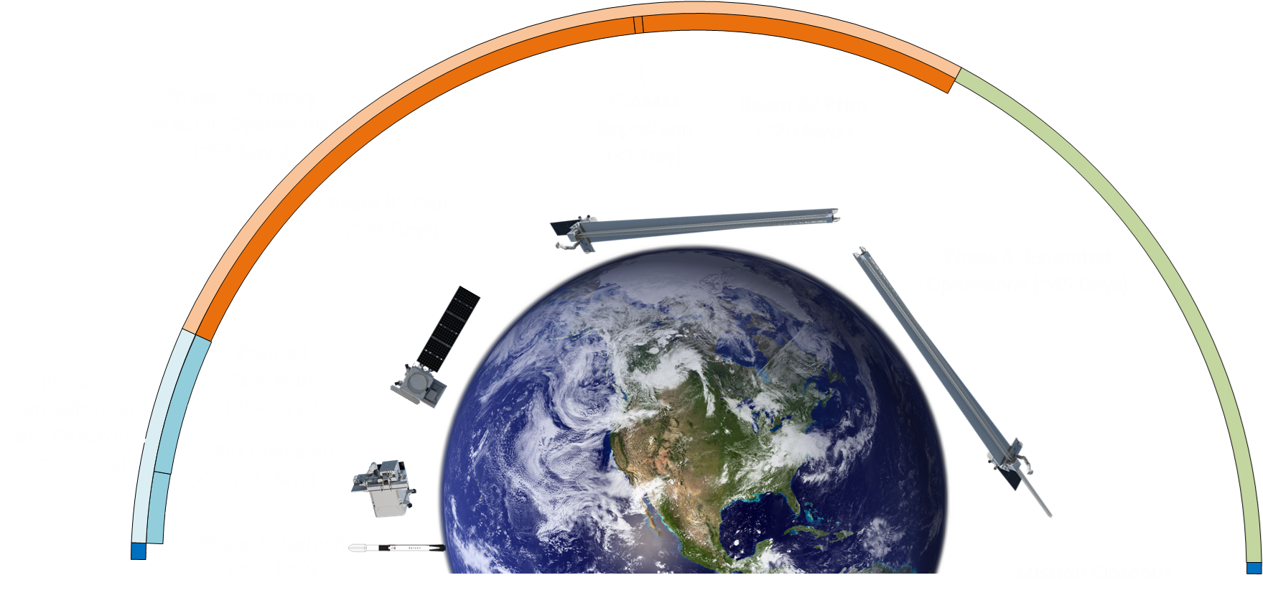
Concept of Operations Timeline
Distribution A. Approved for public release: distribution unlimited.

Slide 9
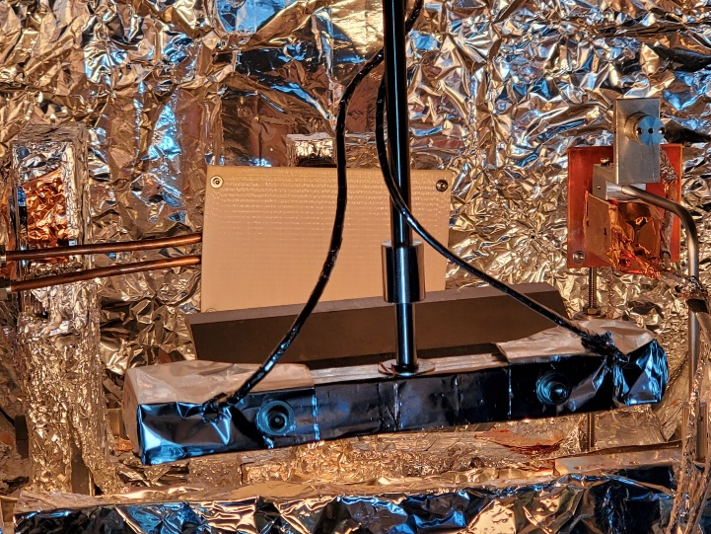
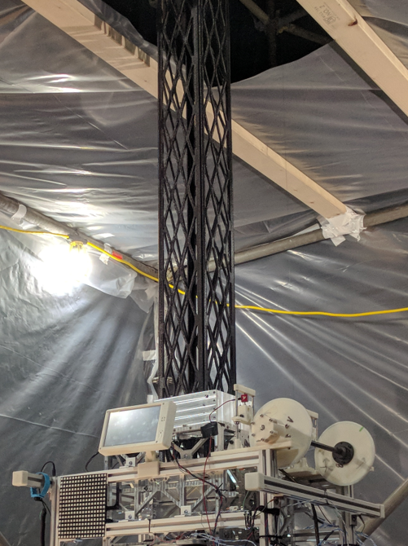
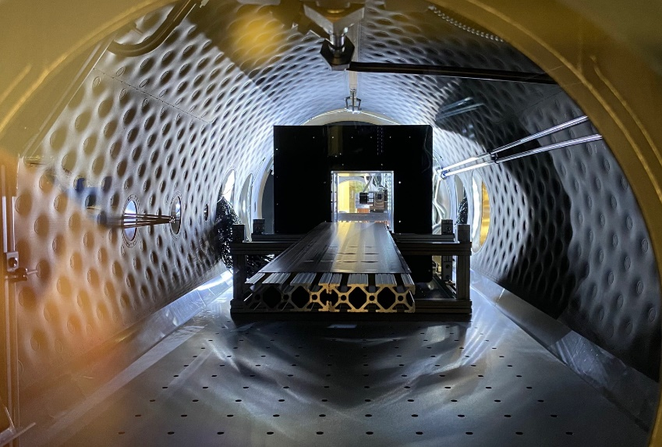
Recent Accomplishments, 1 of 2
Beam material electrostatic discharge (ESD) testing at MSFC
Vertical print test
  Test setup mimics relevant loading environment for on-orbit ESAMM operation
    Off-load mass of beam during printing
    Tension of deploying surrogate solar array
Beam printing in relevant thermal vacuum (TVAC) space environment
Beam Material ESD Test Setup
ESAMM Mk 9 Vertical Print Test
ESAMM Mk 10 in Redwire TVAC Chamber
Distribution A. Approved for public release: distribution unlimited.

Slide 10
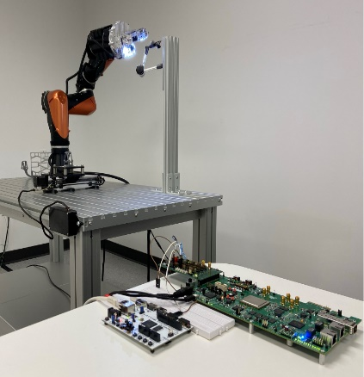
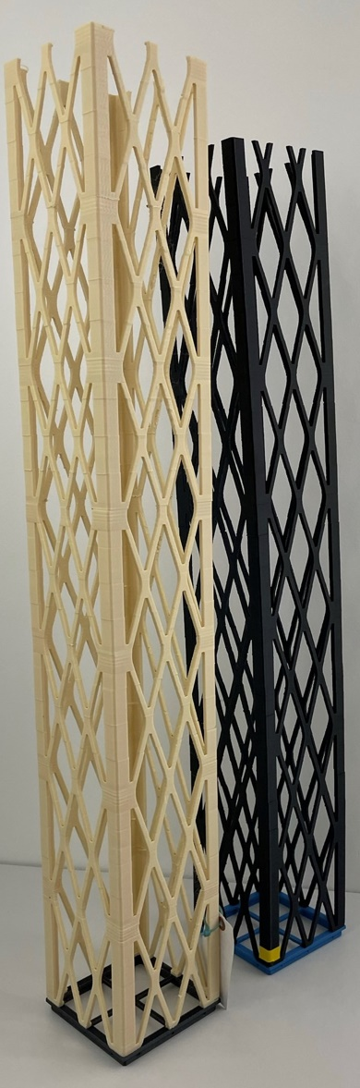
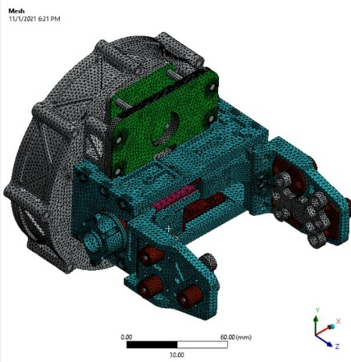
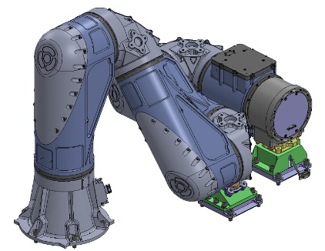
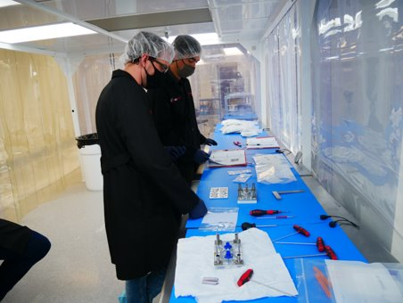
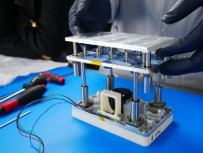
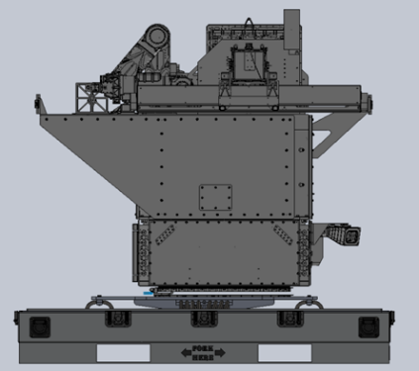
Recent Accomplishments, 2 of 2
Assembly / testing of Engineering Design Units
  Feedstock Canister
  Robotic Arm and Robotic Arm End Effector
  ESAMM Mk 9: Ambient EDU primarily for software/flight avionics testbed
  ESAMM Mk 10: TVAC testing of flight upgrades
Incorporated key advances into ESAMM
Completed flight avionics designs
Simulations of hardware subsystems
Robotic arm robustification
Robotic arm commanding
Software Improvements
Reviews
  Flight Avionics
  Flight Material
  Eight Subsystem Critical Design Reviews
  Mission Critical Design Review
Robotic Arm Commanding
End Effector Simulation
Robotic Arm 1.5
Hardware Assembly
AI&T Planning
Beams
Distribution A. Approved for public release: distribution unlimited.

Slide 11
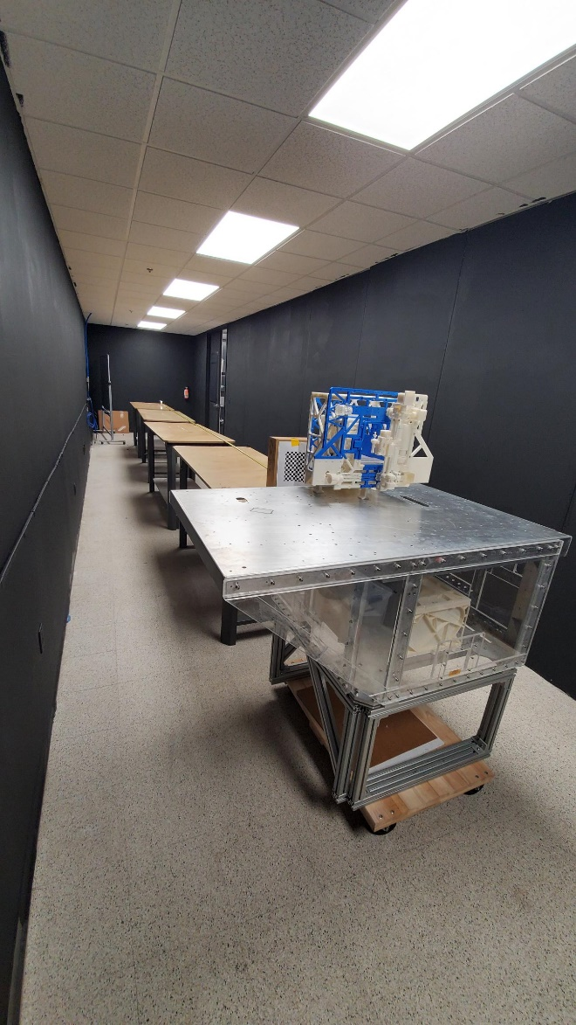
Recent/Upcoming Accomplishments
Received PSSA from Northrop Grumman
Harness routing checkout using mock space vehicle
Bus component integration at Blue Canyon Technologies
Feedstock Canister redesign
Receive Robotic Arm from Motiv Space Systems
ESAMM Mk 11 (flight unit) assembly and verification testing
Begin Payload Integration
  Robotic Arm, ESAMM Mk 11, and Feedstock Cannister onto Payload Support Structure Assembly
Payload End-to-End Operations Test Readiness Review
  Using flight-like EDUs, project will execute end to end test of payload operations
  ESAMM Mk9R will print 10 m beam while deploying surrogate solar array
    Mk9R is an upgraded, flight-like version of Mk9, used for ambient testing
  Rotate Hyper-lite ESAMM 180⁰ with Robotic Arm
  Print 1 m beam
Payload End-to-End Test completion report
Subsystem environmental testing
Receive bus from Blue Canyon Technologies
System Integration Review
Payload End-to-End Test Facility Preparations
Distribution A. Approved for public release: distribution unlimited.

Slide 12
Technology Transition
Big science from a small package
  Core facets of OSAM-2 provide alternative design philosophies, unlocking next generation satellite architectures for future mission applications
    Manufacturing: Utilize OSAM-2 manufacturing subsystems to deploy extended structures for long baseline interferometry missions
    Assembly: Utilize OSAM-2 autonomous robotic assembly for persistent platform architectures that host multiple payloads over the mission life
    Combination: Manufacture and assemble infrastructure on-orbit enabling enhanced capabilities such as large power generation, long baselines for optical benches, and persistent platforms
Near Term Opportunities
  Tipping Point Solicitation
Distribution A. Approved for public release: distribution unlimited.

Slide 13
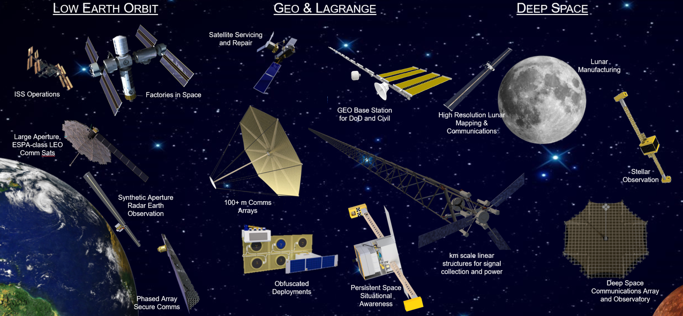
Infusion Potential
Distribution A. Approved for public release: distribution unlimited.

Slide 14
Summary
OSAM-2 is poised to be the first flight demonstration of on-orbit structural manufacturing in an external space environment
When successful, possibilities of technology infusion are rich
Planned Phase II space vehicle milestones
  Assembly and integration of space vehicle by May 2023
  Space vehicle environmental testing by February 2024
  Launch no earlier than April 2024
    Initialization and checkout by L+21 days
    First beam printed and SSA deployed by L+54 days
    Second beam printed by L+75 days
    Mission complete by L+120 days
Distribution A. Approved for public release: distribution unlimited.

Slide 15
Acknowledgments
NASA STMD/TDM
Redwire
Northrop Grumman
Blue Canyon Technologies
Motiv Space Systems
Design Review Team Members
NASA Subject Matter Experts
Distribution A. Approved for public release: distribution unlimited.

Slide 16

www.nasa.gov
Distribution A. Approved for public release: distribution unlimited.

