Slide 1
Single field-of-view sounding Atmospheric Products
Wan Wu¹, Xu Liu¹, Xiaozhen Xiong¹, Qiguang Yang², Allen M. Larar¹, Daniel K. Zhou¹
¹ NASA Langley Research Center, Hampton, VA
² Science Systems and Applications, Inc. Hampton, VA
Notes:
STILL

Slide 2
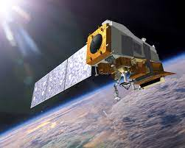
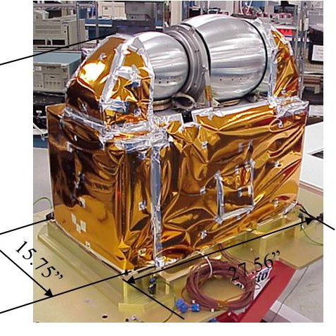
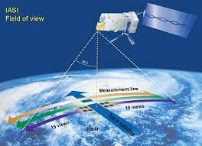
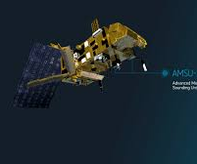
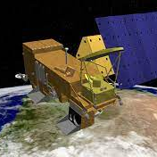
Role of Hyper-spectral IR Sounders
Have a wide range of applications including NWP, environmental monitoring and climate studies.
Have thousands of measurement channels which help to
  Improve the vertical resolution of temperature and moisture sounding
  Capture the fine spectral signature of atmospheric compositions
  Resolve climate signal in the spectral domain
Require algorithms to process hyper-spectral data efficiently (weather applications) and accurately (climate applications).

Slide 3
Existing IR sounder Operational Algorithms
Statistical analysis/training-based algorithms
  UW dual-regression algorithm
  Neural Network based algorithm
Physical algorithms based on the “cloud-clearing” scheme.
  AIRS version 5, 6, 7 (CHART)
  NUCAPS
  Neural Network based algorithm
  Hybrid algorithms that perform physical retrieval for clear sky cases and used regression method for cloudy sky retrievals
    IASI PPF
  “Cloud-clearing” requires the use of multiple FOVs to eliminate the cloud effect, limiting the information retrieval at the native spatial resolution of the instrument.
  Both statistical and “cloud-clearing” algorithms do not establish direct radiative transfer relationship between retrieved geophysical properties and TOA spectral radiances.

Slide 4
Using a Single FOV Algorithm for Meteorological or Climate Study with a Small Horizontal Gradient Scale
Gravity wave detected by AIRS on Oct. 17th, 2010 near South Shetland Islands of Antarctic.
GW signal in BT at 2356.4 cm⁻¹
GW signal in Temp. at 2.7 hPa retrieved from single FOV observations
GW signal in Temp. at 2.7 hPa retrieved using a cloud clearing scheme

Slide 5
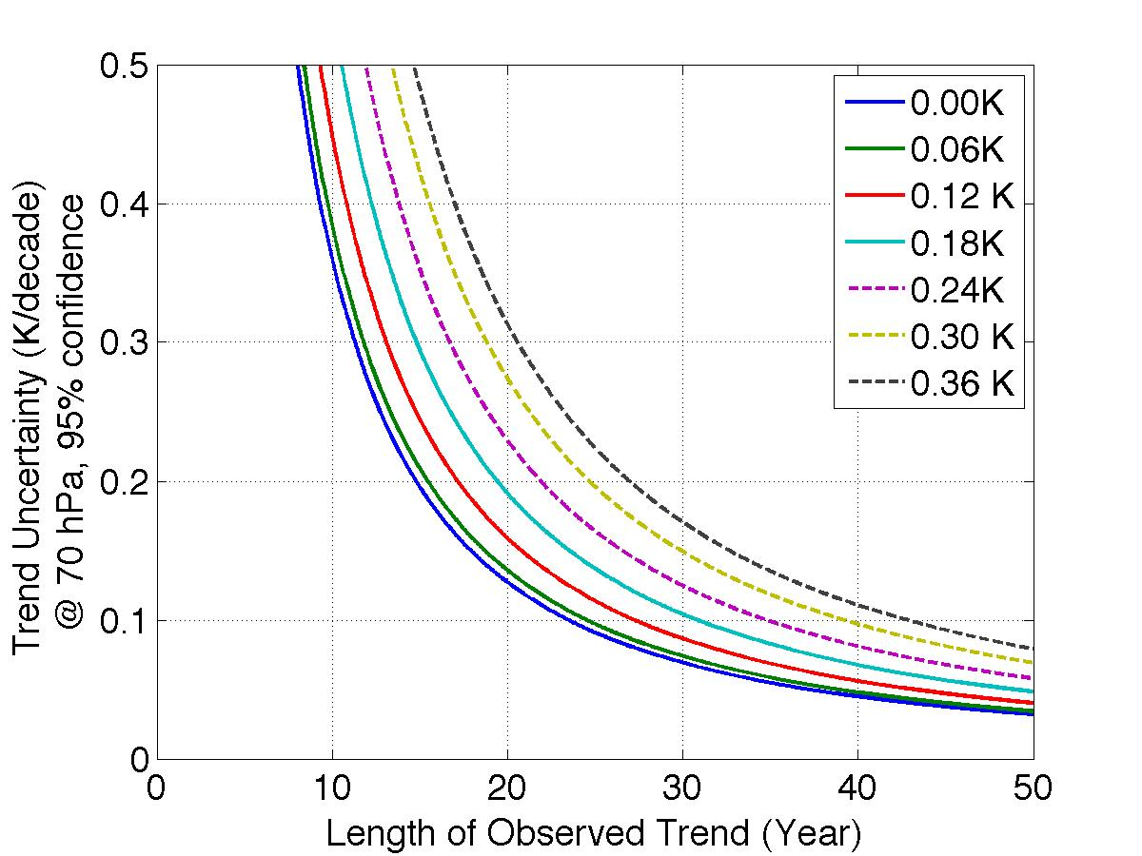
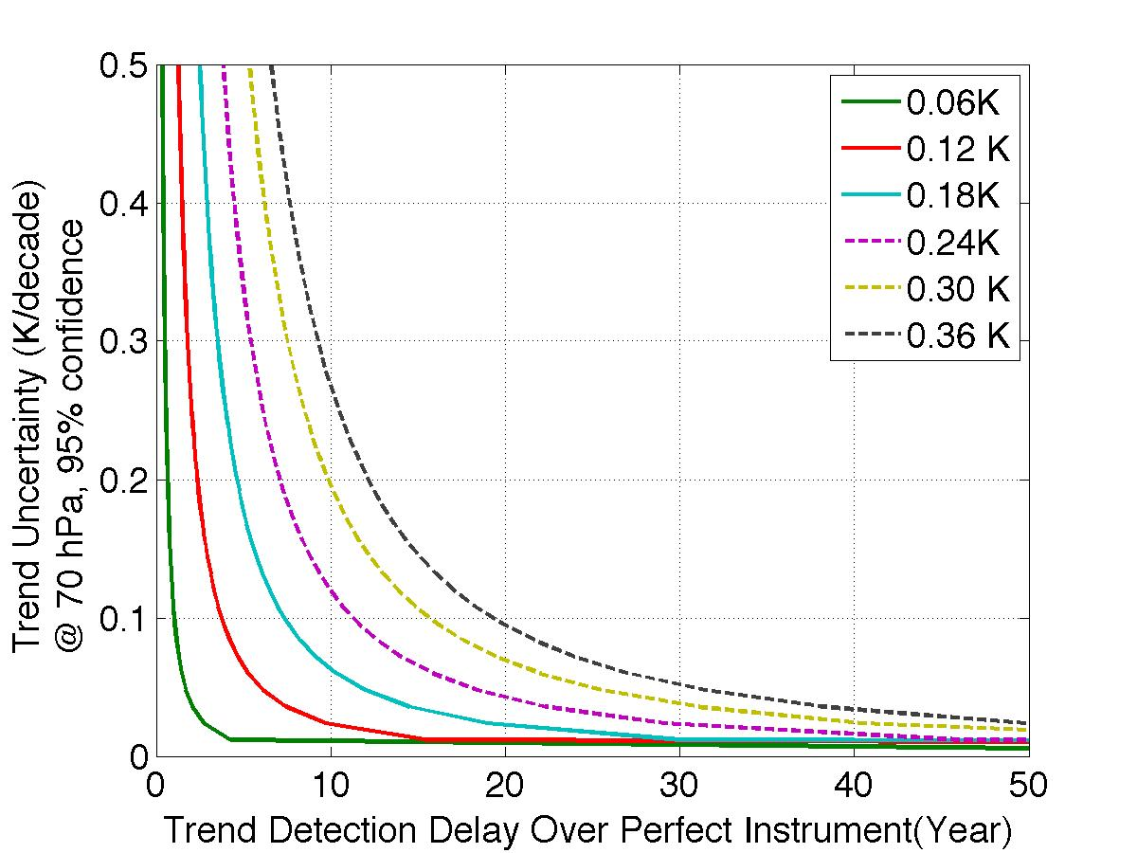
Climate Trend Study
Requirement on Radiance Closure and Measurement Accuracy

Slide 6
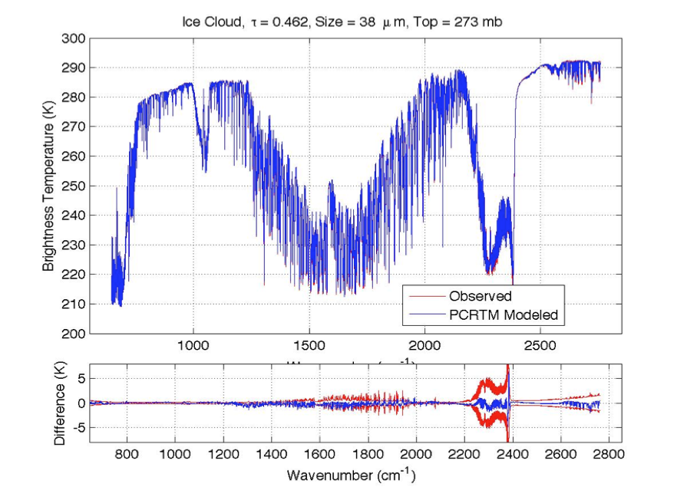
Using a physical algorithm to account for cloud scattering and fit all-sky TOA radiances
Spectral fitting to individual measurements
IASI-CrIS-AIRS
Fitting to CrIS monthly spectral anomaly 2016-2017

Slide 7
Single FOV Sounder Atmospheric Products (SiFSAP)
Optimal estimation method (OEM) based physical retrieval algorithm
Synergistic IR+MW retrieval
Cloud scattering included in the forward model
Principal Component Analysis to utilize all measurement channels
Simultaneous retrieval of Temp., water vapor, O₃, CO₂, CO, CH₄, N₂O, cloud properties and surface properties.
Spectral radiances fitting based quality control
Radiative kernel (Jacobian)
Averaging kernel and error estimation under the OEM scheme
Radiance Bias:
MW, IR
Climatological
background, X₀
Measurement uncertainty, S_{y}
covariance matrices, S_{x},
EOFs, U_{x}
CRTM model
parameters, LUTs
PCRTM model
parameters, LUTs
MW data
Single FOV MW retrieval
GSF Surf. Pres.
GSF Surf. Pres.
MW only
retrieval
results
IR data
Single FOV IR+MW retrieval
QUALITY CONTROL
&
POST PROCESSING
Next FOV
IR + MW
retrieval
results
Next FOV
Flow diagram of the SiFSAP system

Slide 8

Fast and Accurate Forward Model: PCRTM
Sensor | Channel Number | PC score (seconds) | PC score + radiance | PC score + PC Jacobian
CLARREO, 0.5 cm⁻¹ | 5421 | 0.011 s | 0.013 s | 0.039 s
CLARREO, 1.0 cm⁻¹ | 2711 | 0.0096 s | 0.012 s | 0.036 s
IASI, 0.25 cm⁻¹ | 8461 | 0.011 s | 0.012 s | 0.044 s
AIRS, 0.5-2.5 cm⁻¹ | 2378 | 0.0060 s | 0.0074 s | 0.031 s
CrIS,0.625-2.5 cm⁻¹ | 1317 | 0.0050 s | 0.0060 s | 0.021 s
NAST-I, 0.25 cm⁻¹ | 8632 | 0.010 s | 0.013 s | 0.045 s
S-HIS, 0.5 cm⁻¹ | 4316 | 0.008 s | 0.008 s | 0.038 s
CrIS, 0.625 cm⁻¹ | 2211 | 0.009 s | 0.009 s | 0.033 s
Multilayer, multiple scattering clouds included; Cloud transmittance and reflectance LUT established using 32 stream DISORT
15 variable trace gases
Spectral coverage (50-3000 cm⁻¹)
Milliseconds to fraction of seconds in IR
Compared with LBLRTM : Bias error < 0.002 K RMS error < 0.03 K
8

Slide 9
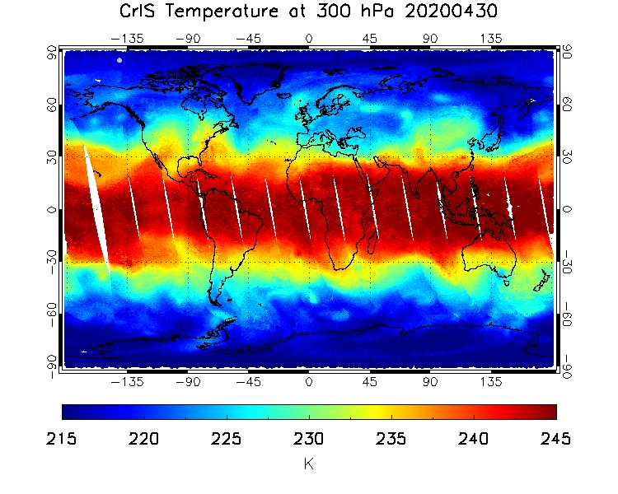
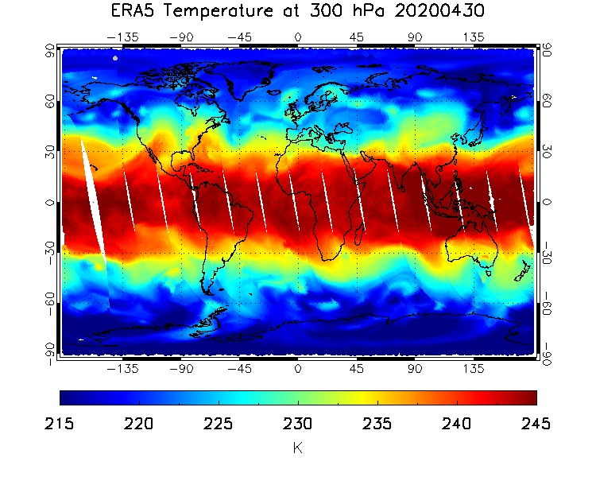
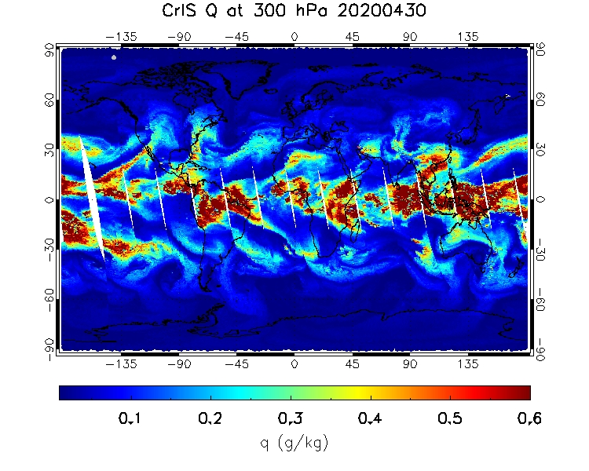
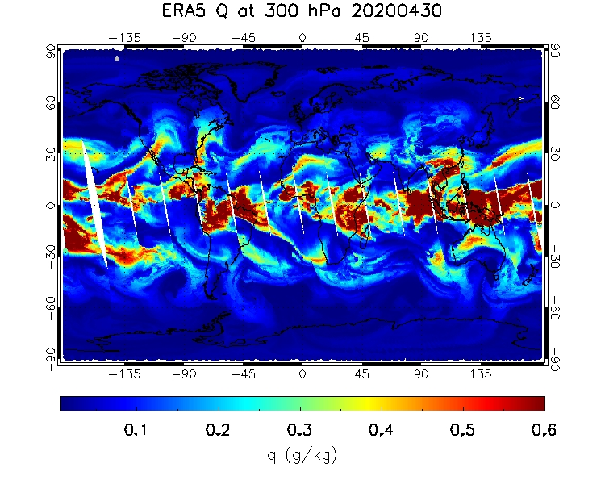
SiFSAP of Temperature
Water Vapor
9

Slide 10
SiFSAP Cloud Optical Depth and Top Pressure

Slide 11
Trace Gases
O₃ | CO
CH₄ | N₂O
SNPP/CrIS SiFSAP
CAM-chem
SNPP/CrIS SiFSAP
CAM-chem
SNPP/CrIS SiFSAP
CAM-chem
SNPP/CrIS SiFSAP
CAM-chem

Slide 12
Current Status and Path Forward
SiFSAP to be released to general public at NASA's Goddard Earth Sciences Data and Information Services Center (GES DISC)
SiFSAP team has provided support for various studies funded by NASA Research opportunities in Space and Earth Sciences (ROSES) proposals
A derivative product – Climate Fingerprinting Sounder Products (ClimFiSP) has been developed to support climate studies that use space-time averaged properties.
Many other environment monitoring applications to be explored

Slide 13
END

