Slide 1
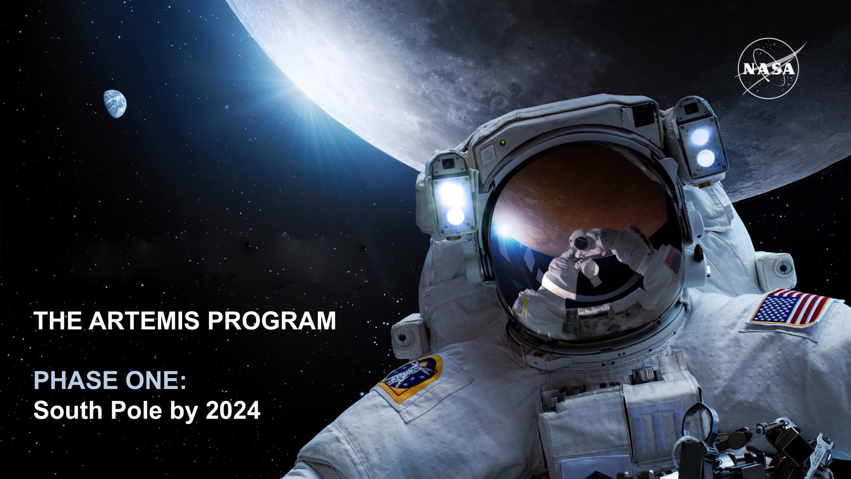
Unique Science from the
Moon: An Overview
James L. Green
NASA Senior Advisor
June 7, 2022

Slide 2
Outline
Atmospheric Windows
Early Cosmic Timeline
Radio emissions from stars and planets
  Star formation (non-thermal processes)
  The Sun as a star
  Planetary Magnetospheres
Black Hole Observations
The Far-Infrared Sky
The next horizon of the Planetary and Astrophysics Decadals
Notes:
Ck planetary decadal
Ck astrophysics decadal
The Sun as a star
Solar radio emissions leading to better understanding of Space Weather
Solar Wind Implantation to discover the history of the SW
Mining of He3 ?
Radar of NEOs, planets, METI

Slide 3
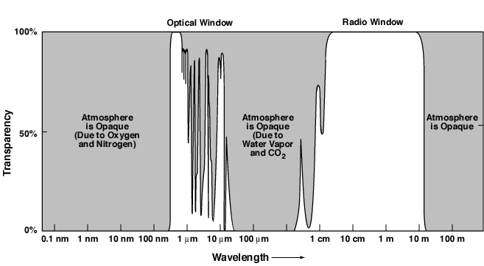
Atmospheric Windows
30 GHz
300 MHz
3 MHz

Slide 4
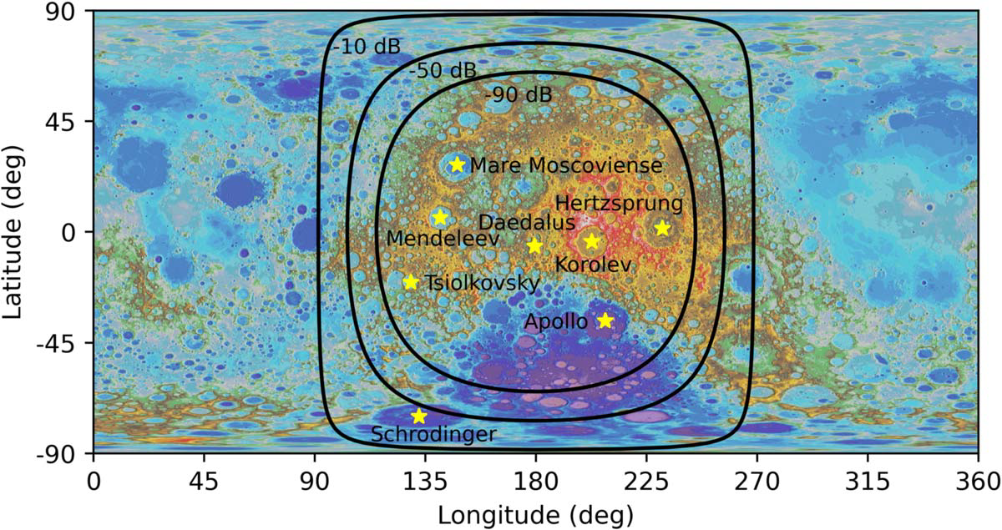
Map of RFI Suppression at 100 kHz
Burns, et al., 2021

Slide 5
Early Cosmic Timeline

Slide 6
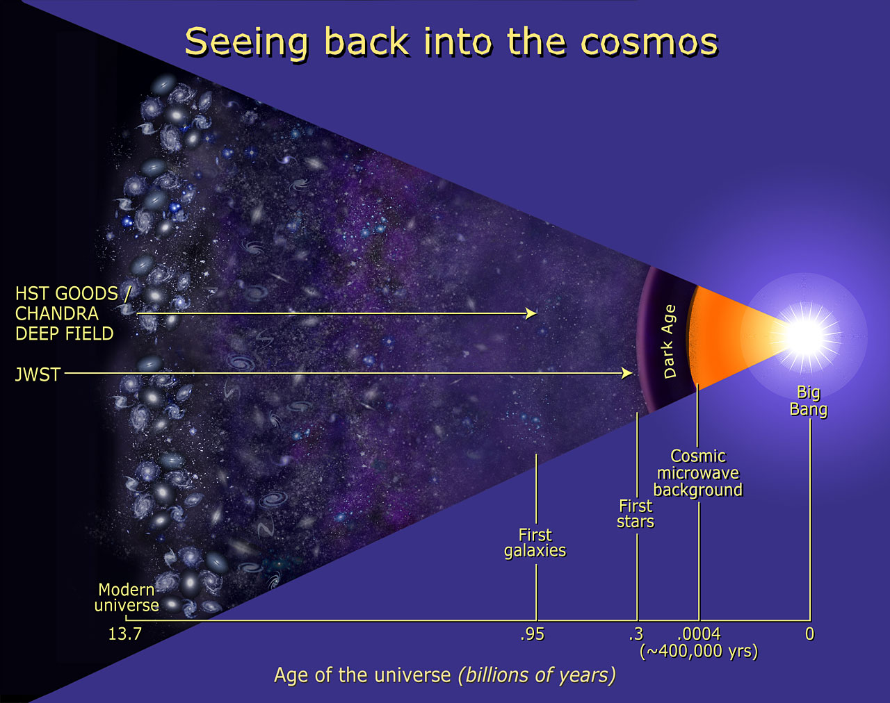
Cosmic Timeline
Cosmic Microwave Background - 2.7 K black body spectrum (peaks at 160.4 GHz or 1.9 mm)
HST
Deep Field
Notes:
The cosmic microwave background is a confirmed prediction of Big Bang theory.

Slide 7
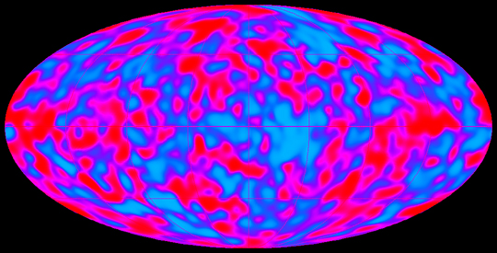
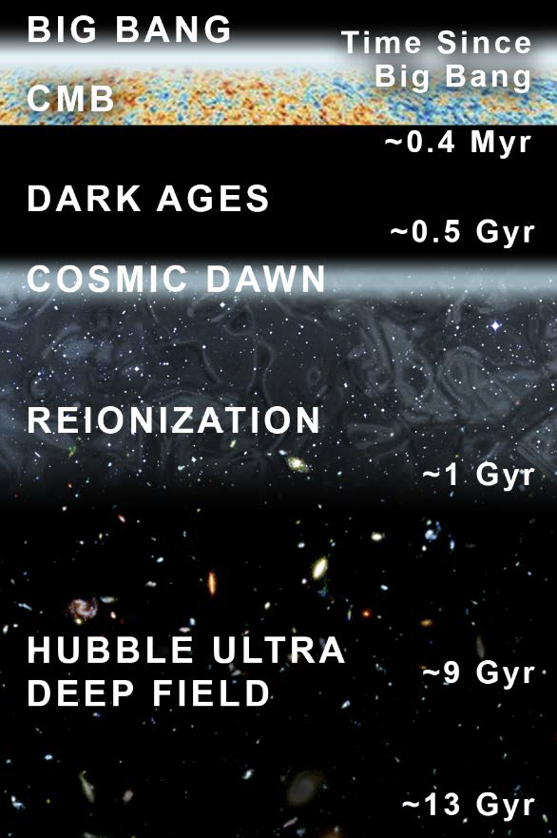
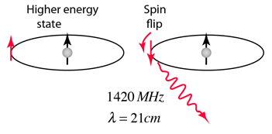
CMB is a snapshot view of
the distribution of matter
No visible or infrared light. Expect simple matter like:
Neutral Hydrogen, photons, and dark matter
Longer the wavelength the older it is. Look for this emission at 10 to 100 m or
From 30 MHz to 3 MHz
The very first stars
James Webb Space Telescope – observing the first galaxies
Adopted from Burns, et al., 2021

Slide 8
Radio Emissions from Other Stars and the Sun

Slide 9
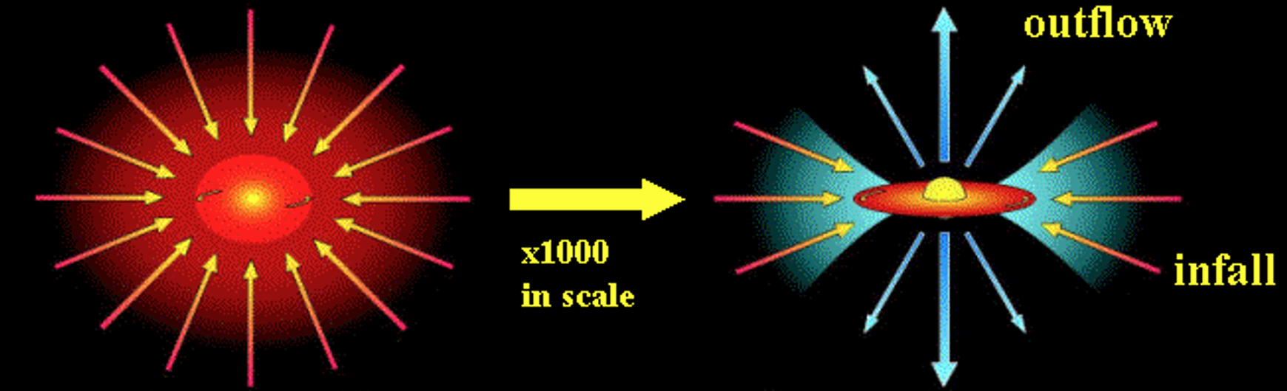
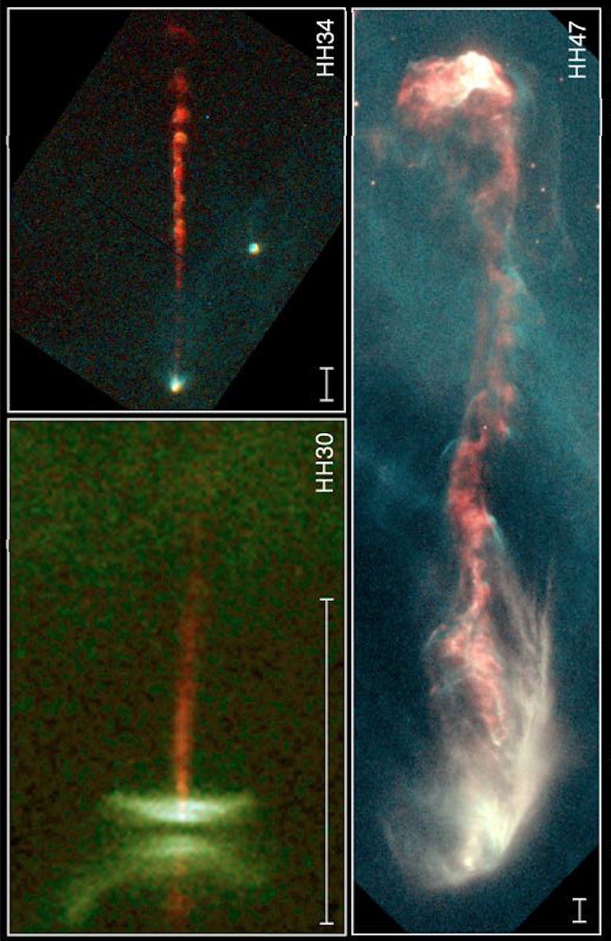
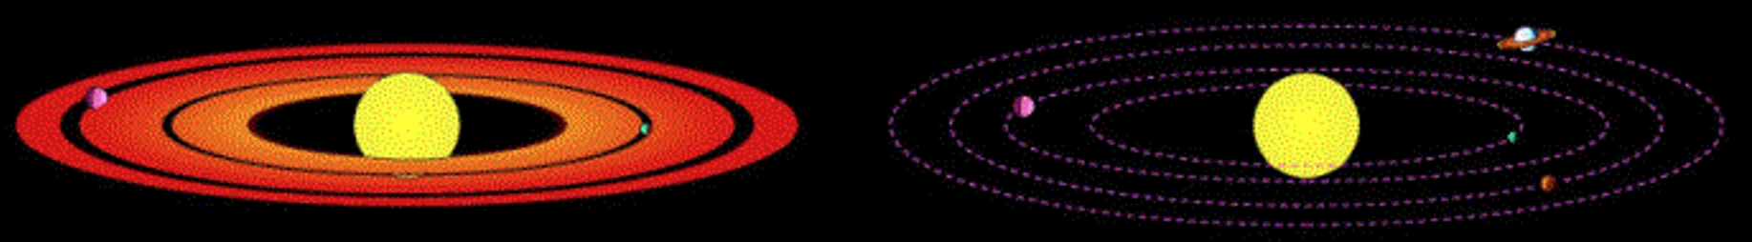
Star Formation Processes
Cloud Collapse
Rotating Disk Phase
Planet Formation
Mature Solar System
Observations with improved sensitivity and
Image quality are needed by combining arrays
(Radio emissions below 1 MHz needed)
Notes:
http://web.gps.caltech.edu/~gab/astrophysics/astrophysics.html
We are carrying out an observational study of the star and planet formation process using Caltech's extraordinary suite of telescopes, including the
Owens Valley Radio Observatory (OVRO) Millimeter Array, the Caltech Submillimeter Observatory (CSO), and the Keck telescopes:

Slide 10
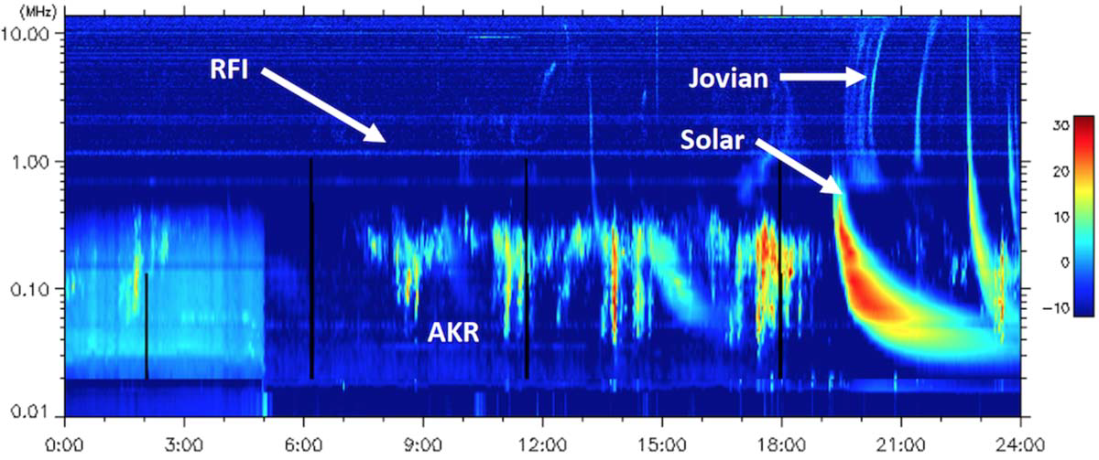
Radio Frequency Spectrum in the Solar System
(All frequencies not observed from the ground)
Source Differentiated by
Emission Spectrum and Polarization
Jupiter
Sun
Earth
Adopted from Burns, et al., 2021

Slide 11
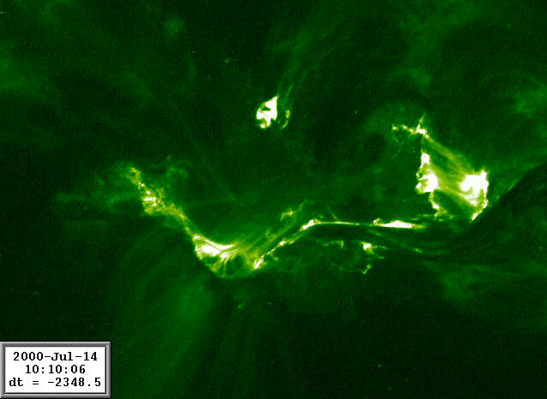
Solar Flares
Flare.mov

Slide 12
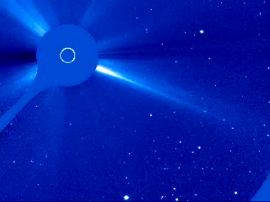
Coronal Mass Ejection
CME_C3.mov

Slide 13
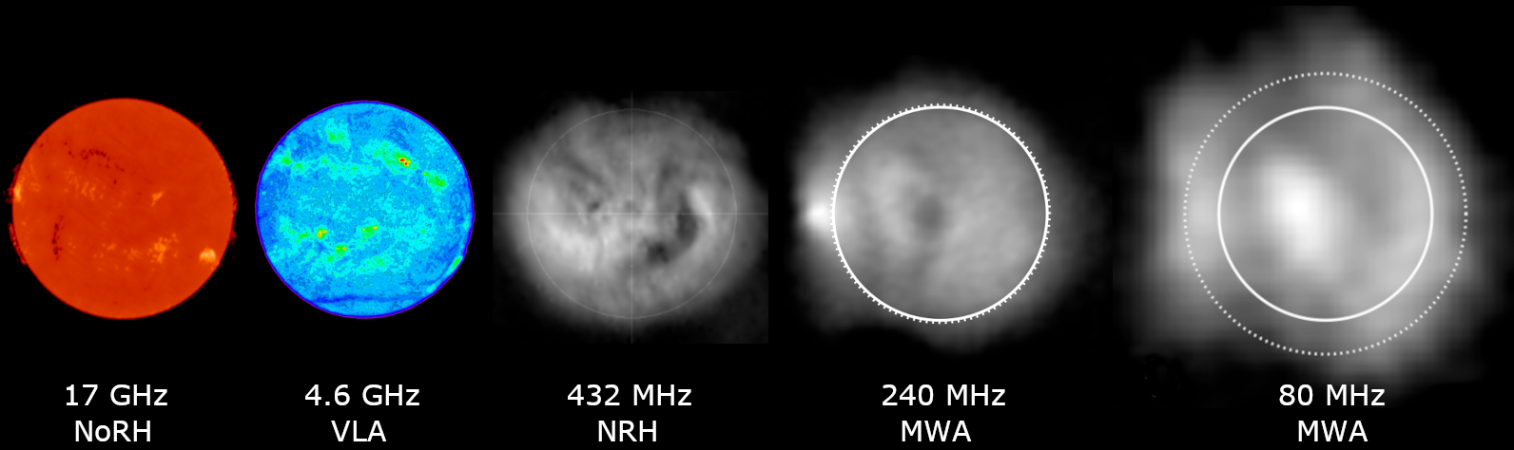
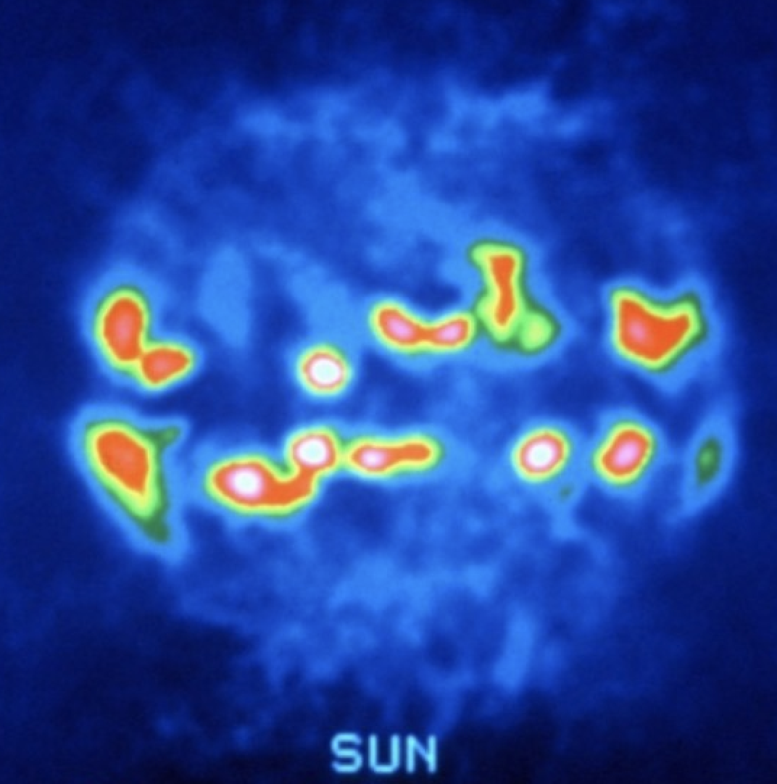
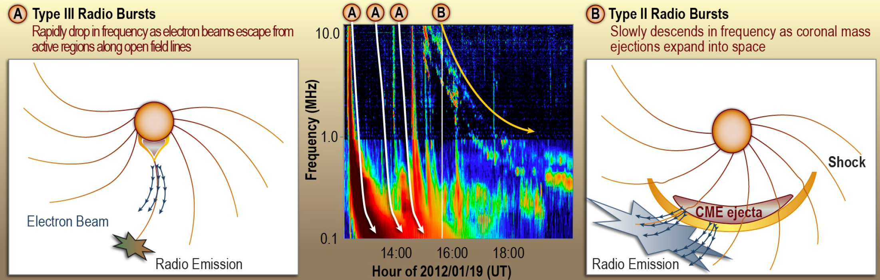
Solar Radio Emissions
11 GHz
VLA
Not Observed
From Earth
Left Hand Polarized
Lazio, et al., 2017
Linear Polarized

Slide 14
Radio Emissions from Planets

Slide 15
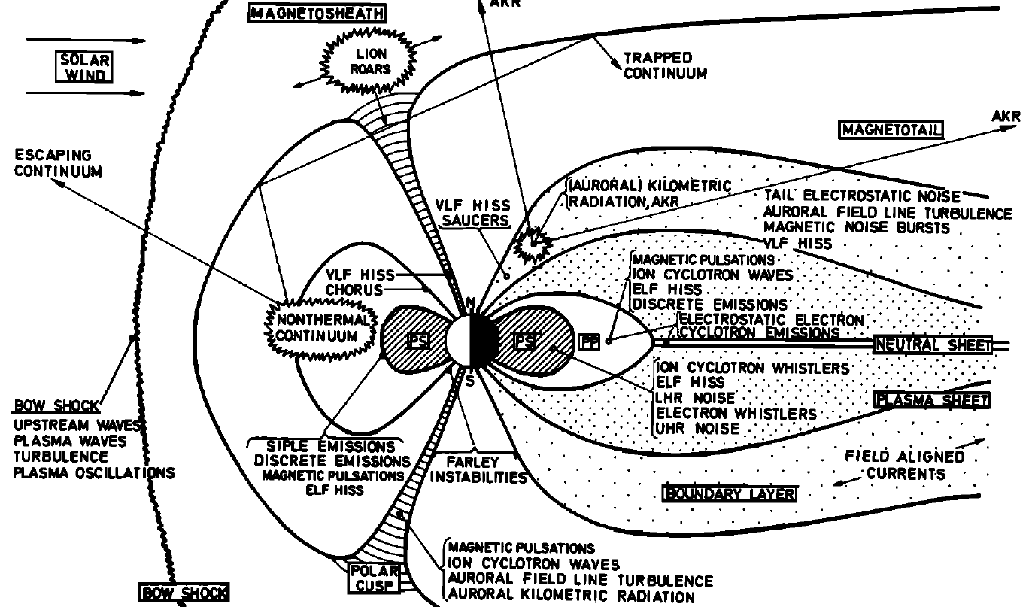
Magnetospheric Plasma Waves
AKR
Shawhan, RG, 1978

Slide 16
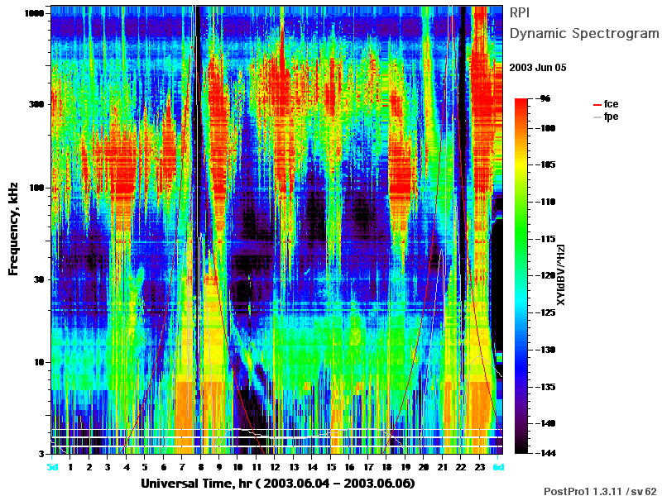
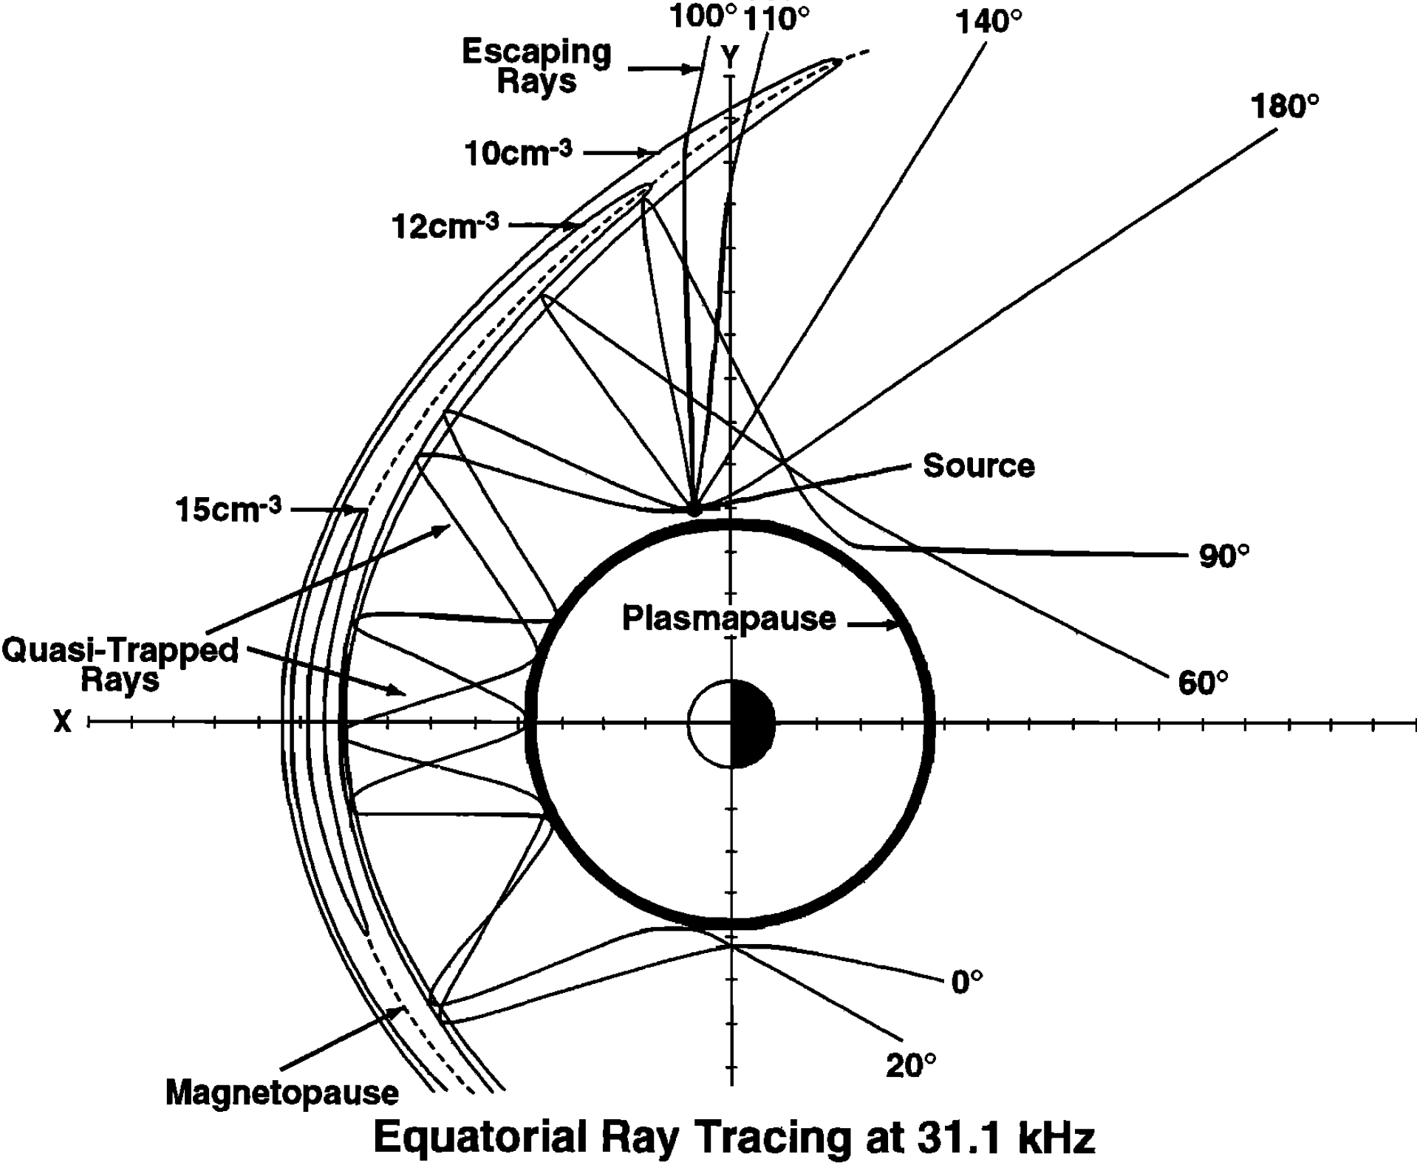
Auroral
Kilometric
Radation
Non-Thermal
Continuum
Fung et al., 2022

Slide 17
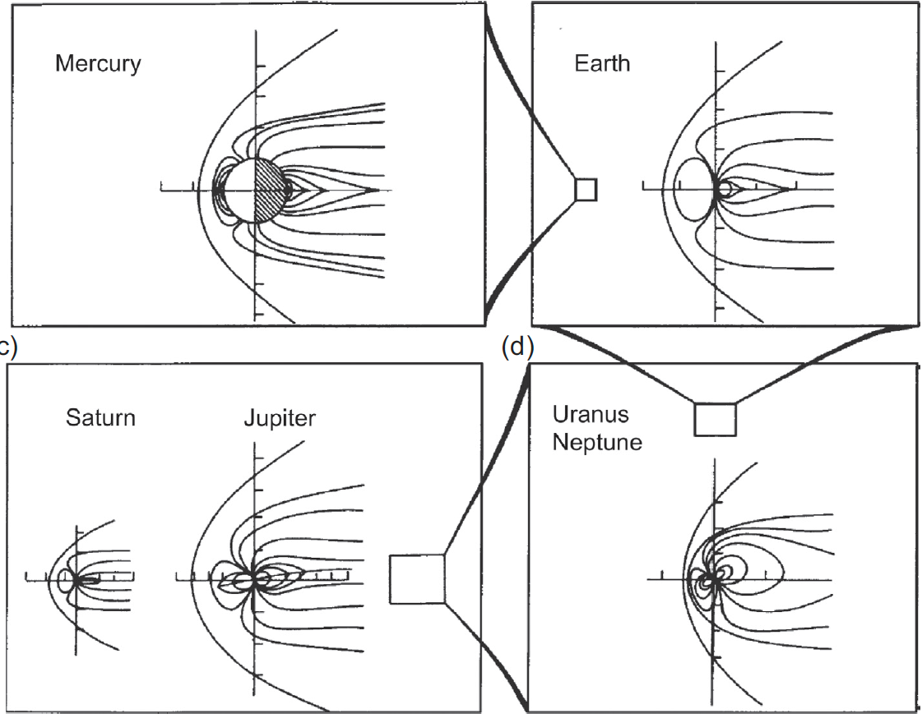
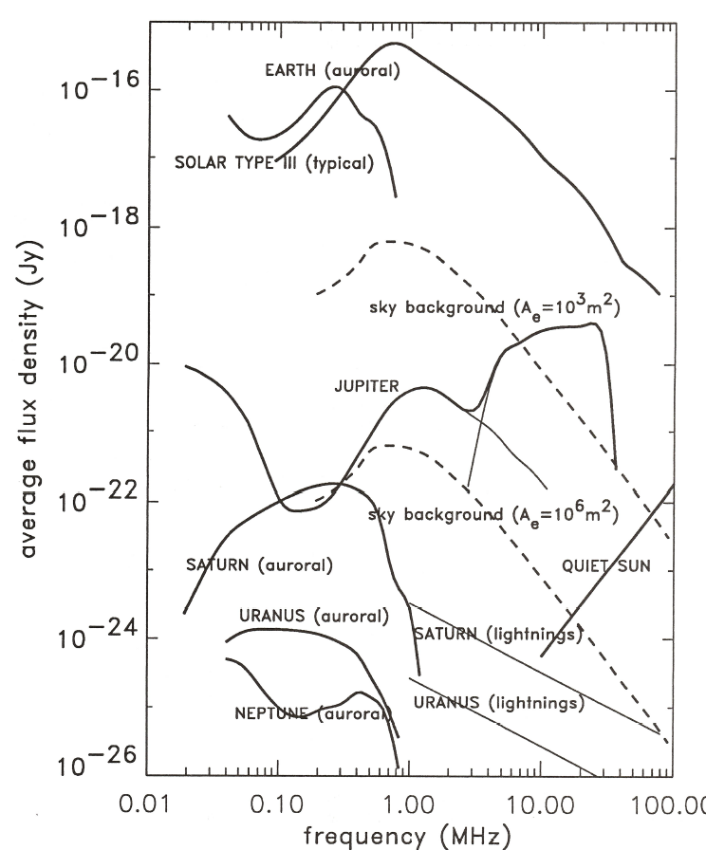
VLF Emission from the Solar System Magnetospheres
40 MHz
Opaque Transparent
• Mars had a magnetosphere but lost it 3 By ago; Unknown if Venus ever did
• Magnetospheres may be a fundamental feature of early planet evolution
0.01 0.1 1 10 100
Frequency (MHz)

Slide 18
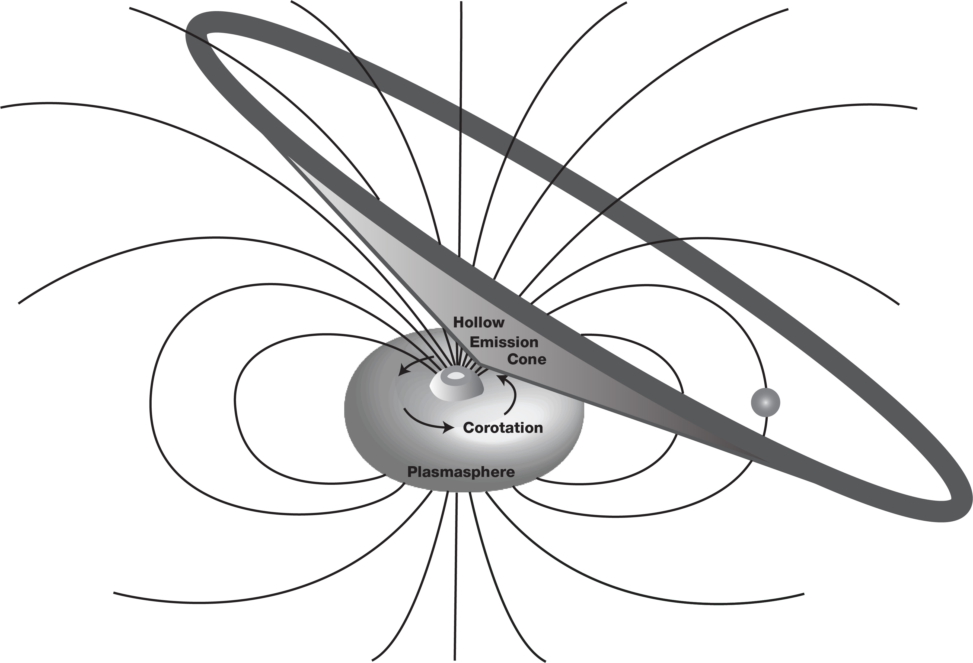
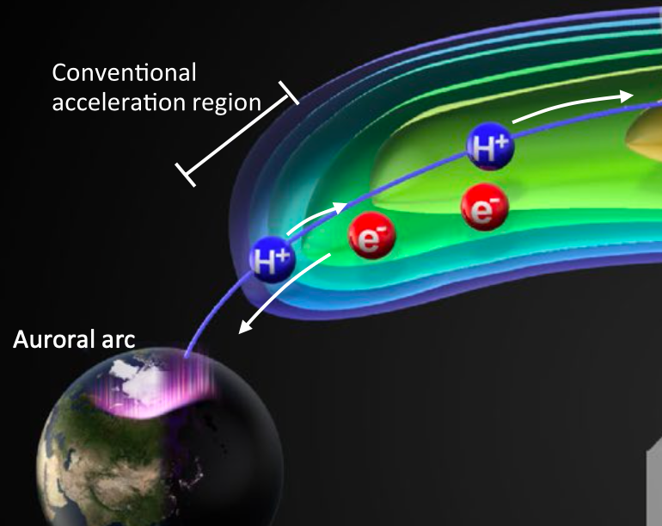

Magnetospheric Auroral Emissions
B
f_{ge} =2.8B MHz
Magnetic field (B) in Gauss
Emission Perpendicular to B
Right-Hand Circular Polarized
Green et al., 2021

Slide 19
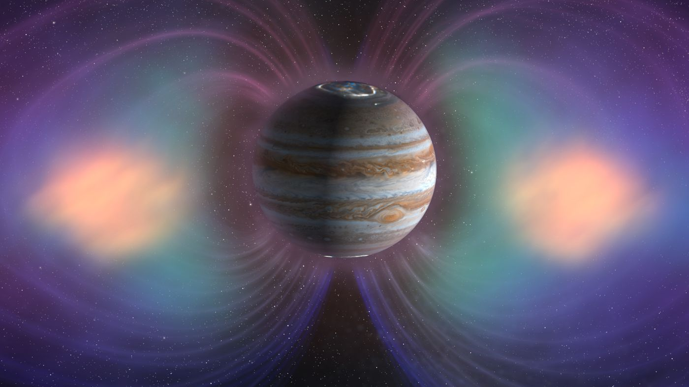
Jupiter’s Escaping High Frequency Radiation
Jovian Decametric radiation - 10 and 40 MHz – Auroral related
Jovian Decimetric radiation - 0.1–15 GHz – Radiation Belts
(wavelength 3 m to 2 cm)

Slide 20

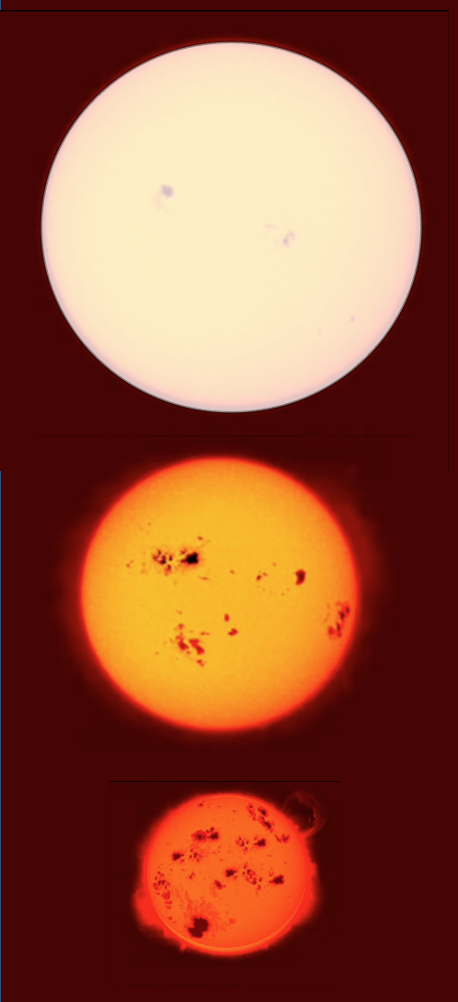
Why are Planets around M-dwarfs so Important?
Stars within
10 pc of the Sun
O
B
A
F
G
K
M
0
0
4 (1%)
6 (2%)
20 (6%)
44 (14%)
246 (77%)
There are ~250 M-dwarfs within 10 pc
Milky Way has ~100-400 billion stars
  M-stars are ~70% of all stars
  There are > 70 billion M-dwarfs
If 50% of M-dwarfs have an Earth-sized planet in the Habitable Zone
  Then ~35 billion potentially habitable planets in our Galaxy
Space Weather varies significantly with star type with M-dwarfs having significant activity
Understanding the Trappist-1 system
is fundamental to our exoplanet life search
Notes:
1 pc is 3.26 Light years
10 pc are ~33 Ly distance

Slide 21
Notes:
TRAPPIST-1 is in the constellation Aquarius

Slide 22

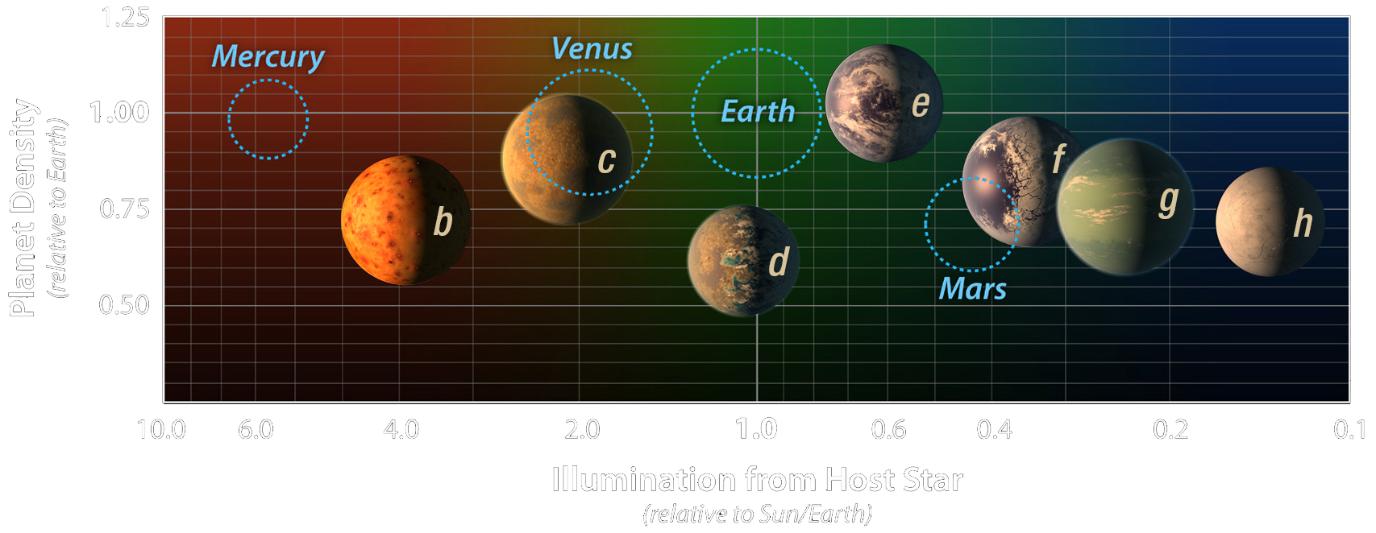
TRAPPIST – 1
Similar density to terrestrial planets and lack extended primitive Hydrogen atmospheres

Slide 23
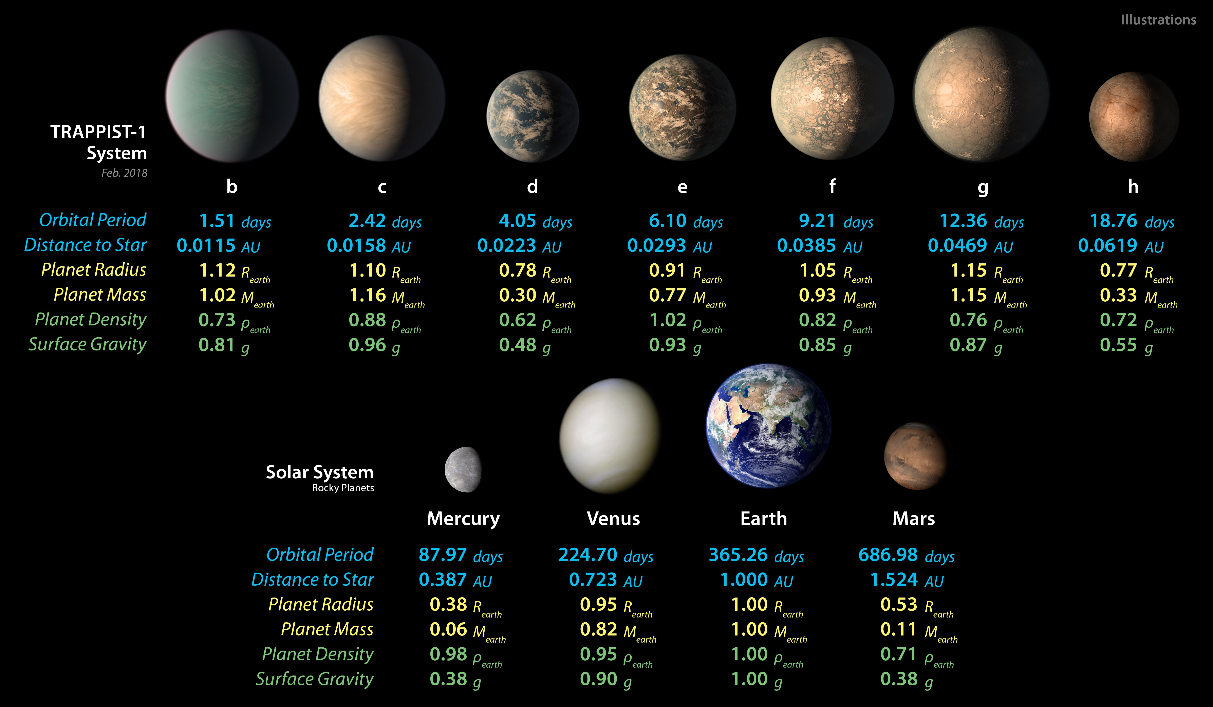
65 hours 97 hours 147 hours
Notes:
Assuming 3:2 resonances – what is the period of a day?
D = 64 hours
E =97 hours
F =147 hours

Slide 24
Time
Green et al., 2021

Slide 25
Black Hole Observations
Far-Infrared

Slide 26
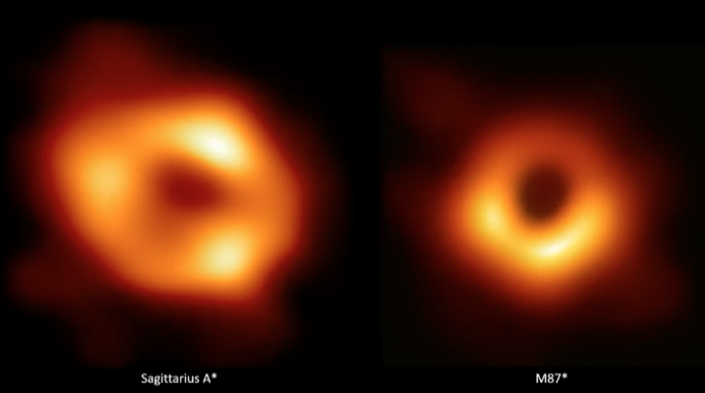
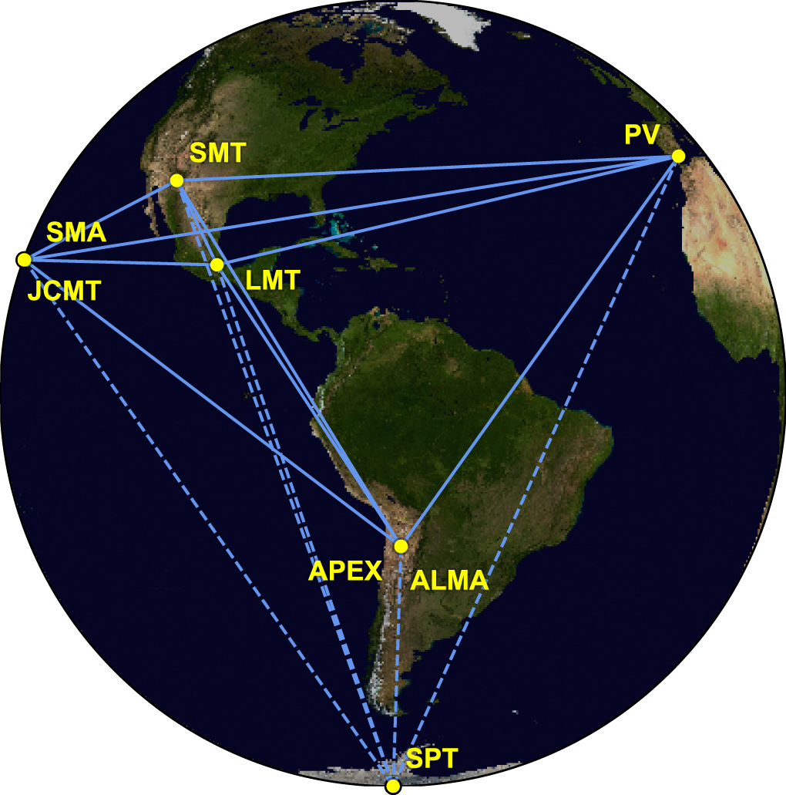
Black Holes imaged by the Event Horizon Telescope (EHT)
Sagittarius A
M87
Event Horizon Telescope uses 8 telescopes at 1.3 mm (230 GHz)
Interferometer at the size of the Earth (for M87 it is less than 1 pixel of HST)
Radio astronomy pioneered interferometry imaging techniques, when the signal from different telescopes at large distances are combined.
The resolving power is determined by the distance between the telescopes.
Notes:
"Radio astronomy pioneered the development of imaging techniques based on interferometry, when the signal from different telescopes at large distances are seamlessly (in our terminology: coherently) combined. In this case, the ultimate factor that determines the resolving power of the instrument is the distance between the telescopes, which we call baselines.”
High angular resolution imaging is achieved in three ways:
by increasing the size of our telescopes,
observing light at shorter wavelengths
eliminating (or at least compensating for) the disturbances caused by the Earth's atmosphere.
.0059 parc across - radius of Schwarzschild radius
1.2 pc the size of the accretion disk

Slide 27
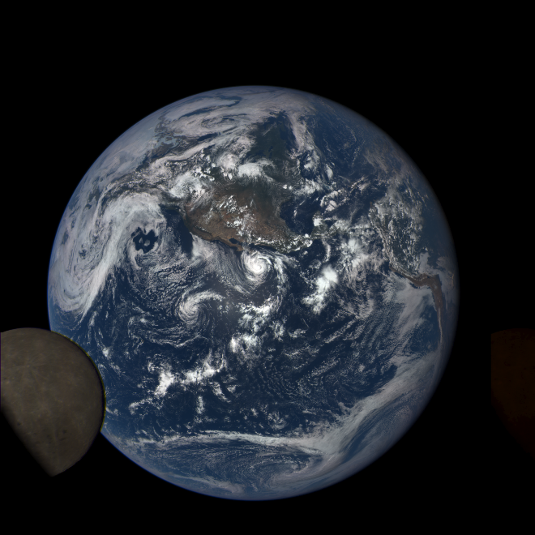
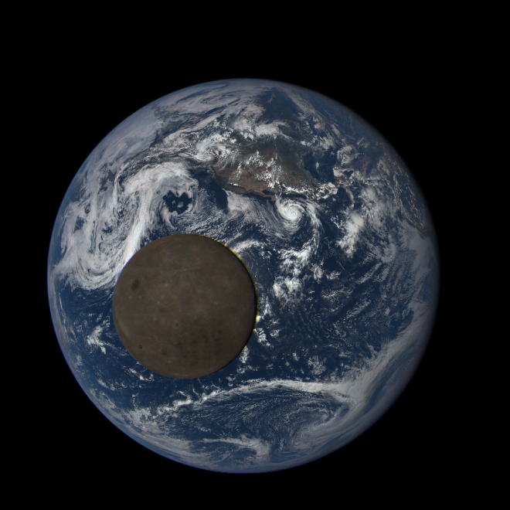
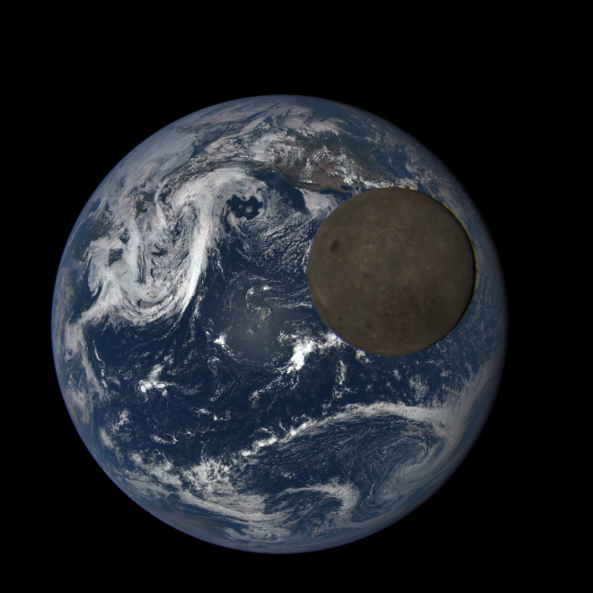
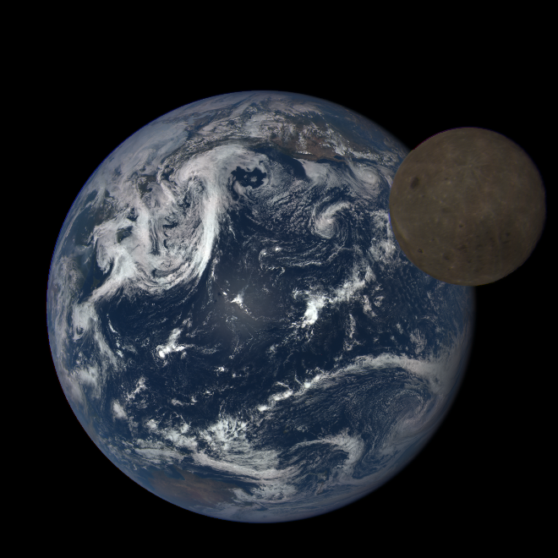
Very-Long Baseline Interferometry (VLBI)
Including the Lunar Farside
DSCOVR – EPIC (Lunar Transit)
Slow Moving Lunar Farside Radio Telescope with significant expanded baseline (resolution)

Slide 28
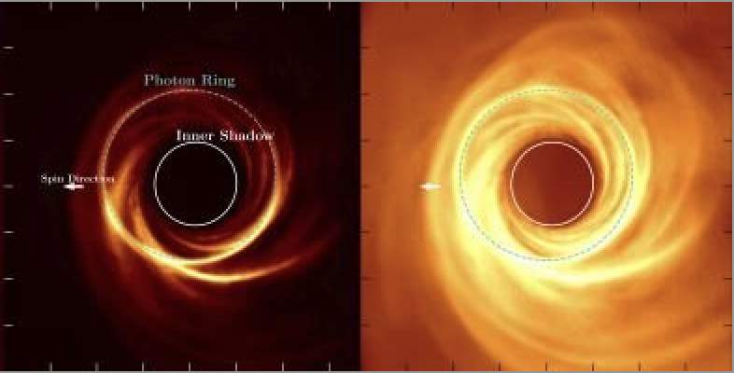
Very-Long Baseline Interferometry (VLBI)
Simulation Images with Larger Baselines
The resolving power is determined by the distance between the telescopes.
Notes:
"Radio astronomy pioneered the development of imaging techniques based on interferometry, when the signal from different telescopes at large distances are seamlessly (in our terminology: coherently) combined. In this case, the ultimate factor that determines the resolving power of the instrument is the distance between the telescopes, which we call baselines.”
High angular resolution imaging is achieved in three ways:
by increasing the size of our telescopes,
observing light at shorter wavelengths
eliminating (or at least compensating for) the disturbances caused by the Earth's atmosphere.
.0059 parc across - radius of Schwarzschild radius
1.2 pc the size of the accretion disk

Slide 29
Infrared Universe

Slide 30
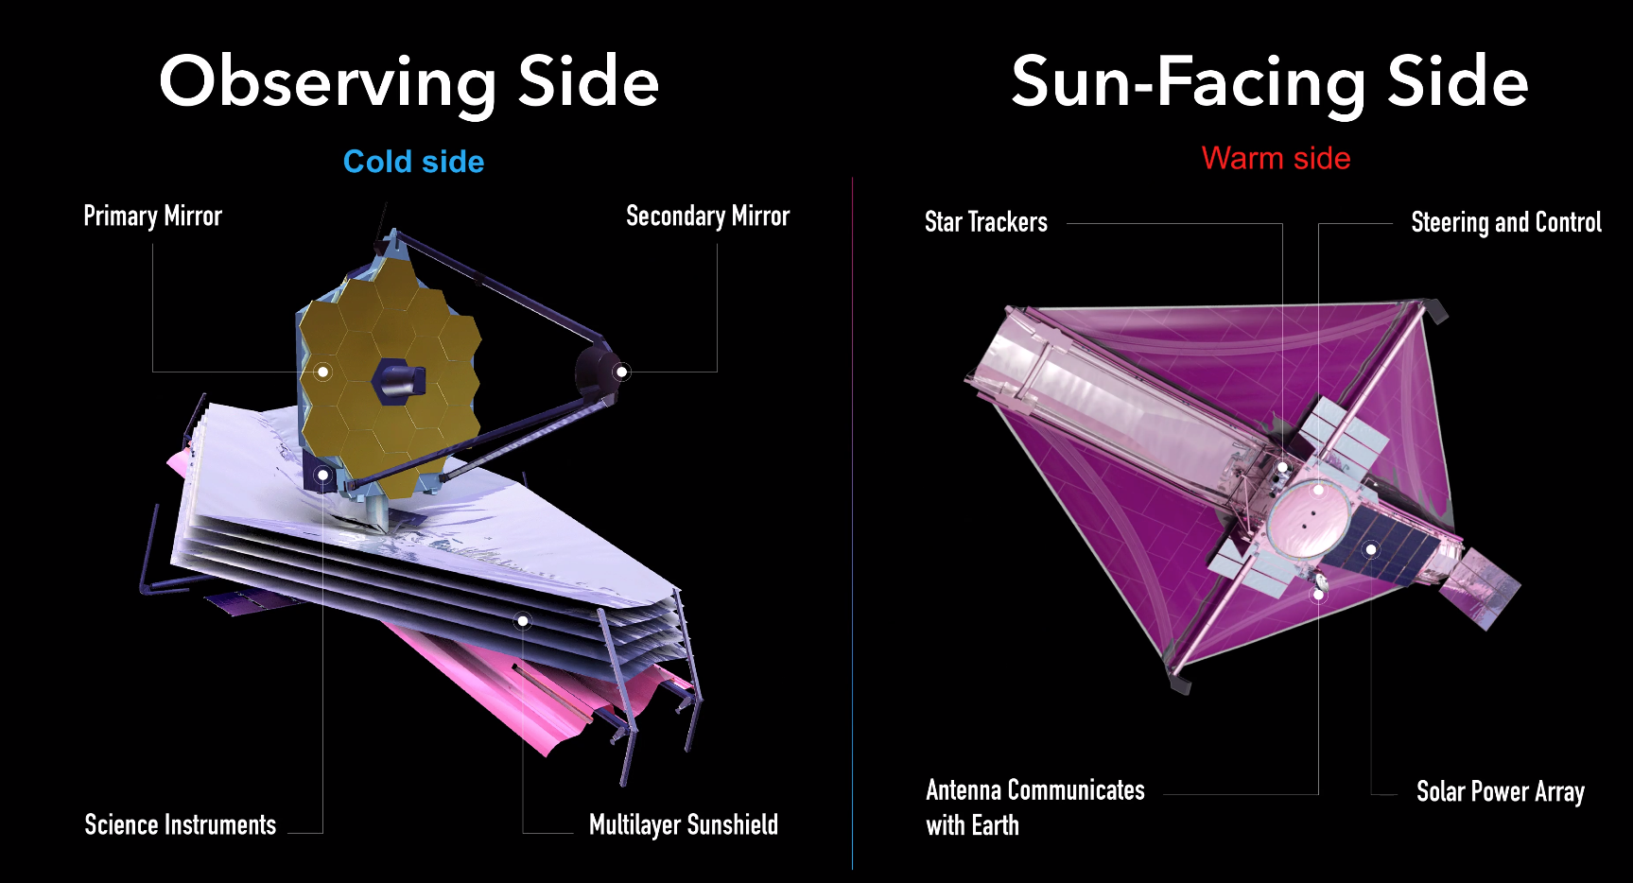
(radiates heat)
T= -370º F
Then cooled
to -447º F
12º above absolute 0
T= 230º F
(radiates heat outward)
We are here
SC Commissioning
Launch – L+30 days
Transition
Telescope Commissioning
L+40 days to L+118 days
Science Instrument Commissioning
L+119 days to L+ 180 days
Notes:
NIRCAM, NIRISS, MIRI, and then NIRSpec

Slide 31
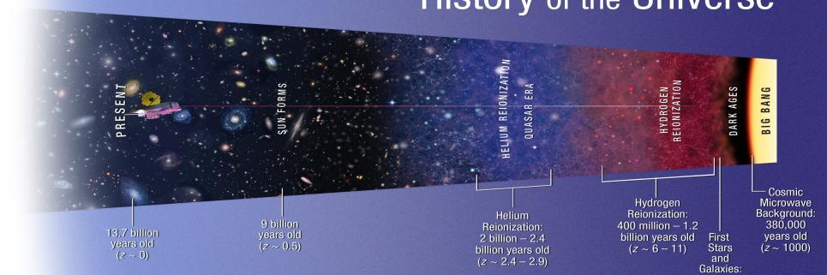
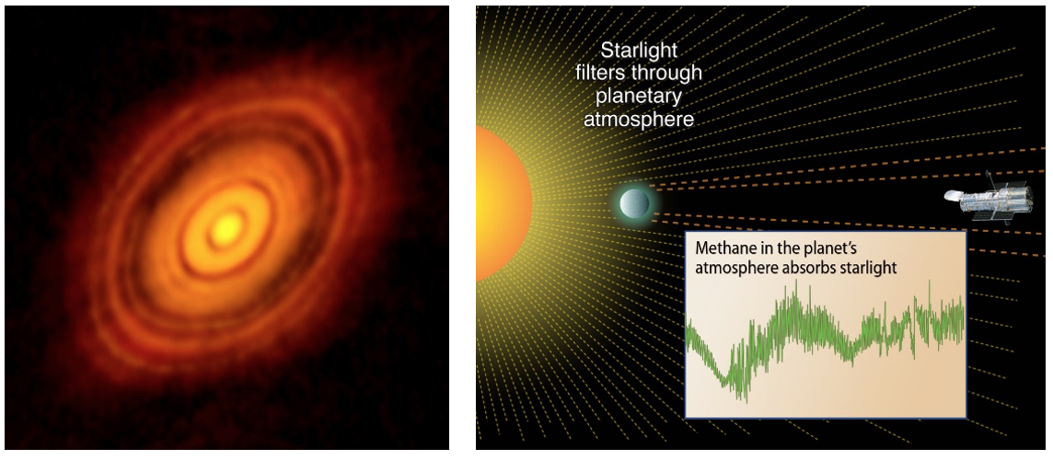
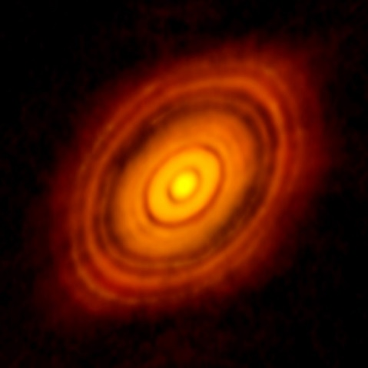
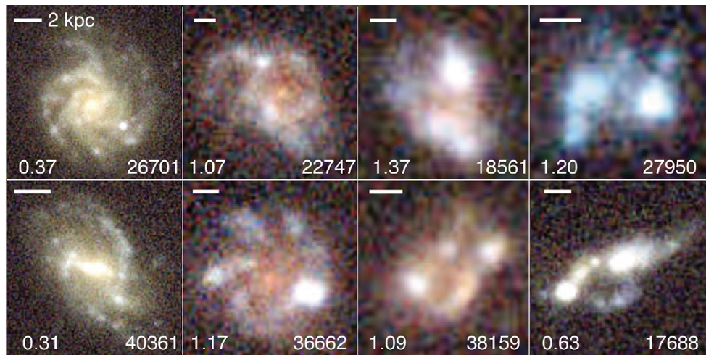
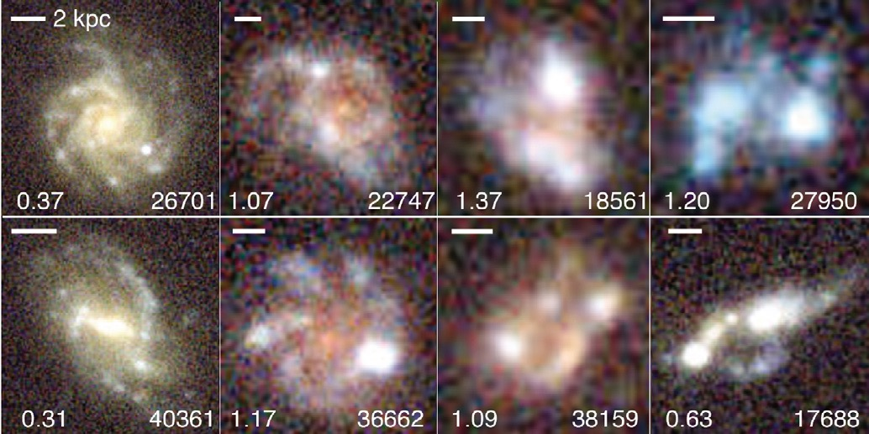
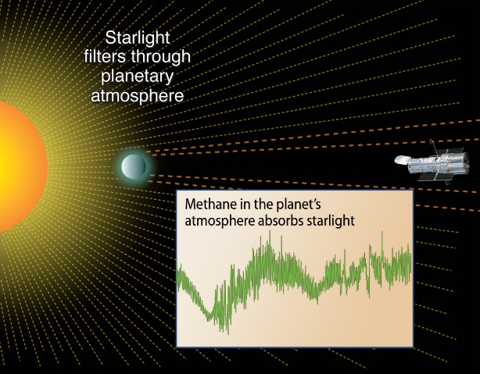
James Webb Space Telescope - Science
31

Slide 32
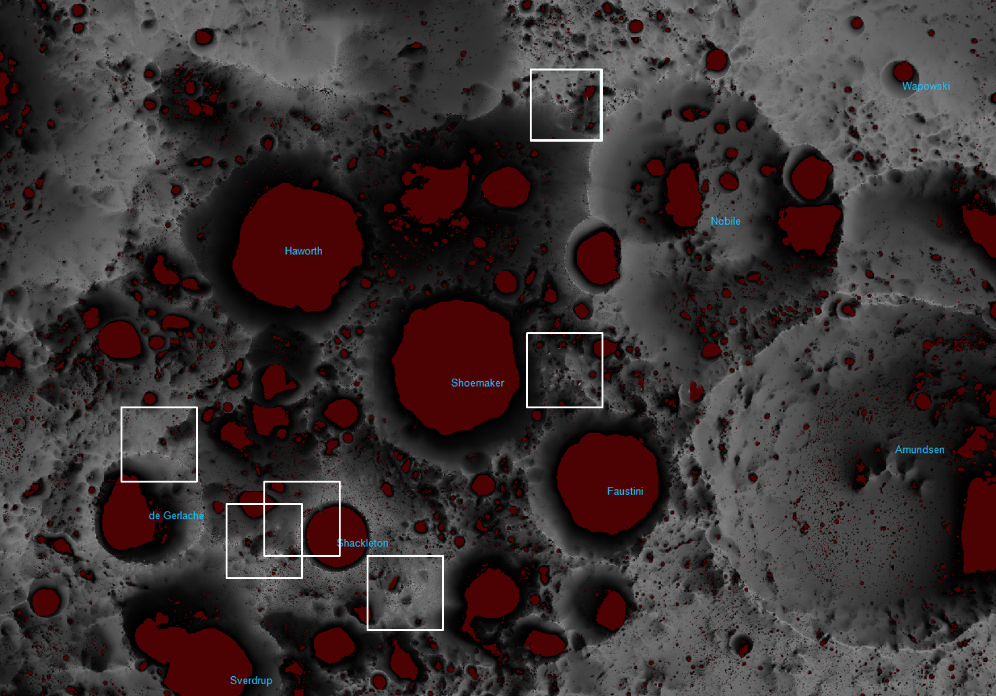
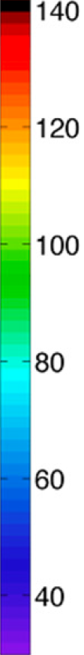
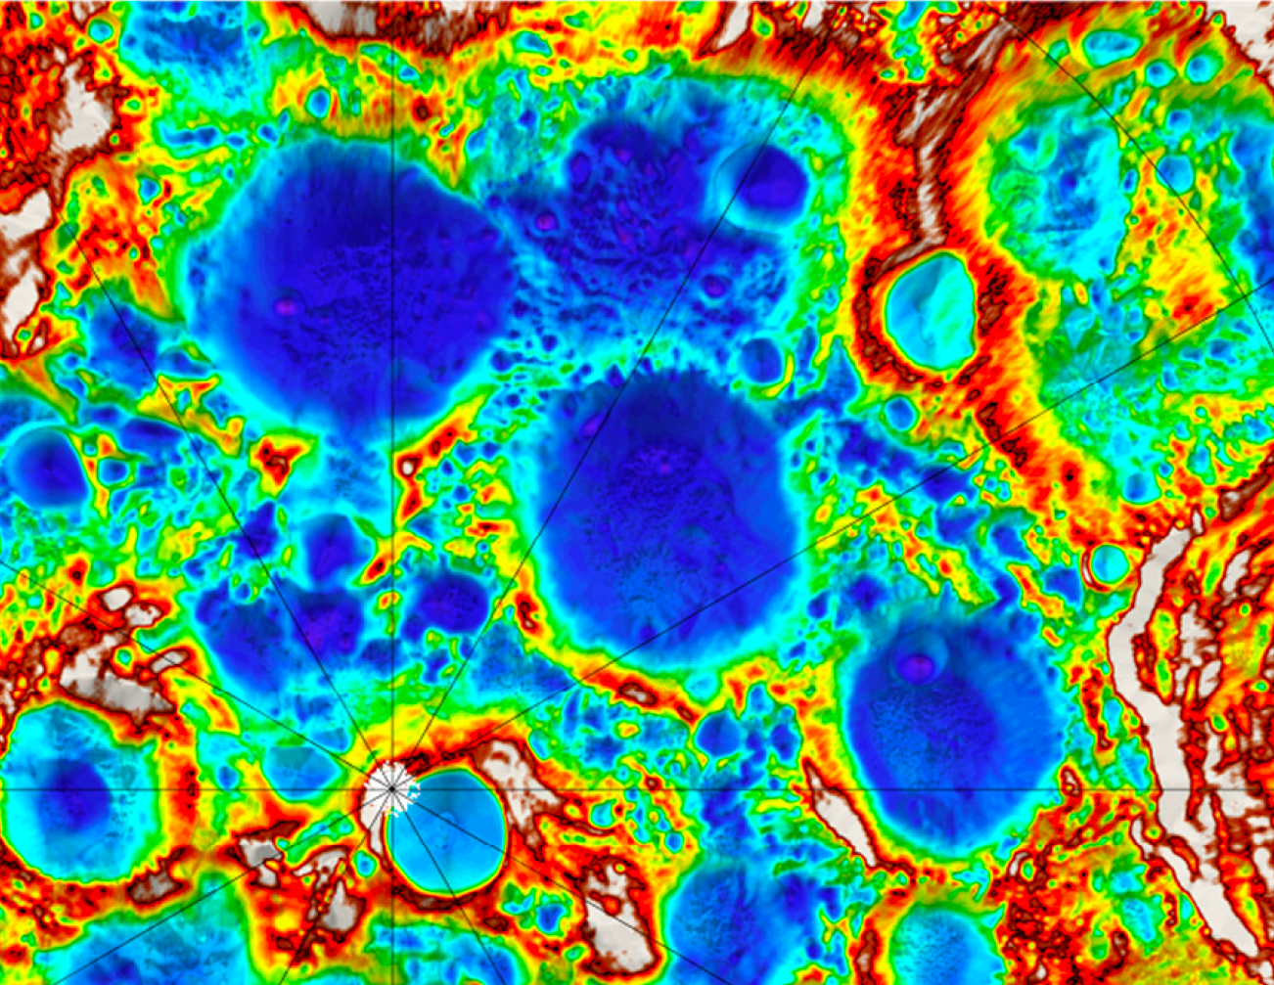
Potential Lunar Landing Sites
Hayne et al., 2015
K
PSRs are very cold, all below the volatility temperature of H₂O (T < 110 K)

Slide 33
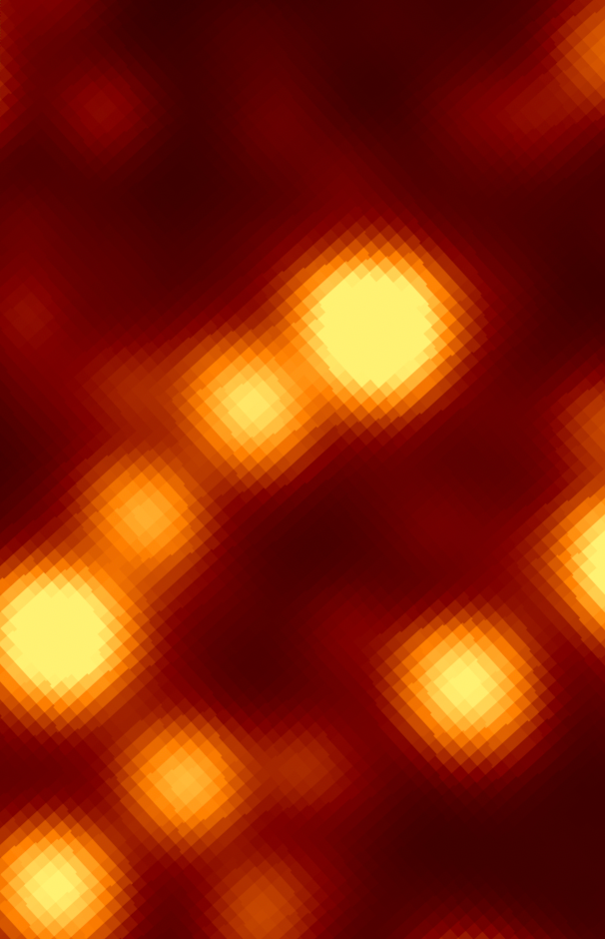
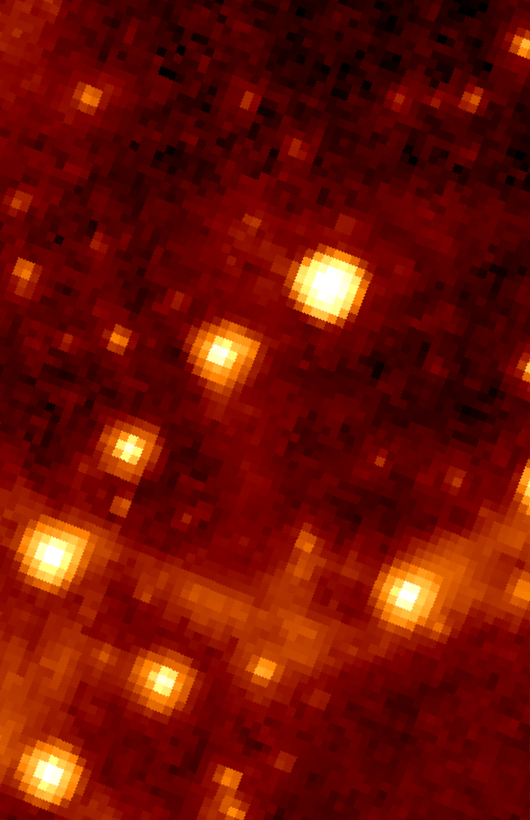
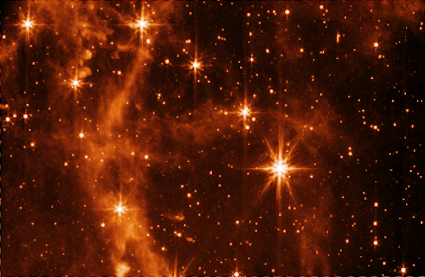
Infrared Space Telescopes – Cooling & Aperture
WISE
Spitzer
JWST

Slide 34

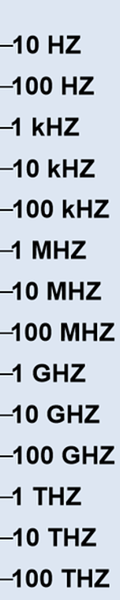
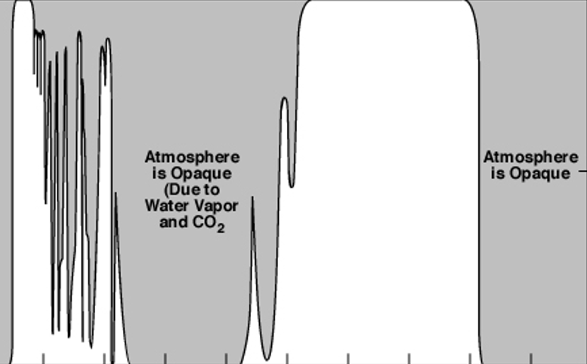
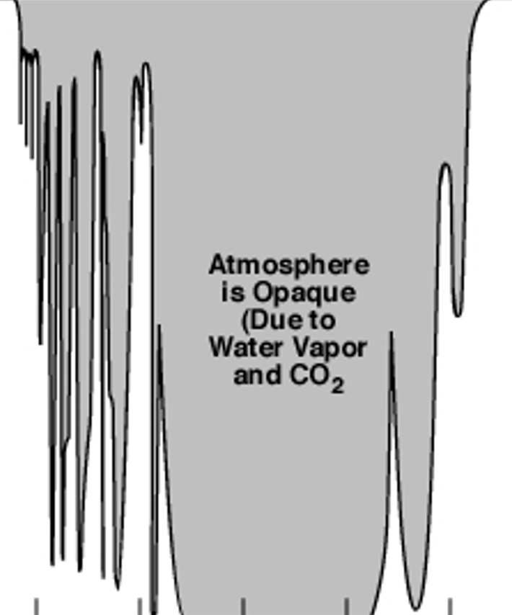
Science Objectives
Summary
Not Observed
From Earth
Planetary Magnetospheres – plasma waves
Planetary Magnetospheres – Aurora Radio
Stellar Radio Emissions
Early Stage of Star Formation (non-thermal)
Cosmic Dawn and the Dark Ages
Atmospheric Opacity
Planetary Magnetospheres – Radiation Belts
Imaging Black Holes
Star formation (thermal radiation)
Active Galactic Nucleus
Notes:
Infrared interferometry
VLTI
Interferometry infra surface of exoplanet
AGN
Radio emission of star formation T-tauro stars (below 1 Mhz

Slide 35

Artemis Base Camp
QUESTIONS?

