Slide 1
Climate Data Record Derived from Hyperspectral Satellite Remote Sensors
Xu Liu
W. Wu, Q. Yang, X. Xiong, D. Zhou, and A. Larar
  NASA Langley Research Center
  With contributions from:
  H. Jang, M. Zhao, L. Lei, W. Smith, P. Yang, H. Li, S. DeSouza-Machado, S. Kizer, J. Welch, N. Nally, X. Huang, Shea, D. Goldin, C. Lukashin, J. Currey, S. Kato, F. Rose, M. Saito, X. Liu, J. Bak, R. Spurr, Q. Yue and many more
Funding Support:
NASA Roses Proposals, NAST-I, NASA NPP Postdoctoral, IPO/JPSS/NOAA
Acknowledgement for computer facilities:
Langley K-cluster, NASA supercomputer, NASA Sounder SIPS

Slide 2
Outline of the Presentation
Introduction: Challenges facing hyperspectral IR sounding and ways to deal with them
New L2 products: Single Field-of-view Sounder Atmospheric Product (SiFSAP)
New L3 products: Climate Fingerprinting Sounder Product (ClimFiSP)
Conclusion and ways forward

Slide 3
There are two key challenges in exploring information content of hyperspectral sounders
20 years of AIRS (and later CrIS and IASI) hyperspectral sounders
  Have provided unprecedented data for atmospheric weather, dynamics, and climate studies
  There still more information that we can gain from these data
Challenge No. 1: computation speed of Radiative Transfer Model (RTM)
  Line-by-line: millions of monochromatic radiative transfer (RT) calculations
  Channel-based RTMs: thousands of polychromatic RT calculations
  Principal Component (PC)-based RTMs: hundreds of monochromatic RT calculations
Challenge No. 2: need effective methods to deal with clouds
  90% of sounder FOVs contain clouds – need accurate and fast cloudy RTMs
  Current NASA & NOAA operational L2 algorithms used cloud-clearing (CC) to remove clouds
  Only 5-20% of channels due to RTMs speed and cloud RT accuracy limitations
  Fitting CC-radiances does not satisfy radiometric closure requirement for physical retrievals
Principal Component-based RTM (PCRTM) addresses these challenges
  Fit cloudy radiance directly
    Avoids scene homogeneity assumption needed by cloud clearing algorithm
    Provides higher spatial resolution and more retrieval products
    Provide radiometric closure needed for climate products
  Include all spectral channels due to faster speed
    All geophysical parameters retrieved simultaneously including cloud parameters

Slide 4
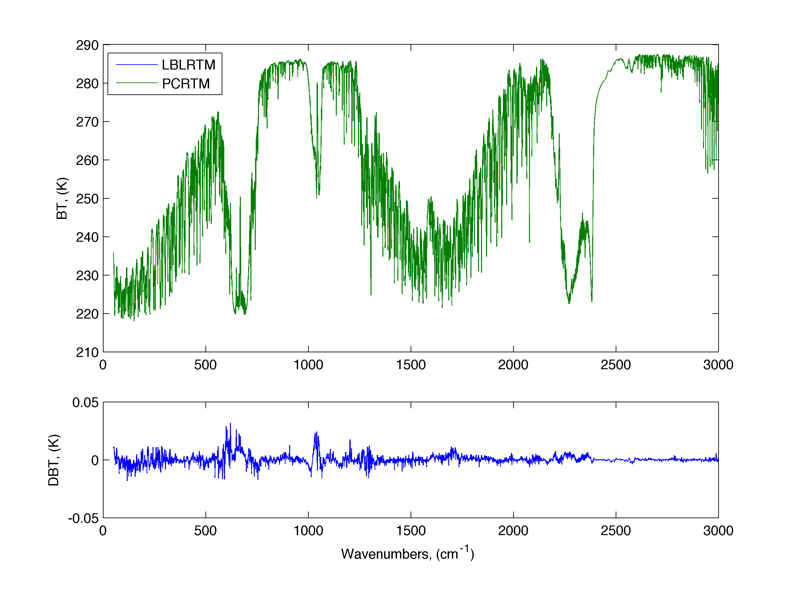
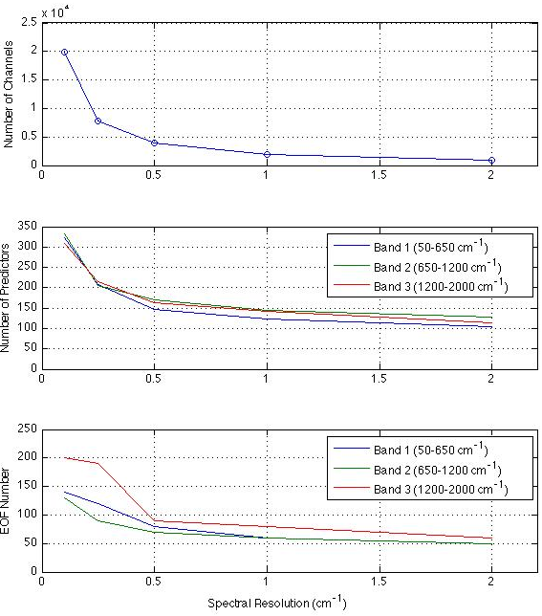
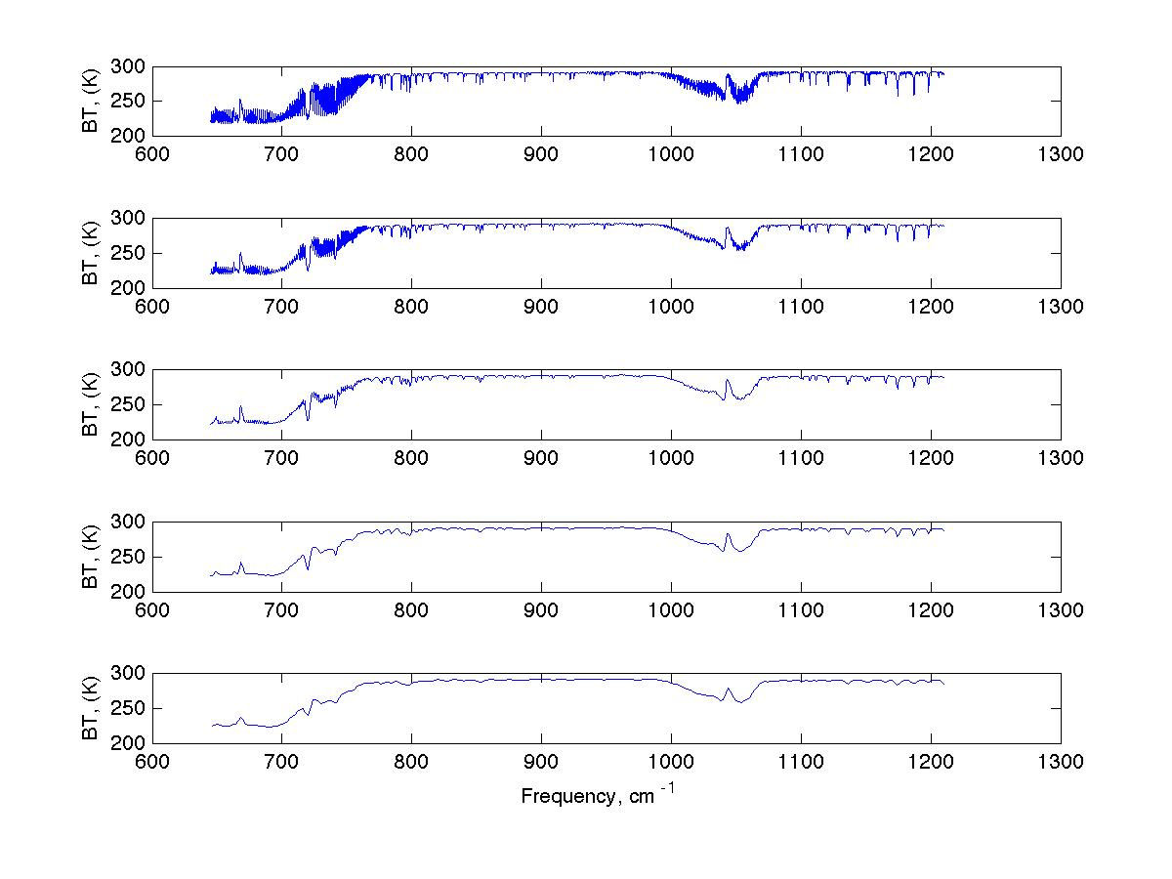
IR sounder information content demonstration using PCRTM
0.1 cm⁻¹, 0.25 cm⁻¹, 0.5 cm⁻¹, 1.0 cm⁻¹, and 2.0 cm⁻¹
0.1 cm⁻¹ model can be used to generate lower spectral resolution instrument forward models
Reduce >1 million mono RT to < 1000
EOF and mono numbers decrease with resolution

Slide 5
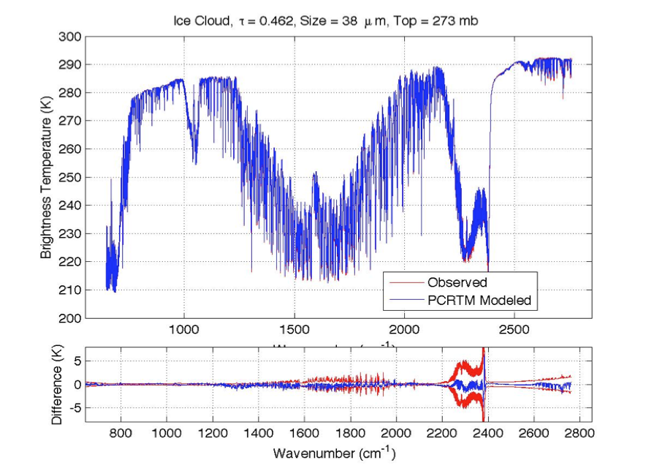
Demonstration of Speed and Accuracy of PCRTM for IR sounders
IASI
CrIS
AIRS
Sensor | Channel Number | PC score (seconds)
CLARREO, 0.1 cm⁻¹ | 19901 | 0.014 s
CLARREO, 0.5 cm⁻¹ | 5421 | 0.011 s
CLARREO, 1.0 cm⁻¹ | 2711 | 0.0096 s
IASI, 0.25 cm⁻¹ | 8461 | 0.011 s
AIRS, 0.5-2.5 cm⁻¹ | 2378 | 0.0060 s
CrIS,0.625-2.5 cm⁻¹ | 1317 | 0.0050 s
NAST-I, 0.25 cm⁻¹ | 8632 | 0.010 s
S-HIS, 0.5 cm⁻¹ | 4316 | 0.008 s
CrIS, 0.625 cm⁻¹ | 2211 | 0.009 s
Accuracy:
  0.03 K RMS error
Speed:
  Milliseconds/spectrum
PCRTM calculated TOA radiance spectra match IASI, CrIS, and AIRS observations very well for both clear and cloudy conditions

Slide 6
PCRTM-based L2 products: Single Field-of-view Sounder Atmospheric Product (SiFSAP)
Supported by NASA NNH17ZDA001N-TASNPP and NNH20ZDA001N-SNPPSP
  Being prepared at Sounder SIPS for transitioning to NASA GES DISC for routine product generation
Key Components:
  PCRTM cloudy forward model
  non-linear optimal estimation physical retrieval algorithm
SiFSAP Products:
  Vertical Profiles of T, H₂O, and trace gases (CO₂, O₃, CO, CH₄, N₂O)
  Cloud (phase, height, cloud top pressure, particle size, optical depth)
  Surface temperature and emissivity
  Averaging kernels and radiative kernels
Algorithm Characteristics | PCRTM L2 Algorithm | CLIMCAPS, NUCAPS, AIRS V7 L2
Spatial Resolution | 15 km | 45 km
Retrieval/FOR | 9 | 1
Number of Spectral channels used | Use 2211-8461 channels | Use 200-400selected channels
Cloud treatment | Retrieve cloud simultaneously | Use cloud-clearing
Use multiple scattering cloud RTM | Yes | No
Radiometric closure | Yes | No
Provide Radiative Kernels | Yes | No

Slide 7
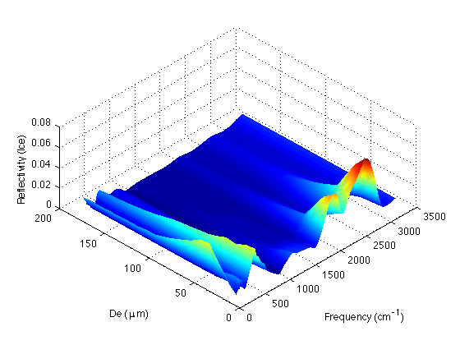
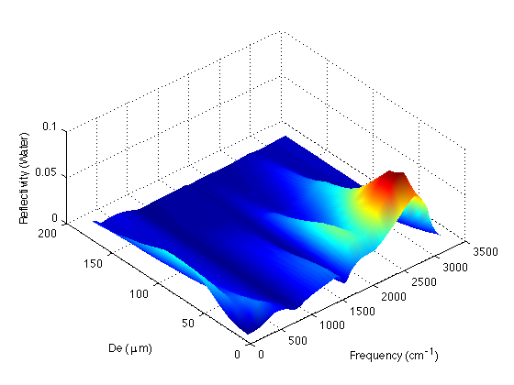
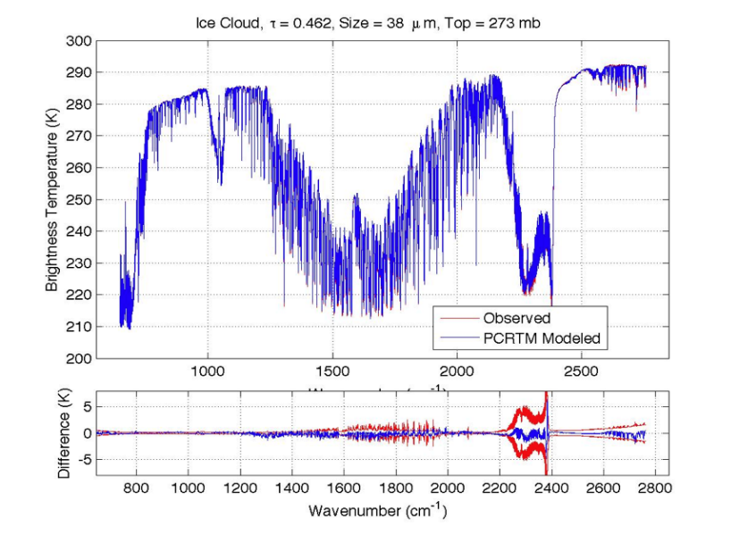
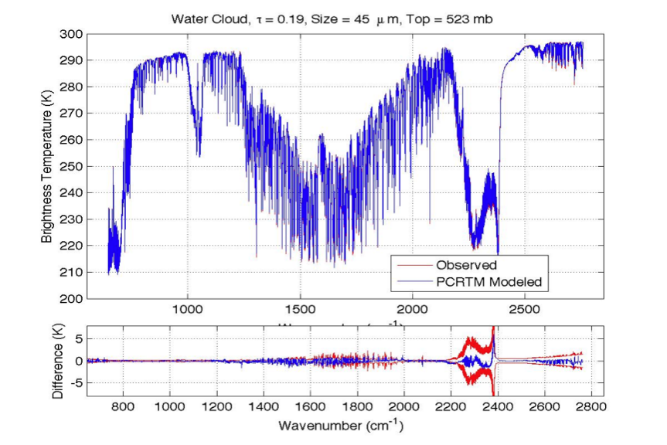
SiFSAP Can Effectively Distinguish Ice and Water Clouds

Slide 8
Full Error Characterization of SiFSAP Products
Averaging kernel (Eq. 2) provide information degree of freedom [trace(A)] and vertical resolution
Error Estimated by the error covariance matrix (Eq. 3) is consistent with simulated retrieval known truth

Slide 9
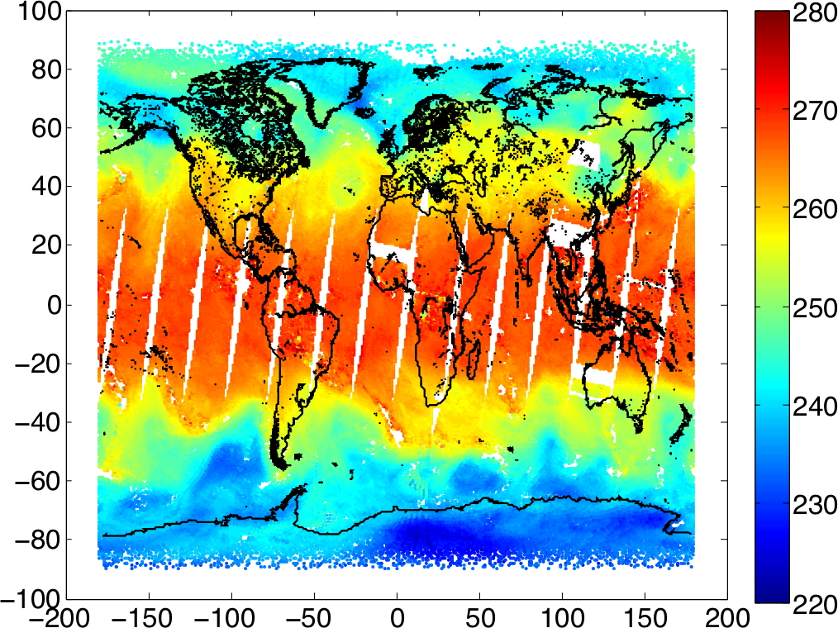
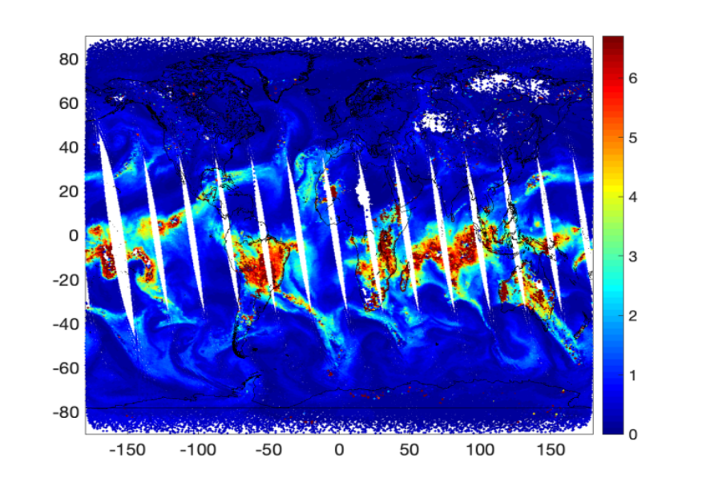
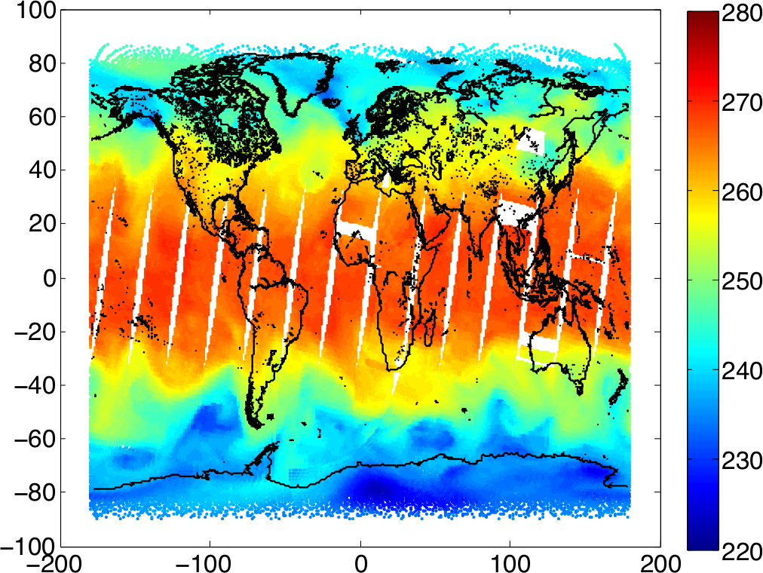
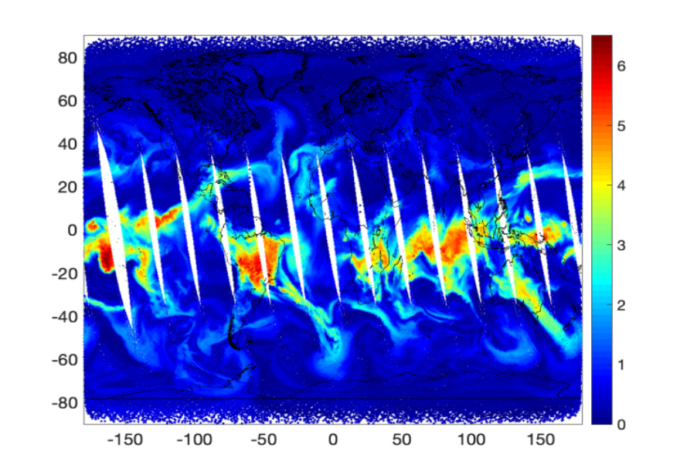
Examples of SiFSAP and ECMWF Atmospheric Temperature and Water Vapor from CrIS
PCRTM-RA Retrieved Temperature at 500 hPa
PCRTM-RA Retrieved H₂O at 500 hPa
500 hPa Temperature from ECMWF
H₂O at 500 hPa from ECMWF

Slide 10
A PCRTM-based L3 Product: Climate Fingerprinting Sounder Products (ClimFiSP)
Issues with traditional L1-L2-L3 climate products
  L2 algorithm inconsistency for different satellite sensors
  Lack of radiance closure (e.g cloud-clearing method)
  L1-L2-L3 algorithm is computational demanding
ClimFiSP is designed to address the above-mentioned deficiencies
  Works on gridded L1 products directly using consistent radiative kernels
  All parameters including clouds retrieved simultaneously
  More than 5 orders of magnitude faster than traditional L1-L2-L3 method
  Quick re-generation of climate products when instrument is re-calibrated or L1 algorithm is improved
Provide radiative kernels needed for climate studies
  Climate model validations using satellite data
  Climate model diagnosis/improvements
Supported by NASA NNH17ZDA001N-TASNPP and NNH20ZDA001N-SNPPSP
  Consistent climate products from AIRS, SNPP CrIS, and JPSS CrIS
  Harvest decades of hyperspectral sounder measurements for climate studies
  Provides products attractive to wide range of users

Slide 11
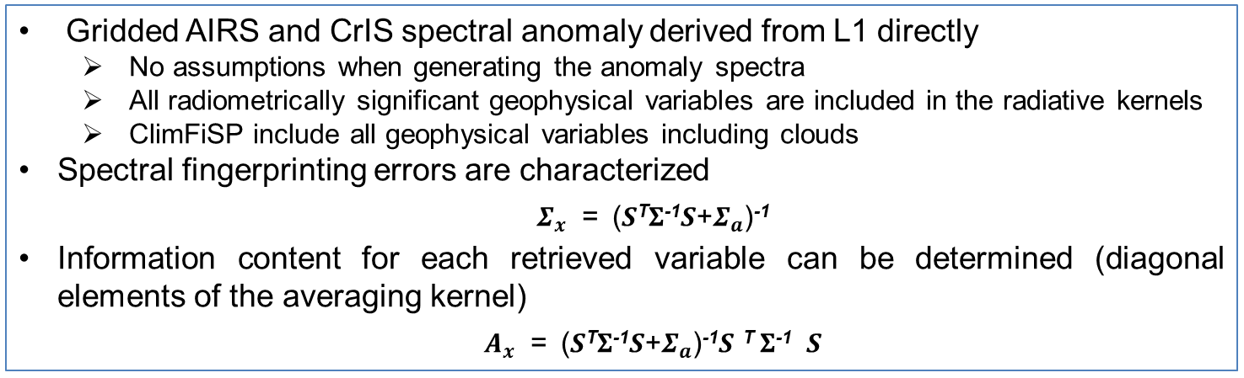
Radiometric Closure for ClimFiSP
Gridded AIRS and CrIS spectral anomaly derived from L1 directly
  No assumptions when generating the anomaly spectra
  All radiometrically significant geophysical variables are included in the radiative kernels
  ClimFiSP include all geophysical variables including clouds
Spectral fingerprinting errors are characterized
  $Σ_{x}$ = (𝑺^{T}𝚺⁻¹𝑺+$Σ_{a}$)⁻¹
Information content for each retrieved variable can be determined (diagonal elements of the averaging kernel)
  $A_{x}$ = (𝑺^{T}𝚺⁻¹𝑺+$Σ_{a}$)⁻¹𝑺 ^{T} 𝚺⁻¹ 𝑺
Examples of CrIS Spectral Anomaly
Closure for CrIS Gridded Spectral Anomaly

Slide 12
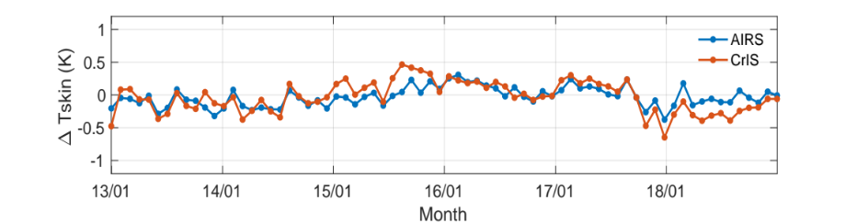
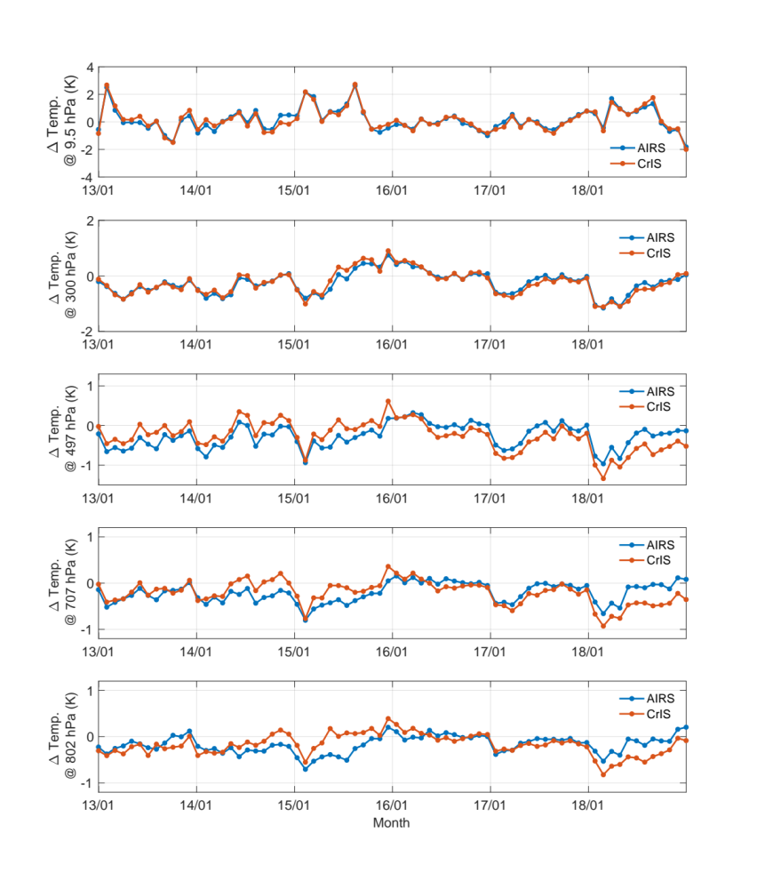
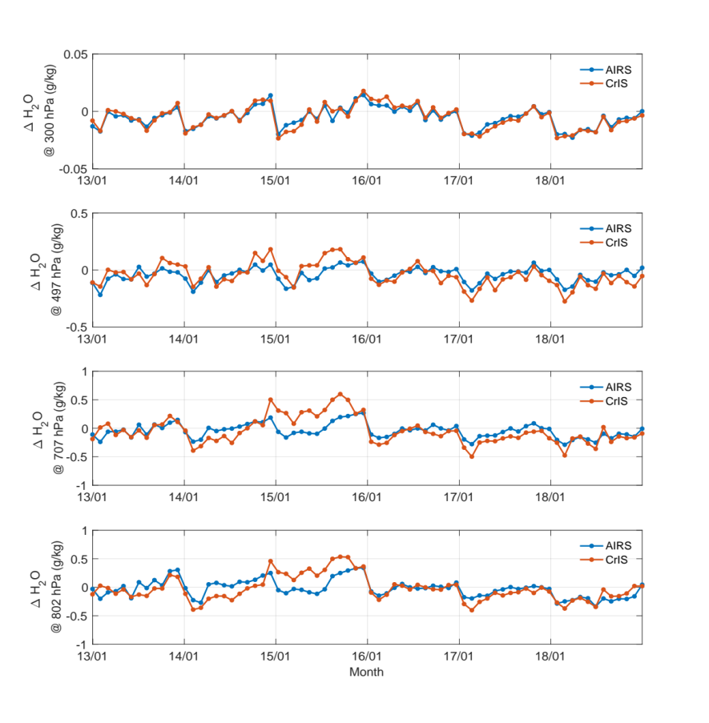
ClimFiSP Results on Overlapping AIRS and CrIS Data
Comparison between the temperature anomalies at different altitudes derived from the monthly mean AIRS spectral anomalies observed over tropical ocean regions from January 2013 to December 2018 and the corresponding values from the CrIS monthly mean spectral anomalies.

Slide 13
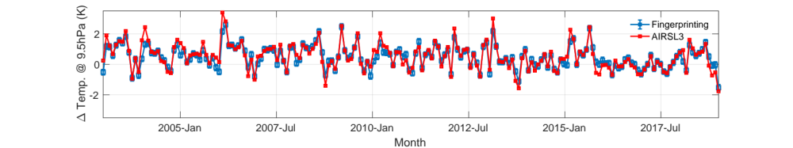
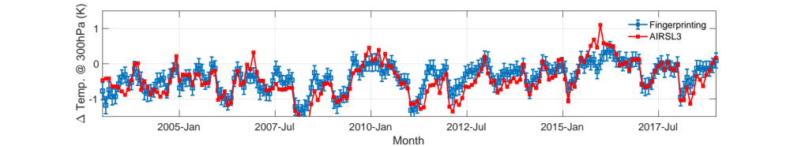
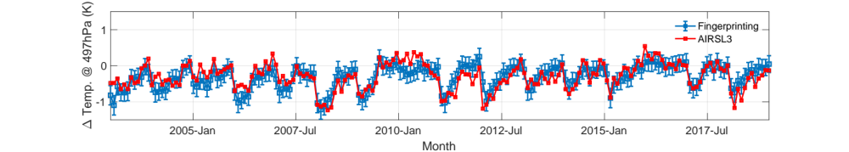
Example of AIRS and CrIS ClimFiSP product
ClimFiSP enables of the fusion of AIRS and CrIS data into a consistent temperature anomalies at different atmospheric pressure levels
ClimFiSP and AIRS L3 temperature anomalies from 2003 to 2018 show general agreement
Wu et. al. (2020) "Radiometrically Consistent Climate Fingerprinting Using CrIS and AIRS Hyperspectral Observations" Remote Sensing. https://doi.org/10.3390/rs12081291

Slide 14
Summary and Path Forward
PCRTM is a fast and accurate RTM addressing IR sounding challenges
  Uses full IR sounder information
  Physically-based with a few hundred RT calculations
  Includes multiple scattering clouds
  PCRTM handles polarization in solar spectral region
PCRTM-based inversion algorithms (SiFSAP and ClimFiSP) provide novel products for satellite IR sounders
  Radiometric closure (avoids CC errors, fits all parameters simultaneous including clouds)
  High-spatial resolution L2 products for weather, air quality, and atmospheric dynamic studies
  Consistent long-term climate data records (T, Q, cloud …) from multiple satellite IR hyperspectral sounders
Beneficial to extend PCRTM IR retrieval approach to other spectral regions
  Using all solar spectral channels to generate more consistent data products
  Provide data fusion solution for multiple satellite sensors (far-IR, IR, and Solar)
PC-based RTMs and all-sky retrieval methods have great potential for NWP satellite data assimilations
  Both ECMWF and UK met office developed PC-based RTMs
  ECMWF is starting to assimilate all IASI channels using PC-RTTOV (for clear-sky only)
  PCRTM can help US NWP community to assimilate all sounder spectral channels under all-sky conditions
PCRTM forward model and inversion algorithm can be easily adapted for new/future satellite sensors
  PCRTM has been developed or being developed for CPF, TEMPO, SBG and other hyperspectral satellite sensors

Slide 15
BACKUP SLIDES

Slide 16
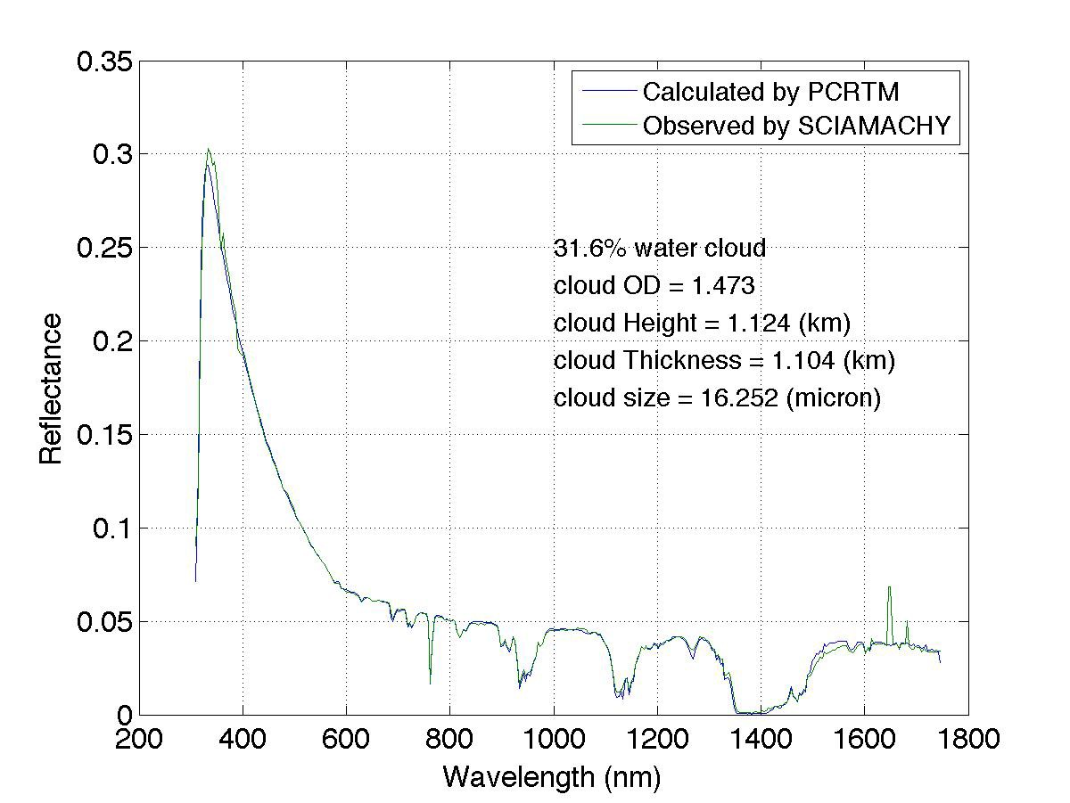
Example PCRTM for Reflected Solar Region
SCIAMACHY
PCRTM Simulated Reflectance @646 nm using MODIS L2 data
MODIS L1 Observed
Reflectance @646 nm
PCRTM calculated reflectances agree well with those observed by SCHIAMACHY and MODIS
PCRTM is 3-4 orders of magnitude faster than MODTRAN
A Climate OSSE, which will take MODTRAN 10 years to run on one CPU, can be accomplished with PCRTM in 10-20 hours using one CPU
MODIS L2 + CPF simulator @646nm

Slide 17
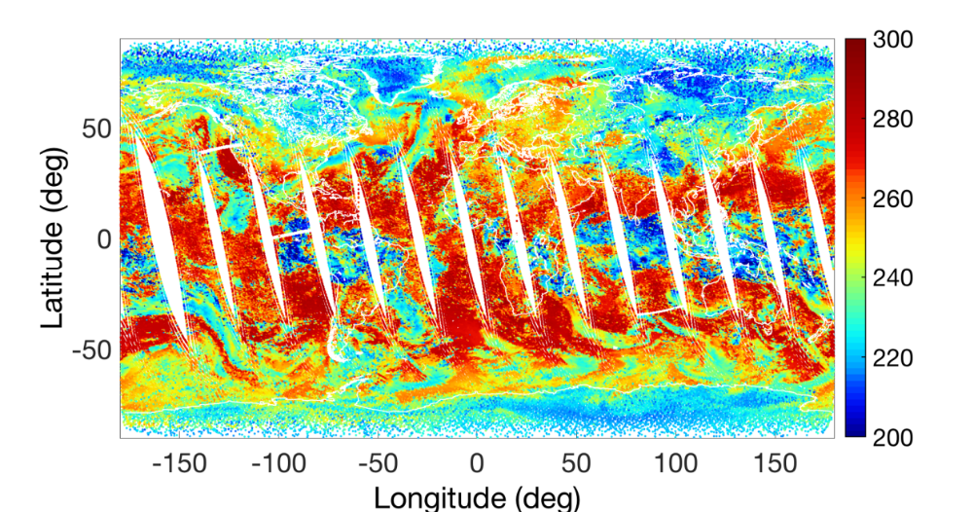
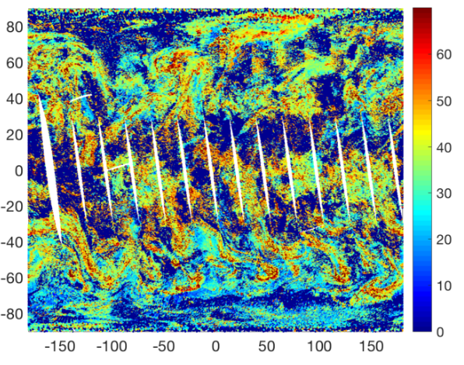
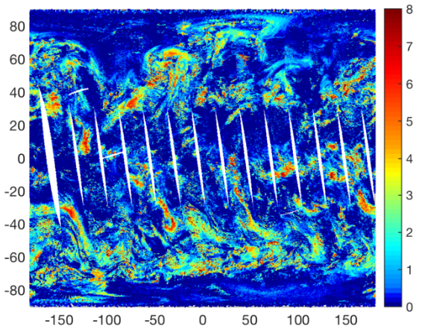
Cloud top Temp., particle size, optical depth
Retrieval results from CrIS/ATMS observations
$$Cloud Temp. (K)$$
Cloud top Temp. retrieval validation using IASI + CALIOP/CLOUDSAT/ECMWF
$De$ (diameter µm)
$τ$ @550nm
(Xu.Liu-1@nasa.gov )

Slide 18
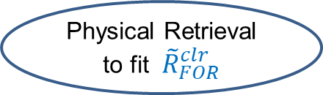
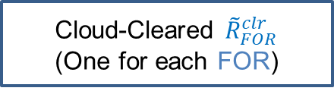
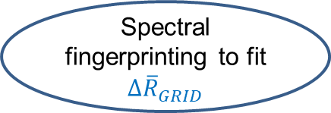
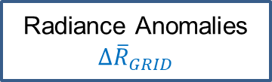
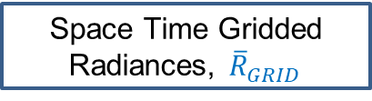
Relationship between CLIMCAPS, NUCAPS, AIRS V7 L2, SiFSAP, and ClimFiSP
CLIMCAPS, NUCAPS, AIRS V7
SiFSAP
ClimFiSP
Sounder FOV radiances
R_{FOV}
Sounder FOV radiances
R_{FOV}
Sounder FOV radiances
R_{FOV}
Cloud Clearing
(Uses 9 FOVs)
Space Time Gridded Radiances, ${\overline{R}}_{GRID}$
Gridded Radiative Kernels (only need 1 year data)
Cloud-Cleared ${\tilde{R}}_{FOR}^{clr}$
(One for each FOR)
Radiance Anomalies ${Δ\overline{R}}_{GRID}$
Physical Retrieval to fit${\tilde{R}}_{FOR}^{clr}$
Physical Retrieval to fit R_{FOV}
Spectral fingerprinting to fit ${Δ\overline{R}}_{GRID}$
geophysical variables (L2)
for each FOR
geophysical variables (L2) for each FOV
Anomalies of geophysical variables L3 for each GRID
Space Time Gridded L3
data record
Space Time Gridded L3
data record
Add reference year to form L3 gridded data record

