Slide 1
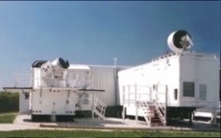
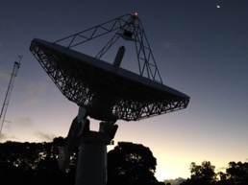
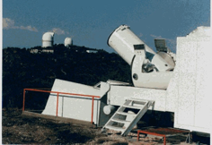
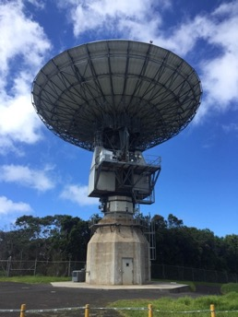
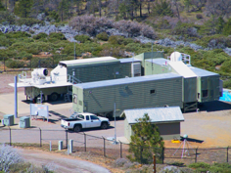
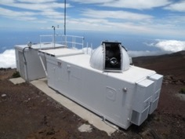
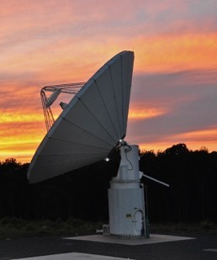
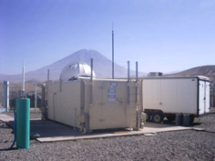
Geodetic Infrastructure
Stephen Merkowitz and Frank Lemoine
NASA Goddard Space Flight Center
April 26, 2022

Slide 2
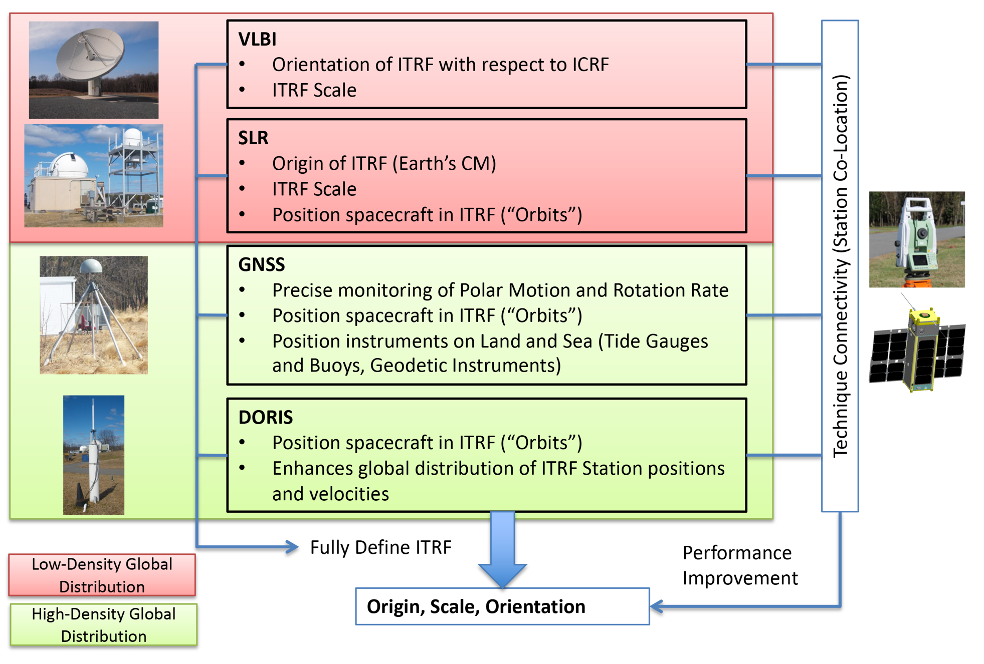
The Geodetic Measurement System

Slide 3
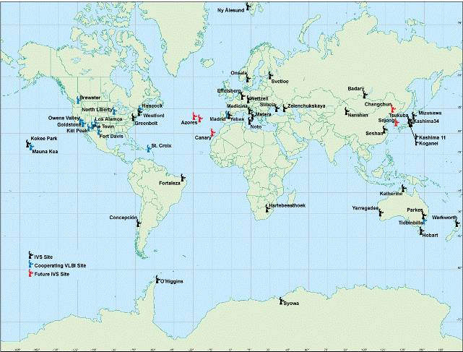
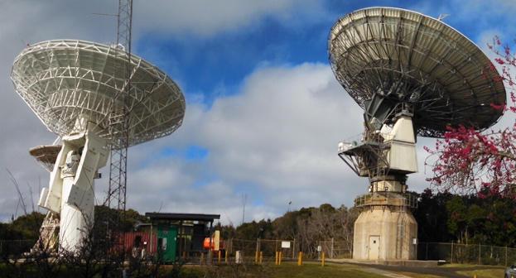
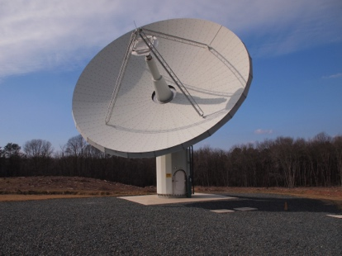
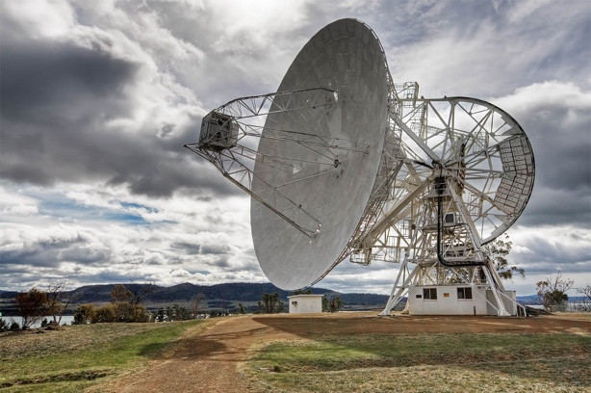
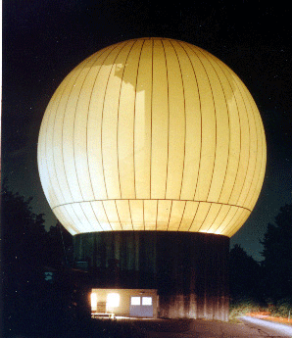
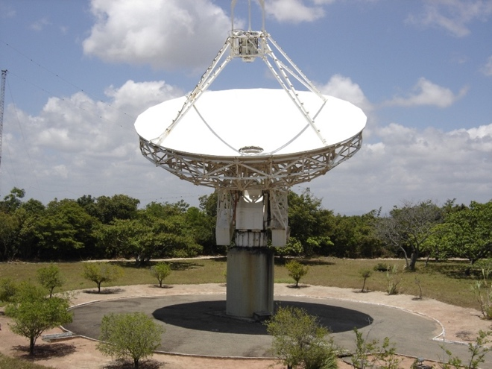
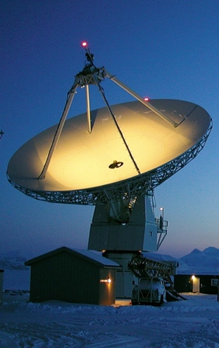
Very Long Baseline Interferometry (VLBI)
Daily VLBI measurements are vital for determining and predicting the time-varying alignment of the Terrestrial Reference Frame with respect to the celestial reference frame (Earth Orientation Parameters).
51 IVS stations; NASA operates 2 legacy and 3 next generation VLBI stations and provides support/equipment for 3 partner stations.

Slide 4

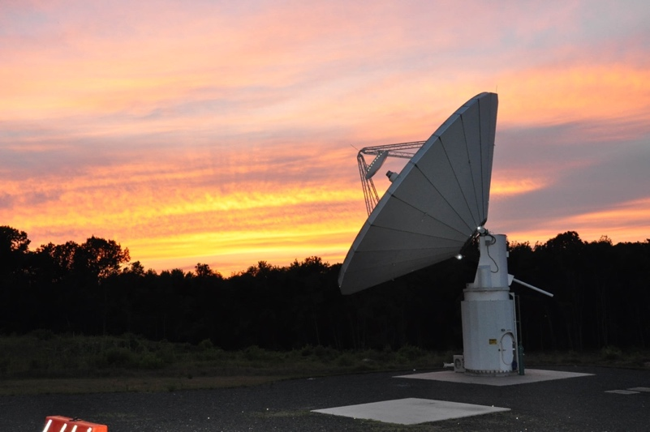
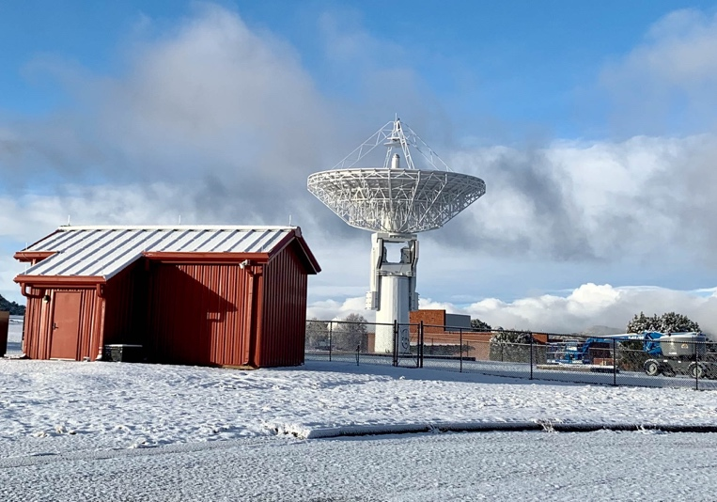
VLBI Global Observing System (VGOS)
Hawaii
Maryland
Texas
Less costly systems with as good or better performance than legacy VLBI.
1 mm measurement accuracy on global baselines
Small (12m), fast, rigid, efficient antennas
Broadband (2-14 GHz) with 4 tunable 512 or 1024 MHz bands,
Fast data recording rates (16 Gbps).
NASA completed deployment of 3 domestic stations, developed the correlation and analysis capabilities, and is helping international partners establish new stations.
Better geographical distribution and additional stations will provide better EOP measurements and enhanced redundancy and robustness.

Slide 5




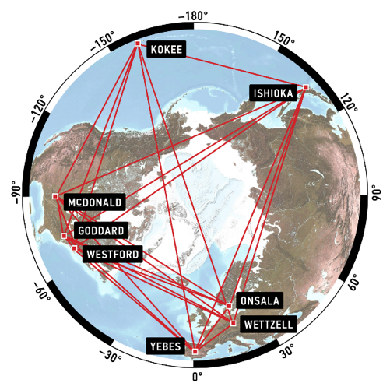
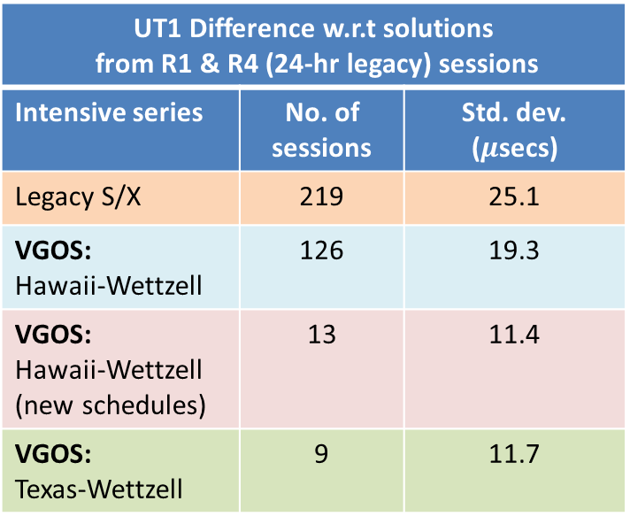
Expanded VGOS UT1 Intensives Program
UT1 (Universal Time) estimates describe the irregularities of the earth's rotation about the spin axis, which are critically required for positioning and navigation.
Increased number of VGOS UT1 1-hour “Intensive” sessions between Hawaii-Wettzell (Germany) to 5 times/week
Initiated Texas-Wettzell Intensive sessions, currently 1x/week.
Testing improved schedules that have more observations/hour that reduces the measurement errors.
VGOS Intensives show a slight performance improvement over legacy measurements with potential for further improvements.
Hawaii
Goddard
Texas
UT1 Difference w.r.t solutions from R1 & R4 (24-hr legacy) sessions
Intensive series | No. of sessions | Std. dev. ($μ$secs)
Legacy S/X | 219 | 25.1
VGOS: Hawaii-Wettzell | 126 | 19.3
VGOS: Hawaii-Wettzell (new schedules) | 13 | 11.4
VGOS: Texas-Wettzell | 9 | 11.7

Slide 6
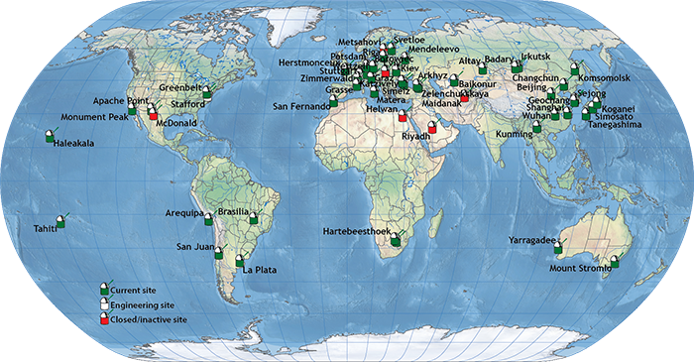
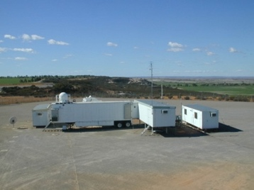
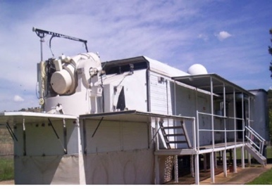
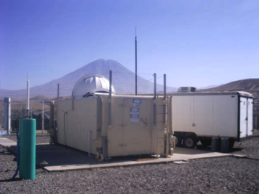
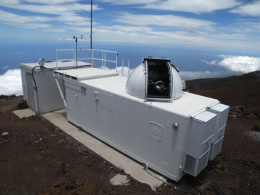
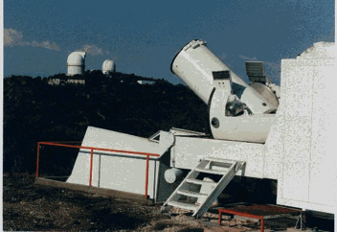
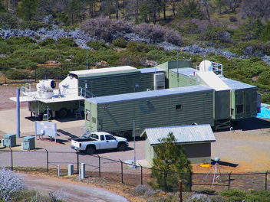

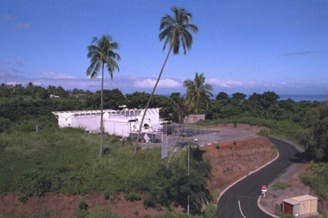
Satellite Laser Ranging (SLR)
Regular SLR measurements are used to improve the orbit determination of nearly 100 active satellites, uniquely defines the ITRF geocenter, and contributes to the EOP products.
44 ILRS stations; NASA maintains and operates 7 legacy SLR stations and 1 Lunar Laser Ranging Station.

Slide 7
ILRS Satellite Tracking (2021)
GNSS
Reference Frame

Slide 8
ILRS Satellite Tracking by Station (2021)

Slide 9
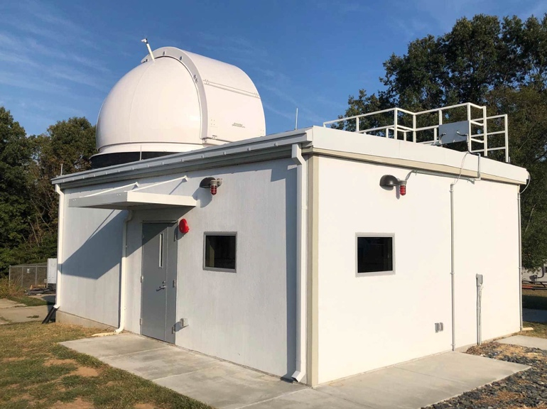
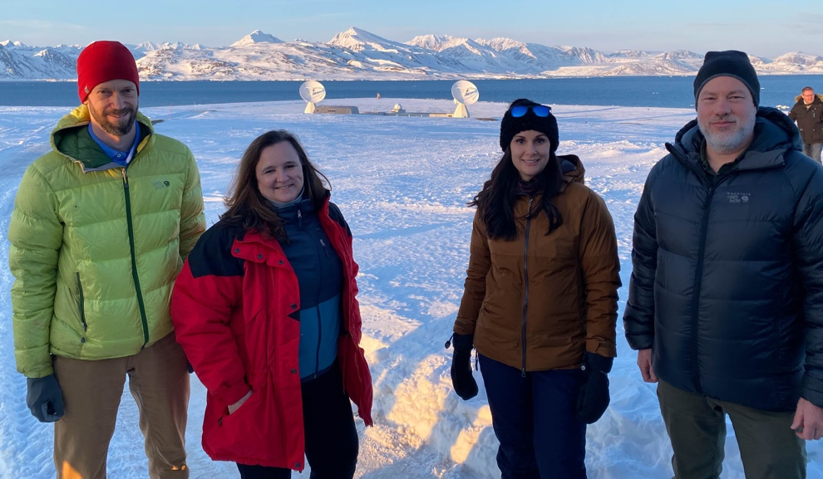
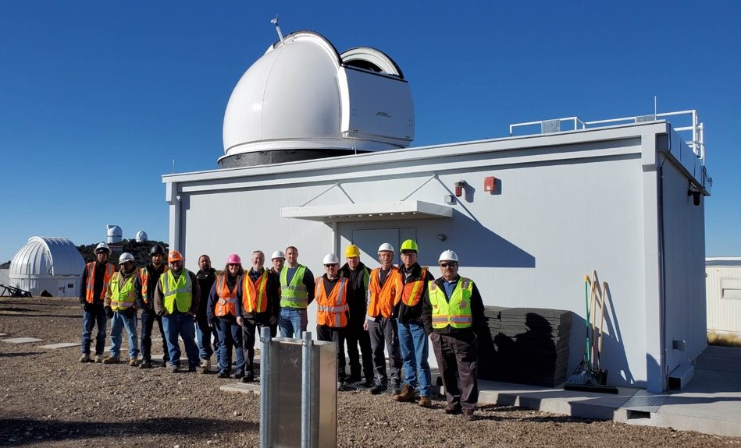
NASA’s Space Geodesy Satellite Laser Ranging (SGSLR) System
Goddard Geophysical and Astronomical Observatory (GGAO), Maryland
Ny-Ålesund Geodetic Observatory (NGO), Svalbard
McDonald Geodetic Observatory (MGO), Texas
24-hour tracking of LEO, LAGEOS & GNSS satellites,
1 mm normal point precision on LAGEOS,
Stability at the 1mm level over one hour,
Calibrated against the network standard,
kHz pulse rate laser with single photon detection system,
Automated operations.
The first 3 new SGSLR stations are currently being built.
Facility work at all three sites complete.
Three gimbals and telescopes (critical path items) being built, and the first integrated unit for GGAO is recently completed factory acceptance testing.

Slide 10
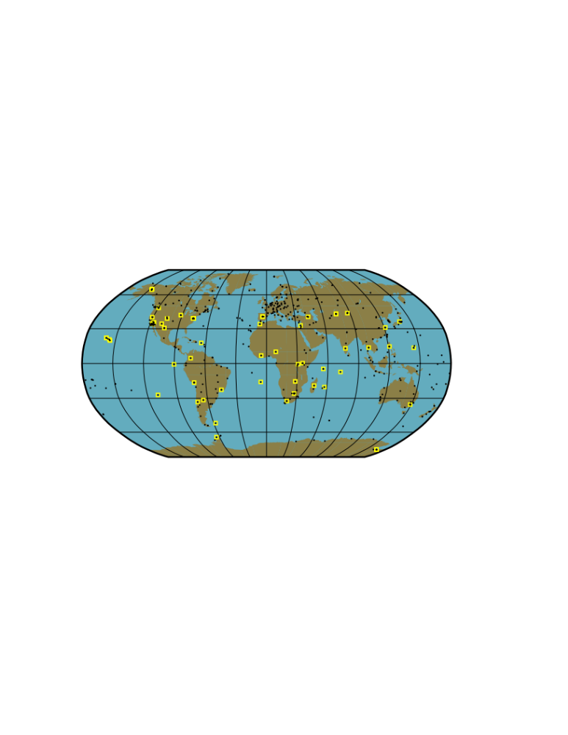
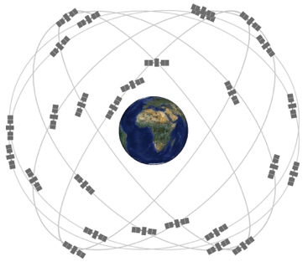
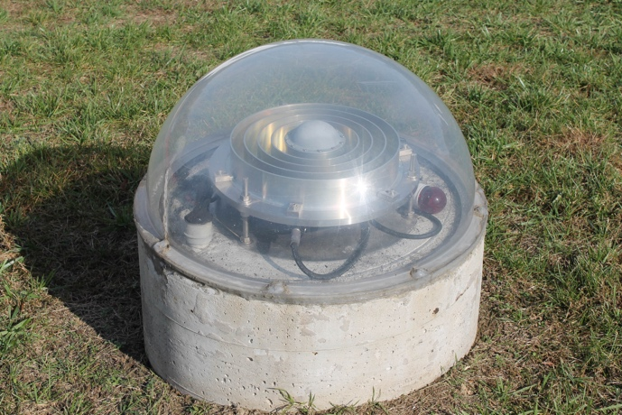
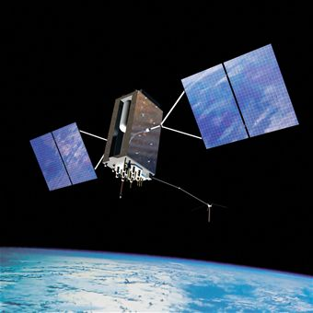
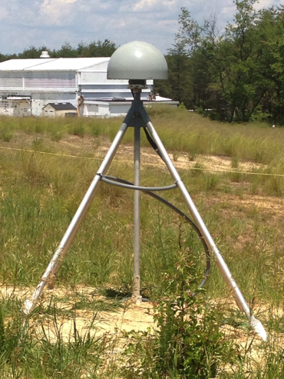
Global Navigation Satellite Systems (GNSS)
The International GNSS Service (IGS) network of over 500 Global Navigation Satellite Systems (GNSS) stations generates raw orbit and tracking data and distributes the terrestrial reference frame to users.
NASA’s Global GNSS Network (GGN) of over 60 multi-constellation GNSS stations contribute to the IGS.
Realtime and other IGS data products available from NASA’s Crustal Dynamics Data Information System (CDDIS)
Multiple GNSS stations are being implemented at NASA multi-technique sites to monitor site stability
NASA is also providing laser retroreflectors for GPS IIIF to enable laser ranging to the constellation.
GGAO

Slide 11
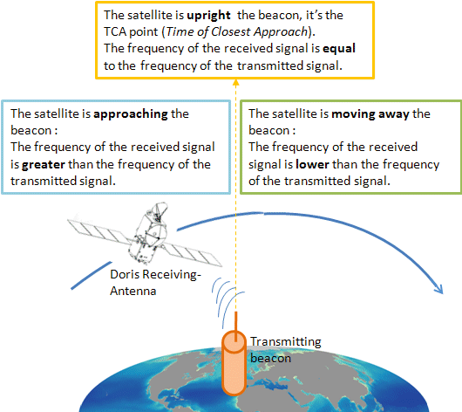
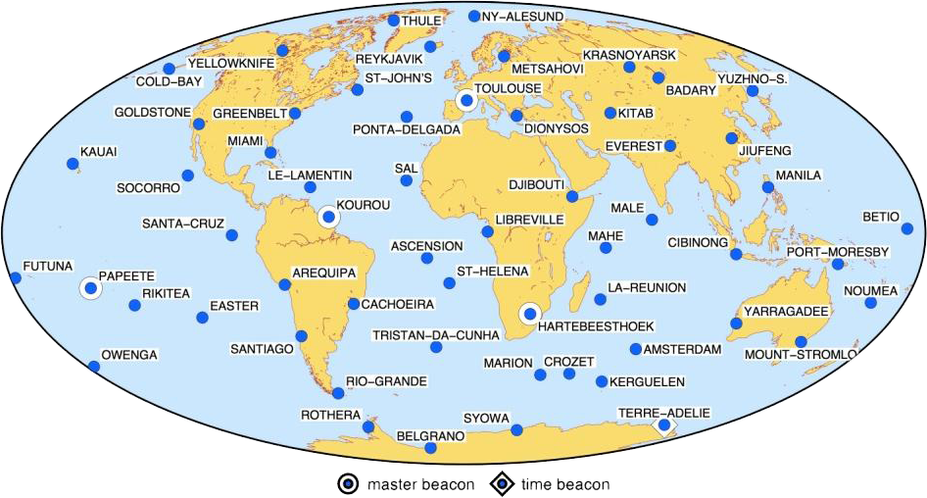
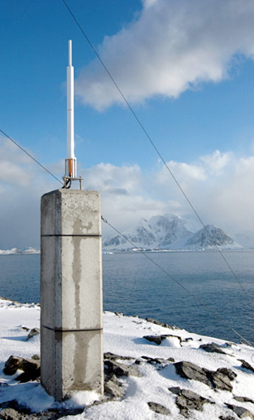
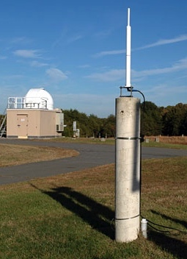
Doppler Orbitography and Radiopositioning Integrated by Satellite (DORIS)
Global network of ~60 autonomous stations managed and deployed by CNES and IGN since 1986
Six DORIS sites within the USA: Greenbelt, Guam, Kauai, Goldstone, Cold Bay, & Miami
DORIS receivers that can track up to 6x beacons at one time are used on altimeter satellites (Jason-3, Sentinel-3A/3B Cryosat-2, and in the future Jason-CS, SWOT), delivering precise orbits with radial RMS accuracy of ~10 mm
NASA GSFC maintains the archival and distribution of the worldwide DORIS geodetic data using the Crustal Dynamics Data Information System (CDDIS)
Rothera
Greenbelt

Slide 12
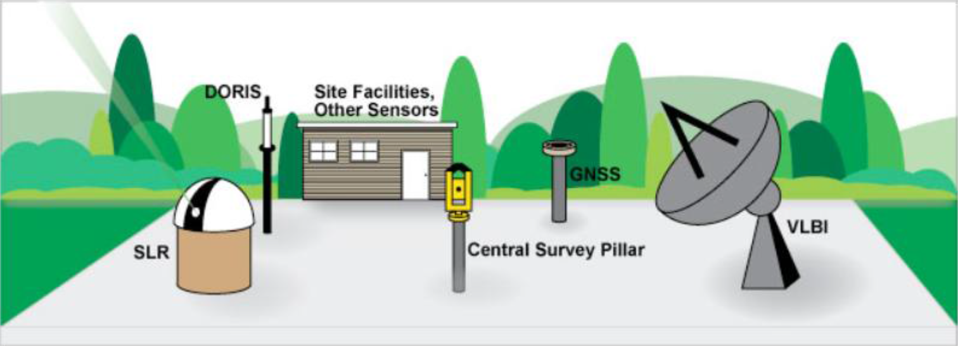
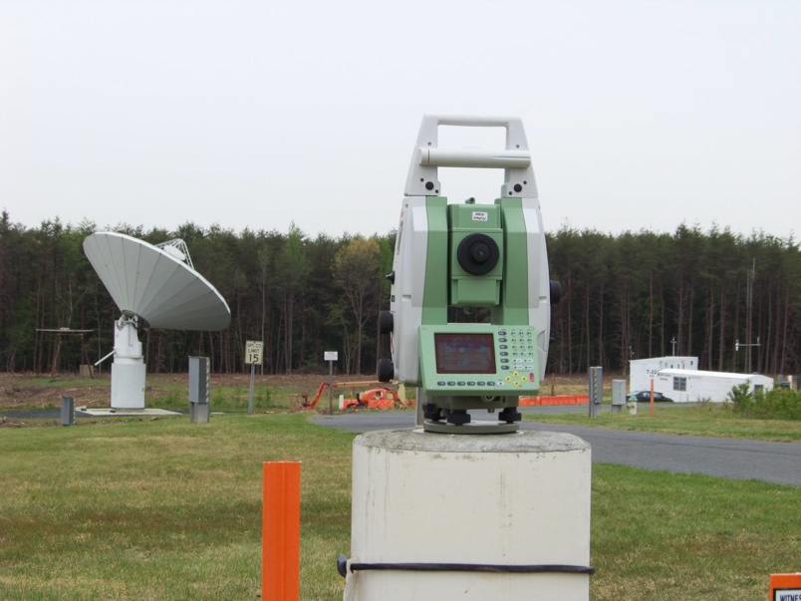
Traditional Local Tie Systems
Periodically perform precise survey of site ground control network, site reference pier, optical access points, and supplemental targets to estimate the measurement points of space geodesy instruments
Site Reference Point: All vector ties to originate here. Equipped with total station robotic surveyor
Instrument Optical Access Point: Point on each instrument structure that can be directly (optically) surveyed from the Site Reference Point
Instrument Monument Point: Point on each instrument that is close to the measurement point but accessible to survey techniques
Estimated Measurement Point: Best estimate of the point where the measurement will actually be referenced to after all known systematic errors are accounted for.
Actual Measurement Point: Point where the measurement is actually made
Local Reference Frame tie to all geodetic Stations
GGAO Robotic Total (Range) Station

Slide 13
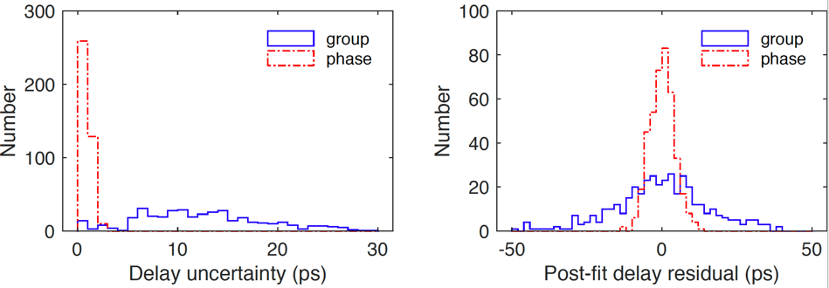
Connecting the Old With the New
Measure with 1-mm precision the vector tie between the two VLBI antennae at KPGO, from dedicated VLBI sessions (both antennae observing the same sources).
The measurement was achieved using phase delays, which are of higher precision than the group delays.
The estimates were compared to standard sub-mm precision in-situ surveys.
A comprehensive error analysis was performed: the limiting error source in exploiting this data is the gravitational deformation of the 20m KPGO antenna.
The results provide a new way to tie VGOS stations to the common frame of VLBI stations (for collocated sites).
The tie measurement in the form of a SINEX file was provided to the IERS as a constraint to be used in ITRF2020.
Statistics of phase- vs. group-delay local- tie geodesy (Niell et al., 2021)
Niell, A., et al. (2021). “VLBI measurement of the vector baseline between geodetic antennas at Kokee Park Geophysical Observatory, Hawaii", J. Geodesy, doi:10.1007/s00190-021-01505-9

Slide 14

Geodesy in the 2018 US Decadal Strategy for Earth Observation from Space
The U.S. National Academy of Sciences conducts a decadal study to inform U.S. priorities for Earth science from space
“A major Earth observing priority for the next decade is to maintain and improve the Terrestrial Reference Frame.”
“Maintaining the reference frame to a positional accuracy of 1 mm and a rate accuracy of 0.1 mm/yr requires NASA’s continued participation and support of VLBI and SLR for defining the terrestrial reference frame, its changes with time, and monitoring Earth rotation”
“Recommendation 4.4: NASA should complete planned improvements to its Global Geodetic Observing System (GGOS) sites during the first half of the decadal survey period as part of its contribution to the establishment and maintenance of the International Terrestrial Reference Frame (ITRF).”
http://nap.edu/24938

Slide 15
Geodetic Infrastructure is the Foundation for Enabling Many Scientific Applications
National Academies: Evolving the Geodetic Infrastructure to Meet New Scientific Needs
https://doi.org/10.17226/25579

Slide 16
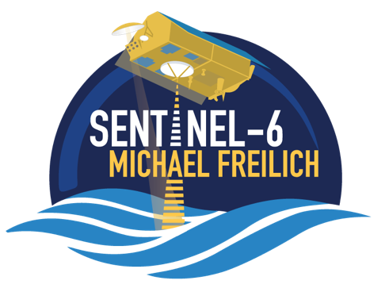
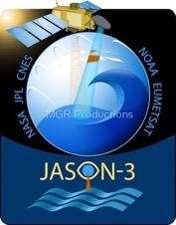
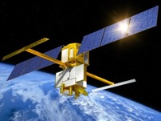
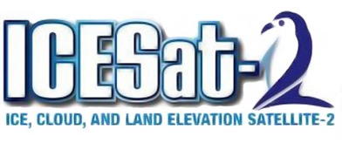
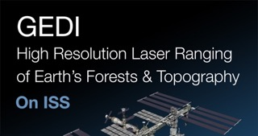
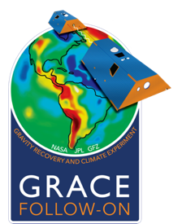
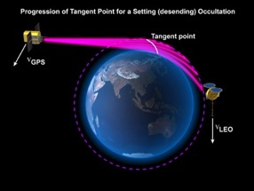


Space Geodesy Provides the Foundation for Studying the Dynamics of the Earth System
Polar Ice Sheet and Glacier changes, sea-ice thickness, Vegetation canopy ht.
3D-Vegetation canopy structure; Forest carbon sources & sinks; Surface topography
SWOT: Surface Waters, Ocean Topography
Ocean topography, mean sea level
Ice-sheet collapse; Ecosystem disturbances; Natural Hazards (Volcanos, earthquakes, landslides)
GNSS RO satellites: Weather forecasting; Climate studies; Global ionosphere models
Mass change (cryosphere, hydrology, solid earth, oceans)
Extreme weather prediction
All these missions have Precision Orbit Determination and geolocation requirements that depend on a stable & precise Terrestrial Reference Frame and accurate Earth Orientation Parameters. SLR data to geodetic satellites determines the geocenter and low degree gravity terms which are a vital input to POD and to measurements of global mass change.

Slide 17





Space Geodesy Impacts Beyond Earth Science
Provides Universal Time and other critical measurements used for high-accuracy navigation, positioning, and other applications.
Supports establishment and maintenance of a lunar reference frame and studies of the lunar interior
Supports position determination of lunar landers and orbiters, including laser ranging to LRO and ESA’s Lunar Pathfinder
VLBI observations of associated Fermi gamma-ray sources improves the position accuracy up to a factor of 10⁵!
Satellite Laser Ranging to LAGEOS provides precision tests of gravitational theories and the precise determination of the Earth's gravitational mass, a vital input for interplanetary spacecraft navigation.
Supports GNSS operations through the delivery of geodetic products and laser ranging to GNSS satellites.

Slide 18

Science Driven Geodetic Accuracy
National Academies: Evolving the Geodetic Infrastructure to Meet New Scientific Needs
https://doi.org/10.17226/25579

Slide 19




Space Geodesy Directly Supports Long-term Mean-Sea Leveling Monitoring
Global and regional mean sea level variations are estimated from more than 1030 ten-day repeat cycles from the TOPEX/Poseidon, Jason-1,2,3 radar altimetry missions.
Continued M.S.L monitoring will be provided by the Sentinel-6/Michael Freilich satellite
Space geodesy underpins M.S.L. monitoring through a precise terrestrial reference frame (e.g. ITRF2014, and now ITRF2020), precise tracking (SLR, GNSS, DORIS), daily determination of EOP (including UT1 determined by VLBI), and time-variable gravity variations determined from GRACE & GRACE-FO, and SLR tracking of geodetic satellites to determine C₂₀ & C₃₀.
Beckley, B.D et al. (2021): “Integrated Multi-Mission Ocean Altimeter Data for Climate Research complete time series Version 5.0”, (https://doi.org/10.5067/ALTTS-TJA50).
1993-2003, +2.7 mm/yr
2010-2020, +4.4 mm/yr

Slide 20

Space Geodesy Supports Applications of Long-term Mean-Sea Leveling Monitoring
The annual and semi-annual cycles in relative mean sea level are determined from 25 years of satellite altimetry (TOPEX & Jasons 1-2-3), corrections for vertical land motion determined from GRACE (2002-2016), and making a correction for the Earth’s geocenter. Knowledge of this annual cycle in “relative” mean sea level could be important in predictions of effects of coastal flooding.
Space geodesy underpins this result through,
(1) a precise terrestrial reference frame (ITRF2014). (2) 25 years of tracking the altimeter satellites with GNSS, SLR & DORIS. (3) the contribution of the LAGEOS satellites to the determination of the reference frame and the Earth’s annual geocenter motion.
Amplitudes (top panel) and phase lags (bottom panel) of the annual (Sa) sea-level oscillations in relative sea level.
Ray R. et al. (2021)
Ray, R.D., Loomis, B.D. & Zlotnicki, V. “The mean seasonal cycle in relative sea level from satellite altimetry and gravimetry”. J Geodesy 95, 80 (2021). doi:10.1007/s00190-021-01529-1.

Slide 21




Space Geodesy Supports Sentinel-6 Science
Sentinel-6/Michael Freilich was launched and inserted into a tandem orbit with Jason-3 to support continuity of measurements for SSH (sea surface height) and Mean Sea Level (MSL) determination.
Sentinel-6 & Jason-3 have flown in a tandem orbit for the past year to support inter-calibration of the altimeter measurements and all the geophysical corrections.
Sentinel-6 & Jason-3 both include SLR retroreflectors, DORIS & GNSS receivers for Precise Orbit Determination (POD).
During this tandem phase, the POD Group of the Ocean Surface Topography Science Team has used the GNSS, SLR & DORIS data to verify that the radial orbit accuracy of the altimeter satellite orbits is 6-8 mm radial RMS.
This validation is a necessary component to extending the altimeter SSH time series from TOPEX, Jason 1-3, with Sentinel-6/MF.
SLR Residuals to NASA GSFC std2006 SLR+DORIS orbits; The average SLR fit to Jason-3 and S6A are 7.3 and 7.7 mm in 2021.
(POD results from N.P Zelensky, UMD/ESSIC & NASA GSFC)

Slide 22



GRACE-FO Gravity Recovery and Climate Experiment – Follow On
SLR corrects 45% underestimated Antarctic ice mass loss rate over 2017-2020
SLR provides direct low-degree gravity change corrections for GRACE-FO through:
  Precise ITRF
  Ranging to retroreflector on G-FO
  Essential tracking of LAGEOS

