Slide 1
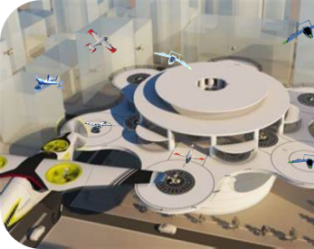

IFAR UAM
Infrastructure Technology
Dr. Marcus Johnson, NASA

Slide 2
Agenda
NASA Vision and High Density Vertiplex (HDV) Research
IFAR Discussion Status

Slide 3
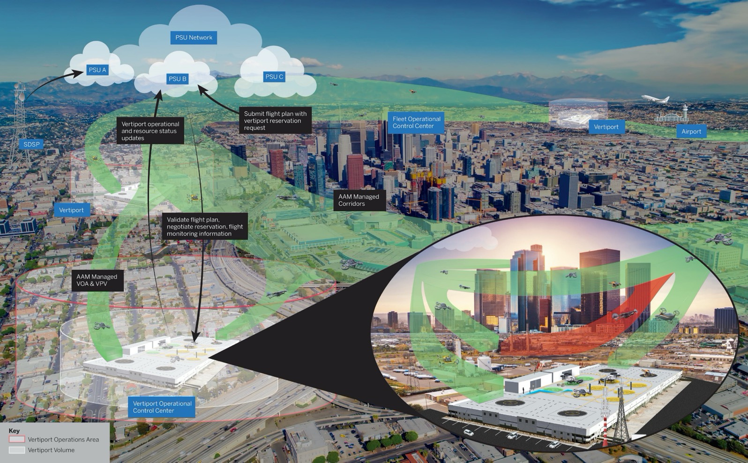
NASA’s Concept for High-Density Automated Vertiport Operations

Slide 4
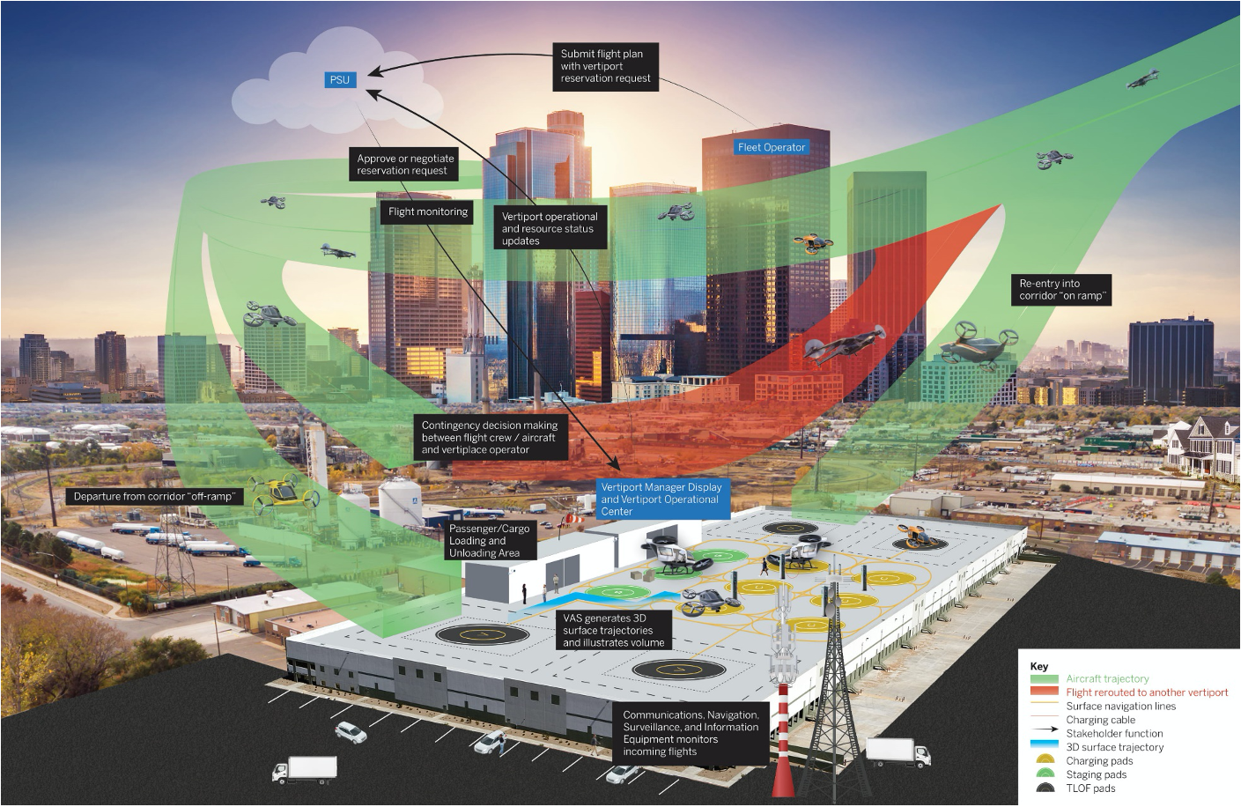
NASA’s Concept for High-Density Automated Vertiport Operations

Slide 5
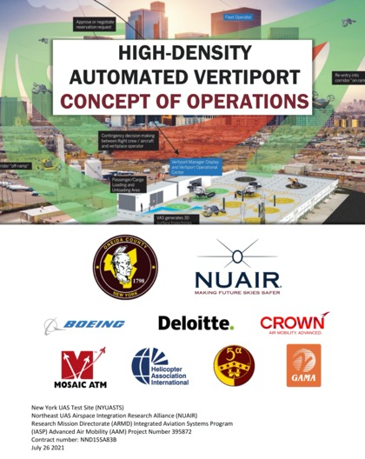
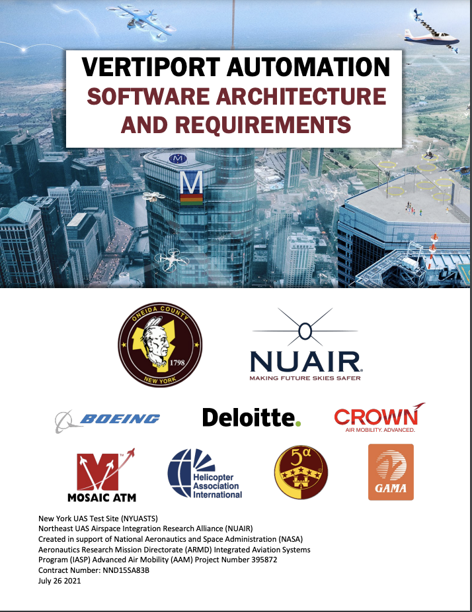
NASA’s Concept for High-Density Automated Vertiport Operations
https://ntrs.nasa.gov/citations/20210016168
https://ntrs.nasa.gov/citations/20210019083
Developed relevant requirements, considerations, barriers, and enabling technologies.
Inform operationalization of vertiports and maturation of vertiport automation technologies at UML-4.
Developed a vertiport automation architecture, requirements, and test methods for services to support CONOPS.
Modeled Vertiport Automation System in MBSE .

Slide 6








CONOPS Organization
ConOps Organization Based on IEEE Standard 1362-1998.
1. Introduction | Purpose and Scope
 | Assumptions and Constraints
 | UML Mapping
 | Operational Stakeholder Descriptions
2. Current State | Description of Current State
 | AAM Vertiport State-of-the-Art Assessment
 | Vertiport Challenges and Barriers
3. Desired Changes | Rationale for Changes
 | Description of Desired Changes
4. Future State Concept of Operations | Description of the Proposed System
 | Operational Environment
 | Operational Stakeholders
 | Vertiport Automation System Services
 | Vertiport Automation System Relationships
 | Configuration Decisions
5. Operational Scenarios | Base Nominal Scenarios
 | Off-Nominal Scenarios
 | Resource Allocation
6. Summary of Impacts | Operational Impacts
 | Organizational Impacts
 | Impacts During Development
7. Analysis of Proposed System | Summary of Improvements
 | Disadvantages and Limitations
 | Alternatives and Tradeoffs Considered
 | Path Forward
Vertiport Automation Supplemental Data Service Provider Interface
Vertiport Manager Display
Vertiport Resource Management and Scheduling Service
Data Management Service
Surface Trajectory Service
Software Monitoring Service
Aircraft Conformance Monitor
Cybersecurity Service
Risk Assessment Service
Hazard Identification Service
Legend
Common Software Infrastructure
Infrastructure Data Connectors
Individual Service

Slide 7
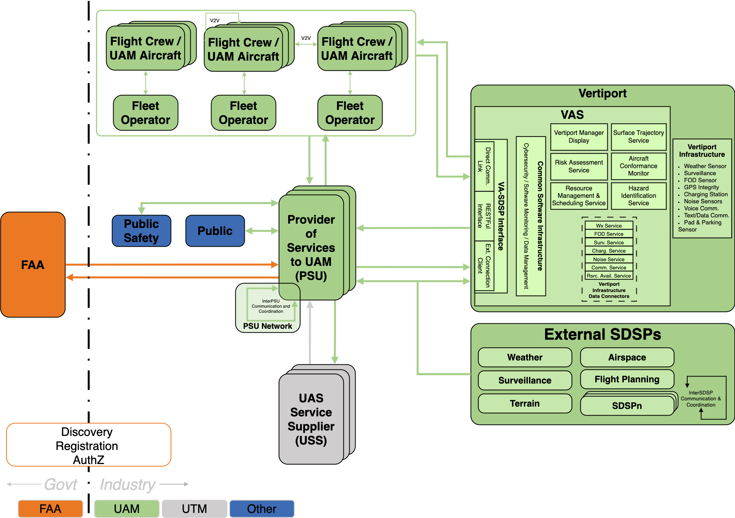
NASA Vertiport Automation System (VAS) Architecture

Slide 8


NASA High Density Vertiplex Research Overview
  CY2021
  CY2022
  CY2023
  CY2024
  CY2025
  CY2026
  Key Deliverables
Advanced Onboard Automation
Scalable Autonomous Operations
NC-3
Vertiplex Operations
IAS-2
Small UAS
Small UAS
Small UAS
AAM eVTOL
Automated Aircraft
Terminal UAM Environment Reference Architecture
X3
X5
X7
Contingency Decision Making
Automated Landing
Missed Approach
Simulation and Multi-Aircraft VLOS Flight Test
High Density Vertiport CONOPS
Simulation and Limited BVLOS
Simulation and Expanded BVLOS Operations
Operations
Operational Environment
Vertiport Use Cases
BVLOS Safety Case
Infrastructure
Vertiport Automation System Architecture & Requirements [MBSE]
Vertiport Terminal Procedures Design
Instrumented and Connected Vertiport
Automated Vertiplex

Slide 9
IFAR UAM Infrastructure Technology Status

Slide 10
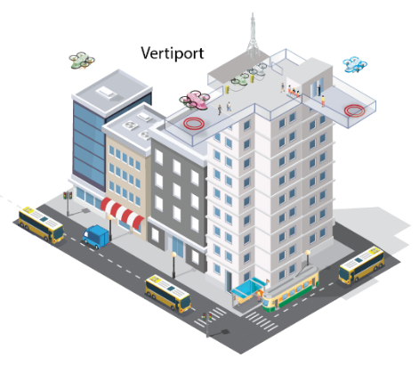

Assumptions – Vertiport Evolution
Initial vertiports will likely be established using current infrastructure (on-airport, off-airport, heliport) in the near-term and new infrastructure in the far term (e.g. greenfield, brownfield).
Current Infrastructure
Urban Area Vertiports

Slide 11
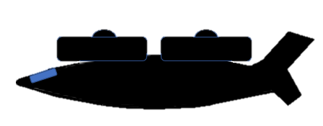

Assumptions – Aircraft and Operations Assumptions
Near Term (2025)
  Operations will be VFR piloted operations
  Low Operational Tempo
  ATC Interactions
Far Term (2035+)
  Operations will be IFR and VFR, including remotely piloted and autonomous
  High Operational Tempo
  Digitalized Air Traffic Management
Vertiport

Slide 12
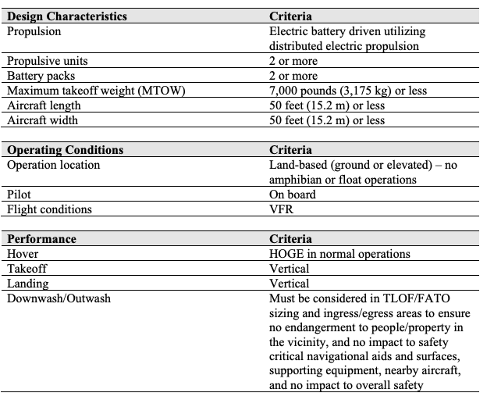
Assumptions – Representative VTOL Aircraft
Limits
  Passenger Carrying (4-5)
  MTOW = 7,000 lbs (3,175 kg) or less
  Aircraft Length = 50 ft (15.2 m)
  Aircraft width = 50 ft (15.2m)
  Power Source = Electric / Hybrid
  Pilot onboard near term, (semi- ) autonomous far term
  No taxing (initially), surface movements / parking / taxing* (long term)
  1 FATO near term, at least (2+) FATOs far-term
Needs more discussion
  Icing / ground handling
  Aircraft Equipage / Autonomy
Reference: FAA Vertiport Engineering Brief
Vertiport

Slide 13
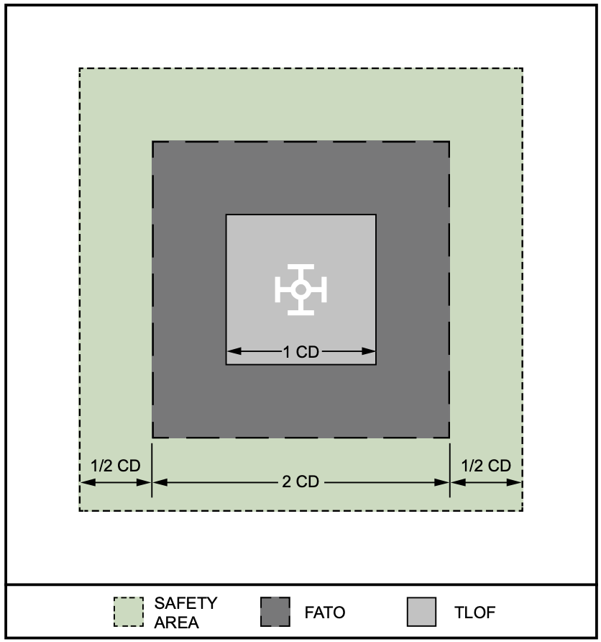
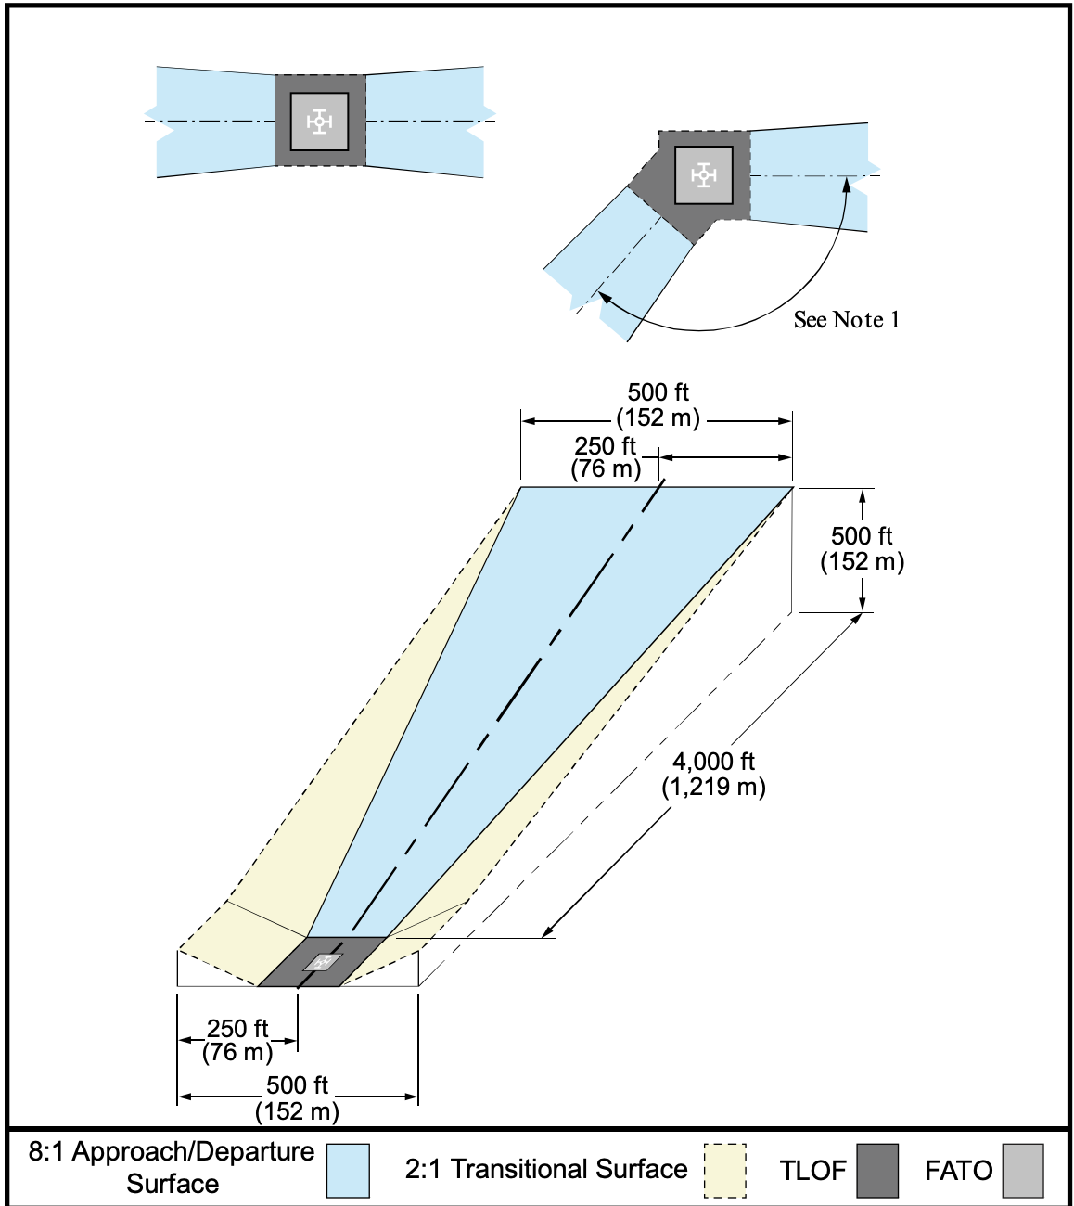
Assumptions – Vertiport Design
Vertiport design criteria guidance will be specified by each national aviation authority
Vertiport design should include a TLOF, FATO, Safety Area and Arrival/Departure surfaces
Considerations for glide path angles, climb gradients on arrival departure consistent with more dynamic aircraft performance
Reference: FAA Vertiport Engineering Brief

Slide 14
Areas of Agreement
Not all solutions employed in today's heliports and airports will be suitable for vertiports
  Many of the technologies are relevant, however need to be optimized for AAM aircraft and operation if deployed at a vertiport
  The scale or tempo of operations may make some technology unsuitable
  Increase in operational tempo will drive the need for more technology to support throughput and complexity.
  Different aircraft fuel sources will have design and operational impacts (e.g. scheduling recharging)
The technology solutions will need to evolve as the operations evolve (pilot vs remotely piloted vs. autonomous)
In order to gain trust in the technologies, multiple pilot tests, demonstrations, and trials are needed to convince stakeholders of the value to invest and deploy in existing or new infrastructure
Technology areas for consideration:
  Communication / Navigation / Surveillance / Information
  Safety Systems
  Refueling / Recharging
  Security
  Handling

Slide 15
Recommendation Status
Discussions ongoing on technology challenges
Discussion ongoing on identifying where technology R&D is warranted
Cataloging ongoing research activities to address
Recommendations will include the assumptions, challenges, and architectures and/or technology research suggestions
  Ongoing testing will inform functional, interface, and performance requirements
Further discussions are need to develop a technology roadmap (from near-term to far-term).

Slide 16
Discussion / Questions

Slide 17
Recent Research Publications
  NASA AAM Vertiport Automation Trade Study
  NASA High Density Vertiport CONOPS
  NASA Vertiport Automation Software Architecture and Requirements

Slide 18
Terminology
Final approach and takeoff area (FATO): The FATO is a defined, load-bearing area over which the aircraft completes the final phase of the approach, to a hover or a landing, and from which the aircraft initiates takeoff. (FAA Engineering Brief #105)
Operational tempo: Representation of the density, frequency, and complexity of operations. Tempo evolves from a small number of low complexity operations to a high density and high rate of complex operations. (FAA Engineering Brief #105)
Touchdown and liftoff area (TLOF): The TLOF is a load bearing, generally paved area centered in the FATO, on which the aircraft performs a touchdown or liftoff. (FAA Engineering Brief #105)
Vertiport: An area of land or a structure, used or intended to be used, for electric, hydrogen, and hybrid VTOL landings and takeoffs and includes associated buildings and facilities. (FAA Engineering Brief #105)
VTOL – Vertical Takeoff and Landing

