Slide 1
Design Considerations for Practical Li-S Battery Components for Electric Aviation
Donald A. Dornbusch¹, Rocco P. Viggiano¹, Yi Lin²,
John W. Connell², James Wu¹, Vadim F. Lvovich¹
¹NASA Glenn Research Center;
²NASA Langley Research Center
241st Meeting of the Electrochemical Society
Presenter: Dr. Donald A. Dornbusch
NASA GRC

Slide 2
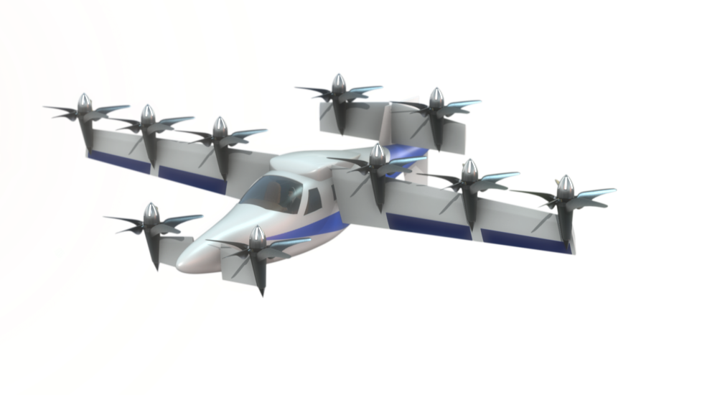
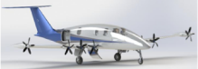
Introduction – Electrified Aviation
Electric and hybrid electric aircraft systems can lead to higher efficiencies, safer designs, and quieter operation
Current battery technology is insufficient to achieve the requirements for electric aviation:
  Energy, Power, and Safety
Higher energy density batteries and current flammable liquid electrolytes lead to safety concerns

Slide 3
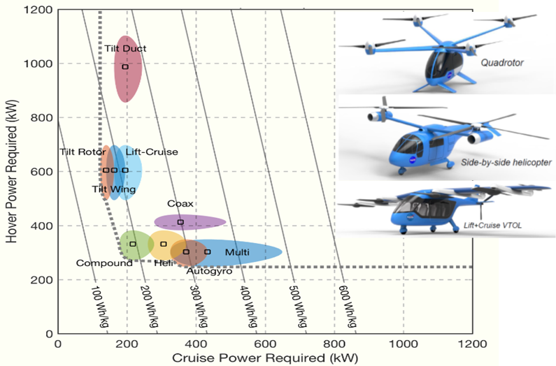
Aircraft Requirements
Aircraft design significantly impacts power requirement
Current battery energy limited to ~200 Wh/kg
Ref: 2017 Uber Elevate Report

Slide 4
Solid-State Electrolytes
Advantages:
Solid-state electrolytes = low flammability
Wide temperature tolerance
Disadvantages:
Difficult to manufacture
Interface issues
  Solid-Solid contact vs Liquid-solid
High density vs liquid (g/cm3)

Slide 5
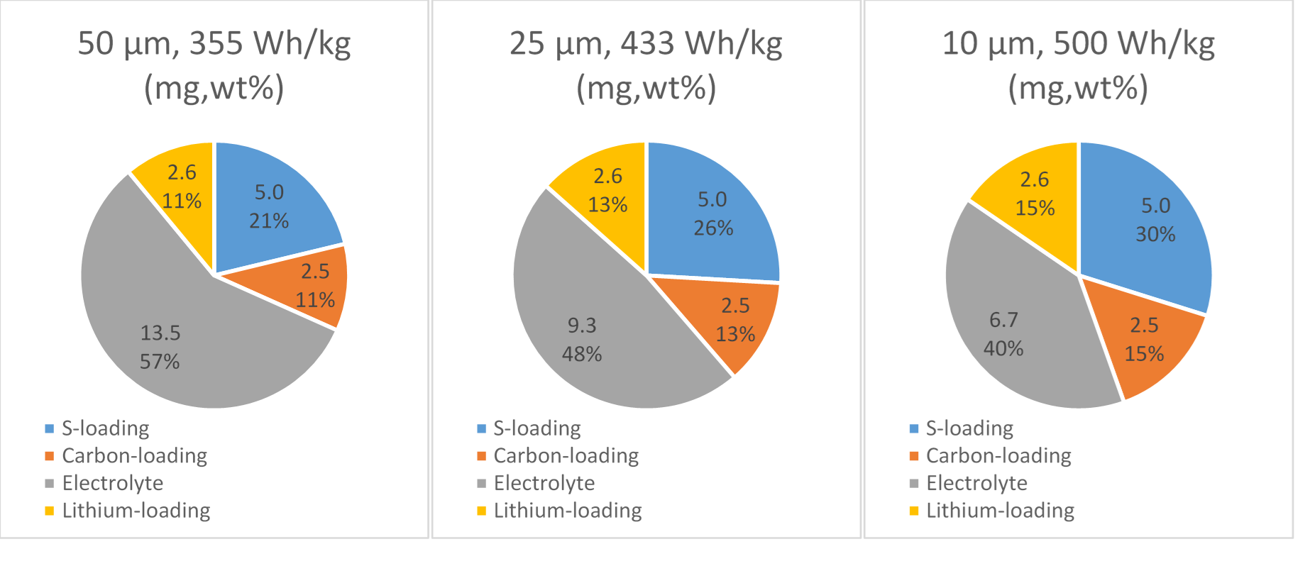
Material Selection
Lithium-Sulfur
  Lithium metal is an ideal anode material
    Lightweight (3860mAh/g), low potential, metallic
  Sulfur has high capacity (1675mAh/g)
    Reasonable potential above lithium (~2V)
    Dissolution prevented in a solid-electrolyte
Solid-Electrolyte 25 micron separator:
  Polymer ~1.2g/mL → 3 mg/cm2
  Sulfide ~1.7 g/mL → 4.25 mg/cm2
  Oxide ~5.6 g/mL → 14 mg/cm2
  Oxides, such as LLZO, must be x3.3 times thinner than corresponding sulfide to achieve same weight penalty
Impact of Solid-Electrolyte (Sulfide):
  Substantial gains in energy by controlling separating layer thickness

Slide 6
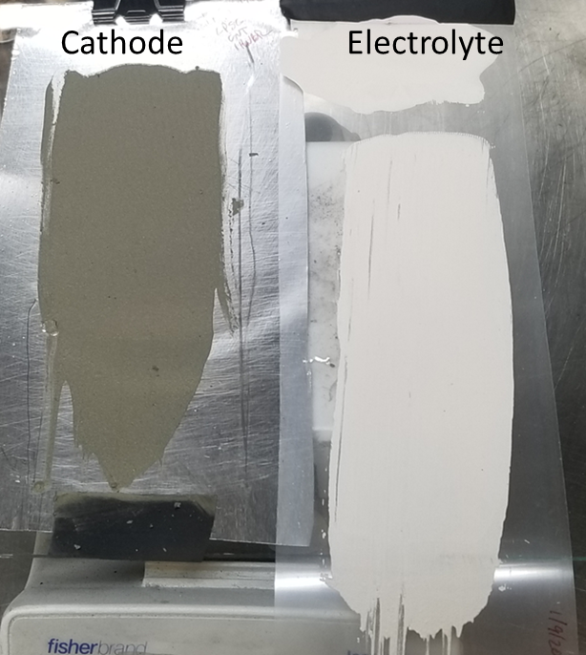
Manufacturing Thin Electrolytes
Sulfide (Li₅PS₅Cl)-Polymer Composites
Tape-casting produces thin electrolytes
Traditional lithium-ion manufacturing technique
Utilizing inert binder (3-5wt%) to achieve well adhered films
Capable of producing multi-phase cathodes
  (Active-Carbon-Electrolyte-Binder)

Slide 7
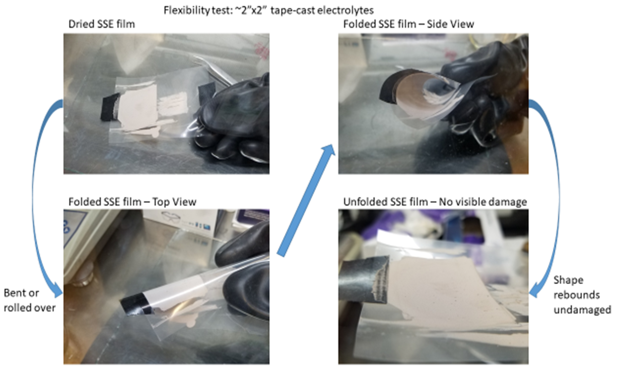
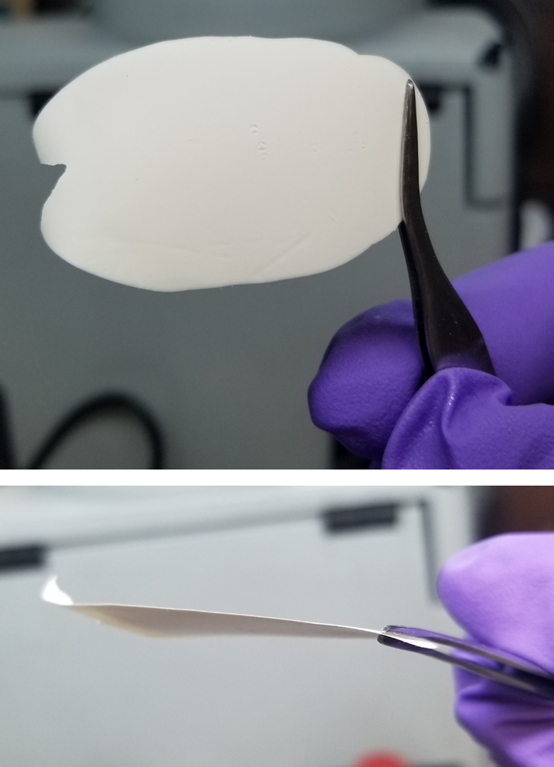
Improved mechanical properties
Mylar Supported
Free-standing
Substantially improved flexibility over pure glass electrolytes

Slide 8
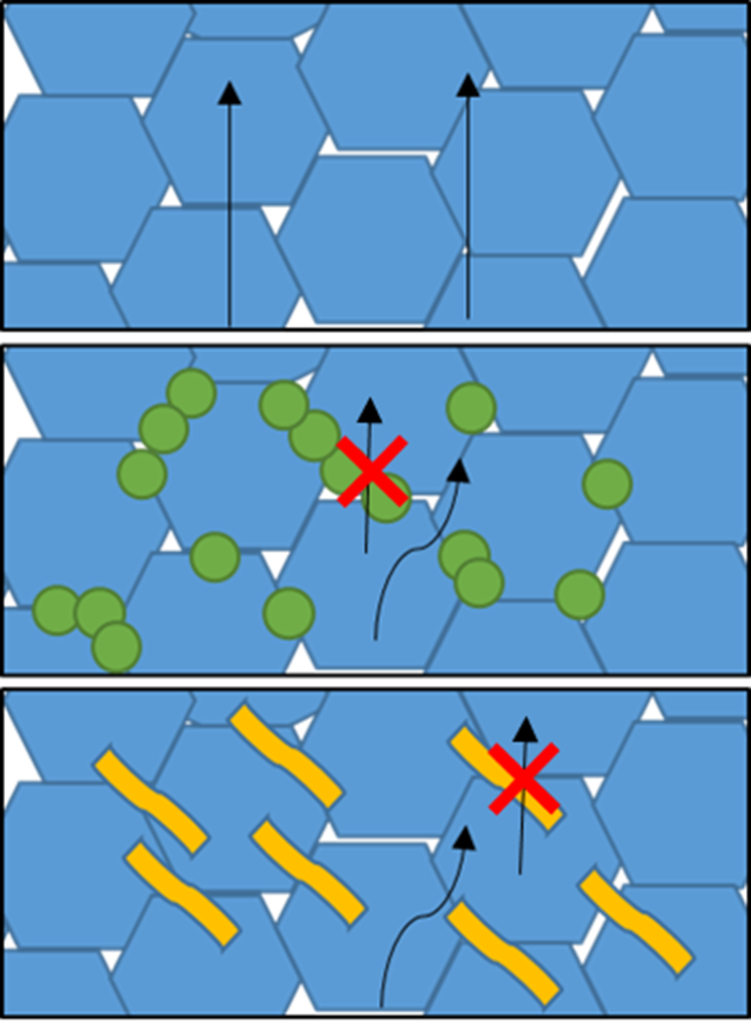
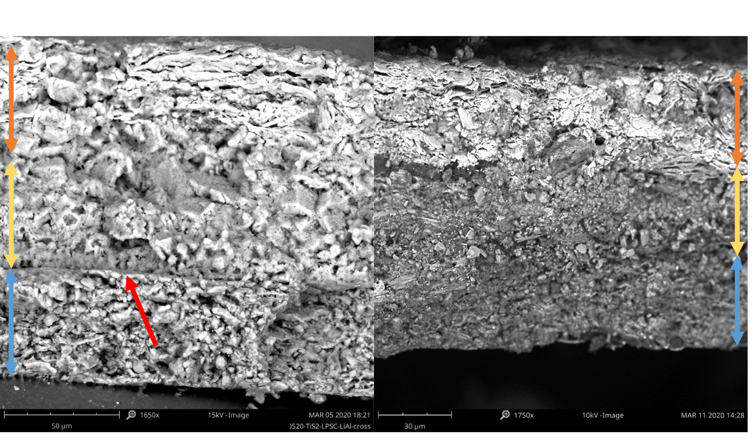
Glass-Polymer Composite Electrolytes
Introduction of a passive phase
  Conduction pathways change
Densification processing improvements lead to better sheet adhesion
(a)
(b)
(c)
Depiction of Li transport through densified solid-state electrolyte for pure (a), composite with PTFE powder binder (b), and composite with solution deposited Styrene-Butadiene-Styrene (SEBS) rubber binder (c).

Slide 9
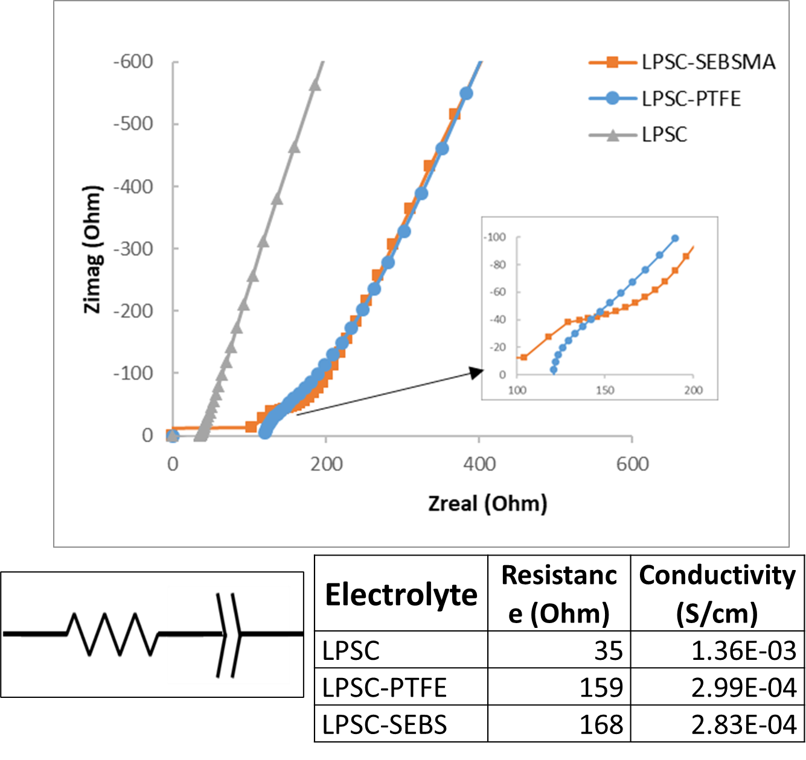
Impedance Data
Increase in impedance through electrolyte layer due to binder phase
Ionic conductivity still retains ~20% of pure LPSC
Binder type has less impact on performance loss

Slide 10
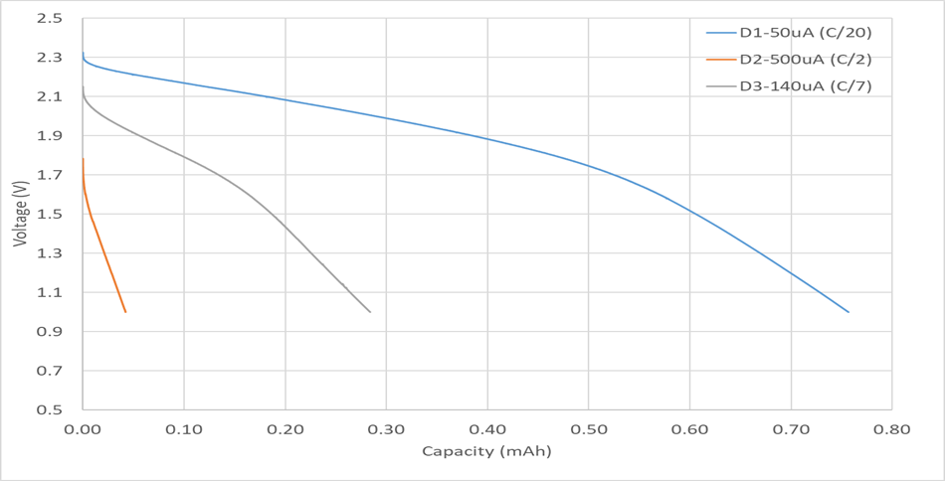
Full Cell Demonstration
TiS₂/Sulfide SSE/Lithium
TiS2 test candidate cathode (1mAh)
  Similar potential window to sulfur
  Lower volume change
  High electrical conductivity
~25 micron thick solid-state electrolyte achievable
Ionic Conductivity Retention of Sulfide-Polymer Composite: ~20% (3E-4 S/cm)
Rate capability/mixing requires further improvements

Slide 11
Limitations of binder-based systems
Reactivity of LPSC with polar solvents forces the use of nonpolar solvents
  Nonpolar solvents are limited to low polarity binders with weaker adhesion to polar LPSC surfaces
Below 30μm films remain fragile

Slide 12
Limitations of binder-based systems
Reactivity of LPSC with polar solvents forces the use of nonpolar solvents
  Nonpolar solvents are limited to low polarity binders with weaker adhesion to polar LPSC surfaces
Below 30μm films remain fragile
Possible solutions:
Explore alternate binders/processing techniques
Introduce a filler material to further strengthen the composites

Slide 13
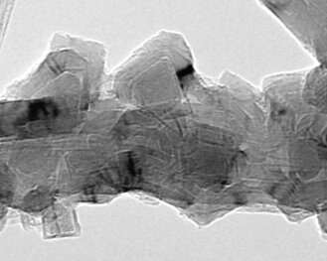
Fiber-based fillers
Polyaramid(Kevlar) Nanoglass NASA forcespun fibers
Boron Nitride NanobarbTM
Source: BNNano.com
Fiber candidates:
Kevlar – high strength polymer fibrils (wide distribution)
Nanoglass – high aspect ratio (700nm x 100’s μm)
Forcespun polymers – high aspect ratio, polymer control
BNNanobarbsTM – insulating analog to CNT (very small, nm x nm)

Slide 14
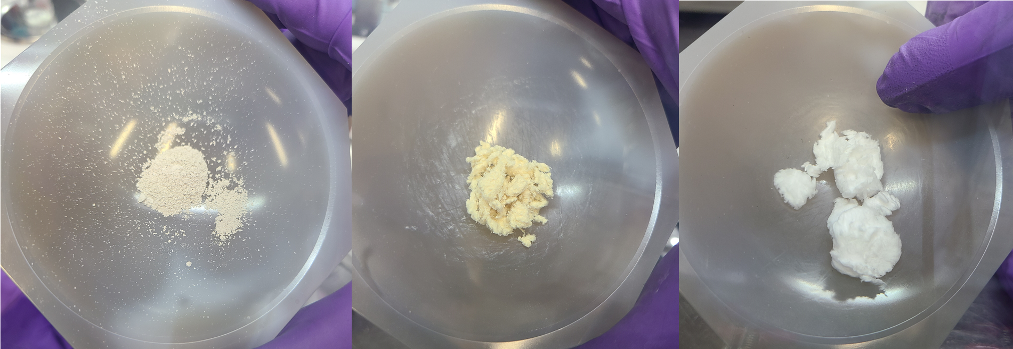
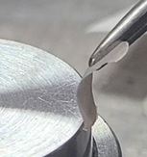
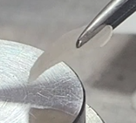
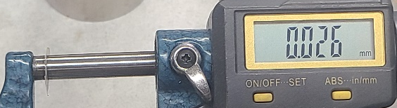
Filler Results
Fillers were added at 5wt% to LPSC-Binder-Toluene slurry
  Alternating centrifugal mixing and sonication to ensure even dispersion
  Tape cast onto mylar substrate
  Dried at 60ºC
Fibrous additives dramatically increased the slurry viscosity
  Viscosity ranged from BN < Nanoglass < Kevlar
  Kevlar viscosity greatly increased after sonication
    Bundle unwrapping and/or stronger interaction with binder
Impact on conductivity
  Largest drop observed for BN, which suggests stronger interference between electrolyte particle-particle contacts within the composite.
  Larger fibers retained more conductivity, close to filler-free composites, indicating less contact interference between LPSC particles.
Mechanical stability
  All three materials showed substantially improved stability
  The samples even showed flexibility after densification.
BN Kevlar Glass
Electrolyte LPSC-based | Conductivity (S/cm)
Pure | 1.36E-03
Binder | 2.83E-04
Binder 3%-BN5% | 6.0E-05
Binder 3%-G5% | 2.2E-04
Binder 3%-KV5% | 2.6E-04

Slide 15
Conclusions
Lithium conducting Li₆PS₅Cl composite electrolytes could be manufactured with thicknesses between 25-50 μm through a scalable process.
Achieved thicknesses were in the practical range to make the chemistry competitive with current lithium-ion cells.
Binder and filler impacted conductivity, but ~20% was retained.
  Significant reduction in thickness will lead to overall improvements in energy and power capability.
  Length-scale of filler influenced conductivity losses
Future Direction
Further optimization of polymer and filler loadings to improve conductivity and mechanical stability for low thickness tape-cast composites.

Slide 16
Design Considerations for Practical Li-S Battery Components for Electric Aviation
Donald A. Dornbusch¹, Rocco P. Viggiano¹, Yi Lin²,
John W. Connell², James Wu¹, Vadim F. Lvovich¹
¹NASA Glenn Research Center;
²NASA Langley Research Center
241st Meeting of the Electrochemical Society
Presenter: Dr. Donald A. Dornbusch
NASA GRC

