Slide 1
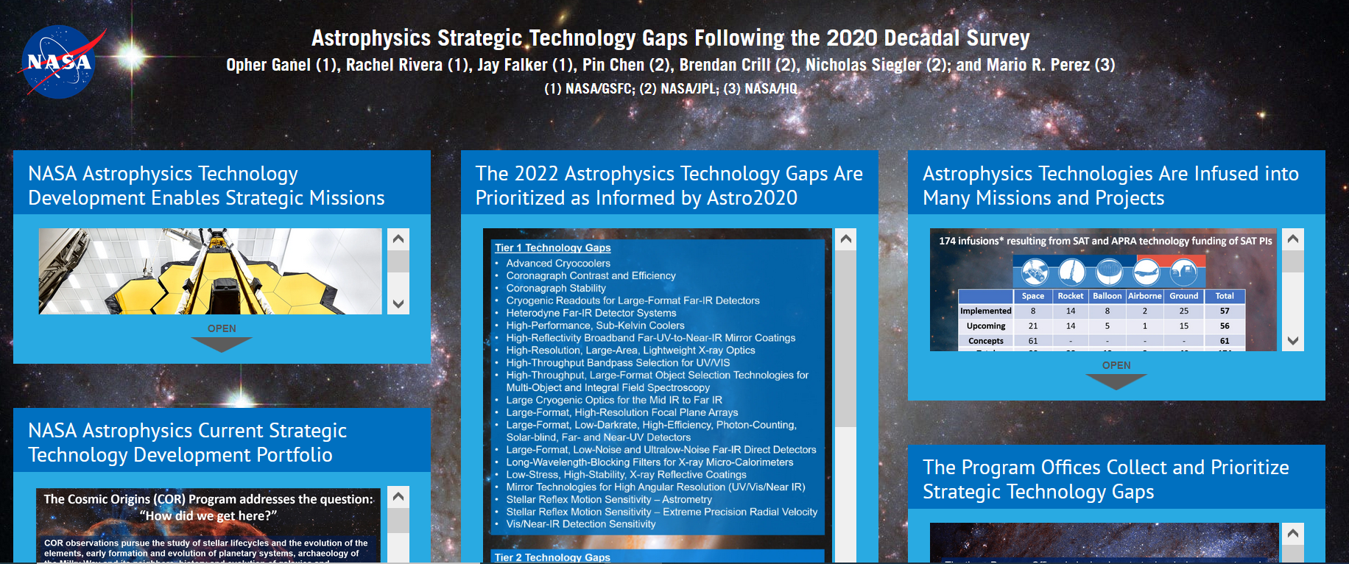
iPoster is not downloadable. It is like a widget where you enter photos and captions on a template. Viewers would select “open” to see the contents which are copy and pasted in this presentation.

Slide 2
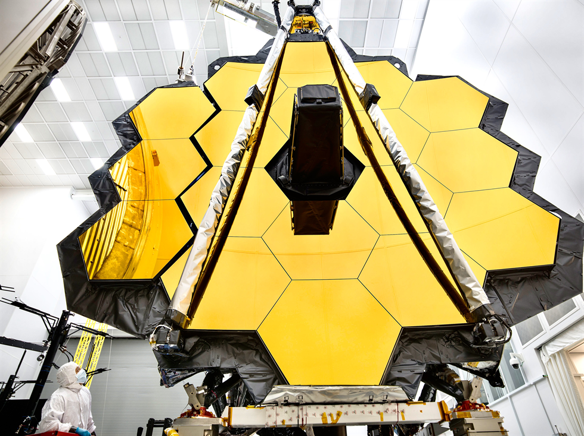
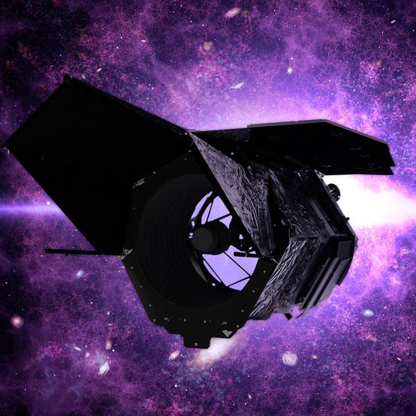
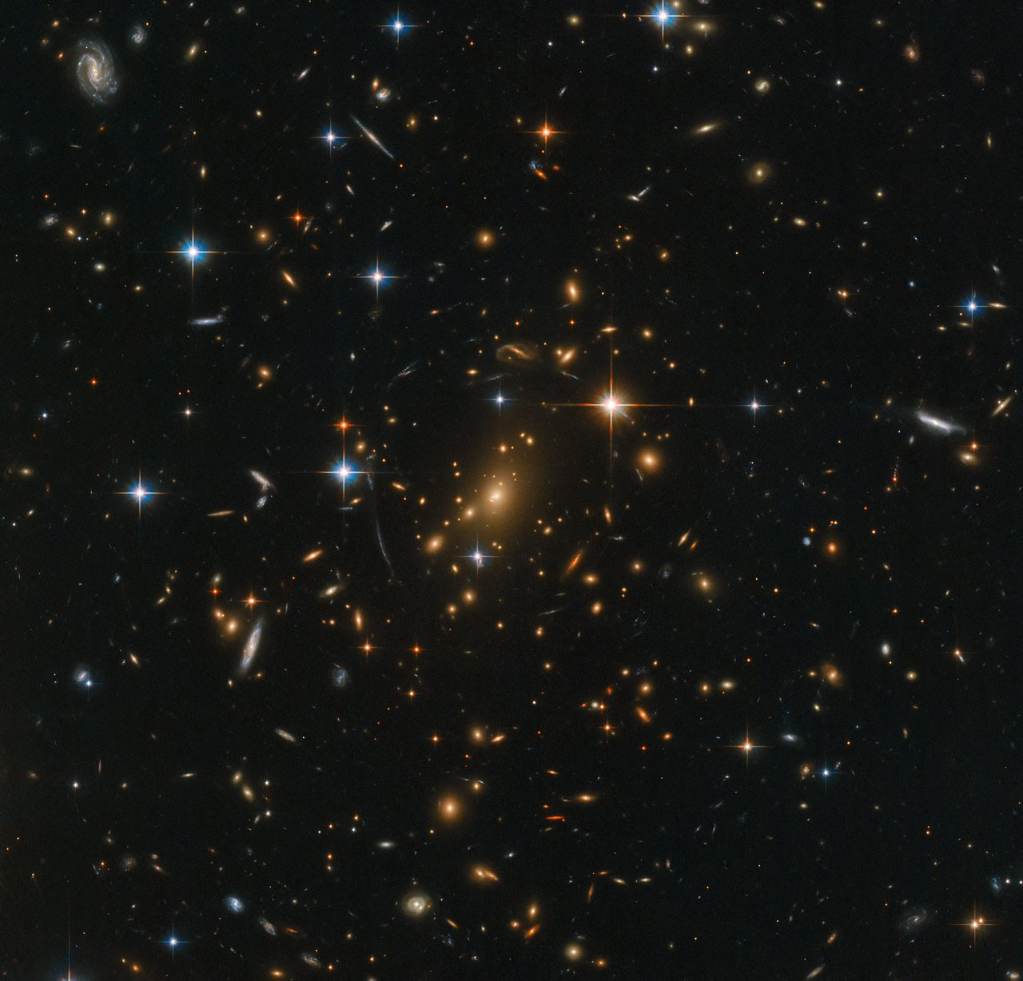
The Decadal Survey on Astronomy and Astrophysics 2020, "Pathways to Discovery in Astronomy and Astrophysics for the 2020s," recommended a suite of compelling missions, including a 6m-class IR/Optical/UV observatory for exoplanet characterization and general astrophysics studies, a far-IR flagship, an X-ray flagship, and three Probe missions.
The proposed launch dates for these are:
Early 2030s for the first Probe (X-ray or far-IR)
Early 2040s for the next Probe (CMB or the one not launched before)
Mid-2040s for the IR/O/UV Great Observatory
The following decade(s) for the far-IR and X-ray Great Observatories.
Such missions require technologies that far exceed today's state of the art. To begin developing and maturing technologies that enable and enhance such missions, NASA established the Strategic Astrophysics Technology (SAT) program. Where needed, direct-funded projects may supplement the SAT program.
… and the Roman Space Telescope currently under development.
NASA's Astrophysics Division undertakes ambitious space missions to explore the nature of the universe at its largest scales, earliest moments, and most extreme conditions. Missions such as the recently launched James Webb Space Telescope...

Slide 3
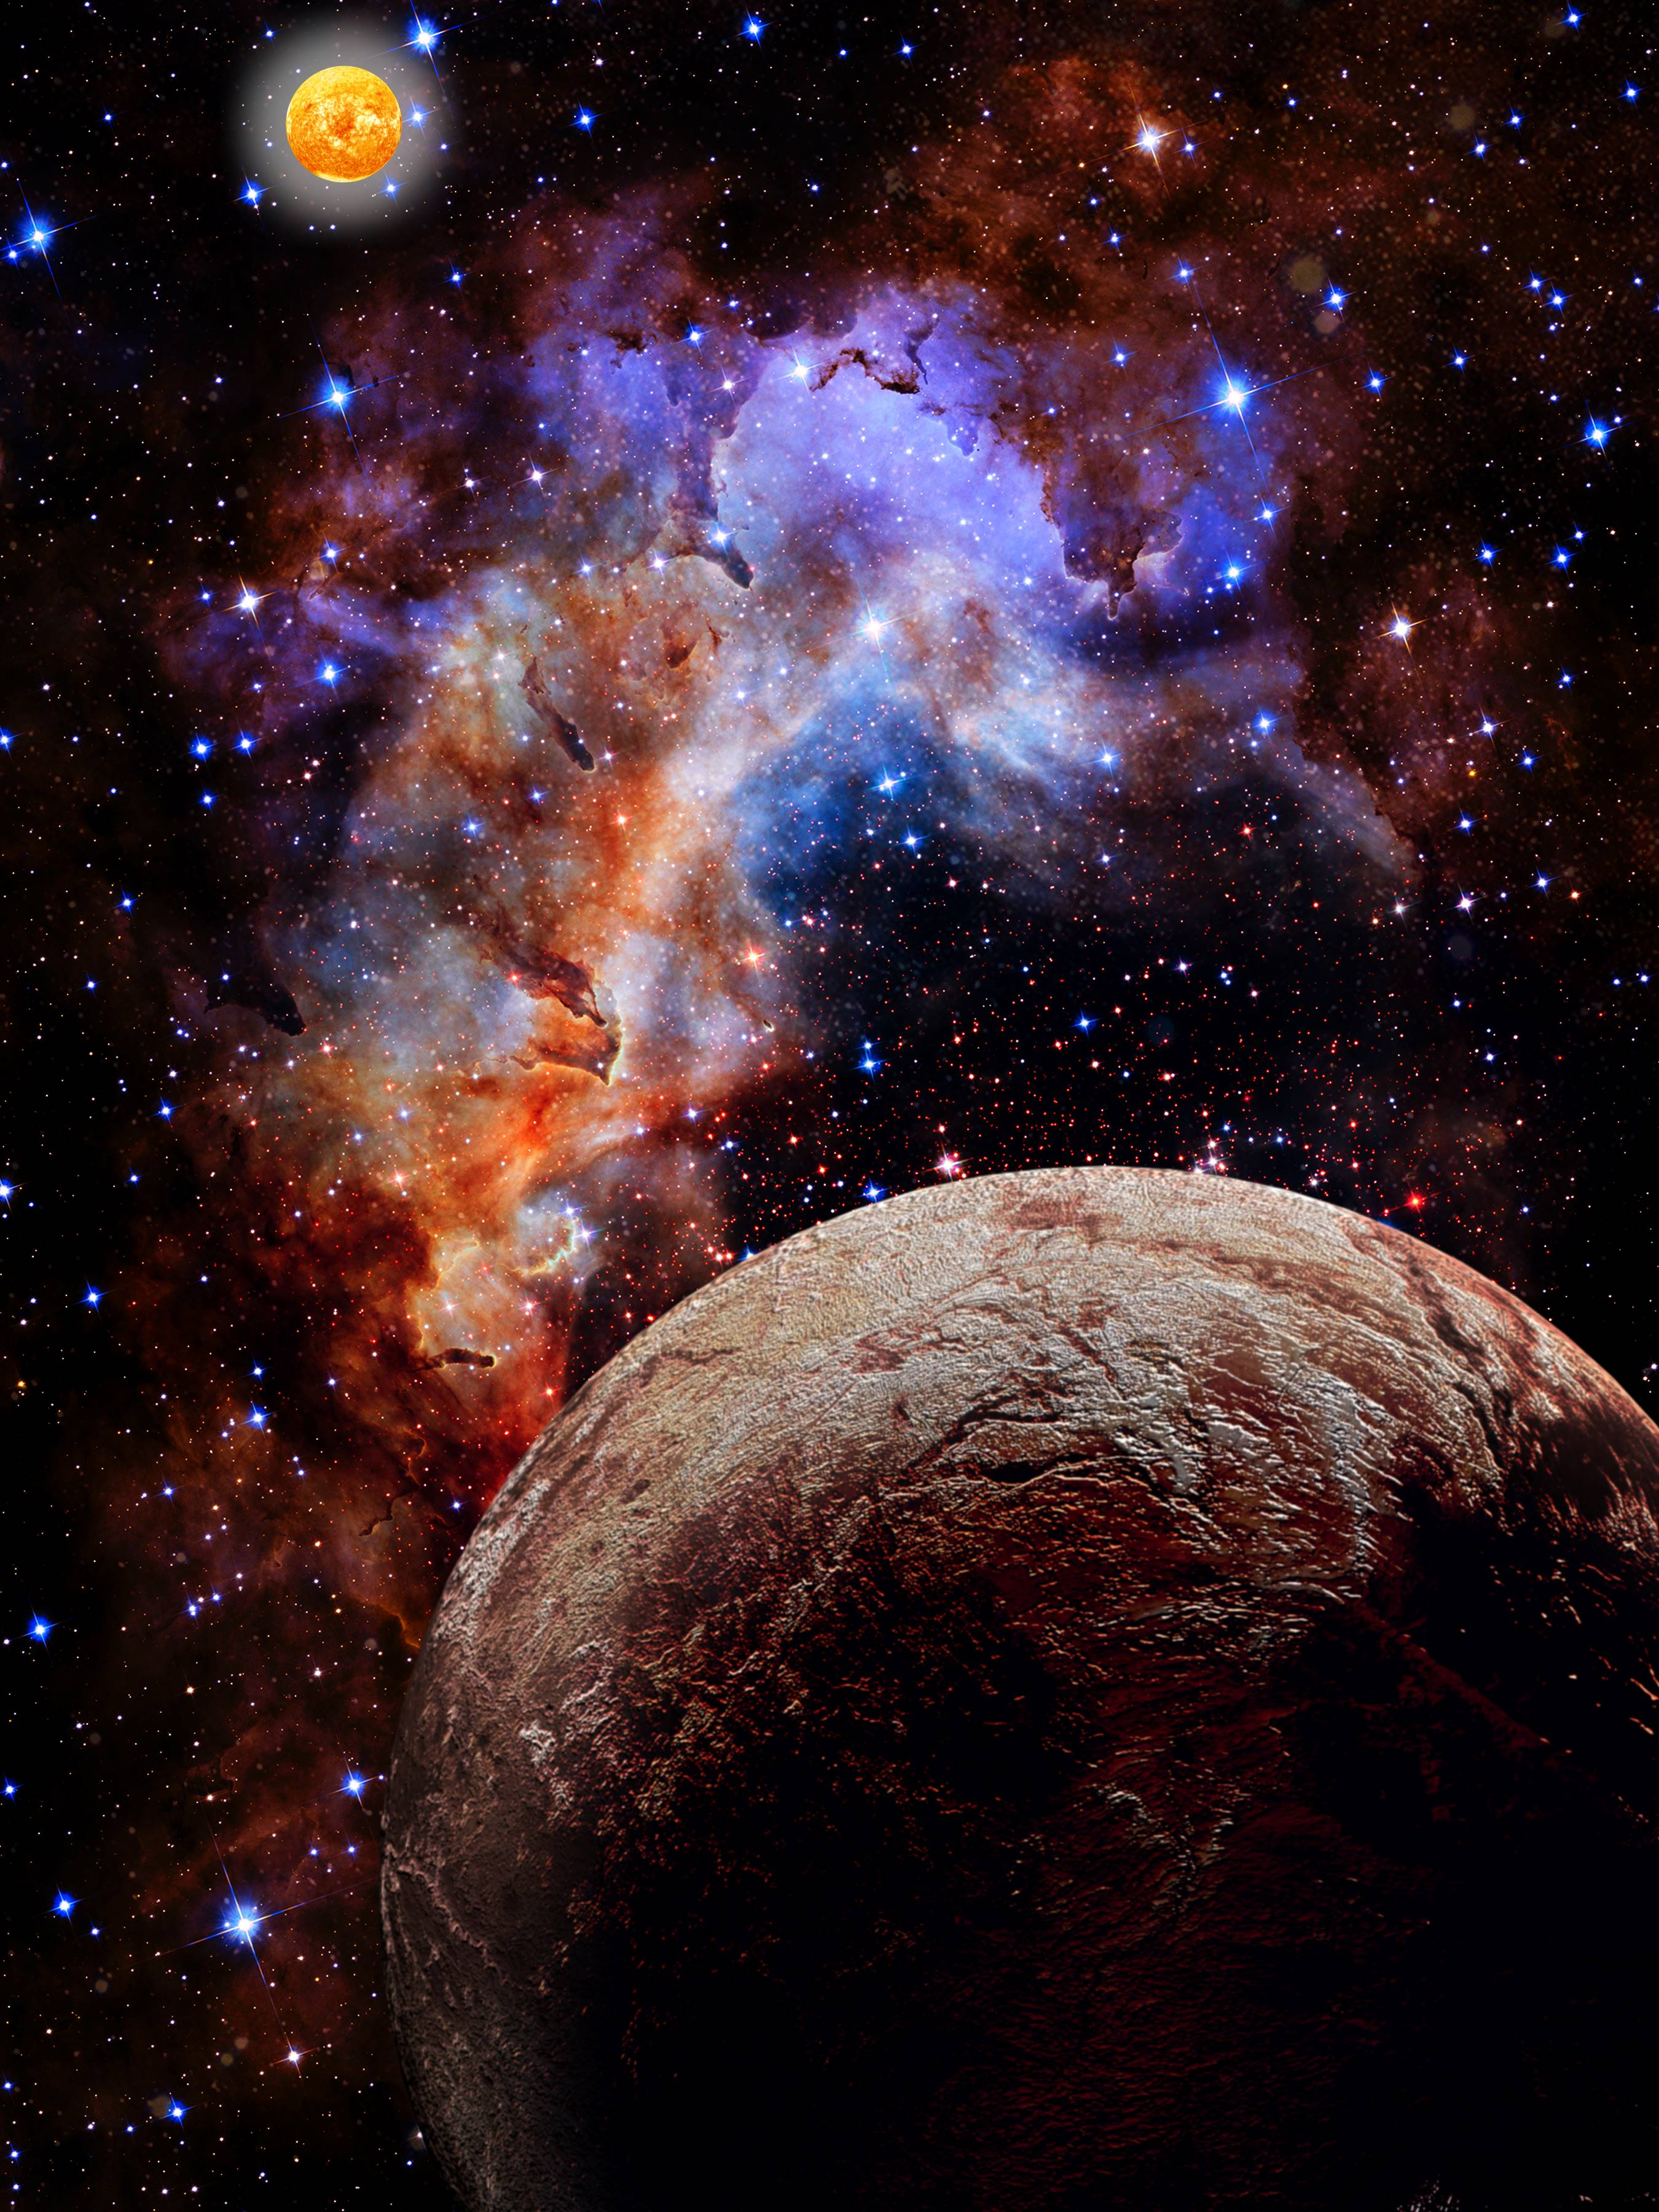
The Exoplanet Exploration Program (ExEP) addresses the question: “Are we alone?”
The Program Offices Collect and Prioritize Strategic Technology Gaps
ExEP observations seek to discover and help us understand planetary systems around nearby stars. This includes detecting and characterizing planets around our stellar neighbors, and especially Earth-like planets in their stars’ habitable zones, and searching for signatures of life there. These require observations across the UV, optical, and IR bands. At this time, technology needs include ultra-stable space telescope architectures, starshades, coronagraphs, optics, and detectors enabling direct imaging and characterization of exo-Earths.
Current ExEP Technology Development Projects | PI Name | Org. | Tech Area
Development of a Method for Exoplanet Imaging in Multi-Star Systems | Belikov, Ruslan | ARC | Coronagraph
Laboratory Demonstration of High Contrast Using PIAACMC on a Segmented Aperture | Belikov, Ruslan | ARC | Coronagraph
Laboratory Demonstration of Multi-Star Wavefront Control in Vacuum | Belikov, Ruslan | ARC | Coronagraph
MEMS Deformable Mirror Technology Development for Space-Based Exoplanet Detection | Bierden, Paul | BMC | Coronagraph
Segmented Coronagraph Design and Analysis Study | Chen, Pin | JPL | Coronagraph
Linear Wavefront Control for High-Contrast Imaging | Guyon, Olivier | Arizona | Coronagraph
Optimal Spectrograph and Wavefront Control Arch. for High-contrast Exoplanet Characterization | Mawet, Dimitri | Caltech | Coronagraph
Radiation-Tolerant, Photon-Counting, Vis. & Near-IR Detectors for Coronagraphs and Starshades | Rauscher, Bernard | GSFC | Detector
Broadband Light Rejection with the Optical Vortex Coronagraph | Serabyn, Eugene | JPL | Coronagraph
Vortex Coronagraph High-Contrast Demonstrations | Serabyn, Eugene | JPL | Coronagraph
First System-level Demonstration of High Contrast for Future Segmented Space Telescopes | Soummer, Rémi | STScI | Coronagraph
Ultra-Stable Mid-Infrared Detector Array for Space-Based Exoplanet Transit Spectroscopy | Staguhn, Johannes | JHU | Detector
Super Lyot ExoEarth Coronagraph | Trauger, John | JPL | Coronagraph
A Novel Optical Etalon for Precision Radial Velocity Measurements | Vasisht, Gautam | JPL | EPRV
Starshade Large-Structure Precision Deployment and Stability | Willems, Phil | JPL | Starshade
Starshade Starlight Suppression | Willems, Phil | JPL | Starshade

Slide 4
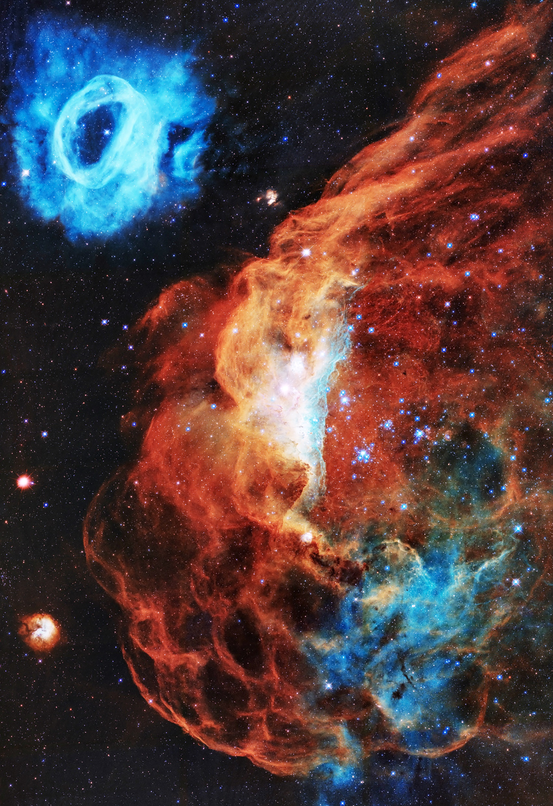
The Cosmic Origins (COR) Program addresses the question: “How did we get here?”
COR observations pursue the study of stellar lifecycles and the evolution of the elements, early formation and evolution of planetary systems, archaeology of the Milky Way and its neighbors, history and evolution of galaxies and supermassive black holes, and first light and reionization in the early universe.
These require observations across much of the electromagnetic spectrum, from UV through the visible and into the IR. At this time, technology needs include detectors and spectrometers, multi-object selection, advanced mirror coatings and optical filters, large cryogenic optics, and advanced cooling.
Current COR Technology Development Projects | PI Name | Org. | Tech Area
Photon-Counting NIR LmAPD Arrays for Ultra-Low-Background Space Observations | Bottom, Michael | UH | Detector
Ultrasensitive Bolometers for Far-IR Spectroscopy at the Background Limit | Bradford, Charles | JPL | Detector
Ultrastable Large Telescope Research & Analysis – Technology Maturation (ULTRA-TM) | Coyle, Laura | Ball | Telescope
A Single-Photon-Sensing and Photon-Number-Resolving Detector for NASA Missions | Figer, Donald | RIT | Detector
Electron Beam Lithography Ruled Gratings for Future UV/Optical Missions | Fleming, Brian | CU Boulder | Optics
Scalable Micro-Shutter Systems for UV, Visible, and Infrared Spectroscopy | Greenhouse, Matthew | GSFC | Optics
High-Performance, Stable, and Scalable UV Aluminum Mirror Coatings Using ALD | Hennessy, John | JPL | Opt. Coating
Development of High-Resolution Far-Infrared Array Receivers | Mehdi, Imran | JPL | Detector
Development of Digital Micromirror Devices for Far-UV Applications | Ninkov, Zoran | RIT | Optics
Technology Maturation for Astrophysics Space Telescopes (TechMAST) | Nordt, Alison | LM | Telescope
Electron-Beam Generated Plasma to Enhance Performance of Protected Aluminum Mirrors | Quijada, Manuel | GSFC | Opt. Coating
Ultra-Stable Structures Development and Characterization Using Spatial Dynamic Metrology | Saif, Babak | GSFC | Metr./ Struct.
High Performance Sealed Tube Cross Strip Photon Counting Sensors for UV-Vis | Siegmund, Oswald | UCB | Detector
Process to Produce Scalable, Superconducting Kilopixel Far-IR Detector Arrays | Staguhn, Johannes | JHU | Detector
Precision Thermal Control (PTC) Performance Tests | Stahl, H. Philip | MSFC | Optics
High-Efficiency Continuous Cooling for Cryogenic Instruments and Sub-Kelvin Detectors | Tuttle, James | GSFC | Cooling Sys.
Large-Format, High-Dynamic-Range UV Detector Using MCPs and Timepix4 Readouts | Vallerga, John | UCB | Detector

Slide 5
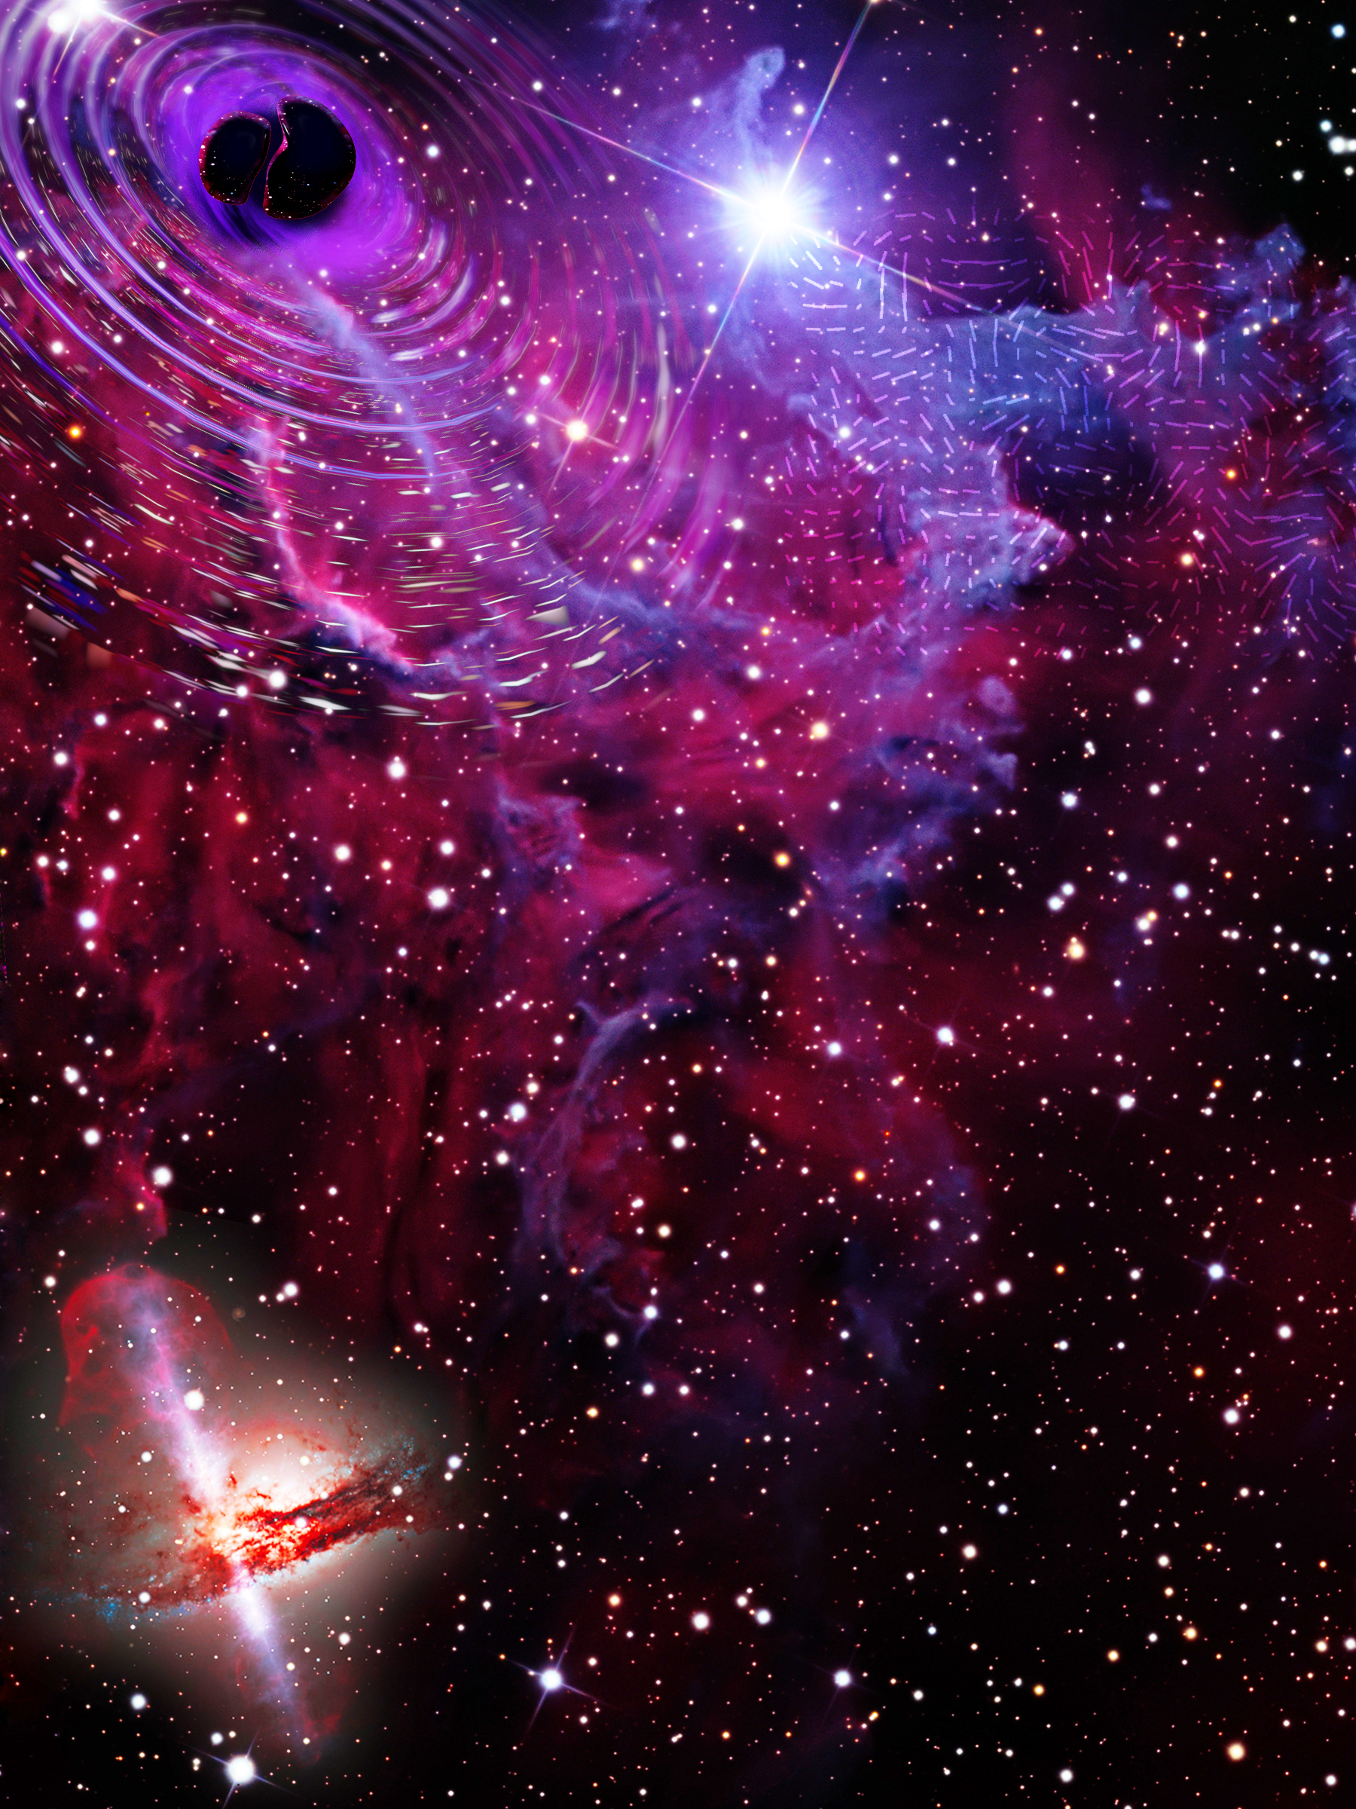
The Physics of the Cosmos (PCOS) Program addresses the question: “How does the universe work?”
PCOS observations seek to test the validity of Einstein’s General Theory of Relativity and understand the nature of space-time, the behavior of matter and energy in extreme environments, the cosmological parameters governing inflation and the evolution of the universe, and the nature of dark matter and dark energy. These require electromagnetic observations (far IR/sub-mm, X rays), and gravitational waves. At this time, technology needs include X-ray detectors, gratings, optics, and optical-blocking filters; and microwave detectors and optical elements.
Current PCOS Technology Development Projects | PI Name | Org. | Tech Area
Advanced X-ray Microcalorimeters: Magnetically Coupled Calorimeters | Bandler, Simon | GSFC | Detector
High-Speed, Low-Noise, Radiation-Tolerant CCD Image Sensors | Bautz, Mark | MIT | Detector
Microwave SQUID Readout to Enable Lynx and Other Future Observatories | Bennett, Douglas | NIST | Electronics
Direct Fabrication of Full-Shell X-ray Optics | Bongiorno, Stephen | MSFC | Optics
Hybrid X-ray Optics by Additive Manufacturing | Broadway, David | MSFC | Optics
Low-Stress Mirror Coatings for X-ray Optics | Broadway, David | MSFC | Opt. Coatings
UV-LED-Based Charge Management System | Conklin, John | UF | Electronics
Computer-Controlled Polishing of High-Quality X-ray Optics Mandrels | Davis, Jacqueline | MSFC | Optics
High-Density Readout Technology for Superconducting Sensor Arrays for Spaceflight | Frisch, Josef | SLAC | Electronics
Differential Deposition for Figure Correction in X-ray Optics | Kilaru, Kiran | MSFC | Optics
Advanced TES Microcalorimeters | Kilbourne, Caroline | GSFC | Detector
Enabling and Enhancing Technologies for ATHENA X-IFU Demonstration Model | Kilbourne, Caroline | GSFC | Detector
Advancing the Focal Plane TRL for LiteBIRD and Other Next-Generation CMB Missions | Lee, Adrian | UCB | Detector
Telescopes for Space-Based Gravitational-Wave Observatories | Livas, Jeffrey | GSFC | Telescope
Development of RFSoC-Based Readout Electronics | Mauskopf, Philip | ASU | Electronics
Superconducting Antenna-Coupled Detectors for CMB Polarimetry | O’Brient, Roger | JPL | Detector
Advanced X-ray Microcalorimeters: Lab Spectroscopy for Space Atomic Physics | Porter, Scott | GSFC | Detector
X-ray Testing and Calibration | Ramsey, Brian | MSFC | Optics
Development of Adjustable X-ray Optics with 0.5 Arcsecond Resolution | Reid, Paul | SAO | Optics
High Resolution High Efficiency X-ray Transmission Grating Spectrometer | Schattenburg, Mark | MIT | Optics
Manufacturability & Alignment of X-ray Gratings and Optics for Space Applications | Smith, Randall | SAO | Optics
Phase Measurement System for Interferometric Gravitational Wave Detectors | Ware, Brent | JPL | Electronics
Space-based Gravitational Wave Laser Technology Development for the LISA Mission | Yu, Anthony | GSFC | Laser
Next Generation X-ray Optics | Zhang, William | GSFC | Optics
LISA Colloid Microthruster Technology | Ziemer, John | JPL | Micropropulsion

Slide 6
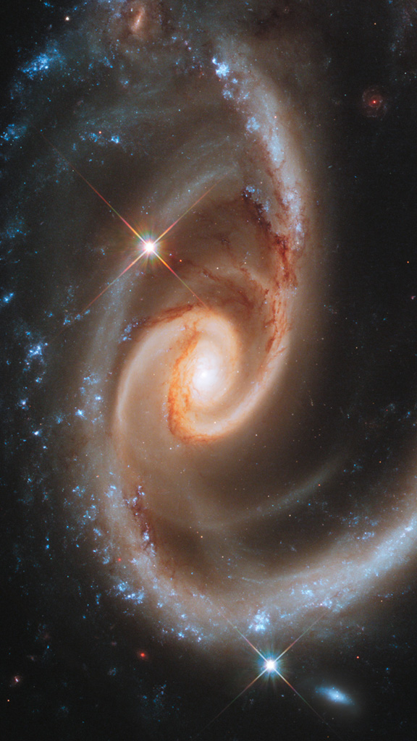
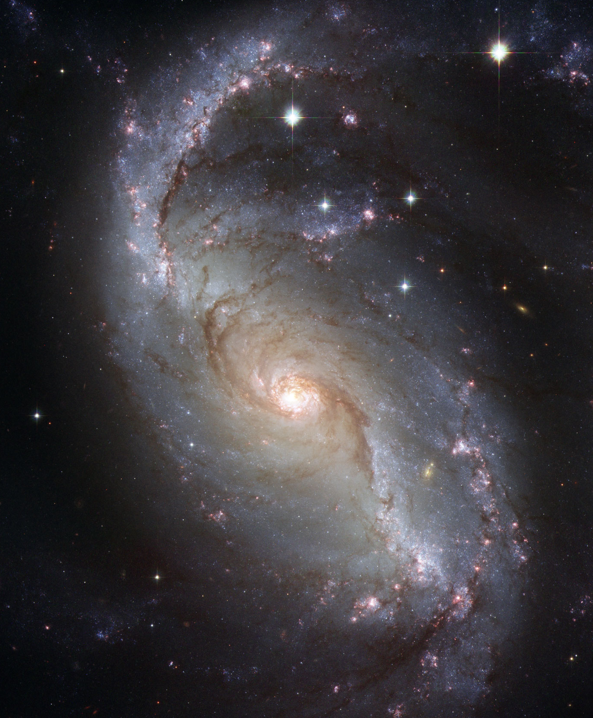
Tier 1 Technology Gaps
Advanced Cryocoolers
Coronagraph Contrast and Efficiency
Coronagraph Stability
Cryogenic Readouts for Large-Format Far-IR Detectors
Heterodyne Far-IR Detector Systems
High-Performance, Sub-Kelvin Coolers
High-Reflectivity Broadband Far-UV-to-Near-IR Mirror Coatings
High-Resolution, Large-Area, Lightweight X-ray Optics
High-Throughput Bandpass Selection for UV/VIS
High-Throughput, Large-Format Object Selection Technologies for Multi-Object and Integral Field Spectroscopy
Large Cryogenic Optics for the Mid IR to Far IR
Large-Format, High-Resolution Focal Plane Arrays
Large-Format, Low-Darkrate, High-Efficiency, Photon-Counting, Solar-blind, Far- and Near-UV Detectors
Large-Format, Low-Noise and Ultralow-Noise Far-IR Direct Detectors
Long-Wavelength-Blocking Filters for X-ray Micro-Calorimeters
Low-Stress, High-Stability, X-ray Reflective Coatings
Mirror Technologies for High Angular Resolution (UV/Vis/Near IR)
Stellar Reflex Motion Sensitivity – Astrometry
Stellar Reflex Motion Sensitivity – Extreme Precision Radial Velocity
Vis/Near-IR Detection Sensitivity
Tier 2 Technology Gaps
Broadband X-ray Detectors
Compact, Integrated Spectrometers for 100 to 1000 μm
Far-IR Imaging Interferometer for High-Resolution Spectroscopy
Far-IR Spatio-Spectral Interferometry
Fast, Low-Noise, Megapixel X-ray Imaging Arrays with Moderate Spectral Resolution
High-Efficiency X-ray Grating Arrays for High-Resolution Spectroscopy
High-Resolution, Direct-Detection Spectrometers for Far-IR Wavelengths
Improving the Calibration of Far-IR Heterodyne Measurements
Large-Aperture Deployable Antennas for Far-IR/THz/sub-mm Astronomy for Frequencies over 100 GHz
Large-Format, High-Spectral-Resolution, Small-Pixel X-ray Focal-Plane Arrays
Polarization-Preserving Millimeter-Wave Optical Elements
Precision Timing for Space-Based Astrophysics
Rapid Readout Electronics for X-ray Detectors
Starshade Deployment and Shape Stability
Starshade Starlight Suppression and Model Validation
UV Detection Sensitivity
Tier 3 Technology Gaps
Advancement of X-ray Polarimeter Sensitivity
Detection Stability in Mid-IR
Far-UV Imaging Bandpass Filters
High-Efficiency Far-UV Mirror
High-Efficiency, Low-Scatter, High- and Low-Ruling-Density, High and Low-Blazed-Angle UV Gratings
High-Quantum-Efficiency, Solar-Blind, Broadband Near-UV Detector
Photon-Counting, Large-Format UV Detectors
Short-Wave UV Coatings
Warm Readout Electronics for Large-Format Far-IR Detectors
Tier 4 Technology Gaps
Advanced Millimeter-Wave Focal-Plane Arrays for CMB Polarimetry
Improving the Photometric and Spectro-Photometric Precision of Time-Domain and Time-Series Measurements
UV/Opt/Near-IR Tunable Narrow-Band Imaging Capability
Very-Wide-Field Focusing Instrument for Time-Domain X-ray Astronomy
Tier 5 Technology Gaps
Complex Ultra-Stable Structures for Future Gravitational-Wave Missions
Disturbance Reduction for Gravitational-Wave Missions
Gravitational Reference Sensor
High-Performance Spectral Dispersion Component/Device
High-Power, High-Stability Laser for Gravitational-Wave Missions
Laser Phase Measurement Chain for a Decihertz Gravitational-Wave Mission
Micro-Newton Thrusters for Gravitational Wave-Missions
Stable Telescopes for Gravitational Wave-Missions

Slide 7
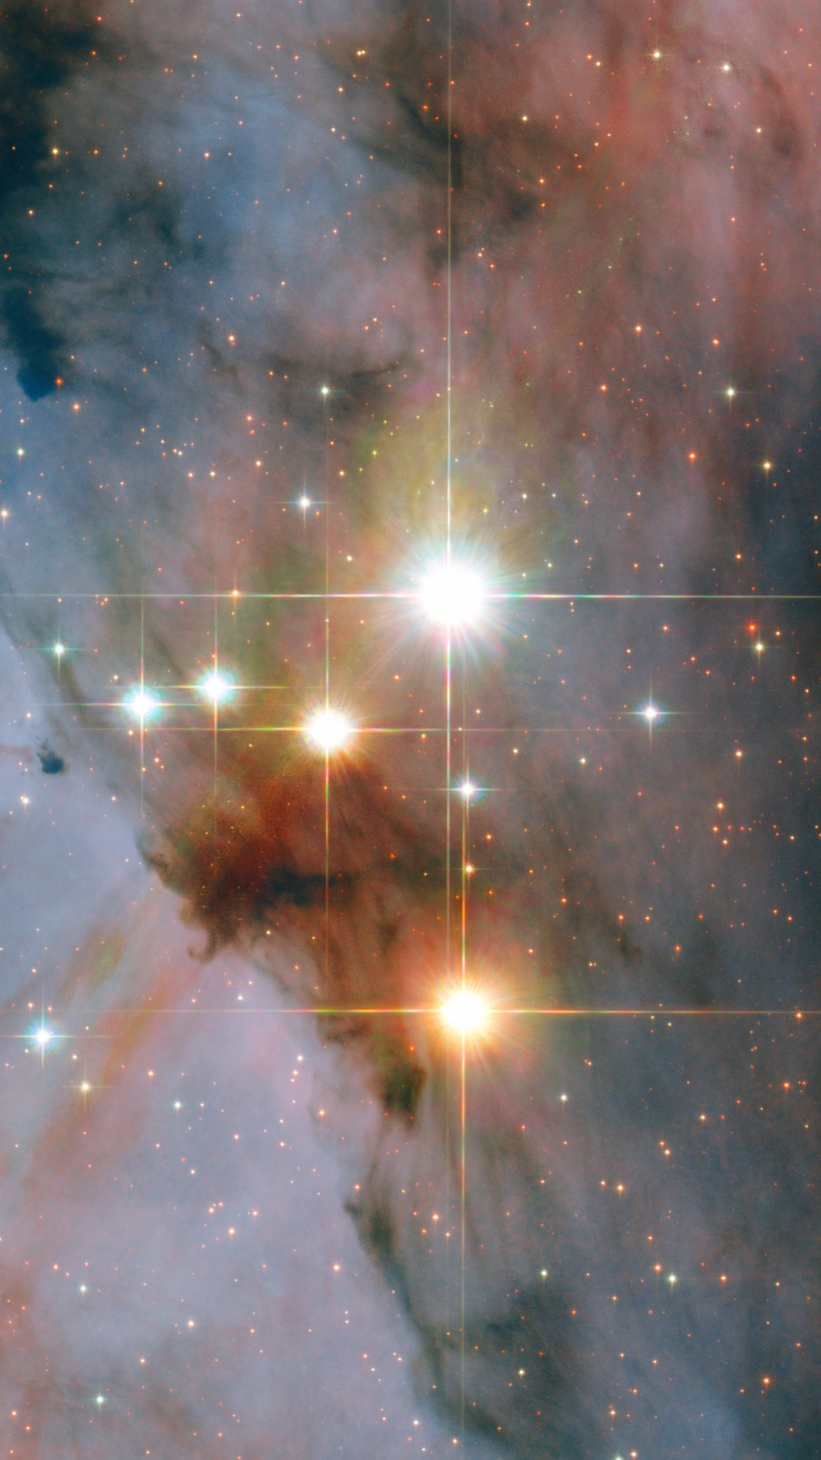
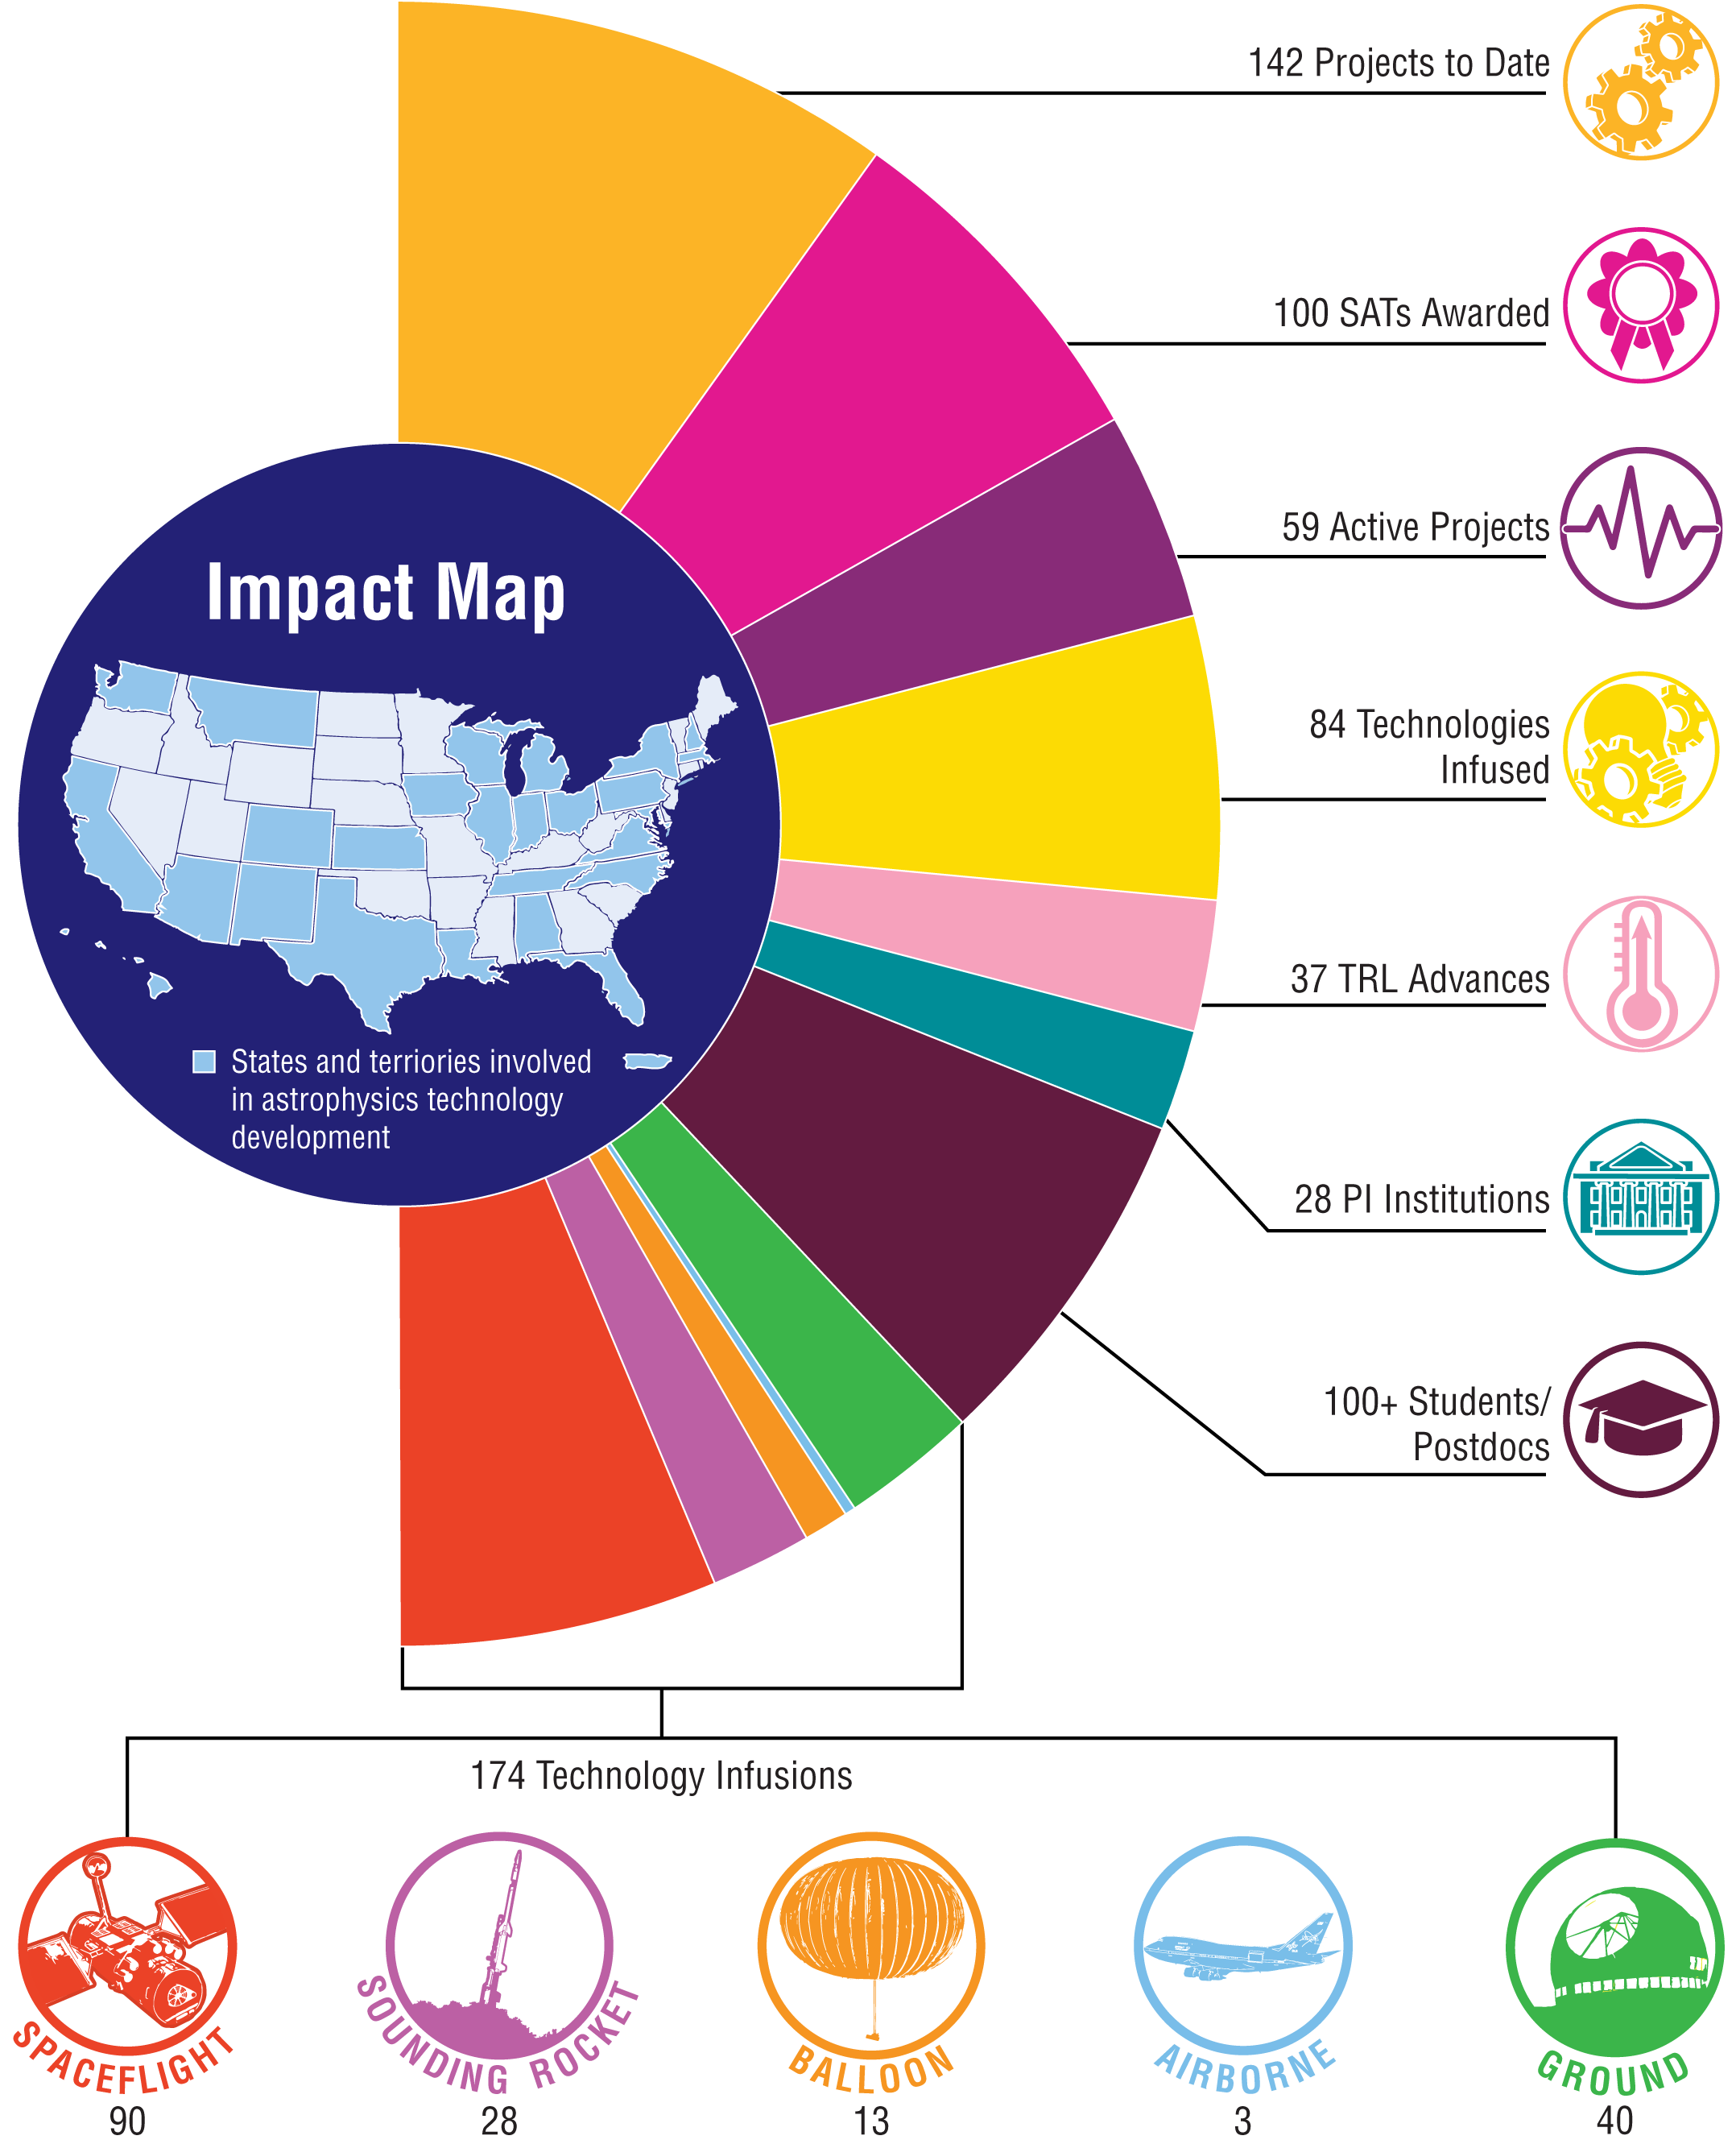
174 infusions* resulting from SAT and APRA technology funding of SAT PIs
* Infusion here is defined as a technology that was implemented in a flight mission or ground-based project, or baselined by a flight mission, or incorporated into the reference design of a large-mission concept, Probe concept, and/or a Phase-A Explorer or Mission of Opportunity study funded by APD. For full list, see the 2022 Astrophysics Biennial Technology Report (ABTR) available on our website (https://apd440.gsfc.nasa.gov/technology.html).
 | Space | Rocket | Balloon | Airborne | Ground | Total
Implemented | 8 | 14 | 8 | 2 | 25 | 57
Upcoming | 21 | 14 | 5 | 1 | 15 | 56
Concepts | 61 | - | - | - | - | 61
Total | 90 | 28 | 13 | 3 | 40 | 174
The following infographic summarizes the impacts of Astrophysics technology funding to date

Slide 8
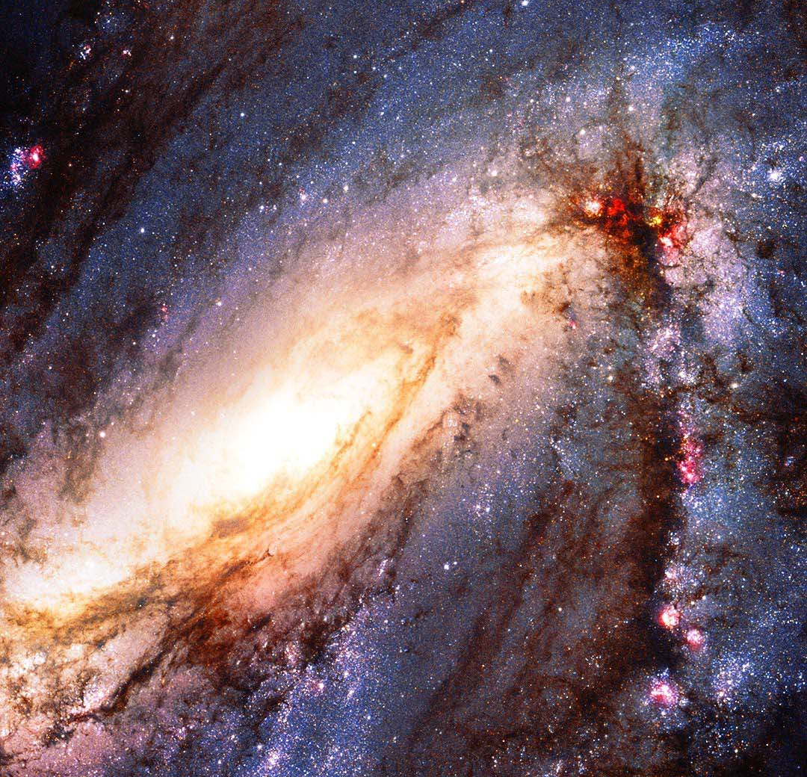
The three Program Offices help develop strategic-mission concepts and technologies, and facilitate science investigations derived from them:
Assess and prioritize technology gaps (see below)
Oversee projects maturing technologies from initial TRLs of 3, 4, or 5
Promote technology infusion into missions and projects
Conduct and support mission studies and develop mission concepts
Communicate progress to and coordinate with the scientific community
Inform the general public about progress (searchable Astrophysics technology development database at https://www.astrostrategictech.us)
Gap prioritization is a multi-step biennial process lasting several months:
Solicit technology gaps from the community
Receive details of tech maturation needed for Program science goals
Consolidate prior-cycle gaps and new gaps
Assign each gap to the Program most impacted
Program Analysis Groups (PAGs) and Technical Assessment Committee recommend edits, additions, and/or subtractions
Program-specific prioritization boards of technologists from all Program Offices, Astrophysics Division staff, and subject matter experts
Consolidate the lists into a unified Astrophysics Technology Gap List
The list informs Astrophysics Division solicitation and funding decisions

