Slide 1
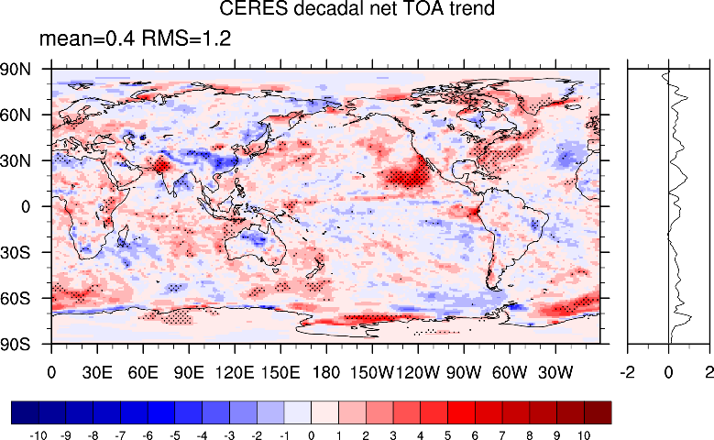
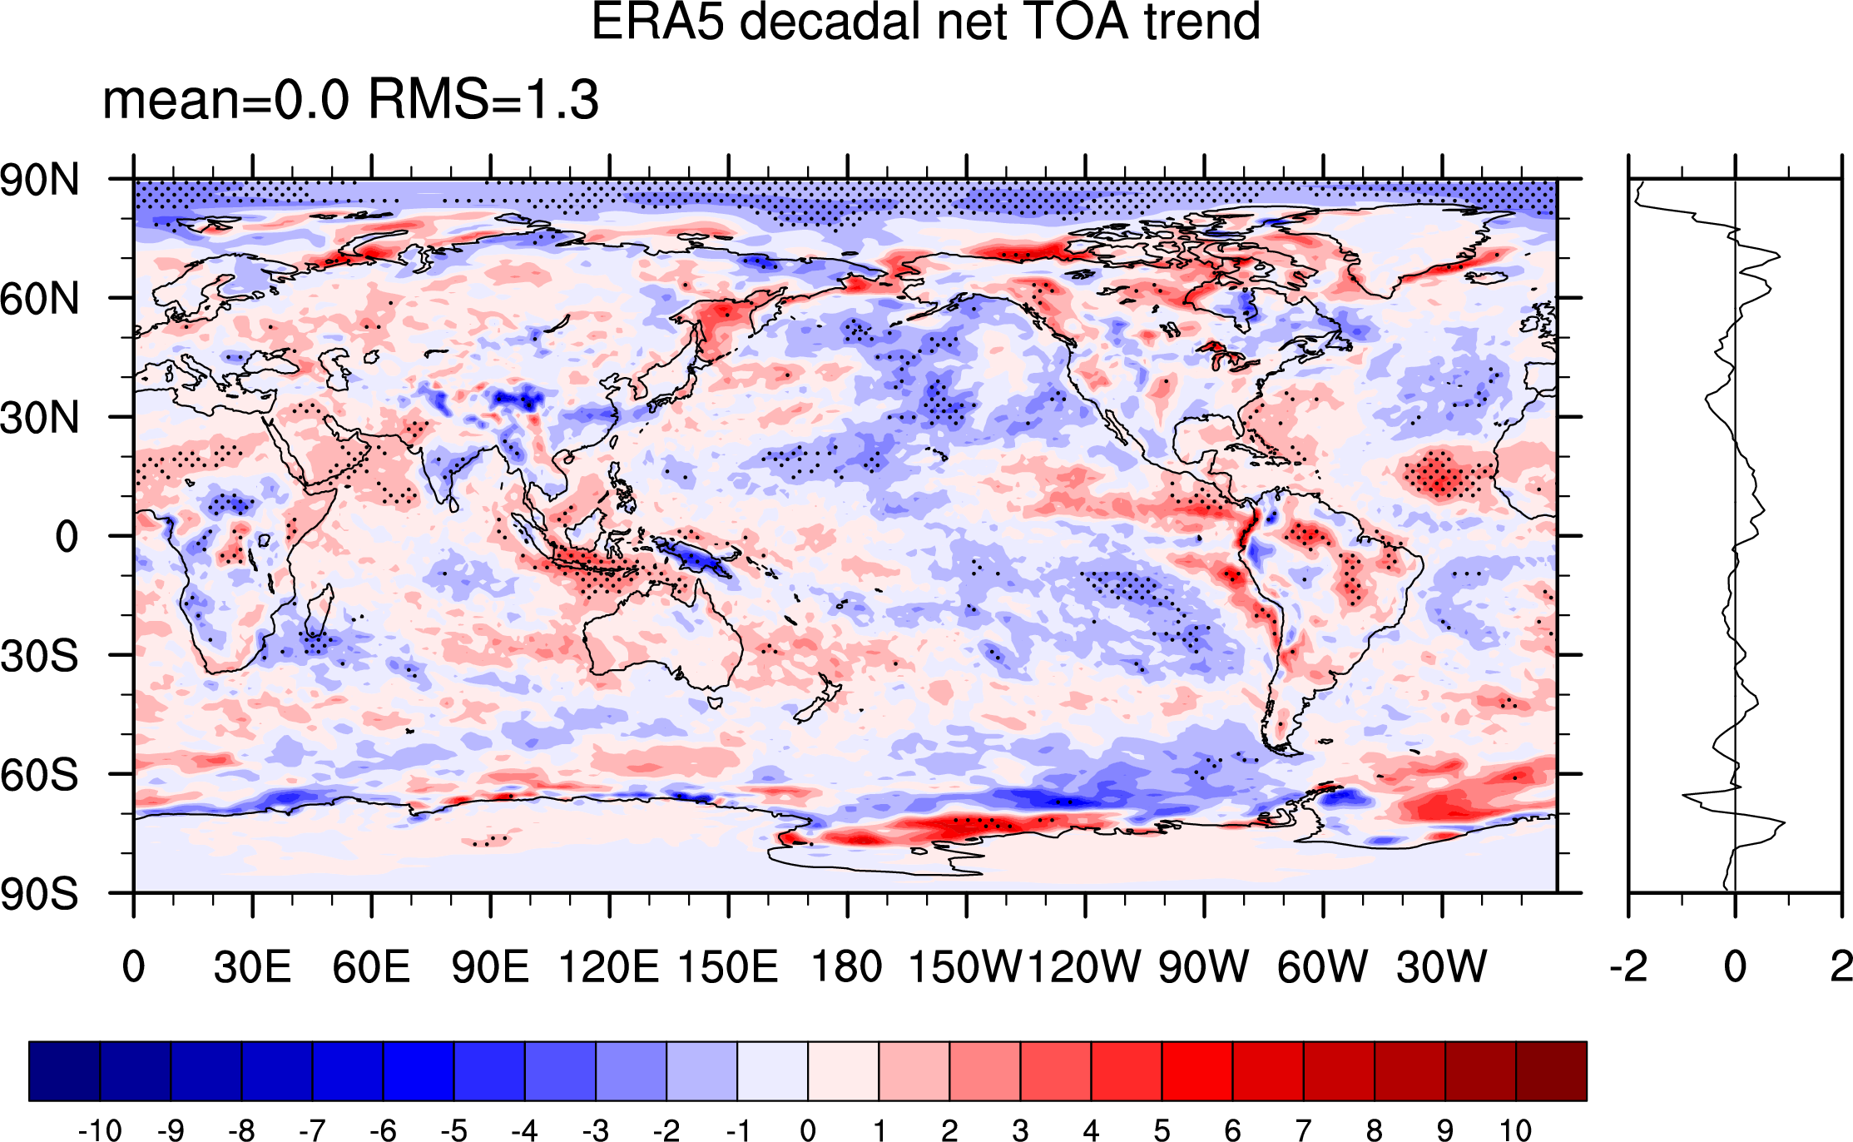
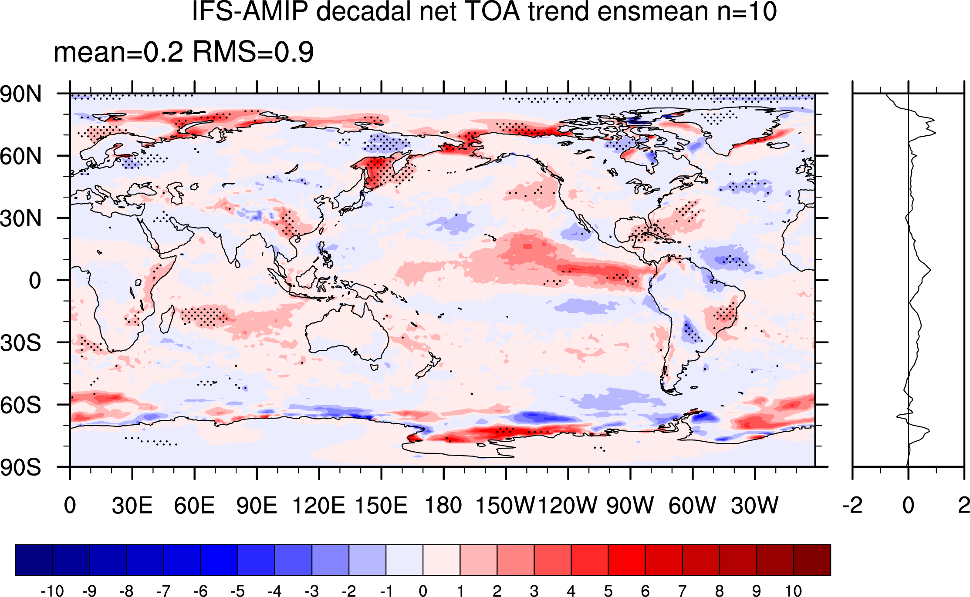
(a) CERES-EBAF
(b) ERA5 forecasts
(c) IFS AMIP
Wm⁻²/decade
Wm⁻²/decade
Wm⁻²/decade
Figure 1 Trends in TOA Net Radiation for 2000/03-2020/02. (a) CERES-EBAF, (b) ERA5 forecasts and (c) IFS AMIP.

Slide 2
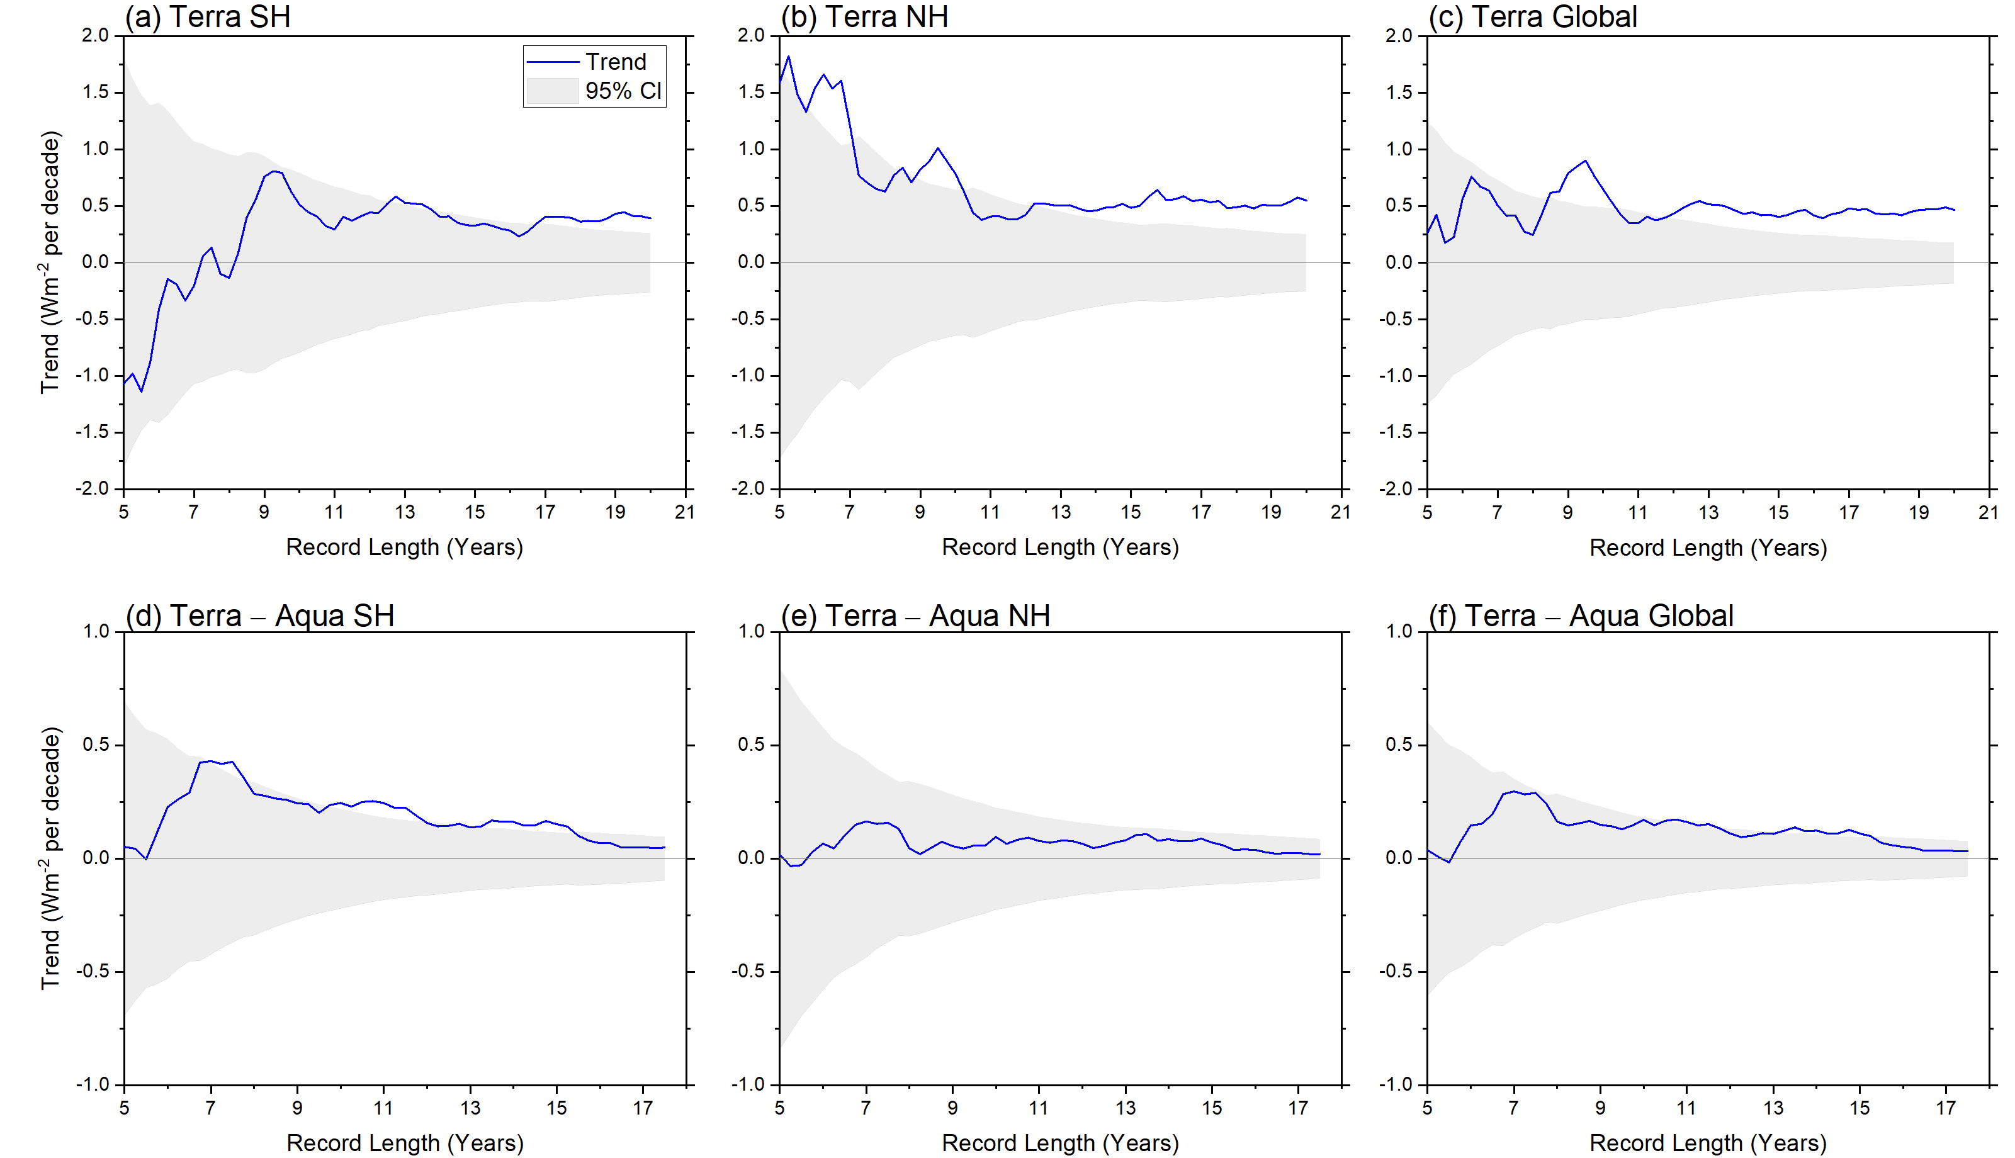
Figure 2 CERES net TOA flux trends against record length for CERES SSF1deg Terra (top) and Terra – Aqua (bottom) for (a, d) SH, (b, e) NH, (c, f) Global. Start date is 03/2000 for Terra and 07/2002 for Terra – Aqua. Gray shading corresponds to 95% confidence interval.

Slide 3
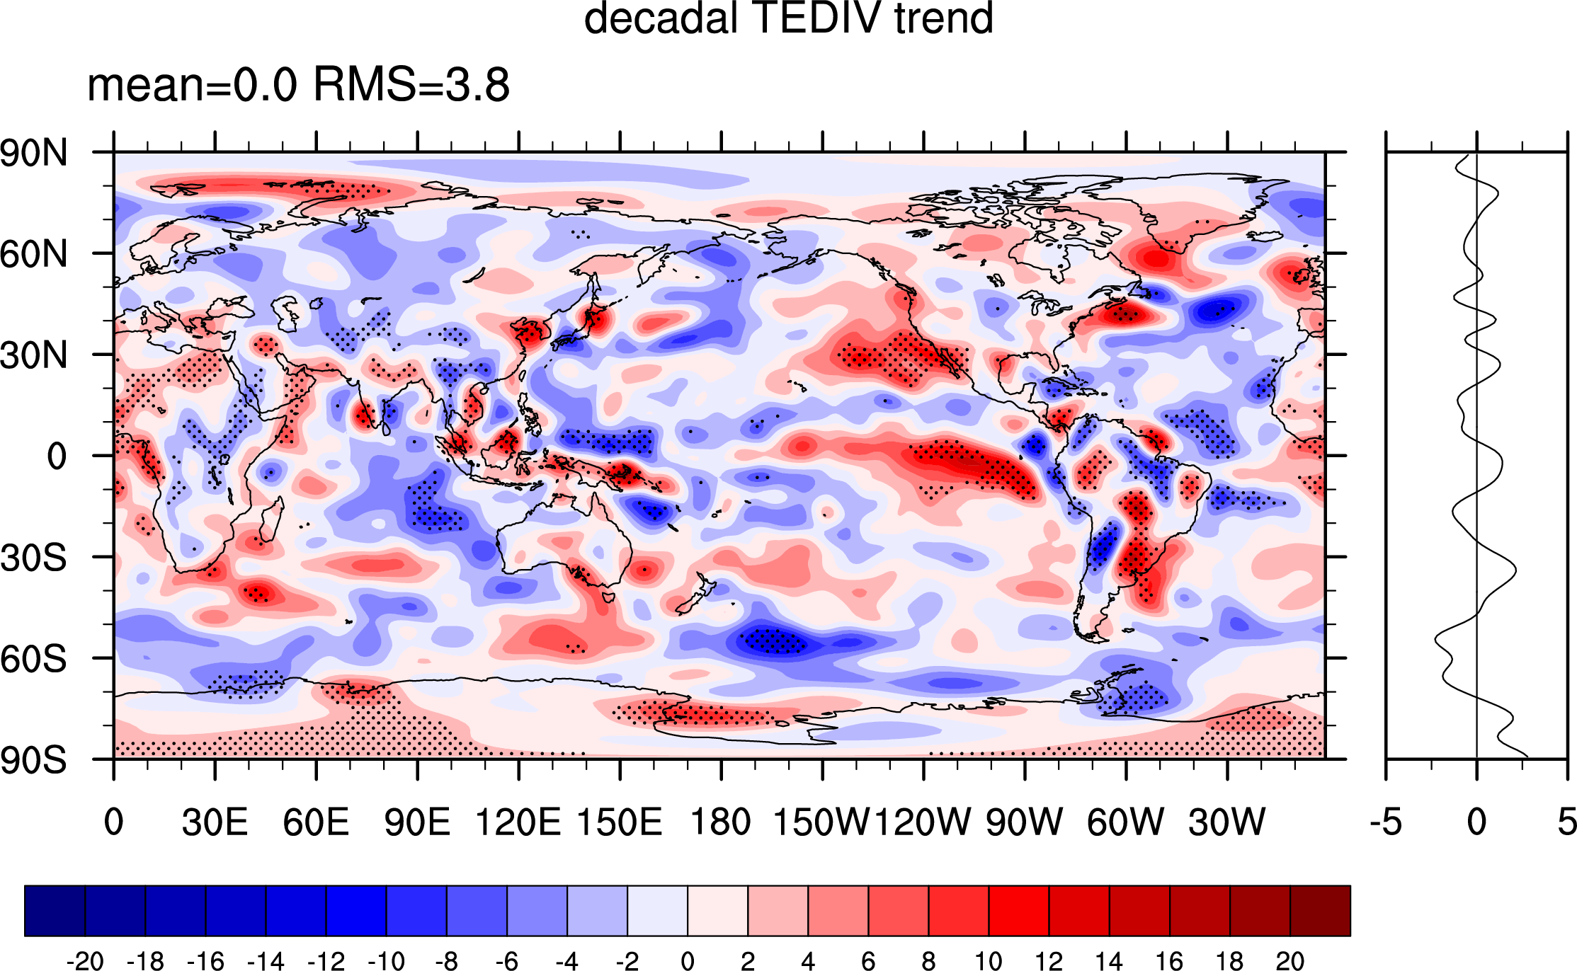
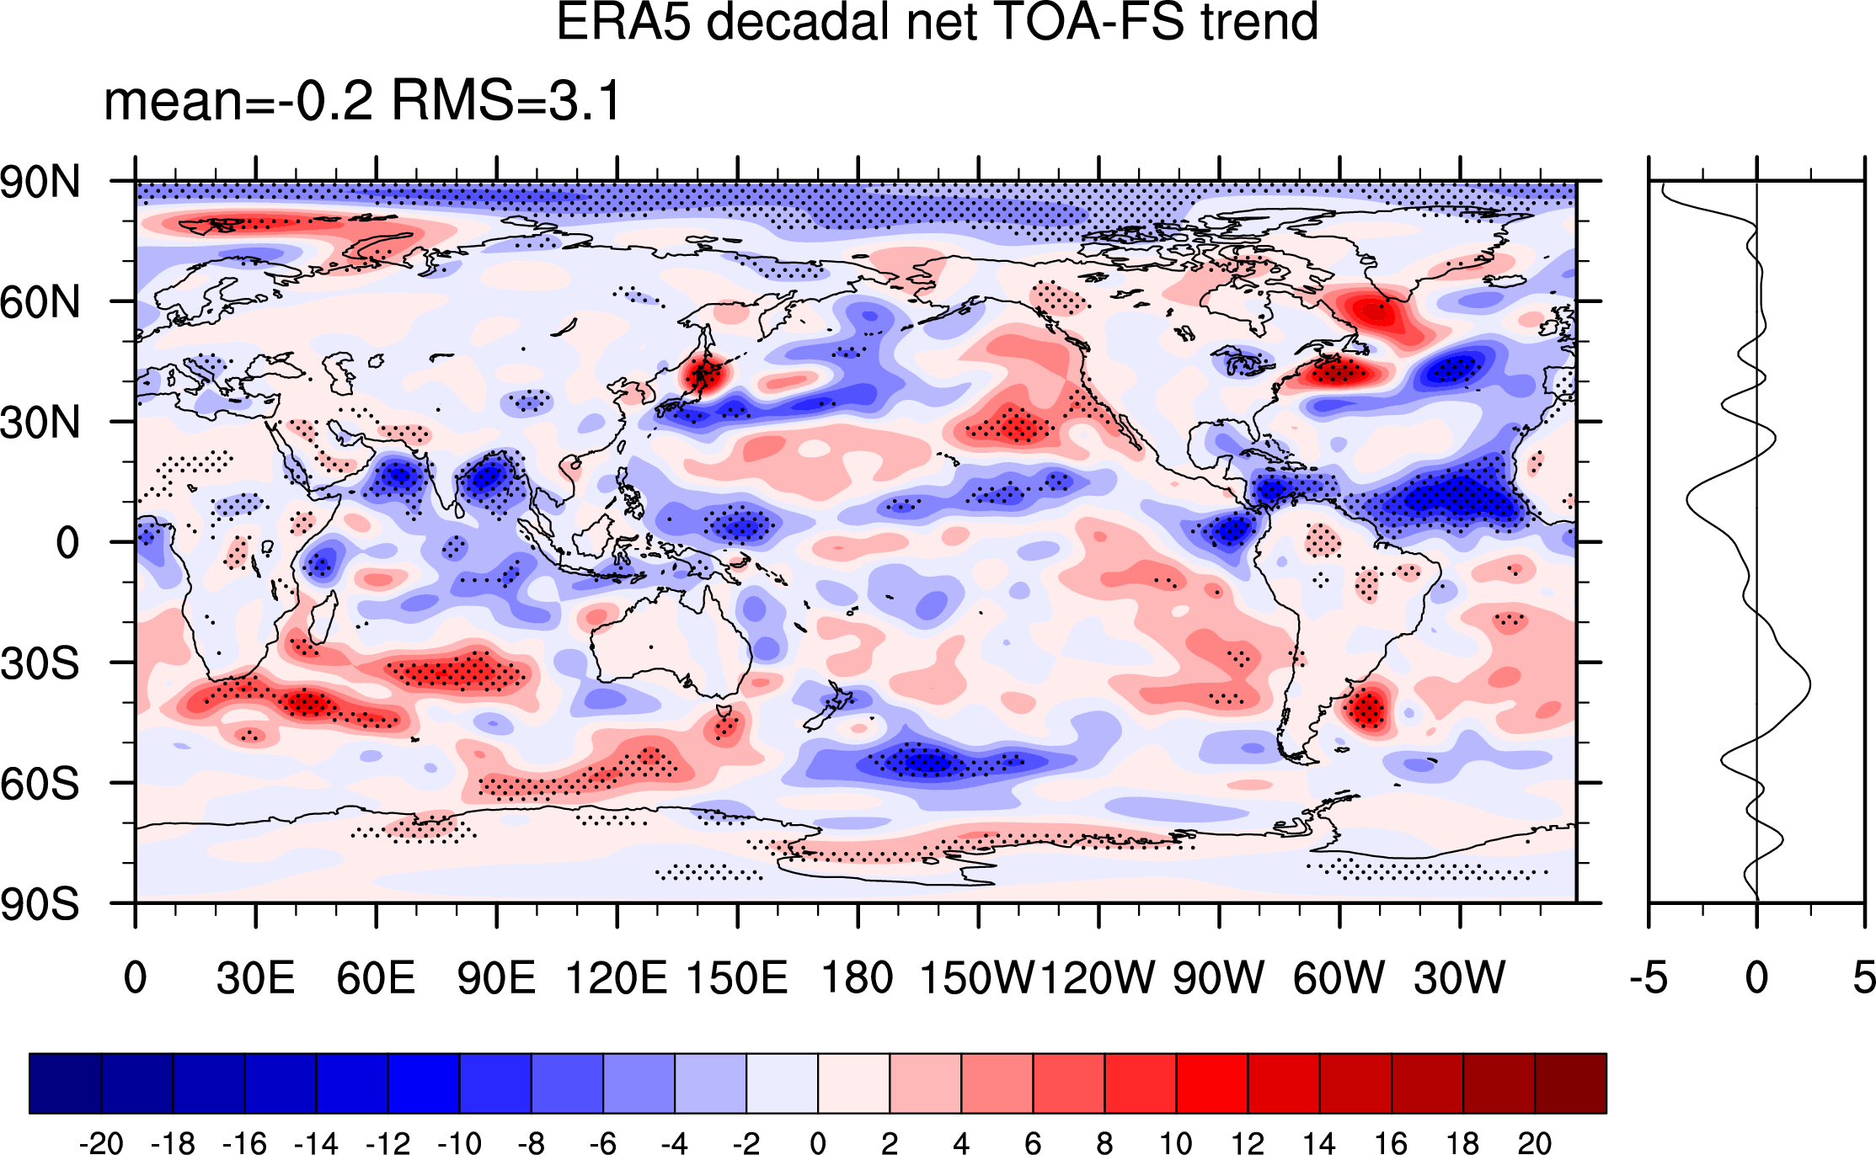
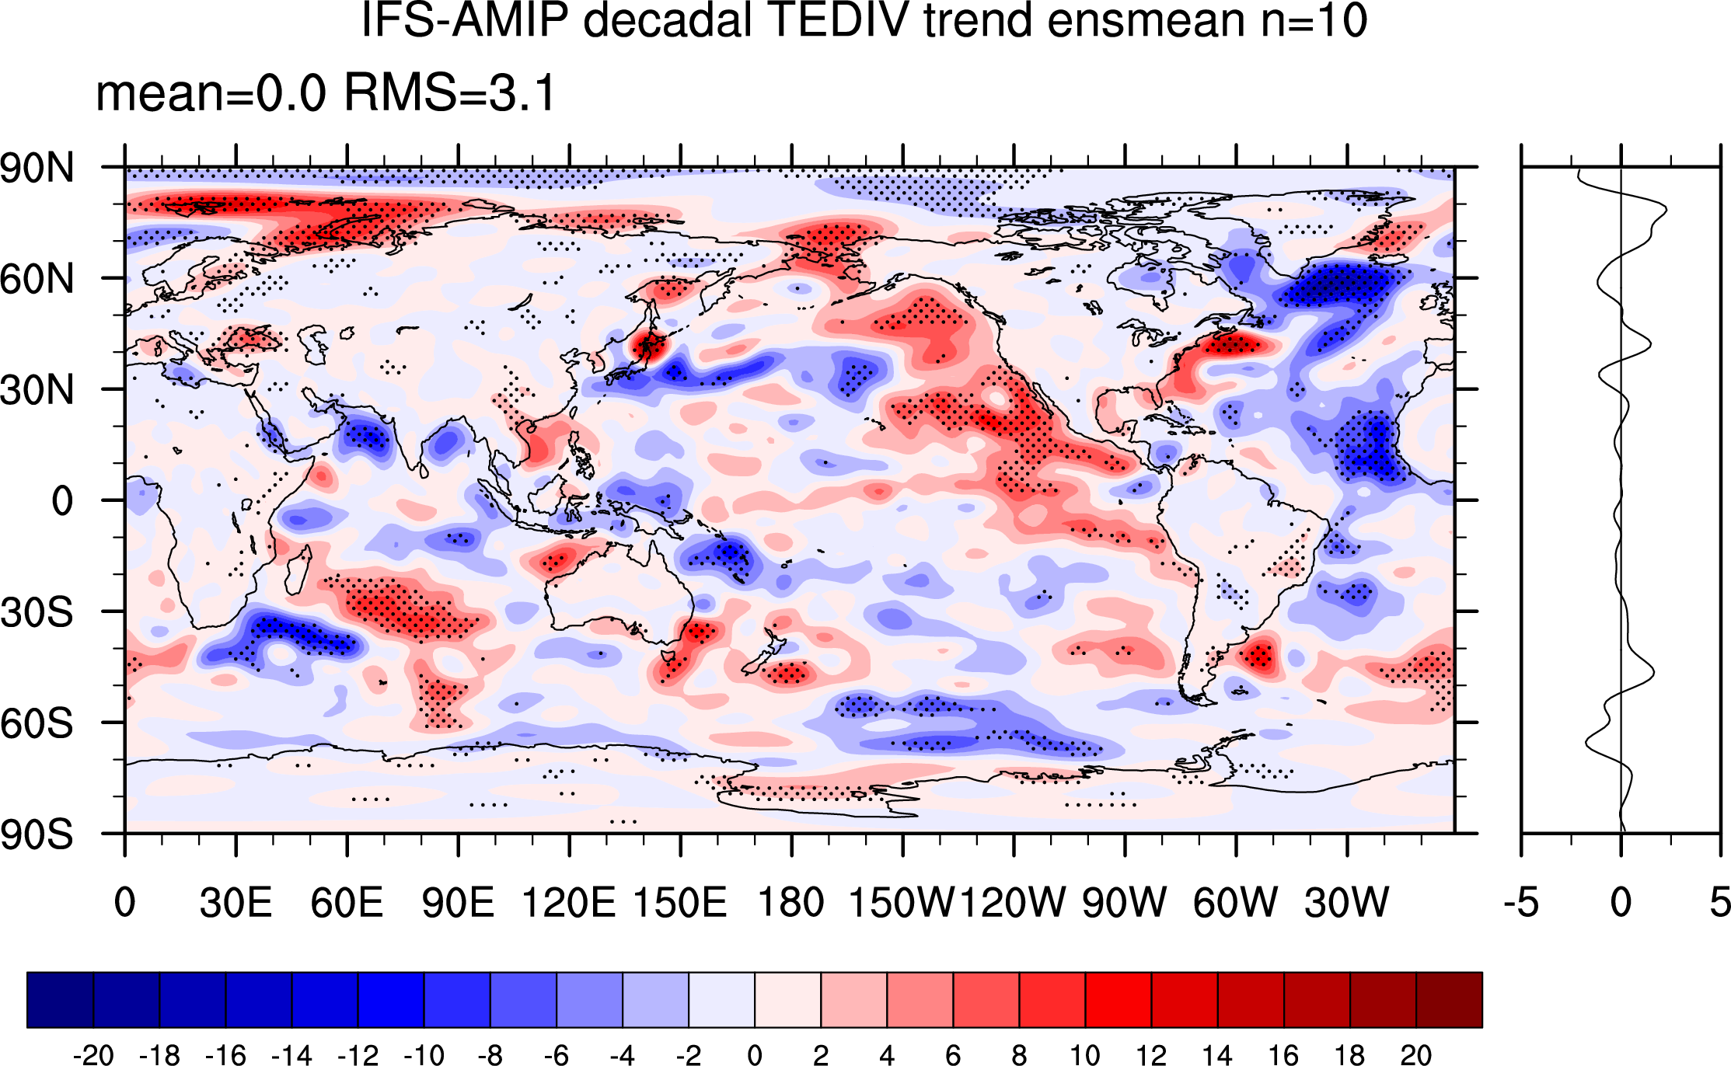
(a) ERA5 Analysis
(b) ERA5 forecasts (net TOA – FS)
(c) IFS AMIP (net TOA – FS)
Wm⁻²/decade
Wm⁻²/decade
Wm⁻²/decade
Figure 3 Trends in vertically integrated divergence of total atmospheric energy transport (TEDIV) for 2000/03-2020/02. (a) ERA5 Analysis (directly from wind, T, q etc), (b) ERA5 forecasts (net TOA – FS) and (c) IFS AMIP (net TOA – FS).
.

Slide 4
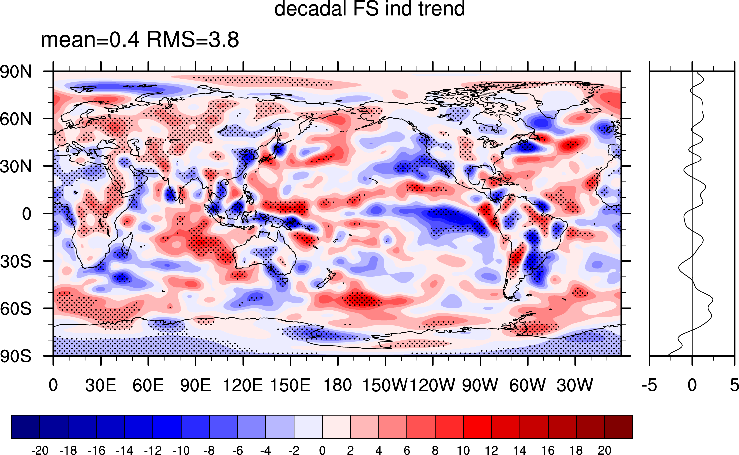
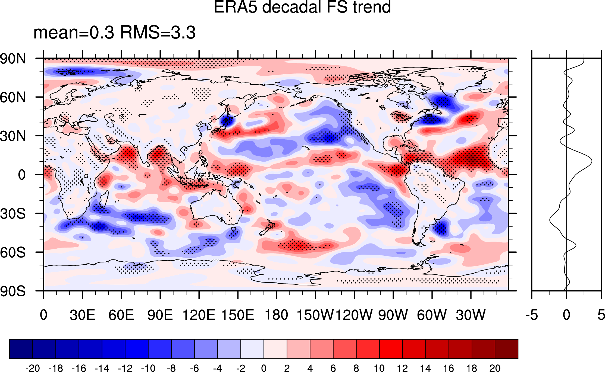
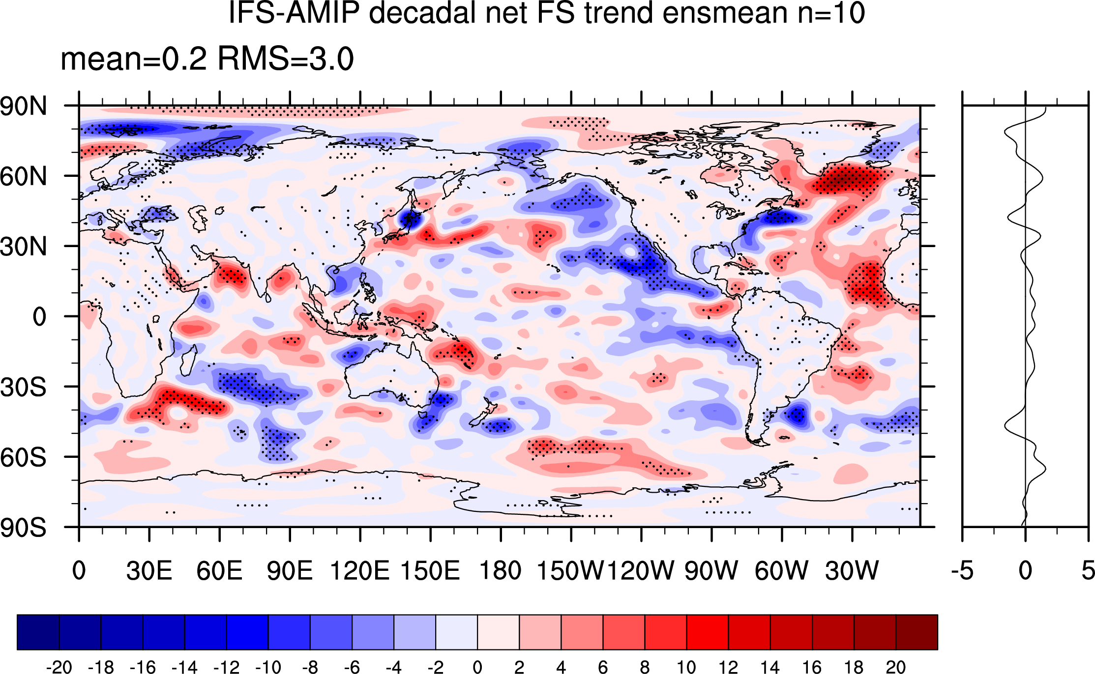
(a) Inferred
(b) ERA5 forecasts
(c) IFS AMIP
Wm⁻²/decade
Wm⁻²/decade
Wm⁻²/decade
Figure 4 Trends in surface flux (positive downward) for 2000/03-2020/02. (a) Inferred (CERES TOA Net − ERA5 TEDIV), (b) ERA5 forecasts and (c) IFS AMIP.

Slide 5
Wm⁻²/decade
Wm⁻²/decade
Figure 5 Trend for 200208-202002 in net total radiative flux at the surface (positive down) from (a) CERES and (b) ERA5 forecasts.

Slide 6
(a) Inferred
(b) ERA5
Wm⁻²/decade
Wm⁻²/decade
Figure 6 Trends in surface turbulent heat flux (positive downward) for 2002/08-2020/02. (a) Inferred (CERES TOA Net − ERA5 TEDIV − CERES Surface Net) and (b) ERA5 forecasts.

Slide 7
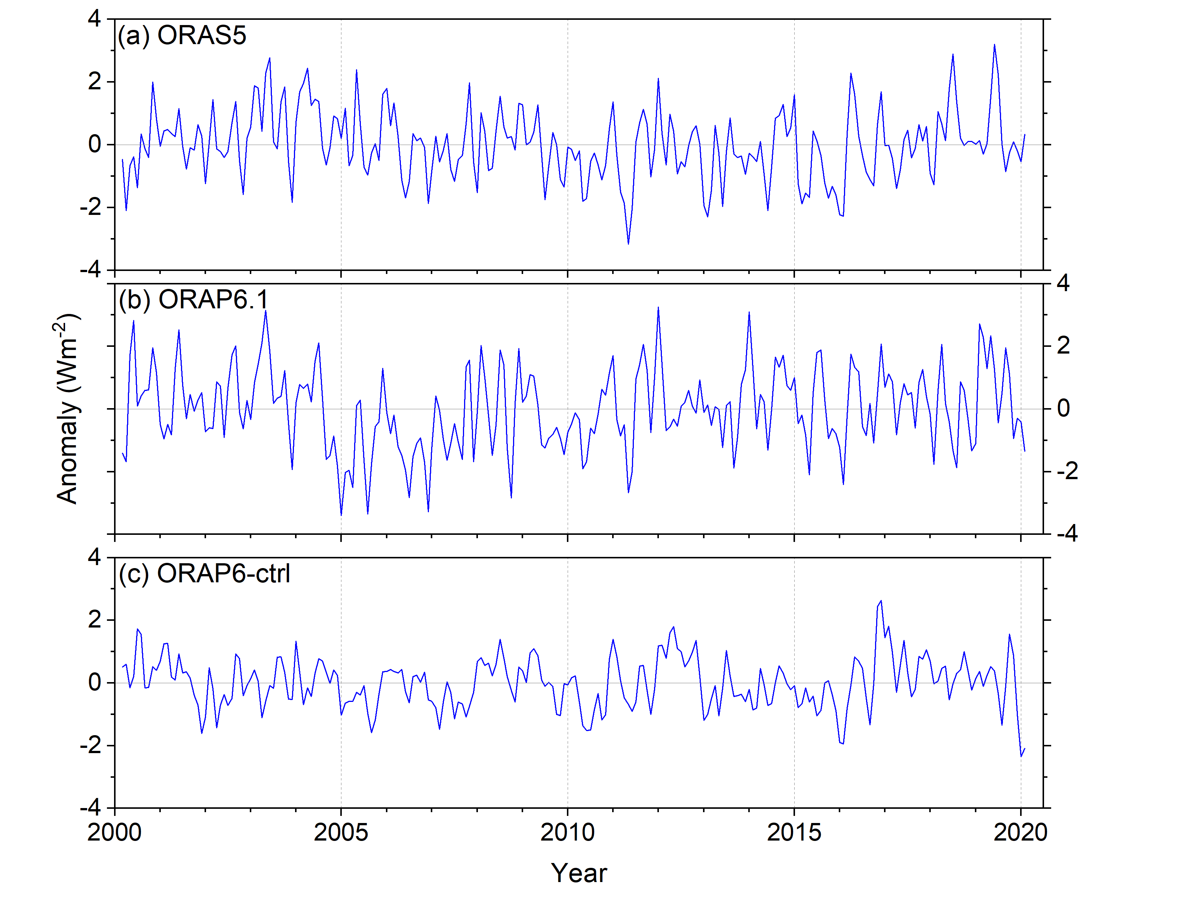
Figure 7 Monthly anomalies in ocean heating rate for (a) ORAS5, (b) ORAP6.1, (c) ORAP6-ctrl.

Slide 8
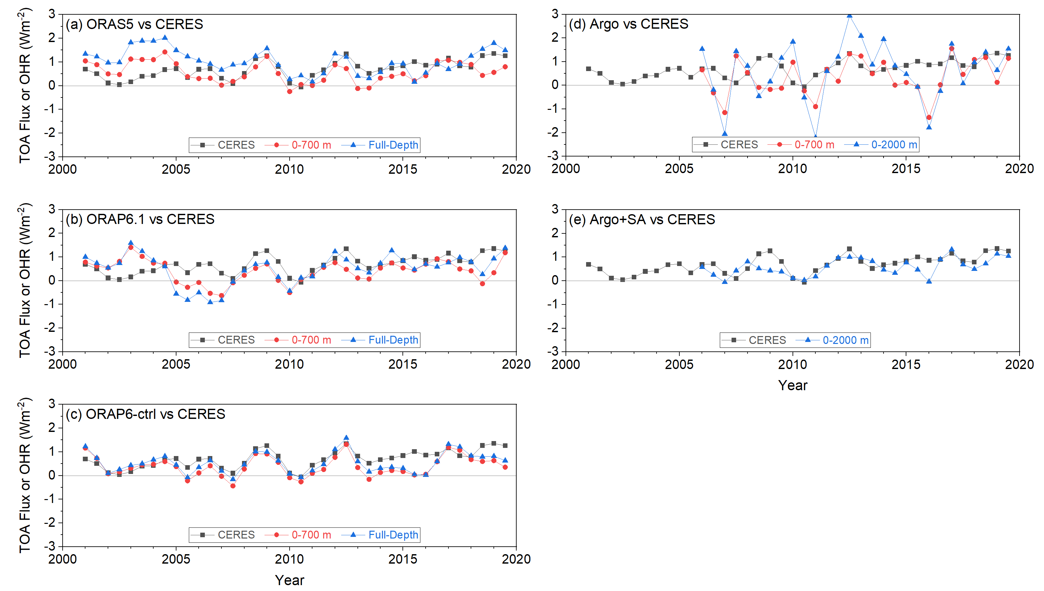
Figure 8 Global annual mean variation in CERES net TOA flux and ocean heating rate for 0-700 m and full-depth or 0-2000 m for: (a) ORAS5; (b) ORAP6.1; (c) ORAP6-ctrl; (d) Argo; (e) Argo+SA.

Slide 9
Supplemental Figures

Slide 10
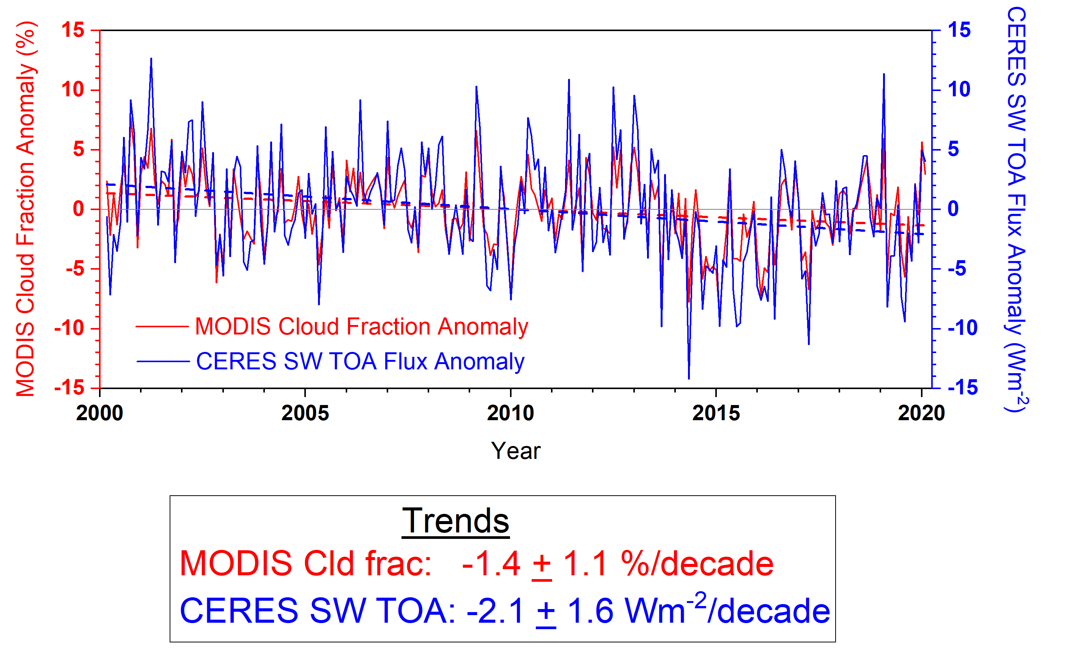
Figure S1 Anomalies in MODIS cloud fraction and CERES SW TOA flux for a region over the Eastern Pacific (10º-40ºN, 150º-110ºW) for 03/2000-02/2020.

Slide 11
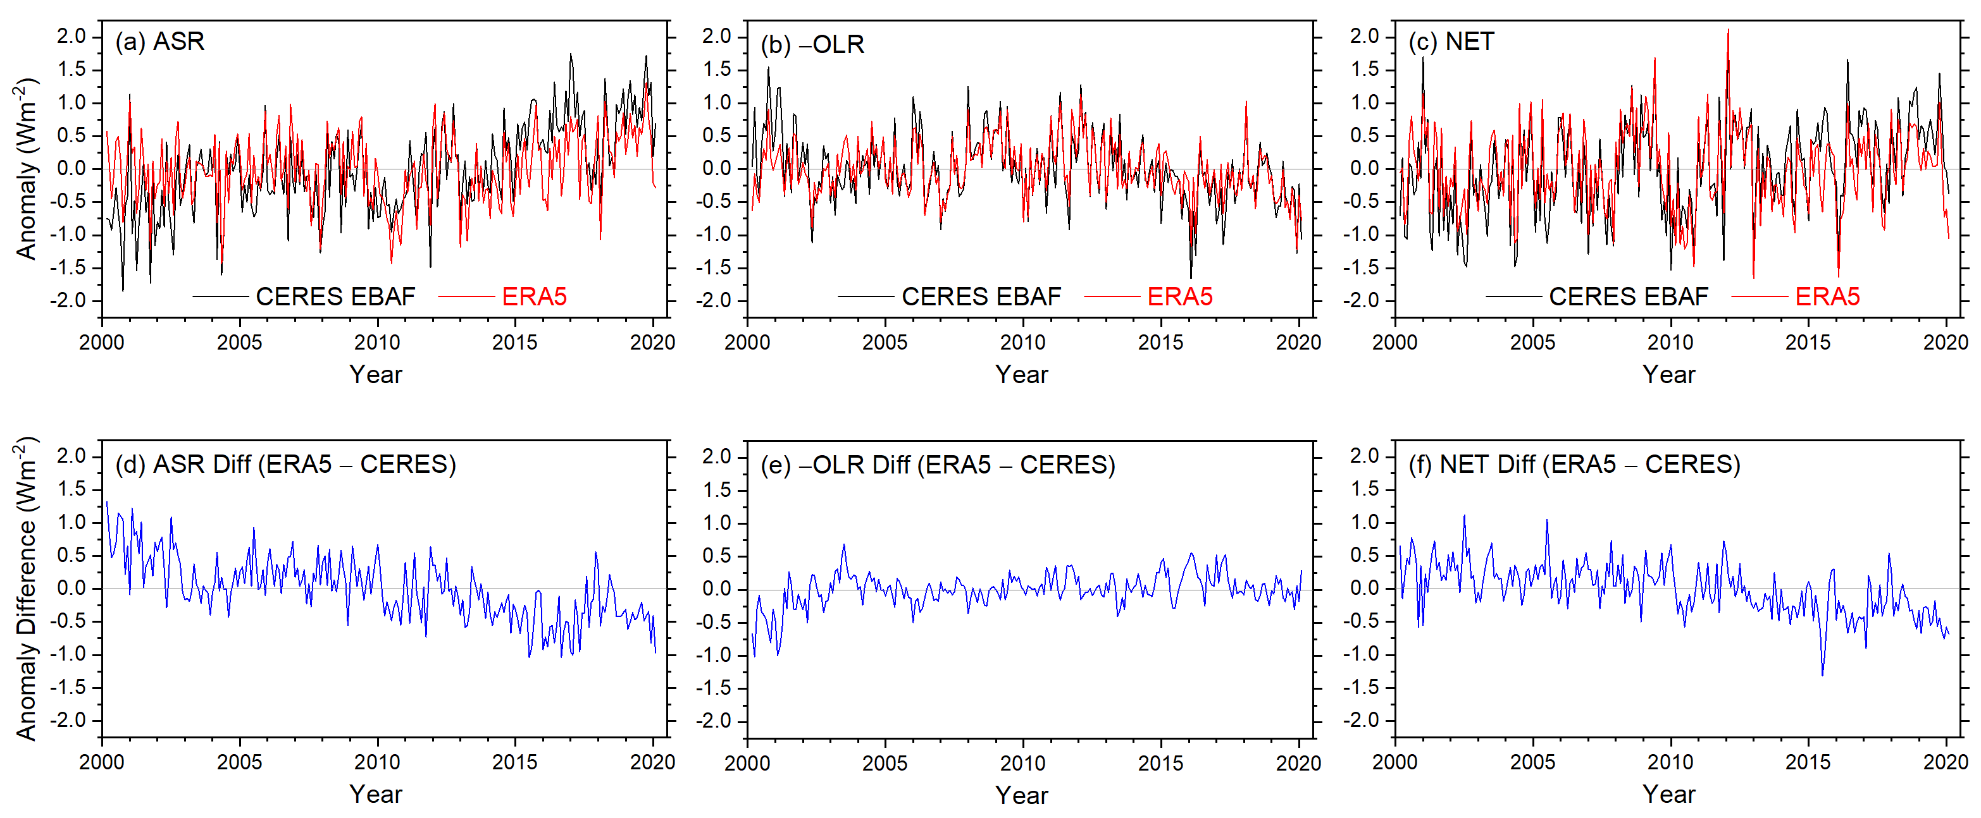
Figure S2 CERES EBAF and ERA5 global monthly anomalies at TOA for (a) ASR, (b) − OLR and (c) Net flux, and ERA5 minus CERES EBAF anomaly difference for (d) ASR, (e) −OLR and (f) Net.

Slide 12
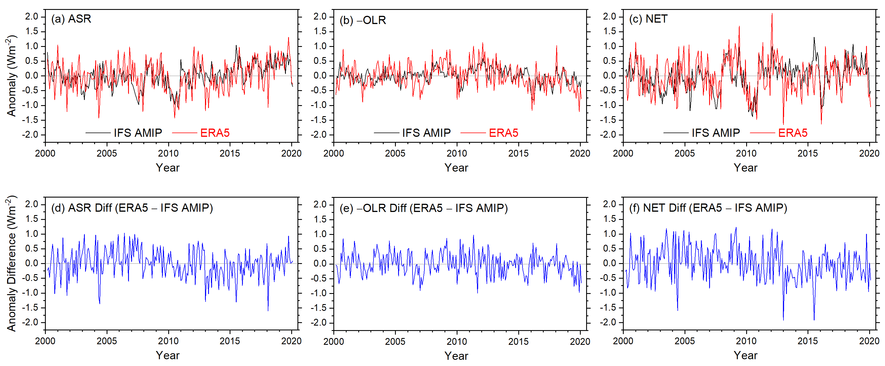
Figure S3 IFS AMIP and ERA5 global monthly anomalies at TOA for (a) ASR, (b) − OLR and (c) Net flux, and ERA5 minus IFS AMIP anomaly difference for (d) ASR, (e) −OLR and (f) Net.

Slide 13
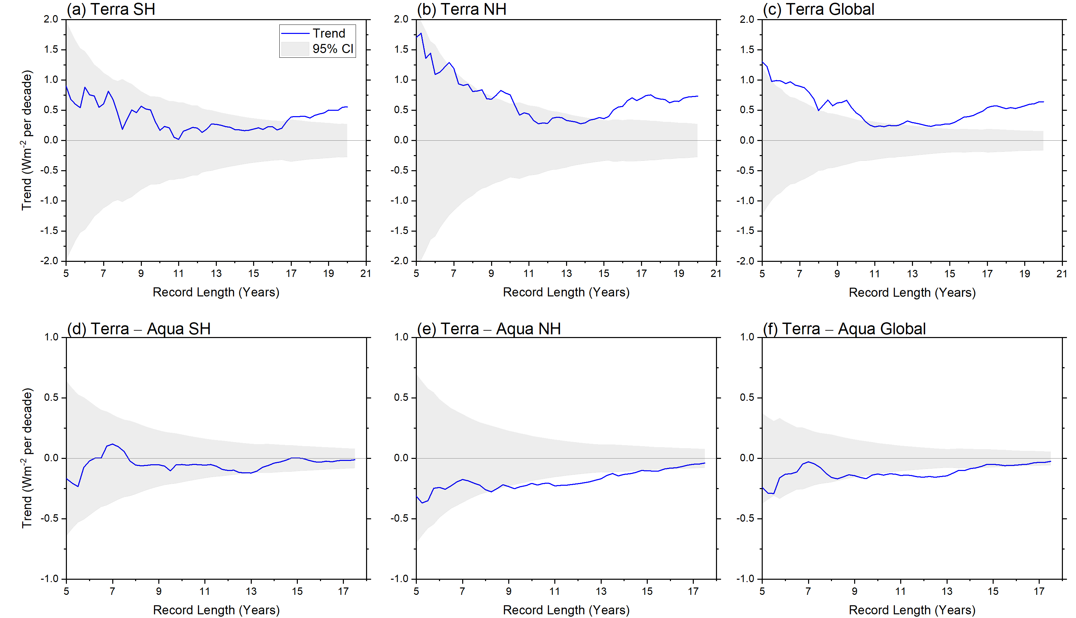
Figure S4 CERES ASR TOA flux trends against record length for CERES SSF1deg Terra (top) and Terra – Aqua (bottom) for (a, d) SH, (b, e) NH, (c, f) Global. Start date is 03/2000 for Terra and 07/2002 for Terra – Aqua. Gray shading corresponds to 95% confidence interval.

Slide 14
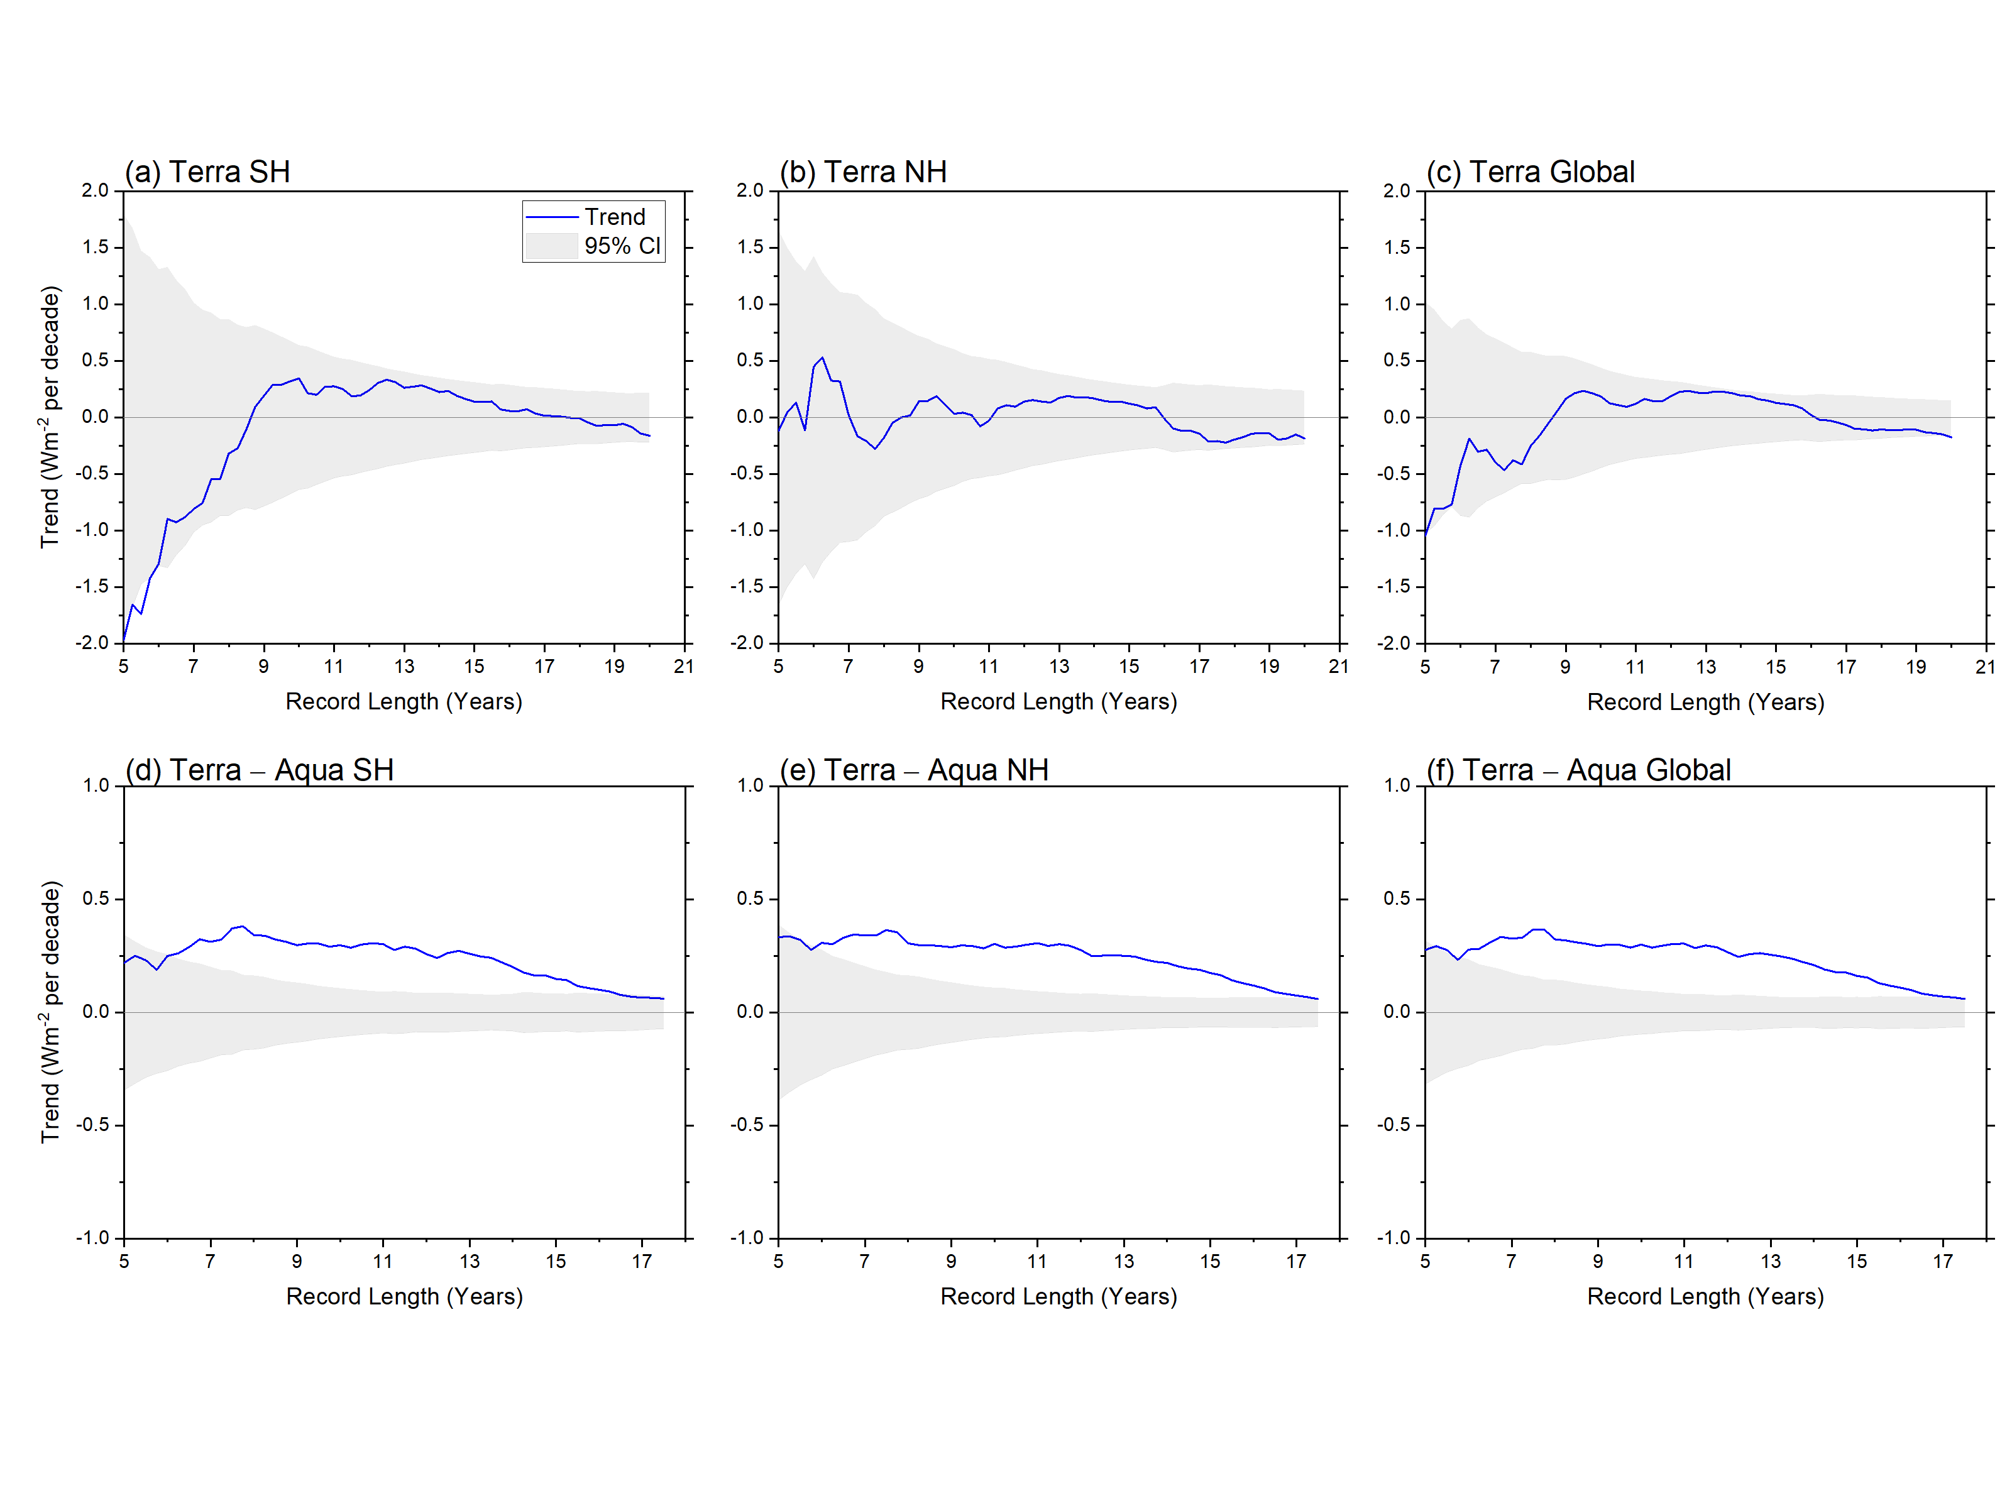
Figure S5 Same as Fig. S4 but for −OLR.

Slide 15
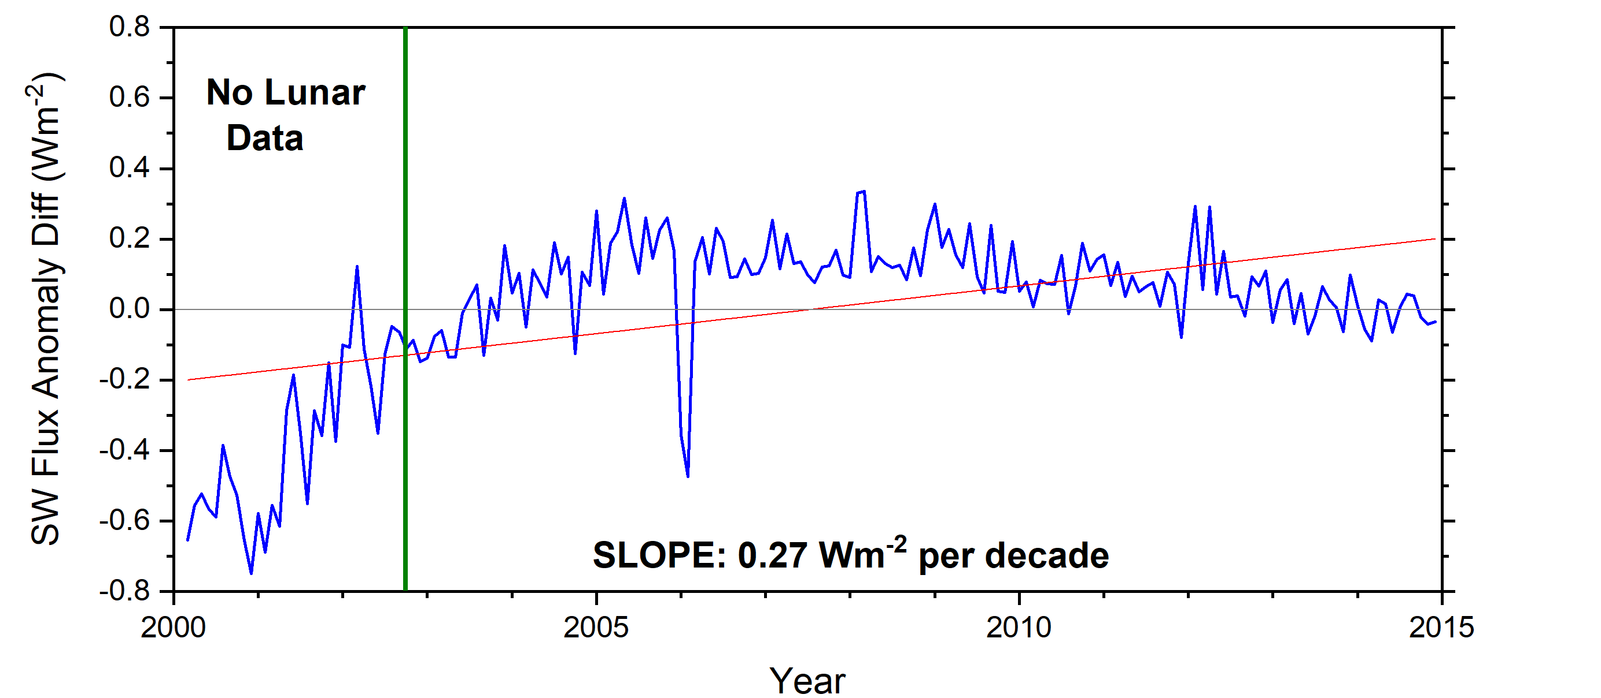
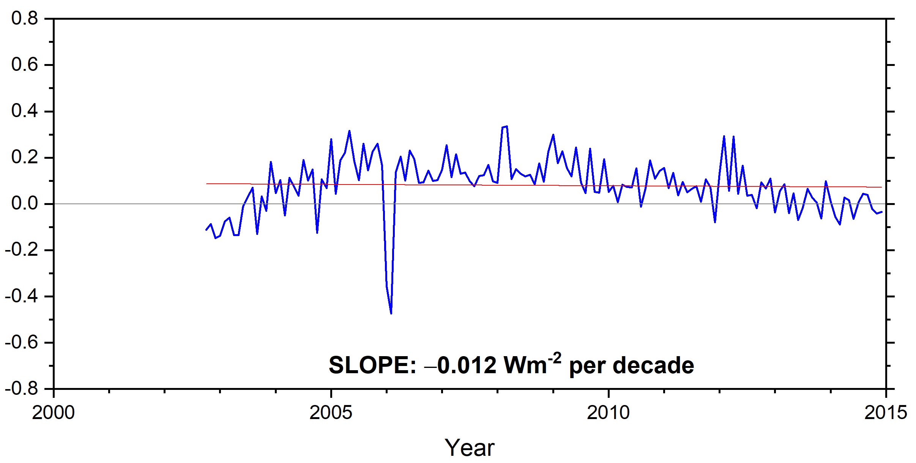
(a) 03/2000 – 12/2014
(b) 10/2002 – 12/2014
Figure S6 Reflected SW TOA flux anomaly differences between adjusted CERES Terra values in Matthews (2021) and the official CERES SSF1deg Ed4.1 product for (a) 03/2000-12/2014 and (b) 10/2002-12/2014.

Slide 16
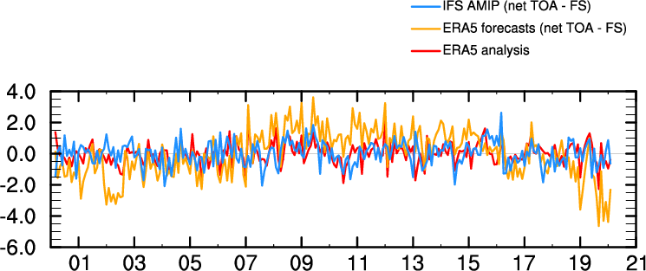
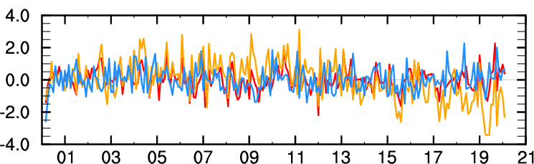
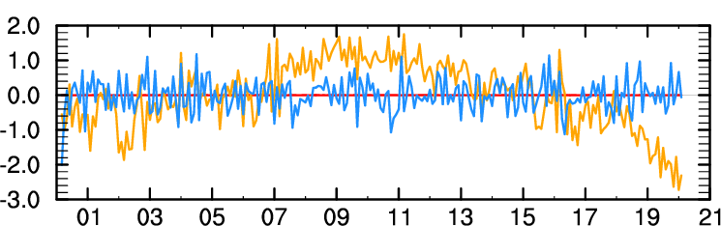
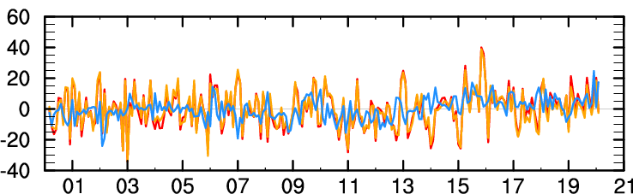
(a) SH
(b) NH
Anomaly (Wm⁻²)
(c) Global
(d) East Pacific (10º-40ºN; 150º-110ºW)
Figure S7 Monthly anomalies in TEDIV for (a) SH, (b) NH, (c) Global and (d) NE Pacific region.

Slide 17
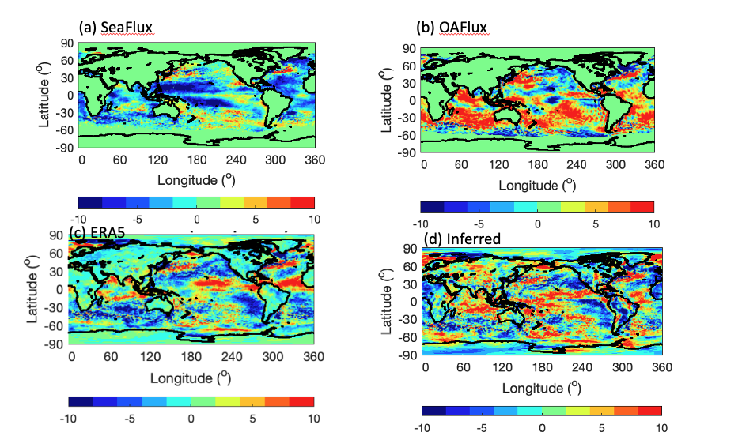
Trends in Surface Turbulent Heat Flux (positive downward)
(2002/08-2018/07)
(H_{L}+H_{S})
(H_{L}+H_{S})
Figure S8 Reflected SW.

