Slide 1


The 7 Year Evolution of EOS CA Support for Planning & Executing Risk Mitigation Maneuvers
Syed Hasan
EOS Lead Collision Avoidance Engineer

Slide 2
Agenda
EOS CA Process
RMM Planning Time Changes
CRMS Overview
CRMS Release Updates
CARA Devolution
CA Process Enhancement
CA Support Process Flow
Pc Thresholds
7-Year Statistics
RMM Planning Examples

Slide 3
EOS CA Process
The Combined Space Operations Center (CSpOC), located at Vandenberg Air Force Base (VAFB) in California provides Space Situational Awareness (SSA) data for the Earth Observing System (EOS) satellites
This data is posted multiple times a day to space-track.org by the Conjunction Analysis Risk Assessment (CARA) Orbital Safety Analysts (OSAs)
The Earth Science Mission Operations (ESMO) Collision Risk Mitigation System (CRMS) tool downloads this data and performs conjunction assessment risk analysis and determines mitigation maneuver solutions based on specific spacecraft constraints
The EOS Flight Dynamics Support (FDS) team generates ephemerides based on each of these maneuver solutions and delivers them to space-track.org for screening
A Risk Mitigation Maneuver (RMM) is selected by the Mission Director (MD), who seeks consultation from the EOS Collision Avoidance (CA) Engineers and Subject Matter Experts (SMEs)
The Flight Operations Team (FOT) executes the RMM unless the MD waives off the burn due to the collision risk subsiding

Slide 4
RMM Planning Time Improvement
At the start of 2015, planning and executing for a RMM by the EOS FOT took approximately 1 to 2 days
The FOT implemented a QDAM (Quick Debris Avoidance Maneuver) process onboard in 2015 which reduced this process time to just 3 hours, which allows for a very quick support turnaround
Throughout the last 7 years, the EOS CA team along with SpaceNav and the EOS FDS team worked through numerous CRMS releases, created several ground system tools, and applied many process improvements to implement effective conjunction assessment and RMM planning to accommodate this turnaround time
The details of these releases and process improvements are explicated in this presentation

Slide 5
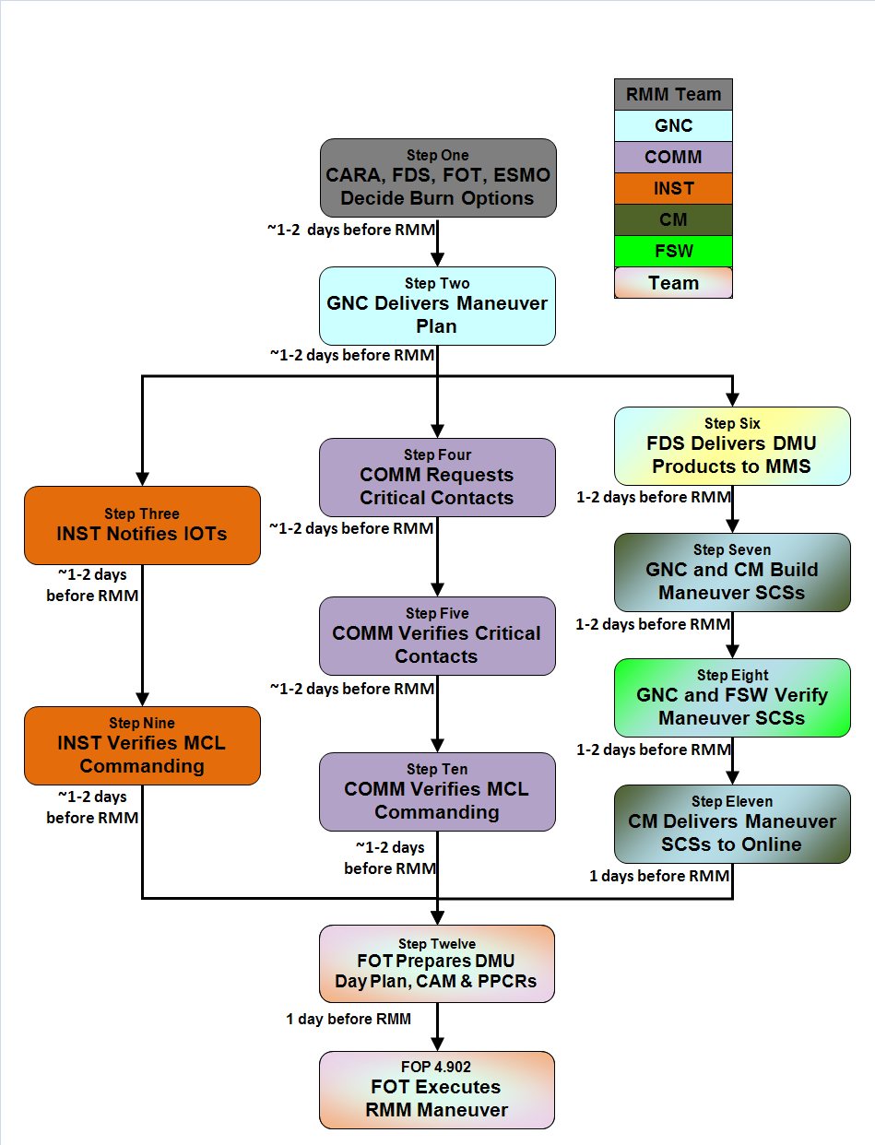
Aqua/Aura Pre-QDAM RMM Planning
7 years ago, our Aqua/Aura burn time was finalized
~1-2 days before an RMM
These 4 steps repeated for each option.

Slide 6
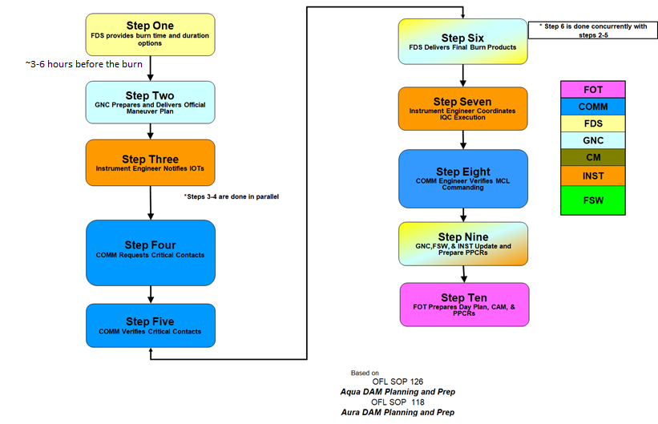
Aqua/Aura Post-QDAM RMM Planning
QDAM burn time finalized
~3 hours before an RMM
Aqua/Aura QDAM implemented in Feb 2015

Slide 7
Terra Pre-QDAM RMM Planning
7 years ago, our Terra burn time was finalized
~1-2 days before an RMM
~1-2 days before RMM
Step #1
FDS selects Target Date and provides ideal Burn Times to GN&C
KEY
FDS
Step #2
Request critical contacts
(may require TDRS Swap)
GN&C
~1-2 days before RMM
INST
Step #3
Finalize Burn Time; Notify ALL parties with Maneuver Notification (CARA, FDS, FOT, ESMO, IOTs)
ONLINE
~1-2 days before RMM
COMM
*Steps 5 and 6-7 are done in parallel
~1-2 days before RMM
Step #4
Create preliminary Maneuver script
Burn duration can still vary for DAM until Step #12
Step #5
Confirm IOTs scheduled commands on MMS: CERES to Contam Safe
Step #6
Finalize Maneuver script based on confirmed contacts
~1-2 days before RMM
ASTER does not require ATC changes for DAM
Step #7
Submit Maneuver ATC commands to PAS
~1-2 days before RMM
1 AND 2 days before RMM
Step #8
Confirm ALL RTCS commands in Original & Late Change ATCs
May not have 2-day QA or may have multiple tables to QA (for different burn durations
1 AND 2 days before RMM
Step #9
QA 2-Day and 1-Day FDS Maneuver Products (Tables #106, 201, 257)
Step #12
Prepare and present CAM
Step #10
Deliver Maneuver Tables from MMS to Online (Tables #106, 201, 257)
Deliver ALL maneuver products options to Online
Step #13
Execute Maneuver
(Final Go/No-Go Decision)
Burn duration must be set before execution
~1 day before RMM

Slide 8
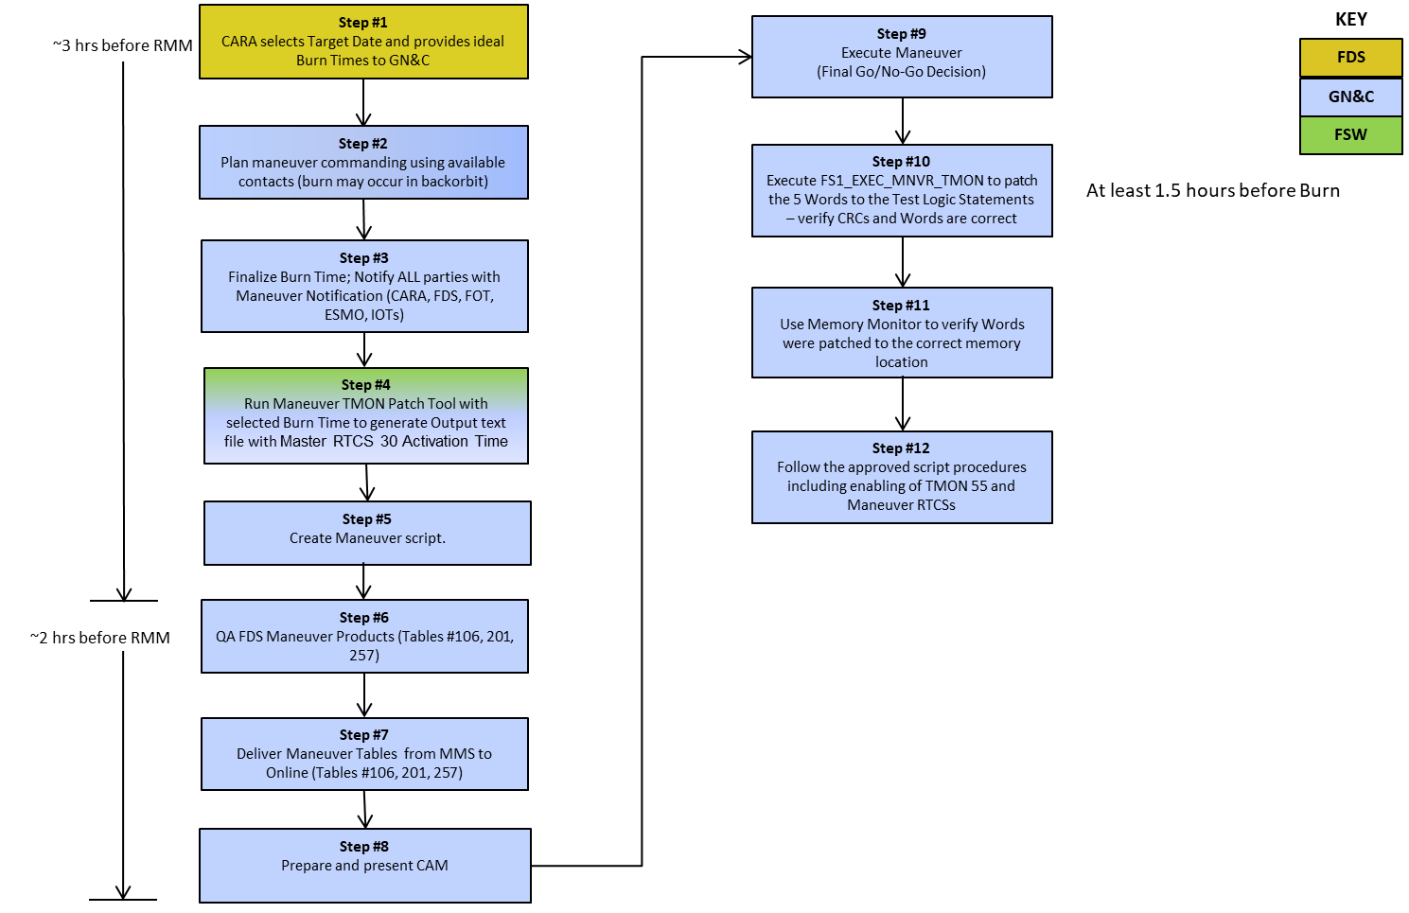
Terra Post-QDAM RMM Planning
QDAM burn time finalized
~3 hours before an RMM
Terra QDAM implemented in August 2015

Slide 9
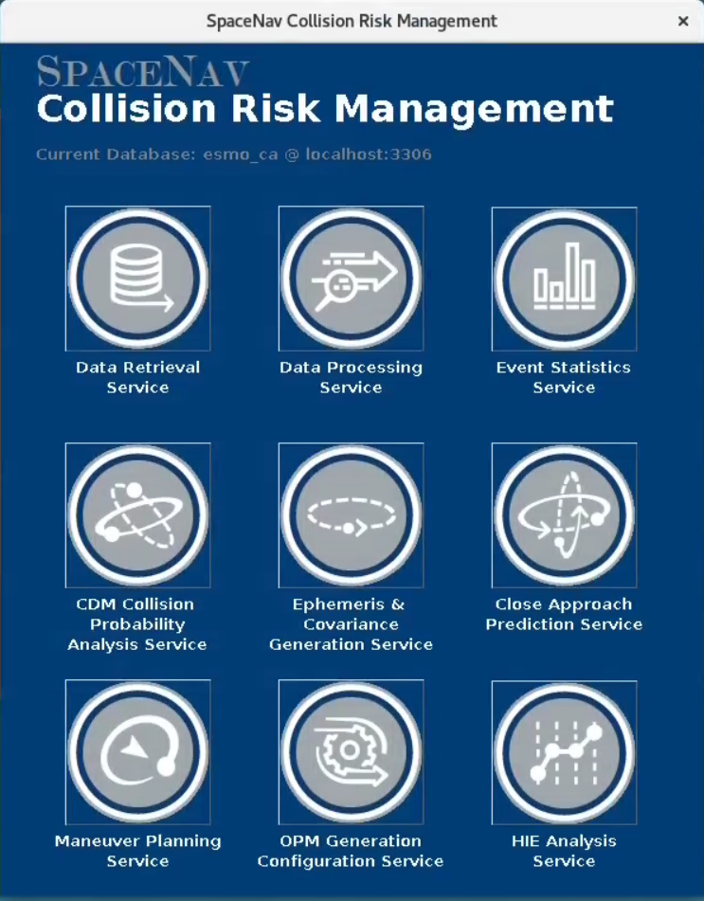
CRMS Overview
The CRMS in-house tool has been created by SpaceNav and is maintained by our System Administrators
It is used by our team to quantify and mitigate high-risk collision events
The software is configured to run through automation, where various sets of analyses are performed, and the results are automatically delivered to the necessary recipients
The software can also be run manually by the CA Engineer for analysis that isn’t covered through automation, or requires a different output from what the automation has produced

Slide 10
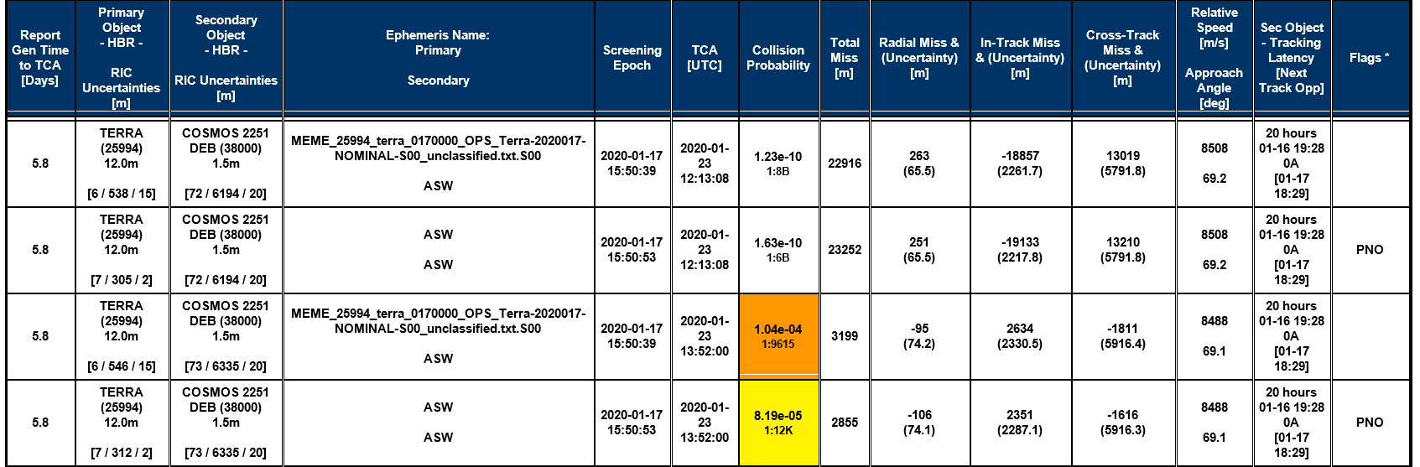
CRMS Summary Reports
CRMS summary reports are processed three times a day during nominal screening Conjunction Data Message (CDM) delivery times of ~4 AM, ~1 PM, and ~8 PM ET. Supplemental reports are also delivered in between these times if additional screenings are performed for maneuver options, or for specific high-risk secondary objects of concern.
Ephemeris Screened
Probability of Collision
Total Miss Distance
Individual Miss Distances
Primary Object Uncertainties
Secondary Object Uncertainties
Individual Miss Distance Uncertainties
Last Track and Next
Tracking Opportunity

Slide 11
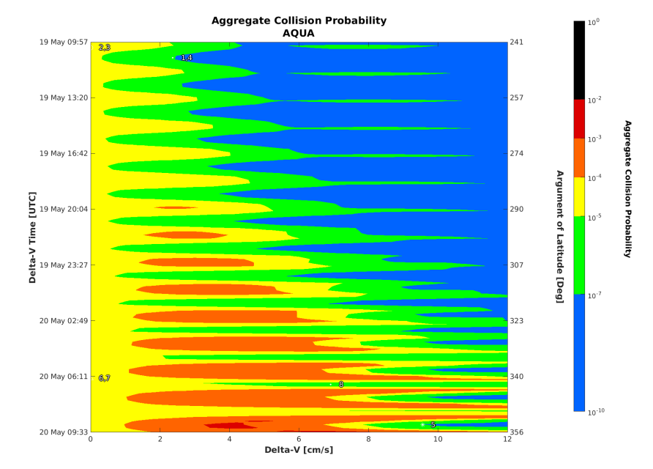
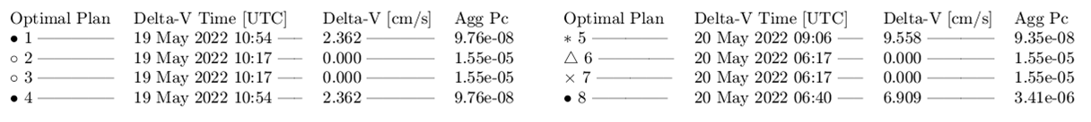
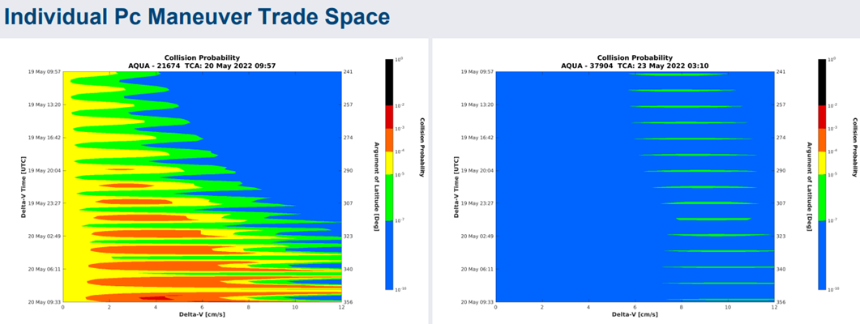
CRMS Maneuver Reports (1 of 2)
CRMS delivers an automated maneuver planning report every time a conjunction event falls within our configurable planning threshold, which is currently set to Time of Closest Approach (TCA) ≤ 3 days and Pc ≥ 1E-5
When maneuver planning is triggered by such an event, CRMS generates an aggregate Maneuver Trade Space (MTS) plot which provides mitigation for objects of concern with TCAs up to 3 days after the TCA of the triggering object, as well as individual MTS plots
Maneuver options are provided based on Delta-V and time constraints we provide to the system
These options are automatically delivered to FDS in the form of an Orbital Parameter Message (OPM) for automatic ephemeris generation, used for maneuver screening

Slide 12
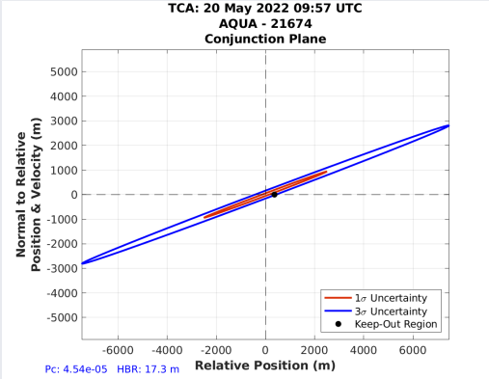
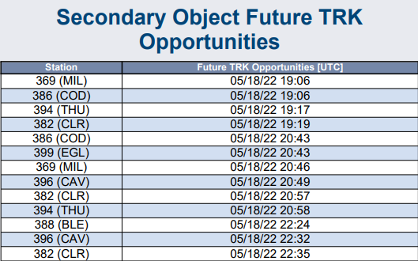
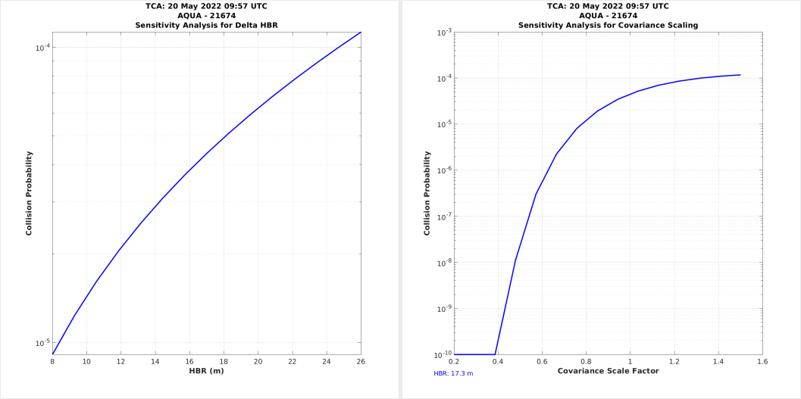
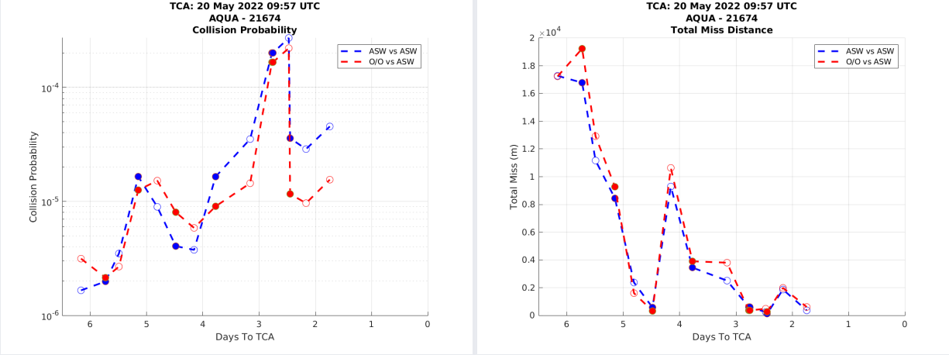
CRMS Maneuver Reports (2 of 2)
Along with the MTS plots, the CRMS maneuver planning report also contains detailed plots and charts for each secondary object of concern (identified through user-defined thresholds)
It is important for the CA Engineers to analyze the orbit determination quality, Pc and miss distance trends, future track opportunities, and sensitivity analysis of any secondary object that poses a threat to our spacecraft, so that proper planning and action can be taken accordingly.

Slide 13
CRMS Release Updates
CRMS Release # | Date in Operations | RMM Planning Enhancements
1 | April 14, 2015 | CDMs ingested into the CRMS database
2 | June 19, 2015 | Tools/capabilities added to design
3 | March 29, 2016 | Automated summary report generation
4 | August 24, 2016 | Deployment of CRMS as MATLAB executable Incorporation of Owner Operator (O/O) covariance for Pc Automated maneuver report generation
5 | February 9, 2017 | Multi-time window constrained maneuver plan optimization
6 | January 18, 2018 | Reporting of individual position uncertainty values E-mail attachment display for mobile mail clients
7 | April 30, 2019 | Content updates to Summary/Maneuver reports
8 | March 2, 2020 | Secondary Owner/Operator data processing Maneuver planning prioritization Course of Action table generation for flags
9 | August 5, 2021 | Check to verify correct ephemeris has been screened Automatic maneuver planning triggered for any message type Automated maneuver planning triggered by miss distance

Slide 14
CARA Devolution
Until Fall 2019, the CARA team was prime for EOS CA support
ESMO was asked in mid 2018 to be the first to exercise the CARA Devolution process
After ~1 year of intense planning/preparation, the Devolution Parallel Operations period ran from 03/26/19 to 09/25/19
The following prime responsibilities have been incorporated by EOS since we have now completed Devolution parallel operations, significantly reducing RMM planning time:
All Documentation has been finalized and ESMO is now performing prime CA duties for their own missions with CARA in shadow mode
  Ephemeris generation/delivery to space-track for screening
  CDM retrieval from space-track for CA data assessment
  Direct contact with CARA OSAs for data processing support
  Analysis and action for all events that violate Pc maneuver thresholds
  CA GO/NO-GO decision making at Command Authorization Meetings

Slide 15
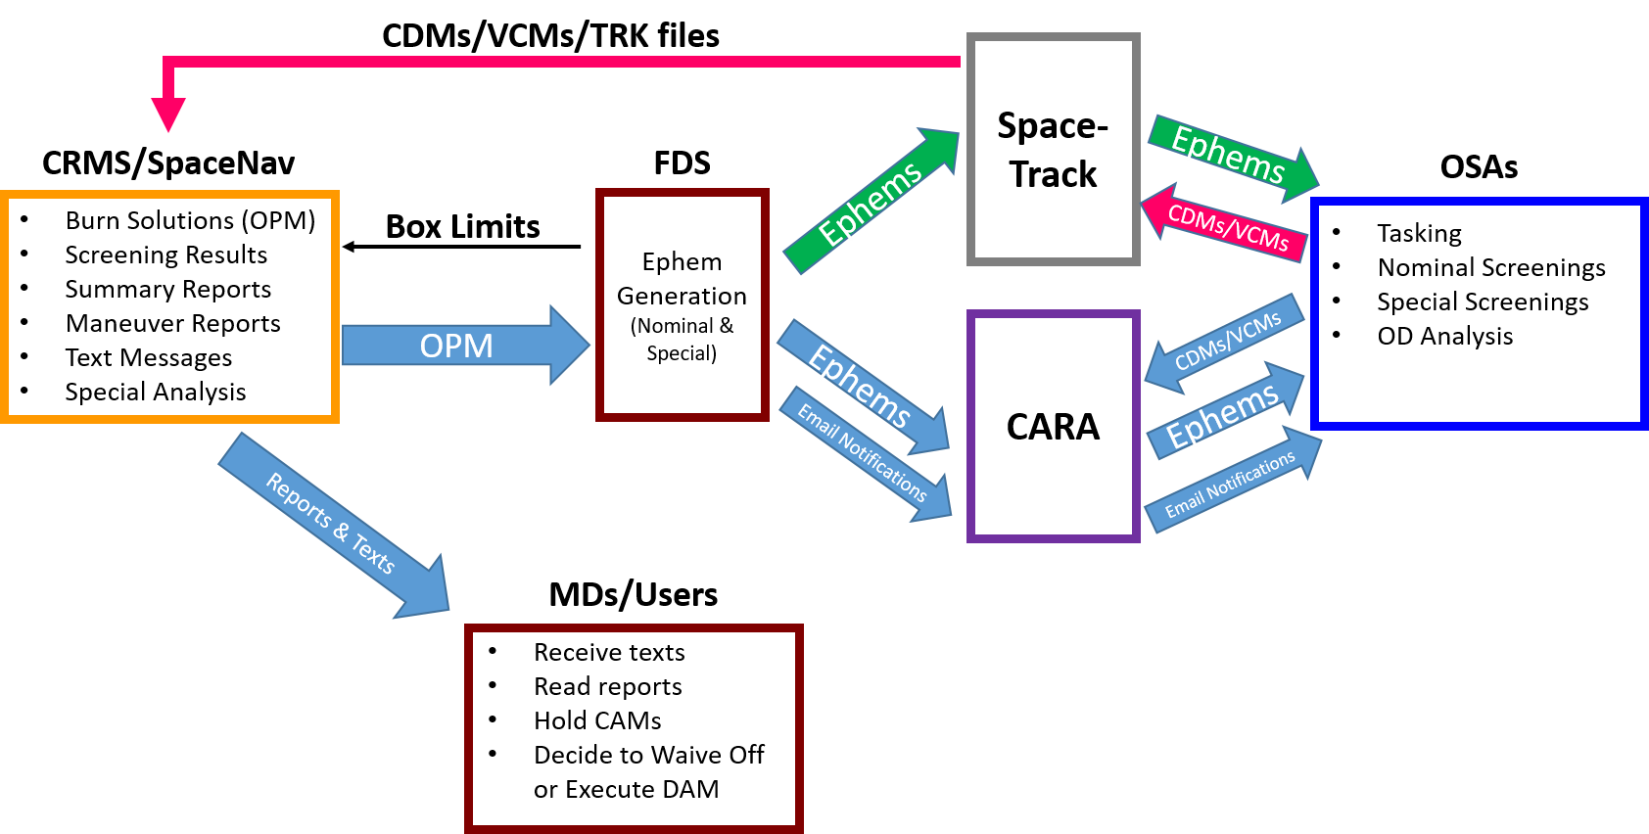
Devolution Data Process Flow
The CA data process flow that was used for the devolution parallel operations is summarized in the image below. By posting and receiving data directly using Space-Track, screening time was significantly reduced.
New feature in parallel ops
No longer needed after devolution

Slide 16
CA Process Enhancement
PRE-DEVOLUTION PROCESS | POST-DEVOLUTION PROCESS
Identify High Interest Event (HIE) via visual inspection of CARA Summary Report | Identify HIE via text message sent by CRMS and visual inspection of CRMS Summary Report
Call HIE Briefing Meeting to gather details of conjunction with CARA presenting HIE slides | CRMS produces maneuver report with all conjunction details and mitigation options
Pick mitigation solutions from selecting points off a Maneuver Trade Space Plot | CRMS produces new report every time new data is received and computes mitigation solutions
FDS generates ephemerides for each maneuver solution (~ 1 hour per ephemeris) | FDS generates ephemerides for each maneuver solution automatically based on output delivered by CRMS
CARA receives ephemerides from FDS and transfers them to CSpOC for screening | FDS automatically transfers ephemerides to Space-Track (CSpOC) for screening
CSpOC transfers screening results back to CARA | CSpOC directly posts screening results on Space-Track
CARA generates screening results report and briefs interested parties | CRMS generates screening results report automatically based on data posted to Space-Track
Black text = Manual
Blue text = Automated

Slide 17
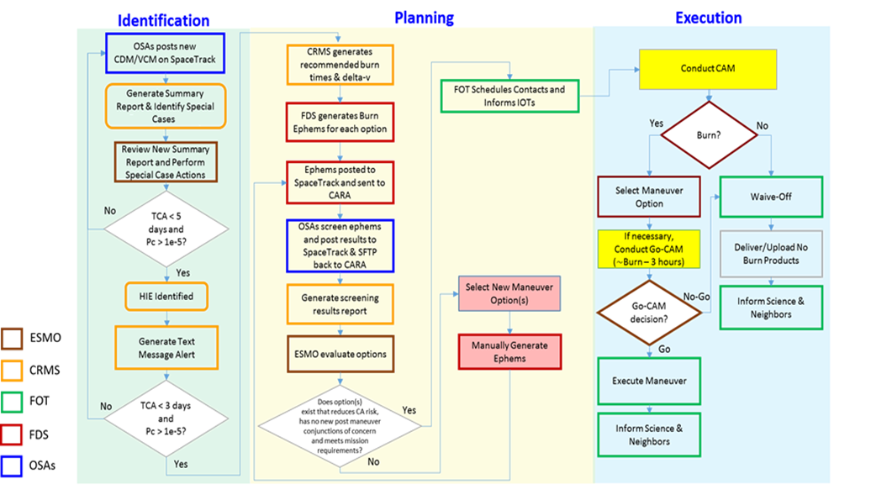
CA Support Process Flow

Slide 18
Probability of Collision Thresholds
The Probability of collision (Pc) is the principal metric used to specify the risk of collision between the primary object (our satellite) colliding with the secondary object of concern. In the image below, Pc thresholds are defined and classified by color for our missions to specify what course of action is recommended for the MD.
Color | Pc Thresholds | Odds Range | Course of Action | Caveats
Green | < 1.0e⁻⁵ | 1:100,000 to 0 | No DAM
Yellow | (1.0e⁻⁴-1.0e⁻⁵) | 1:10,000 to 1:100,000 | No DAM | …unless there is a scheduled DMU that can be altered to mitigate the conjunction
Orange | (1.0e⁻³-1.0e⁻⁴) | 1:1,000 to 1:10,000 | DAM | …unless the maneuver violates the mission’s science requirements (with CARA approval)
Red | (1.0e⁻²-1.0e⁻³) | 1:100 to 1:1,000 | DAM | …unless the DAM process cannot be executed due to vehicle condition or time constraints
Black | ≥ 1.0e⁻² | 1:1 to 1:100 | DAM | …unless the DAM process cannot be executed due to vehicle condition or time constraints

Slide 19
EOS 7 Year (5/1/15–4/30/22) Statistics
Satellite Name | # of Events | # of HIEs | Maneuvers Postponed | RMMs Executed
Aqua | 17018 | 121 | 8 | 3
Aura | 17416 | 107 | 3 | 11
Terra | 15546 | 82 | 0 | 13
Total EOS | 49,980 | 310 | 11 | 27

Slide 20
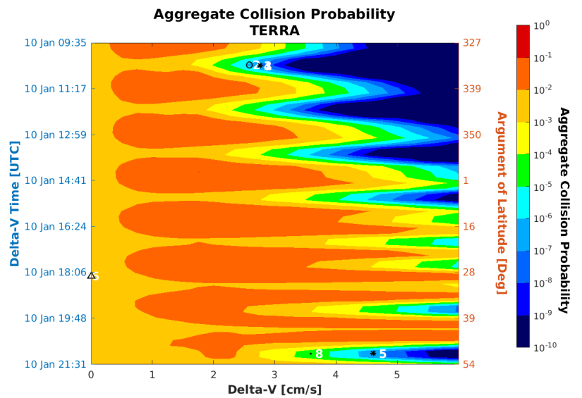
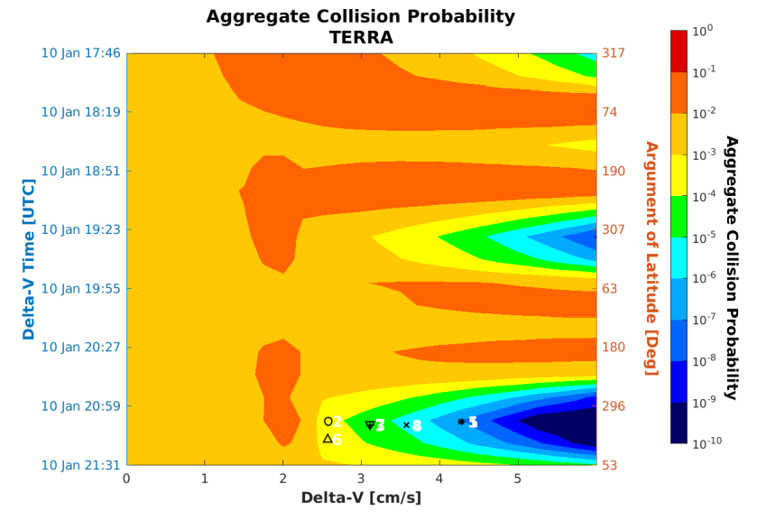
Terra vs. 80326 (TCA: 1/10/20)
Report Gen Time to TCA [Days] | Primary Object - HBR - RIC Uncertainties [m] | Secondary Object - HBR - RIC Uncertainties [m] | Ephemeris Name: Primary Secondary | Screening Epoch | TCA [UTC] | Collision Probability | Total Miss [m] | Radial Miss & (Uncertainty) [m] | In-Track Miss & (Uncertainty) [m] | Cross-Track Miss & (Uncertainty) [m] | Relative Speed [m/s] Approach Angle [deg] | Sec Object - Tracking Latency [Next Track Opp] | Flags *
0.9 | TERRA (25994) 12.0m [2 / 52 / 6] | UNKNOWN (80326) 1.5m [31 / 482 / 29] | O/O ASW | 2020-01-09 23:06:44 | 2020-01-10 21:55:17 | 1.90e-12 1:526B | 300 | 124 (31.3) | -10 (482.2) | 273 (61.8) | 173.9 | 11 hours 01-09 11:22 2M [Unk] | M SLO SW
0.5 | TERRA (25994) 12.0m [2 / 52 / 6] | UNKNOWN (80326) 1.5m [34 / 331 / 32] | O/O ASW | 2020-01-10 07:34:48 | 2020-01-10 21:55:17 | 4.21e-03 1:238 | 113 | 78 (34.2) | -8 (334.0) | 82 (47.7) | 173.9 | 7 hours 01-10 00:22 2M [Unk] | SNO M SLO SW DPc
0.2 | TERRA (25994) 12.0m [2 / 52 / 6] | UNKNOWN (80326) 1.5m [34 / 329 / 32] | O/O ASW | 2020-01-10 15:46:37 | 2020-01-10 21:55:17 | 4.10e-03 1:244 | 113 | 78 (34.2) | -6 (331.9) | 82 (47.5) | 173.9 | 15 hours 01-10 00:22 2M [Unk] | M SLO SW DPc
This event jumped up in risk from E-12 to E-3 just 12 hours to TCA. The risk remained steady at 4E-3 up to TCA due to no additional track received.
MTS plot generated 0.5 days to TCA
~4.5 cm/s required for mitigation
MTS plot generated 0.1 days to TCA
~4.5 cm/s required for mitigation
Terra FOT successfully executed a 4.61 cm/s RMM on 1/10/20 at 21:07 GMT

Slide 21
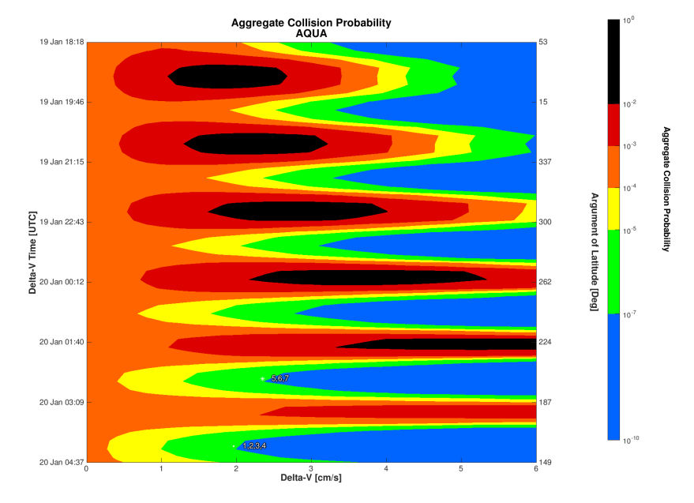
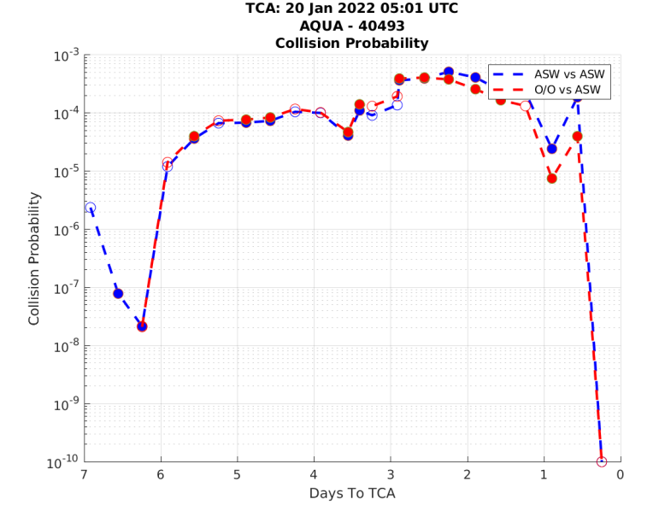
Aqua vs. 40493 (TCA: 1/20/22)
Report Gen Time to TCA [Days] | Primary Object - HBR - RIC Uncertainties [m] | Secondary Object - HBR - RIC Uncertainties [m] | Ephemeris Name: Primary Secondary | Screening Epoch | TCA [UTC] | Collision Probability | Total Miss [m] | Radial Miss & (Uncertainty) [m] | In-Track Miss & (Uncertainty) [m] | Cross-Track Miss & (Uncertainty) [m] | Relative Speed [m/s] Approach Angle [deg] | Sec Object - Tracking Latency [Next Track Opp] | Flags *
0.5 | AQUA (27424) 15.8m [8 / 42 / 4] | DMSP 5D-2 F13 DEB (40493) 1.5m [28 / 680 / 18] | ASW ASW | 2022-01-19 15:26:04 | 2022-01-20 05:01:58 | 1.87e-04 1:5348 | 477 | -14 (29.4) | -127 (589.5) | 460 (342.5) | 14471 149.9 | 3 hours 01-19 12:49 4M [01-19 18:05] | M SEDR PLO PNO SNO
0.1 | AQUA (27424) 15.8m [8 / 34 / 4] | DMSP 5D-2 F13 DEB (40493) 1.5m [20 / 205 / 16] | ASW ASW | 2022-01-20 00:02:39 | 2022-01-20 05:01:59 | 0.00e+00 | 1088 | 11 (21.6) | -281 (180.0) | 1051 (105.0) | 14471 149.9 | 11 hours 01-19 12:49 4M [01-20 01:56] | SEDR PLO PNS SNS
The Pc dropped down to zero 0.1 days to TCA due to a Secondary New Solution.
MTS plot generated 0.5 days to TCA
~2 cm/s required for mitigation
The risk dropped off ~3 hours prior to RMM execution leading to a waive off

Slide 22
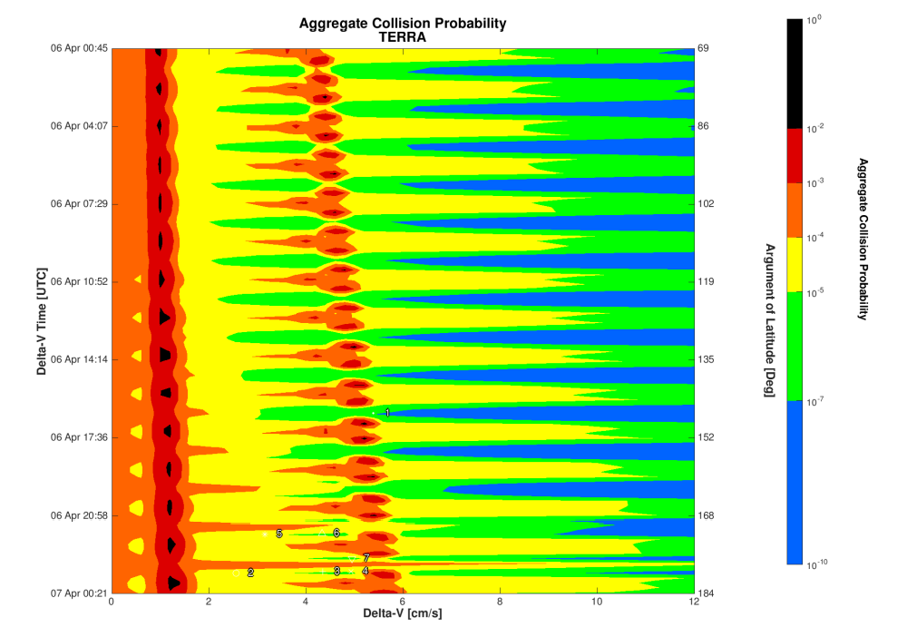
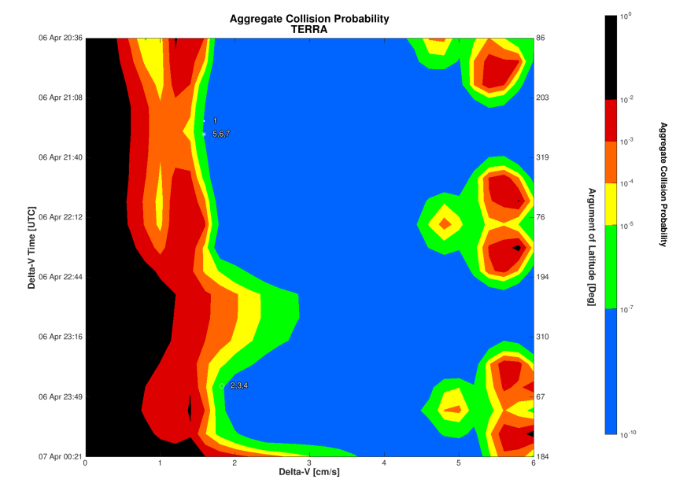
Terra vs. 47212 (TCA: 4/7/22)
Report Gen Time to TCA [Days] | Primary Object - HBR - RIC Uncertainties [m] | Secondary Object - HBR - RIC Uncertainties [m] | Ephemeris Name: Primary Secondary | Screening Epoch | TCA [UTC] | Collision Probability | Total Miss [m] | Radial Miss & (Uncertainty) [m] | In-Track Miss & (Uncertainty) [m] | Cross-Track Miss & (Uncertainty) [m] | Relative Speed [m/s] Approach Angle [deg] | Sec Object - Tracking Latency [Next Track Opp]
0.0 | TERRA (25994) 12.0m [4 / 21 / 3] | COSMOS 2506 DEB (47212) 1.5m [8 / 51 / 8] | ASW ASW | 2022-04-06 22:02:35 | 2022-04-07 00:45:12 | 8.17e-02 1:12 | 22 | 12 (8.7) | 19 (52.7) | 1 (17.5) | 1559 12.0 | 6 hours 04-06 15:58 4M [04-06 23:51]
MTS plot generated 1.7 days to TCA
~6 cm/s required for mitigation
MTS plot generated 0.2 days to TCA
~2 cm/s required for mitigation
Terra FOT successfully executed a 1.95 cm/s RMM on 4/7/22 at 00:16 GMT

Slide 23
Quick RMM Planning Time Benefits
All 3 real time examples demonstrate that by enhancing and refining our CA support tools and resources to support a short RMM turnaround time, we have the capability to:
  Receive an alert of a late notice (within 12 hours to TCA) high Pc event and safely execute an RMM to mitigate the risk
  Plan to execute an RMM half a revolution prior to TCA, and waive off shortly before the maneuver if the risk subsides
  Wait for updates up to 3 hours to TCA to finalize burn time and Delta-V values for RMM execution
Note: Sometimes maneuvering ~1-2 days prior to TCA is preferred for extremely high Pc events with very well-tracked secondary objects

Slide 24
Acronyms
Acronym | Definition
ASW | Astrodynamics Support Workstation
CA | Collision Avoidance
CAM | Command Authorization Meeting
CDM | Conjunction Data Message
CRMS | Conjunction Risk Mitigation System
CSpOC | Combined Space Operations Center
DMU | Drag Make Up
EOS | Earth Observing System
ESMO | Earth Science Mission Operations
FDS | Flight Dynamics Support
FOT | Flight Operations Team
HIE | High Interest Event
MD | Mission Director
MTS | Maneuver Trade Space
O/O | Owner/Operator
OPM | Orbital Parameter Report
OSA | Orbital Safety Analyst
Pc | Probability of collision
QDAM | Quick Debris Avoidance Maneuver
RMM | Risk Mitigation Maneuver
SME | Subject Matter Expert
SSA | Space Situational Awareness
TCA | Time of Closest Approach
VAFB | Vandenberg Air Force Base

