Slide 2

NASA Langley Research Center’s Open-Source NDE Simulation and Modeling Tools
Elizabeth Gregory, Bill Schneck, and Erik Frankforter
Notes:
STILL

Slide 3
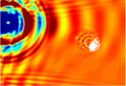
Agenda
Motivations for Simulating UT
Open-Source Code
swSim
PanNDE
Future work

Slide 4
Ultrasound Testing Simulation for NDE
Ultrasonic elastic waves excited using transducer, piezoelectric wafers, pulse laser, or other methods.
Elastic waves interact with defect/damage, propagating with damage information.
Detection of these waves using a piezoelectric transducer, fiber optic sensor, non-contact laser Doppler vibrometer, etc.
Provide insight into underlying interaction phenomena and energy paths.
Predict and quantify energy-damage interaction.
Extract features correlated with relevant parameters.
Optimize inspection setup.
Provide confidence in inspection results.
Notes:
General Goals for Simulating UT

Slide 5
Goals for Open-Source Software
Human Readable Inputs with XML
Easy editing
Easy sharing
Procedurally generated via outside tools
Easily Buildable Problems
Modular approach
Problem agnostic
Robust Tool for Long Use Life
Robust Testing with Test Driven Development
Unit and case testing
Test during development
Automatic Testing
Sharable Outputs with VTK
Easy data visualization
Already optimized parallel output
Self documenting output files
Trade names and trademarks are used in this report for identification only. Their usage does not constitute an official endorsement, either expressed or implied, by the National Aeronautics and Space Administration.

Slide 6
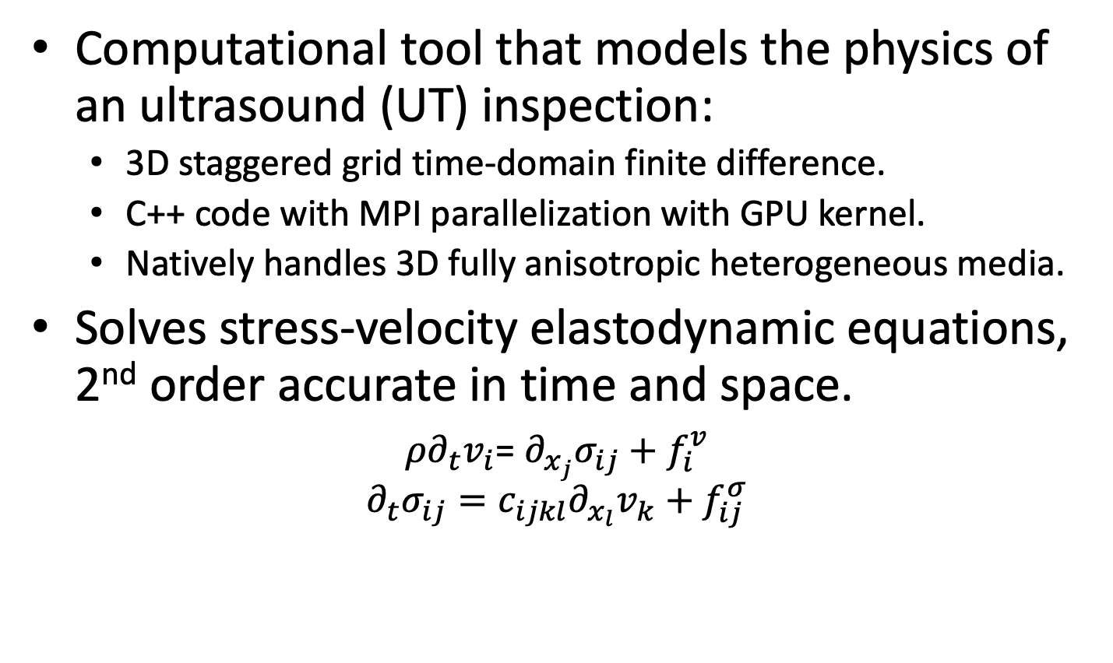


Solid Wave Simulation (swSim) Description
Computational tool that models the physics of an ultrasound (UT) inspection:
  3D staggered grid time-domain finite difference.
  C++ code with MPI parallelization with GPU kernel.
  Natively handles 3D fully anisotropic heterogeneous media.
Solves stress-velocity elastodynamic equations, 2nd order accurate in time and space.
$ρ∂_{t}v_{i}$= $∂_{x_{j}}σ_{ij}+f_{i}^{v}$
$$∂_{t}σ_{ij}=c_{ijkl}∂_{x_{l}}v_{k}+f_{ij}^{σ}$$
$σ_{xx},σ_{yy},$ $σ_{zz} ,τ_{xz, }τ_{yz, }τ_{xy }$
$$v_{x},v_{y},v_{z}$$
Repeating unit cell for ultrasound simulation algorithm – rotated staggered grid (RSG) finite difference
Trade names and trademarks are used in this report for identification only. Their usage does not constitute an official endorsement, either expressed or implied, by the National Aeronautics and Space Administration.

Slide 7
Simulation Structure
Kernel Composer GPU
Read Input Parameters
Read Geometry
Partition Geometry
Create State Variable Vectors
Register Host Data
Create State Transition Matrices
Register Operations
Simulation Complete?
Yes
No
Write Output
Map data from GPU
Advance kernel to saving ‘checkpoint’
Decommit
Trade names and trademarks are used in this report for identification only. Their usage does not constitute an official endorsement, either expressed or implied, by the National Aeronautics and Space Administration.

Slide 8
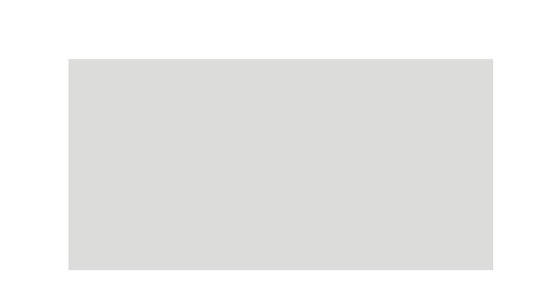
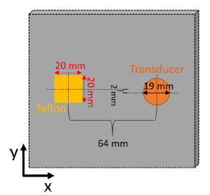
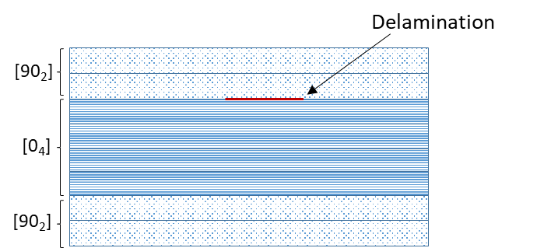
Benchmark Case
v_{z} surface wavefield, swSim simulation code
Delaminated Composite Plate
  Normal incidence contact transducer. Delamination via Teflon insert between 2nd and 3rd ply
  Full wavefield capture via laser Doppler vibrometry (LDV)
Velocity/wavenumber/wavelength changes above delamination observed via simulation and LDV
Run time comparison with COMSOL, Abaqus, ANSYS, CPU RSG
 | T_{run} (hours) | # DoF (10⁶) | Memory (GB)
COMSOL | 19.5 | 7.77 | 266
ABAQUS Implicit | 40 | 1.7 | 28
ABAQUS Explicit | 53 | 26 | 30
ANSYS | 170 | 10 | 16
swSim | 0.02-0.62 | 17.1 | 41.9
Leckey, Cara AC, et al. "Simulation of guided-wave ultrasound propagation in composite laminates: Benchmark comparisons of numerical codes and experiment." Ultrasonics 84 (2018): 187-200.
Between 2-3 orders of magnitude faster simulation time for converged model, using comparable compute resources
Notes:
4 sockets of skylakes
4 V100

Slide 9
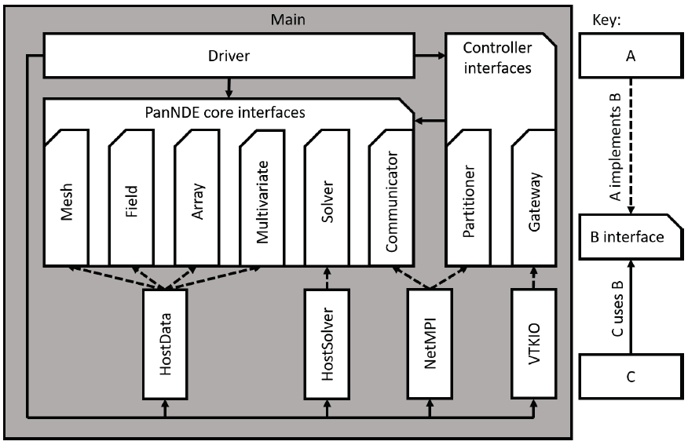
PanNDE
Emphasis on^{1,2}
  delineation between components (e.g. single responsibility principle)
  interconnection between components (dependency inversion)
Influence of modularization:
  Extensibility (e.g. physics solved is ‘just another module’)
  Maintenance of independent components
  Reduction in technical debt
During development:
  Encapsulation of MPI reduced overhead of testing and maintenance
  Insulation from I/O library allowed pivoting from CGNS to VTK
  Modularization allowed porting mesh and I/O modules to another project
1. R. Martin, Clean Architecture: A Craftsman's Guide to Software Structure and Design, Prentice Hall, 2018.
2. O'Connell, Matthew, et al. "Application of the Dependency Inversion Principle to Multidisciplinary Software Development." 2018 Fluid Dynamics Conference. 2018.https://doi.org/10.2514/6.2018-3856
Simplified architectural diagram
PanNDE elastodynamic simulation software

Slide 10
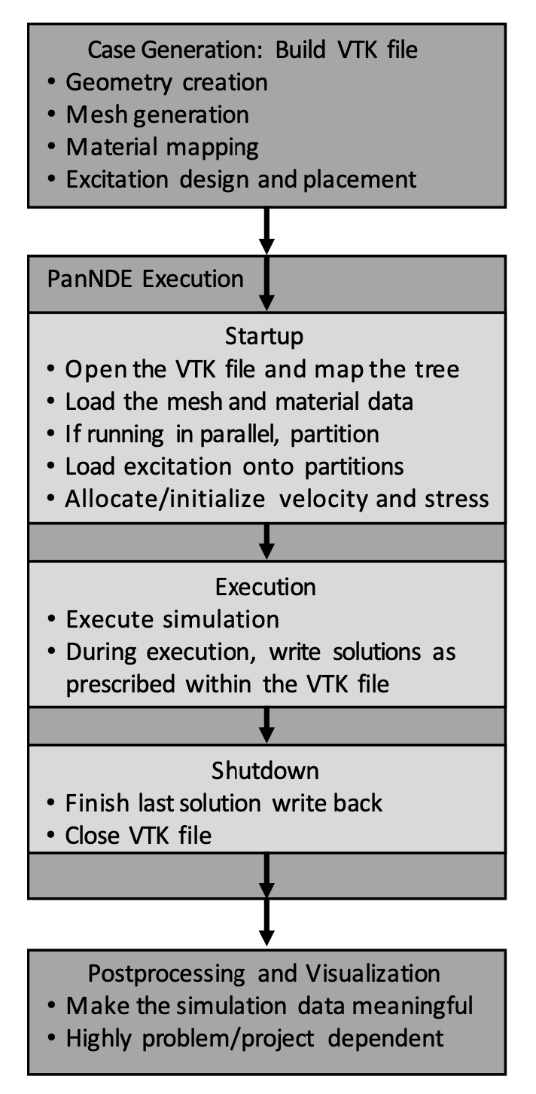
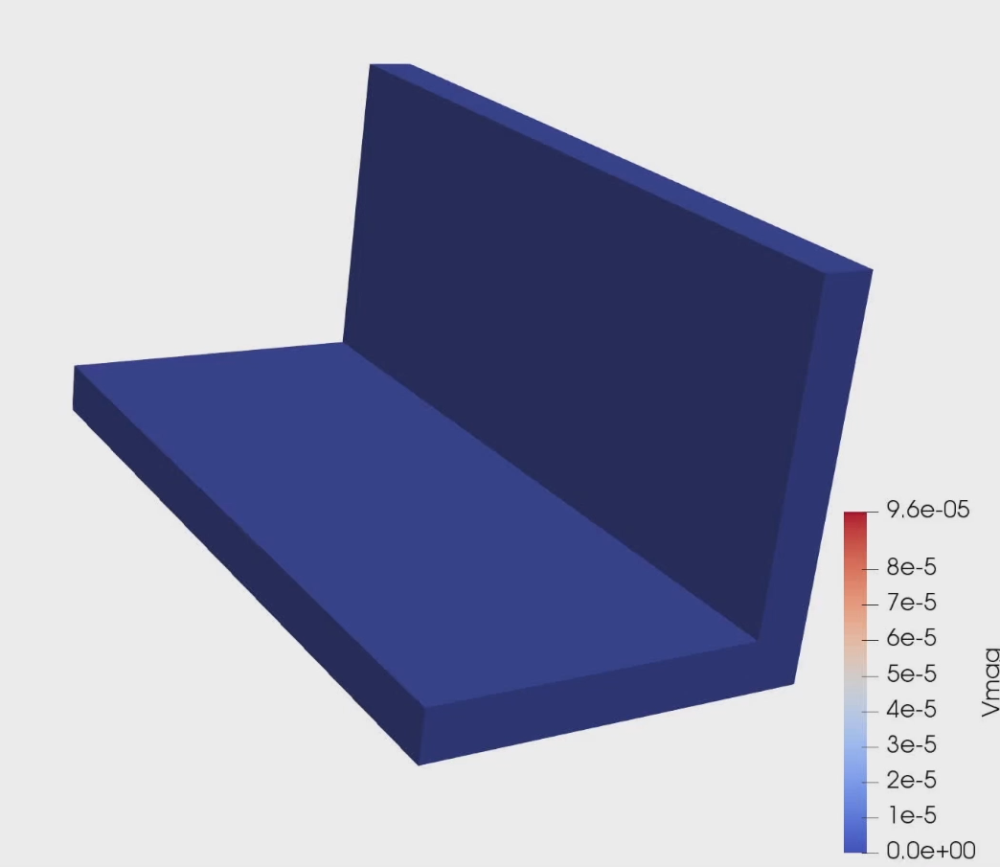
PanNDE Results

Slide 11
LaRC CNDE Software Dev Process
Workflows
Version Control
Code Reviews
Development Tools (Cross-Platform Compilation, Static Code Analyzer)
Development
Guides & Standards
Quality Agreements
Software Architecture, Library Usage
Formal Code Review Before Release
Testing
On-Demand, Multi-Level Testing Using Testing Framework
Continuous Integration / Continuous Deployment (CI/CD) Pipelines
Automatic Test Coverage Assessment
Documentation
Issue Tracking
README, Installation Guide
Documentation Generators
Descriptive Naming Practices
Trade names and trademarks are used in this report for identification only. Their usage does not constitute an official endorsement, either expressed or implied, by the National Aeronautics and Space Administration.
11

Slide 12
Questions
Software Available at: github.com/nasa/swsim/ github.com/nasa/pannde/

