Slide 1


Current and Future ESPO Supported Missions
July 7, 2022

Slide 2


Current and Future ESPO Supported Missions
July 7, 2022
Agenda
ESPO Mission at NASA
2022 Missions
Future Missions
Questions?

Slide 3
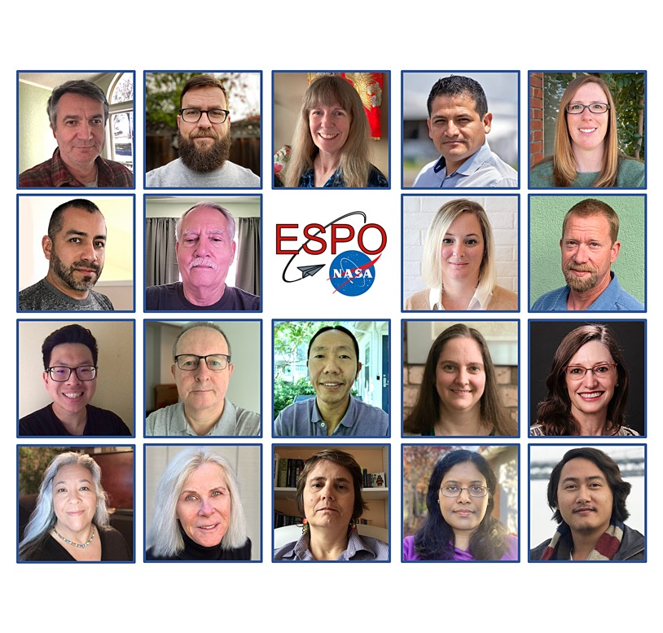
Current and Future ESPO Supported Missions
July 7, 2022
ESPO Team
ESPO is a group of success-oriented individuals providing a long history of project management for NASA’s Science Mission Directorate.
ESPO oversees mission planning, including but not limited to conducting site visits to potential deployment sites, working with project teams to plan the details of the field operations, and setting up deployment locations.
ESPO Responsibilities:
Management – Schedule, Planning, Budget, Reviews, Coordination
Travel Requirements – Site Surveys, Deployment Operations, Science Meetings
Logistics – Operations Website, List Serves, Lodging, Transportation, Shipping
Facilities – Setup Lab/Office/Hangar, Rentals, Badging/Access, Ground Sites
Mission Supplies – Office Supplies, Printers, Gases/Cryogens
Communications – Network, Phone
Mission Closeout – Contracts, Accounts
External Support – PAO
Notes:
Keep things moving. The glue and also the filler. No one’s boss - no carrot, no stick – luckily we work with great teams across the country. Communication is the key. We are part of teams that make agreements with international governments, get support from embassies, work out contracts to build temporary hangars in Korea, move sea containers full of equipment and gasses around the world. We collaborate across centers, across agencies, with private companies. We also keep the printer stocked with paper and clean out bathrooms. We work out solutions for people whose focus necessarily needs to be on science rather than operations or logistics. If as a PI or Program manager, you see that things are moving along fine, and you know where to show up, and everyone seems to be at a manageable stress level, this is when we are operating at our best.

Slide 4
Current and Future ESPO Supported Missions
July 7, 2022
Pre-Mission Services
  Mission requirements
    Interface with NASA HQ on pre-mission requirements, reviews, and deliverables
  Budget
    Establish grants with non-federal entities
    Facilitate funds transfers between HQ and NASA centers
    Prepare and track mission budget
  Mission planning and schedule
    Coordinate with HQ Program Managers, Project Scientists, and flight operations to formulate project plan and schedule
  Site Survey
    Conduct site survey
    Issue reports regarding feasibility, cost & concerns
    Provide recommendations

Slide 5
Current and Future ESPO Supported Missions
July 7, 2022
Pre-Mission Services
  Aircraft instrument payload
    Interface with aircraft management on required payload development, modifications, and reviews
    Track cost and schedule
  Contracts
    Establish contractual agreements concerning aircraft support, hangar space, office/lab space, lodging, network, etc.
  Risk management
    Identify potential cost, schedule, or safety issues that could affect mission and provide recommendations for mitigation
    Monitor and report on risks as required
    Coordinate and lead Mission Readiness Review

Slide 6
Current and Future ESPO Supported Missions
July 7, 2022
Pre-Mission Services
  Mission registration
    Collect mission participant information using secure database to facilitate access to deployment sites
    Create, maintain & publish mission participant lists
  Communication
    Coordinate regular teleconferences for science team
    Develop and maintain mission website and list serves
    Develop and publish deployment guide that covers travel requirements, transportation, lodging, medical/emergency services, etc.
  Public Affairs and Outreach
    Coordinate with agency and center offices of Public Affairs and Educational Outreach
    Notify local authorities of mission activities

Slide 7
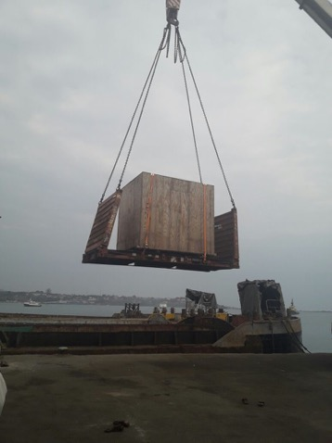
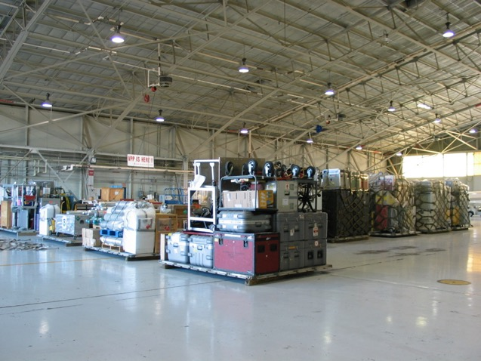
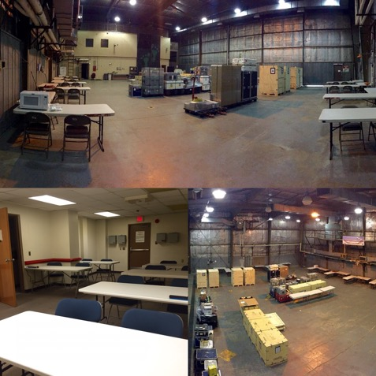
Current and Future ESPO Supported Missions
July 7, 2022
Pre-Mission Services
  Site Preparation
    Collect Logistics needs (shipping/consumables)
    Ship mission support equipment to field deployment locations
    Be onsite prior to mission to receive/unload shipments

Slide 8
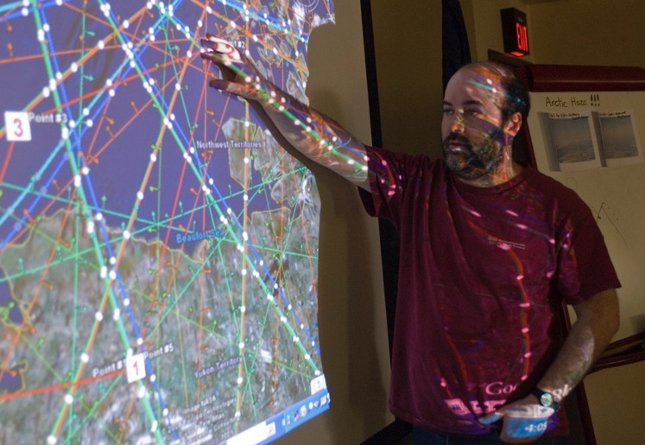
Current and Future ESPO Supported Missions
July 7, 2022
Deployment Services
  Set Up
    Base of operations
    Finalize all contracts and agreements
    Facilitate access to access-controlled deployment sites
  Coordination with aircraft management
    Instrument status and readiness
    Aircraft status and flight schedules
  In-field communications
    Plan of the Day (POD)
    Maintain communication with hosts
    Setup and coordinate science meetings and debriefings
    Aircraft status and flight schedules

Slide 9
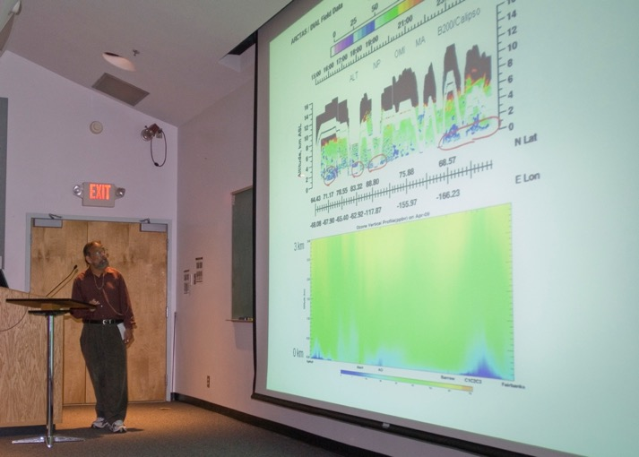
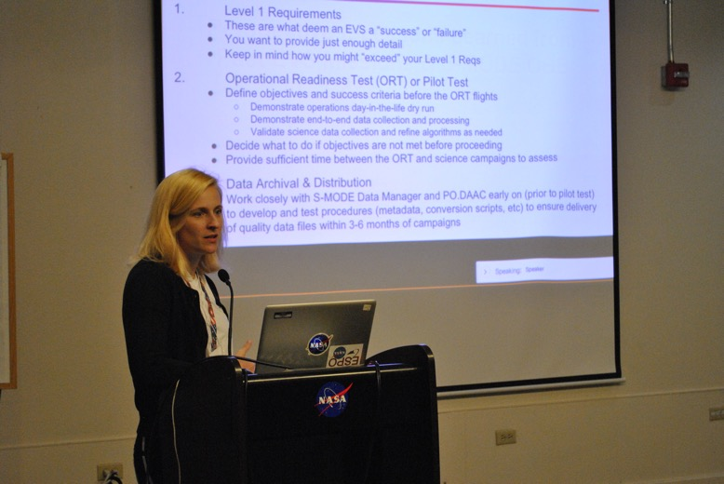
Current and Future ESPO Supported Missions
July 7, 2022
Post Mission Services
  Closeout
    Final closure with hosts and local accounts
    Collect and relay lessons learned
    Coordinate post-mission science meetings and workshops

Slide 10











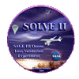









































Current and Future ESPO Supported Missions
July 7, 2022
Past and Current Missions
50+ supported missions since 1987

Slide 11
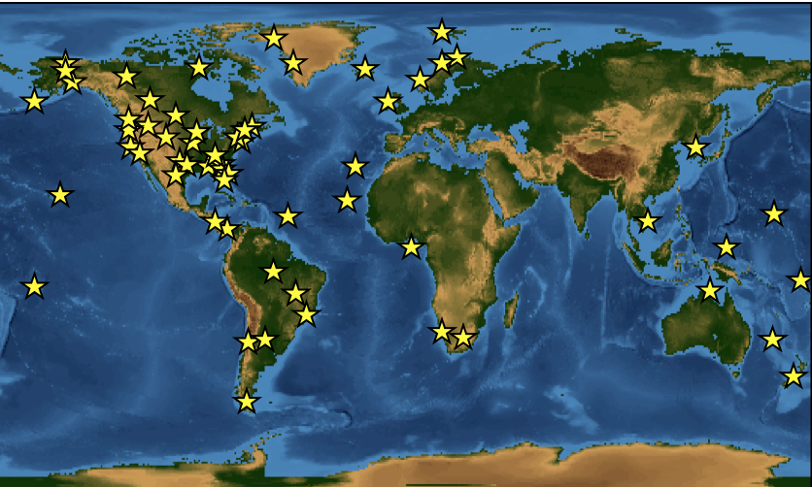
Current and Future ESPO Supported Missions
July 7, 2022
Past and Current Mission Locations

Slide 12
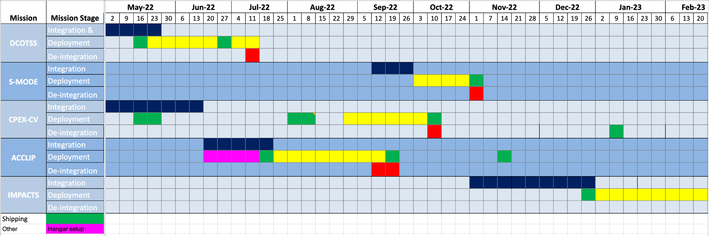
Current and Future ESPO Supported Missions
July 7, 2022
CY22 and CY23 ESPO Supported Missions

Slide 13

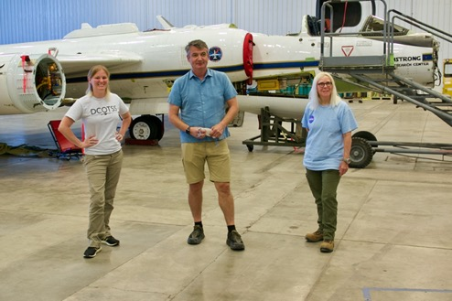
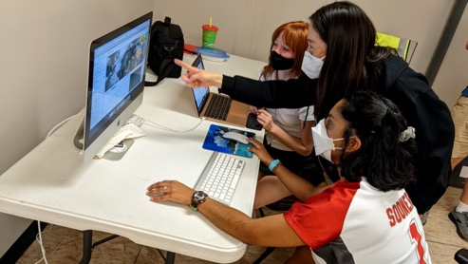
Current and Future ESPO Supported Missions
July 7, 2022
Dynamics and Chemistry of the Summer Stratosphere (DCOTSS)
Current Deployment: May 17 – Jul 15, 2022
Aircraft: NASA ER-2 (AFRC)
Location: Salina, Kansas (Salina Regional Airport) and Palmdale, CA (NASA AFRC)
Science Goals: To better understand the coupling of tropopause-penetrating convection with large-scale monsoonal motion, and the impact of convection on the chemical composition of the lower stratosphere, both in monsoon regions and in the global stratosphere.
Funding Source: Earth Venture Suborbital-3 Program
PI: Kenneth Bowman (Texas A&M) Deputy: Frank Keutsch (Harvard University)
ESPO Project Management: Dan Chirica (PM), Sommer Nicholas (Deputy PM)
ARC DCOTSS Science Team Members: Rei Ueyama (Forecasting & Flight Planning Lead), Paul Bui (MMS PI), Dylan Baker (MMS), Cecilia Chang (MMS), Jonathan Dean-Day (MMS), Richard Kolyer (MMS)
Caitlin Murphy, Dan Chirica, and Judy Alfter in Salina, KS for DCOTSS.
Rei Ueyama discussing weather and flight planning with students from the University of Oklahoma.

Slide 14
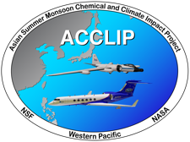
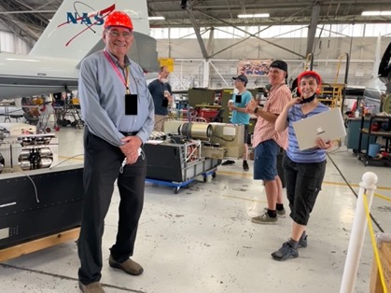
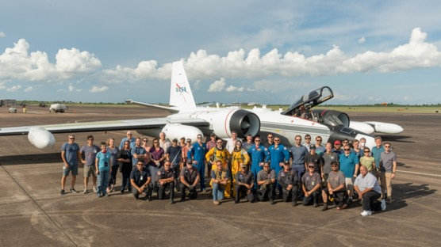
Current and Future ESPO Supported Missions
July 7, 2022
Asian Summer Monsoon Chemical & Climate Impact Project (ACCLIP)
Deployment Dates: Jun 21 - Sep 16, 2022
Aircraft: NASA WB-57F (JSC), NCAR GV
Location: Osan Air Base, Republic of Korea (ROK)
Science Goals: To characterize the impact on global chemistry and climate of the Asian Summer Monsoon – the largest meteorological pattern in the Northern Hemisphere summer season.
Science Leads: Paul Newman (NASA GSFC), Laura Pan (NCAR)
Funding Source: SMD Upper Atmosphere Research Program
Program Manager: Ken Jucks (NASA HQ)
ESPO Project Management: Jhony R. Zavaleta (PM), Andrian Liem (Deputy PM)
ARC ACCLIP Science Team Members: Paul Bui (MMS PI) and team, Rei Ueyama (Forecasting), James Podolske (COMA PI), Laura Iraci (COMA Deputy PI), Caroline Dang (COMA), James Eilers (COMA), Levi Golston (COMA), Roy Johnson (COMA), Richard Kolyer (COMA/MMS), Kristen Okorn (COMA), Emma Yates (COMA)
James Podolske, Ken Jucks, Roy Johnson, and Laura Iraci at Ellington Field, TX
NASA ACCLIP team photo with JSC WB-57 in the background at Ellington Field, TX

Slide 15

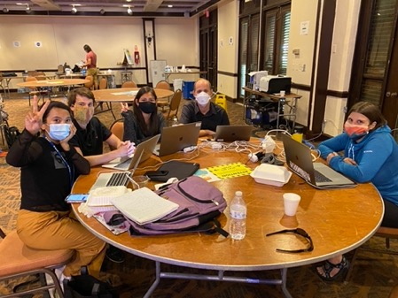
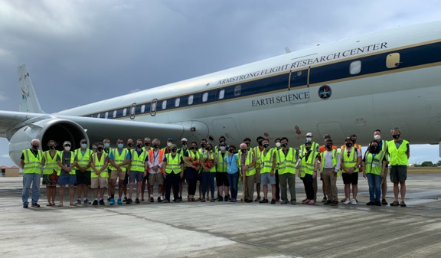
Current and Future ESPO Supported Missions
July 7, 2022
Convective Processes Experiment – Cabo Verde (CPEX-CV)
Deployment Dates: Aug 15 – Oct 5, 2022
Aircraft: NASA DC-8 (AFRC)
Location: Sal Island, Republic of Cabo Verde
Science Goals: Investigate atmospheric dynamics, marine boundary layer properties, convection, the dust-laden Saharan Air Layer, and their interactions across various spatial scales to improve understanding and predictability of process-level lifecycles in the data-sparse tropical East Atlantic region.
PI: Jon Zawislak​ (University of Miami), Ed Nowottnick (NASA GSFC)
Funding Source: SMD Atmospheric Dynamics and Precipitation Program
Program Manager: Will McCarty (NASA HQ)
ESPO Project Management: Vidal Salazar (PM)
CPEX forecasting and flight planning teams
CPEX team photo in St. Croix, USVI in 2021

Slide 16

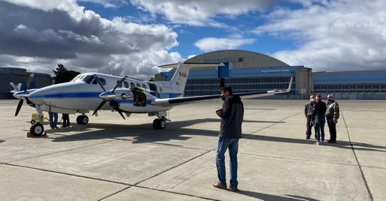
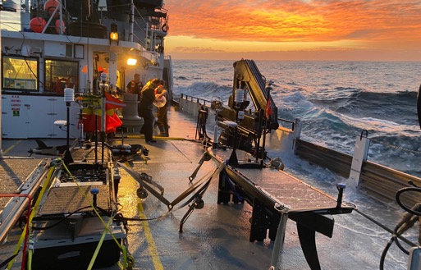
Current and Future ESPO Supported Missions
July 7, 2022
Sub-Mesoscale Ocean Dynamics and Vertical Transport Experiment (S-MODE)
Current Deployment: Sep 12 – Nov 1, 2022
Platforms: AFRC B200, LaRC G-III, TOI Twin Otter, Wave Gliders (WHOI and Scripps), Saildrones, Seagliders (UW), Lagrangian Floats (UW)
Locations: Moffett Field, CA (AFRC B200, LaRC G-III); Salinas, CA (Twin Otter); ~150 miles offshore of the SF Bay Area (All in situ platforms)
Science Goal: Test hypothesis that submesoscale ocean dynamics make important contributions to vertical exchange of climate and biological variables in the upper ocean.
PI: Tom Farrar (WHOI); Deputy PIs: Ernesto Rodriguez (JPL), Eric D’Asaro (UW), Andrey Shcherbina (UW)
Funding Source: Earth Venture Suborbital-3 Program
ESPO Project Management: Erin Czech (PM), Sommer Nicholas (Deputy PM)
AFRC B200 at NASA ARC during S-MODE. Hector Torres (JPL) in the foreground.
S-MODE science party preparing balloonsonde onboard R/V Oceanus during S-MODE. Wave Gliders pictured in foreground.

Slide 17
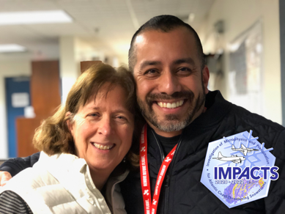
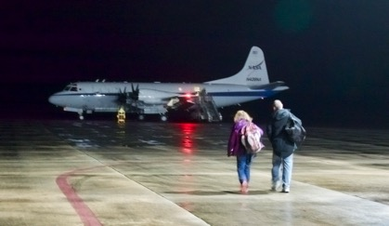
Current and Future ESPO Supported Missions
July 7, 2022
Investigation of Microphysics and Precipitation for Atlantic Coast-Threatening Snowstorms (IMPACTS)
Deployments: Three 6-week campaigns (mid January through February 2020, 2022, and 2023)
Aircraft: NASA ER-2 (AFRC) and NASA P-3 (WFF)
Locations: [ER-2] Dobbins AFB (2023); [P-3] NASA Wallops
Science Goals: Determine how multi-scale dynamical and microphysical processes in winter storms interact to produce banded regions of snowfall to improve US storm prediction capabilities.
PI: Lynn McMurdie (University of Washington); Deputies: Gerald Heymsfield, John Yorks, and Scott Braun (GSFC)
Funding Source: Earth Venture Suborbital-3 Program
ESPO Project Management: Vidal Salazar (PM)
IMPACTS PI and PM: Lynn McMurdie (UW) and Vidal Salazar (ESPO) at NASA WFF
IMPACTS scientists walking to the NASA P-3 before a flight

Slide 18

Current and Future ESPO Supported Missions
July 7, 2022
Atmospheric Emissions and Reactions Observed from Megacities to Marine Areas (AEROMMA)
Deployment: ~Jul 2023
Aircraft: NASA DC-8 (AFRC), NASA GV (JSC), NASA G-III (LaRC)
Location: Eastern USA (TBD)
Science Goals: Address emerging research needs in urban air quality, marine emissions, climate feedbacks, and atmospheric interactions at the marine-urban interface and future satellite capabilities of monitoring atmospheric composition over North America
Funding Source: NOAA
ESPO Project Management: Jhony Zavaleta (PM)

Slide 19

Current and Future ESPO Supported Missions
July 7, 2022
Biodiversity Survey of the Cape (BioSCape)
Deployment: Oct – Nov 2023
Aircraft: NASA GV (JSC), NASA G-III (LaRC)
Location: Cape Town, South Africa
Science Goals: Measure and understand functional, phylogenetic, and taxonomic biological ​diversity​ and how it relates to ecosystem functions and services in the region
Funding Source: SMD Biological Diversity and Ecological Forecasting Program
Program Manager: Woody Turner (NASA HQ)
ESPO Project Management: Dan Chirica (PM)

Slide 20
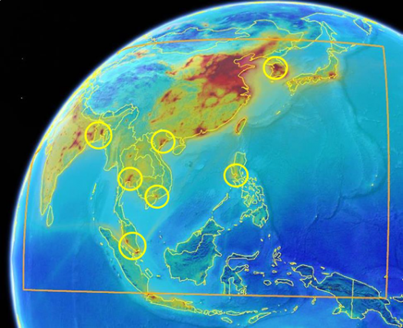
Current and Future ESPO Supported Missions
July 7, 2022
Airborne and Satellite Investigation of Asian Air Quality (ASIA-AQ)
Deployment: Early 2024
Aircraft: NASA DC8 (AFRC), NASA GV (JSC)
Possible Locations: Seoul, South Korea; Tokyo, Japan; Manila, Philippines; Hanoi and Ho Chi Minh City, Vietnam; Bangkok, Thailand; Kuala Lumpur, Malaysia; Singapore; Dhaka, Bangladesh; Kolkata, India
Science Goals: Improve understanding of the factors controlling local air quality across Asia through multi-perspective observations and modeling.
Funding Source: SMD Tropospheric Composition Program
Program Manager: Barry Lefer (NASA HQ)
ESPO Project Management: Jhony Zavaleta (PM)

Slide 21
QUESTIONS?

