Slide 1
Aluminum borohydride ammines as fuels for hybrid rocket motors: theoretical performance and particle synthesis
Distribution Statement A: Approved for public release; distribution is unlimited.
David L. Drewniak, J. Eric Boyer, Richard A. Yetter
David Drewniak– david.drewniak@psu.edu
Ph.D. Student
Mechanical Engineering Department
NASA Space Technology Graduate Research Fellow ’21
JANNAF 51st Combustion Subcommittee, Session 1O, 6 June 2022

Slide 2
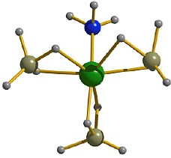
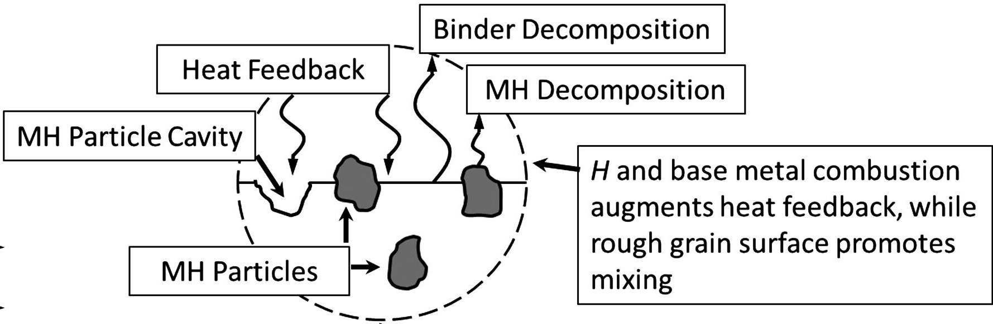
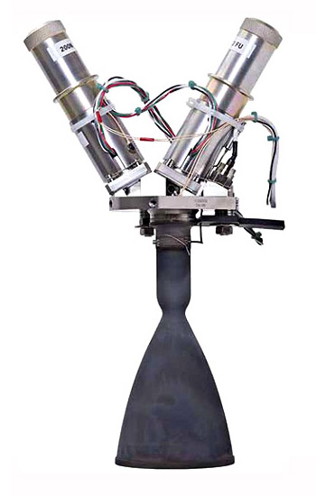
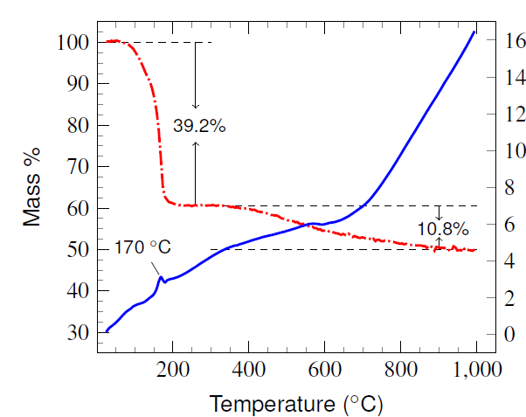

Outline
What are aluminum borohydride ammines?
Applications
Additives for upper stage hybrid motors
Safer storable
in-space thrusters
Aluminum borohydride hexammine, $Al{\left(BH_{4}\right)}_{3}⋅6NH_{3}$
Synthesis
Thermal decomposition properties
$3NaBH_{4}\text{(}\text{s}\text{)}+AlCl_{3}\text{(}\text{s}\text{)}→Al{\left(BH_{4}\right)}_{3}$(g) | (1)
$6NH_{3}\text{(}\text{g}\text{)}+Al{\left(BH_{4}\right)}_{3}\text{(}\text{g}\text{)}→$ $Al{\left(BH_{4}\right)}_{3}⋅6NH_{3}$(s) | (2)

Slide 3
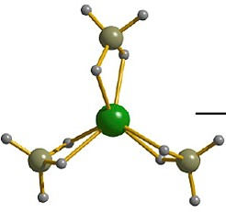
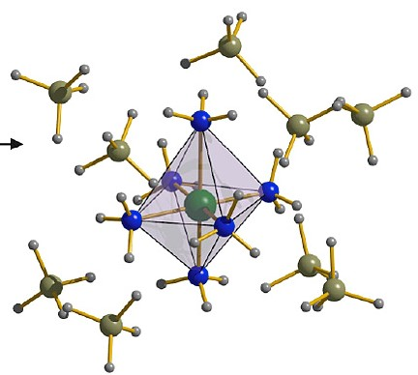



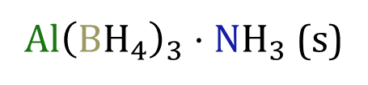
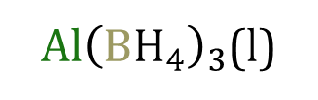
Aluminum borohydride ammines, $Al{\left(BH_{4}\right)}_{3}⋅XNH_{3}$
Distribution Statement A: Approved for public release; distribution is unlimited.
$Al{\left(BH_{4}\right)}_{3}$(l)
$Al{\left(BH_{4}\right)}_{3}⋅NH_{3}$ (s)
$$[Al{\left({NH}_{3}\right)}_{6}^{3+}{]\left[{BH}_{4}^{−}\right]}_{3}\text{(}\text{s}\text{)}$$
$$Al{\left(BH_{4}\right)}_{3}⋅6NH_{3}$$
Figures from: Dovgaliuk, I., & Filinchuk, Y. (2016). Aluminium Complexes of B- and N-Based Hydrides: Synthesis, Structures and Hydrogen Storage Properties. International Journal of Hydrogen Energy, 41(34), 15489–15504.

Slide 4
Theoretical Performance

Slide 5
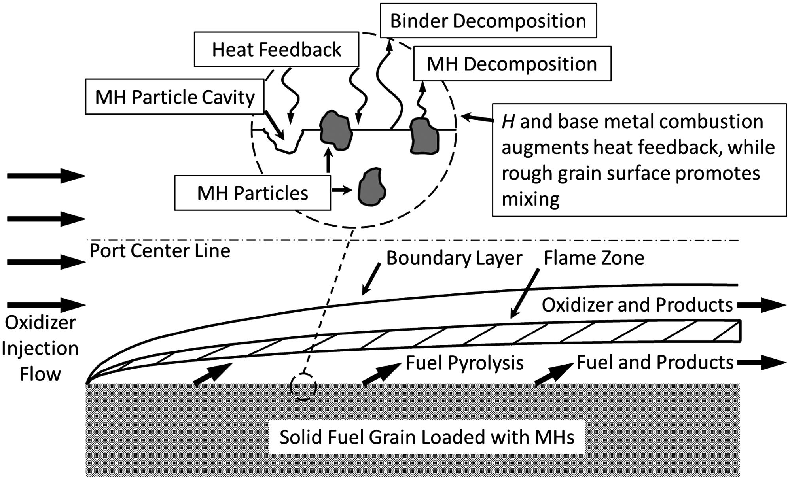
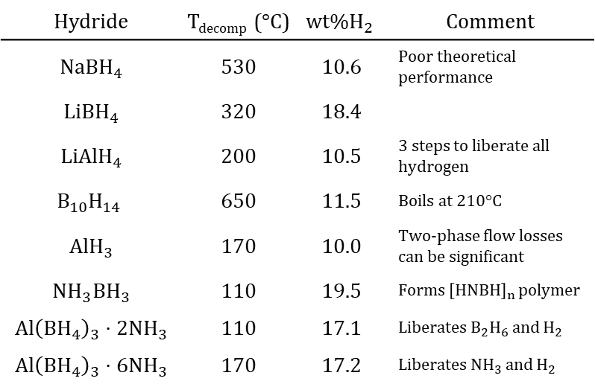
Hydride particle additives can increase regression rate of hydrocarbon fuel binders
Hydride | T_{decomp} (°C) | $${wt\%H}_{2}$$ | Comment
$$NaBH_{4}$$ | 530 | 10.6 | Poor theoretical performance
$$LiBH_{4}$$ | 320 | 18.4
$$LiAlH_{4}$$ | 200 | 10.5 | 3 steps to liberate all hydrogen
$$B_{10}H_{14}$$ | 650 | 11.5 | Boils at 210°C
$$AlH_{3}$$ | 170 | 10.0 | Two-phase flow losses can be significant
$${NH}_{3}BH_{3}$$ | 110 | 19.5 | Forms ${\left[HNBH\right]}_{n}$ polymer
$$Al{\left(BH_{4}\right)}_{3}⋅2NH_{3}$$ | 110 | 17.1 | Liberates $B_{2}H_{6}$ and $H_{2}$
$$Al{\left(BH_{4}\right)}_{3}⋅6NH_{3}$$ | 170 | 17.2 | Liberates ${NH}_{3}$ and $H_{2}$
Shark, S. C., Pourpoint, T. L., Son, S. F., & Heister, S. D. (2013). Performance of Dicyclopentadiene/H₂O₂-Based Hybrid Rocket Motors with Metal Hydride Additives. Journal of Propulsion and Power, 29(5), 1122–1129.
At lower additive loading, all hydrides increase regression rate. At high loading, regression rate can be attenuated due to agglomeration and blocking.

Slide 6
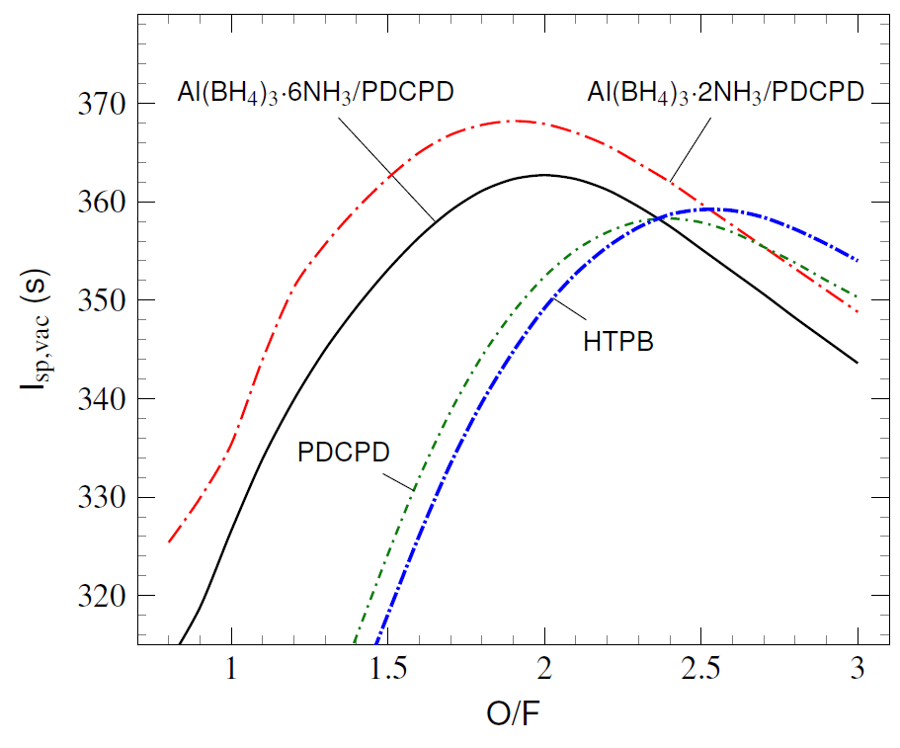
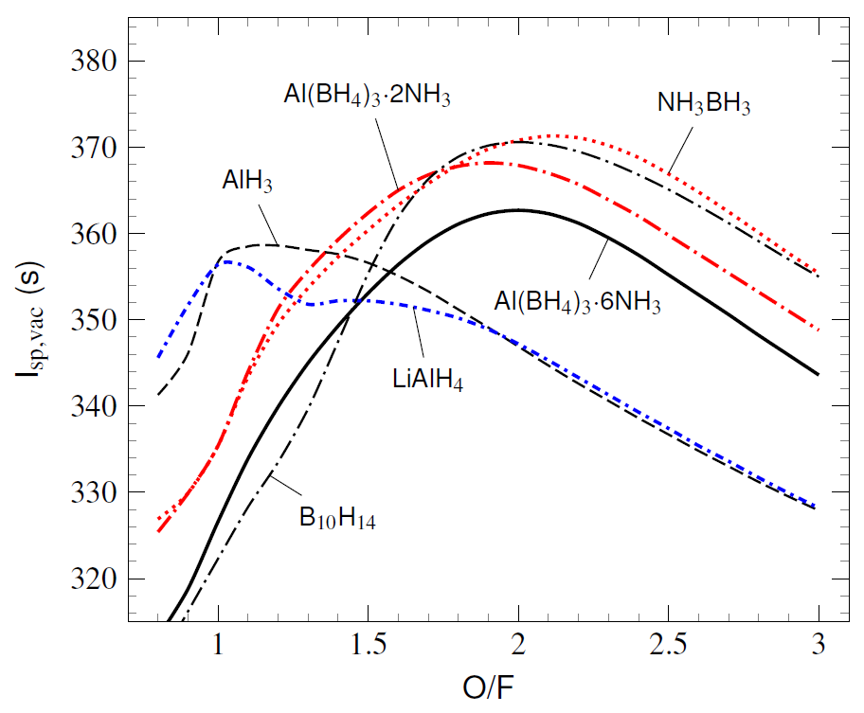
Additives can increase specific impulse slightly and decrease O/F ratio
Calculated vacuum specific impulse (I_{sp,vac}) for 50 wt% hydride particles with PDCPD binder and O₂(L) oxidizer, P_{chamber} = 600 psi, ε = 50, equilibrium composition, B₂O₃(L) omitted, two-phase losses included, η_{vel} = 0.90
Poly(dicyclopentadiene) (C₁₀H₁₂, PDCPD) is a hydrophobic plastic binder that is compatible with metal hydrides and can protect them from hydrolyzing

Slide 7
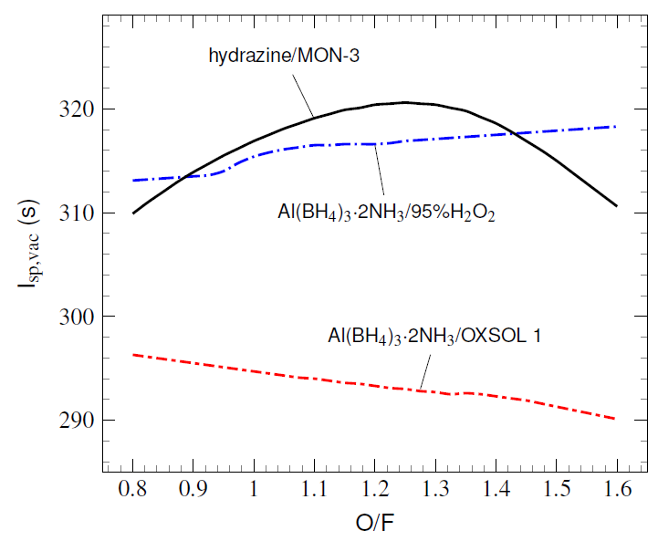
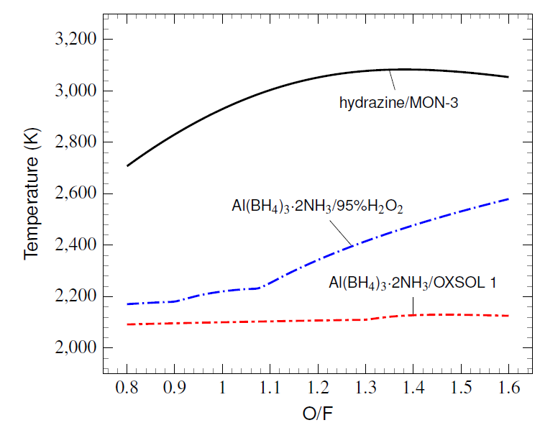
Al(BH₄)₃・2NH₃ with non-toxic oxidizers has performance comparable to hydrazine/MON-3, but much lower temperature
P_{chamber} = 200 psi, ε = 15, frozen composition @ ε = 2, η_{vel} = 0.95
Calculated combustion chamber temperature, P_{chamber} = 200 psi
Requires powders to be pressed into a fuel grain so no binder is needed. Historical precedence with LiAlH₄.*
*Osmon, R. V. (1966). An Experimental Investigation of LiAlH₄-H₂O₂Hybrid Rocket. Chemical Engineering Progress, 62(61), 92–102.

Slide 8
Particle Synthesis

Slide 9
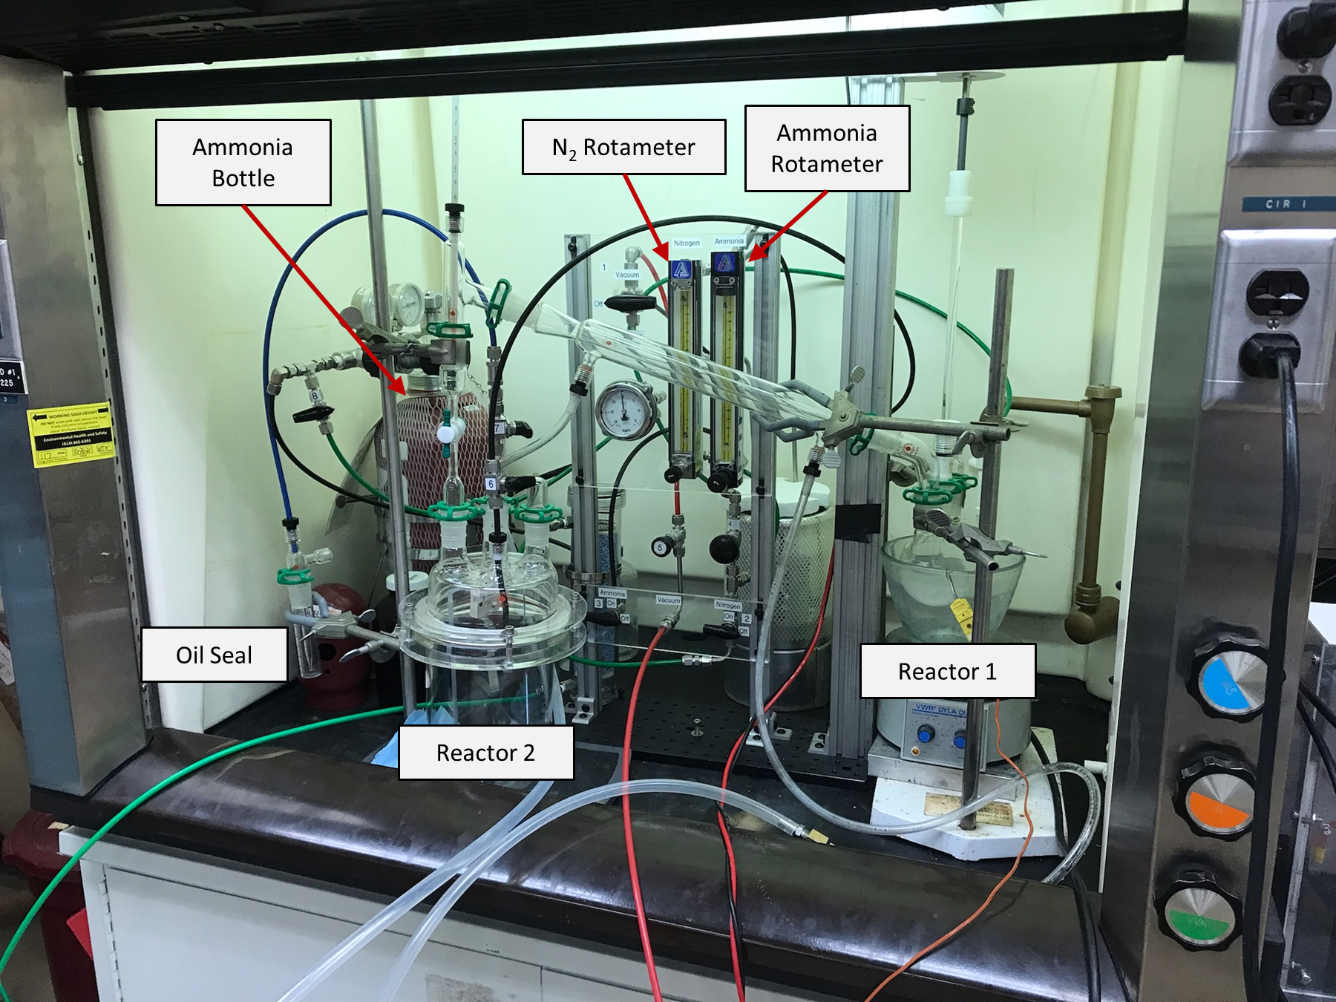
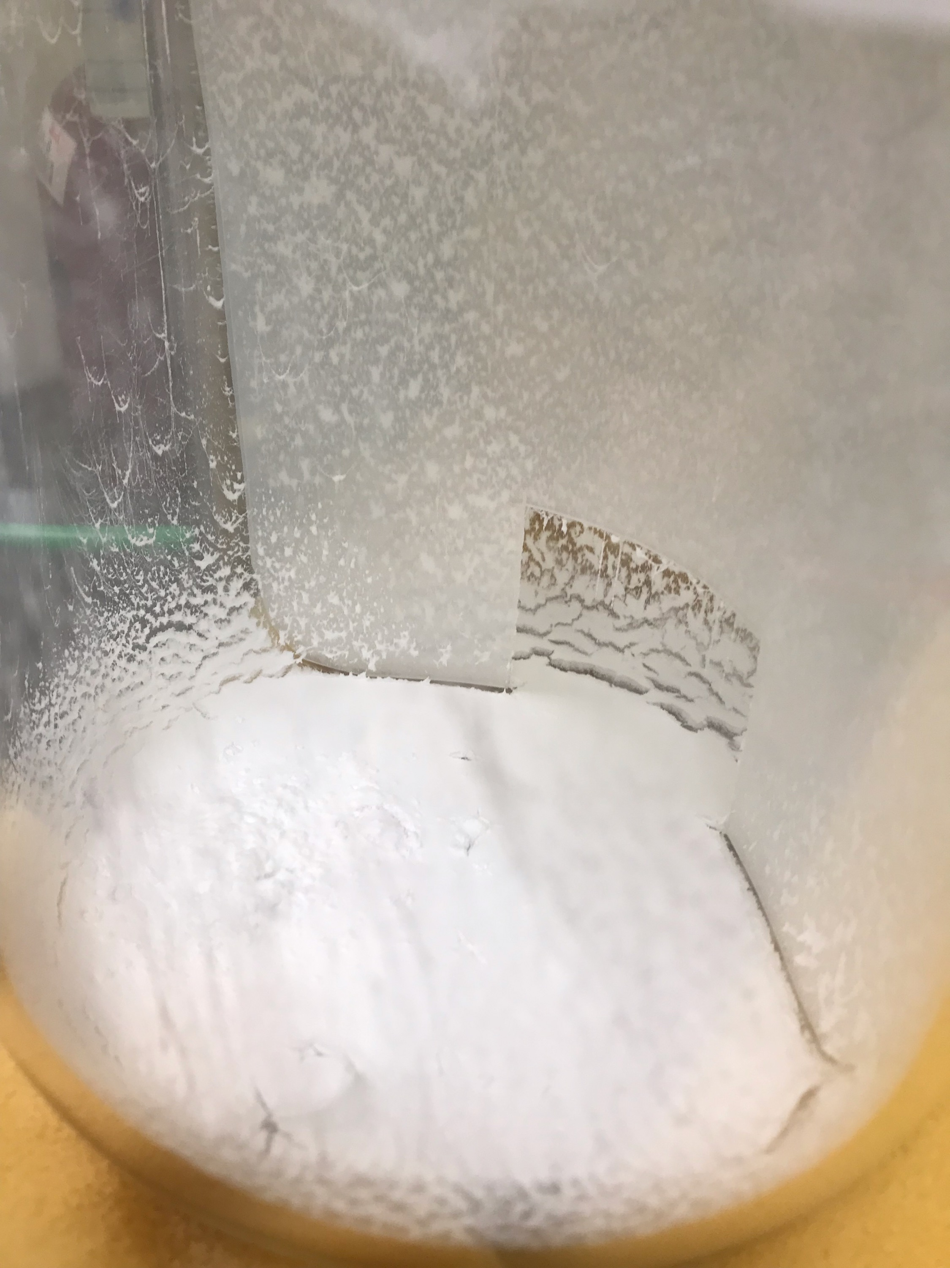
Aluminum borohydride ammine synthesis
$3NaBH_{4}\text{(}\text{s}\text{)}+AlCl_{3}\text{(}\text{s}\text{)}→Al{\left(BH_{4}\right)}_{3}$(g) | Reactor 1
$6NH_{3}\text{(}\text{g}\text{)}+Al{\left(BH_{4}\right)}_{3}\text{(}\text{g}\text{)}→$ $Al{\left(BH_{4}\right)}_{3}⋅6NH_{3}$(s) | Reactor 2
$Al{\left(BH_{4}\right)}_{3}⋅6NH_{3}\text{(}\text{s}\text{)}+3Al{\left(BH_{4}\right)}_{3}\text{(}\text{g}\text{)}→$ $Al{\left(BH_{4}\right)}_{3}⋅2NH_{3}$(s) | TBD
Reactor 2

Slide 10
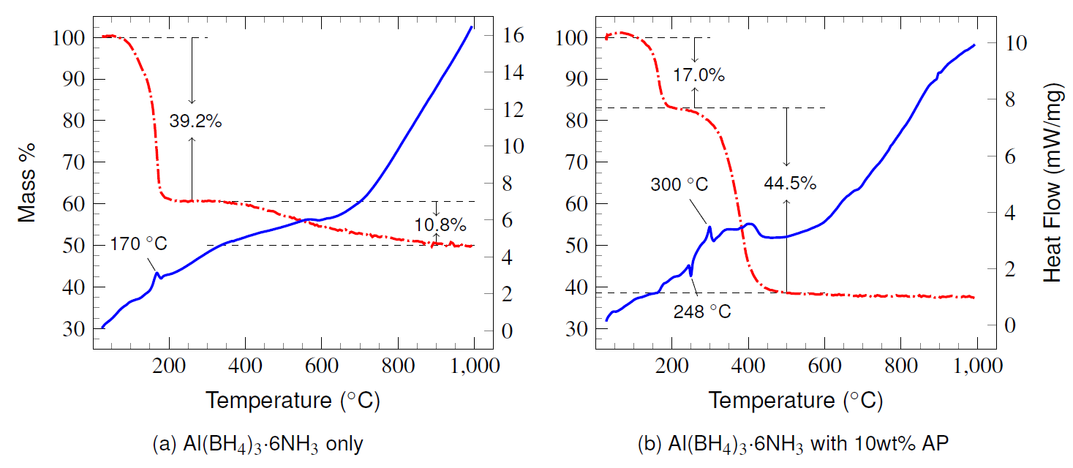
TG/DSC analysis of $Al{\left(BH_{4}\right)}_{3}⋅6NH_{3}$
Large value may be due to clathrate NH₃ or N₂
Ammonium perchlorate (NH₄ClO₄, AP) added to investigate effects of NH₄ ⁺ ion on decomposition steps. Recent studies* found decomposition of NH₃BH₃ found significant effect of NH₄ ⁺ inclusion.
*Biswas, P., Ghildiyal, P., Kwon, H., Wang, H., Alibay, Z., Xu, F., Wang, Y., Wong, B. M., & Zachariah, M. R. (2022). Rerouting Pathways of Solid-State Ammonia Borane Energy Release. The Journal of Physical Chemistry C, 126(1), 48–57.

Slide 11
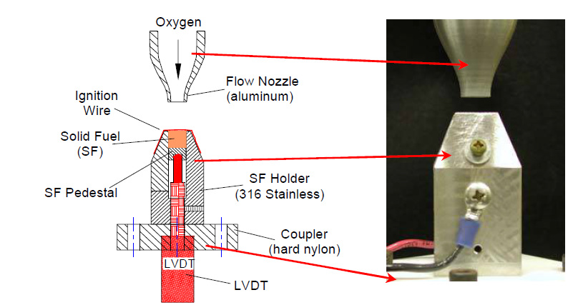
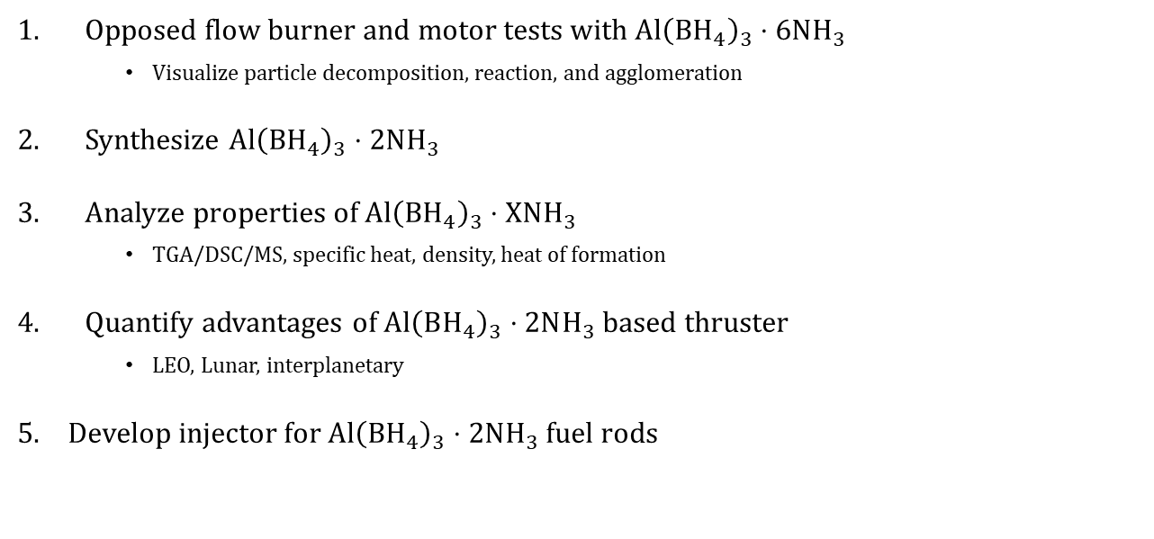
Future Work
Opposed flow burner and motor tests with $Al{\left(BH_{4}\right)}_{3}⋅6NH_{3}$
Visualize particle decomposition, reaction, and agglomeration
Synthesize $Al{\left(BH_{4}\right)}_{3}⋅2NH_{3}$
Analyze properties of $Al{\left(BH_{4}\right)}_{3}⋅XNH_{3}$
TGA/DSC/MS, specific heat, density, heat of formation
Quantify advantages of $Al{\left(BH_{4}\right)}_{3}⋅2NH_{3}$ based thruster
LEO, Lunar, interplanetary
Develop injector for $Al{\left(BH_{4}\right)}_{3}⋅2NH_{3}$ fuel rods
Lee, J., Weismiller, M., Connell, T., Risha, G., Yetter, R., Gilbert, P., & Son, S. (2008). Ammonia Borane Based-Propellants. In 44th AIAA/ASME/SAE/ASEE Joint Propulsion Conference \& Exhibit. American Institute of Aeronautics and Astronautics.

Slide 12
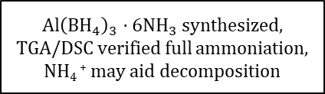
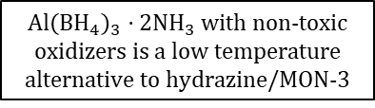
Conclusion
Aluminum borohydride ammines may increase the regression rate of conventional hybrid rocket motors due to high H₂ content and favorable decomposition pathway
$Al{\left(BH_{4}\right)}_{3}⋅6NH_{3}$ synthesized,
TGA/DSC verified full ammoniation,
NH₄ ⁺ may aid decomposition
$Al{\left(BH_{4}\right)}_{3}⋅2NH_{3}$ with non-toxic oxidizers is a low temperature alternative to hydrazine/MON-3
This work was supported by a NASA Space Technology Graduate Research Opportunities Award.
Questions?

Slide 13
Backup

Slide 14
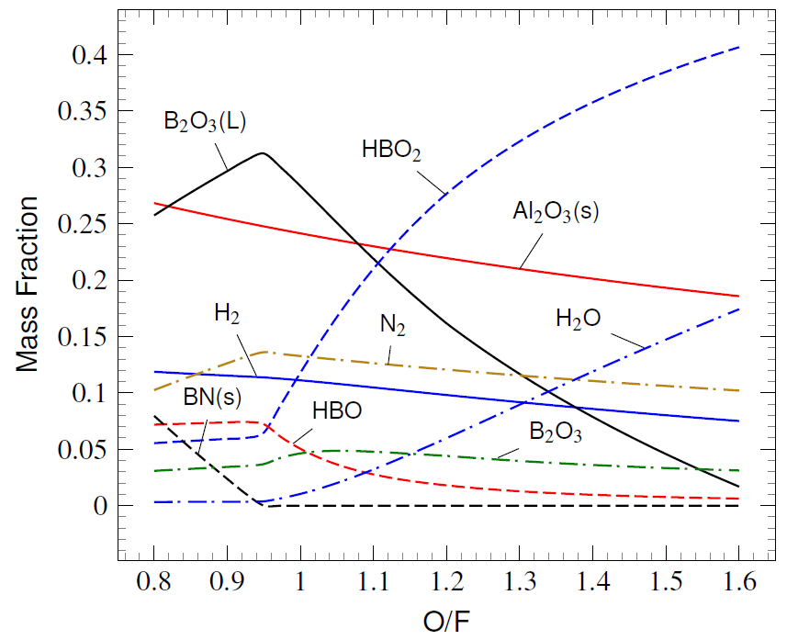
Combustion product species at $ε$= 2
Exhaust combustion mass fractions for $Al{\left(BH_{4}\right)}_{3}⋅2NH_{3}$/$95\%H_{2}O_{2}$, frozen chemical composition, temperature = 1930 ± 20K for all O/F at ε = 2; all species gaseous unless labeled otherwise

Slide 15
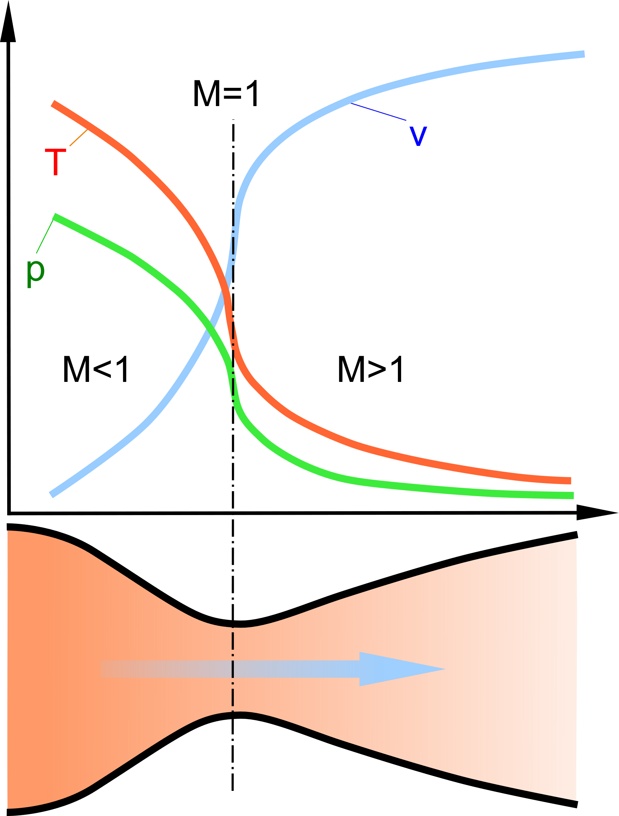





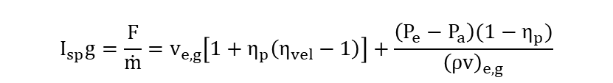

Derivation of two-phase flow losses
$$η_{vel}=\frac{v_{e,p}}{v_{e,g}}$$
$$η_{p}=\frac{{\dot{m}}_{p}}{\dot{m}}$$
$$\dot{m}=\frac{{\dot{m}}_{g}}{(1−η_{p})}$$
$${\dot{m}}_{g}={\left(ρAv\right)}_{e,g}$$
particles
gas
$$F={\left(\dot{m}v_{e}\right)}_{p}+{\left(\dot{m}v_{e}\right)}_{g}+A_{e}\left(P_{e}−P_{a}\right)$$
[1]
$=\dot{m}η_{p}η_{vel}v_{e,g}+$ $\dot{m}{(1−η}_{p})v_{e,g}$ $+A_{e}\left(P_{e}−P_{a}\right)$
$$I_{sp}g=\frac{F}{\dot{m}}=v_{e,g}\left[1+η_{p}\left(η_{vel}−1\right)\right]+\frac{\left(P_{e}−P_{a}\right)(1−η_{p})}{{\left(ρv\right)}_{e,g}}$$
[2]
$$ε=2$$
Particles don’t contribute to pressure

Slide 16
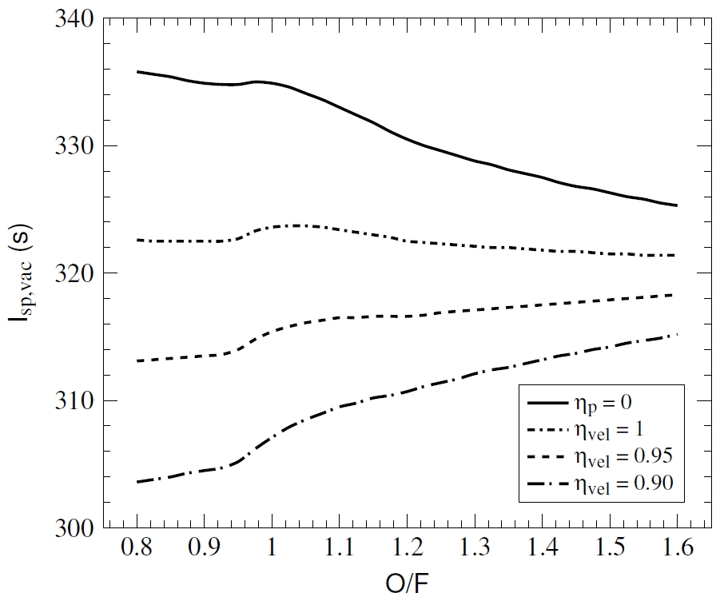
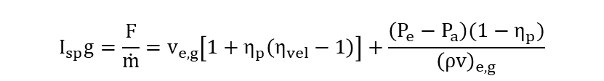


Two-phases losses can have significant effects on performance
$$η_{vel}=\frac{v_{e,p}}{v_{e,g}}$$
$$η_{p}=\frac{{\dot{m}}_{p}}{\dot{m}}$$
$$I_{sp}g=\frac{F}{\dot{m}}=v_{e,g}\left[1+η_{p}\left(η_{vel}−1\right)\right]+\frac{\left(P_{e}−P_{a}\right)(1−η_{p})}{{\left(ρv\right)}_{e,g}}$$
Al(BH₄)₃・2NH₃/95%H₂O₂ with various levels of two-phase flow losses applied, P_{chamber} = 200 psi, ε = 15, frozen composition @ ε = 2

Slide 17


Two-phase flow loss derivation
$$F={\left(\dot{m}v_{e}\right)}_{p}+{\left(\dot{m}v_{e}\right)}_{g}+A_{e}\left(P_{e}−P_{a}\right)$$
$=\dot{m}η_{p}η_{vel}v_{e,g}+$ $\dot{m}{(1−η}_{p})v_{e,g}$ $+A_{e}\left(P_{e}−P_{a}\right)$
$$I_{sp}g=\frac{F}{\dot{m}}=\frac{\dot{m}η_{p}η_{vel}v_{e,g}+\dot{m}{(1−η}_{p}v_{e,g}+A_{e}\left(P_{e}−P_{a}\right)}{\dot{m}}$$
$$=v_{e,g}\left[1+η_{p}\left(η_{vel}−1\right)\right]+\frac{A_{e}\left(P_{e}−P_{a}\right)}{{\dot{m}}_{g}/(1−η_{p})}$$
$$=v_{e,g}\left[1+η_{p}\left(η_{vel}−1\right)\right]+\frac{\left(P_{e}−P_{a}\right)(1−η_{p})}{{\left(ρv\right)}_{e,g}}$$
Al(BH₄)₃・2NH₃/95%H₂O₂ with various levels of two-phase flow losses applied, P_{chamber} = 200 psi, ε = 15, frozen composition @ ε = 2

