Slide 1
Modeling approaches to estimate community annoyance due to sonic booms using data from repeated surveys
Robyn Ferg
Jean Opsomer
ITACOSM 2022

Slide 2
Introduction
NASA is working on development of the X-59, a low-boom supersonic plane for over-land flights
Westat is part of the project team, responsible for conducting community surveys to estimate community annoyance levels based on noise level from X-59 supersonic flights
Use previous flight tests from QSF18 study to develop and apply candidate modeling approaches
QSF18 study used different plane and different maneuver, but methods still applicable to X-59
Notes:
QSF18 stands for Quiet Supersonic Flights 2018. It utilized an F-18 Hornet aircraft performing what's called a low-boom dive maneuver to create the booms or thumps. X-59 will not need to perform this maneuver but will instead fly supersonic with wings level in a steady-state cruise condition.

Slide 3
QSF18 Study
Flight tests over a two-week period in November 2018 in Galveston, Texas
52 sonic thumps delivered over the test period
Noise monitors used to measure sound levels across the survey area

Slide 4
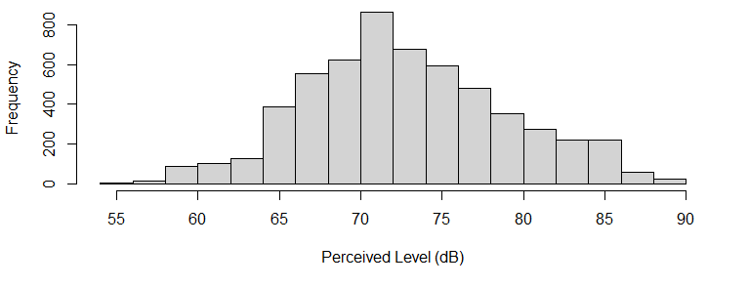
QSF18 Data
5634 total observations from 373 participants
Each observation has an estimated noise level (PL) based on the participant’s location at the time of the flight

Slide 5
QSF18 Data
Annoyance is measured on a five-point scale:
  Not at all annoyed
  Slightly annoyed
  Moderately annoyed
  Very annoyed
  Extremely annoyed
Top two categories are considered ‘highly annoyed’
Challenge: only 1.1% of responses were highly annoyed

Slide 6
QSF18 Data
Demographic data
  Gender
  Age
  Household size
  Kids under 6
  Geographic quadrant
  Education
No weights included in the data set
Since X-59 study will include weights calibrated to Census Bureau totals, simulate weights for QSF18 data ~unif(50, 250)

Slide 7
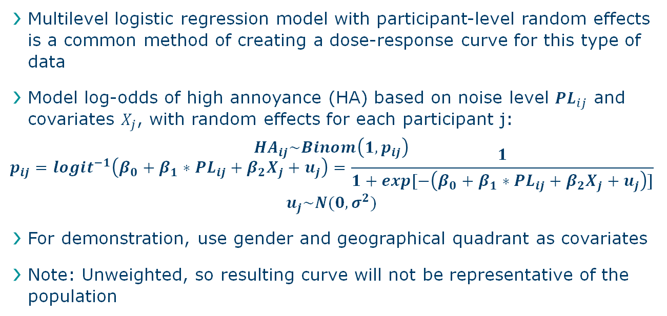
Multilevel Logistic Regression
Multilevel logistic regression model with participant-level random effects is a common method of creating a dose-response curve for this type of data
Model log-odds of high annoyance (HA) based on noise level $PL_{ij}$ and covariates $X_{j}$, with random effects for each participant j:
$$HA_{ij}\sim Binom\left(1, p_{ij}\right)$$
$$p_{ij}=logit^{−1}\left(β_{0}+β_{1}∗PL_{ij}+β_{2}X_{j}+u_{j}\right)=\frac{1}{1+exp[−\left(β_{0}+β_{1}∗PL_{ij}+β_{2}X_{j}+u_{j}\right)]}$$
$$u_{j}\sim N(0, σ^{2})$$
For demonstration, use gender and geographical quadrant as covariates
Note: Unweighted, so resulting curve will not be representative of the population

Slide 8
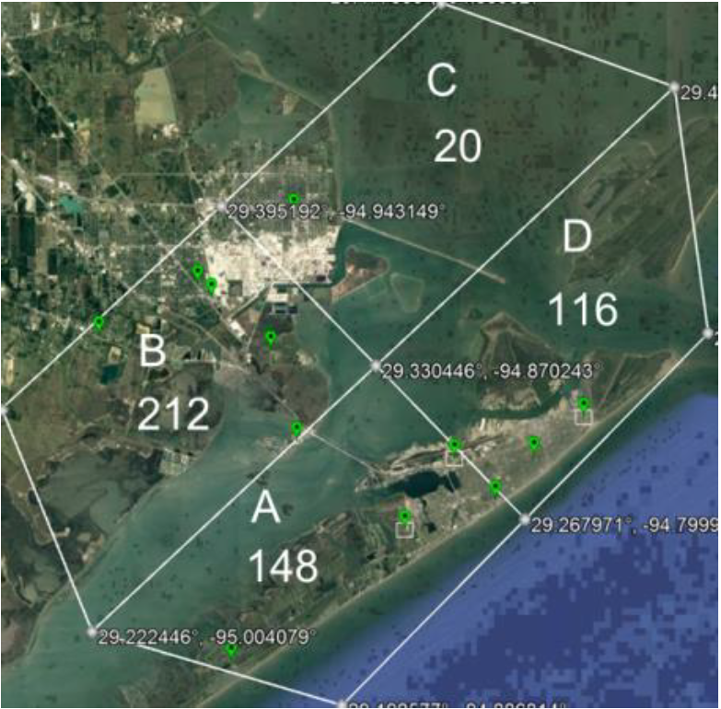
Quadrants

Slide 9
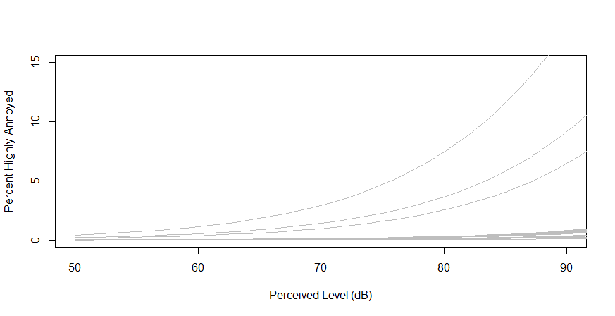
Sample of 100 Participant-Level Dose-Response Curves

Slide 10
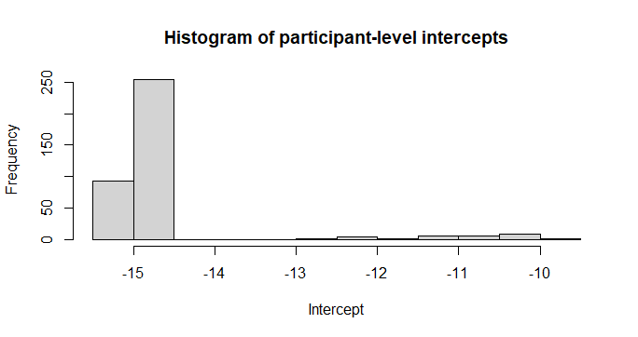
Participant-Level Intercepts

Slide 11
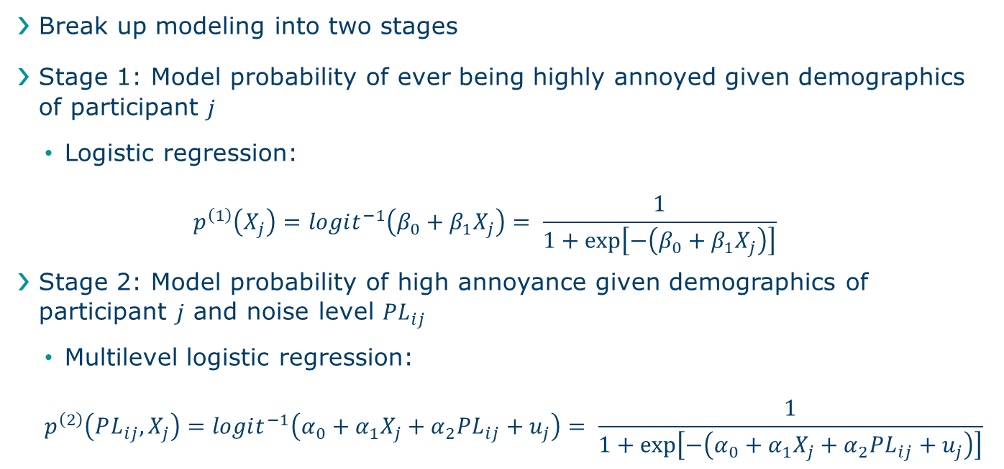
Proposed Two-Stage Model
Break up modeling into two stages
Stage 1: Model probability of ever being highly annoyed given demographics of participant $j$
  Logistic regression:
  $$p^{\left(1\right)}\left(X_{j}\right)=logit^{−1}\left(β_{0}+β_{1}X_{j}\right)= \frac{1}{1+\exp\left[−\left(β_{0}+β_{1}X_{j}\right)\right]}$$
Stage 2: Model probability of high annoyance given demographics of participant $j$ and noise level $PL_{ij}$
  Multilevel logistic regression:
  $$p^{\left(2\right)}\left(PL_{ij}, X_{j}\right)=logit^{−1}\left(α_{0}+α_{1}X_{j}+α_{2}PL_{ij}+u_{j}\right)= \frac{1}{1+\exp\left[−\left(α_{0}+α_{1}X_{j}+α_{2}PL_{ij}+u_{j}\right)\right]}$$

Slide 12
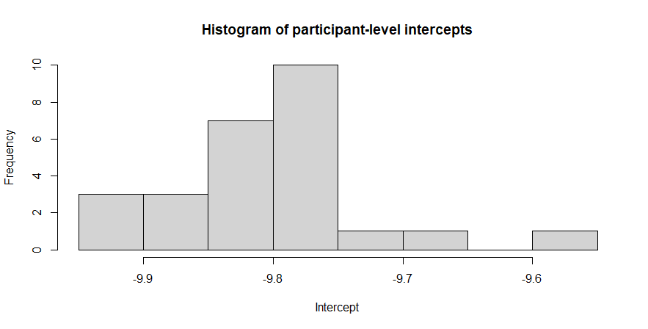
2nd Stage Participant-Level Intercepts

Slide 13
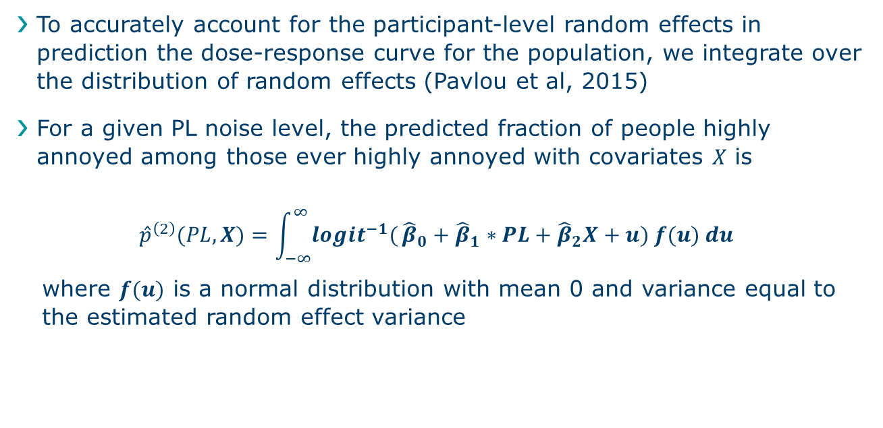
Marginal Dose-Response Curve
To accurately account for the participant-level random effects in prediction the dose-response curve for the population, we integrate over the distribution of random effects (Pavlou et al, 2015)
For a given PL noise level, the predicted fraction of people highly annoyed among those ever highly annoyed with covariates $X$ is
$${\hat{p}}^{\left(2\right)}(PL, X)=\int_{−∞}^{∞}{logit^{−1}(}{\hat{β}}_{0}+{\hat{β}}_{1}∗PL+{\hat{β}}_{2}X+u) f(u) du$$
where $f(u)$ is a normal distribution with mean 0 and variance equal to the estimated random effect variance

Slide 14
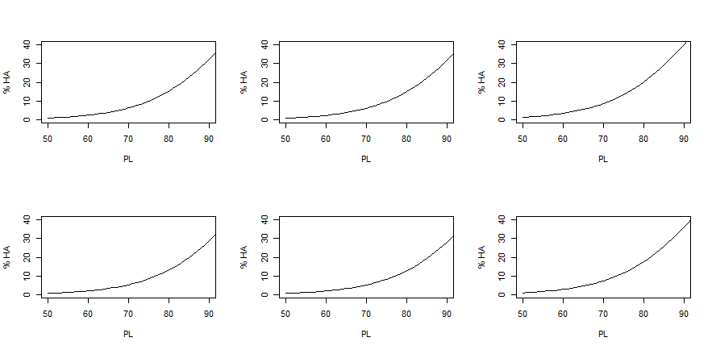
2nd-Stage Marginal Post-Strata Curves
Quadrant A Quadrants B&C Quadrant D
Male
Female

Slide 15
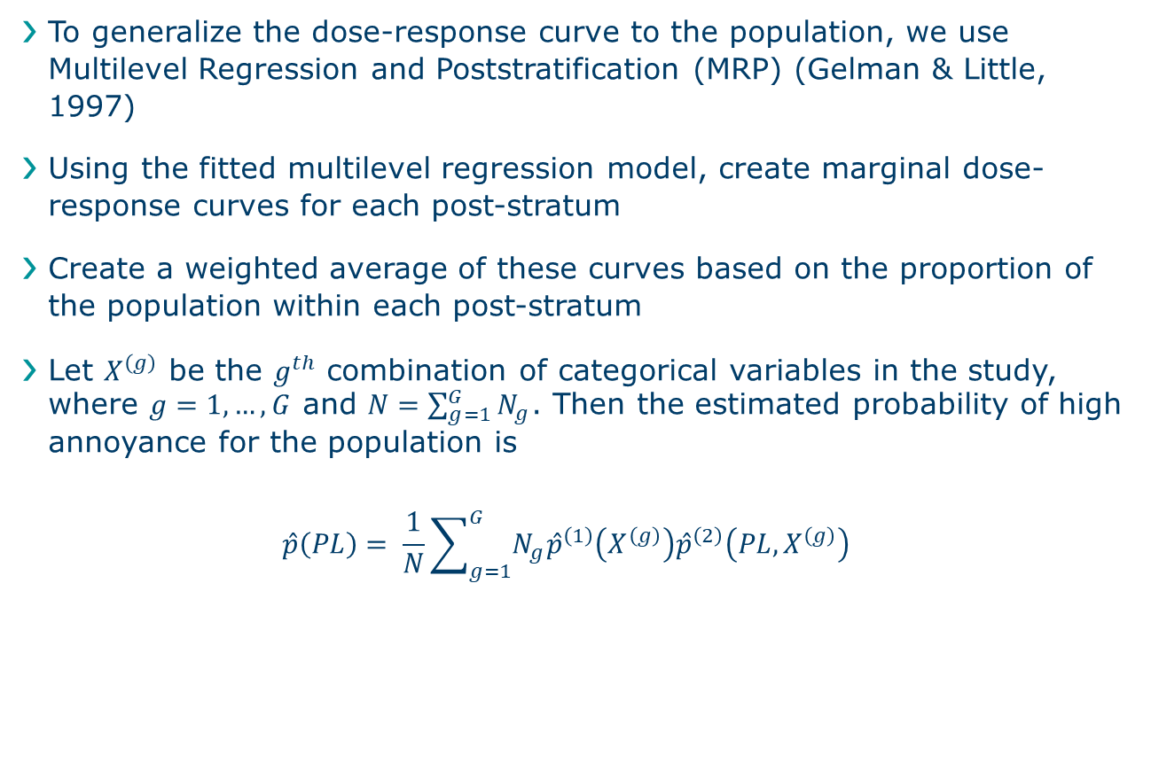
Multilevel Regression and Poststratification
To generalize the dose-response curve to the population, we use Multilevel Regression and Poststratification (MRP) (Gelman & Little, 1997)
Using the fitted multilevel regression model, create marginal dose-response curves for each post-stratum
Create a weighted average of these curves based on the proportion of the population within each post-stratum
Let $X^{\left(g\right)}$ be the $g^{th}$ combination of categorical variables in the study, where $g=1,…, G$ and $N=\sum_{g=1}^{G}{N_{g}}$. Then the estimated probability of high annoyance for the population is
$$\hat{p}\left(PL\right)= \frac{1}{N}\sum_{g=1}^{G}{N_{g}{\hat{p}}^{\left(1\right)}\left(X^{\left(g\right)}\right){\hat{p}}^{\left(2\right)}\left(PL, X^{\left(g\right)}\right) }$$

Slide 16
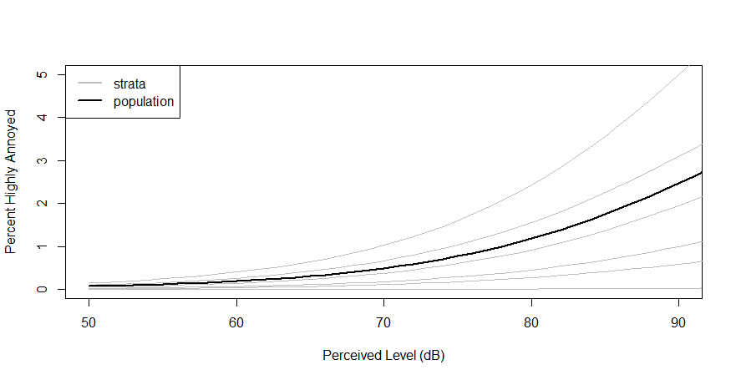
Population Dose-Response Curve

Slide 17
Inference
Confidence intervals and standard errors can be estimated through bootstrapping
Take 100 samples with replacement from the data
Repeat the exact same process of fitting a multilevel logistic regression model and use MRP to estimate the study region population-level curve for the subsample
100 resulting study region population-level curves
At each PL level, take the standard deviation of the 100 curves

Slide 18
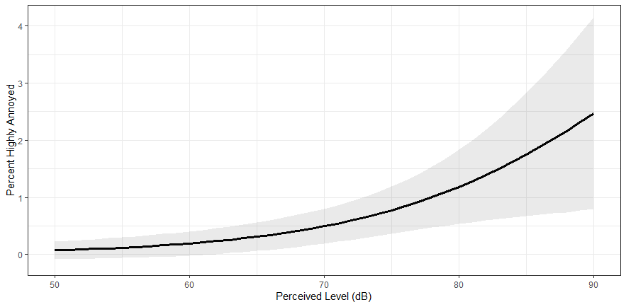
Population-Level Dose Response Curve with 95% Confidence Interval

Slide 19
Summary
Two-Stage Model
Multilevel regression and Post-stratification (MRP)
Bootstrap inference
Not included, but possible extensions:
  Multilevel ordinal regression or monotone regression model
  Bayesian hierarchical model to account for covariate (noise level) uncertainty

