Slide 1

SAGE III/ISS: Continuing the Legacy of SAGE Data Products
Susan Kizer
S. Kizer^{1,2}, M. Roell², D. Flittner², R.Damadeo², K. Leavor^{1,2}, M. Kovilakam^{1,2}, T. Knepp², C. Roller^{1,2}, D. Hurst^{3,4}, E. Hall^{3,4}, A. Jordan^{3,4}, P. Cullis^{3,4}, B. Johnson⁴, R. Querel⁵
Global Monitoring Laboratory | 50th Global Monitoring Annual Conference 2022 | Session 3

Slide 2
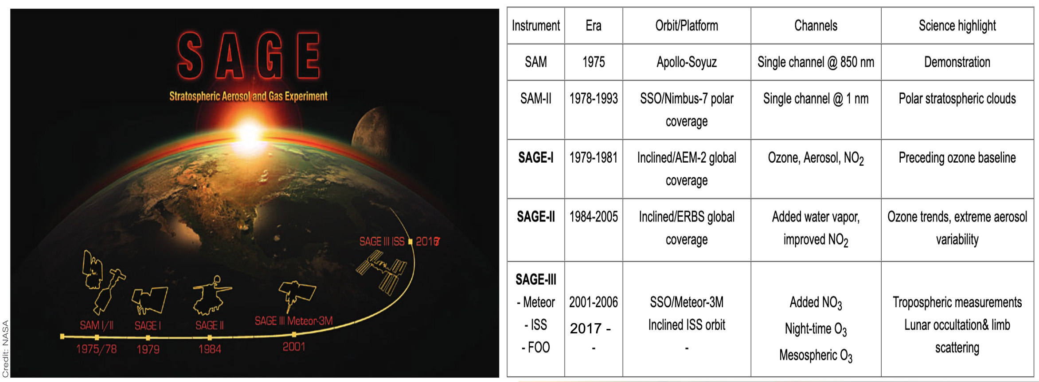
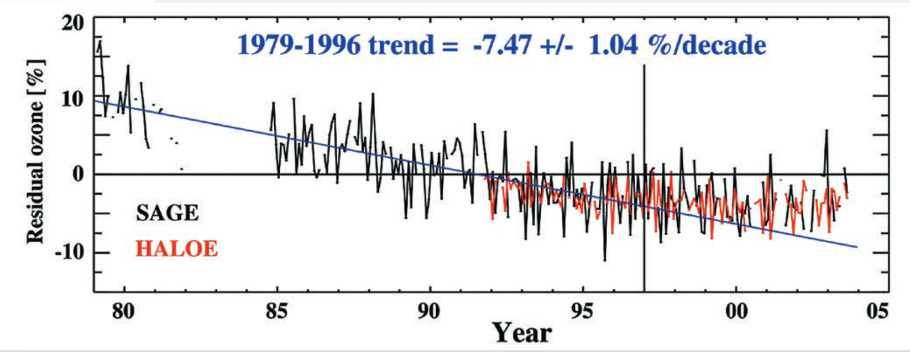
SAGE has been producing stratospheric data since the 1970’s.
Long-term data trends have been a vital part of monitoring strat. ozone depletion and recovery.
Evidence for slowdown in stratospheric ozone loss: First stage of ozone recovery; Newchurch et al.; JGR, August 2003;
https://doi.org/10.1029/2003JD003471

Slide 3
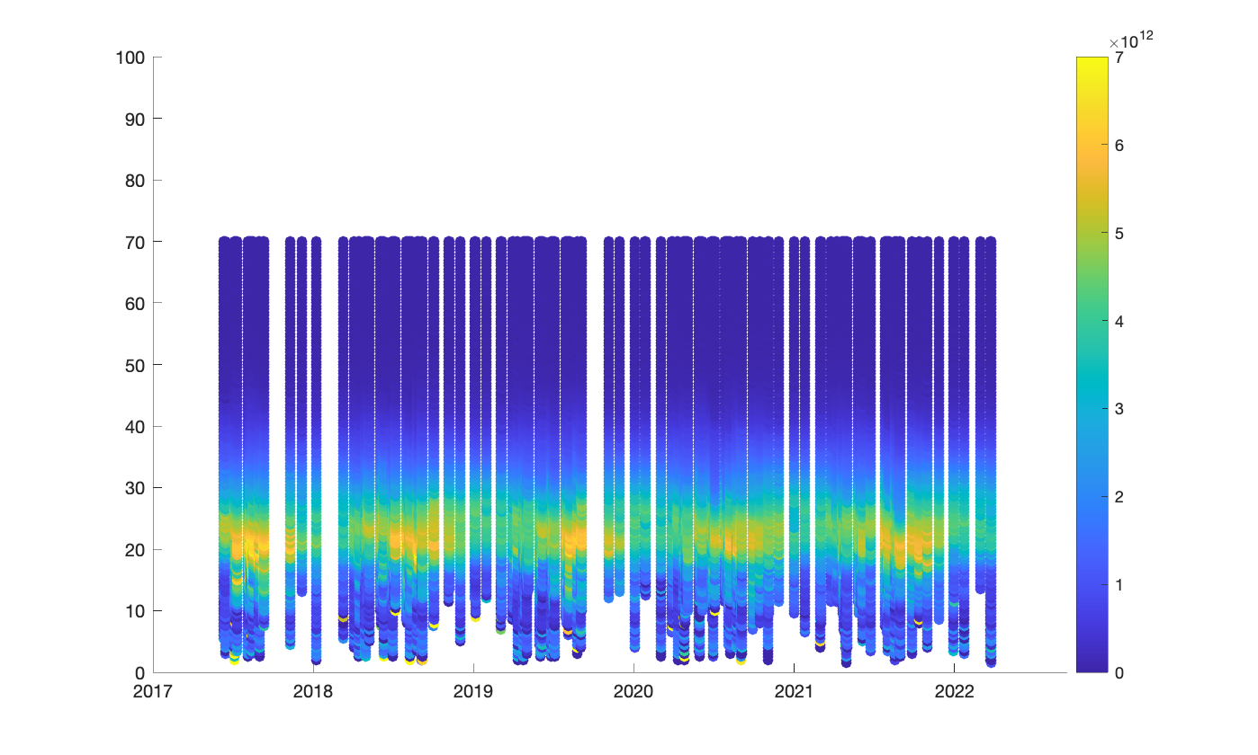
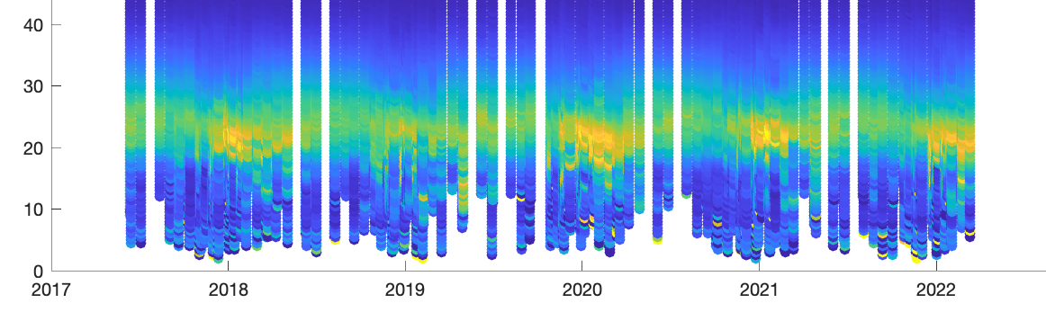
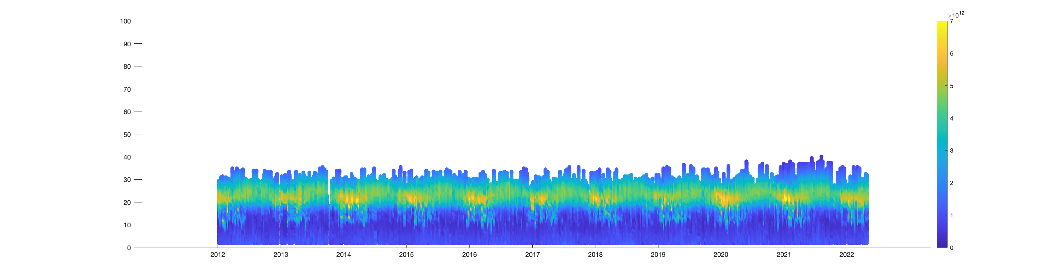
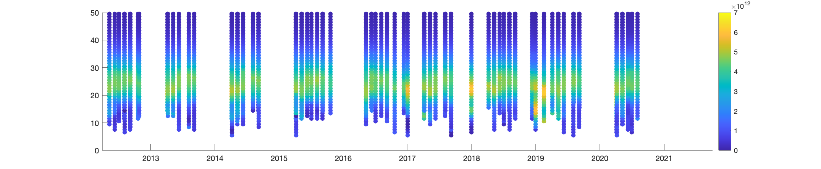
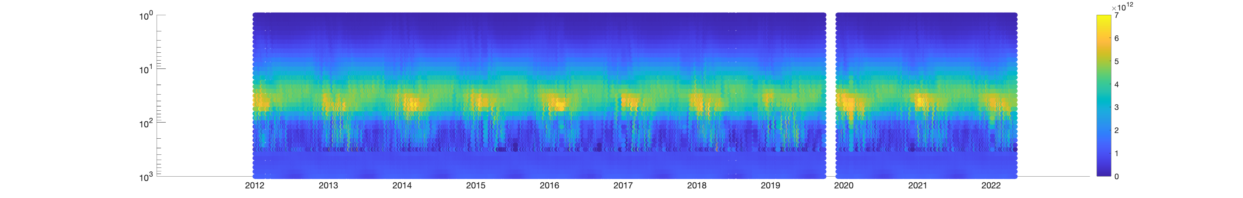
Boulder vs SAGE Ozone (aO3)
SAGE
Altitude (km)
Sonde
ACE-
FTS
v4.0
Aura
MLS v4.0

Slide 4
SAGE Ozone Comparison Data
Note: The ACE-FTS v4.0 dataset was used for this visualization. This dataset was only provided through September 2020. It is necessary to update our database with the most recent ACE-FTS dataset.
Also, the Aura MLS v4.0 dataset was used for this visualization. Our local database also contains JPL Derived Meteorological Products (DMP) using Merra-2 for 2017 – 2022. We use the JPL DMP for converting MLS ozone volume mixing ratio on a pressure grid to ozone number density on an altitude grid. Shown here is the MLS data using its own meteorological information to convert to ozone number density on a pressure grid. It is necessary to update our database with Aura MLS v5.0 data and the accompanying JPL DMP.
To match satellite and in-situ data events with SAGE, we use the guidelines as outlined in “Validation of SAGE III/ISS Solar Ozone Data with Correlative Satellite and Ground Based Measurements”, H.J. Ray Wang et al, JGR 2020 (https://doi.org/10.1029/2020JD032430).

Slide 5
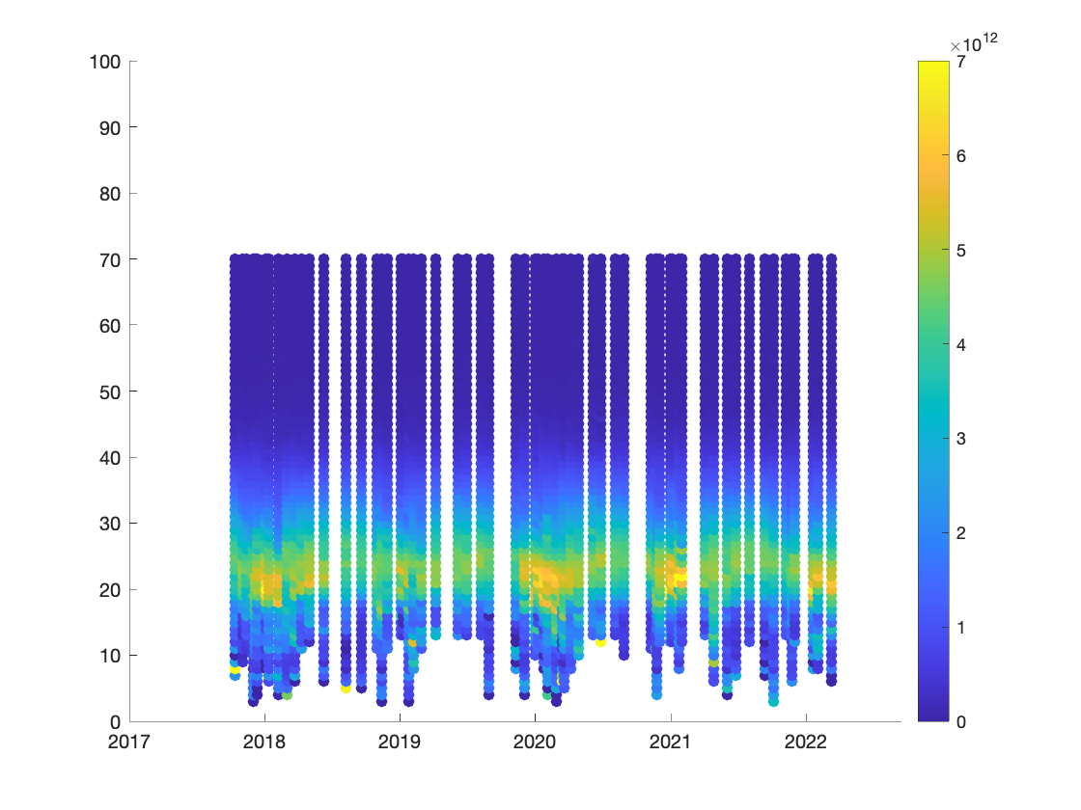
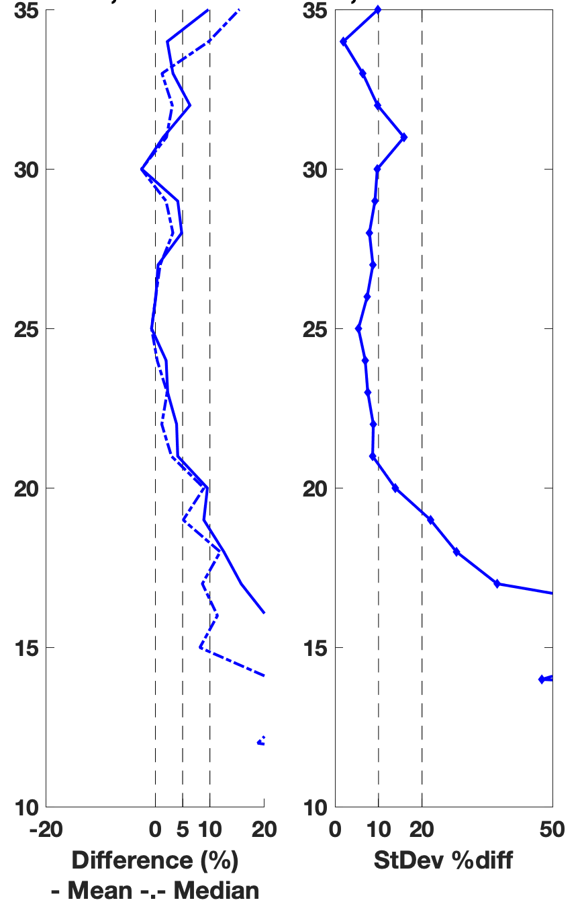
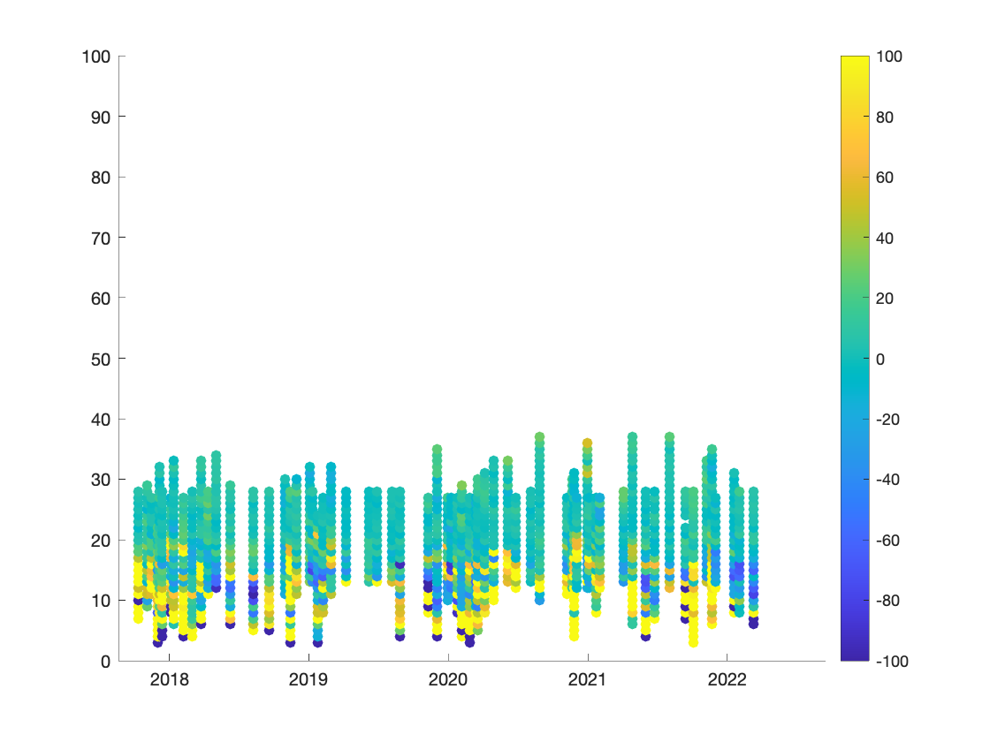
Boulder vs SAGE Ozone (aO3)
Percent Difference: (SAGE – sonde)/sonde * 100
SAGE matched to Sonde
Perc. Diff (SAGE – sonde)/sonde * 100

Slide 6
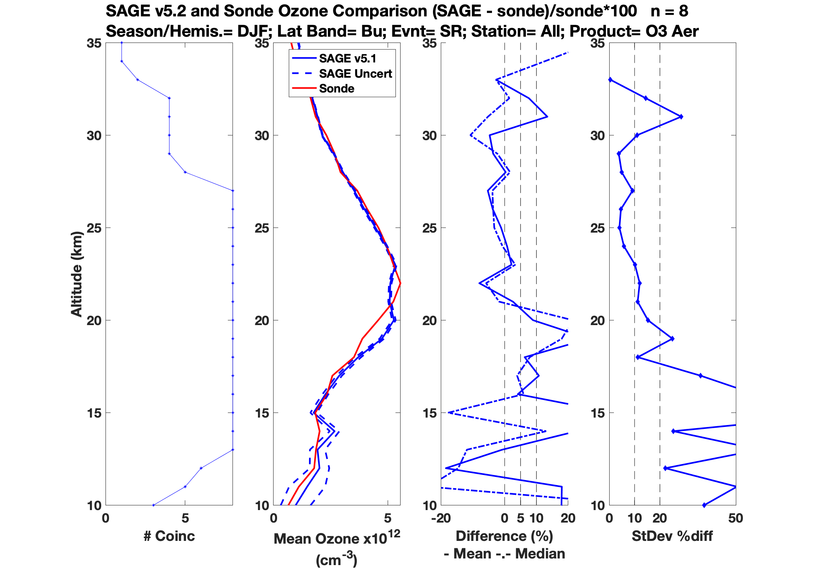
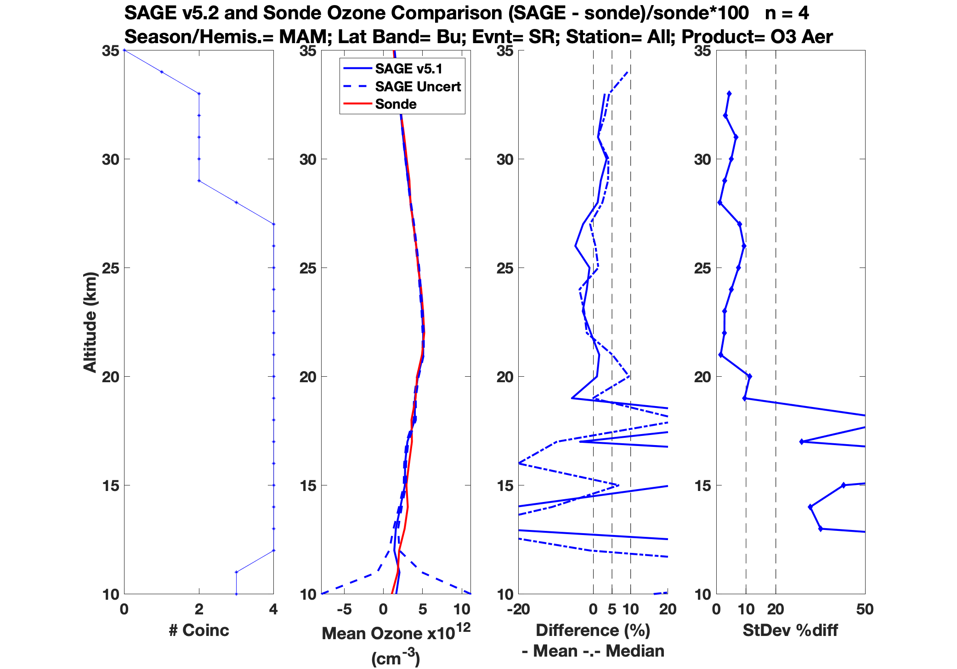
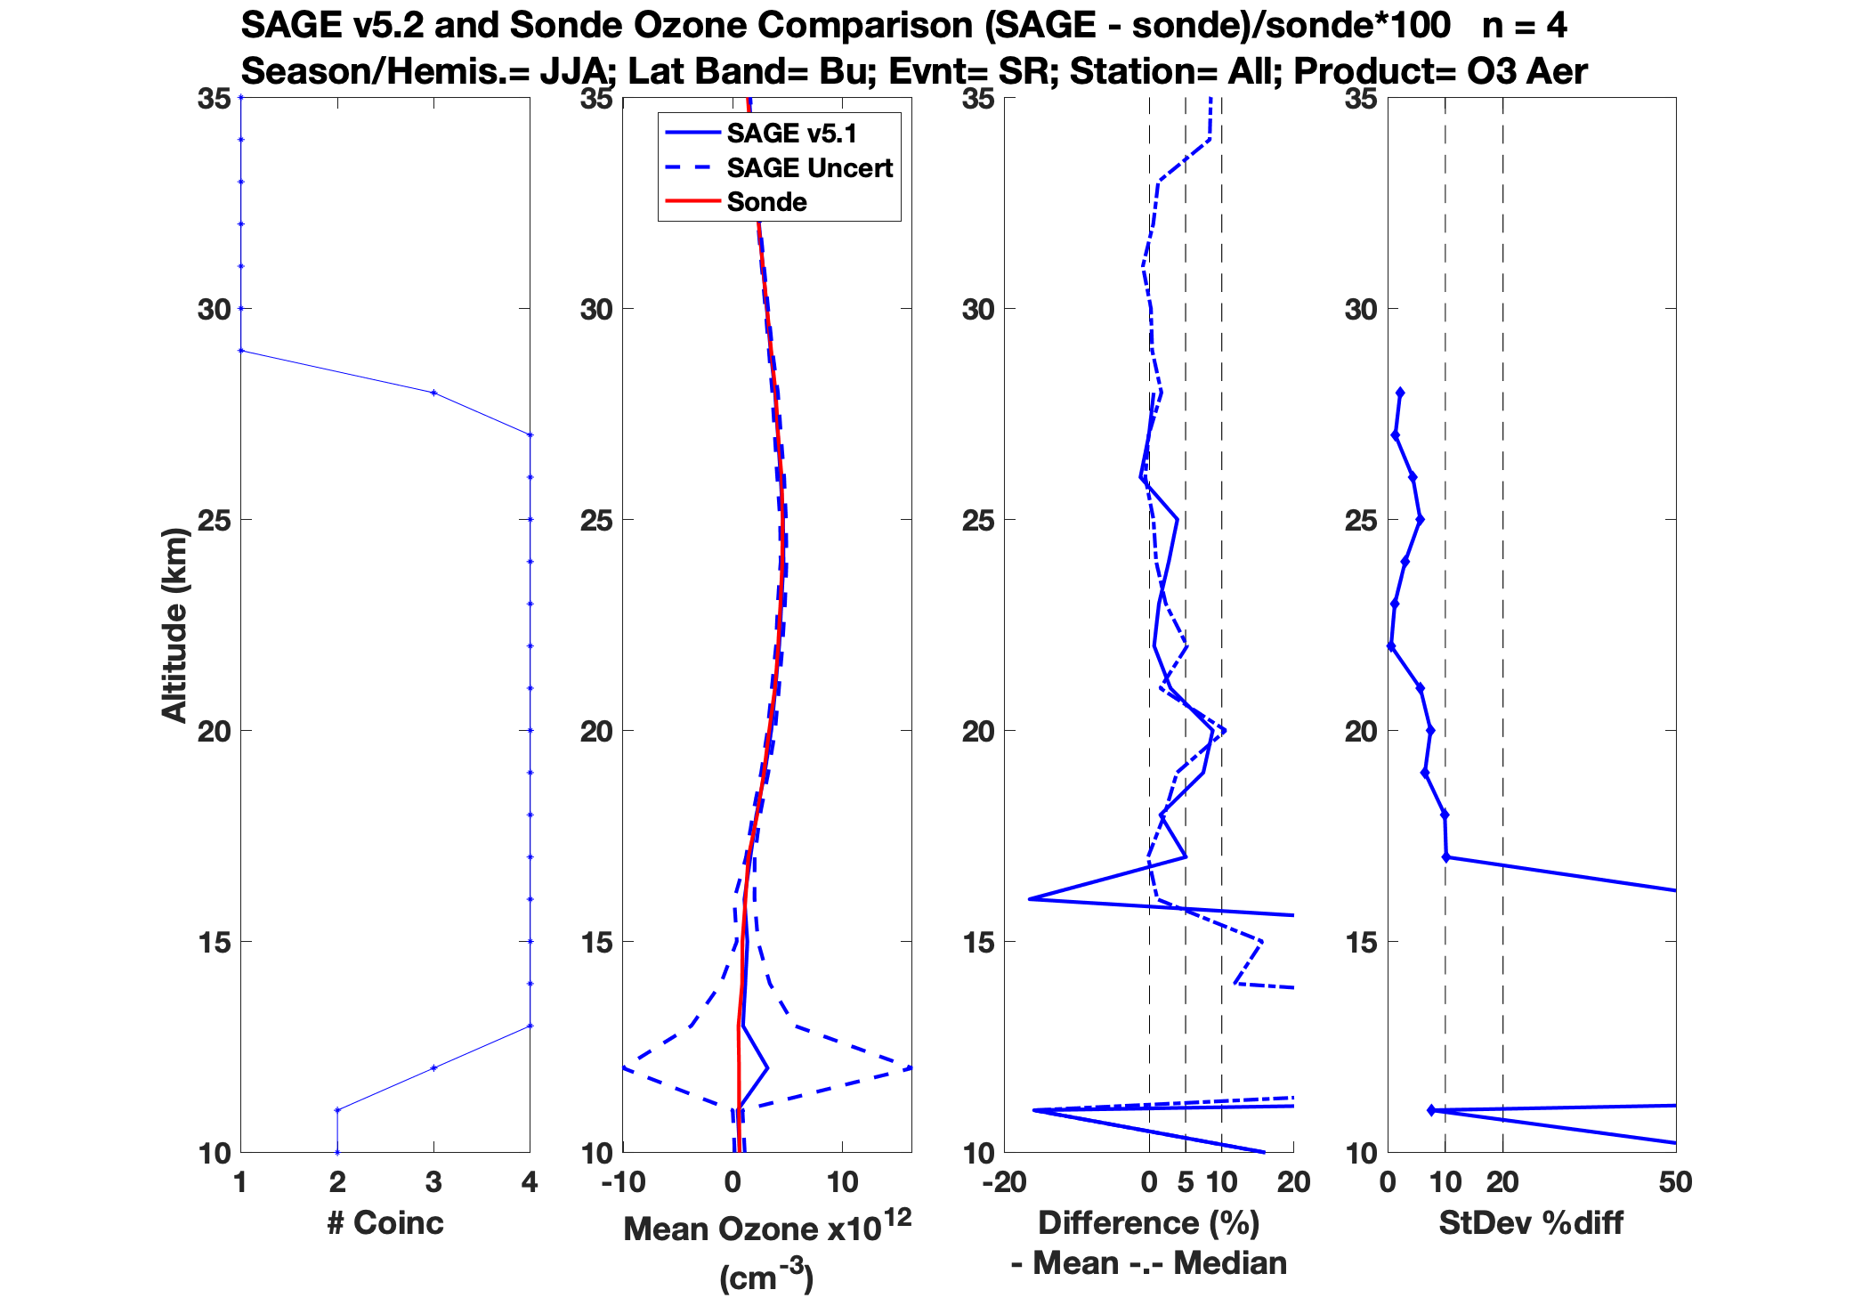
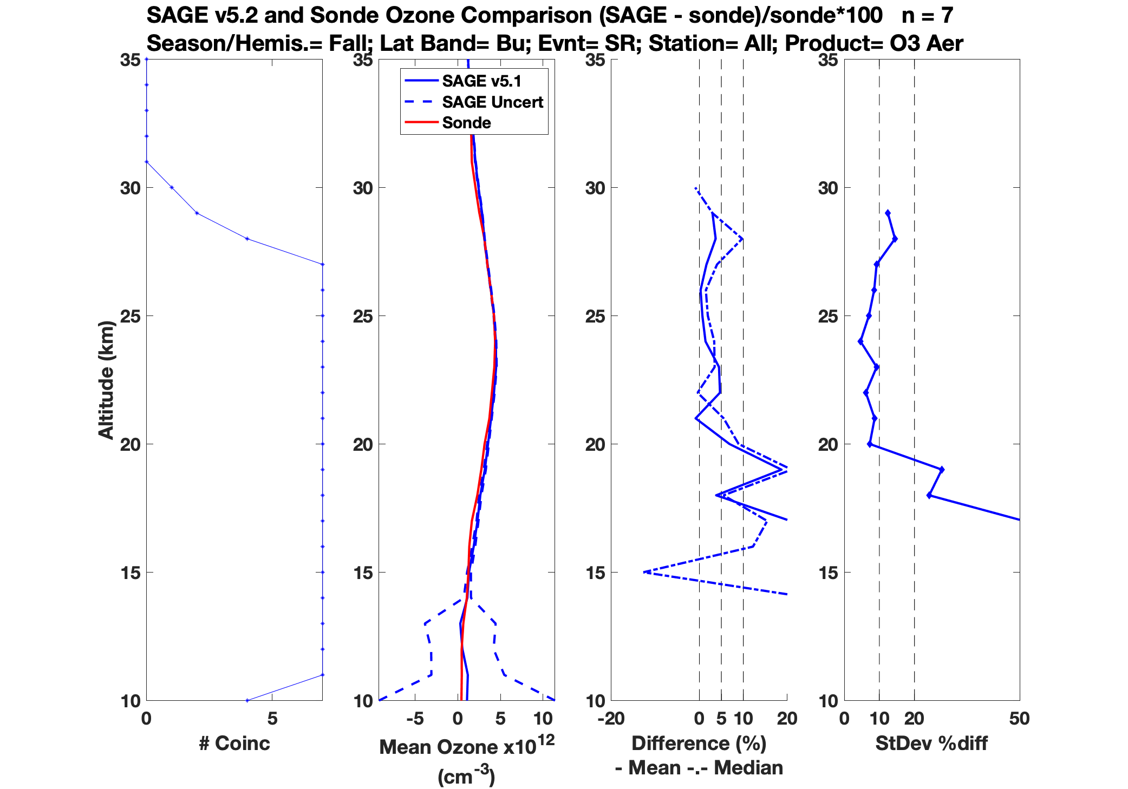
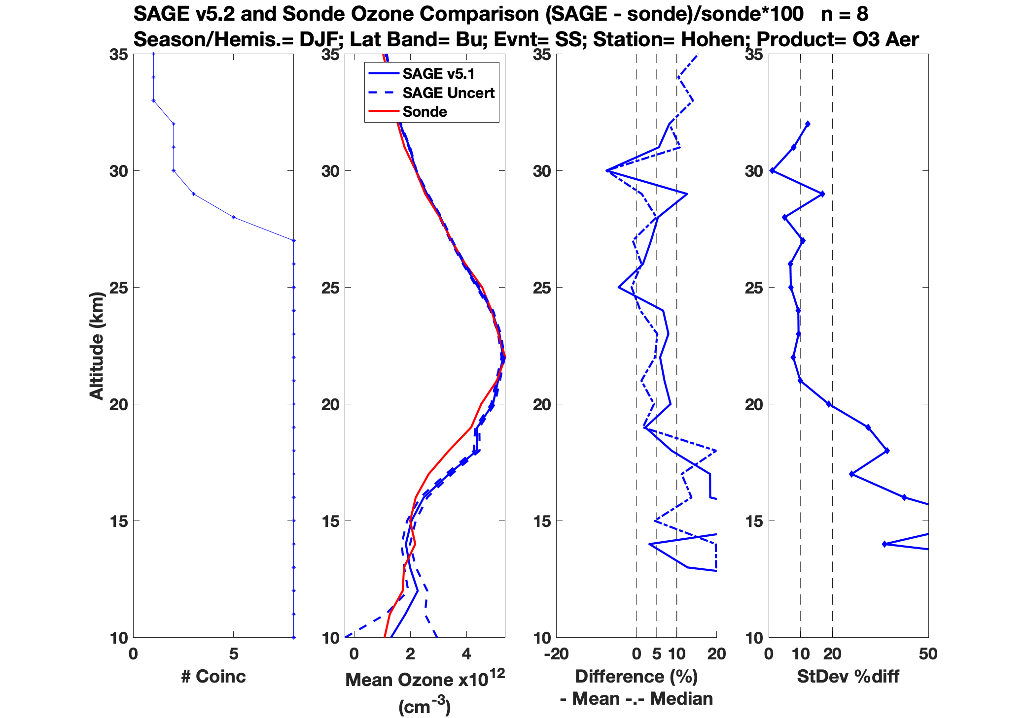
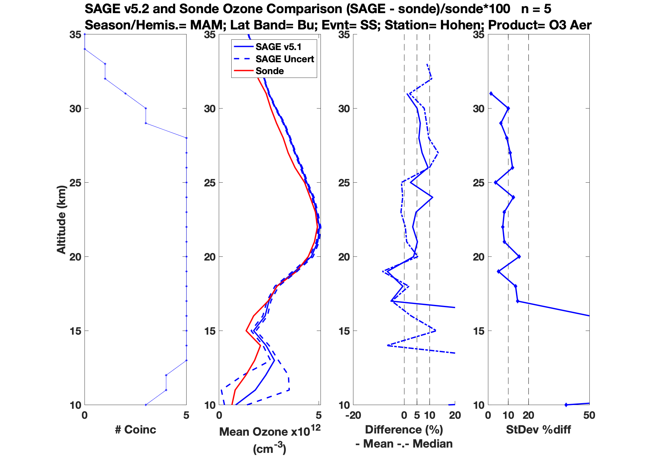
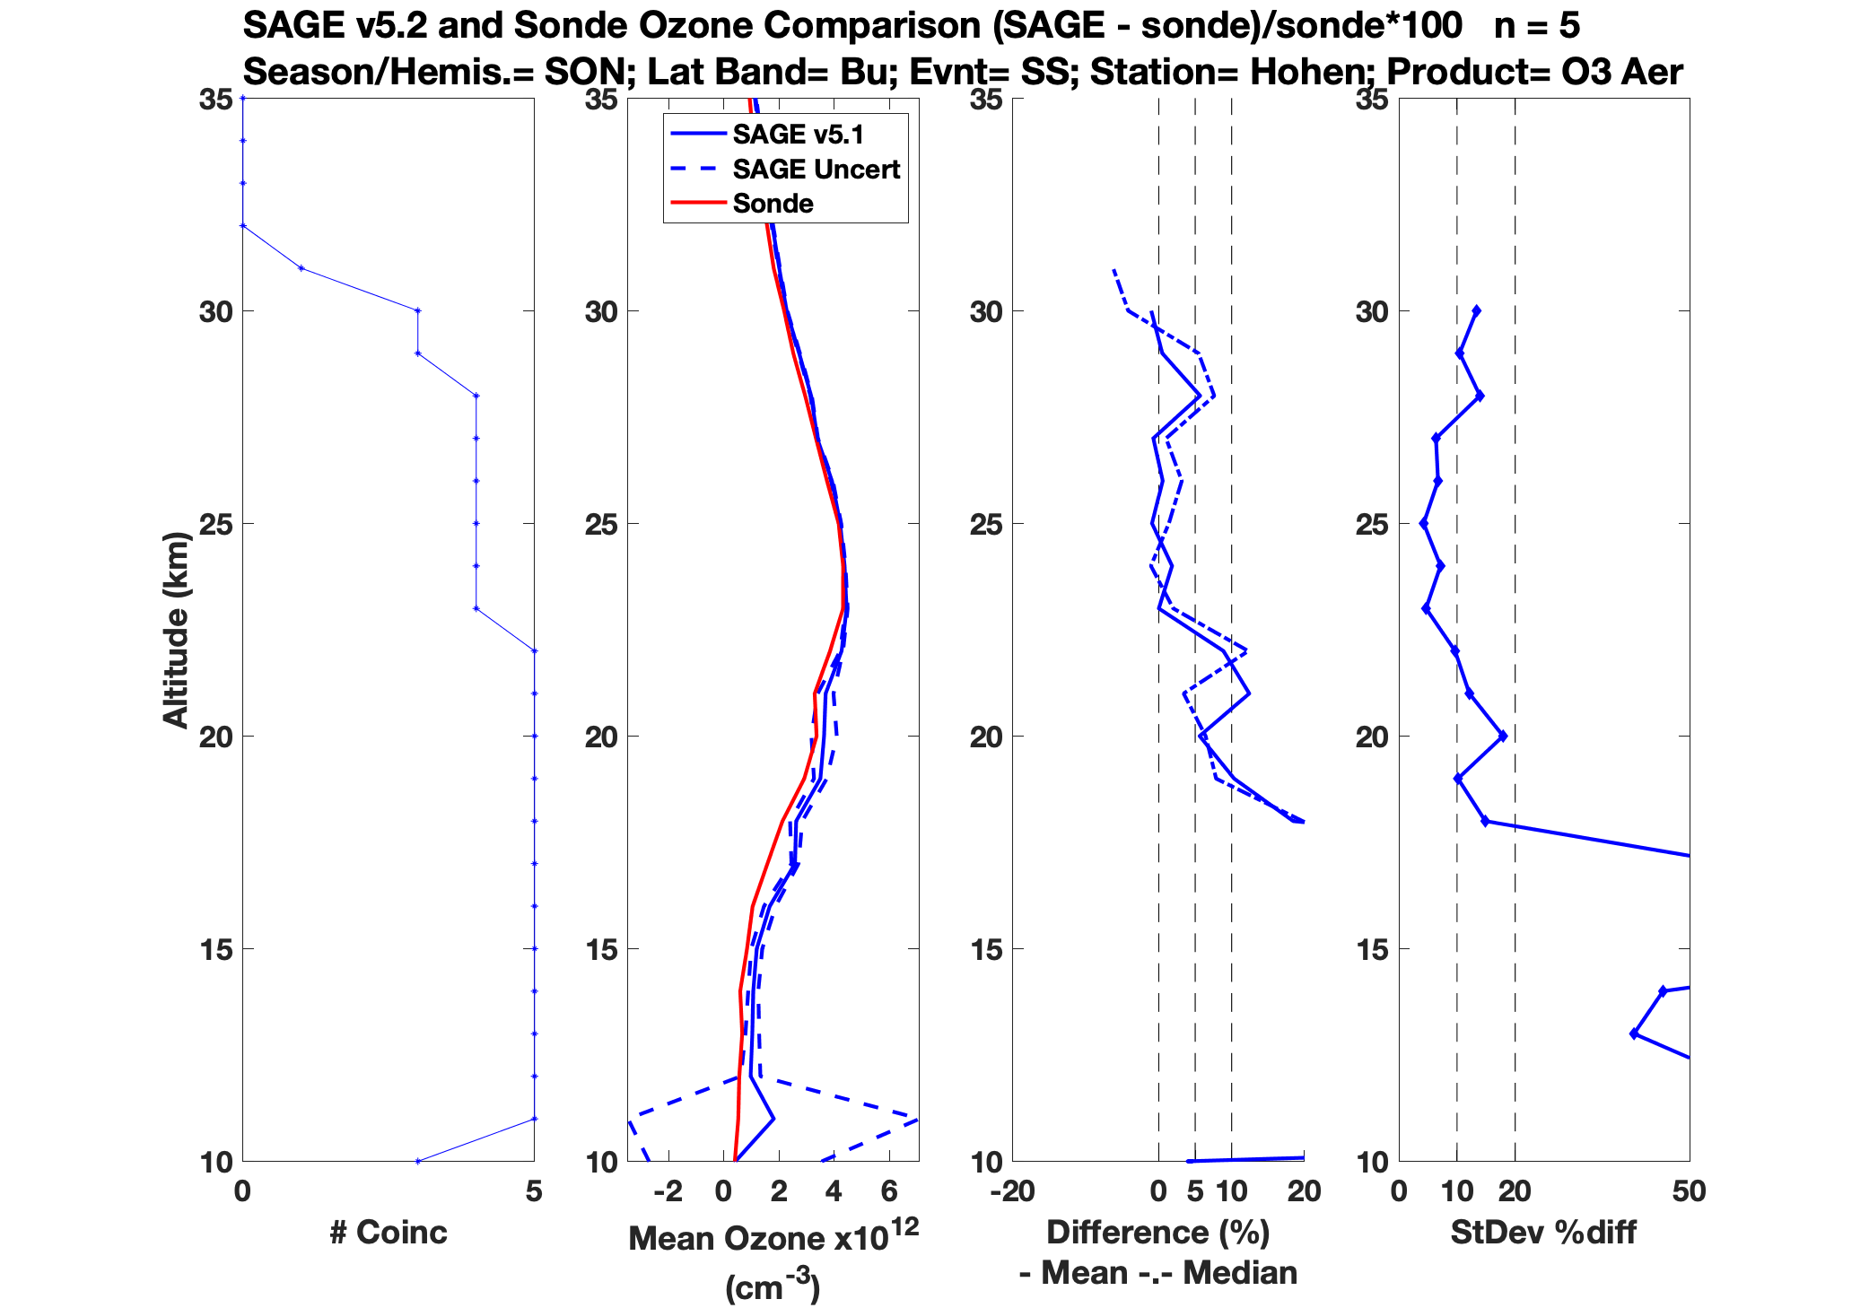
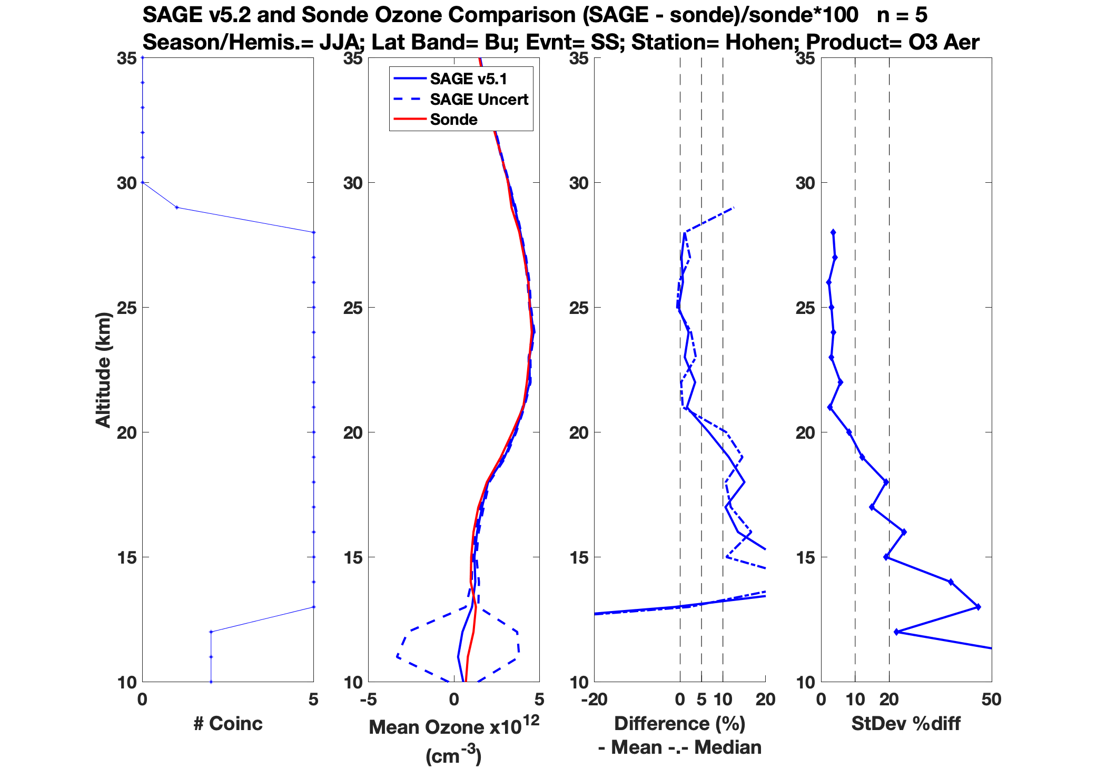
Sunrise
DJF; n = 8
MAM; n = 4
JJA; n = 4
SON; n = 7
Sunset
DJF; n = 8
MAM; n = 5
JJA; n = 5
SON; n = 5

Slide 7
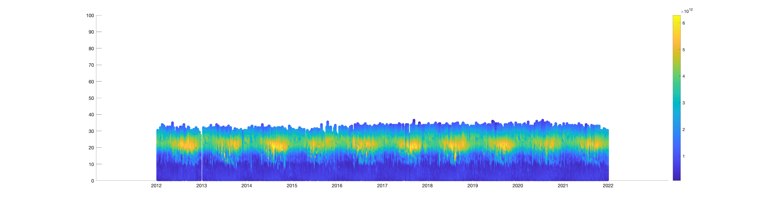
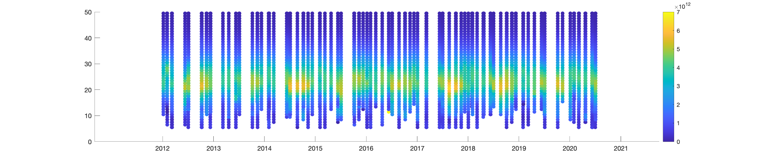
Lauder vs SAGE Ozone (aO3)
SAGE
Sonde
ACE-
FTS
v4.0
Aura
MLS v4.0

Slide 8
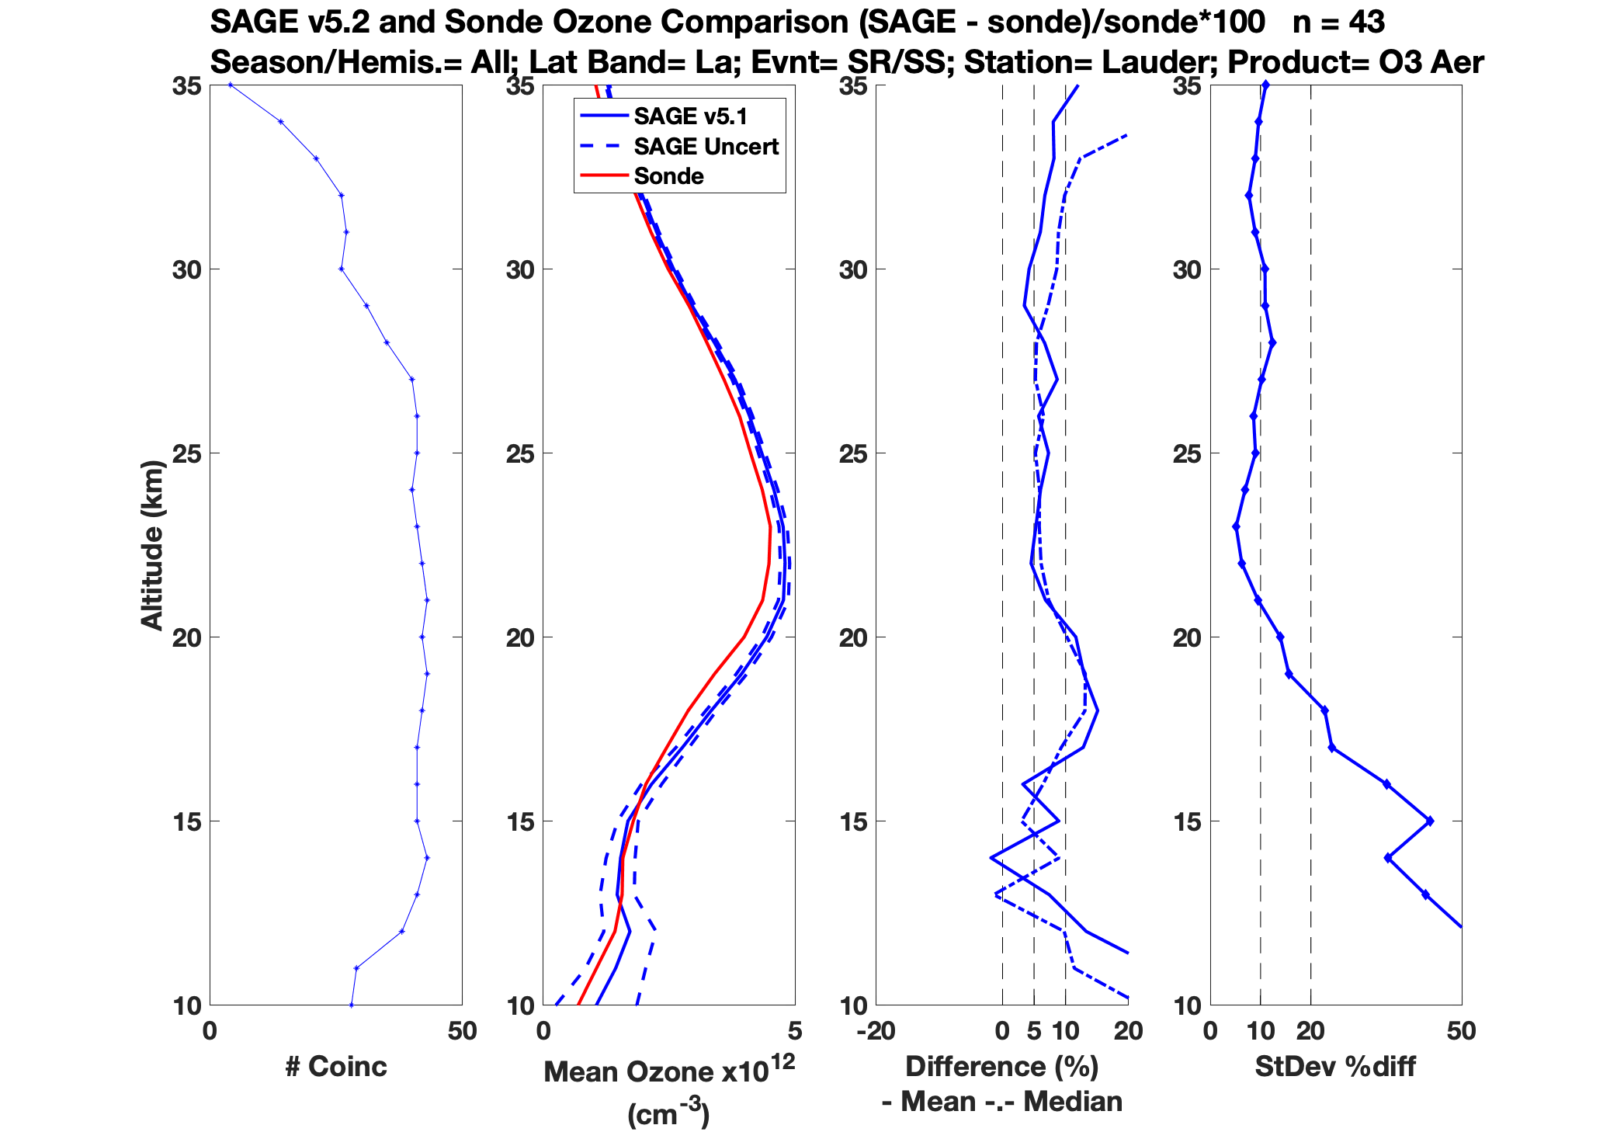
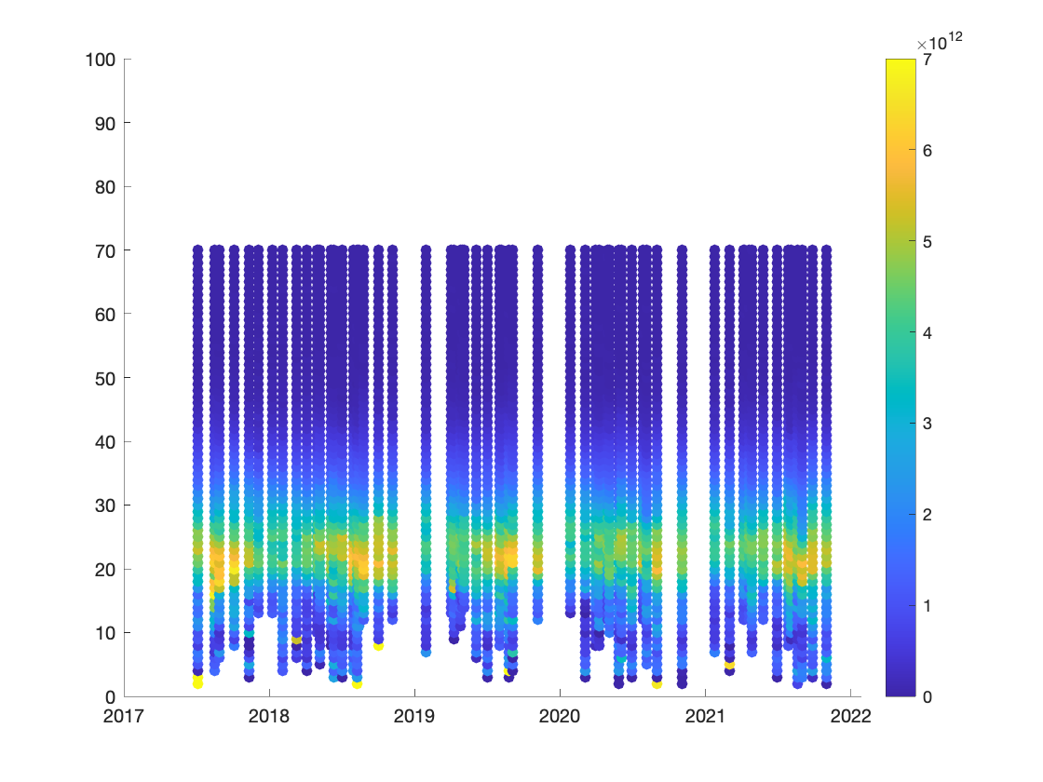
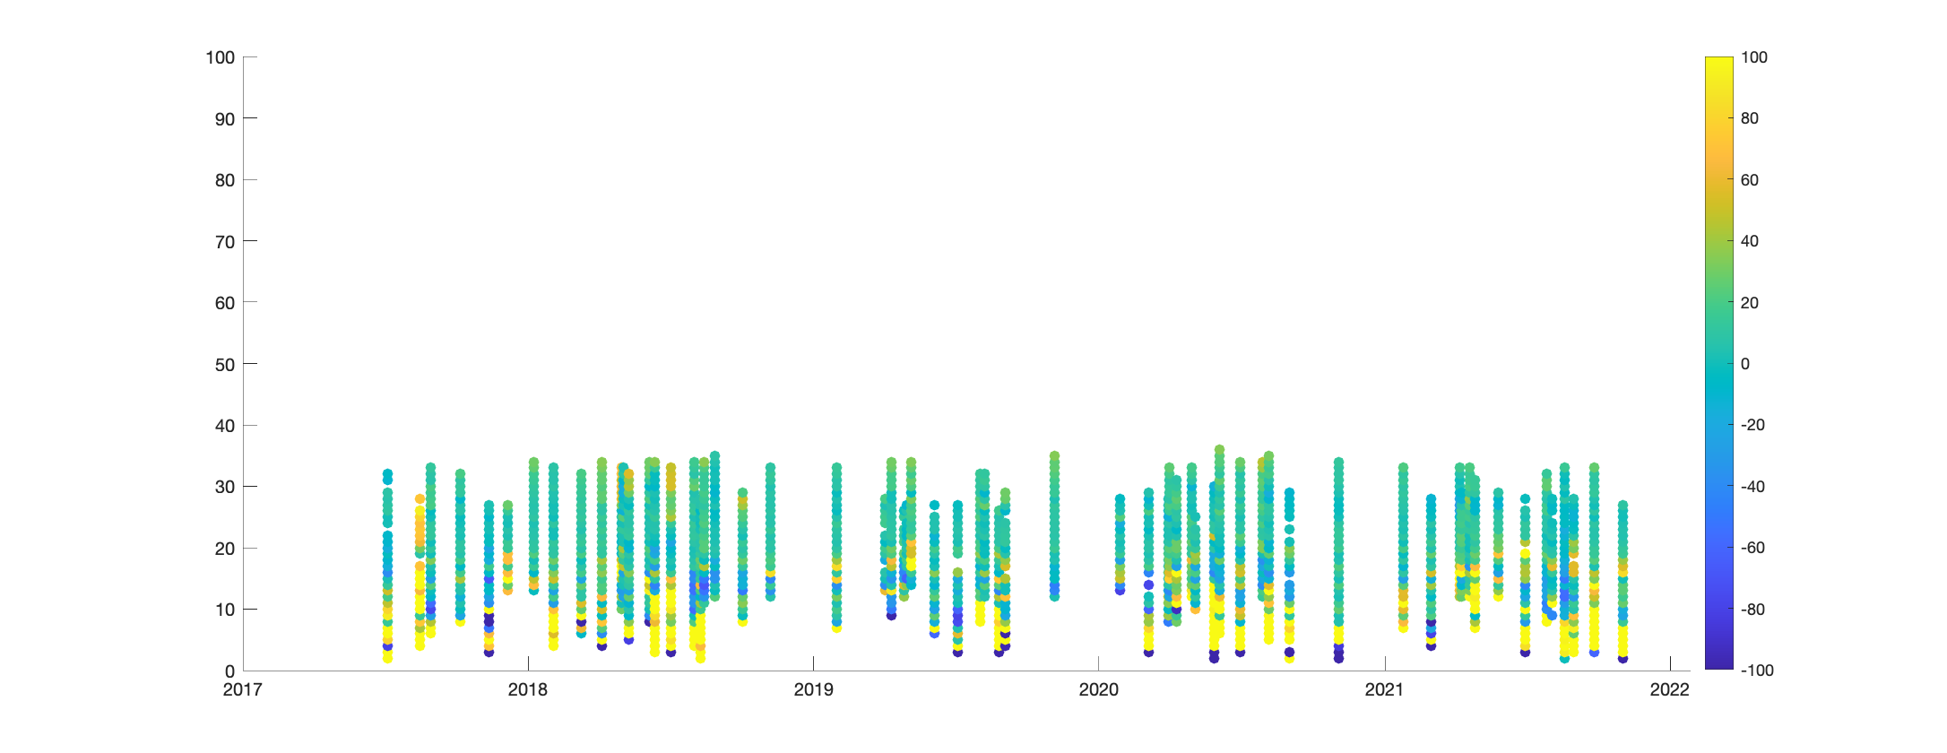
Lauder vs SAGE Ozone (aO3)
Percent Difference: (SAGE – sonde)/sonde * 100
SAGE matched to Sonde
Perc. Diff (SAGE – sonde)/sonde * 100

Slide 9
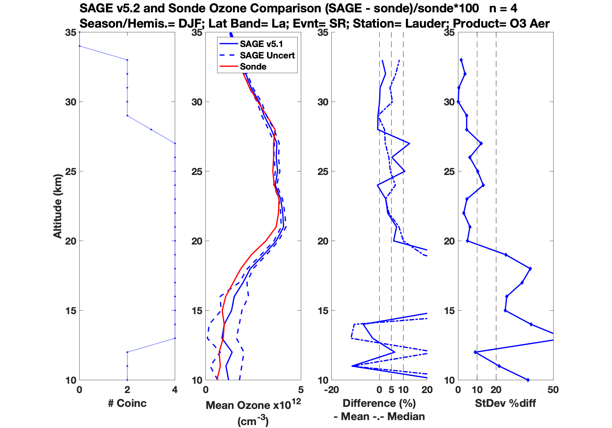
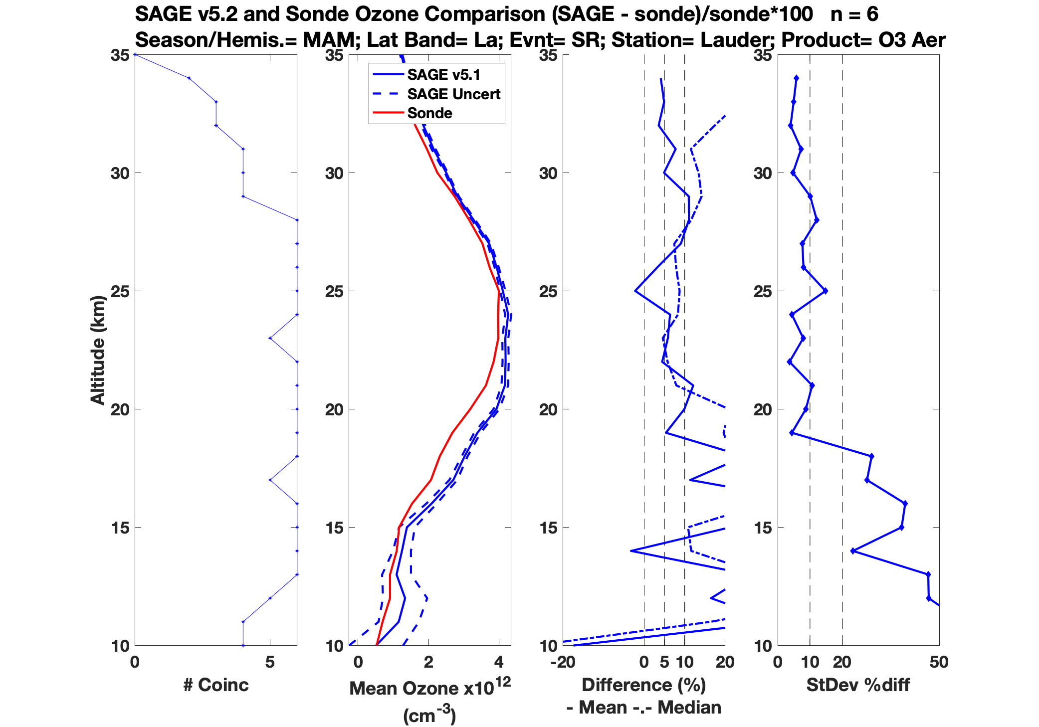
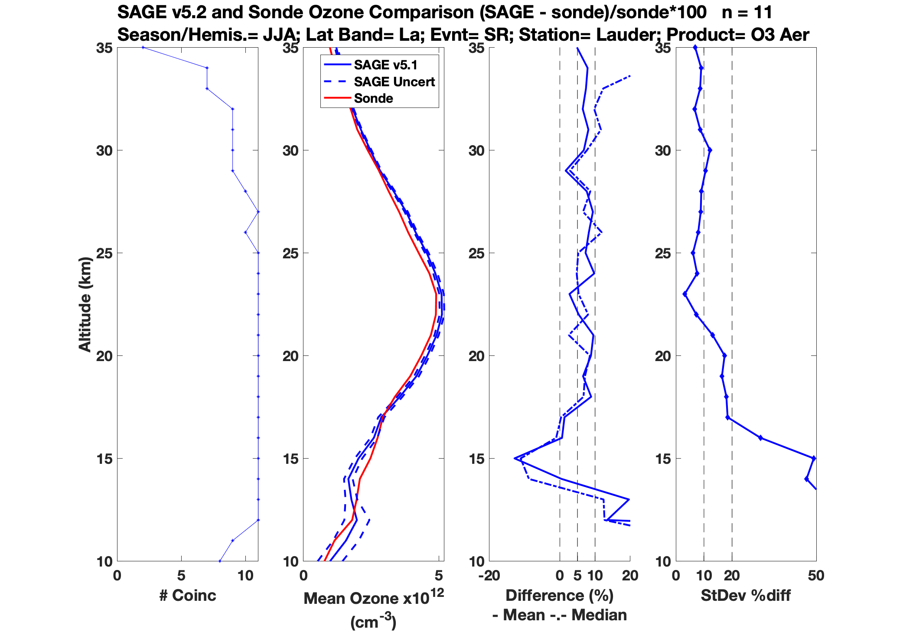
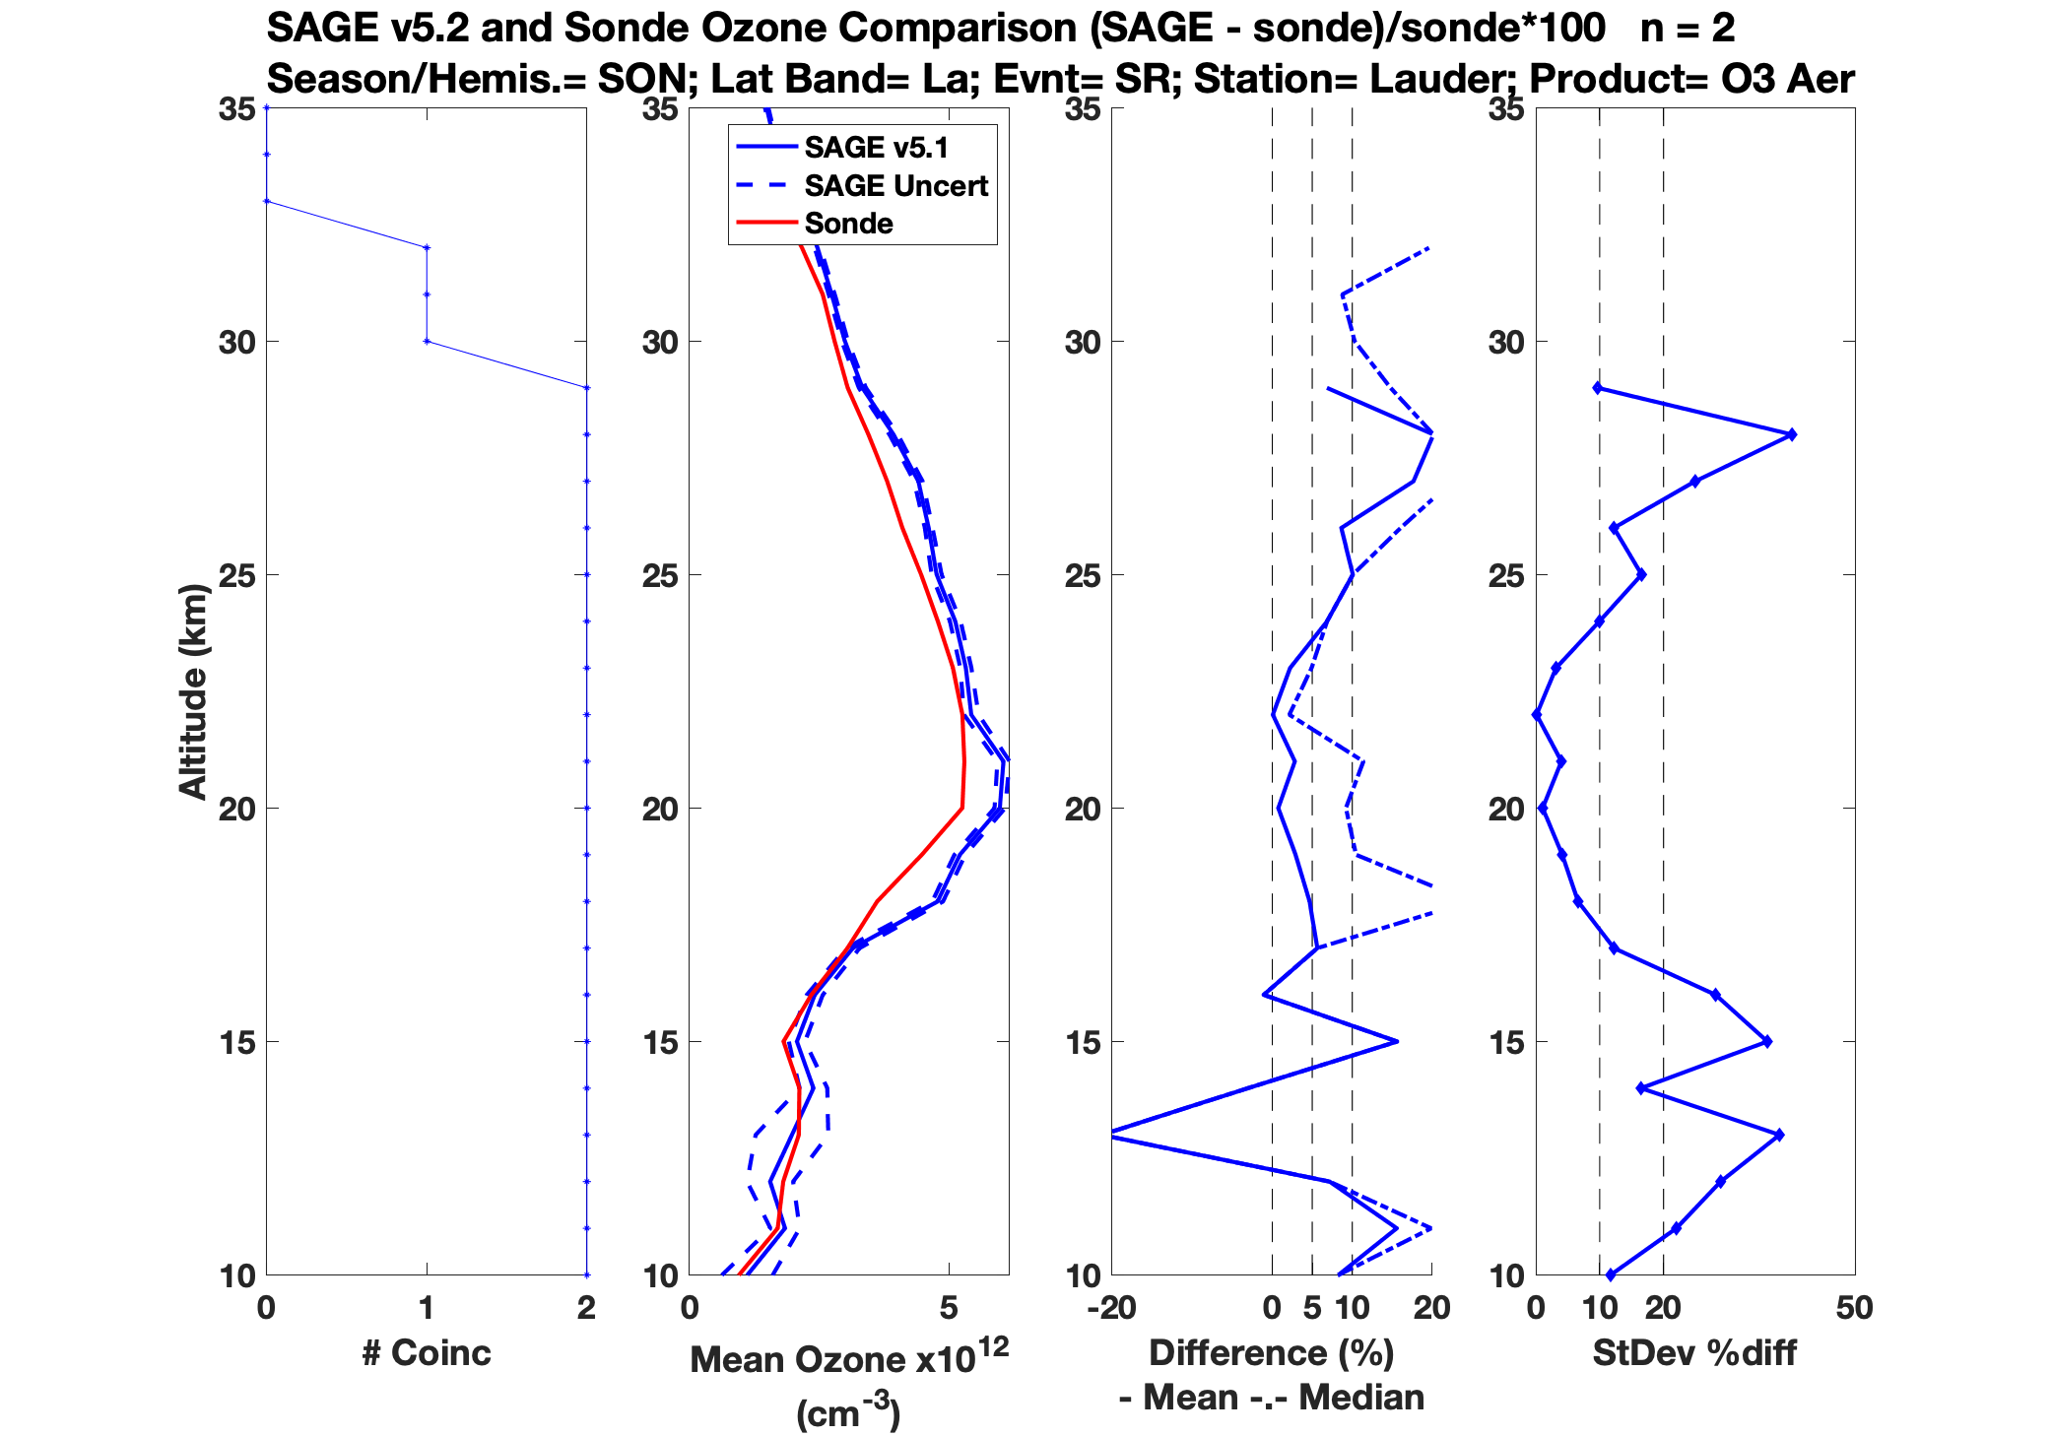
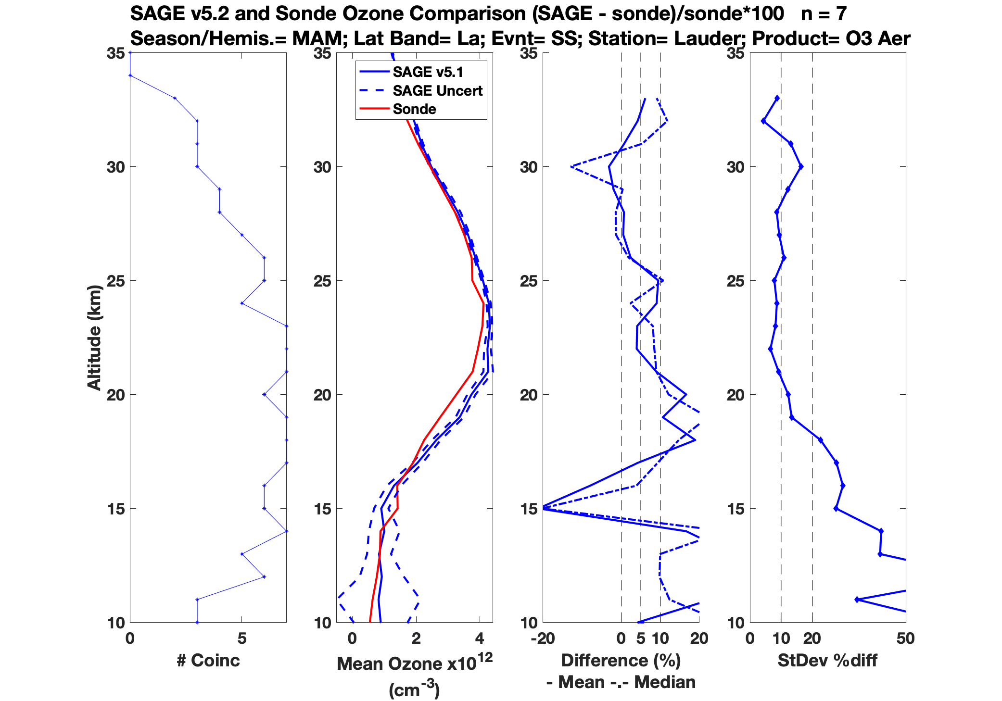
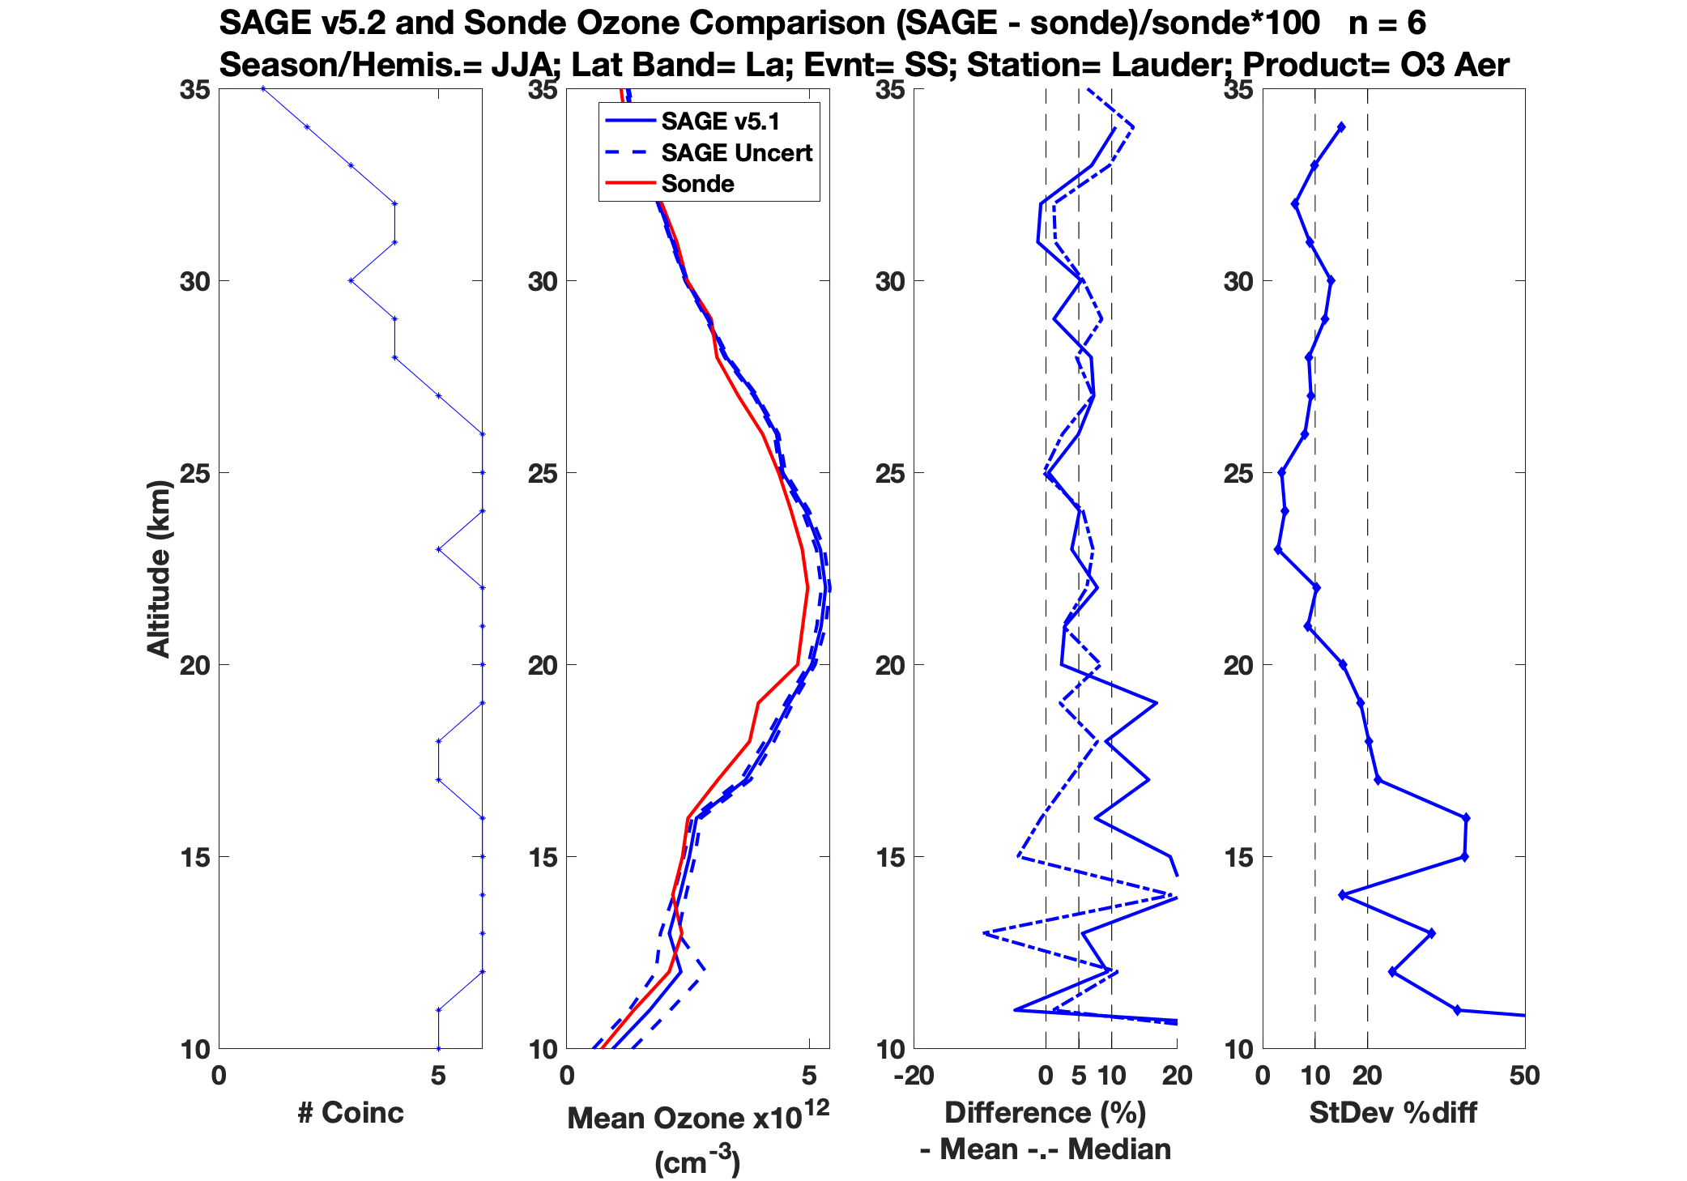
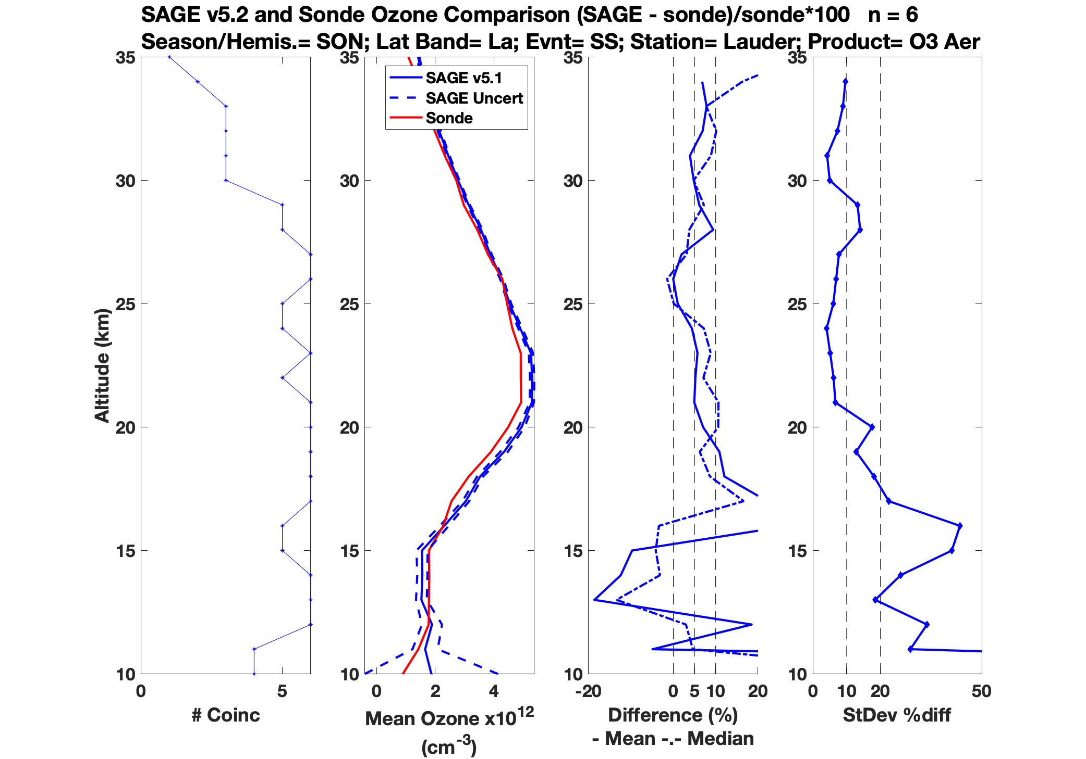
Sunrise
DJF; n = 4
MAM; n = 6
JJA; n = 11
SON; n = 2
Sunset
DJF
MAM; n = 7
JJA; n = 6
SON; n = 6

Slide 10
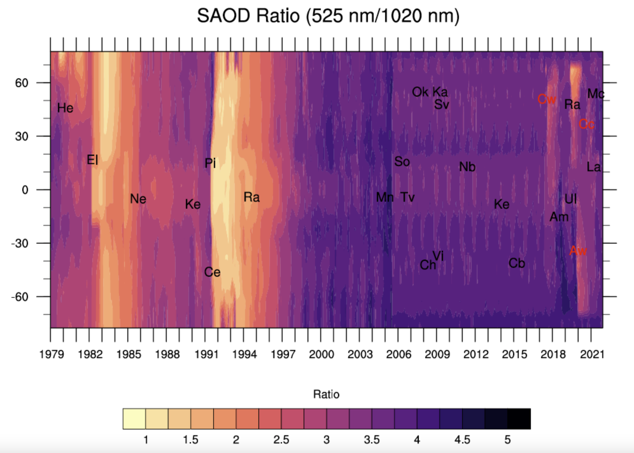
SAGE III/ISS Aerosol Extinction Ratio
1979-2021

Slide 11
SAOD Ratio 525nm/1020nm
The figure shows the ratio between 525 and 1020 nm extinction coefficients.
Labeled are various volcanic/PyroCb events with abbreviations.
Following a major event, we clearly see change in extinction ratios. For example, following Pinatubo (Pi) in 1991 we can infer size of aerosol based on extinction ratios (smaller ratio implies larger aerosol). We clearly see larger particles following Pinatubo as the ratios are as small as 1.5.
For a background stratosphere, the ratios hover around 4.
For the period between 1979-August 2005 we have multiple wavelength measurements available from SAGE series of measurements.
For the period between 2005 and June 2017 we have used Angstrom exponent to convert aerosol extinction coefficient from OSIRIS and CALIPSO to 525 and 1020 nm channels. We miss information on aerosol size during this period as it is evident in the figure where multiple volcanic eruptions have occurred, but the ratios show no change.
After SAGE III/ISS measurements are available starting June 2017, we see the extinction ratio values fall during aerosol events again. We are at an advantage to have SAGE-type measurements for the long-term stratospheric aerosol record.
EGU22-1805 | Presentations | AS3.6
SAGE III/ISS aerosol/cloud categorization and its impact on GloSSAC
Mahesh Kovilakam, Larry Thomason, and Travis Knepp
Thu, 26 May, 15:15–15:20 Room M1

Slide 12
Conclusion
The SAGE III/ISS data record that has almost reached 5 years, or a half decade, of measurements adds to the SAGE legacy that dates pre-1980. This allows SAGE to continue to be a vital part of a worldwide database of measurements of ozone recovery in the stratosphere.
The SAGE III/ISS Level 2 ozone_AO3 concentrations continue to show good agreement with coincident measurements from satellite and in-situ database sampling of ozonesondes and LIDAR. Shown in this presentation, SAGE solar data agrees within percent differences of 5% in the altitude range of 20–30km with mid-latitude sondes at Boulder and Lauder. SAGE continues to add to a robust data record of ozone in the stratosphere.
Next in preparing for SAGE III/ISS long-term data records is to include the SAGE III/ISS mesospheric ozone and water vapor visualization and statistics. Kevin Leavor is currently establishing a database of deseasonalization, QBO, and ENSO factors for this effort.
SAGE III/ISS is the only self-calibrating occultation instrument that directly measures aerosol extinction. It is useful in validating measurements for other instruments.
It is important to provide occultation measurements and have a plan for continuation. SAGE III/ISS is in extended phase of mission and cannot last forever. There is a current proposal for a SAGE follow-on mission.

Slide 13
Acknowledgements
Stations such as the NOAA Earth System Research Laboratory (ESRL) in Boulder, CO and the National Institute of Water and Atmospheric Research (NIWA) in Lauder, NZ have planned ozonesonde launches to coincide with SAGE III/ISS overpasses. The number of stations within the NDACC community that use the SAGE III Validation tool to plan balloon launches with a SAGE flyover is growing. Please take advantage of the SAGE III/ISS Validation Prediction Tool when planning LIDAR, ozonesonde, frost point hygrometer, etc. measurements.
We would like to acknowledge the upper atmosphere observational community for their active participation in the on-going SAGE III/ISS validation program. Particularly NDACC (www.ndacc.org), WOUDC (www.woudc.org), NOAA ESRL (https://www.esrl.noaa.gov/gmd/), and SHADOZ (https://tropo.gsfc.nasa.gov/shadoz/index.html). Please visit these sites for individual station and contact information. Meteorological data provided by the JPL Derived Meteorological Products (https://mls.jpl.nasa.gov/dmp/) are used with the ozonesondes, SAGE and MLS for improved event matching.
SAGE III/ISS is a NASA Science Mission Directorate/Earth Science Division (SMD/ESD) mission on the International Space Station and a collaborative endeavor between SMD and the ISS Program and between NASA and the European Space Agency (ESA).

