Slide 1
Animations
Nathan Schilling

Slide 2
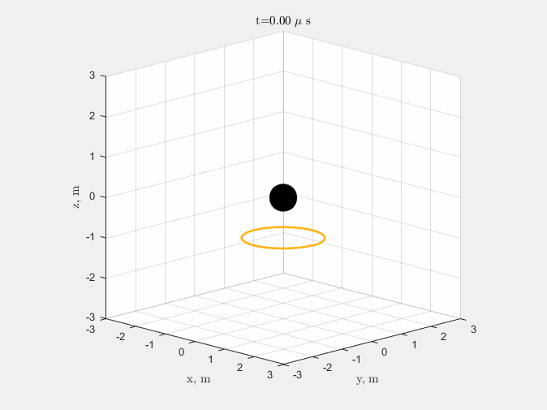
Solenoidal test case

Slide 3
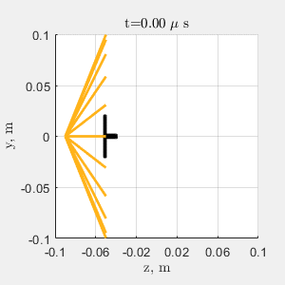
Axial test case

Slide 4
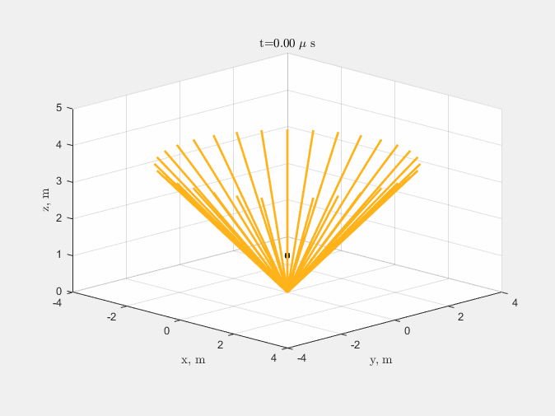
Axial base case

Slide 5
Axial double current

Slide 6
Axial half current

