Slide 1



Human Autonomy Teaming:
Principles and Applications
Jay Shively
NASA Ames Research Center
FAA Human Systems Integration Summit:
Human Machine Interfaces
JUNE 7, 2022

Slide 2
Outline
Automation
  Issues
  Growth
Human Autonomy Teaming (HAT)
  What is it?
  Why should you care?
  How?
Principles
  Bi-directional communication
  Transparency
  Operator directed interface
  Shared situation awareness
  Meaningful Human Control (MHC)
Applications
  Reduced Crew Operations
  Multi-Vehicle Control
  High Density Vertiplex
  Wildfire Mitigation

Slide 3
Continued Growth of Automation
Urban Air Mobility
Autonomous Cars
M:N operations
Unmanned traffic management (UTM)
Small drone delivery
High altitude long endurance platforms

Slide 4



System Configurations
Human & System
Human & AI (automation) & System
Human interacts directly with the work system.
AI is between the human and the work system

Slide 5
Problems with Serial Arrangement
Brittle
  Automation often operates well for a range of situations but requires human intervention to handle boundary conditions (Woods & Cook, 2006)
Opaque
  Automation interfaces often do not facilitate understanding or tracking of the system (Lyons, 2013)
Mis-calibrated Trust
  Disuse and misuse of automation have led to real-world mishaps and tragedies (Lee & See, 2004; Lyons & Stokes, 2012)
Out–of-the-Loop Loss of Situation Awareness
  Trade-off: automation helps manual performance and workload but recovering from automation failure is often worse (Endsley, 2016; Onnasch, Wickens, Li, Manzey, 2014)
Notes:
We all have some familiarity with the issues with automation.
These are 4 commonly identified problems.
Endsley, M. R. (2016) From Here to Autonomy: Lessons Learned From Human–Automation Research. Human Factors.
Lee, J. D., & See, K. A. (2004). Trust in Automation: Designing for Appropriate Reliance. Human Factors: The Journal of the Human Factors and Ergonomics Society, 46(1), 50-80.
Lyons, J. B. (2013). Being Transparent about Transparency: A Model for Human-Robot Interaction Symposium conducted at the meeting of the 2013 Association for the Advancement of Artificial Intelligence Spring Symposium, Palo Alto, CA.
Lyons, J. B., & Stokes, C. K. (2012). Human–human reliance in the context of automation. Human Factors, 54(1), 112-121.
Onnasch, L., Wickens, C. D., Li, H., & Manzey, D. (2014). Human performance consequences of stages and levels of automation: An integrated meta-analysis. Human Factors, 56, 476–488.
Woods, D. D., & Cook, R. I. (2006). Incidents: Markers of resilience or brittleness? In E. Hollnagel, D. D. Woods, & N. Leveson (Eds.), Resilience engineering: Concepts and precepts (pp. 69–76). Aldershot, UK: Ashgate.

Slide 6
Human-AI Teaming (Simple Concept)
Human and AI “team” to interact with the work system.
🤝

Slide 7
Principles (Not Exhaustive)
Bi-directional Communication
Transparency
Shared situation awareness (mental model)
Pilot directed interface
Meaningful Human Control

Slide 8
Bi-Directional Communication
Humans and AI should have a channel to communicate
Human can ask about reasoning:
  Why did you choose A?
  What about B?
About confidence:
  How sure are you of A?
  How close was B?
Human can input information that the AI doesn’t have
  e.g., alternative C doesn’t have good emergency medical response

Slide 9
Bi-Directional Communication (cont.)
Human should be able to bounce ideas off the AI (and vice versa) like a TEAMMATE
These capabilities do levy requirements on the AI
  Common/understandable comm mode (e.g., cockpit control language)
  Natural language interface (desired but not required)
  Explainability
  Self-awareness? Level of confidence

Slide 10
Transparency
Human should be able to understand the reasoning for AI recommendations/decisions
  Level 1: What is the system doing?
  Level 2: Why is the system doing that?
  Level 3: What can I expect to happen next?
Critical component in fostering calibrated trust of AI
Calibrated trust fosters appropriate utilization/reliance behaviors between teammates

Slide 11







Transparency: Issues
  Granularity: how much detail is enough but not too much?
  Time pressure: processing information takes time; how much time is available?
Transparency Goldilocks:
How transparent is “just right?”
🥶
🤔
🥵
TOO COLD
TOO HOT
Too Opaque
↓
Confused, uninformed, misinformed pilot
Too Transparent
↓
Information Overload

Slide 12
Operator Directed Interfaces
No set “roles and responsibilities”
  Default assignments for nominal operations
Fluid assignment set by operator actions
  Take control of stick and fly aircraft
Requires some degree of ”Intent Inferencing” – can be problematic
Can be difficult to implement in highly automated systems

Slide 13
Shared Situation Awareness
Humans and AI should have:
  A shared model of system operation
  A shared understanding of external influences to the system
  A shared understanding of the current situation
    State of the system
    State of the environment
  How do you ensure?
  How do you transfer info, if not available?
  How do you measure (continually)?

Slide 14
Meaningful Human Control
Humans should have the ability to exert “meaningful” control
  Not just hit the red button
Take advantage of human decision making and analytical skills
Ethical, moral, humanistic reasons

Slide 15
MHC
How do you define?
How do you measure?
Where in the design-operation cycle?
Human limitations
Humans have the ability to make informed choices in sufficient time to influence automation-based systems; these can enable a desired effect or to prevent an undesired immediate or future effect on the environment.
Please write an ‘X’ in the box that best represents your opinion in each of the dimensions below:
Range of Options: Did you have the range of response options required to respond as needed?
1----------2----------3----------4----------5-----------6----------7
Not at all Moderate Absolutely
Temporal Availability: Did you have the time to assess the situation and respond as required?
1----------2----------3----------4----------5-----------6----------7
Not at all Moderate Absolutely
Interface Layout: Did interface elements support an efficient and effective workflow?
1----------2----------3----------4----------5-----------6----------7
Not at all Moderate Absolutely
Information Availability: Was the information that you needed to respond available?
1----------2----------3----------4----------5-----------6----------7
Not at all Moderate Absolutely
Workload: Was your workload low enough for you to respond appropriately?
1----------2----------3----------4----------5-----------6----------7
Not at all Moderate Absolutely
Overall MHC: Did you feel you were able to exert meaningful human control?
1----------2----------3----------4----------5-----------6----------7
Not at all Moderate Absolutely
WORK IN
PROGRESS

Slide 16
Applications
Reduced Crew Operations
  Reduced Costs
  Pilot Shortage
m:N Vehicle Control
  Commercial viability
  Multiple domains (UAM, drone delivery, High Altitude Pseudo Satellite, infrastructure inspection, auto cargo)
Wildfire Mitigation
  Human failsafe

Slide 17
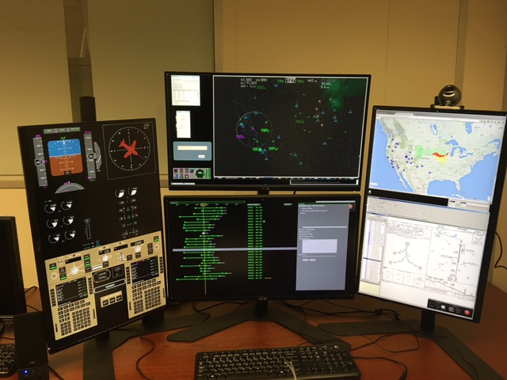
Reduced Crew Operations
Notes:
We’ve been doing a series of studies using a ground station and gradually trying to incorporate more of these HAT principles into the station
Spiral development – not building an operational system; focused on demonstrating capabilities
Point out Top display for traffic, weather, terrain; Bottom display to manage aircraft list/events

Slide 18
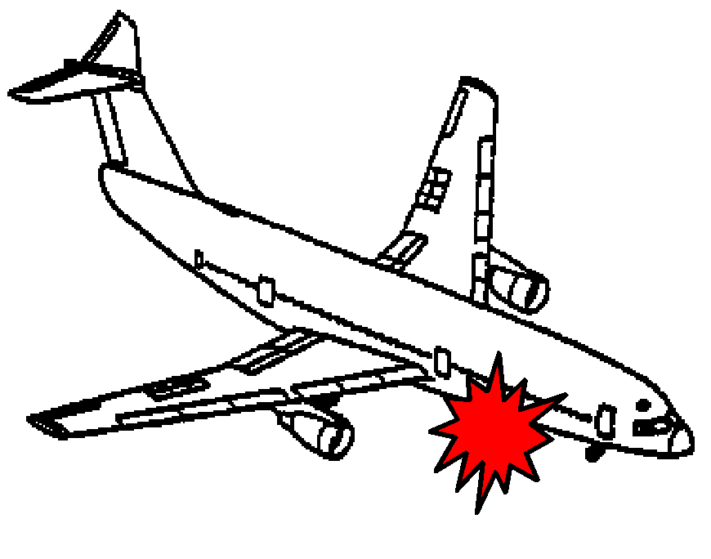
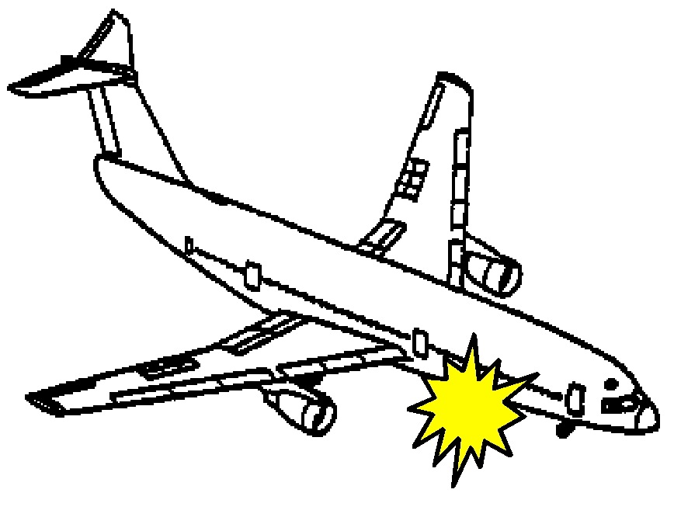


Emergency Landing Planner Objective
damage/failures
recovery
En route Weather
Icing
Facilities
Distance
Altitude
Wind
Ceiling, Visibility
Runway
length/width/condition
Approach
Population
Find the best landing sites and routes
for the aircraft

Slide 19
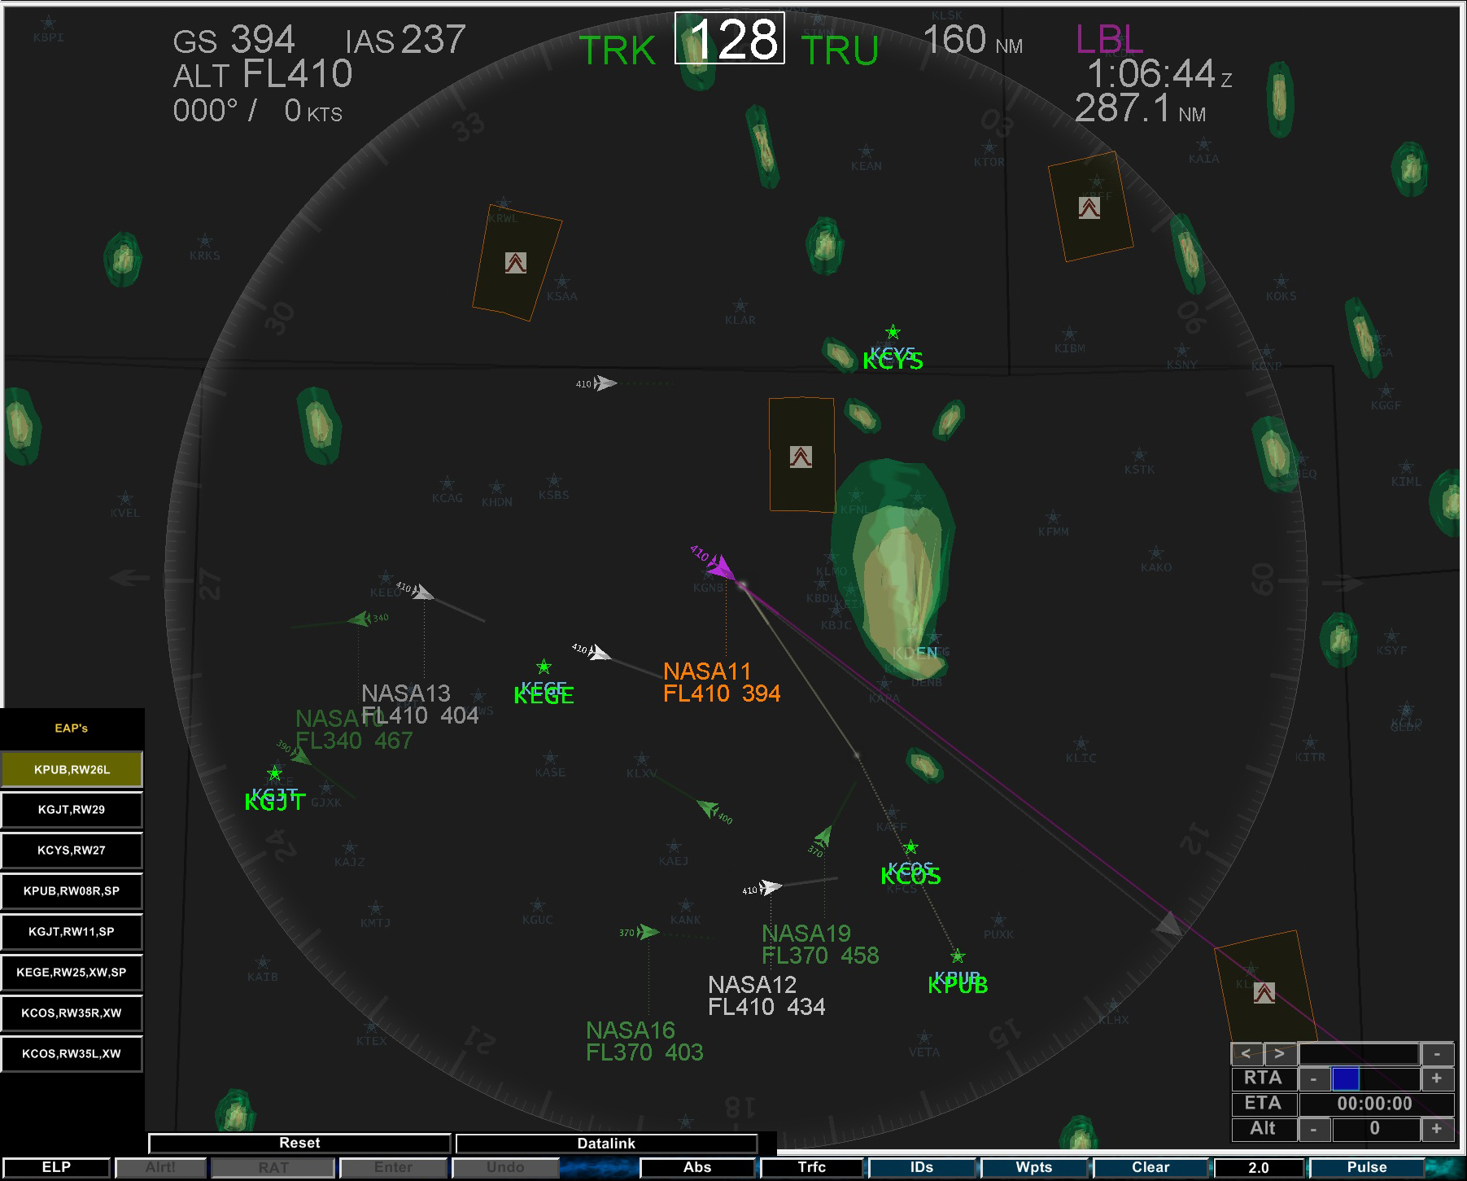
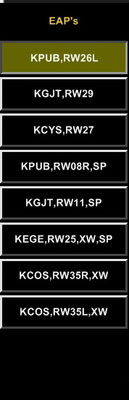
Before HAT
Original
Recommended airports - rank ordered.
Notes:
ACFP– automated recommender system being used as a diversion/re-routing planner.
Developed at NASA Ames
This system looks at many factors: weather, terrain, airport and runway characteristics, flyability of the aircraft
Here’s an example of the earliest implementation…
Aircraft needs to divert to the nearest suitable aircraft (medical emergency)
Provided a rank ordered list of options. Shows you the airports, runway and codes for any issues (e.g., XW – crosswind)
Operator could toggle between the options and the route was graphically display on the traffic situation display
Operator could datalink a selected route to the flightdeck.
While the tool was promising, there were a number of problems including operators not understanding why the automation recommended what it did.

Slide 20
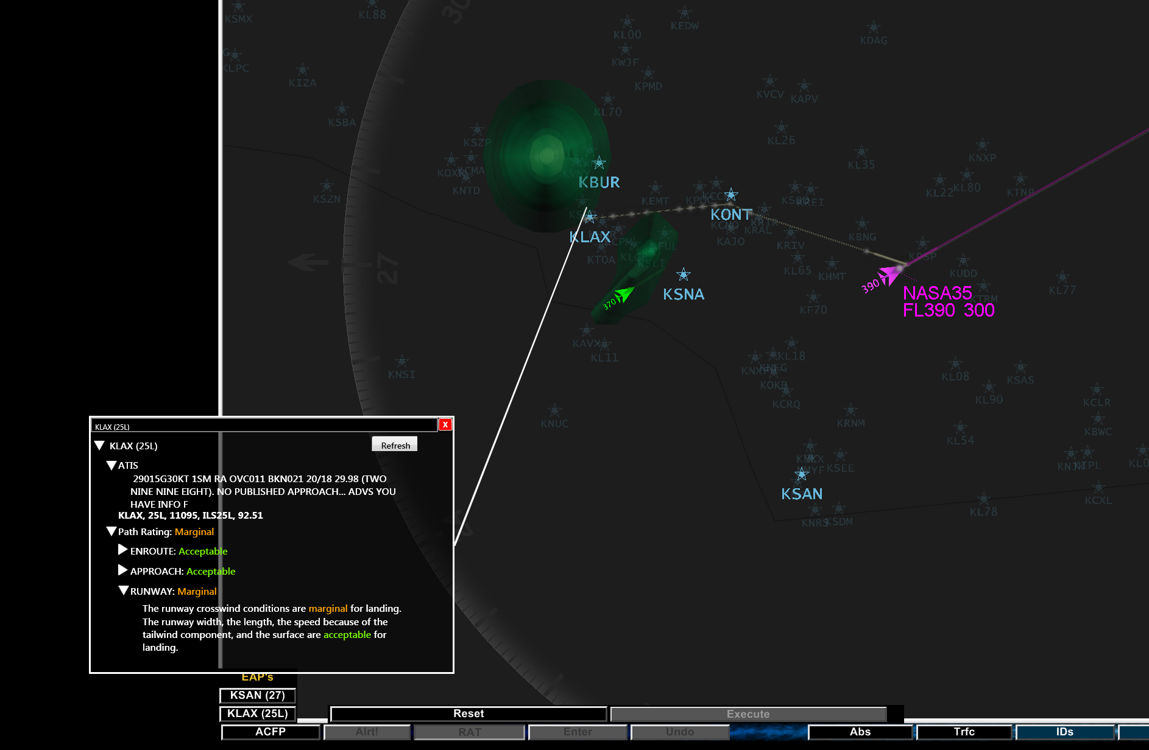
Adding HAT Principles to the Ground Station
With Added Transparency
Notes:
One of the first things we did with this tool was start to add transparency to the automation’s selections. This is from a different study, new scenario, added features.
Based on all the information the ACFP has, it calculates an overall risk value. We wanted to unpack this and show it’s evaluation by segment as well as entire route.
So here is how we’re now displaying a risk evaluation. It gives an overall path rating and allows the operator to drill down for more details. We integrated weather and runway information

Slide 21
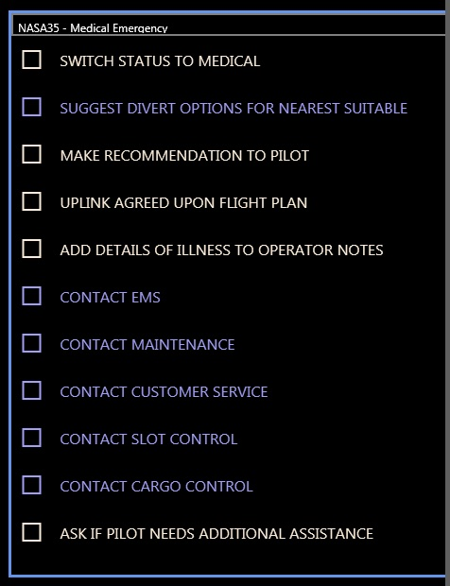
Adding HAT Principles to the Ground Station
    Human-Directed: Operator calls “Plays” to delegate authority to
    automation
A play encapsulates a plan for achieving a goal.
It includes roles and responsibilities
what is the automation going to do
what is the operator going to do
Notes:
One thing people have mentioned is the idea that you need to keep the operator in control. But what does that mean when you have an automated system? We’ve adopted the “playbook” approach where the operator calls plays that determines who does what.
This is a first cut at implementing plays. What you see here is a play for a Medical Emergency.
As you can see, it’s a simple checklist where the operator’s tasks are in white, automation in blue. The idea is that this will become more flexible with varying levels of automation and branch points.

Slide 22
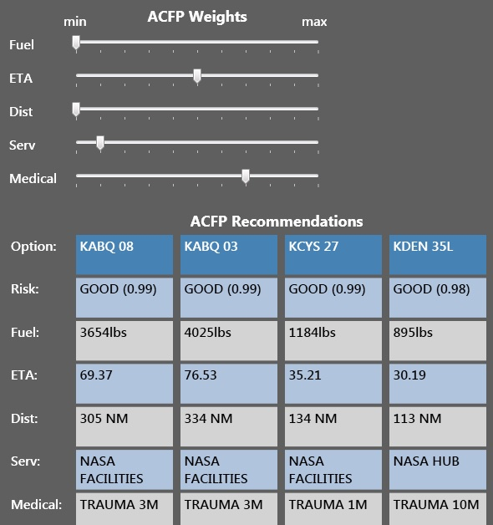
Adding HAT Principles to the Ground Station
Transparency: Divert reasoning and factor weights are displayed.
Negotiation/Dialog: Operators can change factor weights to match their priorities.
    Shared Language/Communication: Numeric output from planner was found to be misleading by pilots. Display now uses English categorical descriptions.
Notes:
The ACFP takes into account more than just the risk. It looks at fuel, distance, services available, etc. It also has the capability of weighting these factors differently based on the situation. We increased the transparency by explicitly showing the factors and weights.
We have provided an ability to “negotiate” with the system by allowing the operator to change these weights to better fit the situation.
It is interesting to note that once we started using this process, we realized the ACFP was systematically underweighting distance and that has since been fixed.
We also tried to present the information in the way pilots think about it. Specifically, the ACFP thinks of each of these factors as a rating score and we translated those scores into meaningful numbers or descriptors for the operator.

Slide 23
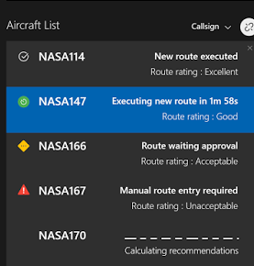
ALTA Action Phase
Based on working agreements, the Agent will do one of the following:
[Auto] autonomously executes and informs operator
[Veto] presents a solution which will be autonomously executed unless the operator intervenes
[Select] presents multiple options for operator selection
Notes:
If best solution has LOA = Autonomous, then agent executes the solution and informs operator (requiring acknowledgement)
If best solution has LOA = Veto then the agent presents solution to operator and allows a user defined time interval for the operator to veto or execute. If time elapses without response fro operator then the agent executes, and informs operator (requiring acknowledgement.)
If best solution has LOA = Select or Manual, or if Operator has vetoed a solution, the agent presents multiple options for operator selection.

Slide 24
Working Agreements: A Path to Full Autonomy
Codified levels of automation
Working agreements allow the task structure to remain the same while the involvement of human operators decreases due to improvements in the automation and increases in trust

Slide 25
HAT Simulation: Results
Participants preferred the HAT condition overall (rated 8.5 out of 9).
HAT displays and automation preferred for keeping up with operationally important issues (rated 8.67 out of 9)
HAT displays and automation provided enough situational awareness to complete the task (rated 8.67 out of 9)
HAT displays and automation reduced the workload relative to no HAT (rated 8.33 out of 9)
Notes:
Overall, participants preferred having the HAT tools. It helped them with their task, SA and workload

Slide 26
HAT Simulation: Results
HAT workload reduction was marginally significant (HAT mean 1.7; No HAT mean 2.3, p = .07)

Slide 27
HAT Simulation: Debrief
Transparency
  “This [the recommendations table] is wonderful…. You would not find a dispatcher who would just be comfortable with making a decision without knowing why.”
Negotiation
  “The sliders was [sic] awesome, especially because you can customize the route…. I am able to see what the difference was between my decision and [the computer’s decision].”
Human-Directed Plays/Shared Plans
  “Sometimes [without HAT] I even took my own decisions and forgot to look at the [paper checklist] because I was very busy, but that didn’t happen when I had the HAT.”
Notes:
Here are some quotes that capture how they felt about the tools.

Slide 28
m:N Aircraft Operations

Slide 29


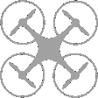
M:N Configuration
m:N Paradigm
  Multiple operators to multiple vehicles, where:
    m = # of operators
    N = # of vehicles
Roles in m:N operations:
  Tactical Operator (TO)
    Pilot-in-Command (PIC) of multiple assets
    Monitors airspace and hazards
    Attends to assets
    Participant’s role in the study
  Fleet Area Manager (FAM)
    Responsible for overseeing a select number of TOs in a specific area
    Monitors fleet health and system health
    Evaluates TO performance and workload online
    Played by researcher confederate
FAM
TO 1
TO 2
TO 3
Assets

Slide 30
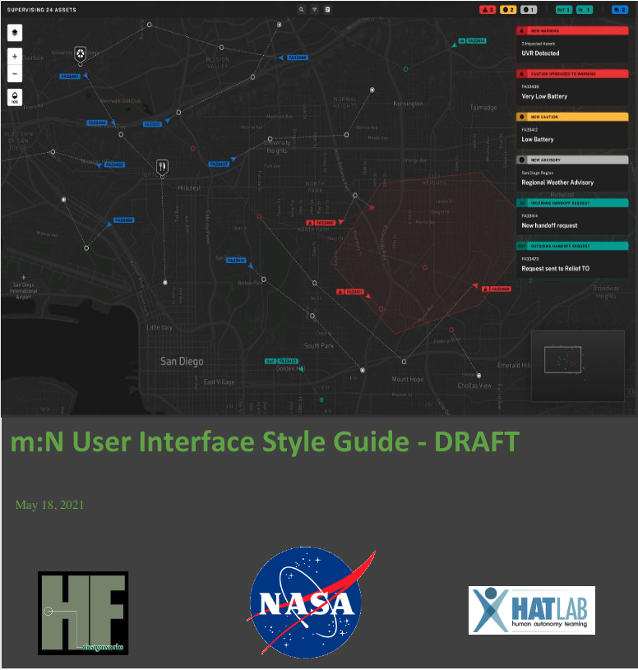
m:N GCS Design
HAT GCS interfaces for m:N applications currently in design
Design aims to be applicable to multiple m:N domains
  Small UAS
  Large UAS
  UAM
  HAPS
  Swarms
Utilizes HAT principles
  Bi-directional Communication
  Transparency
  MHC (hopefully)
So far…

Slide 31
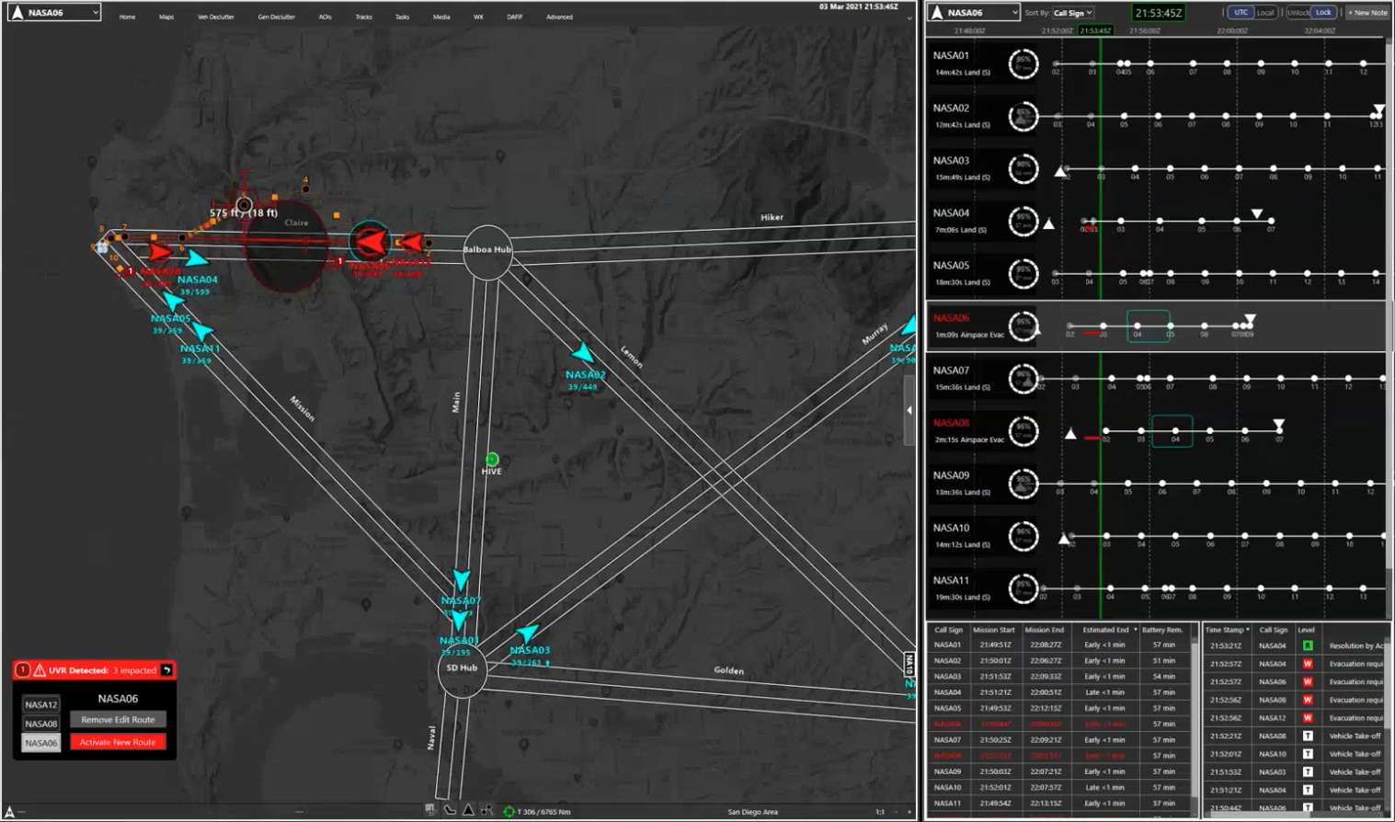
m:N HITL Work: ConOps/R&R Simulation
Tactical Situation Display (TSD)
Timeline
Status & Event Log
HUMAN-AUTONOMY TEAMING LABORATORY
Notes:
Bi directional communication: the TO was provided a tool to reroute which s/he could use to try route modifications in real time and get assessments for conformance and terrain.
Above interface was adapted to from our multi-monitor GCS to a single display so that we could conduct the experiment over Teams.
Alert “toast” messages: ad hoc transparency prompted by a change in the situation
Timeline, status, and event log provide overall transparency info (L1 and L3 transparency)
Current system does n’t provide L2 transparency but this is a work in progress

Slide 32
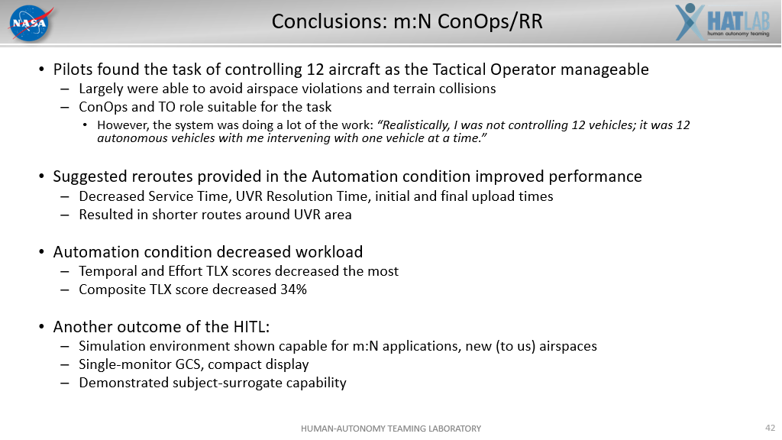
M:N Summary
Delayed due to Pandemic
Ran surrogate simulation
Prelim results ??
Hand-offs, tools, next sim

Slide 33
Wildfire Mitigation
Human as the “failsafe”
Embrace the “well, the automation failed, throw it the human!!”
Anticipate critical conditions by tread analysis, displays and cueing the PIC to potential mitigations
Risk based, trend analysis, cueing and HAT assistant
Test in a wildfire m:N context (HITL) early next year

Slide 34
Summary
HAT Philosophy
  Not just interface design
  Not just HCI
  A paradigm change in the way we view the interaction
Defined Basic Principles
  Need to be refined and added to
Applied to our projects
  Future of our lab is tied to this philosophy
  Perhaps automation, not AI, but building the architecture & methodology
As with most things, simple in principle, harder in practice

