Slide 1
A Data-Driven Bayesian Crack Nucleation Model for Fatigue in Nickel-based Superalloys
George R. Weber¹, Max Pinz², Somnath Ghosh²
¹NASA Langley Research Center, Hampton, VA
(former postdoc at JHU where work was performed)
²Johns Hopkins University, Baltimore, MD
Engineering Mechanics Institute Conference 2022
Johns Hopkins University, Baltimore, MD
June 2, 2022

Slide 2

Nickel (Ni)-based Superalloys
Material of choice for the most extreme environments in jet turbine engine applications
What makes superalloys “super”?
Blades rotate at 10,000 rpm
Tip velocity at 1,200 km/h (750 mph)
Alloy Chemistry
Stresses of 180 MPa
Multiscale Microstructure
Gas stream at 1750K
Equivalent to the weight of a heavy truck hanging from each blade
Microstructure of Ni-based superalloy Rene 88DT
Roger Reed. The Superalloys 2008

Slide 3
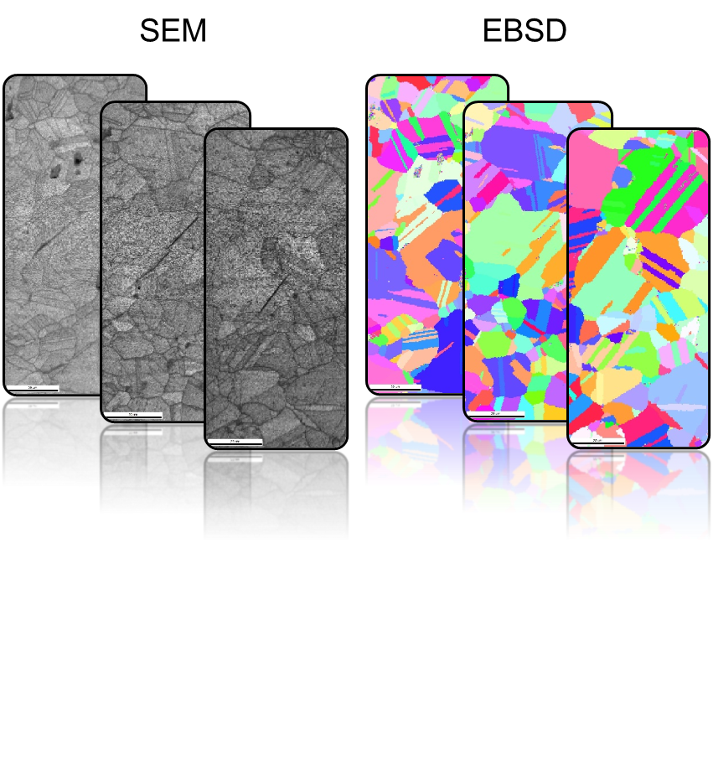
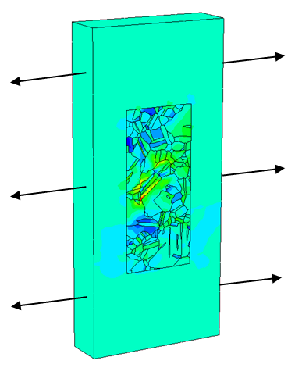
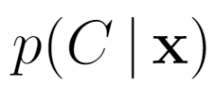
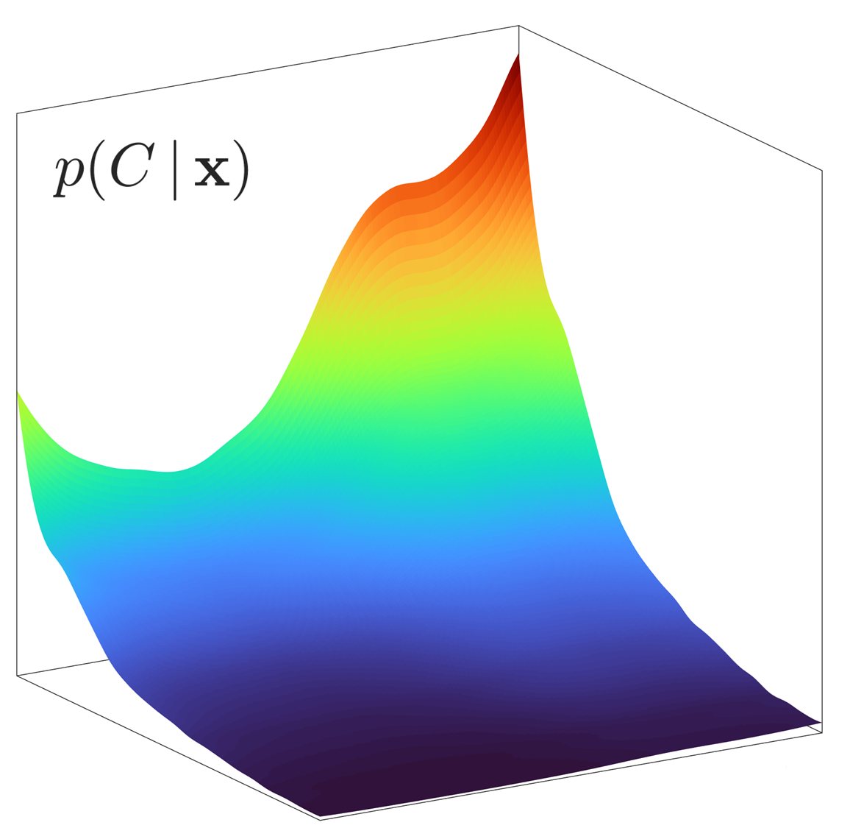
Overview of Model Development Process
Objective
Combine experimental data and a multiscale simulation toolchain to develop a crack nucleation criteria based on material state for Ni-based superalloys
Multiscale Simulation Toolchain
Bayesian Model
Fatigue Experiments
Material State
Crack Nucleation Probability
(Stinville, Pollock, UCSB)
Pinz, Weber, Stinville, Pollock, Ghosh. NPJ Comput Mater 2022

Slide 4

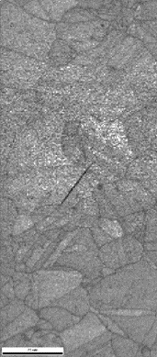
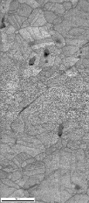
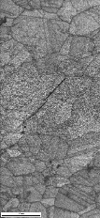
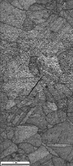





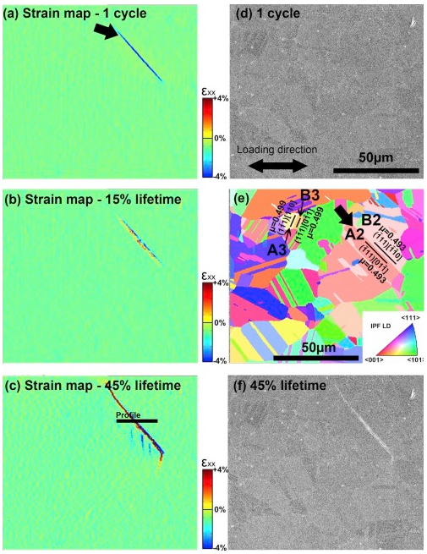
Experimental Data Sets and Crack Nucleation Observations
Interrupted fatigue experiments with crack nucleation sites along twin boundaries
Data Set of 12 Microstructures
…
Type I Crack Nucleation
Image
Quality Maps
…
Electron Backscatter Diffraction (EBSD) Maps
Digital image correlation fields indicate fatigue cracks at early cycles of deformation
Stinville, et al. Acta Mater 2016

Slide 5
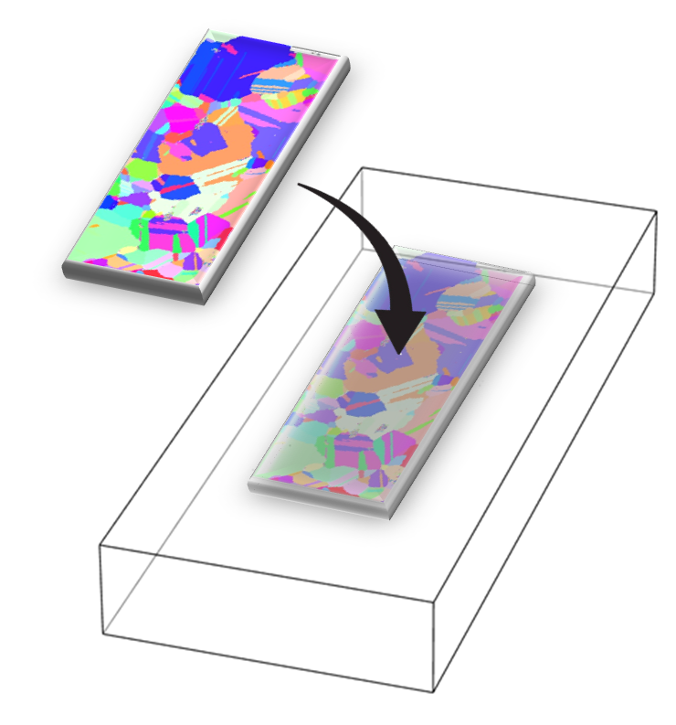
Concurrent Multiscale Model for Simulation of Polycrystals
Rate-dependent Elastoplasticity
Anisotropic elasticity
Power-law flow rule
Generalized von Mises plasticity
Exponential and linear hardening
Extruded Microstructure
Crystal Plasticity
Anisotropic elasticity
Thermally-activated flow rule
Self and latent hardening
Homogeneous Medium

Slide 6
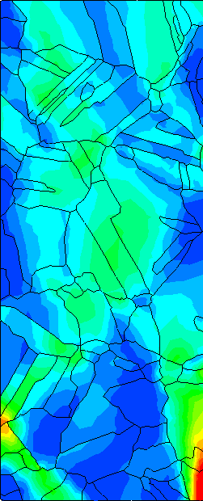
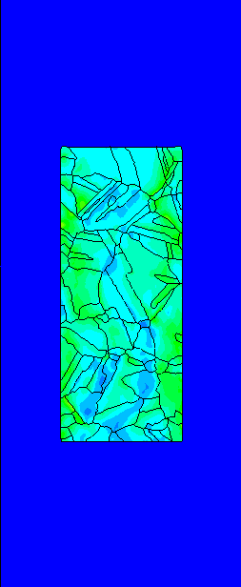
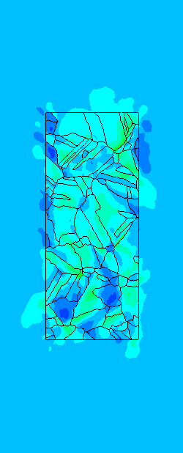
Comparison of Boundary Conditions for an Extruded Two-Dimensional Microstructure
What boundary conditions are sufficient for localization studies?
ε_{p}
10%
0%
Free Surfaces
Elastic Medium
Homogenized Medium
Constant Strain Rate Loading to 1% Strain

Slide 7





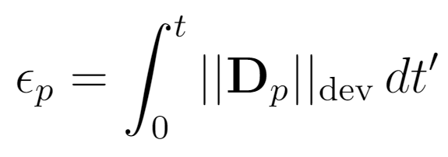


Cyclic Loading and Assembling Mechanical Response Database
External Cyclic Loading
10 State Variable Output Fields Are Extracted
on all 12 microstructures
Principal Stresses:
Von Mises Stress:
Elastic Helmholtz Energy:
Plastic Defect Energy:
Max. Plastic Slip:
Equivalent Plastic Strain:
Max. Resolved Shear Stress:
Max. Normal Slip System Stress:

Slide 8
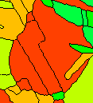
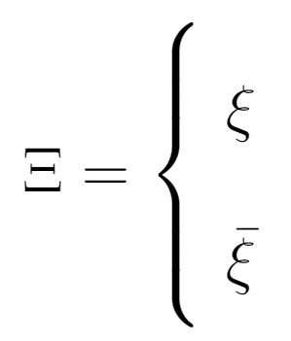
Parallel Slip Configuration
Out-of-plane slip
Shared Slip Plane
A
C
Parallel slip
B
Twin Boundary (111)
Parallel Slip occurs when slip along a parallel slip plane is favored over all other slip planes, and the slip plane is shared between adjacent grains
Active parallel slip
Parallel Slip Indicator
Otherwise
EBSD scan with marked
crack nucleation boundary
This is an empirical sufficiency condition for crack nucleation

Slide 9
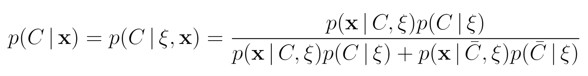
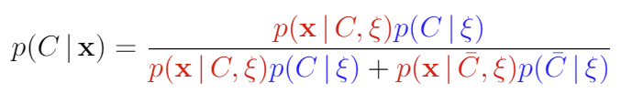
A Bayesian Crack Nucleation Framework
Objective:
At every point, find
“Given the state of the material x, what is the probability of observing a crack?”
Bayesian Model
Large, highly covariant
joint distributions
Can approximate priors from total observed cracked volumes

Slide 10





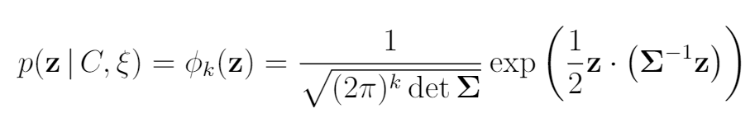


Nataf Transformation
Approximation of
To retain the covariance structure while gaining simplification, the joint distributions
are approximated by a Nataf Transformation
1) Transform to Marginally Uniform Random Variable
2) Transform to Marginally Standardized Random Variable
3) Determine Multivariate Normal

Slide 11
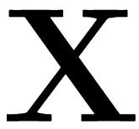
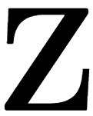
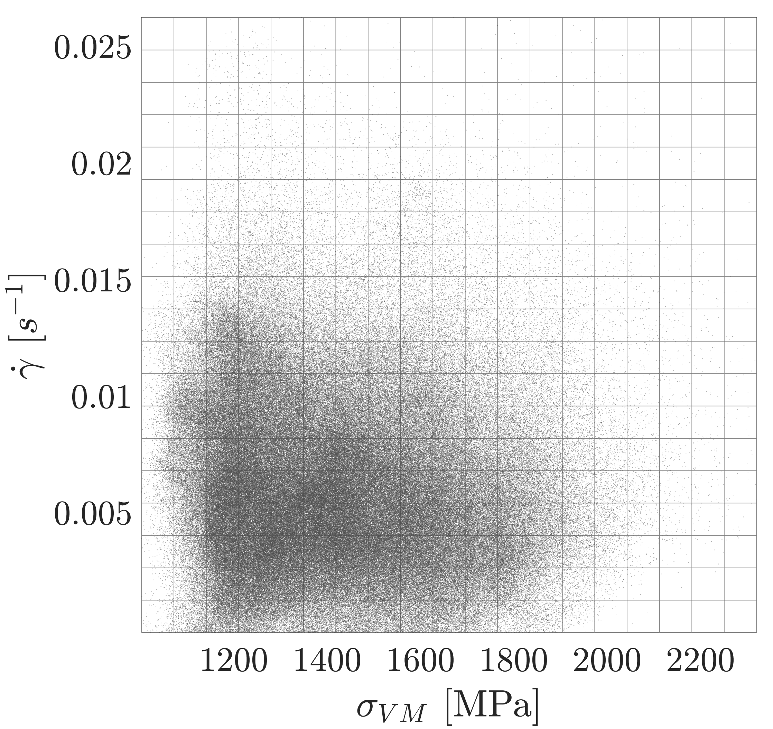
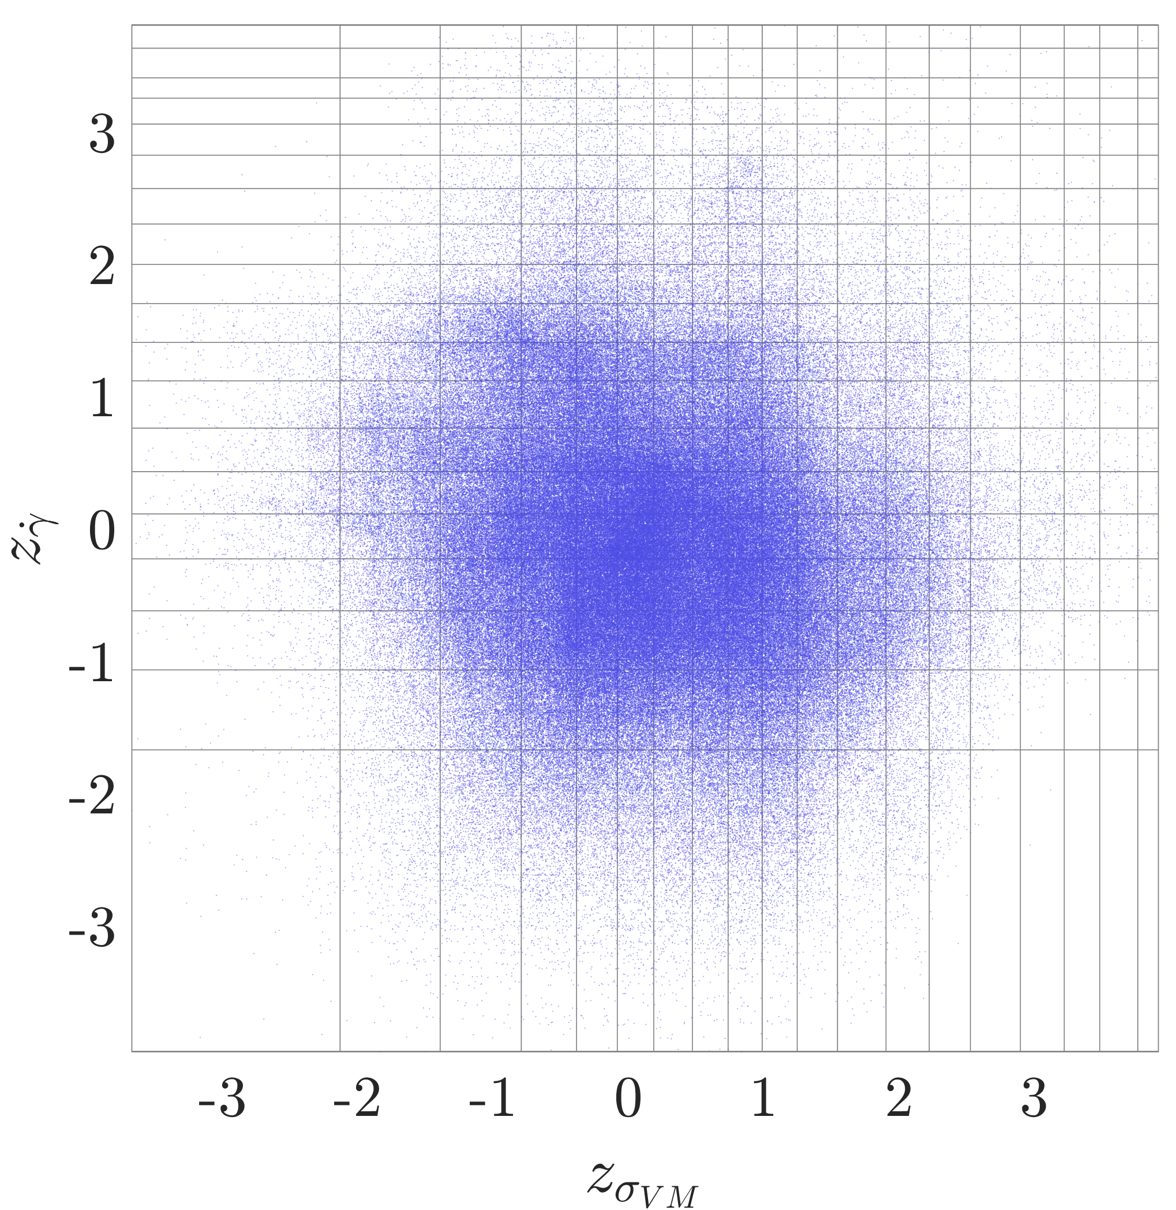

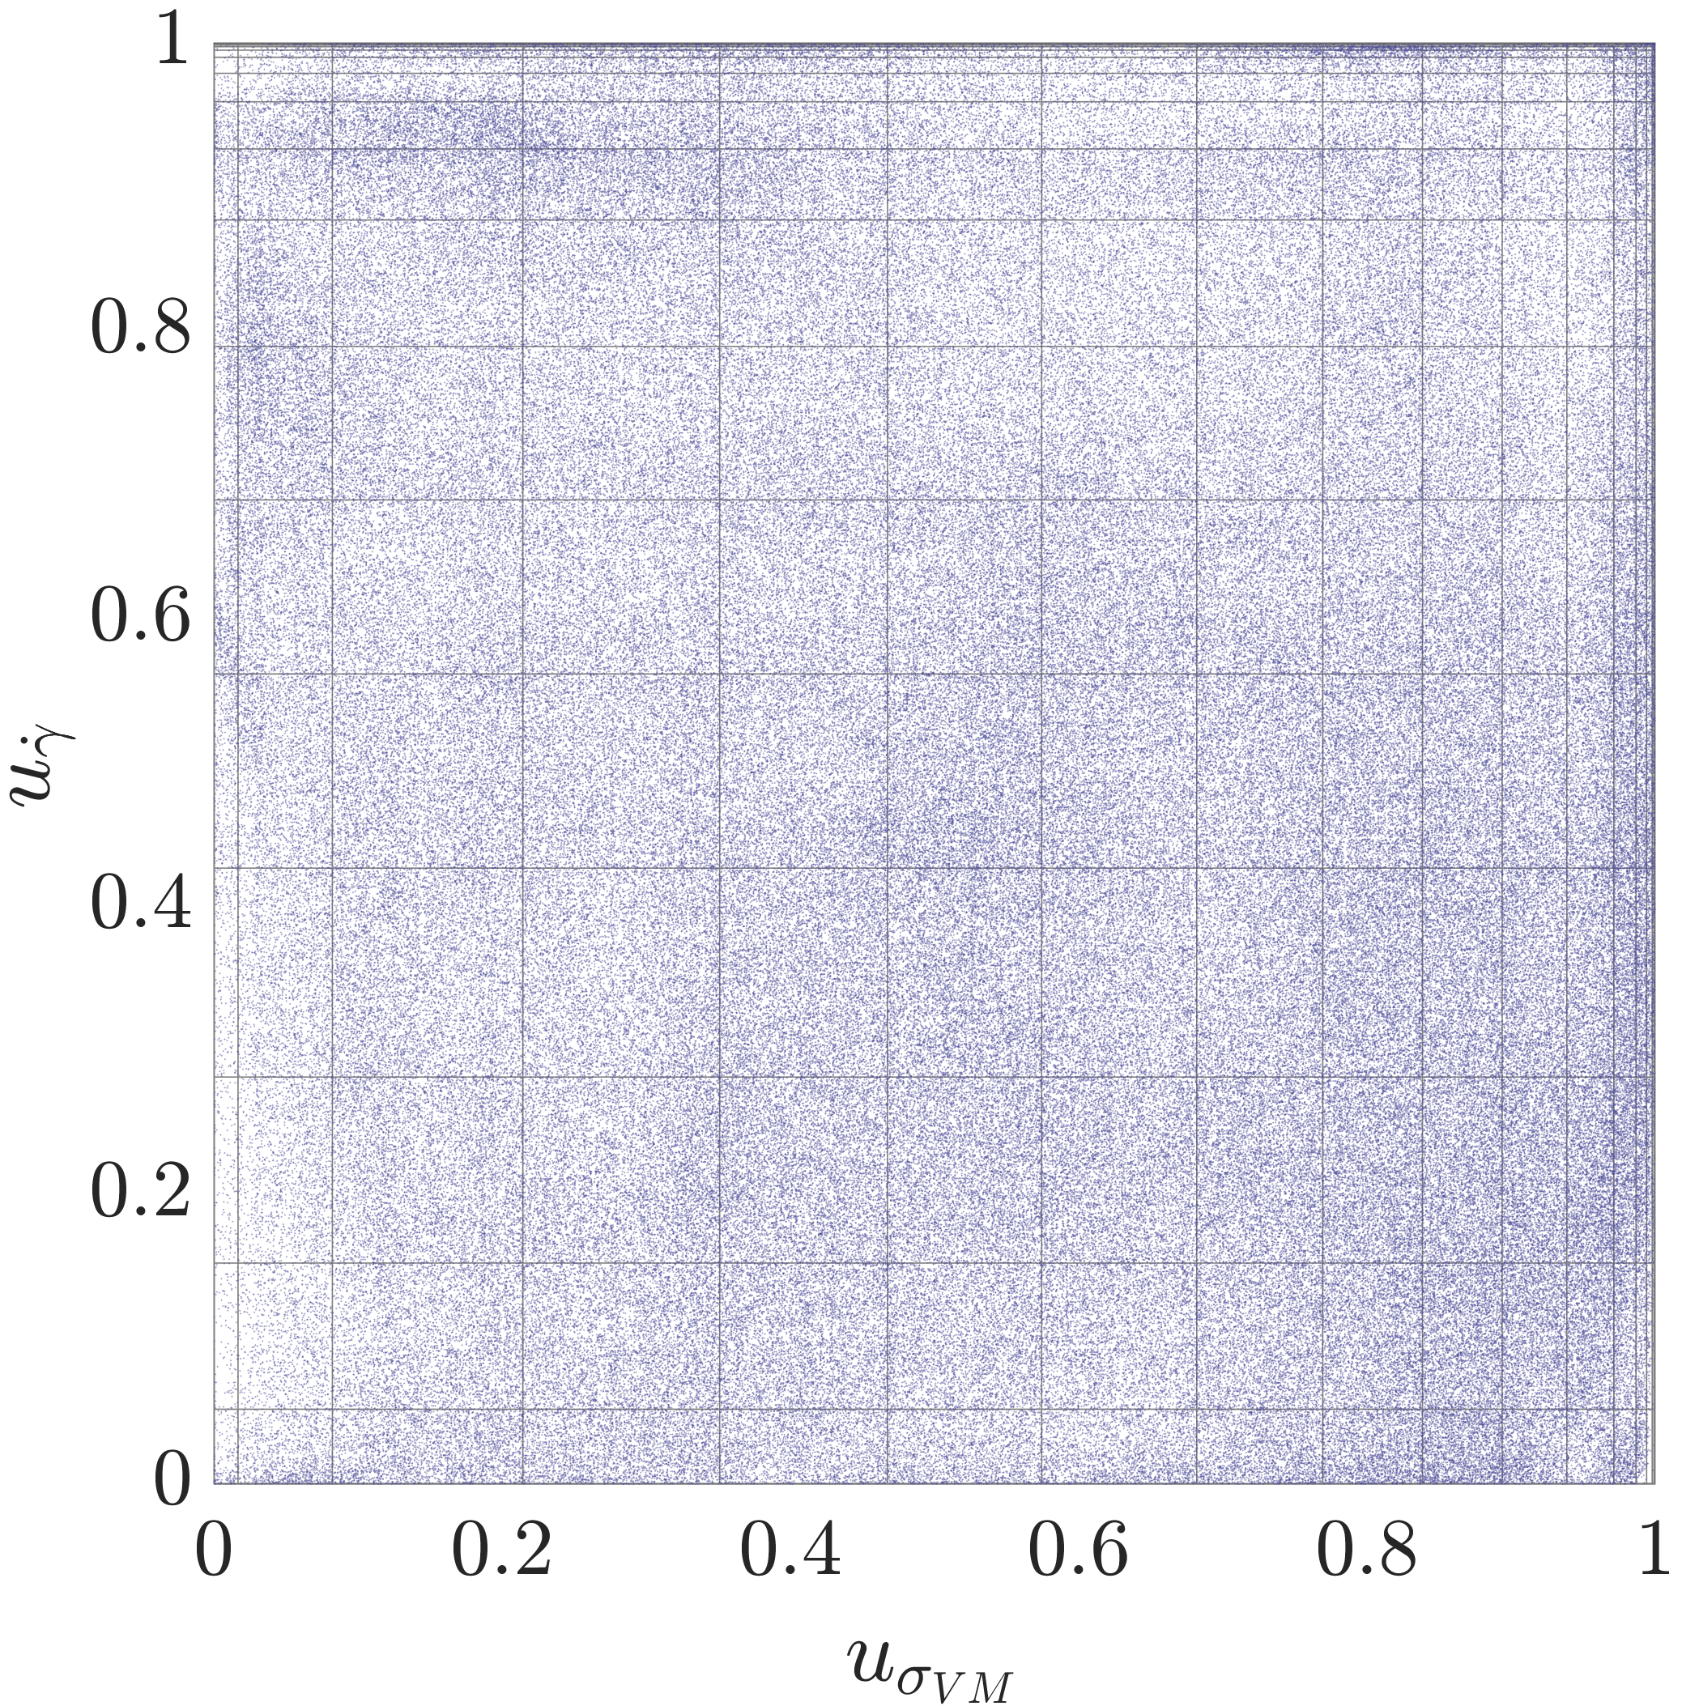

Visualization of Nataf Transformation for Bivariate Case
Original Data
Marginally Standard Data
Marginally Uniform Data

Slide 12
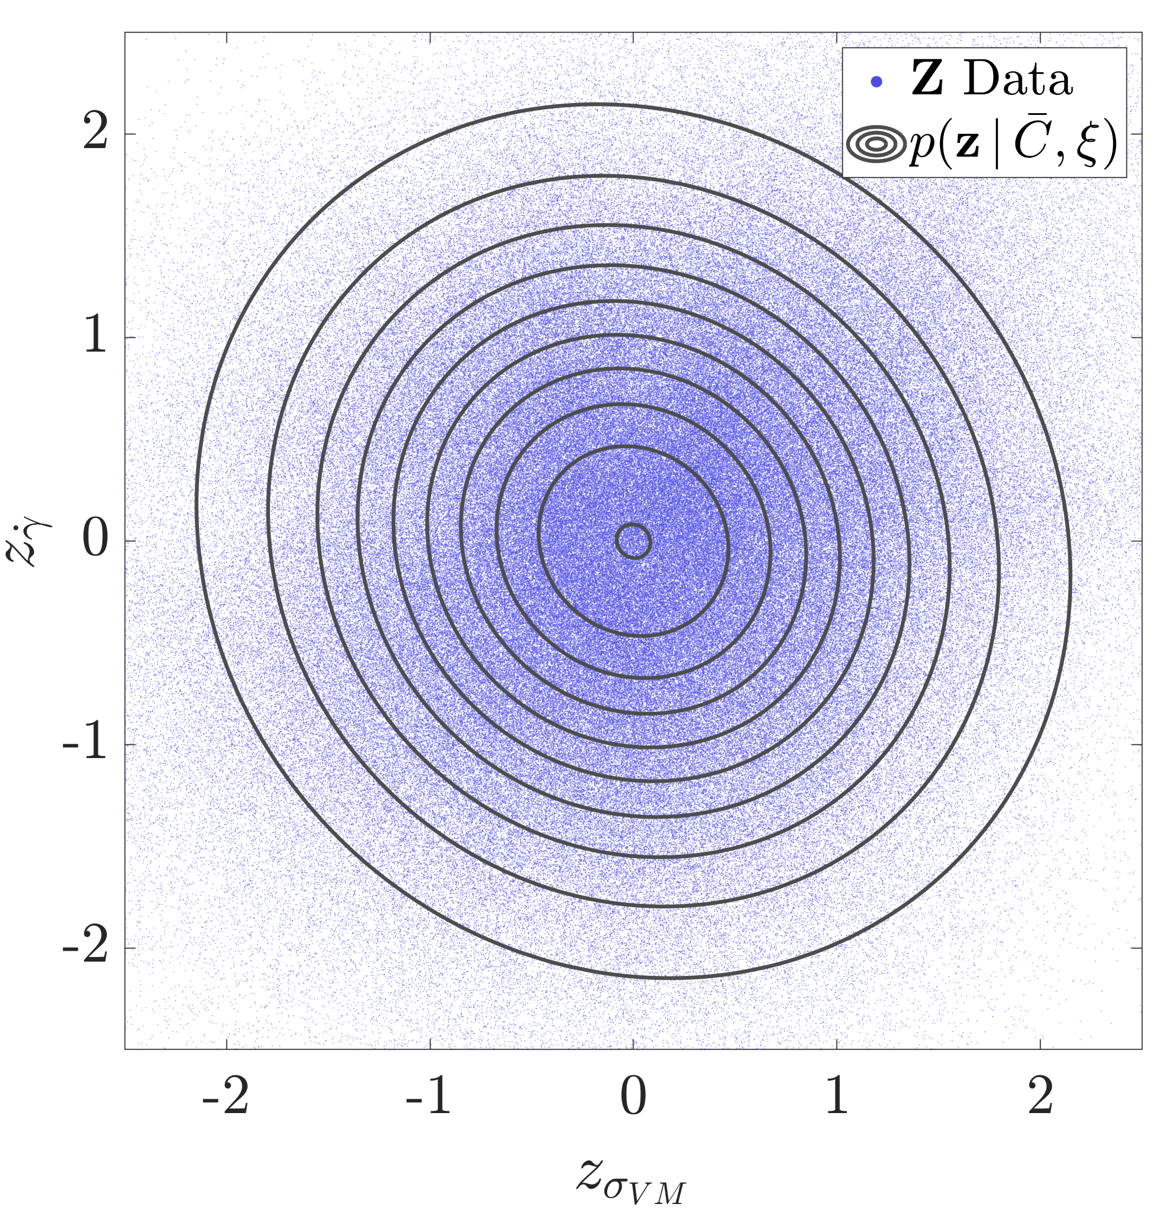
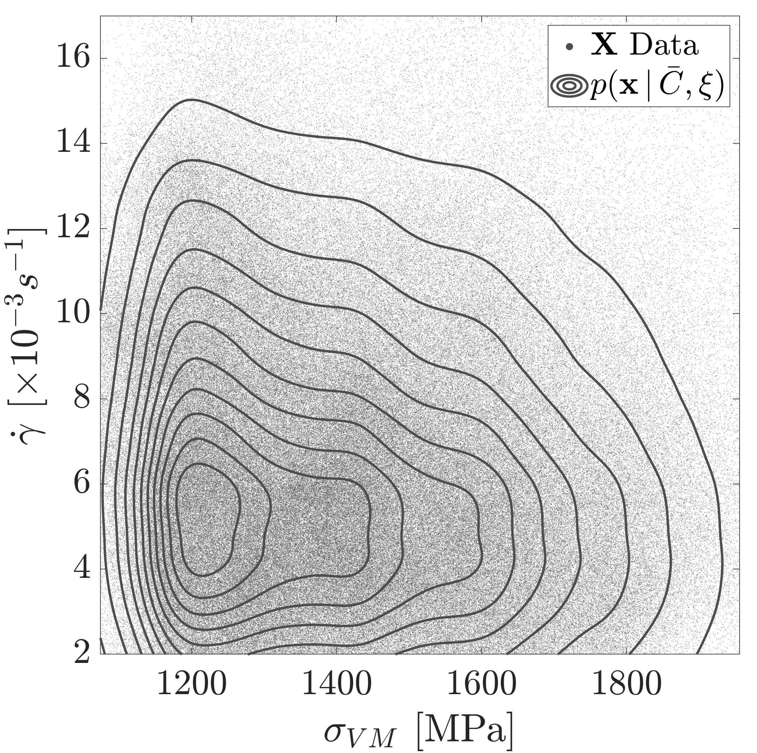
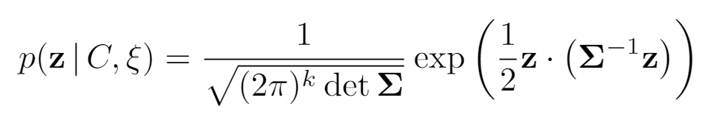
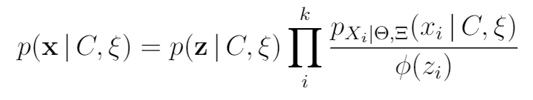
Nataf Model for Likelihood Probability Density Function (PDF)
Model Fit in Standard Space
Model Transformed to Original Space

Slide 13

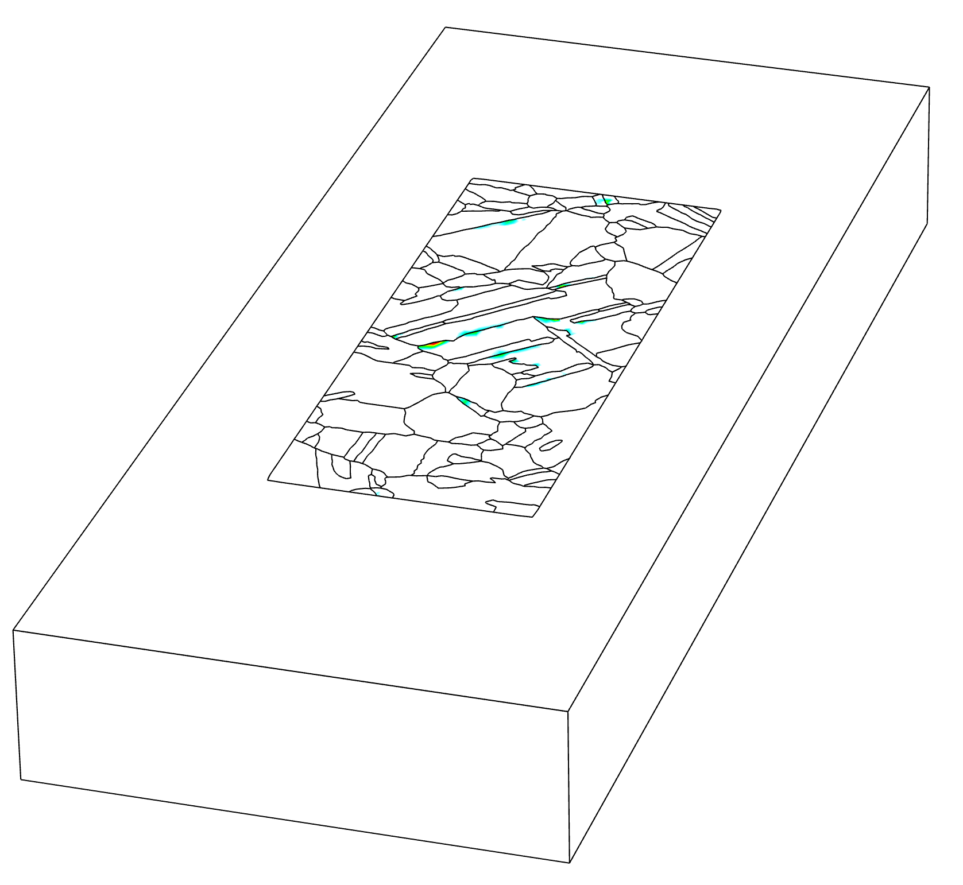
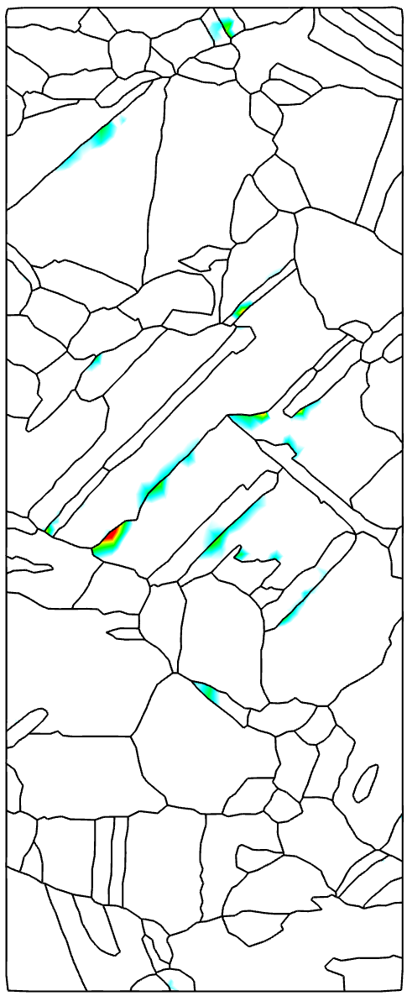
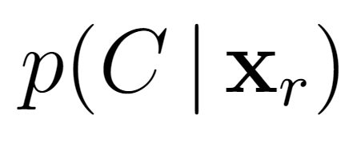

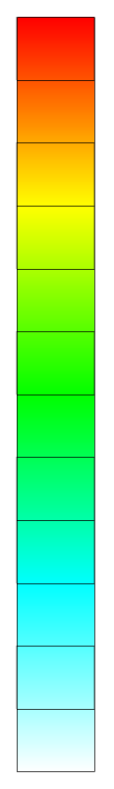
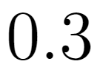
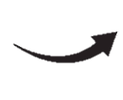


Crack Nucleation Probability Field on a Case Microstructure
Top 3 most significant state variables for crack nucleation prediction
Von Mises Stress
Maximum Plastic Slip Rate
Plastic Defect Energy
Crack Nucleation

Slide 14
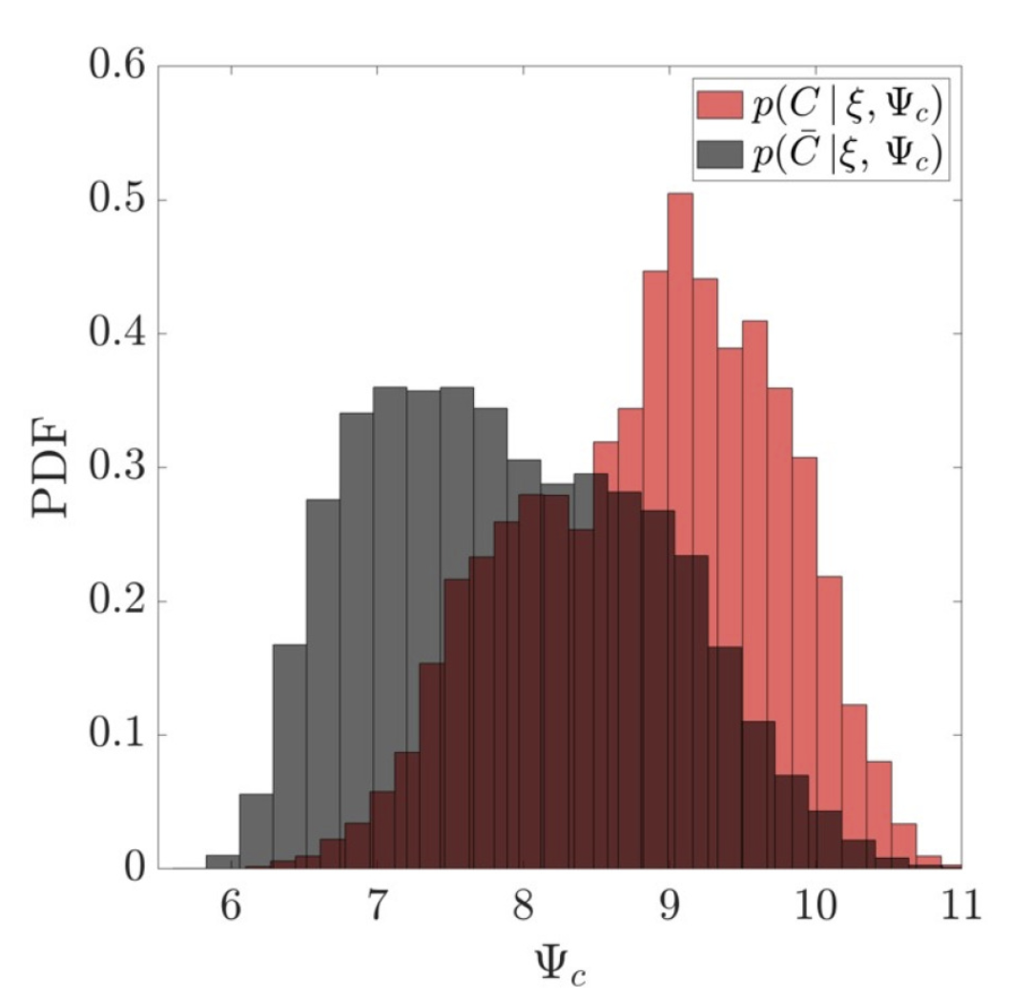
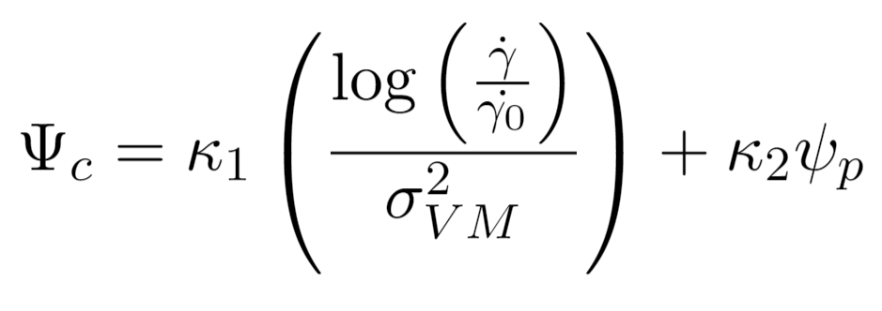
Scalar Crack Nucleation Indicator
Building a Simple One-Dimensional Model
Uncracked Regions
Cracked Regions
Linear Discriminant Analysis
Directionally dependent shear
Build up of dislocation structures

Slide 15
Concluding Remarks
Probabilistic Crack Nucleation Model
Enables crack nucleation prediction based on local material state
Yields probabilistic output to allow direct comparison between potential sites for failure
Leads to simple scalar mechanistic indicator to explain precursors of nucleation events
Generalizable set of methods for other materials and problem sets
Pinz, Weber, Stinville, Pollock, Ghosh. NPJ Comput Mater 2022

Slide 16
Additional Slides

Slide 17

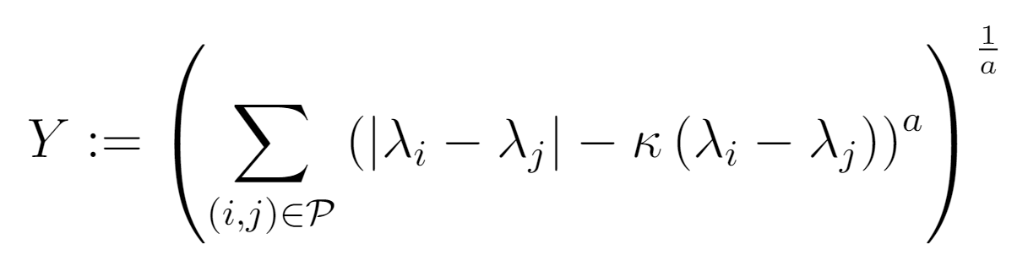
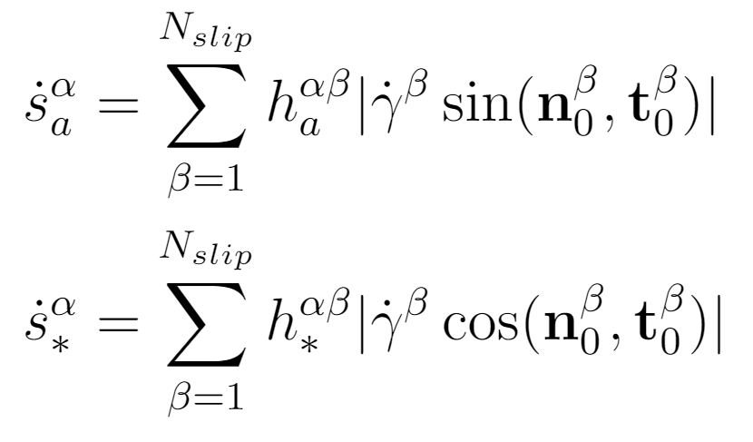


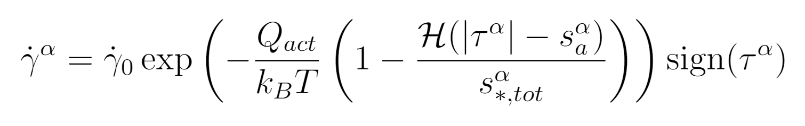
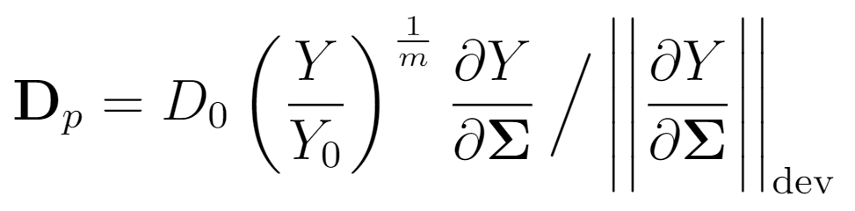
Concurrent Multiscale Model for Simulation of Polycrystals
Crystal Plasticity
Rate-dependent Elastoplasticity
Extruded Microstructure
Anisotropic Elasticity
Anisotropic Elasticity
Yield Function
Hardening Evolution
Hardening Law
Orowan Flow Rule
Homogeneous Medium
Flow Rule

Slide 18
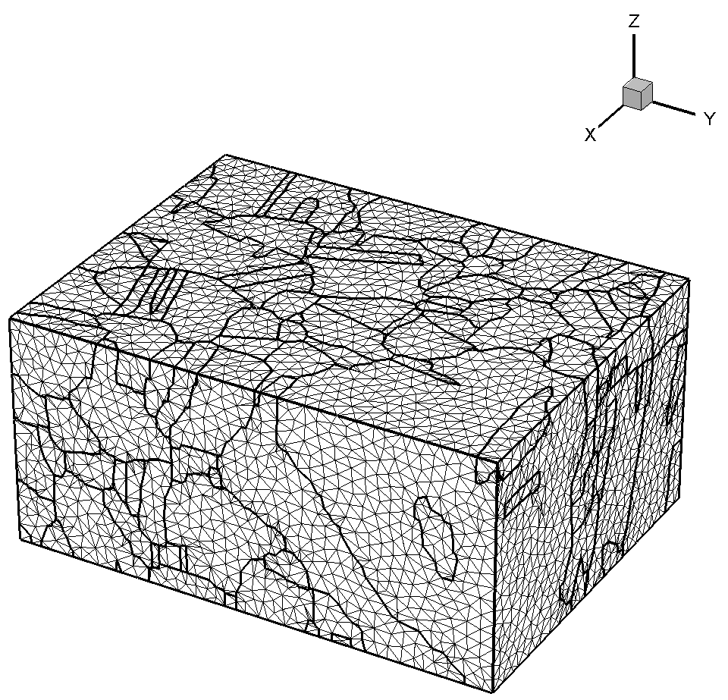
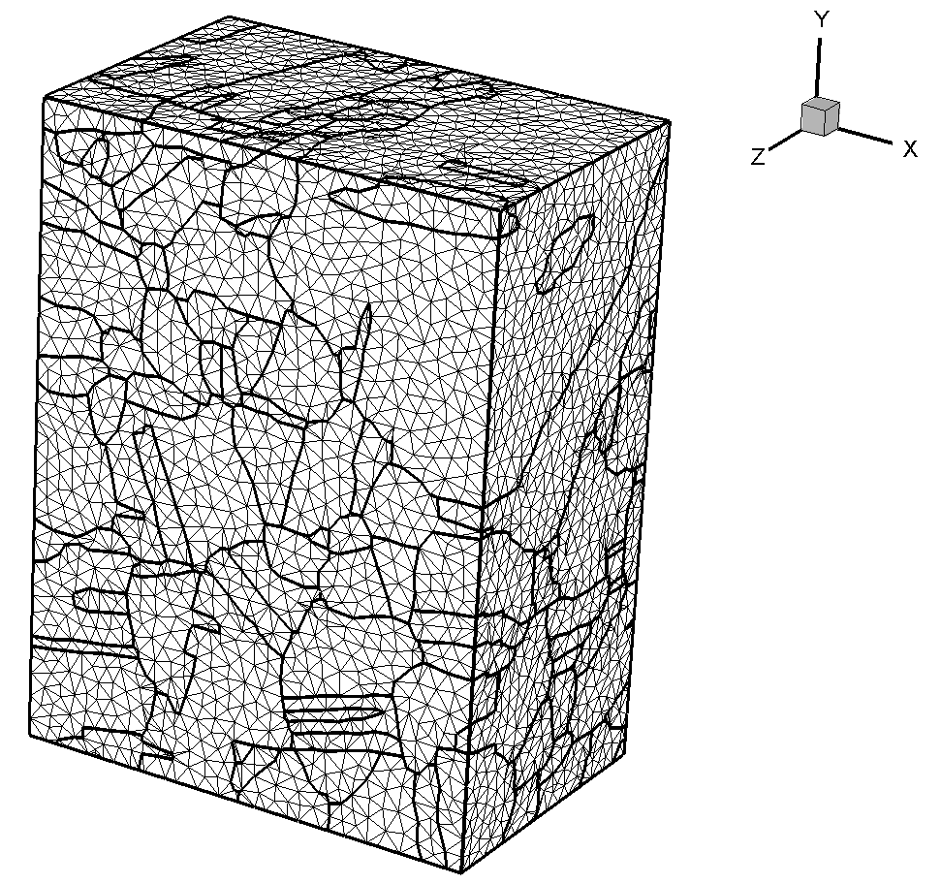
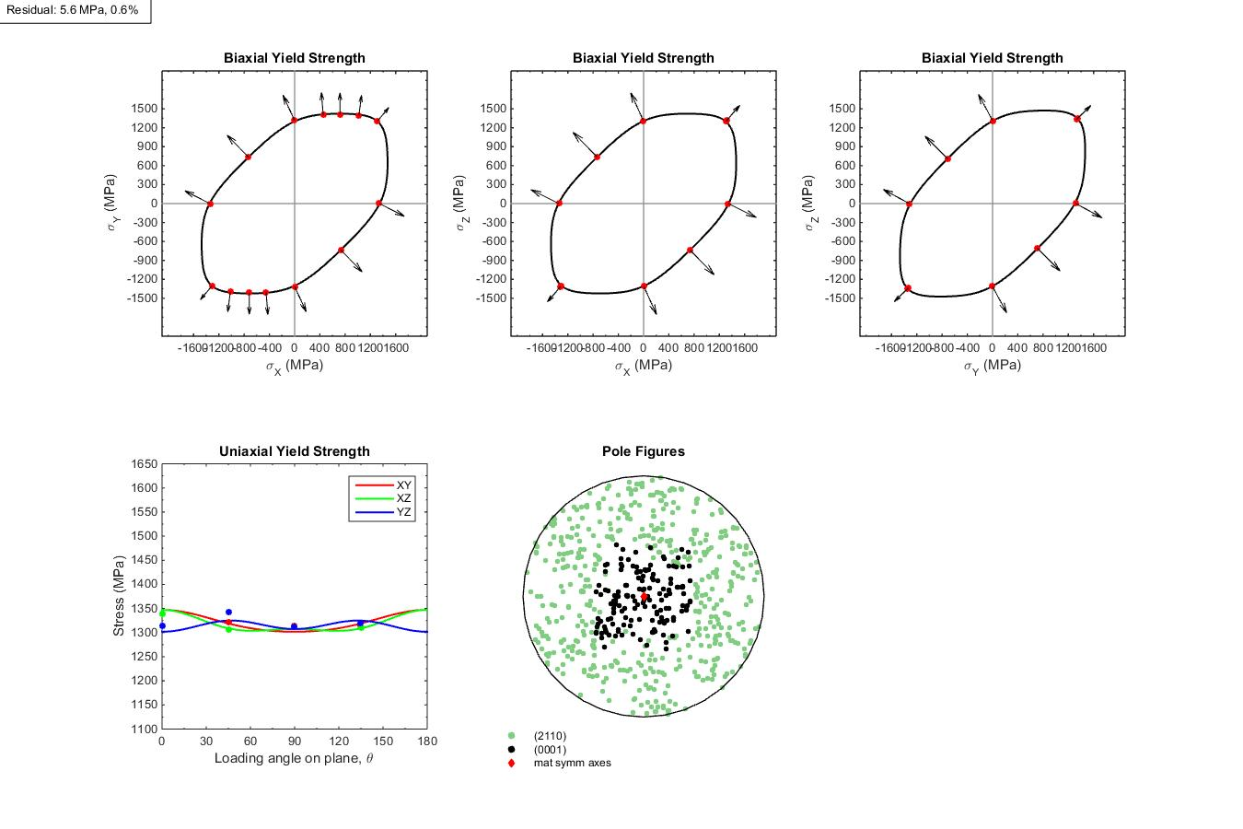
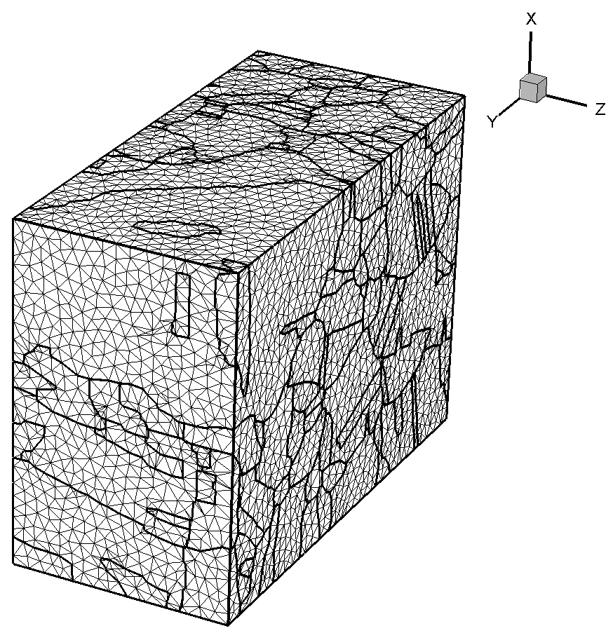
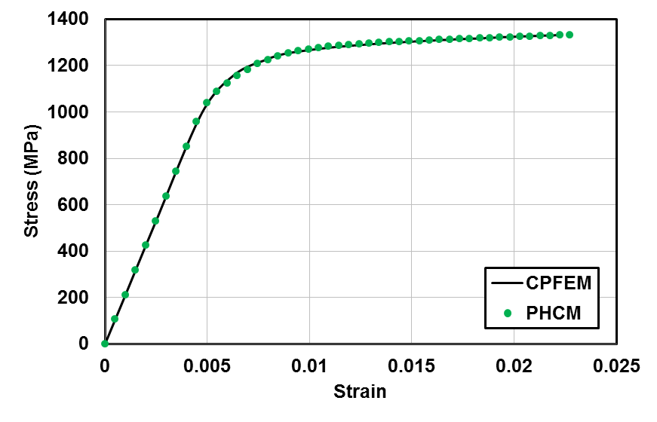
Homogenization of Crystal Plasticity Constitutive Model
Controlled Stress Loading: Mapping the Yield Function
For a given von Mises strain rate, incrementally load in a stress plane at a fixed stress ratio
Crystal Plasticity
Homogenous
θ
Constant Strain Rate: Strain Hardening
Crystal Plasticity
Homogenous

Slide 19





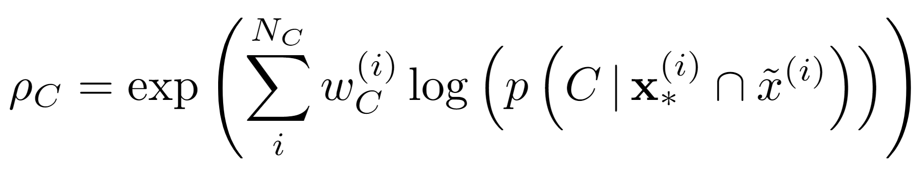
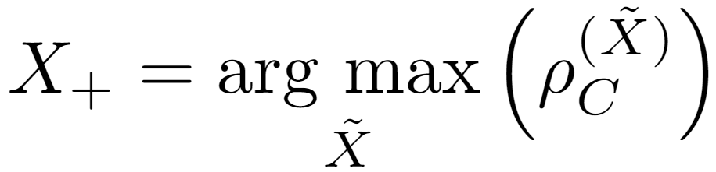
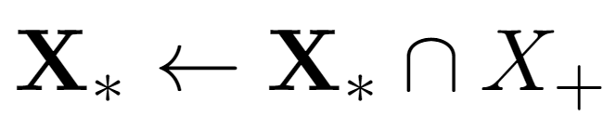
Model Selection and Order Reduction
Instead of calculating at once, the model is incrementally built
Allows the assessment of relevance of each state variable
Reduces the order of the final model
Selection algorithm to determine top state variables from data set
(Create a set for selected state variables to fill)
(Loop over number of variables needed)
(Loop over remaining variables, not already selected)
(Build model with one new variable)
(Calculate the “average” probability of correctly predicting nucleation)
(Select the most predictive state variable)
(Add this state variable to the final set)

Slide 20

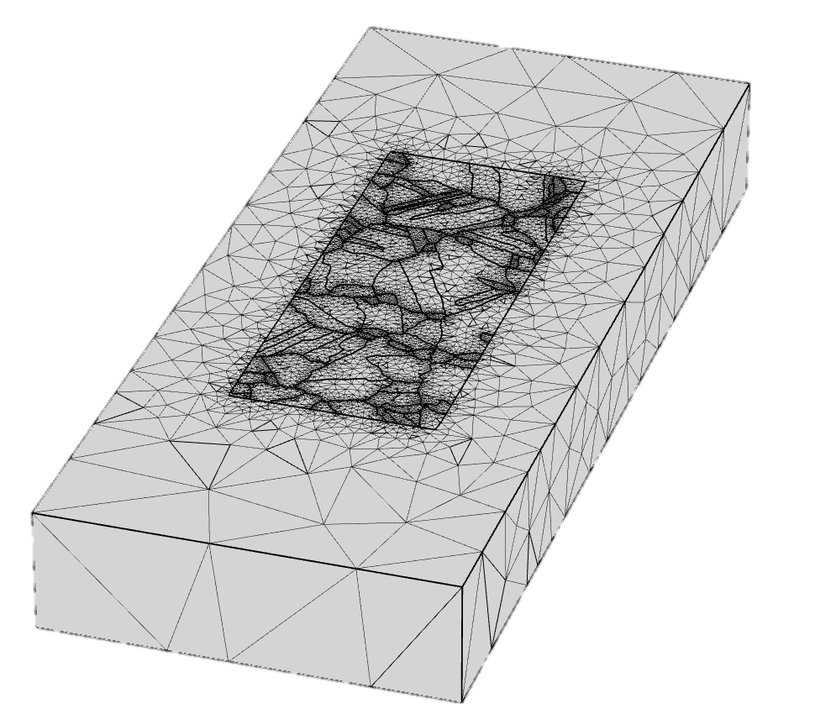
Bayesian Crack Nucleation Model Development Pipeline
Module I
Module II
Experimental Testing
and Characterization
Concurrent Multiscale Model Development
with Embedded Microstructural RVE
Module III
Module IV
Creating Database of
Microstructural State Variables
Development of a Bayesian
Crack Nucleation Model

