Slide 1
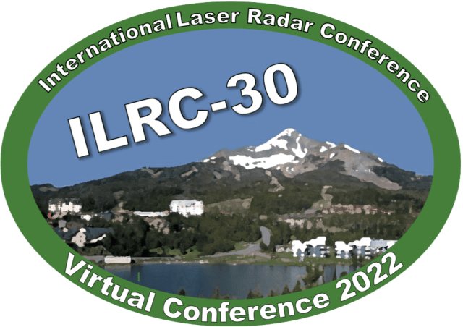
Column Optical Depth (COD) Derived from CALIOP Ocean Surface Returns
Robert A. Ryan¹, Mark A. Vaughan², Sharon D. Rodier¹, Brian J. Getzewich², David M. Winker²
¹Science Systems and Applications, Inc., Hampton, VA, USA
²NASA Langley Research Center, Hampton, VA, USA
01.Space-borne lidar missions, instruments and science
30-Jun, 12:00 (UTC)
251
The 30th International Laser Radar Conference (ILRC) virtual conference, June 26th – July 1st, 2022.

Slide 2
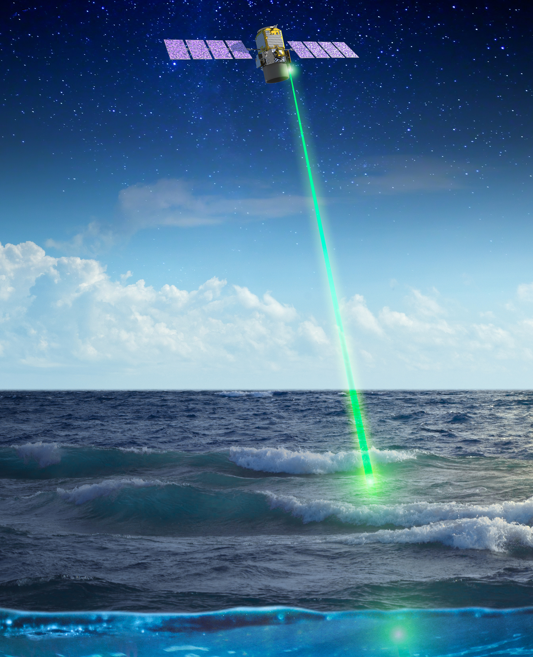
COD Derived from CALIOP Ocean Surface Returns
1
Overview
Cloud-Aerosol Lidar with Orthogonal Polarization (CALIOP) onboard the Cloud Aerosol Lidar Infrared Pathfinder Satellite Observations (CALIPSO) spacecraft
  Active direct detection of clouds and aerosols
  Estimation of optical properties
  Small but significant fraction below detection threshold
Ocean Derived Column Optical Depths (ODCOD)
  Adaptation of Venkata & Reagan 2016
  Passive style estimate of column optical properties from CALIPSO
  Mostly independent single instrument estimate of optical depth
Venkata, S.L., Reagan, J.A., Aerosol Retrievals from CALIPSO Lidar Ocean Surface Returns. Remote Sensing 8(12) 1006 (2016). https://doi.org/10.3390/rs8121006
NASA’s Cloud-Aerosol LIdar with Orthogonal Polarization, an instrument aboard the Cloud-Aerosol Lidar and Infrared Pathfinder Satellite Observation satellite launched in 2006
Credits: NASA/Timothy Marvel
The 30th International Laser Radar Conference (ILRC) virtual conference, June 26th – July 1st, 2022.

Slide 3
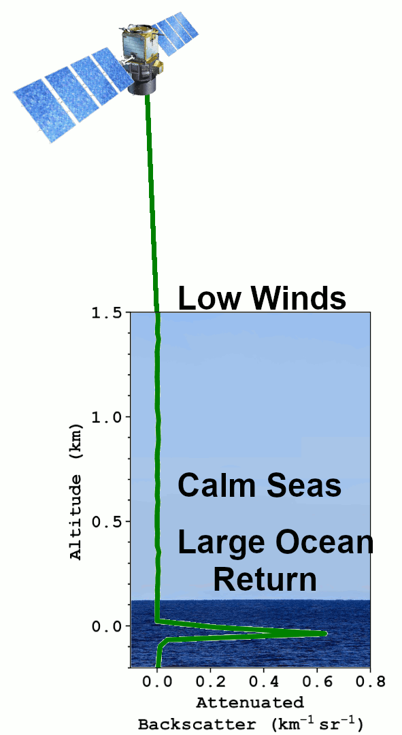
COD Derived from CALIOP Ocean Surface Returns
2
Technique
ODCOD uses the magnitude of CALIPSO's ocean surface return compared to a modeled ideal ocean return to estimate optical depth
The surface points are fit to a model lidar ocean return by an iterative shifting and scaling technique shown to the right
Only 3 measured points at 532nm and 2 points at 1064nm make up the surface return which causes the retrieval success rate to be less at 1064nm
An accurate wind speed estimate is required to calculate a model surface reflectance
Returns with surface saturation or negative surface anomalies are not attempted
Surface depolarization is tested to ensure ocean water and not sea ice or shallow water bottom is in the return
The 30th International Laser Radar Conference (ILRC) virtual conference, June 26th – July 1st, 2022.

Slide 4
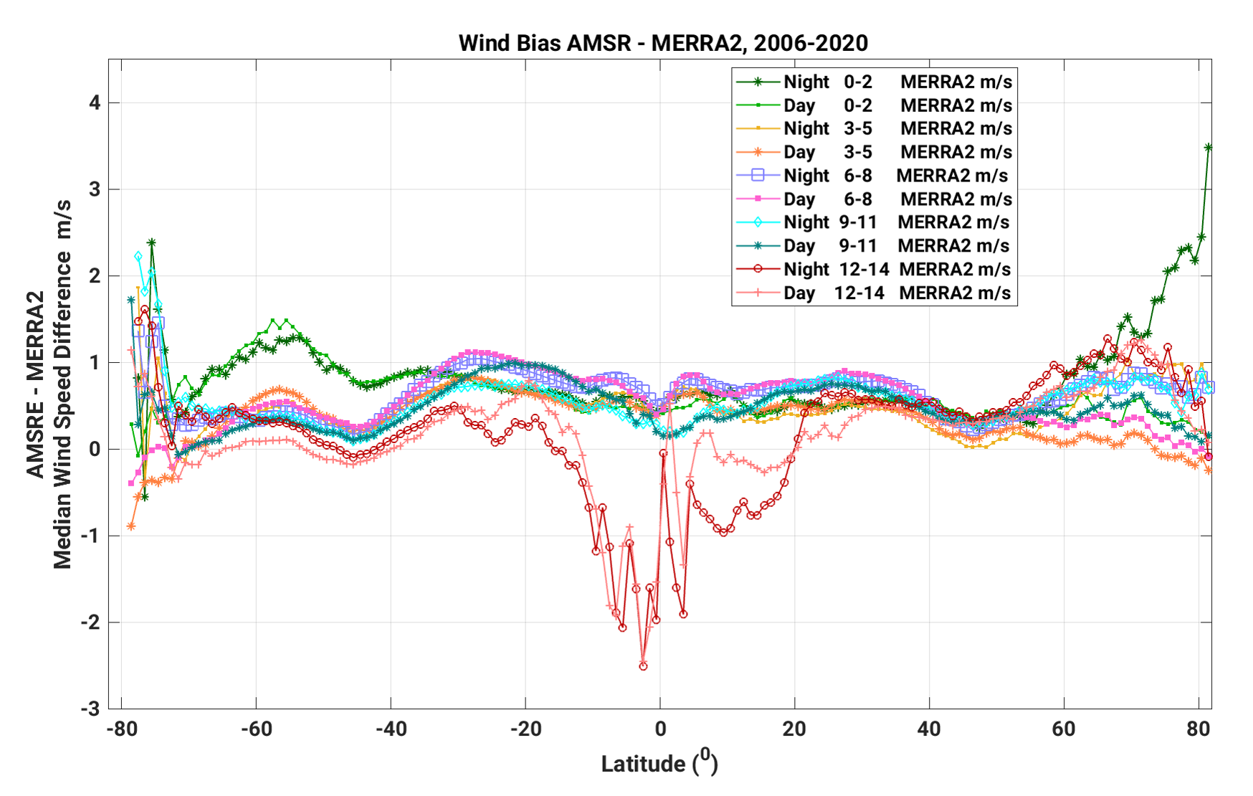
COD Derived from CALIOP Ocean Surface Returns
3
Wind Speed Inputs
ODCOD is a single instrument retrieval
ODCOD uses wind speeds from the MERRA-2 meteorological data used throughout the CALIPSO processing
MERRA-2 winds have a low bias on the order of ~0.5 m/s over ocean at 10m (Carvalho 2019)
For ODCOD, this translates to ~0.02 high bias in optical depth
Use AMSR-E winds to apply corrective scaling to MERRA-2
AMSR – MERRA-2
Wind speed groups at 3m/s apart
2006-2020 Median Values
Latitudes from 82S to 82N
Carvalho, D. An Assessment of NASA’s GMAO MERRA-2 Reanalysis Surface Winds, Journal of Climate, 32(23), 8261-8281 (2019). https://doi.org/10.1175/JCLI-D-19-0199.1
The 30th International Laser Radar Conference (ILRC) virtual conference, June 26th – July 1st, 2022.

Slide 5
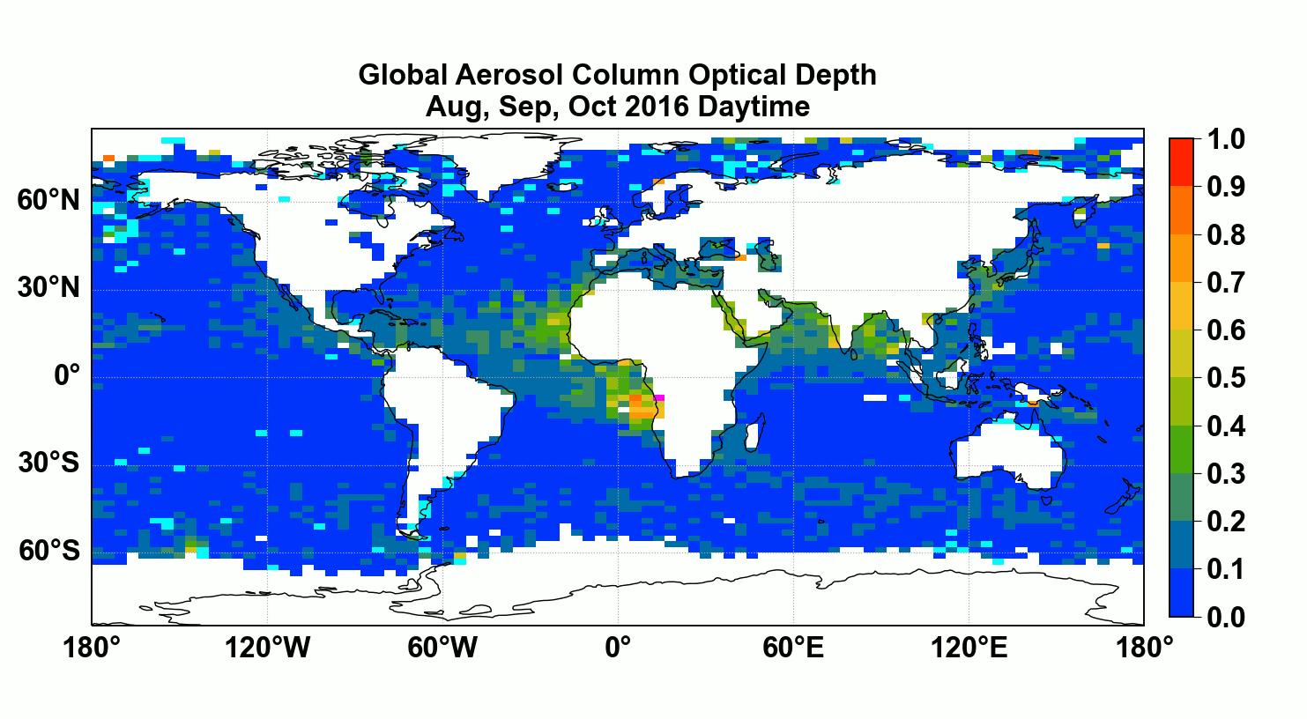
COD Derived from CALIOP Ocean Surface Returns
4
ODCOD provides optical depth estimates nearly globally over ocean during both day and night for the entire CALIPSO record
ODCOD 532 nm using AMSR-E winds
Only CALIPSO Detected Aerosols
August, September, and October 2016
The 30th International Laser Radar Conference (ILRC) virtual conference, June 26th – July 1st, 2022.

Slide 6
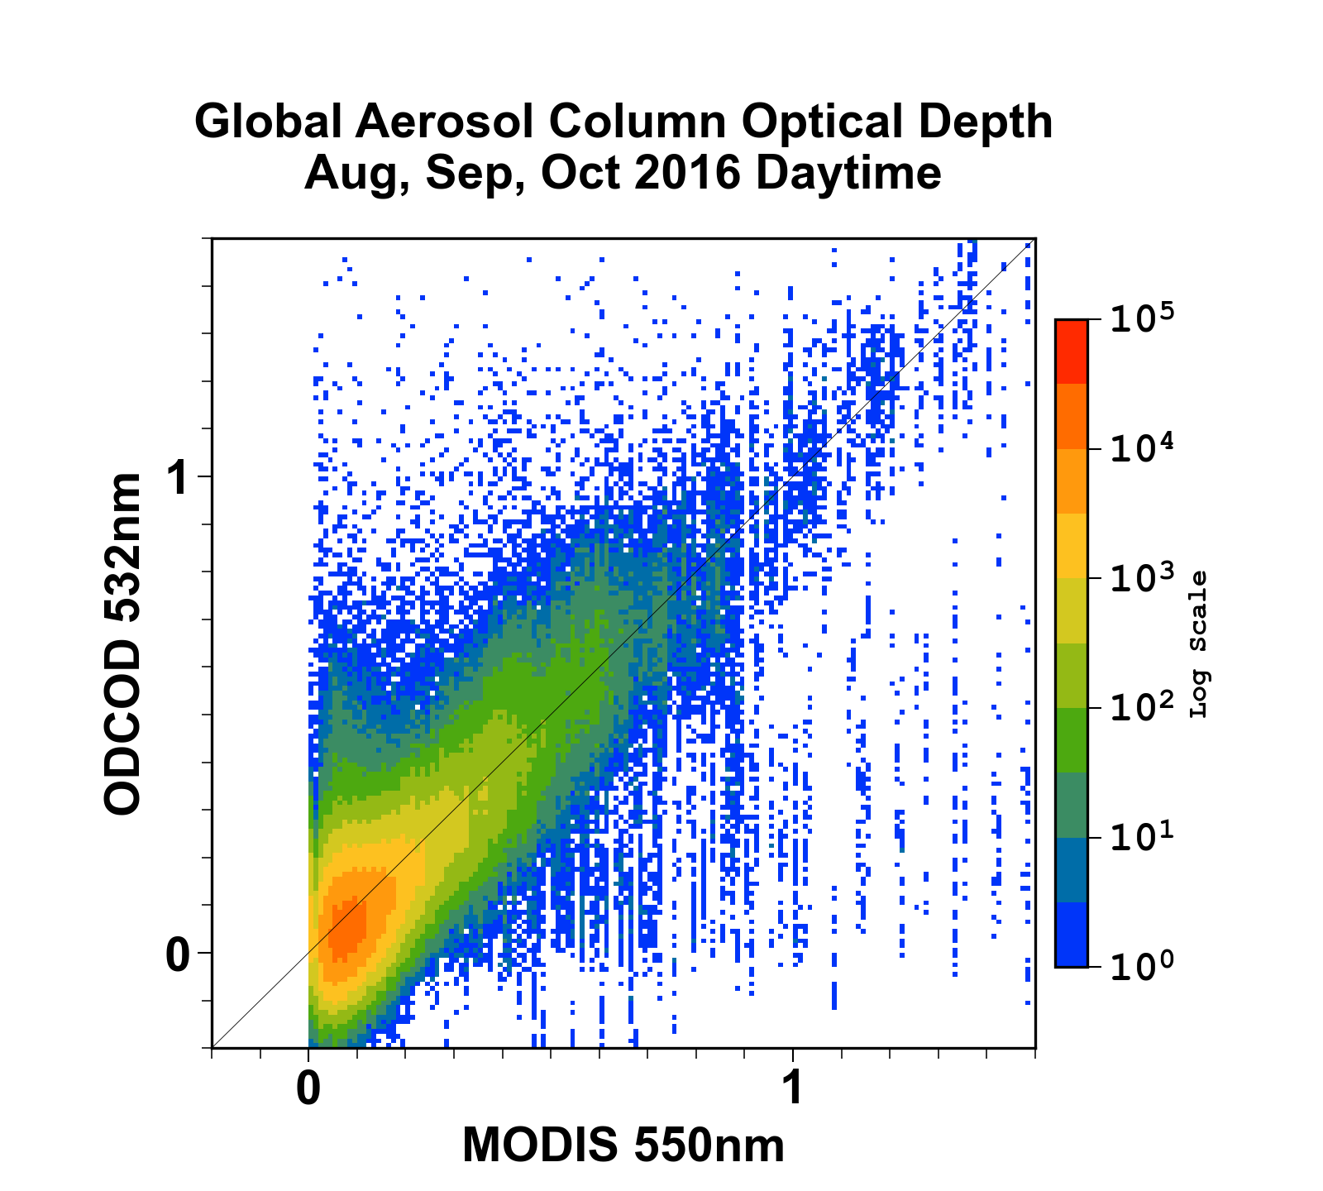
COD Derived from CALIOP Ocean Surface Returns
5
ODCOD 532nm using AMSR-E winds compared to MODIS 550nm
Daytime
August, September, & October 2016
No Clouds detected by CALIPSO
Median difference 0.0275 (MODIS higher)
  Possibly due to MODIS cloud contamination
Note: Vertical striping due to different spatial resolutions (333 m footprint vs MODIS 10 km×10 km pixel)
The 30th International Laser Radar Conference (ILRC) virtual conference, June 26th – July 1st, 2022.

Slide 7
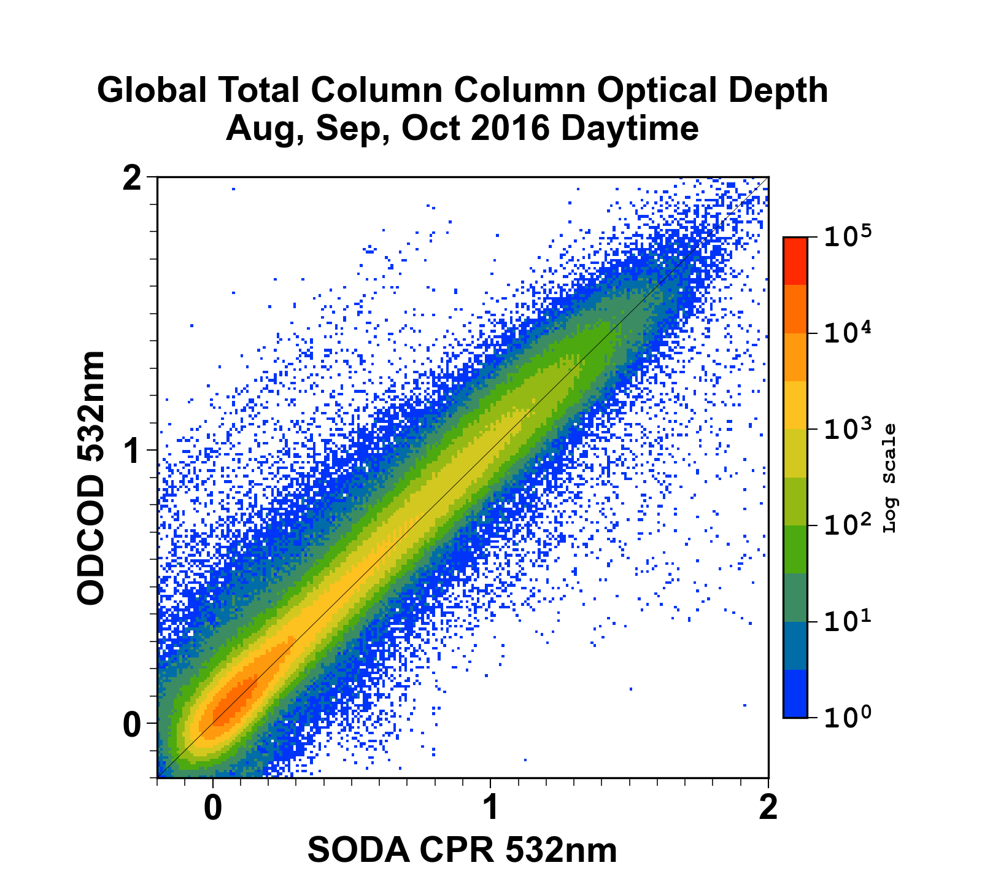
COD Derived from CALIOP Ocean Surface Returns
6
ODCOD 532nm using AMSR-E winds compared to SODA CPR
Daytime
Both Thin Clouds and Aerosols
August, September, & October 2016
All profiles
Median difference 0.0085 (SODA CPR higher)
Median difference 0.0008 for Aerosols only (SODA CPR higher)
SODA (Synergistic Optical Depths of Aerosols) CPR (Cloud Profiling Radar) is a multi-instrument technique that relies on CloudSat and AMSR and uses, among other things, a very different surface return estimation technique but has been validated as having acceptable optical depth estimates.
The 30th International Laser Radar Conference (ILRC) virtual conference, June 26th – July 1st, 2022.

