Slide 1
Automated Airspace Management: Concept, Development, and Testing
Todd Lauderdale
NASA Ames Research Center
June 2, 2022

Slide 2
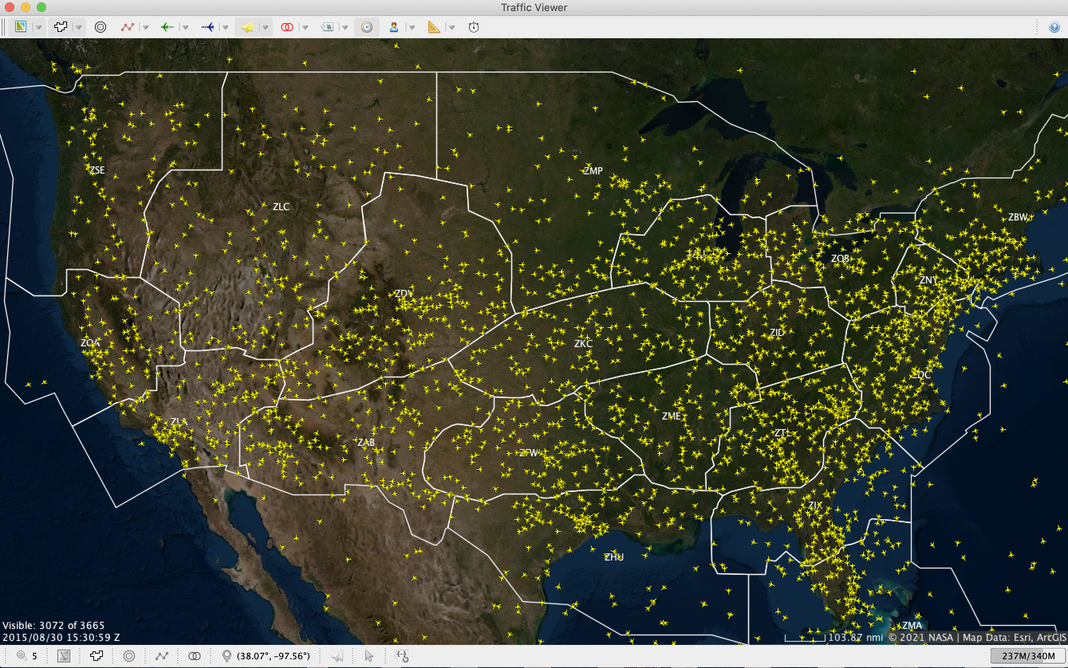
Airspace Management

Slide 3
Main Functions of Airspace Management
Ensuring resource capacity
Ensuring separation between aircraft
Merging and spacing for arrival
Avoiding weather and other restricted areas

Slide 4
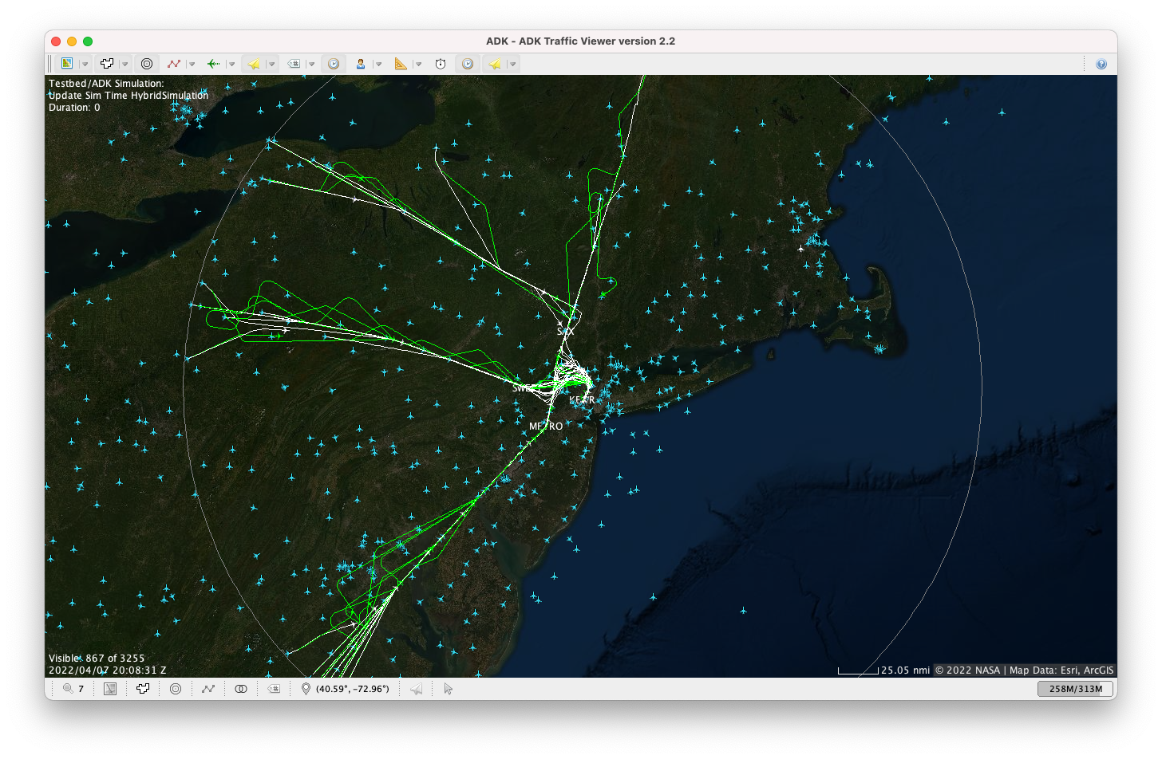
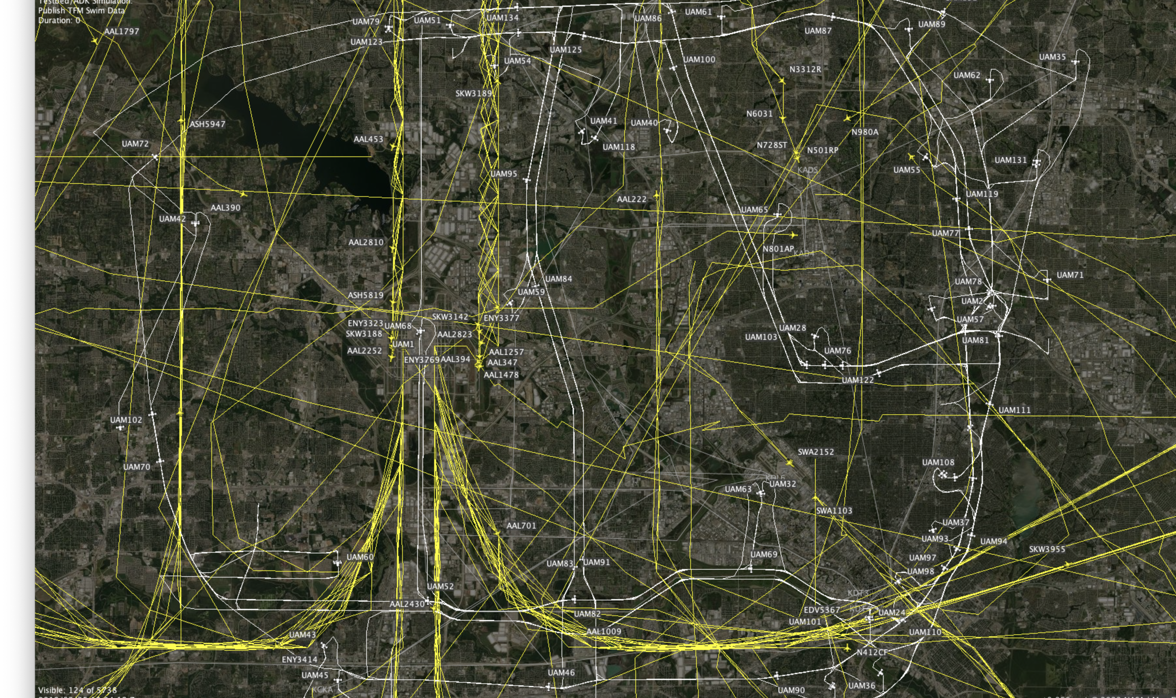
Diverse Operations
Conventional Operations
Urban Air Mobility
Unmanned Aircraft Systems

Slide 5

Current Operations
Humans make most discissions about how to ensure efficient and safe operations
Human-centric control introduces inefficiencies and integration challenges
  Operational restrictions such as level-outs during climb and descent
  Aircraft count restrictions due to cognitive load
  Rigid procedural separation
  Difficulty managing non-standard operations

Slide 6

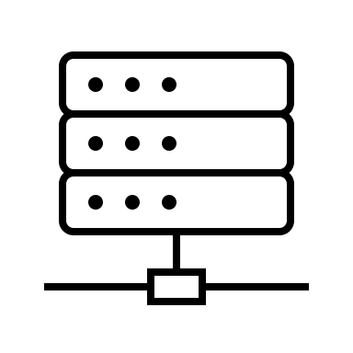
Why Automation?
Deal with aircraft at the trajectory level, treating all aircraft types equally
Fast computers and parallelization lead to easy scaling
Trajectories can be continuously optimized by users or the system

Slide 7
Autonomy for Conventional Operations

Slide 8
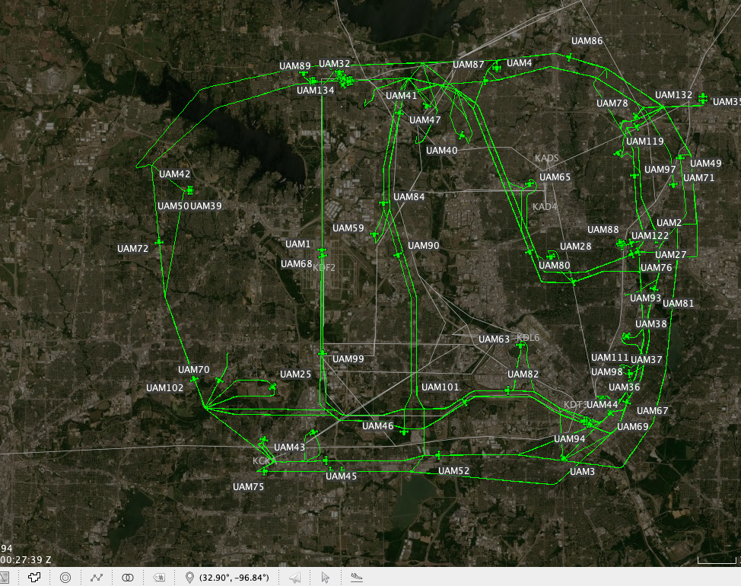
Autonomy for New Operations

Slide 9
Autoresolver
Conflicts
Arrival Merging and Spacing
Weather Avoidance
Automated tool to handles issues that R-side controller manages
Solves things at the trajectory level in an integrated fashion
Continuous development since about 2005

Slide 10
High-Level Procedure
Autoresolver
National
Airspace
System
Aircraft States
Predicted Trajectories
Trajectory
Prediction
Problem
Detection
Iterate
List of Problems
Trial Resolutions
Problem
Solver
Resolutions (After all Iterations Complete)
Notes:
Pair-wise conflict resolution. No coordinated maneuvers (only maneuver one aircraft)

Slide 11
Problem Solving
Performs an optimization through the solution space
The optimization is constrained by rules-based logic
Horizonal, vertical, speed and combination maneuvers are explored
A1
Mach
A2
Time

Slide 12
“Proving” Autonomy
To be accepted, autonomous systems need to be demonstrated in a realistic environment
They must both be proven to be safe and to perform the desired role and to provide benefits to the user
Flight-test can be very expensive and should be reserved for the final step because of safety issues
The limits of the system must also be determined by testing in as many different situations as possible
Therefor a highly realistic simulation capability is required

Slide 13


National Airspace System (NAS) Digital Twin
Built on NASA’s Testbed simulation capability
Decades of historical Data
Aircraft dynamics models
Fast-time and real-time simulation capabilities
Easy integration of new algorithms (API)
Blended simulated and historical operations
Historical Data
Algorithms
Algorithm API
Testbed

Slide 14
Autoresolver and NAS Digital Twin Examples
Autoresolver management of flights into Newark
Separation of UAM aircraft in a complex network

Slide 15
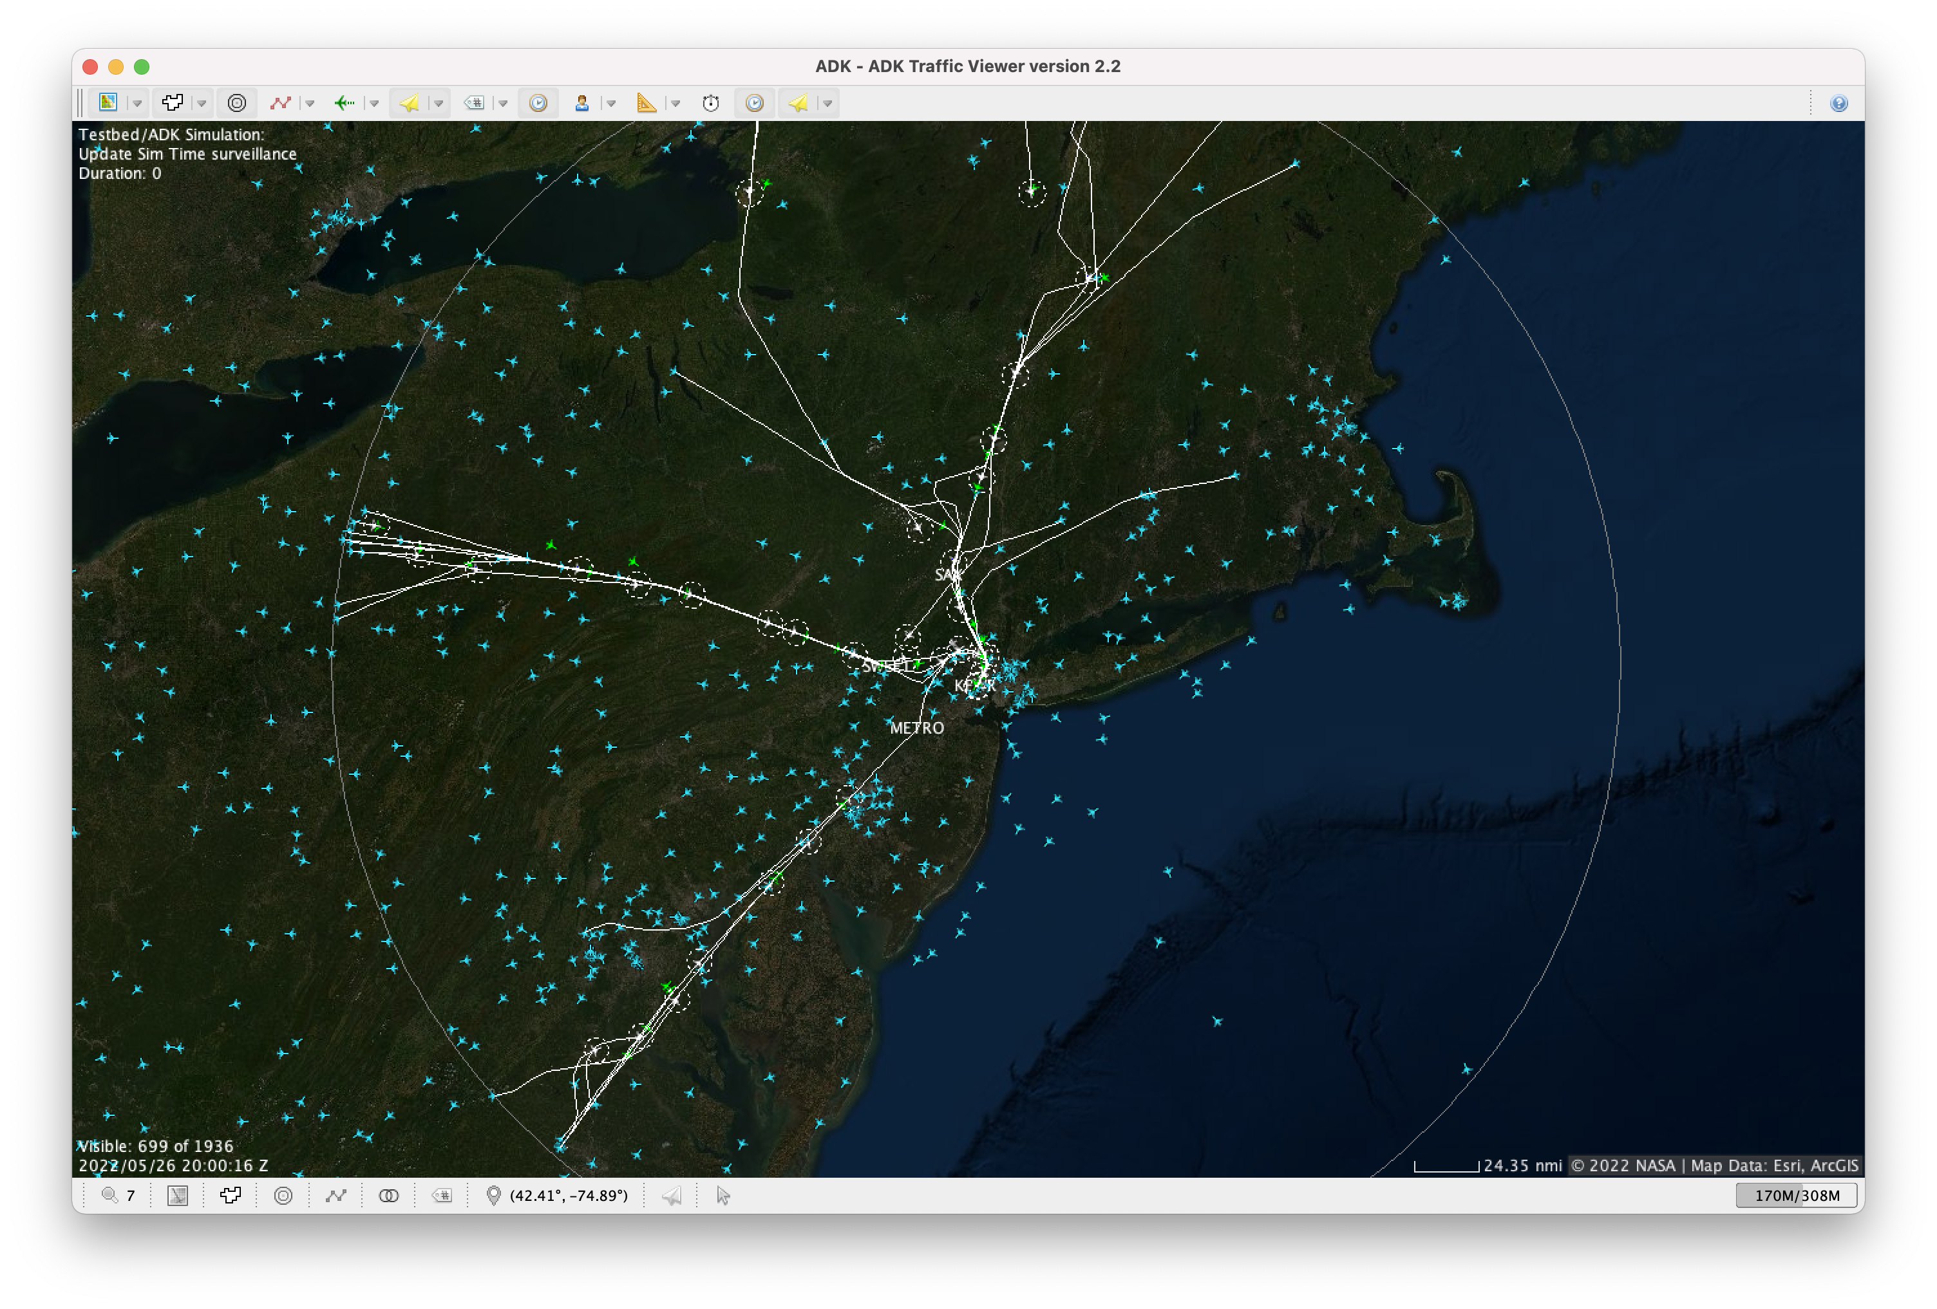
Efficient Arrivals into Newark
Playback historical traffic data for any day
250 nm from Newark,
twin each arrival flight
Manage twinned flights autonomously
Compare trajectory- and system-level performance against historical results

Slide 16
Autonomous Arrivals
Meter Fixes
Schedule to runway
Assign delay to fixes
Use Autoresolver to safely meet scheduled times at fixes
Take required delay at cruise altitude
Reduces noise and fuel burn
Increases predictability and controllability
Runway

Slide 17
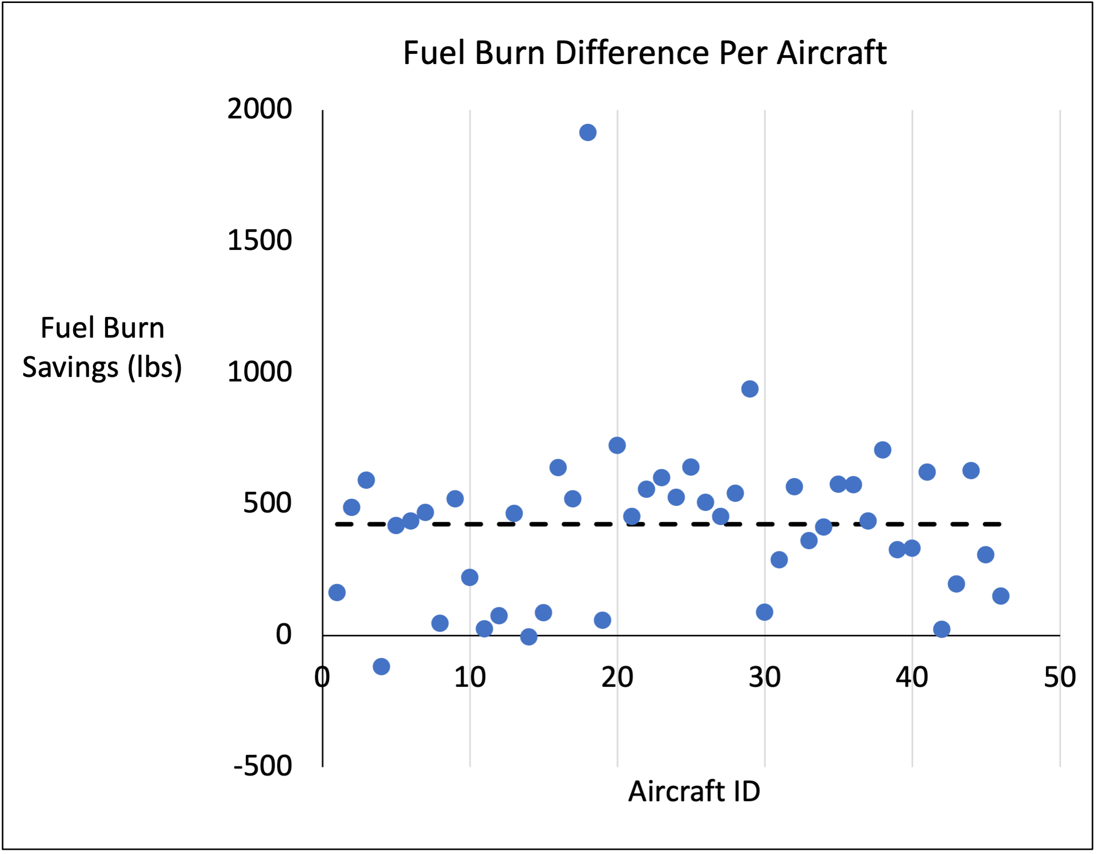
Newark Arrivals: Fuel Burn Comparison
420 lbs/aircraft
Notes:
Lauderdale presents
Can’t do this study without Testbed; Also can’t do it only with Testbed.
This was done by extending Testbed with Sherlock, TAM algorithms and ADK to form a Digital Twin of the Newark Arrival process.
Alternative to fast-time would be to feed live SWIM data and wx data and let the TAM algorithms run. Compile the data over days, weeks or months.

Slide 18
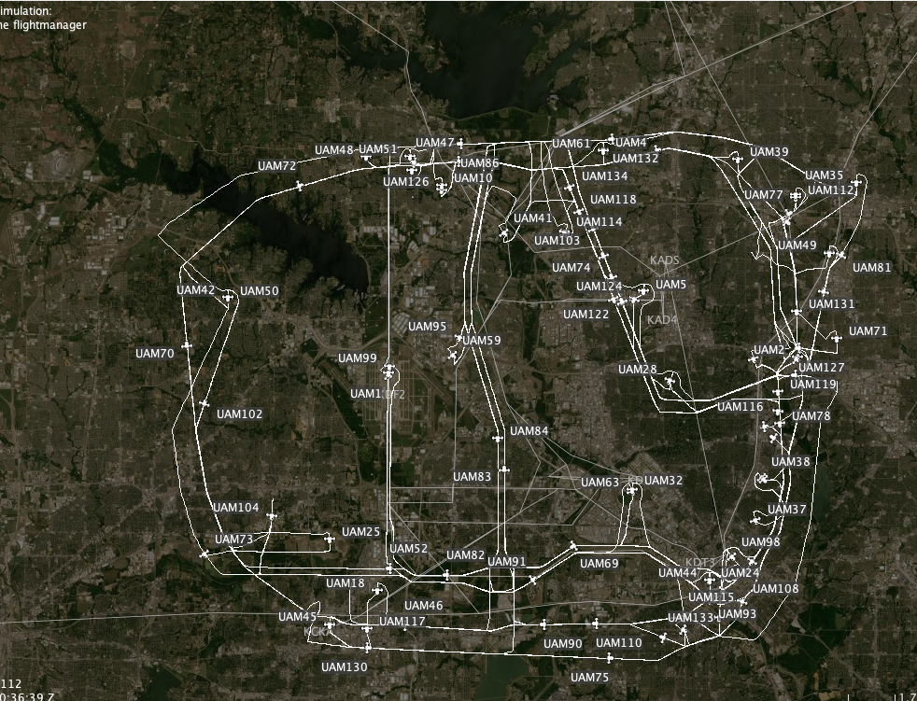
Managing a Complex UAM Network
Network of UAM operations over the Dallas/Fort Worth area
Large number of aircraft operating in a tight airspace
Autoresolver manages departures and separation in the network

Slide 19
Integrating Autonomous Algorithms
Aircraft Issues
Aircraft Separation
See and Avoid
See and Avoid
Autonomous Airspace Management
Scheduling
Aircraft Issues
Aircraft Separation
Etc…
Etc…
Airport Configuration
Airport Configuration
Scheduling
Add all functions to one algorithm
Decompose into independent algorithms

Slide 20
Higher-Level System to Enable Decomposition
Executive Reasoner
See and Avoid
Aircraft Issues
Aircraft Separation
Etc…
Airport Configuration
Scheduling

Slide 21
Thanks!
todd.a.lauderdale@nasa.gov

