Slide 1
Development of Slat-gap and Slat-cove Filler Treatments for Noise Reduction Assessment on the High-Lift Common Research Model in the NASA LaRC 14x22
Turner, T. L.∗, Mulvaney, J. W.†, Lockard, D. P.‡, Allen, A. R.*, and Brynildsen, S. E.§
*Structural Acoustics Branch
†Space Mission Analysis Branch, formerly Aeronautics Systems Engineering Branch
‡Computational Aerosciences Branch
§Analytical Mechanics Associates
NASA Langley Research Center
28th AIAA/CEAS Aeroacoustics Conference, June 14-17, 2022

Slide 2
Companion Papers
A/HLN-01, Tuesday 06/14
Aeroacoustic Simulations of the High-Lift Common Research Model and Validation with Experiment
  Lockard, D. P., Choudhari, M. M., and Vatsa, V. N.
Phased Array Characterization of Slat Noise Radiation from the High-Lift Common Research Model
  Humphreys Jr., W. M., Lockard, D. P. and Bahr, C. J.
ATT-02, Tuesday 06/14
Accounting for the Influence of Decorrelation in Microphone Phased Array Deconvolution Methods
  Bahr, C. J.
A/HLN-06, Thursday 06/16
On the Alleviation of Background Noise for the High-Lift Common Research Model Aeroacoustics Test
  Hutcheson F. V., Lockard D. P., Stead D. J.
Notes:
Last of 5 papers on the test of the CRM-HL in the NASA LaRC 14x22 completed in the spring of 2021
Two highlighted papers offer computational results and wind tunnel measurements of the performance of treatments described in this paper.

Slide 3
SGF Aerodynamic and Acoustic Performance
2020 14x22 Experiment
Lift
Noise
Notes:
Sample wind tunnel test results demonstrating aerodynamic and aeroacoustic success of SGF treatment

Slide 4
Outline
Objective – Describe noise reduction advancements and model design features necessary to demonstrate slat noise reduction on a large wind tunnel model with flight-like treatments
High-Lift Common Research Model (CRM-HL)
Legacy slat-gap filler (SGF) and slat-cove filler (SCF) concepts
SGF & SCF advancements for 3D CRM-HL
Aerodynamic loads and SGF/SCF sizing
Treated CRM-HL design
Concluding Remarks

Slide 5
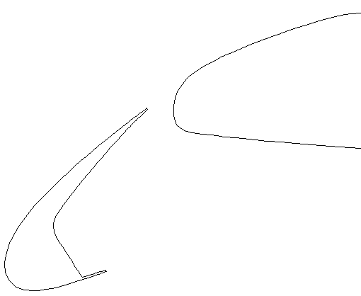
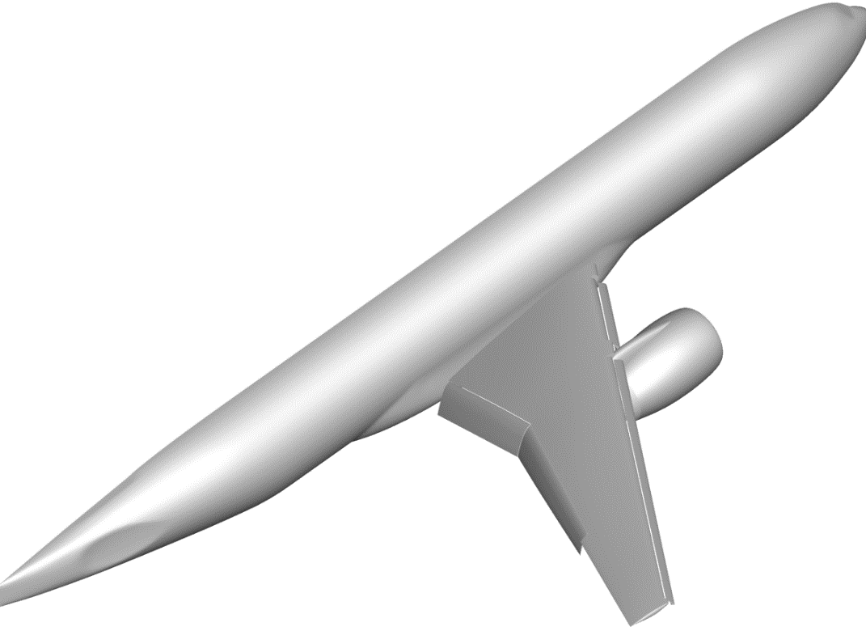
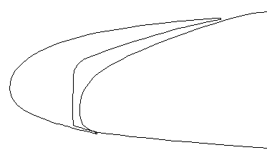
CRM-HL and Legacy SGF & SCF Concepts
High Lift Common Research Model (CRM-HL)
2D Slat-Gap Filler (SGF)
2D Slat-Cove Filler (SCF)
Deployed
Main wing
Main wing
Inboard (IB) slat
SGF
SCF
Slat
Slat
Main wing
Outboard (OB) slat
Retracted
Flaps
Boeing-NASA collaborative geometry
Nonproprietary
Represents twin-aisle transport
Blocks gap flow
Overleaf to stressed skin
Stress free deployed/retracted
Conformal transition geom.
Guides gap flow
Reconfig. addition to slat
Stress free when deployed
Noise minimization geom.
Notes:
CRM-HL developed under Boeing-NASA collaboration as a testbed for airframe noise reduction research among other things
Represents a twin-aisle commercial transport
Wind tunnel model is semispan
Pylon and flow-through nacelle
SGF and SCF are focus of this study for slat noise treatments
Legacy SGF shown here
Blocks gap flow under all normal circumstances
Overleaf of stressed skin on main wing
Trades between SFD and SFR
Envisioned as conformal transition geom.

Slide 6
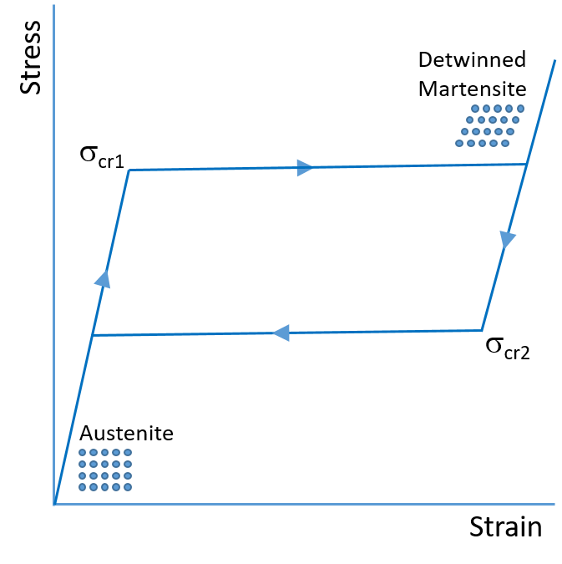
CRM-HL and Legacy SGF & SCF Concepts
Superelastic Shape Memory Alloy (SMA)
2D Slat-Gap Filler (SGF)
2D Slat-Cove Filler (SCF)
Deployed
Main wing
Main wing
Main wing
SGF
SGF
SCF
Slat
Slat
Slat
Retracted
Blocks gap flow
Overleaf to stressed skin
Stress free deployed/retracted
Conformal transition geom.
Revert to baseline in anomaly
Guides gap flow
Reconfig. addition to slat
Stress free when deployed
Noise minimization geom.
SGF & SCF incur large deformation
Superelastic SMA of main interest
Passively reconfigures under articulation loads
Notes:
Legacy SGF shown here
Blocks gap flow under all normal circumstances
Overleaf of stressed skin on main wing
Trades between SFD and SFR
Envisioned as conformal transition geom.
Opens in emergency
Legacy SCF shown here
Guides gap flow to reduce unsteadiness
Attaches to slat cusp and TE, reconfigurable but fixed length
Stress free deployed
Shaped to minimize noise
SGF for most of wingspan and all of SCF incur large strain during reconfiguration – demanding unconventional material – SMA
Superelasticity is the main interest in this work, but shape memory effect being studied
Superelastic SMA deforms by stress-induced transformation under articulation loads to reconfigure in application

Slide 7
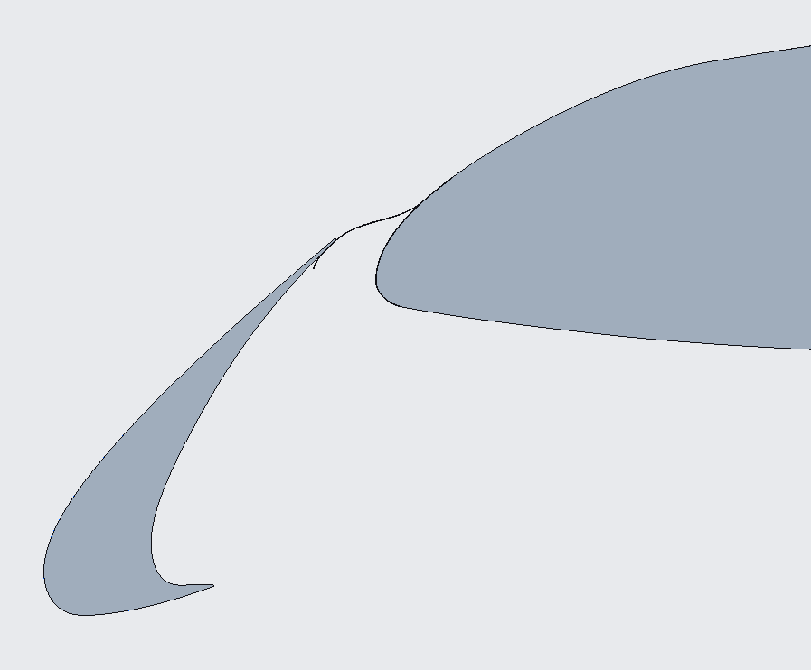
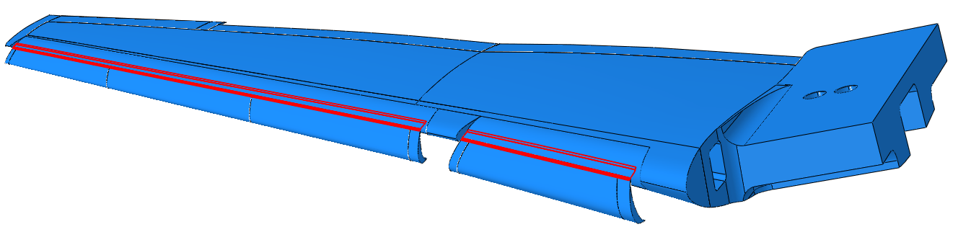
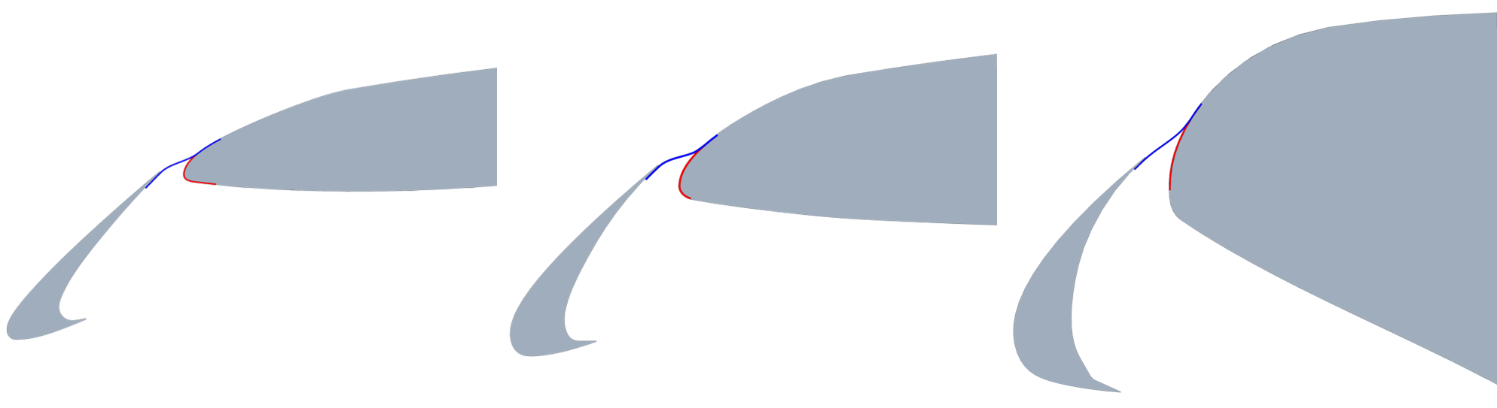
SGF Advancement for 3D CRM-HL
OB Slat Midspan Section
SGF Deployed Geometry and Cross Sections
Conformal SGF
Baseline SGF (deployed)
Main wing
Main wing thickness
OB slat
IB slat
Deployed SGF
Wing under slat surface
(WUSS)
Gap
Baseline SGF (retracted)
Outboard
Midspan
Inboard
Retracted SGF
Slat
3D geometry challenges – slat gap/wing thickness variation
SGF curvature varies greatly w/ spanwise position
  Reconfiguration strain requirement - SMAs
  Configuration/actuation strategy
3D simulations substantiated SGF treatment for testing
CRM-HL slat position dissimilar to others studied
Conformal SGF geometry not practical
SGF geometry rules developed
Notes:
3D CRM-HL presented many challenges to SGF implementation
First – slat is high
Conformal geom. not practical
Rules developed to result in reasonable compromise – presents adverse slope to flow
Second – slat gap/wing thickness variation most difficult 3D challenge
SGF curvature varies greatly
SMA required for much of airframe
Competing objectives achievable via gradients in thickness, material properties, and prestress
Modifications to mechanization also possible
3D simulations substantiated baseline SGF for testing

Slide 8
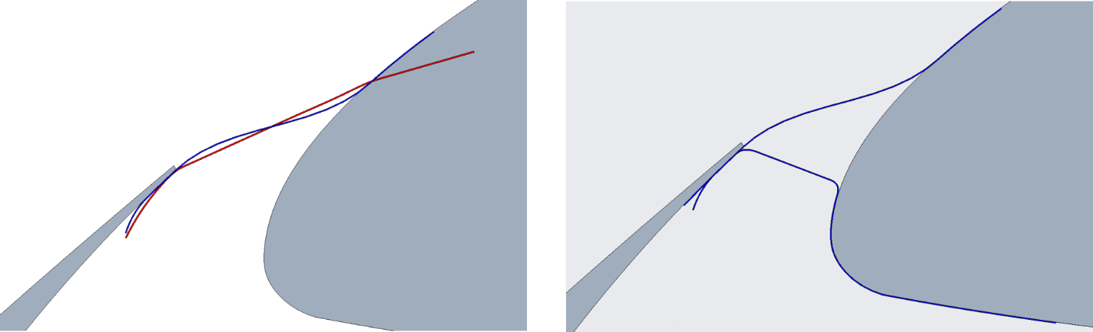
SGF Advancement for 3D CRM-HL
Baseline SGF
Baseline SGF
Main wing
Main wing
Slat
Slat
Alternative baseline
Min-distance
Baseline SGF CFD/CAA results showed no decrement in aerodynamics or aeroacoustics
Geometric insensitivity
  Confidence in Baseline SGF approach
  Opportunity to explore other SGF concepts – Alternative Baseline, Min-Distance
  Opportunity to explore flow resistive or porous SGF
  Aluminum solid and porous Alternative Baseline and Min-Distance for cost/time savings
Notes:
Recall experimental results shown on slide 3
Early CFD and CAA analysis performed to assess effect of adverse geometry imposed by baseline SGF showed similar promising results of no decrement to aero or acoustics
Insensitivity of flow to SGF geometry led to three observations…

Slide 9
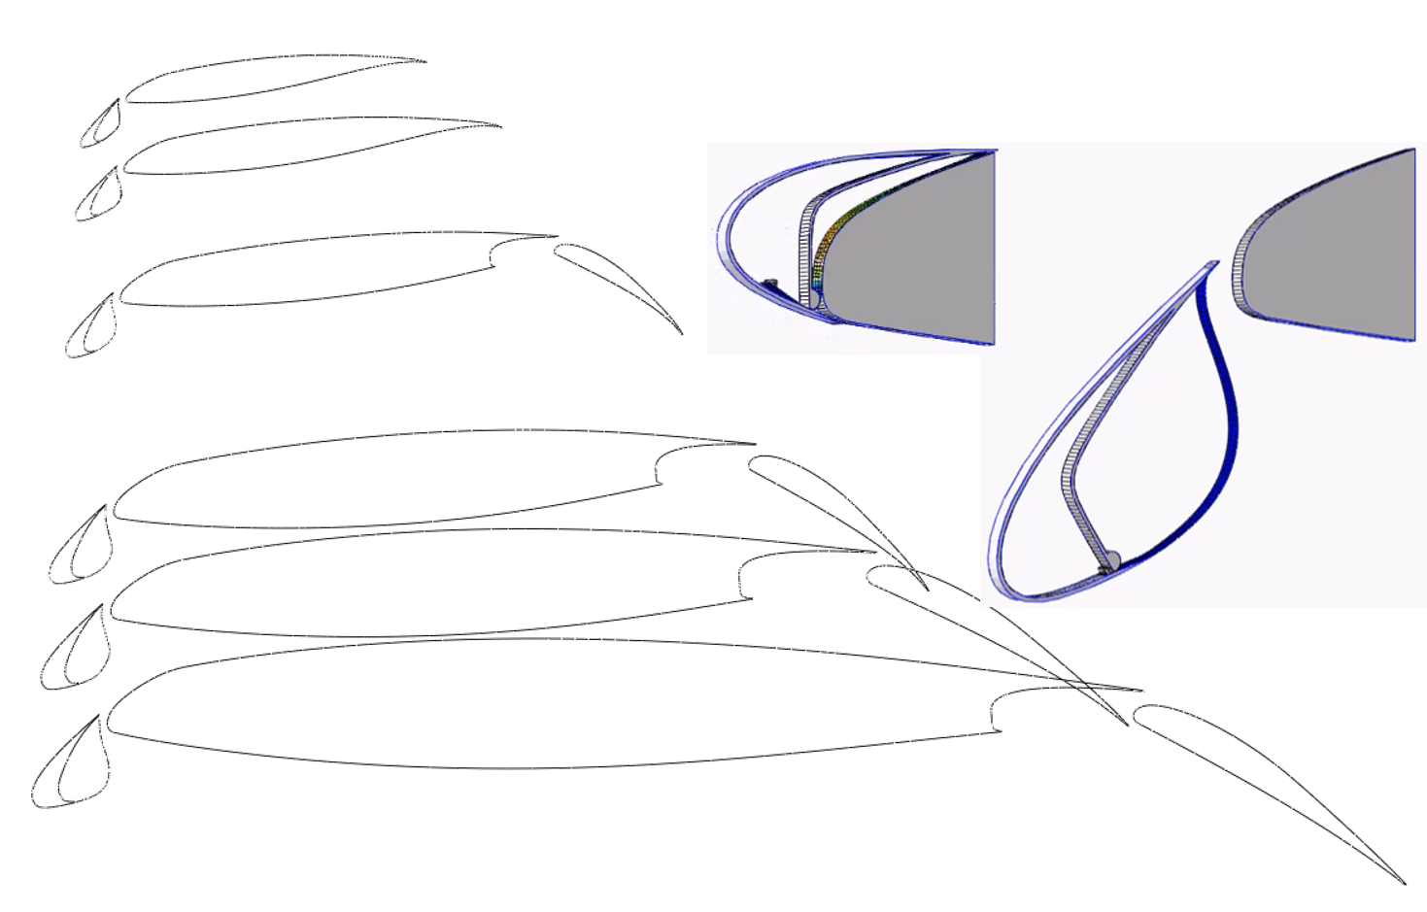
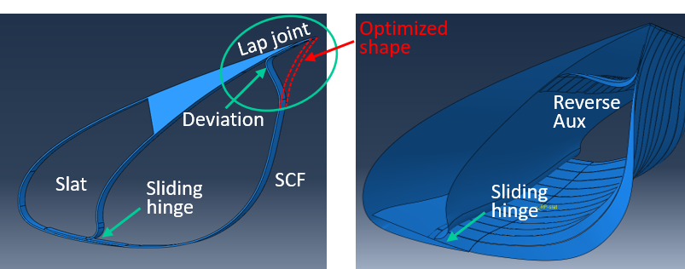
SCF Advancement for 3D CRM-HL
Sliding Flexure Hinge
Auxiliary Components
Retracted
Deployed
OB Section: SCF/cove ≈ 1
SCF profile
Chord
Slat cove profile
Steep angle between SCF and slat at TE
Leagacy deviation for lap joint incompatible
Aux component enables adherence to optimal shape
Variants exist – Rev Aux only option at 10% scale
3D simulations substantiated SCF treatment
Thickness
IB Section: SCF/cove >> 1
Slat thickness/chord dissimilar to previous airframes studied
SCF/cove ratio large and varies greatly
Baseline fixed length SCF incompatible
Sliding flexure hinge enables dynamic balancing of kinematics and deformation
Notes:
Similarly, 3D CRM-HL presented many challenges to SCF implementation
Slat thickness/chord greater than others studied
SCF/cove ratio incompatible with baseline fixed length SCF
Sliding flexure hinge enables autonomous balance of kinematics and deformation
Steep angle between SGF and slat at TE made legacy deviation method for lap joint impractical
Auxiliary components allow adherence to optimized shape
Reverse aux is the only option at model scale
3D simulations substantiated SCF for testing

Slide 10
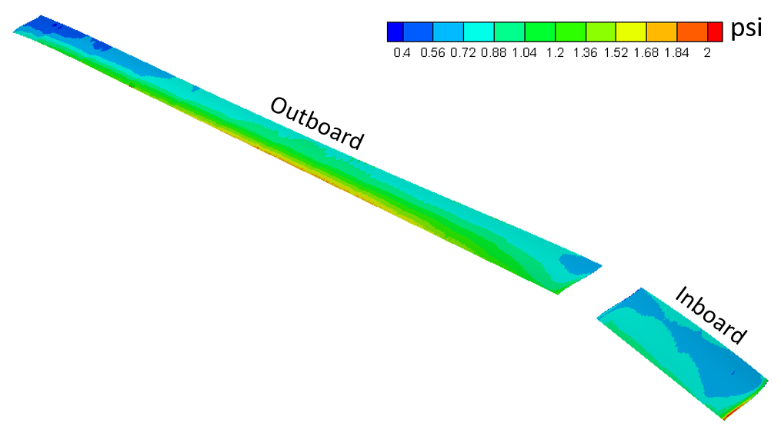
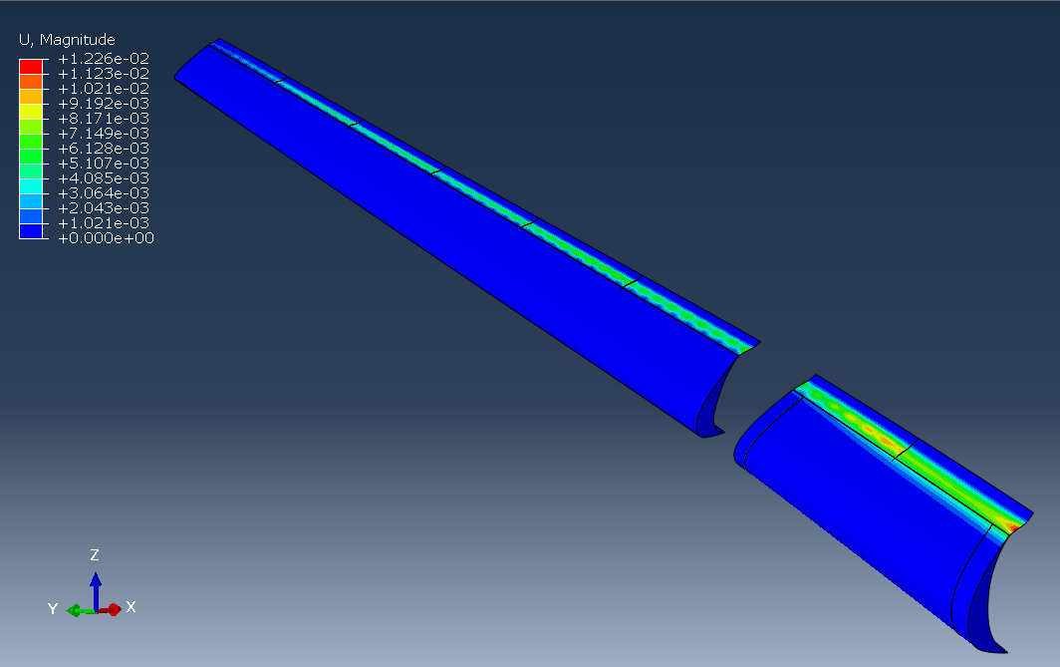
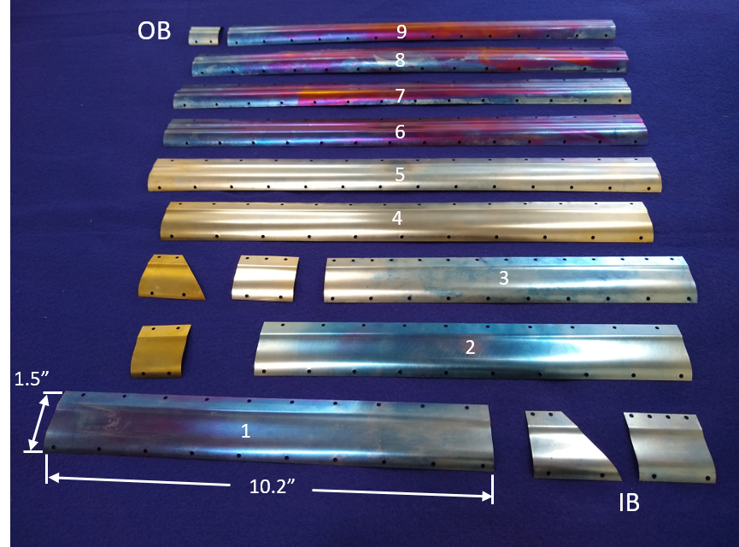
Aerodynamic Load and SGF Sizing
Time Averaged ΔP from CFD
Steady SGF Deflection
6 SGF segments
OB slat
WUSS attachment edge
2 SGF segments
SGF Components, Ni-55.75Ti wt. %
IB slat
Aero load exhibits spanwise & chordwise gradient but undetectable bracket features
Designed w/o benefit of fluid structure interaction (FSI) insights
Thickness sized by static defl. allowable – 2 x thick
Notes:
3D CFD provided aerodynamic load
Worst case of Mach 0.24 and AoA of 8 degrees
Differential pressure field shows some variation spanwise but greater stream/chordwise, and average of about 1 psi
FEM developed to represent treatment integration with CRM-HL
Load applied and treatment thickness varied to study deflection
FSI unavailable at time of design so conservative estimate of 2x
Deflections to aero load shown
SGF segmented as flight vehicle on OB slat
Segmented IB due to manufacturing limitation
Baseline SGF components fabricated by FWD Technologies from NiTi (Ni-50.75Ti at. %) to represent flight-like, dynamically-scaled treatment
Extra component is for transition slat and small pieces are for interchangeability of slat end treatments

Slide 11
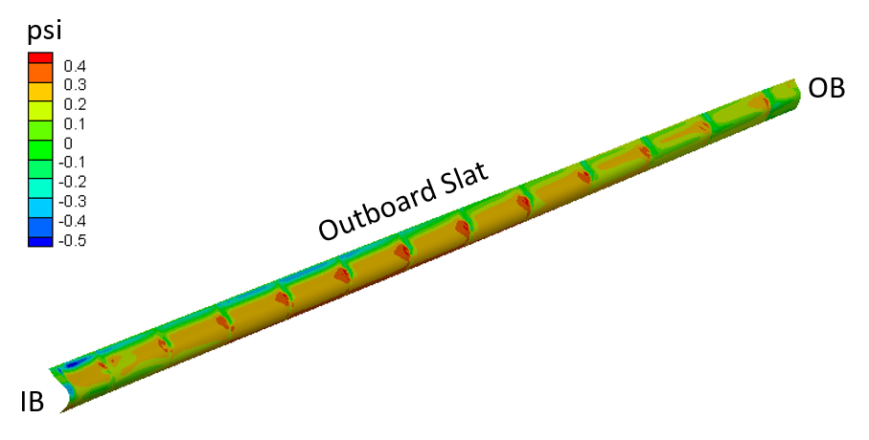
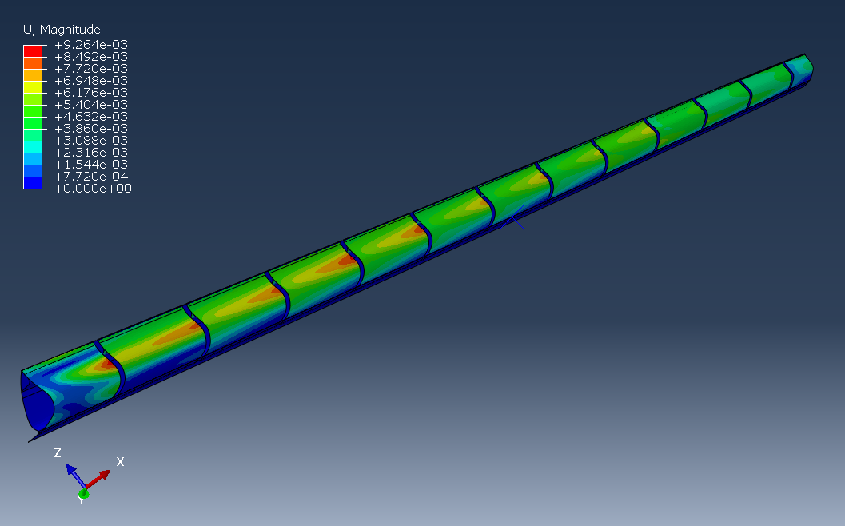
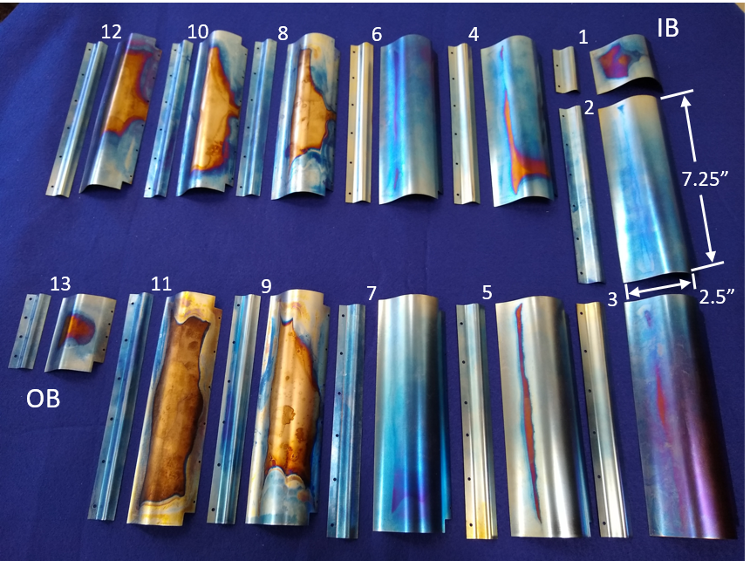
Aerodynamic Load and SCF Sizing
Time Averaged ΔP from CFD
Steady SCF Deflection
13 SCF segments
SCF Components, Ni-55.75Ti wt. %
Bracket-induced flow features load OB end of SCF segments
Design guided by 2D FSI – 1 x thickness guideline
SCF assemblies (main & aux) sized together in thickness
Localized displacement drove thickness – conservative
Notes:
SCF segmented around each bracket of OB slat
Aero load from CFD (Mach 0.24, AoA=8 deg) shows highly localized max pressure at OB end of each SCF section – stagnation of spanwise flow and maybe vortex impingement
FEM developed to represent SCF integration with CRM-HL
Limited 2D FSI results suggested defl. > 1 thickness could get into destructive coupling regime
Assemblies sized together in thickness for simplicity – parameter for flight hardware
Displacements shown – localized displ. drove thickness requirement
Again, components provided by FWD Technologies in Fort Wayne Indiana
NiTi composition with austenite finish below 32 F (below average daytime temp at NASA LaRC in winter)
Different composition would be used in flight hardware

Slide 12
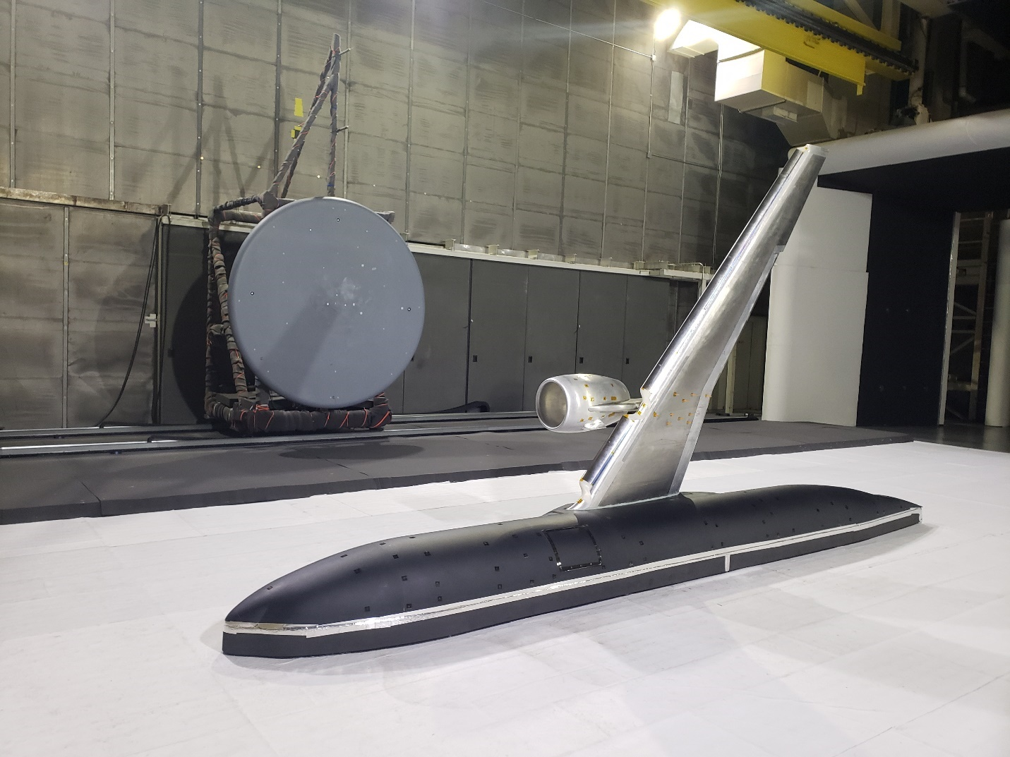
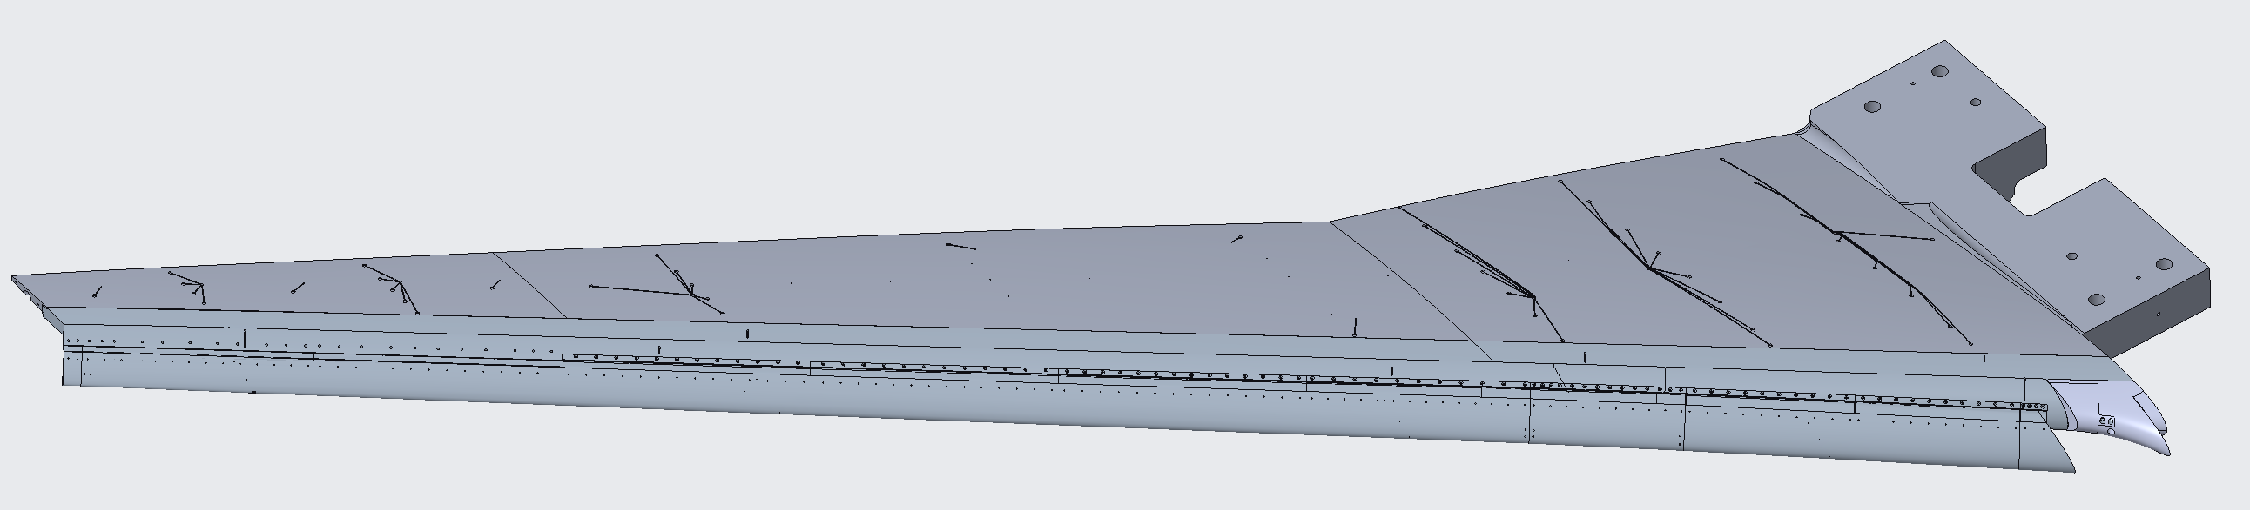
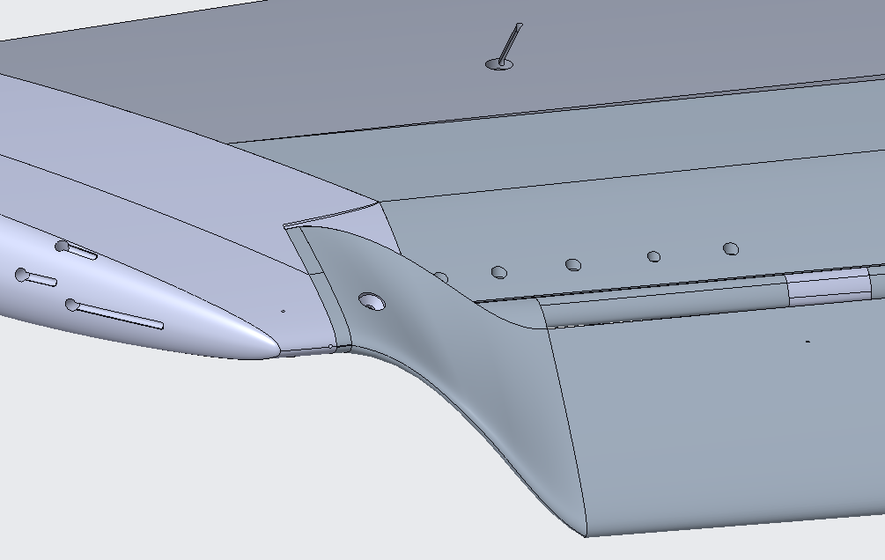
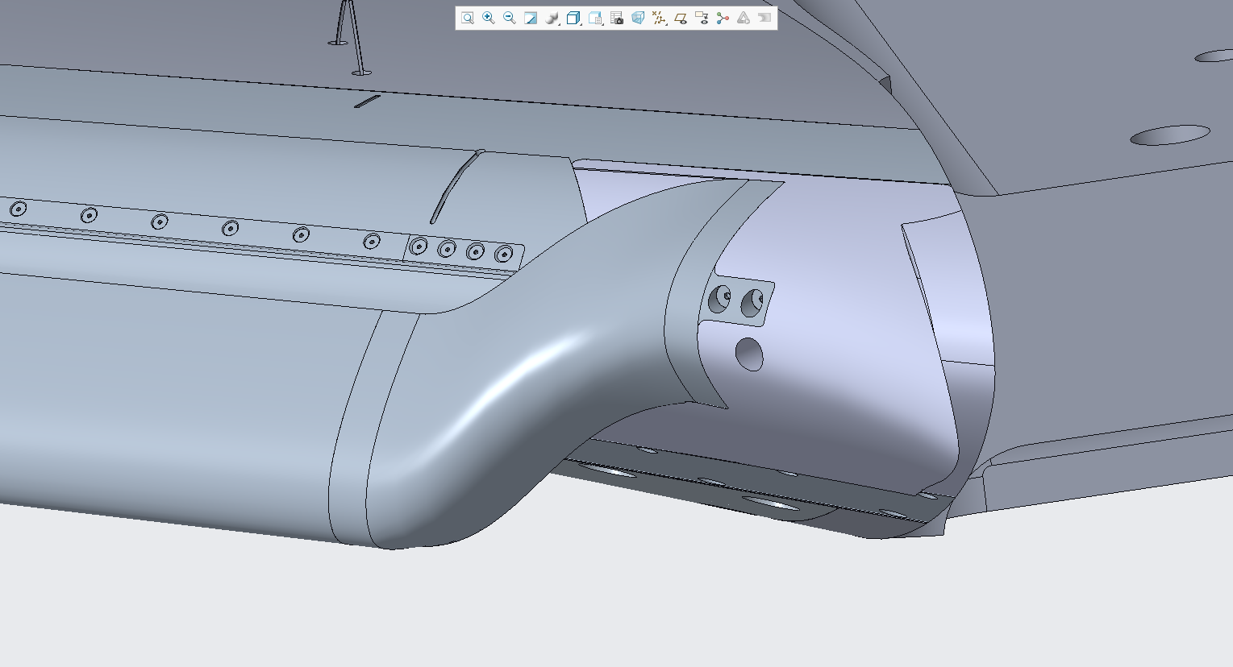
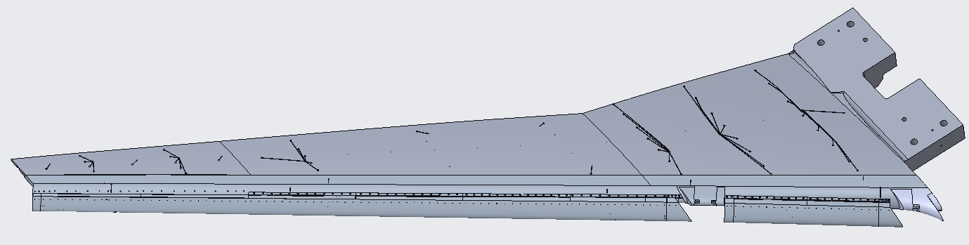
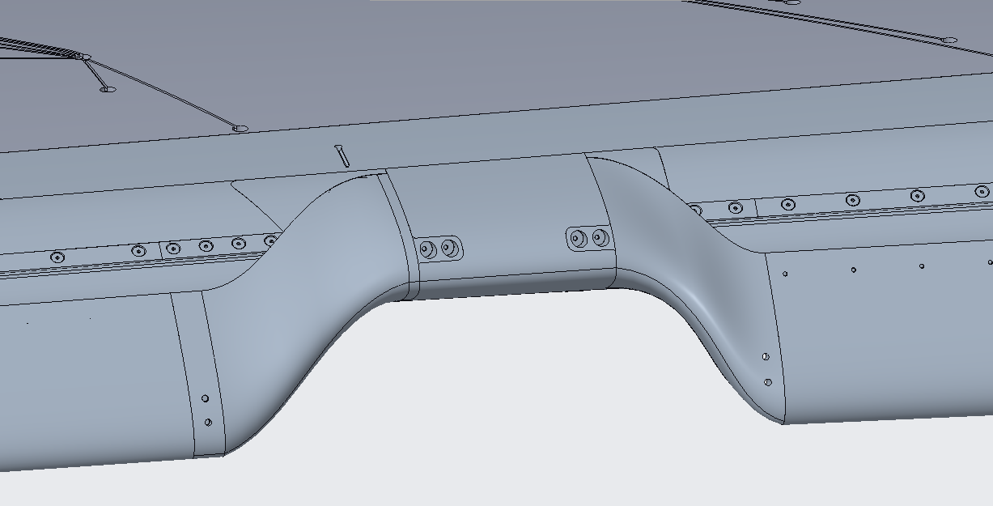
CRM-HL Wind Tunnel Model & SGF Assembly Design
10% Semispan CRM-HL
Full Span Slat
Split Slat
Interchangeable leading edge assemblies
10% CRM-HL tested in NASA LaRC 14’x22’ tunnel
Many test configurations – interchangeable leading edge assemblies: baseline, SGF, SCF
SGF treatment tested with baseline split slat and full span slat configurations
End treatments representative of recent work employed at slat ends
Notes:
10% CRM-HL shown in 14x22
Interchangeable slat/wuss assemblies fabricated to test SGF & SCF treatments
SGF tested with both full and split slat config.
Tested with and without slat end treatments representing SOA to complete slat treatment

Slide 13
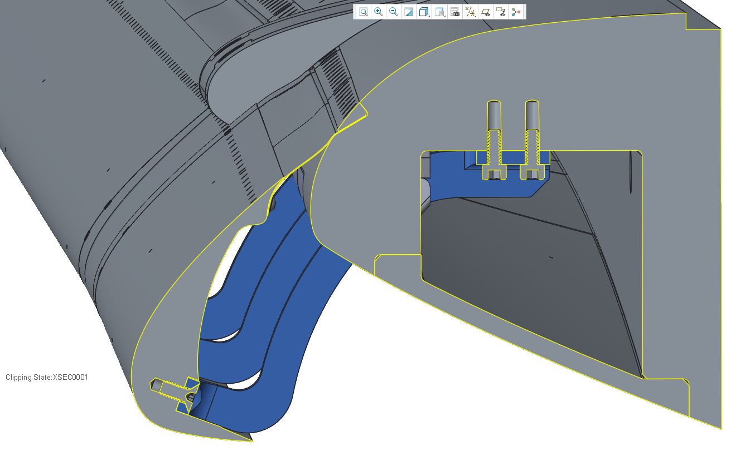
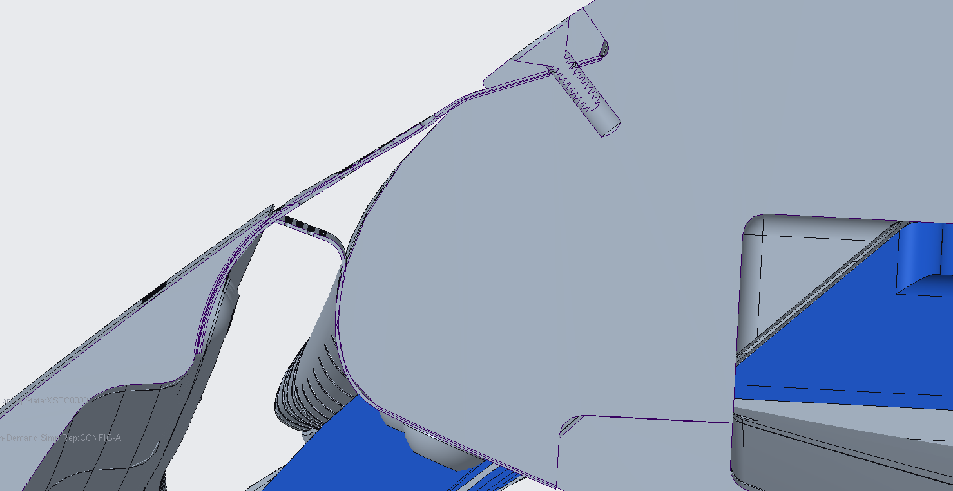
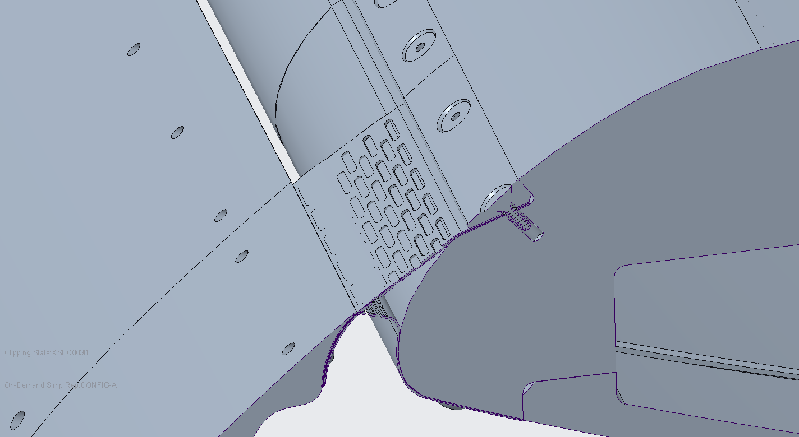
SGF Assembly Design
Baseline SGF
Aft attachment
SGF
Alternative baseline
Forward attachment
Main wing
Min-distance
Slat
Slat Bracket
Fastened joint designed for fail-safety
Slat trailing edge and main wing modified for fastener attachment due to scale
Boundary conditions approximate flight hardware
Baseline, alternative baseline, and min-distance SGFs tested
Notes:
SGF fastened to model for tunnel safety
Slat TE and main wing required mods for fastening due to small scale
Resulting boundary conditions on SGF treatment approximate flight hardware
Alternative baseline and min-distance designs made use of fastener attachments of baseline treatment
Study of sensitivity of aero/noise to geometry
Study of porosity – three levels (15, 30, 50 POA) tested

Slide 14
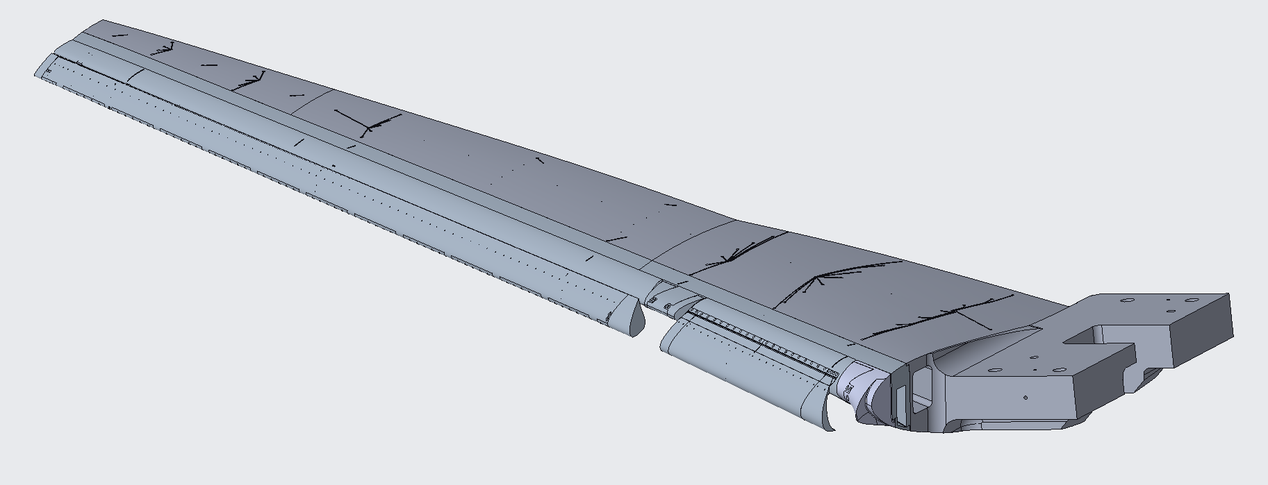
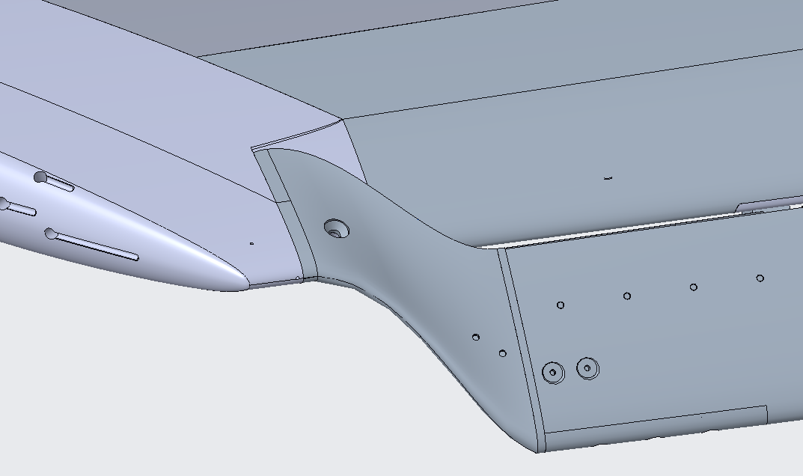
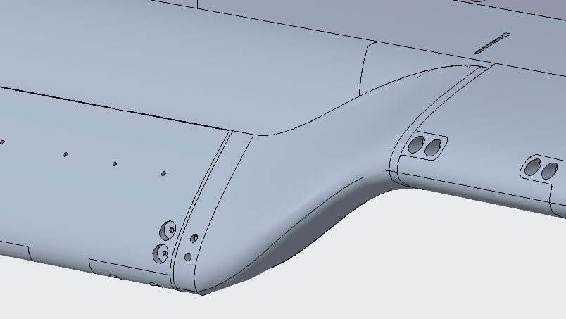
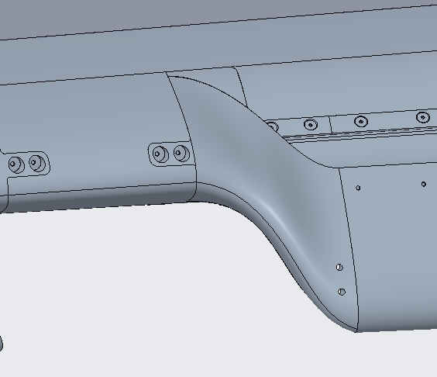
SCF Assembly Design
SCF Model – Split Slat Only
Inboard Slat Treated with SGF
Outboard Slat Treated with SCF
SCF treatment tested in split slat configuration only
OB slat treated with SCF and IB slat treated with SGF
Tested with and without slat end treatments
Notes:
SCF treatment applied to OB slat only – IB SCF impractical
IB slat treated with SGF
Tested in split slat configuration only
Tested with and without slat end treatments that represent SOA to complete noise treatment of slat

Slide 15
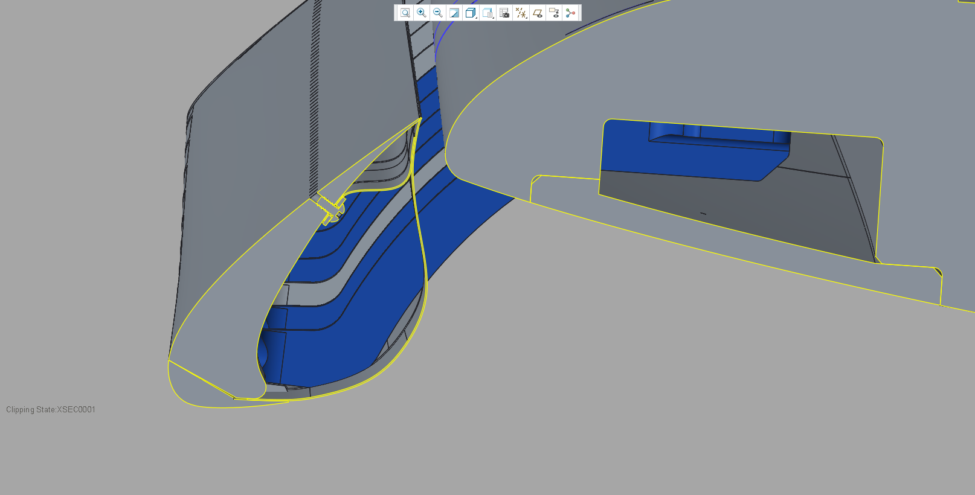
SCF Assembly Design
Adhesive joint
SCF Rev. Aux.
Main wing
Slat
Slat Bracket
Slat Leading Edge
Component
SCF Main Component
Adhesive joint between main and rev. aux. SCF components
SCF assembly fastened to model for fail-safety
Boundary conditions approximate flight hardware
Tested with SCF main component attached and free at slat trailing edge
Notes:
Main and rev aux components adhesively joined - adhesive is 3M Scotch Weld 2216 (if anyone asks)
SCF assembly fastened to slat via screws in the rev aux and dowel pins at forward edge – simulating boundary conditions of flight hardware
Main component also bonded to slat TE in 1st test but released as a 2nd distinct configuration in further testing

Slide 16
Concluding Remarks
SGF & SCF advancements met challenges of 3D CRM-HL geometry
Model integration represents flight conditions
Components sized to realistic worst-case loads and dynamically scaled to the 10% CRM-HL
Components successfully tested in 2020-2021 entry in 14x22
All components performed as expected structurally
Additional studies of articulating models under load are ongoing

Slide 17
Questions?
This work was supported by the Advanced Air Transport Technology (AATT) Project

