Slide 1

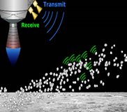
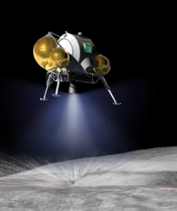
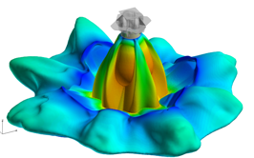
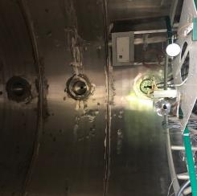
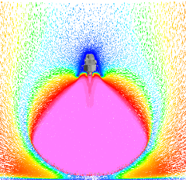
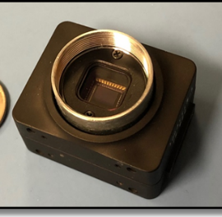
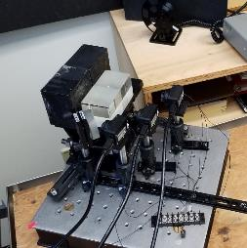
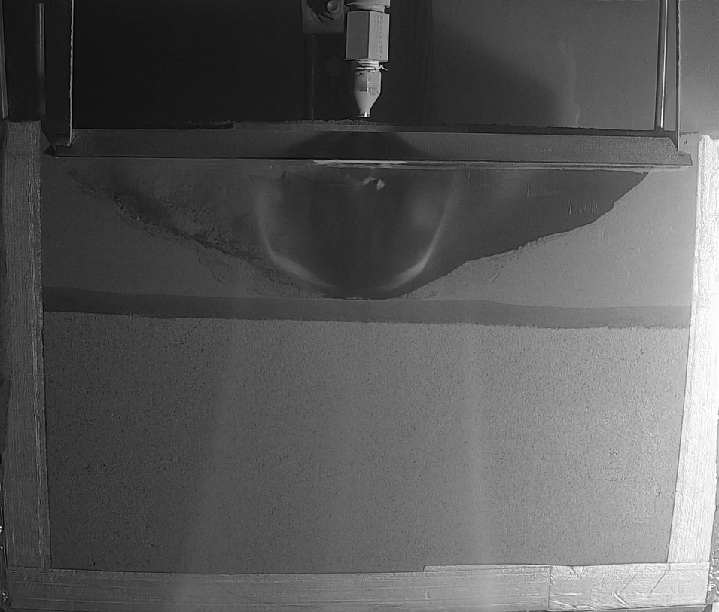
NASA Exploration Systems Development Mission Directorate
HLS Advanced Development Office (ADO)
Plume Surface Interaction (PSI) Instrumentation | Space Resources Round Table | Golden, Colorado, June 7-10, 2022

Slide 2
Team Members
KSC ESDMD PSI Project Team:
Dr. Jim Mantovani
Austin Langton
Dr. Beverly Kemmerer
Austin Atkins
Dr. Dan Batcheldor
Matt Wittal
Dr. Gary Bastin
Dr. Manish Mehta (MSFC)
PM: Samantha Harris
Special thanks to NASA ESDMD for continuing to support the PSI project

Slide 3
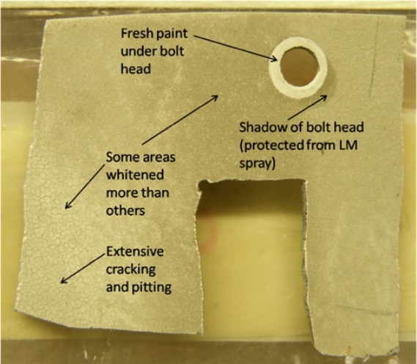
Importance of Ejecta Energy Flux
High-speed PSI ejecta pose a significant risk to lunar surface assets due to impact energy/flux and abrasive blasting effects.
Risk assessment requires knowledge of PSI ejecta particle size, velocity, and density.
The only data that exists on ejecta velocities is from video footage of the Apollo Lunar Module landings.
Impact damage to the Surveyor 3 coupon returned by Apollo 12 due to PSI ejecta from the LM descent engine. More concentrated ejecta produce more significant damage. Credit: UCF/NASA.”

Slide 4
Plume Surface Interactions Instrumentation
PSI Instrumentation will provide a unique dataset based on direct measurements of ejecta particle velocities and particle concentrations during plume surface interactions, which will help inform risk assessments associated with impacts by high-speed PSI ejecta particles (energy flux).
PSI Instrument data will inform the development of high-fidelity computational models of PSI effects and will help address NASA Strategic Knowledge Gaps related to characterizing PSI effects during descent and landing, and the risks associated with high-speed PSI ejecta on the lander and lunar surface assets.
MWDR is a candidate flight instrument for a CLPS or HLS lander mission.

Slide 5
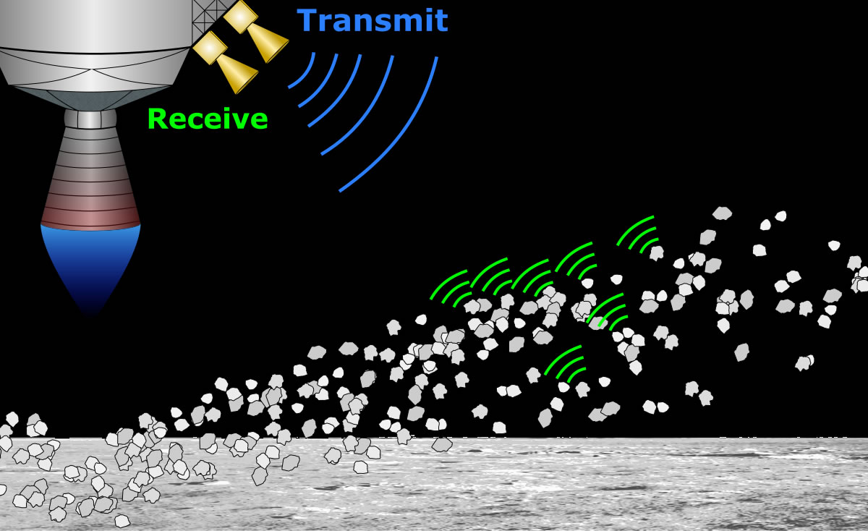
Millimeter Wave Doppler Radar – 94 GHz
The Millimeter Wave Doppler RADAR (MWDR) will provide a unique dataset based on direct measurements of ejecta particle velocities during plume surface interactions, which will help inform risk assessments associated with impacts by high-speed PSI ejecta particles (energy flux).
Transmitted RF waves scatter off particles ejected in the plume resulting in a Doppler shifted returned signal which provides velocity information.
Flight Instrument design concept. Photo Credit: Austin Atkins

Slide 6
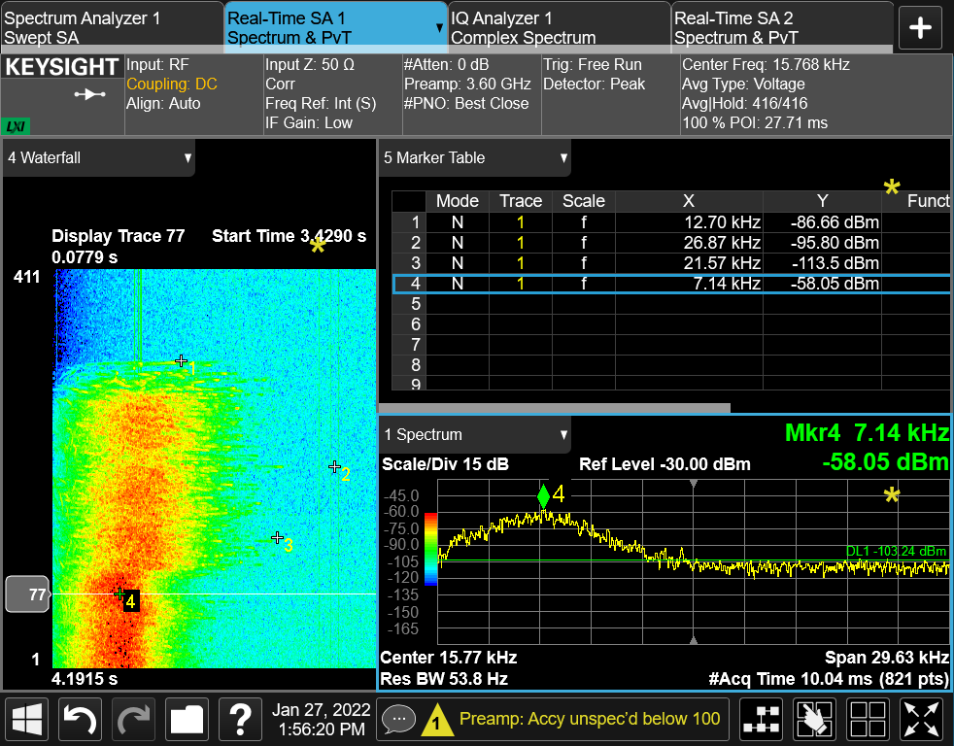
Data
MWDR measures the speed of moving particles towards or away from the radar antennas.
Analog voltage received from the down converting heterodyne mixer is sampled and collected and transformed into the frequency domain.
Data is then represented in the form of a spectrum of frequencies over a designated acquisition time
Spectral Analysis of plume ejecta data requires more extensive analysis than typical radar single target detection
Velocity data is limited to:
Returned signals that are sufficiently above the Noise Floor ~10dB SNR
Frequency data that is not derived from known interference: i.e. backgrounds and vibrations, instrumentation artefacts, RF spurs, etc.
Secondary measurements from other instruments improve upon understanding of particle ejecta events
Time
Power in dBm = Nano Watts
Frequency(Velocity)
Spectrum+Waterfall+Marker N9020B display for the Test Set Up described in “High Speed Camera Validation”

Slide 7
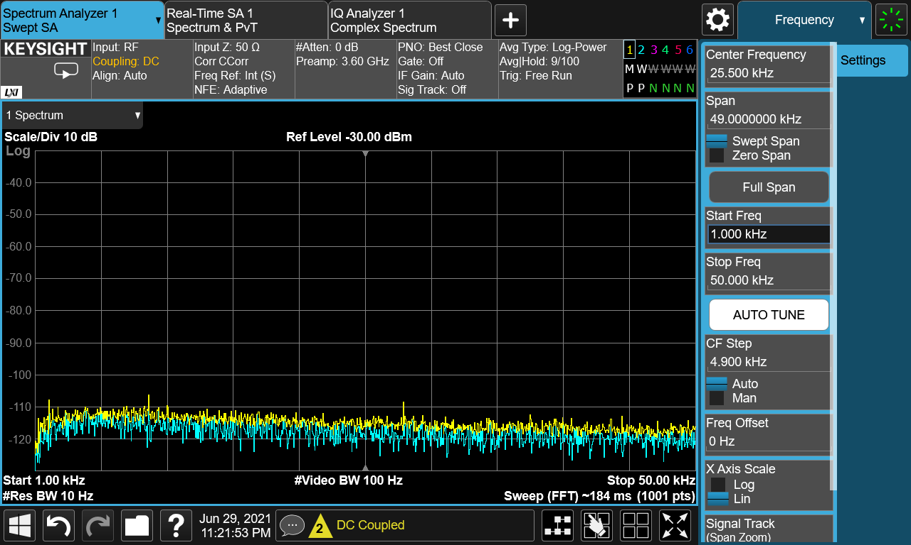
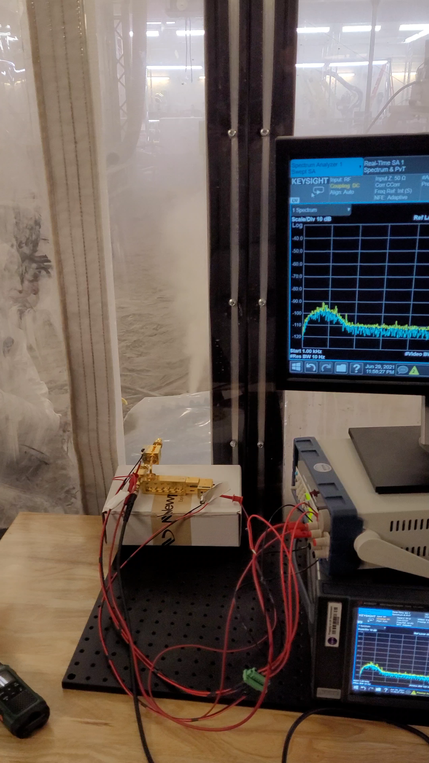
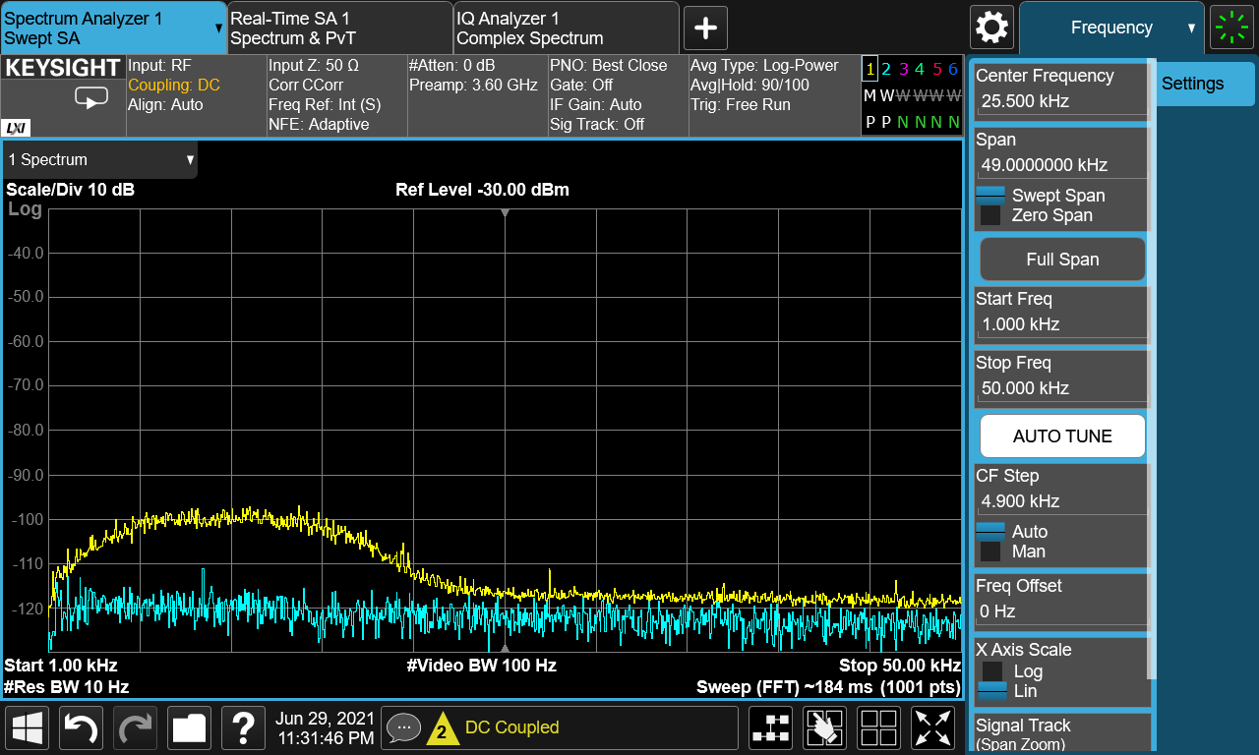
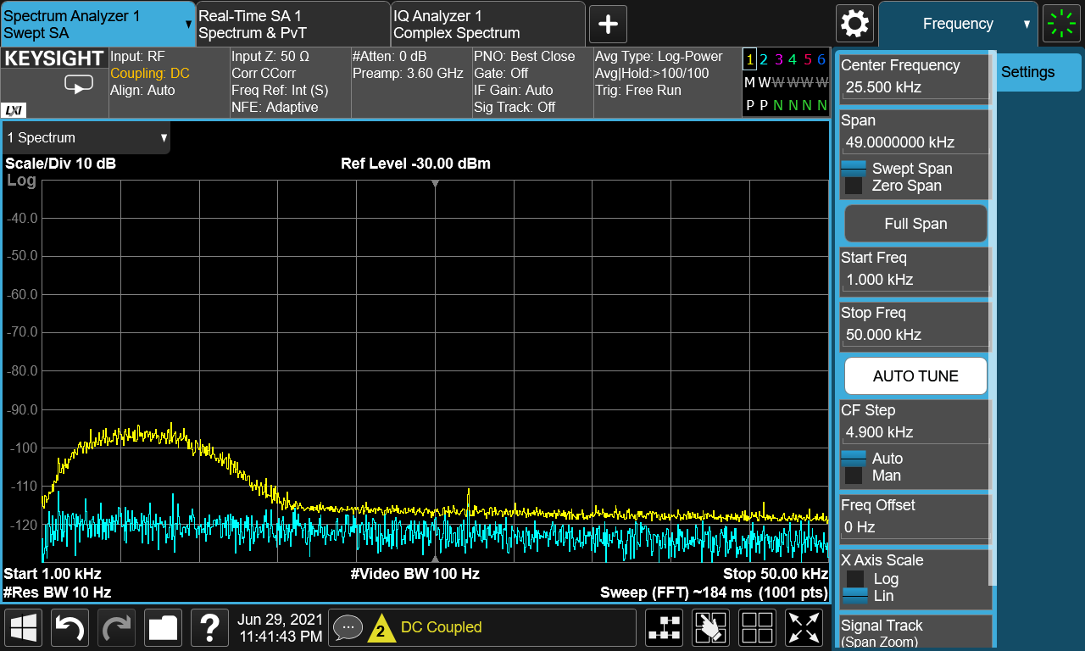
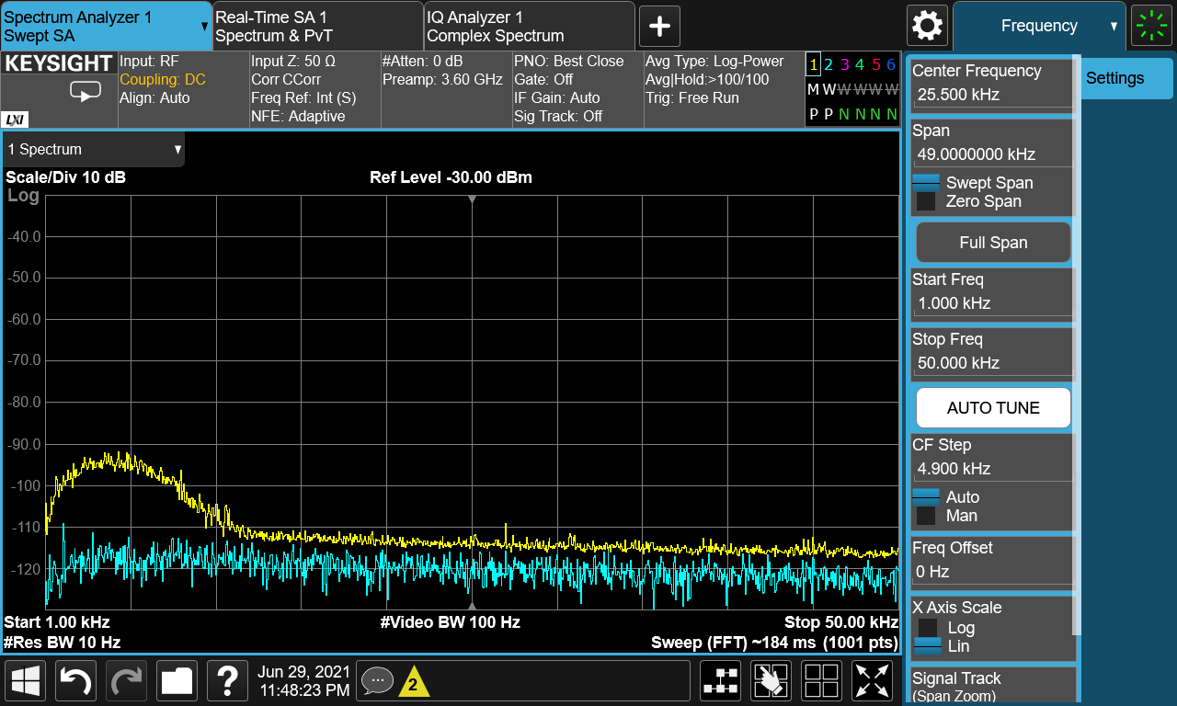
Lab Test Results
Background
This experiment was conducted to compare results with different air pressures of shop air supplied to an eductor regolith ejecta setup.
RF Absorbent material was used to cover the dirt ejecta device.
A medium sized Nozzle was used and regolith was accelerated for 5 seconds at 25, 50 and 100 PSI.
The radar has a 0° Elevation look angle with no near background behind ejecta stream
100 PSI
50 PSI
25 PSI

Slide 8
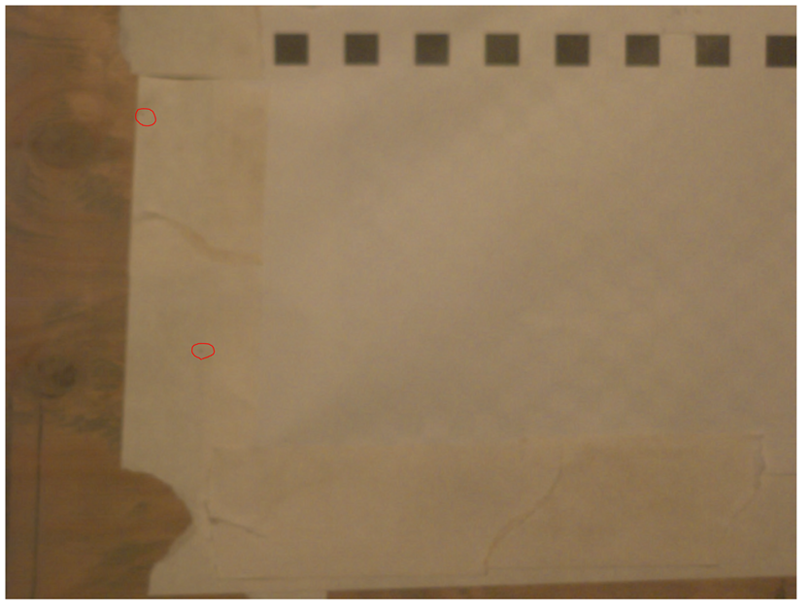
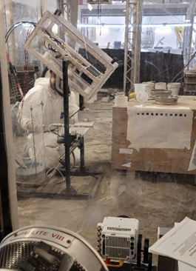
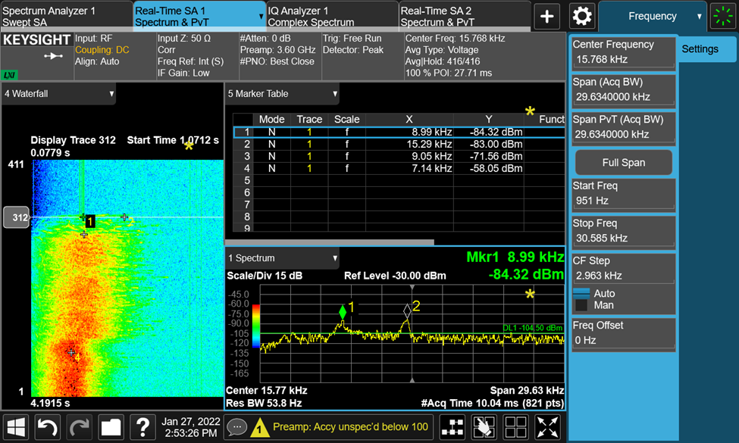
High Speed Camera Validation Test Setup
This experiment was conducted to validate the accuracy of velocity measurements with the highspeed camera.
The radar and the camera are synchronized, and both are sampling the volume of space as shown on the image to the left.
BP-1 particles were sieved so that only larger (850um-1mm) particles that are easily resolved by the camera were accelerated in a stream.
Data was collected over a 4.195 second period by the radar and camera. The camera was capturing video at 1000 fps and the radar was collecting spectrum data in acquisitional chunks of 10ms (corresponding to 100 camera frames).
The first signals were recorded around 1 second and single and double particle events were recorded captured with both instruments
Camera frame #10766 is shown on the top right corresponding to the spectrum trace below which begins at 1.0712 seconds

Slide 9
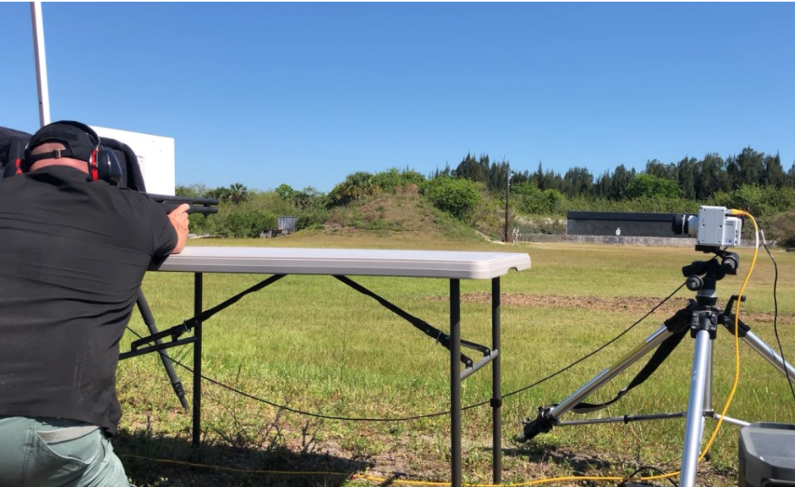
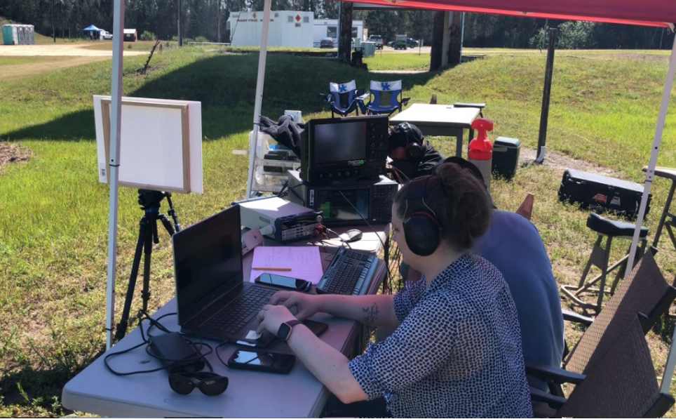
MWDR Weapons Training Area Validation
The KSC Weapons Training Area was used on May 17-18, 2022 to validate high velocity objects (bullets/shot/shell-loaded BP-1) using the MWDR
A high-speed camera was used to validate the measured the velocities.

Slide 10
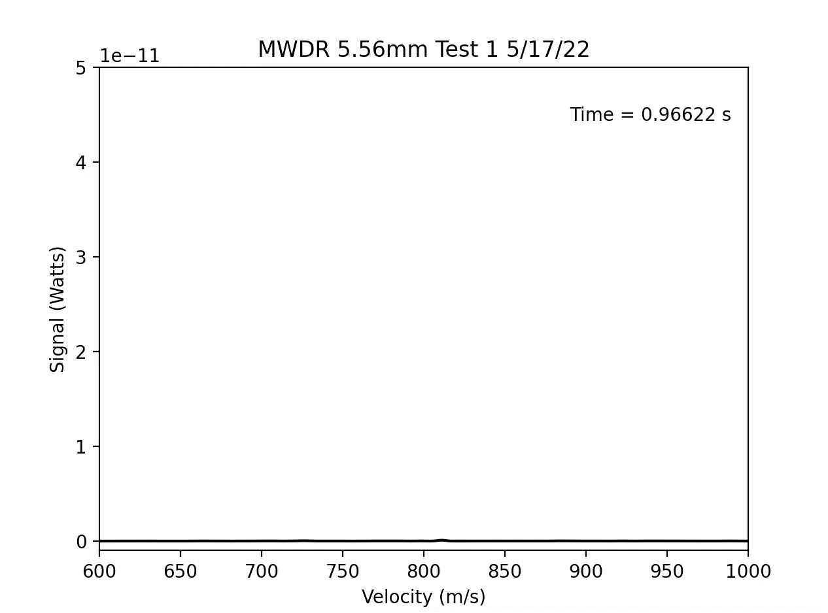
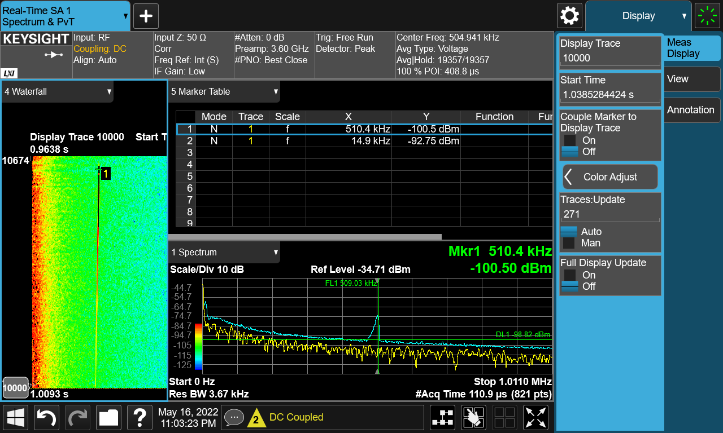
MWDR Weapons Training Area Validation
The MWDR data has been extracted showing ~800 m/s for a 5.56 mm NATO round.

Slide 11
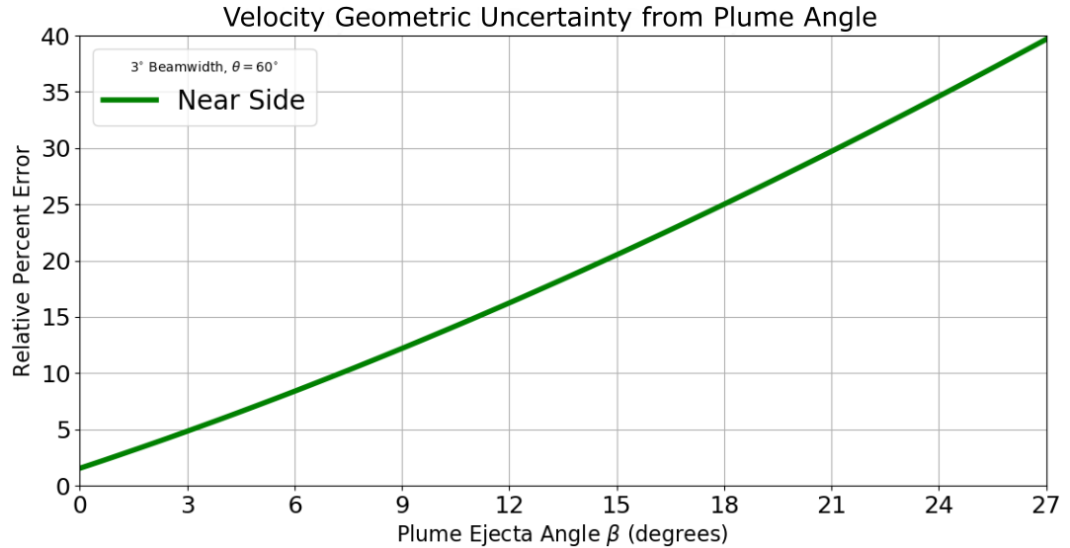
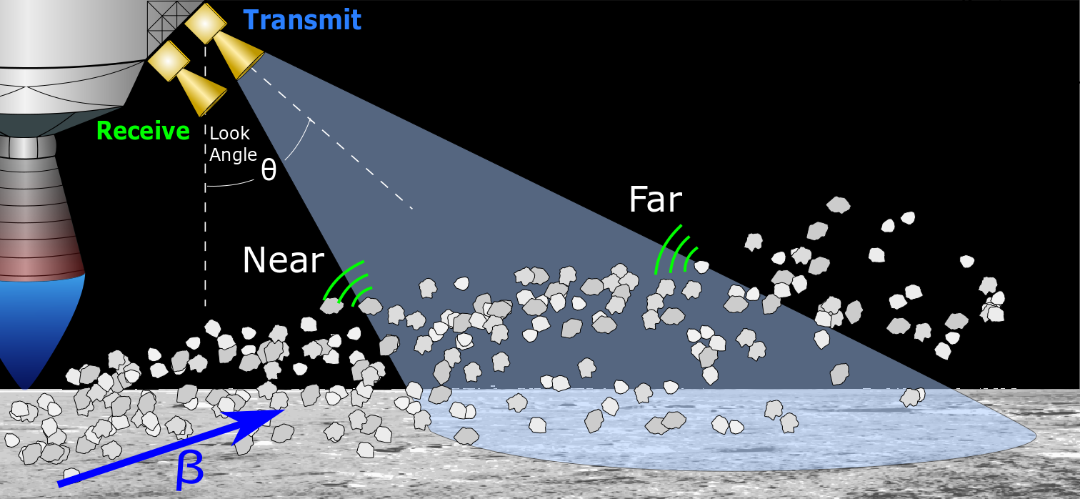
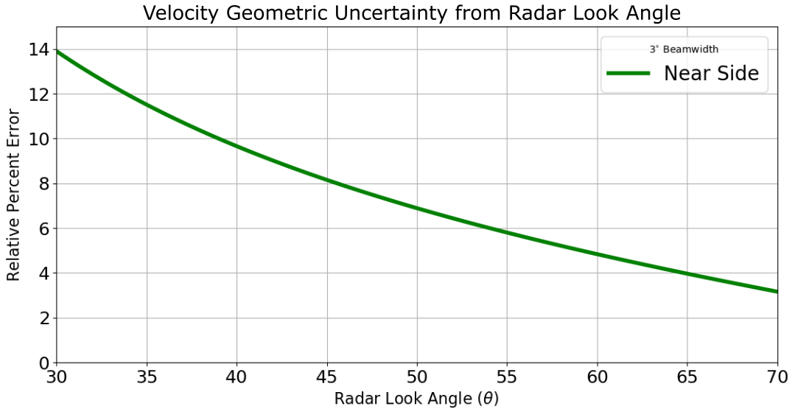
Geometric Uncertainty for Lunar Lander Case
Measured Doppler shifts are most accurate when particles move in “line of sight” of radar. ​
Look angle of RADAR (θ) produces a fixed geometric uncertainty that can be accounted for. Geometric velocity uncertainty occurs as particles move through the “3 dB radar cone” due to projection of particle velocity vector onto the radar line of sight. Uncertainty is largest at the near side of radar cone. ​
Velocity geometric uncertainty is increased with particle plume ejecta angle (β). With a 3-degree beam width, the relative error is approximately 5% for a pitch angle (β) of 3 degrees.

Slide 12
Next Steps
Analyze Range Data
Continue testing MWDR with lunar simulants
Johns Hopkins University Shadowgraph setup
CLPS Payload Development

Slide 13

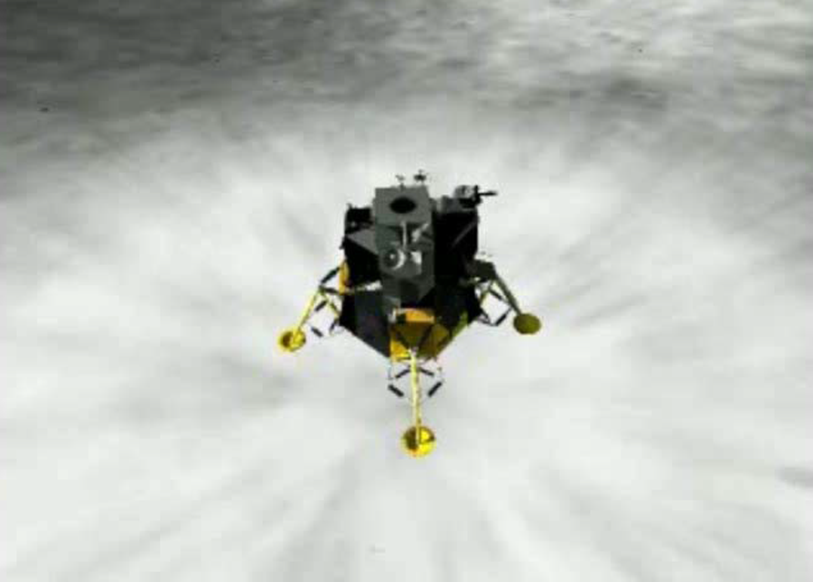
Summary
Unique Database of Direct In-Situ PSI Measurements to be used to validate PSI Modeling Work for ESDMD PSI Project
Informs CLPS Providers
CLPS Payload Suite of Flight Instruments Dedicated to PSI
Leverages Current/Previous Investments in:
NASA-led FI’s, NASA SBIRs, University-led FI’s
Informs Dust Mitigation Tech Dev
Informs HLS Designs
Informs Designs for Mars Lander Architecture
Enables Commercialization of Similar Instruments as Standard Equipment on Future Lunar and Mars Landers

Slide 14

Q & A

Slide 15
Backup Slides

Slide 16
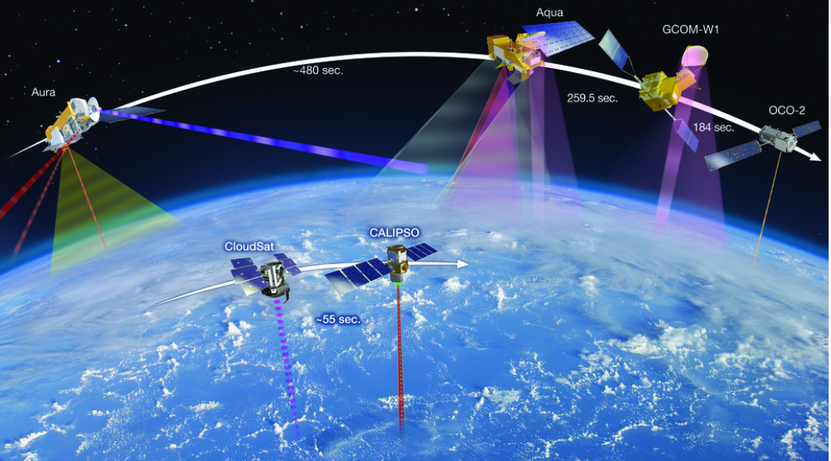
Millimeter Wave Doppler Radar: History
The Feasibility of Using Millimeter Wave Doppler Radar (MWDR) to Measure the Velocity and Particle Mass Flow of Rocket Plumes on Mars and the Moon was first proposed by Dr. Bob Youngquist and Stan Starr at NASA KSC.
Millimeter Wave Radar applications: Landing RADAR, imaging, radio astronomy, remote sensing, automotive radars, military and space applications, airport security screening, telecommunications, and to study Sand/Duststorms and Doppler Radar Observations of Dust Devils in Texas
CloudSat - Overview: Home (colostate.edu)
Credit: NASA Goddard Space Flight Center
Notes:
CloudSat was selected as a NASA Earth System Science Pathfinder satellite mission in 1999 to provide observations necessary to advance our understanding of cloud abundance, distribution, structure, and radiative properties. Since 2006, CloudSat has flown the first satellite-based millimeter-wavelength cloud radar—a radar that is more than 1000 times more sensitive than existing weather radars. Unlike ground-based weather radars that use centimeter wavelengths to detect raindrop-sized particles, CloudSat's radar allows us to detect the much smaller particles of liquid water and ice that constitute the large cloud masses that make our weather.

Slide 17
Key Performance Parameters: PSI Instruments
Performance Parameter |  | SOA | Threshold Value | Project Goal
KPP
Lunar Environment | Prediction of ejecta energy flux (W/m²) | N/A | Predict within +/- 50% | Predict within +/- 10%
Mars Environment | Prediction of ejecta energy flux (W/m²) | TBD | Predict within +/- 25% | Predict within +/- 10%
Notes: a) Predictions developed through (1) computational approaches and (2) ground test and flight data-driven scaling correlations b) Approach for evaluating the predictions specified in the above the KPPs will be outlined in the Project Plan and detailed in an attachment to the Project Plan.

Slide 18
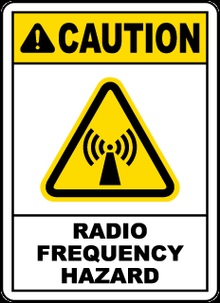
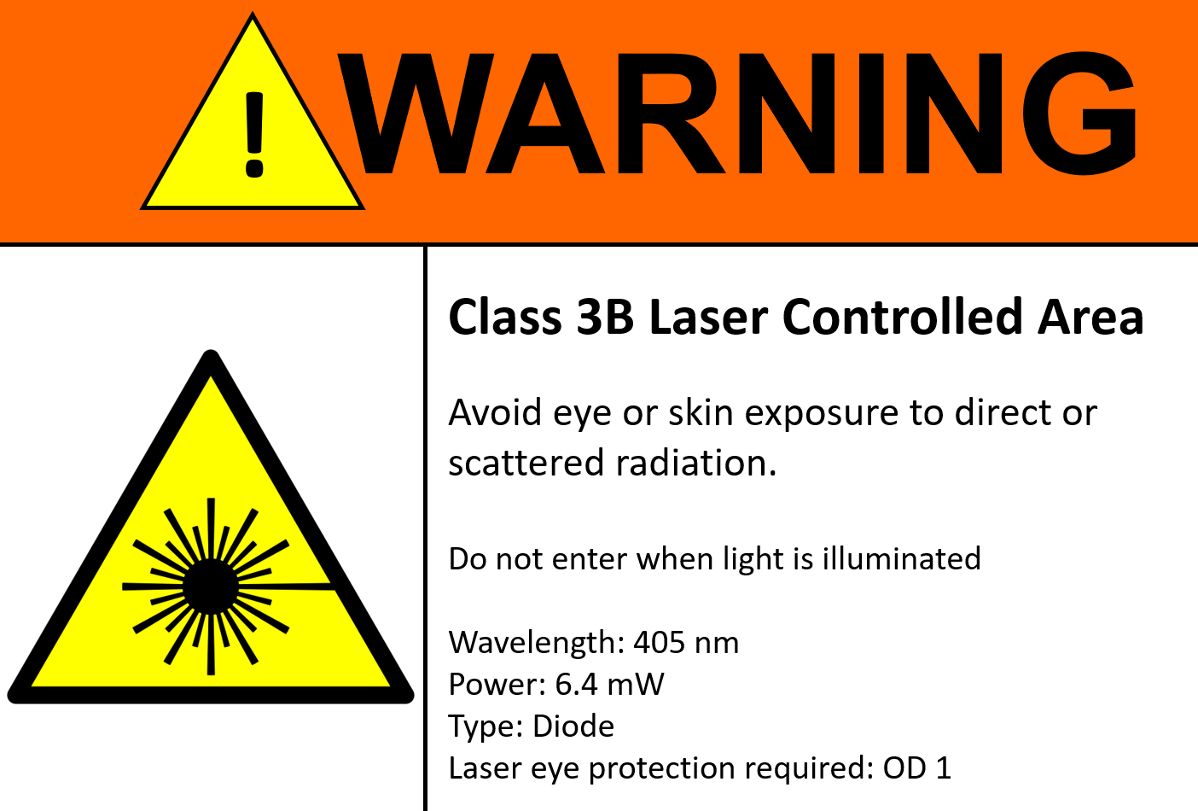

Safety
The Laser and RF Hazard:
Electromagnetic energy interacts with the human body through oscillating electric and magnetic fields that can vary in both amplitude and frequency.
In addition, the intensity of the radiation (energy per unit area) is the primary value measured for hazard and risk mitigation.
There are many mechanisms by which the electromagnetic energy can affect various tissues / organs etc. and the dominating factor is determined by the frequency.
For microwaves the primary hazards are tissue heating and whole-body heating where the penetration depth is limited to the outer layers of skin.
For lasers, the primary hazards are injury to the eyes (burned retina) and burned skin.
The Silica Hazard:
Workers who inhale these very small crystalline silica particles are at increased risk of developing serious silica-related diseases, including:
  Silicosis, an incurable lung disease that can lead to disability and death;
  Lung cancer;
  Chronic obstructive pulmonary disease (COPD); and
  Kidney disease.
Handling Lunar Simulants such as BP-1 is an Authorized Lab Capability by users in the GMRO

Slide 19
Further Capabilities of MWDR
KSC New Technology Report
Kinetic Energy Density Measurement with MWDR (Submitted by Dr. Bob Youngquist and team):
Kinetic Energy Density Measurement of a Particle Cloud Using Heterodyne Millimeter Wave Doppler Radar
Millimeter Wave Radar Phased Array Antenna Electronic Beam Steering:
IBM Builds MM-Wave Transceiver To Improve Mobile Communications, Radar Imaging - Millimeter Wave Products | Waveguide Products | MM Wave Components (miwv.com)
Reflectivity, Rain Rate, and Kinetic Energy Flux Relationships Based on Raindrop Spectra
Reflectivity, Rain Rate, and Kinetic Energy Flux Relationships Based on Raindrop Spectra in: Journal of Applied Meteorology and Climatology Volume 39 Issue 11 (2000) (ametsoc.org)
60 Ghz, 600 ps pulsed Millimeter Wave Radar used for Hand Gesture detection:
Pulsed Millimeter Wave Radar for Hand Gesture Sensing and Classification | IEEE Journals & Magazine | IEEE Xplore/
Outside Work
Notes:
Data that is collected will not only inform PSI Project but will also inform flight design. the radar reflectivity factor provides an effective means to monitor rainfall kinetic energy flux

