Slide 1
Lighting and the lunar surface environment
Wesley A. Chambers, Ph.D.
Natural Environments Branch / Marshall Space Flight Center
NESC Lunar Lighting Workshop
June 14 – 16, 2022

Slide 2
Outline
Natural environments and SLS-SPEC-159 DSNE
Natural light sources
Lighting and environmental effects
Lunar surface properties
  Regolith properties
    Albedo
    Phase dependent reflectance
  Surface features
    Rock distributions
    Slope distributions
    Crater distributions

Slide 3
SLS-SPEC-159 DSNE
The Cross-Program Design Specification for Natural Environments defines the natural environment for crewed, deep-space NASA programs
Baselined for SLS, Orion, Gateway, and HLS
Latest revision (Rev I) available through the NASA Technical Reports Server (NTRS)
  https://ntrs.nasa.gov/citations/20210024522
  When searching, latest revision is not always the first result
  Best to filter by Report Number using “SLS-SPEC-159”

Slide 4
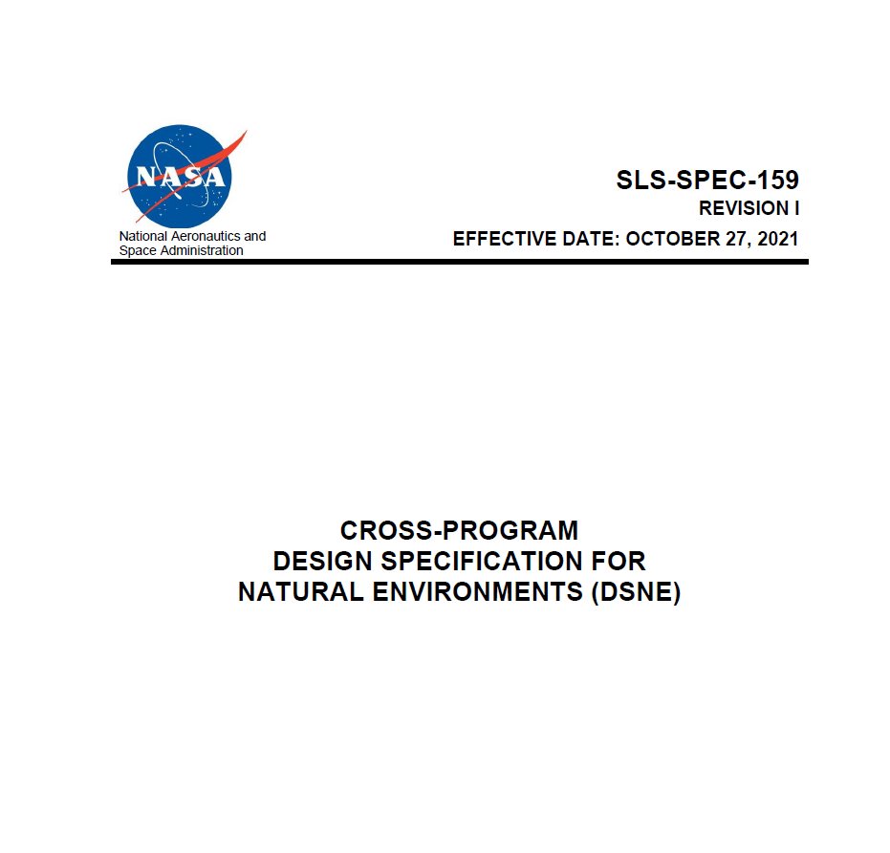
SLS-SPEC-159 DSNE
3.4 | Lunar Surface Operational Phases
3.4.1 | Lunar Surface Geological and Geomorphological Environment
3.4.2 | Lunar Regolith Properties
3.4.3 | Lunar Surface Plasma Environment
3.4.4 | Lunar Regolith Electrical Properties
3.4.5 | Optical Properties
3.4.6 | Lunar Thermal Environment
3.4.7 | Lunar Ionizing Radiation Environment
3.4.8 | Lunar Meteoroid and Ejecta Environment
3.4.9 | Lunar Illumination

Slide 5
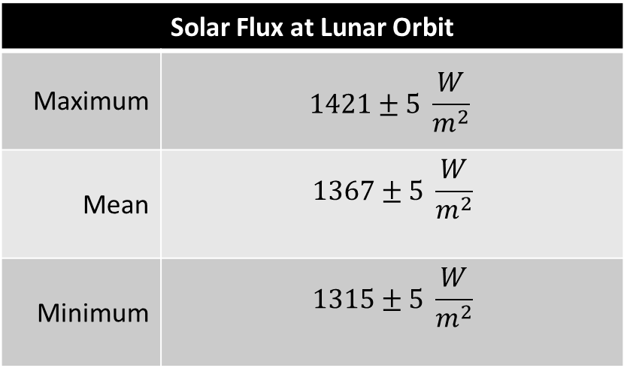

Natural light sources
Solar illumination
  Average solar flux at Moon same as that at Earth
  Maximum and minimum affected by lunar orbit
  Incident light nearly collimated (angular diameter $≈0.5°$)
  Lunar day, or synodic period, is 29.5 Earth days
Solar Flux at Lunar Orbit
Maximum | $$1421±5 \frac{W}{m^{2}}$$
Mean | $$1367±5 \frac{W}{m^{2}}$$
Minimum | $$1315±5 \frac{W}{m^{2}}$$
DSNE Section 3.3.9.1.1

Slide 6
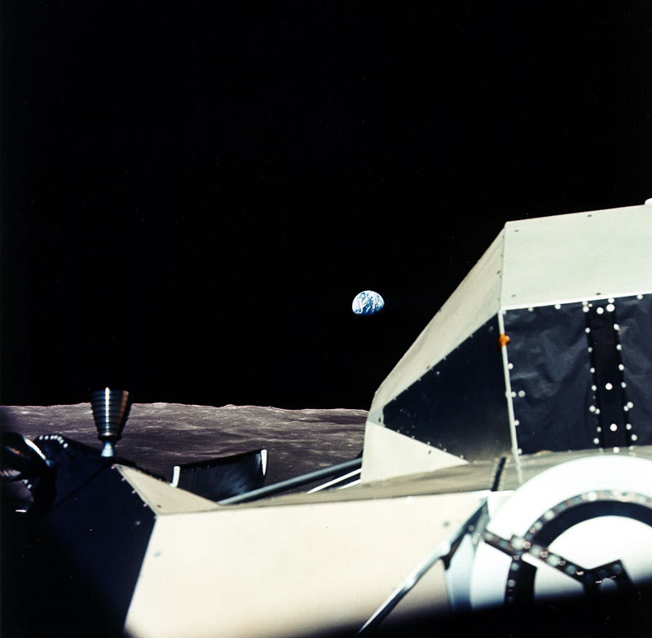

Natural light sources
Earthshine as illumination source studied by Glenar et al. 2019
  Broadband flux ranges from approximately $60\frac{mW}{m^{2}}$ (thermal) up to $150\frac{mW}{m^{2}}$ depending on phase angle
  Earth “would appear some 20–30 times brighter at visible wavelengths than would the Moon at similar phase over a terrestrial landscape” (Glenar et al. 2019)
  Possible use for science/exploration
  May affect lighting/thermal environment of PSRs
NASA/AS17-151-23188
Scanned by Kipp Teague
Notes:
Photo source: The Project Apollo Image Gallery (apolloarchive.com)

Slide 7
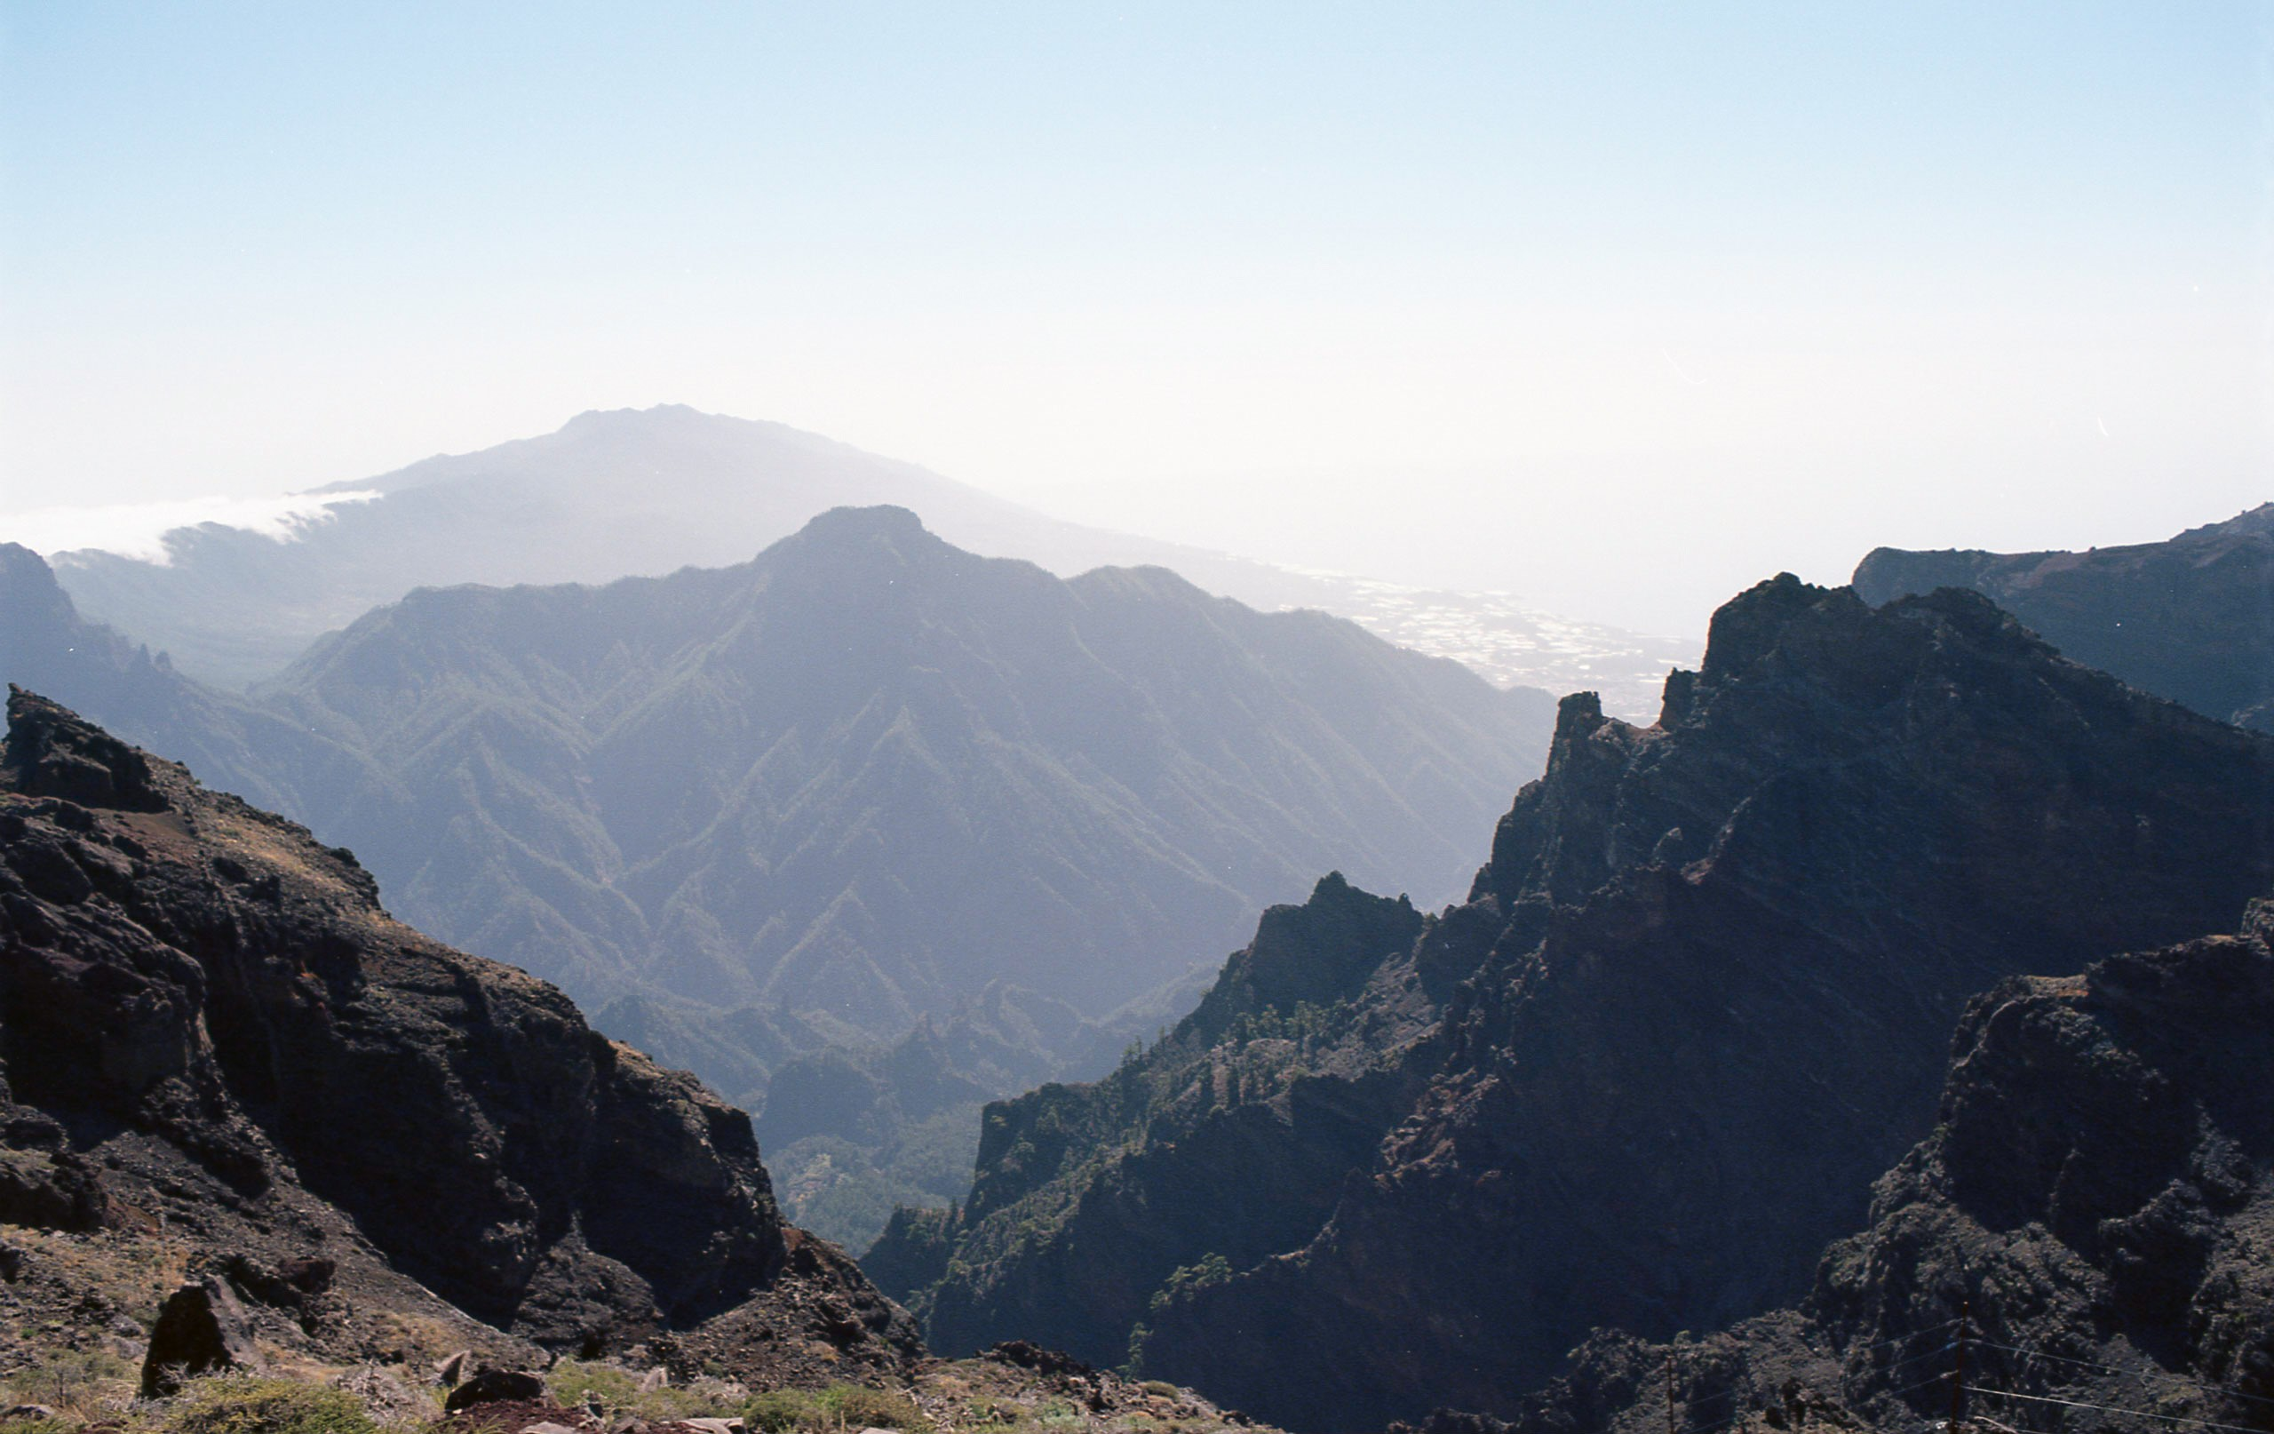
Earth’s lighting environment
Rayleigh scattering
Mie scattering
Aerial perspective
W.A. Chambers
Diffused light
Notes:
Image Source: presenter’s personal work

Slide 8
Earth’s lighting environment
1807 m (5928 ft) elevation
17 km (11 mi) distant
1844 m (6050 ft) elevation
6.6 km (4.1 m) distant
W.A. Chambers
(distances/elevations measured with Google Earth)
Notes:
Image Source: presenter’s personal work

Slide 9
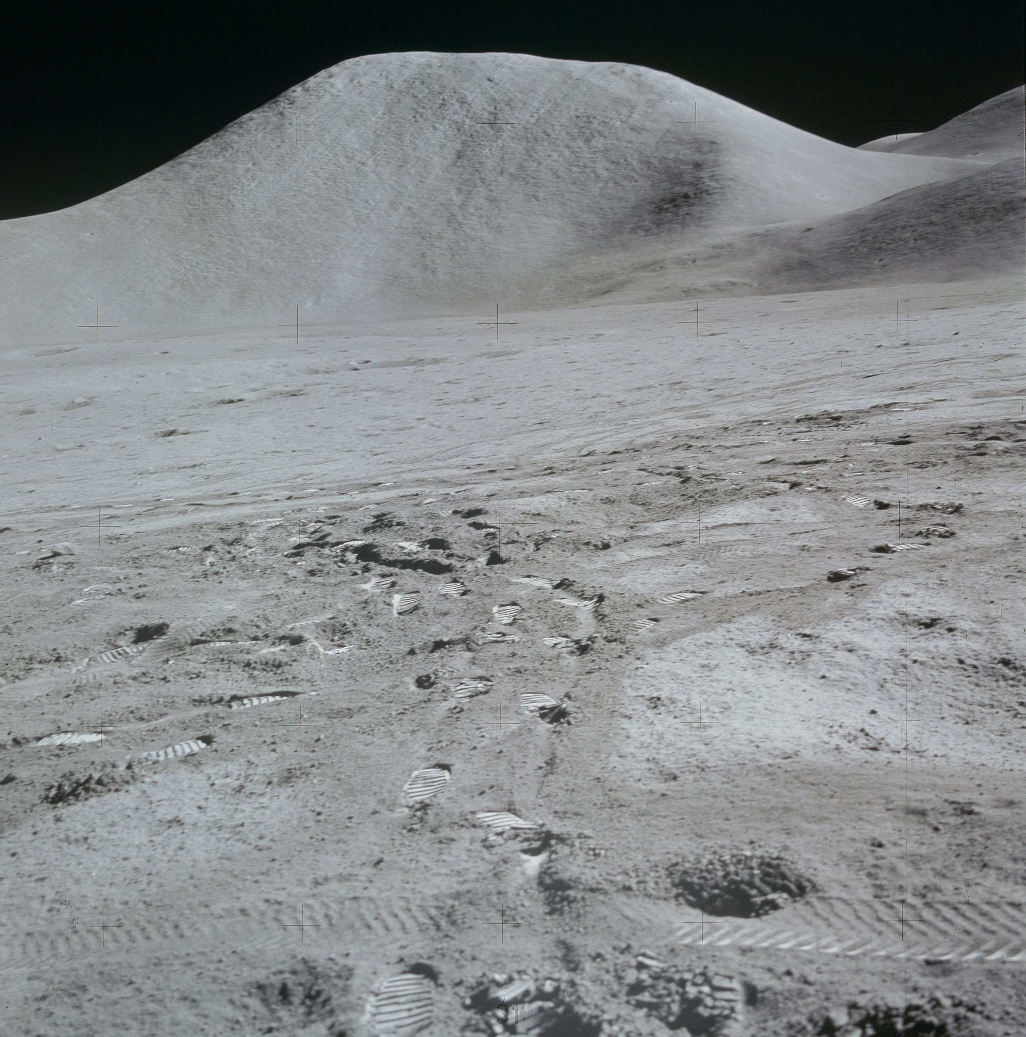
AS15-87-11793
NASA/scanned by Kipp Teague
Notes:
Image Source: The Project Apollo Image Gallery (apolloarchive.com)

Slide 10
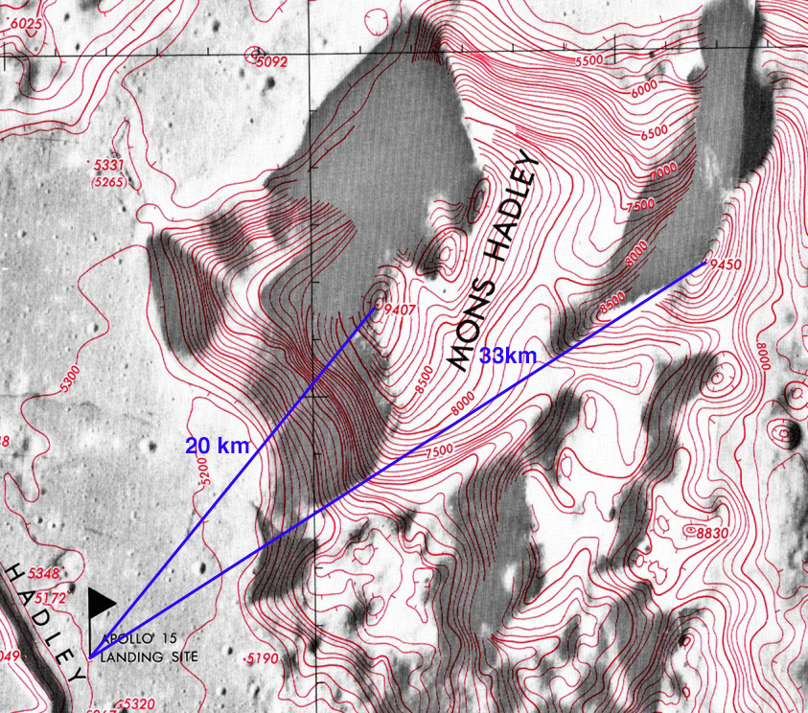
Mons Hadley
4100 m (13,000 ft) elevation change
20 km (12 mi) distant
AS15-87-11793
NASA/scanned by Kipp Teague
Labeled detail from LTO41B4
NASA/U.S. Defense Mapping Agency/scanned by LPI
Notes:
Apollo Photograph Source: The Project Apollo Image Gallery (apolloarchive.com)
Labeled map source: Apollo 15 Map and Image Library (nasa.gov)
Scanning credit to LPI per: Lunar Topographic Orthophotomaps (nasa.gov)

Slide 11
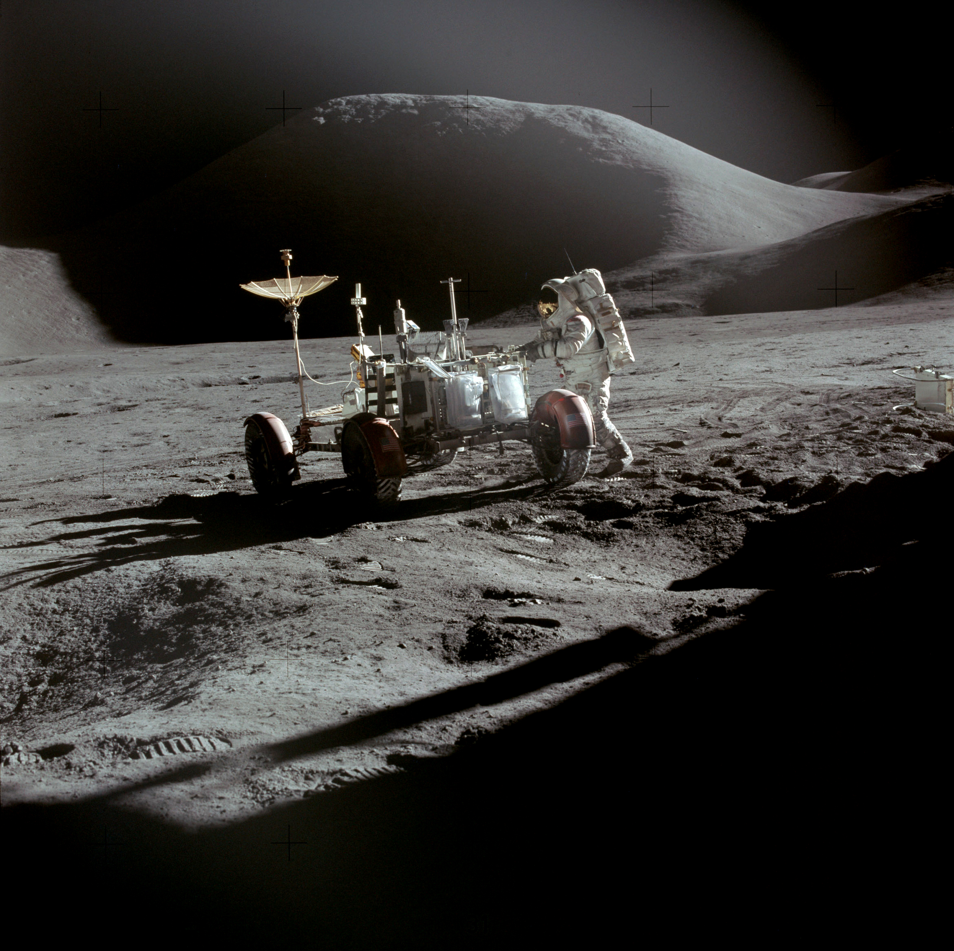
AS15-86-11603
NASA/scanned by Kipp Teague
Notes:
Image Source: https://www.hq.nasa.gov/alsj/a15/images15.html

Slide 12

Lunar lighting environment
Lack of lunar atmosphere has a significant effect on lighting environment, and therefore on human perception
  No atmospheric scattering
    Solar flux nearly a point source
  No atmospheric distortion
    Ground: no heat haze, mirages
    Sky: stars do not twinkle or blur
      Perfect “seeing”
  No atmosphere → no clouds or trees for visual scale
    Lack of familiar visual cues
AS15-86-11603
NASA/scanned by Kipp Teague
Notes:
Image Source: https://www.hq.nasa.gov/alsj/a15/images15.html

Slide 13
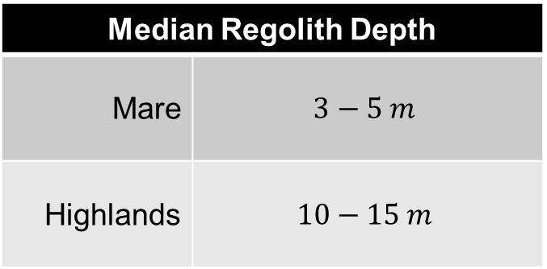
Lunar regolith properties
“The lunar regolith is the surficial layer of fragmented material (rocks, soil, and dust) that covers virtually the entire surface of the Moon.” –DSNE Section 3.4.2.1, General Description of the Lunar Regolith
Median Regolith Depth
Mare | $$3−5 m$$
Highlands | $$10−15 m$$
DSNE Section 3.4.2.1

Slide 14
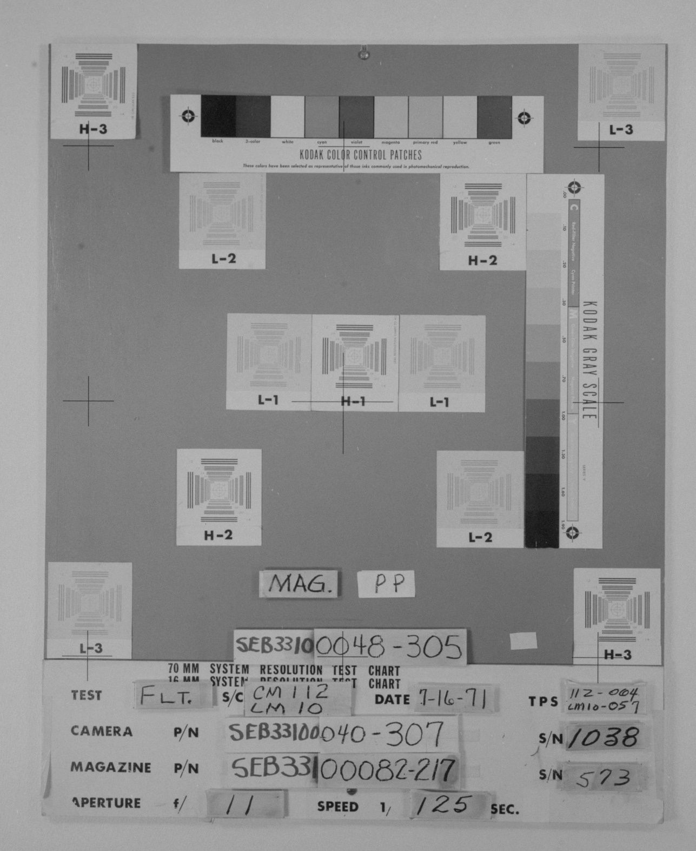
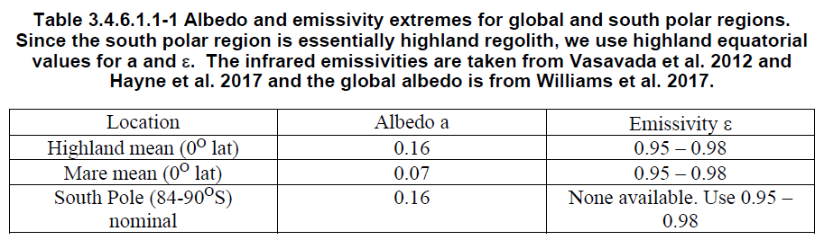
Lunar regolith properties
Lunar albedo varies with terrain type
  Highlands/South Pole albedo = 0.16
  Mare albedo = 0.07
DSNE Table 3.4.6.1.1-1
AS15-90-CHART
NASA/JSC
Notes:
Image Source: as15-90-chart | Apollo 15 Hasselblad image from film magazin… | Flickr

Slide 15
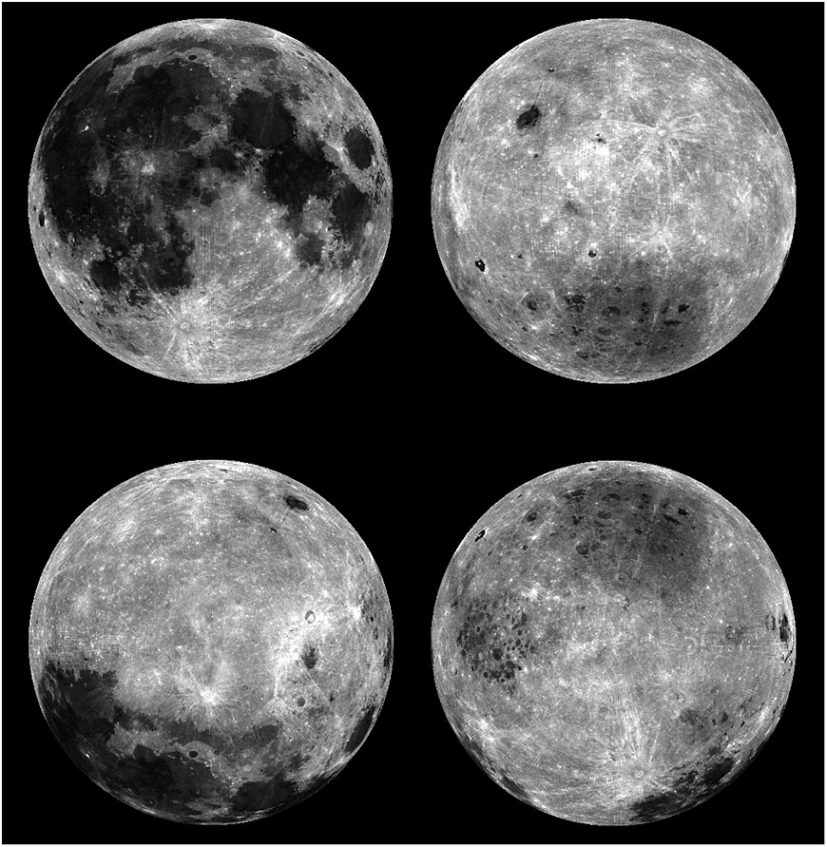
Lunar albedo
Four views of the normal albedo of the Moon at 1064 nm in orthographic projection: (top left) Earth-facing view, (top right) farside view, (bottom left) north pole view, and (bottom right) south pole view.
Figure and caption source: Lucey, P. G., et al. (2014), The global albedo of the Moon at 1064 nm from LOLA, J. Geophys. Res. Planets, 119, 1665– 1679, doi:10.1002/2013JE004592.
Notes:
Figure source: https://doi.org/10.1016/j.icarus.2016.02.006

Slide 16
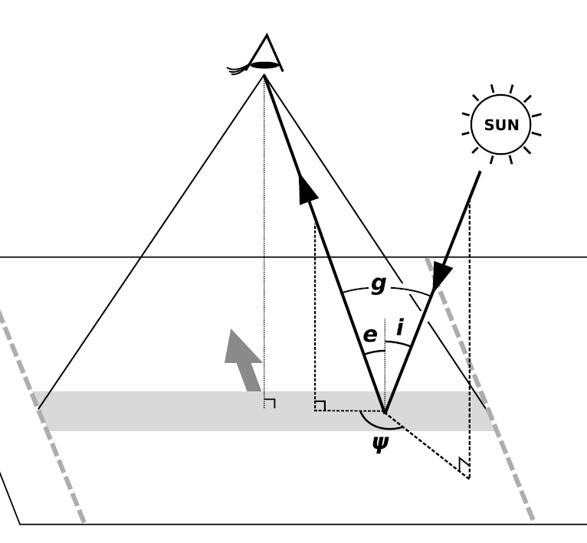

Phase-dependent reflectivity
Reflectivity of the lunar regolith increases for phase angle $(g)$ approaching $0°$
  Zero phase angle = looking directly away from the Sun
  Increased backscatter
Figure source: Sato, H., Robinson, M. S., Hapke, B., Denevi, B. W., and Boyd, A. K. (2014), Resolved Hapke parameter maps of the Moon, J. Geophys. Res. Planets, 119, 1775– 1805, doi:10.1002/2013JE004580.
Notes:
Figure source: https://doi.org/10.1002/2013JE004580

Slide 17
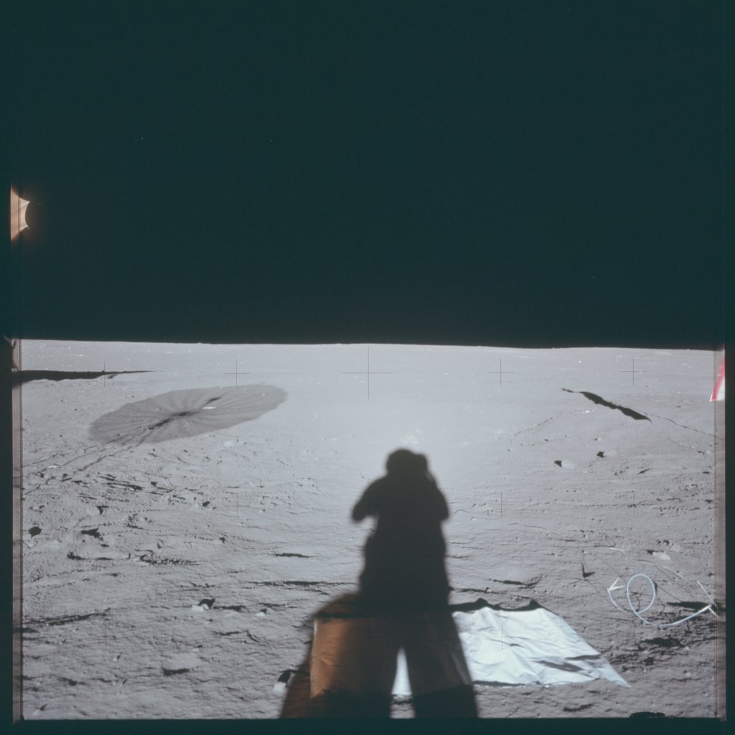
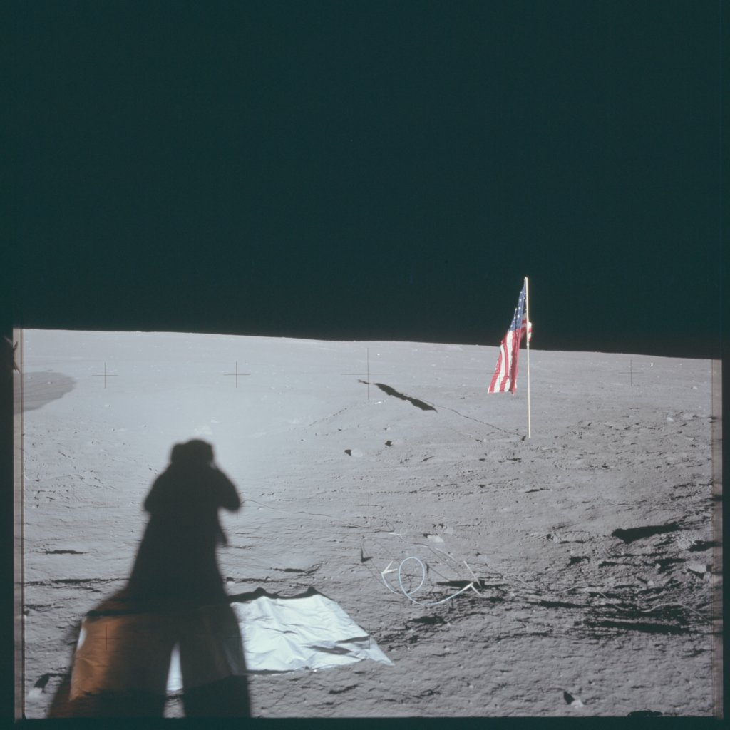
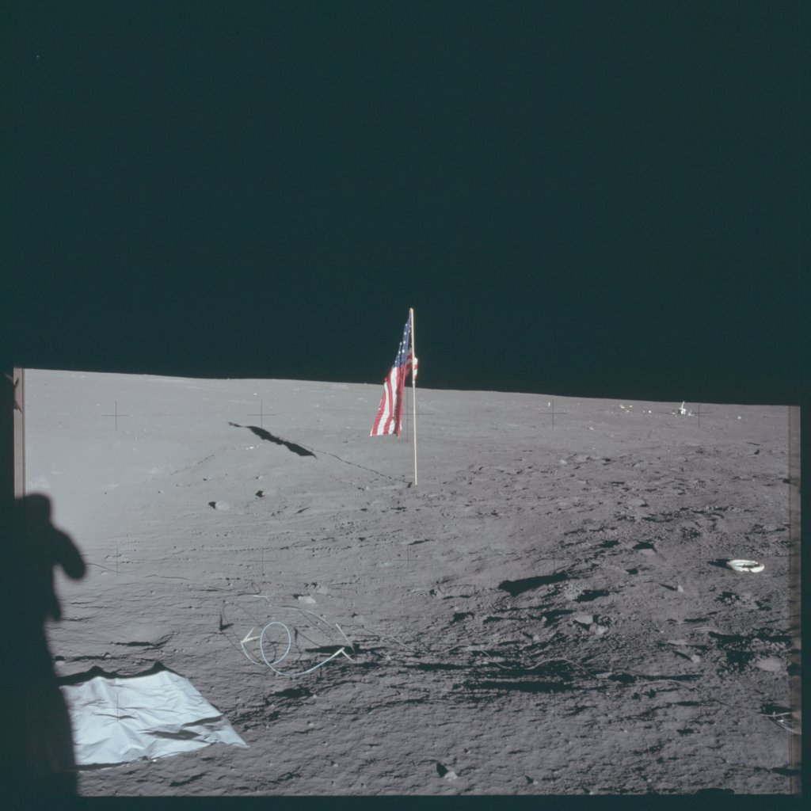
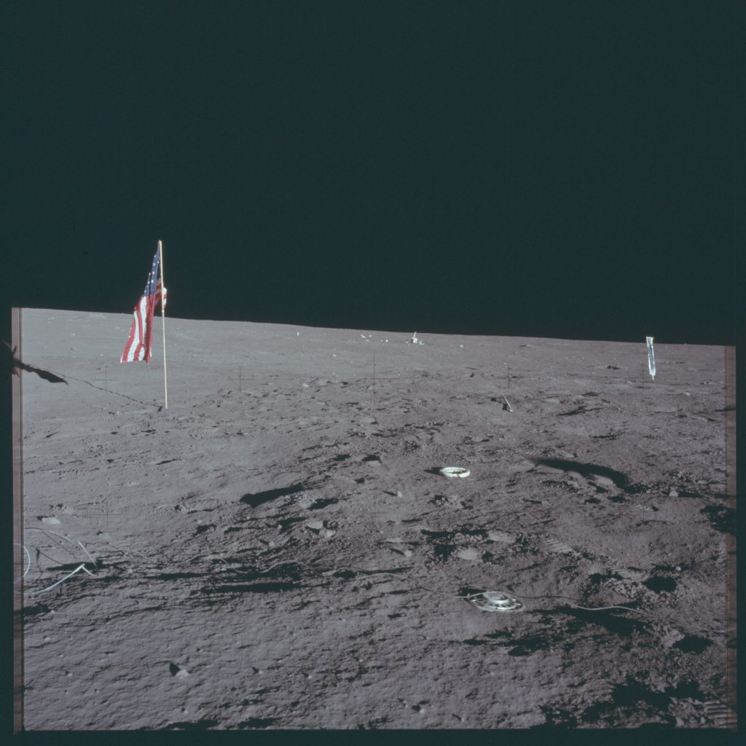
AS12-47-6982 through AS12-47-6985
NASA/JSC
Notes:
Image source: https://www.flickr.com/photos/projectapolloarchive/

Slide 18
AS12-47-6982 and AS12-47-6985
NASA/JSC
Notes:
Image source: https://www.flickr.com/photos/projectapolloarchive/

Slide 19
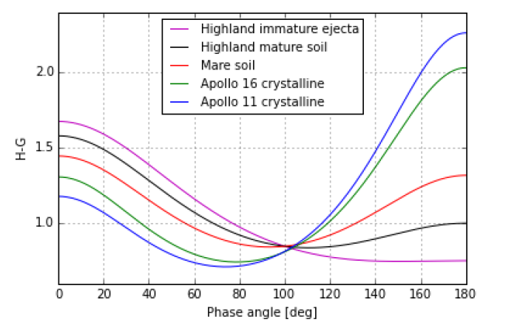
Phase-dependent reflectivity
Light scattering from regolith modeled in detail by the Hapke function (Sato et al. 2014)
The simpler Henyey-Greenstein (H-G) phase function is sufficient for engineering analyses
  H-G function and parameters provided in DSNE section 3.4.5.1
For simulation purposes, full Hapke function from Sato et al. 2014 may be preferred
DSNE Figure 3.4.5.1-1 Henyey-Greenstein phase functions using the parameters listed in DSNE Table 3.4.5.1-1.
Notes:
Figure from DSNE

Slide 20
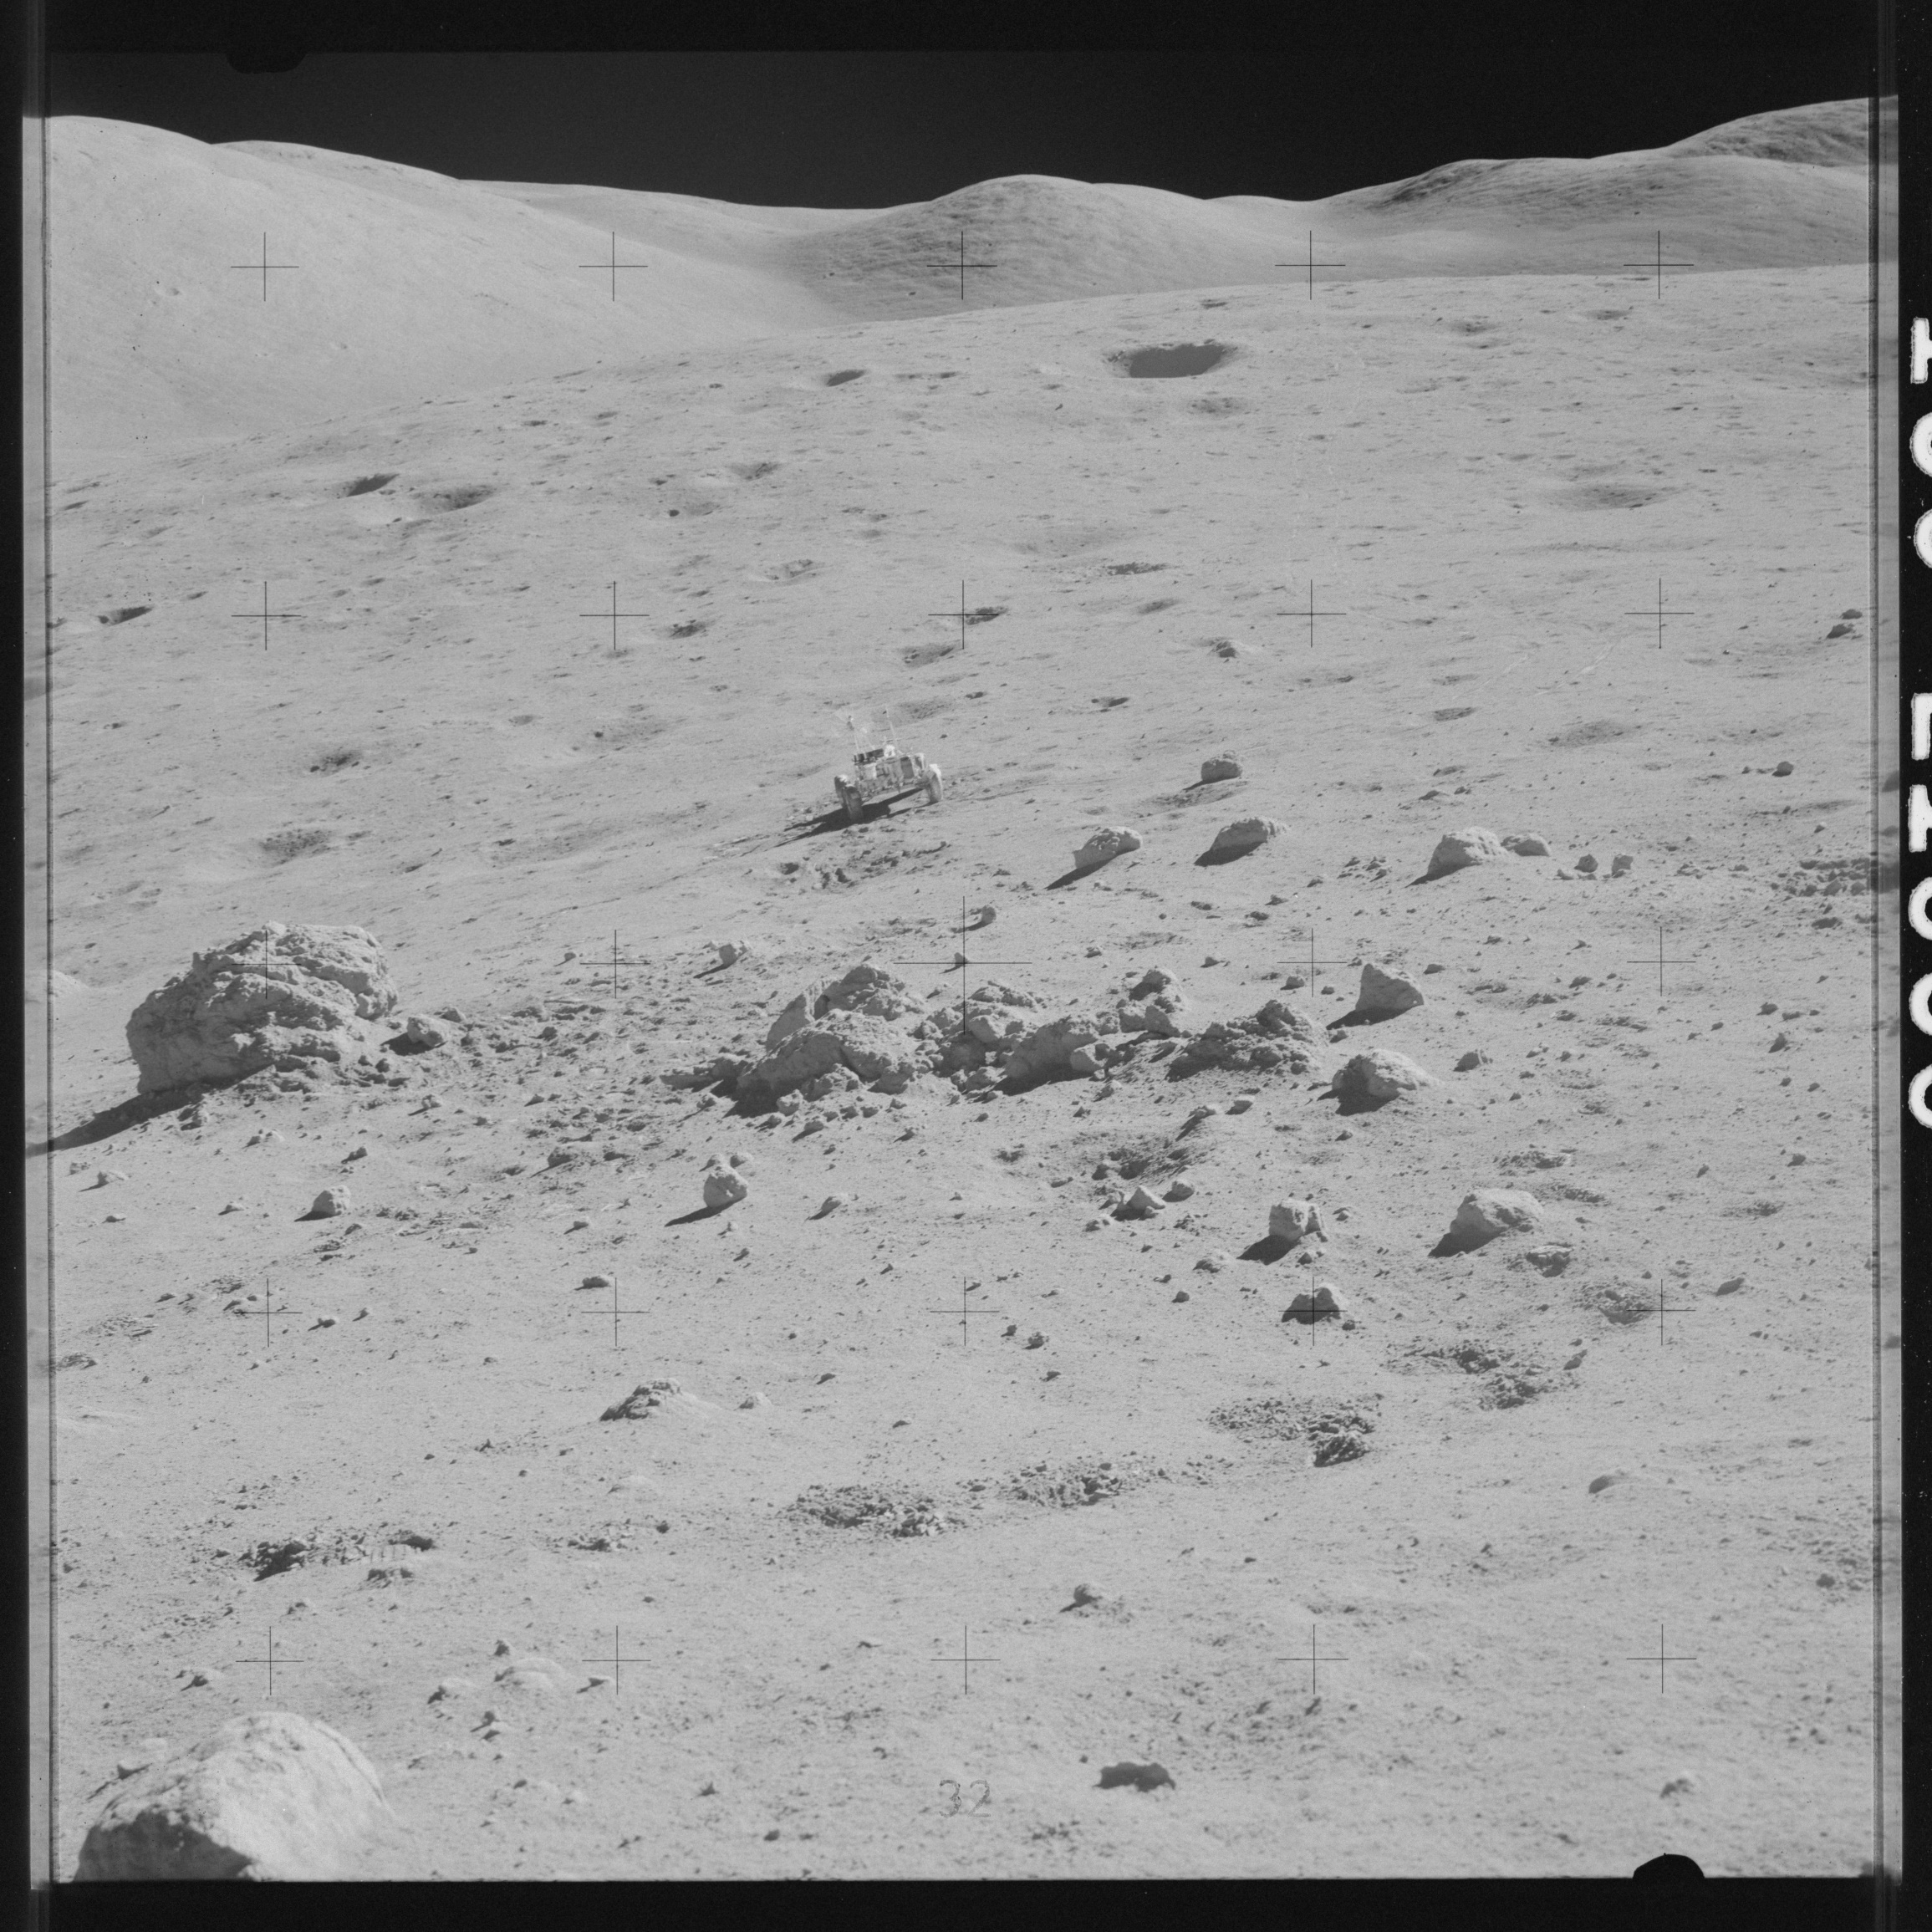

Rock distributions
DSNE 3.4.1.4
Rocks are relatively rare on lunar surface; fractional area of rocks $≥1 m$ typically $<1\%$.
Rocks are not randomly distributed, fractional area can be high ($10\% – 20\%$) in certain regions.
Rock abundance should be locally assessed during site characterization; size-frequency distribution may be used for sizes $< 2 m$.
NASA/JSC/AS17-138-21039
Notes:
Image source: AS17-138-21039 | Apollo 17 Hasselblad image from film magazi… | Flickr

Slide 21
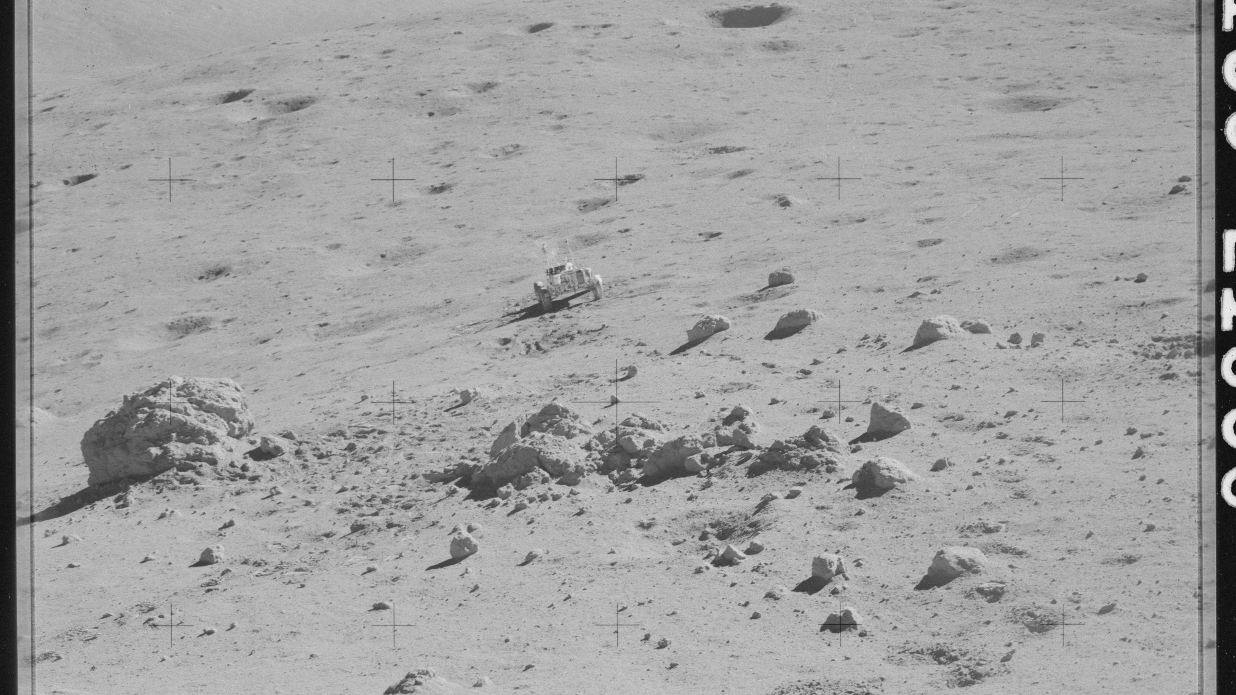
Notes:
Image source: AS17-138-21039 | Apollo 17 Hasselblad image from film magazi… | Flickr

Slide 22
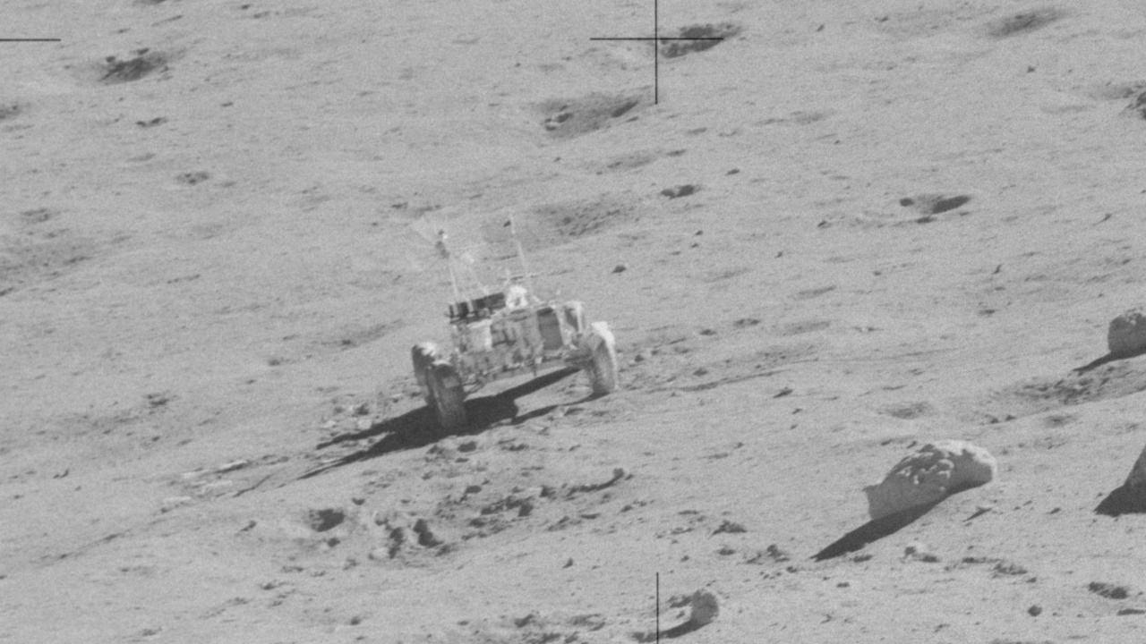
Notes:
Image source: AS17-138-21039 | Apollo 17 Hasselblad image from film magazi… | Flickr

Slide 23
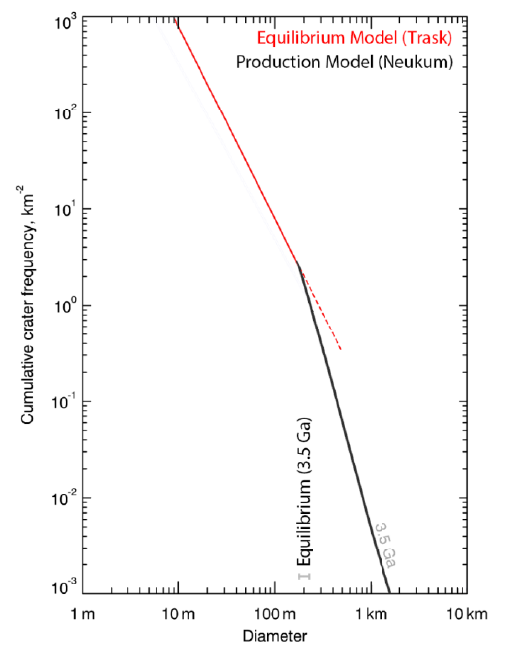
Crater size-frequency distributions, topography
DSNE 3.4.1.1, 3.4.2.2, and 3.4.1.3
Global slope distributions
Generalized crater statistics
  Larger craters using Neukum production function
  Smaller craters using Trask equation
Site analysis should be performed as local distributions may differ
Descriptions of crater morphology, features, depth/diameter ratios provided
DSNE Figure 3.4.1.1-1
Notes:
Figure from DSNE

Slide 24
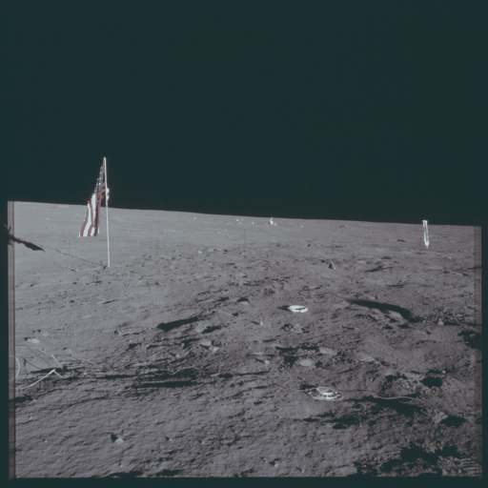
Questions?
AS12-47-6982 through AS12-47-7006
NASA/JSC
Notes:
Image source: https://www.flickr.com/photos/projectapolloarchive/

Slide 25
Resources & References
Project Apollo Archive: https://www.flickr.com/people/projectapolloarchive/
Apollo Lunar Surface Journal: https://www.hq.nasa.gov/alsj/
SLS-SPEC-159 Cross-Program Design Specification for Natural Environments: https://ntrs.nasa.gov/citations/20210024522
Glenar, D. A., Stubbs, T. J., Schwieterman, E. W., Robinson, T. D., & Livengood, T. A. (2019). Earthshine as an illumination source at the Moon. Icarus, 321, 841–856. https://doi.org/10.1016/j.icarus.2018.12.025
Lemelin, M., Lucey, P. G., Neumann, G. A., Mazarico, E. M., Barker, M. K., Kakazu, A., Trang, D., Smith, D. E., & Zuber, M. T. (2016). Improved calibration of reflectance data from the LRO Lunar Orbiter Laser Altimeter (LOLA) and implications for space weathering. Icarus, 273, 315–328. https://doi.org/10.1016/j.icarus.2016.02.006
Sato, H., Robinson, M. S., Hapke, B., Denevi, B. W., & Boyd, A. K. (2014). Resolved Hapke parameter maps of the Moon. Journal of Geophysical Research: Planets, 119(8), 1775–1805. https://doi.org/10.1002/2013JE004580

