Slide 1
Worksite Design & Lighting
Charles Dischinger
Technical Lead,
NASA Engineering & Safety Center
Assessment of Effects of Lunar Polar Light Environment on EVA Astronaut Performance
Notes:
My talk is about two things that may not apply to all: the Lunar South Pole, and astronaut interaction in general. I know that many are planning for other landing sites, and many know that astronauts will not ever visit their site. I suggest that even if you are in these categories, you keep these considerations in mind, as mission plans tend to change over time.

Slide 2
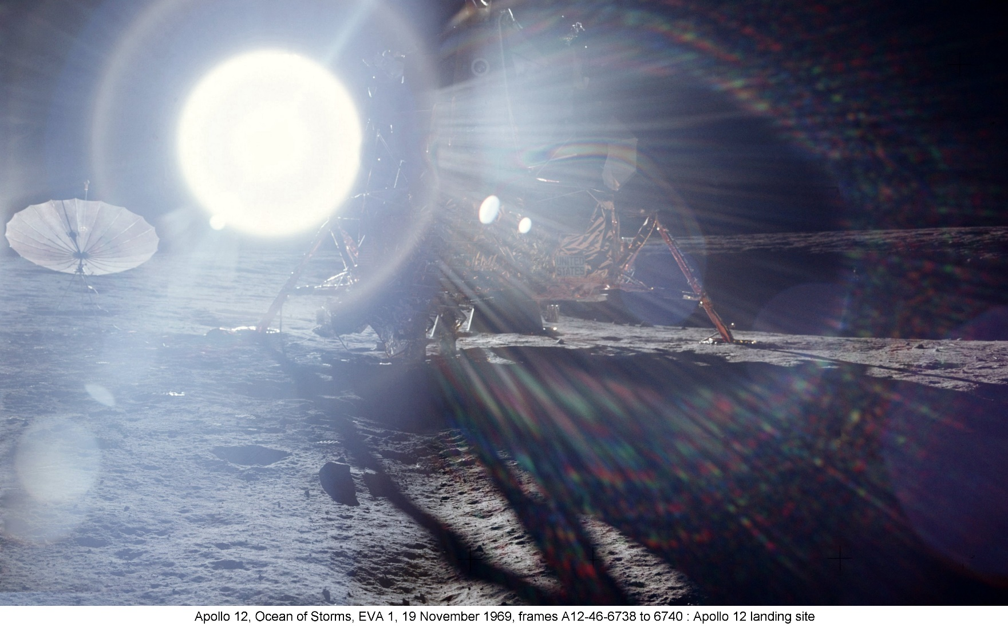
NESC Assessment (study)
Humans lack experience operating on planetary surfaces and for long durations in complete darkness, or when lighted, with harsh sun angles and long shadows

Slide 3
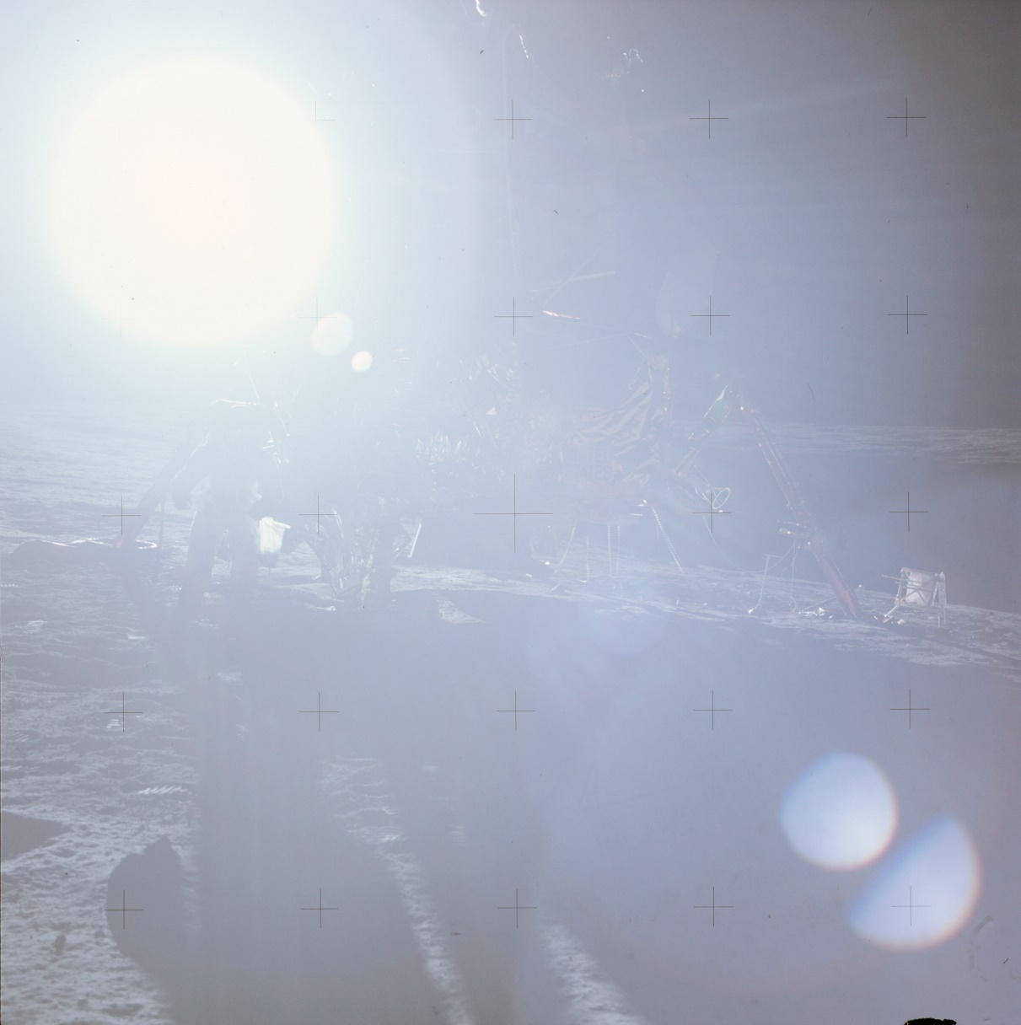
What are the lighting concerns?
Can you spot the LEM, Astronaut, Hand Tool Carrier (HTC) and Modular Equipment Stowage Assembly (MESA)?
There is no color video footage of Apollo 12 because the video camera was inadvertently pointed at the Sun, burning out its sensor
Sun angle of Apollo 12, EVA1 = 7.5°
(lowest of the Apollo EVAs)
Sun angle in Polar Area of the Moon ≤ 5°
(2-3° is typical)
Shadow at 2.5° is ~3X as long as shadow at 7.5°
  6’ object casts ~137’ shadow, with Sun at 2.5°
    All black
Ambient lighting on the Moon too bright for EVA operations …
  And too dark
“Man, that Sun is bright!”
– Pete Conrad, Apollo 12, EVA1
3
Notes:
Camera consequences: with lots of experience in space, designers generally know now how to avoid pointing sensors toward the sun, though it must be a design consideration, if the sensor is sensitive to solar radiation. Real point here is that looking in general direction of the sun will blind astronauts, and looking downsun is looking into a shadow (your own).

Slide 4
SVS video
https://www.youtube.com/watch?v=aD1OQ9UBwuU
Notes:
Science Visualization studio. Note time in sunlight.

Slide 5
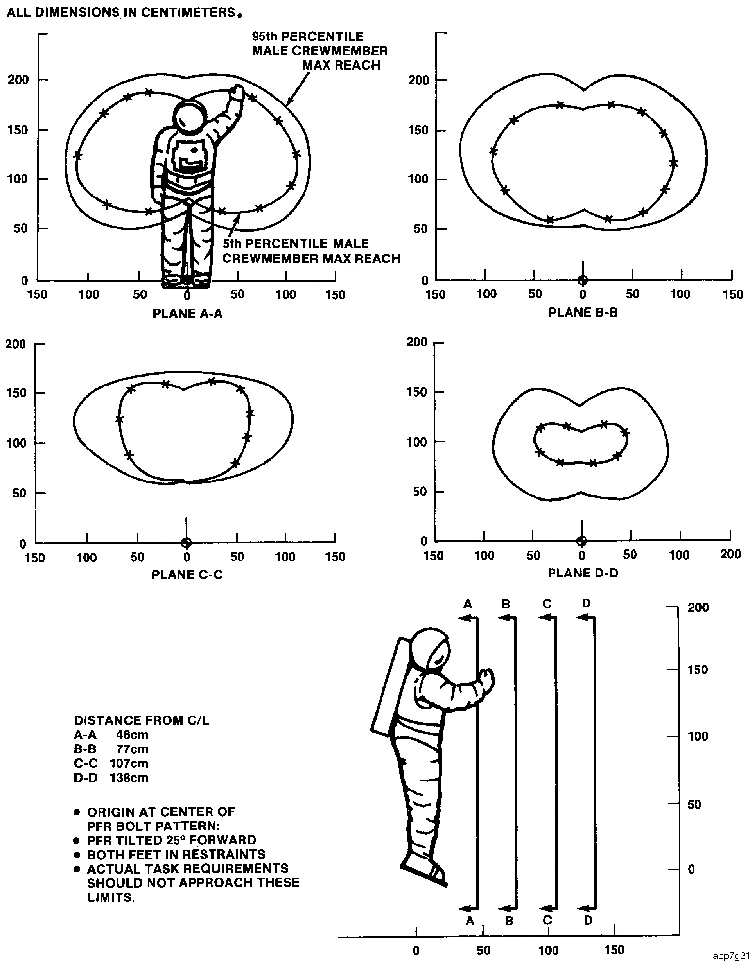
Worksite design
General considerations 1: astronaut reach envelopes
If she cannot reach it, she cannot actuate, remove, or insert it
Notes:
This is very old design guidance and will not translate exactly to people in lunar suits, which are still in development. The thing to remember is that suit constrains the body’s ability to achieve positions in ways you must understand and reflect in the design.. So any experiment which needs service by an astronaut MUST BE DESIGNED TO ACCOMMODATE THE CONSTRAINTS IMPOSED BY SPACESUITS

Slide 6
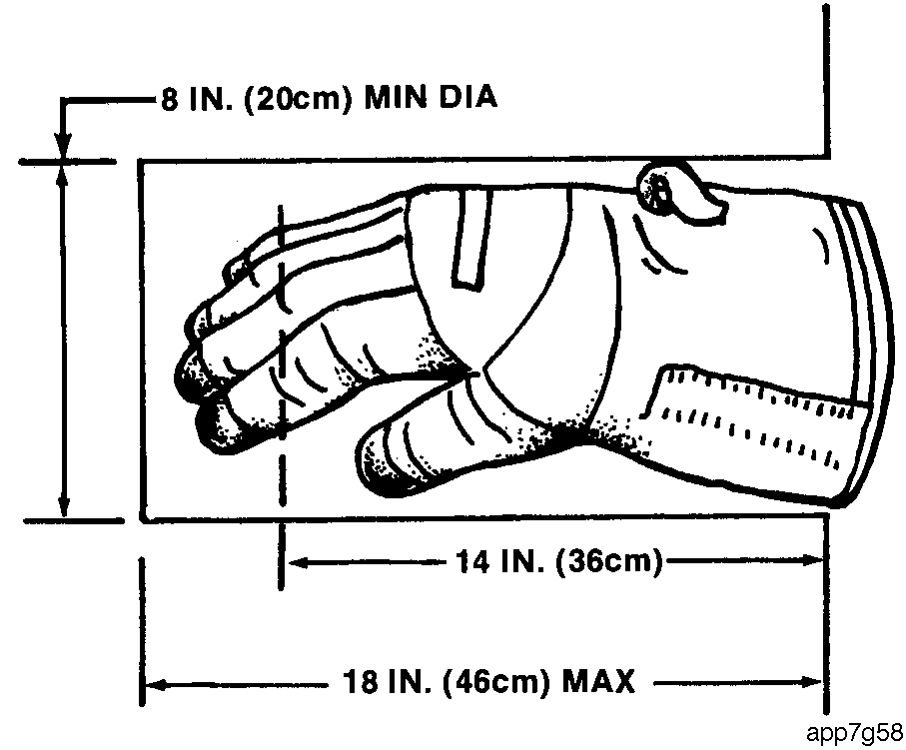
Worksite design
General considerations 2: suit glove & sleeve envelopes
If the glove cannot fit into an opening, or the sleeve is constrained by the opening, she cannot work there.
Notes:
Agfain, old design. But the glove will not get a whole lot smaller.

Slide 7
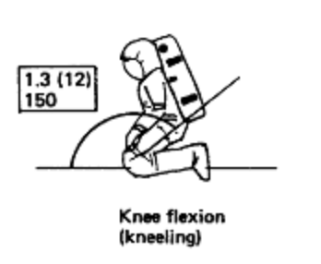
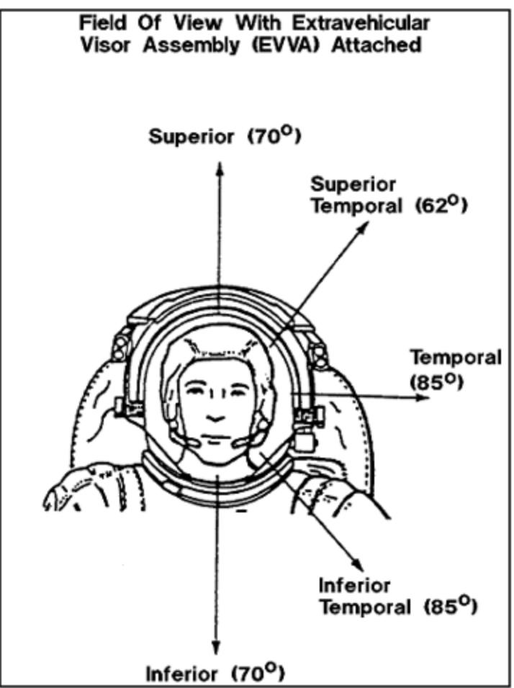
Worksite design
General considerations 3: other suit concerns
Can the astronaut bend to reach a task site?
Is there a risk that the suit will tear?
Will additional lighting be required?
Can the astronaut see the task site?
Will the needed tool fit into the task site?
Can an astronaut grasp it (does it have a handle?)?
Visual envelope definition
Notes:
If this bend is difficult, may constrain breathing or reach & work envelopes. It is not certain that knees of suits can withstand dust abrasion. Your system must have rounded edges, to accommodate suit contact. Will the overall architecture provide lights, or will you need to?

Slide 8
Worksite design robots
Same considerations as for people

Slide 9
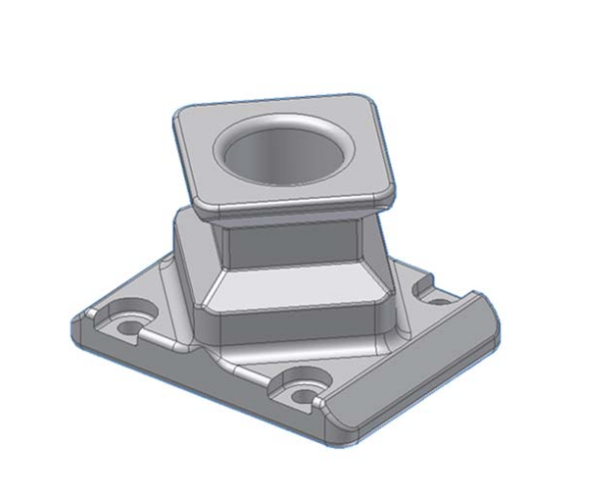
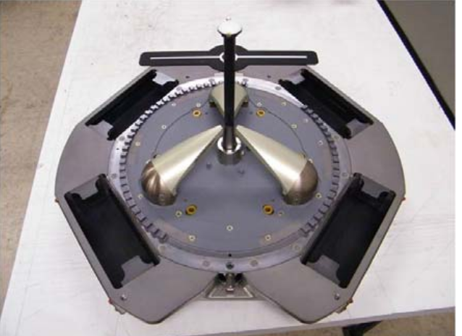
Worksite design robots
Same considerations as for people
  Work envelope
  Visual envelope
  Reach envelope
  Tool (end effector) envelope
  Need a “grasp” interface
Examples of robotic grapple interfaces

Slide 10
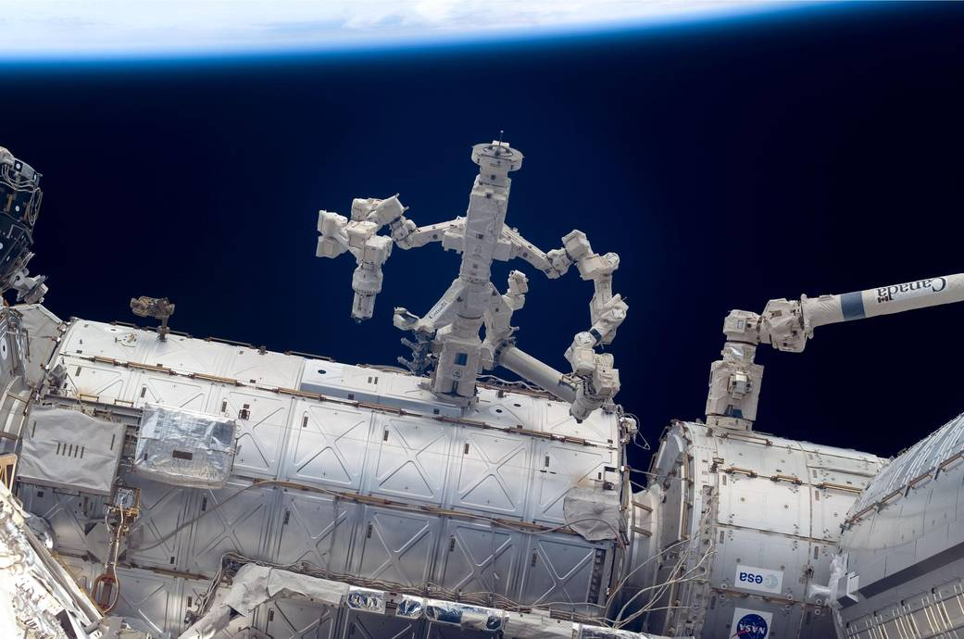
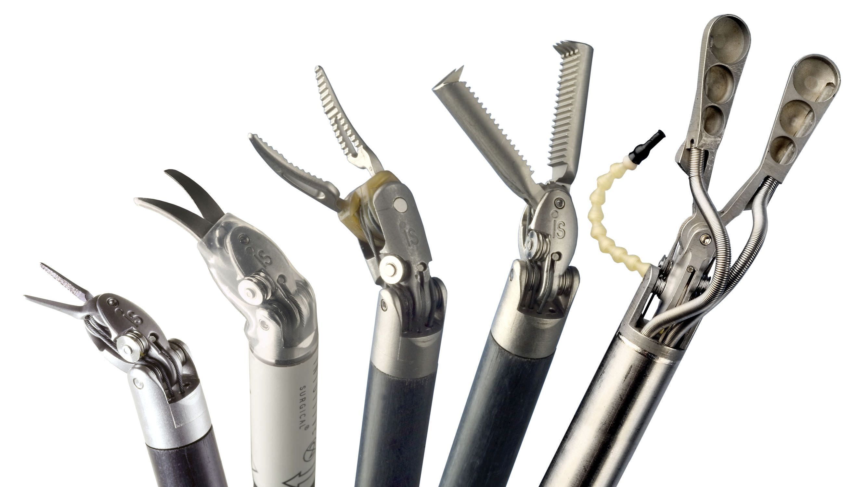
Two robots
Notes:
Neither of these

