Slide 1


DEVELOP
2022 Summer Preview

Slide 2
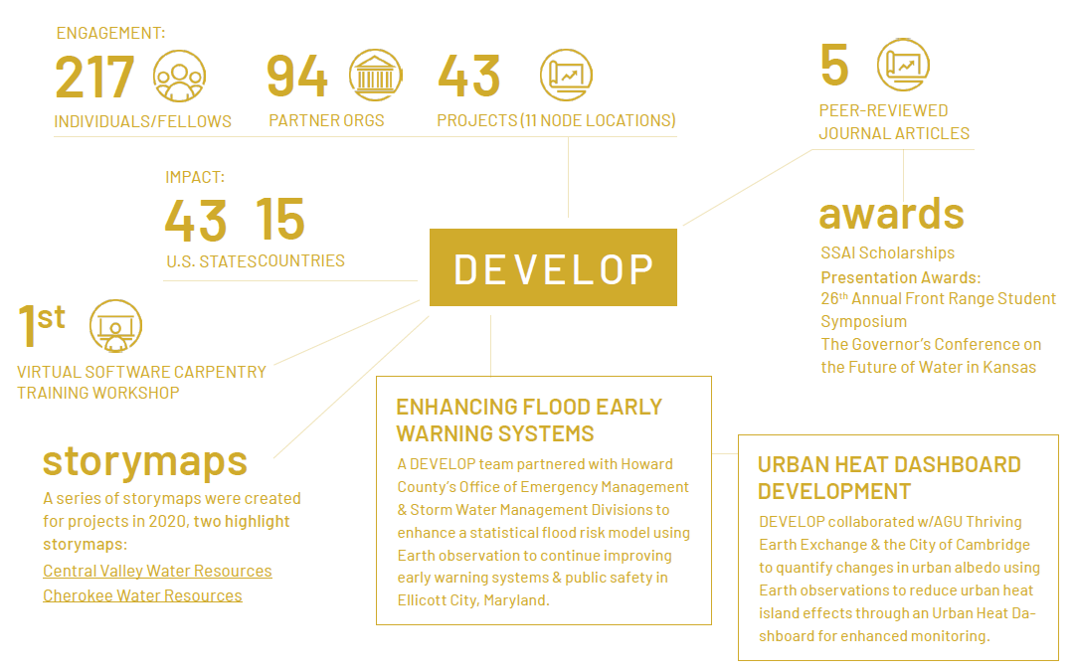
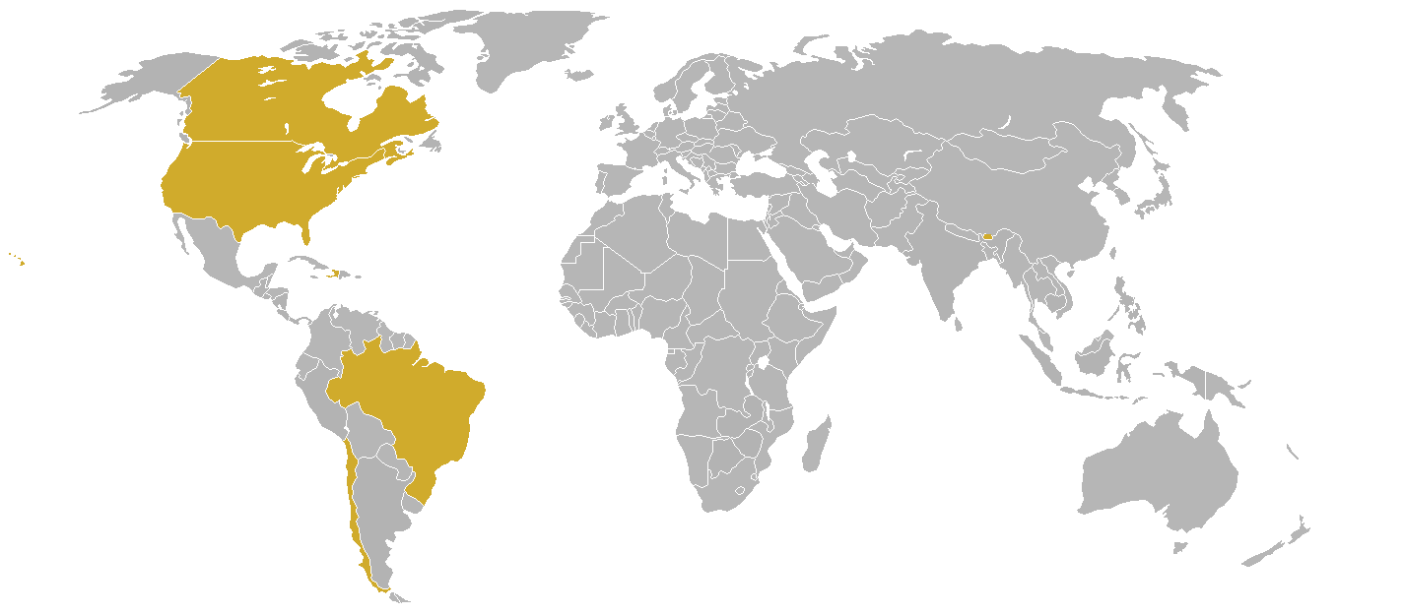



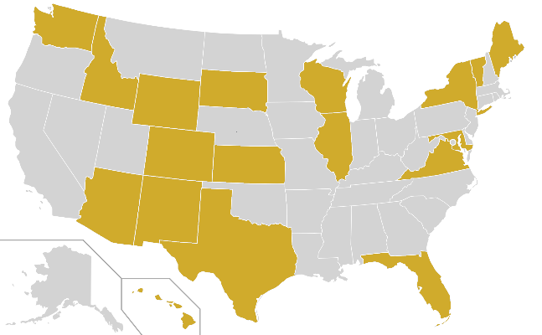

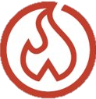







*IMPACTS AND PARTNERS ARE TENTATIVE
2022 SUMMER PORTFOLIO
ENGAGEMENT:
110
64
27
PARTICIPANTS
PARTNER ORGS
PROJECTS
TERM I: 23
IMPACT:
TERM II: 3
18
6
TERM III: 1
U.S. STATES
COUNTRIES
ACADEMIC
DISASTERS
CONSORTIUM
WILDFIRES
LOCAL GOVERNMENT
AGRICULTURE
STATE GOVERNMENT
ENERGY
FEDERAL GOVERNMENT
ECOLOGICAL FORECASTING
THEMATIC AREA
INSTITUTIONAL SECTOR
INTERGOVERNMENTAL
WATER RESOURCES
FOR-PROFIT
URBAN DEVELOPMENT
NON-PROFIT
CLIMATE
NGO
HEALTH & AIR QUALITY
INTERNATIONAL
Notes:
(25 project x 4 participants each) + (2 project x 5 participants each) = 110 participants

Slide 3
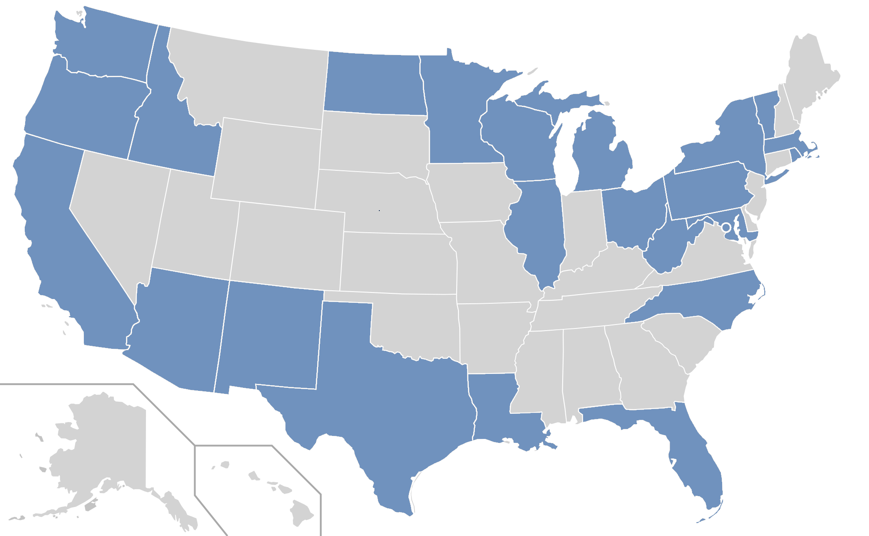

2022 SUMMER PARTICIPANTS
110
PARTICIPANTS
26 (24%)
RETURNERS
84 (76%)
NEW PARTICIPANTS
66 (60%)
VIRTUAL
44 (40%)
IN PERSON
23
STATES + WASHINGTON DC

Slide 4
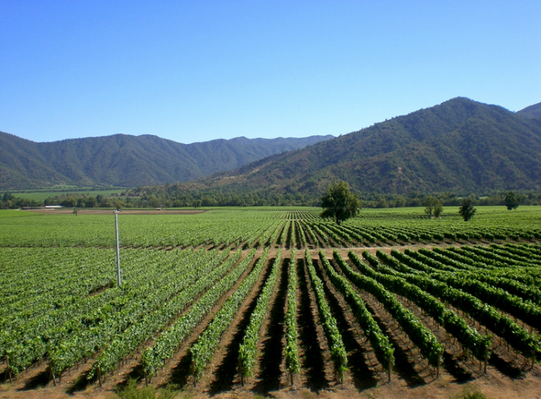
Maipo River Valley Agriculture
Community Concern: Crop coefficients (Kc) are commonly used to calculate actual crop evapotranspiration and assess irrigation. Although variability between growing seasons, frequently used Kc estimates do not account for geographic and climate conditions which commonly results in inaccurate representations of water usage needs.
Partners:
Centro de Información de Recursos Naturales (CIREN)
Oficina Agrícola de la Embajada de Chile en los Estados Unidos de América
Pop-Up Project at University of Virginia
Earth Observations:
Landsat 8 OLI
Aqua MODIS
Terra MODIS
Suomi NPP VIIRS
ISS ECOSTRESS
Impact: Dual crop coefficient methodologies will provide the partners more accurate approaches to evaluating irrigation needs among crop fields in the Maipo River Valley in Chile.
Image Credit: robsonfilho
Notes:
------------------------------Image Information Below ------------------------------
Image Credit: "Vale Maipo, Chile" by robsonfilho. Free to use under Flickr license CC BY-NC 2.0
Image Source: https://flic.kr/p/4ouZ6m

Slide 5
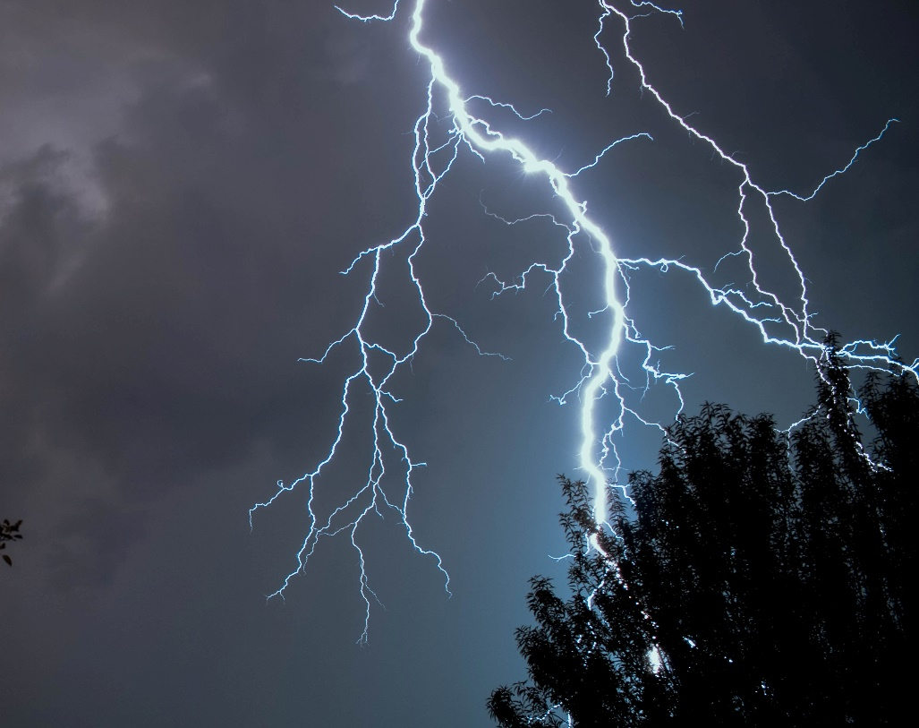
Chile Wildfires
Community Concern: In early 2017 high heat and drought contributed to some of the most damaging fires in Chilean history. One of the ways CONAF is preparing for preventative fire management is by quantifying fires ignited by lightning strikes.
Partners:
Corporación Nacional Forestal (CONAF)
Embassy of Chile, Agricultural Office
Virginia – Langley
Earth Observations:
GOES-16 GLM
Suomi NPP VIIRS
Terra MODIS
Aqua MODIS
Landsat 8 OLI
Impact: This work will benefit end users by providing trends in lightning strike location and frequency, as well as observing vegetation health within those high frequency areas. This will allow partners to plan preventative fire measures for areas most at risk for wildfire ignition.
Image Credit: Jonas Kaiser on Unsplash
Notes:
Image Credit: Photo by Jonas Kaiser on Unsplash
Image Source: https://unsplash.com/photos/I621uimW8p0; license: https://unsplash.com/license

