Slide 1
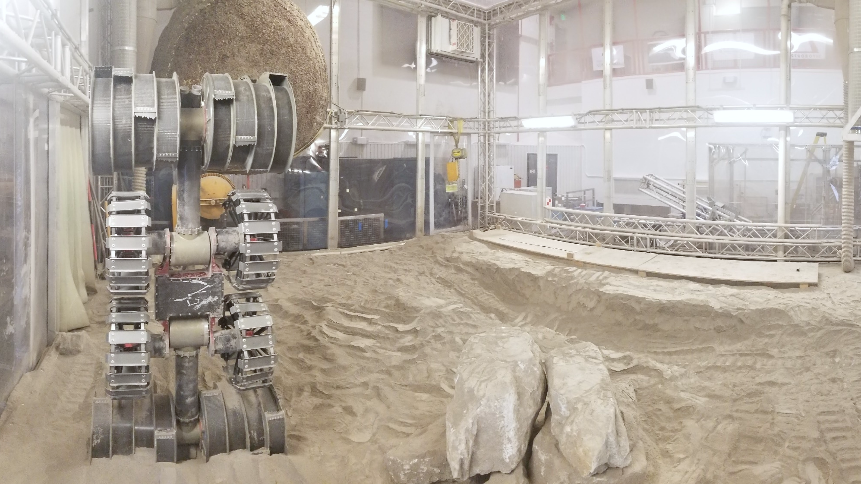

Development of Autonomous Excavation Algorithms
Brad Buckles
Bradley.Buckles@nasa.gov

Slide 2
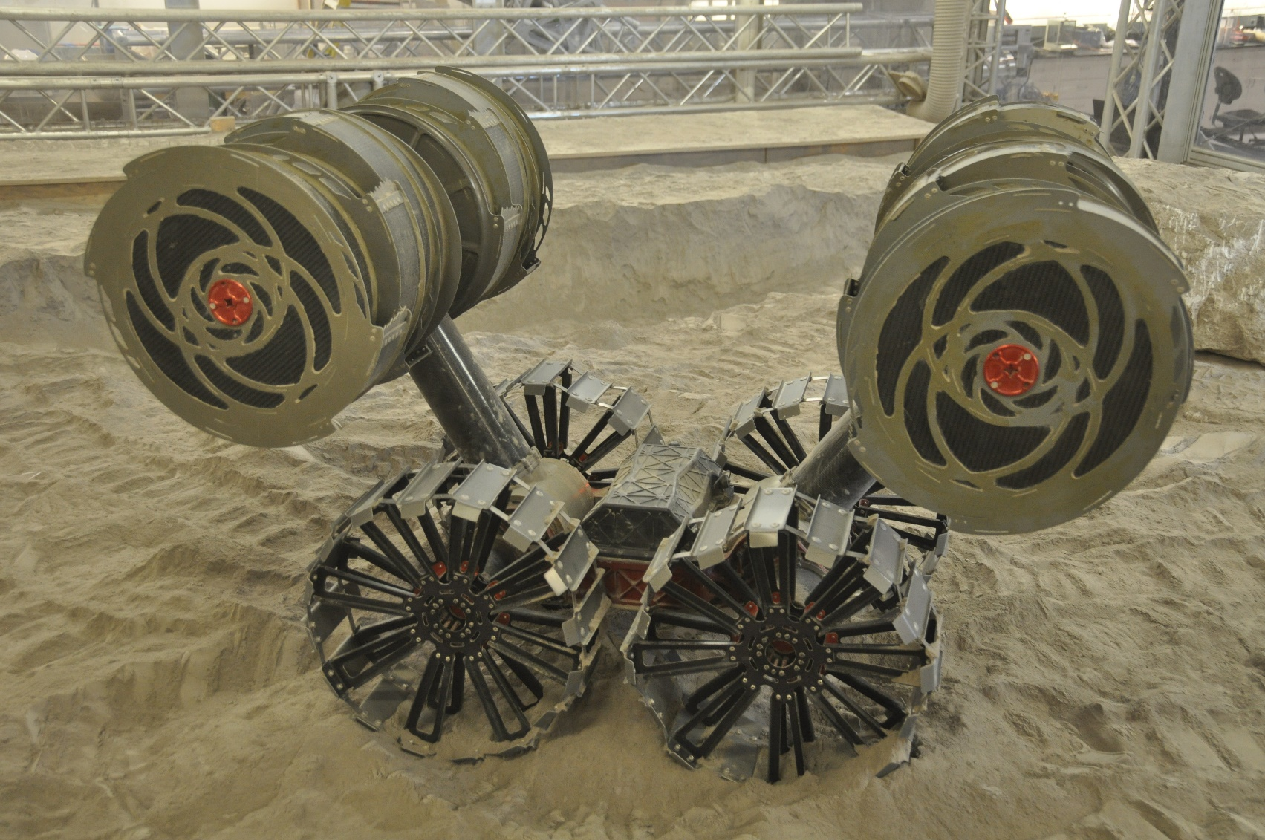
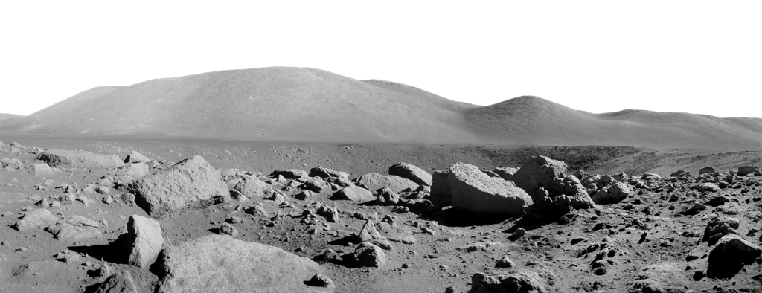

RASSOR 2.0 Prototype Excavation Rover
RASSOR 2.0 is a prototype robotic excavator developed in the Granular Mechanics and Regolith Operations (GMRO) Lab at Kennedy Space Center
Currently being used for development of excavation algorithms to inform the ISRU Pilot Excavator (iPEX) project
iPEX is a NASA Game Changing Development (GCD) funded project to develop a flight ready robotic excavator to demonstrate lunar excavation.
iPEX is planned to fly as a Commercial Lunar Payload Service (CLPS) payload

Slide 3
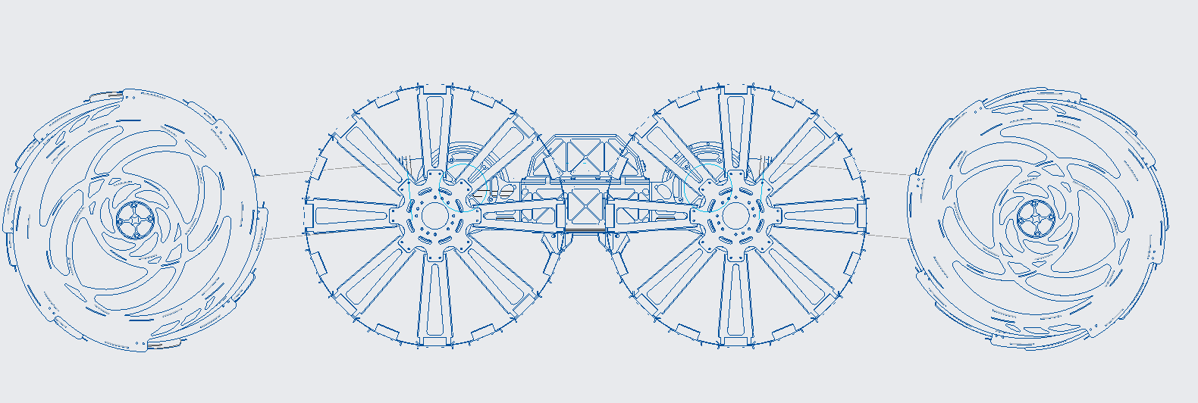
Excavation Free Body Diagram
Mg
F_{H}
T
T
F_{H}
F_{N}
F_{N}
F_{V}
F_{V}

Slide 4
Excavation Concept
Reduced gravity and mass limitations limit the traction of the vehicle
Need to be able to excavate without a large reaction force
Counter rotating bucket drums cancel the horizontal digging forces
In order for the forces to be continually balanced, we need autonomy
We call the control loop that enables this autonomy “autodig”

Slide 5
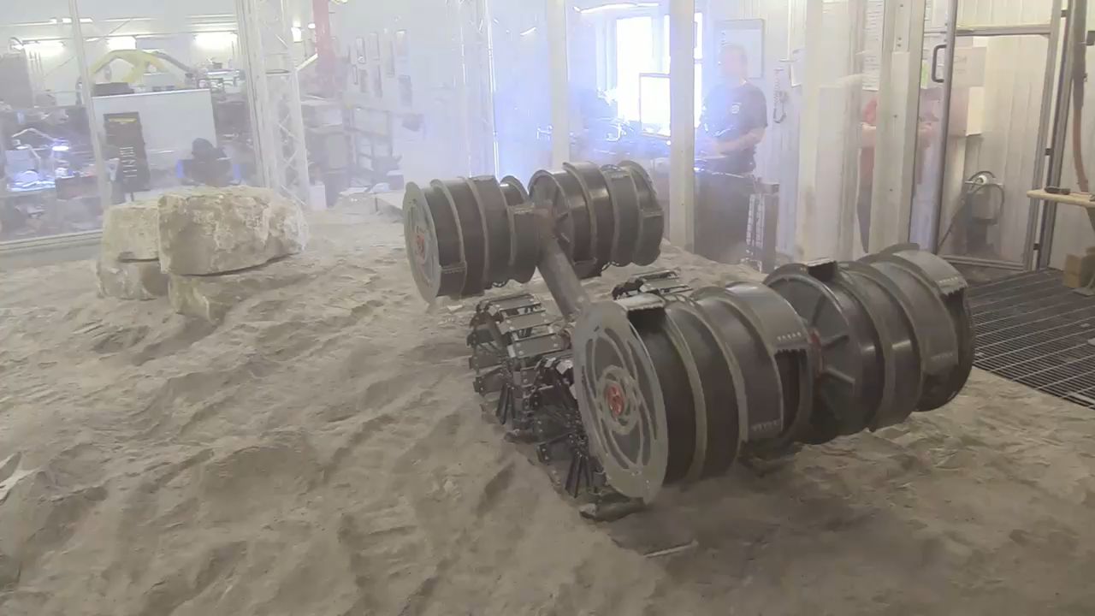
Autodig Demonstration Video

Slide 6
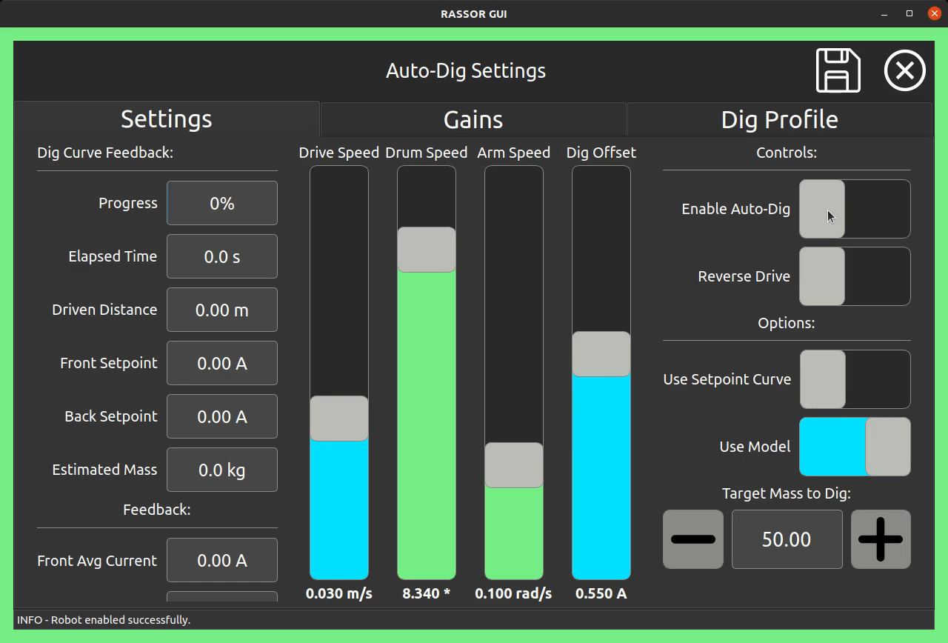
Autodig Software Demonstration Video

Slide 7
Excavation Concept Continued
A PID loop is used to maintain matching currents (torque) on the front and rear drum
The arms servo up and down to increase/decrease the depth of cut and engagement of the soil
This increases or decreases the resultant torque on the drum
As regolith is collected and stored in the drum, additional current is required to compensate for the increased torque from “tumbling” the regolith inside
The current required to tumble a known mass in free air with no excavation is referred to as the “nominal tumbling current”

Slide 8
Excavation Concept Continued
Since our goal is to excavate, we need additional torque beyond what it takes to just tumble the mass in the drum
The current setpoint for the PID becomes:
  Current Setpoint = Nominal Tumbling Current + Dig Offset
Where the dig offset is a commanded value that encourages digging
A higher dig offset will result in deeper cuts and more “aggressive” digging

Slide 9
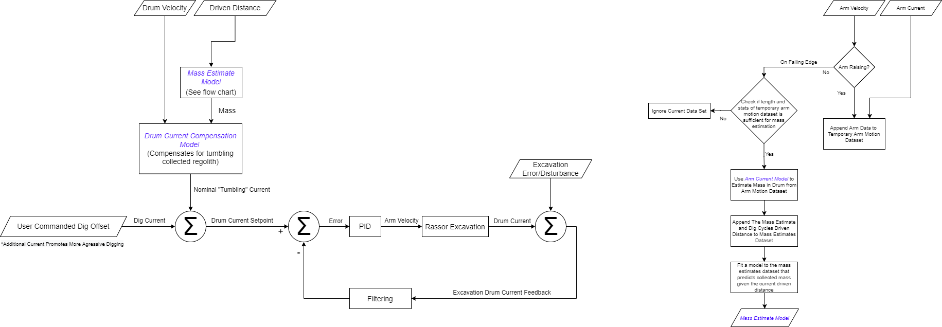
Autodig Algorithm Block Diagram

Slide 10
Mass Estimate Model Generation

Slide 11
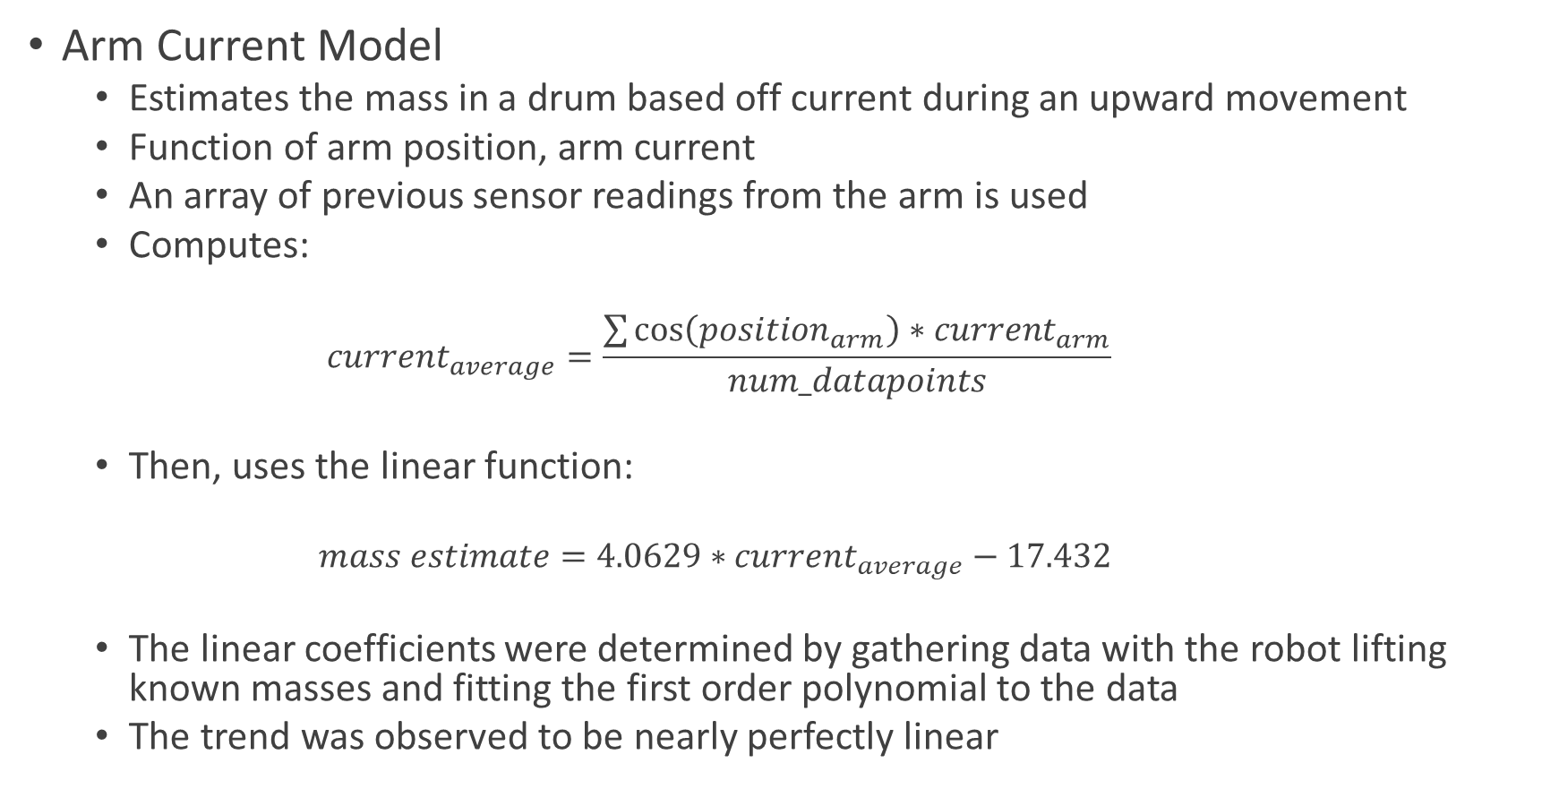
Arm Current Model
Arm Current Model
  Estimates the mass in a drum based off current during an upward movement
  Function of arm position, arm current
  An array of previous sensor readings from the arm is used
  Computes:
    $$current_{average}=\frac{\sum{\cos\left(position_{arm}\right)∗current_{arm}}}{num_datapoints}$$
  Then, uses the linear function:
    $$mass estimate=4.0629∗current_{average}−17.432$$
  The linear coefficients were determined by gathering data with the robot lifting known masses and fitting the first order polynomial to the data
  The trend was observed to be nearly perfectly linear

Slide 12
Mass Estimate Model
Mass Estimate Model
  Periodic mass estimates are provided by the Arm Current Model
  These typically happen every few seconds
  We could use the latest estimate for our drum compensation until we get a new one, Or…
We can interpolate between each new mass estimate:
  This provides smoother and more consistent digging,
  Added benefit of filtering some of the error in mass estimations
  The excavation rate is assumed to be constant with constant drive speed
  Each time we get a new mass estimate, we add that to a dataset with the corresponding distance that has been driven during the dig cycle
  A first order polynomial is refit with each estimate
  In real-time, the autodig algorithm evaluates the polynomial at its current driven distance and uses the computed mass estimate for drum current compensation

Slide 13
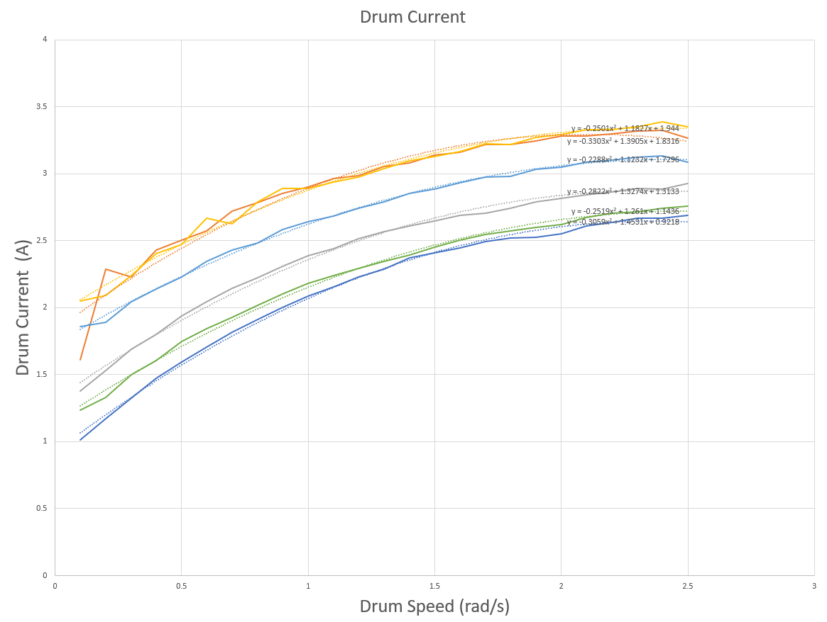
Drum Current Compensation Model
A test was conducted where a known mass is spun in the drum in free air, while the drum was ramped through a range of drum speeds
This test was conducted for multiple known masses
The corresponding plots provided insight to the trends
The same trend was observed across drums speeds for all masses
The regolith mass contributed to a Y-offset of the 2nd order polynomial

Slide 14
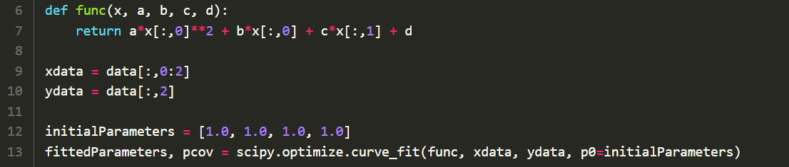
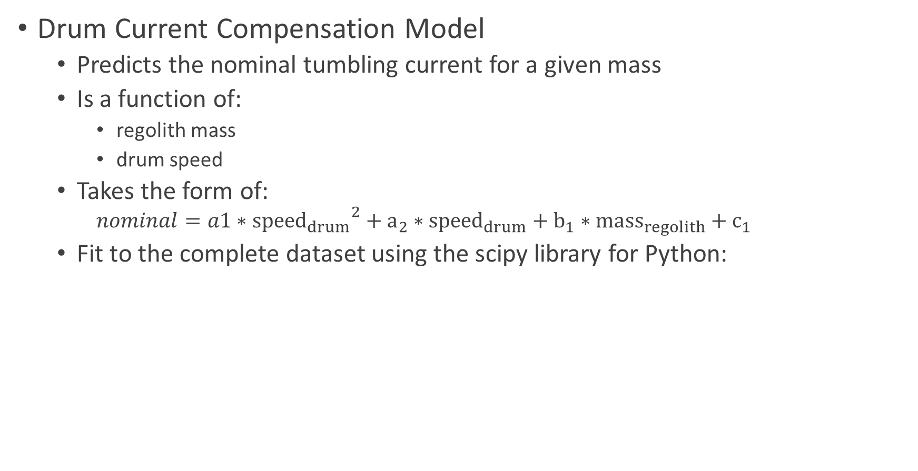
Drum Current Compensation Model Continued
Drum Current Compensation Model
  Predicts the nominal tumbling current for a given mass
  Is a function of:
    regolith mass
    drum speed
  Takes the form of:
    $$nominal=a1∗{{speed}_{drum}}^{2}+a_{2}∗{speed}_{drum}+b_{1}∗{mass}_{regolith}+c_{1}$$
  Fit to the complete dataset using the scipy library for Python:

Slide 15
Autodig Performance
Testing of the prototype algorithm showed
  Consistency in cut depth
  A constant excavation rate
  Acceptable accuracy in predicting the collected mass
  Responsiveness to disturbances and variation in terrain
  Overall, provided reliable excavation
Improvements
  Many of the models can be improved
  Very small data sets were used for fitting models, use larger datasets
  Additional logic, filtering, and intelligence can be added to the algorithm

Slide 16
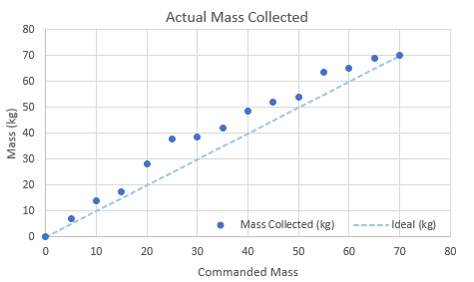
Autodig Performance Continued
A test was conducted where a range of masses to collect was commanded
The excavator automatically stops when it reaches its target
The actual collected regolith was weighed and plotted

Slide 17
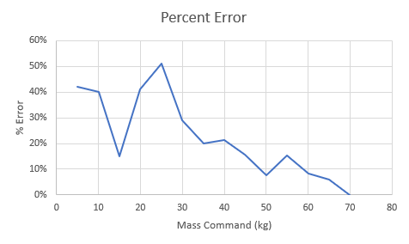
Autodig Performance Continued
Some outliers were observed, but improvement of models will help with this
It was observed that the error decreased at higher masses

Slide 18
Future Work
Continue development of the autodig algorithm
Improve the models used in the algorithm
Develop automatic calibration routines to tune the various models
Enhance the hazard and rock encounter capabilities
Develop rock clearing algorithms based off of autodig

