Slide 1
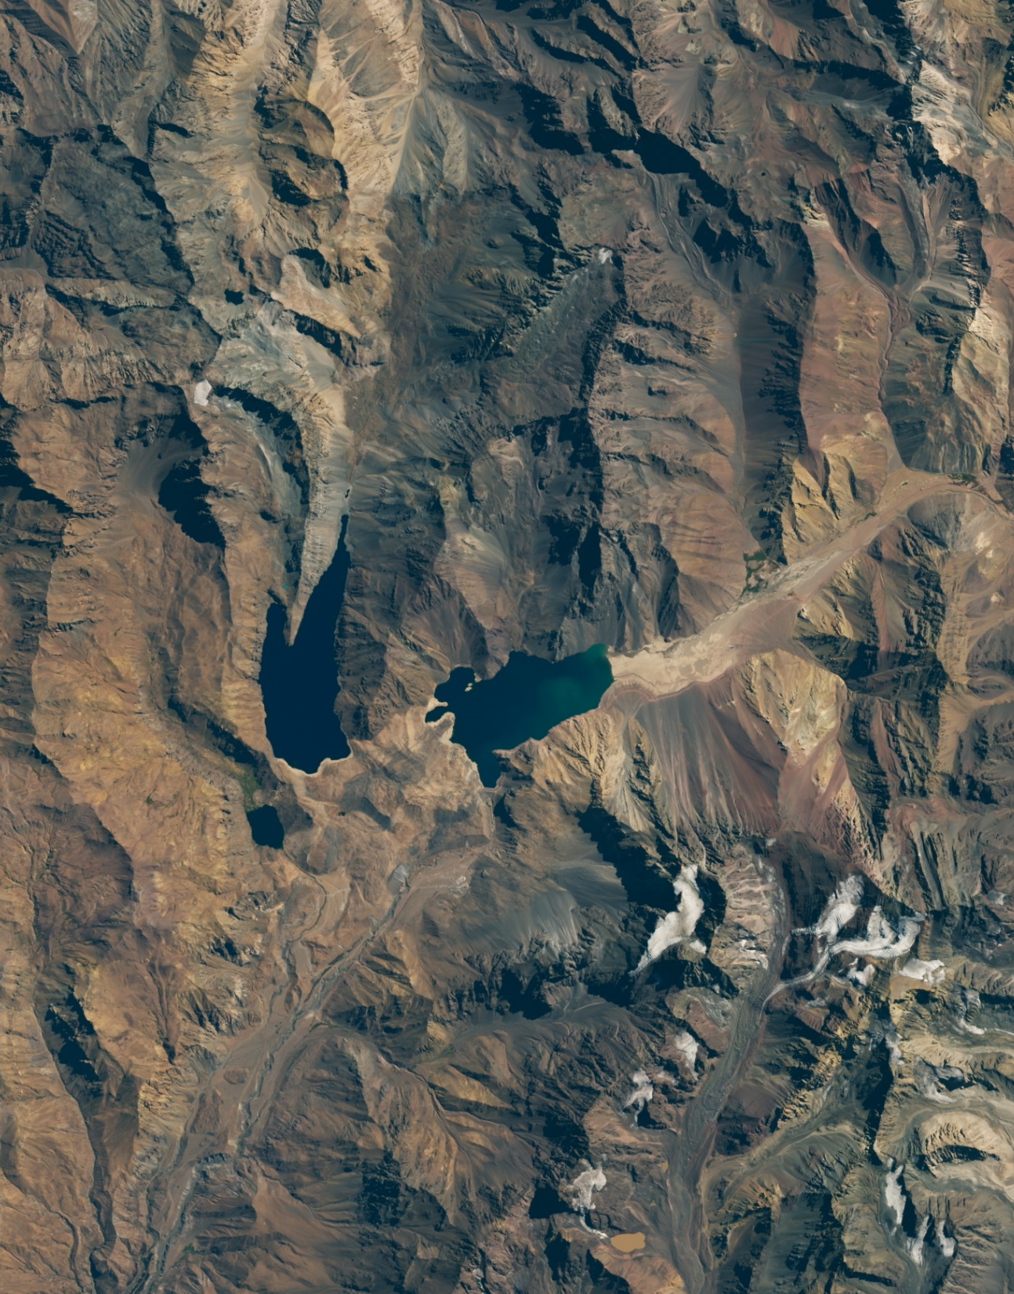

2020 Landsat 8 OLI Image of the El Yeso reservoir in Chile
Introduction to NASA Earth Science Division’s Applied Sciences Program
June 7, 2022

Slide 2
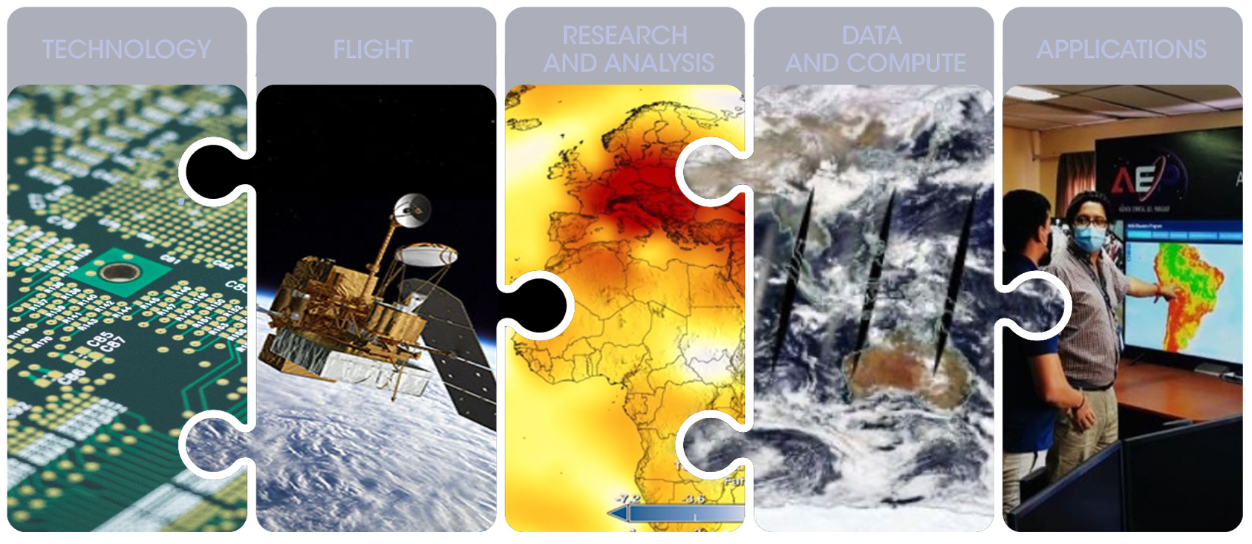
INTRODUCTION
Earth Science Division
Using the global vantage point of space, ESD builds fundamental, scientific knowledge about Earth and how it is changing. ESD advances understanding of Earth as an integrated system and develops and tests applications that deliver direct societal benefit. It has five lines of business:

Slide 3
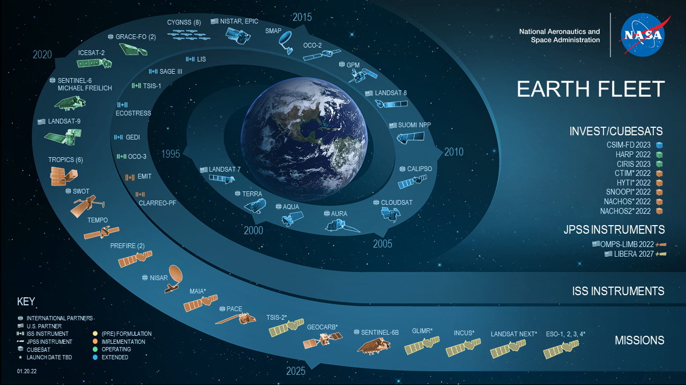
INTRODUCTION TO NASA EARTH SCIENCE

Slide 4








INTRODUCTION
HEALTH &
AIR QUALITY
Harnessing Earth observations to find solutions to Earth’s greatest challenges.
DISASTERS
The Applied Sciences Program helps people across the world use NASA data to solve big problems right here on Earth.
Provides support and funding to help institutions and individuals make better decisions about our environment, food, water, health & safety
Enables the early and ongoing involvement of users throughout the lifecycle of Earth science satellite and instrument missions
Supports improved abilities for users to ideate applications, contribute to planning and design, be prepared to use the data after launch, engage with mission scientists, & provide unique feedback to mission teams
Three lines of business: mission engagement, thematic applications, and capacity building
WILDFIRES
AGRICULTURE
ECOLOGICAL FORECASTING
WATER RESOURCES
CLIMATE
CAPACITY BUILDING
Notes:
Reference: https://appliedsciences.nasa.gov/

Slide 5

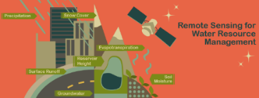

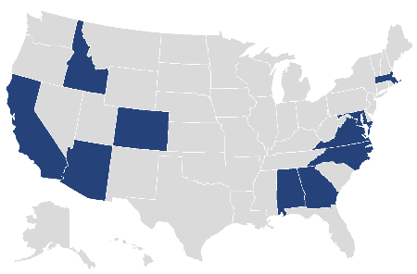

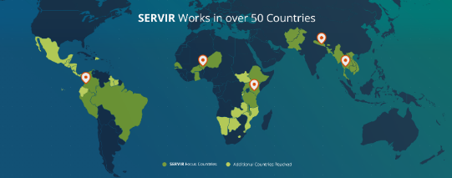
INTRODUCTION
ARSET
https://appliedsciences.nasa.gov/arset
Making Earth Data Accessible to All
Part of NASA’s Applied Sciences, the Capacity Building Program provides individuals and institutions with workforce development, training activities, and collaborative projects to strengthen understanding of Earth observations and expand their use around the world.
Through our ARSET, DEVELOP and SERVIR programs and our Indigenous Peoples Initiative and Prizes & Challenges element, we work with everyone at every level — from first-time users to long-time professional users of Earth observation data.
We work through global and domestic networks and organizations, to promote open data access and coordinate capacity building activities focused on users needs.
DEVELOP
https://appliedsciences.nasa.gov/nasadevelop
SERVIR
https://servirglobal.net

Slide 6
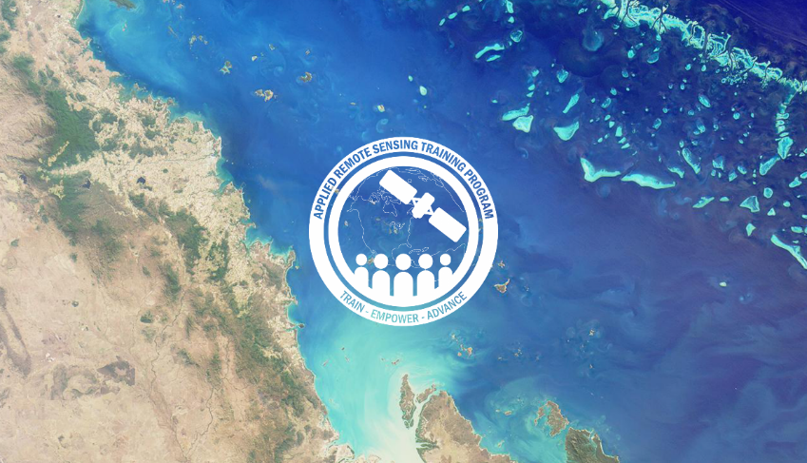

INTRODUCTION
ARSET Trainings
Through ARSET trainings, you can learn how to:
Use NASA data for environmental management
Search and access NASA resources relevant to your needs
Visualize, interpret, and apply remote sensing data and imagery
Recent Agriculture Trainings: available for viewing at any time.
  ARSET - Mapeo de Cultivos y sus Características Biofísicas con SAR Polarimétrico y Teledetección Óptica: https://appliedsciences.nasa.gov/join-mission/training/spanish/arset-mapeo-de-cultivos-y-sus-caracteristicas-biofisicas-con-sar
  ARSET - Clasificación de Cultivos Agrícolas con Radar de Apertura Sintética y Teledetección Óptica: https://appliedsciences.nasa.gov/join-mission/training/spanish/arset-clasificacion-de-cultivos-agricolas-con-radar-de-apertura

Slide 7
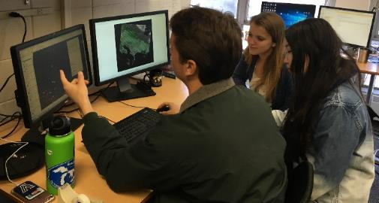
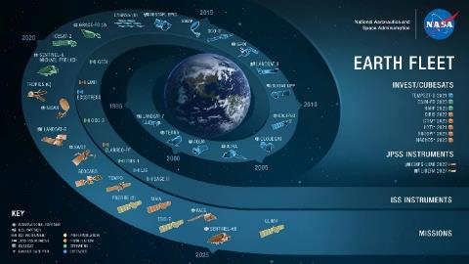
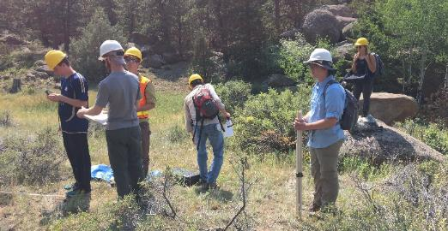
INTRODUCTION
NASA’s DEVELOP Program
Empowered Participants + Earth Observations + Engaged Decision Makers
“Shaping the future by integrating Earth observations into global decision making”
DEVELOP bridges the gap between NASA Earth Science and society, building capacity in both its participants and partner organizations to better prepare them to use remote sensing to address environmental challenges. DEVELOP addresses these challenges by conducting interdisciplinary feasibility projects that apply the lens of NASA Earth observations to community concerns around the globe.

Slide 8




INTRODUCTION
DEVELOP Project Characteristics
50+ DEVELOP projects take place each year – at their core they share these characteristics:
Highlight the applications and capabilities of NASA Earth observations
Assess the feasibility of using Earth observation data for to address community concerns relating to decision-making for real-world environmental issues
Co-developed with partner organizations who can benefit from using NASA Earth observations to enhance decision making by providing decision support tools
Conducted in 10-week terms (spring, summer, and fall) by small teams with diverse backgrounds
Create a consistent set of deliverables
Research is conducted under the guidance of Science Advisors and mentors from NASA and partner organizations
Align with at least one of the nine NASA Applied Sciences Program’s National Application Areas:

Slide 9
INTRODUCTION
Project Development Process
Idea Generation & Partner Engagement
Proposal Writing & Approvals
Project Execution & More Iteration
Initial engagement w/potential partner – listen to their interests, priorities, needs, and understand their decision-making process.
Generate project idea – identify: study area, thematic focus area, actionable decision, potential end-products
Initial ideas reviewed by DEVELOP National Program Office.
If approved, Fellows draft a proposal – including the partner in review and iteration.
Proposals reviewed and approved by HQ, those selected are scheduled for a specific term and listed in the DEVELOP application.
Communication lines are reopened with partners following approvals.
Partners regularly meet with DEVELOP team during the term to discuss progress and results.
Project results and methods are handed off at the end of the term.

Slide 10
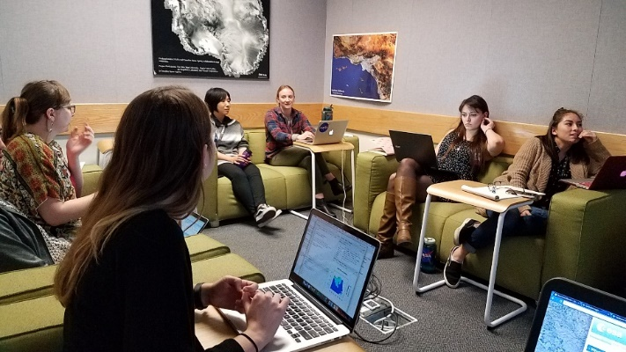
INTRODUCTION
Past Projects Partnered w/Chile
Chile Water Resources – Fall 2013
Assessing Potential Water Availability from Andean Snowpack for Agricultural Uses in the Coquimbo Region of Chile
Chile Water Resources – Spring 2014
Modeling of Snow Melt from Andean Snowpack for More Effective Water Allocation and Planning in the Atacama Region of Chile
Chile Water Resources – Spring 2017
Integrating NASA Earth Observations into the Google Earth Engine Platform to Enhance Drought Monitoring in Chile
Chile Water Resources – Summer 2017
Remote Monitoring of Glacier Dynamics and Hydrologic Indicators in Chile's Aconcagua River Valley
Chile Water Resources – Spring 2019
Monitoring the Extent and Distribution of Saline Systems in Chile’s Atacama Desert Utilizing NASA Earth Observations
Chile Disasters – Spring 2022
Automating Wildfire Risk and Occurrence Mapping in Google Earth Engine to Improve Wildfire Detection and Response Time Efforts

Slide 11
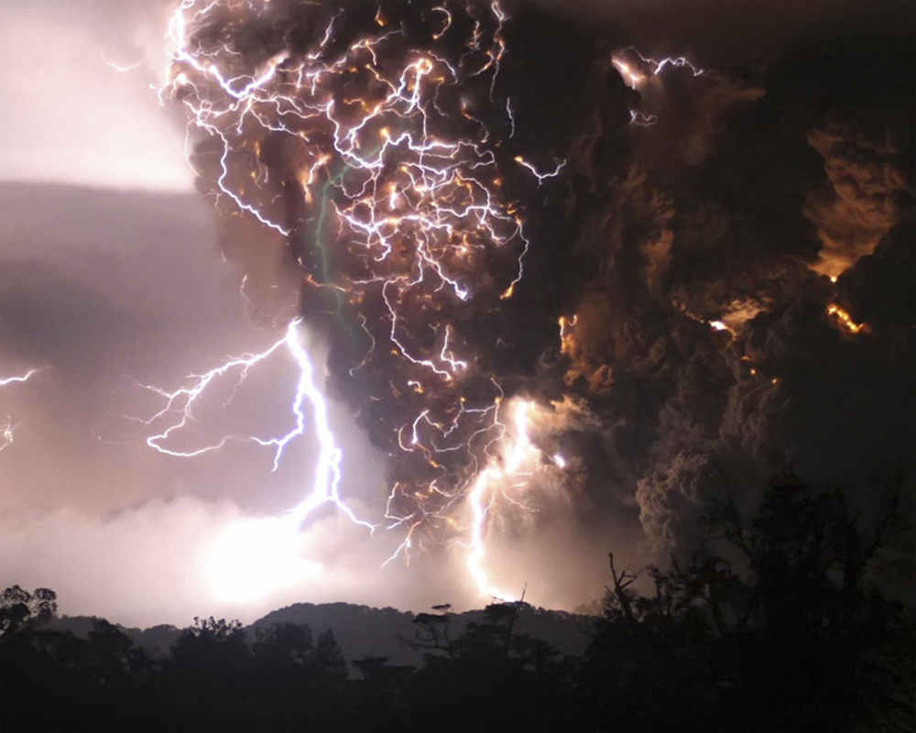
Chile Wildfires (Sum 2022)
Community Concern: In early 2017 high heat and drought contributed to some of the most damaging fires in Chilean history. One of the ways CONAF is preparing for preventative fire management is by quantifying fires ignited by lightning strikes.
Partners:
Corporación Nacional Forestal (CONAF)
Embassy of Chile, Agricultural Office
Virginia – Langley
Earth Observations:
GOES-16 GLM
Suomi NPP VIIRS
Terra MODIS
Aqua MODIS
Landsat 8 OLI
Impact: This work will benefit end users by providing trends in lightning strike location and frequency, as well as observing vegetation health within those high frequency areas. This will allow partners to plan preventative fire measures for areas most at risk for wildfire ignition.
Image Credit: NASA Applied Sciences
Notes:
Image Credit: Photo by Jonas Kaiser on Unsplash
Image Source: https://unsplash.com/photos/I621uimW8p0; license: https://unsplash.com/license

Slide 12
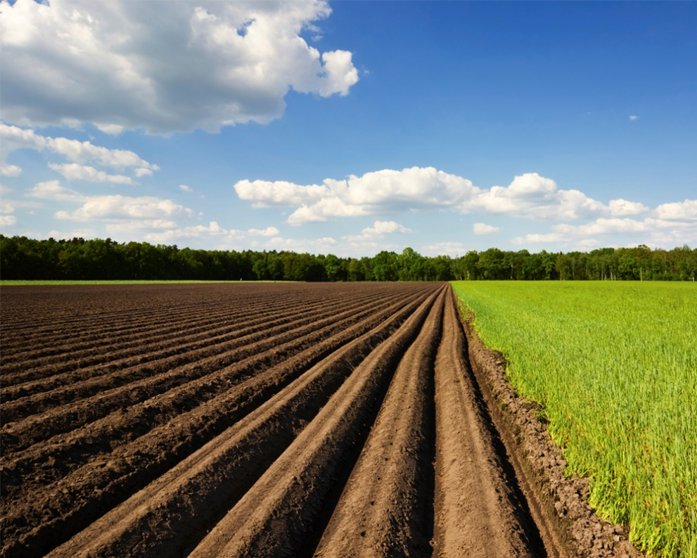
Maipo River Valley Agriculture (Sum 2022)
Community Concern: Crop coefficients (Kc) are commonly used to calculate actual crop evapotranspiration and assess irrigation. Although variability between growing seasons, frequently used Kc estimates do not account for geographic and climate conditions which commonly results in inaccurate representations of water usage needs.
Partners:
Centro de Información de Recursos Naturales (CIREN)
Oficina Agrícola de la Embajada de Chile en los Estados Unidos de América
Pop-Up Project at University of Virginia
Earth Observations:
Landsat 8 OLI
Aqua MODIS
Terra MODIS
Suomi NPP VIIRS
ISS ECOSTRESS
Impact: Dual crop coefficient methodologies will provide the partners more accurate approaches to evaluating irrigation needs among crop fields in the Maipo River Valley in Chile.
Image Credit: NASA Applied Sciences
Notes:
------------------------------Image Information Below ------------------------------
Image Credit: "Vale Maipo, Chile" by robsonfilho. Free to use under Flickr license CC BY-NC 2.0
Image Source: https://flic.kr/p/4ouZ6m

Slide 13
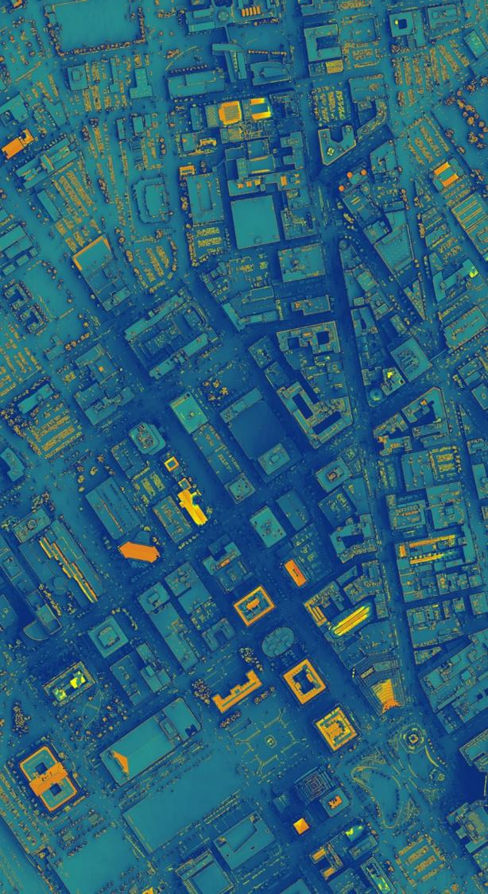
THANK YOU
Discussion &
Q + A
Kenton.W.Ross@nasa.gov
https://appliedsciences.nasa.gov/

