Slide 1
The Imaging X-Ray Polarimetry Explorer (IXPE)
Brian D. Ramsey for the IXPE Team
NASA/Marshall Space Flight Center
Huntsville
Al 35812

Slide 2
IXPE Mission Overview
Launch Dec 9, 2021 on a Falcon 9 from KSC
~600-km circular orbit at a nominal 0° inclination
2-year baseline mission, optional extension with GO program
Point and stare (with dither) at pre-selected targets
Malindi ground station - primary (Singapore - secondary)
Mission Operations Center (MOC) at the University of Colorado, Laboratory for Atmospheric and Space Physics (LASP)
Sciences Operations Center (SOC) at MSFC
Data archiving at NASA’s HEASARC
  During the first 3 months of the mission, including one month of orbital checkout, all IXPE data shall be made publicly available at the HEASARC within 30 days of the end of an observation, which is defined as when data for 90% of the scheduled observation time are received by the MOC
  After the first 3 months of the mission, data shall be made available to the HEASARC within 1 week of the end of an observation, which is defined as when data for 90% of the scheduled observation time are received by the MOC

Slide 3
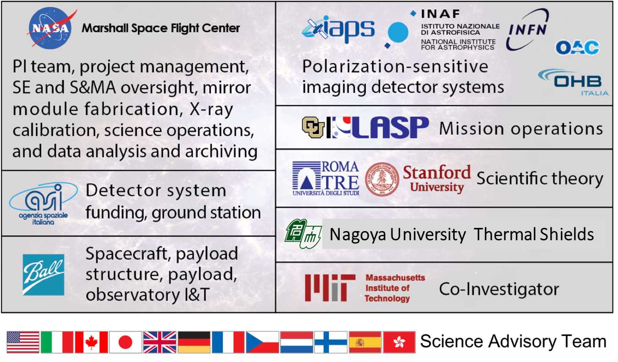
IXPE Team Members
SAT currently comprises > 90 scientists from 12 countries

Slide 4
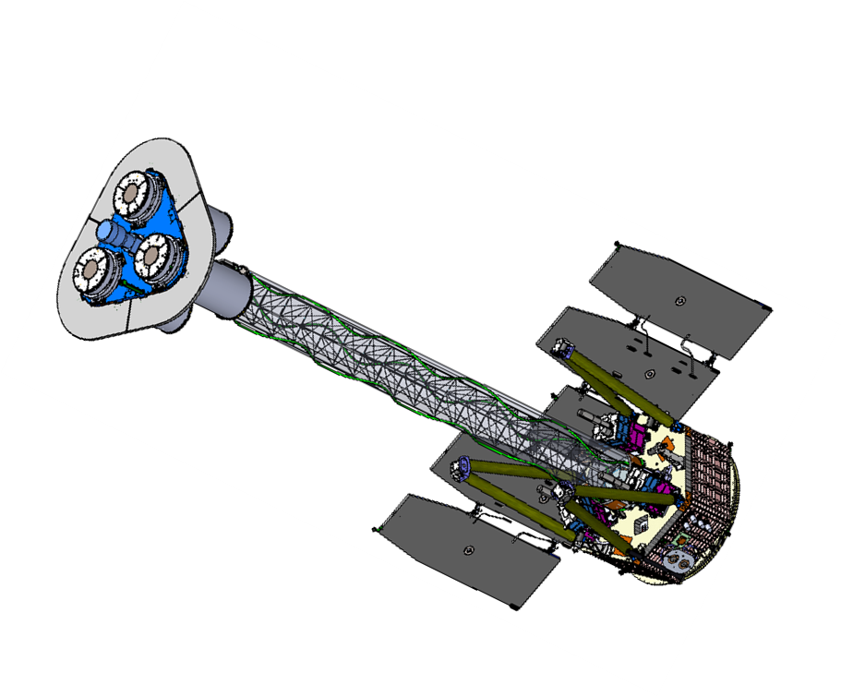
Payload Overview: Deployed Configuration
+Z Star Tracker
Mirror Module
Assembly (MMA x 3)
X-Ray Shields
Boom Harness
Detectors Service Unit (DSU) (mounted on bottom side of deck)
Mirror Module
Support Structure
(MMSS) Deck
Detector Unit x 3
Deployable Boom
with Thermal Sock

Slide 5
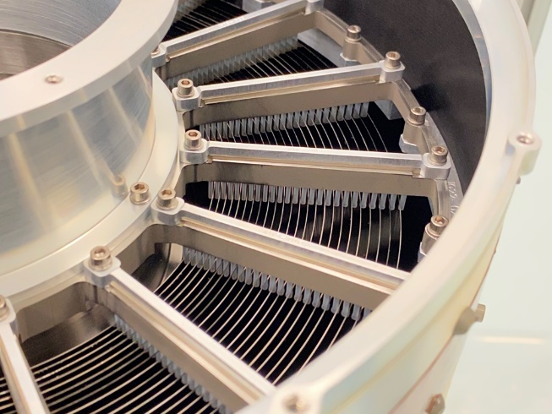
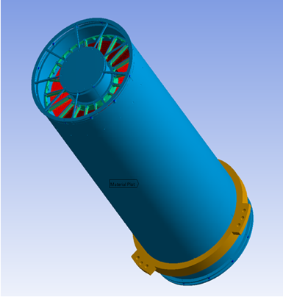
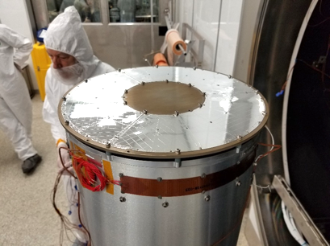
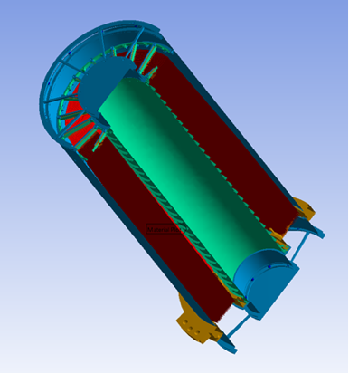
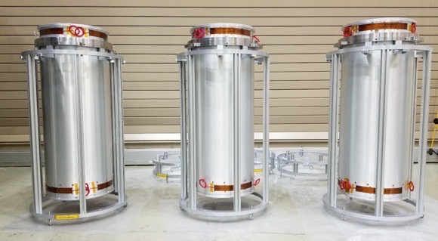
Mirror Module Assemblies (MMA)
Parameter | Value
Number of mirror modules | 3
Number of shells per mirror module | 24
Focal length | 4 m
Total shell length | 600 mm
Range of shell diameters | 162–272 mm
Range of shell thicknesses | 0.18–0.25 mm
Shell material | Electroformed nickel–cobalt alloy
Effective area per mirror module | 166 cm² (@ 2.3 keV); > 175 cm² (3–6 keV)
Angular resolution (HPD) | ≤ 28 arcsec
Field of view (detector limited) | 12.9 arcmin square
Rear Spider Assembly
Outer Housing Tube
Front Spider Assembly
Rear of MMA Showing 24 Nested Mirror Shells
X-ray Mirror Shells
(24)
MMA with Thermal Shield
Three IXPE Mirror Module Assemblies

Slide 6
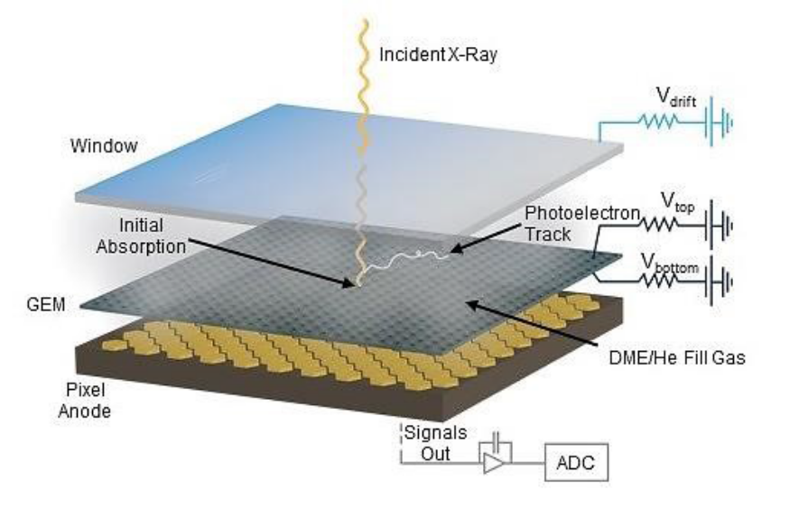
Detector Units
The gas pixel detector, the heart of the detector unit, tracks photoelectrons to measure the polarization angle of absorbed photon
Parameter | Value
Sensitive area | 15 mm × 15 mm (13 x 13 arcmin)
Fill gas and asymptotic pressure | DME @ 0.656 atmosphere
Detector window | 50-µm thick beryllium
Absorption and drift region depth | 10 mm
Spatial resolution (FWHM) | ≤ 123 µm (6.4 arcsec) @ 2 keV
Energy resolution (FWHM) | 0.57 keV @ 2 keV (∝ √E)
Useful energy range | 2 - 8 keV
30 cm
20 cm
Expanded view of a detector unit (left) and a completed flight detector unit (right)

Slide 7
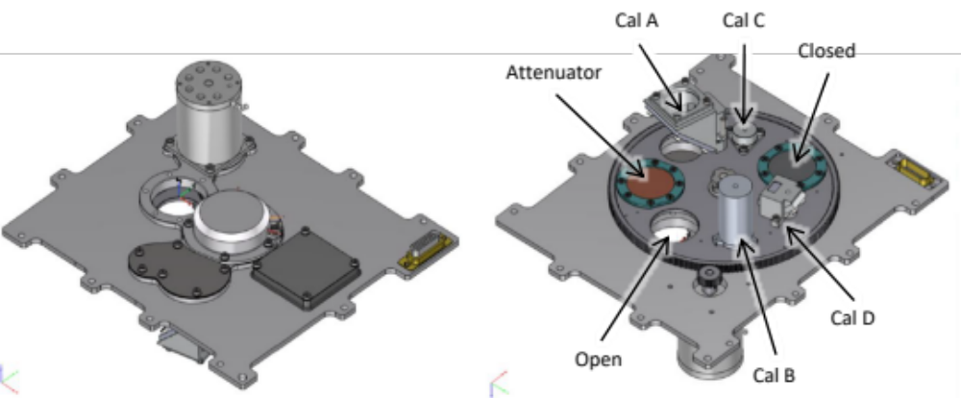
On-Board Calibration Sources: Filter Calibration wheel Assembly
Filter and Calibration Wheel (FCW), providing open, attenuated, and closed positions, plus four ⁵⁵Fe-powered calibration sources:
  Cal A – Bragg-reflected polarized 2.98-keV (Ag-L𝛼 fluorescence) and 5.89-keV (Mn-K𝛼)
  Cal B – unpolarized 5.89-keV spot
  Cal C – unpolarized 5.89-keV flood
  Cal D – unpolarized 1.74-keV (Si-K𝛼 fluorescence) flood

Slide 8
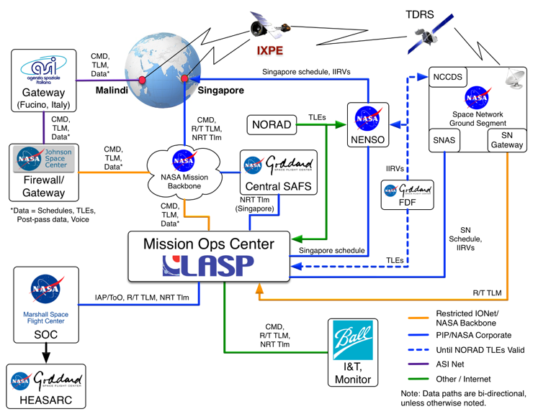
Ground Network

Slide 9
Science operations interfaces
MOC – SOC
  Schedule observations with MOC, at U Colorado’s Laboratory for Atmospheric and Space Physics (LASP)
  Ingest and aggregate science and engineering telemetry from the MOC
SOC – ASI Organizations
  Transmit low-level data products to Instrument Team; receive recommendations for adjustments
  Collaborate with ASI’s Space Science Data Center (SSDC) to develop and maintain the Instrument Pipeline and CalDB at the SOC
SOC – HEASARC
  Archive science data products at NASA’s HEASARC for public access to IXPE data and tools
  Test HEASoft tools provided by the HEASARC for analysis of IXPE data
Observatory
Ground Stations
Italian Instrument Team (I2T)
Space Science Data Center (SSDC)
Science Community
COMMANDING
TELEMETRY
MONITORING & TRENDS
INSTRUMENT PIPELINE
DATA PRODUCTS
SCHEDULING
Mission Operations Center (MOC)
Science Operations Center (SOC)
HEASARC
TELEMETRY
DATA PRODUCTS

Slide 10
Working groups
Science Working Group
  Serves as steering group comprised of official mission investigators (Principal and Co- Investigators)
Science Analysis and Simulation Working Group
  Coordinates development of software for advanced analysis and simulation of IXPE observations
    Including ixpeobssim
  Chaired by Luca Baldini (INFN-Pisa) and Herman Marshall (MIT)
Science Advisory Team
  Coordinates science activities required for planning, analyzing, interpreting, and reporting IXPE observations
  Chaired by Giorgio Matt (Uni Roma Tre) and Roger Romani (Stanford)
  Organized into seven Topical Working Groups
    TWG1 Pulsar Wind Nebulae, led by Niccolò Bucciantini (INAF-Arcetri)
    TWG2 Supernova Remnants, led by Pat Slane (CfA)
    TWG3 Accreting Black Holes, led by Michal Dovčiak (CAS-ASU)
    TWG4 Accreting Neutron Stars, led by Juri Poutanen (Turku)
    TWG5 Magnetars, led by Roberto Turolla (Uni Padua)
    TWG6 Radio-Quiet AGN & Sgr A, led by Frédéric Marin (Strasbourg)
    TWG7 Blazars & Radio Galaxies, lead by Alan Marscher (Boston U)
  Recommends list of targets for observation during the baseline (2-year) mission
    For an extended mission, HEASARC will administer an IXPE General Observer (GO) program

Slide 11
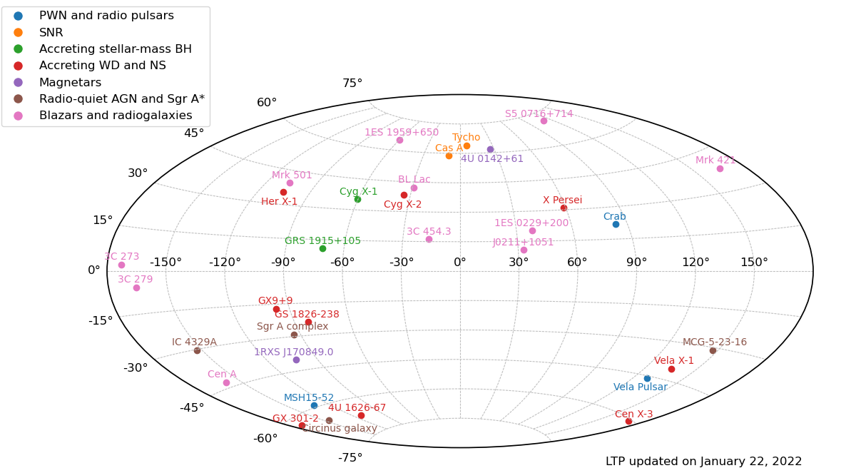
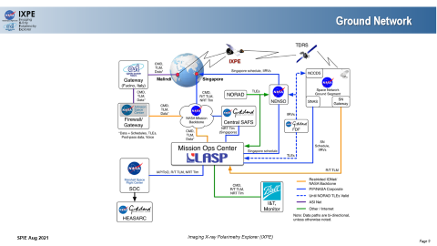
Year-1 targets
Equatorial Coordinates
INFN-PI/ Luca Baldini

Slide 12
Execution of observing plan
Name | TWG | Exposure [d] | Start | Stop
Vela X-1 | Acc NS | 3.47 | 2022-04-15T18:11 | 2022-04-21T12:17
Vela Pulsar (2 of 2) | PWN | 5.24 | 2022-04-21T12:24 | 2022-04-30T10:02
Cyg X-2 | Acc NS | 1.16 | 2022-04-30T11:04 | 2022-05-02T11:07
Cyg X-2 (off-set) | Acc NS | 0.57 | 2022-05-02T11:11 | 2022-05-03T11:13
1ES 1959+650 | Blazar | RG | 0.58 | 2022-05-03T11:29 | 2022-05-04T09:49
Mrk 421 | Blazar | RG | 1.16 | 2022-05-04T10:11 | 2022-05-06T10:50
BL Lac | Blazar | RG | 4.63 | 2022-05-06T11:30 | 2022-05-14T12:27
MCG-5-23-16 (1 of 2) | RQ AGN | Sgr A | 0.58 | 2022-05-14T13:17 | 2022-05-15T14:55
Cyg X-1 | Acc BH | 3.47 | 2022-05-15T15:45 | 2022-05-21T17:52
MCG-5-23-16 (2 of 2) | RQ AGN | Sgr A | 5.21 | 2022-05-21T18:42 | 2022-05-31T03:47
3C 454.3 | Blazar | RG | 1.16 | 2022-05-31T04:36 | 2022-06-02T08:40
3C 273 | Blazar | RG | 1.16 | 2022-06-02T08:53 | 2022-06-04T10:48
Mrk 421 | Blazar | RG | 1.16 | 2022-06-04T11;05 | 2022-06-06T10:57
1ES 1959+650 (adjust) | Blazar | RG | 0.58 | 2022-06-06T11:20 | 2022-06-07T08:38
Mrk 421 | Blazar | RG | 1.16 | 2022-06-07T09:01 | 2022-06-09T09:39
3C 273 | Blazar | RG | 1.16 | 2022-06-09T09:57 | 2022-06-11
3C 279 | Blazar | RG | 1.16 | 2022-06-11 | 2022-06-13
Observed and delivered to HEASARC
Observed before this week
To be observed during this week
To be observed later

