Slide 1
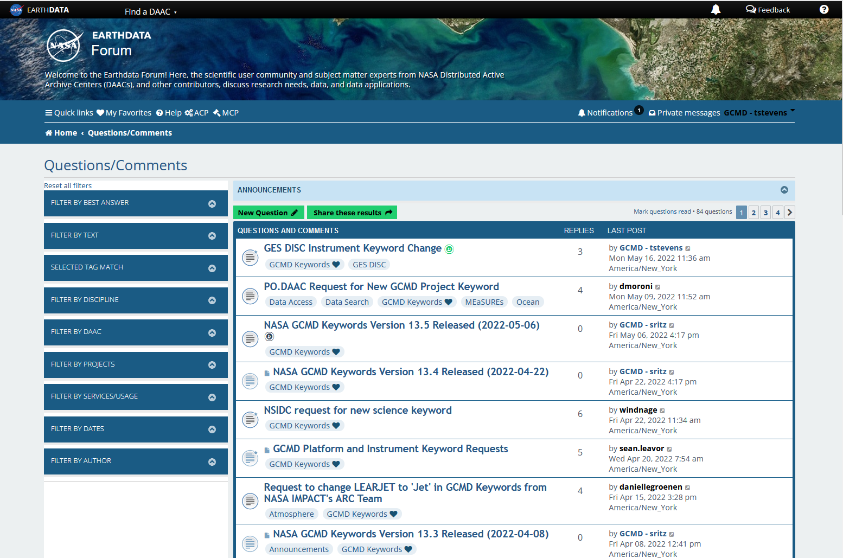
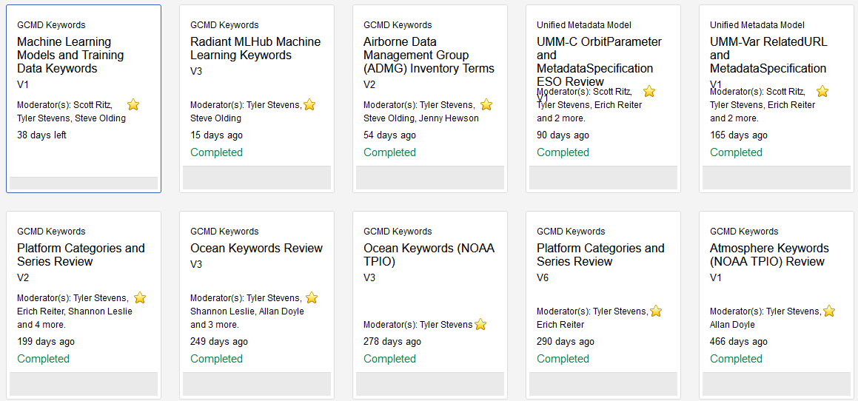
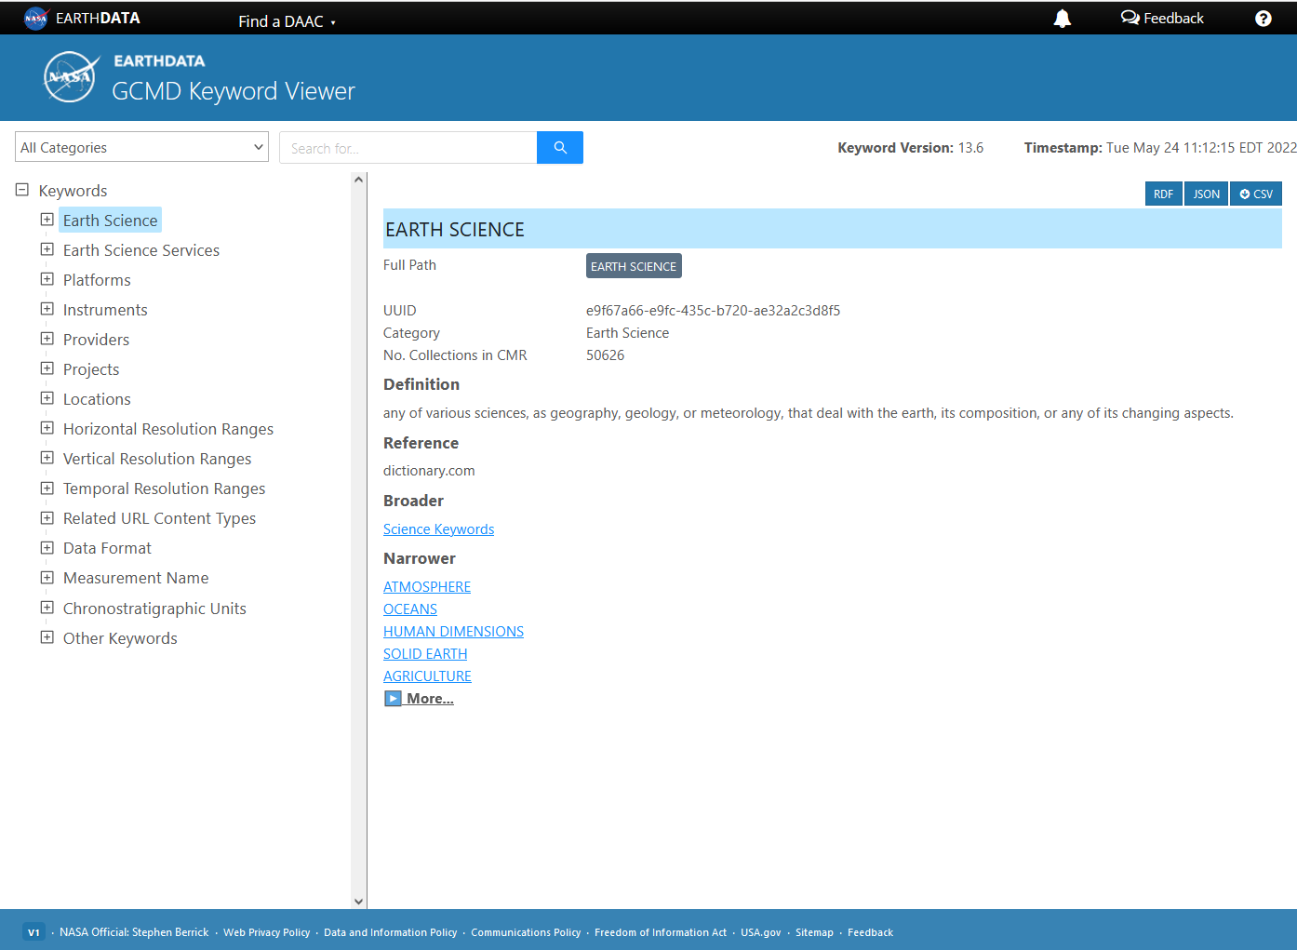
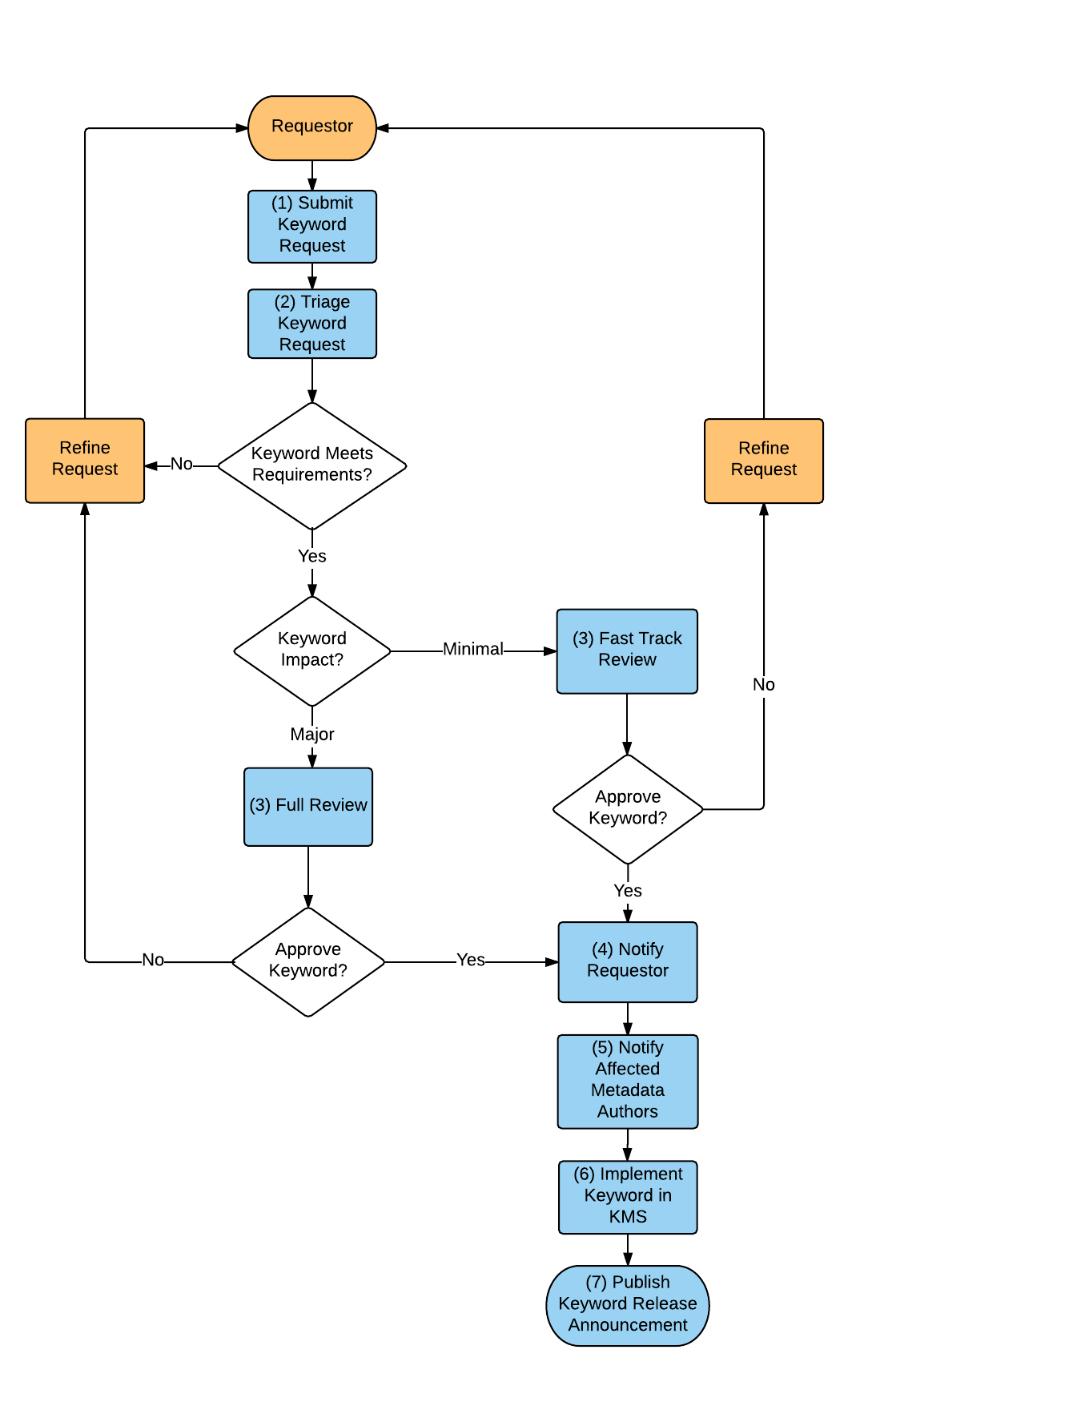
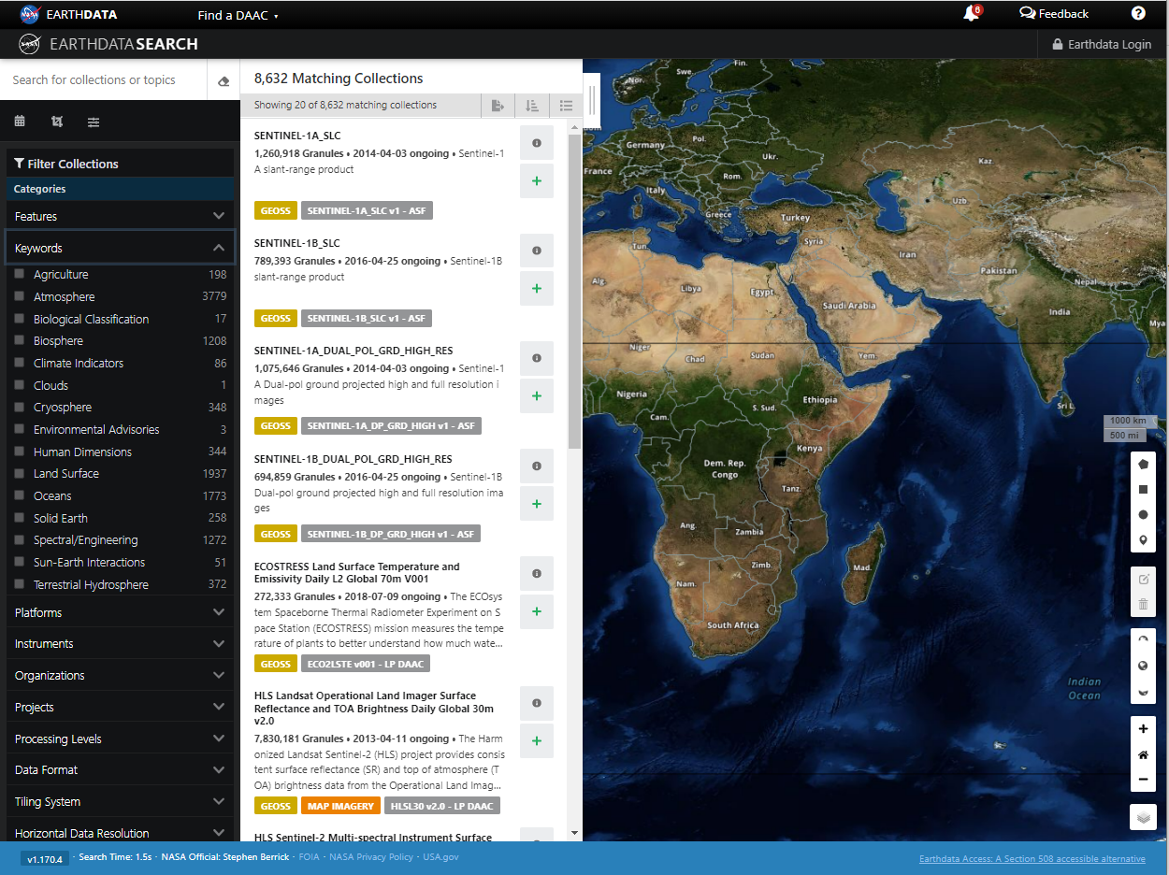

Keywords for All People: How Keyword Governance and Coordination with the NASA ESDIS Standards Coordination Office (ESCO) Improves GCMD Keywords For Discovery and Use
ABSTRACT
The Global Change Master Directory (GCMD) Keywords, initiated over twenty years ago, are a hierarchical set of controlled Earth Science vocabularies that help ensure Earth science data, services, and variables are described in a consistent and comprehensive manner and allow for the precise searching of metadata and subsequent retrieval of data, services, and variables. GCMD keywords are periodically analyzed for relevancy and will continue to be refined and expanded in response to user needs. The periodic analysis is a result of successful coordination with the ESDIS Standards Coordination Office (ESCO), which is responsible for standards activities across ESDIS, and assists with providing valuable stakeholder and subject matter expert (SME) feedback on GCMD vocabularies. The ESCO is also turning to the GCMD to discuss how the keyword review process can be improved and more streamlined. In addition to the ESCO, keyword requests and feedback are also received through the GCMD Keyword Forum.
Recent Keyword Activities
The keyword reviews and associated feedback are managed through the Jama requirement software, which allows for easy tracking, triaging, and accepting of feedback.
List of Recent Keyword Reviews (2020-2022)
Success Stories/Lessons Learned
Diverse feedback and perspective from stakeholders is key to having clear and concise keywords that can be widely adopted for search and discovery.
Internal reviews with the ESCO are essential to ensure that the intent of keyword changes are clearly communicated.
Tooling is essential for tracking, triaging, and resolving feedback from stakeholders.
Alignment with NOAA for Atmosphere and Ocean keywords was key in promoting interoperability between different search/discovery systems.
Utilizing a keyword review template made compiling and communicating the keyword review more streamlined.
Meeting with keyword requesters early was essential in understanding their needs and use cases.
Submit Keyword Requests Using the Earthdata Forum
The GCMD Keyword Forum provides keyword users and metadata providers with an area for discussion of topics related to GCMD keywords. Participants can use the forum to ask questions, submit keyword requests, discuss trade-offs, and track the status of keyword requests.
ESCO Stakeholder Review
NASA's ESCO assists the NASA's Earth Science Data and Information System (ESDIS) Project in formulating standards policy for NASA Earth Science Data Systems (ESDS), coordinates standards activities within ESDIS, and provides technical expertise and assistance with standards related tasks within NASA's Earth Science Data System Working Groups (ESDSWG).
Key Activities
Provides key web infrastructure and tooling for facilitating and conducting the review
Assists with compiling a list of subject matter experts (SMEs) tailored for each review
Offers guidance on how the review can be improved through a preliminary internal review
Engages the science community and encouraging contribution to the review
Implement Keywords for Discovery and Use
Keyword Reviewer Groups
SME’s Providing Keyword Feedback
Academic
U.S Government Agencies
Non-U.S Government Agencies
Consortia/Institutions
Keyword Governance Process
The keyword governance/change process conveys the end-to-end process of a keyword including initial request, triage, approval, notification, and implementation. Fast-track keywords get added/implemented every two weeks. A full review goes through the ESCO.
The GCMD Keyword Viewer allows users to view and navigate the keyword hierarchy and see the keyword definitions, references, and related keywords. Users can also access the RDF, JSON, and CSV representations of the keywords in the Keyword Management System (KMS).
Earthdata Search is a web app that allows users to search, discover, visualize, refine, and access NASA Earth Observation data. Users can search by spatial, free-text or GCMD keyword facets (see left-side search panel).
For More Information:
GCMD Landing Page: https://earthdata.nasa.gov/earth-observation-data/find-data/idn/gcmd-keywords
Keyword Viewer: https://gcmd.earthdata.nasa.gov/KeywordViewer/
Keyword Forum: https://forum.earthdata.nasa.gov/app.php/tag/GCMD+Keywords
ESDIS Standards Coordination Office: https://earthdata.nasa.gov/esdis/esco
Release Announcements: https://wiki.earthdata.nasa.gov/display/ED/Keyword+Release+Announcements
ESIP Meeting July 19-22, 2022
Tyler Stevens (EED-3) (Tyler.B.Stevens@nasa.gov); Valerie Dixon (NASA/ESDIS) (valerie.dixon@nasa.gov)

