Slide 1
HDF5 OPeNDAP Handler Updates, and Performance Discussion
2022 ESIP Summer Meeting
Kent Yang
Software Engineer/NASA EED-3 contractor
myang6@hdfgroup.org
This work was supported by NASA/GSFC under Raytheon Technologies contract number 80GSFC21CA001.
This document does not contain technology or Technical Data controlled under either the U.S. International Traffic in Arms Regulations or the U.S. Export Administration Regulations.

Slide 2
HDF*5 OPeNDAP** Handler History
2001: A prototype of HDF5 data handler
  HDF5 to DAP***2: Default option
2008: Handler in production
  Climate and Forecast(CF) option:
    Translate HDF5 metadata to follow CF
2008-2018: Significant improvement
  Still HDF5 to DAP2
* Hierarchical Data Format
** Open-source Project for a Network Data Access Protocol
*** Data Access Protocol

Slide 3
HDF5 OPeNDAP Handler Update
Support DAP4
  CF option
    Support 8-bit and 64-bit integer mapping
  Default option
    Support NetCDF* data model(group etc. )
Documentation
  A comprehensive user’s guide at github
    https://github.com/OPENDAP/hyrax_guide/blob/master/handlers/BES_Modules_The_HDF5_Handler.adoc
* Network Common Data Form

Slide 4
HDF5 Handler Performance Study
Output NetCDF file via the handler
  Sometimes it is very slow
Hyrax
Core
HDF5
File
File netCDF
NetCDF
File
HDF5 handler

Slide 5
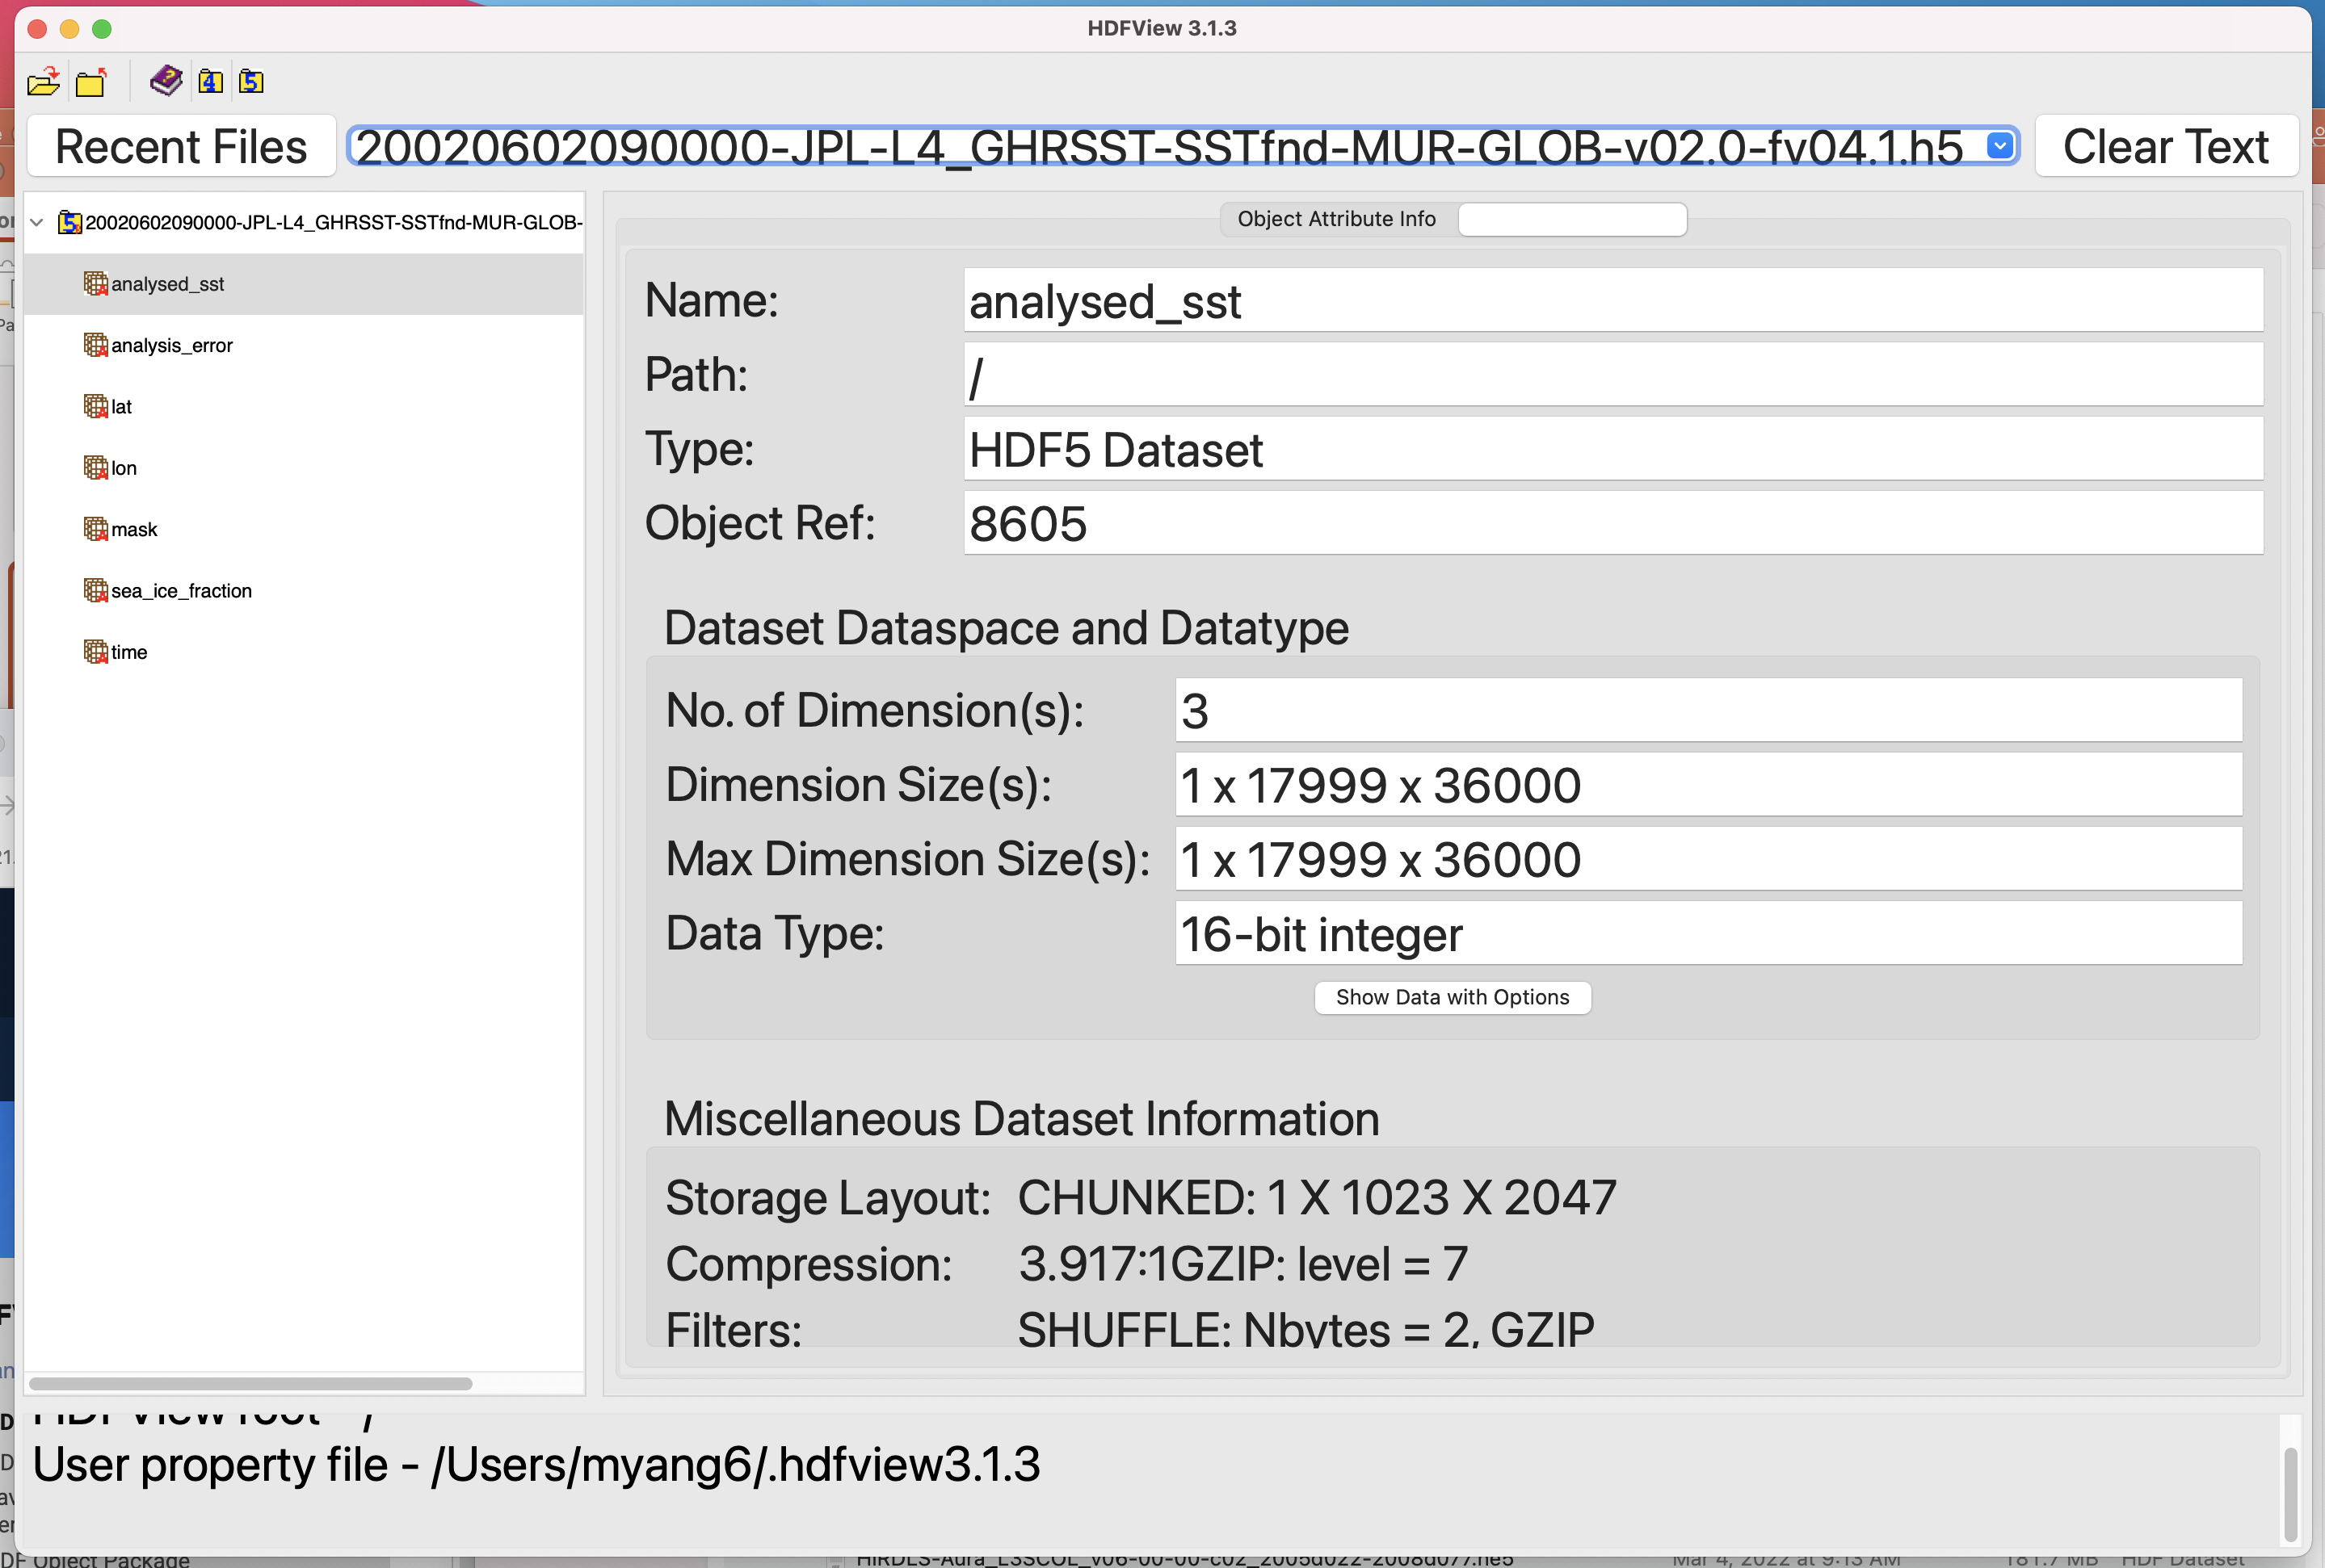
HDF5 Handler Performance Study
Because HDF5 variables are compressed.

Slide 6
HDF5 Handler Performance Study
How compressed variables are processed
  HDF5 handler: Decompress via H5Dread
  File NetCDF: Compress via H5write
Hyrax
Core
HDF5
File
File NetCDF
NetCDF
File
HDF5 handler
Decompress
Compress

Slide 7
HDF5 Handler Performance Study
Compression/decompression is costly
Solution
  Passing through the compressed data
Hyrax
Core
HDF5
File
File NetCDF
NetCDF
File
HDF5 handler
Decompress
Compress
Pass through the data
Pass through the data

Slide 8
HDF5 Handler Performance Study
Hyrax
Core
HDF5
File
File NetCDF
NetCDF
File
HDF5 handler
Pass through the data
Pass through the data
Is this possible?
A proof-of-concept Study

Slide 9
HDF5 Handler Performance Study
A proof-of-concept study
  Use HDF5 direct chunk IO* API**s
Packages that need to be updated
  HDF5 handler
    Read the passing-through compressed data
  DAP library
    Pass through the variable storage information
  NetCDF-4
    Write the passing-through compressed data
* Input Output
** Application Programming Interface

Slide 10
HDF5 Handler Performance Study
Testing Files Used
  GHRSST* and MERRA-2** data
    Repack the data to one chunk per variable
Test Approach
  Only Hyrax Back-End Server(BES)
  besstandalone program on a Linux server
  Measure the wall clock time to output a NetCDF-4 file
GHRSST: Group for High Resolution Sea Surface Temperature
MERRA: Modern-Era Retrospective analysis for Research and Applications

Slide 11
HDF5 Handler Performance Study
Testing Files
  GHRSST
    File size: 237 MB
    About 20 variables
    5392x3200 8-bit or 16-bit integer
  MERRA-2
    File size: 489 MB
    About 50 variables
    24x361x576 32-bit floating-point

Slide 12
Performance Study Results
Performance improved ~17 and ~30 times compared to the standard way
Wall Clock Time(Seconds) | MERRA2 | GHRSST
Standard Way (Decompress and compress the data) | 55 | 26
Pass through the compressed data | 1.8 | 1.5
Speed up | ~ 30 | ~17
Credit to the HDF5 library.

Slide 13
This work was supported by NASA/GSFC under Raytheon Technologies contract number 80GSFC21CA001.

