Slide 1

xEMU Integrated Communication System
Ian Meginnis
NASA JSC
Bill Foster
NASA JSC / ERC Inc.
International Conference on Environmental Systems
July 10-14, 2022
St. Paul, Minnesota
Trade names and trademarks and company names are used in this report for identification only. Their usage does not constitute an official endorsement, either expressed or implied, by the National Aeronautics and Space Administration.

Slide 2
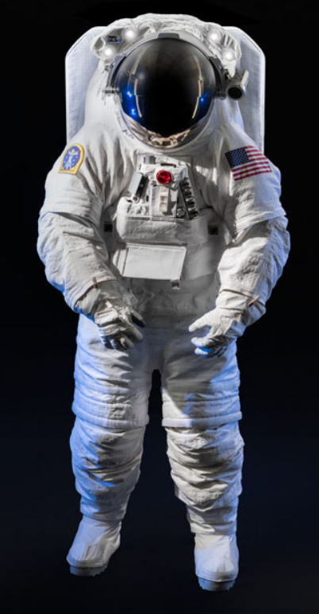
xEMU Overview
xEMU Space Suit
Exploration Extra-Vehicular Mobility Unit (xEMU) space suit is NASA’s latest space suit development effort
xEMU was intended to support missions to International Space Station (ISS) and moon landing in 2024
xEMU is culmination of last 50 years of NASA’s space suit research and testing experience
xEMU is comprised of new suit architectural elements, including:
  Hard upper torso assembly
  Waist brief hip assembly
  Helmet assembly
  Shoulders
  Walking boots
  Heart rate monitor
  Integrated communication system

Slide 3
Introduction
xEMU Integrated Communication System (ICS) is suit’s audio communication system, providing 2-way communication to suited crew member
To date, all of NASA’s flight suits have incorporated a head-worn audio communication system
Head-worn systems present some challenges related to long duration missions, including:
  Sizing
  Durability
  Cleanliness
There can also be issues related to comfort and limitations to range of motion
NASA sought an improved audio communication system for xEMU

Slide 4
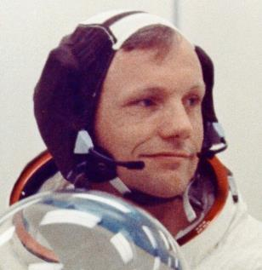
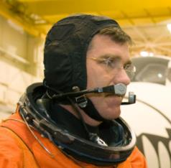
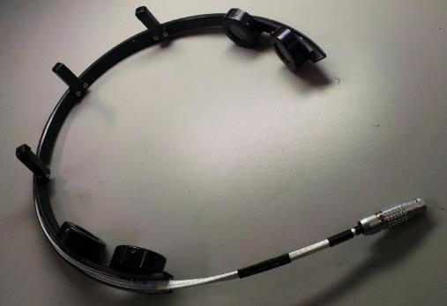
Background – Comm Systems at NASA
Mercury, Gemini, Apollo, Skylab, EMU
  David Clark / Plantronics headset
Shuttle ACES: David Clark headset
Mark III, REI, Z-1
  Integrated communication – microphones on neck ring, speakers in hatch
Z-2
  Integrated communication system in neck ring – 3 microphones, 4 speakers
Apollo Headset
ACES Headset
Z-2 ICS

Slide 5
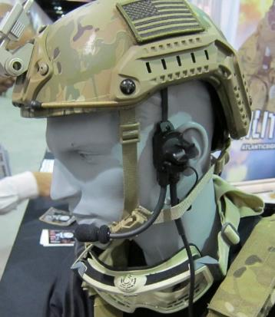
Development History - Market Survey
Before selecting a suit-integrated architecture, NASA conducted market survey to identify Commercial Off-the-Shelf (COTS) solutions that could provide audio communication
Outbound Audio
  Throat microphone
  Bone conduction microphone
Inbound Audio
  In-ear molded earpiece
  Bone conduction speaker
Bone Conduction Speaker

Slide 6
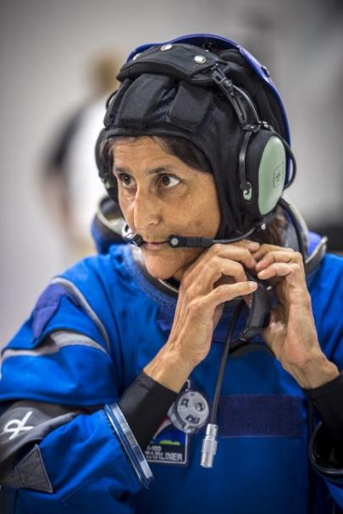
Development History - Market Survey
Inbound/Outbound Audio
  Head-mounted headset: Most COTS headsets that the team evaluated did not securely attach to the head or were large/cumbersome
  Ear-mounted headset
Results from market survey showed that no COTS solution would likely be better than a suit-integrated system

Slide 7
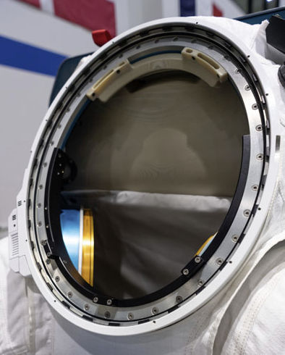
Development History
Several NASA prototype space suits have used suit-integrated communication systems
  Mark III [2004]
  Z-1 [2012]
  Z-2 [2015]
  Z-2.5 [2018]
These suits were extensively tested by engineering and astronaut test subjects in a variety of environments, including the lab and the Neutral Buoyancy Laboratory (NBL)
Test subjects reported acceptable speaker audio quality for all of these test environments
Z-2.5 ICS

Slide 8
Driving Requirements
Requirement | Specification Summary
Comfort | System shall be comfortable for at least 10 hours.
Speech Intelligibility | System shall ensure 90% English word recognition.
Speaker/Microphone Hydrophobicity | Speakers and microphones shall be protected from damage caused by water contact
Fault Tolerance | System shall be at least single-fault tolerant
Ionizing Radiation | No destructive failures at exploration radiation levels

Slide 9

Heritage EMU Comm Cap
EMU communications carrier assembly (CCA) provides two-way audio communication to the suited crewmember
Fundamental design of CCA dates back to the Apollo program
CCA includes pair of speakers in earmold assembly, and pair of microphones that are mounted inside flexible booms in front of mouth
EMU CCA
Reported issues with CCA:
  Wearing CCA over long periods required for an EVA can become uncomfortable
  Microphone booms can be difficult to manage during EVA, resulting in increased mental fatigue
  Bulk of CCA limits head mobility in EMU, particularly for people with larger heads
  Electrical cable that connects the CCA to HUT can interfere with head movement

Slide 10
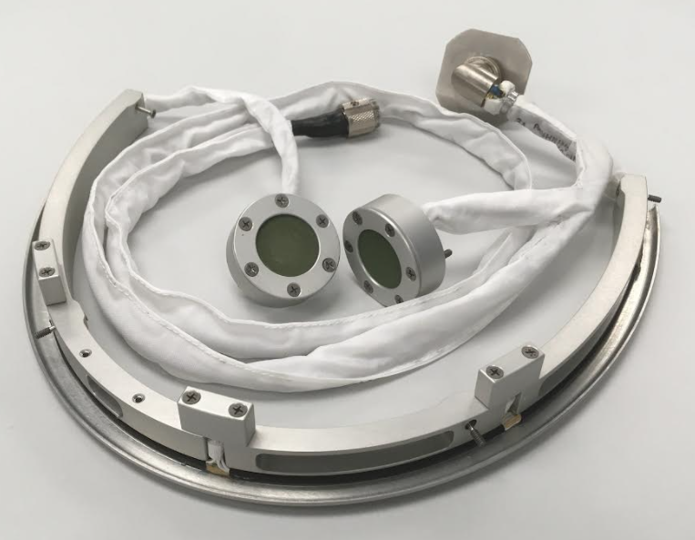
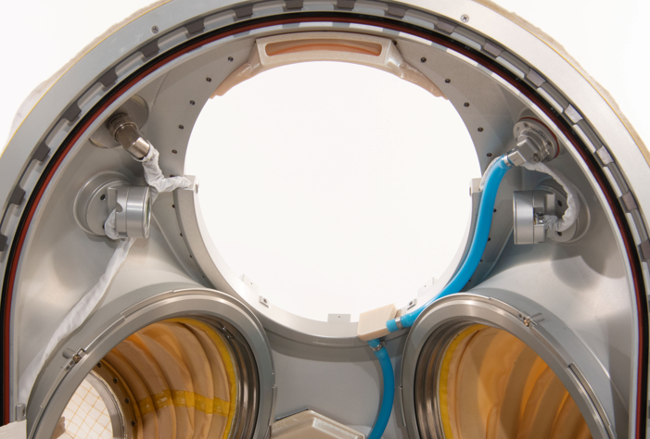
Design Overview

Slide 11
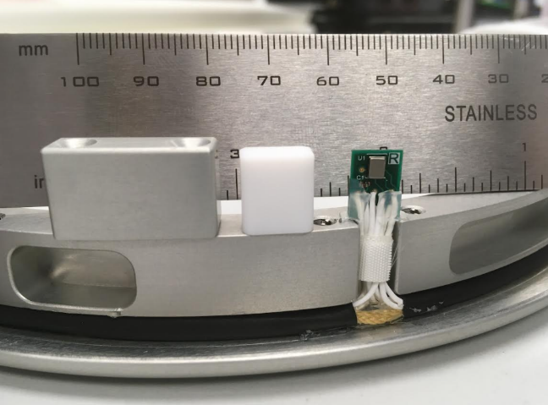
Design Overview
ICS uses three, digital COTS microphones that communicate via the I2S (Inter-IC Sound) interface protocol
Digital microphone was selected instead of analog microphone because digital mics typically have:
  Lower power consumption
  Smaller packaging (due to micro-electromechanical systems (MEMS) technologies and no need for amplifier)
  Higher reliability due to fewer moving parts
  Improved tolerance to electromagnetic interference
Hydrophobic wire mesh is installed between microphone diaphragm and suit

Slide 12
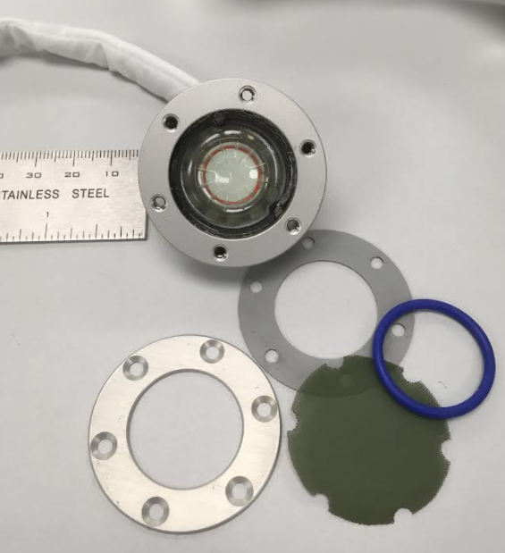
Design Overview
ICS uses two COTS, 8-ohm loudspeakers
Speakers are mounted into aluminum enclosures on the side walls of HUT
Hydrophobic wire mesh is installed between speaker diaphragm and suit
ICS team also conducted market survey to see if better speakers existed in the commercial space.
The team tested approximately 15 speakers from several different manufacturers
The required small size of the speaker limited the number of available options.
The selected speaker produced best frequency response, and it was one of a few speakers that output a volume high enough for use ispace suit (approximately 85dBA).

Slide 13
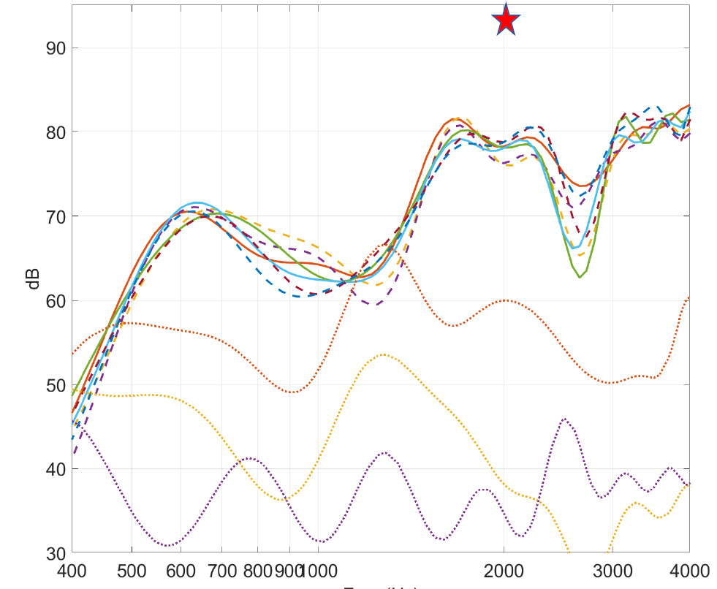
ICS Testing – Component Level
Speech Intelligibility
  Provide TBD results here
TBD frequency response plots

Slide 14
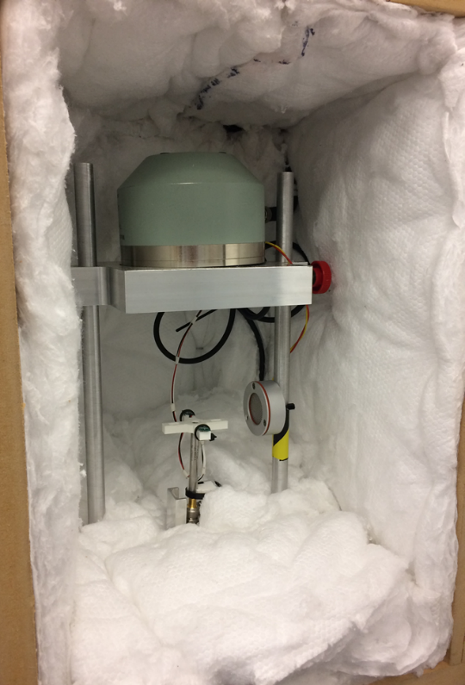
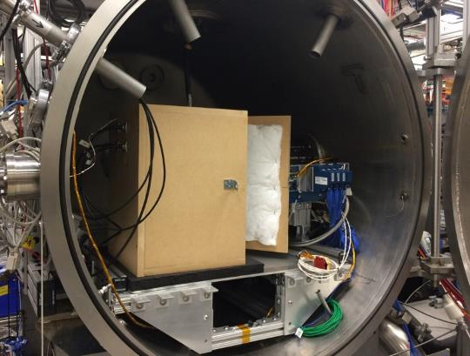
ICS Testing – Component Level
Reduce Pressure Testing
  Problem: Microphone and speaker manufacturers do not provide performance data for components at reduced pressures
  Testing: Testing performed in PLSS Chamber C to quantify performance of microphones and speakers at flight-like pressures (3.5, 4.3, 8 psia) and frequencies (250, 500, 1000, 2000, 3100 Hz)
  Results: Microphone & speaker sensitivities decrease with decreasing pressure (expected behavior) – sensitivities can be automatically corrected by SSEER software or by manual volume adjustments by astronaut
    Results summarized in: EV3-ADL-2019-001
Test Setup
Mouth simulator
Test Setup in Chamber
ICS Speaker
ICS Microphones (x2)
Reference Microphone

Slide 15
ICS Radiation Assessment
ICS Radiation Requirements
  Non-destructive failure rate (MTBF) of < 10⁻²/2000hrs for LET: 60 MeV-cm²/mg
  No destructive failures for LET < 60 MeV-cm²/mg
  Functional after receiving a TID 13325 Rad (including displacement damage)
Microphone element (ICS-43434) is only ICS component that is sensitive to ionizing radiation
Radiation Test Results
  Microphone was tested at Brookhaven National Lab in 2017
  MTBF for LET of 60 MeV-cm²/mg: 2.2*10⁻³/2000hrs (meets requirement)
  No destructive failures for LET < 60 MeV-cm²/mg (meets requirement)
  Functional after receiving a TID 13325 Rad (meets requirement)
Forward Work
  For SEE: Lot testing is not required
  For TID: Lot testing is required
Location | Non-Destructive SEE Rates | Linear Energy Transfer (MeV-cm²/mg) | Total Ionizing Dose Rad (Si)
LEO | < 10⁻²/2000hrs | > 36 | 2000
Exploration | < 10⁻²/2000hrs | > 60 | 13325

Slide 16
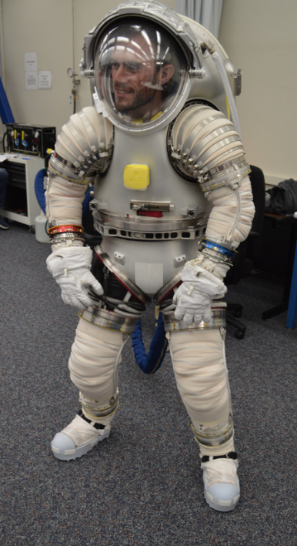
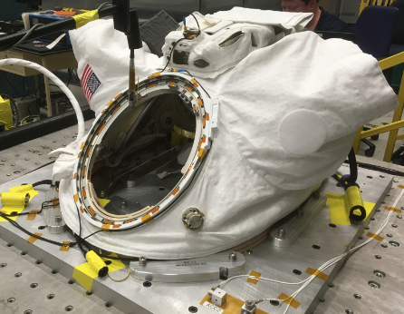
ICS Testing
System-Level Tests
  ICS has been used over 50 human-in-the-loop suited events in lab and micro-g analog environments and all subjects have rated audio quality as acceptable
  Vibration testing

Slide 17
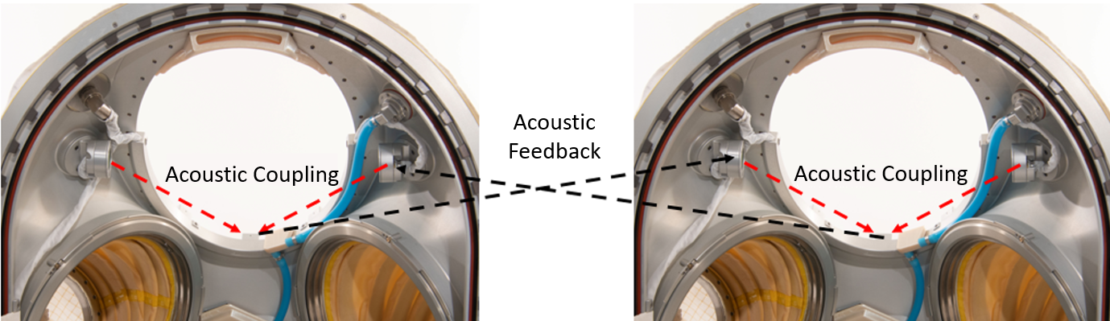
Risk – Acoustic Echo
Open nature of ICS microphones and speakers and enclosed environment of space suit results in acoustic coupling between microphones and speakers
This acoustic coupling creates loud squeal when two open-mic/speaker systems are connected together (i.e. two xEMU ICS units)

Slide 18
Risks – Acoustic Echo
Prior to assembly of two xEMU space suits, it was hypothesized that acoustic coupling could be addressed by careful placement/orientation of the speakers/microphones, microphone sensitivity adjustment, or by adjustment of a voice-operated switch (VOX) setpoint
However, none of these relatively simple solutions prevented acoustic coupling.
Risk Mitigations
Orientation of Speaker/Microphones
Echo Cancellation Software
Push to Talk
High VOX Setpoint
Headset Speakers

Slide 19
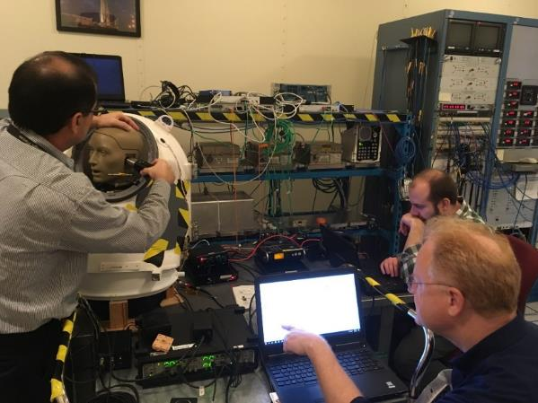
Echo Cancellation Software – Testing
Echo cancellation algorithm has been successfully evaluated with 3D-printed xEMU HUT at ambient and sub-ambient pressures
  AEC algorithm effectively removes acoustic echo with helmet on or off at max allowed speaker volume at ambient and sub-ambient static pressures
  Additional testing will be conducted to assess AEC ability, with algorithm optimization, to operate in double-talk condition without degrading outbound audio
Test Plan
  Test at ambient pressure with manikin & 3D-printed xEMU HUT
  Test at sub-ambient pressures with manikin & 3D-printed HUT
  Test at ambient/super-ambient pressures with person and suit
  Test at sub-ambient pressures with person and suit
Echo Cancellation Algorithm Testing

Slide 20
Risks – Miscellaneous
Sidetone
  Sidetone is feature microphone audio is fed back into speakers
  Commonly used by headset-based systems when a user’s voice is isolated from their ears
  For xEMU ICS, sidetone results in run-away squeal (due to open-nature of mics/speakers)
  Sidetone cannot be included with open mics/speaker system, without other controls to mitigate squeal
Audio Attenuation
  Unlike a headset, the ICS does not attenuate ambient noise from inside or outside the suit.
  this attenuation is not expected to be needed because xEMU is required to limit noise to low levels
  Regarding suit-external noises (e.g. ISS Air-lock depressurization/repressurization), preliminary testing has shown that the xEMU helmet bubble provides sufficient attenuation to protect the crewmember’s ears and not interfere with two-communication

Slide 21
Forward Work
ICS design is considered complete pending additional changes from DVT
NASA plans to complete integrated tests with the PLSS at sub-ambient pressures to characterize the performance of the ICS and AEC software in flight-like environments
NASA will work with commercial xEVAS vendors to share design and test information for xEMU ICS

