Slide 1

NASA Advanced Space Suit xEMU Development Report – Hard Upper Torso (HUT)
Richard Rhodes
NASA JSC
Ian Meginnis - NASA JSC
Daniel Kim - NASA JSC
International Conference on Environmental Systems
July 10-14, 2022
St. Paul, Minnesota
Trade names and trademarks and company names are used in this report for identification only. Their usage does not constitute an official endorsement, either expressed or implied, by the National Aeronautics and Space Administration.

Slide 2
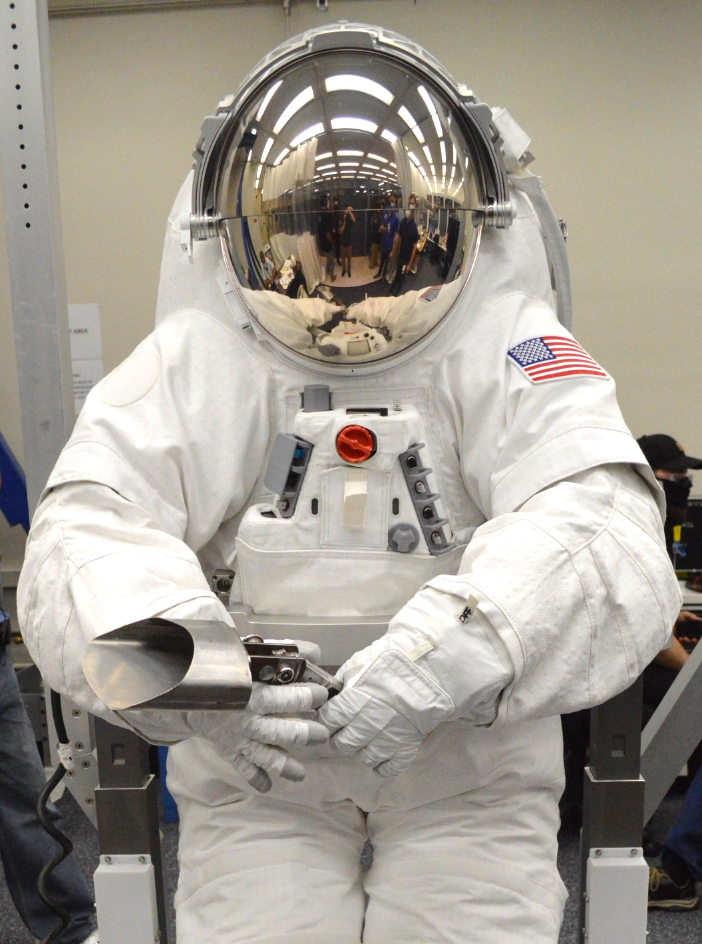
xEMU Development Report: HUT
HUT Background
xEMU HUT Design
  Key Driving Requirements
  Detailed Design
  Sub-assemblies
Testing and Analysis
Technical Gaps / Forward Work
Conclusion

Slide 3
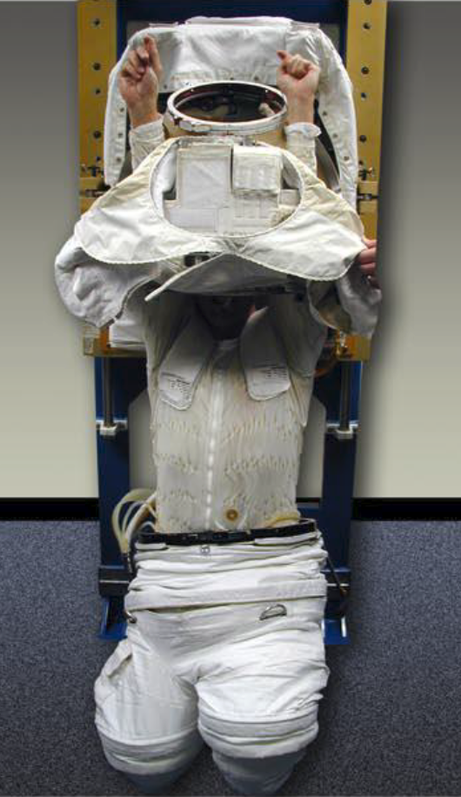
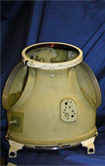
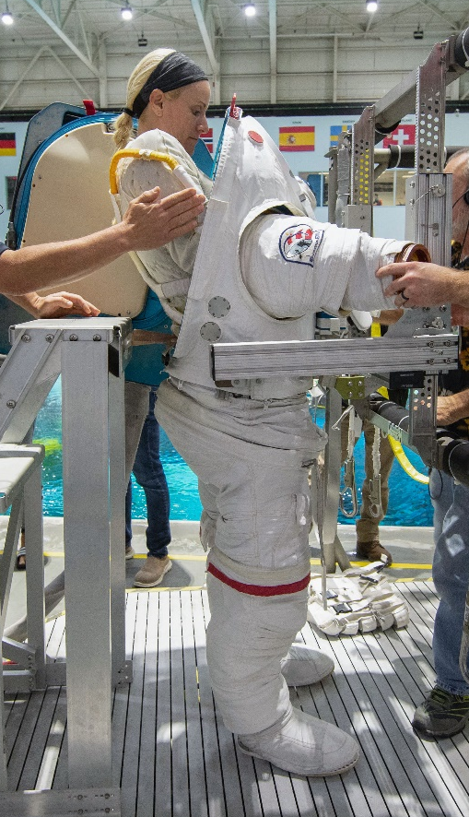
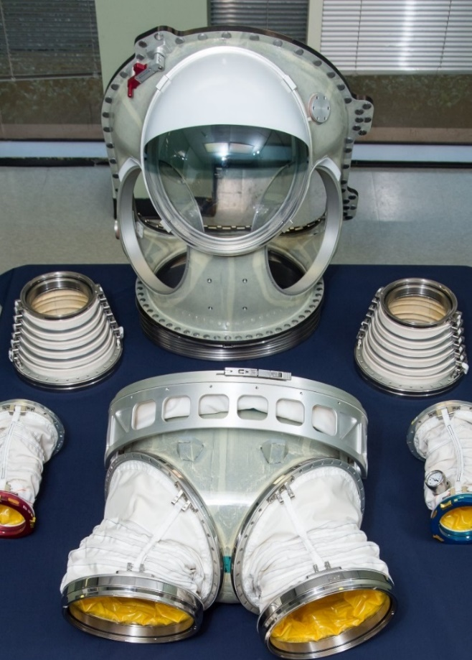
HUT Background
EMU HUT
  Composite structure
  Waist-entry
xEMU HUT Architecture
  Evolves HUT design from Mark III, Z-2, REI-suit, and Orlan
  Composite structure
  Rear-entry
    Addresses risks to shoulder injury and improves shoulder mobility
EMU HUT
(Waist-Entry)
Mark III HUT
(Rear-Entry)
Z-2 Suit
(Rear-Entry)

Slide 4
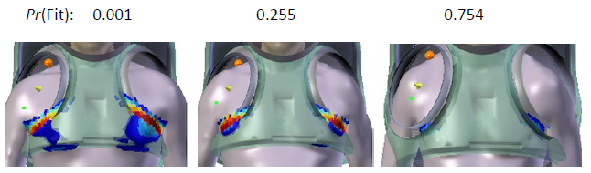

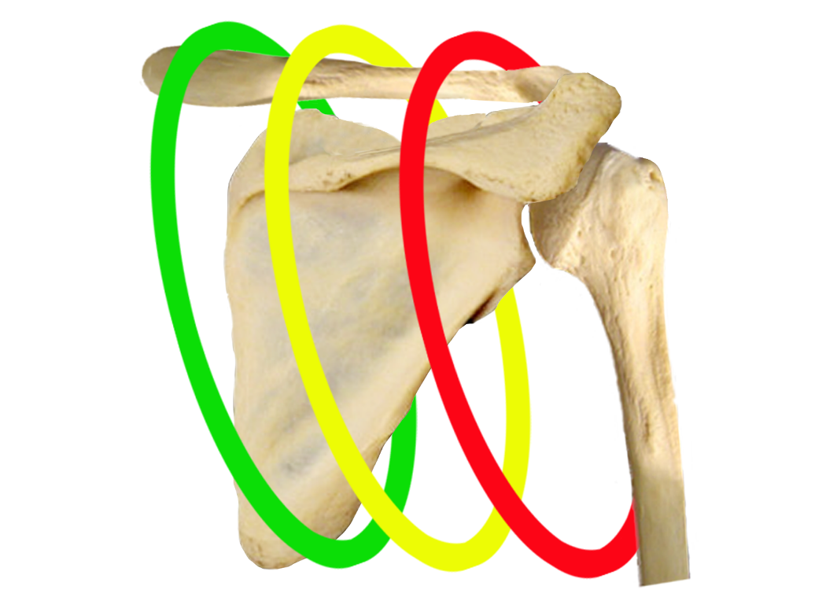
Requirements: Anthropometry & Sizing
Requirement Summary: Fit 90% of the relevant crew population
  Relates to 1st percentile female to 99th percentile male for each of the key anthropometric measures
Suit was sized and designed around driving anthropometries and utilizes a scye sizing feature to meet equivalent sizing of 2 HUTs in 1 structure
  Development of HUT shape included the use of 3D modeled fitchecks of full crew and ANSUR database scans
  Sizing ring can be swapped without the use of tools
Larger scye opening, rear-entry design, and use of shoulder harness to index shoulder in shoulder joint
An example of fit and sizing analysis across the anthropometry range
xPGS
Scye In (left-gold) and scye out (right-black) sizing rings
Relative positioning of scye opening, in reference to EMU

Slide 5
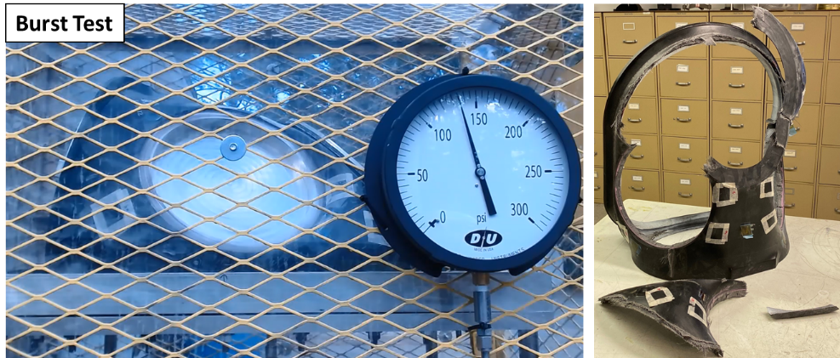
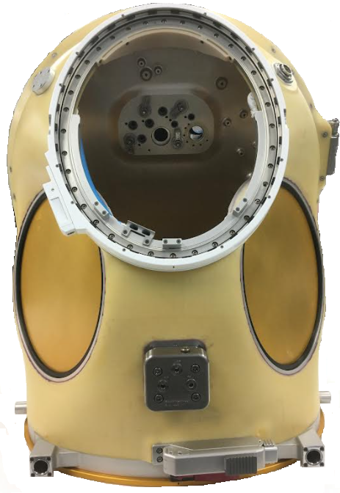
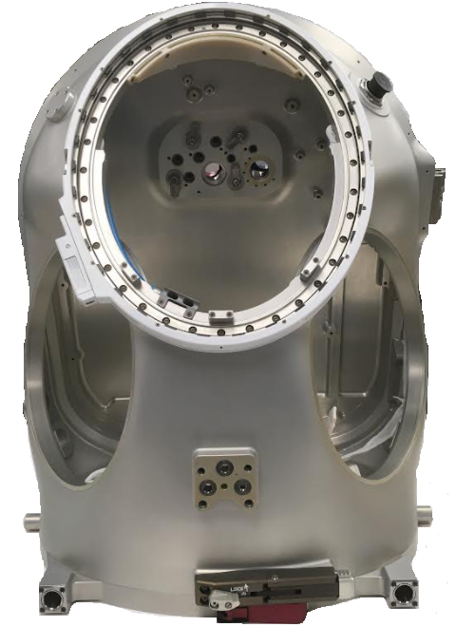
Requirements: Pressure
Operating Pressure: As high as 8.2 psid
  xEMU was designed to operate at 4.2, 6.2, or 8.2 psia
  For composite structures damage tolerance drove the structural design
    Room to significantly reduce system mass if threat of damage can be mitigated (discussed later)
xEMU Composite HUT
xEMU Aluminum HUT

Slide 6
Requirements: Mass
Mass:
  HUT/Hatch Assembly: 49.5 lbs (small; excluding PLSS components and EPG)
    Use of lighter weight structures, such as 3D woven composites and fiber reinforced thermoplastics have been investigated to reduce system mass
    Aluminum and Composite HUT structures were developed in parallel to reduce schedule and mass risks, respectively
Simplified Material Trade Matrix
HUT Material | HUT/Hatch Mass | Robustness | Manufacturing/ Schedule Risk
Aluminum | 16.4 / 13.3 lb | Medium | Low
S-Glass Composite | 14.7 / 15.1 lb | Medium | Medium
Thermoplastic Composite | 25% reduction (est.)* | Medium | High
Ultra-Lightweight Composite | 50% reduction (est.)* | Medium | High
*Reduction from S-Glass Composite

Slide 7
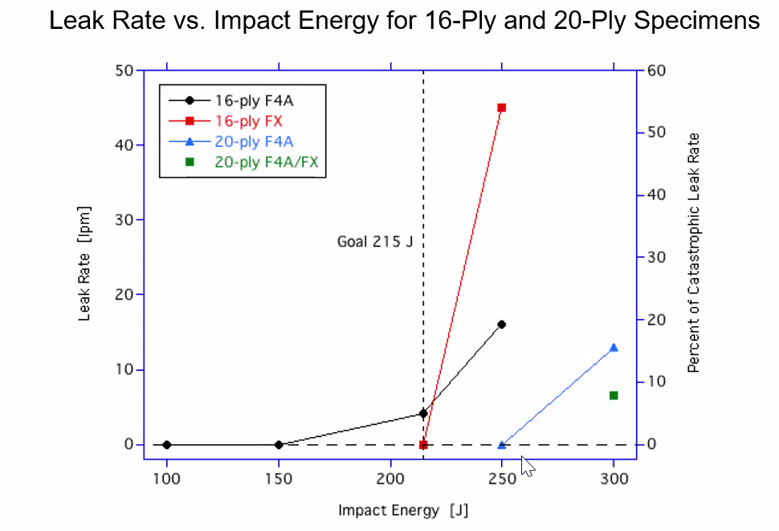
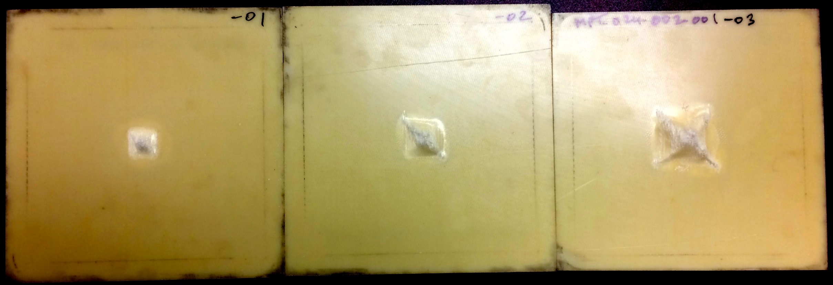
Requirements: Lunar Impact
Requirement: Space suit design shall provide a Probability of no Impact Failure (PnIF) of 0.997 (TBR) or better while supporting 40 hours of two person EVAs in the lunar surface environment as defined in EVA-EXP-0039
Risk Model was developed to identify the:
  1) likelihood of a fall and
  2) likelihood of a critical outcome in the case of a fall
  Likelihood of a fall is highly based on historical Apollo data as the only historical reference for falling in a lunar planetary environment
    Added spacesuit capability (field of view and mobility) should decrease likelihood of a fall
    Lunar surface lighting and future operations concept may affect likelihood of a fall
  Outcome criticality of a fall is based off operations concept, suit robustness, surface characteristics, and fall protection equipment
Back Surfaces of 16-ply F4A Specimens after Impact
100 J
Leak < 0.5 lpm
150 J
Leak < 0.5 lpm
215 J
Leak 4.2 lpm @ 4.3 psi

Slide 8
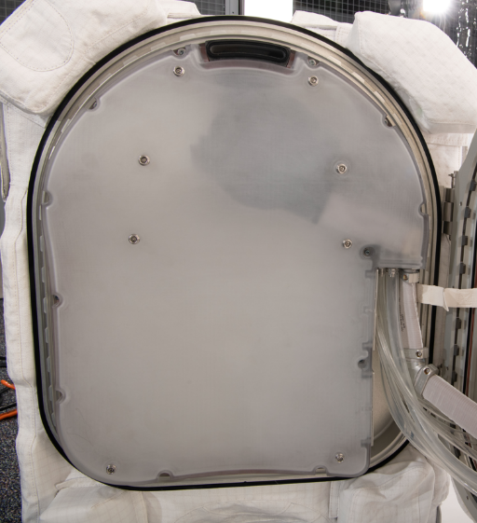
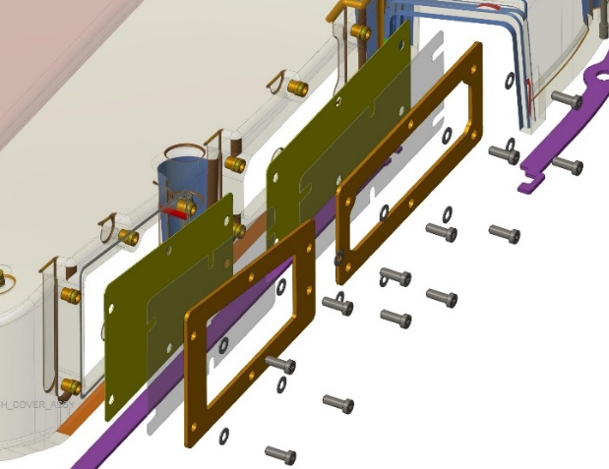
Requirements: Water Containment
Requirement: Contain free water
  Freewater inside of the suit in a micro-gravity environment is extremely hazardous
    ISS EVA 23 and EVA 80 both had free water and resulted in close calls and extensive investigations to mitigate any free water inside of the EMU
  xEMU design utilizes suit pressure on the feedwater supply assembly (FSA) bags, located inside of the hatch
  Hatch cover design is sealed to prevent the migration of any feedwater to the crewmember
  Zitex membranes are used to limit pressure differential across hatch cover

Slide 9
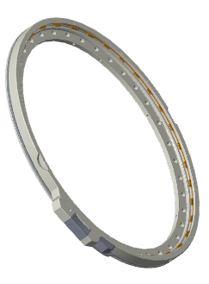
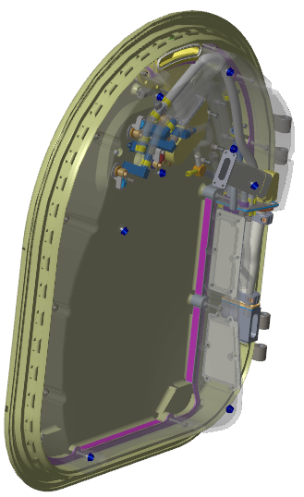
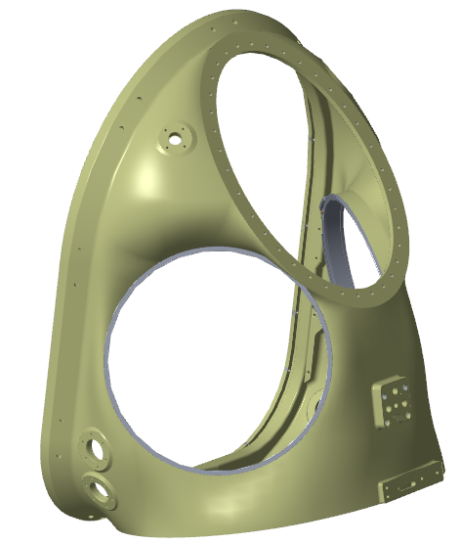
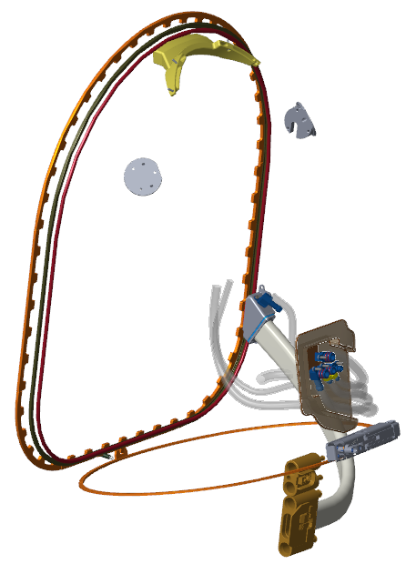

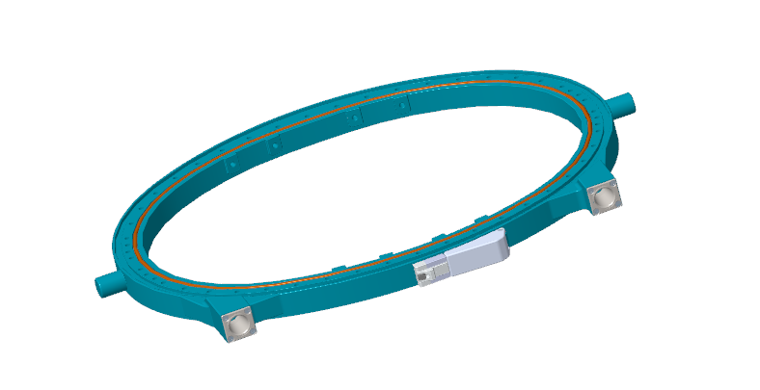
HUT Assembly - Design Overview
Rear-Entry Design
Outer Dimensions:
  17” x 21.6” x 26”
Mass (with hatch and sub-assemblies):
  Total: 49.5 lbs
ORU-able Items:
  Hatch
  Hatch Cover
  Water Line Vent Tube Assembly
Disconnects – Breach-lock style
  Hatch
  Neck Ring
  BSC
Sizing Features
  2 HUT Sizes (Small & Large)
  Scye Sizing Rings
  Scye Retainer Rings
Notes:
Provide a detailed overview of the mechanical design. Start at a high level and then dive deeper into the details. If the component is an ORU, be sure to explain how it is removed and replaced.

Slide 10
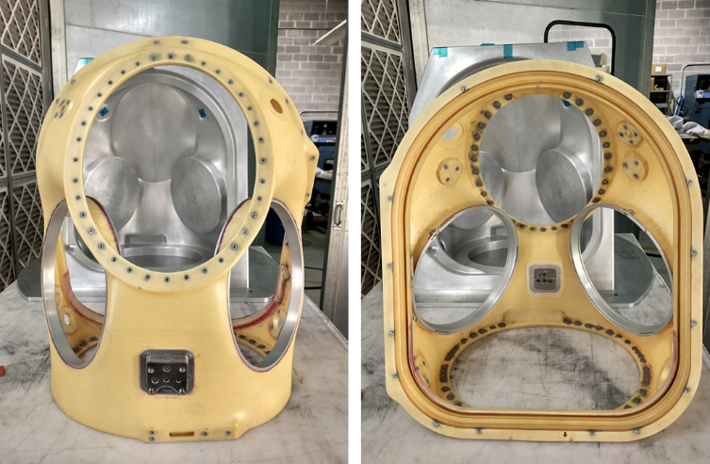
HUT Structure - Materials
Materials
  Lightweight fiberglass composite structure (HexForce 6781HT/Patz PMT-F4A)
    16-ply quasi-isotropic lay-up
    Stainless steel bonded threaded inserts
    Titanium DCU interface pad
    Aluminum scye carrier rings
  Aluminum 6061-T6 HUT structure also built to mitigate schedule risk
  Aluminum Body Seal Closure (BSC), Neck Ring Disconnect, and Scye sizing rings
xEMU Composite HUT

Slide 11
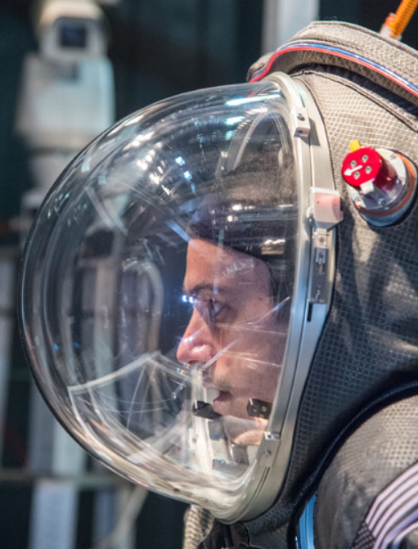
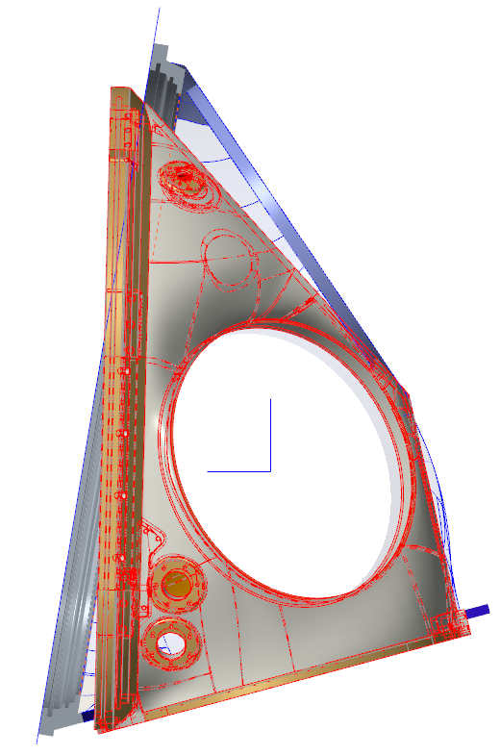
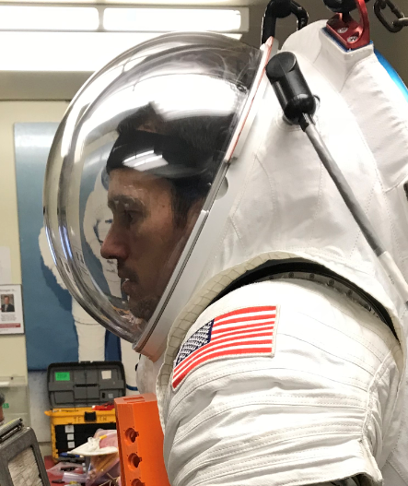
HUT Structure - Geometry
Modifications from Z-2 NBL Lessons Learned
  Decrease full suit depth, to ease ISS airlock ingress/egress
  Reduce helmet bubble work-site interference
  Improve in-suit comfort in 1-G testing
    Reduced scye bearing depth
    Incorporation of indexing internal cover and reshaped hatch cover
  Improve integration with the Lower Torso Assembly and Tools
Z-2 to Z-2.5 HUT Geometry Comparison
Z-2 & Z-2.5 Head Position Comparison

Slide 12
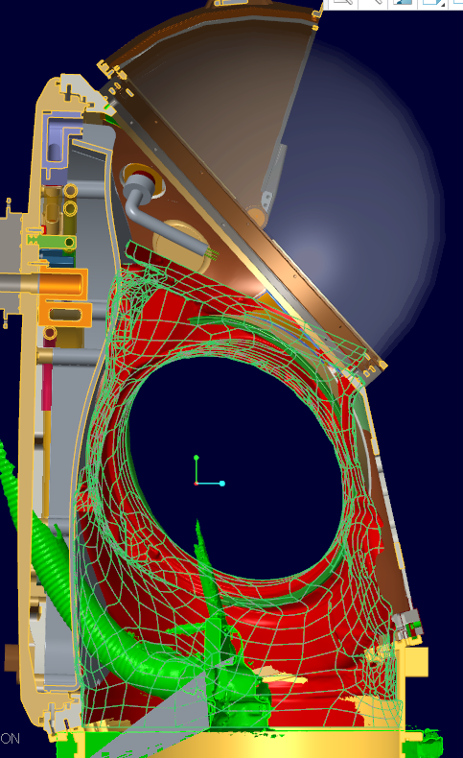
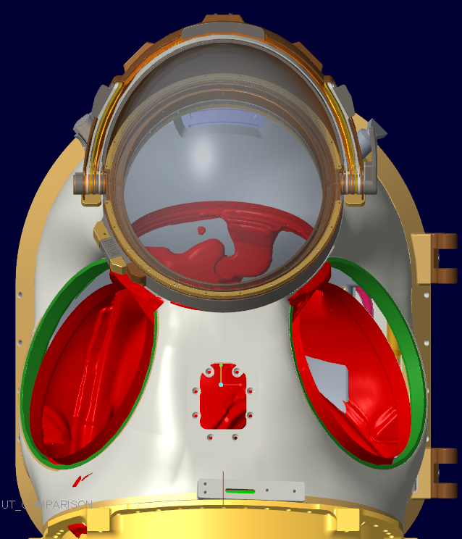
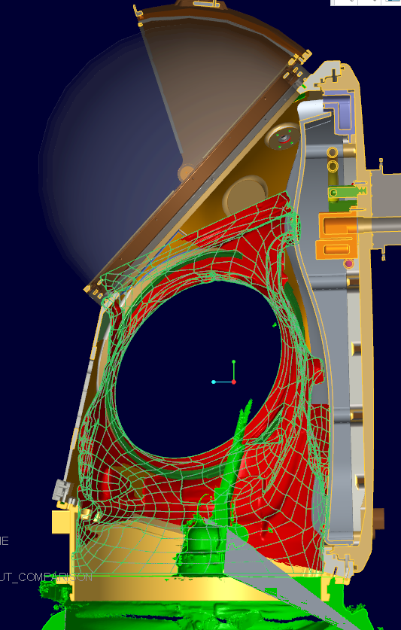
HUT Geometry – Small EMU vs Small xEMU

Slide 13
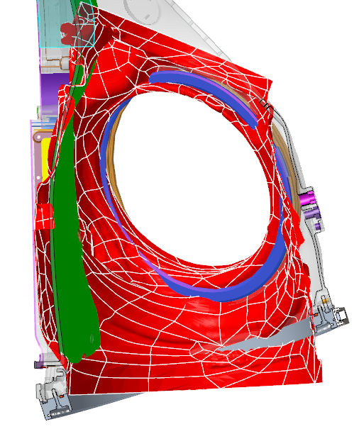
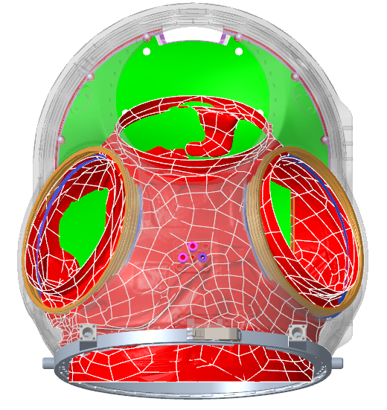
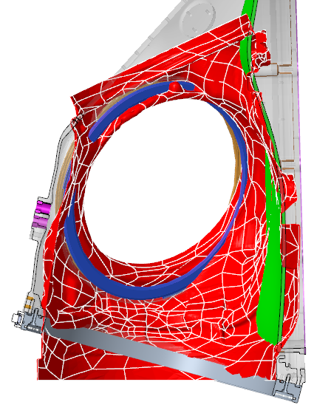
HUT Geometry – XL EMU & Large xEMU Comparison

Slide 14
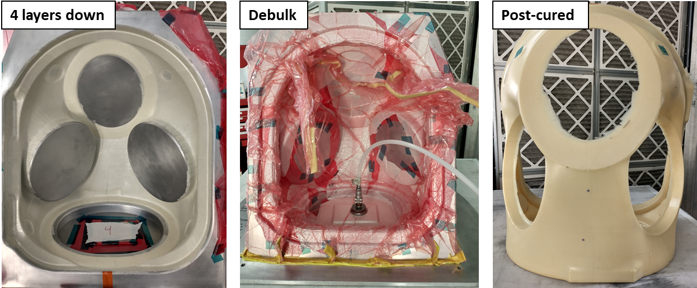
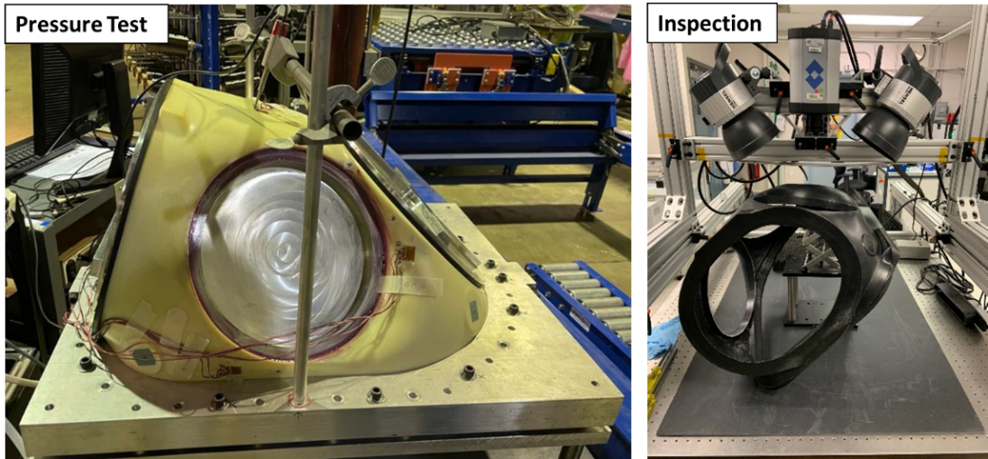
HUT Manufacturing & Damage Tolerance
Manufacturing - Composite
  Manufactured using a female tool
  Cured to near net shape in autoclave
  Post-cure, machined to final geometry
  Bonded in inserts are installed for final product
Fracture Control (NASA-STD-5019)
  Damage threat assessment
    Residual strength with impact damage and manufacturing flaws
  Impact Damage Mitigation Plan
  Residual Threat Determination
  Damage tolerance testing

Slide 15
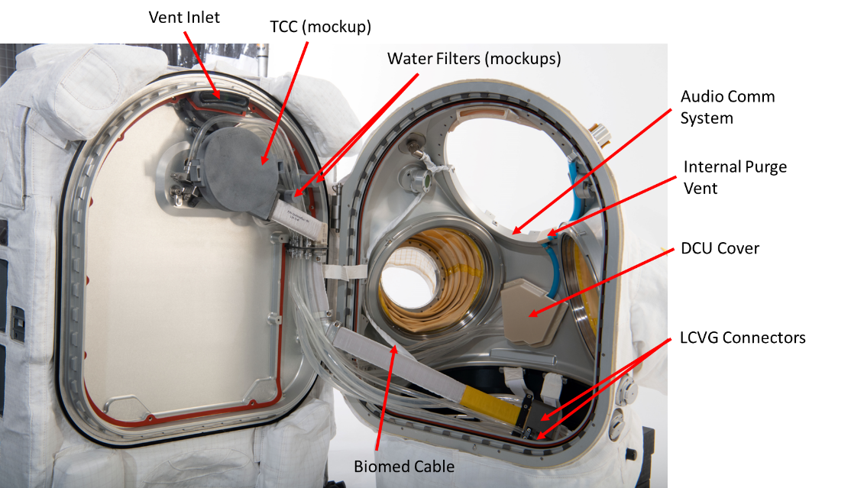
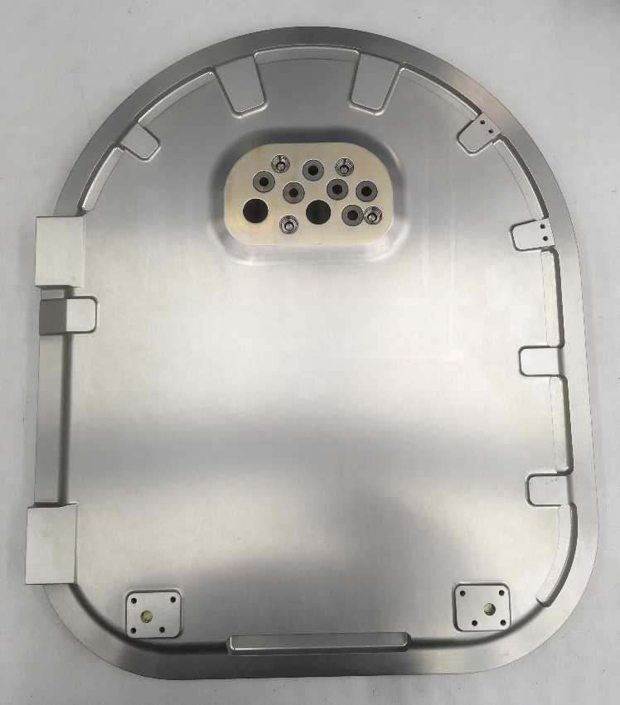
Hatch Assembly
Structure: Aluminum 7475-T7351
  Bonded in Titanium inserts at wetted interfaces
Hatch Cover machined from polycarbonate
Includes the Water Line Vent Tube Assembly (WLVTA)
Interfaces to PLSS components (FSA, Water filters, TCC)

Slide 16
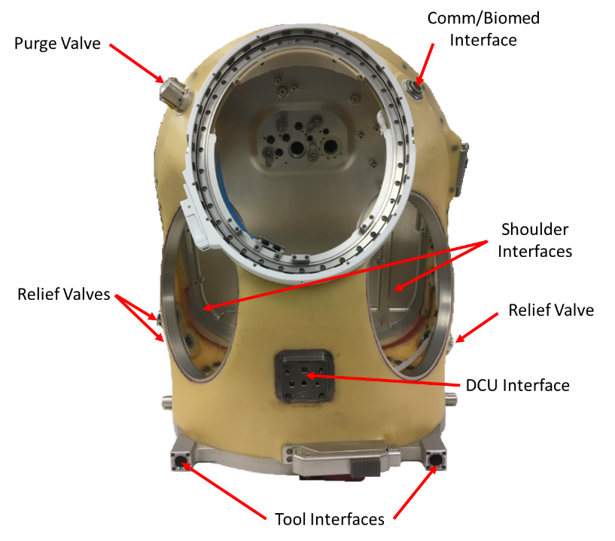
Interfaces & PLSS Integration
PGS Interfaces
  Shoulders, Helmet/EVVA, Waist-Brief-Hip Assembly
PLSS Interfaces
  HUT Purge Valve
  2x Positive Pressure Relief Valves (PPRVs),
  1x Negative Pressure Relief Valve (NPRV)
  DCU Interface Pad
  Communication/Biomed Interface
  Square Boss Interface (Tools, Donning Stands)

Slide 17
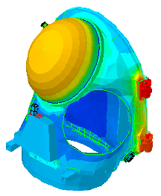
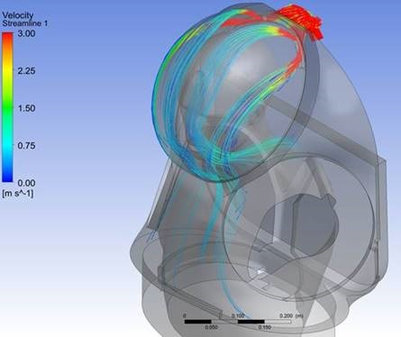
Testing & Analysis Summary
Testing
  Damage Tolerance
    Manufacturing Flaw – Pressure cycle testing
    Impact Damage – Pressure cycle testing
    Burst Testing
  PDA/PIA & Functional
    NDI Inspections
    Pressure Testing (Proof, Leakage, Delta-P)
    Functional Testing
    Water Containment
  CO2 Washout
  Mechanical Cycle Testing
  Human in the Loop
    Fit, Comfort, Mobility
    Emergency Extraction
    Secondary Egress
Analysis
  Structural
    Pressure, vibe, kickload
  Thermal
    Lunar - Hot and Cold
    ISS – Hot and Cold
  Flow
    Delta pressure
    CO2 Washout
      Nominal and Contingency
Thermal Analysis Example
CO2 Washout Analysis Example

Slide 18
Technical Gaps / Forward Work
Complete system-level functional and environmental testing
Full verification of fleet sizing and mobility testing with large HUT
Completion of mass reduction efforts
  Impact padding
  Lightweight materials development
Incorporation of DVT lessons learned
  Improved sealing of hatch cover and manifold design
  Improved EPG integration
  Use of external harness for incapacitated crew lift

Slide 19
Conclusions
NASA’s development of xPGS space suit has been huge step towards enabling human exploration beyond LEO, including incorporation of 3-D human centric design methodology
Lessons learned from design, analysis, and testing will be relevant to any future development efforts
Pressure Garment Development team is highly motivated to utilize lessons learned and design heritage from the xEMU effort to help xEVAS teams succeed

Slide 20

Questions?
Richard Rhodes
NASA Pressure Garment Team Lead
Ian Meginnis
NASA xPGS Hardware Team Lead
NASA HUT Component Owner

Slide 21
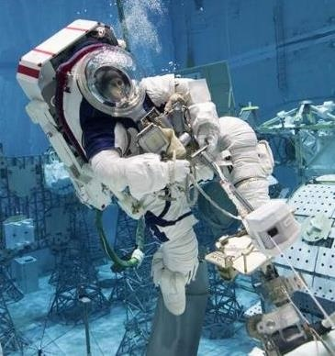
PG Development History: Z-2 NBL Runs
Performed 16 runs + 2 test prep
Assessed configurations using the EMU lower torso and Z-2 lower torso with the Z-2 upper torso
Assessed complex tasks, volume constrained task sites, and airlock ingress/egress
Last two runs investigated airlock ingress/egress with reduced front-to-back suit dimension
Major findings:
  Improved upper body mobility and visibility
  Need to reduce helmet bubble depth
  Airlock ingress/egress required increased control over that needed for EMU
    However, subjects were successful in all configurations
  Mobile lower torso provided improved capability in most cases

Slide 22
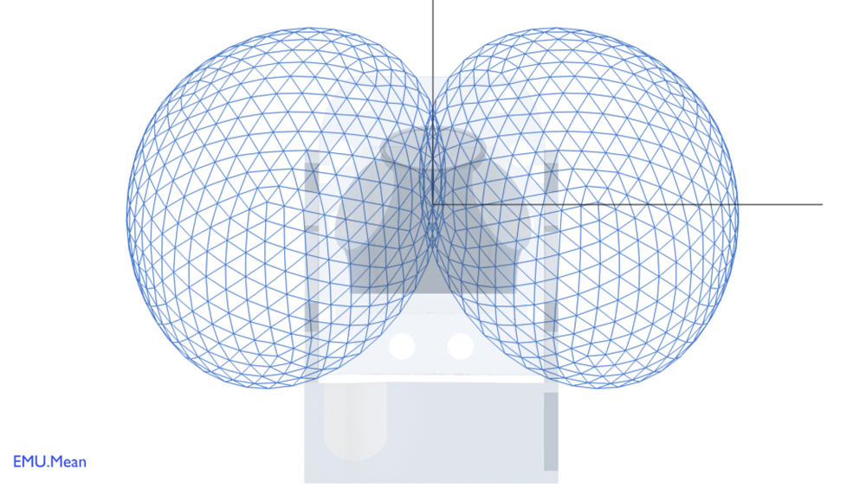
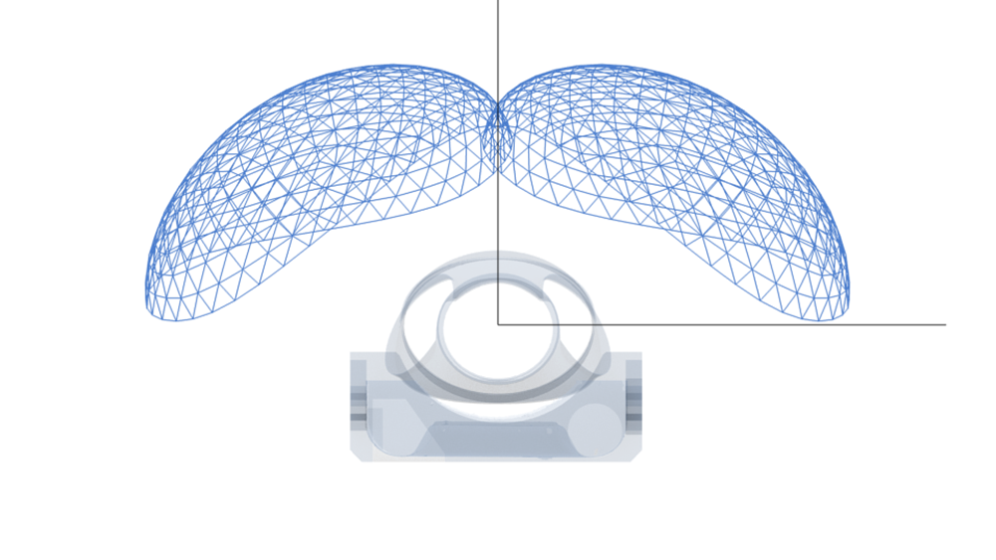
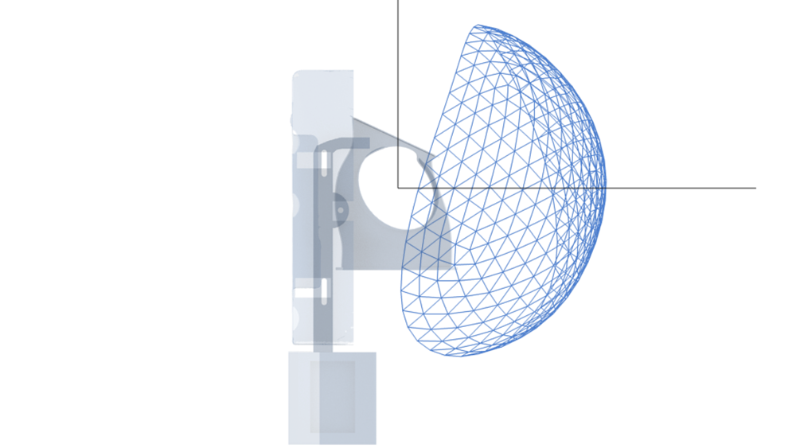
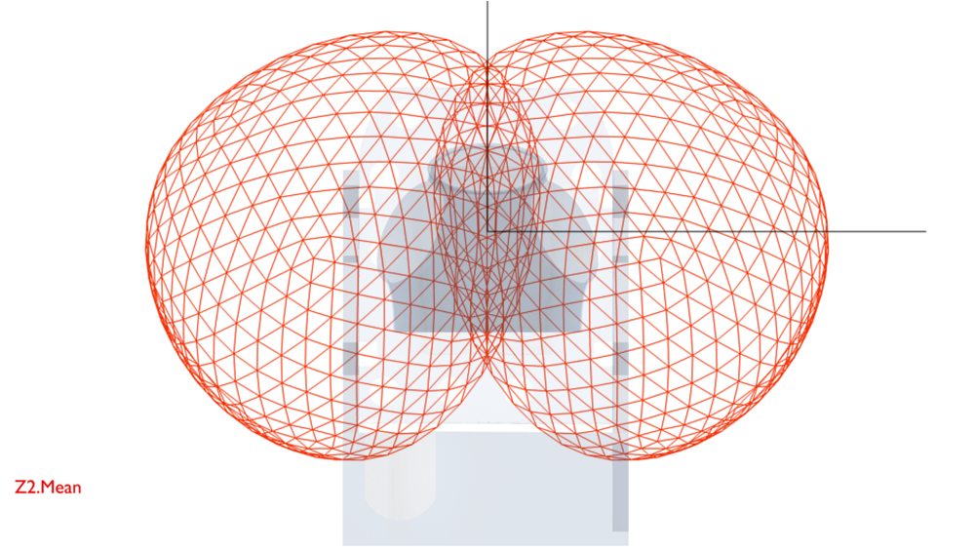
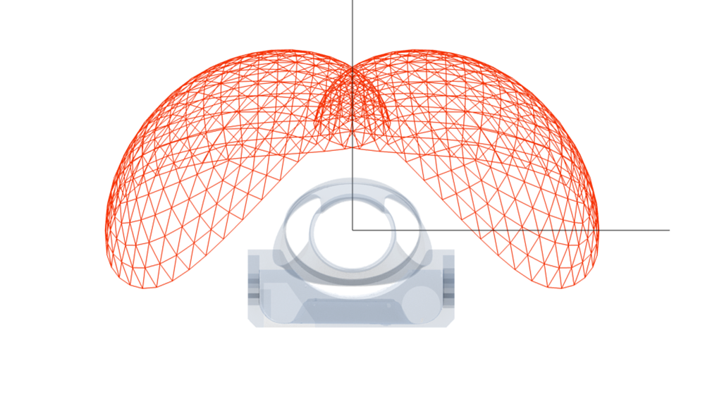
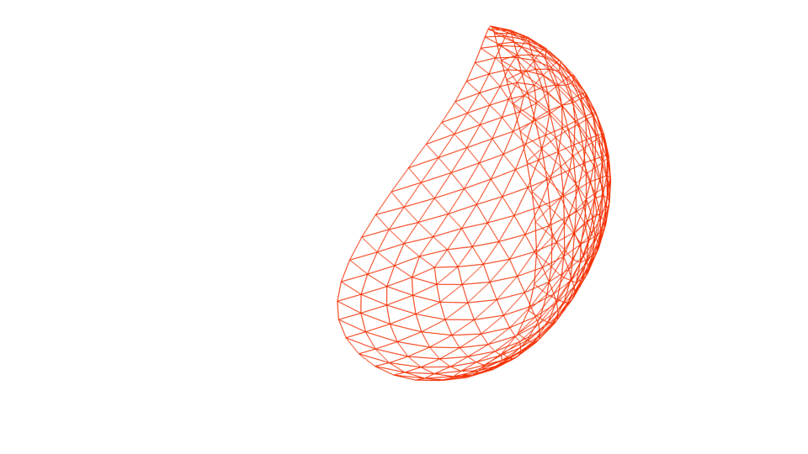


Z-2 vs EMU - Isolated Reach Envelopes
*Average of 5 CMs
Front View
Top View
Side View
EMU
Gored Shoulder
Improved Overhead Reach
Improved Backwards Reach
Z-2
Rolling Convolute Shoulder
Improved Cross-Reach

Slide 23
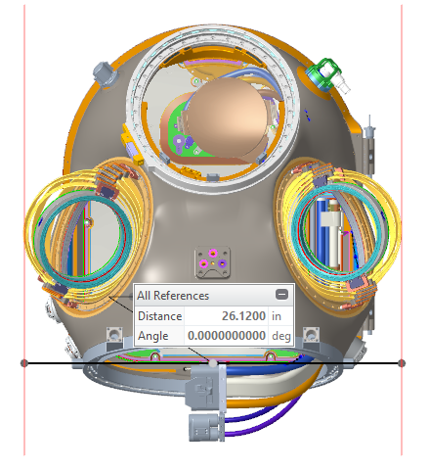
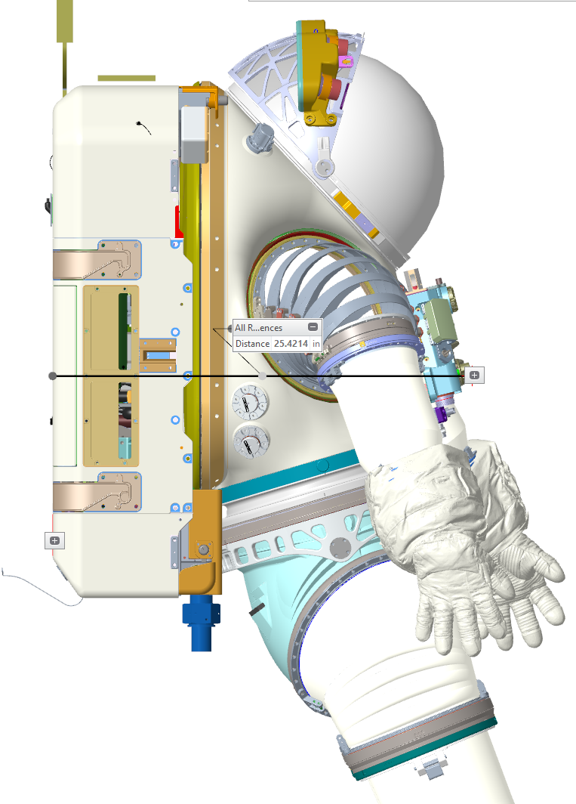
Outer Mold Line
 | Width, HUT Only | Width, HUT + Shoulders
Small | 22.2 | 23.76
Large | 22.86 | 26.12
Dimensions shown are for the Large HUT width and Small HUT assembly depth, to the end of the TCV knob
  TCV knob height contributes to 0.5” of depth and may change
  Large HUT is 0.125” deeper than small HUT

