Slide 1

xEMU Shoulder Assembly
Ian Meginnis
NASA Johnson Space Center
Trade names and trademarks and company names are used in this report for identification only. Their usage does not constitute an official endorsement, either expressed or implied, by the National Aeronautics and Space Administration.
Additional ICES Authors:
Richard Rhodes & Jeff Watters – NASA JSC
Shane McFarland & Dave Cox – Aegis Aerospace, NASA JSC
International Conference on Environmental Systems
July 10-14, 2022
St. Paul, Minnesota

Slide 2
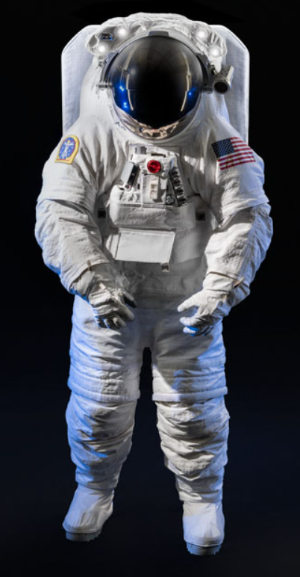
xEMU Introduction
Exploration Extra-Vehicular Mobility Unit (xEMU) space suit is NASA’s latest space suit development effort
xEMU was intended to support missions to International Space Station (ISS) and moon landing in 2024
xEMU is culmination of last 50 years of NASA’s space suit research and testing experience
xEMU is comprised of new suit architectural elements, including:
  Hard upper torso assembly
  Waist brief hip assembly
  Helmet assembly
  Shoulders
  Walking boots
  Heart rate monitor
  Integrated communication system

Slide 3
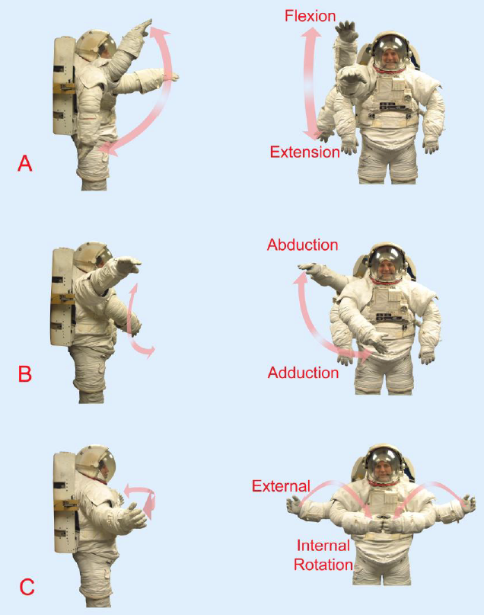
Shoulder Introduction
Shoulder is most complex joint in human body
  Flexion/Extension
  Abduction/Adduction
  External/Internal Rotation
Performance of space suit’s shoulder joint directly impacts efficiency of the crewmember’s primary working envelope
  Minimize energy expenditure
  Addressing shoulder injuries
Space suit engineers have tested wide variety of shoulder designs to address this challenging design problem

Slide 4
Driving Requirements
Requirement | Specification Summary
Comfort | Shoulder assembly shall be comfortable
Shoulder Design | Shoulder shall be an external link, rolling convolute joint
Scye Bearing Diameter | Scye bearing shall have diameters of ≥ 9.00 in (22.86 cm) (small) and ≥ 9.45 in (24.00 cm) (large)
Arm Bearing Diameter | Arm bearing shall have diameters of ≥ 5.25 in (13.33 cm) (small) and ≥ 5.70 in (14.48 cm) (large)
Operating Pressure | Extensible to 8.2 psid (56 kPa) operations

Slide 5
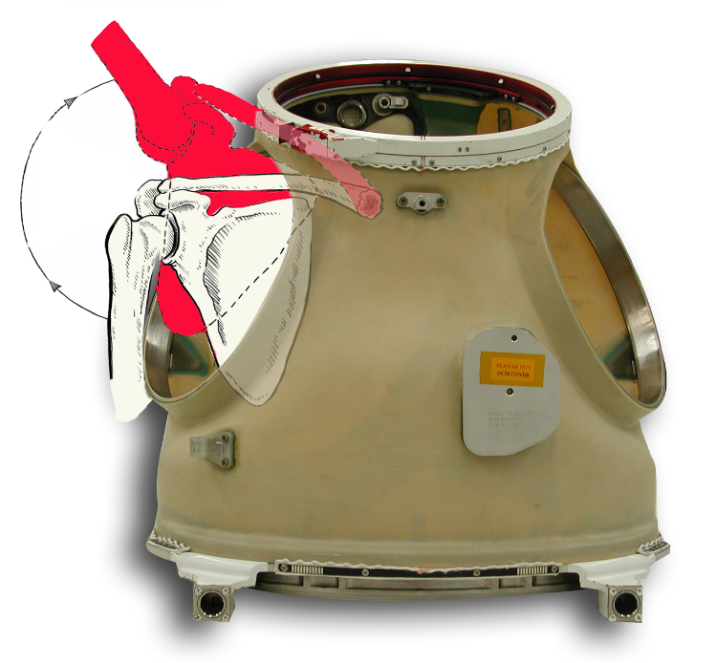
Driving Requirements – Comfort
Shoulder injuries have been reported with heritage EMU space suit
Possible causes include:
  Restriction of Normal Scapulothoracic Motion of Shoulder Joint
  Internal Shoulder Rotation: Orientation of scye bearing joint increases internal rotation of subject’s shoulder joint at rest
Restricted Motion of Clavicle and Shoulder Blade

Slide 6
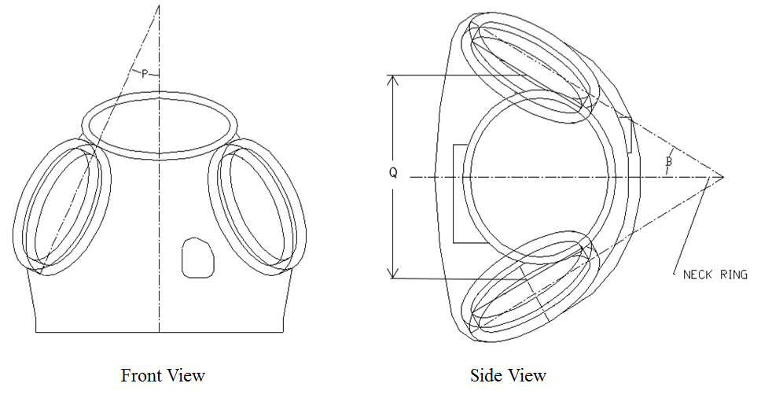
Driving Requirements – Comfort
xPGS shoulder design changes to mitigate injuries:
  Shoulder diameter is increased relative to EMU
  Shoulder joint is moved inward as far as possible
  xPGS shoulder has larger scye horizontal angle and a smaller vertical angle, with respect to EMU -- better position subject’s shoulders in HUT’s scye joint
HUT | Inter Scye Distance | Scye Bearing Inner Diameter
xEMU, Small | 10.9 in or 11.7 in (27.7cm or 29.7cm) | 9.00 in (22.9 cm)
xEMU, Large | 12.9 in or 13.7 in (32.8cm or 34.8cm) | 9.45 in (24.0 cm)
EMU, Medium | 11.8 in (30.0 cm) | 8.50 in (21.6 cm)

Slide 7
Driving Requirements – Design
NASA and other aerospace companies have been iterating on space suit shoulder concepts since the 1950s
Rolling convolute joint design was originally developed by Litton Company in 1950s for RX-series of space suits
NASA has used external-link, rolling convolute shoulder on several recent prototype suits
  Mark III [1990s]
  Z-2 [2015]
  Z-2.5 [2018]

Slide 8
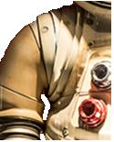
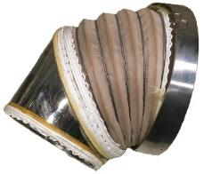
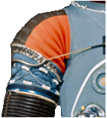
Shoulder Development History
Shoulder | Mobility | Complexity | Mass without bearings (per shoulder) | Mass with bearings (per shoulder) | Notes | Picture
Armored rolling convolute (Litton RX series) | High | High | – | 3.50 lb² (1.57 kg) | Less ROM than stacked rolling convolute²
Toroidal convolute (AiResearch EX-1) | High | Medium | Medium |  | Wear concerns of fabric; evaluated in ZPS and not preferred over rolling convolute²
Molded convolute (Apollo A7L/B) | Low | Low | Low |  | High torque at extremes of range of motion and higher pressures; mono-stable²

Slide 9
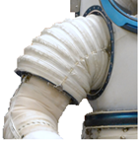
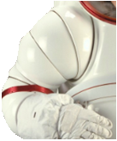
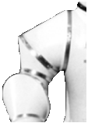
Shoulder Development History
Shoulder | Mobility | Complexity | Mass without bearings (per shoulder) | Mass with bearings (per shoulder) | Notes | Picture
Two-bearing, flat-patterned convolute (I-Suit) | Medium | Low | Low | High torque at extremes of range of motion and higher pressures† | Two-bearing, flat-patterned convolute (I-Suit)
Four-bearing, spherical stovepipe (AX-5, AiResearch AES) | High | Medium | Very High | Complicated and costly to machine; limited life cycle experience² | Four-bearing, spherical stovepipe (AX-5, AiResearch AES)
Three-bearing, spherical stovepipe (AX-1, AX-2, Litton CVS) | Medium | Medium | Very High | Challenging programming due to three bearings and no dedicated flex/ex feature² | Three-bearing, spherical stovepipe (AX-1, AX-2, Litton CVS)

Slide 10
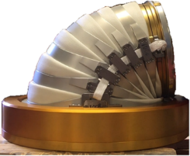
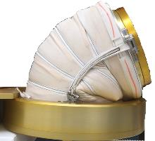
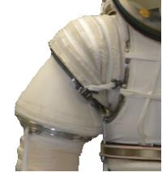
Shoulder Development History
Shoulder | Mobility | Complexity | Mass without bearings (per shoulder) | Mass with bearings (per shoulder) | Notes | Picture
Two-bearing, external link rolling convolute (xPGS, Mark III, Litton AES) | High | High | 2.56 lb (1.16 kg) (small xPGS) | 5.75 lb (2.61 kg) (small xPGS) | Low torque; stable throughout ROM; low sensitivity to high suit pressures; extensive test experience with Mark III†
Two-bearing, flat-patterned gore (EMU) | Medium | Low | 0.75 lb (0.34 kg) | 4.96 lb (2.25 kg) | Higher torque at exploration suit pressures; not stable throughout ROM
Three-bearing, flat-patterned convolute (Z-1) | Medium | Low | 3.15 lb (1.43 kg) | 6.75 lb (3.06 kg) | Three bearings did not provide better mobility than two-bearing design†

Slide 11
Shoulder Development History
Benefits of rolling convolute joint design include:
  Low actuation torque
  Stability throughout range of motion
  Less sensitivity to increasing joint pressure
Downsides of rolling convolute joint design include:
  Increased mass from metal rings and linkages
  Increased complexity from layup, bonding, and assembly processes
When trading downsides with improved mobility, NASA prioritized mobility and selected external link, rolling convolute architecture for xEMU

Slide 12
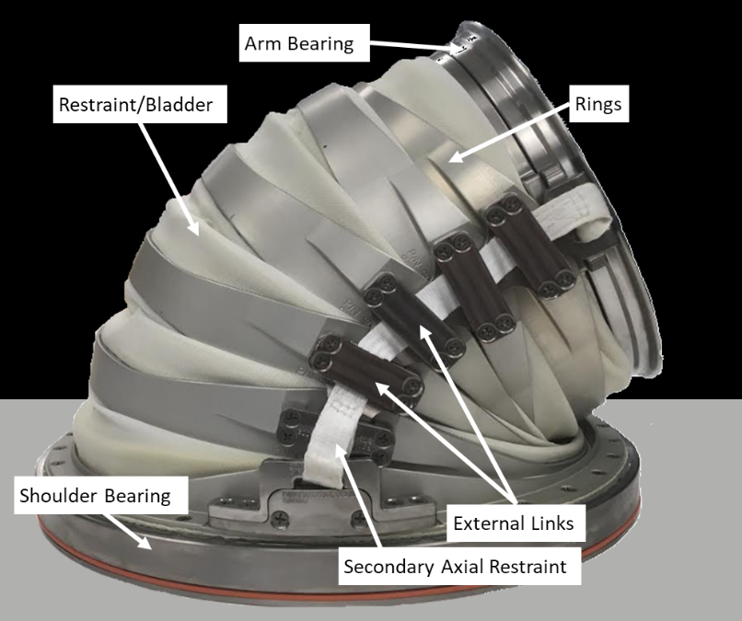
Shoulder Overview
xEMU Shoulder: Externally-linked Rolling Convolute shoulder with Scye and Arm bearings
  Similar concept as Mark-III shoulder
  Iterative design from Z-2 shoulder
Primary Components:
  Scye and arm bearing
  Aluminum rolling convolute rings
  Titanium primary linkages
  Spectra secondary webbing
  Softgoods: restraint, bladder, and abrasion-resistant inner layer

Slide 13
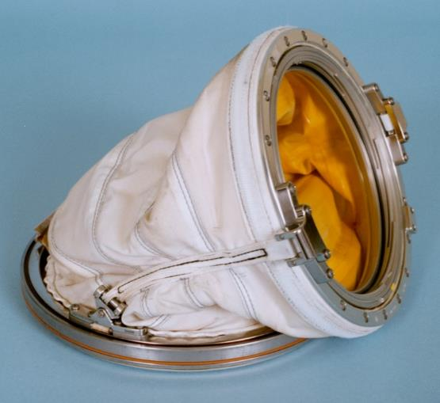
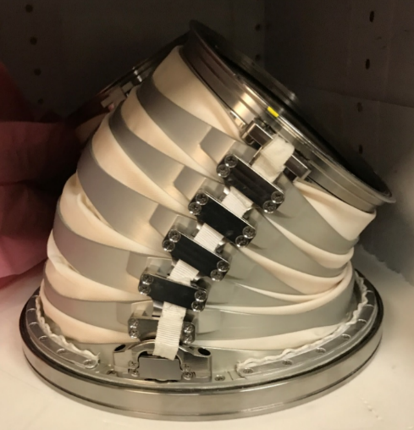
EMU vs xEMU Shoulders
(2) xEMU utilizes completely different shoulder design and construction
EMU Upper Arm Assembly
Two bearing gored soft shoulder with pivoted axial brackets
No adjustability in scye placement
xEMU Shoulder Assembly
Two bearing rolling convolute shoulder with titanium primary linkages
Sizing rings allow for two sizes with one HUT

Slide 14
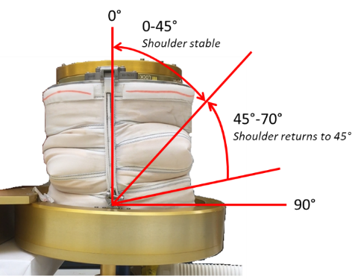
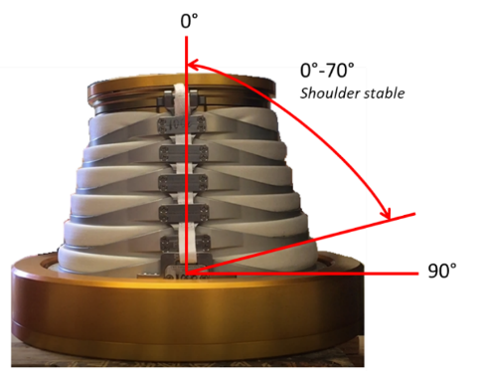
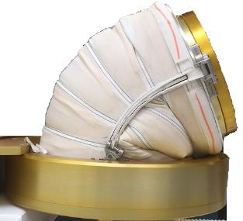
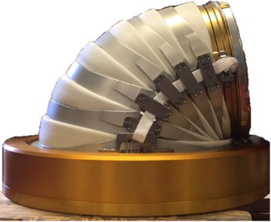
Stability Through ROM
EMU Shoulder vs xPGS Shoulder:
(Neutral Position)
(Flexed Position)
EMU Shoulder
xPGS Shoulder
EMU Shoulder
xPGS Shoulder

Slide 15
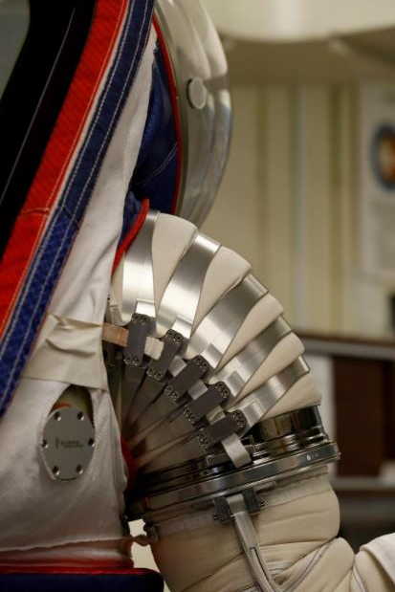
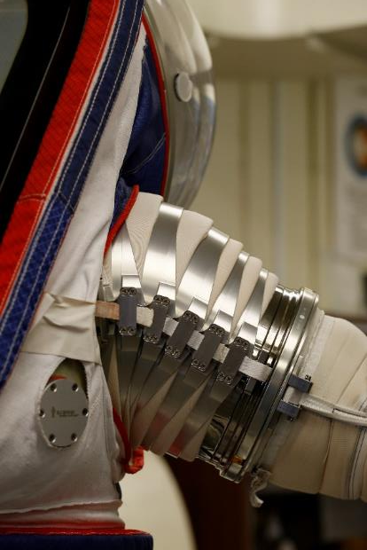
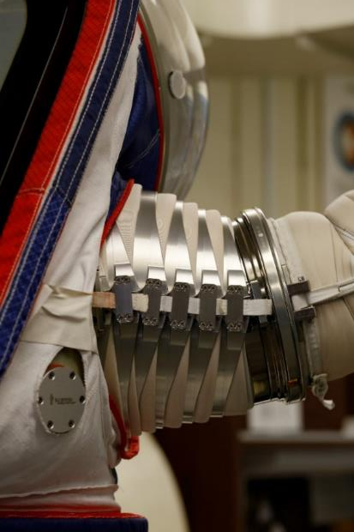
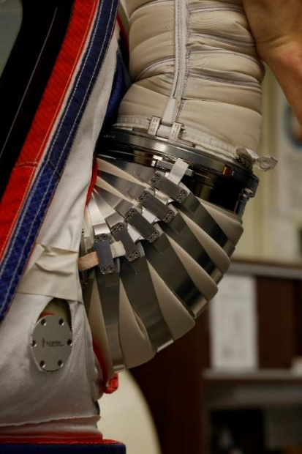
Constant Volume Joint
Rolling convolute rings maintain nearly constant volume throughout full range of motion (ROM), which minimizes joint torque

Slide 16
Shoulder Design Overview

Slide 17
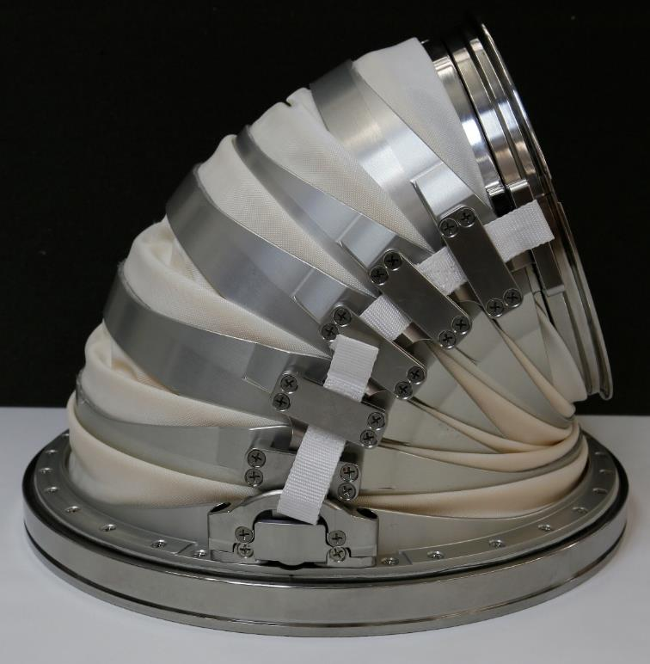
Mechanical Design: Hardware
HARDWARE
Arm and Scye Bearings:
  Inner and Outer Races: Titanium Ti-6Al-4V
  Ball Bearings: 440C Stainless Steel
  Ball Separators: Vespel SP-1
Primary Axial Restraints: Titanium 6AL-4V Linkages
Secondary Axial Restraints: Spectra Webbing
Clamping Rings: Aluminum 7075
Rolling Convolute Rings: Aluminum 7075
  R/C rings are bonded to polyester restraint fabric with UR1087 urethane adhesive

Slide 18
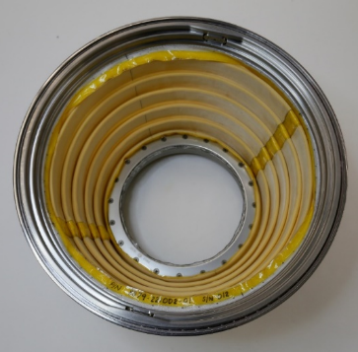
Mechanical Design: Softgoods
Vacuum
SOFTGOODS LAYUP
(0) Environmental Protection Garment (EPG)
(1) Restraint Layer = Polyester
  Restraint bonded to Bladder underneath R/C rings
(2) Bladder Layer = Urethane-Coated Nylon
  Bladder RF heat-sealed to abrasion-resistant layer
(3) Abrasion Layer = Urethane-Coated Polyester
0
EPG
1
Polyester Restraint
Urethane Adhesive Bond
2
Nylon Bladder
Thermal Bond
3
Polyester Abrasion Layer
100% O2

Slide 19
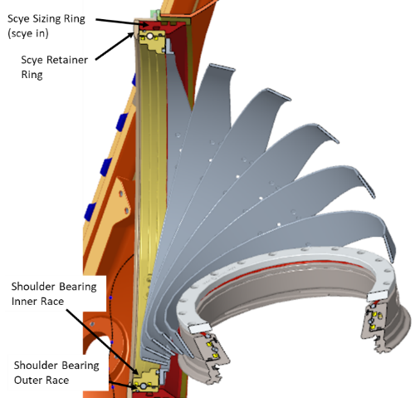
Integration into HUT
Integration into Hard Upper Torso (HUT)
  Sizing Rings at Scye joint gives 1” total adjustability to scye bearing placement to fit wider range of subjects
  Two sizes with one xEMU HUT
    Scye-In
    Scye-Out
  Tool-less installation
    Spring-loaded detent locks the retainer ring in shoulder joint

Slide 20
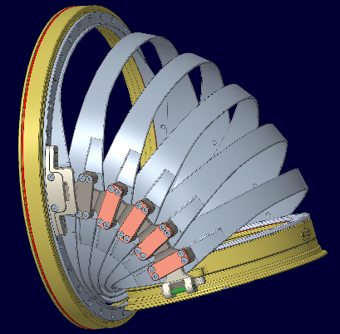
Large Shoulder Design
Two sizes of xPGS Shoulder
  Small (9.00” ID at Scye Bearing)
  Large (9.45” ID at Scye Bearing)
Both sizes use common bracketry to minimize part count
HUT | Inter Scye Distance | Scye Bearing Inner Diameter | Arm Bearing Inner Diameter | Scye Horizontal Angle | Scye Vertical Angle
xEMU, Small | 10.9 in or 11.7 in (27.7cm or 29.7cm) | 9.00 in (22.9 cm) | 5.25 in (13.3 cm) | 35° | 20°
xEMU, Large | 12.9 in or 13.7 in (32.8cm or 34.8cm) | 9.45 in (24.0 cm) | 5.70 in (14.5 cm) | 35° | 20°
EMU, Medium | 11.8 in (30.0 cm) | 8.50 in (21.6 cm) | 5.70 in (14.5 cm) | 30° | 23°

Slide 21
Tests and Analyses

Slide 22
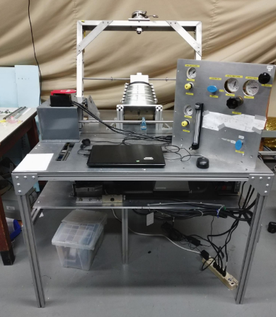
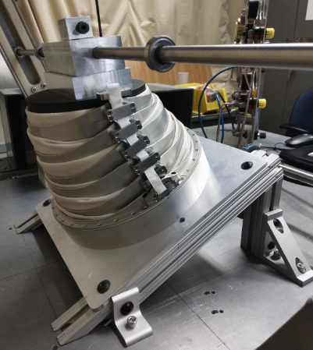
Test and Analyses
Component-Level Tests
  Acceptance Testing
  Pre-DVT Cycle Testing
Test Subject Evaluations
Analyses
  Stress & Kickloads
  Fracture Control
  Thermal (Preliminary)
  Reach Envelopes: Next Slide →

Slide 23
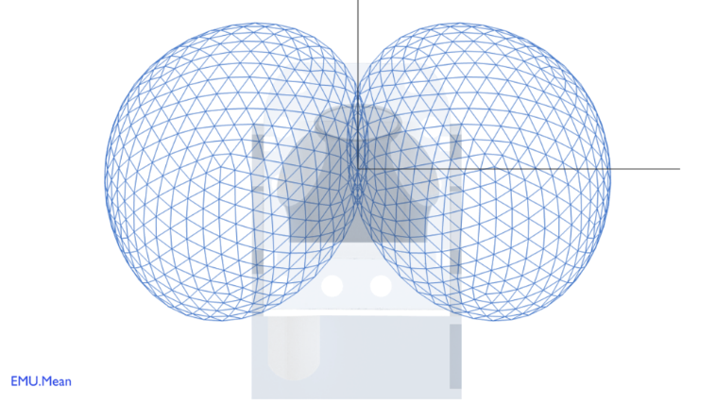
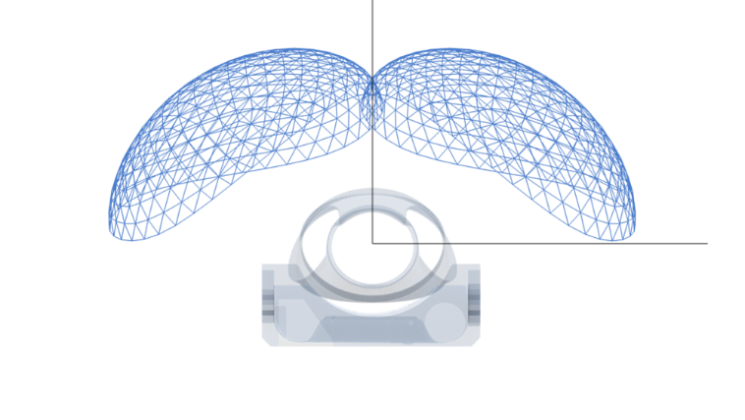
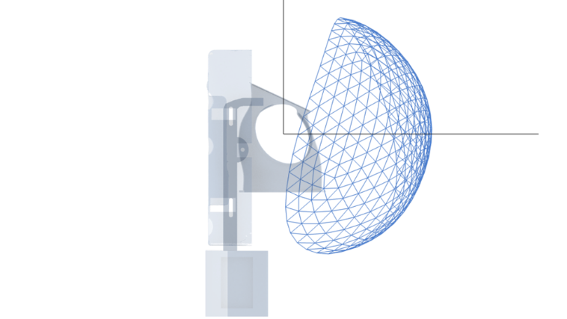
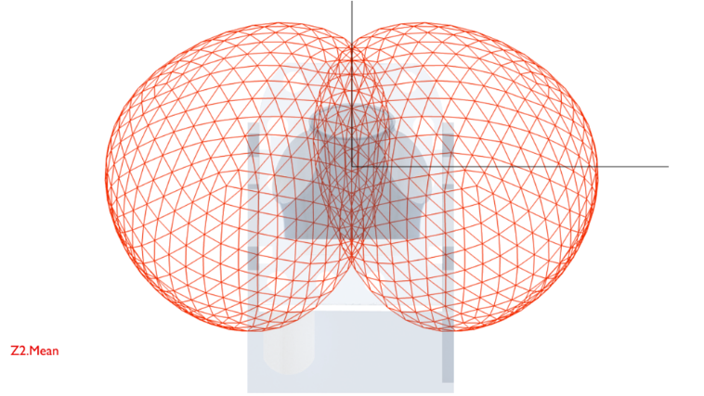
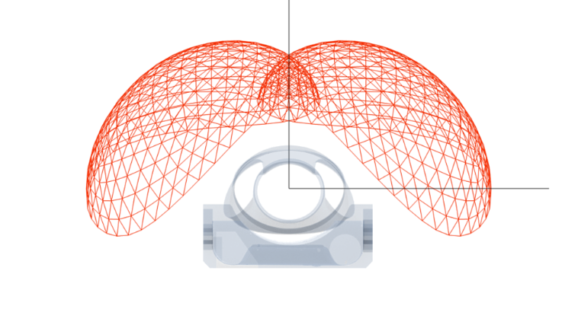
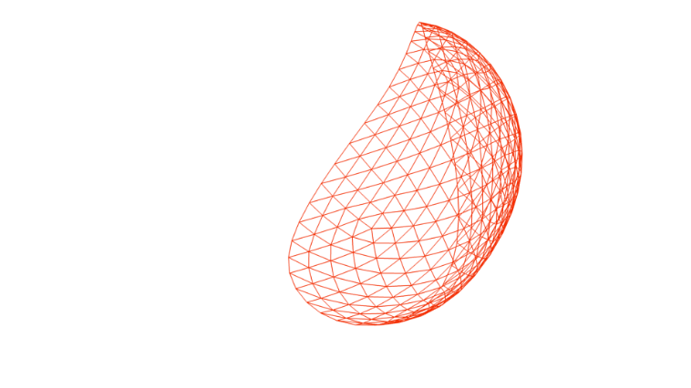


Isolated Reach Envelopes
*Average of 5 CMs
Front View
Top View
Side View
EMU
Gored Shoulder
Improved Overhead Reach
Improved Backwards Reach
Z-2
Rolling Convolute Shoulder
Improved Cross-Reach

Slide 24
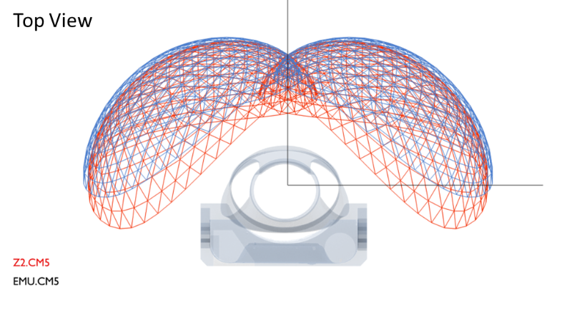
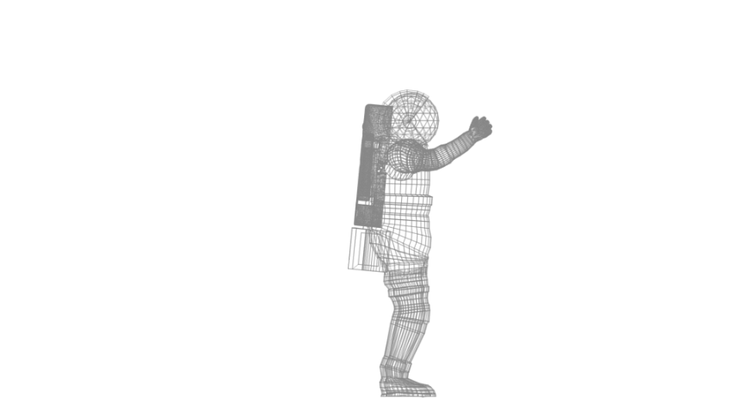
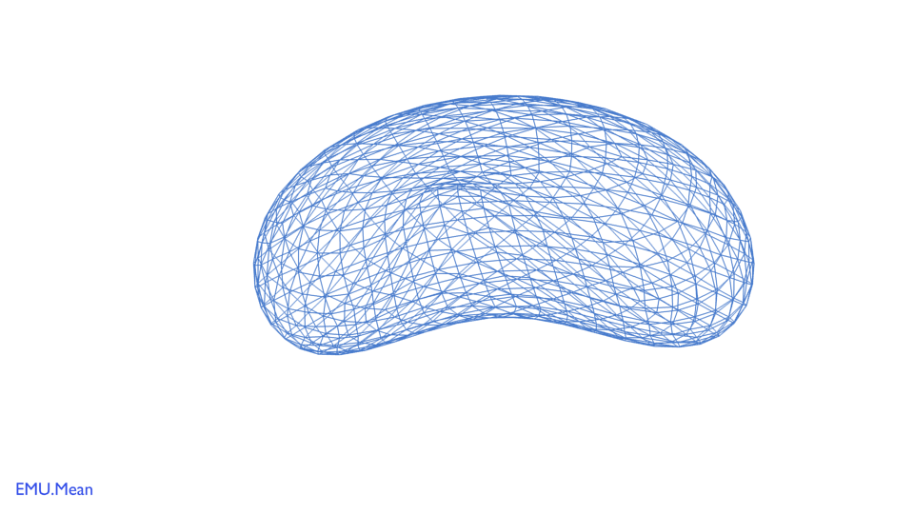
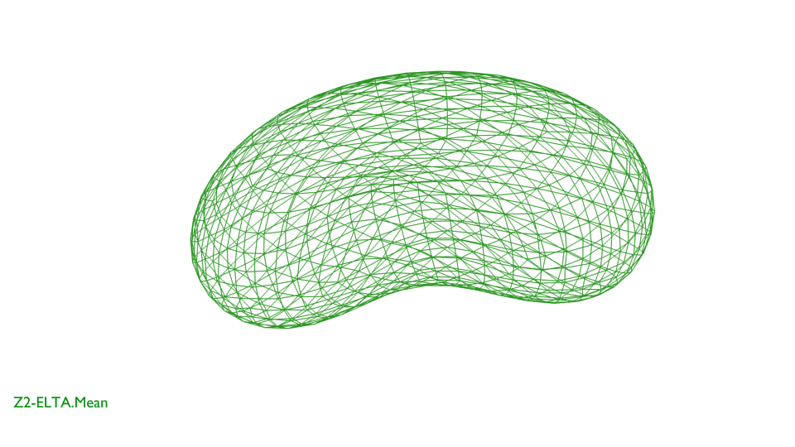
Reach Envelopes: EMU vs Z-2
Isolated Arm-Hand Reach Area*
 | EMU | Z-2 | Delta
Right | 1.00 m² | 1.27 m² | +27%
Right + Left | 1.96 m² | 2.31 m² | +18%
Intersection | 0.04 m² | 0.23 m² | +475%
Whole-Body Reach Volume*
 | EMU | Z-2 + EMU LTA | Delta
Right | 1.78 m³ | 2.45 m³ | +38%
Right + Left | 3.06 m³ | 3.81 m³ | +25%
Intersection | 0.51 m³ | 1.10 m³ | +116%
Side View
*Preliminary statistics from average of 5 crewmembers

