Slide 1

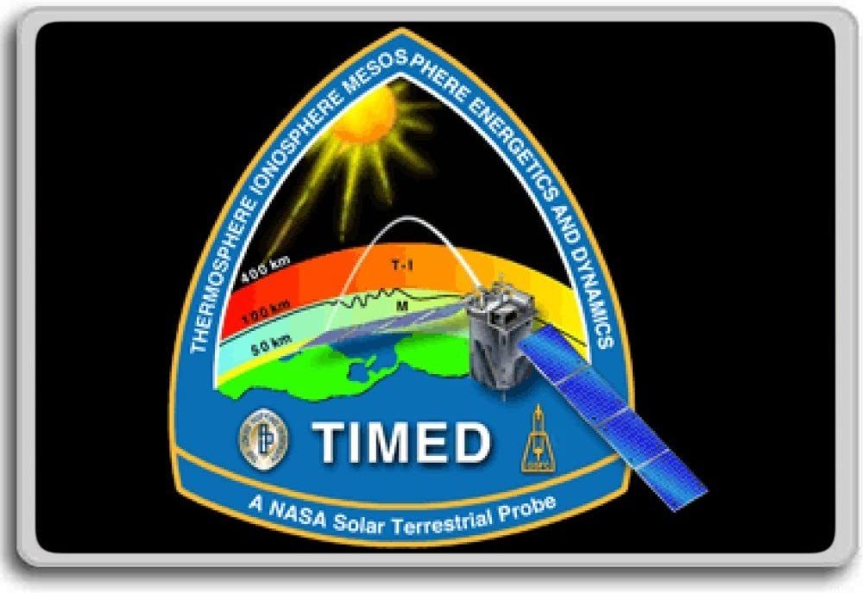

Nitric Oxide Concentration: A New Dataset Derived from SABER
Ningchao Wang¹, Manuel López-Puertas², Bernd Funke², John Emmert³, and Martin Mlynczak¹
1. NASA Langley Research Center, Hampton, VA, USA
2. Instituto de Astrofisica de Andalucia, Granada, Spain
3. U.S. Naval Research Laboratory, Washington, DC, USA
2022 CEDAR Workshop

Slide 2
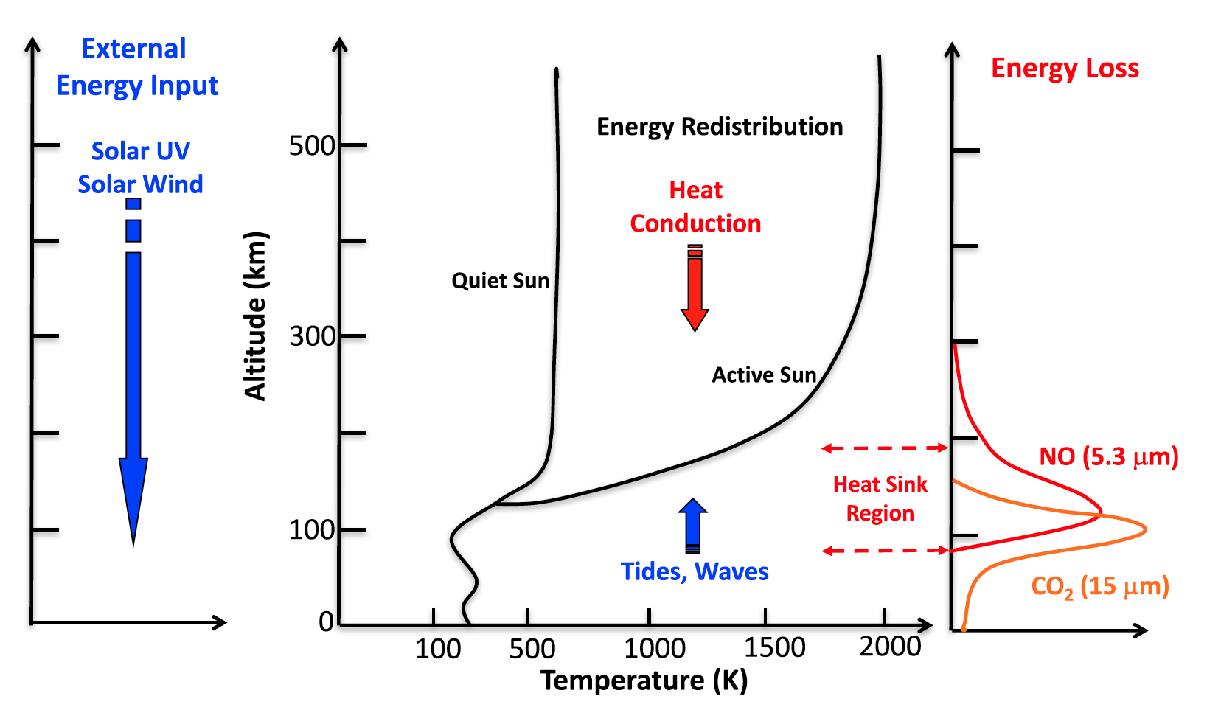
Radiative Cooling in the Thermosphere
(Mlynczak et. al., 2018)

Slide 3
Radiative Cooling in the Thermosphere
O, NO, CO2 are three major radiators in Earth’s atmosphere.
CO2 and NO radiative cooling are the major cooling mechanism that cool the thermosphere between 100 km and 200km.
(Mlynczak et. al., 2018)
Notes:
O, NO, CO2 are three major radiators in Earth’s atmosphere.
O cooling is at high altitude (200-250). CO2 and NO radiative cooling are the major cooling mechanism that cool the thermosphere between 100 km and 200km.
As a thermostat, NO plays important role in regulating the energy budget in the thermosphere, thus the long term precise datasets of NO cooling and NO concentration are of great important.
In this work, we will show a more precise NO cooling derived from SABER measurement and the first global, long-term dataset of thermospheric NO concentration.

Slide 4
Motivation and Objective
Nitric Oxide :
  Is a thermostat of the thermosphere.
  plays important role in regulating the energy budget in the thermosphere.
Motivation:
  To provide long term datasets of NO concentration.
Objective:
  Derive the NO concentration from SABER NO cooling and MSIS simulations.
(Mlynczak et. al., 2018)
Notes:
O, NO, CO2 are three major radiators in Earth’s atmosphere.
O cooling is at high altitude (200-250). CO2 and NO radiative cooling are the major cooling mechanism that cool the thermosphere between 100 km and 200km.
As a thermostat, NO plays important role in regulating the energy budget in the thermosphere, thus the long term precise datasets of NO cooling and NO concentration are of great important.
In this work, we will show a more precise NO cooling derived from SABER measurement and the first global, long-term dataset of thermospheric NO concentration.

Slide 5
NO Cooling Derived from SABER Measurements
SABER (Sounding of the Atmosphere using Broadband Emission Radiometry) instrument:
  Scans the Earth’s limb from 400 km to the hard surface.
  Measures profiles of infrared limb radiance in a spectral interval.
  Encompasses ~60% of the emission lines from NO bands of 1 to 0, 2 to 1, and 3 to 2.
The in-band NO cooling is converted into the full band NO cooling by a unfiltered factor:
  V(z) = I(z) x U(z)
  Where I(z) is the in-band measurements, U(z) is the ‘unfiltered factor’, and V(z) is the full band NO cooling, z is altitude.

Slide 6
SABER measurement and NO cooling
SABER (Sounding of the Atmosphere using Broadband Emission Radiometry) instrument:
  Scans the Earth’s limb from 400 km to the hard surface.
  Measures profiles of infrared limb radiance in a spectral interval.
  Encompasses ~60% of the emission lines from NO bands of 1 to 0, 2 to 1, and 3 to 2.
The in-band NO cooling is converted into the full band NO cooling by a unfiltered factor:
  V(z) = I(z) x U(z)
  Where I(z) is the in-band measurements, U(z) is the ‘unfiltered factor’, and V(z) is the full band NO cooling, z is altitude.

Slide 7
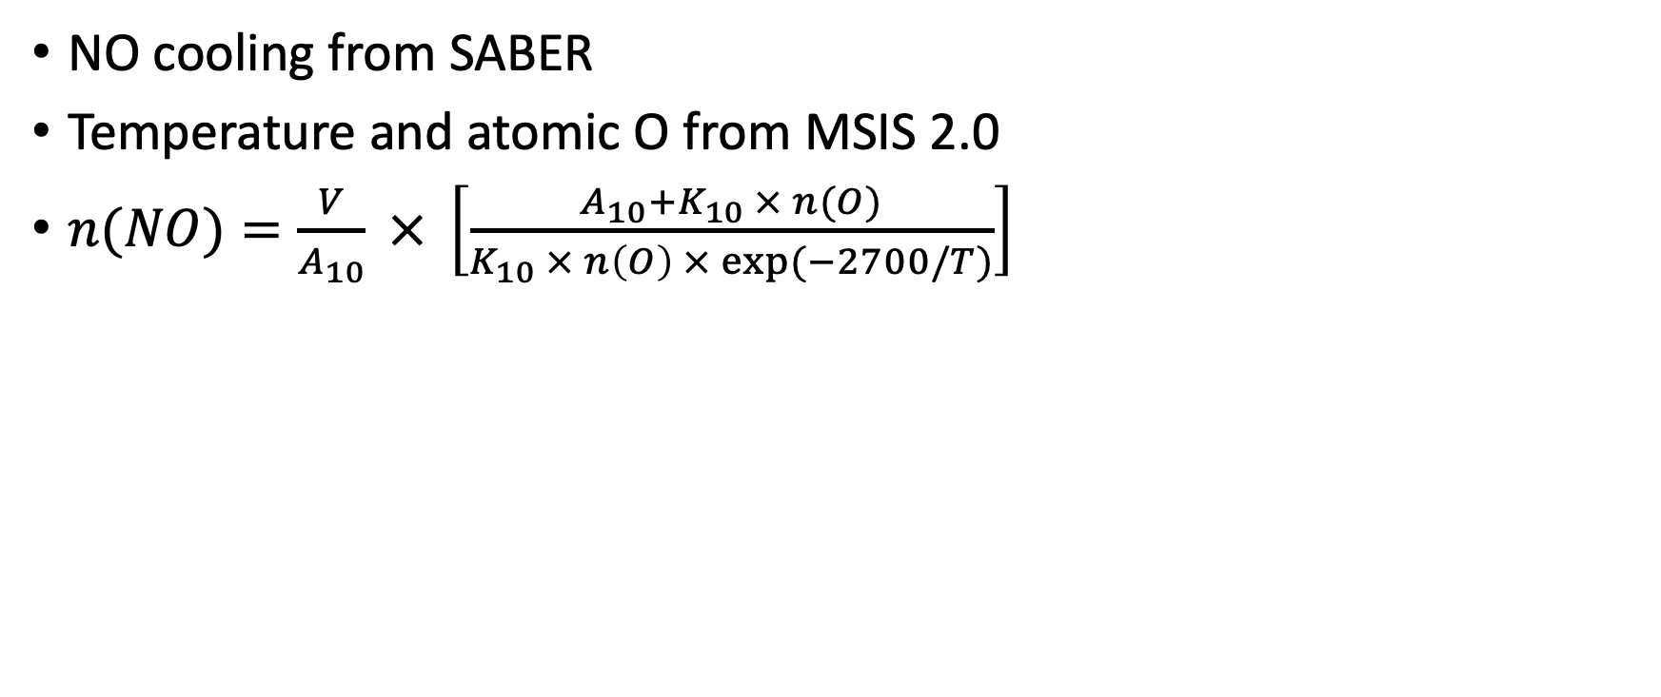
NO concentration
NO cooling from SABER
Temperature and atomic O from MSIS 2.0
$n(NO)=\frac{V}{A_{10}} × \left[\frac{A_{10}+K_{10} × n(O)}{K_{10} × n\left(O\right) × exp⁡(−2700/T)}\right]$

Slide 8
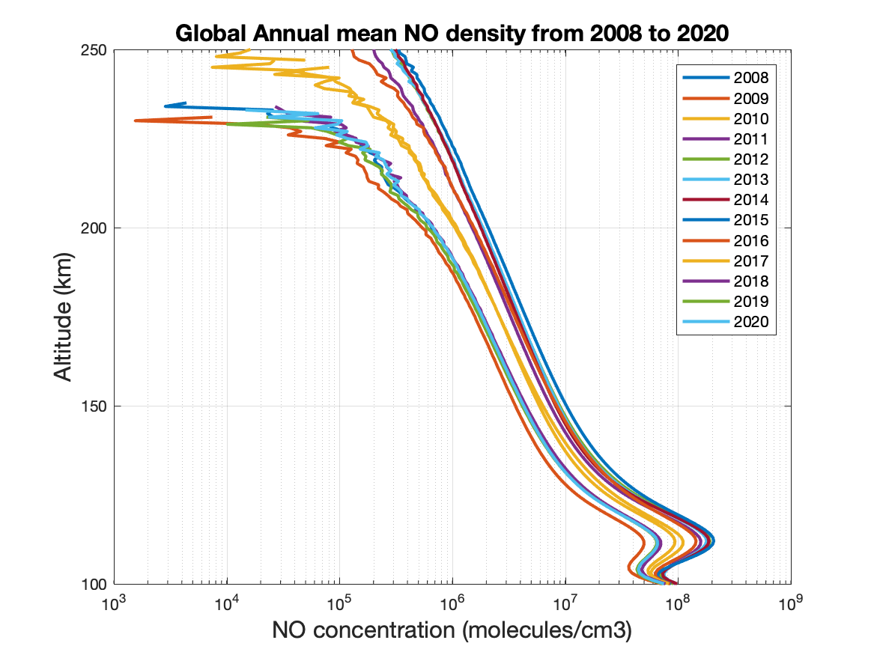
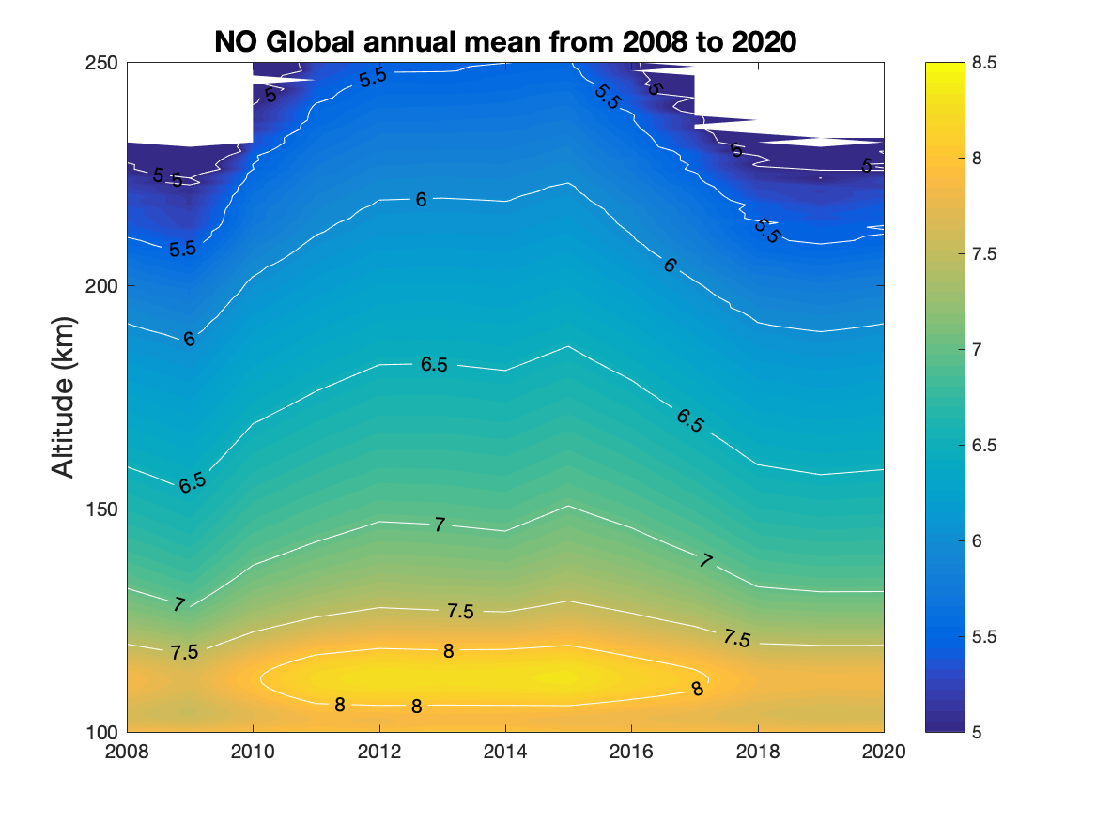
NO Density from 2008 to 2020

Slide 9
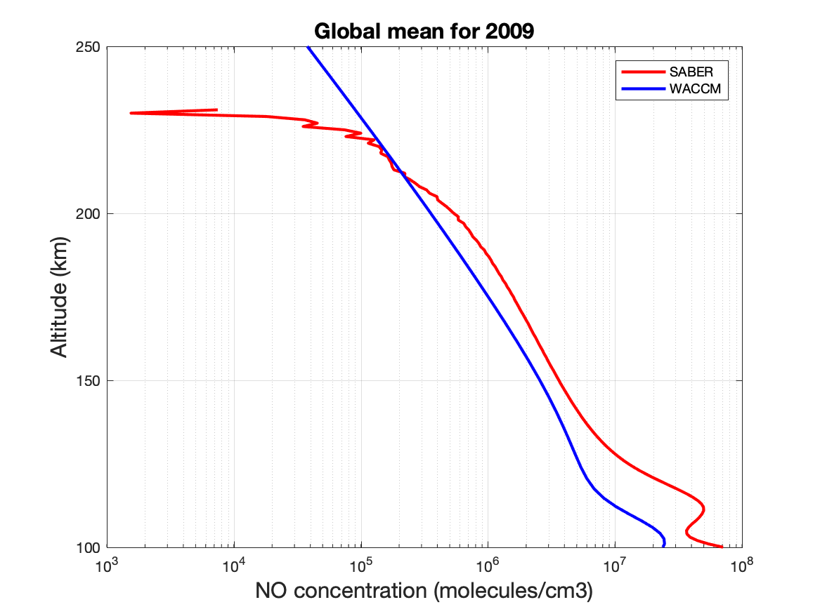
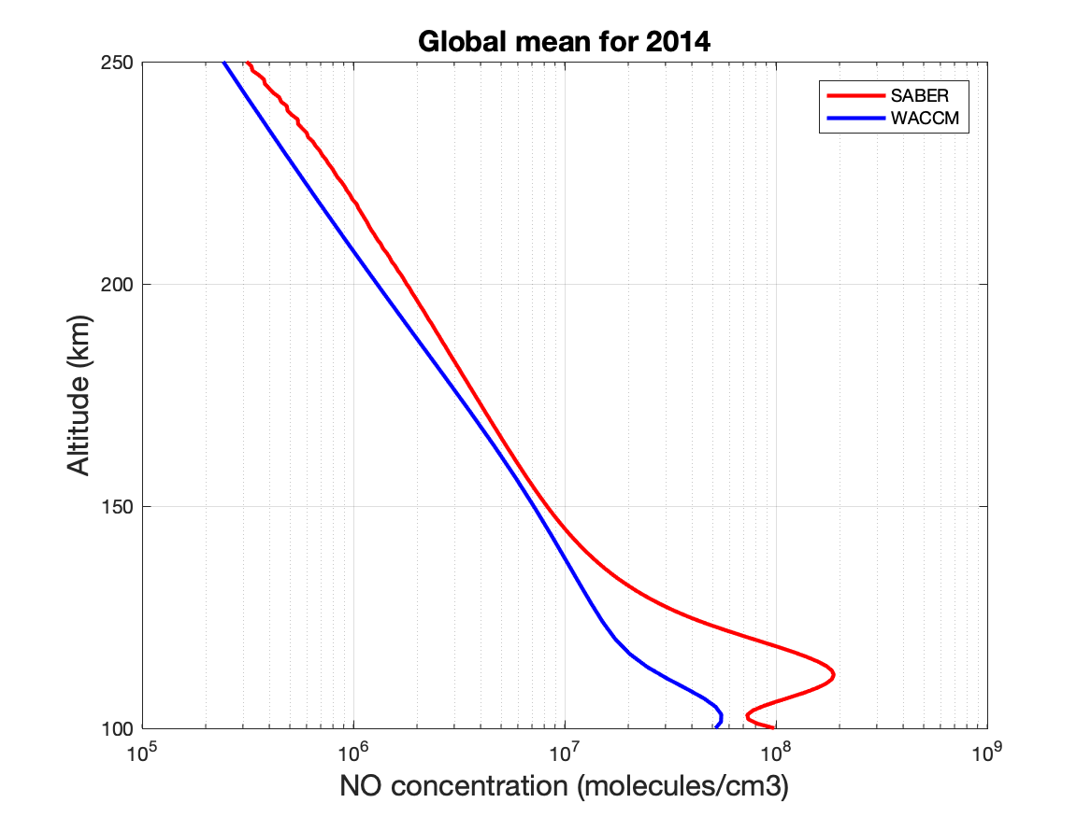
NO Concentration Results: SABER VS SD-WACCM

Slide 10
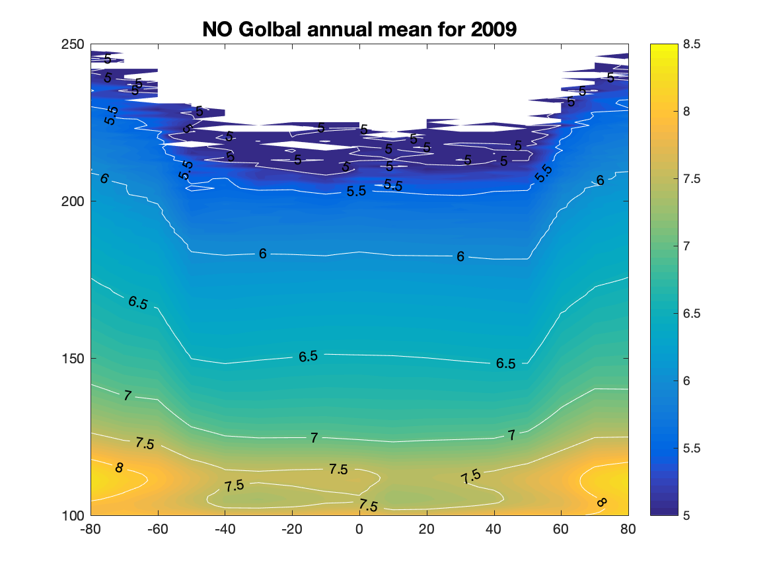
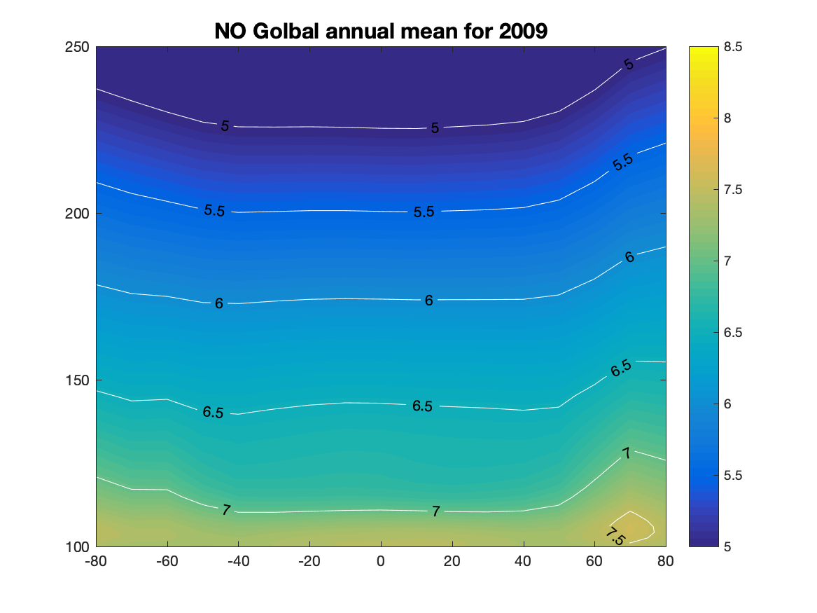
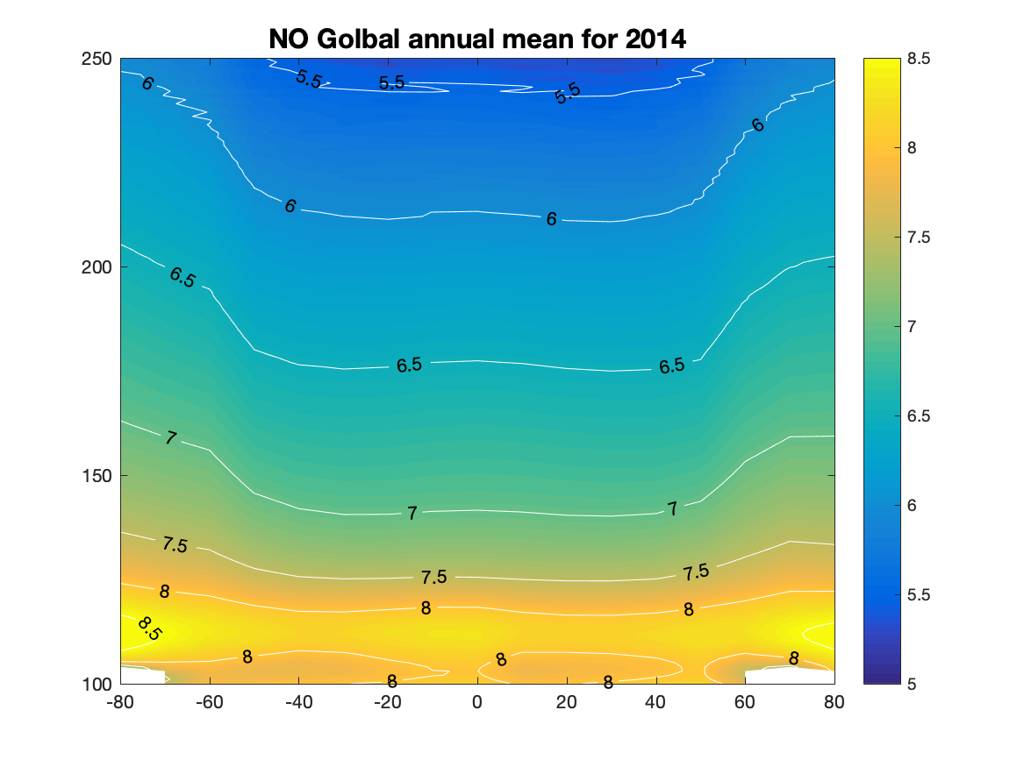
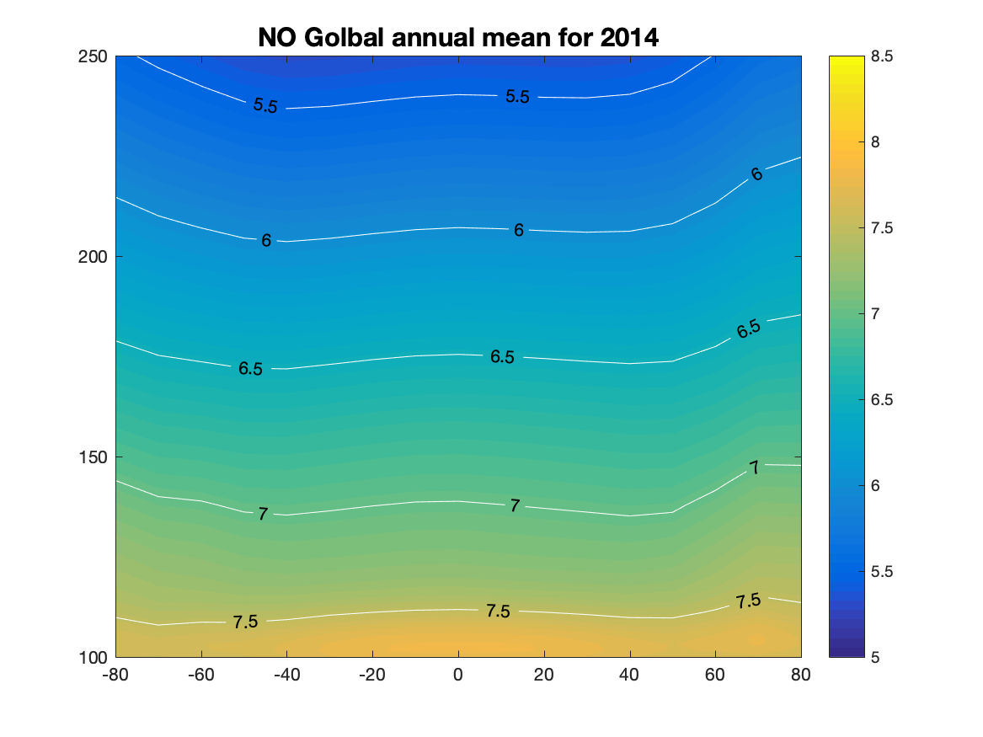
NO Concentration Results: SABER VS SD-WACCM

Slide 11
Summary
NO concentration from 2008 to 2020 are derived from SABER measurements with the NEW unfiltered factor and MSIS 2.0 simulations.
The NO concentration is peak at ~ 110 km and varying with the solar cycle as expected.
SABER NO concentration is larger than SD-WACCM simulation for both 2009 (solar minimum year) and 2014 (solar maximum year) below 200 km.

Slide 12
Extra slices

Slide 13
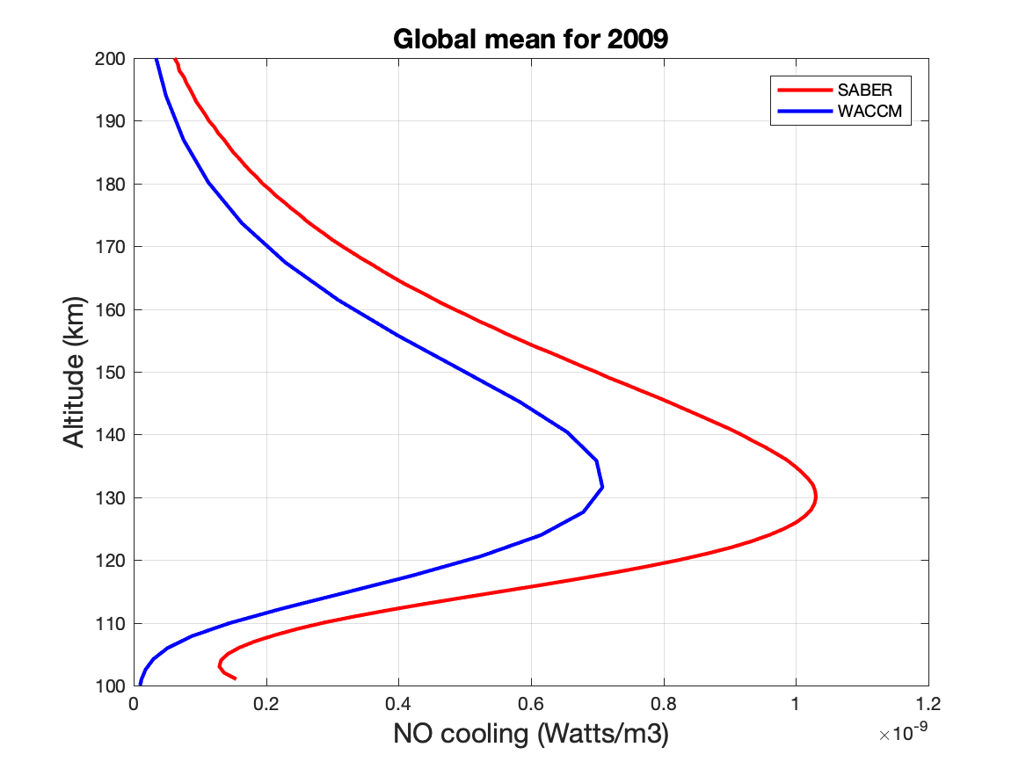
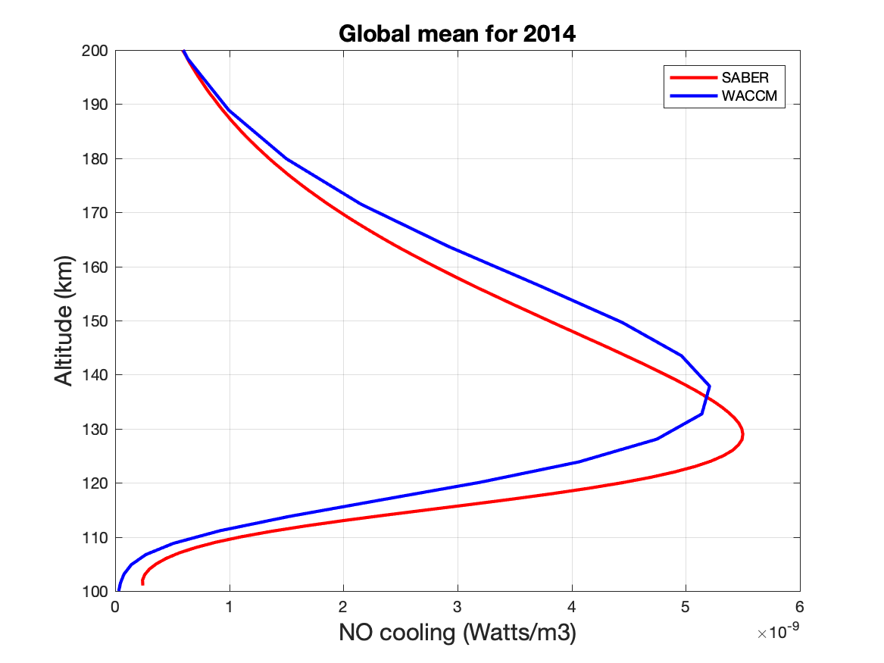
NO Cooling Results: New SABER VS SD-WACCM

Slide 14
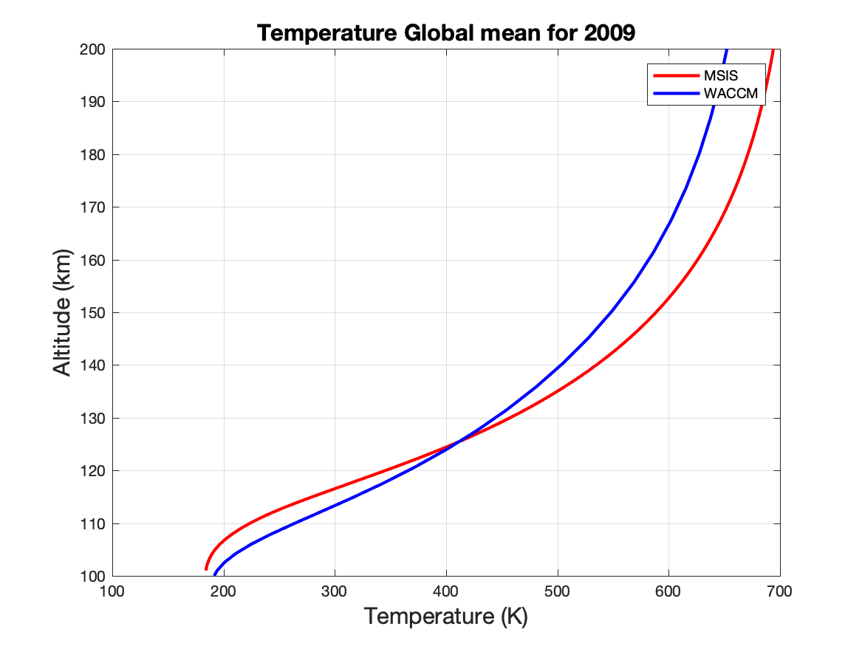
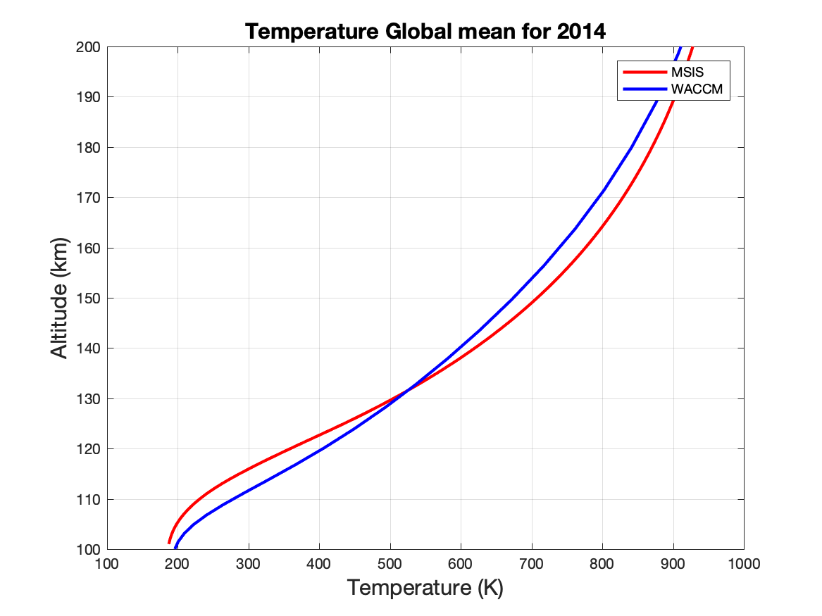
MSIS vs WACCM: Temperature

Slide 15
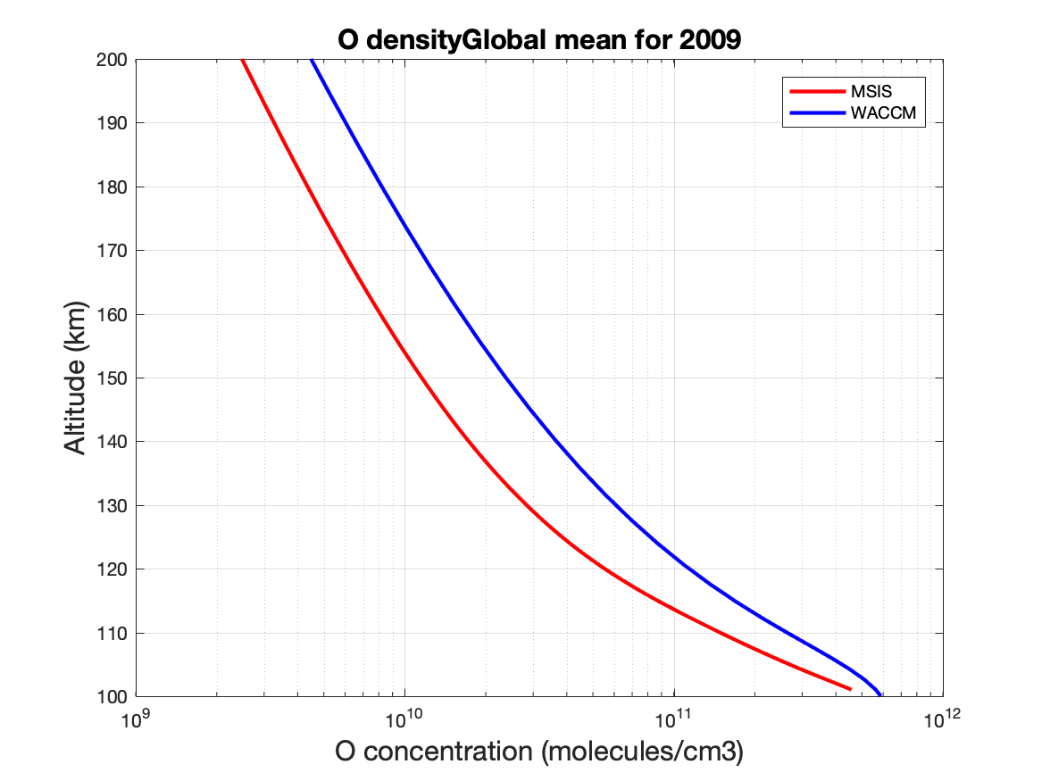
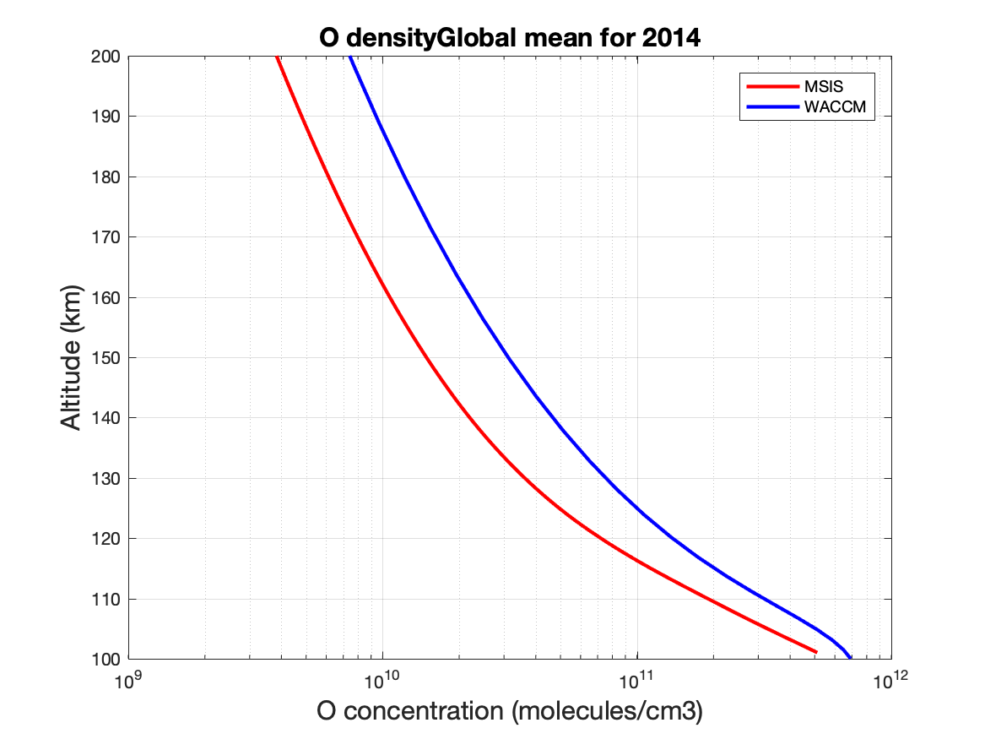
MSIS vs WACCM: O density

Slide 16
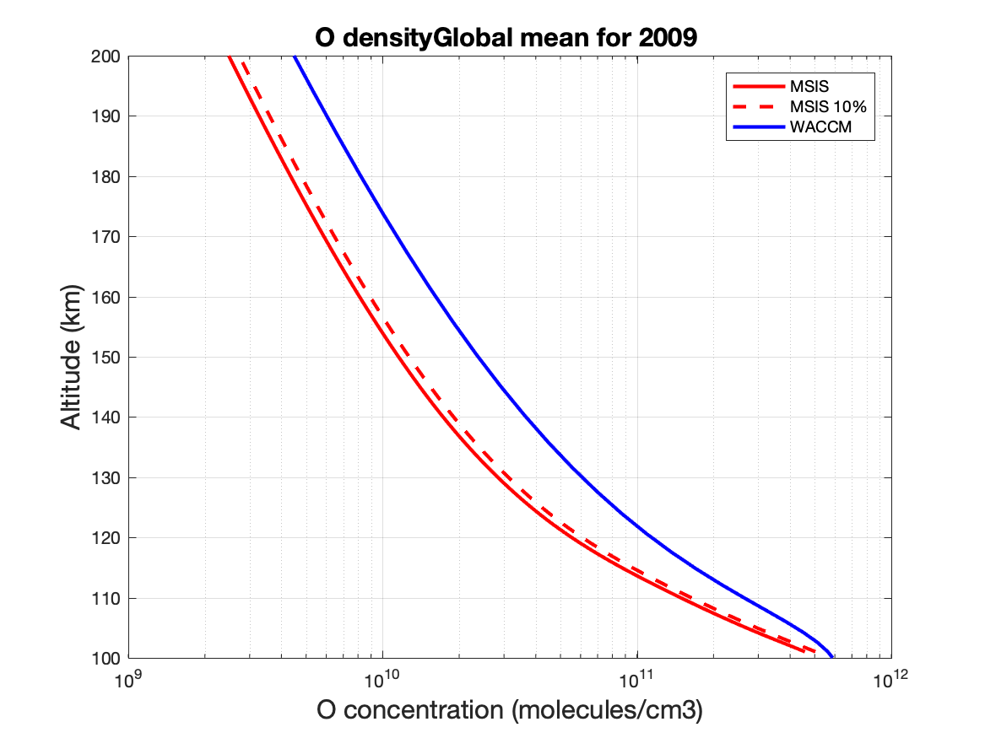
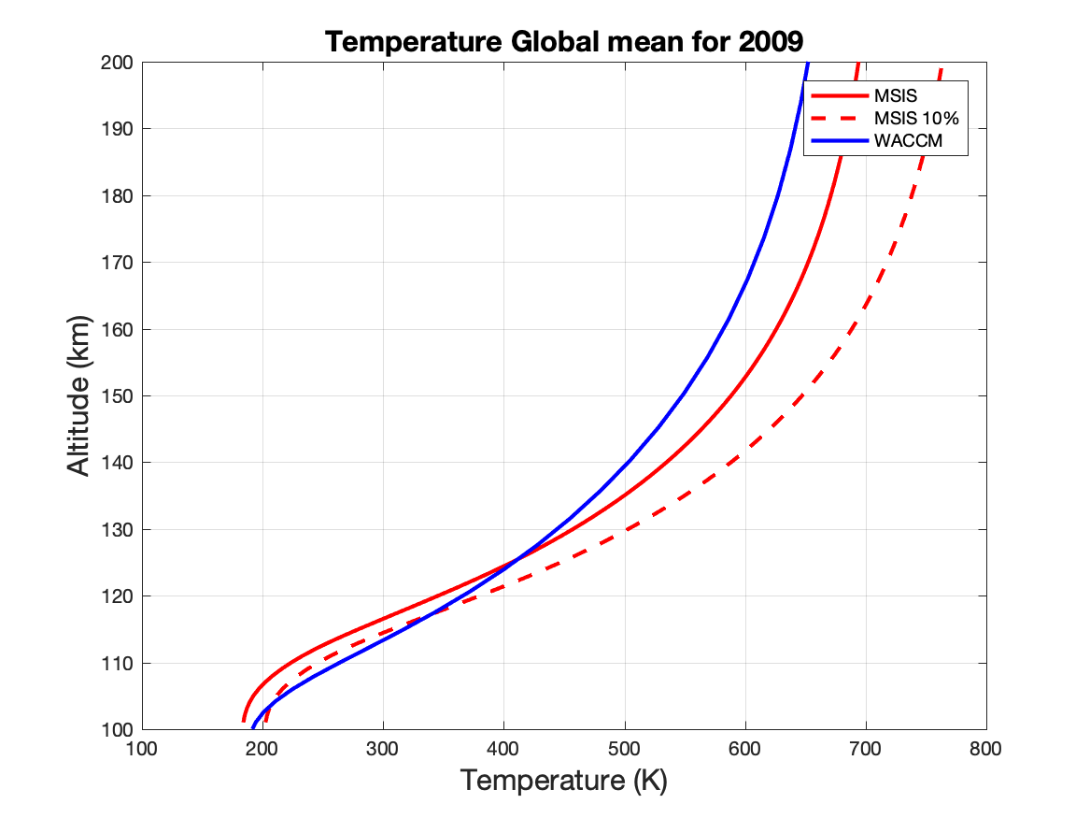
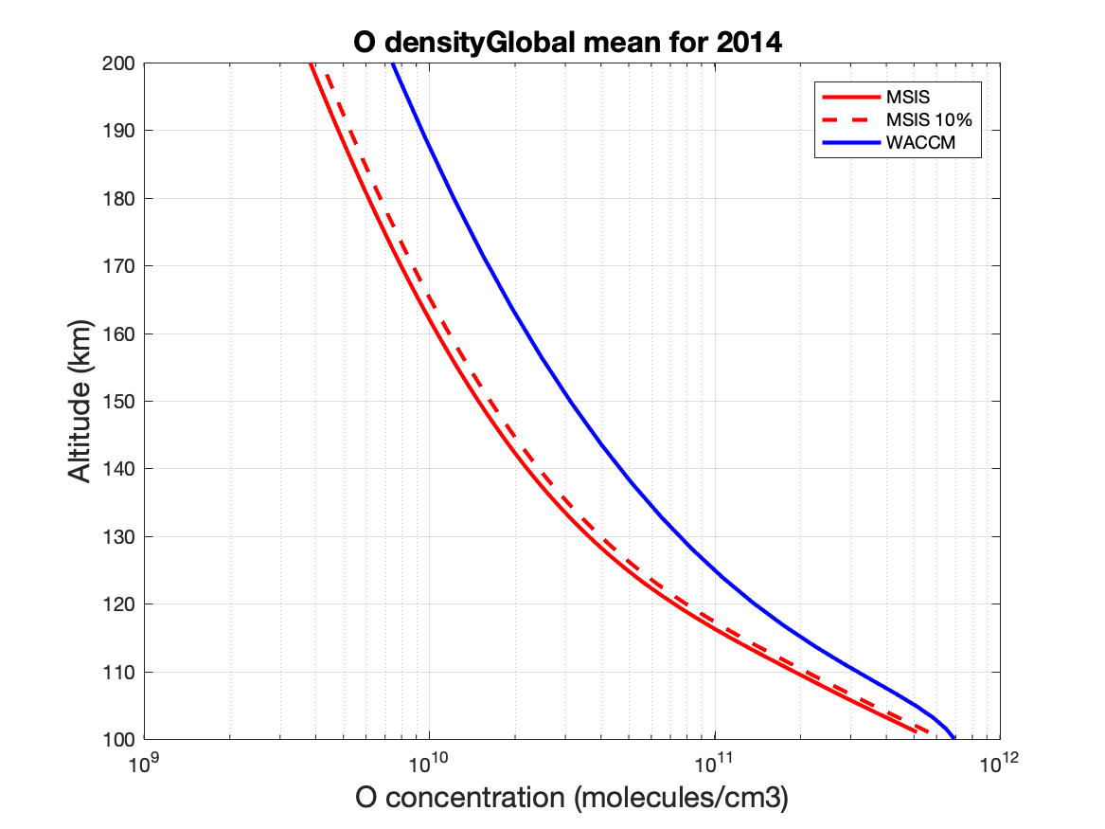
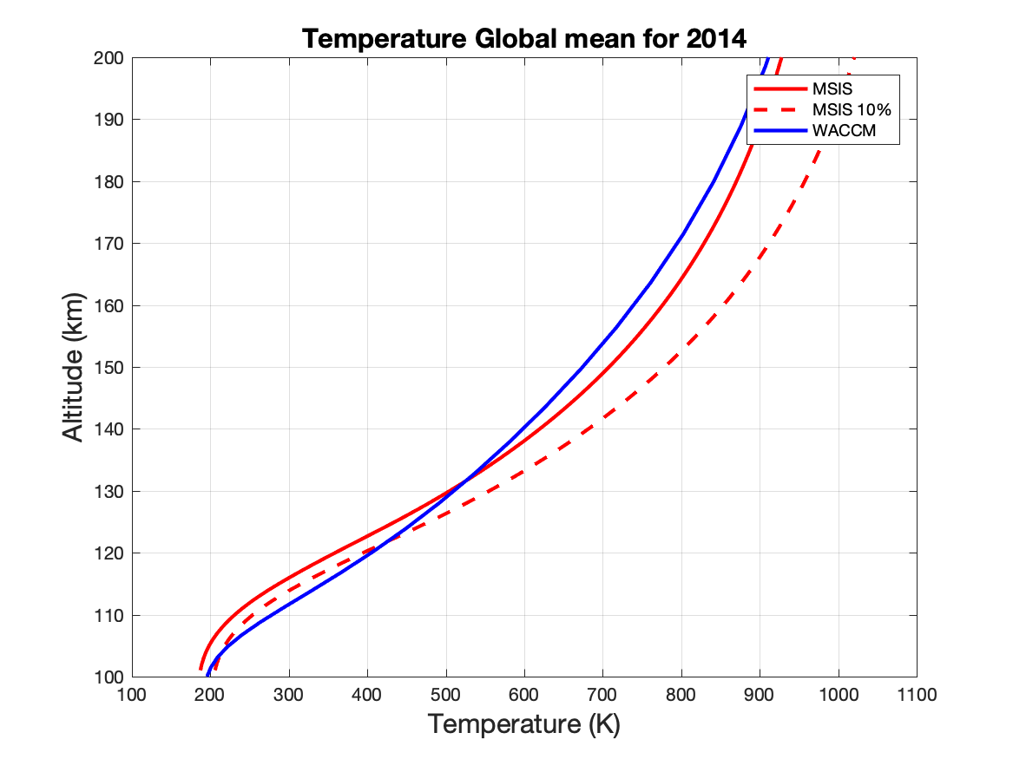

Slide 17
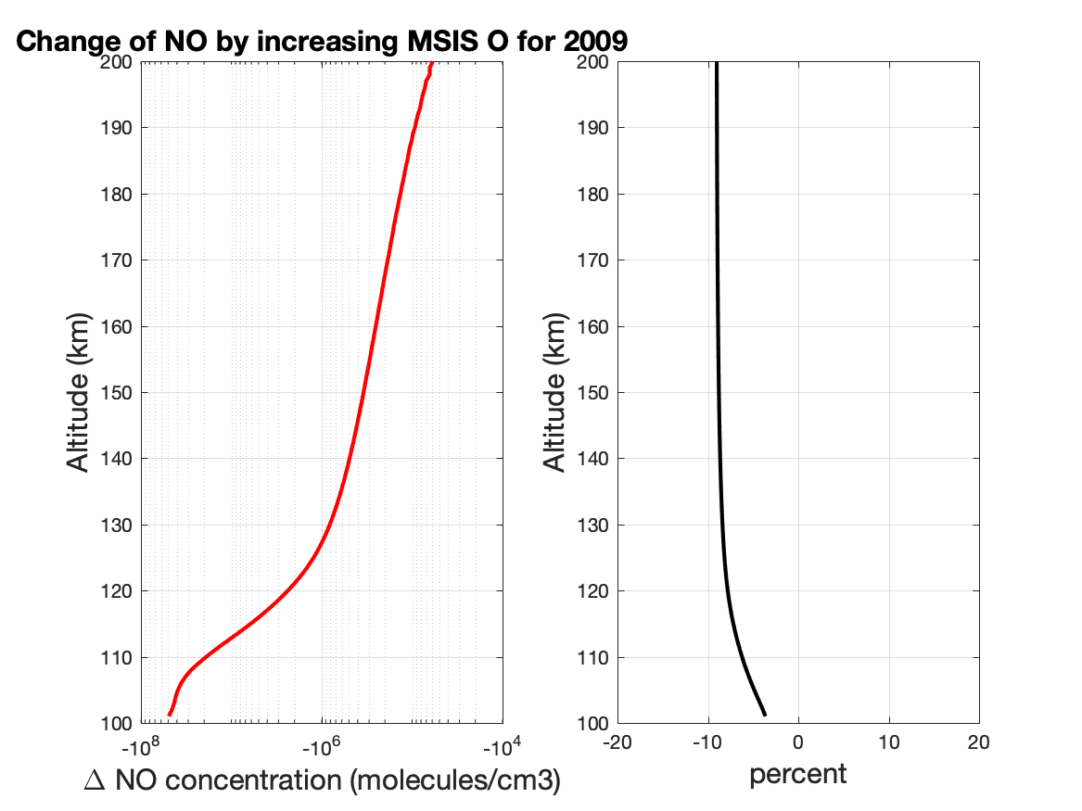
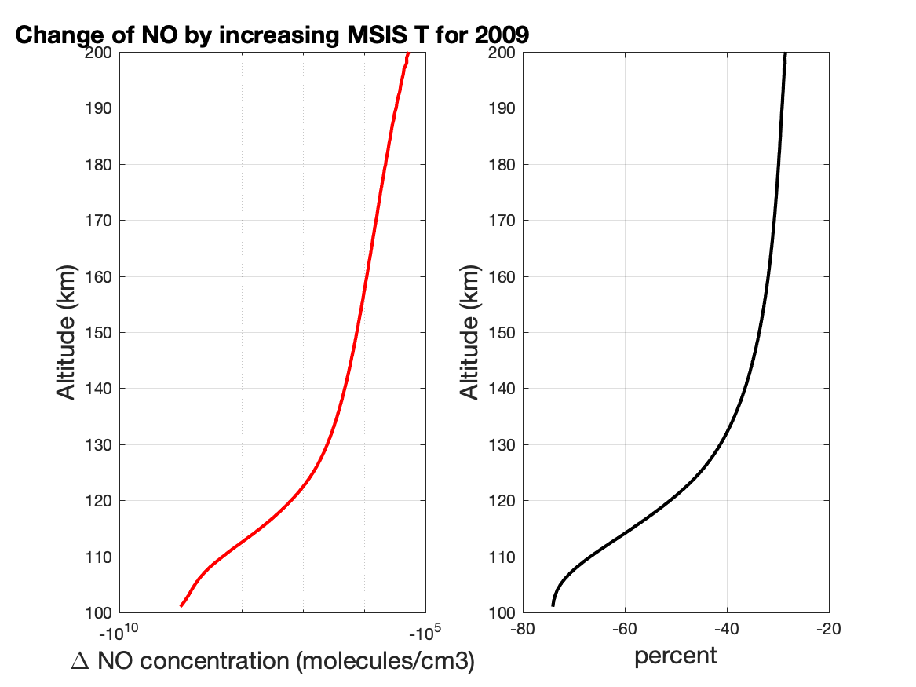
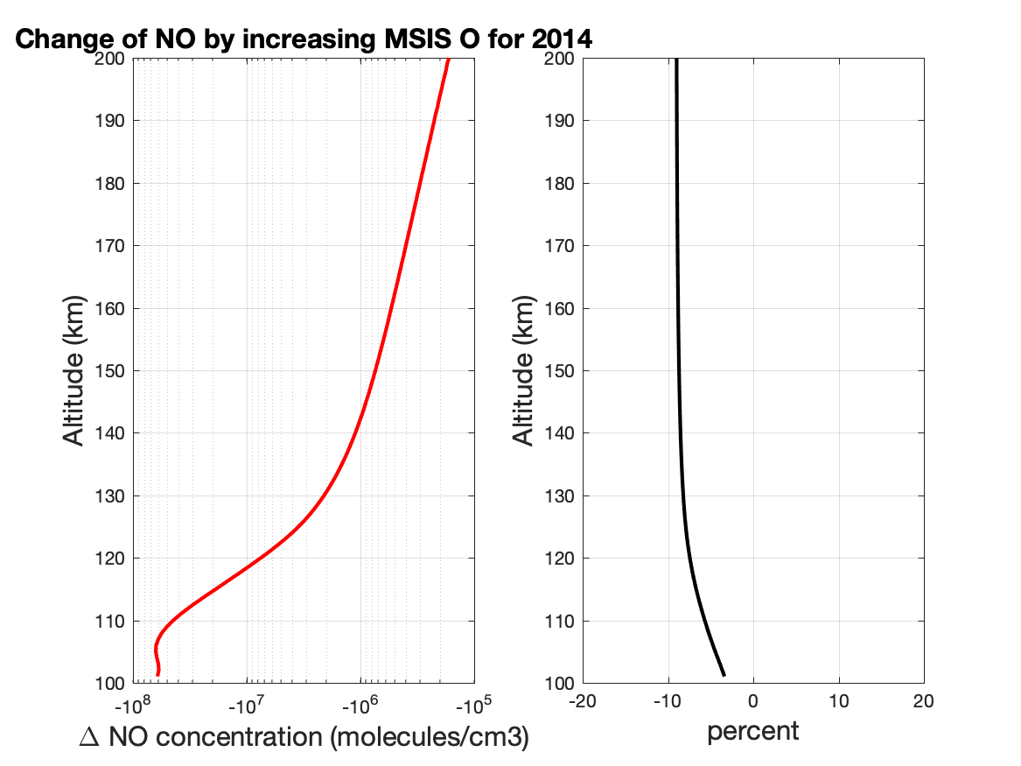
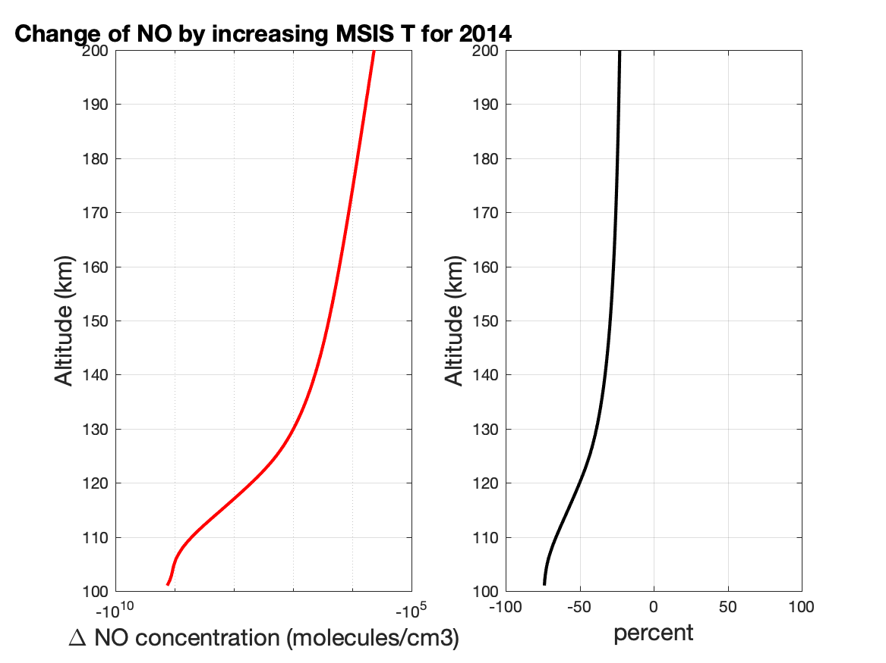
Adjust MSIS T and O by 10%

