Slide 1
UAM Airspace Research Roadmap Orientation
AAM Airspace Working Group
June 21, 2022

Slide 2
Purpose
Introduce the UAM Airspace Research Roadmap
What it is, how it is being used, and how you can help

Slide 3
UAM Airspace Research Roadmap
A living document that describes how research informs the progression of UAM airspace capabilities
High-level requirements
Assumptions
Constraints
Oct 2020 | Jan 2021 | Apr 2021 | June 2021 | Oct 2021 | Jan 2022 | Apr 2022 | June 2022 | Oct 2022 | Jan 2023+
Started
V1.0
NASA Technical Memo
V1.1
NASA-FAA review
V1.2
NASA Technical Memo
V2.0
Baseline
Community-Informed
NASA-Informed
FAA-Informed
Notes:
Would benefit from the COP rules/COP practices
A living document that describes what research tells us about the progression of UAM airspace capabilities”. May want to consider- “A living document that describes how research informs the progression of UAM airspace capability maturity”. The word ‘informs’ is already supported on this same slide. I presume the tense neutral word “tells us” or “informs”- is because it can describe both past and future progression. If that is the case, then I think it is the right tense

Slide 4
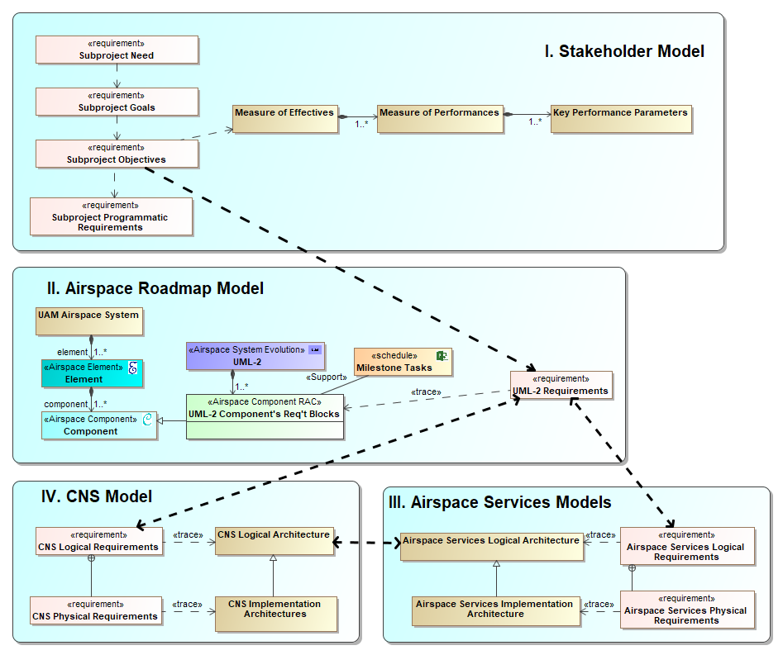
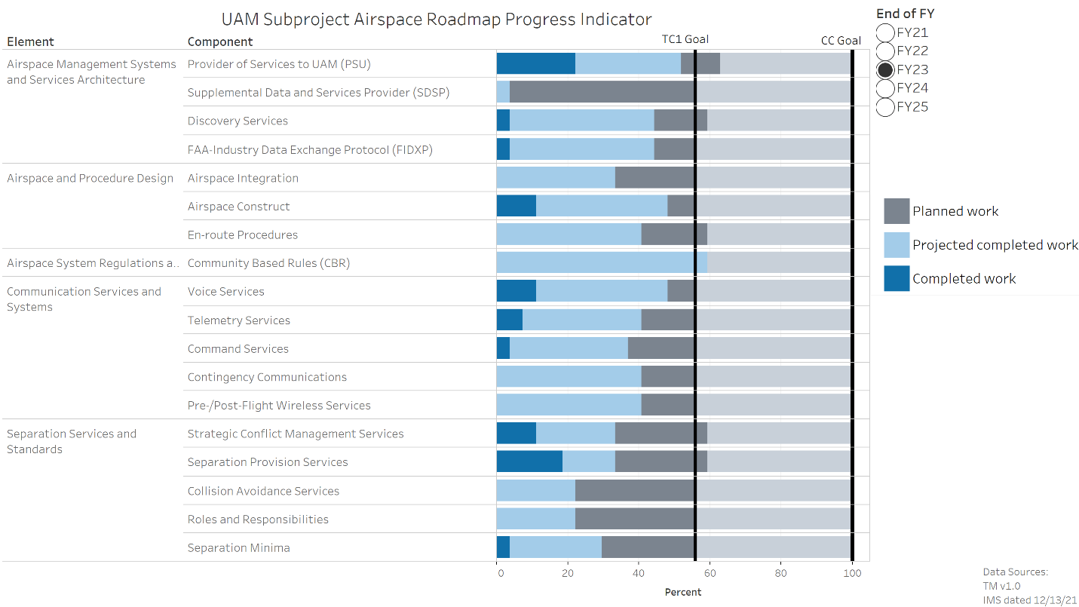
Under-the-hood System Engineering
Digital Engineering methodology
Lower-level requirements
Inter-dependency traces
System analysis
Dashboard reports
Phojanamongkolkij, N., Levitt, I., Barnes, P. “Overview of Model-Based Systems Engineering Efforts to Evolve the Airspace Research System Roadmap,” 2022 AIAA Aviation Forum, June 2022
Cheng, A., Witzberger, K., Phojanamongkolkij, N., and Levitt, I., " Urban Air Mobility (UAM) Airspace Research Roadmap Systems Engineering Approach to Managing Airspace Evolution Towards UML-4," 2022 AIAA Aviation Forum, June 2022

Slide 5
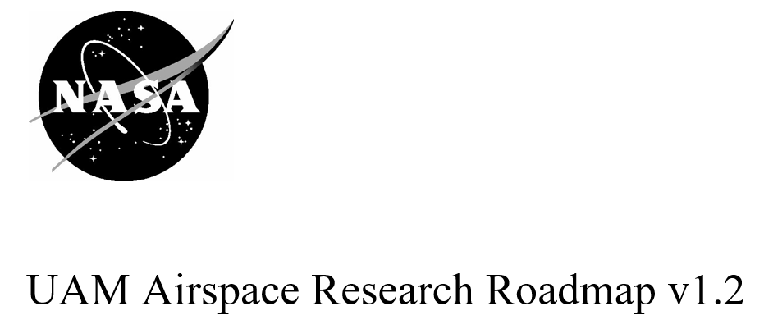
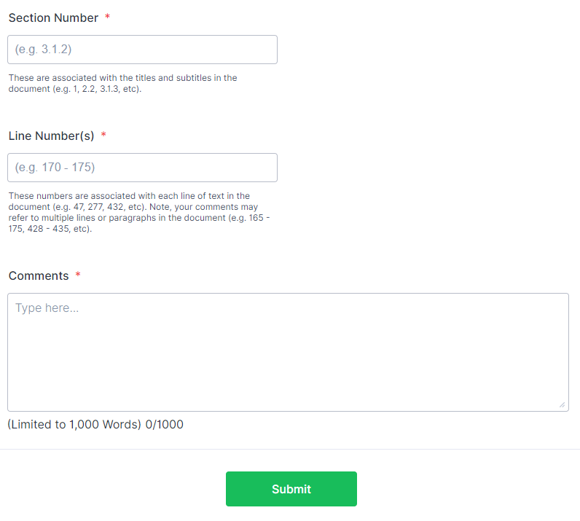
Informing the Roadmap by the Community
NASA is:
Publicly sharing stakeholder engagement document
Targeting the highest technical quality
Developing for public good
Not seeking consensus
Seeking diverse and expert insights and opinions
Requirement Number
(e.g. 34 UML-3.AM)
AAM Ecosystem Engagement Plans
V1.2 posted to NARI website
  Online submission form open through Sep 6th
  Comment dispositions will be provided wherever possible
July 19 Airspace WG agenda: Roadmap v1.2 Q&A session
September workshop
  Discuss comments and updates
V2.0 and subsequent versions will be posted by NARI
Notes:
Tie Cop in here

Slide 6
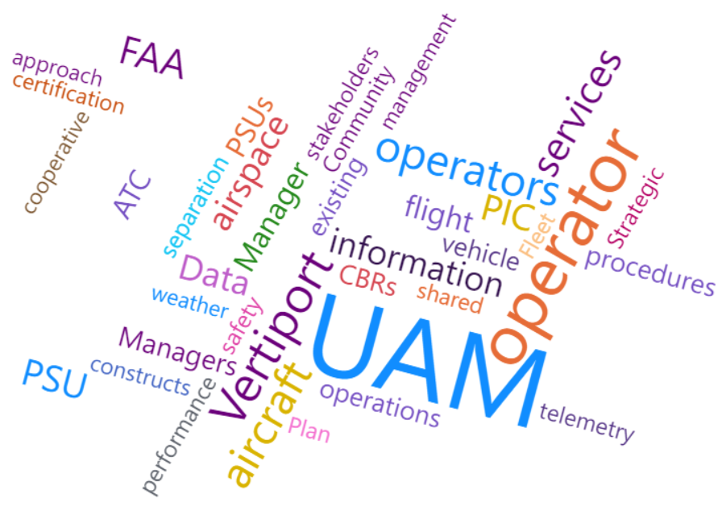
Outline and Orientation
§1 Introduction
§2 UAM Airspace System Definition
§3 UAM Airspace System Progression
§4 System Engineering Methodology
§5 Roadmap Requirements Tables
§6 Conclusions and Next Steps
References
Appendix A: Acronyms
Appendix B: Glossary
UAM Airspace Research Roadmap v1.2 Word Cloud
Developed by NASA/Nipa Phojanamongkolkij

Slide 7
Outline and Orientation
→ About 65 pages
§1 Introduction
§2 UAM Airspace System Definition
§3 UAM Airspace System Progression
§4 System Engineering Methodology
§5 Roadmap Requirements Tables
§6 Conclusions and Next Steps
References
Appendix A: Acronyms
Appendix B: Glossary
UAM Airspace Research Roadmap v1.2 Word Cloud
Developed by NASA/Nipa Phojanamongkolkij

Slide 8
Outline and Orientation
→ About 65 pages
→ 266 requirements, assumptions, and TBRs
  Expected to grow to 500-1000+
§1 Introduction
§2 UAM Airspace System Definition
§3 UAM Airspace System Progression
§4 System Engineering Methodology
§5 Roadmap Requirements Tables
§6 Conclusions and Next Steps
References
Appendix A: Acronyms
Appendix B: Glossary
UAM Airspace Research Roadmap v1.2 Word Cloud
Developed by NASA/Nipa Phojanamongkolkij

Slide 9
Outline and Orientation
→ About 65 pages
→ 266 requirements, assumptions, and TBRs
  Expected to grow to 500-1000+
→ 27 References used
  Expected to grow
§1 Introduction
§2 UAM Airspace System Definition
§3 UAM Airspace System Progression
§4 System Engineering Methodology
§5 Roadmap Requirements Tables
§6 Conclusions and Next Steps
References
Appendix A: Acronyms
Appendix B: Glossary
UAM Airspace Research Roadmap v1.2 Word Cloud
Developed by NASA/Nipa Phojanamongkolkij

Slide 10
Outline and Orientation
→ About 65 pages
→ 266 requirements, assumptions, and TBRs
  Expected to grow to 500-1000+
→ 27 References used
  Expected to grow
§1 Introduction
§2 UAM Airspace System Definition
§3 UAM Airspace System Progression
§4 System Engineering Methodology
§5 Roadmap Requirements Tables
§6 Conclusions and Next Steps
References
Appendix A: Acronyms
Appendix B: Glossary
UAM Airspace Research Roadmap v1.2 Word Cloud
Developed by NASA/Nipa Phojanamongkolkij

Slide 11
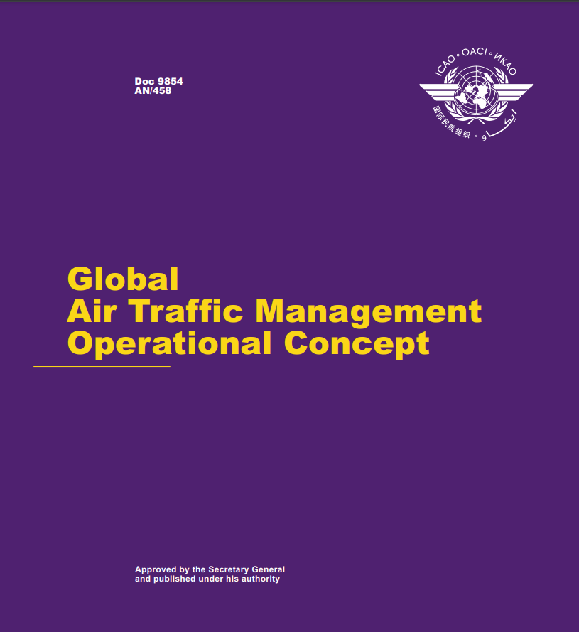






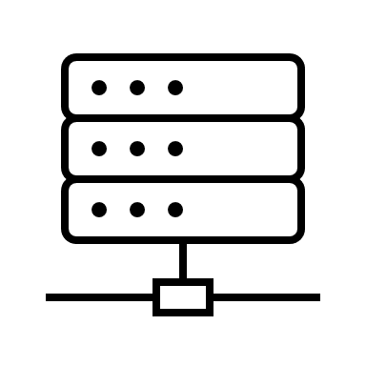
§2 UAM Airspace System Definition
§2.1 Operational Assumptions
  Constrain the design space
§2.2 System Actors
  Derived from International Civil Aviation Organization (ICAO), “Global Air Traffic Management Operational Concept,” Doc 9854 AN/458, Montreal, Canada, 2005
§2.3 Level of Automation
  Taken from Goodrich, K., Theodore, C., "Description of the NASA Urban Air Mobility Maturity Level (UML) Scale," AIAA 2021-1627, AIAA SciTech 2021 Forum, January 2021

Slide 12







§2 UAM Airspace System Definition
§2.1 Operational Assumptions
  Constrain the design space
§2.2 System Actors
  Derived from International Civil Aviation Organization (ICAO), “Global Air Traffic Management Operational Concept,” Doc 9854 AN/458, Montreal, Canada, 2005
§2.3 Level of Automation
  Taken from Goodrich, K., Theodore, C., "Description of the NASA Urban Air Mobility Maturity Level (UML) Scale," AIAA 2021-1627, AIAA SciTech 2021 Forum, January 2021
Important

Slide 13
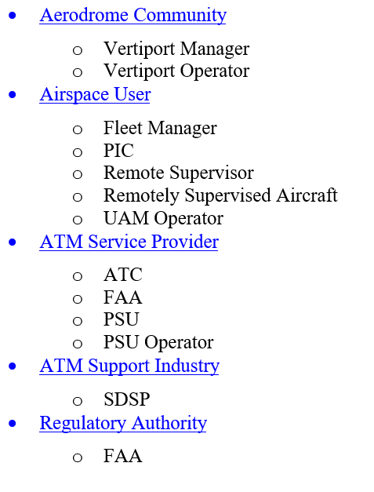
§2.2 System Actors
Operator refers to the organization
Manager refers to an agent of the organization
  Note: PSU = PSU Manager
PIC can either be remote and onboard, unless specified
Actors can consist of both humans and automation components
FAA serves multiple roles
  Key regulatory roles in the FAA Lines of Business (LOBs) are identified

Slide 14




§3 UAM Airspace System Progression
Urban Air Mobility Maturity Level (UML)
Naturally progressive in time
  E.g., UML-3 comes after UML-2
  No dates are specified
Each UML increases capability
  New requirements are added to the system of systems (SoS)
  All requirements from prior UMLs are still available for use
§3.1 UML-1: Pre-Operational
§3.2 UML-2: Initial
  eVTOL introduced
  Shadow mode and data collection
§3.3 UML-3: Transition and Growth
  Vertiports and other airspace constructs introduced
  PSU introduced
  Aircraft technology expands
  Early operations and data collection
§3.4 UML-4: New Predetermined Separator
  New mode of operation, different from VFR, where ATC is not the separator
  RPIC and SVO
Progress of Time

Slide 15
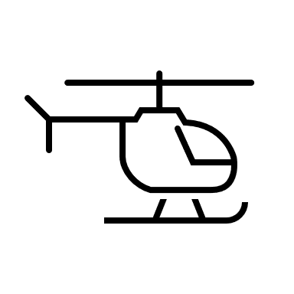




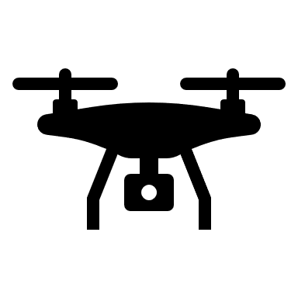


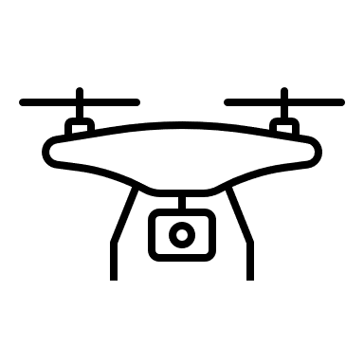


§4 System Engineering Methodology
UAM System of Systems
partially decomposed into
capabilities that cover
the airspace system
Notes:
Roadmap requirements
Roadmap assumptions
Should/Shall/Will
TBR

Slide 16
§4 System Engineering Methodology
Airspace Mgmt
Airspace Design
Regulations & Policies
Communications
Navigation
Secured Airspace
Separation Services
Surveillance
Vertiport Operations
Weather
UAM System of Systems
partially decomposed into
capabilities that cover
the airspace system
Notes:
Roadmap requirements
Roadmap assumptions
Should/Shall/Will
TBR

Slide 17
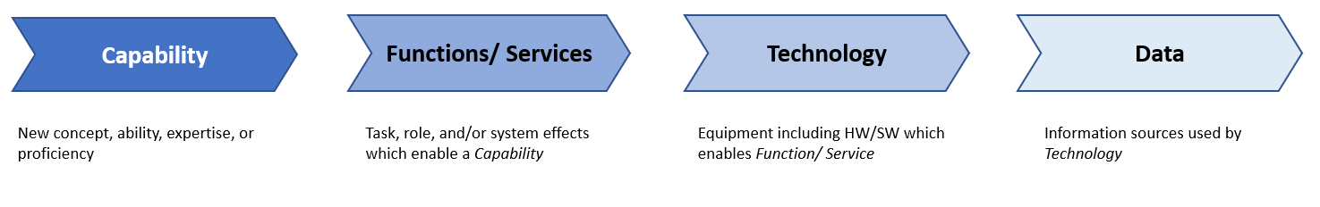
§4 System Engineering Methodology
Airspace Mgmt
Airspace Design
Regulations & Policies
Communications
Navigation
Secured Airspace
Separation Services
Surveillance
Vertiport Operations
Weather
UAM System of Systems
partially decomposed into
capabilities that cover
the airspace system
Capability Maturity Model
Notes:
Roadmap requirements
Roadmap assumptions
Should/Shall/Will
TBR

Slide 18
§4 System Engineering Methodology
Progress of Time
Airspace Mgmt
Airspace Design
Regulations & Policies
Communications
Navigation
Secured Airspace
Separation Services
Surveillance
Vertiport Operations
Weather
UAM System of Systems
partially decomposed into
capabilities that cover
the airspace system
Capability Maturity Model
Notes:
Roadmap requirements
Roadmap assumptions
Should/Shall/Will
TBR

Slide 19
§4 System Engineering Methodology
Progress of Time
Airspace Mgmt
Airspace Design
Regulations & Policies
Communications
Navigation
Secured Airspace
Separation Services
Surveillance
Vertiport Operations
Weather
Research Assumptions
  will
UAM System of Systems
partially decomposed into
capabilities that cover
the airspace system
Capability Maturity Model
Notes:
Roadmap requirements
Roadmap assumptions
Should/Shall/Will
TBR

Slide 20
§4 System Engineering Methodology
Progress of Time
Airspace Mgmt
Airspace Design
Regulations & Policies
Communications
Navigation
Secured Airspace
Separation Services
Surveillance
Vertiport Operations
Weather
Research Assumptions
  will
Research Requirements
shall/should
Operational and
Functional
UAM System of Systems
partially decomposed into
capabilities that cover
the airspace system
Capability Maturity Model
Notes:
Roadmap requirements
Roadmap assumptions
Should/Shall/Will
TBR

Slide 21
§4 System Engineering Methodology
Progress of Time
Airspace Mgmt
Airspace Design
Regulations & Policies
Communications
Navigation
Secured Airspace
Separation Services
Surveillance
Vertiport Operations
Weather
Research Assumptions
  will
Research Requirements
shall/should
Operational and
Functional
TBR
UAM System of Systems
partially decomposed into
capabilities that cover
the airspace system
Capability Maturity Model
Notes:
Roadmap requirements
Roadmap assumptions
Should/Shall/Will
TBR

Slide 22
§4 System Engineering Methodology
Progress of Time
Airspace Mgmt
Airspace Design
Regulations & Policies
Communications
Navigation
Secured Airspace
Separation Services
Surveillance
Vertiport Operations
Weather
Research Assumptions
  will
Research Requirements
shall/should
Operational and
Functional
TBR
UAM System of Systems
partially decomposed into
capabilities that cover
the airspace system
Capability Maturity Model
§5
Notes:
Roadmap requirements
Roadmap assumptions
Should/Shall/Will
TBR

Slide 23
§5 Roadmap Requirements Tables
§5.1 Airspace Management Systems and Services
§5.2 Airspace and Procedure Design
§5.3 Airspace System Regulations and Policies
§5.4 Communication Services and Systems
§5.5 Navigation Services and Systems
§5.6 Secured Airspace
§5.7 Separation Services and Standards
§5.8 Surveillance Services and Systems
§5.9 Vertiport Services and Systems
§5.10 Weather

Slide 24
§5 Roadmap Requirements Tables
5.X Capability
[Capability Definition]
Component A: [Description]
Component B: [Description]
Component C: [Description]
Component D: [Description]
§5.1 Airspace Management Systems and Services
§5.2 Airspace and Procedure Design
§5.3 Airspace System Regulations and Policies
§5.4 Communication Services and Systems
§5.5 Navigation Services and Systems
§5.6 Secured Airspace
§5.7 Separation Services and Standards
§5.8 Surveillance Services and Systems
§5.9 Vertiport Services and Systems
§5.10 Weather
2-3 pages

Slide 25
§5 Roadmap Requirements Tables
5.X Capability
[Capability Definition]
Component A: [Description]
Component B: [Description]
Component C: [Description]
Component D: [Description]
§5.1 Airspace Management Systems and Services
§5.2 Airspace and Procedure Design
§5.3 Airspace System Regulations and Policies
§5.4 Communication Services and Systems
§5.5 Navigation Services and Systems
§5.6 Secured Airspace
§5.7 Separation Services and Standards
§5.8 Surveillance Services and Systems
§5.9 Vertiport Services and Systems
§5.10 Weather
2-3 pages
Table X:

Slide 26
§5 Roadmap Requirements Tables
5.X Capability
[Capability Definition]
Component A: [Description]
Component B: [Description]
Component C: [Description]
Component D: [Description]
§5.1 Airspace Management Systems and Services
§5.2 Airspace and Procedure Design
§5.3 Airspace System Regulations and Policies
§5.4 Communication Services and Systems
§5.5 Navigation Services and Systems
§5.6 Secured Airspace
§5.7 Separation Services and Standards
§5.8 Surveillance Services and Systems
§5.9 Vertiport Services and Systems
§5.10 Weather
2-3 pages
Table X:
Capability
 | UML-2 | UML-3 | UML-4
Component A
Component B
Component C
Component D

Slide 27
§5 Roadmap Requirements Tables
5.X Capability
[Capability Definition]
Component A: [Description]
Component B: [Description]
Component C: [Description]
Component D: [Description]
§5.1 Airspace Management Systems and Services
§5.2 Airspace and Procedure Design
§5.3 Airspace System Regulations and Policies
§5.4 Communication Services and Systems
§5.5 Navigation Services and Systems
§5.6 Secured Airspace
§5.7 Separation Services and Standards
§5.8 Surveillance Services and Systems
§5.9 Vertiport Services and Systems
§5.10 Weather
2-3 pages
Table X:
Capability
 | UML-2 | UML-3 | UML-4
Component A
Component B
Component C
Component D
Requirements, Assumptions, TBRs
Requirements, Assumptions, TBRs
Requirements, Assumptions, TBRs
Requirements, Assumptions, TBRs

Slide 28
§5 Roadmap Requirements Tables
5.X Capability
[Capability Definition]
Component A: [Description]
Component B: [Description]
Component C: [Description]
Component D: [Description]
§5.1 Airspace Management Systems and Services
§5.2 Airspace and Procedure Design
§5.3 Airspace System Regulations and Policies
§5.4 Communication Services and Systems
§5.5 Navigation Services and Systems
§5.6 Secured Airspace
§5.7 Separation Services and Standards
§5.8 Surveillance Services and Systems
§5.9 Vertiport Services and Systems
§5.10 Weather
2-3 pages
Table X:
Capability
 | UML-2 | UML-3 | UML-4
Component A
Component B
Component C
Component D
Requirements, Assumptions, TBRs
Requirements, Assumptions, TBRs
Requirements, Assumptions, TBRs
Requirements, Assumptions, TBRs

Slide 29
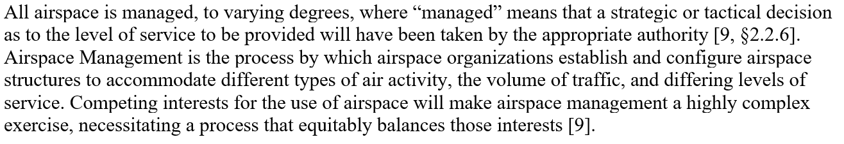
§5.1 Airspace Management Systems & Services

Slide 30
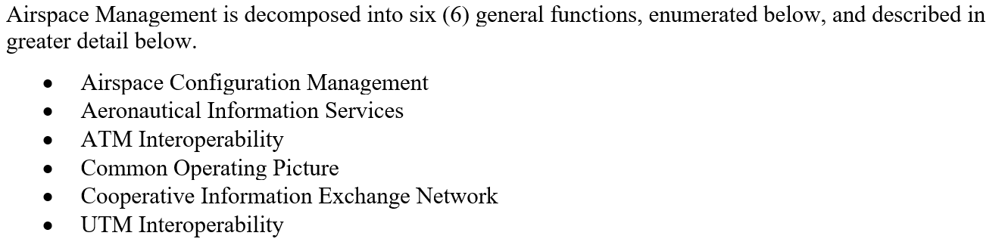
§5.1 Airspace Management Systems & Services
…

Slide 31
§5.1 Airspace Management Systems & Services
…

Slide 32
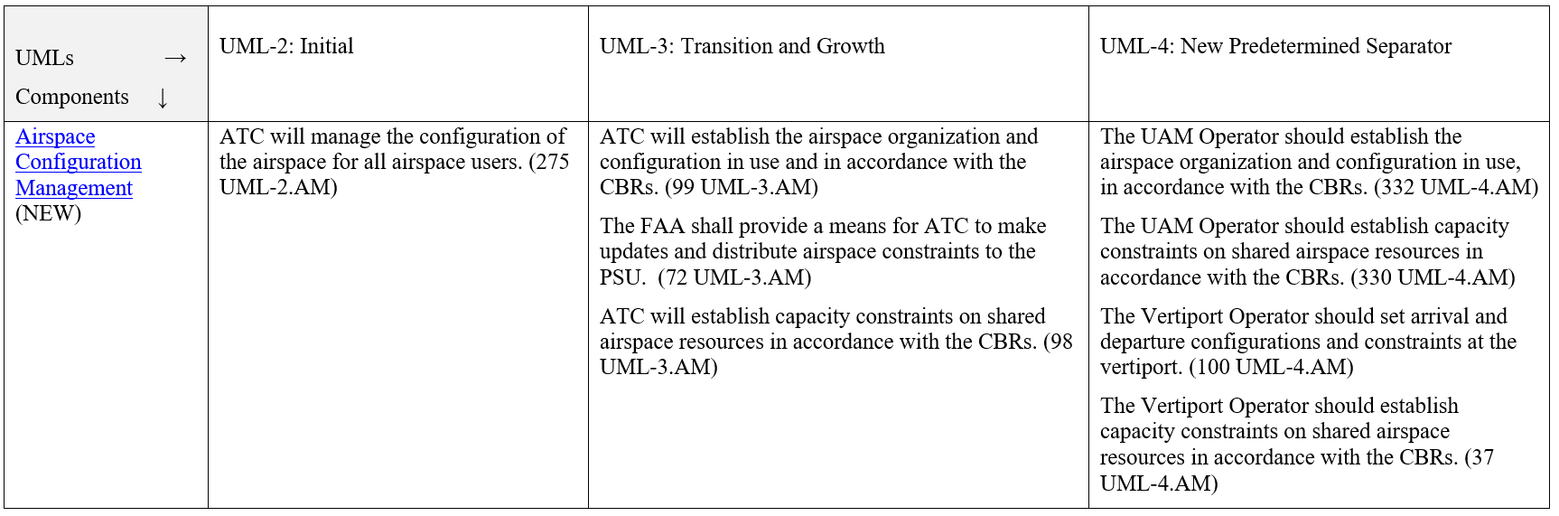
Table 1: Airspace Configuration Management

Slide 33
Table 1: Airspace Configuration Management
Progression of an assumption

Slide 34
Table 1: Airspace Configuration Management
Progression of an assumption

Slide 35
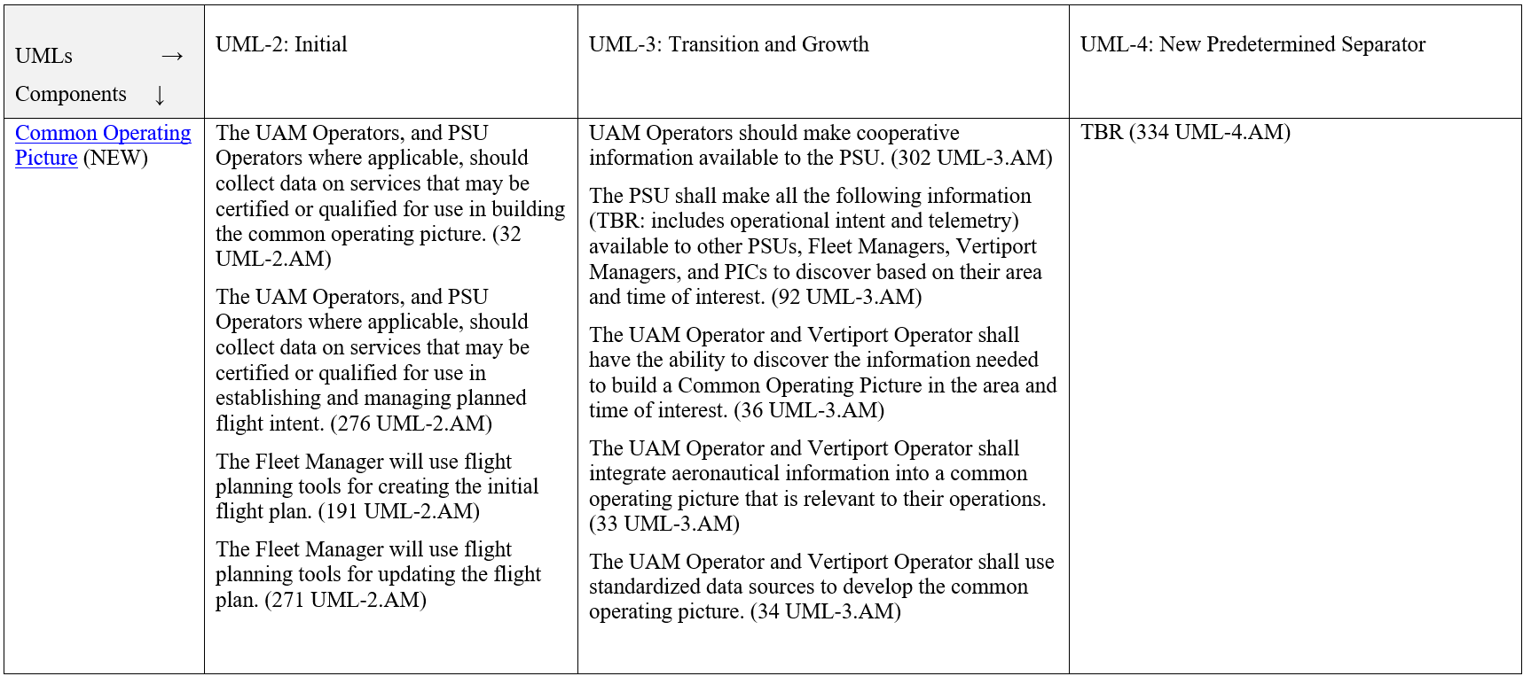
Table 1: Airspace Configuration & Management

Slide 36
Table 1: Airspace Configuration & Management
Progression of shadow mode and data collection to Operational Requirements

Slide 37
Table 1: Airspace Configuration & Management
New requirements cannot be identified from existing research
Progression of shadow mode and data collection to Operational Requirements

Slide 38
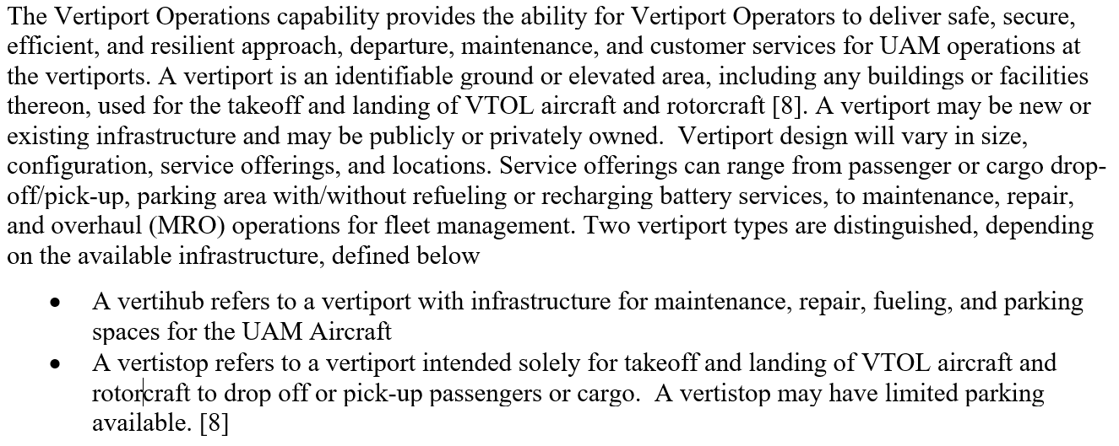
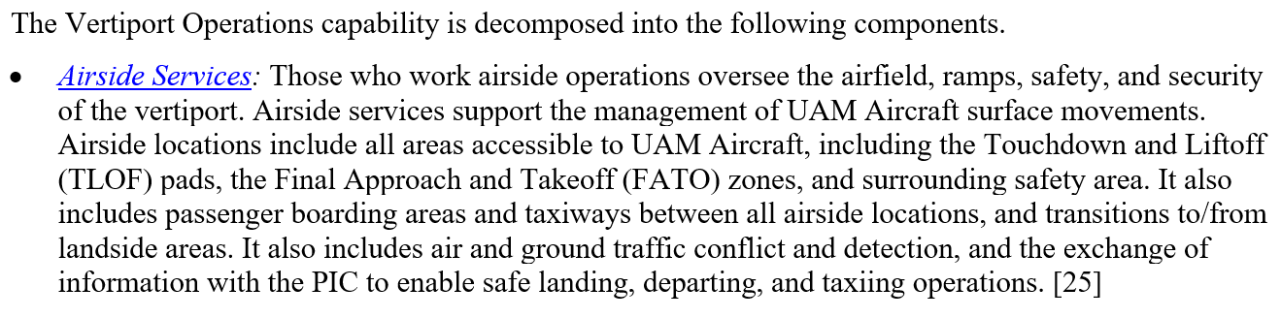
§5.9 Vertiport Operations
:
…

Slide 39
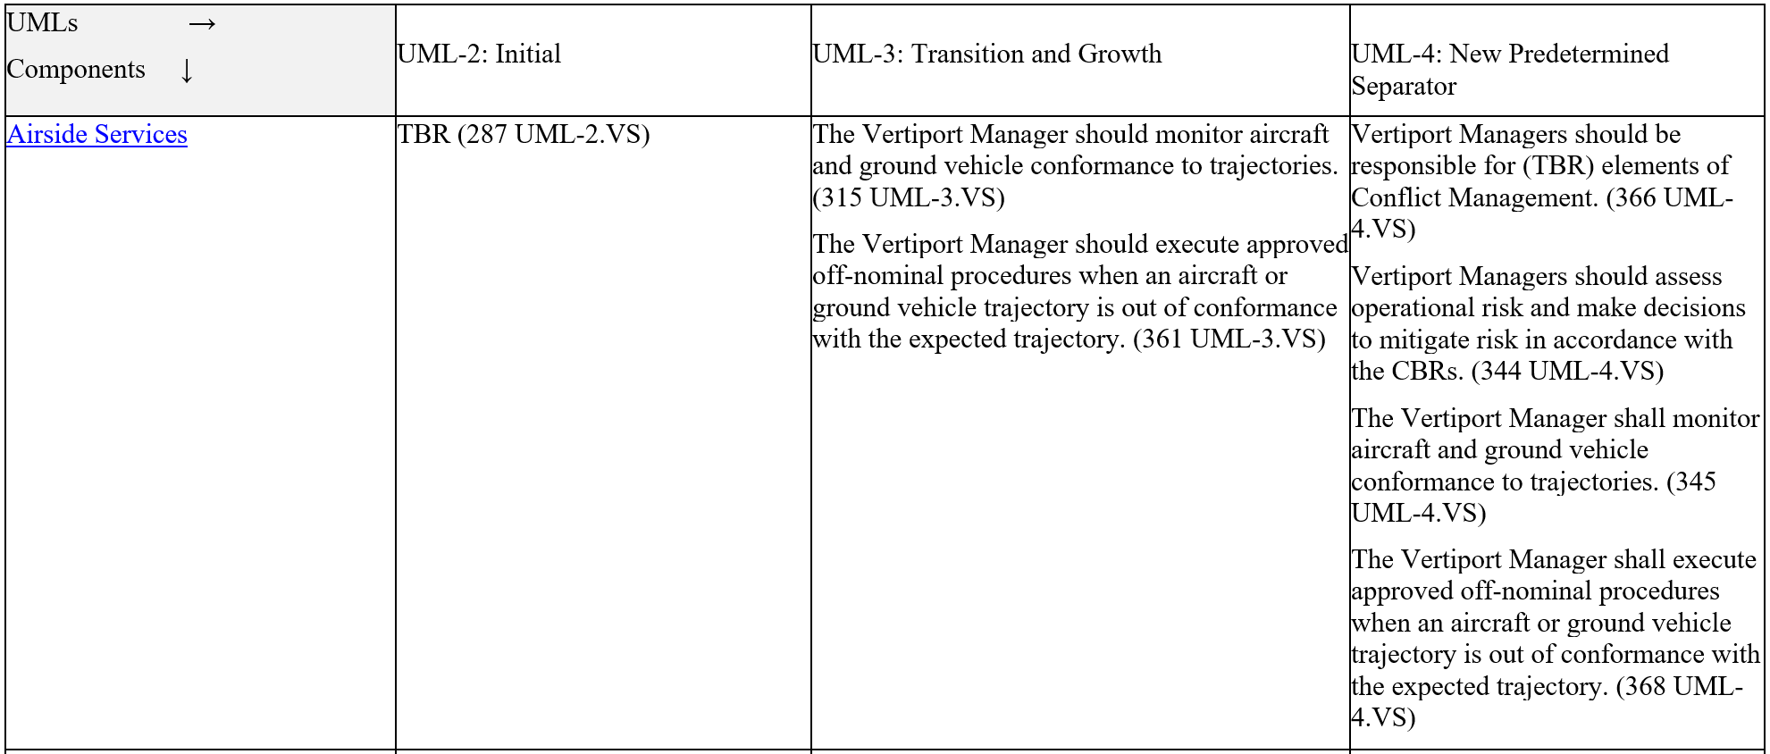
Table 9: Vertiport Operations

Slide 40
Table 9: Vertiport Operations
Progression of should to shall

Slide 41
§6 Conclusions and Next Steps
Building to a baseline (v2.0)
Will be used and maintained by the ATM-X UAM Airspace Subproject
Requirements maturity will be characterized
  not all requirements are created equally

Slide 42







Next Steps
Building to a baseline that NASA can use and maintain for UAM Airspace research and development
Make anticipated changes
  §5.4 Communications updates with RTCA V2V white paper
  §5.5 Navigation and Surveillance updates from NARI PNT workshop
  §5.9 Vertiport Operations matured
Build up MBSE database
Conduct system analysis
Develop data science applications

