Slide 1
LESSONS LEARNED FROM AEROTHERMAL FLIGHT DATA ON NASA MARS ENTRY VEHICLES
Karl Edquist (karl.t.edquist@nasa.gov)
NASA Langley Research Center, Hampton, VA, USA
Milad Mahzari, Suman Muppidi, Todd White
NASA Ames Research Center, Moffett Field, CA, USA
2nd International Conference on Flight Vehicles,
Aerothermodynamics and Re-entry Missions Engineering
Session 4.5: Flight Data Analysis and Exploitation
Heilbronn, Germany, 19-23 June 2022
This material is a work of the U.S. Government and is not subject to copyright protection in the United States

Slide 2
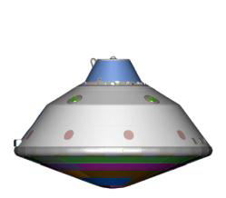
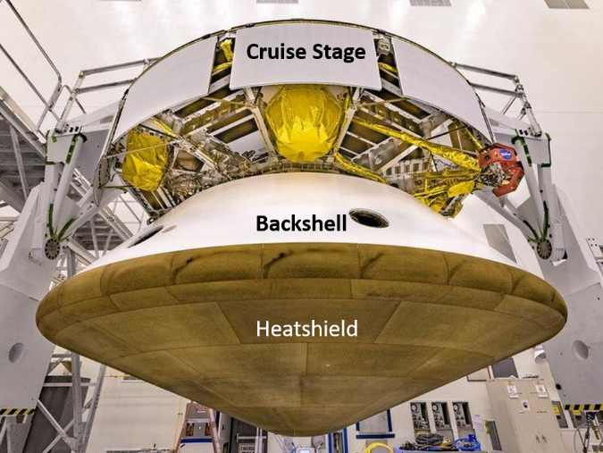
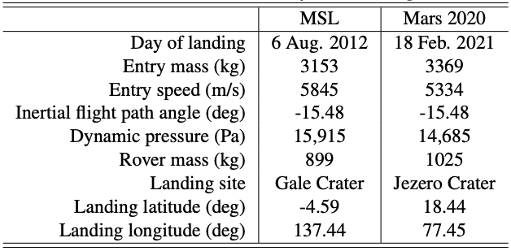
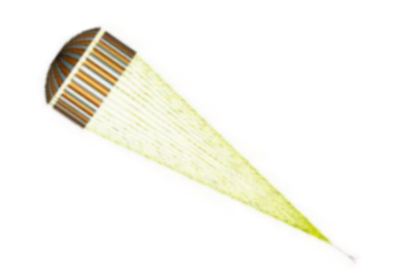
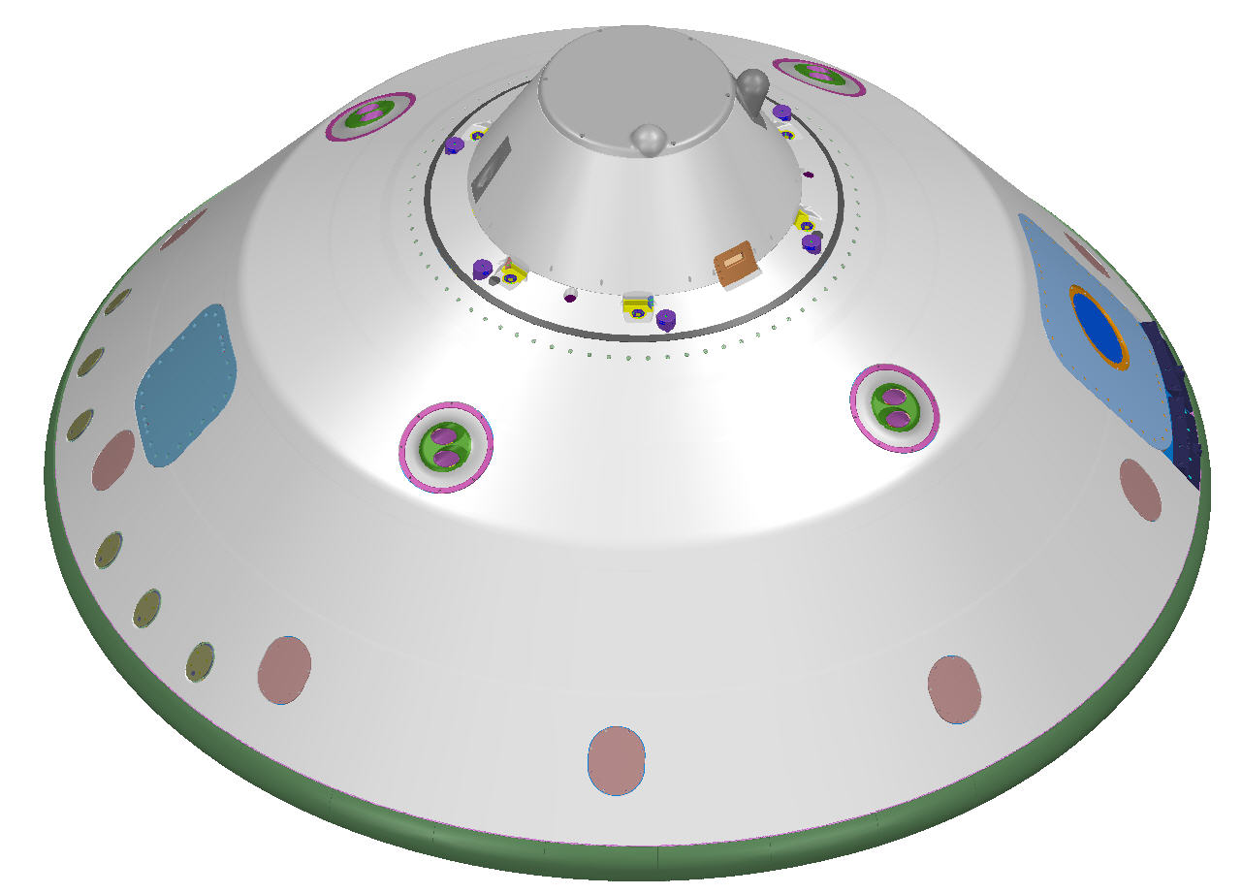
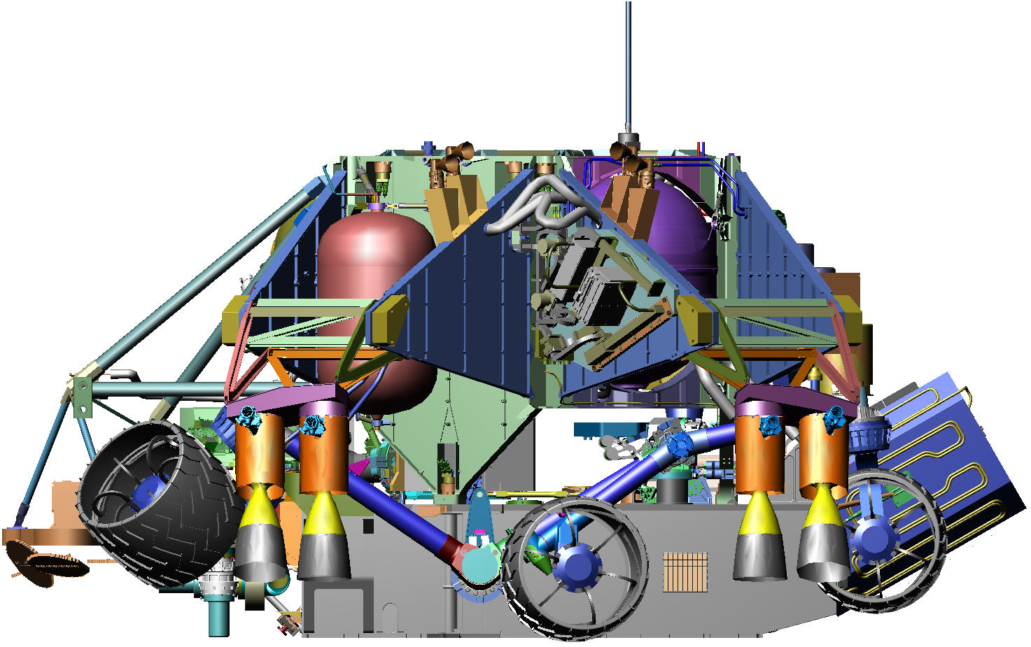
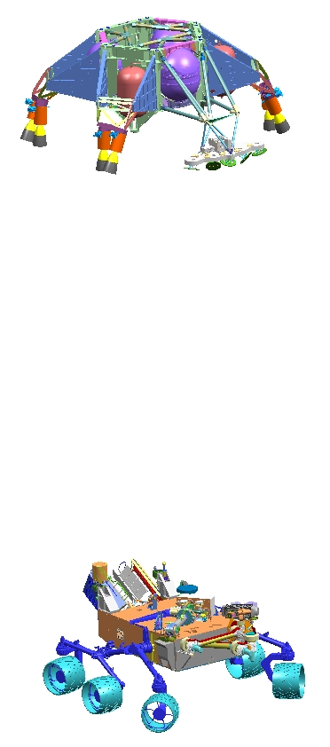
Introduction
The Mars Science Laboratory (MSL) and Mars 2020 entry systems successfully delivered the Curiosity rover in 2012 and Perseverance rover in 2021, respectively
The entry vehicles and thermal protection system (TPS) were nearly identical for both missions
Entry, Descent, and
Landing (EDL) System
Rigid Aeroshell
Guided Entry (α = ~16 deg)
Supersonic
Parachute
Subsonic
Powered
Descent
4.5 m
Sky Crane
Notes:
Challenges of MSL due to size and weight

Slide 3
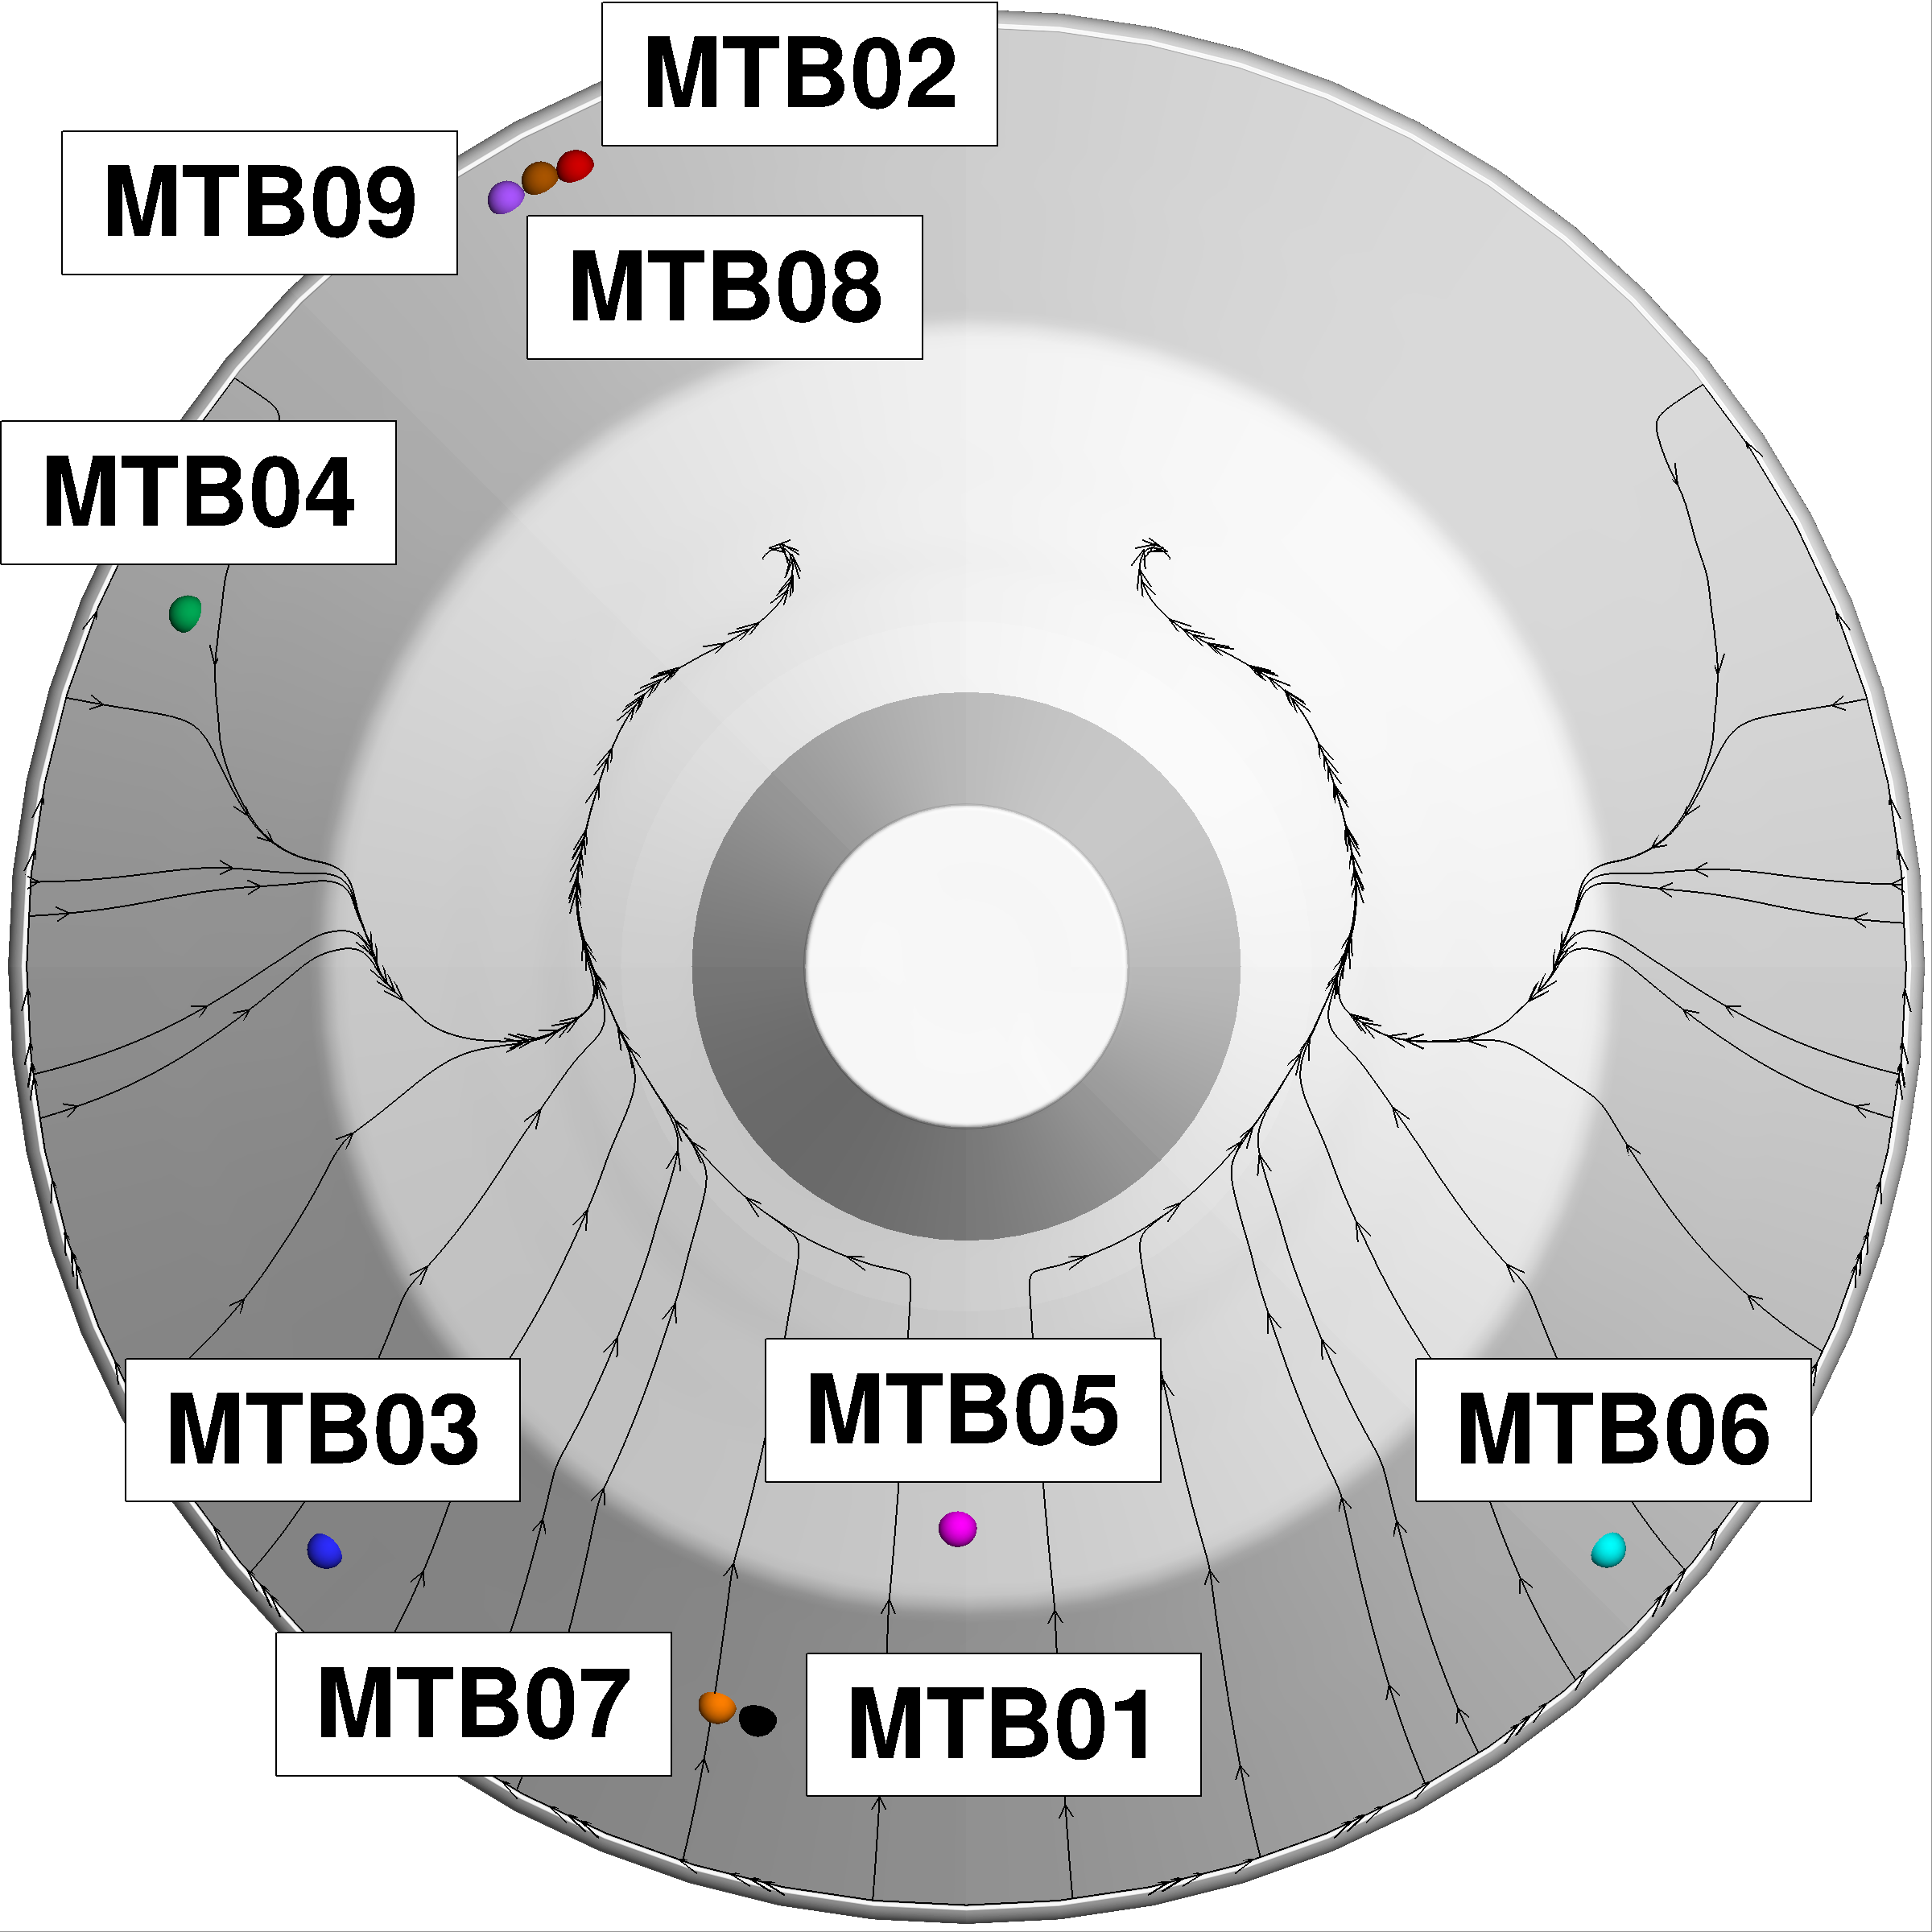
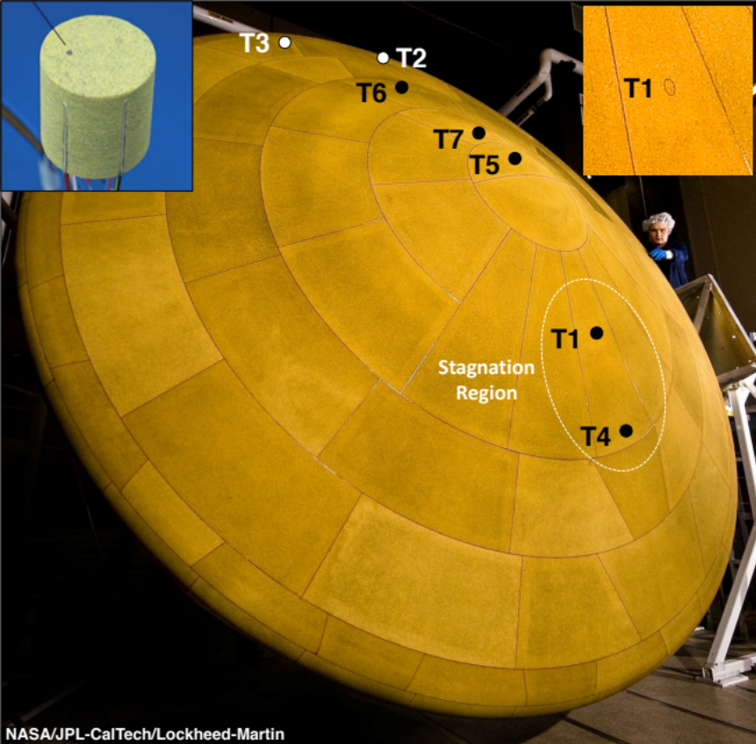
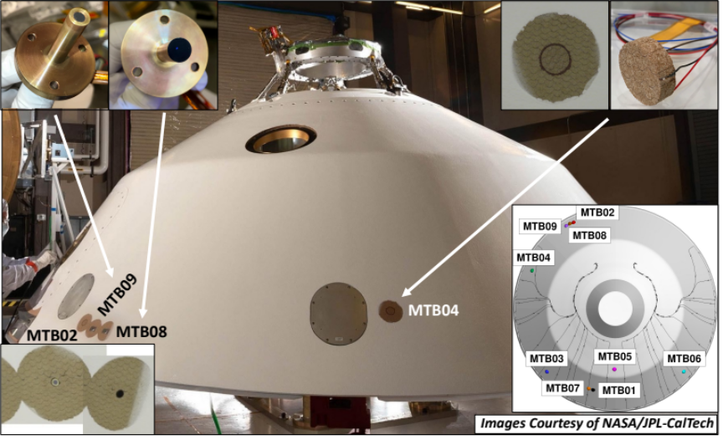
Motivation
The MSL and Mars 2020 Heatshields, and Mars 2020 Backshell, were instrumented to measure TPS temperature and direct surface heat flux to assess TPS performance and predictive modeling capabilities
Mars Science Laboratory (MEDLI)
Mars 2020 (MEDLI2)
MTB01-06 – Thermocouple plug
MTB07-08 - Total heat flux sensor
MTB09 - Radiometer
Thermocouple (TC) plug
4 TCs 2.54 to 17.78 mm below surface
1-3 TCs 1.95 to 11.5 mm below surface
MTH - MEDLI2 Thermal Heatshield
MTB - MEDLI2 Thermal Backshell
MEDLI - Mars Entry, Descent, and Landing Instrumentation
Heatshield - Phenolic Impregnated Carbon Ablator (PICA)
Backshell - Super-Lightweight Ablator (SLA-561V), covered in white paint
This presentation summarizes the flight data, reconstructed heating, measured heating (Mars 2020),
new computational analysis, and lessons learned for future missions
Notes:
Challenges of MSL due to size and weight

Slide 4
Outline
Heatshield Data and Boundary Layer Transition
Mars 2020 Backshell Data and Shock Layer Radiation
Reconstructed/Measured vs. Calculated Aerothermal Environments
Summary of Lessons Learned

Slide 5
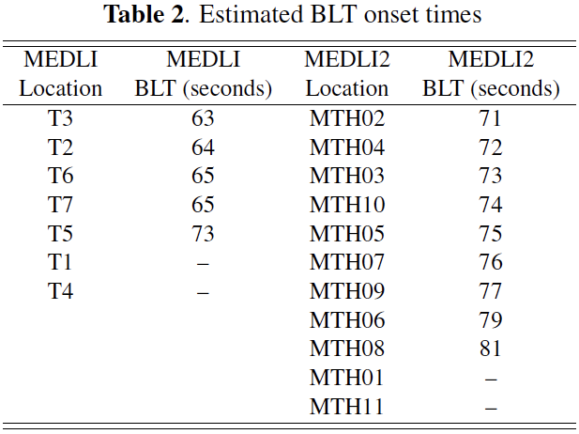
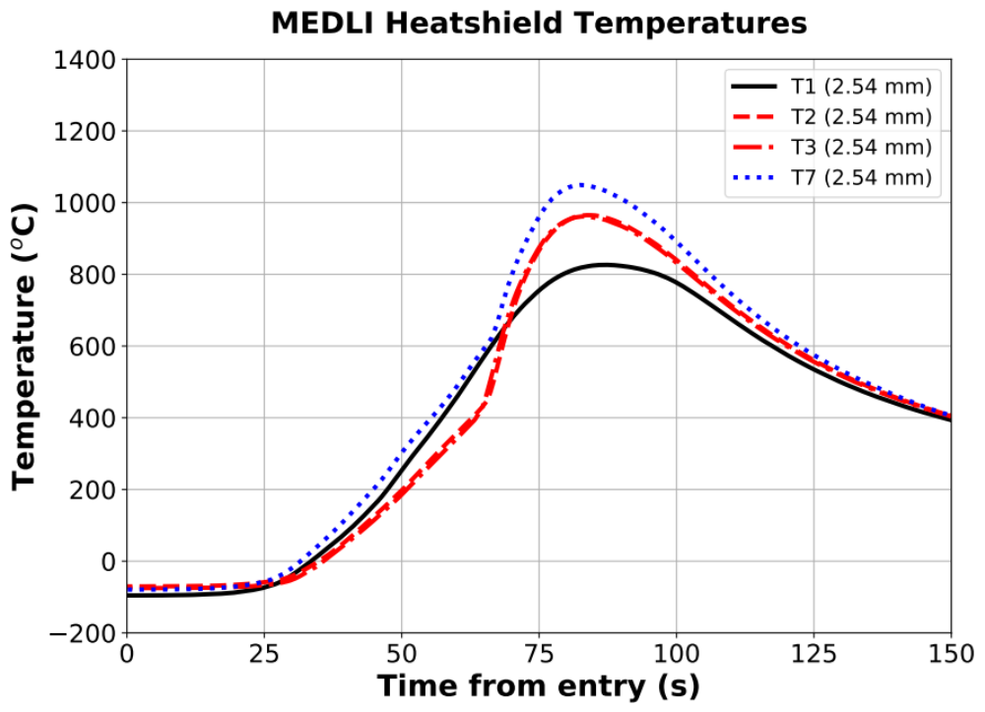
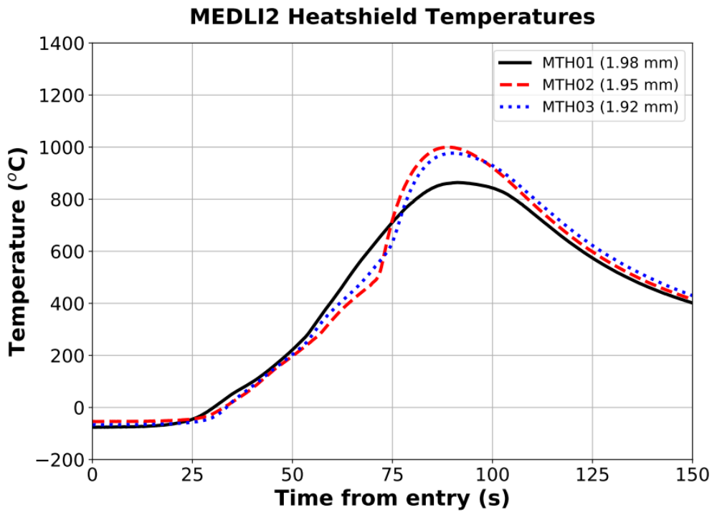
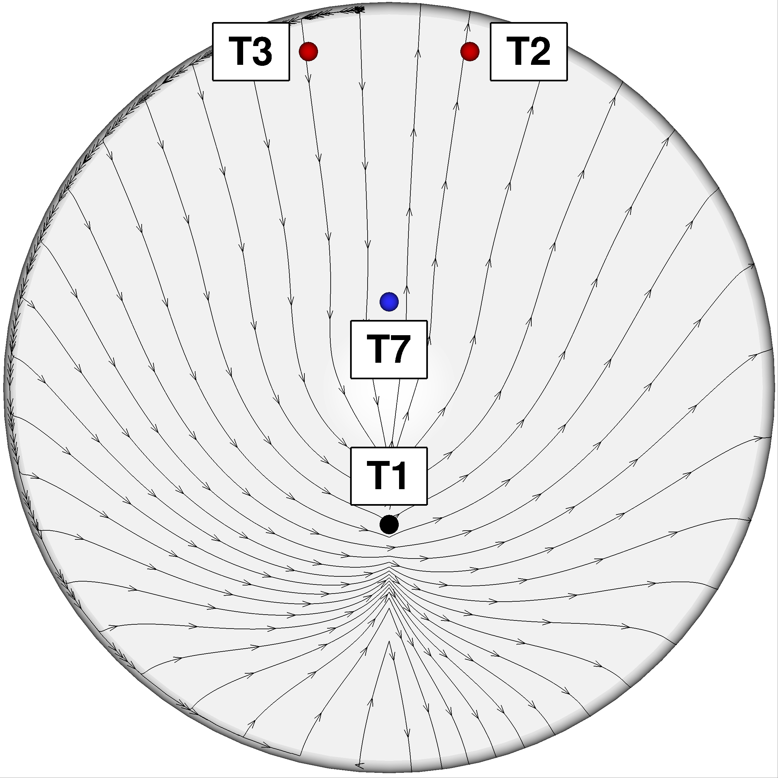
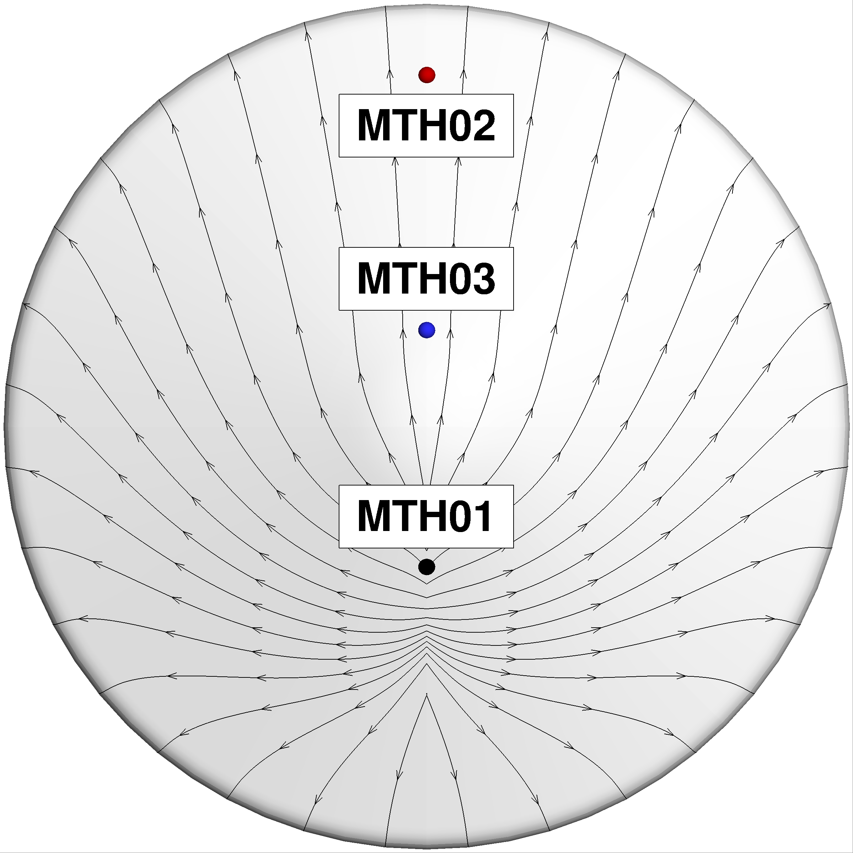
Heatshield Temperatures at Shallowest TCs
All thermocouples (TCs) closest to the surface survived - TPS recession never reached those depths
  Temperatures were well within material capabilities
The highest temperatures occurred away from the stagnation region, as expected
Slope changes in the temperature curves indicate boundary layer transition (BLT), which was expected for both missions
Boundary Layer Transition Times

Slide 6
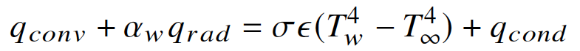
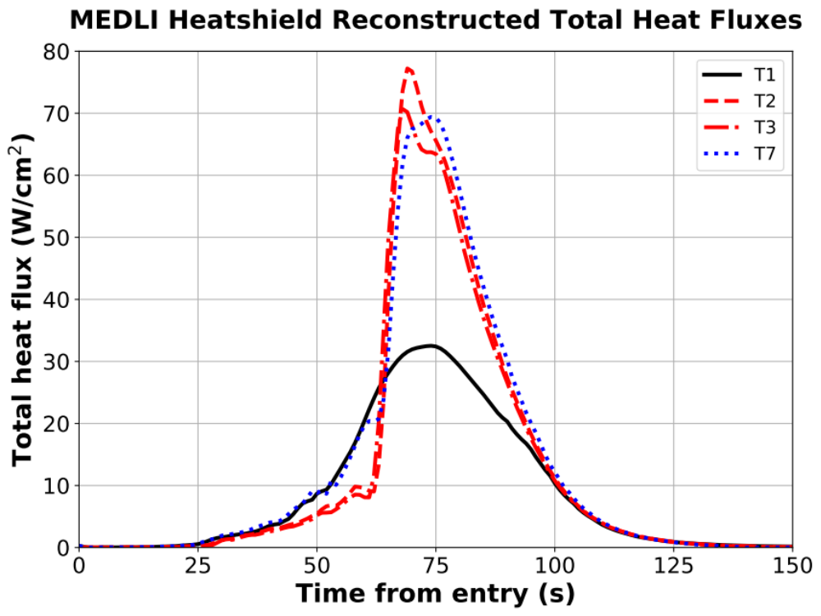
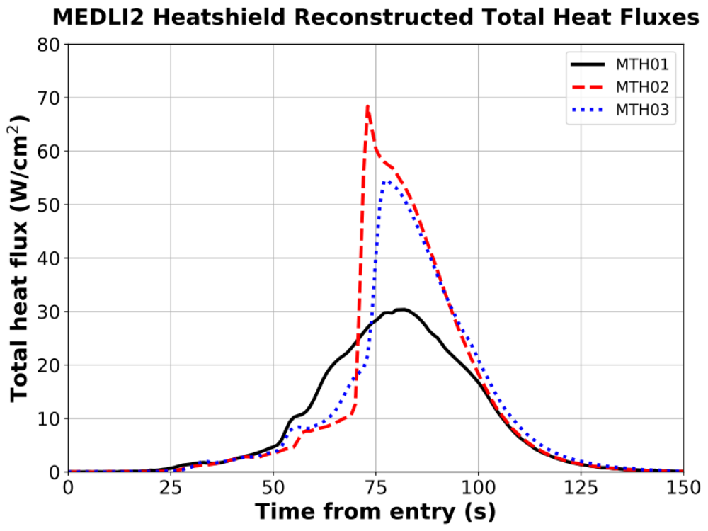
Reconstructed Heatshield Total Heat Flux
The thermocouple (TC) data and FIAT analytical model for PICA thermal response were used to reconstruct the convective plus absorbed radiative heat flux (left-hand side of equation below)
Highest heating is away from stagnation region (angle of attack = ~16 deg), due to turbulence
MSL experienced higher heating due to a higher entry speed
α_{w} = absorptivity, σ = Stefan’s constant, ε = emissivity, recession turned off

Slide 7
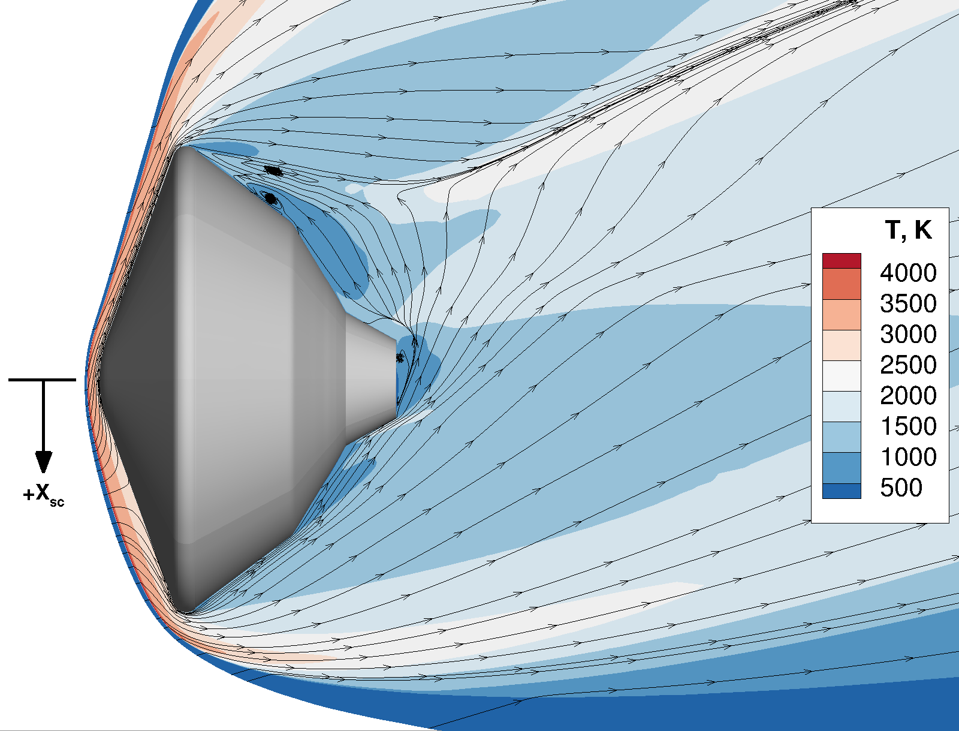
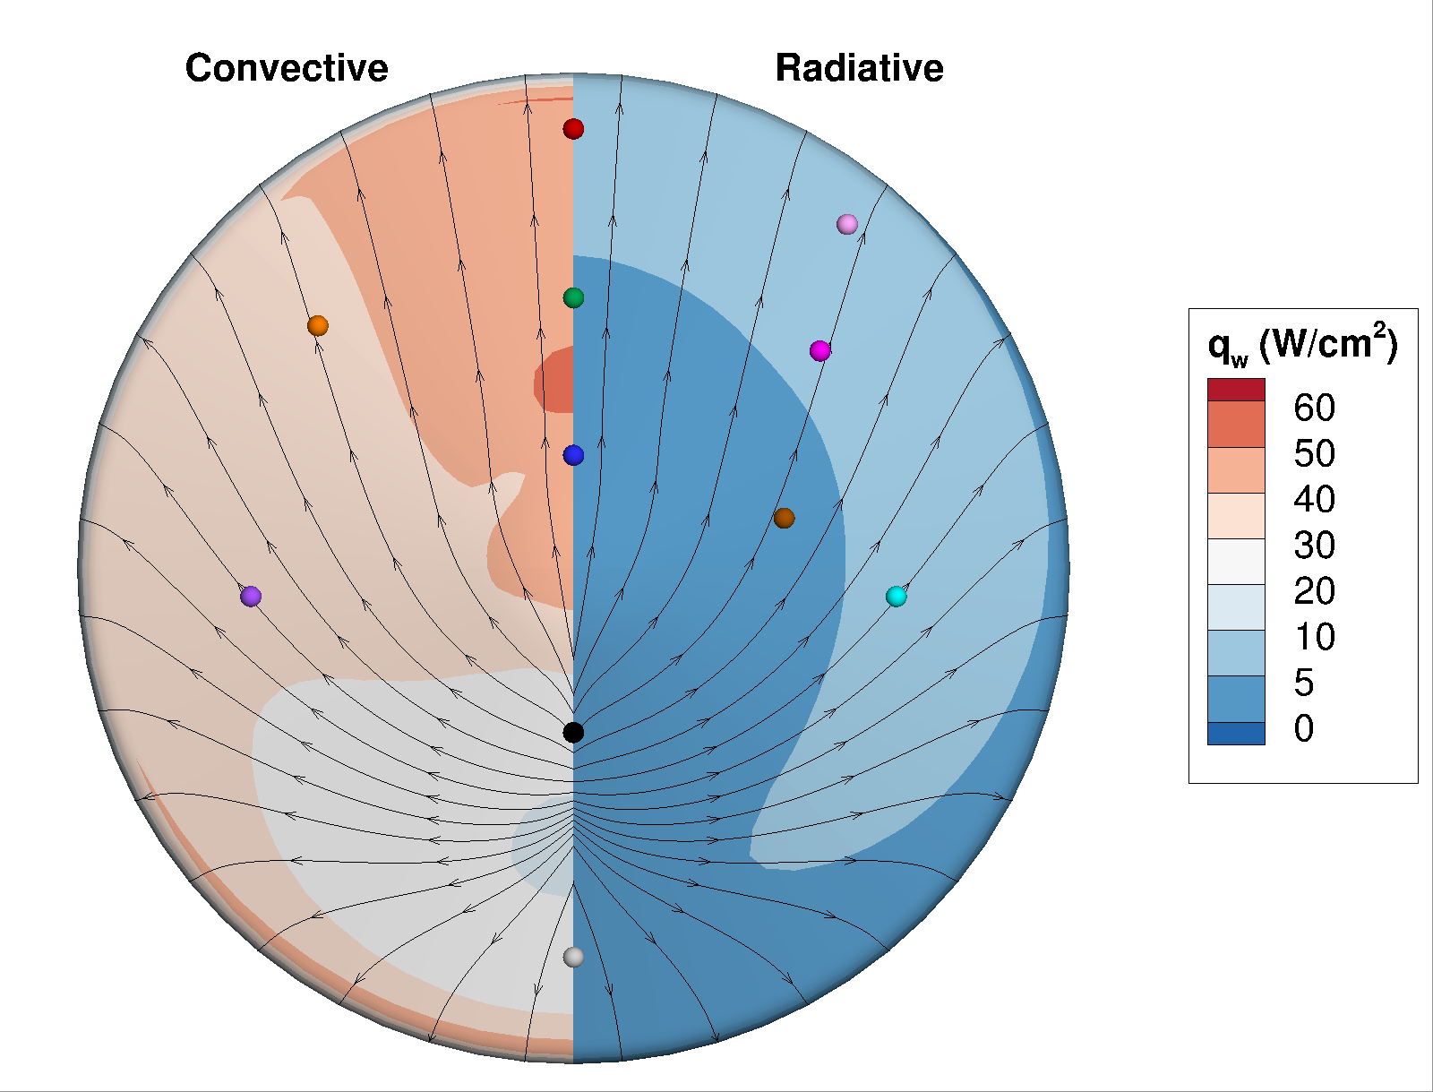
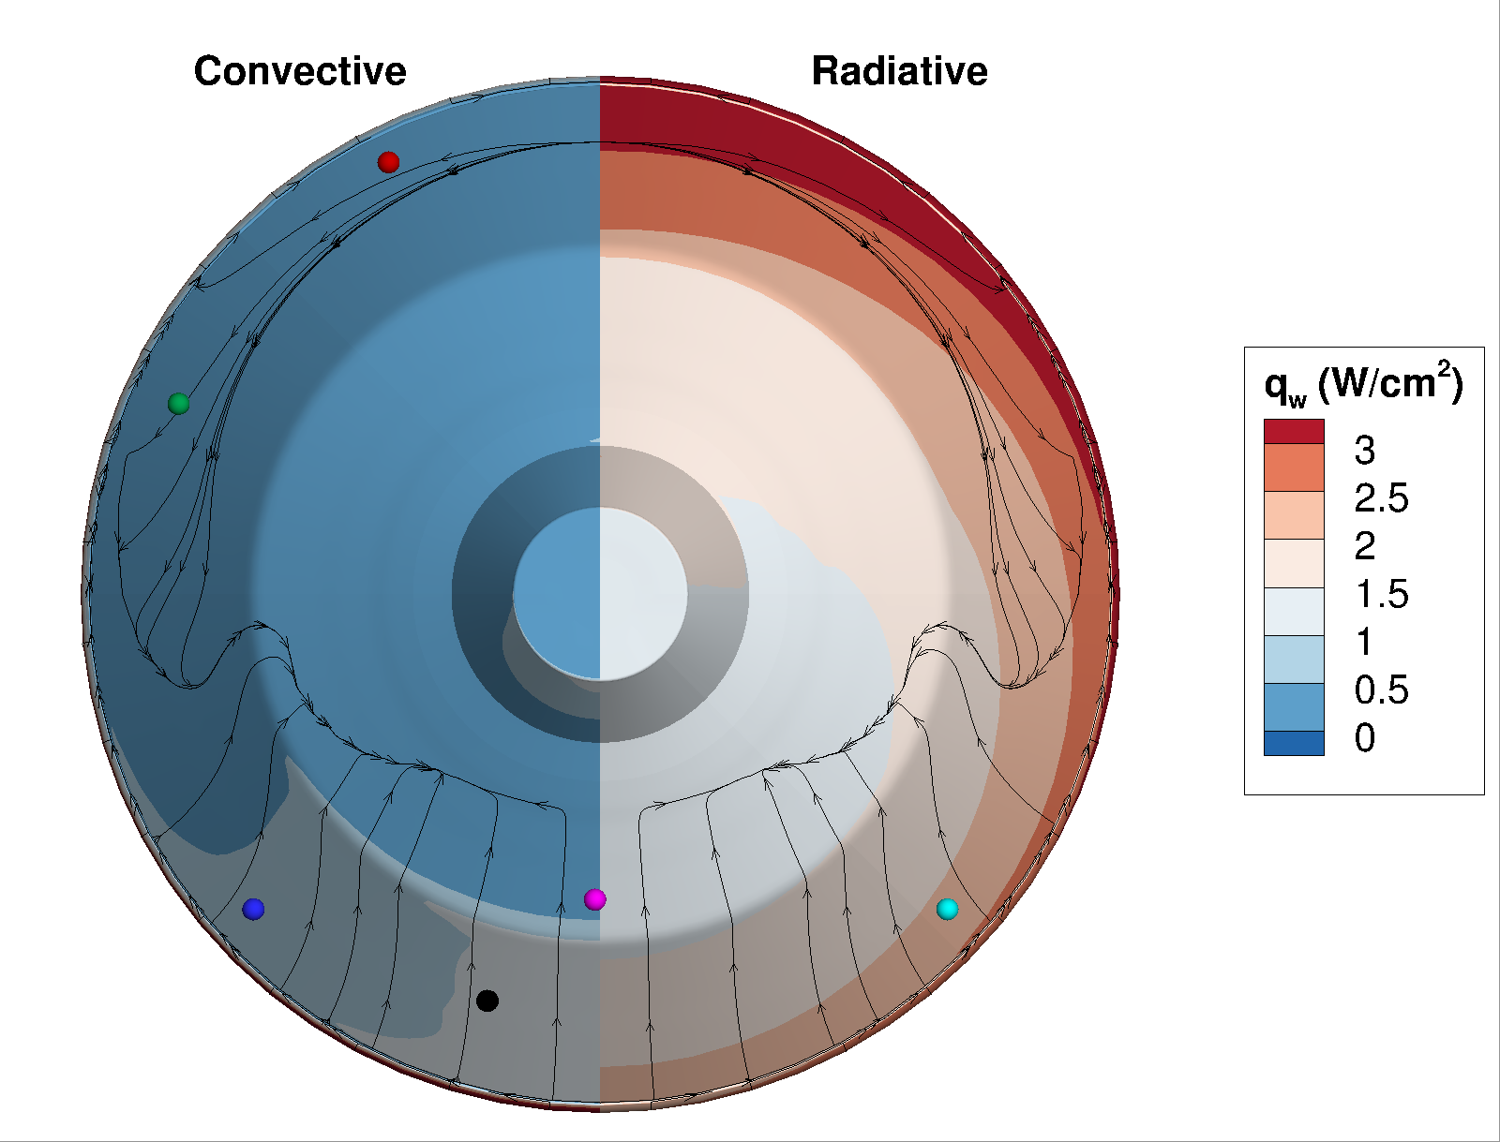
Computational Analysis
Analysis using the pre-flight aerothermal design tools, LAURA for convective heating and HARA for radiative, was completed on the best estimated trajectory (BET) and compared to the reconstructed/measured heating
  New analysis: smooth-wall, non-blowing, fully-catalytic surface in radiative-equilibrium, laminar and Cebeci-Smith algebraic turbulence model
  Design environments: fully-turbulent, super-catalytic, roughness augmentation added to smooth-wall results
LAURA = Langley Aerothermodynamic Upwind Relaxation Algorithm
HARA = High-Temperature Aerothermodynamic Radiation Algorithm
Sample results at peak dynamic pressure, angle of attack = ~16 deg
Temperature | Heatshield heat flux | Backshell heat flux

Slide 8
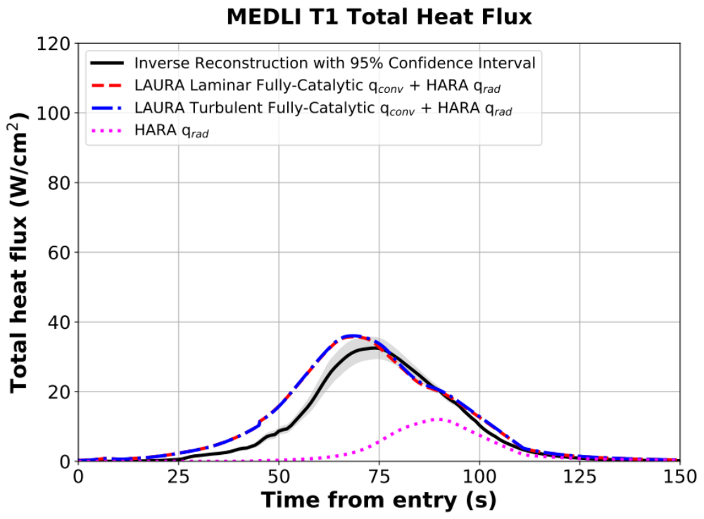
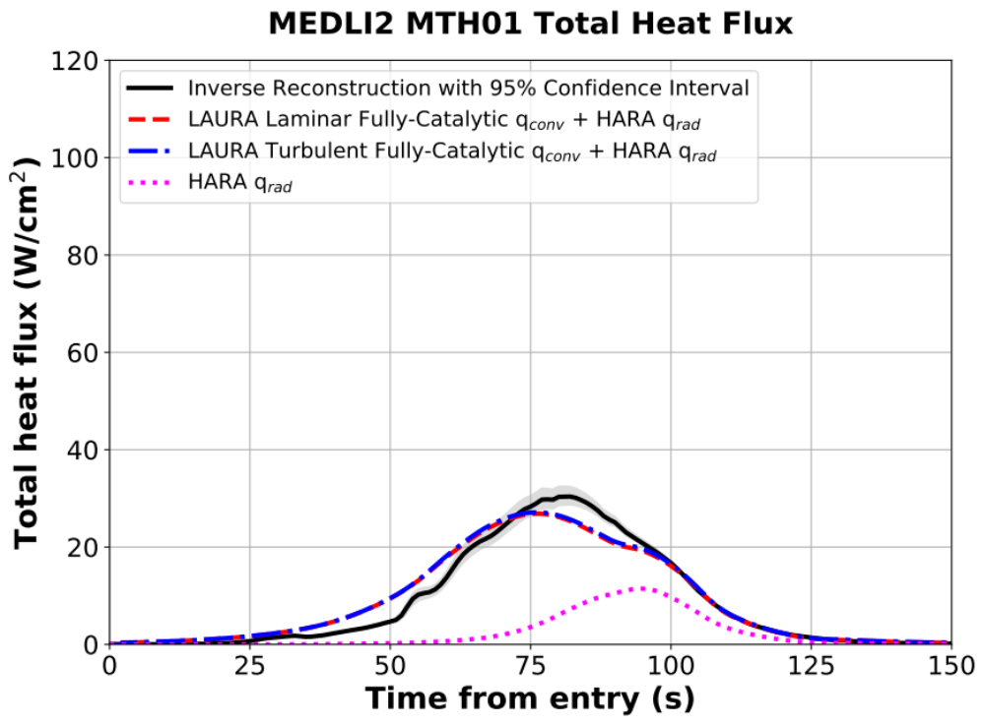
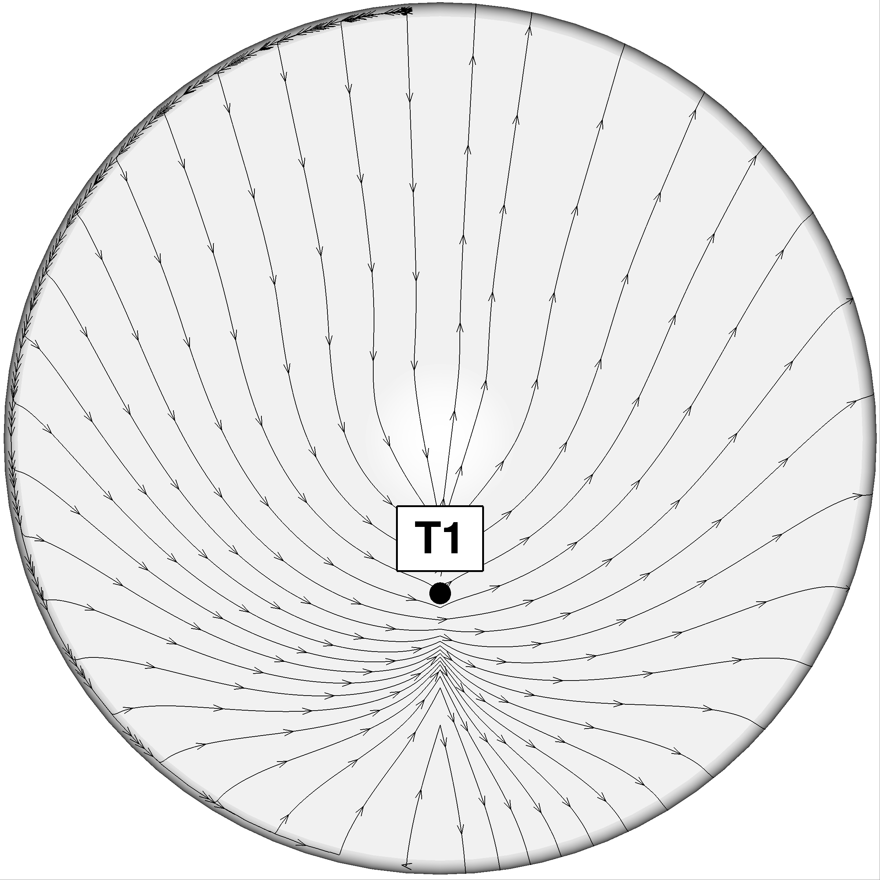
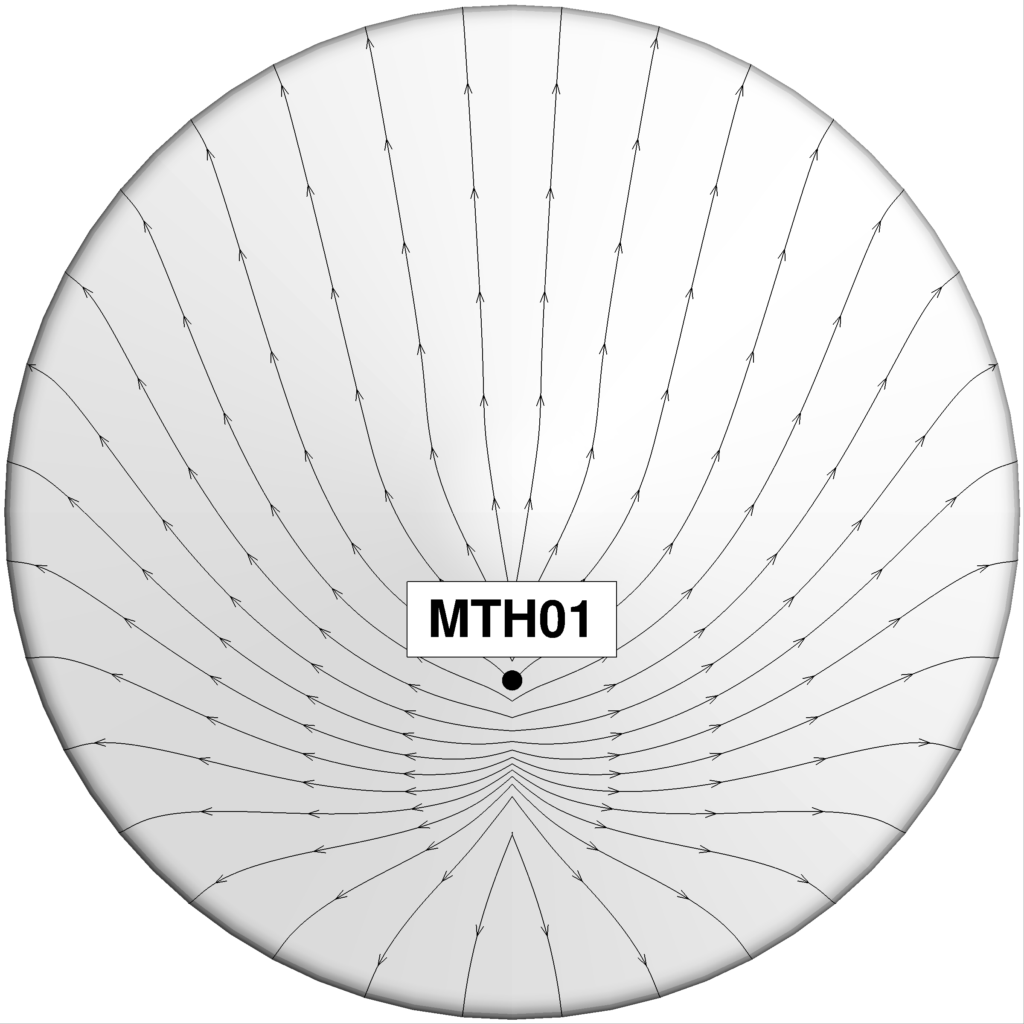
Heatshield Stagnation Region
The predictions are qualitatively similar to the reconstructed heating
The LAURA/HARA calculations predict convective heating >> radiative for most of the trajectory
Design values are from conservative analysis on stressing trajectories, plus uncertainties
Caveat: Comparing CFD to reconstructed heating is approximate, due to different assumptions (gas-surface reactions, pyrolysis gas blowing, surface temperature)
Design = 63 W/cm²
Radiation not included
Design = 58 W/cm²
Radiation included

Slide 9
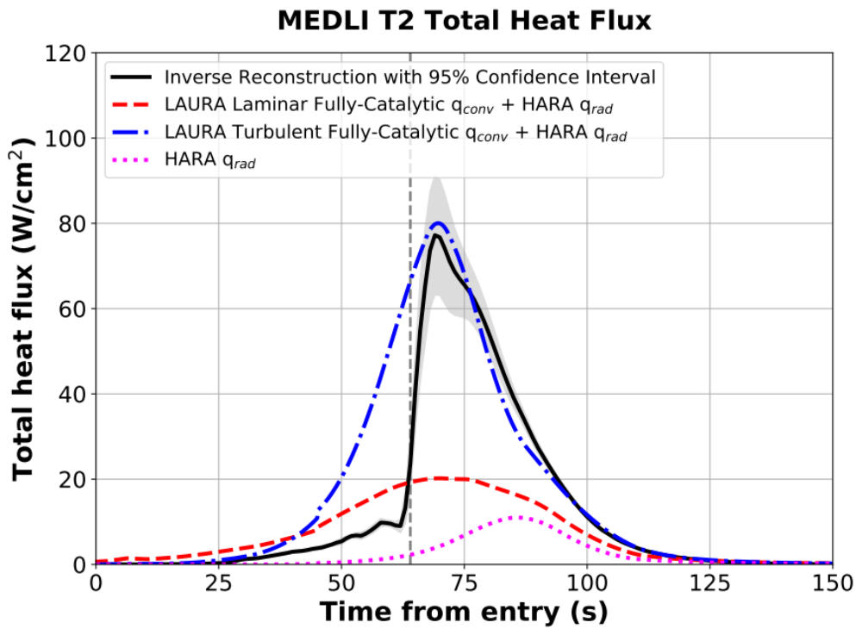
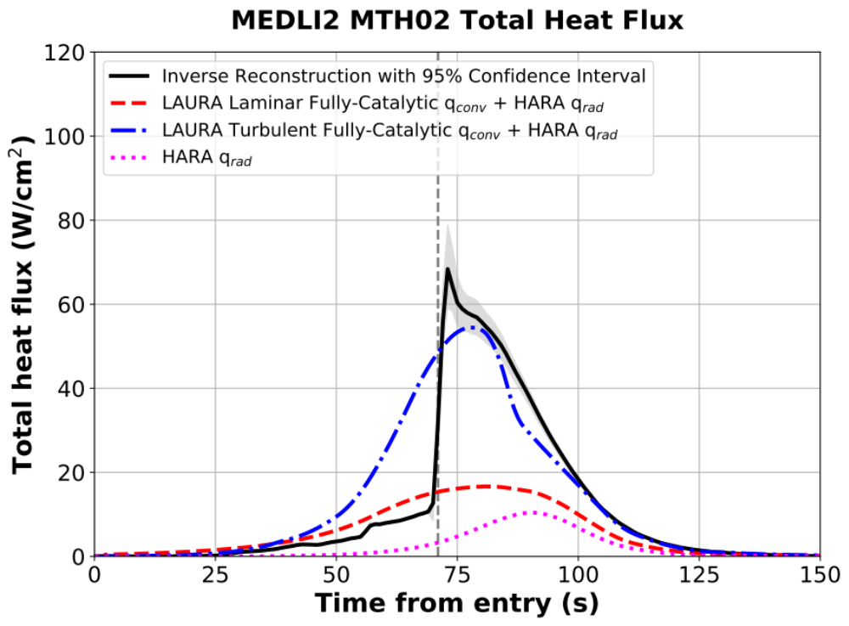
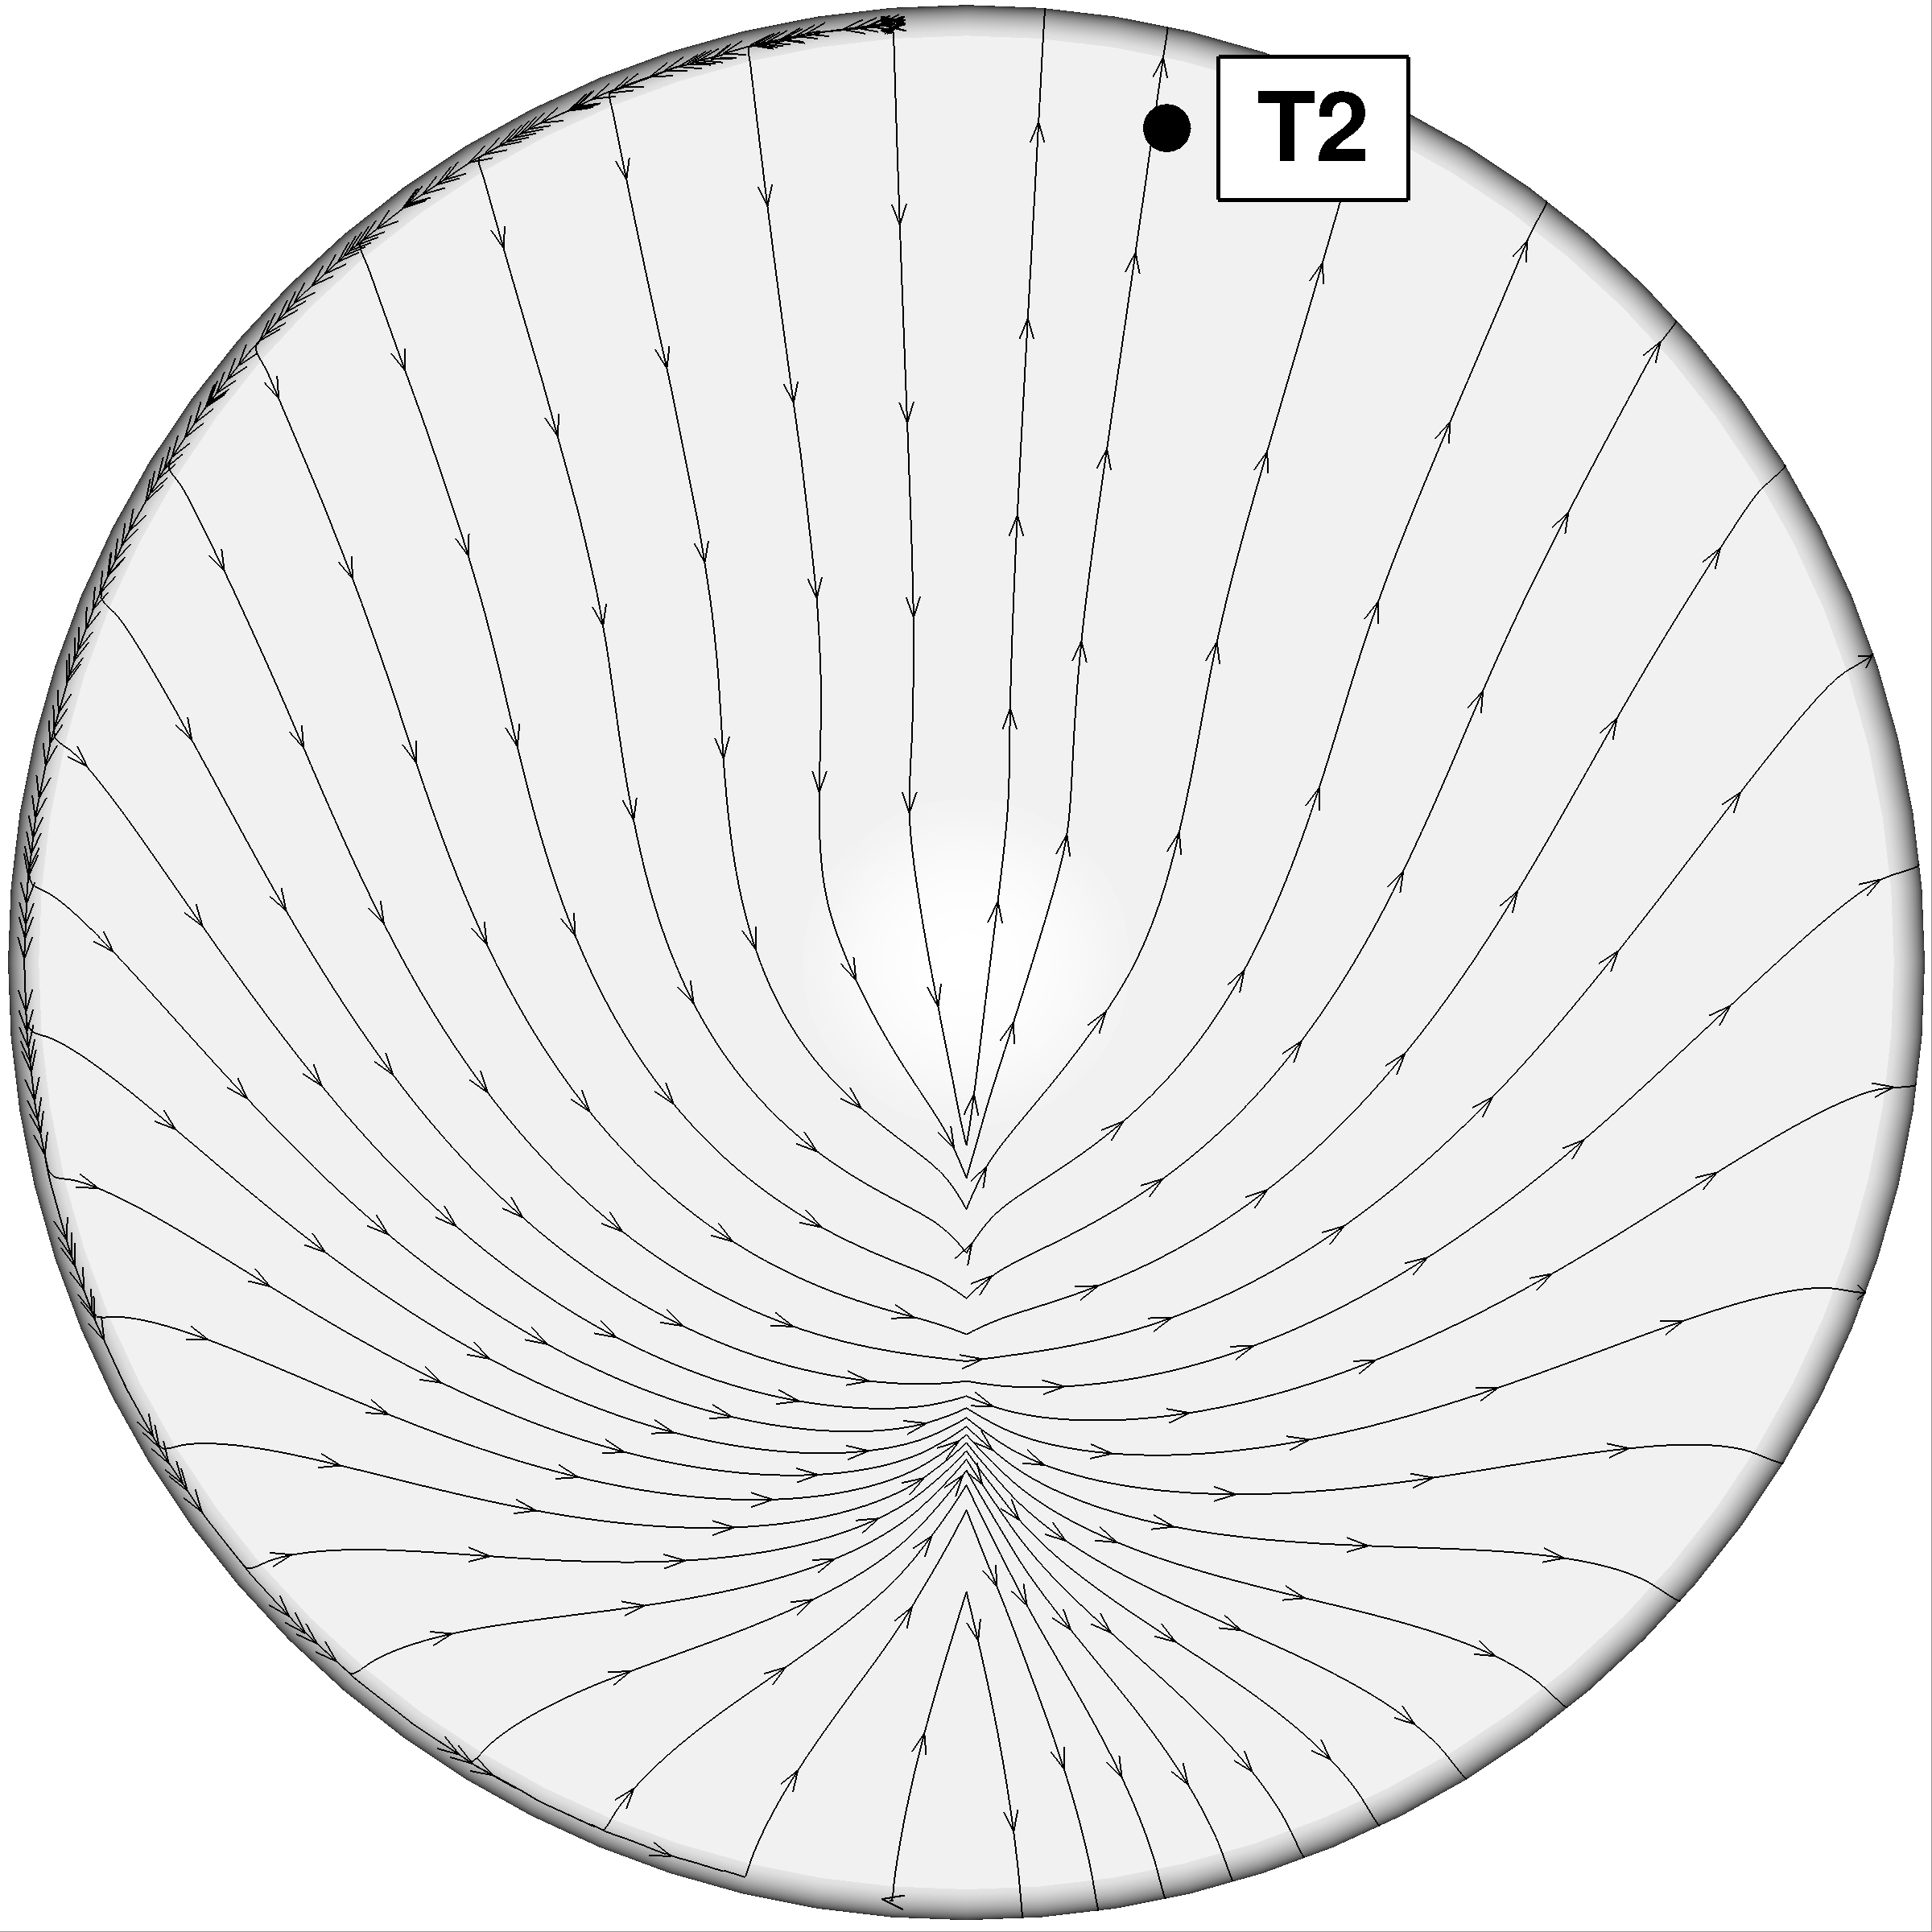
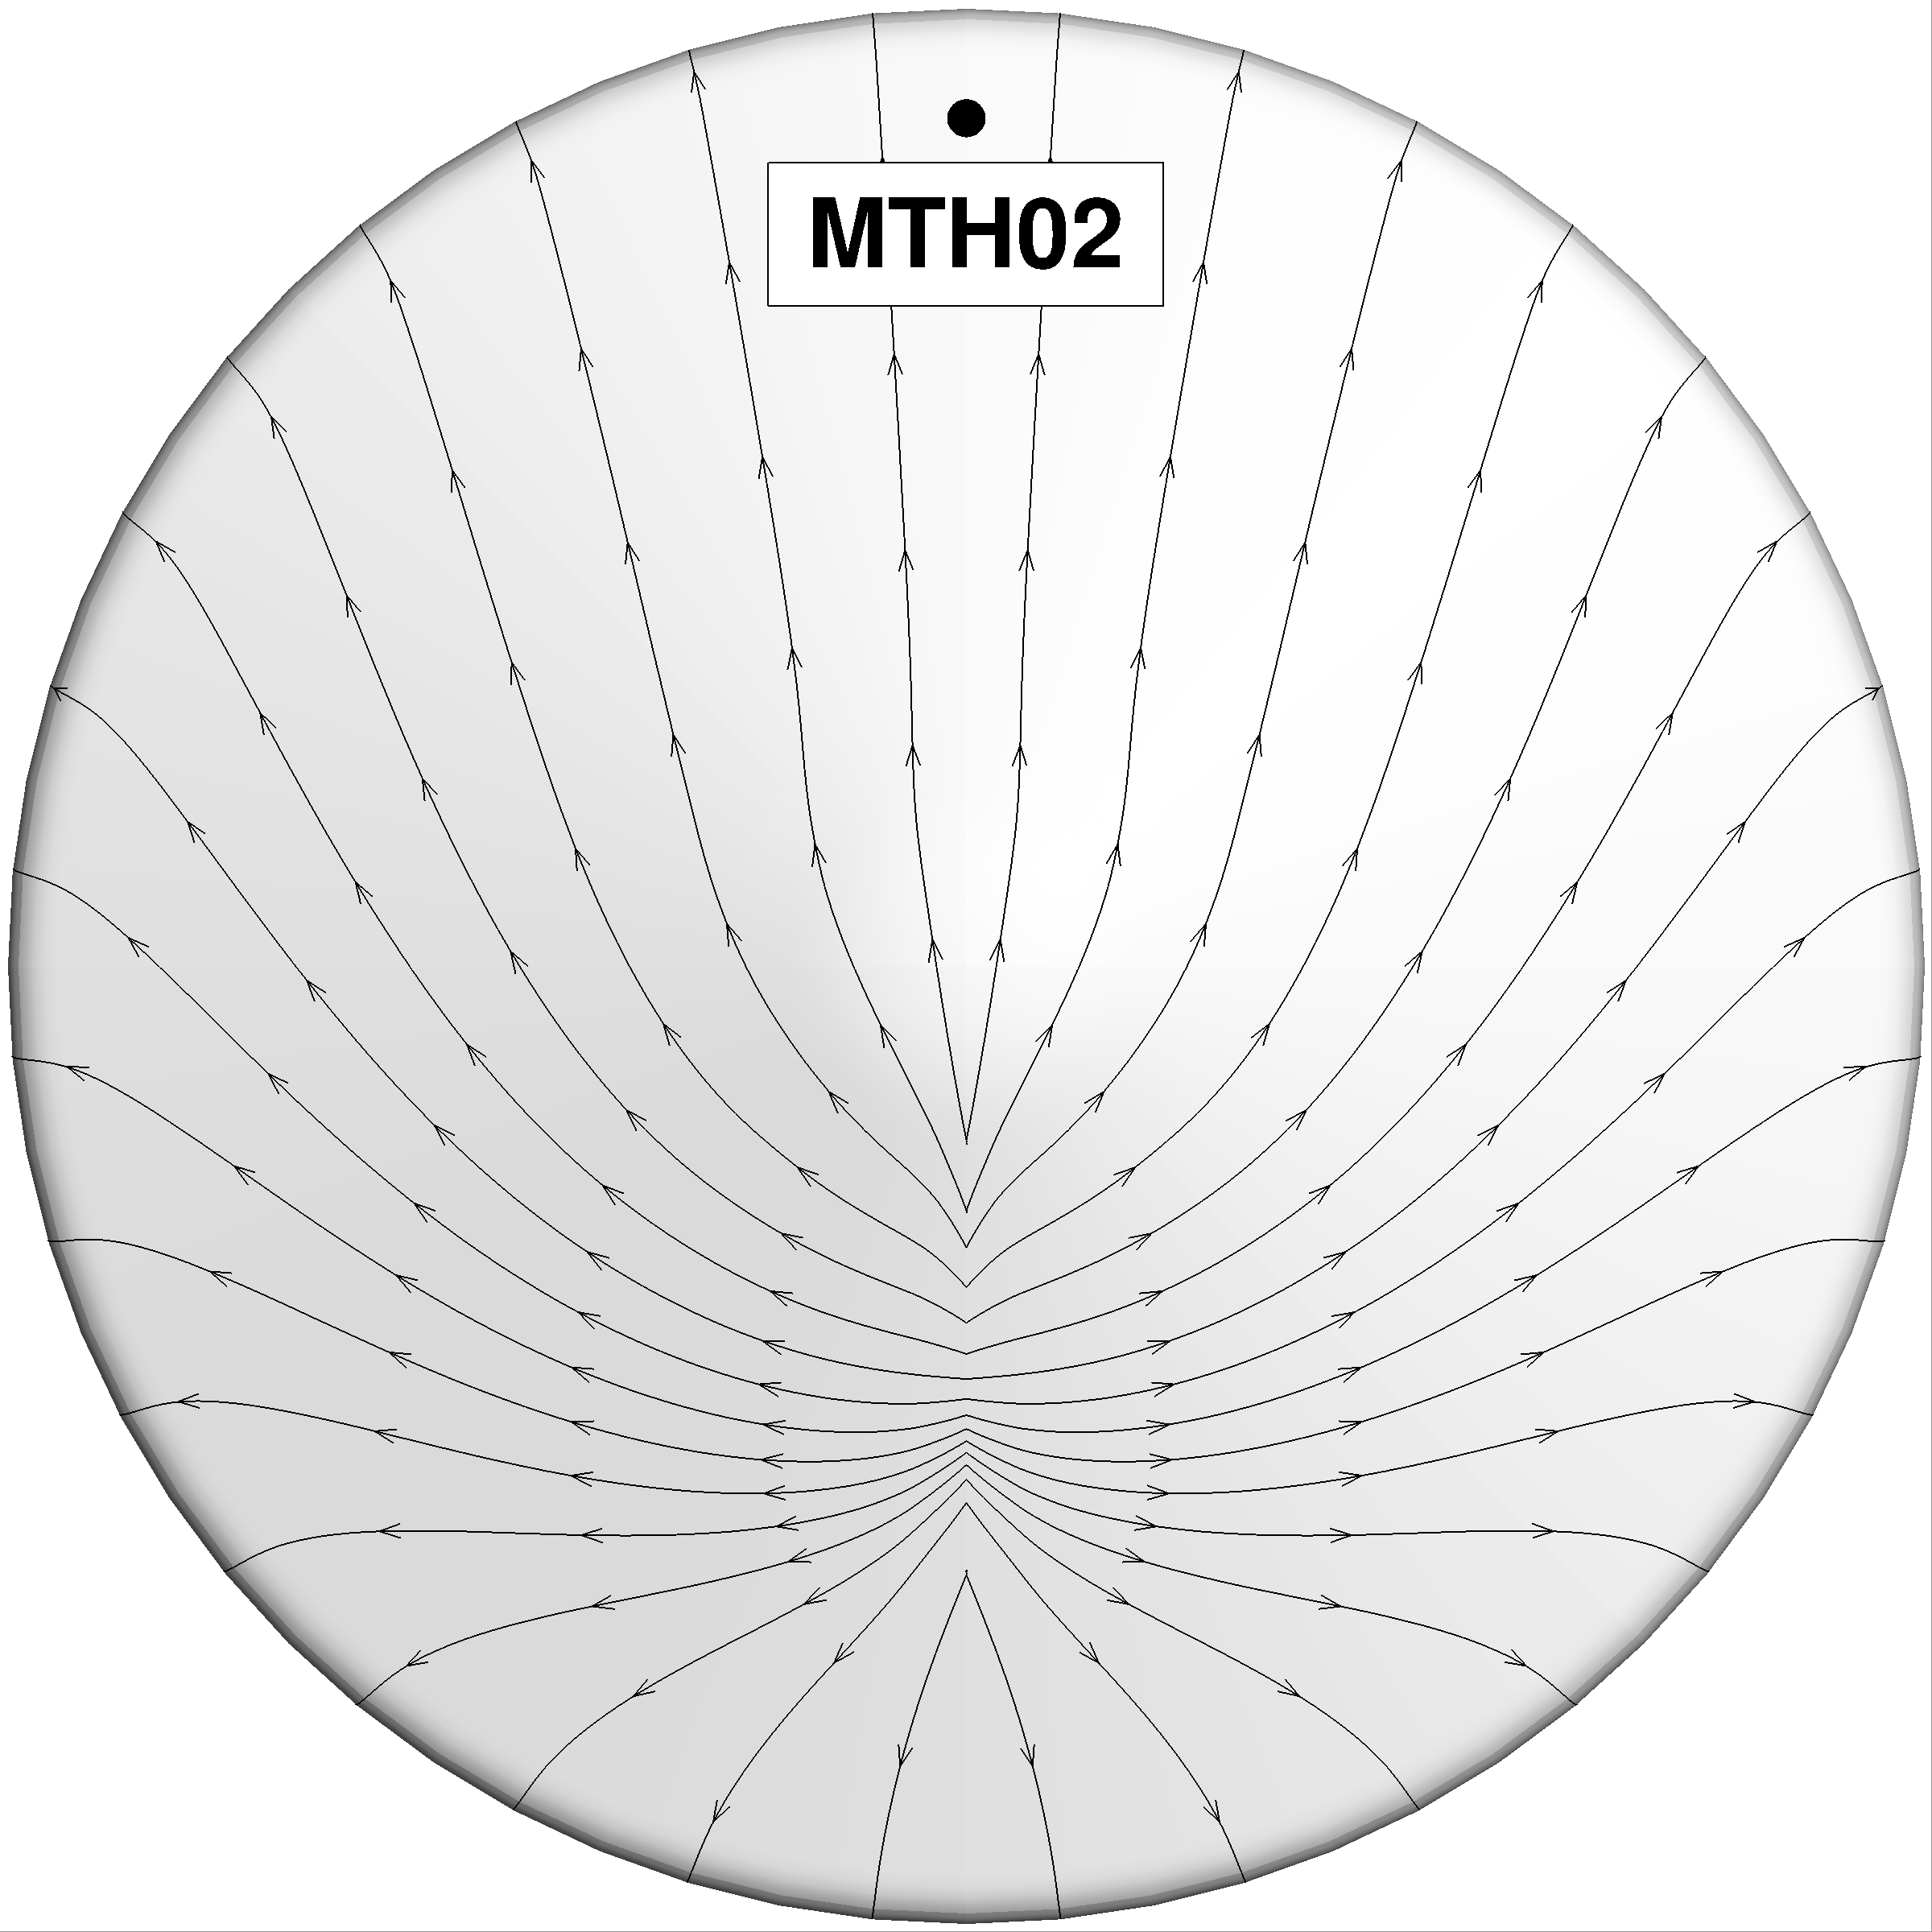
Heatshield Leeside Flank
Leeside shoulder is near the location of highest predicted turbulent heating
Compared to the reconstructed heating, laminar LAURA/HARA heating tends to be high prior to BLT, better agreement after BLT with algebraic turbulence modeling
Bottom line: reasonable agreement using non-blowing, smooth-wall CFD with algebraic turbulence model, but root causes for differences cannot yet be pin-pointed – surface catalysis? turbulence model? chemistry model? trajectory errors? – multi-year deep-dive analysis is underway
Design = 219 W/cm²
Design = 168 W/cm²

Slide 10
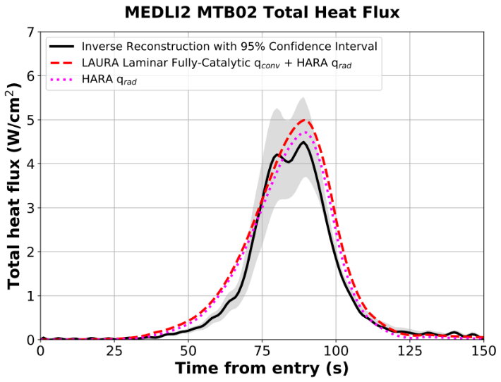
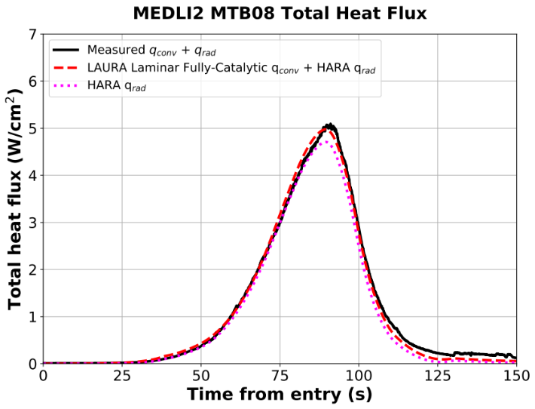
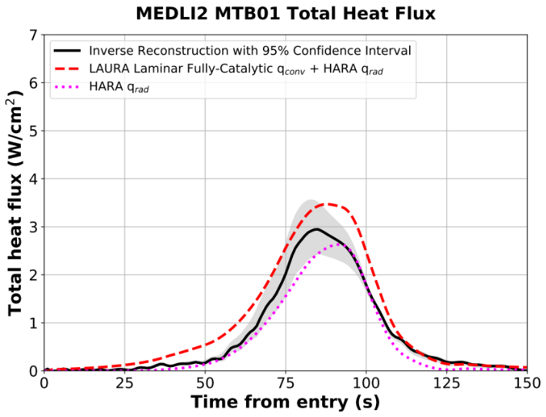
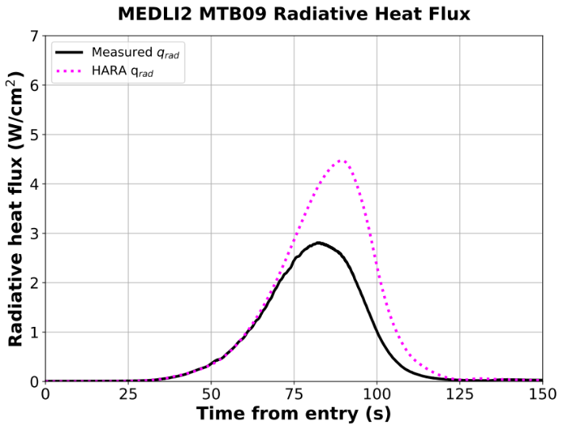
Mars 2020 Backshell Summary
Laminar-based predictions qualitatively match the reconstructed heating, predicted radiative heating >> convective
Leeside heating (MTB02) > windside heating (MTB01), due to predicted higher radiative heating
Leeside
Design = 8.7 W/cm²
Design = 8.8 W/cm²
TC plug
Total heat
flux sensor
Radiometer measurement
likely reduced by ablation
product deposition
Design = 8.6 W/cm²
Design = 8.7 W/cm²
TC plug
Radiometer
Windside

Slide 11
Summary of Lessons Learned
The following lessons learned are intended for future Mars missions to consider under the constraints of their technical details, budgets, risks, and schedules e. g. Mars Sample Return
Future JSR articles and NASA deep-dive analysis are forthcoming and will include more details, focusing on the Mars 2020 flight data and analysis
Lesson | Benefits | Risks
1. Expect BLT for 70-deg sphere-cone tiled heatshields, even earlier in the trajectory with higher ballistic coefficient or steeper flight path angle | Fully-turbulent design is conservative | Excessive TPS mass
2. Improved confidence in predictive methods for heatshield (mostly convective heating, algebraic turbulence modeling) and backshell (mostly radiative heating) | No new tool development needed | ----
3. Re-evaluate (reduce) overall heating uncertainties: heatshield roughness augmentation of turbulent convective heating, stagnation region uncertainties, super-catalytic surface assumption, backshell convective heating | Reduced TPS mass, reduced testing environments | Technical, cost, schedule
4. Consider including BLT in the heatshield design environments, since turbulent augmentation is significant | Reduced TPS mass | Technical, cost, schedule
5. Consider tailoring the heatshield TPS thickness to the environments, rather than using a uniform thickness, since the environments differ significantly by location | Reduced TPS mass | Technical, cost, schedule
6. Use Direct Simulation Monte Carlo methods for high-altitude calculations, since the predictions tend to over-predict heating early in the trajectory | Reduced TPS mass, reduced conservatism | Cost

Slide 12
Backup

Slide 13
Motivation
The MSL and Mars 2020 Heatshields, and Mars 2020 Backshell, were instrumented to measure TPS temperature and direct surface heat flux to assess TPS performance and predictive modeling capabilities
Mars Science Laboratory (MEDLI)
Mars 2020 (MEDLI2)
Thermocouple (TC) plug
MTB01-06 – Thermocouple plug
MTB07-08 - Direct total heat flux sensor
MTB09 - Radiometer
MEDLI - Mars Entry, Descent, and Landing Instrumentation
Heatshield - Phenolic Impregnated Carbon Ablator (PICA)
Backshell - Super-Lightweight Ablator (SLA-561V), covered in white paint
This presentation summarizes the flight data, reconstructed heating, measured heating (Mars 2020),
new computational analysis, and lessons learned for future missions
Notes:
Challenges of MSL due to size and weight

Slide 14
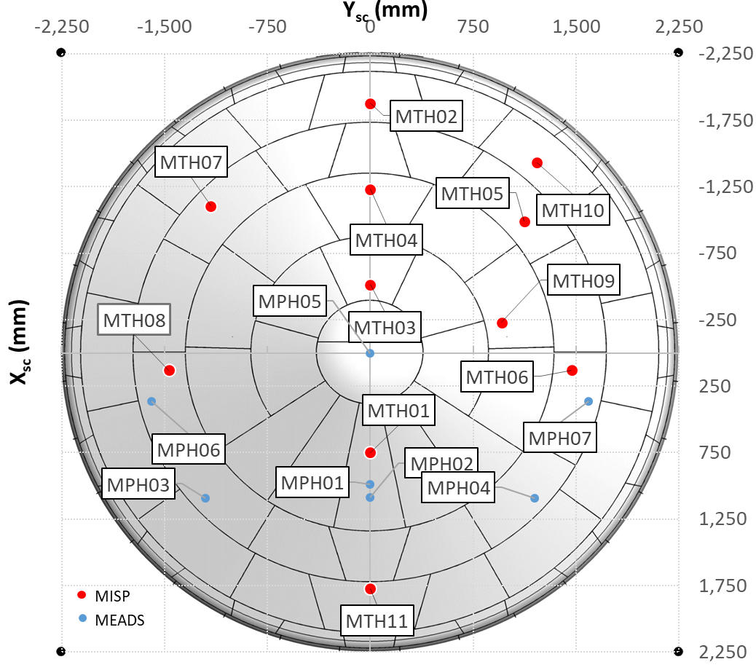
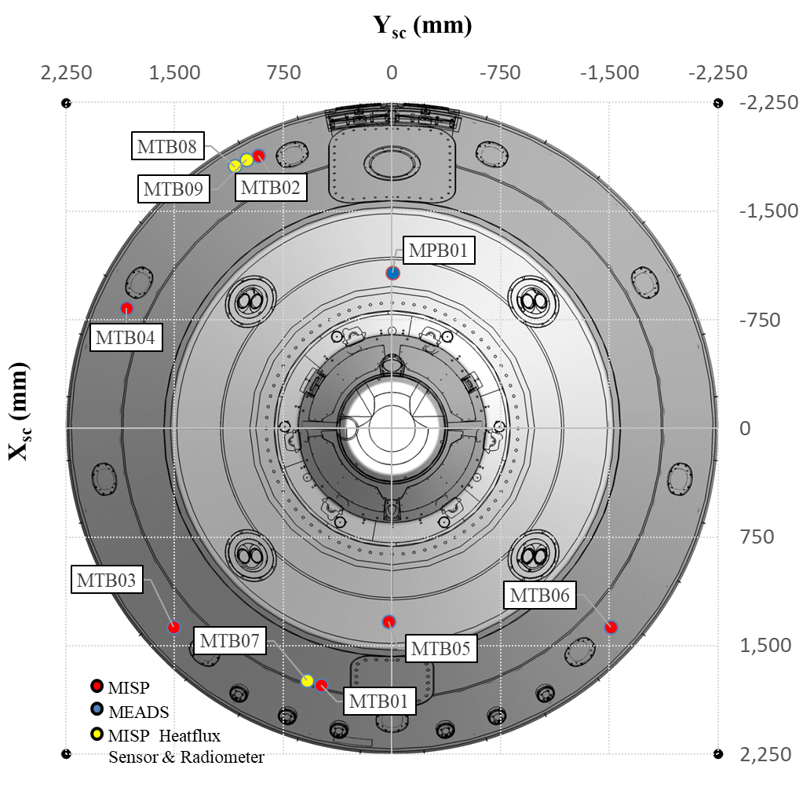
Mars 2020 Entry, Descent, and Landing Instrumentation (MEDLI2)
Measurement | Heatshield | Backshell | Comment | Purpose
Pressure | MPH (7) | MPB (1) | Pressure transducer | Atmosphere and vehicle attitude reconstruction
Temperature | MTH (11) | MTB (6) | Thermocouples (TCs), 1-3 TCs per plug | TPS response, total heat flux reconstruction
Heat Flux | N/A | MTB (3) | Total heat flux (MTB07-08), radiometer (MTB09) | Total and radiative heat flux

Slide 15
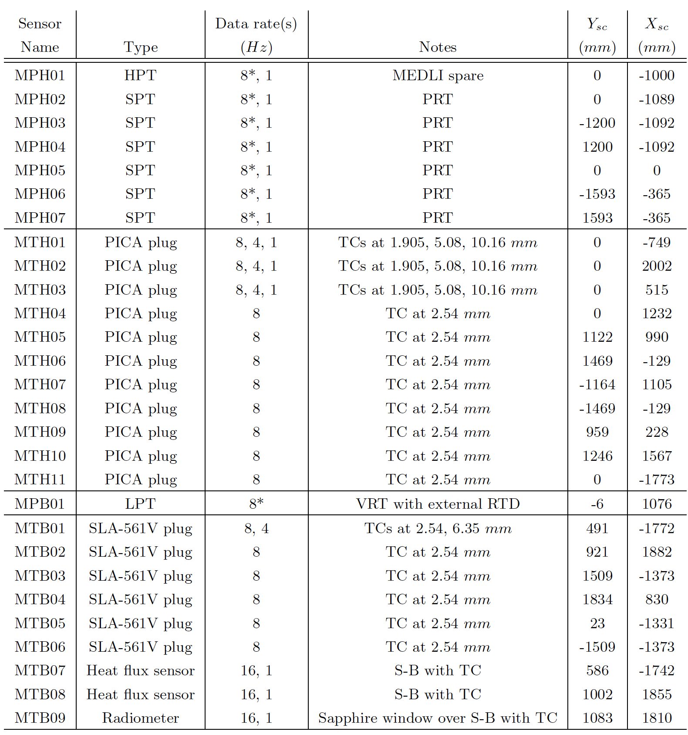
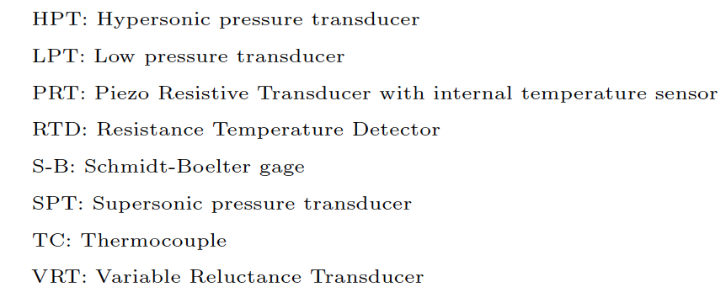
MEDLI2 Details

Slide 16
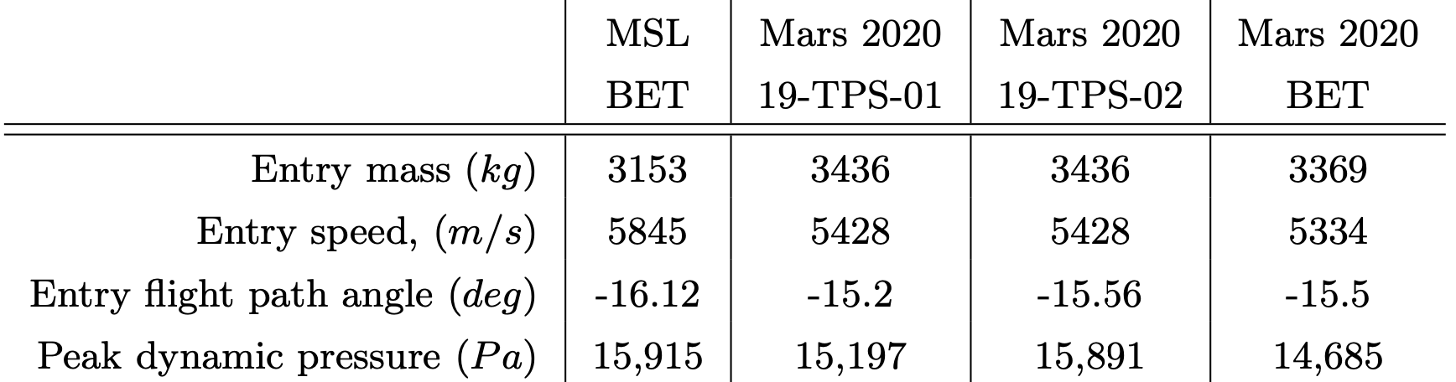
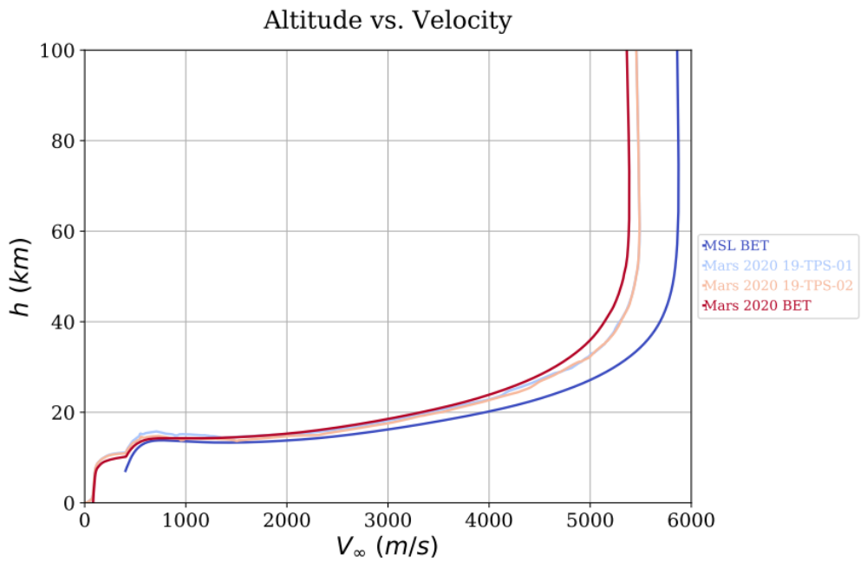
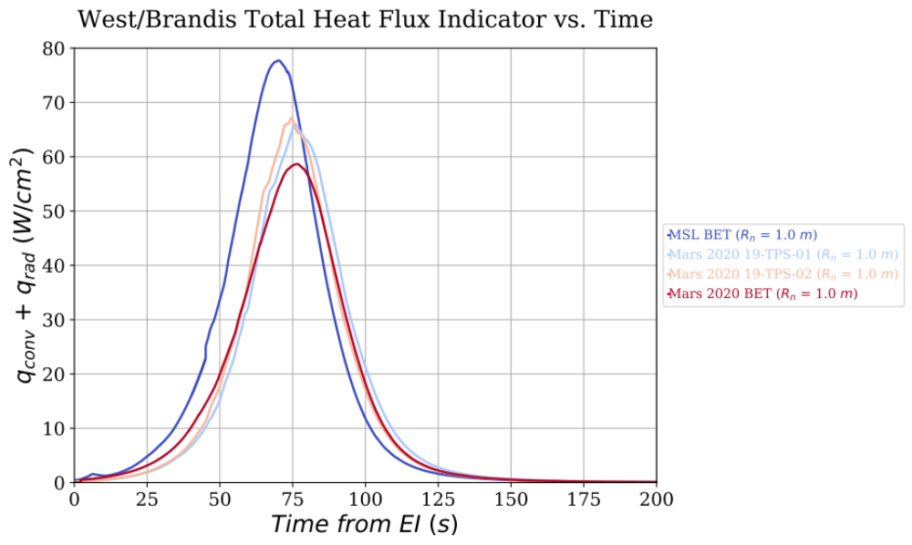
Best Estimated Trajectory (BET)

Slide 17
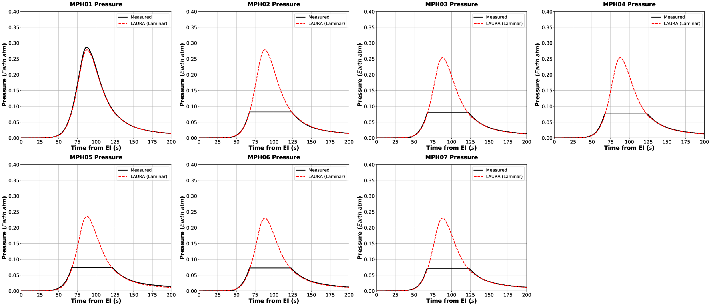
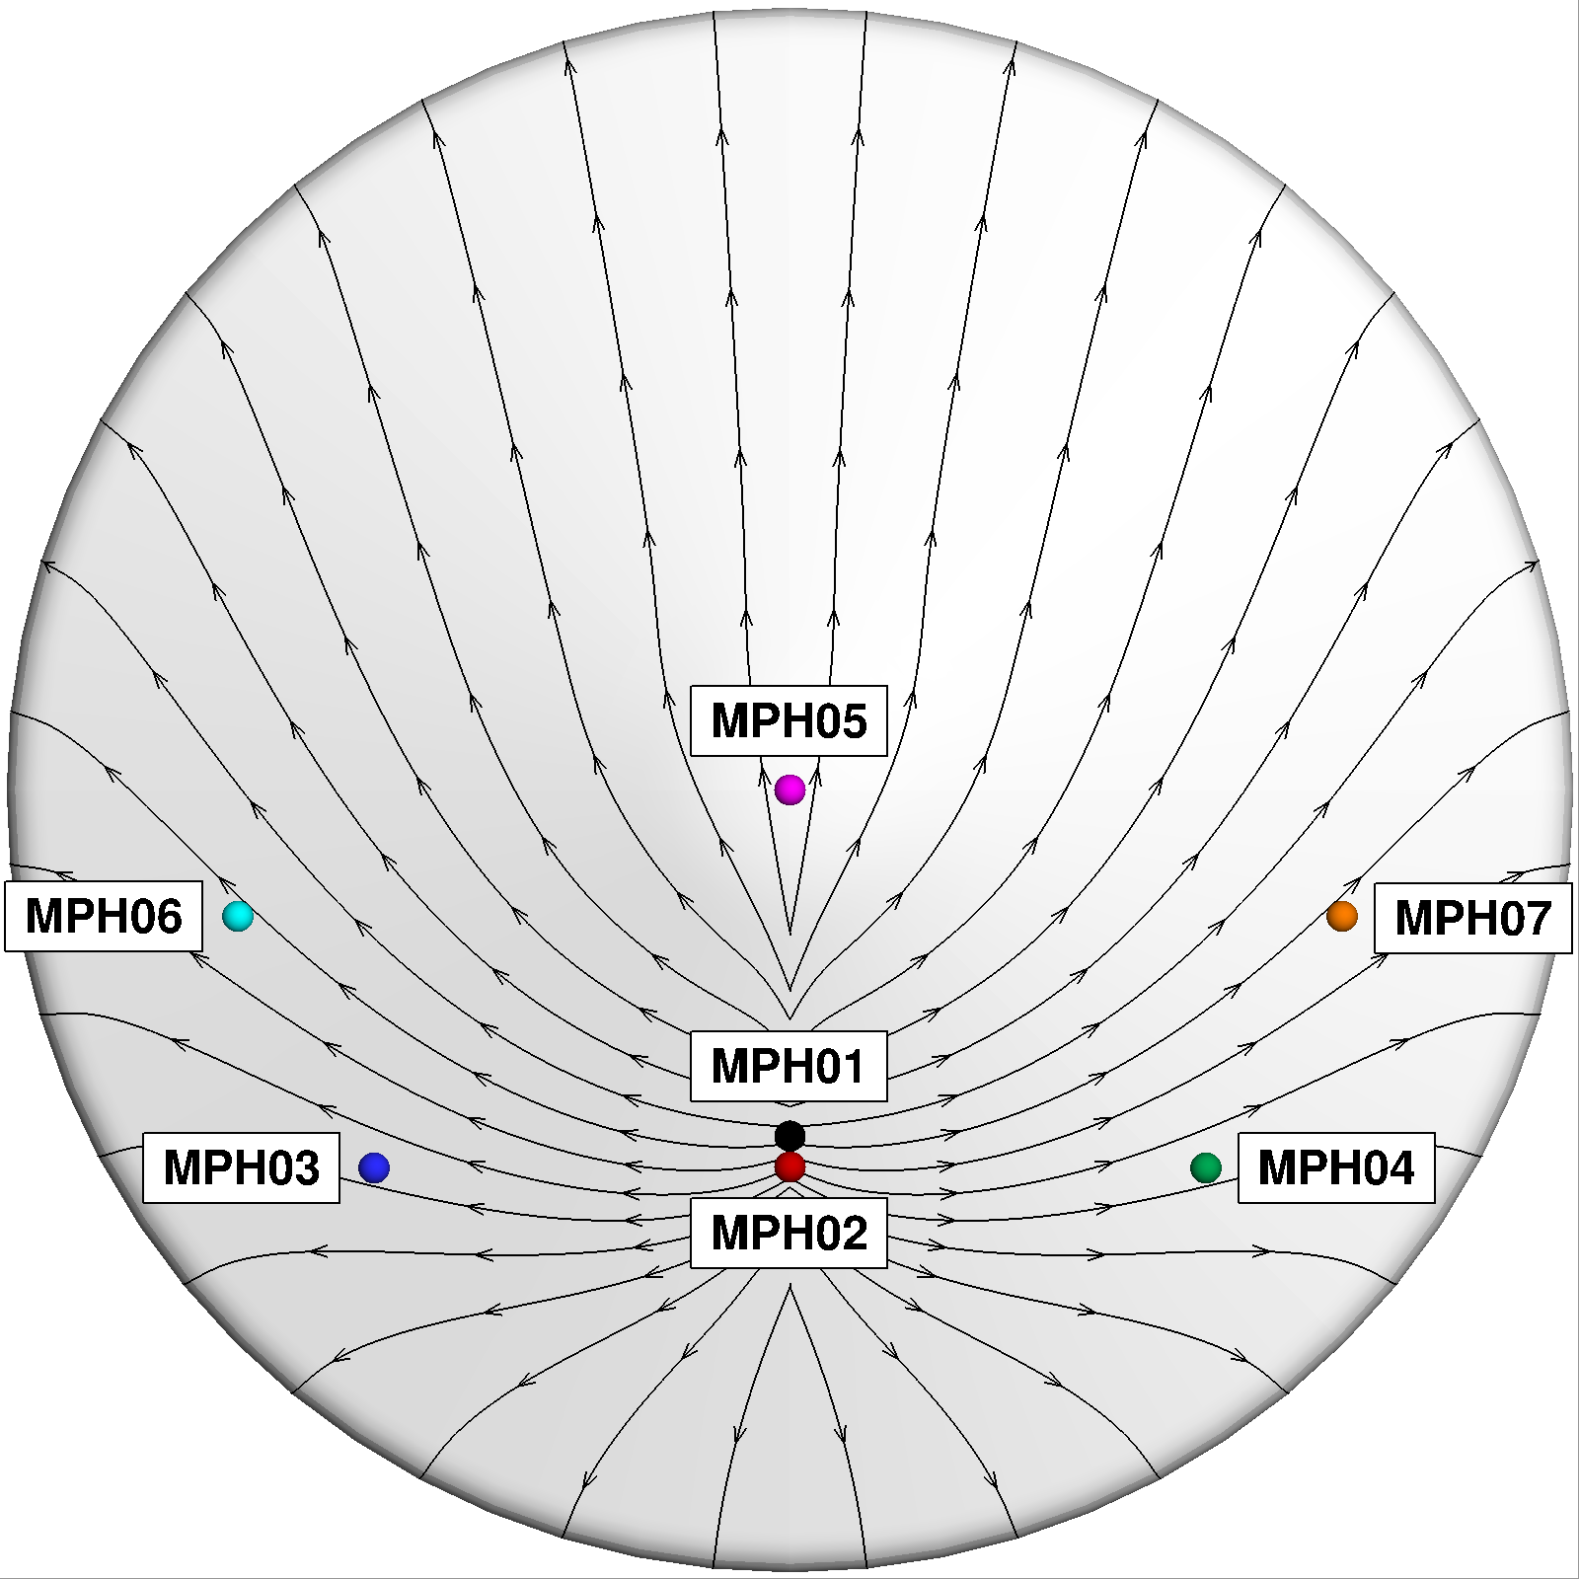
Mars 2020 Heatshield Pressures vs. CFD
Predicted peak pressure at MPH01 is within 3% of data

Slide 18
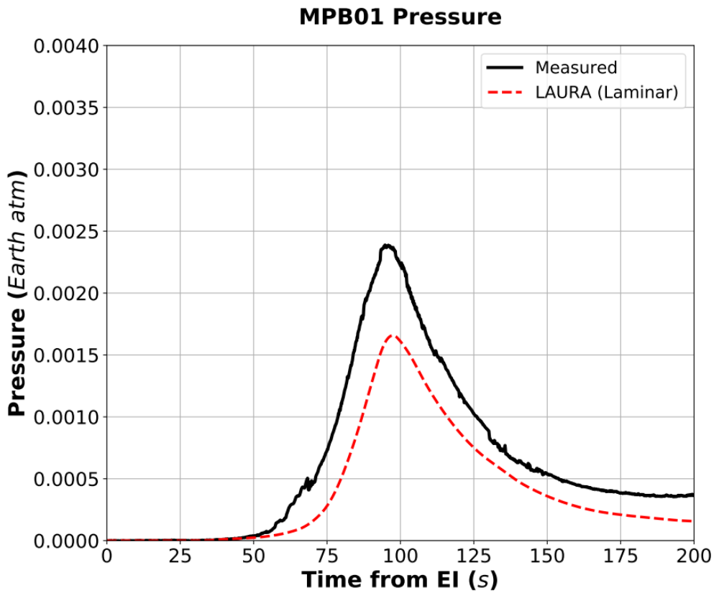
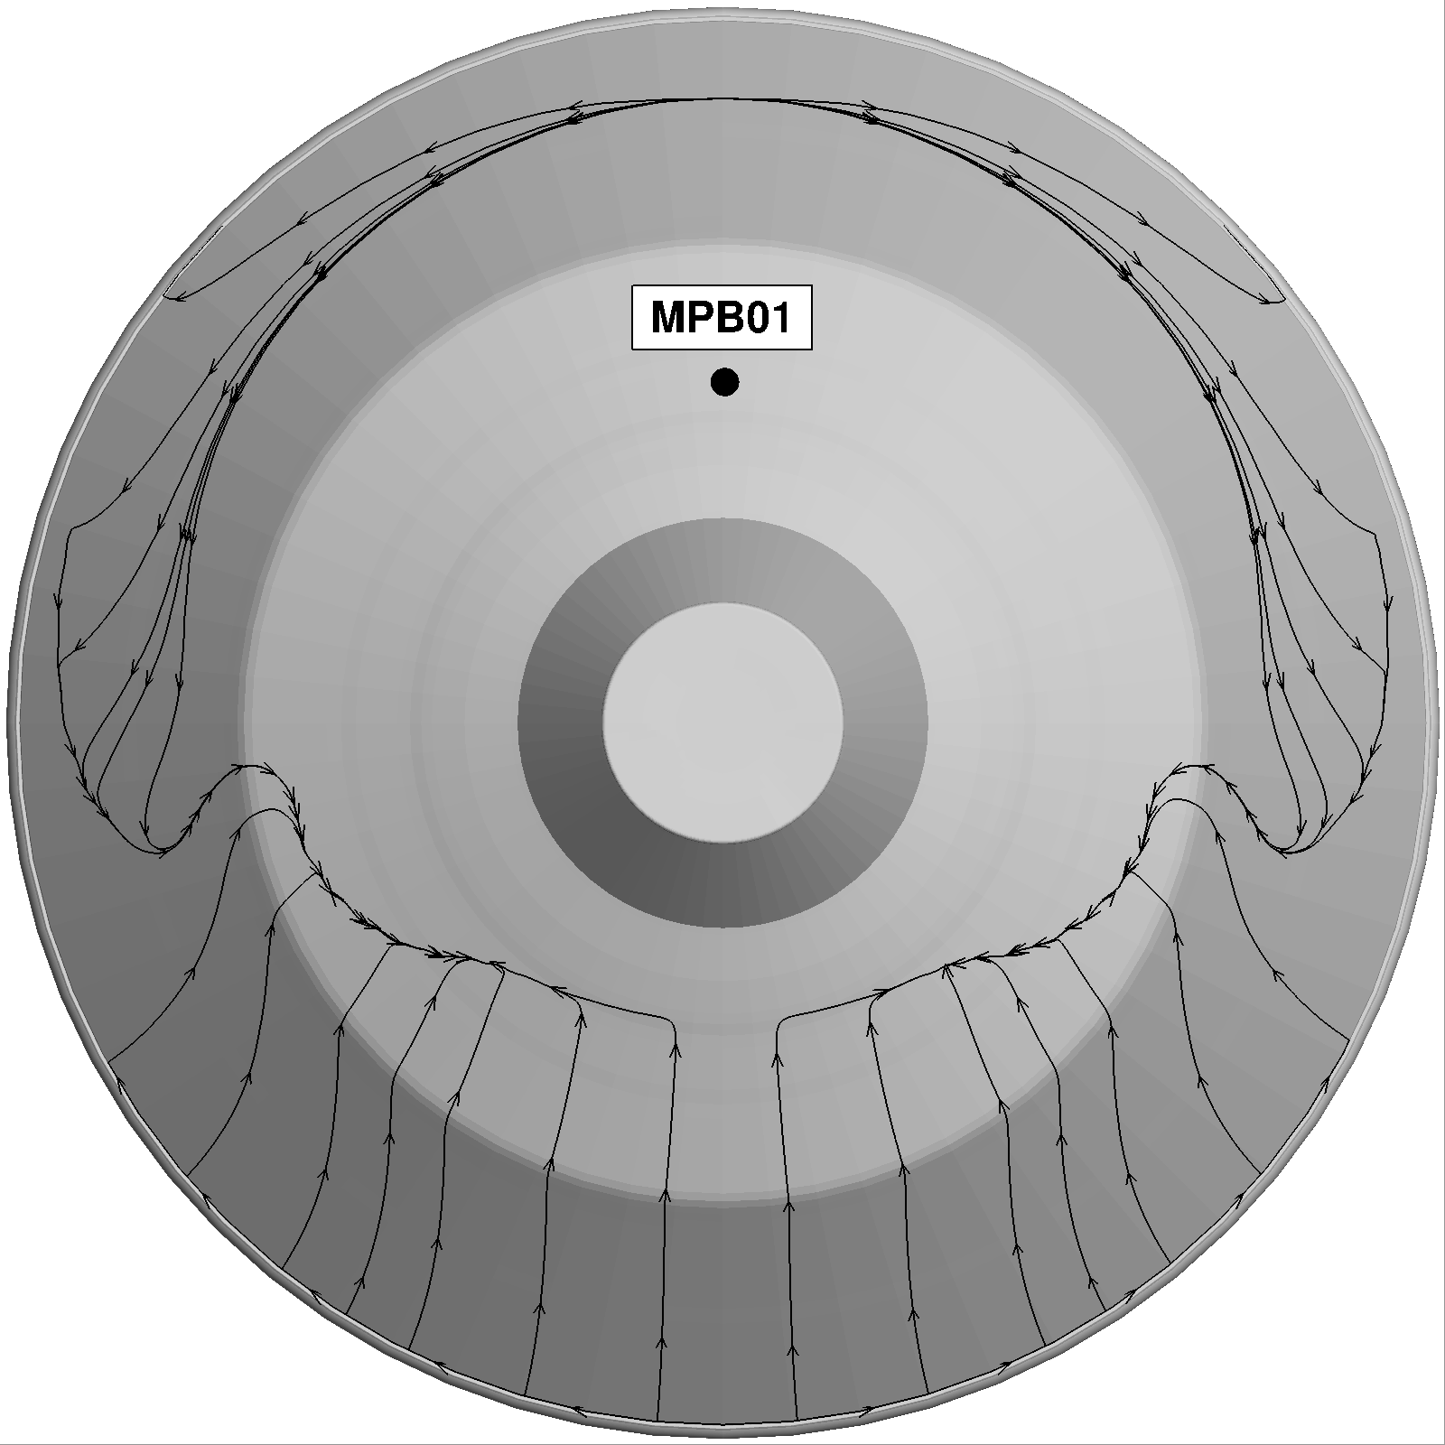
Mars 2020 Backshell Pressure vs. CFD
Pressure was measured to help improve our understanding of how the Backshell contributes to aerodynamics at supersonic conditions
Time-averaged pressure from unsteady laminar LAURA predictions qualitatively match the measured profile, but with lower magnitudes

