Slide 1
Leveraging CSPP:
Building a cloud based direct broadcast processing system
Thad Chee (SSAI), Louis Nguyen (NASA), Andrei Vakhnin (SSAI), A. Jason Barnett (BAH)
Notes:
I’ll be expanding on Louis’ talk first with a bit of background and then describing the iterations we went through with the end result being the processing engine that I’ll describe in detail.

Slide 2
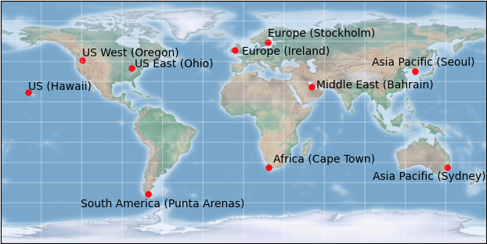
Leveraging CSPP: Building a cloud based direct broadcast processing system
Why build a cloud-based system for direct broadcast reception and processing?
Up front costs are lower than building your own antenna network
Reception of Direct Broadcast signals as needed
Ground Station Network Providers
  Leaf Space
  Kongsberg Satellite Services
  The Swedish Space Corp (SSC)
  CONTEC
  Sfera Technologies
  ATLAS Space Operations
  BridgeComm, Inc.
  Libre Space Foundation*
Ground Station Capacity Aggregators
StellarStation
Global Ground Station Network
AWS Ground Station
Microsoft Azure Orbital
* Open source
Notes:
When we talk about direct broadcast, the first reasonable question is why build a cloud based system in the first place?
After all, we already have IPOPP and CSPP.
The simple reason is that the cloud providers are now building out antenna networks that allow both sending and receiving and there is a good cost based argument to using the service versus building your own network.
The map on the left shows the location of the current set of amazon’s ground stations and each provider has a similar map so you can see that overall the coverage isn’t that bad – except if you want to receive direct broadcast over the poles.
You can receive direct broadcast signals and process them when you need them. This is a compelling argument when you are talking about an emergency situation where the time that it takes to receive information is at a premium.
Sources:
https://blog.satsearch.co/2019-09-25-ground-station-service-providers-an-overview-of-telemetry-and-telecommand-communication-services-and-networks-for-small-satellites
https://azure.microsoft.com/en-us/services/orbital/#features

Slide 3
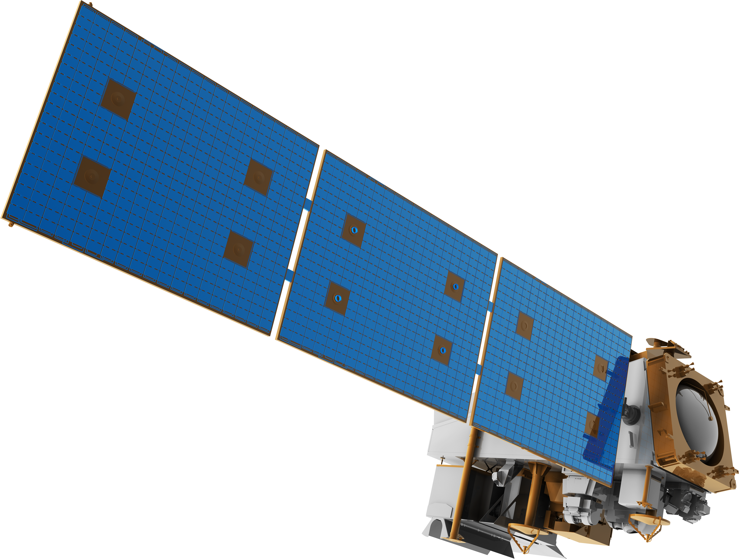




Leveraging CSPP: Building a cloud based direct broadcast processing system
How does AWS GS work? The first implementation:
The version 1 implementation of a direct broadcast system worked well with some scaling issues discovered later.
  Managing the receiver ends
  IPOPP’s operation is for a different model of operation
Note the use of the AWS S3 bucket, it’s pivotal from a regional standpoint
Virginia Region
EC2 IPOPP System
Get L0 Files
IPOPP Processing
Send L1 and L2 files to S3
Oregon Region
AWS Ground Station
Demodulate and Decode
S3 Bucket
Transfers L0 files across regions
Stores outputs (L1, L2, logs, etc)
Strongly consistent storage
EC2 Receiver
Data Defender
Python Script
RT-STPS (DRL)
Send L0 files to S3
Notes:
The reason S3 is pivotal is that S3 is a global resource while all the other blocks in the diagram above are regional ones. Regional resources exist in a specific set of data centers. For example, we use us-east-1” as our processing center, it’s the oldest region and also the most unreliable. Its

Slide 4
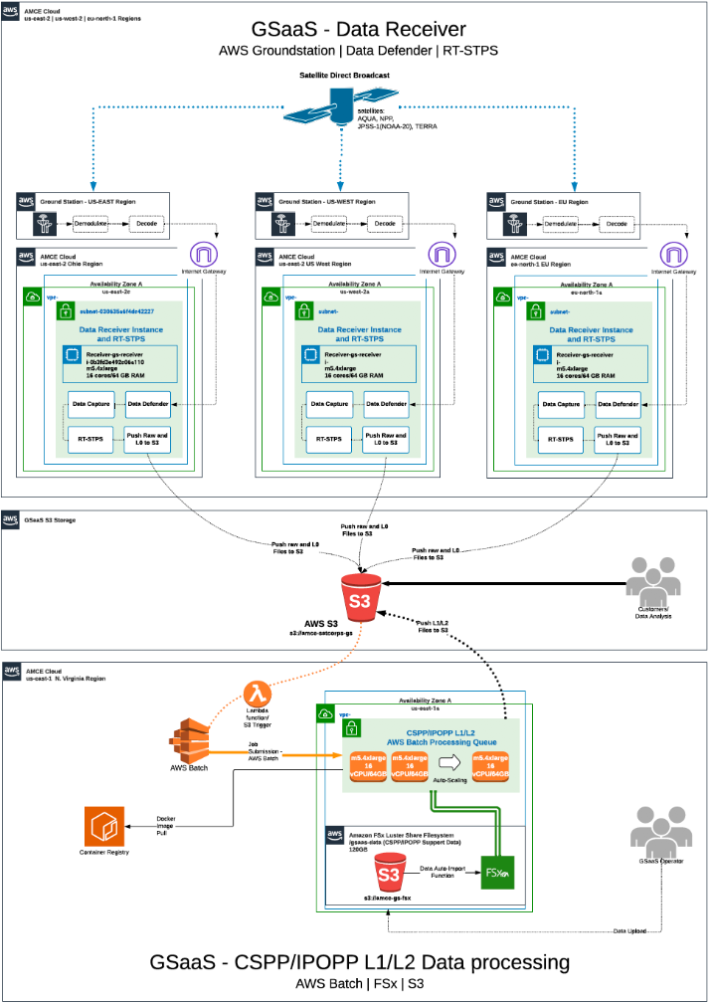
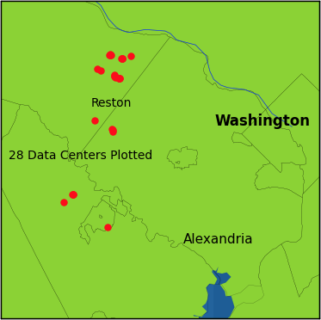
Leveraging CSPP: Building a cloud based direct broadcast processing system
A management problem:
This is an example using the version 1 set up if you are using only three ground stations.
Each ground station operates its own receiver instance with a data defender, python scripts and RT-STPS installed in each geographical location.
Notes:
Thank you to Andrei Vakhnin for the graphic on the right

Slide 5
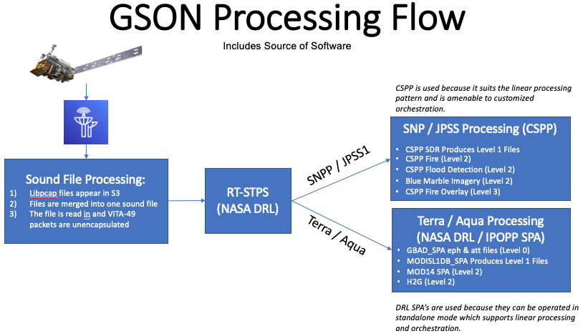
Leveraging CSPP: Building a cloud based direct broadcast processing system
Leveraging CSPP:
Initially started with a bespoke linear script
We realized that after running CSPP SDR, that there was no need to run any of the other packages serially
Notes:
With all of that background, we come to the part that the meeting is about, CSPP or the Community Satellite Processing Package. And more specifically, how did we leverage its use in the cloud?

Slide 6
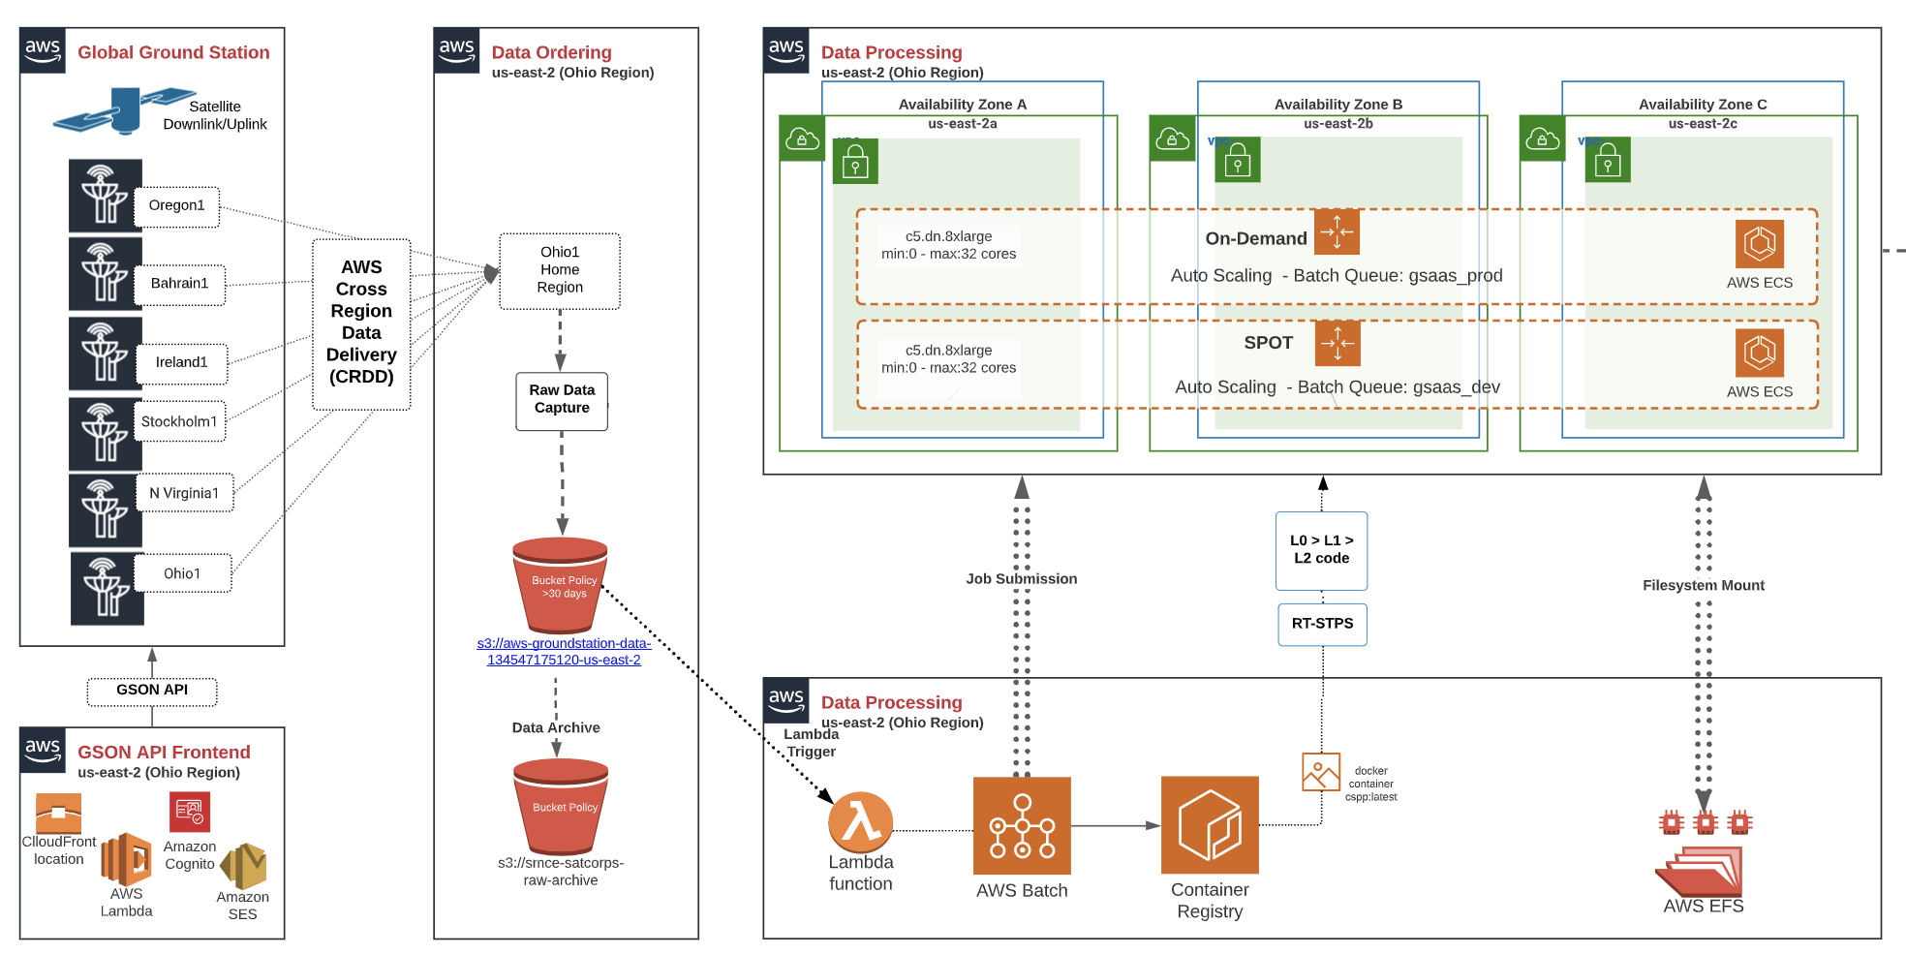
Leveraging CSPP: Building a cloud based direct broadcast processing system
Enter CRDD:
Cross Region Data Delivery (CRDD) – an architectural change presented a new opportunity for a new processing model
No more receivers!
  management headaches
  No more “Must work” pieces
  Easier to debug and develop
Notes:
At the same time that we were thinking about how we were using CSPP and how many scripts we had for each satellite and how we didn’t need to process EVERYTHING (fire, flood, clouds) every time, Amazon announced a new delivery system, Cross Region Data Delivery, or CRDD. In this version 2 of their system, the receiver system is internalized into the ground station itself and streaming data is delivered every 50 megabytes.
CRDD uses dedicated data-center to data-center connections, not the general internet to put the files into S3
Lambda function is triggered when overpass completes (event: contactState=COMPLETED). The function then starts an AWS batch job to processing the received packets.
The AWS Batch job does the following steps:
Merge all pcap files into a single file
Remove all VITA-49 encapsulation – this is done in the same way that the python port program (receivedata.py/awsgs.py) performs the task except no reception via a port interface because that method peaks out at 200mbps in testing due to buffer overflow issues in the network stack.
Trigger RT-STPS to start and process the generated outputs.

Slide 7
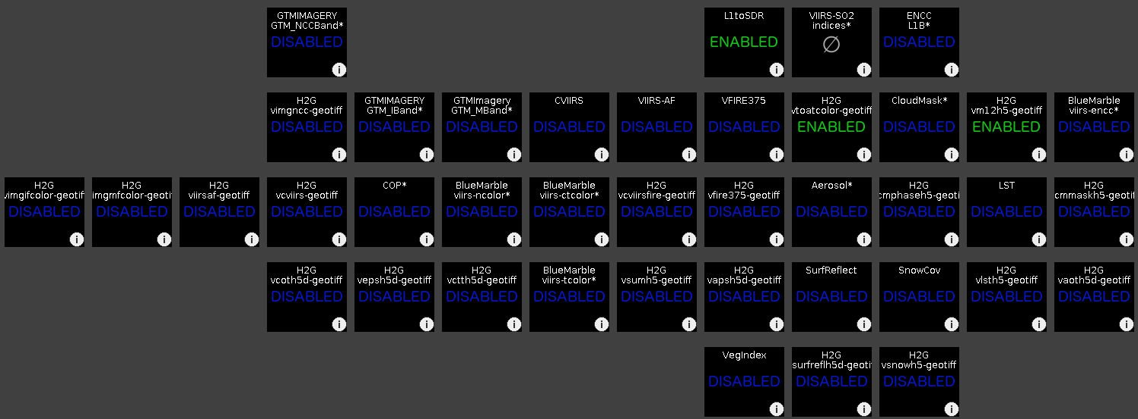
Leveraging CSPP: Building a cloud based direct broadcast processing system
Leveraging CSPP:
With the realization that we could mix and match different CSPP software, we also realized they could be run in parallel as long as prerequisites are met (L1 exists etc)
IPOPP Status Screen over VNC
We also realized that the bespoke linear design was repeating the same steps over and over, just with different CSPP commands and that the CSPP software all had the same general requirements.
After reviewing our existing code and identifying these patterns, we developed an abstraction that captures how we use CSPP as JSON objects.
This “step” model encapsulates each work task and its requirements and insulates the system from the details. This is very similar to the IPOPP processing tree.
Notes:
With all of that background, we come to the part that the meeting is about, CSPP or the Community Satellite Processing Package. And more specifically, how did we leverage its use in the cloud?

Slide 8
Leveraging CSPP: Building a cloud based direct broadcast processing system
The idea of “steps”
  Each step is given a “name”
  A step is a unit of work of any size:
    RT-STPS
    CSPP SDR
    Fire / Flood
    Copying results to S3
  How to coordinate the steps in sequence and in parallel – state tags
The engine keeps a “bag” of state tags
  Start state tag – the step has started
  End state tag– the step has completed
  End_OK state tag – the step has completed successfully
  End_Failed state tag – the step has completed but in a failed state
The engine is really a coordinator of the steps
  Initializing, loading steps
  Picking steps to run
  Determining when there are no more steps that can run
    No running steps
    No steps that can run - there are normally steps that don’t run (error handling steps)

Slide 9
GSON System – The State Driven Engine
Leveraging CSPP: Building a cloud based direct broadcast processing system
Start and End state tags
State tags - just the names of each step
Additional state tags, defined by the step
Tag: RT-STPS:
RT-STPS_START
And
RT-STPS_END
Tags: VIIRS_L0, CRIS_L0, ATMS_L0, L0
Tags: VIIRS_L1, CRIS_L1, ATMS_L1, L1
Tags: VIIRS_L2_FLOOD_HDF, VIIRS_L2_FLOOD_TIF
VIIRS Flood
Tags: VIIRS_L2_FIRE_HDF, VIIRS_L2_FIRE_TIF
VIIRS Level 0
VIIRS Level 1
VIIRS Fire
Tags: VIIRS_TRUE_COLOR_TIF
RT-STPS
CRIS Level 0
CRIS Level 1
VIIRS True Color
ATMS Level 0
ATMS Level 1
Processing Steps
Notes:
Important: each generated state tag has “START” and “END” appended to it. An example is the RT-STPS tag, but I’ve omitted the start and end on all the remaining tags shown.
Additionally, the tags above the Level 0 and Level 1 are for each of the different steps, so VIIRS generates VIIRS tags and CRiS would generate its own tags, that’s why there is no arrow pointing to that orange set of tags.
Each follow on step (Say, VIIRS Level 1) lists the “END” tag of the previous step (In this case, VIIRS_L0_END) as the tag needed to trigger this processing
Note, all of the steps do not need to execute – if a required tag is never generated, then the step is never executed. The engine only looks for how many steps exist that still have outstanding state tags left.
Each step can also create its own state tags, note how the VIIRS flood generates a “VIIRS_L2_FLOOD_HDF” and “VIIRS_L2_FLOOD_TIF” state tag in addition to the “VIIRS_L2_FLOOD_END” tag. The different state tags allow for faster or specialized processing to start.

Slide 10
Leveraging CSPP: Building a cloud based direct broadcast processing system
Benefits of a state driven engine:
Parallelism: Speed
  Notifications happen immediately, L0, L1, L2 as soon as files are available on s3
  All instruments and Levels are processed simultaneously
Modularity: Flexibility
  Processing steps can be easily swapped in or out by modifying the JSON meta-data
  Ease of debugging or prototyping – Changing JSON meta-data to linear script
Complexity: With error handling, the linear execution script was very large with multiple scripts for each satellite or sensor. The state engine reduced the code complexity by 70%
Simple debugging: Change the start tag allows one to test specific parts of the processing individually
Allows us to run CSPP science algorithm on multiple satellites/instruments by only modifying meta-data, not code. You can run serial or parallel depending on your situation.
Notes:
By making things happen in parallel, tasks get completed faster. An example is notifications. Processing all instruments at the same time is also an obvious time saver, with VIIRS being the slowest instrument to process.

Slide 11
Leveraging CSPP: Building a cloud based direct broadcast processing system
Going Forward:
Additional input sources: Azure and other Direct Broadcast Receivers
Increases in capability:
  More options for user steps
  Adding capability to the step processing
Increases in speed:
  Starting earlier
  Processing the CRDD granules as they arrive
  Parallelizing: Processing 1 granule per CSPP run instead of all
    Minimal benefits anticipated from Fire algorithm – it is already internally parallelized
    Expect to see flood algorithm speed gains but need to merge netcdf’s afterwards (currently about 20 minutes to run)
User defined monitoring in addition to MQTT

Slide 12
Thank you!
Questions?
Trade names and trademarks are used in this report for identification only. Their usage does not constitute an official endorsement, either expressed or implied, by the National Aeronautics and Space Administration.

