Slide 1


Jeff Gramling​
Director, Mars Sample Return Program
Dr. Michael Meyer
Mars Lead Scientist
Planetary Science Advisory Committee
June 21, 2022
Notes:
STILL

Slide 2
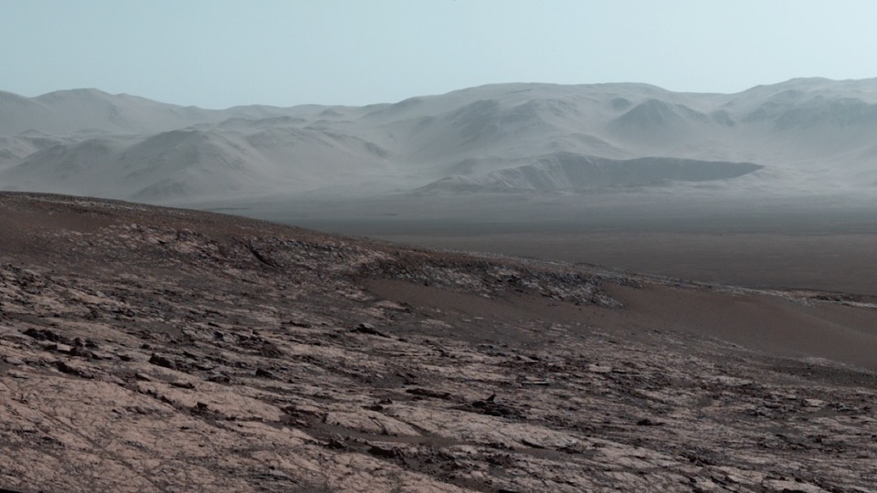
GOAL —
First Sample Return From Another Planet
A priority since 1980 and of three National Academy Decadal Surveys
A first-step “round-trip” in advance of humans to Mars
The oldest known life on Earth existed ~3.5 billion years ago,
a time when Mars was habitable. Today,
<<1% of the Earth’s surface is 3 billion years or older
    >50% of the Mars’ surface is 3 billion years or older
The first billion years and life’s beginning in the Solar System:
The record is on Mars
2

Slide 3
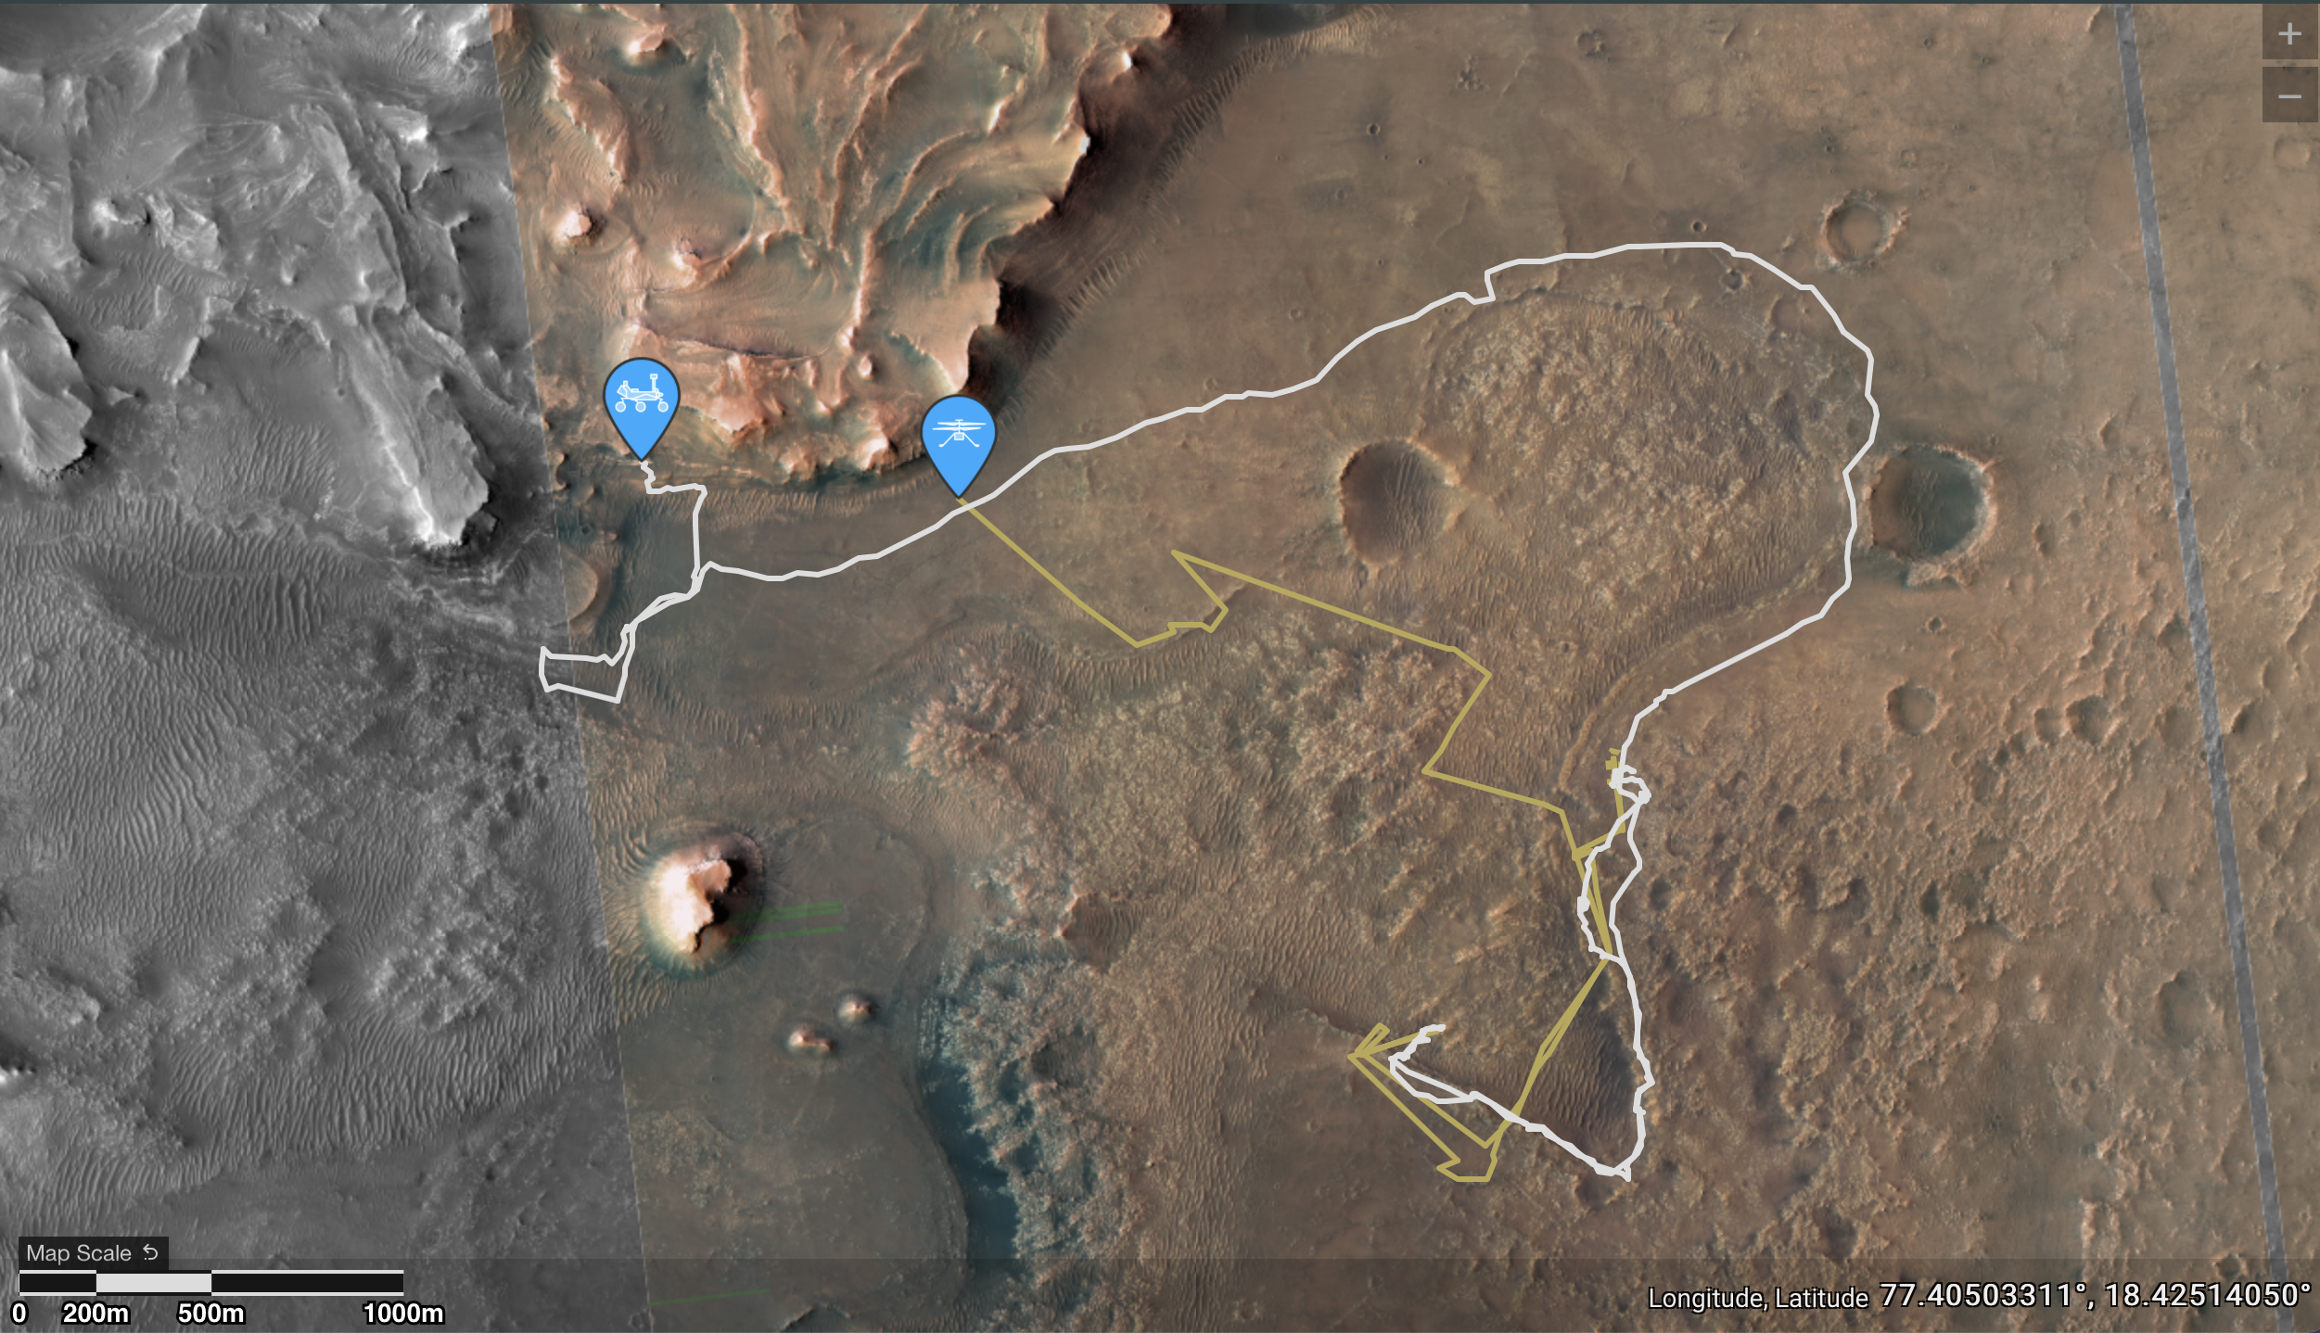
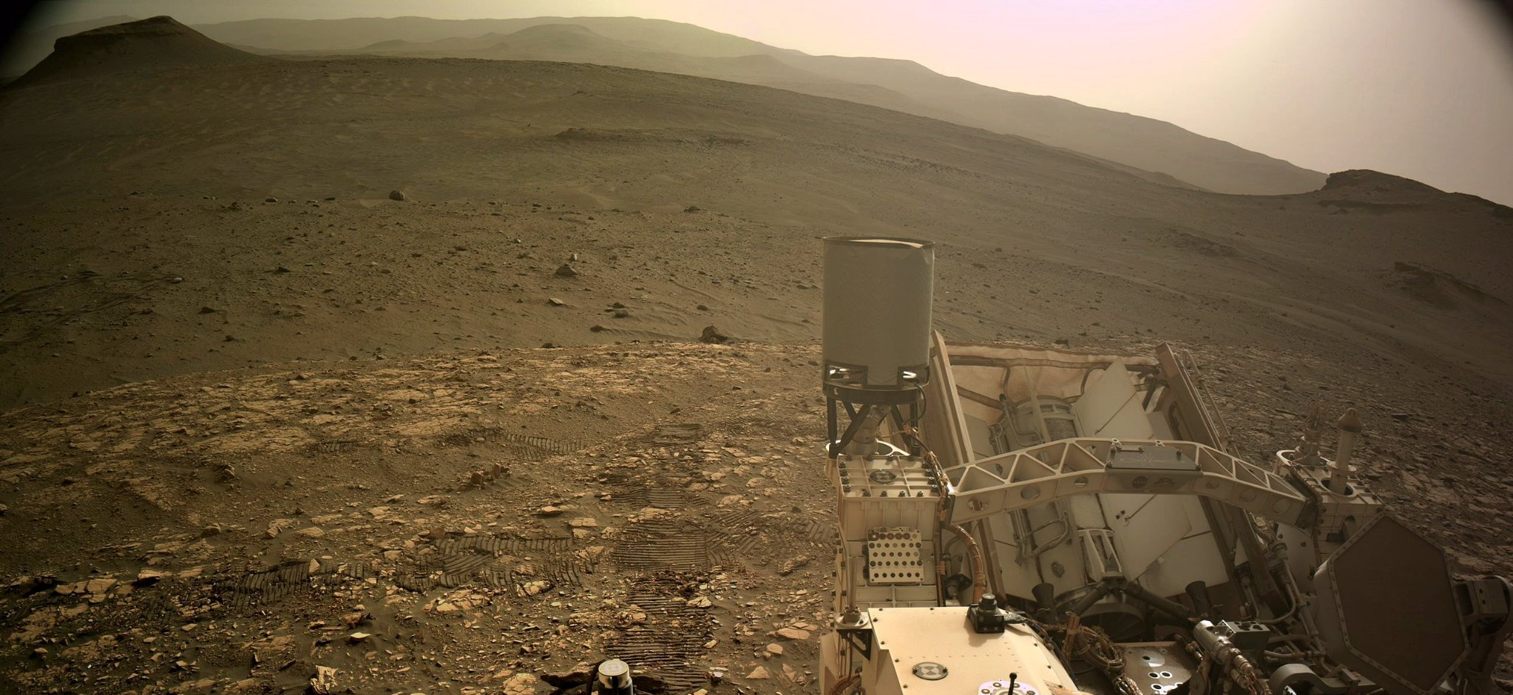
Perseverance Odometer: 12052.7 meters*
Ingenuity Log: 28 flights, 6909 m, 3254.9 sec*
*June 10, 2022, Sol 464
Mars2020
  Power of AutoNav Perseverance set multi-sol plan record distance 528.673 m (Sol 404-405 )
  28 successful flights & over 1 yr of ops for Ingenuity!
Three Forks
Octavia E. Butler Landing Site
Crater Floor Science Campaign Area
  Perseverance set single-sol record 319.786m (Sol 351 )
NASA’s Perseverance rover at Hogwallow Flats on June 10, 2022, the 464th Martian day, or sol, of the mission. Credit: NASA/JPL-Caltech/USGS/UofA (PH)
Notes:
-NASA’s Perseverance rover arrived at the doorstep of Jezero Crater’s ancient river delta April 13. Dubbed “Three Forks” by the Perseverance team (a reference to the spot where three route options to the delta merge), the location serves as the staging area for the rover’s second science expedition, the “Delta Front Campaign.”
-The Delta Front Campaign kicked off April 18th (edge of delta outlined in Orange)
-Team scoping out the best route to ascend the delta, which rises about 130 feet (40 meters) above the crater floor
-The delta, a massive fan-shaped collection of rocks and sediment at the western edge of Jezero Crater, formed at the convergence of a Martian river and a crater lake billions of years ago. Its exploration tops the Perseverance science team’s wish list because all the fine-grained sediment deposited at its base long ago is the mission’s best bet for finding the preserved remnants of ancient microbial life.
-Perseverance is kicking off its second science campaign more than a month earlier than planned due to the rover’s ability to autonomously negotiate Jezero Crater’s sandpits, craters, boulders, and fields of sharp rocks. The rover’s six flight-grade-aluminum wheels completed 3,116.25 revolutions during the 16,617-foot (5,065-meter) journey to Three Forks. Averaging 692 feet (211 meters) per drive (no driving occurred on six sols), the rover’s artificial-intelligence-assisted autonavigation capability, or AutoNav, assessed 10,744 navigation camera images during the road trip and commanded the rover to halt and turn in place to negotiate surface hazards 55 times.
-Ingenuity successfully completed Flight 26 on sol 414 (April 19) to survey the backshell & parachute, and Flight 27 on sol 418 (April 23) was headed toward Three Forks.

Slide 4
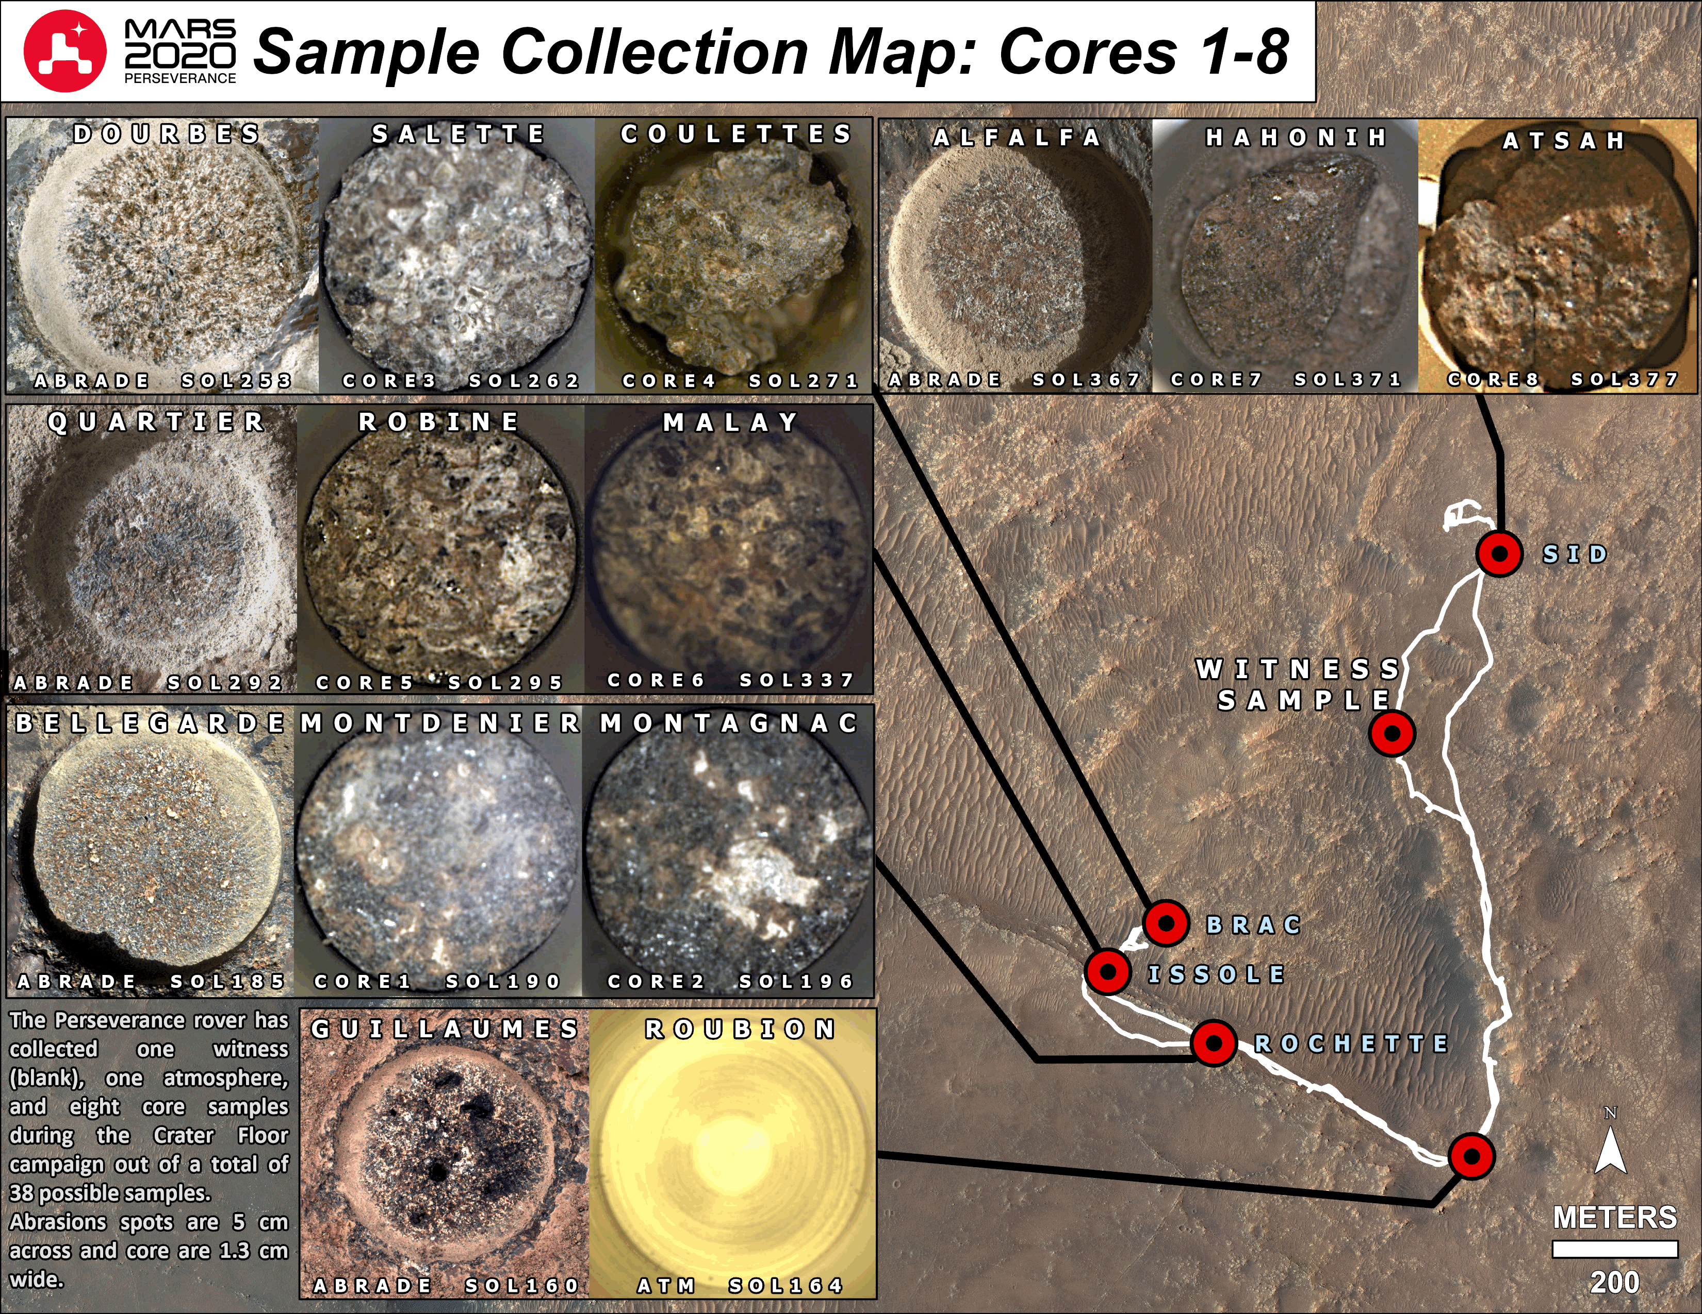
Samples Collected by Perseverance
Perseverance has arrived at the delta front. Has 8 rock samples collected during Crater Floor Science Campaign.
  Total 10 tubes sealed:
  1 Witness blank
  1 Atmospheric sample
  4 pairs of rock core samples
An initial 30-day report is prepared for each sample that will provide contextual information on the returned samples.
Landing site characterization for the first depot at the “Landing Strip” are underway.
Science Community Workshop for depot of the first sample set is being planned for last week in September 2022
Sampling Sites
4

Slide 5
MSR:
Potential benefits from samples already cached
Igneous rocks will provide absolute age of the Jezero crater region and anchor the ages of martian epochs
Salts and other products of aqueous alteration will provide insights into the history of water in this region on Mars
Organic compounds already detected in some samples – will be able to determine the specific compound(s) and potentially deduce their origin (biogenic vs abiogenic)
The samples will help address major gaps in our knowledge for future human exploration

Slide 6





“Mars Sample Return (MSR) has been a high priority for the planetary science community for more than four decades. Analyzing martian samples in terrestrial laboratories would advance our understanding of Mars in multiple ways that are impossible using in situ missions alone," states special supplement authors in the forward. "The purpose of this special issue of Astrobiology is to collate and publish these scientific and planning reports for MSR in a single location and make them available to the community of scientists interested in MSR."
View this email online
Latest Impact Factor: 4.335
SPECIAL SUPPLEMENT Mars Sample Return: Planning for Returned Sample Science
"Mars Sample Return (MSR) has been a high priority for the planetary science community for more than four decades. Analyzing martian samples in terrestrial laboratories would advance our understanding of Mars in multiple ways that are impossible using in situ missions alone," states special supplement authors in the foreword. "The purpose of this special issue of Astrobiology is to collate and publish these scientific and planning reports for MSR in a single location and make them available to the community of scientists interested in MSR." Read the full special supplement now:
In Memoriam
[Open Access]
Tullis C. Onstott
Read Now
Foreword
[Open Access]
Mars Sample Return (MSR): Planning for Returned Sample Science
Gerhard Kminek, Michael A. Meyer, David W. Beaty, Brandi L. Carrier, Timothy Haltigin, and Lindsay E. Hays Read Now
News & Views
[Open Access]
Final Report of the Mars Sample Return Science Planning Group 2 (MSPG2)
Michael A. Meyer, Gerhard Kminek, David W. Beaty, Brandi L. Carrier, Timothy Haltigin, Lindsay E. Hays, Carl B. Agree, Henner Busemann, Barbara Cavalazzi, Charles S. Cockell, Vinciane Debaille, Daniel P. Glavin, Monica M. Grady, Ernst Hauber, Aurore Hutzler, Bernard Marty, Francis M. McCubbin, Lisa M. Pratt, Aaron B. Regberg, Alvin L. Smith, Caroline L. Smith, Roger E. Summons, Timothy D. Swindle, Kimberly T. Tait, Nicholas J. Tosca, Arya Udry, Tomohiro Usui, Michael A. Velbel, Meenakshi Wadhwa, Frances Westall, and Maria-Paz Zorzano Read Now
[Open Access]
Rationale and Proposed Design for a Mars Sample Return (MSR) Science Program
Timothy Haltigin, Ernst Hauber, Gerhard Kminek, Michael A. Meyer, Carl B. Agee, Henner Busemann, Brandi L. Carrier, Daniel P. Glavin, Lindsay E. Hays, Bernard Marty, Lisa M. Pratt, Arya Udry, Maria-Paz Zorzano, David W. Beaty, Barbara Cavalazzi, Charles S. Cockell, Vinciane Debaille, Monica M. Grady, Aurore Hutzler, Francis M. McCubbin, Aaron B. Regberg, Alvin L. Smith, Caroline L. Smith, Roger E. Summons, Timothy D. Swindle, Kimberly T. Tait, Nicholas J. Tosca, Tomohiro Usui, Michael A. Velbel, Meenakshi Wadhwa, and Frances Westall Read Now
[Open Access]
Preliminary Planning for Mars Sample Return (MSR) Curation Activities in a Sample Receiving Facility (SRF)
Kimberly T. Tait, Francis M. McCubbin, Caroline L. Smith, Carl B. Agee, Henner Busemann, Barbara Cavalazzi, Vinciane Debaille, Aurore Hutzler, Tomohiro Usui, Gerhard Kminek, Michael A. Meyer, David W. Beaty, Brandi L. Carrier, Timothy Haltigin, Lindsay E. Hays, Charles S. Cockell, Daniel P. Glavin, Monica M. Grady, Ernst Hauber, Bernard Marty, Lisa M. Pratt, Aaron B. Regberg, Alvin L. Smith, Roger E. Summons, Timothy D. Swindle, Nicholas J. Tosca, Arya Udry, Michael A. Velbel, Meenakshi Wadhwa, Frances Westall, and Maria-Paz Zorzano Read Now
[Open Access]
Time-Sensitive Aspects of Mars Sample Return (MSR) Science
Prof. Nicholas J. Tosca, Dr. Carl B. Agee, Prof. Charles S. Cockell, Dr. Daniel P. Glavin, Dr. Aurore Hutzler, Dr. Bernard Marty, Dr. Francis M. McCubbin, Dr. Aaron B. Regberg, Prof. Michael A. Velbel, Dr. Gerhard Kminek, Dr. Michael A. Meyer, Dr. David W. Beaty, Dr. Brandi L. Carrier, Dr. Timothy Haltigin, Dr. Lindsay E. Hays, Dr. Henner Busemann, Dr. Barbara Cavalazzi, Dr. Vinciane Debaille, Dr. Monica M. Grady, Dr. Ernst Hauber, Dr. Lisa M. Pratt, Dr. Alvin L. Smith, Dr. Caroline L. Smith, Prof. Roger E. Summons, Dr. Timothy D. Swindle, Dr. Kimberly T. Tait, Prof. Arya Udry, Prof. Tomohiro Usui, Prof. Meenakshi Wadhwa, Dr. Frances Westall, and Dr. Maria-Paz Zorzano Read Now
[Open Access]
Planning Implications Related to Sterilization-Sensitive Science Investigations Associated with Mars Sample Return (MSR)
Prof. Michael A. Velbel, Prof. Charles S. Cockell, Dr. Daniel P. Glavin, Dr. Bernard Marty, Dr. Aaron B. Regberg, Dr. Alvin L. Smith, Prof. Nicholas J. Tosca, Prof. Meenakshi Wadhwa, Dr. Gerhard Kminek, Dr. Michael A. Meyer, Dr. David W. Beaty, Dr. Brandi Lee Carrier, Dr. Timothy Haltigin, Dr. Lindsay E. Hays, Dr. Carl B. Agee, Dr. Henner Busemann, Dr. Barbara Cavalazzi, Dr. Vinciane Debaille, Dr. Monica M. Grady, Dr. Ernst Hauber, Dr. Aurore Hutzler, Dr. Francis M. McCubbin, Dr. Lisa M. Pratt, Dr. Caroline L. Smith, Prof. Roger E. Summons, Dr. Timothy D. Swindle, Dr. Kimberly T. Tait, Prof. Arya Udry, Prof. Tomohiro Usui, Dr. Frances Westall, and Dr. Maria-Paz Zorzano Read Now
[Open Access]
Scientific Value of Including an Atmospheric Sample as Part of Mars Sample Return (MSR)
Timothy D. Swindle, Sushil Atreya, Henner Busemann, Julia A. Cartwright, Paul Mahaffy, Bernard Marty, Andreas Pack, and Susanne P. Schwenzer Read Now
[Open Access]
The Scientific Importance of Returning Airfall Dust as a Part of Mars Sample Return (MSR)
Monica M. Grady, Roger E. Summons, Timothy D. Swindle, Frances Westall, Gerhard Kminek, Michael A. Meyer, David W. Beaty, Brandi L. Carrier, Timothy Haltigin, Lindsay E. Hays, Carl B. Agee, Henner Busemann, Barbara Cavalazzi, Charles S. Cockell, Vinciane Debaille, Daniel P. Glavin, Ernst Hauber, Aurore Hutzler, Bernard Marty, Francis M. McCubbin, Lisa M. Pratt, Aaron B. Regberg, Alvin L. Smith, Caroline L. Smith, Kimberly T. Tait, Nicholas J. Tosca, Arya Udry, Tomohiro Usui, Michael A. Velbel, Meenakshi Wadhwa, and Maria-Paz Zorzano Read Now
[Open Access]
COSPAR Sample Safety Assessment Framework (SSAF)
Gerhard Kminek, James N. Benardini, Frank E. Brenker, Timothy Brooks, Aaron S. Burton, Suresh Dhaniyala, Jason P. Dworkin, Jeffrey L. Fortman, Mihaela Glamoclija, Monica M. Grady, Heather V. Graham, Junichi Haruyama, Thomas L. Kieft, Marion Koopmans, Francis M. McCubbin, Michael A. Meyer, Christian Mustin, Tullis C. Onstott, Neil Pearce, Lisa M. Pratt, Mark A. Sephton, Sandra Siljeström, Haruna Sugahara, Shino Suzuki, Yohey Suzuki, Mark van Zuilen, and Michel Viso Read Now
[Open Access]
Science and Curation Considerations for the Design of a Mars Sample Return (MSR) Sample Receiving Facility (SRF)
Brandi L. Carrier, David W. Beaty, Aurore Hutzler, Alvin L. Smith, Gerhard Kminek, Michael A. Meyer, Timothy Haltigin, Lindsay E. Hays, Carl B. Agee, Henner Busemann, Barbara Cavalazzi, Charles S. Cockell, Vinciane Debaille, Daniel P. Glavin, Monica M. Grady, Ernst Hauber, Bernard Marty, Francis M. McCubbin, Lisa M. Pratt, Aaron B. Regberg, Caroline L. Smith, Roger E. Summons, Timothy D. Swindle, Kimberly T. Tait, Nicholas J. Tosca, Arya Udry, Tomohiro Usui, Michael A. Velbel, Meenakshi Wadhwa, Frances Westall, and Maria-Paz Zorzano Read Now
[Open Access]
Recommendation on Orbiting Sample Cleanliness
Charles S. Cockell, Rohit Chitale, Brian Clement, Alfonso Davila, Katherine H. Freeman, Katherine L. French, Daniel P. Glavin, Lindsay E. Hays, Kimberly Hummel, Michael A. Meyer, Lisa M. Pratt, Christopher Salvo, Elaine Seasly, and Kar Wing Tsang Read Now
Maximize the global visibility and impact of your next published article.
© 2022 Mary Ann Liebert, Inc., publishers. All Rights Reserved 140 Huguenot Street, 3rd Floor, New Rochelle, NY, 10801-5215, USA Refine your email preferences: Liebert Connect You have received this email at michael.a.meyer@nasa.gov. Make sure you receive your requested Mary Ann Liebert, Inc. email alerts; add updates@email.liebertpub.com to your Address Book or Safe Senders List.
Privacy Policy | Unsubscribe from Featured Articles
SPECIAL SUPPLEMENT
Mars Sample Return: Planning for Returned Sample Science
Volume 22 Supplement 1 June 2022

Slide 7
NASA ESA MSR Science MoU in review at State Department – soon to ESA
"NASA and ESA, through a dedicated joint body to be established, shall have and provide, equitable access to returned samples for scientific research, and shall establish procedures for open competition for access by the international scientific community. Use and curation of samples shall be governed by a future agreement between the Parties, and be based on the principles of transparency, scientific maximization, accessibility, return of investment, and recognizing the samples as a single collection.” – NASA ESA MoU signed October 2020
The scope of the MSR Science MoU covers the science management of the Mars samples, from the caching of M2020 samples, through the MSR program flight elements, to the sample handling, curation and scientific analyses on ground until completion of the first round of objective-driven science.
  Does not intend to cover any agreements on the ground-based infrastructure to be used once the samples landed on Earth but permit the needed planning activities to prepare for handling the samples upon return to Earth.

Slide 8
MSR Campaign Science Group phase 1 meeting June 28-29
MCSG1 to support the Lead Scientists in the planning and oversight process during the implementation of the Science Management Plan and the execution of the MSR Science Program
  members selected through an open, international, competitive call (80 applicants, 16 selected)
  co-chaired by Michael Meyer (NASA) and Gerhard Kminek (ESA), MSR Lead Scientists
Reviewing Level 1 and derived science requirements
Maintaining what constitutes a Scientifically Return Worthy (SRW) sample cache and strategy for depot formation
Developing MSR science R&D roadmap; selection criteria for science team; MSR Sample Management Plan; Data Management Plan; and Communication Plan
Establishing MSR science objectives and MSR science success criteria
Supporting depot location, science requirements for handling the samples, coordination with curation and planetary protection
Informing and participating in the public outreach process

Slide 9
MCSG1 Members
Audrey Bovier | Universität Bayreuth, Bayerisches Geoinstitut | Suzanne Schwenzer | Open University, School of Earth, Environment and Ecosystem Sci.
Andrew Czaja | University of Cincinnati, Dept. of Geology | Andrew Steele | Carnegie Institution of Washington, Earth and Planetary Laboratory
Nicolas Dauphas | The University of Chicago, Dept. Geophys. Science & Fermi Inst. | Kimberly Tait | Royal Ontario Museum (ROM), Department of Natural History
Katherine French | U.S. Geological Survey (USGS), Central Energy Resources Science Center | Michael Thorpe | Texas State University, JSC
Lydia Hallis | University of Glasgow, School of Geographical and Earth Sci. | Tomoshiro Usui | Japan Aerospace Exploration Agency (JAXA), Institute of Space and Astronautical Science (ISAS)
Rachel Harris | Harvard University, Dept. of Organismic and Evolutionary Biology | Jessica Vanhomwegen | Institut Pasteur, Laboratory for Urgent Response to Biological Threats
Ernst Hauber | German Aerospace Center (DLR), Institute of Planetary Research | Michael Velbel | Michigan State Un. Dept. Earth & Environmental Sci; Dept. Mineral Sci. National Museum of Natural History
Laura Rodriguez | NASA Jet Propulsion Laboratory (LPI beginning Oct 2022) | Maria-Paz Zorzano | Center of Astrobiology (CAB), National Inst. for Aerospace Tech.

Slide 10
Science Management Plan internal review; approved by Sept. 2022
Agreements and funding for engineering elements of MSR have been established, but management, oversight, planning, and resources for scientific elements remain undefined
Science functionalities required to carry out MSR include science leadership, science investigations, and involvement of the broader science community
These functionalities are outside the scope of existing scientific bodies/activities
  Some scientific functions covered by M2020, but most are not yet assigned
New science bodies are needed for functionalities not yet assigned requires the establishment of an overarching MSR science management structure that should be initiated as soon as possible → MSR Campaign Science Group
*Science Management Plan based on: Rationale and Proposed Design for a Mars Sample Return (MSR) Science Program Astrobiology, Haltigen et al., in press, doi: 10.1089/ast.2021.0122.

Slide 11
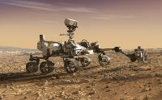
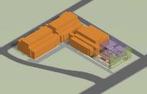
MSR Campaign
Mars Sample Return Program
1 2 3 4
Long-term Curation & Science Investigations
NASA/ESA
Sample Caching
Collect samples of rock and sediment
Cache samples on the surface for retrieval
Sample Retrieval
Retrieve samples cached by Mars 2020 rover
Launch samples into orbit around Mars
Earth Return
Capture and contain samples in Mars orbit
Safely return samples to Earth for recovery at landing site
Sample Receiving
Transport contained samples to receiving facility
Safety assessment and sample containment
Initial sample science and curation
The MSR Campaign spans flight elements and one ground element
The MSR Program manages development and operations of Sample Retrieval and Earth Return and interfaces to Sample Caching and Sample Receiving; program concludes upon safe return at the landing site
The MEP Program manages M2020 Phase E operations & the home of the future Sample Receiving Project

Slide 12

Vertically Ejected Controlled Tip-Off Release (VECTOR)
VECTOR is a pre-ignition separation mechanism for the Mars Ascent System (MAS)
VECTOR provides a MAS separation state with a vertical velocity and pitch rate
MAS ignition occurs a set time after separation within an established window that allows for successful flyaway
12

Slide 13

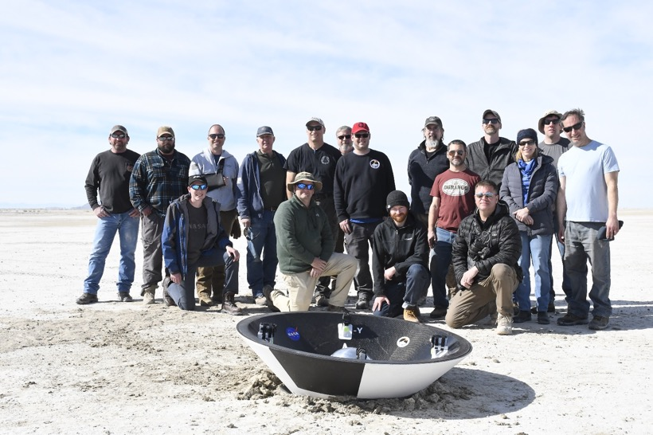

Earth Entry Vehicle Manufacturing Demonstration Unit #1
Drop Altitude: ~1000 ft
Terminal Velocity at impact: ~33 m/s / ~74 mph
Utah Test and Training Range – March 1, 2022
NASA / USAF Team Photo
13
Notes:
EES Manufacturing Development Unit (MDU) Drop Test: Drop altitude was ~1000 feet, and the aeroshell impacted at around 74 mph, which is roughly 15-20 mph less than what we expect the actual sample return EES would be—so very close to what we expect it will be in real life. The outer mold line of the aeroshell is the shape of what would actually fly. The mass was also equivalent to the expected flight mission. In short, it was a very successful test -- the aeroshell landed intact and everything worked as expected.

Slide 14
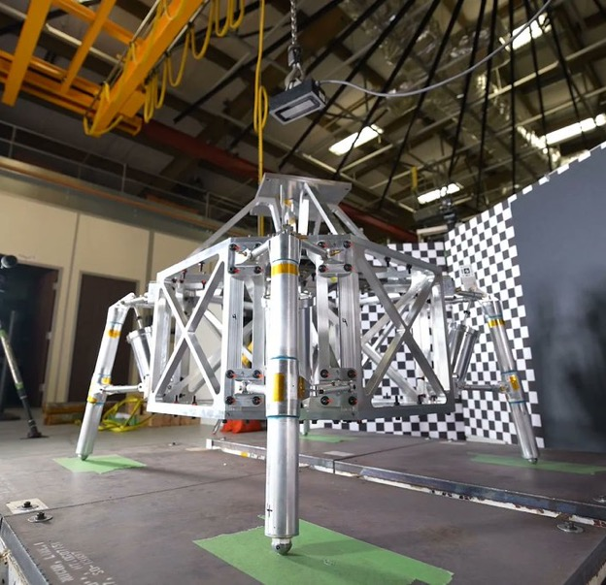
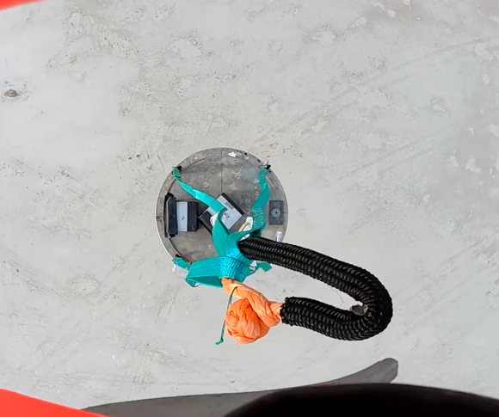
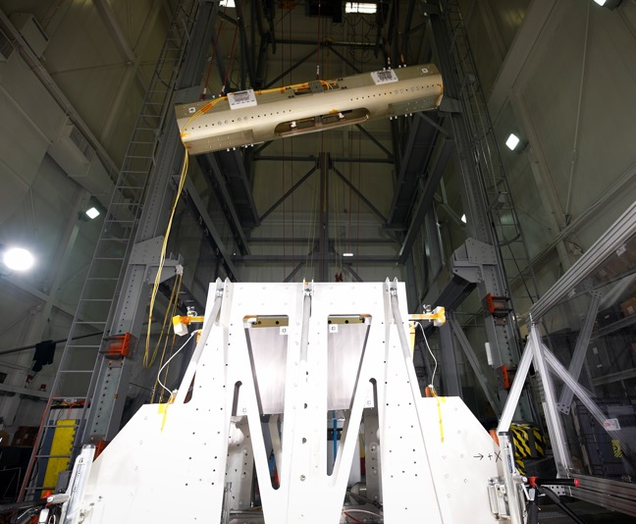
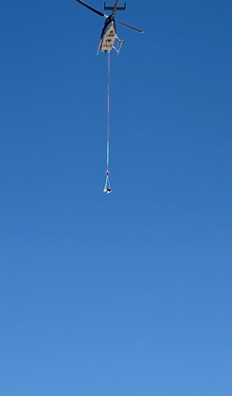
Technology and Engineering Development Progress
Technology and engineering developments continue with progress on several prototypes
Landing Legs
Earth Entry System Drop Test
MAV VECTOR launch system

Slide 15
Phase A Accomplishments
Primary trades: Single vs. Dual Lander architecture, need for MMRTG, launch dates
Addressed pre-formulation architecture issues
  CCRS rearchitected to establish viable on-orbit assembly approach
  Established assurance case architecture for Back Planetary Protection to const
Matured Key Technology/Engineering Development
  Advanced key technologies & engineering developments
  Modified aseptic sealing process for primary containment vessel from brazing to heated shrink fit to reduce complexity and provide ability to achieve verifiable containment/seals
Addressed Acquisition Risks
  Simplified and consolidated NASA Center assignments
  Established system level “buy” plans for MAV & EES Aeroshell
Performed updated Perseverance Reliability Assessment
  Reaffirms confidence in ability to support MSR surface mission operations
Systems Requirement Review/Mission Design Review July 12th
  Expect to enter Phase B early in FY’23

Slide 16
Summary
This is the most significant planetary science undertaking in a generation
Now is the time
  Perseverance on surface of Mars collecting samples
  Orbital Relay assets in place around Mars
  European Partnership in place with substantial mission contributions
Over the past three years, the NASA-ESA team has considered a broad set of implementation options and developed a feasible baseline concept
  Key technologies and engineering developments have been matured
Significant work remains, but the team is on track to launch the remaining flight elements in this decade

Slide 17


with us

