Slide 1
Understanding the Geophysical Environment in the Field
Renee Weber, Nick Schmerr, Ernie Bell, Matt Siegler, Noah Petro, Taichi Kawamura
LSSW 16: Assessing the Value of Modern Field Geology Tools for Artemis
June 16, 2022
Notes:
Virtual Session 16: Assessing the Value of Modern Field Geology Tools for Artemis
June 16, 2022
A key theme of the Artemis campaign is evolving the lessons of Apollo to move into the next bold era of human planetary exploration. This workshop will focus on a key question that has emerged in previous LSSW virtual sessions: Can we leverage 21st–century advances in field geology tools and practices to improve the science return from Artemis missions?
Focusing Questions
LSSW 16: Assessing the Value of Modern Field Geology Tools for Artemis, the first of two planned workshops, will start this community conversation by considering several key questions:
Should astronauts focus on traditional field geology or making in-situ measurements while on the surface of the Moon?
How would fieldwork on the Moon compare to modern fieldwork in other remote or extreme locations on Earth?
What types of measurements should be done in-situ during astronaut surface EVAs, and what specifically needs to be brought back to Earth for analyses? What equipment should astronauts have available to make those measurements?
What role would handheld or “field laboratory” instruments have in high-grading and in-situ sample analysis, particularly in the context of potential long-duration operations at the Artemis Base Camp?
The first session, LSSW 16, will consist of invited speakers and focused breakout sessions designed to promote conversations on these important questions.

Slide 2

Science drivers for geophysical measurements
NASA’s Artemis Plan Science Objectives
(AIII SDT Deployed & In-Situ Experiments):
1: Understanding Planetary Processes
Formation of the Earth-Moon system
Planetary differentiation and evolution: formation of a magma ocean, crust, mantle, and core
2: Understanding the Character and Origin of Lunar Volatiles
Understand the transport, retention, alteration, and loss processes that operate on volatile materials near and at permanently shaded lunar regions
3: Interpreting the Impact History of the Earth-Moon system
4: Revealing the Record of the Ancient Sun and Our Astronomical Environment
5: Observing the Universe and the Local Space Environment from a Unique Location
6: Conducting Experimental Science in the Lunar Environment
7: Investigating and Mitigating Exploration Risks
The Planetary Decadal Survey recommends a Lunar Geophysical Network among its highest priority robotic missions, with the additional recommendation that conducting decadal-level science should be a central requirement of the overall human exploration program.
Notes:
left: NASA/SP-20205009602

Slide 3
Field geophysics: Types of investigations and measurements
Geophysics is the only direct way to probe the interior of a planet
Deployed
Seismic properties | Subsurface layering, seismic velocities, seismicity
Heat flow | Heat flux, temperature gradient, thermal conductivity
Electromagnetic properties | Electrical conductivity, layering, subsurface heterogeneity
Geodetic monitoring | Moment of inertia, Love numbers, core eccentricity
In-situ
Traverse measurements | Gravimetry, magnetometry, ground penetrating radar
Regolith geotechnical properties | Bulk density and porosity, relative density, compressibility, shear strength, permeability

Slide 4
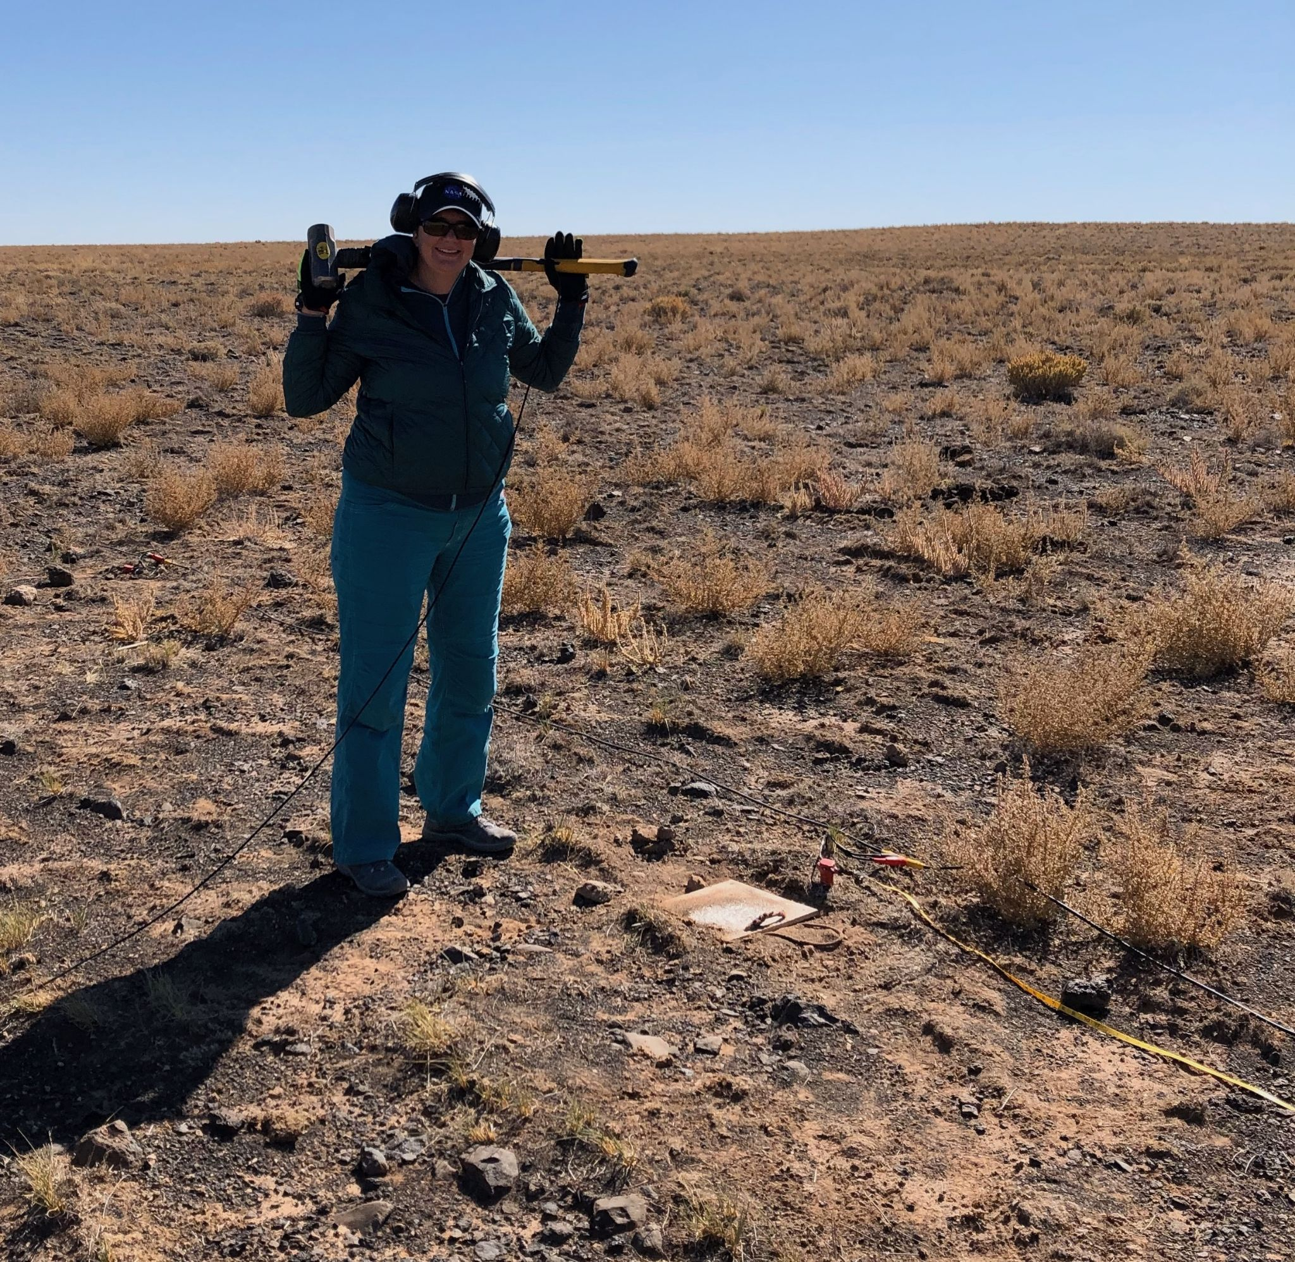
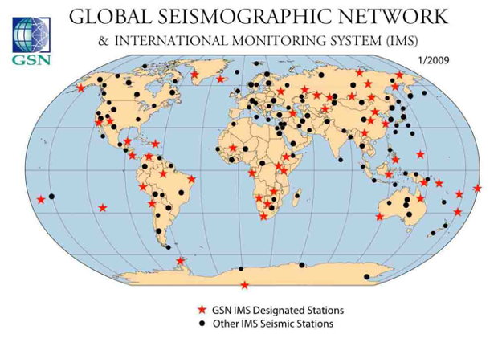
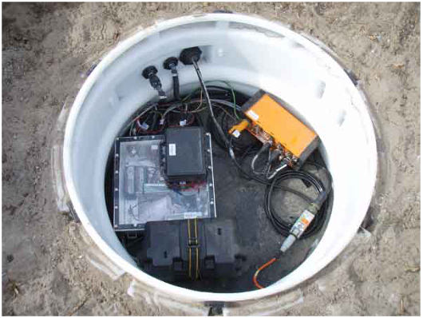
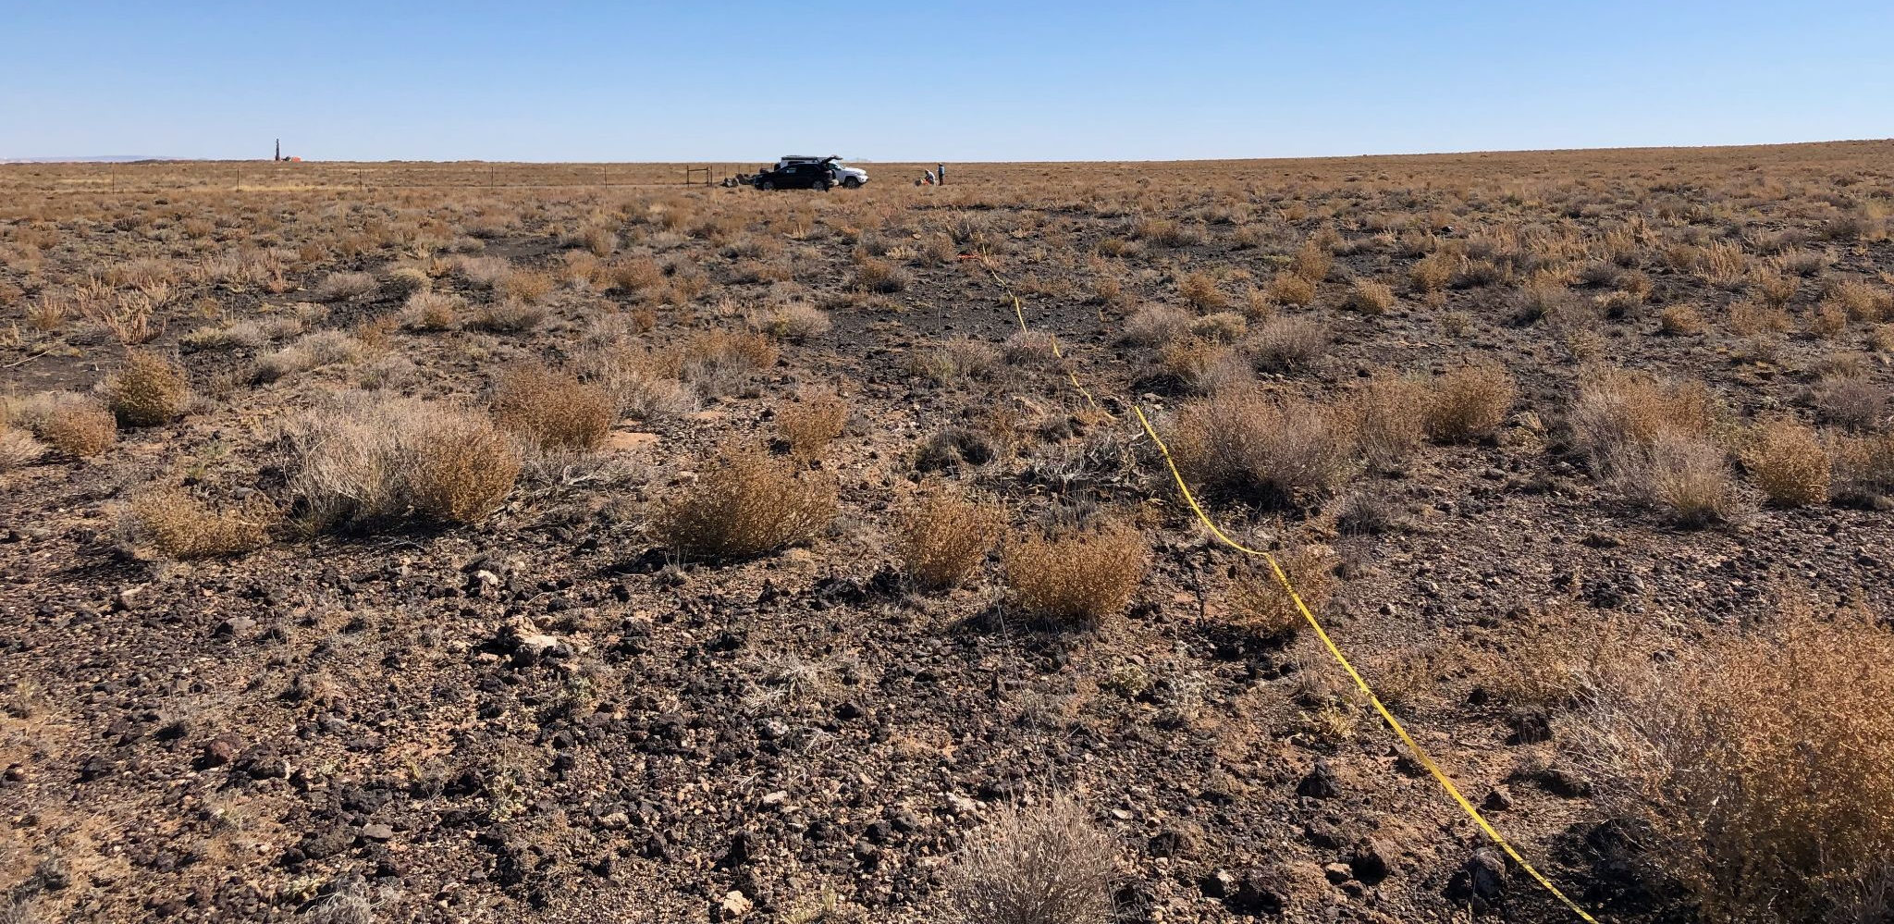
Lunar structure: global vs. regional
Seismology example:
Global structure:
Requires globally distributed stations
Stations are typically deployed in permanent vaults with direct coupling to the ground, where noise sources are minimized or mitigated
Records natural seismicity
Constrains global structure (1-D)
Regional structure:
Uses “survey” style deployment
Stations are temporary and easily installed/removed
Records artificially induced seismicity
Constrains regional structure (2-D & 3-D)
Notes:
Left images: IRIS.edu
Right images: author personal photos

Slide 5
Factors that influence geophysical data quality
Landing site:
Safety is primary driver for both robotic and human missions: may not be most scientifically interesting
Proximity to sources of noise or signal contamination
Distribution of measurements: multiple diverse/dispersed sites vs. repeat visits to same site
Illumination:
Sufficient for solar-powered instruments?
Large diurnal thermal cycle can introduce trends and/or noise
Regolith geotechnical properties:
Regolith can cause seismic reverberations and scattering that contaminate seismic data
Some instruments require burial, and are sensitive to human-induced albedo and surface changes
Deployment & ground preparation:
Most instruments require moderately level ground with navigable rocks and debris
Many instrument & measurement-specific factors

Slide 6
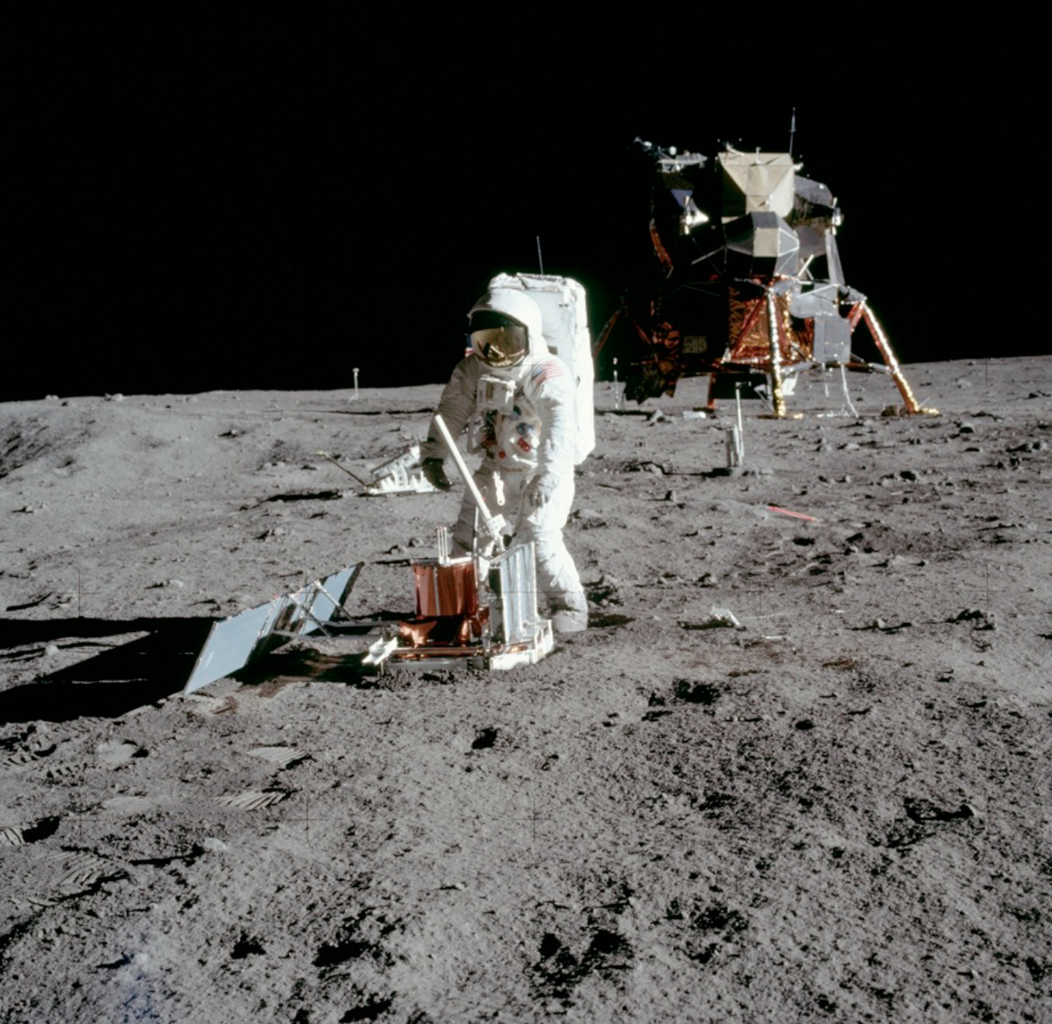
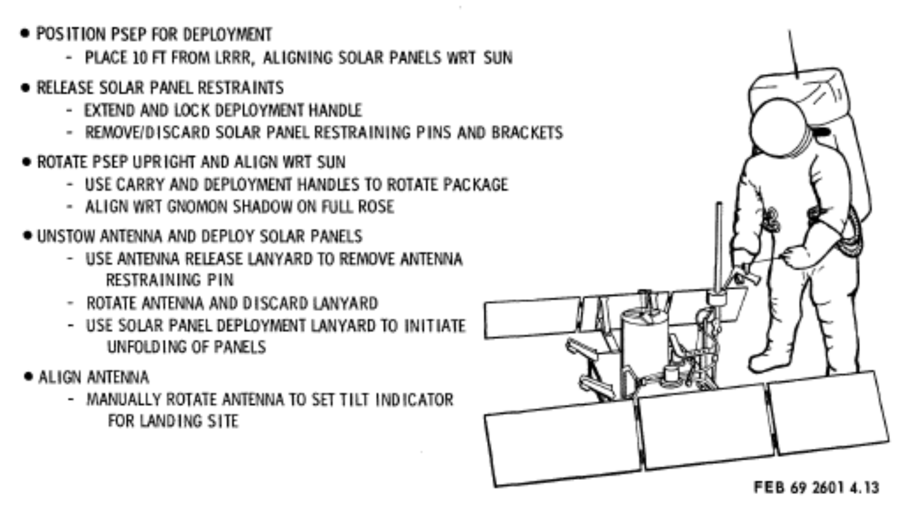
Deployment: Seismometer
Apollo 11 deployment influence on data:
Proximity to the LM: it became a source of noise. Seismic signals generated by the LM include venting of gasses, circulating fluids, & inelastic deformation of the LM structure in response to thermoelastic stress.
Low efficiency for thermal insulation: Unable to detect changes in gravity associated tilt on the lunar surface.
Notes:
Left: NASA, Apollo 11 image AS11-40-5947
Right: Apollo 11 EASEP Familiarization Course Handout

Slide 7
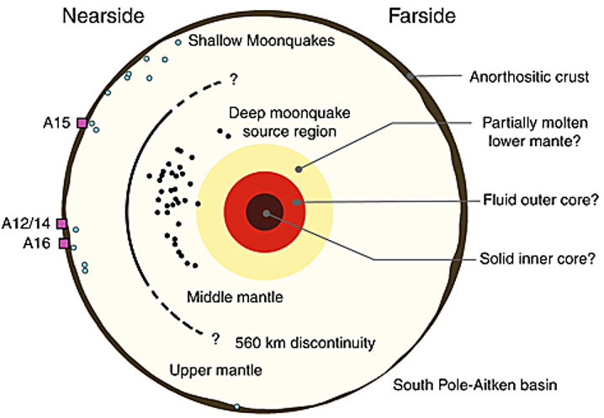
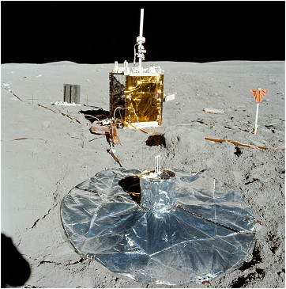
Deployment: Seismometer
Apollo 16
Wieczorek et al., 2006
Apollo 12-16 deployment influence on data:
The instruments were wrapped with an aluminized Mylar skirt for thermal insulation. It was found that spreading the skirt smoothly over the surface was difficult. In addition, seismic disturbances were observed on the LP seismometers that were assumed to result from thermal contraction and expansion of the skirt.
For Apollo 12 and 15, the crew tried to prepare the surface for experiment emplacement by tamping the surface with the ribbed sole of their boots. This did not seem to be effective. The total compaction achieved was reported to be small.
Notes:
left: Apollo 16 image AS16-113-18347
right: Wieczorek et al. (2006) Rev. Mineral. Geochem. 60, 221 – 364.

Slide 8
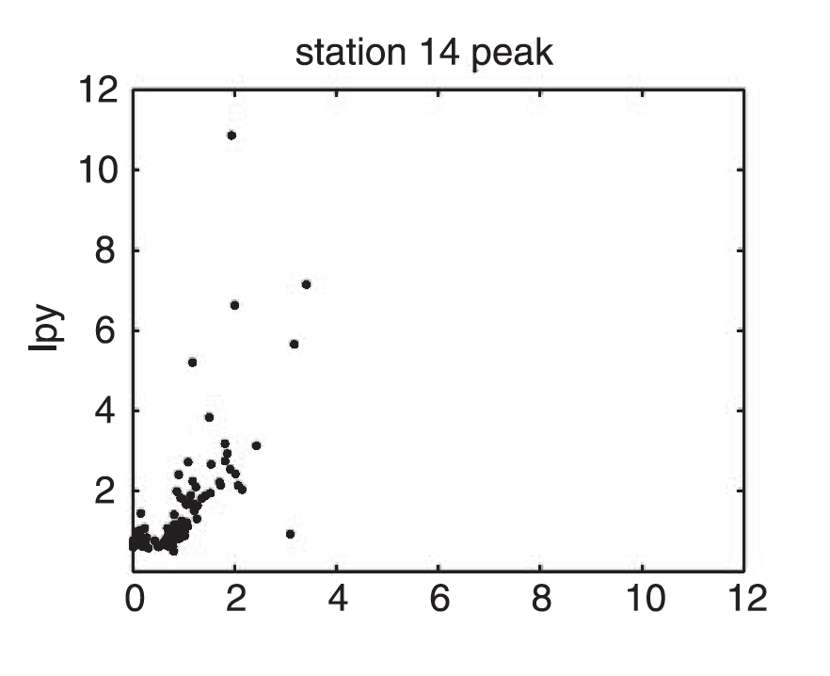
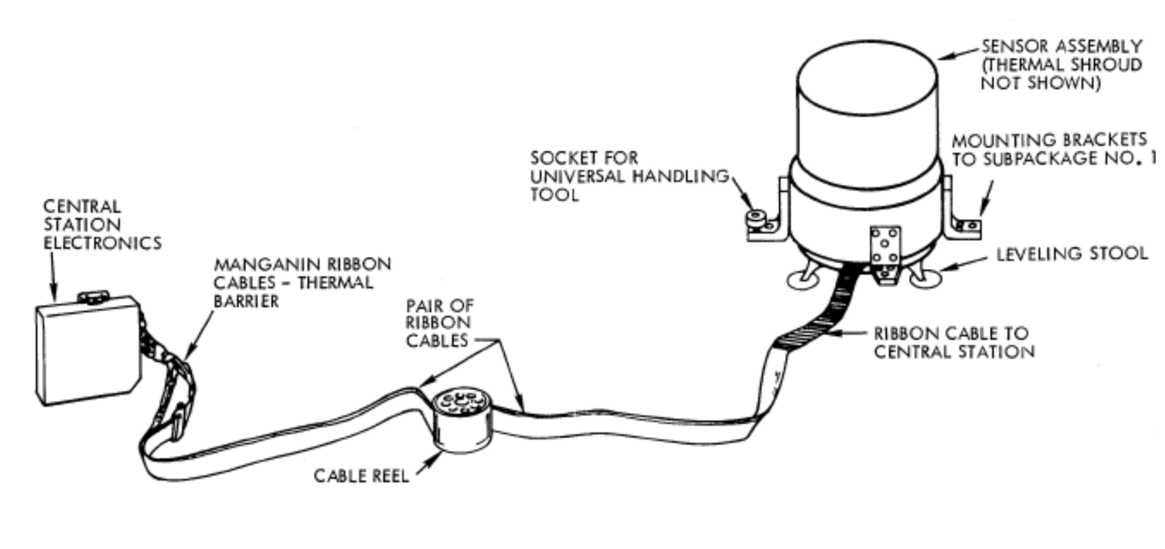
Deployment: Seismometer
Bulow et al., 2005
lpx
Apollo 12-16 deployment influence on data:
There was a requirement to “orient PSE cable exit toward central station”
Relatively large amplitude of the LPY components with respect to the LPX or LPZ components were observed for Apollo 14, 15, and 16. It is believed that this is a result of a stiff connecting cable that exits from the sensor unit along the Y axis.
Notes:
left: Apollo 15 Mission Science Planning Document
right: Bulow et al., 2005, JGR VOL. 110, E10003, doi:10.1029/2005JE002414

Slide 9
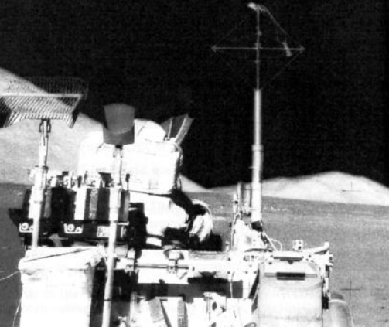
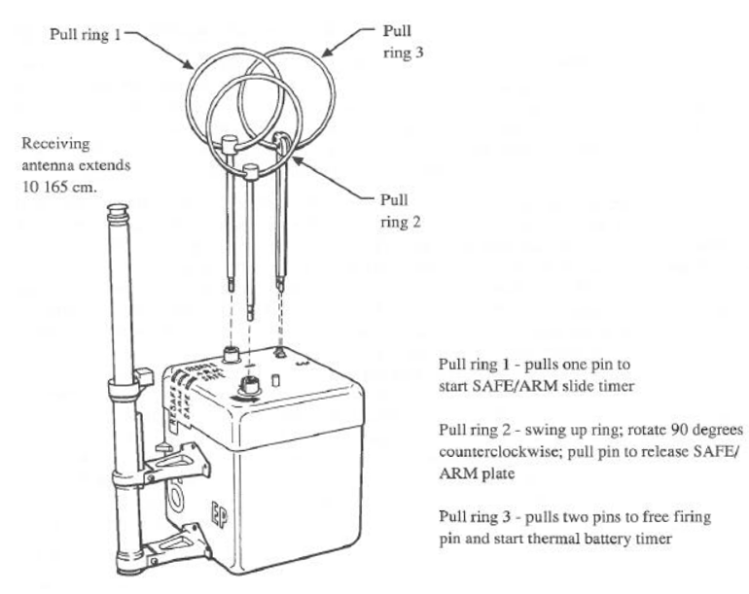
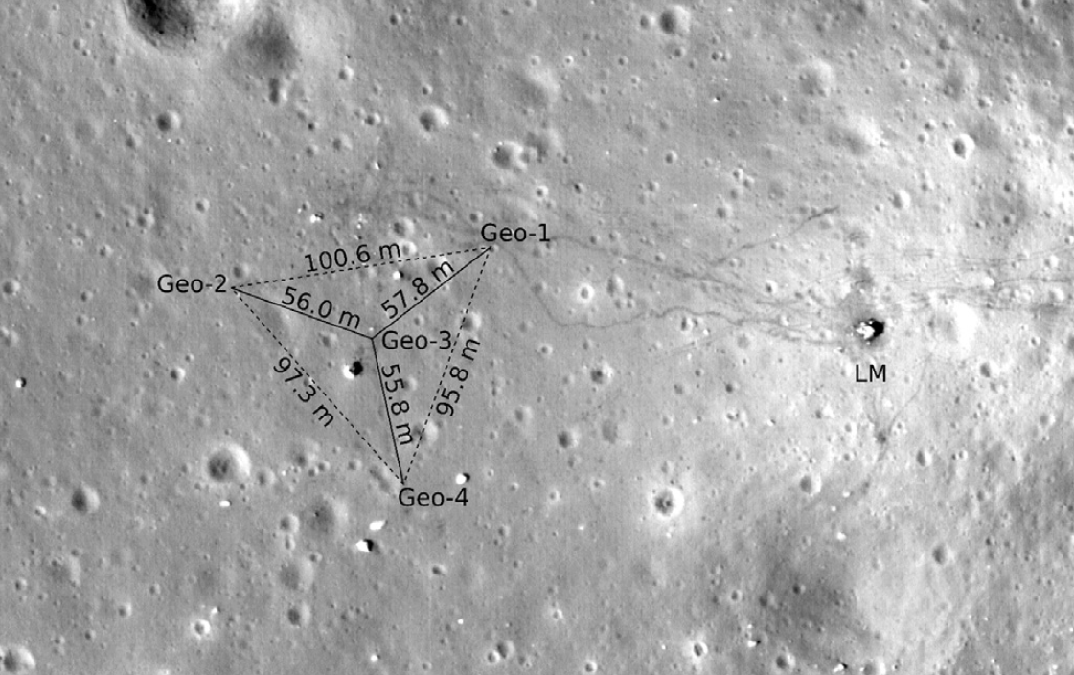
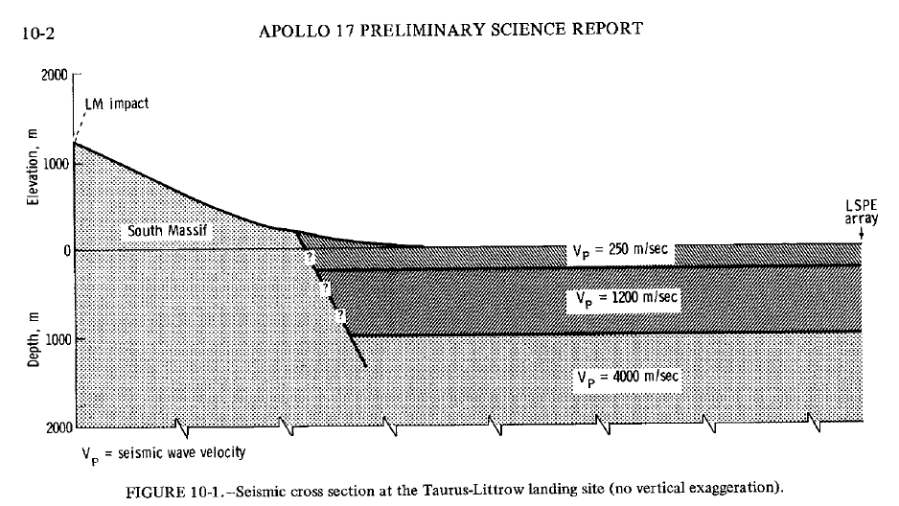
Deployment: Active seismic experiments
Heffels et al., 2017
Apollo 17 Lunar Seismic Profiling Experiment
Triangular array of 4 geophones deployed to the west of the LM
(active) Series of 8 explosive packages deployed during EVA and detonated post departure
(passive) Instruments were also operated in “listening mode” and detected thermal moonquakes
Lunar module still evident as a source of contaminating signal
Notes:
Left: Heffels et al., 2017. Planetary and Space Science 135 (2017) 43–54
middle: NASA reference publication 1317: Catalog of Apollo Experiment Observations
upper right: Apollo 17 image
lower right: Apollo 17 preliminary science report

Slide 10
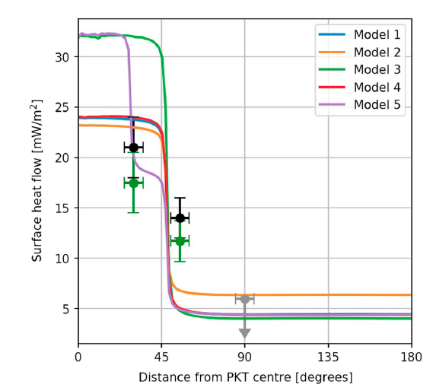
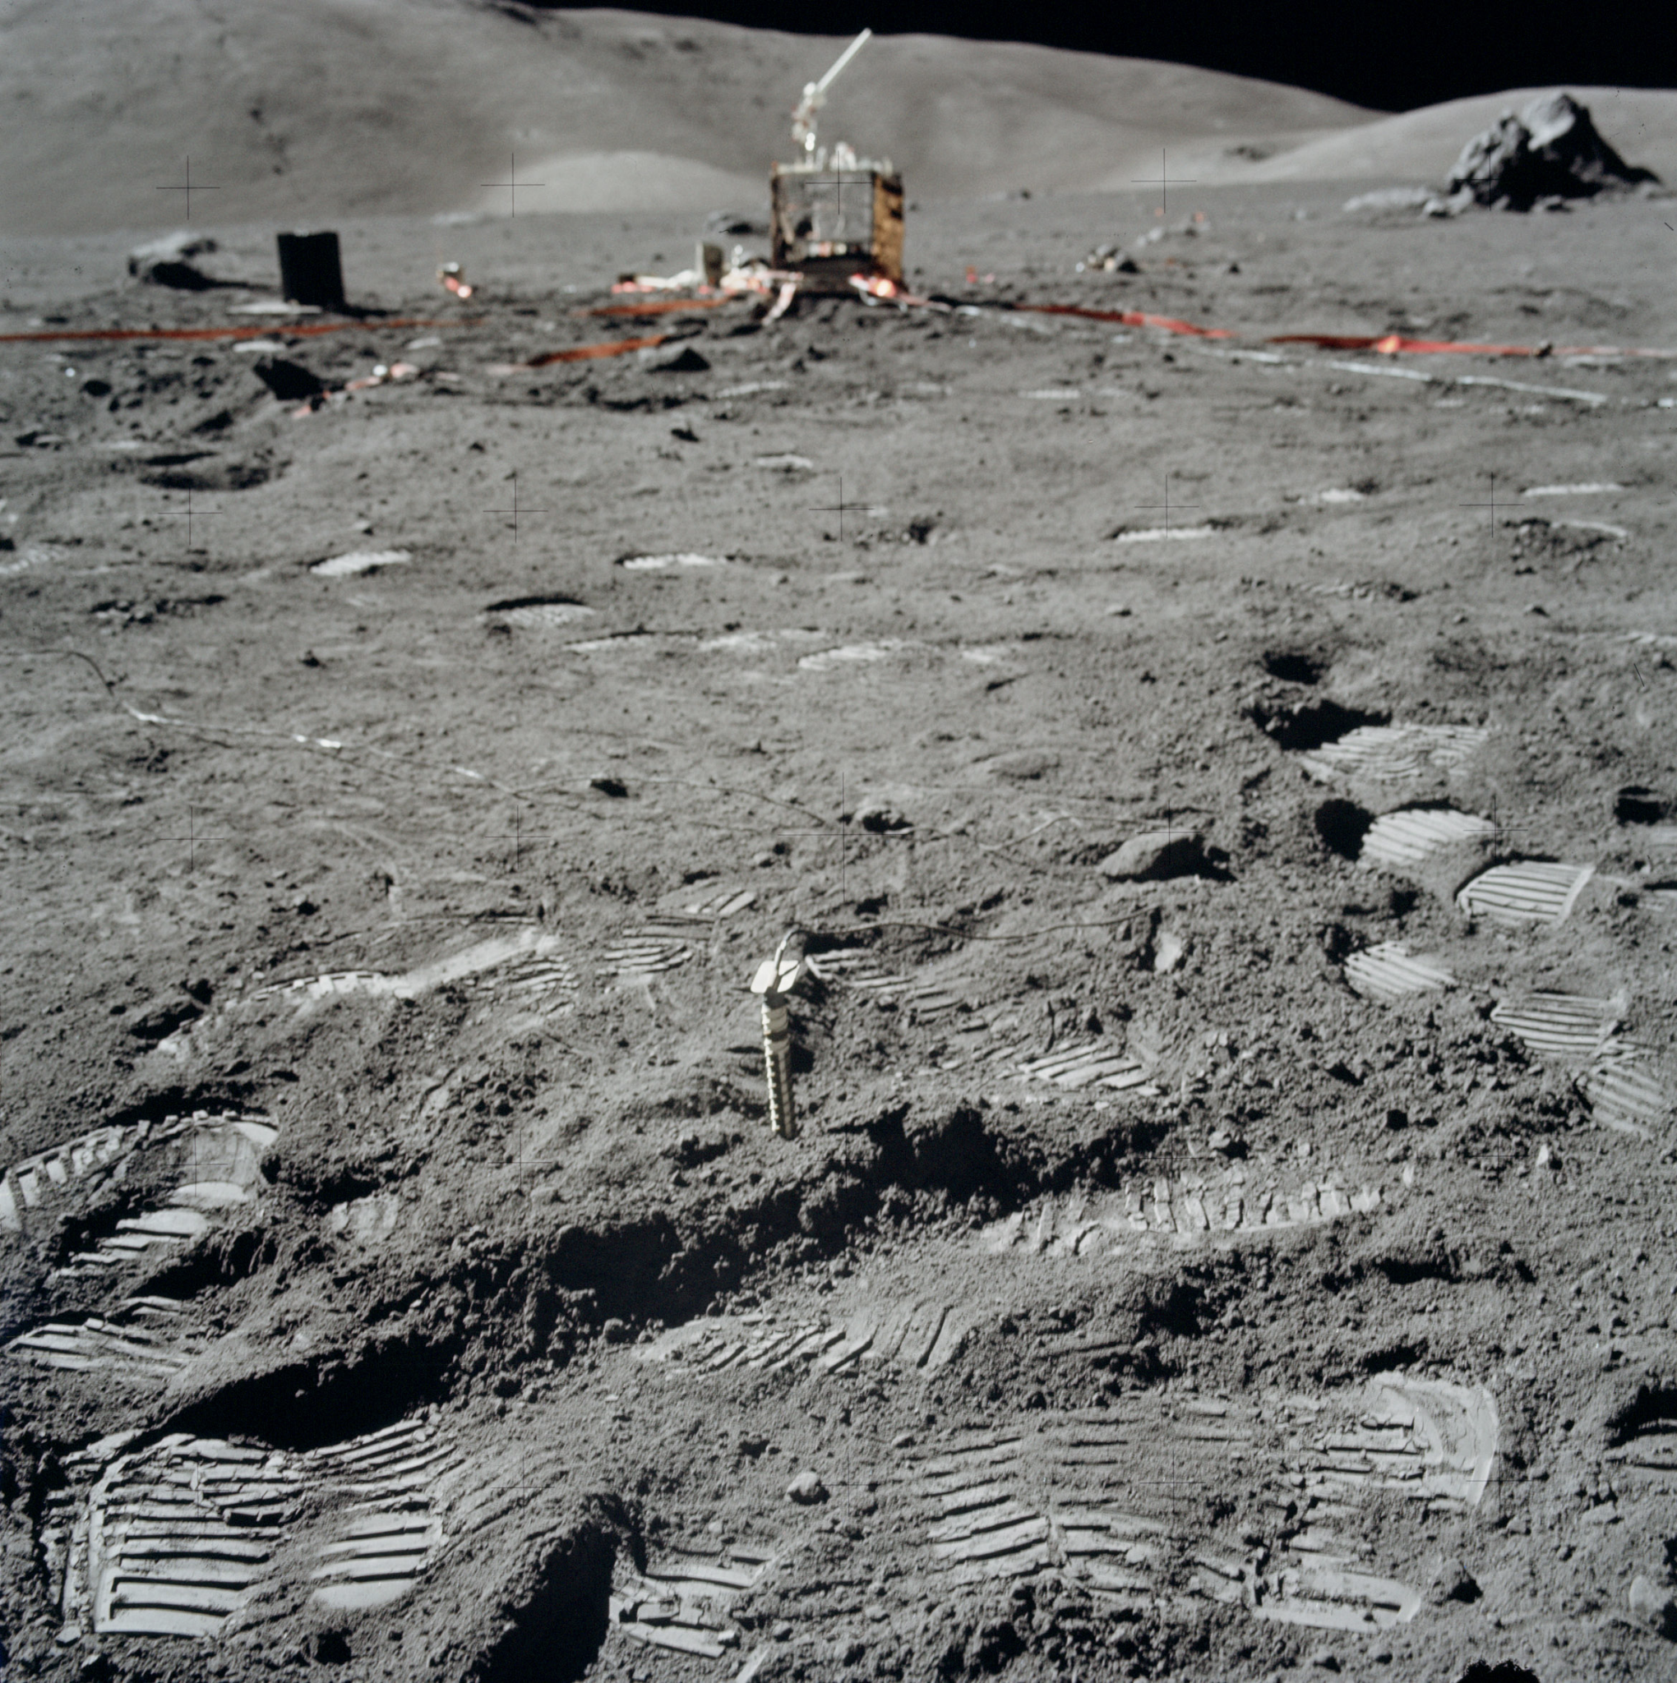
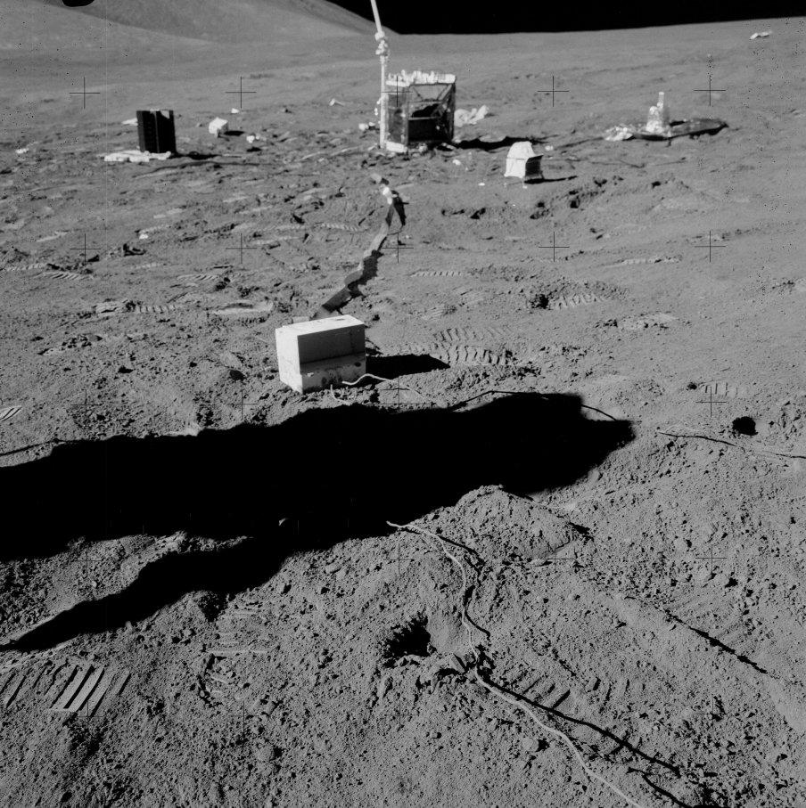
Deployment: Heat flow
15
17
Diviner
Laneuville et al., 2018
Apollo 15
Apollo 17
Geothermal measurements track heat production and interior temperature distribution.
Deployment:
Holes were drilled using hollow drill stems, with a closed bit on the bottom stem to keep the string open.
Once a hole was drilled to the desired depth, a multi-sensor probe was inserted and a thermal cap emplaced around the cable that connected the probe to the HFE electronics package.
Notes:
Left: Laneuville, M., Taylor, J., & Wieczorek, M. A. (2018). Distribution of radioactive heat sources and thermal history of the Moon. JGR Planets, 123. https://doi.org/10.1029/2018JE005742
Center: https://www.hq.nasa.gov/alsj/a17/AS17-134-20493.jpg
Right: https://www.hq.nasa.gov/alsj/a15/AS15-92-12416.jpg

Slide 11
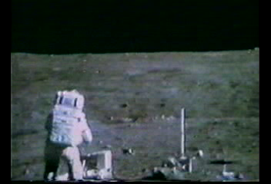
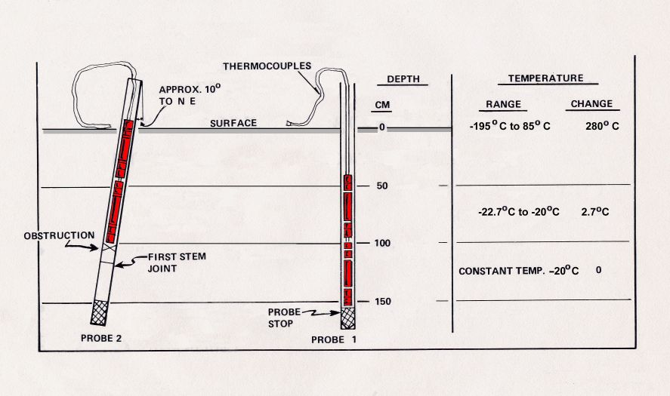
Deployment: Heat flow
A re-design of the stem joints eliminated the problem of binding on Apollo 16 and 17.
Unfortunately, no data were returned from Apollo 16 after the heat flow experiment’s ribbon cable was accidentally sheared off at the base of the Central Station.
Only one of the two Apollo 15 heat flow probes was successfully emplaced to full depth. There was evidently an obstruction in the drill string in Hole No. 2, believed to be due to separation of two stems that occurred when the astronauts tried to overcome binding of the stems in the hole.
Notes:
left: NASA Apollo lunar surface journal
right: Apollo 16 footage (NASA) (John Young accidentally tripping over the heat flow cable on Apollo 16)

Slide 12
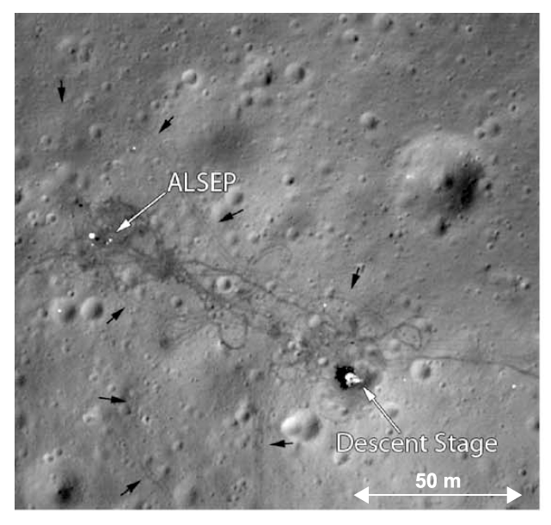
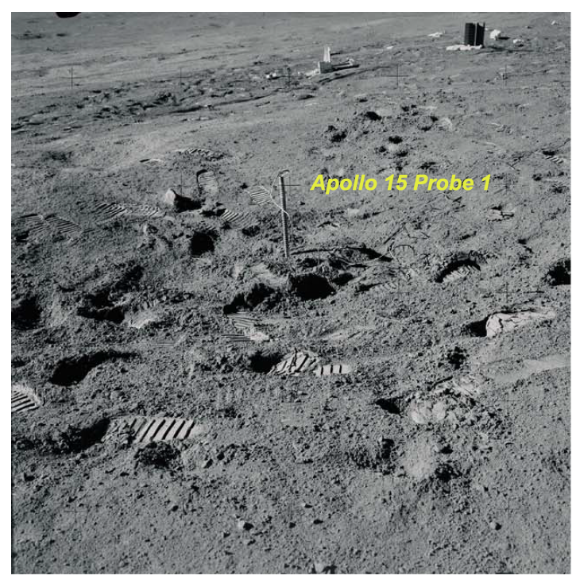
Deployment: Heat flow
Nagihara et al., 2018
Other considerations:
Lander jets will disturb the surface properties and albedo
The regolith is really compact at >1m depth and was very hard to drill through
Subsurface rocks are always a potential threat
Surface thermal properties are very important in recovering subsurface temperature
The regolith on the footpaths of the astronauts turned darker, lowering the albedo.
As a result of the astronauts’ activities, solar heat intake by the regolith increased slightly on average, resulting in a warming trend
Thermal conductivity of lunar materials is incredibly low
Heat can conduct down the drill and take a long time (~1 month) to cool down to the background temperature
Future instruments either need to get deep without delivering any heat and measure quickly (before the thermal wave hits) or not disturb the surface at all
Notes:
both images from Nagihara, S., Kiefer, W. S., Taylor, P. T., Williams, D. R., & Nakamura, Y. (2018). Examination of the long-term subsurface warming observed at the Apollo 15 and 17 sites utilizing the newly restored heat flow experiment data from 1975 to 1977. Journal of Geophysical Research: Planets, 123, 1125–1139. https://doi.org/10.1029/ 2018JE005579

Slide 13
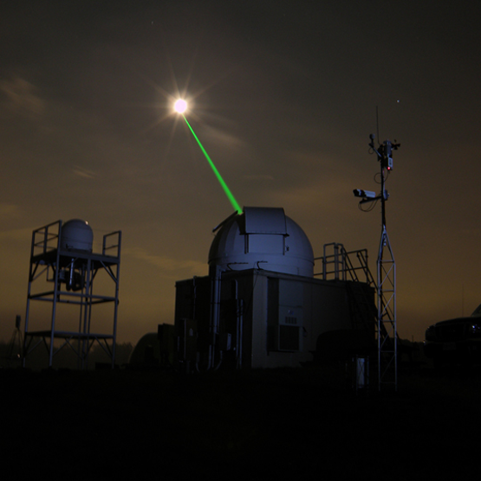
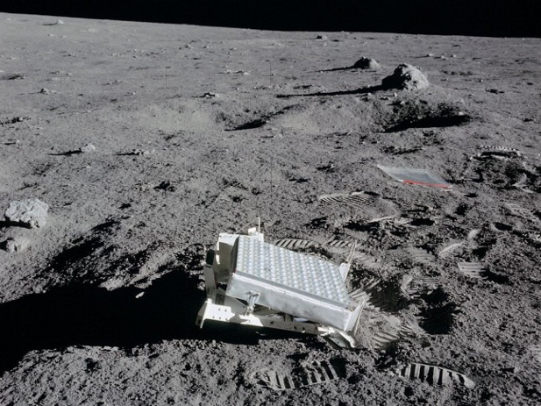
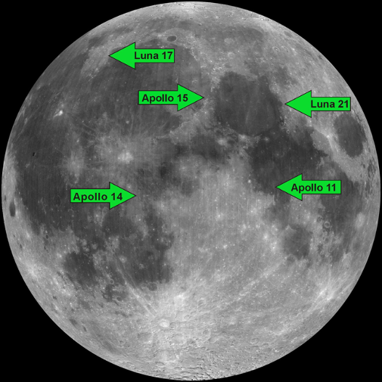
Deployment: Laser retroreflectors
The only Apollo science payload still operating!
The magnitude of the return signal has decreased by a factor of ~10-100 since the arrays were deployed (does not decrease the ranging accuracy from which the science is derived)
Postulated causes include deposit of lunar dust on the front faces of the Cube Corner Reflectors, darkening due to UV and/or particle exposure, micrometeorite bombardment, or other changes in the properties of the thermal coating. The dust may be due to secondary ejecta from micrometeorite impacts in the near vicinity, electrically levitated dust and/or dust from the LEM liftoff.
Factors to consider for future instrument design
Notes:
left: NASA
center: Apollo 14 image AS14-67-09386
right: NASA

Slide 14
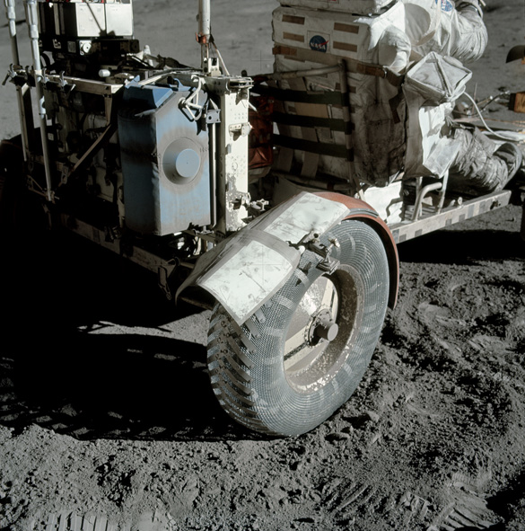
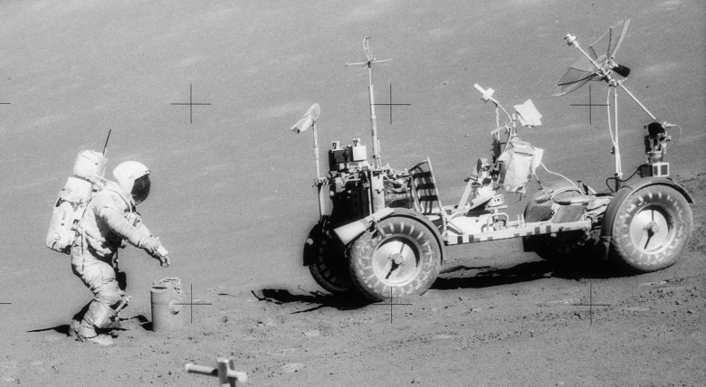
Mobile measurements: human vs. LTV
Mobility increases science capability by:
Providing access to a diverse sample of geologic units
Facilitating deployment of experiments over a broader area than can be accessed on foot during a single EVA
Permitting a greater amount of field equipment/instruments to be carried on a traverse
Examples include gravimetry, magnetic surveys, GPR, deploying active seismic sources
Apollo 17 LTV fender repair:
Example of how the ability to troubleshoot issues in real-time enables more science
Notes:
left: Apollo 17 photo AS17-142-21730
right: Apollo 17 photo AS17-137-20979

Slide 15
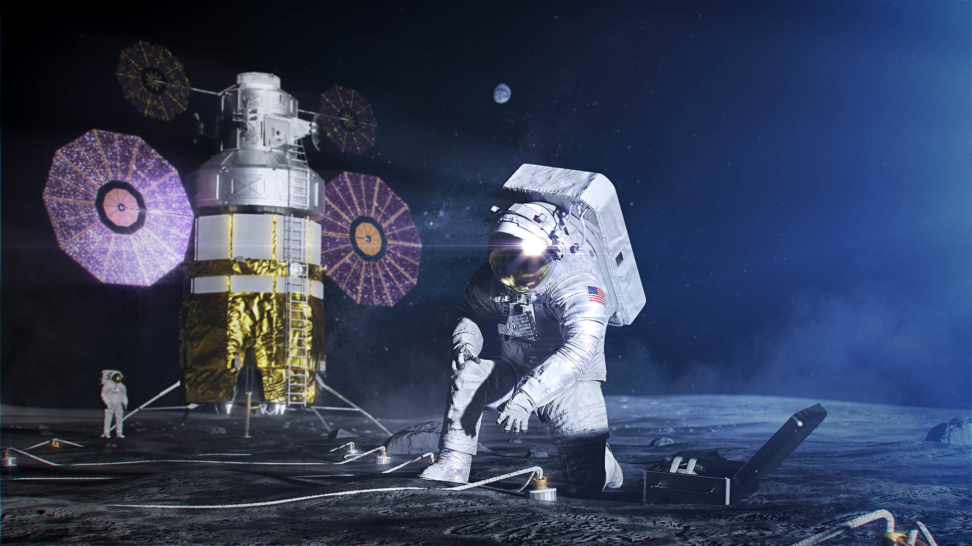
Field geophysics: types of instruments and investigations
Conclusions
Geophysics is the only direct way to probe the interior of a planet
Key geophysical investigations are enabled by humans on the Moon
Many lessons from Apollo valuable for future instrument design and conops
Text
Notes:
Image: NASA
Note: There were many other ALSEP experiments that are relevant to geophysical objectives, but I did not have time to cover here

